Slide 1
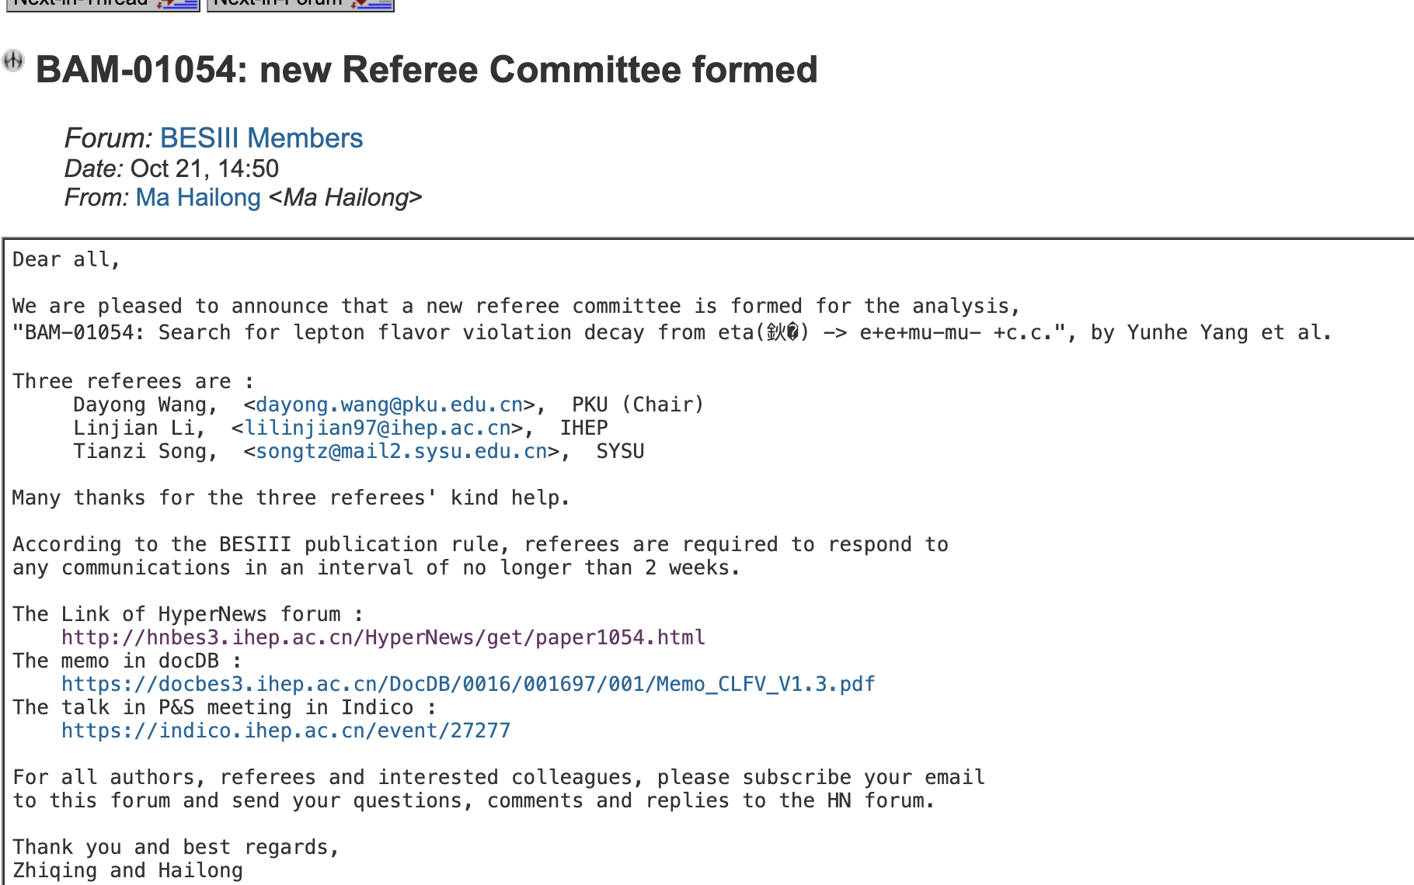
CLFV

Slide 2



CPV
Add a CP violation delta = 0.172.
$$pull=\frac{δ_{out}−δ_{in}}{σ_{in}}$$
$$μ=−0.087$$
$$σ=0.974$$
$$pull$$

