Slide 1
Tuesday, October 28, 2025

Slide 2
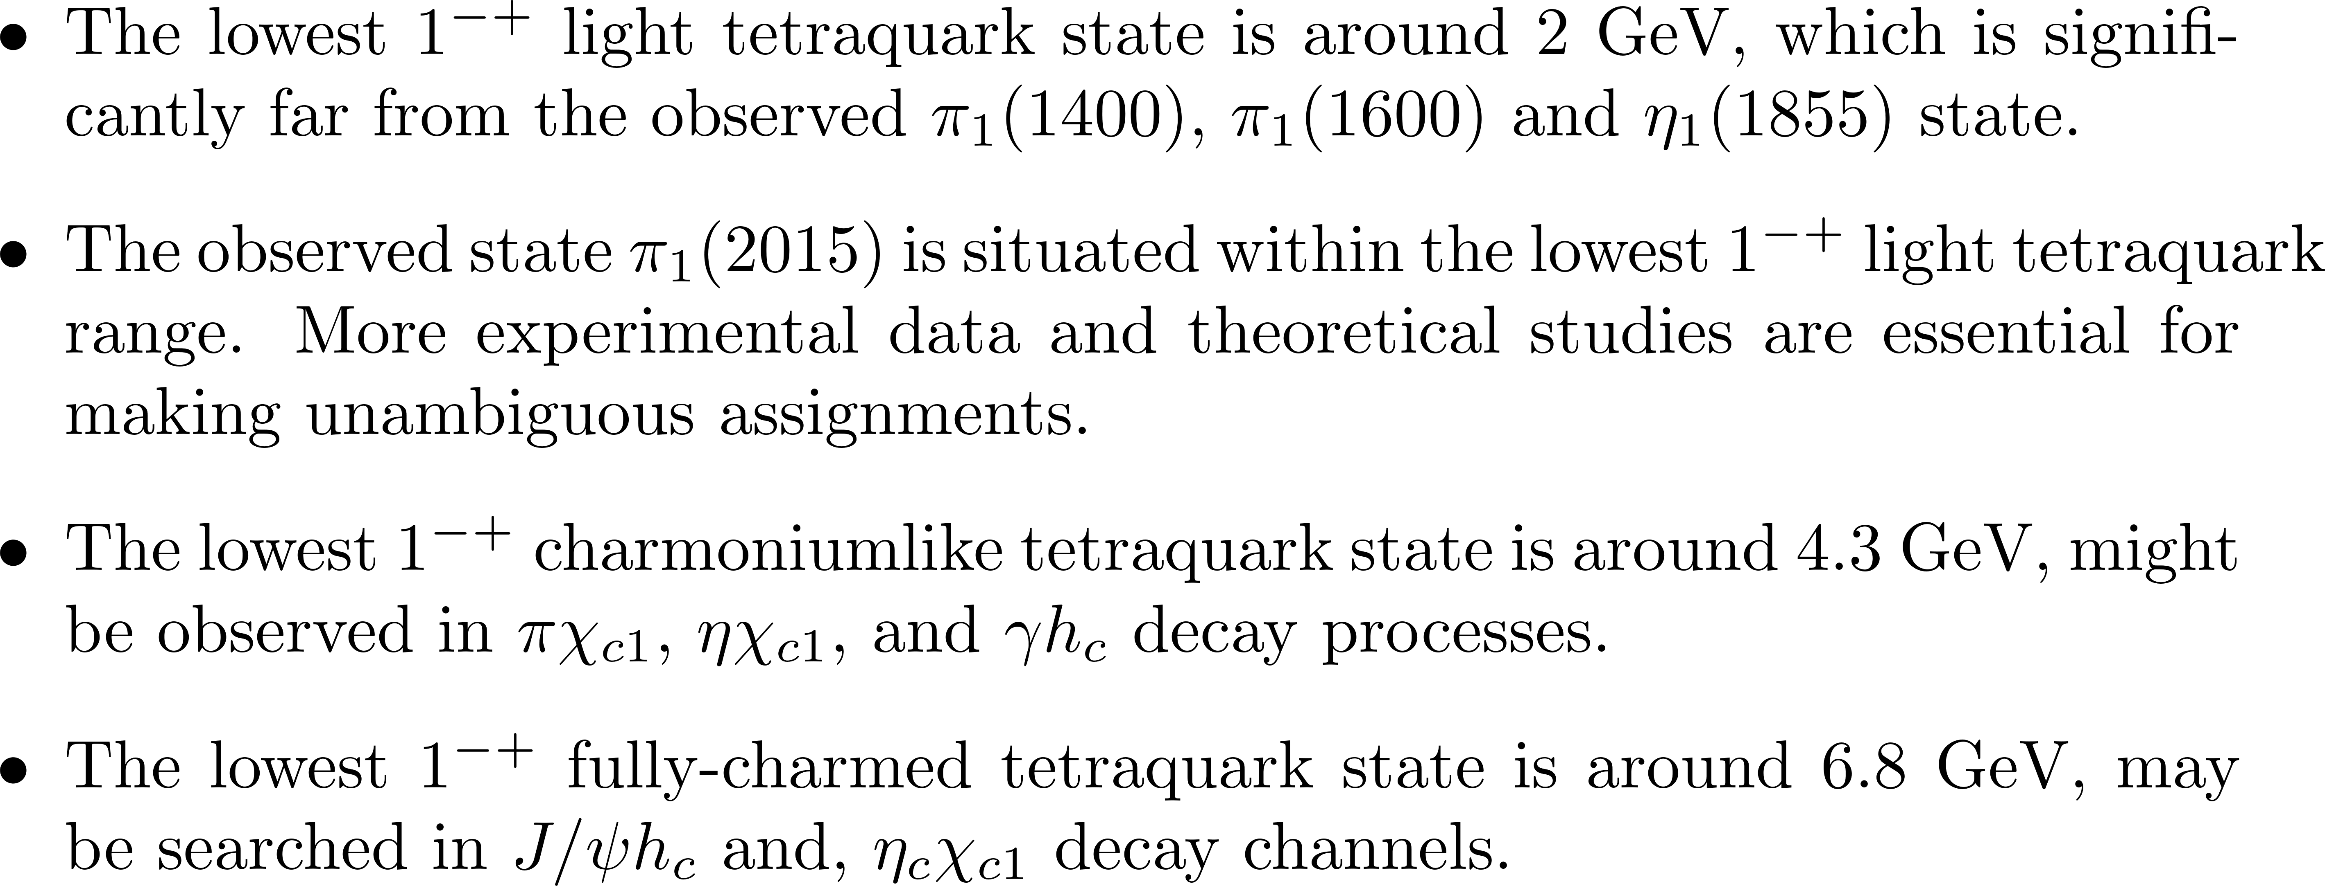





Prediction

Slide 3
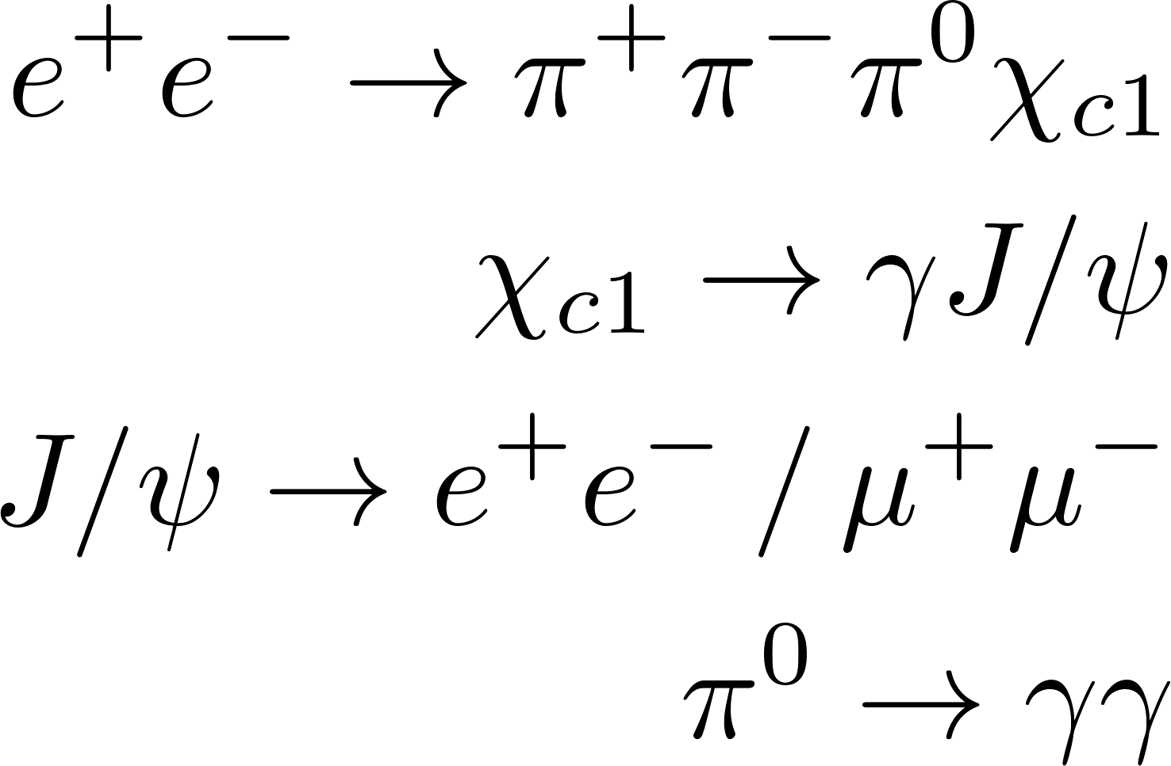


Event Selection
Final state$:$
BOSS version: 7.0.9
1) Charged tracks (MDC)
$\left|cos θ\right|$ < 0.93
$R_{xy}<1.0 cm,$ $R_{z}<10 cm$ (the beam line)
nGood $≥$ 4
total charge is 0
2) Neutral track
$E_{barrel}>25 MeV,\left|cosθ\right|<0.8$
$E_{endcap}>50 MeV,0.86<\left|cosθ\right|<0.92$
EMC time $0≤t≤14$ (50 ns)
the angle between the cluster and
the nearest charged track < 10 degree
$N_{γ}≥$ 3
Data sets
Data : 2020 (@4640) run no. 63516-63715
Inclusive MC : XYZ sample run no. 35227-36213 (@4600)

Slide 4
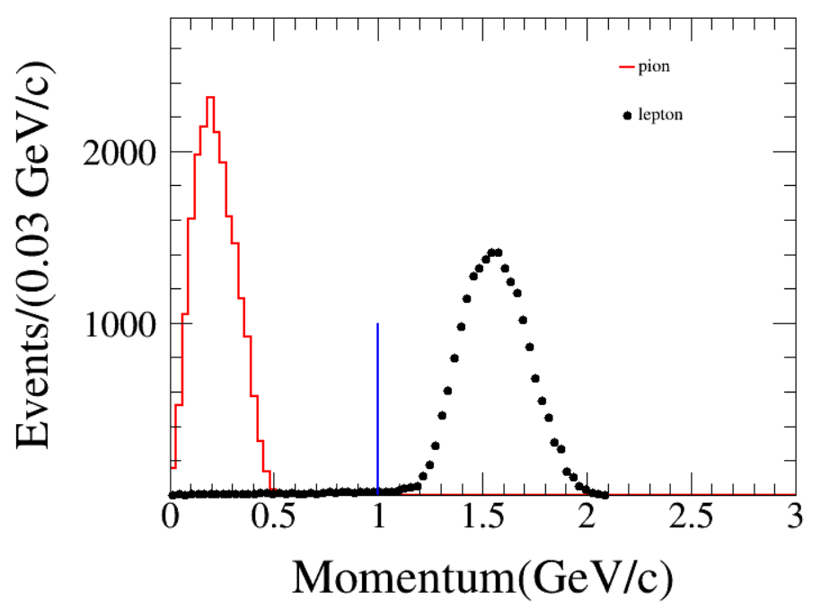
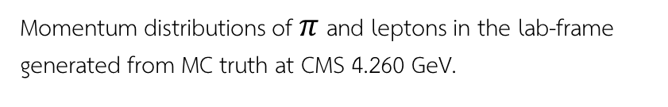
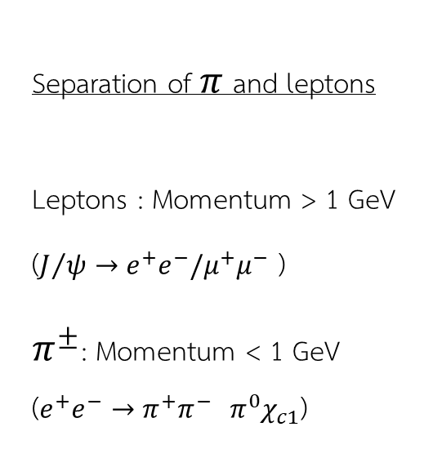
Separation of $π$ and leptons
Leptons : Momentum > 1 GeV
($J/ψ→e^{+}e^{−}/μ^{+}μ^{−}$ )
$π^{±}$: Momentum < 1 GeV
($e^{+}e^{−}→π^{+}π^{−}$ $π^{0}χ_{c1}$)
Momentum distributions of $π$ and leptons in the lab-frame generated from MC truth at CMS 4.260 GeV.

Slide 5
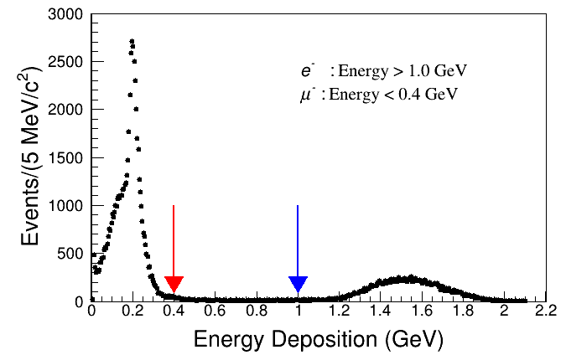
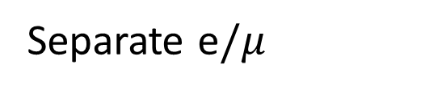
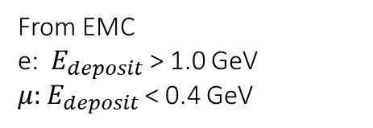
Separation of leptons
Separate e$/μ$
From EMC
e: $E_{deposit}$ > 1.0 GeV
$μ:$ $E_{deposit}$< 0.4 GeV

Slide 6
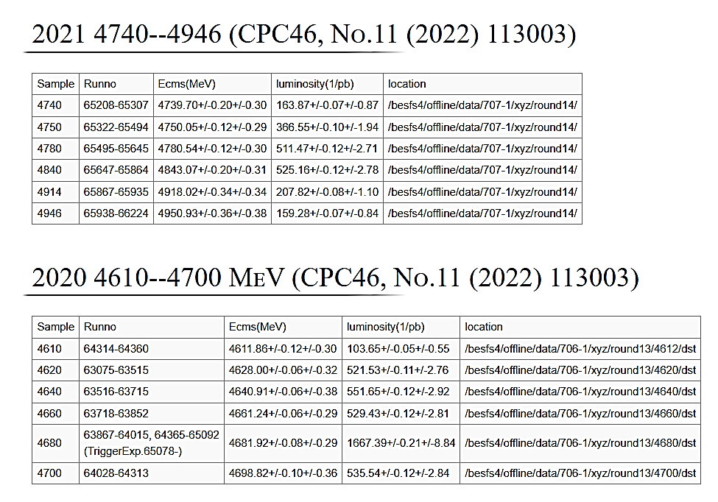
Run more data

Slide 7
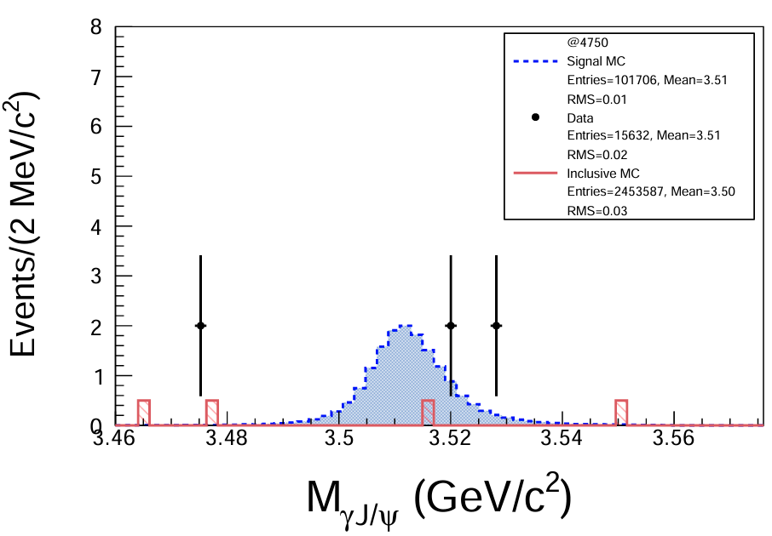
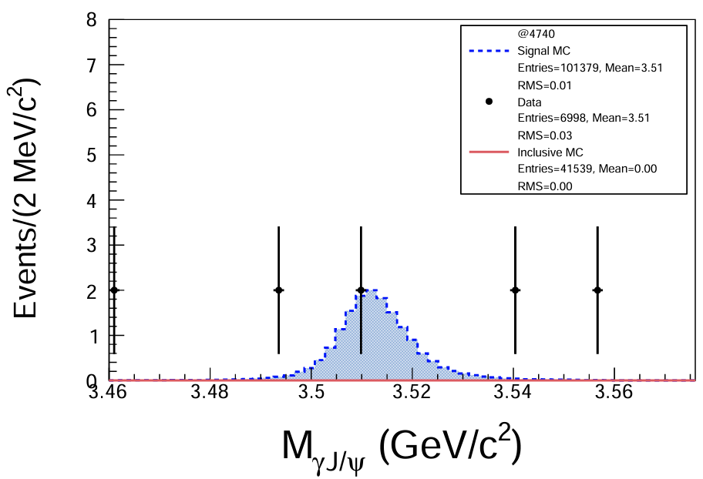
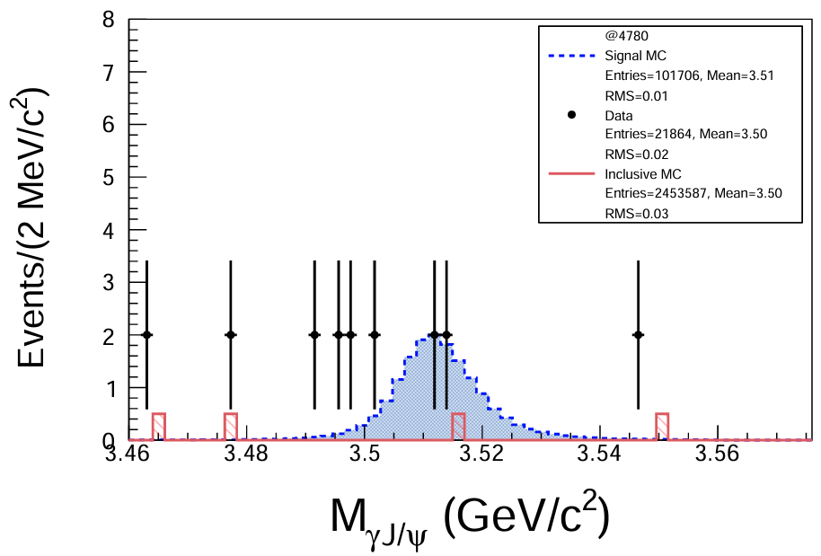
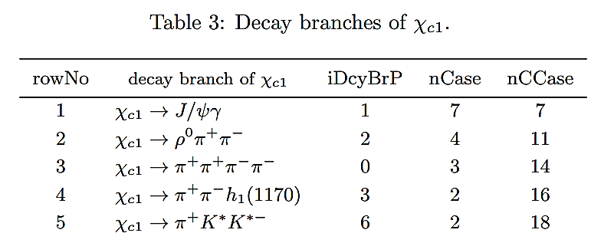
Data in 2021 @4740 - 4946

Slide 8
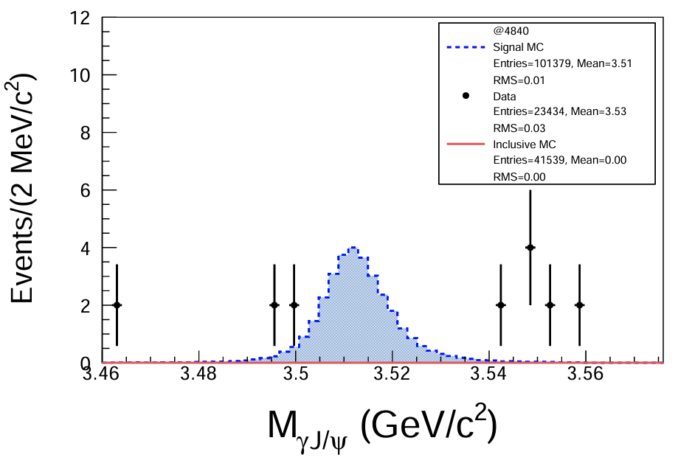
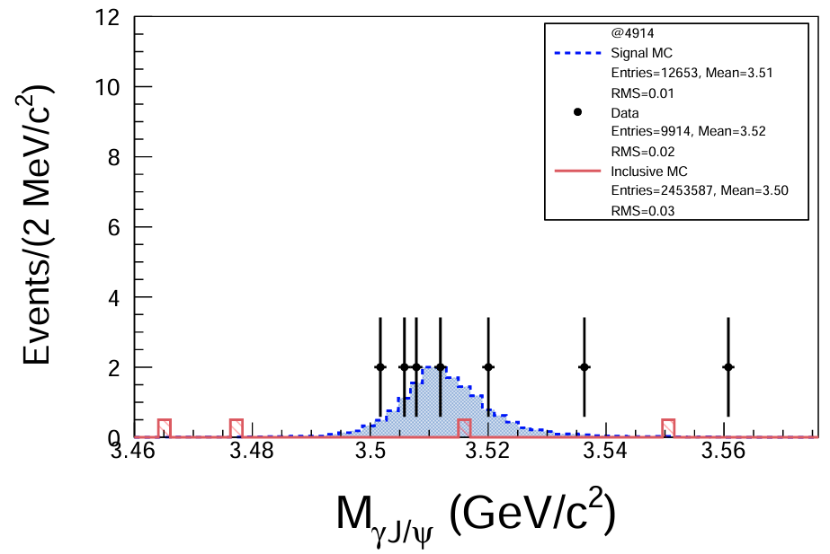
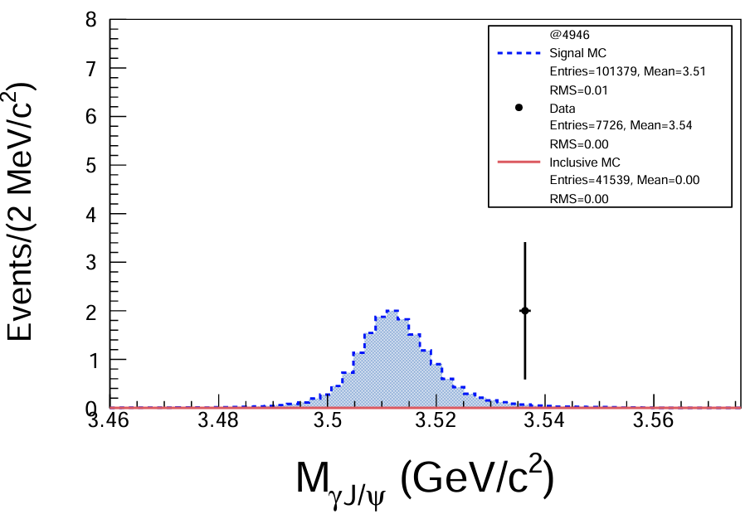

Slide 9
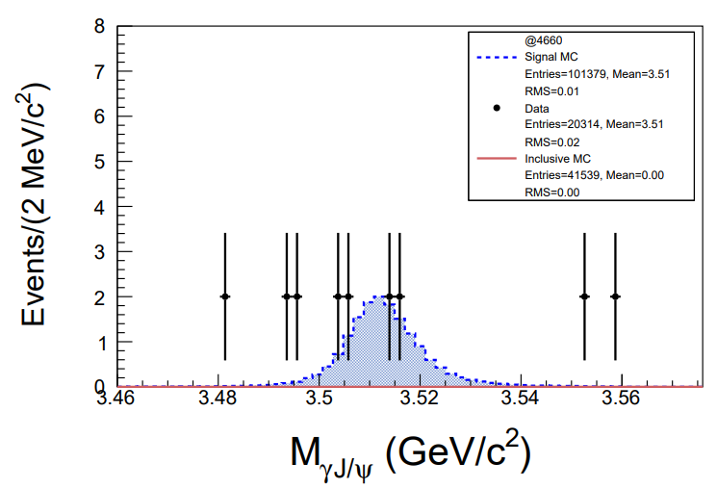
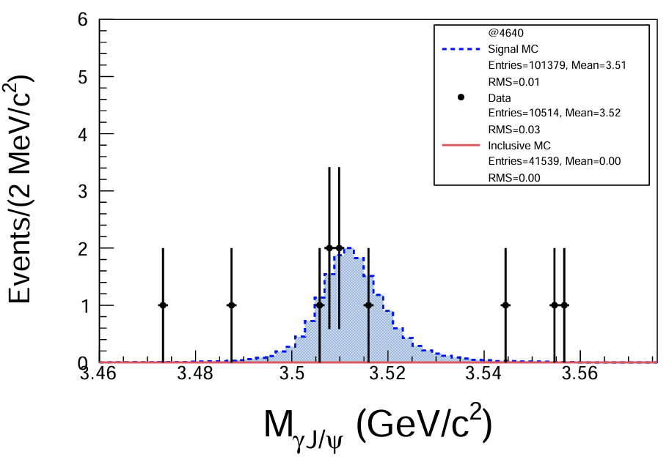
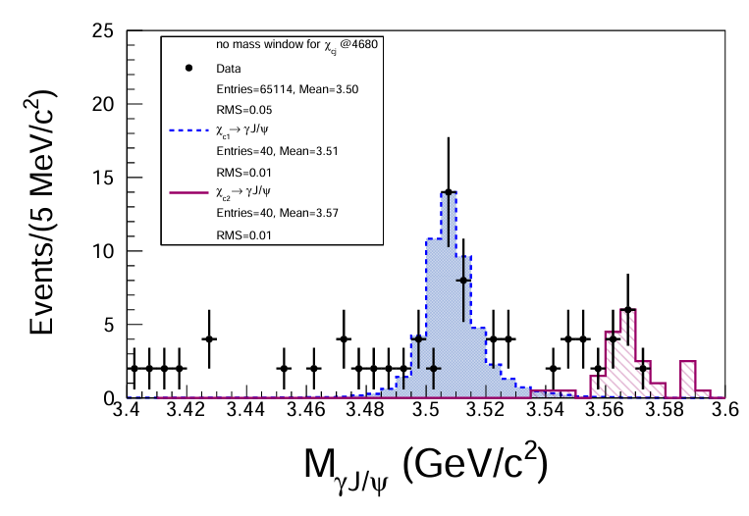
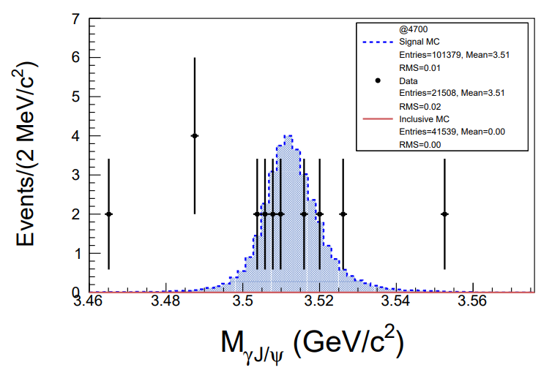
Data in 2020

Slide 10
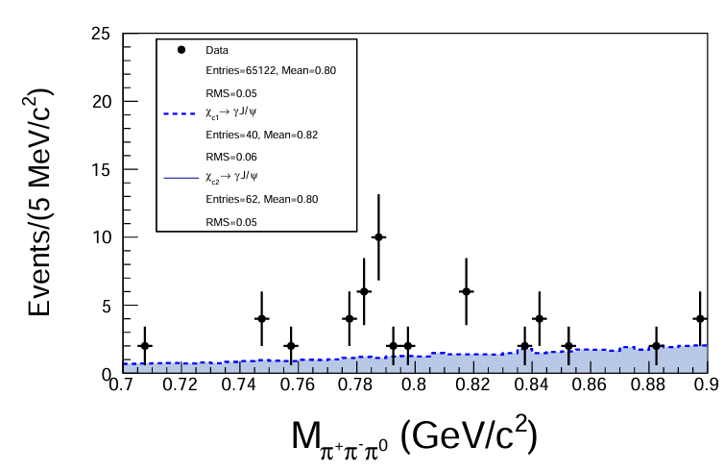
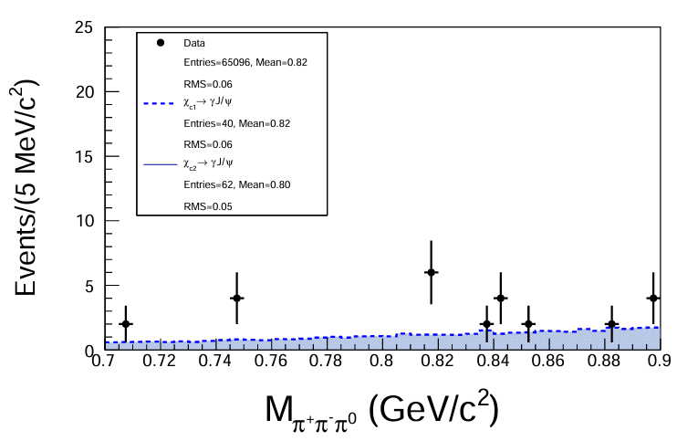

Veto $ω→π^{+}π^{−}π^{0}$
Take out events in the range 0.752 GeV ≤ $M_{π^{+}π^{−}π^{0}}$≤ 0.812 GeV.

Slide 11

No mass window for $χ_{cj}$

Slide 12
Next to do
Combine events from several energy points.

Slide 13
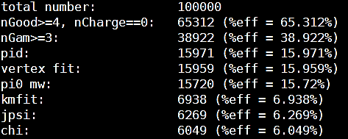
Cut flow

Slide 14
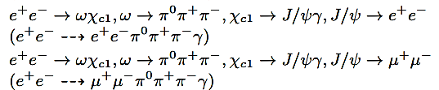

Next to do
Find
Perform $χ_{c1}$ invariant mass distribution.
Study and suppress background.
Prepare .dst files for signal MC at Ecms = 4.700 GeV.

Slide 15
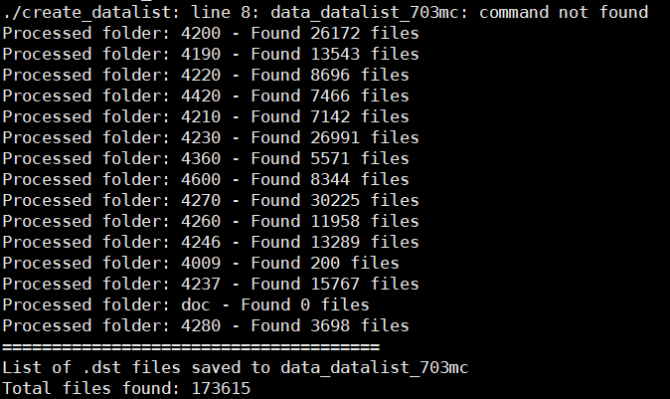
Mc 703

