Slide 1



LHCb实验上CKM矩阵元和相角的测量
周晓康
华中师范大学(CCNU)
2026.02.02
味物理前沿研讨会暨味物理讲座100期特别活动, 2026@三亚

Slide 2
Outline
Introduction
Measure CKM elements in LHCb
Measure CKM angle in LHCb
Summary

Slide 3
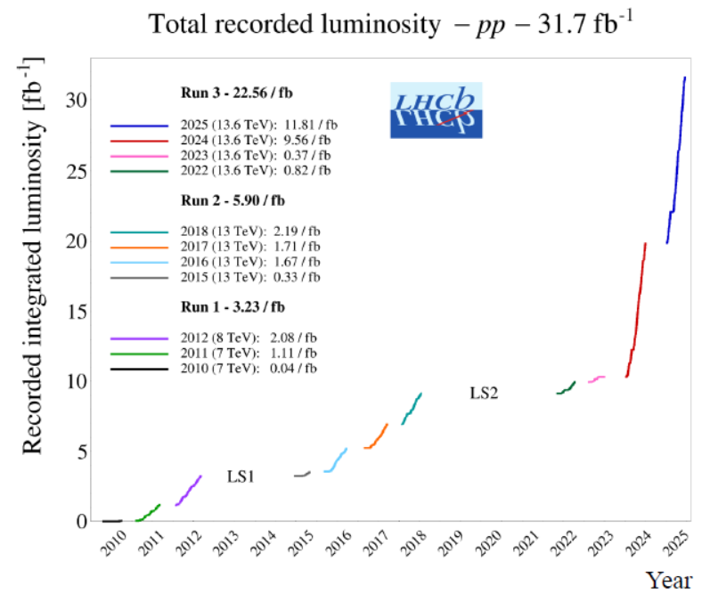
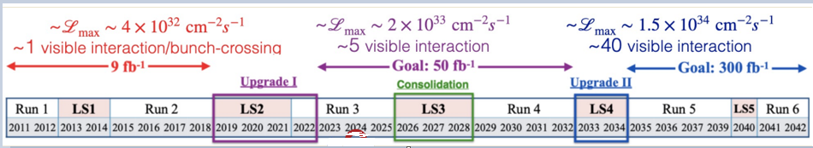
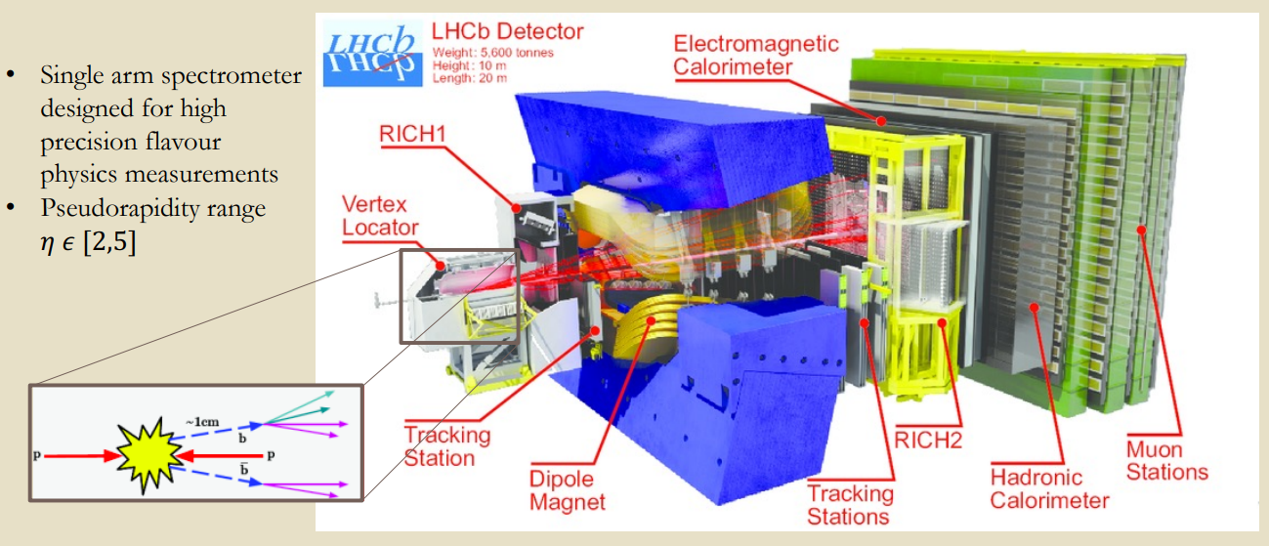
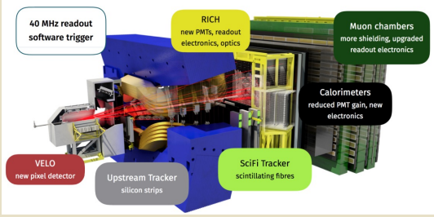
LHCb detector and dataset
Run 1 & 2 (2011-2018)
New detector for LS2 (now)
Run 1:
2011 (7 TeV): 1 fb⁻¹
2012 (8 TeV): 2 fb⁻¹
Run 2:
2015-2018 (13 TeV): 6 fb⁻¹
Run 3:
2024 alone (13.6 TeV): 9.56 fb⁻¹
2025 (13.6 TeV): 11.81 fb⁻¹

Slide 4
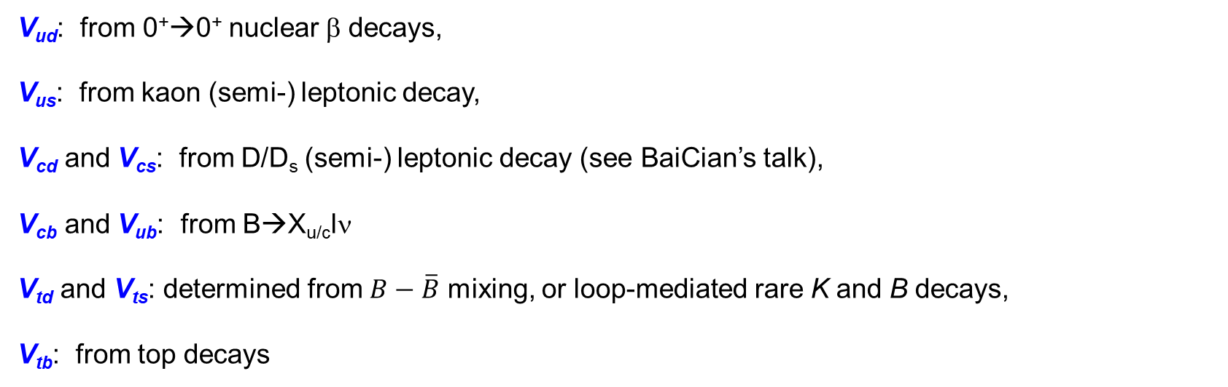
CKM matrix elements
CKM matrix: 3×3 unitary matrix
Unitarity test remains one of the main directions to probe NP beyond SM
Precision essential to constrain NP scenarios
V_{ud}: from 0⁺→0⁺ nuclear β decays,
V_{us}: from kaon (semi-) leptonic decay,
V_{cd} and V_{cs}: from D/D_{s} (semi-) leptonic decay (see BaiCian’s talk),
V_{cb} and V_{ub}: from B→X_{u/c}lν
V_{td} and V_{ts}: determined from $B−\overline{B}$ mixing, or loop-mediated rare K and B decays,
V_{tb}: from top decays
LHCb-PAPER-2025-030

Slide 5
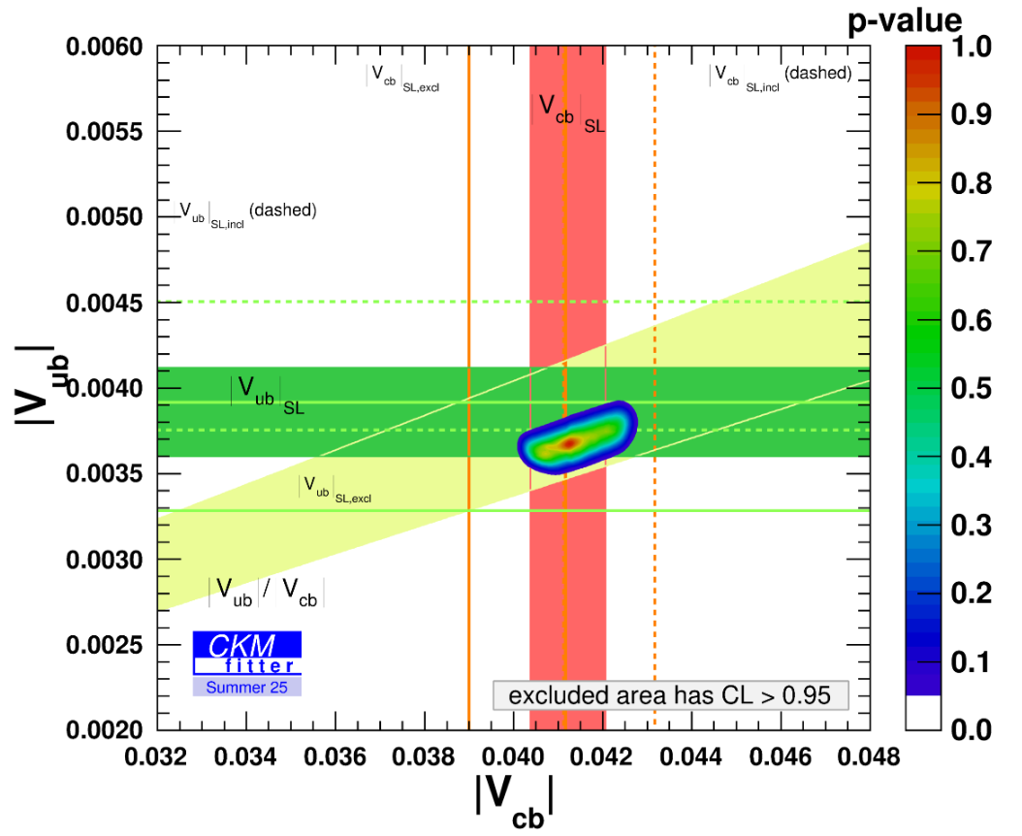
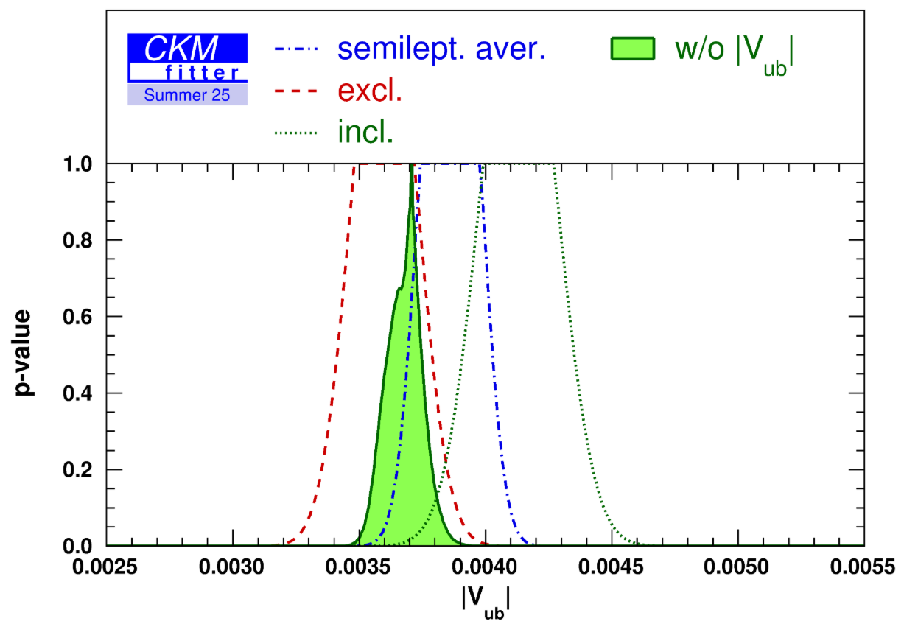
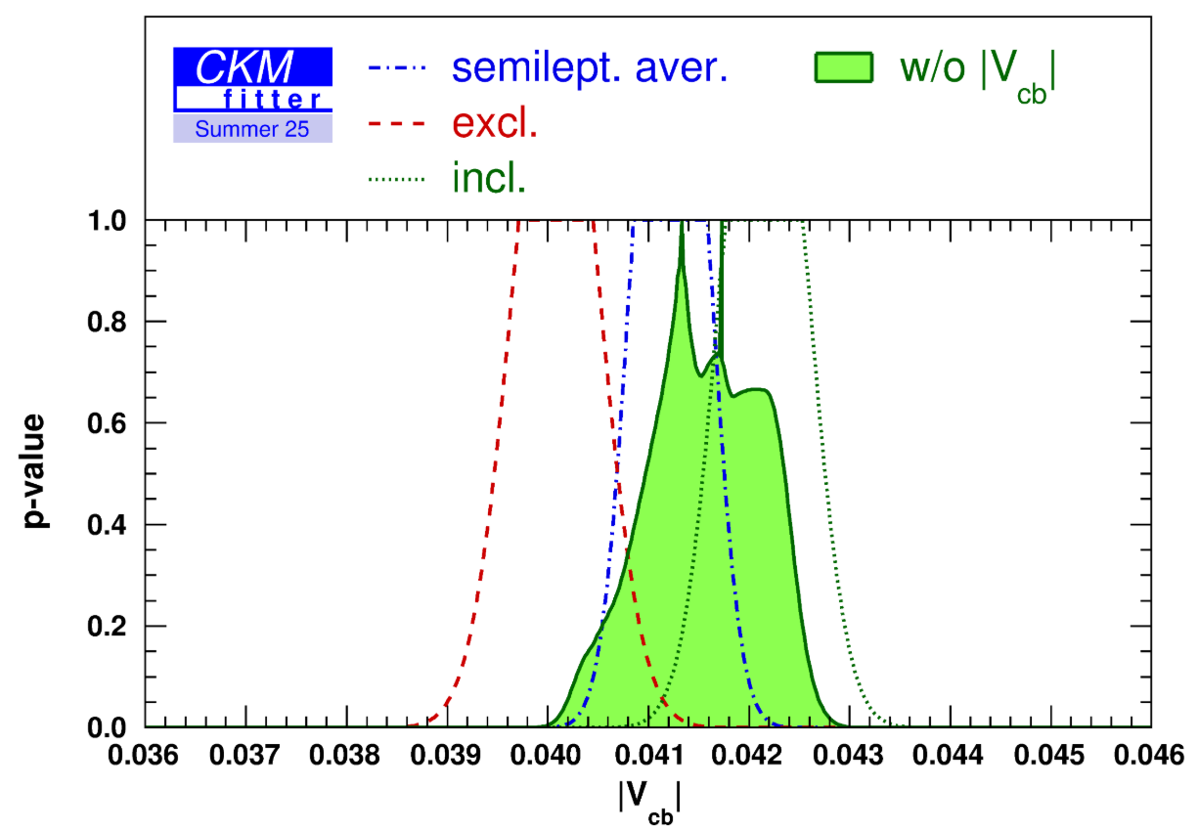

Status of $|V_{ub}|$ and $|V_{cb}|$
$|V_{ub}|$ and $|V_{cb}|$ remains one of the main limitations in CKM global fit
Long standing tension: inclusive vs exclusive
difficulties in reconstructing missing particles and more precise in measuring ratios in LHCb
LHCb also plays a leading role

Slide 6
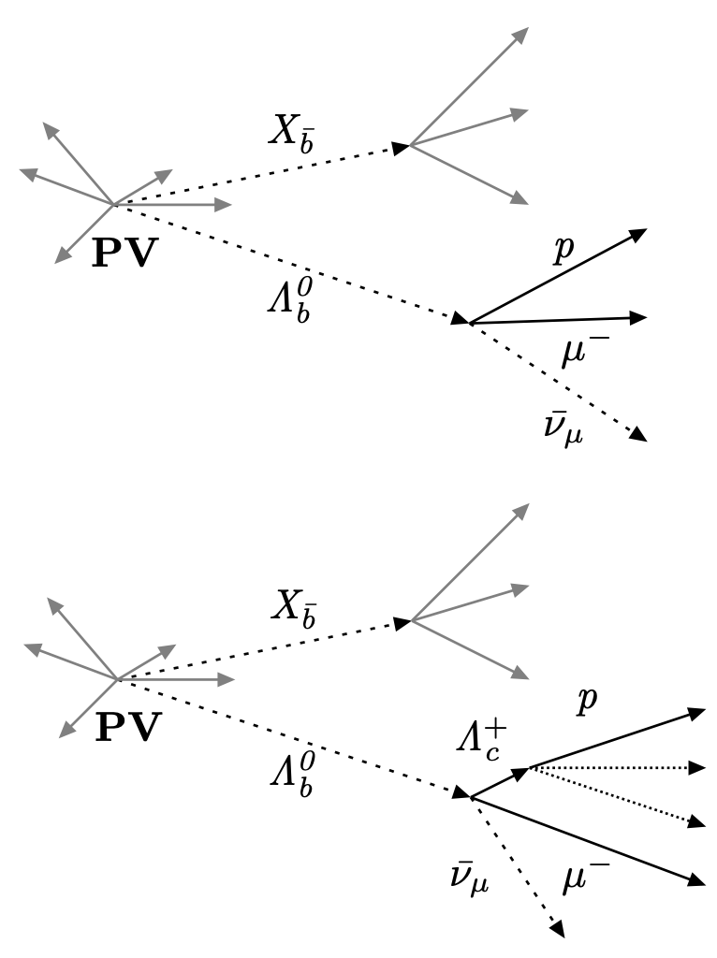
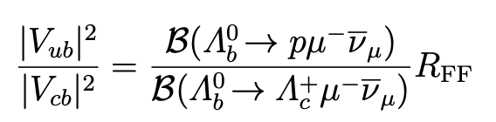

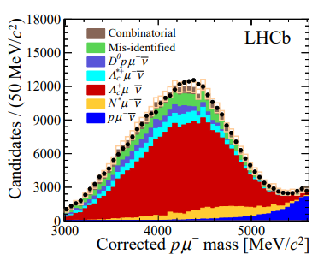
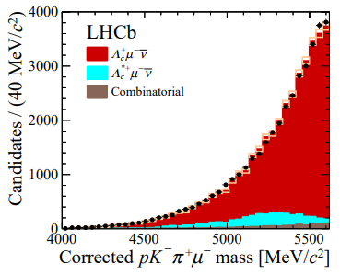


Determination of |V_{ub}| using baryonic decays
Nature Physics 11 (2015) 743
Dataset: 2 fb⁻¹ at $\sqrt{s}$ = 8 TeV (2012)
Ratio between $\left|V_{cb}\right|$ and $|V_{ub}|$ determined using $Λ_{b}^{0}→pμ^{−}{\overline{ν}}_{μ}$ and $Λ_{b}^{0}→Λ_{c}^{+}μ^{−}{\overline{ν}}_{μ}$
Inputs from LQCD
(1.00 ± 0.04 ± 0.08)×10⁻²
Half systematic from Br($Λ_{c}^{+}→pK^{+}π^{−}$)

Slide 7
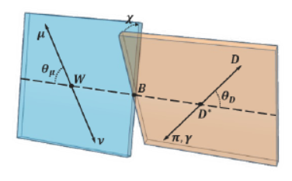
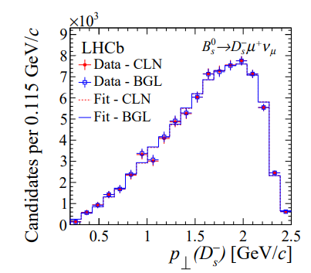
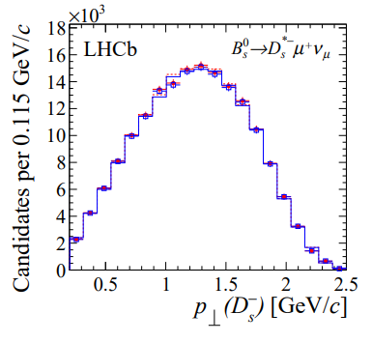

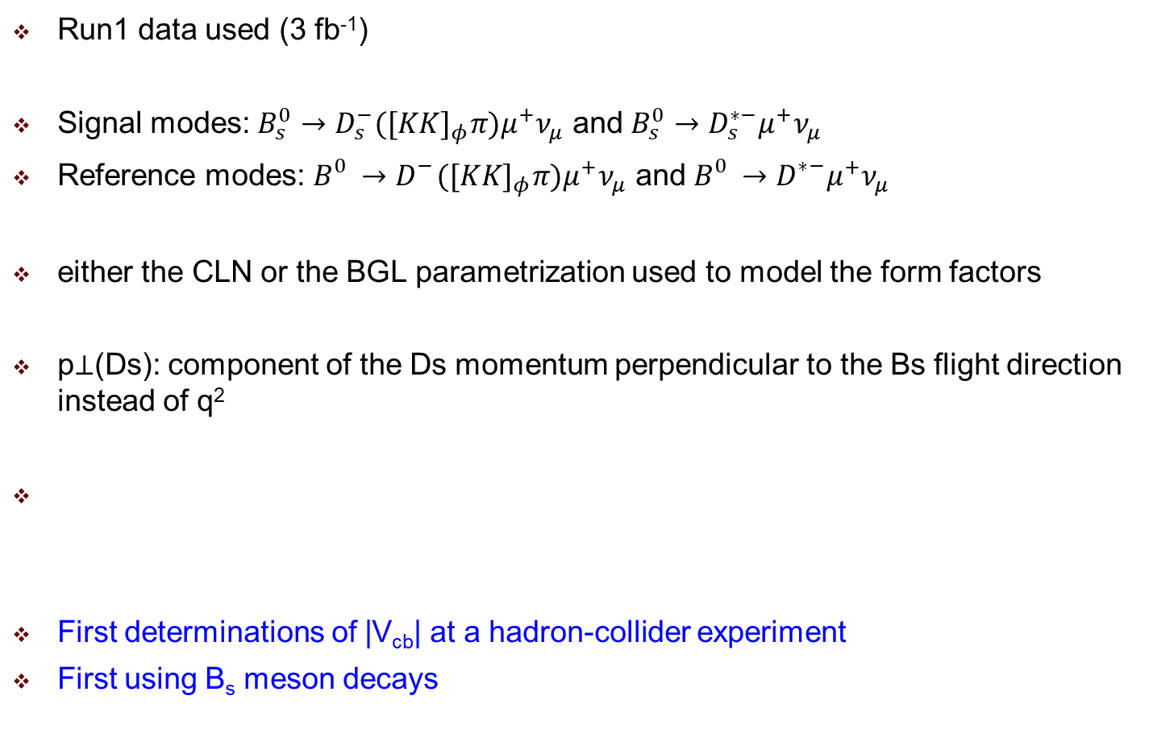
Meausre |V_{cb}| in LHCb
PRD101 (2020) 072004
Run1 data used (3 fb⁻¹)
Signal modes: $B_{s}^{0}→D_{s}^{−}({[KK]}_{φ}π)μ^{+}ν_{μ}$ and $B_{s}^{0}→D_{s}^{∗−}μ^{+}ν_{μ}$
Reference modes: $B_{}^{0}→D_{}^{−}({[KK]}_{φ}π)μ^{+}ν_{μ}$ and $B_{}^{0}→D_{}^{∗−}μ^{+}ν_{μ}$
either the CLN or the BGL parametrization used to model the form factors
p⊥(Ds): component of the Ds momentum perpendicular to the Bs flight direction instead of q²
First determinations of |V_{cb}| at a hadron-collider experiment
First using B_{s} meson decays

Slide 8
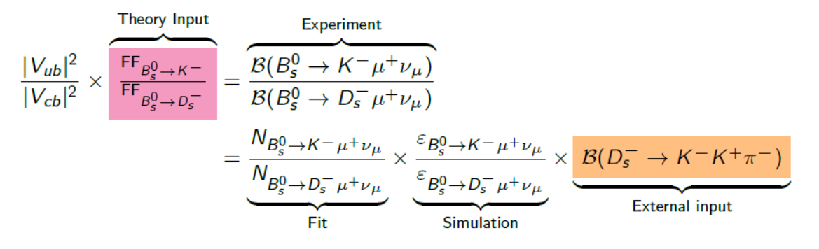
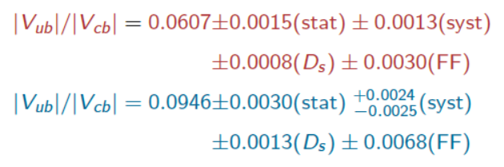
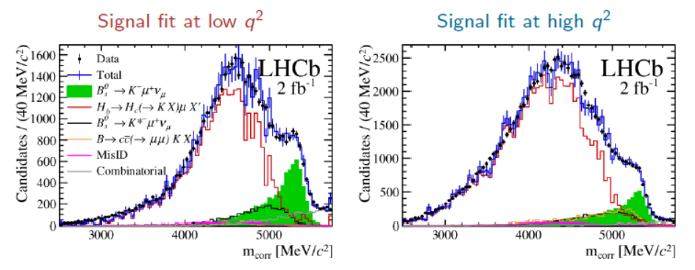
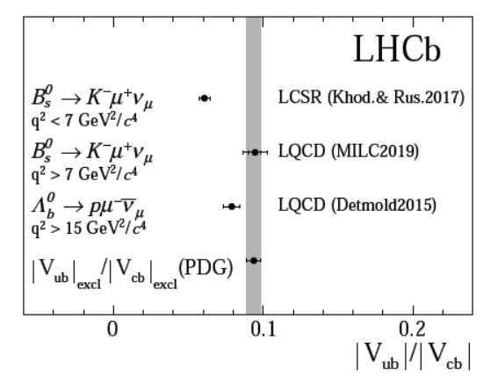

Measurement of |V_{ub}|/|V_{cb}|
PRL126 (2021) 081804
Dataset: 2 fb⁻¹ at $\sqrt{s}$ = 8 TeV (2012)
First observation for $B_{s}^{0}→K^{−}μ^{+}ν_{μ}$
Normalization: $B_{s}^{0}→D_{s}^{−}(KKπ)μ^{+}ν_{μ}$
|V_{ub}|/|V_{cb}| extraction in two q² bins
Tension is driven by difference in FF calculation

Slide 9
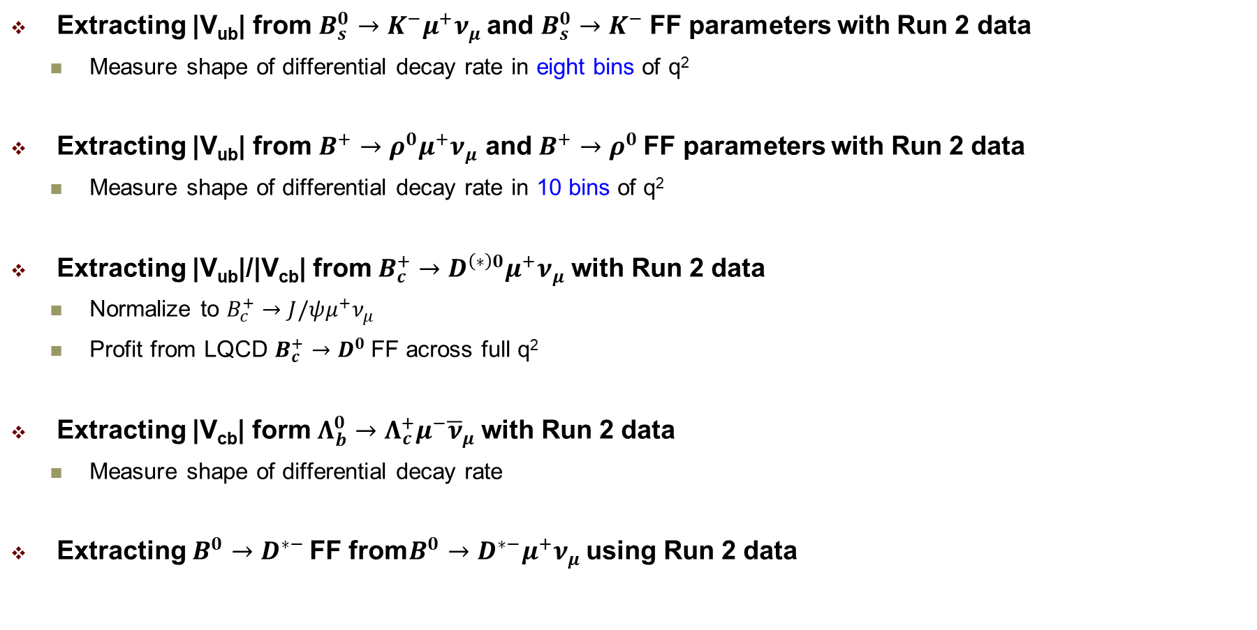
Upcoming measurements at LHCb
Extracting |V_{ub}| from $B_{s}^{0}→K^{−}μ^{+}ν_{μ}$and $B_{s}^{0}→K^{−}$FF parameters with Run 2 data
Measure shape of differential decay rate in eight bins of q²
Extracting |V_{ub}| from $B^{+}→ρ^{0}μ^{+}ν_{μ}$ and $B^{+}→ρ^{0}$FF parameters with Run 2 data
Measure shape of differential decay rate in 10 bins of q²
Extracting |V_{ub}|/|V_{cb}| from $B_{c}^{+}→D^{\left(∗\right)0}μ^{+}ν_{μ}$with Run 2 data
Normalize to $B_{c}^{+}→J/ψμ^{+}ν_{μ}$
Profit from LQCD $B_{c}^{+}→D^{0}$FF across full q²
Extracting |V_{cb}| form $Λ_{b}^{0}→Λ_{c}^{+}μ^{−}{\overline{ν}}_{μ}$with Run 2 data
Measure shape of differential decay rate
Extracting $B^{0}→D^{∗−}$FF from$B^{0}→D^{∗−}μ^{+}ν_{μ}$ using Run 2 data
Phys. Rev. D 105, 014503 (2022)
Many exciting Run 2 results upcoming
Expect more data in Run3

Slide 10
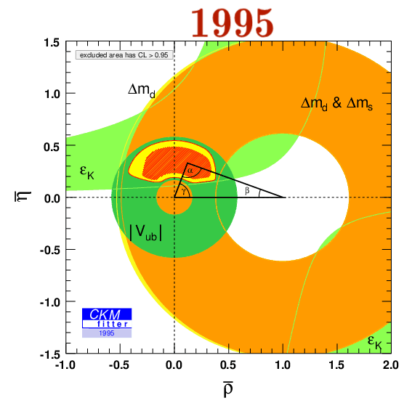
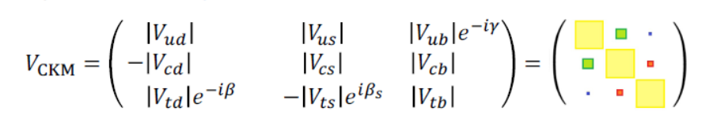
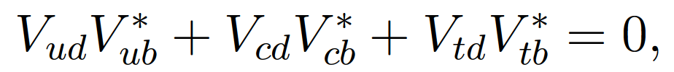
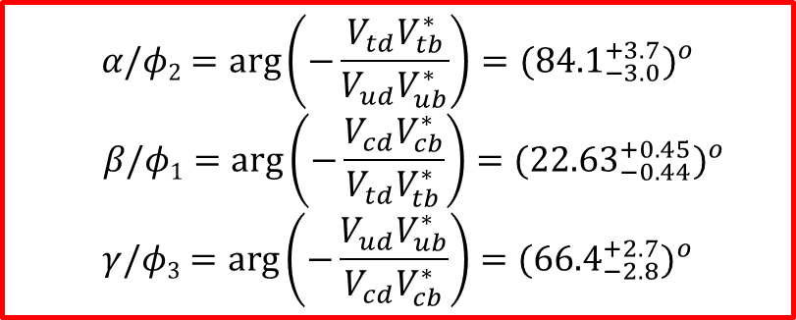
CKM angle
CKM matrix unitarity: key test of the SM
Latest results from HFLAV:
$$α/φ2=\arg\left(−\frac{V_{td}V_{tb}^{∗}}{V_{ud}V_{ub}^{∗}}\right)={({84.1}_{−3.0}^{+3.7})}^{o}$$
$$β/φ1=\arg\left(−\frac{V_{cd}V_{cb}^{∗}}{V_{td}V_{tb}^{∗}}\right)={({22.63}_{−0.44}^{+0.45})}^{o}$$
$$γ/φ3=\arg\left(−\frac{V_{ud}V_{ub}^{∗}}{V_{cd}V_{cb}^{∗}}\right)={({66.4}_{−2.8}^{+2.7})}^{o}$$

Slide 11
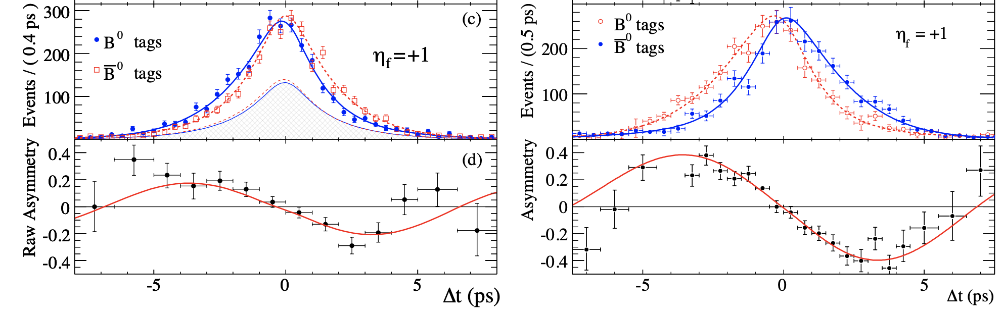



measure$β/φ1$ angle
Time dependent CP-violation → $β/φ1$ angle
Golden decay: $B^{0}→J/ψK^{0}$
$$\sin{2β=0.709±0.011}$$
Dominated by LHCb run1&2
PRL132 (2024) 021801
$$≈η_{f}\sin{2β}\sin\left(Δm_{d}t\right)$$
Penguin amplitude ~λ²-suppressed
BaBar
Belle

Slide 12
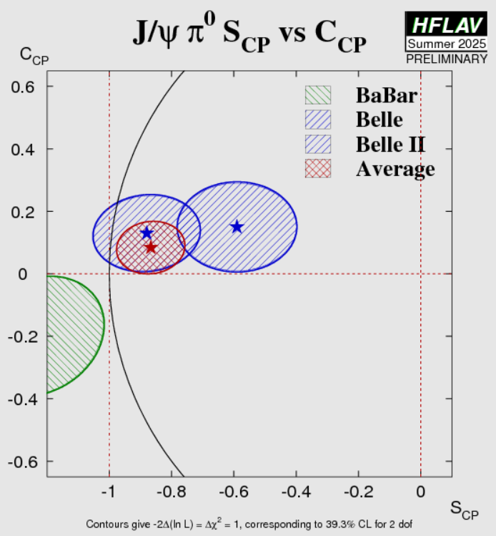
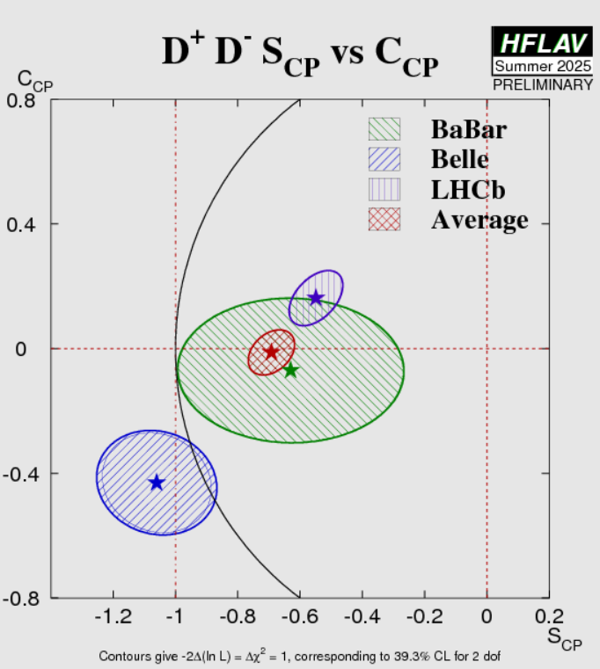
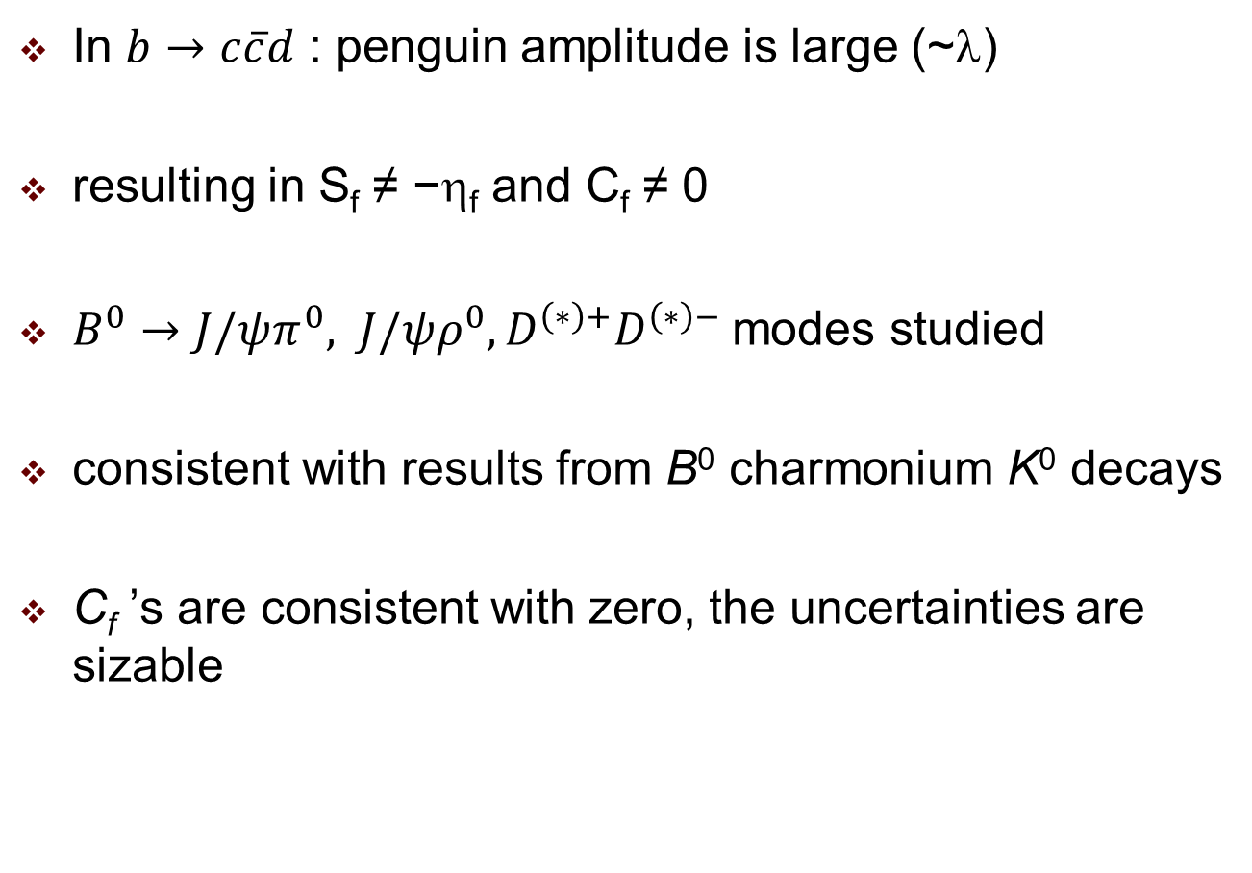
measure$β/φ1$via $b→c\overline{c}d$ decay
In $b→c\overline{c}d$ : penguin amplitude is large (~λ)
resulting in S_{f} ≠ −η_{f} and C_{f} ≠ 0
$B^{0}→J/ψπ^{0}, J/ψρ^{0}, D^{\left(∗\right)+}D^{\left(∗\right)−}$modes studied
consistent with results from B⁰ charmonium K⁰ decays
C_{f} ’s are consistent with zero, the uncertainties are sizable
JHEP 01 (2025) 061
PLB 742 (2015) 38

Slide 13
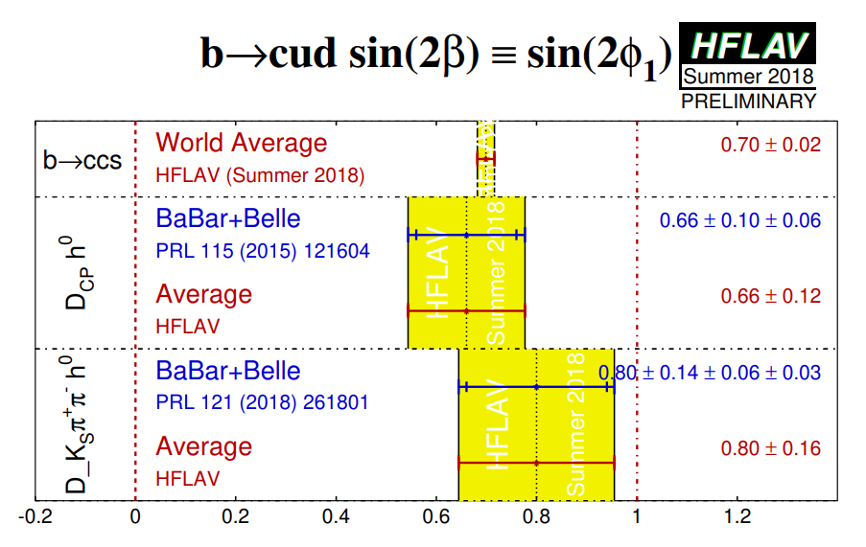
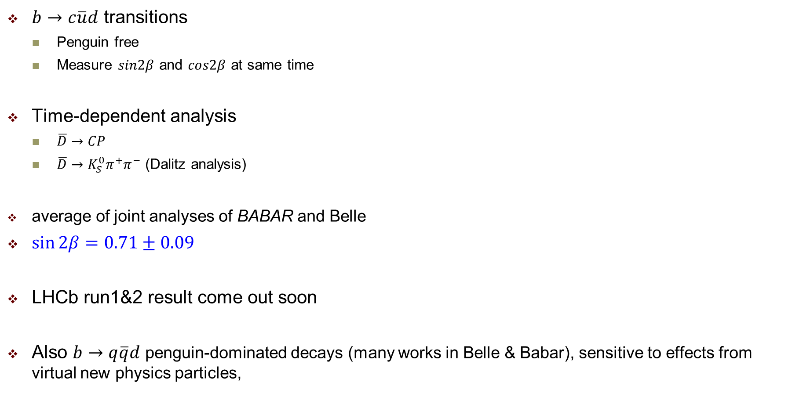
$β/φ1$ in $B^{0}→{\overline{D}}^{0(∗)}h$($b→c\overline{u}d$) decay
$b→c\overline{u}d$ transitions
Penguin free
Measure $sin2β$ and $cos2β$ at same time
Time-dependent analysis
$\overline{D}→CP$
$\overline{D}→K_{S}^{0}π^{+}π^{−}$ (Dalitz analysis)
average of joint analyses of BABAR and Belle
$\sin{2β=0.71±0.09}$
LHCb run1&2 result come out soon
Also $b→q\overline{q}d$ penguin-dominated decays (many works in Belle & Babar), sensitive to effects from virtual new physics particles,

Slide 14
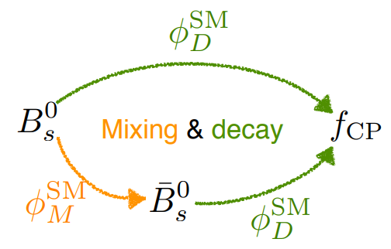
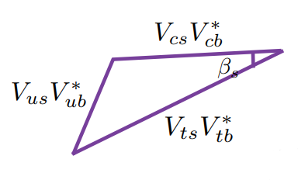

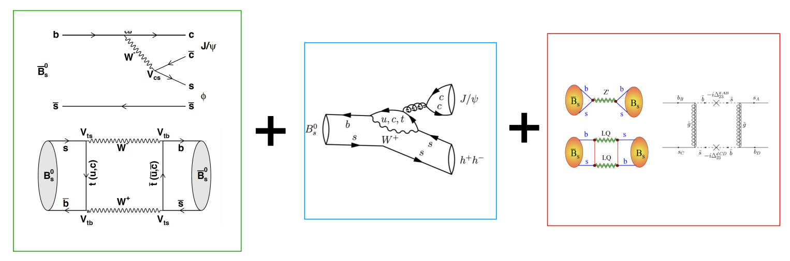
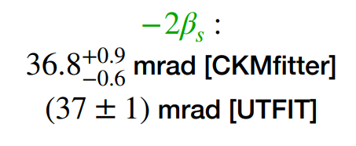
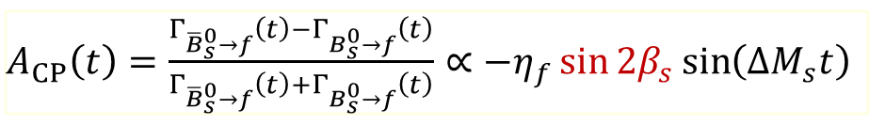

φ_{s} in $b→c\overline{c}s$Transition
φ_{s} mixing-induced CPV phase in $B_{s}^{0}$ decay through $b→c\overline{c}s$transitions
$A_{CP}\left(t\right)=\frac{Γ_{{\overline{B}}_{s}^{0}→f}\left(t\right)−Γ_{B_{s}^{0}→f}\left(t\right)}{Γ_{{\overline{B}}_{s}^{0}→f}\left(t\right)+Γ_{B_{s}^{0}→f}\left(t\right)}∝−η_{f}\sin{{2β}_{s}}\sin\left(ΔM_{s}t\right)$

Slide 15
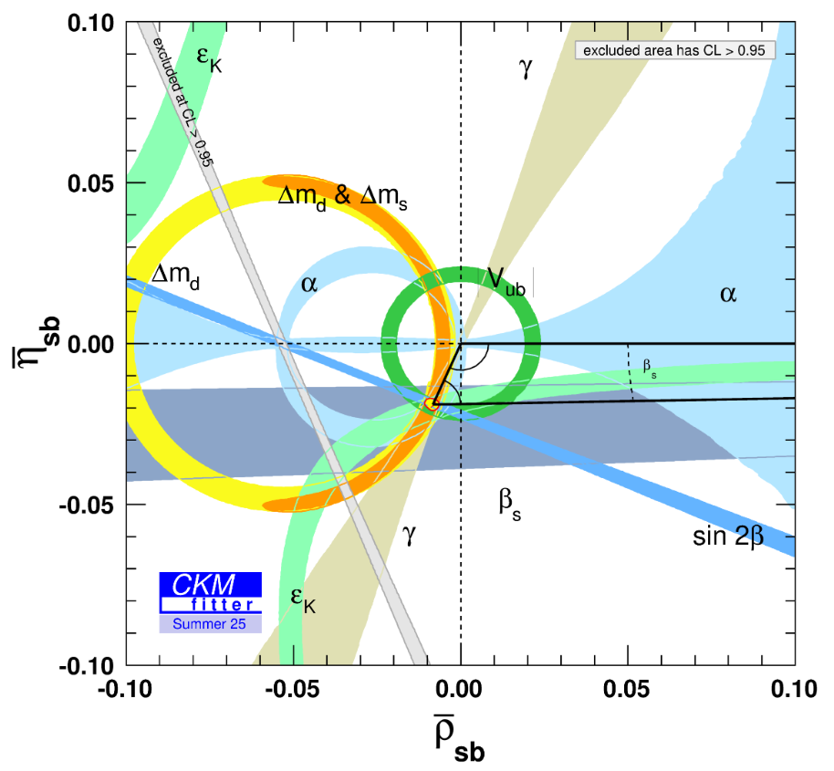
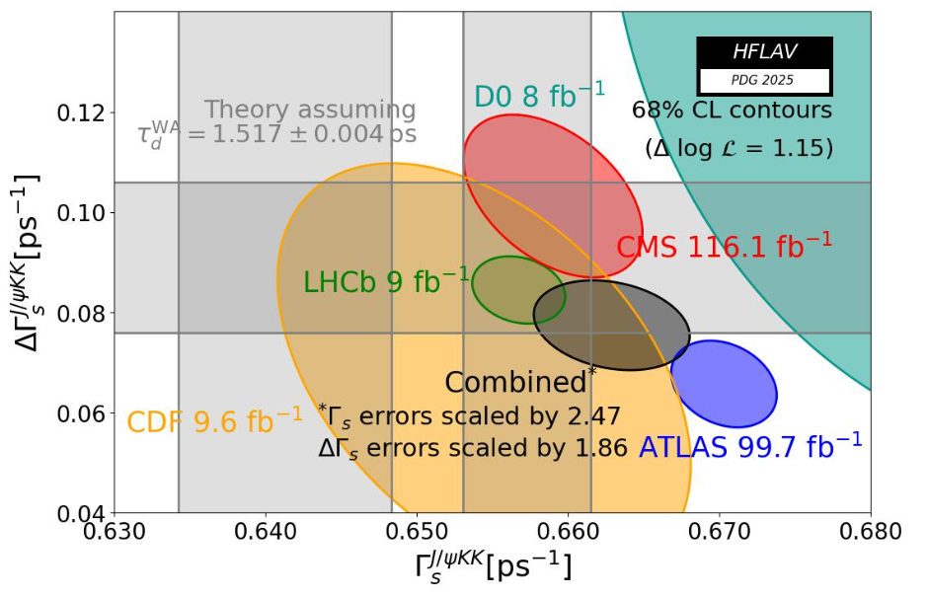
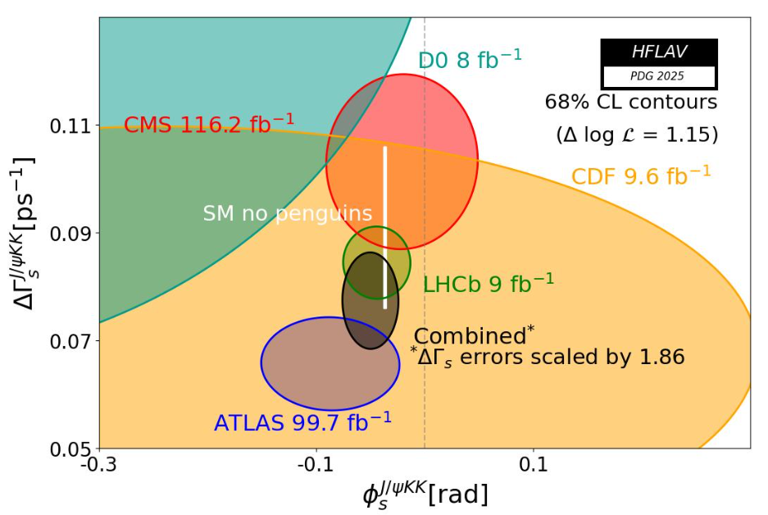

Status of φ_{s} Measurements
$B_{s}→J/ψφ$: Golden mode
Measure φ_{s}, ΔΓ, Γ_{s}-Γ_{d}
Experimental Combination (CDF, D0, ATLAS, CMS, LHCb):
$φ_{s}^{c\overline{c}s}=(−50±17)$ mrad $∆Γ_{s}=\left(0.077±0.006\right)$ ps⁻¹
LHCb dominated
PRL 132 (2024) 051802

Slide 16
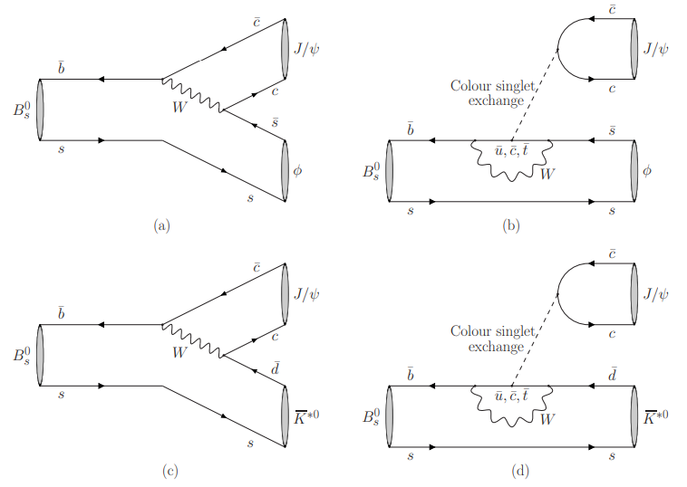
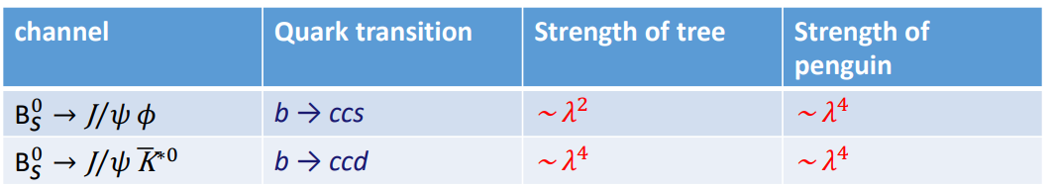


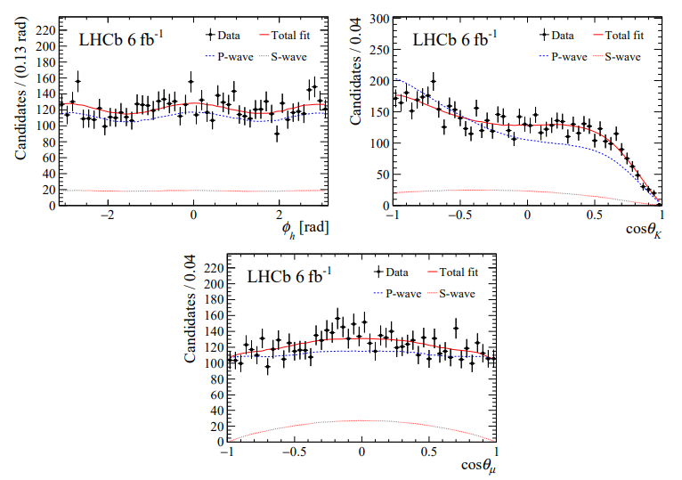

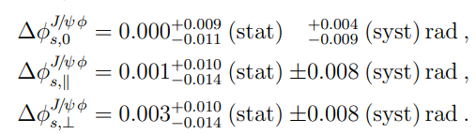
CPV parameters in $B_{s}→J/ψ{\overline{K}}^{∗0}$
Angular Analysis
Assuming
Run1 result (JHEP 11 (2015) 082)
Run2 analysis published JHEP10(2025)173

Slide 17
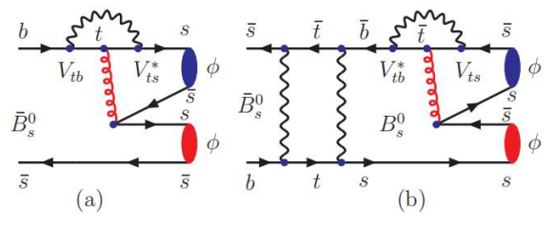
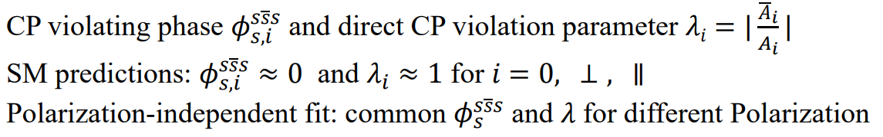



CPV parameters in $B_{s}→φφ$
$B_{s}→φφ$: golden channel to study CPV in $b→s$ decays
Tiny CPV in SM
Sensitive to NP in B_{s} mixing and $b→s$ decay
CP violation observables from flavor-tagged time-dependent angular analysis
Full Run 2 data, and make a combination with Run 1
Consistent with SM expectation
No sign of polarization-dependence observed
Most precise measurement of time-dependent CP violation in $b→s$ decay
PRL 131 (2023) 171802

Slide 18



How to measure α/φ₂
Typical decay: $B^{0}→π^{+}π^{−}π^{0}, ππ, ρρ…$
If $B^{0}→π^{+}π^{−}$only determined by b→u tree diagram，similar to β
$B^{0}→π^{+}π^{−}$ penguin contribution same order to tree diagram
M. Gronau & D. London: Isospin analysis of CP asymmetries in B decays，simultaneously measure $B_{d}^{0}→π^{+}π^{−}$，$B_{d}^{0}→π^{0}π^{0}$and $B_{u}^{+}→π^{+}π^{0}$
Other methods（e.g. $B^{}→ρ^{+/0}ρ^{−/0}$）
Limited to the statistics，still much room for improvement in accuracy of α
PRL 65 (1990) 3381

Slide 19


How to measure γ/φ₃: direct CPV
Interference between favoured b→c and suppressed b→u decay amplitude
tree-level decays, theoretically clean(δγ/γ<10⁻⁷)
Ideal decays: B→DK (clean background, large branching fraction)
Different method according to D decay modes
GLW method: CP modes such as D→K⁺K⁻,π⁺π⁻
ADS method: Flavor modes such as D→Kπ, Κππ⁰
BPGGSZ method: D→K_{s}ππ/K_{s}KK (golden mode)
JHEP 1401(2014)051

Slide 20


Evolution of γ results
The precision of γ improved significantly over the past two decades
LHCb dominates current world averages of direct γ measurements
Many more modes still need to add
Need D strong parameters from charm factory as input (see BaiCian’s talk)

Slide 21



GLW method ^{[1,2]}
D (quasi-)CP-eigenstate states such as D→K⁺K⁻,π⁺π⁻,π⁺π⁻π⁰…
Use the yields of B+ and B- to construct observables related to γ
$$A^{f}=\frac{N\left(B^{−}→f_{D}K^{−}\right)−N\left(B^{+}→f_{D}K^{+}\right)}{N\left(B^{−}→f_{D}K^{−}\right)−N\left(B^{+}→f_{D}K^{+}\right)}=\frac{2κr_{B}sinδ_{B}sinγ}{R^{f}}$$
insert a factor of (κ=2F₊-1) before interference terms (F₊=CP even content), need charm input
$$R^{f}=\frac{N\left(B^{−}→f_{D}K^{−}\right)−N\left(B^{+}→f_{D}K^{+}\right)}{N\left(B^{−}→{[Kπ]}_{D}K^{−}\right)−N\left(B^{+}→{[Kπ]}_{D}K^{+}\right)}=1+r_{B}^{2}+2κr_{B}cosδ_{B}cosγ$$
Notice r_{B}/δ_{B} need input

Slide 22



ADS method^{[1,2]}
Consider the Cabibbo-favored decay D⁰→K⁻π⁺ and doubly-Cabibbo-suppressed decay D⁰→K⁺π⁻
r_{B}/δ_{B} can be obtained directly, but external input r_{D}/δ_{D}
$$Γ\left(B^{±}→f_{D}K^{±}\right)∝r_{B}^{2}+r_{D}^{2}+2R_{f}r_{B}r_{D}cos\left(δ_{B}+δ_{D}±γ\right)$$
$$Γ\left(B^{±}→{\overline{f}}_{D}K^{±}\right)∝{1+r}_{B}^{2}r_{D}^{2}+2R_{f}r_{B}r_{D}cos\left(δ_{B}−δ_{D}±γ\right)$$
$$R_{K3π}e^{−iδ_{K3π}}=\frac{\int{A_{K^{−}3π}\left(x\right)A_{K^{+}3π}\left(x\right)dx}}{A_{K^{−}3π}\left(x\right)A_{K^{+}3π}\left(x\right)}$$
Need inputs from charm factory
For K3π mode, coherence factor R_{K3π} and δ_{K3π} averaged over phase space not good for whole space

Slide 23




γ from $B^{±}→D[K^{∓}π^{±}π^{±}π^{∓}]h^{±}$ decays
JHEP 07 (2023) 138
Large CPV observed in local bins!
Large expected improvement from incoming 20fb⁻¹ of BESIII ψ(3770) data
Comparable to golden mode!

Slide 24



BPGGSZ method
Golden mode: D→K_{s}ππ/K_{s}KK (large statistic, large r_{D})
Model-dependent method (not used now)
Model-independent binned method (BPGGSZ method^{[1]})
Binned Dalitz plane according to δ_{D}, measure B± yields in each bins
Sensitivity from phase-space distribution, not overall asymmetries → not impacted by production/detection asymmetries
LHCb latest $K_{s}hh$ result:${ γ=({68.7}_{−5.1}^{+5.2})}^{o}$(uncertainty~1º from BESIII input)
JHEP 02 (2021) 169
External input from BESIII and CLEO-c

Slide 25



Unbinned model-independent method
Basic idea: Bins → Events (EPJC, 2018, 78(2))
Make most use of amplitude info in phase space
Fourier expansion the amplitude by strong phase
Parameters definition similar to BPGGSZ method
LHCb&BESIII joint analysis comes out soon

Slide 26




Time dependent measurement
JHEP 03 (2025) 139
Golden decays: B_{S}→D_{S}K
larger interference: $r_{B}^{D_{s}K}\sim 0.4 (r_{B}^{DK^{+}}\sim 0.1)$
Use flavor tagging to determine the initial flavor
Interference between mixing and decay amplitudes gives sensitivity to γ+(-)2β_{(s)}

Slide 27





LHCb γ combination
LHCb-CONF-2025-003
Best knowledge of γ comes from combination of many measurements
20 LHCb $B$ decay measurements + 12 $D$ decay measurements + 14 inputs from LHCb, HFLAV, BESIII and CLEO-c = 29 physics parameters of interest + additional nuisance parameters
$${ γ=(62.8±2.6)}^{o}$$
surpass LHCb design: $4^{∘}$
Previous tension between $B_{s}^{0}$ and other modes smaller, $B_{s}^{0}$ modes still with largest uncertainty
Sensitivity dominated by $B^{+}$ modes
Charm inputs crucial for $γ$ measurements

Slide 28


Future prospects for γ @ LHCb
Status now：
Error for γ is about 4º
BESIII contribute about 1º
Around 2030
Less than 1º will be achieved
BESIII 20fb⁻¹ data → improve the error to 0.4º
(>)2035
LHCb upgradeII → sensitivity <0.4º
Need more charm factory data (STCF)
Full combination
dataset | Int. Lum | Achieve year | γ precision
LHCb Run1 (7,8TeV) | 3 fb⁻¹ | 2012 | 8º
LHCb Run2 (13TeV) | 6 fb⁻¹ | 2018 | 4º
BelleII Run | 50 ab⁻¹ | 20xx | 1-2º
LHCb upgrade (14TeV) | 50 fb⁻¹ | 2030 | <1º
LHCb upgradeII (14TeV) | 200 fb⁻¹ | (>)2035 | <0.4º

Slide 29

Summary
The precision of the CKM elements and angles have greatly improved
LHCb play important role in measuring CKM elements and angle
Already collected more data in Run 3 than in Run 1+2 combined, Stay tuned !
Carry out an unprecedentedly rigorous test of the Standard Model in UpgradeII
Thank you!

Slide 30


α status
α is complex, isospin analysis by using:
$B_{d}^{0}→ρ^{+}ρ^{−},$ $ρ^{0}ρ^{0}, B_{u}^{+}→ρ^{+}ρ^{0}$
Time-dependent CP Asymmetries
LHCb can contribute in many modes

Slide 31


