Slide 1
CSNS-II MEBT Beam Instrumentation
R. Yang
On behalf of beam-instrumentation group
Acknowledge to mechanical, control, vacuum and survey & alignment groups
17/12/2024

Slide 2
Overview
Beam position monitor（BPM）
Beam current monitor（BCT）
Emittancemeter+profile monitor（EM&PM）

Slide 3
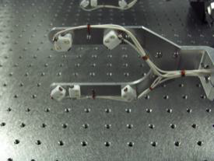
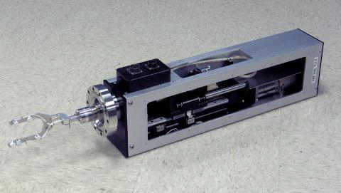
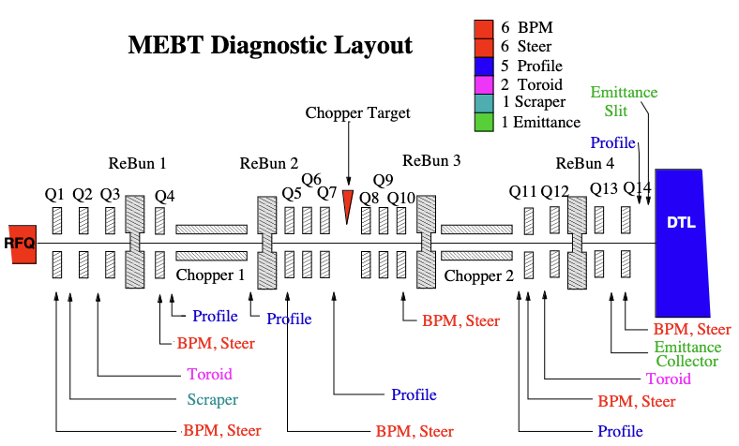
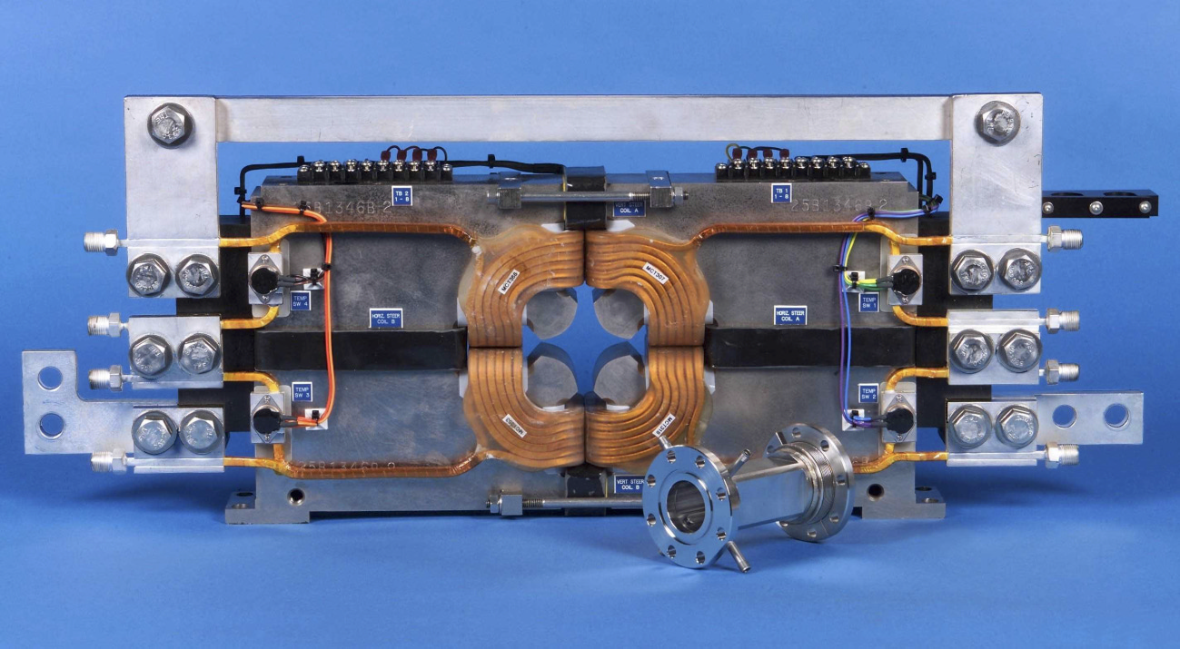
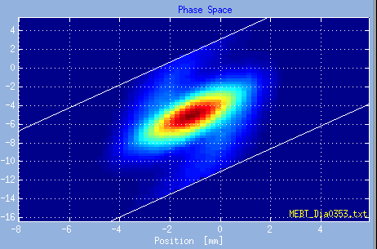
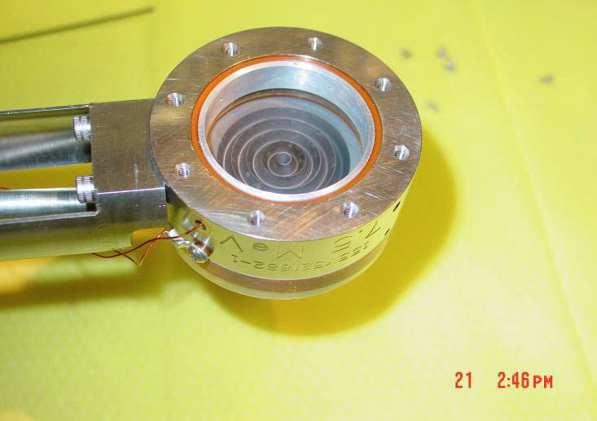
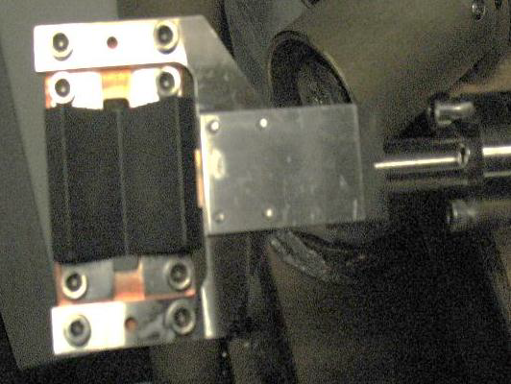
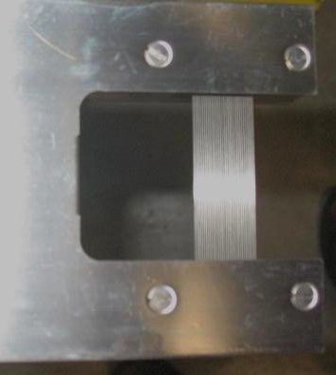
SNS MEBT
Highlights
6 BPMs spaced roughly every π/2 phase advance
CT: nearly Bergoz FCT-082-50:1, droop 0.06%/us, 37 mm from the quad. (magnet fringe field)
WS (d100 μm W wire) works at 100 us, 6 Hz
Quad. and BPM
Faraday cup in 2002
[1] A. Aleksandrov, SNS beam diagnostics (2011)
[2] L. Doolittle et al., SNS Front End Diagnostics (2000), D. Oshatz et al., LBNL-047343 (001)

Slide 4
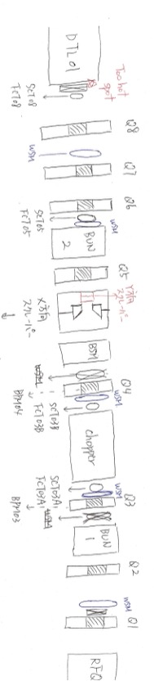
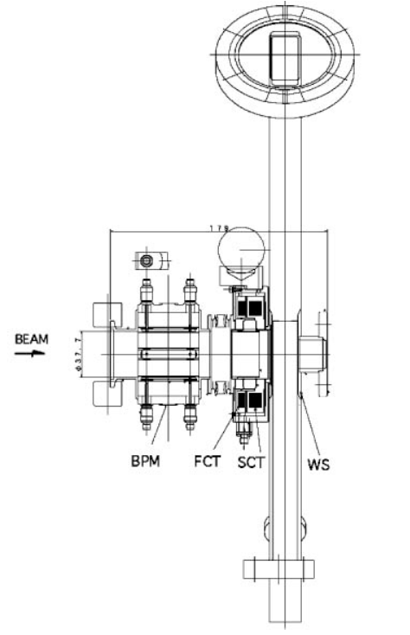
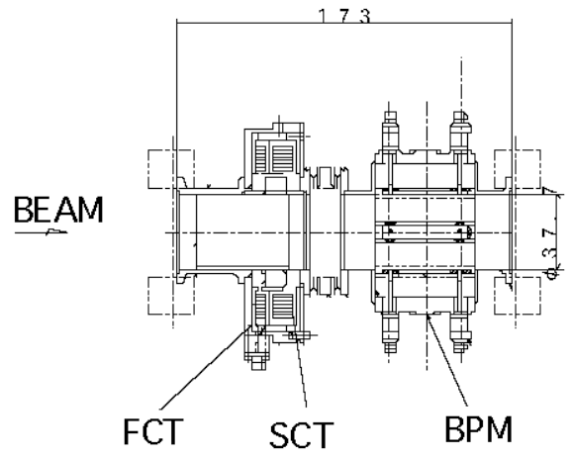
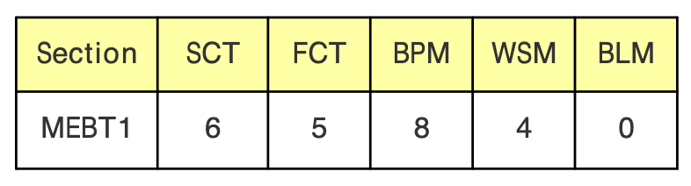
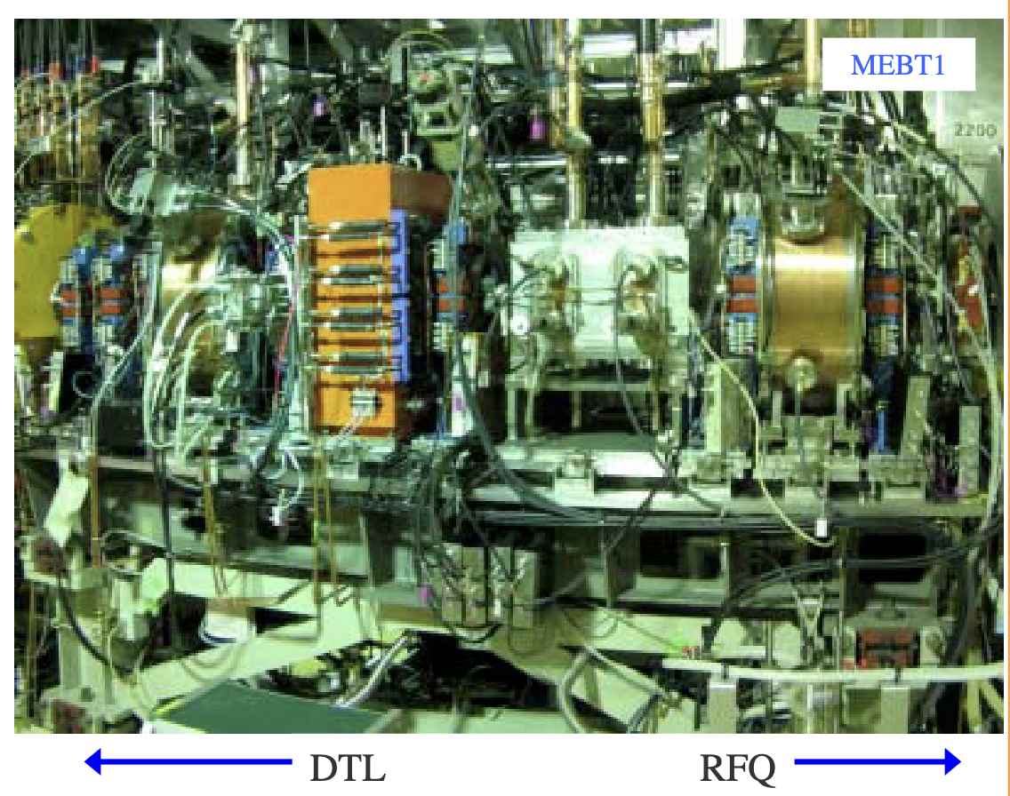
J-PARC MEBT
Highlights
BPM embedded in every quad.
SCT+FCT+X assembly type1: BPM+FCT+SCT+WS welded (179 mm) type2: FCT+SCT+BPM welded (173 mm)
No emittancemeter, but do desired to have one (Y. Liu)
BSM newly installed, but not used properly (Y. Liu)
type1
type2
[1] H. Sasaki et al., IFMIC mini-workshop on beam instruments (2007)
[2] A. Miura et al., IBIC2012
[3] Y. Liu, private communication (2024)

Slide 5
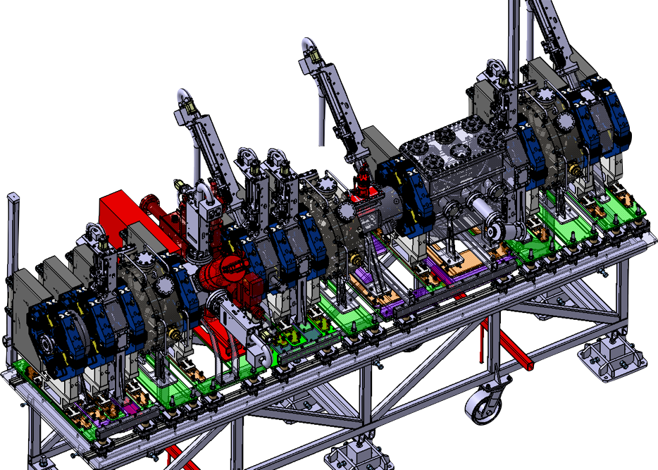
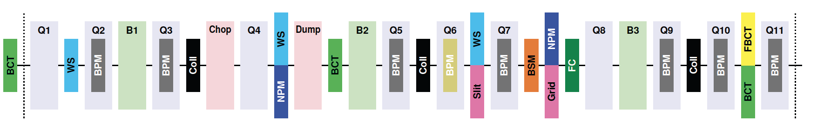
ESS MEBT beam diagnostics
Highlights
longitudinal margin for almost all instruments except for the stripline BPM embedded in quad. as usual
Beam
Instr. | Number
BCT | 3
FCT | 1
BPM | 7 (w/ 11 quads.)
Profiler Monitors | 4
Emittancemeter | 1 (slit-grid)
BSM | 1
FC | 1
[1] N. Milas et al., IBIC2022, M02C2 (2022)

Slide 6
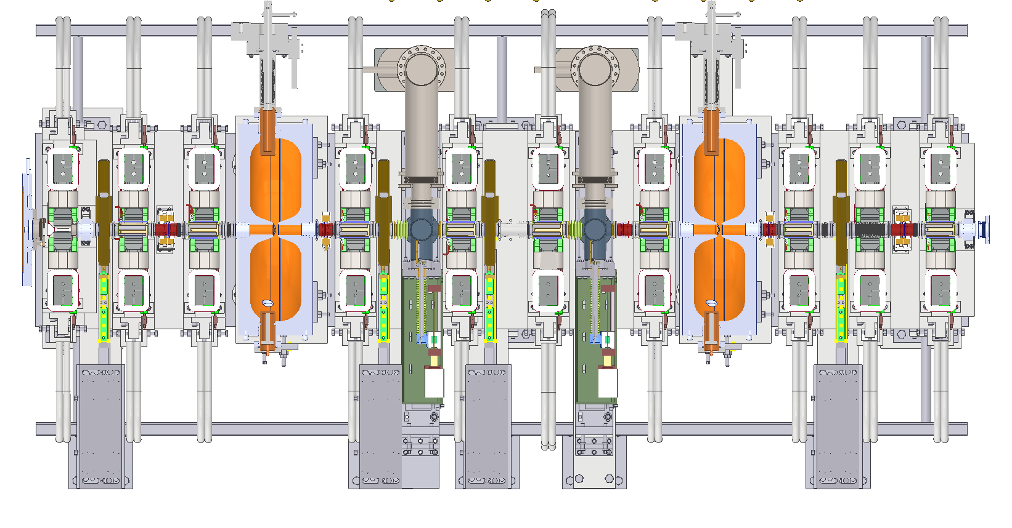
Current MEBT beam diagnostics
Name | No. | Functions | Features
EM | 1 | Transverse phase-space distributions; emittance and Twiss parameters | Slit-slit/FC scheme, slit widths=0.2 mm, drift distance=0.54 m, BW=30 kHz
BPM | 7 | Beam central position | BPM inside quad.; Commercial electronics
CT/FCT | 2/5 | Current/transmission; phase/beam energy | Commercial FCT (Bergoz)
WS | 4 | Beam profile/emittance and Twiss parameters | d33 μm CF wire，x, y & 45 deg
3D模型俯视图
Buncher 1
Buncher 2
Q1
Q2
Q3
Q4
Q5
Q6
Q7
Q8
Q9
Q10
H⁻ beam
WS
CT
FCT
FCT
EM
WS
WS
EM
FCT
FCT
WS
CT
FCT
BPM
BPM
BPM
BPM
BPM
BPM
BPM
BPM

Slide 7
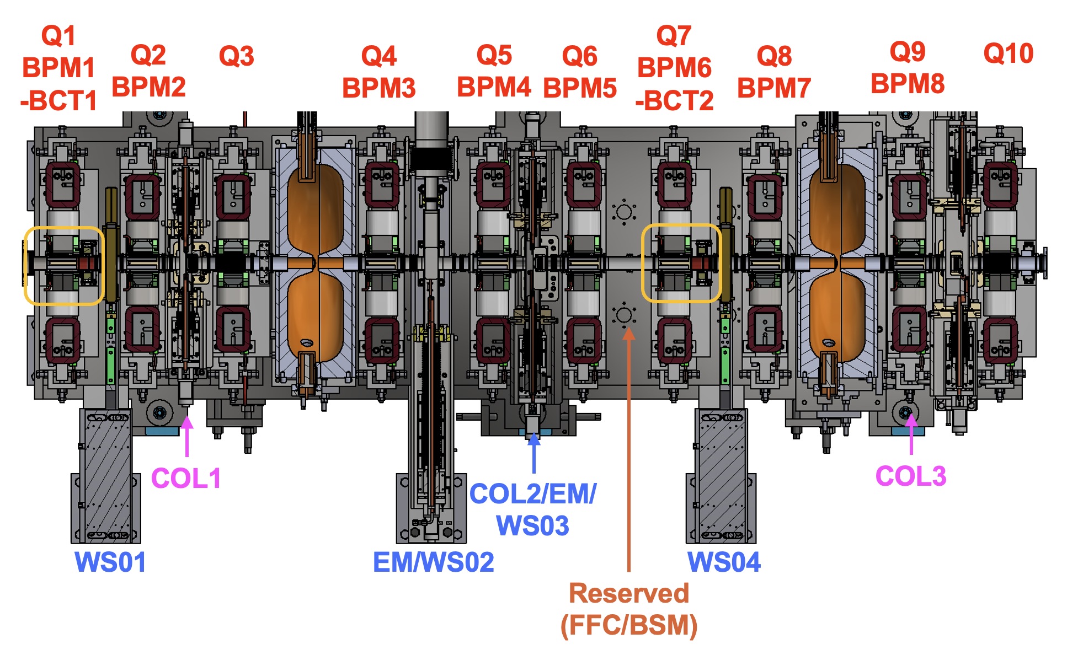
CSNS-II MEBT beam diagnostics
Name | No. | Requirements | Features | Budget
Emittancemeter | 1 | Max. beam power: 50 mA*20 μs Accuracy: ~10% @0.2-0.3 mm.mrad^{[1]} Measurement time: <10 mins | Slit-wire configuration, integrated with collimator (COL2) and WS01, WS02, 4 wires for beamlet (4X faster) | ~38 W
BPM | 8 | Position resolution <0.2%*R, accuracy ±0.1 mm^{[2]}; phase resolution 0.2º@324 MHz, accuracy ±1º@324 MHz^{[3]} | BPM embedded in quad. poles (2 new BPM+1 LIBERA electronics) | 85 W
CT | 2 | Range: 1-50 mA Linearity: ±0.5% Droop: ≤1% Ristime: ≤10 μs | BPM1-BCT1 welded together | ? W
WS | 2 | Range: ±R (radius of beampipe) Resolution: ≤0.2 mm | d100 μm CNT wire, x&y&45º (re-use WS01/WS04) | 35
Total: 115 W
[1] in simulation
[2] in lab. (wrt. geometric center)
[3] w/ beam, but no clear of how to calibrate

Slide 8
Overview
Beam position monitor（BPM）
Beam current monitor（BCT）
Emittancemeter+profile monitor（EM&PM）

Slide 9
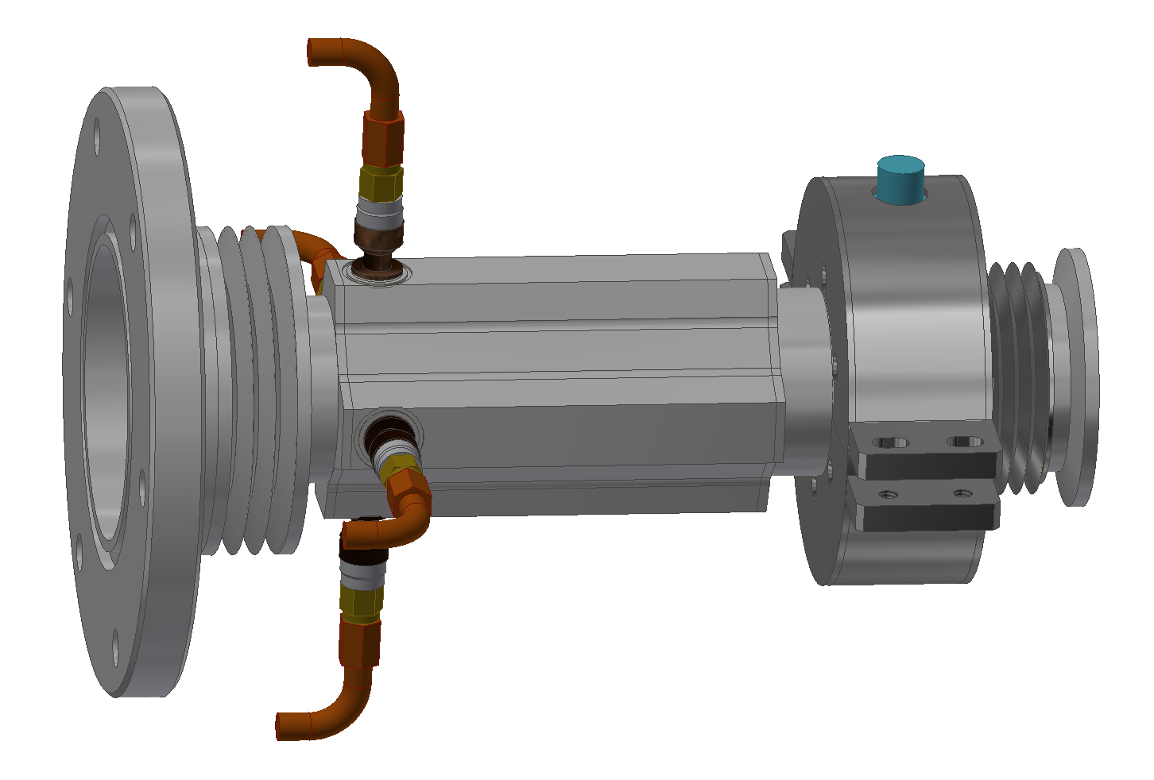
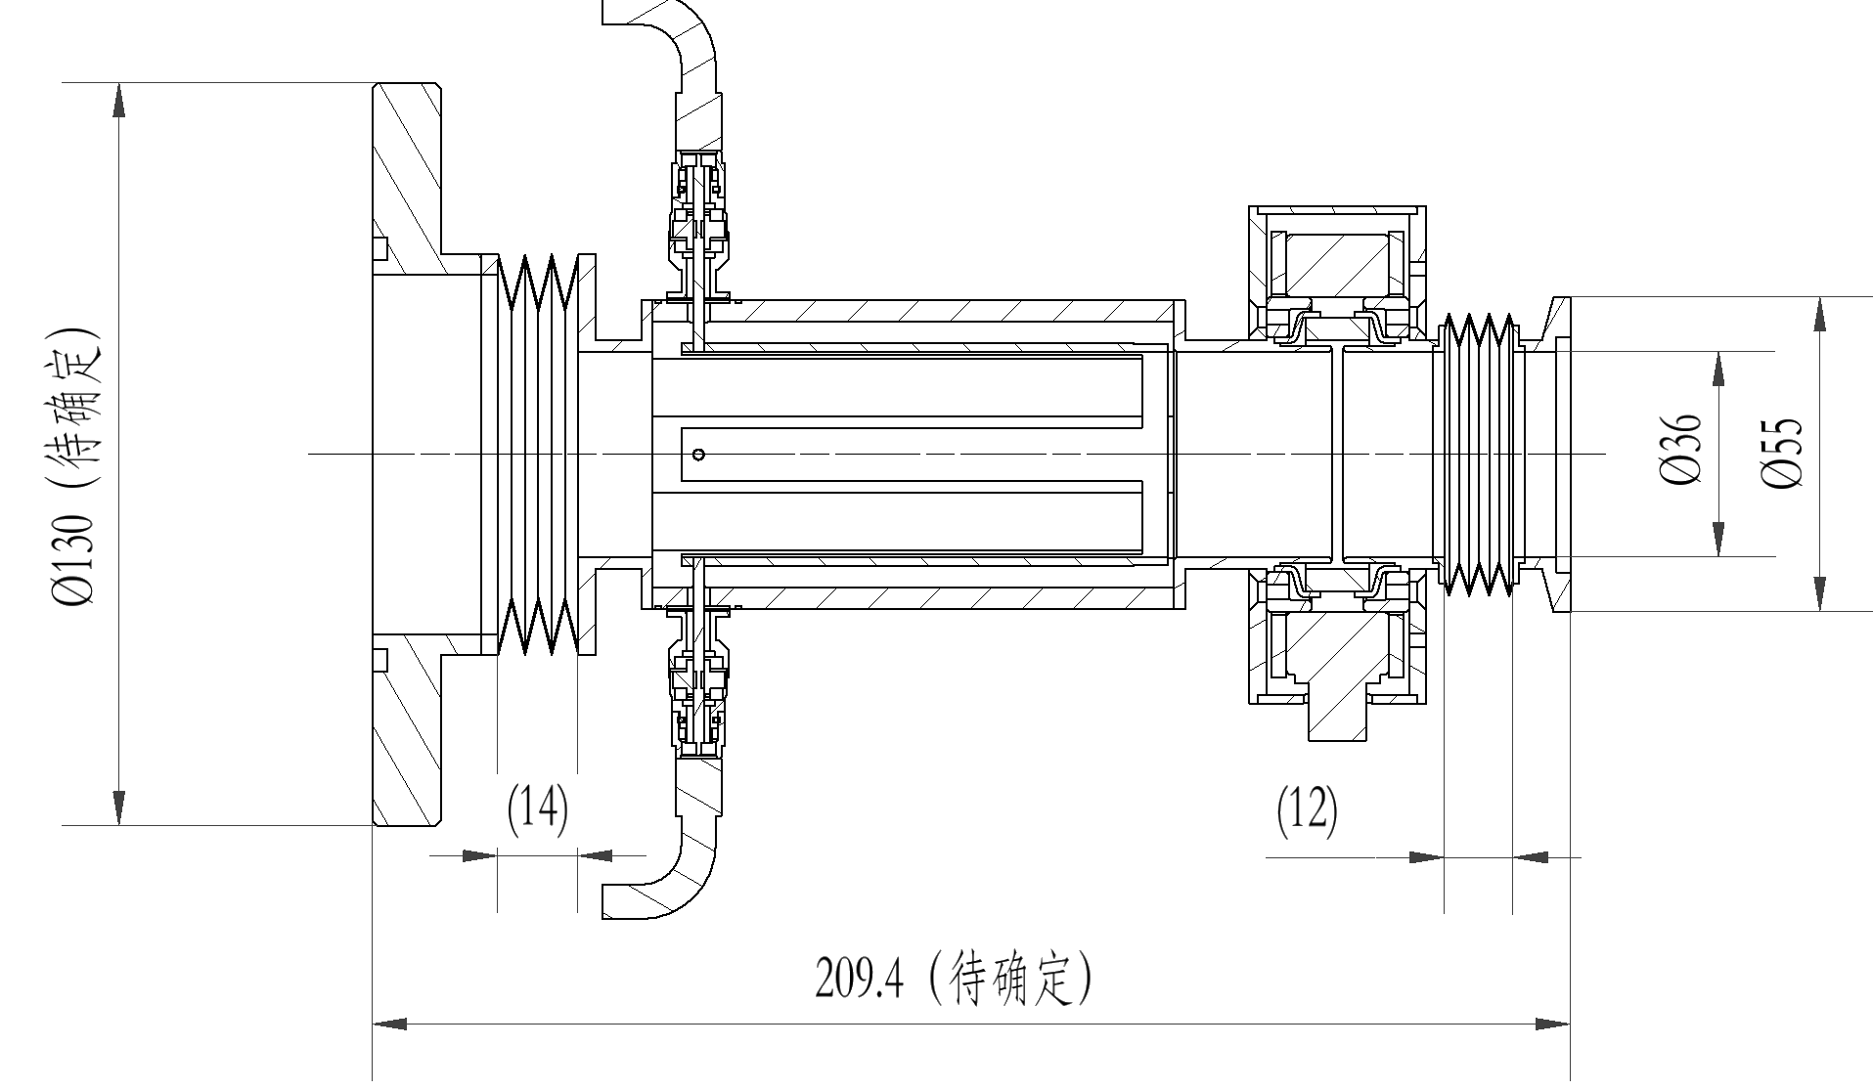
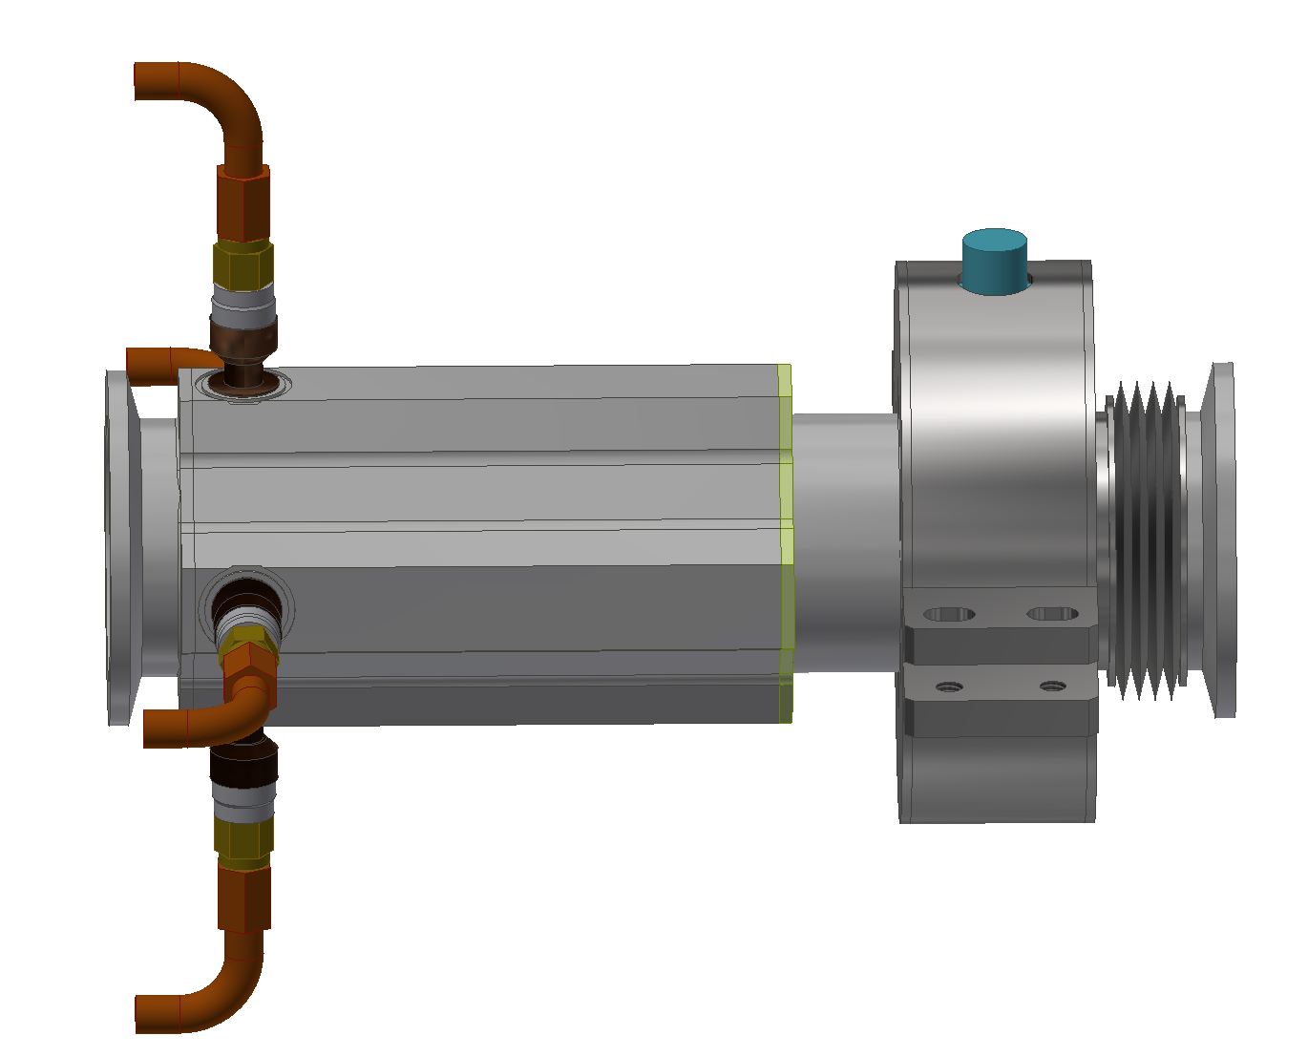
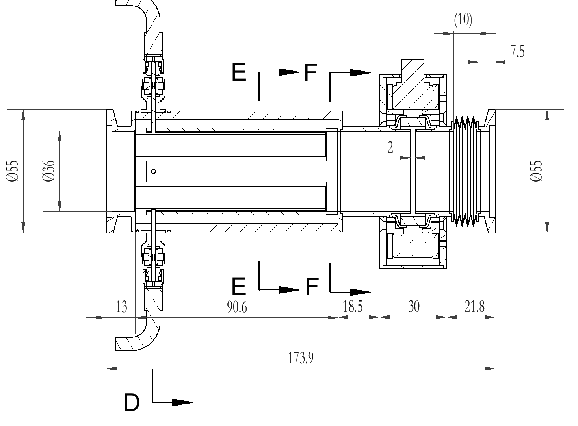
Beam position monitor
Requirements
Two BPMs welded together with the BCT (BPM1-CT1)
Six BPMs with extra bellow or modified geometry size for installation
BPM attached to the quad. via a mechanical clamp aiming for a position error of ~0.2 mm (xyz, rms?)
Specifications of BPM
Range: ≤±R/2
Position resolution: R*0.2%@20-40 mA (R=18 mm)
Position accuracy: ±0.1 mm (in lab.)
Phase resolution: 0.2º@324 MHz
Phase accuracy: ±1º@324 MHz (nominally)
BPM1-BCT1
BPM6-BCT2
Courtesy: M. Rehman, Xiaojun Xie

Slide 10
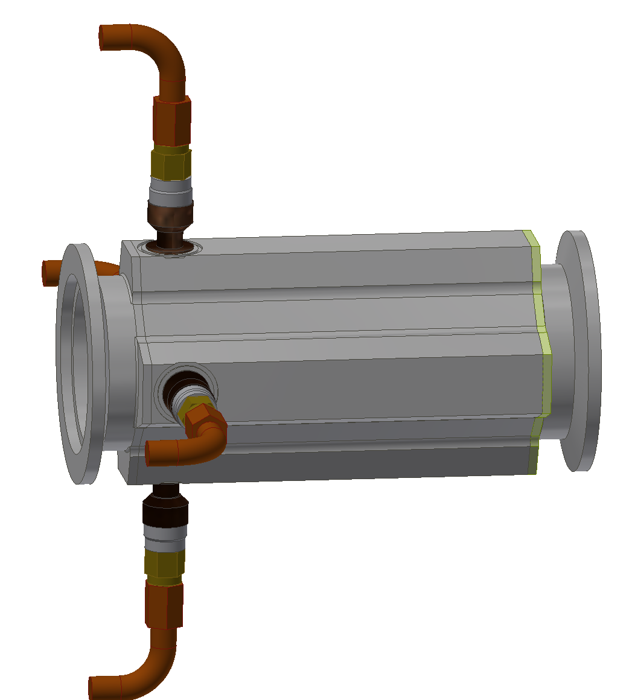
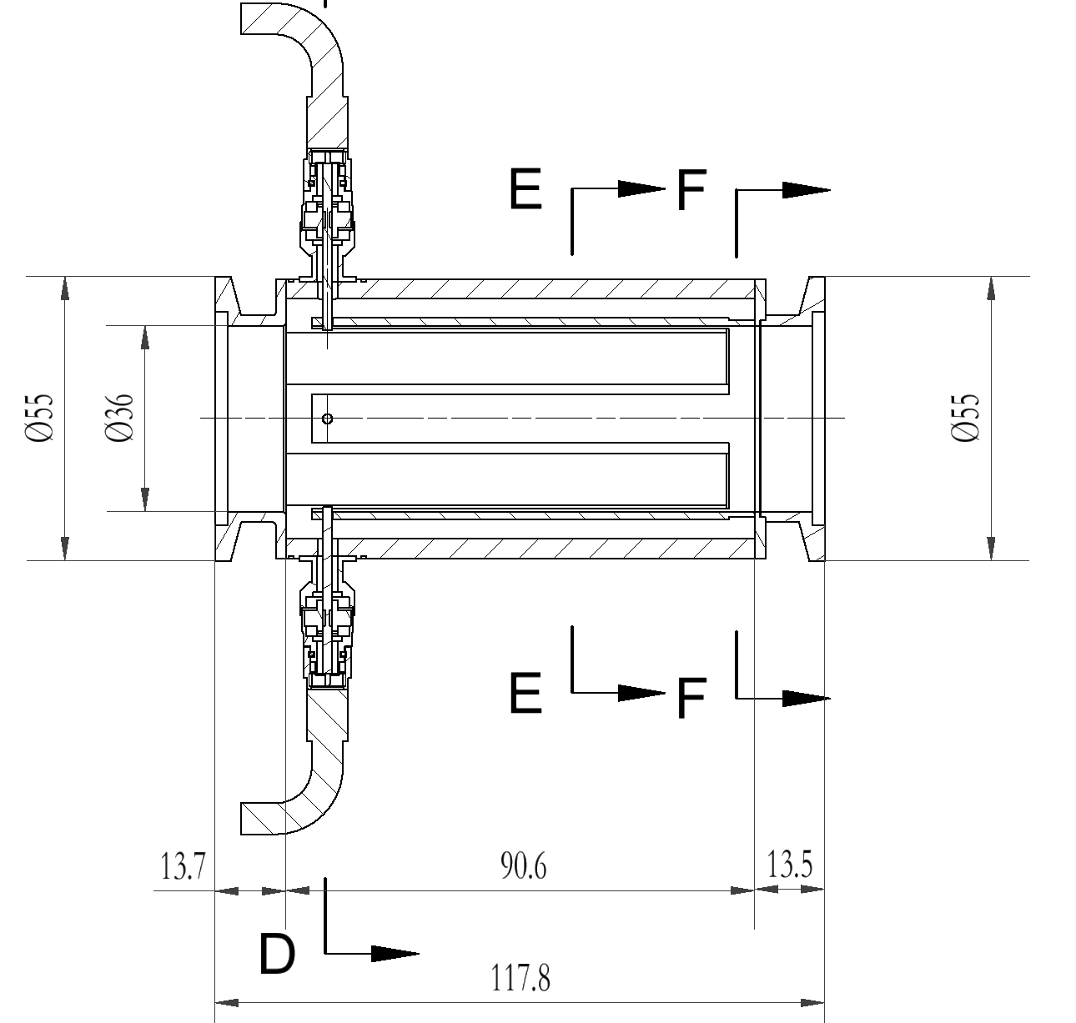
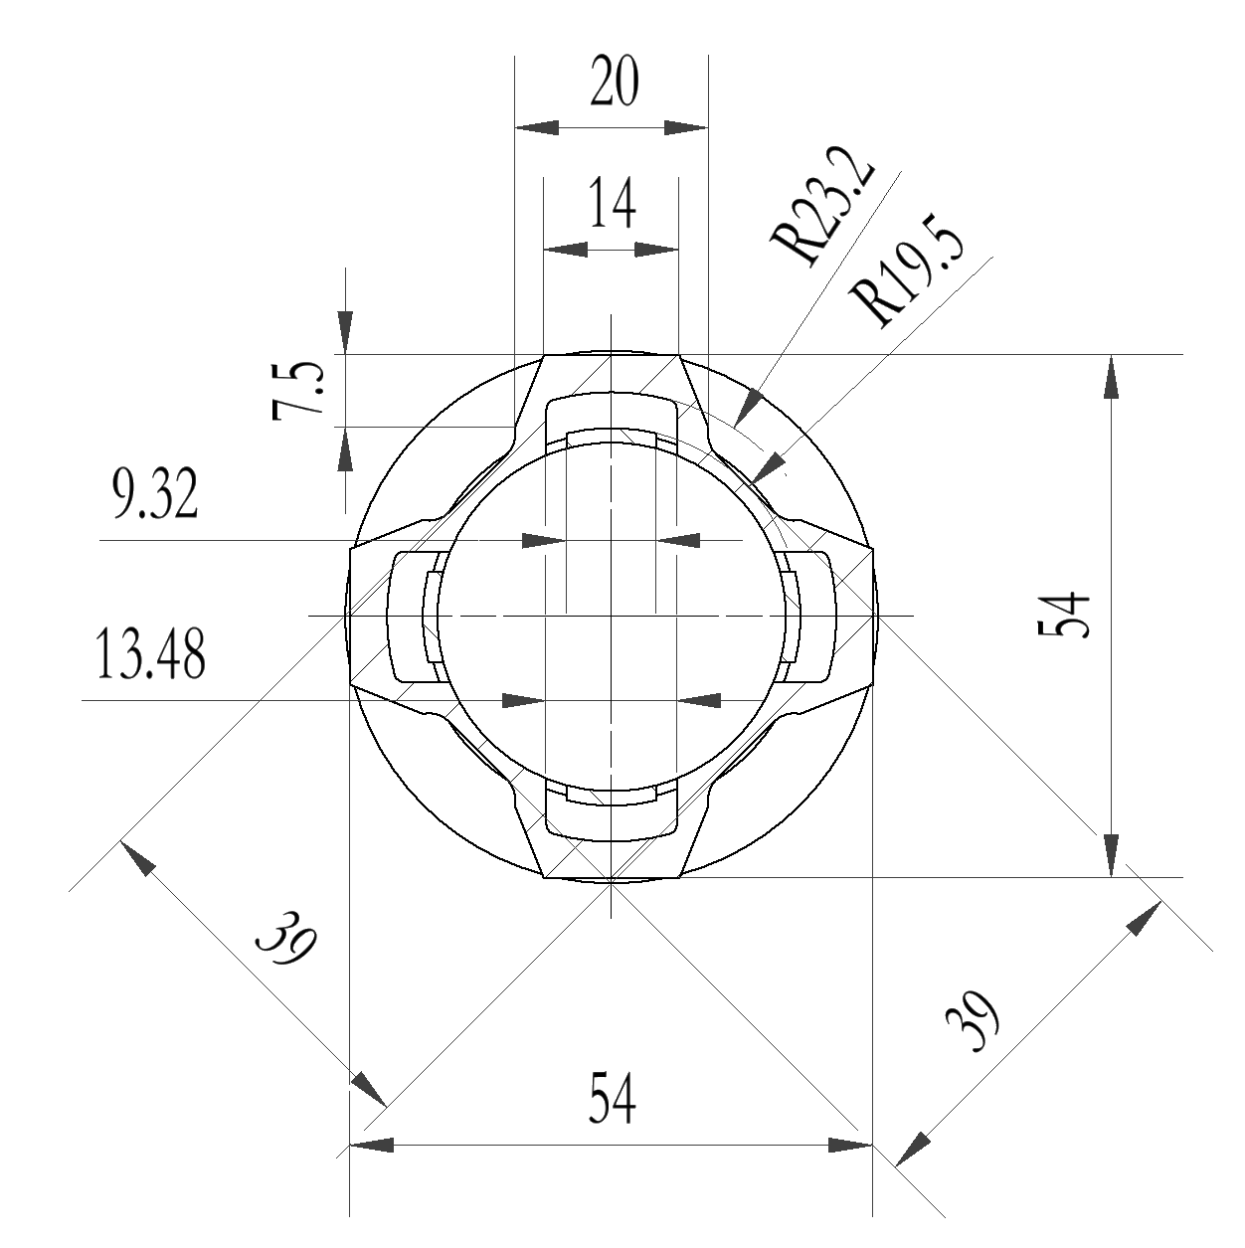
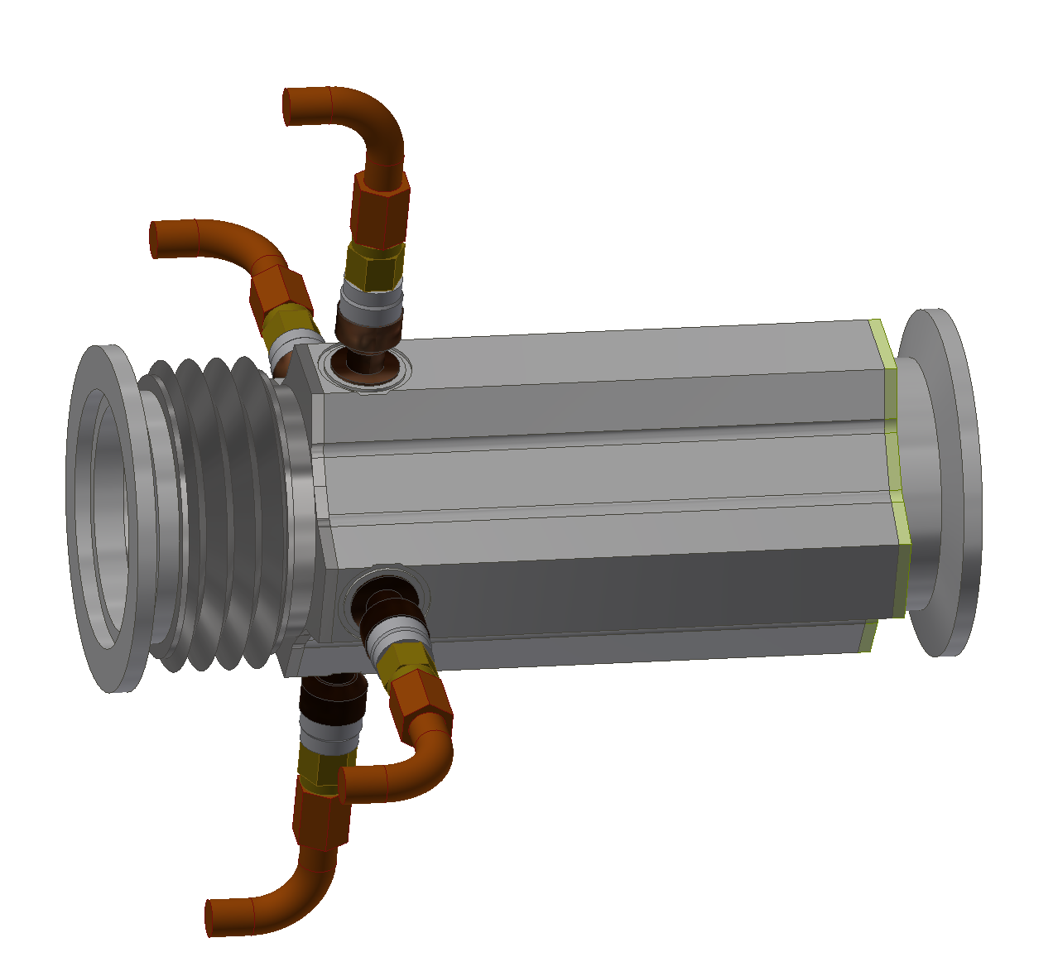
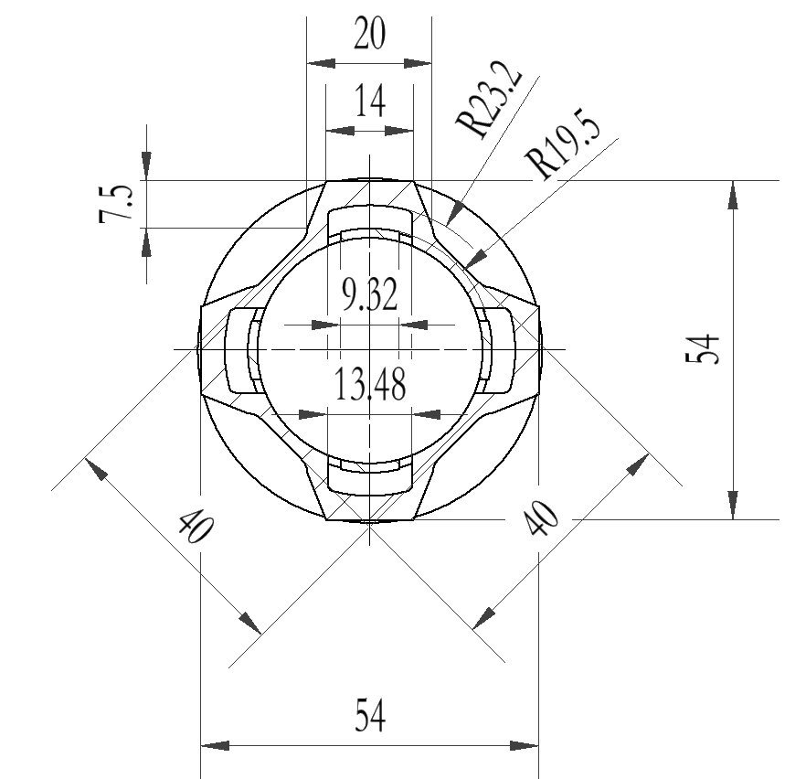
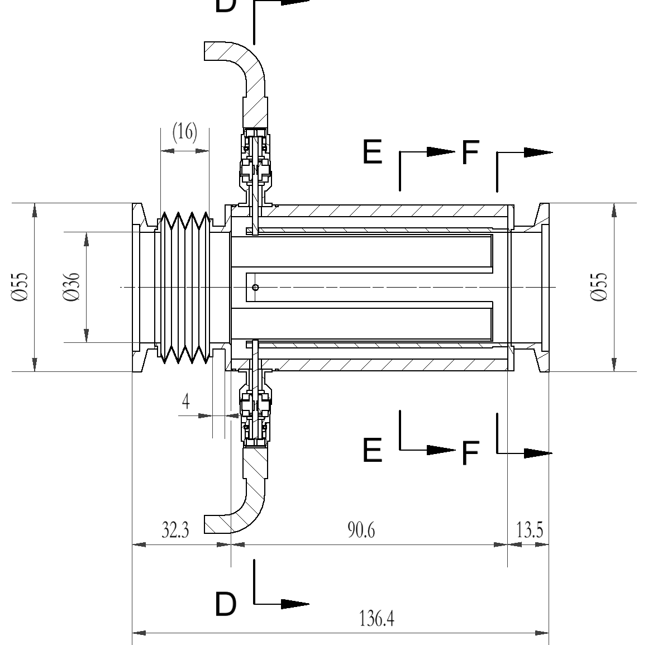
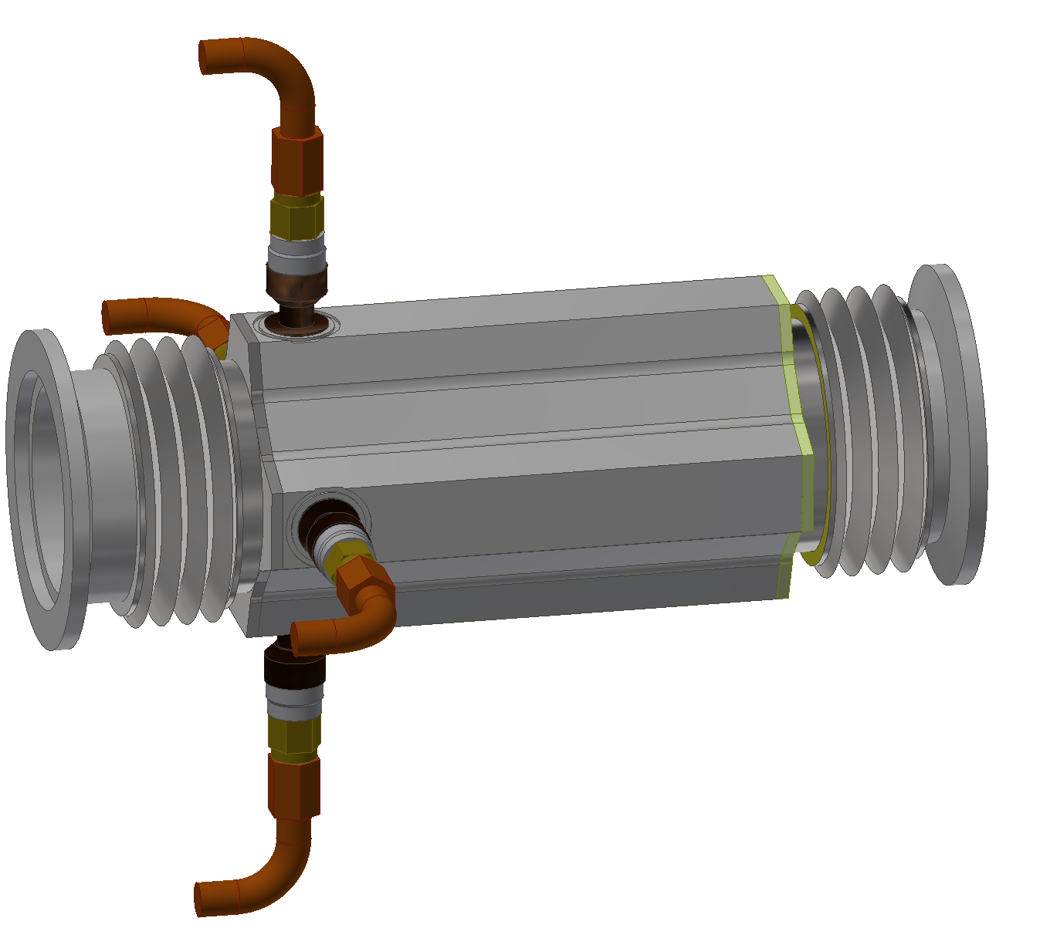
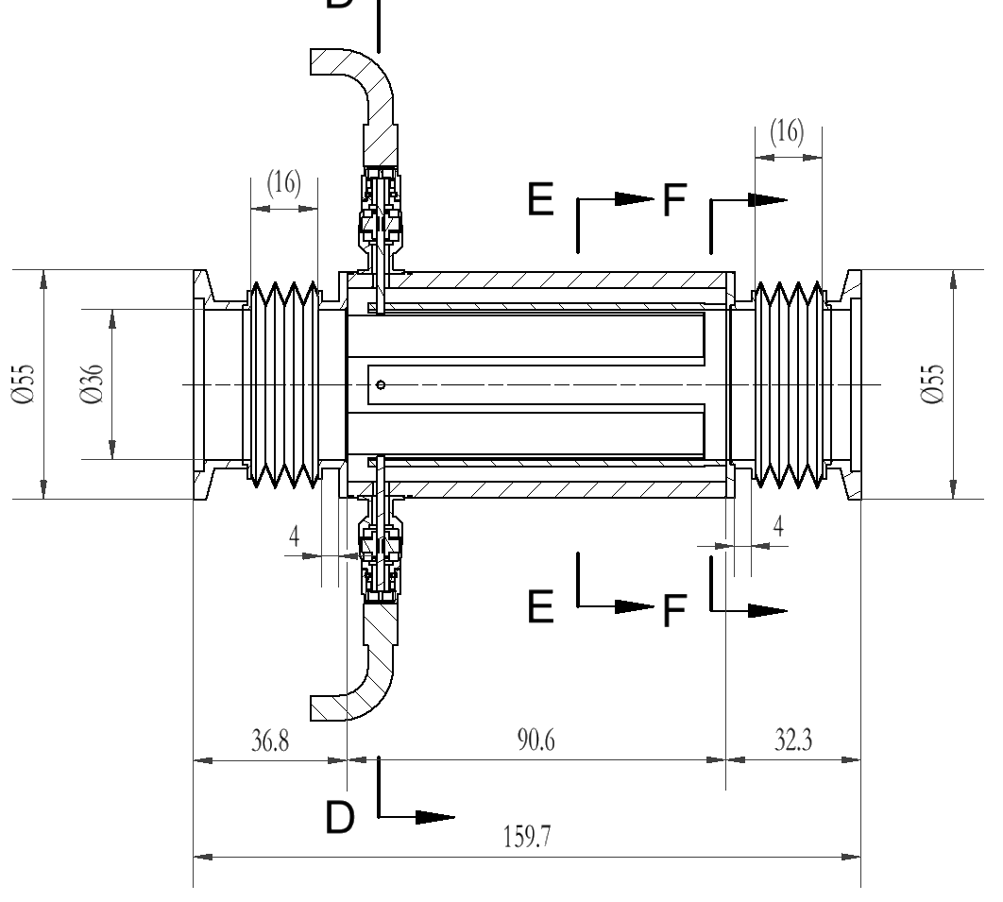
Beam position monitor
BPM2-BPM5: optimized length adapting the overall arrangement, and the updated outline dimensions (to fix BPM sensor to quad.)
BPM7: append bellow to the entrance
BPM8: append bellows to the both sides
Maruwa SMA feedthru provided by CSNS
BPM3
Total cost: 85 W
BPM7
 | Cost (W)
BPM bodies | 4*8=32
Coax. cable+connector | 3
Electronics，Cable & connector | 50
2026.08.01-
installation
BPM8
Manufacture
2026.07.01 Mapping Start
2025.12 billing & contract

Slide 11
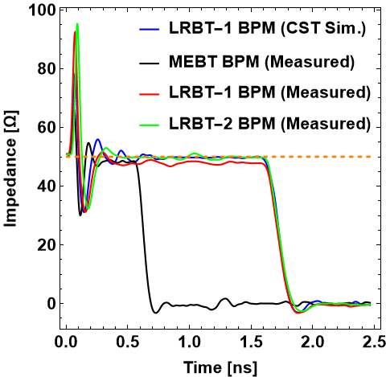
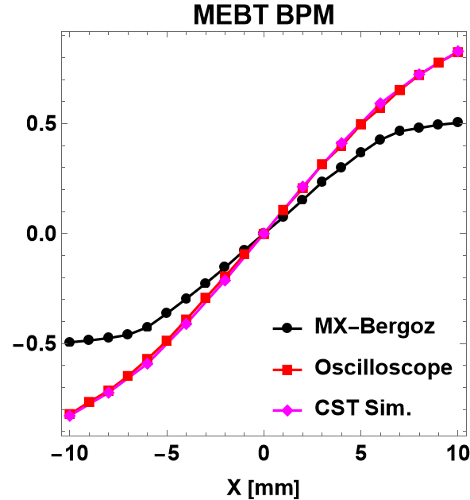
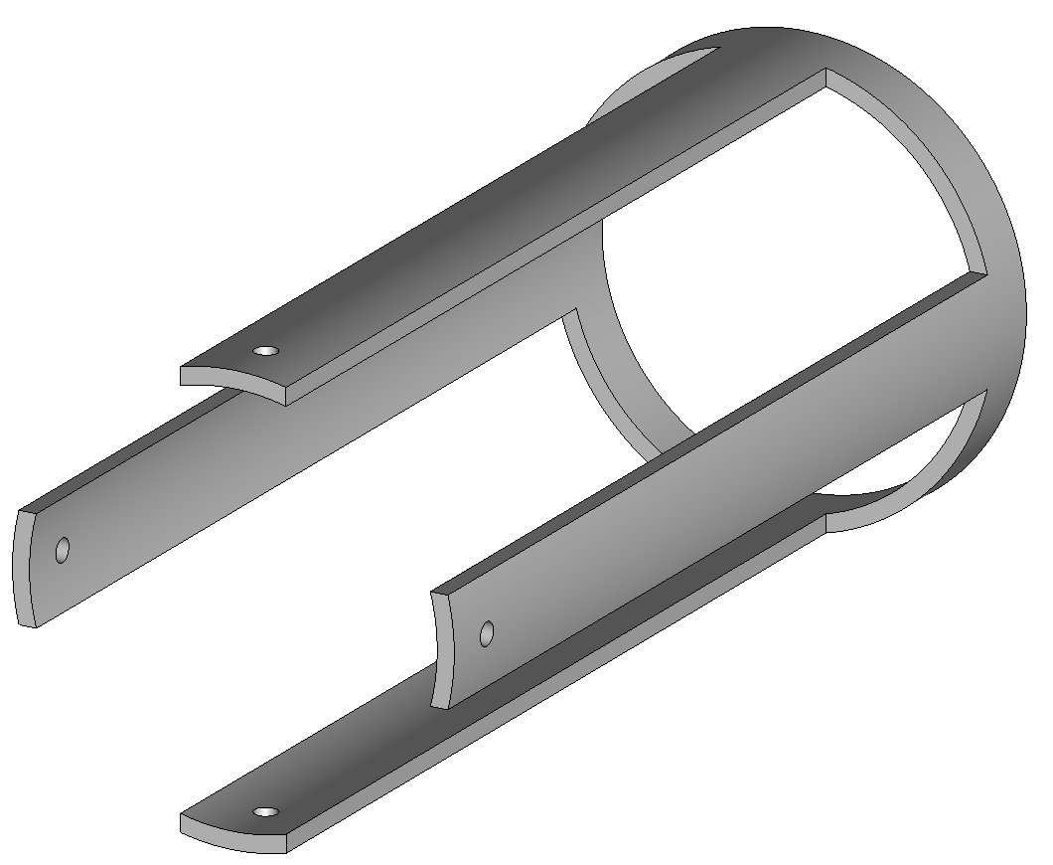
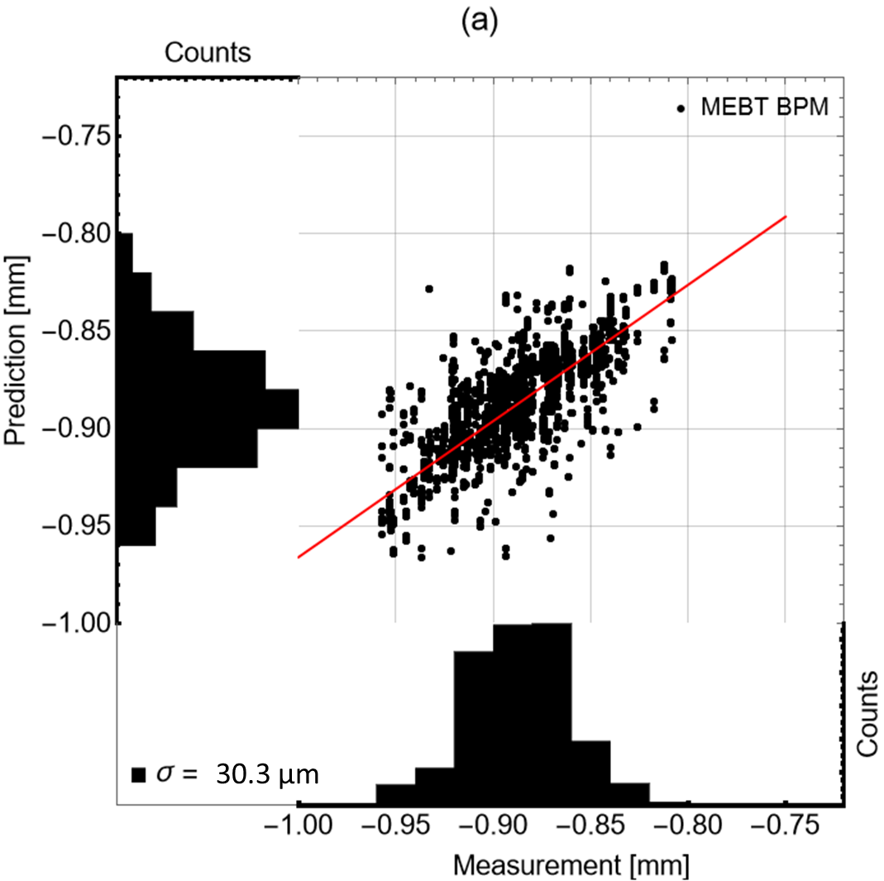
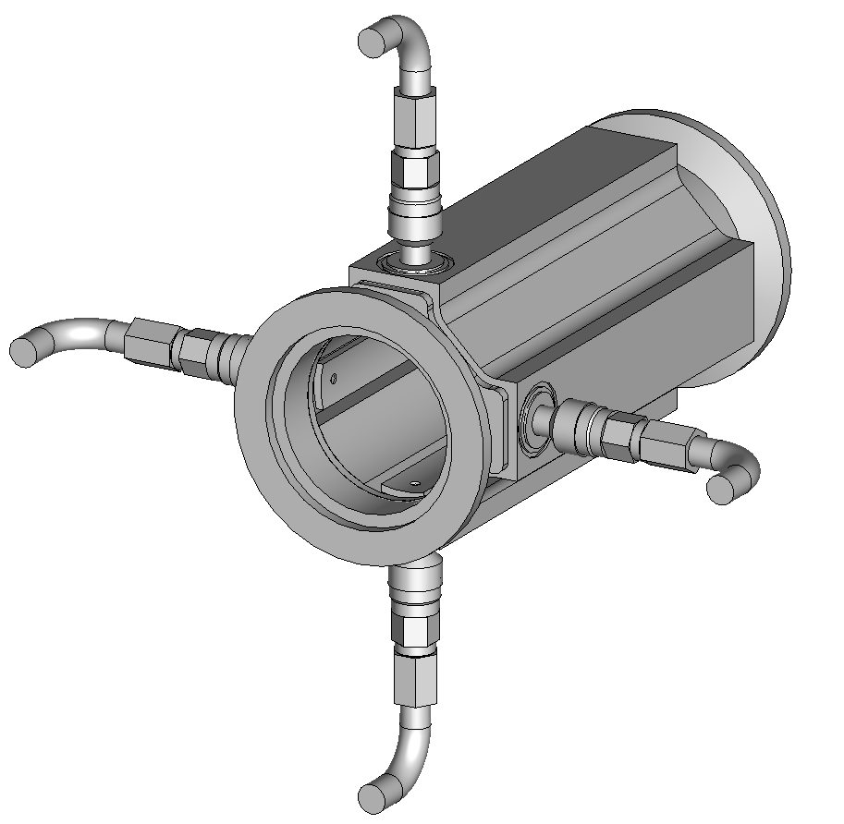
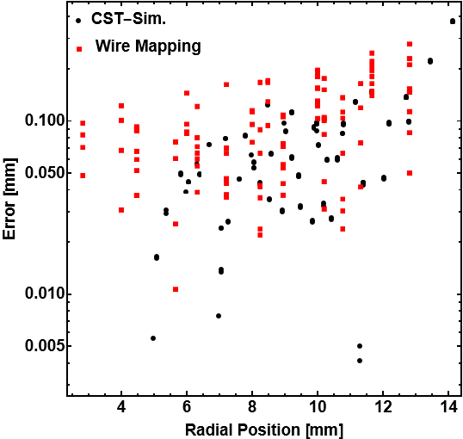
Beam position monitor
We plan to re-use the shorted stripline BPM with necessary modifications (mechanical)
The resolution of position measurement is <50 μm (experiment w/ beam) and, the position accuracy excluding alignment errors is ~150 μm (<±R/2)
Mapping
Parameters of CSNS MEBT BPM
 | BPM
Inner aperture (mm) | 36
Electrode length (mm) | 77.6
Electrode opening angle (deg) | 29.65
Electrode thickness (mm) | 1.5
Gap between electrode and wall | 1.5/3 (trans./longi.)
Characteristic impedance (Ω) | 50 (design) 48 (meas.)
Relative permeability | <1.05
U
w/ beam
in lab.
Courtesy: M. Rehman

Slide 12
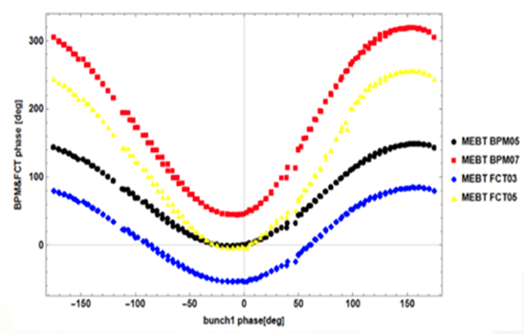
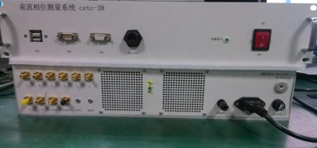
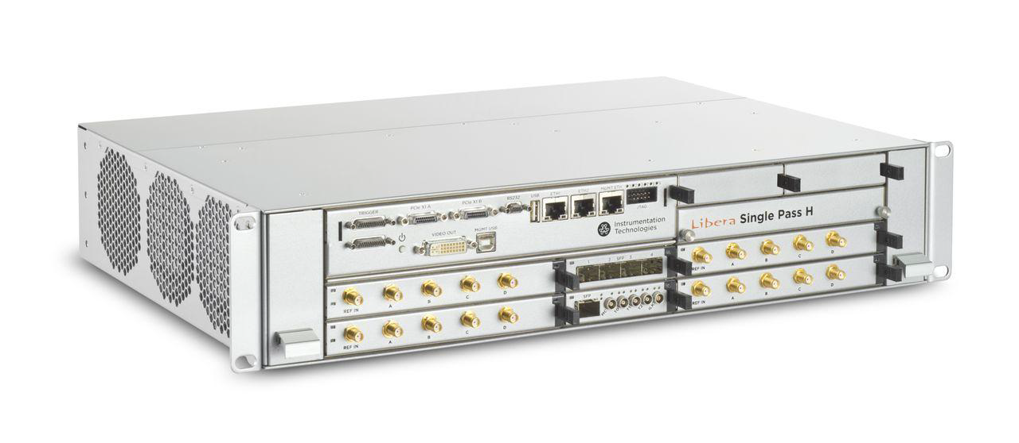
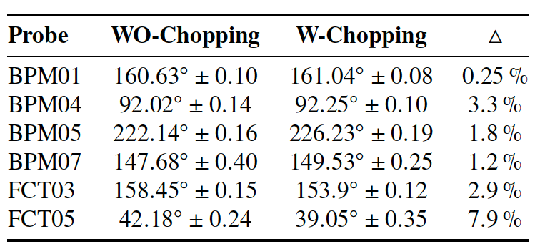
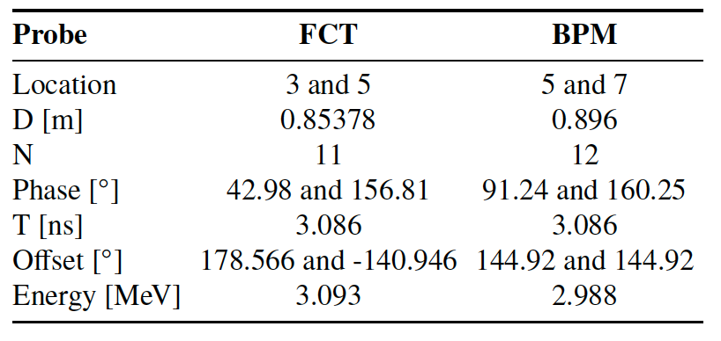
Electronics & Phase measurement
Reuse the Bergoz LR module (4 pcs) + New Libera SP electronics modules
We have compared the phase measurement employing FCT and BPM this year. The methods are validated while the difference are to be understood
FCT electronics at CSNS
MEBT Buncher1 scan
 | FCT-based | BPM-based
Frequency (MHz) | 324 | 324 & 648
Input range (Vpp) | 0.02~0.45 | 2
ADC clock frequency (MHz) | f_{b}/3 | f_{b}/3
Resolution | 0.1º | 0.1º
Accuracy (in lab.) | ±0.3º | -
Libera single-pass
Influence of chopper
Beam energy measurment
Price: ~48 W RMB (4 BPMs)
[1] F. Li et al., IBIC2024, THP04 (2024)

Slide 13
Overview
Beam position monitor（BPM）
Beam current monitor（BCT）
Emittancemeter+profile monitor（EM&PM）

Slide 14
Beam current monitor
Two CTs at the entrance and end of the MEBT section
BPM1-BCT1 & BPM6-BCT2 welded together; re-use the CSNS-I MEBT BPM design
经费需求：15 W
Key specifications
 | Cost (W)
Torus | 10
Manufacture & support | 3
Electronics，Cable & connector | 2
BPM1-BCT1
Range | ±1 mA~± 50 mA
Risetime | ＜10 μs
Droop | ≤1%/ms
Linearity | ≤±1% FS
Output voltage | ±10V
Inner aperture | 36 mm
Length | 214 mm & 54 mm
Inductance of torus (required) | >0.4 H
Inductance of torus (measured) | 1.3 H@10 Hz 3.0 H@50 Hz
Magnetic shield efficiency | ~1076 (permalloy 1J85)
BPM6-BCT2
2026.07-09
calibration & installation
Manufacture
2026.6 arrive CSNS
2025.11 billing & contract
Courtesy: Weiling Huang
2026.12 design & review

Slide 15
Overview
Beam position monitor（BPM）
Beam current monitor（BCT）
Emittancemeter+profile monitor（EM&PM）

Slide 16
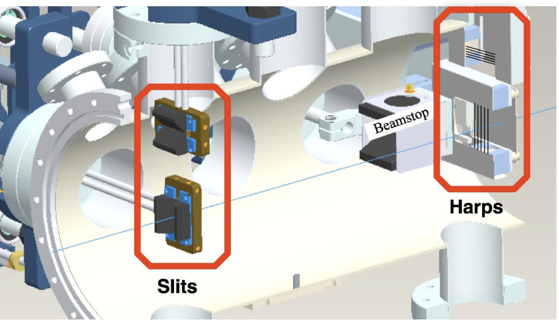
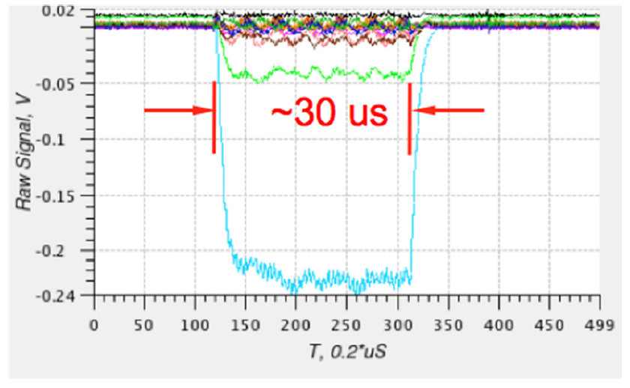
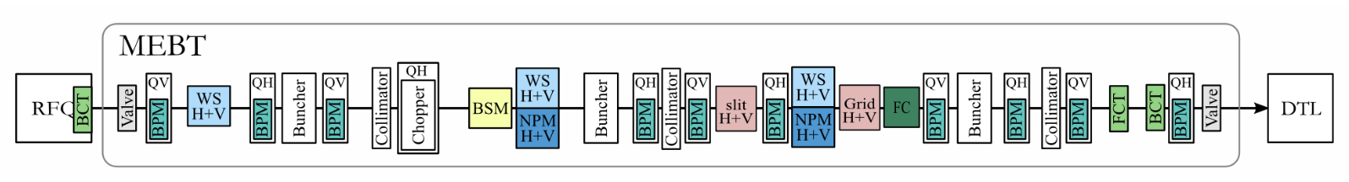
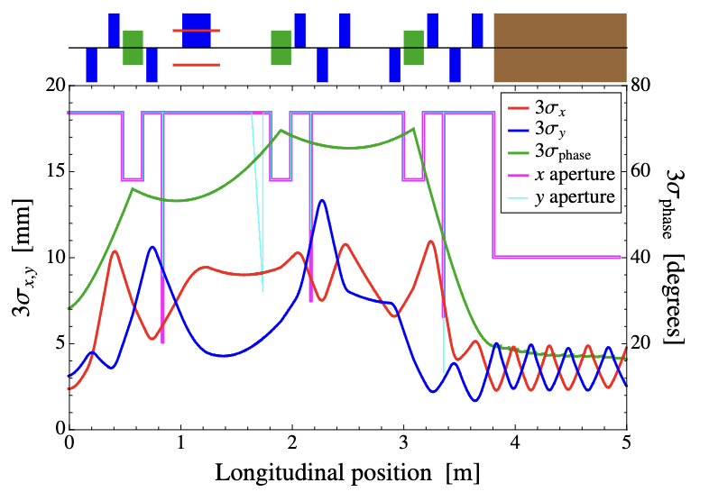
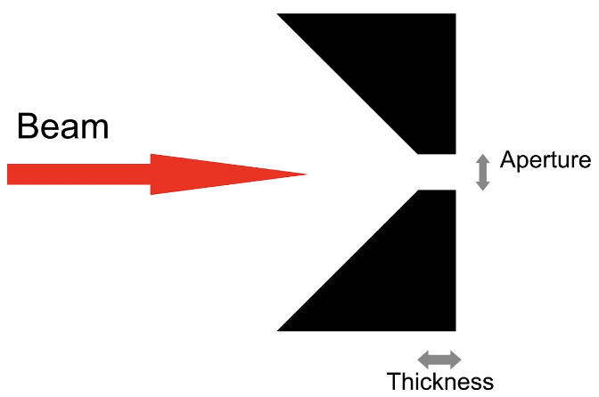
SNS/ESS/LINAC4 MEBT EM
SNS (Allison scanner, slit-harp)
H- beam: 2.5 MeV, ~30 mA, 40 μs
slit width = 0.1 mm (graphite, tilt angle=π/4) slit thinkness= 0.5 mm
slit-harp distance = 353 mm
16 tungsten wires (d=0.1 mm, bias +300 V) with a wire space of 1 mm
5 MSPS
ESS
Mimic SNS/CERN-LINAC4’s EM w/ necessary improvements
slit width = 0.1 mm, thickness = 0.2 mm
d0.05 mm tungsten wire, wire space = 0.5 mm
[1] J. Pogge, AIP Conf. Proc. 868, 435-444 (2006)
[2] A. Zhukov and A. Aleksandrov, LINAC2012 (2012)
[3] B. Cheymol, LINAC2014, TUPP039 (2014)

Slide 17
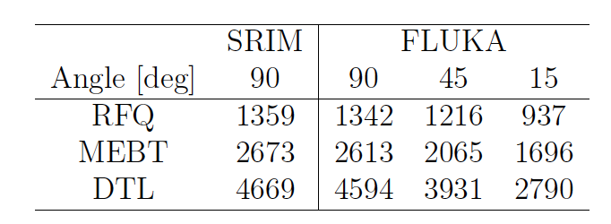
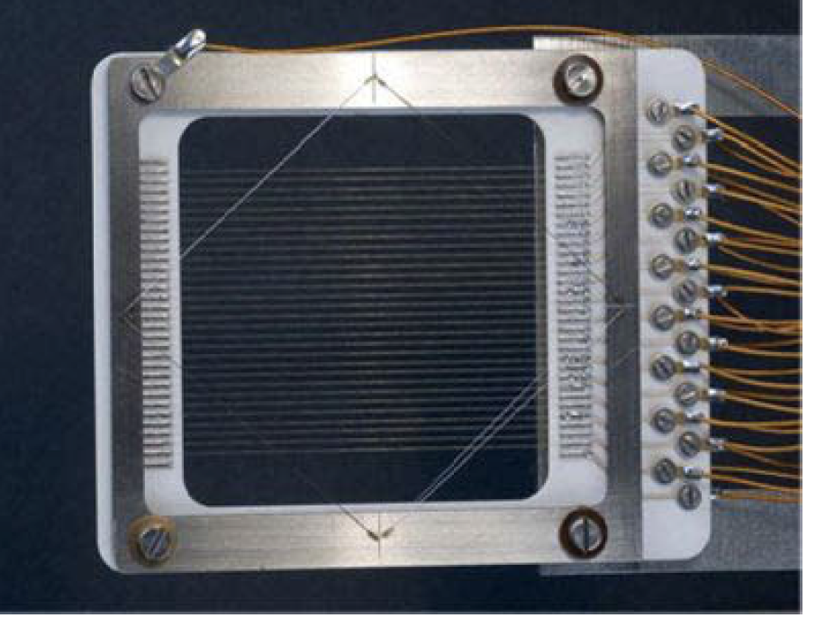
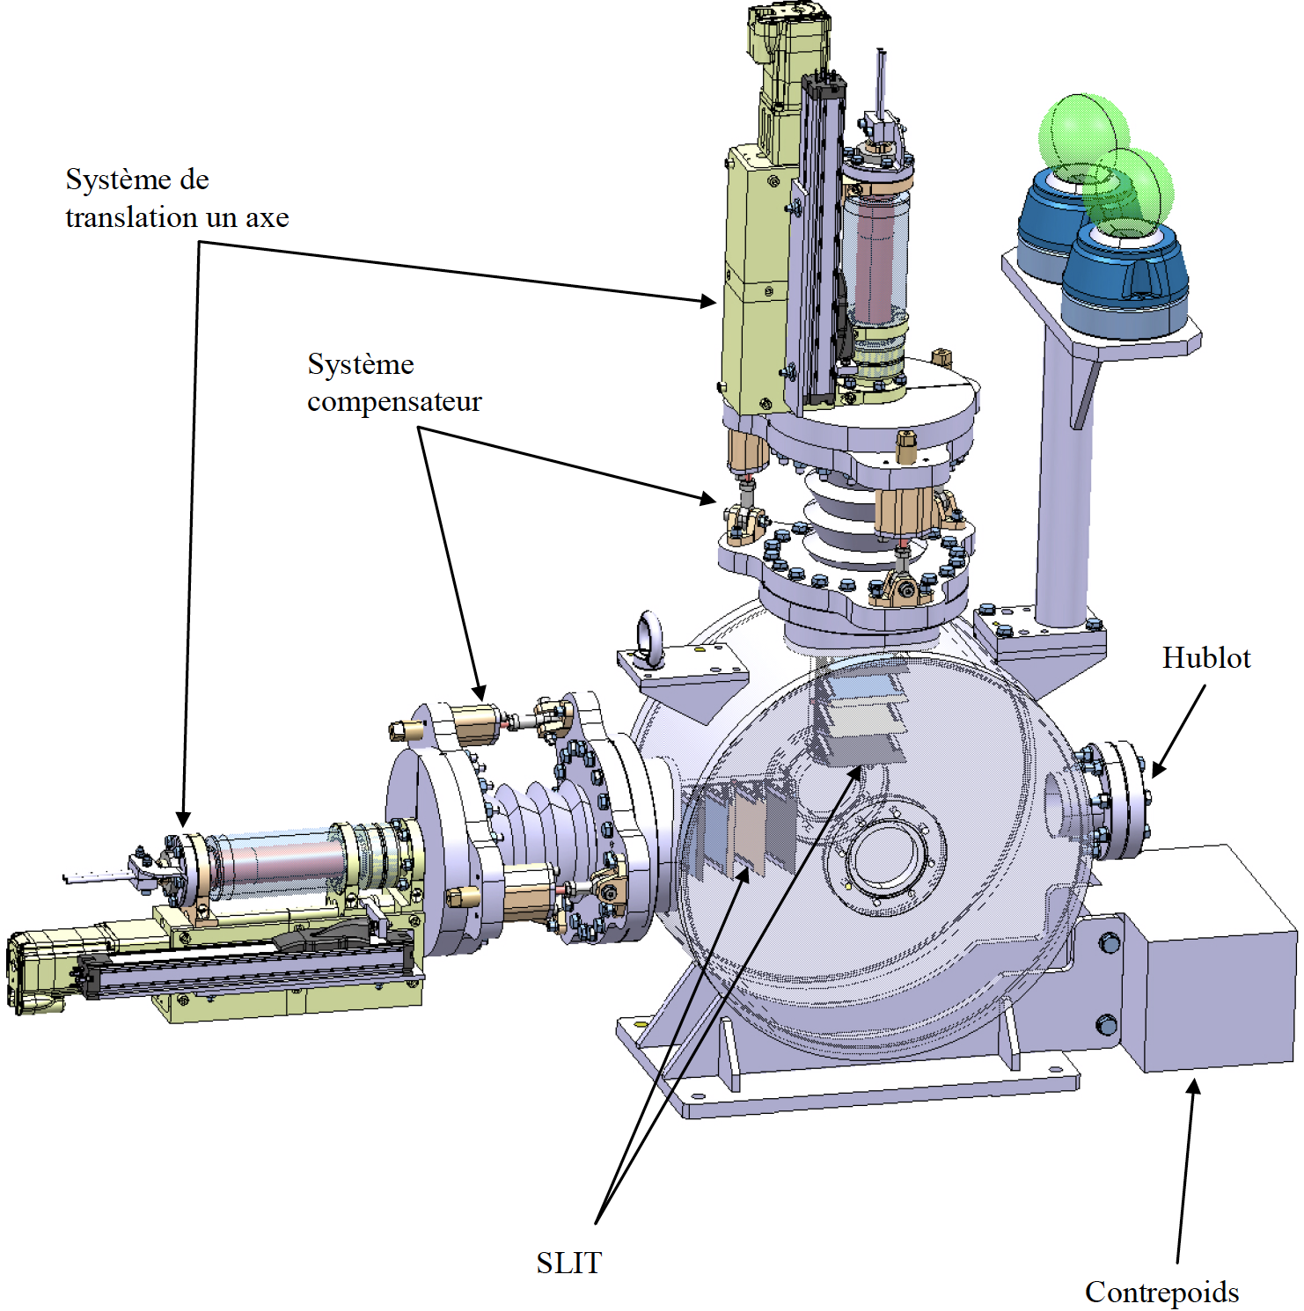
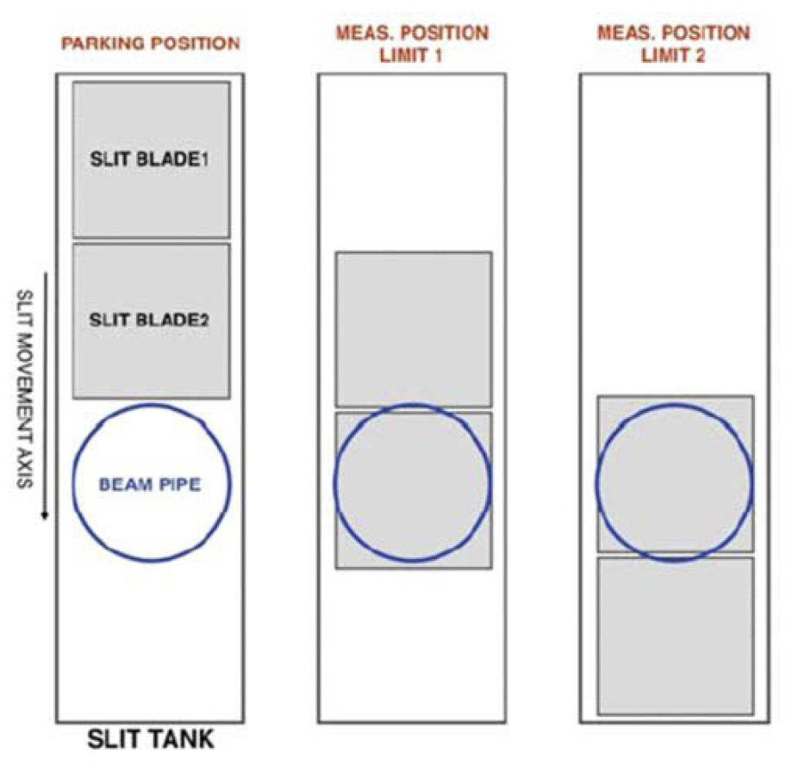
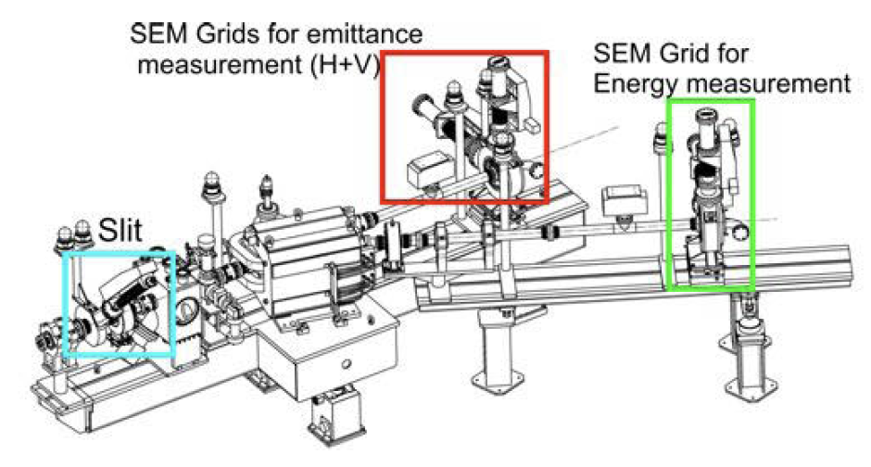

LINAC4 MEBT EM
LINAC4 MEBT EM
H- beam：3 MeV, 65 mA, 100 μs （design） 3 MeV, 40 mA, 50 μs (recommended）
Slit-grid scheme (shorten measurement time)
slit width = 0.1/0.2 mm (graphite, tilt=15º), slit width = 3 mm
d33 μm carbon fiber as wire material (eager for d100μm carbon wire, but not adequate material available at that time)
Exist there only for front-end commissioning phase
Evaluation of the slit temperature w/ 65 mA, 100 us H-
[1] B. Cheymol, PhD thesis (2011)

Slide 18


The current EM at CSNS MEBT
Slit-Slit/FC configuration w/ slit widths=0.2 mm, slit thickness= 0.5 mm, slit-slit distance=0.54 m,
Slit and FC collection plate materials are tungsten and copper, respectively
Analog electronics: trans. impedance=35 V/mA, BW~30 kHz, Equ. noise level <100 pC
w/ water cooling to the front slit plate (d=4 mm, flow rate~3 m/s)， but the tungsten slit mask is not brazed to frame
Offline emittance determination by threshold analysis
Buncher 1
Buncher 2
Q1
Q2
Q3
Q4
Q5
Q6
Q7
Q8
Q9
Q10
H⁻ beam
WS
CT
FCT
FCT
EM
WS
WS
EM
FCT
FCT
WS
CT
FCT
BPM
BPM
BPM
BPM
BPM
BPM
BPM
BPM

Slide 19

Requirements & design considerations
Requirements
Accuracy: 10%@0.2-0.3 mm.mrad
Measurement time: <10 min
Max. beam power: >50 mA*20 μs
No significant vacuum drop during measurement
Slit width $w≪σ_{x}$→ $w$<0.2 mm ($σ_{x}$≥1 mm), for instance
Slit thickness higher than the project range in material → A min. thickness>0.2 mm for C/Cu/SS/W…
Slit acceptance > rms. beam divergence
Beam size at the beamlet profile monitor <R/5≈3.6 mm For beam divergence $σ_{x′}$~2 mrad, $σ_{x′}L<3.6$ mm → $L<$1.8 m
Beamlet size at the PM location $σ_{x}\left(L\right)>3w$ (naïve!!). For $w=0.1\sim 0.2$ mm, $σ_{x′}$~2 mrad → $L$>0.15~0.3 mm
~% emittance error due to space charge
Good SNR of the beamlet visualizations

Slide 20







Assessed measurement accuracy
Slit width
A slit width <0.2 mm is suggested wrt. the $R_{sc}$ equation $R_{sc}=\sqrt{2/3π}I/(γI_{A} ) (w/ε_{n})2$
where 𝐼_{A}=31 MA and $w$ the slit width
Assuming a slit thickness of 0.2 mm, particle loss <1% for a slit width >0.05 mm
Wire diameter vs. detection noise
Tracking simulation in ASTRA w/ macro-particle distribution exported from TraceWin
Space-charge module benchmarked w/ TraceWin
$Δε_{x} /ε_{x0}$<5% and $Δε_{y} /ε_{y0}$<5% for w=0.1~0.2 mm, L=0.34 m and equ. charge noise level<50 pC
Reconstructed phase-space distributions
Horizontal
slit width=0.2 mm
L=0.34 m
Horizontal
slit width=0.1 mm
L=0.34 m
Vertical
slit width=0.2 mm
L=0.34 m
Vertical
slit width=0.1 mm
L=0.34 m
Slit thickness=0.2 mm

Slide 21








Assessed measurement accuracy
A rms. spot size of ≤1 mm may melt the slit mask for a high beam power (max. 50 mA*20 μs)
The spot size at the slit was enlarged to 2-3 mm, and the numerical simulations indicate that the predicted emittance/Twiss-parameter measurement errors are <10% (w/ space charge, w/o dynamic errors)
I=10 mA
ε=0.21 mm.mrad
σ=1.67 mm
β=1.06
$\sqrt{ε/β}$=1.56
Grid
Grid
I=50 mA
ε=0.23 mm.mrad
σ=2.91 mm
β=2.98
$\sqrt{ε/β}$=0.97
Grid
Grid

Slide 22


Assessed measurement accuracy
Beam current=10 mA, slit width=0.2 mm, L=0.34 m
=> Grid-scan step length ≤3*d_wire is required to reduce measurement error <10%
d80 μm
d200 μm

Slide 23


Slit structure & dimensions
Slit structure
Carbon materials (Graphite, CFC) have potential outgassing issue => tungsten w/ a tilt angle wrt. beam axis?
d100 μm CNT wire for x/y profile, floating
CNT wire welded/clamped to the frame
Water cooling for the slit mask (d4mm, 3 m/s)
Min. scan step length ≥0.1 mm w/ a displacement accuracy≤10 μm
Two scan modes: WS or EM, max. range>72 mm
15 deg design@CERN LINAC4
CSNS design
Home position
dx=0
Inner aperture
CNT wire scan done
dx≥36 mm
slit scan start
dx≥36 mm
slit scan done
dx>72 mm
slit mask
slit
CNT wire
slit mask
slit
CNT wire
slit mask
slit
CNT wire
slit mask
slit
CNT wire
≥38x3=114 mm

Slide 24




Selection of slit materials
Thermal analysis done in ANSYS wrt. the following assumptions
Graphite or Tungsten material, 50*70*1 mm³, rms. spot size=1.3-2 mm
Incident H- beam perpendicular to slit mask
For σ_{x}≈1.3 mm (x&y), the max. beam power is ~40mA*40 us for graphite.
For σ_{x}≈2 mm (x&y), the max. beam power is ~50mA*50 us for tungsten
Graphite, 50 mA/50 μs/σ=1.3 mm
Max. temperature (σ=1.3 mm)
 | 30 mA | 40 mA | 50 mA
30 μs | 1156 K | 1395 K | 1636 K
50 μs | 1514 K | 1887 K | 2267 K
Tungsten, 40 mA/50 μs/σ=2 mm
Max. temperature (σ=2 mm)
 | 30 mA | 40 mA | 50 mA
50 μs | 1273 K | 1594 K | 1905 K
100 μs | 1810 K | 2300 K | 2790 K

Slide 25

SEM grid optimizations
Grid structure
4+4 wires as beamlet profilers appended to the hor. & ver. scrapers (head part)
Adjacent wire spacing ~2mm, and covering the region of interest by multi-wire scan
Wire welded/clamped to the frame; biased to 0~100 V to absorb secondary e- (~10 eV)
Min. scan step length ≥0.1 mm w/ a displacement accuracy≤10 μm
Full phase-space scan time@1Hz
Slit scan range=20 mm，interval=0.2 mm → 100 beamlets
MWS scan range=30 mm → ~8 sec. for every beamlet scan
==> Full scan time<15 mins, and could be reduced to <10 mins for a larger slit or MWS step length
wire welded to ceramic plate
Clamped to pin connectors
Home position
MWS scan done
R=18 mm
water pipe
scraper
MWS frame
CNT grid
Inner aperture
water pipe
scraper
CNT grid
CERN
CSNS
MWS frame

Slide 26

Selection of wire material
Constraints
Peak temperature must be lower than the melting or sublimation temperature
Mechanical stress in the wire must not exceed the failure stress
As high as possible output signal
A merit index has been proposed concerning the above two constraints
$$M=c_{p} T_{max}\sqrt{σ_{f}/ρ}$$
where $c_{p}$ is the specific heat capacity, $T_{max}$ the max. temperature, $σ_{f}$ the failure stress and $ρ$ the mass density. The $c_{p} T_{max}$ represents a material-dependent energy per unit mass that should be maximized. $σ_{f}/ρ$ is for selecting a light & strong material best suited for engineering application. (Ashby selection method)
Thermal
[1] J. E. Huber et al., ARIES workshop (2021)
[2] M.F. Ashby. Materials selection in mechanical design, 2005.
Mechanical

Slide 27





Selection of wire material (cont’)
The output current signal mainly consists of the secondary yield and electron strip. The charge creation for a
H⁻ striking a solid wire could be given by
$$Q = Δ_{in}+Δ_{ex}η_{p}−η_{p}−1$$
where $Δ_{in}$and $Δ_{ex}$are the secondary yields (SEY) at the entry and rear surfaces, respectively and $η_{p}$the fraction of stripped particles escaping the wire. The SEY could be theoretically assessed following the E. Sternglass the formulas, and the fraction of stripped particles (H⁺) escaping the solid is approximated wrt. the projected range of particles.
For the 3 MeV H- beam, the $ϕ$75 um CNT rope’s signal is expected to be 3X larger than the $ϕ33$ um CF/graphite wire. However, the observersions reveal a 6X enhancement
Analytical assessments
Experiments on 10/01/2024
$ϕ$75 um CNT
$ϕ33$ um CF

Slide 28



Emittance calculations
 | Threshold analysis | Eliptical exclude method | SCUBEEx
Features | 1. set a BG threshold value K 2. Zero all the signal values below K, and assess the rms. emittance ε(K) 3. Repeat 1-2 for a sequence of thresholds, e.g., 1%, .., 10% 4. Determine the rms. emittance when ε(K) tends to be const. for a higher threshold | 1. Define an elliptical boundaries wrt. the calculated β, α values; 2. Ignores the values outside of the exclusion boundary 3. Adjust HAP and repeat 1-2 4. Determine the rms. emittance when ε(HAP) tends to be const. for a higher HAP | 1. Define an elliptical boundaries wrt. the calculated β, α values; 2. Estimate a noise level K using data outside of the exclusion ellipse 3. Adjust HAP and repeat 1-2 4. Determine the rms. emittance when ε(HAP) tends to be const. for a higher HAP
Applications | PITZ、CSNS.. | ISIS | SNS, SARAF、IFMIF
The threshold analysis w/ extra delegated threshold adjustment is currently employed for MEBT EM.
SCUBEEx method will be appended to the future GUI
Threshold method
Elliptical exclude method
SCUBEEx

Slide 29







Feasibility studies at MEBT
Use MEBT EM 1# slit and downstream WS03 (drift distance = 225 mm, $ϕ$33 μm CF wire)
Experimental campaigns in 2024 early half year w/ many failures (setting, beam…)
Succeeded to map the hor. phase space and reconstructed the emittance However, the discrepancies between slit-slit/FC and slit-harp are visible (wrong wire?)
Courtesy: Fang Li
24/06/24 data
Emittance by threshold analysis
 | Threshold | $ε_{n}$ [mm mrad] | $$α$$ | $$β$$
Slit + slit | 3% | 0.207 | -1.04 | 0.318
 | 8% | 0.13 | -0.91 | 0.32
Slit + wire | 8% | 0.207 | -0.58 | 0.172
 | 11% | 0.163 | -0.74 | 0.24
Threshod@3%
Emittance by SCUBEEX method
 | $ε_{n}$ [mm mrad] | $$α$$ | $$β$$ | $σ_{x}$ [mm] | $σ_{x′}$[urad]
Slit + slit | 0.180 | -0.98 | 0.31 | 0.942 | 1.87
Slit + wire | 0.190 | -9.04 | 0.85 | 0.992 | 2.60
Threshod@10%

Slide 30






Mechanical structure: a glance
Slit-Wire
EM mode：generate beamlets (beam at slit mask)
Profiler mode: as a wire scanner (w/o intercepting slit mask)
SEM Grid
EM mode：imagine beamlet
Profiler mode: fast wire scanner
Vertical Scraper/ EM/PM
Hor. slit/Ver. profiler
Horizontal Scraper/ EM/PM
H-
- CNT wires clamped to L shape
small pin connectors pressed into holes of a ceramic wind
frame
- $ϕ0.5$ mm coil springs to apply tension (0.2-0.3 N)
- wire spacing at 2 mm to avoid capacitive coupling^{[1]}
Pump
CNT rope
Slit assembly
(tilt angle=30º)
Ver. slit/Hor. profiler
Scraper
[1] S. Hiroki et al., EPAC08, TUPC036 (2008)
Price ~20 W (merged in the COL contract?)

Slide 31
DAQ and control
A button for switching to the profile/emittance measurement mode (Control room)
New analogue electronics (2+4+4 ch) + 1*PS
Motor control: Control + Beam Instr.
Additional 4-core coax., 2-core coax
Encoder for a higher positioning accuracy
LINAC Tunnel
Electronics hut
Slit &wire
(X&Y)
Digitizer
NI-6358
Amp
coax. cable
Programable PS
Display: raw signal, slit/wire position, profile, 2D density plot…
Scan: scan range, step, velocity…
Parameter setting: Bias, amp. gain, digitizer config., trigger, ..
Quick analysis: beam size, Twiss, emit.
Status & alarm: home, moving, limit switch, failure …
Multi-wire
(X&Y)
GUI
LabVIEW
Amp
coax. cable
Programable PS
Trigger
4
Motors
Driver
Control
Server
Ethernet
Ethernet
10-core cables

Slide 32
Analog electronics
Requirements:
Input signal: 1 μA-10 mA, 30-50 μs
equ. input current noise: <50 pC (50 us)
Bias output range: 0-100 V
Channel numbers: 12(3CH*4)
Design & Specifications
Transimpedance 35 V/mA, gain accuracy 1%
Bandwidth (-3 dB):45kHz
Rise/Fall time: 10us
Linear output voltage range: ±10V
Equ. input current noise : 0.3 μA
Bias output range: 0~100 V
Cost evaluations
5k/ch*12 = 6 W

Slide 33



Digitizer & Controller
Needs:
1, Data acquisition: 10 CH; ≥10 MSPS (min. pulse width~1 μs)@≥14 bits, Input range: ±10 V (New)
2, Analog amplifier gain control, wire bias voltage control (4 CH, -300~0 V), step motor control (reuse NI module)
=> Hardwares: JYTEK PXIe9813 *3+Caen DT5519E*1 + Connector/feedthru/cable ≈ 12 W
 | CAEN DT5519E | ISEG SHR4020
Range | 500 V/3 mA | 2 kV/6 mA
Ripple | 2 mVpp (typ.) | <10mVPP (typ.)
CH. | 4 | 4
Lead time | 6 month | 6 month
Price | 4.5 W | ~8 W
JYTEK (简仪) PXIe9813
~1.5 W/pc
Ch. No.: 4
Resolution: 14 bit
Sampling rate: 2 kS/s~20 MS/s
BW: 65 MHz
RAM: 512 MB
Input ranges: ±0.5 V、±1 V、±5 V or ±10 V (programmable)
Ext. reference clock（10 MHz）
Input impedance: 50Ω or 1MΩ
Lead time: 6 months
Caen DT5519E
Iseg SHR4020

Slide 34
Schedule
Review
Decision making
~Delivery
2025.12
2026.01
2026.05
2026.06-
Billing
Contract
Arrive CSNS
calibration, control, software, integration, …

Slide 35
Missing info.
updated overall conf. figure w/ new WS model
BCT budget update
EM/WS analogue schematic figure: gain, filter, control, communication
WS budget request, timeline, (mover control by CO group?)
Linux-PIXe DAQ introduction
New GUI (EM)

Slide 37



Needs and methods
Requirements
Accuracy: 10%@0.2-0.3 mm.mrad (both emittance and Twiss parameters)
Measurement time: <10 min
Max. beam power: 50 mA*20 μs
No significant vacuum drop during measurement
Methods for the emittance measurement of the low-β beam
slit scan（2D）: multi-shot, relative complete phase-space visualization, simple but time consuming,
multi-slit（2D）: fast & capable of single-short emittance measurement, giving an incomplete phase-space
peper-pot（4D）: capable of providing 4D phase-space distributions in single-shot
Schematic of slit-scan method
peper-pot
Image of beamlets
[1] P. Forck, JUAS Archamps

Slide 38





Scheme1: Slit-Q3-Q4-grid
The slit-grid scheme was adapted to shorten the scan time using SEM grid as beamlet profile monitor
An independent emittancemeter (WS functioned): Slit-Q3-Q4-grid
pros: sufficient beamlet drift distance
cons: measurement accuracy>10% (vertical, slit width=0.1 mm, slit thickness=1 mm); $σ_{y}\left(L\right)$=6-8.5 mm ($L$=0.5 m)≈1/3*R !!
Not promising at all → Upstream!
Horizontal
Vertical

Slide 39








Scheme2: Slit-Q2-grid
Portray transverse phase-space distribution at very upstream
To control the beam size at the grid, the Q1 strength has to be halved
For a slit width=0.1 mm, slit thickness=0.2 mm, and $L$=0.2~0.3 m, the emittance measure- ment error is 6-8%. Assessed Twiss parameters beats as <10%
EM/WS-Q2/BPM-COL/EM/WS make things become super complicate and compact!
$σ(L)$≈3.5 mm≈R/5
Looks good, still margins for improvement.
Horizontal
Vertical
α
γ
β

Slide 40






Scheme3: Slit-Q5-MWS
Slit-Q5-MWS vs. Slit-Q6-MWS
Leaving a dedicated space in between Q6 and Q7 for an instr. capable to obtain x/y/z profile
Power off Q5 and the rms. beam size at grid is <2 mm (favourable)
For a spot size at slit ~1 mm → slit width <0.2 mm (reasonable) Regarding a rms. beam divergence of 2 mrad. → beamlet size>0.6 mm
SEM grid integrated into COL2 (feasible)
==> Optimization of the slit and grid!
Major beam parameter at Q4 exit
Current [mA] | $σ_{x}$ [mm] | $σ_{y}$ [mm] | $ε_{x}$ [mm.mrad] | $ε_{y}$ [mm.mrad]
10 | 0.78 | 1.48 | 0.209 | 0.209
20 | 0.82 | 1.37 | 0.212 | 0.211
30 | 0.90 | 1.33 | 0.215 | 0.213
40 | 1.00 | 1.33 | 0.219 | 0.215
50 | 1.10 | 1.35 | 0.224 | 0.217
Phase-space distribution at Q4 exit
Horizontal
Vertical
$σ\left(L\right)$<2 mm≈R/10

Slide 41




Vacuum compatibility
The figures of merit for determining the best slit material are melting (or sublimation) temperature, heat capacity and thermal conductivity. graphite, tungsten and tantalum can be considered for their high melting point (above 3000 K), while beryllium and again graphite for high specific heat capacity.
If we remove the surface contaminants by a proper chemical cleaning, the outgassing flow coming from a material, which has been exposed to air, is dominated by water vapour (≥80%)
Method to reduce materials outgassing: bake-out and vacuum firing Baking (250 ℃, 24h) → reduce LHC collimator outgassing by ~1.3
@CERN
vacu. level: 1e-5 mbar@900 ℃ recommended vacu. firing: 2 h@950 ℃
Sample heating in chamber
~940 ℃
10-20 °C/min
~4e-10 mbar.L.s⁻¹ (S=30 cm²)
~3e-11 mbar.L.s⁻¹ (S=30 cm²)
[1] C. Accettura, PhD thesis (2017)
[2] C Accettura et al 2019 J. Phys.: Conf. Ser. 1350 012085
However, these are not the outgassing rate w/ beam heating!

Slide 42

Q1
BPM1
-BCT1
Q2
BPM2
Q3
Q4
BPM3
Q5
BPM4
Q6
BPM5
Q7
BPM6
-BCT2
Q8
BPM7
Q9
BPM8
Q10
COL1
COL2/EM/
WS03
COL3
WS01
EM/WS02
WS04
Reserved
(FFC/BSM)

