Slide 1
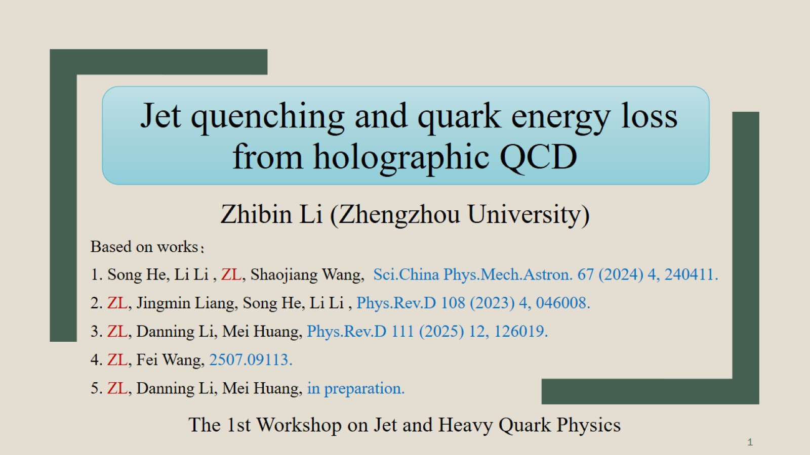
Jet quenching and quark energy loss from holographic QCD

Slide 2
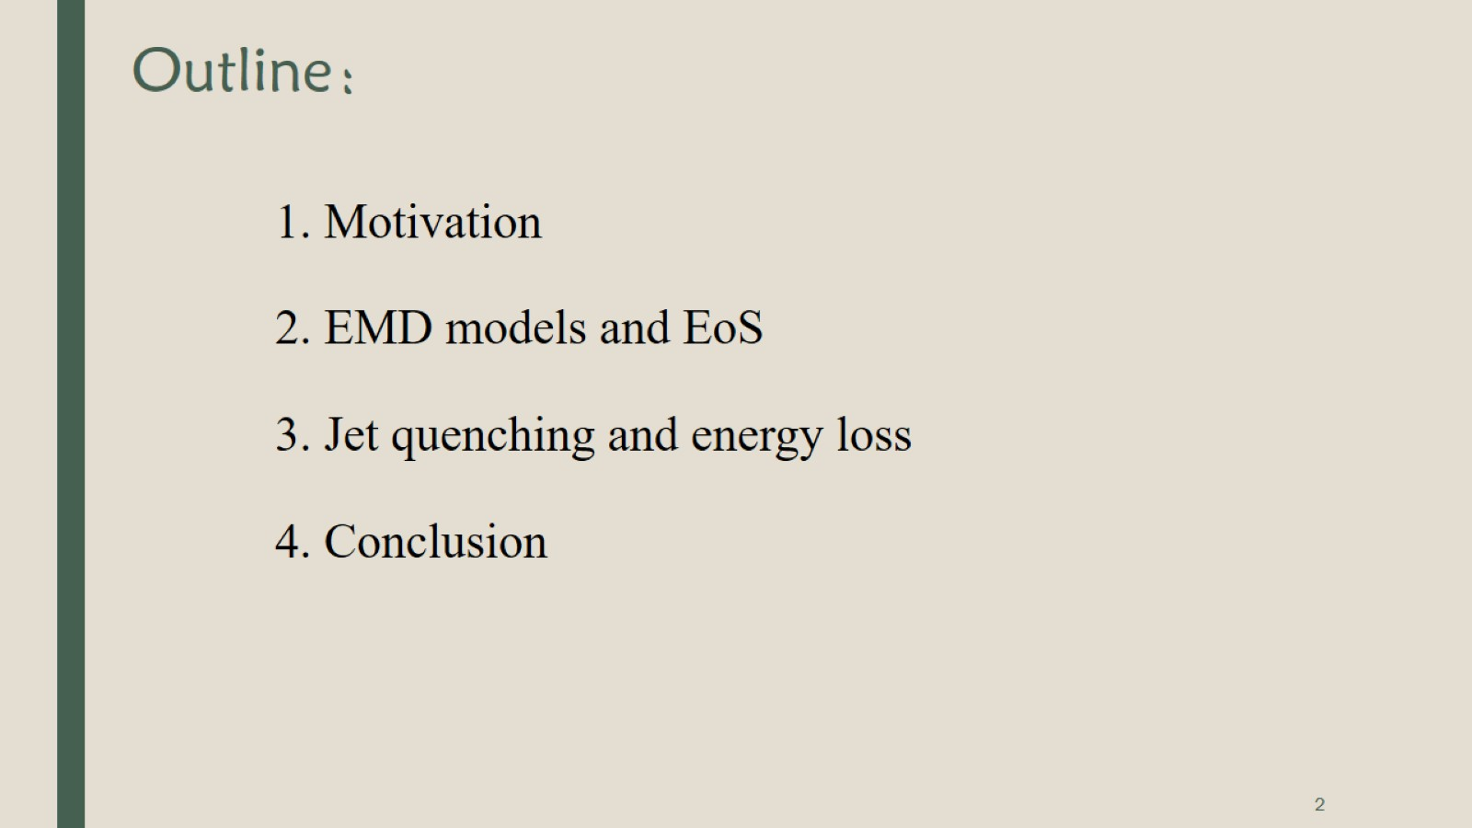
Outline：

Slide 3
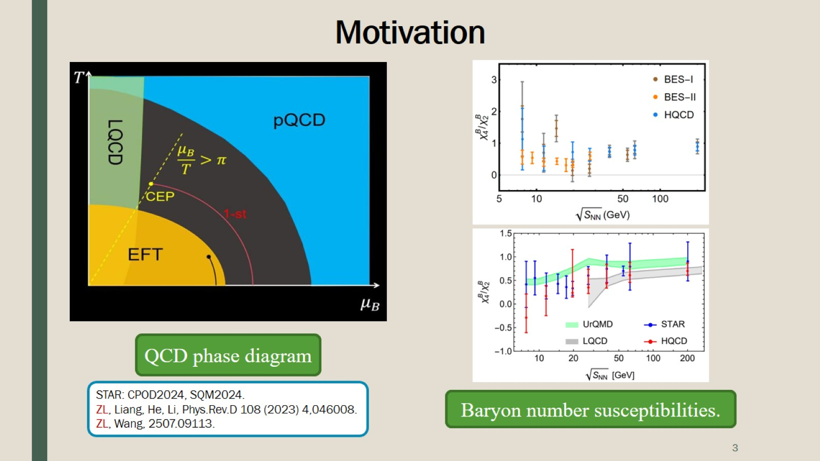
Motivation

Slide 4
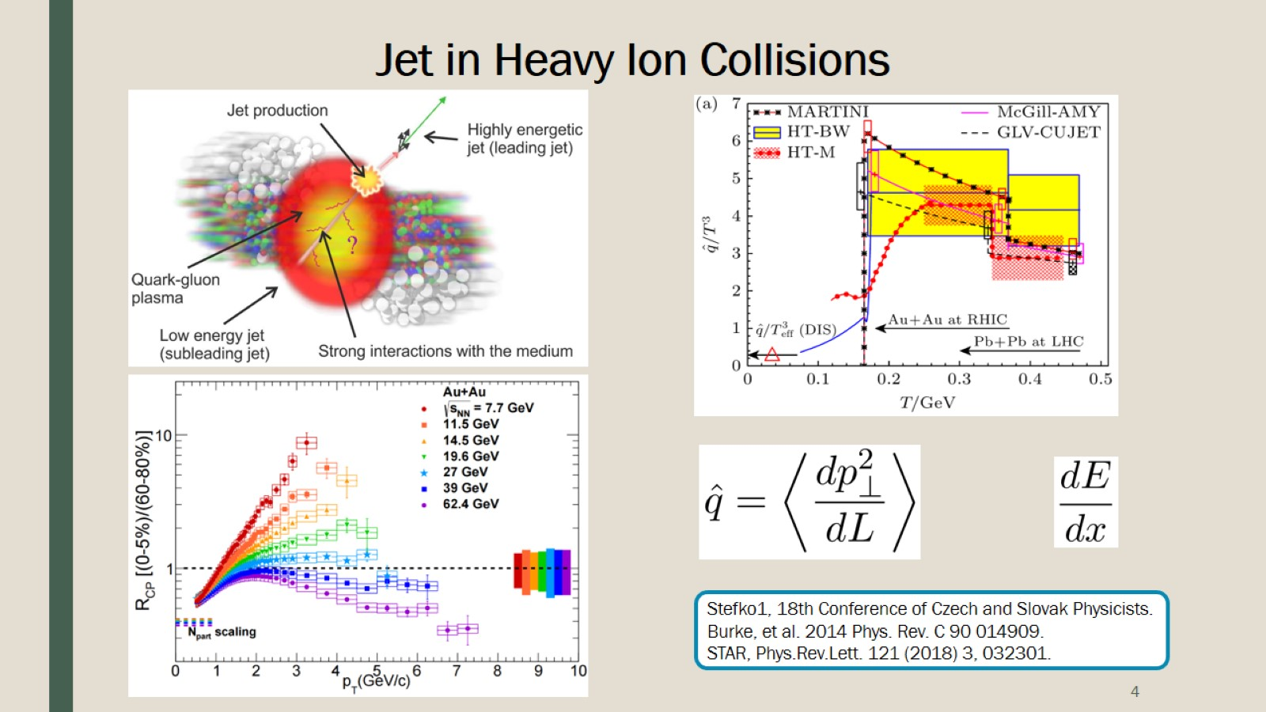
Jet in Heavy Ion Collisions

Slide 5
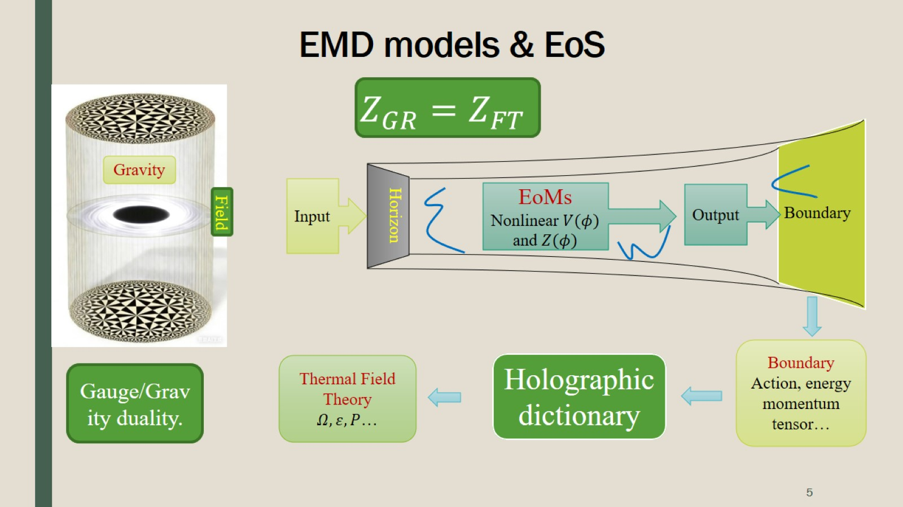
EMD models & EoS

Slide 6
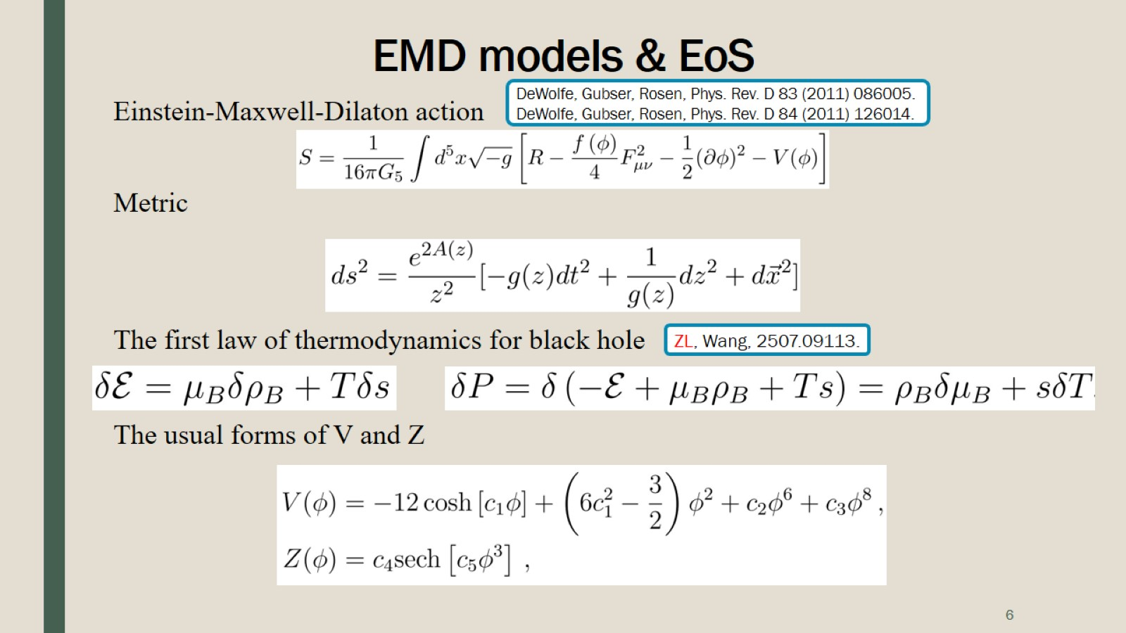
EMD models & EoS

Slide 7
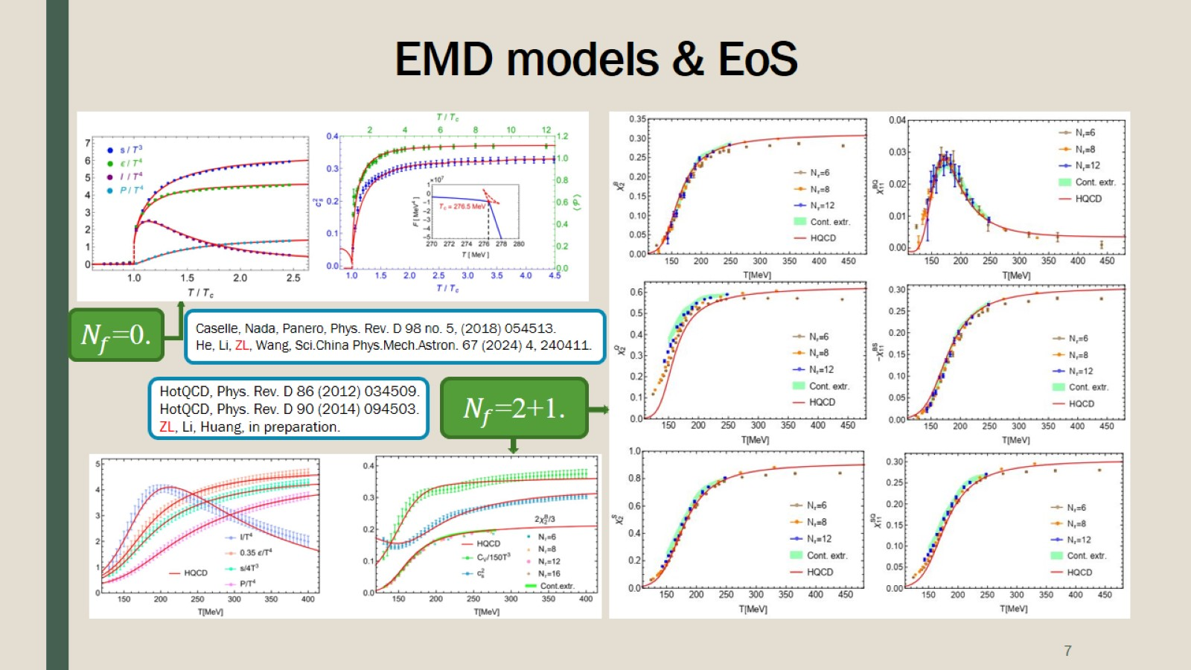
EMD models & EoS

Slide 8
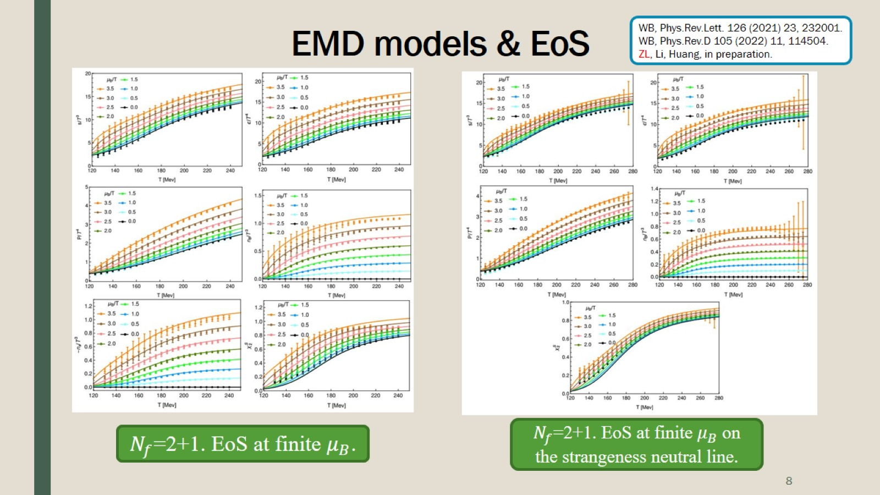
EMD models & EoS

Slide 9
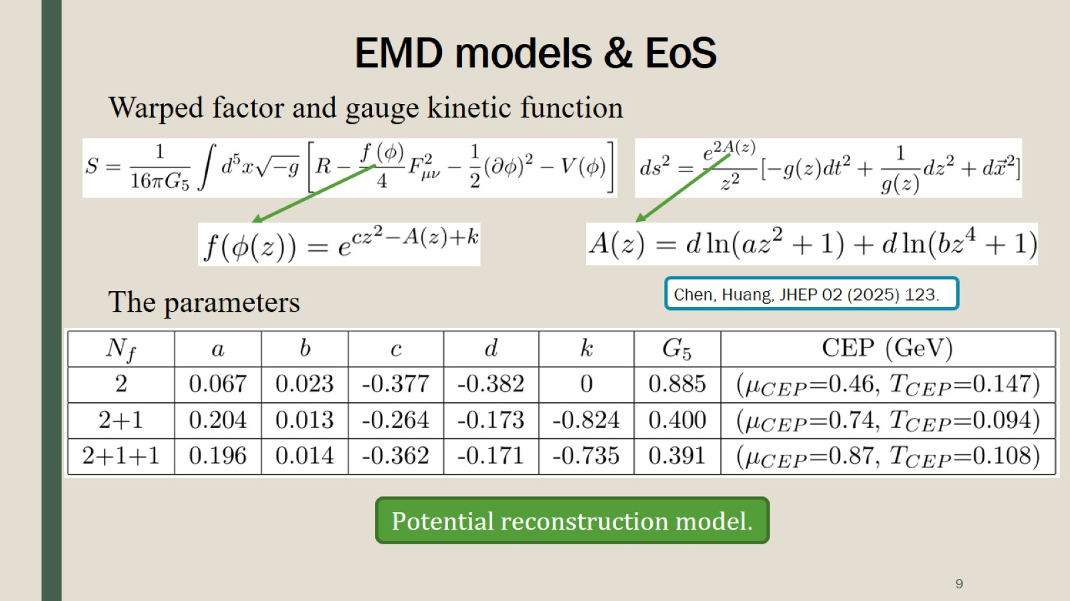
EMD models & EoS

Slide 10
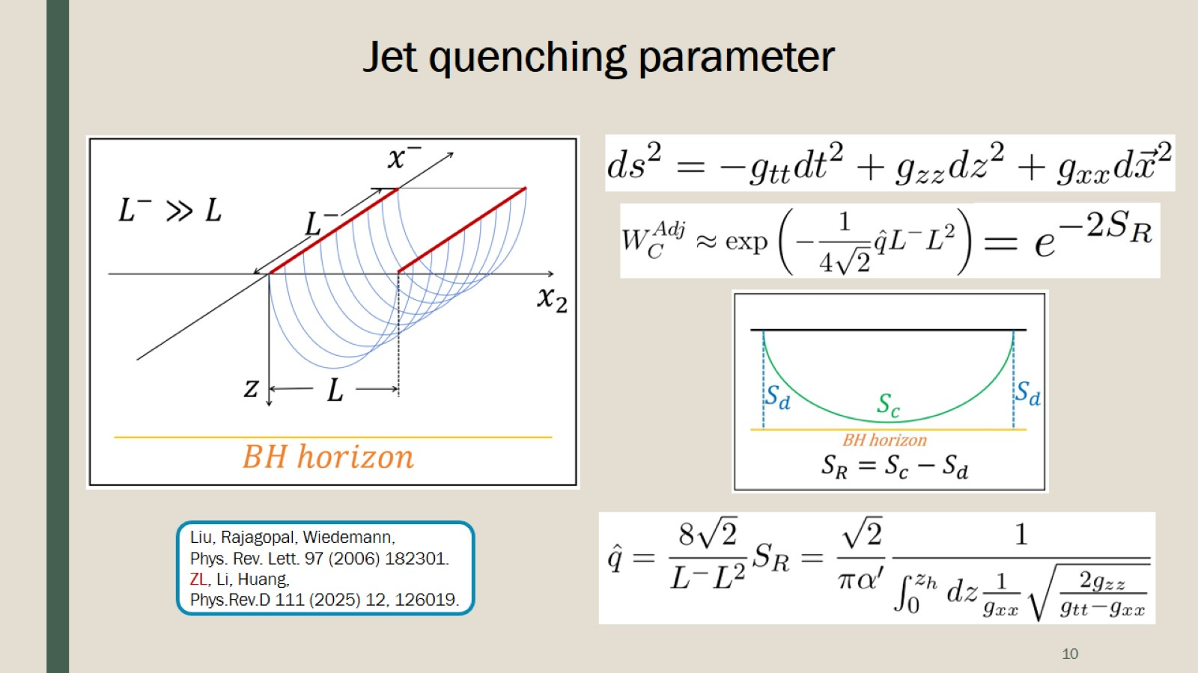
Jet quenching parameter

Slide 11
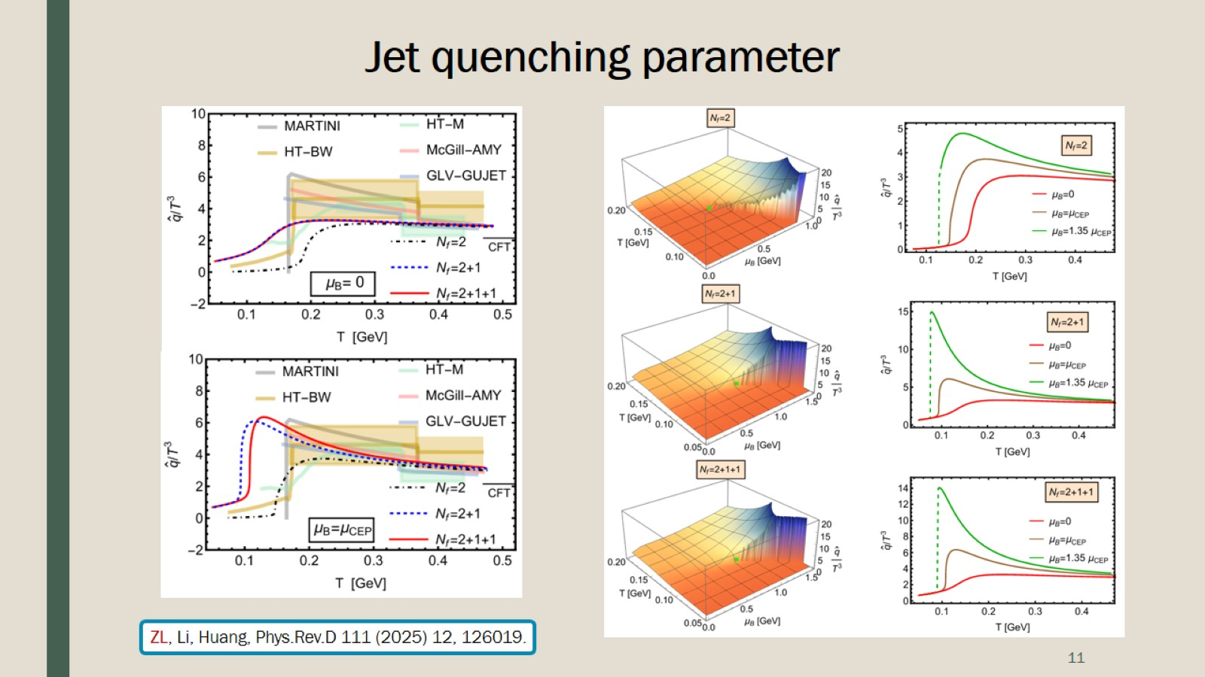
Jet quenching parameter

Slide 12
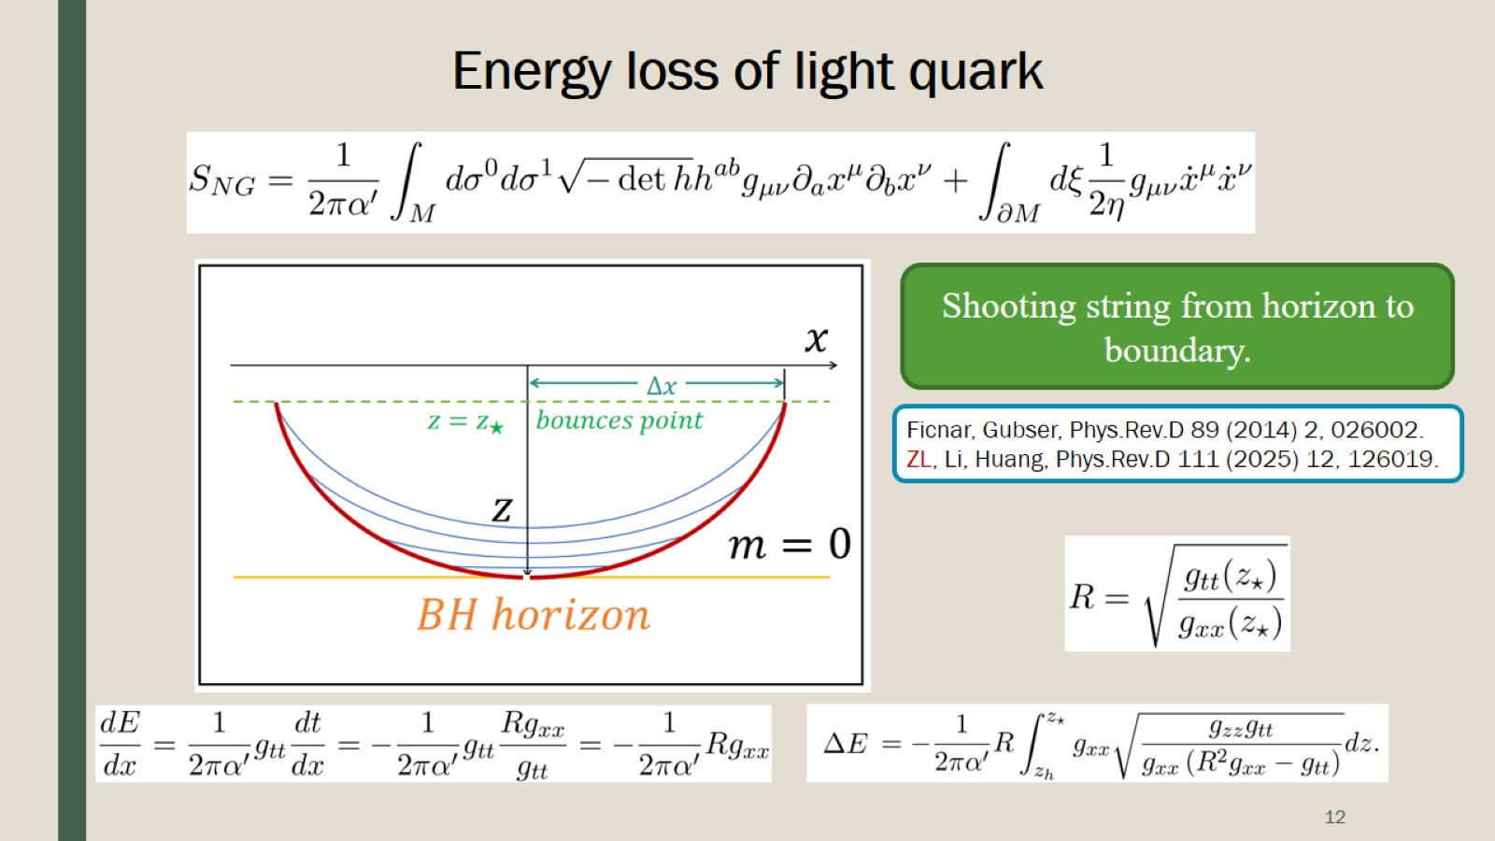
Energy loss of light quark

Slide 13
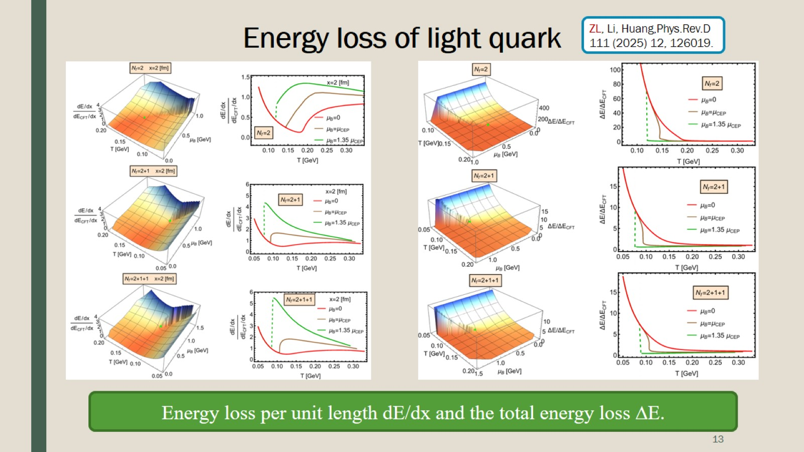
Energy loss of light quark

Slide 14
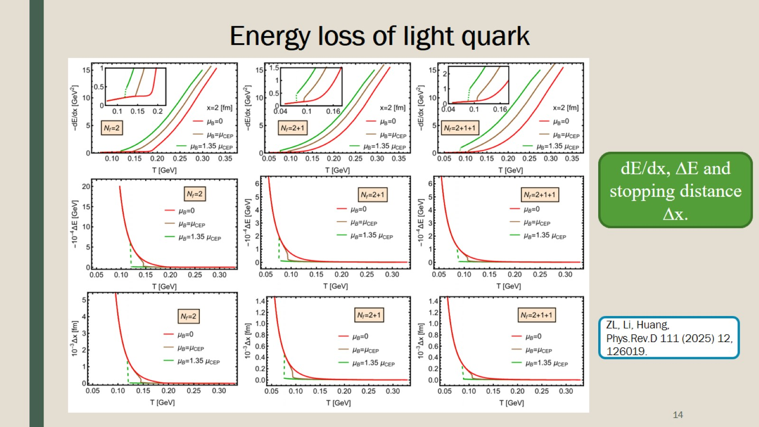
Energy loss of light quark

Slide 15
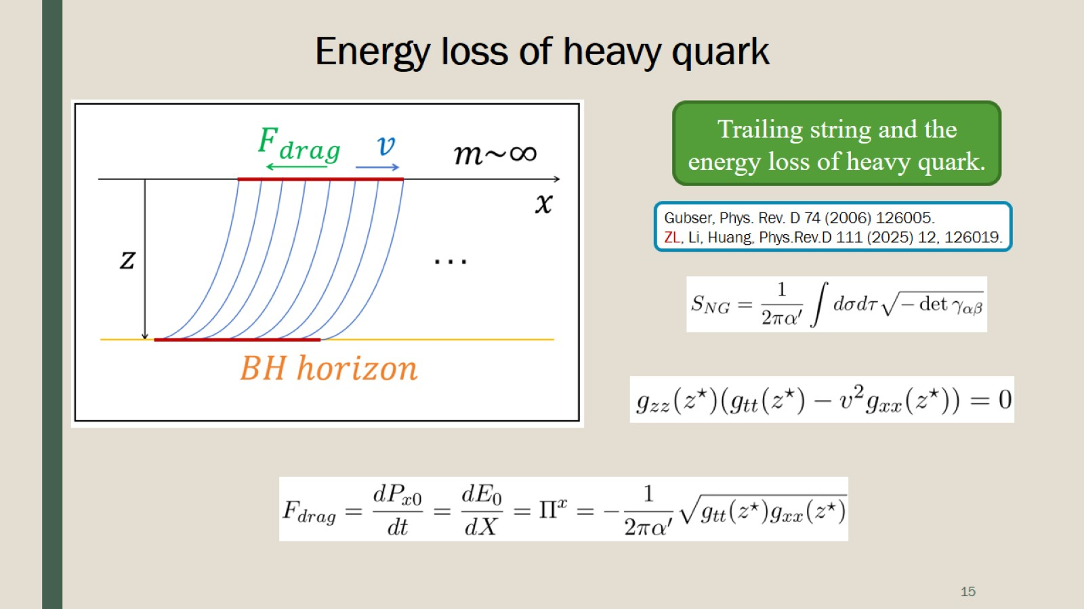
Energy loss of heavy quark

Slide 16
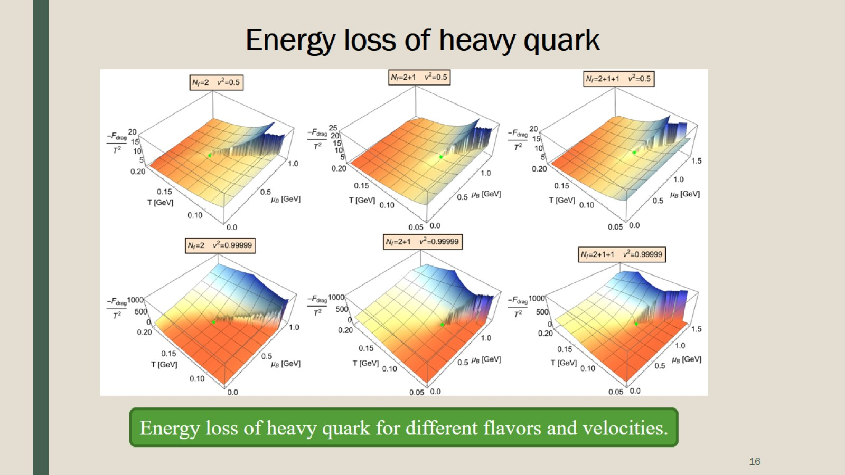
Energy loss of heavy quark

Slide 17
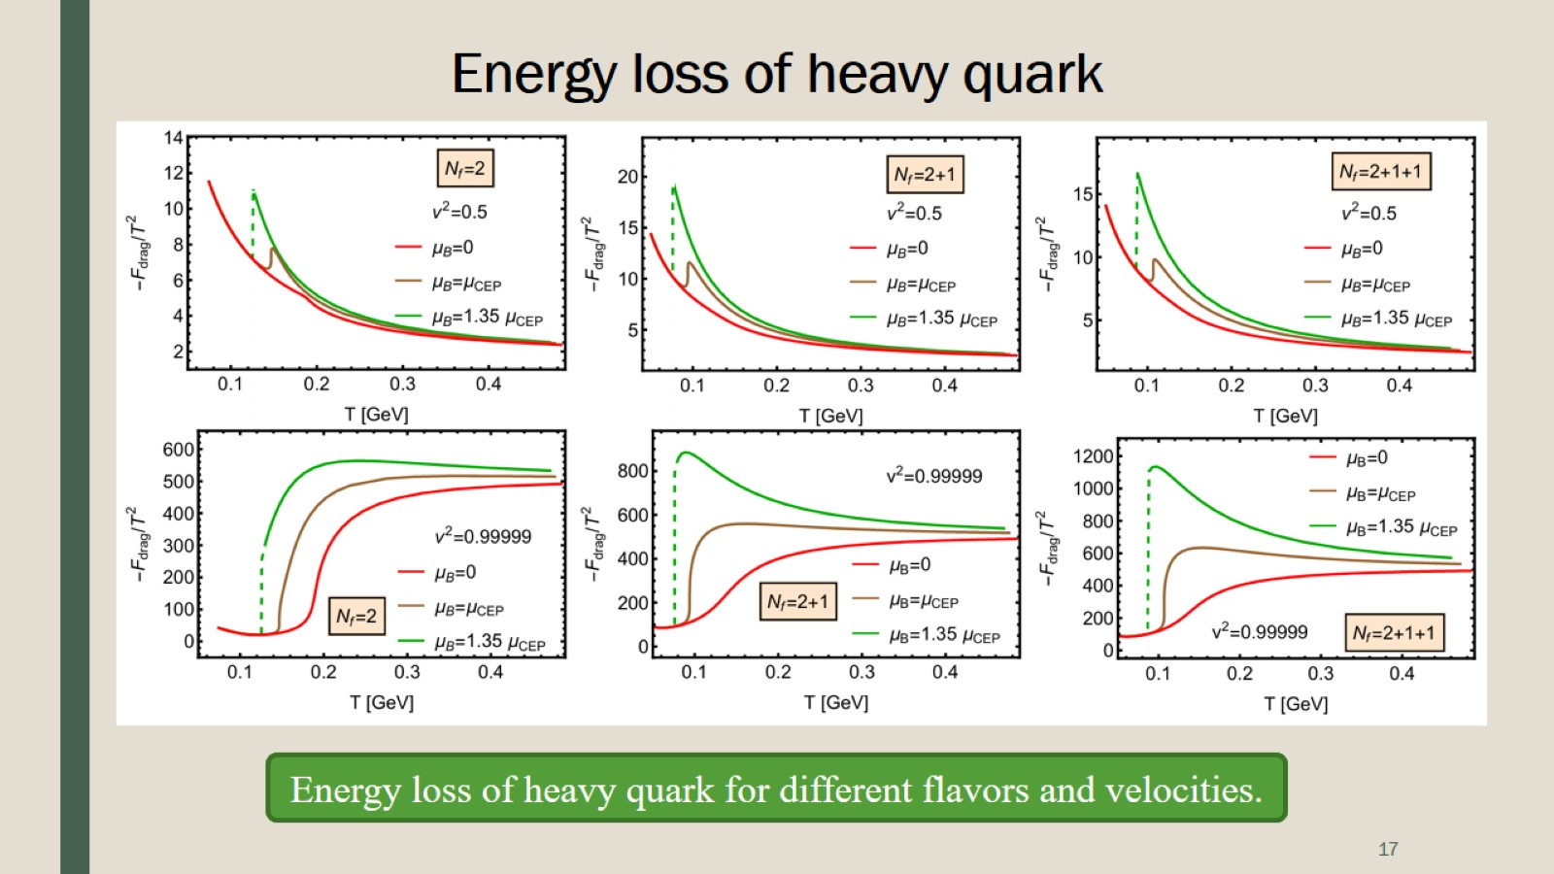
Energy loss of heavy quark

Slide 18
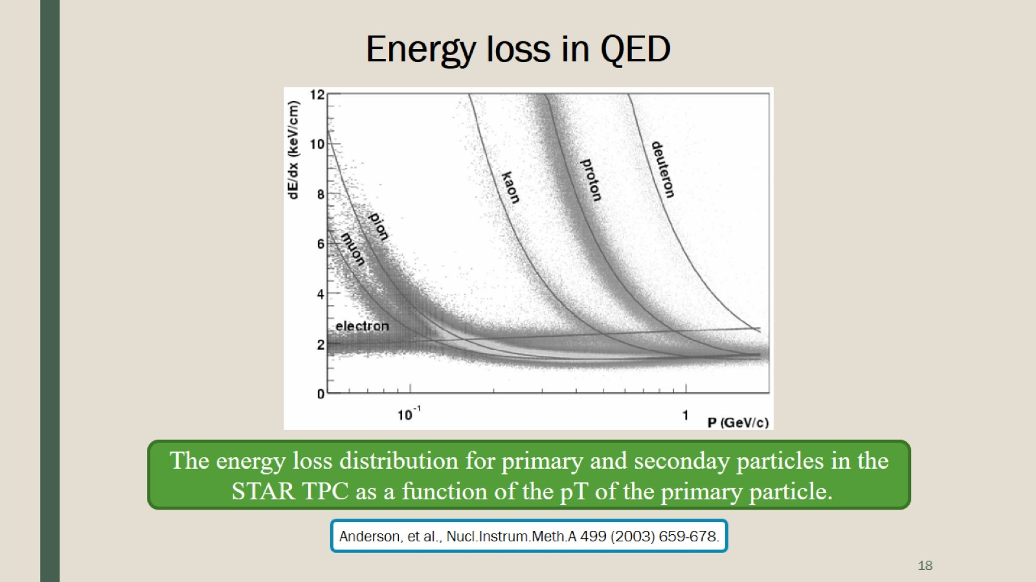
Energy loss in QED

Slide 19
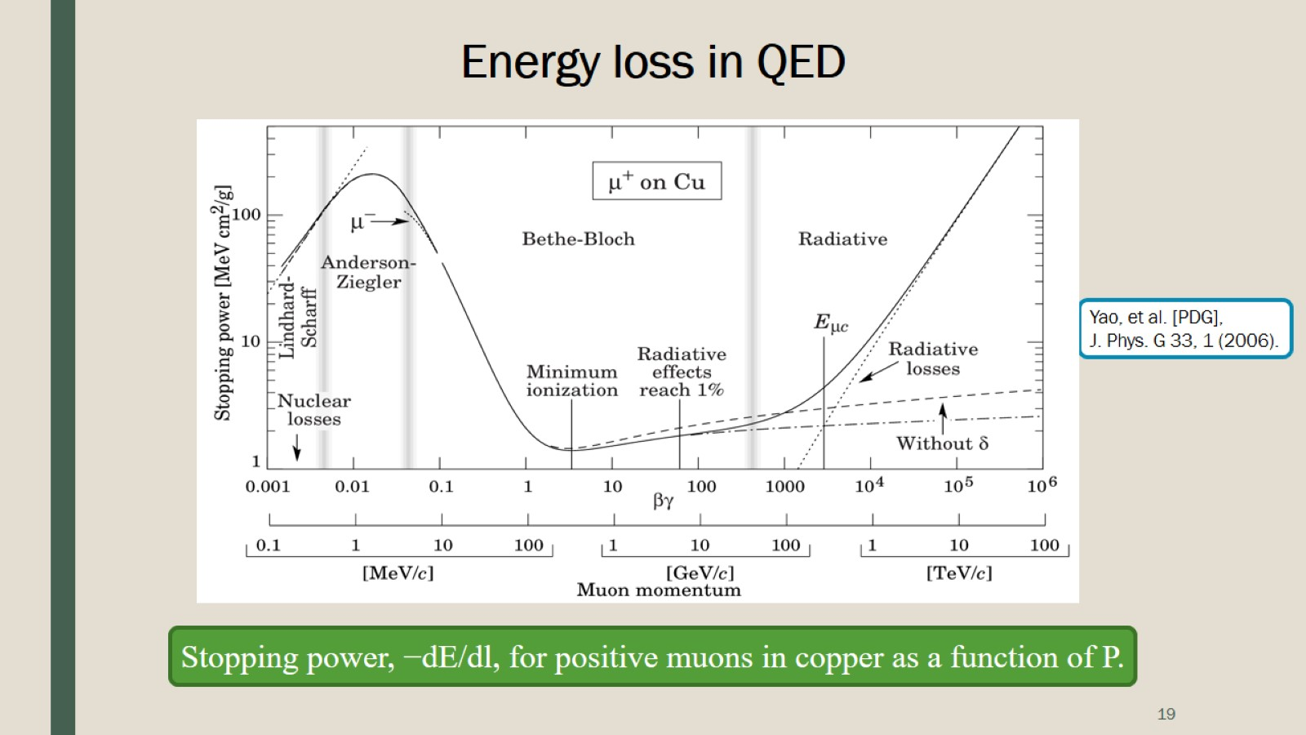
Energy loss in QED

Slide 20
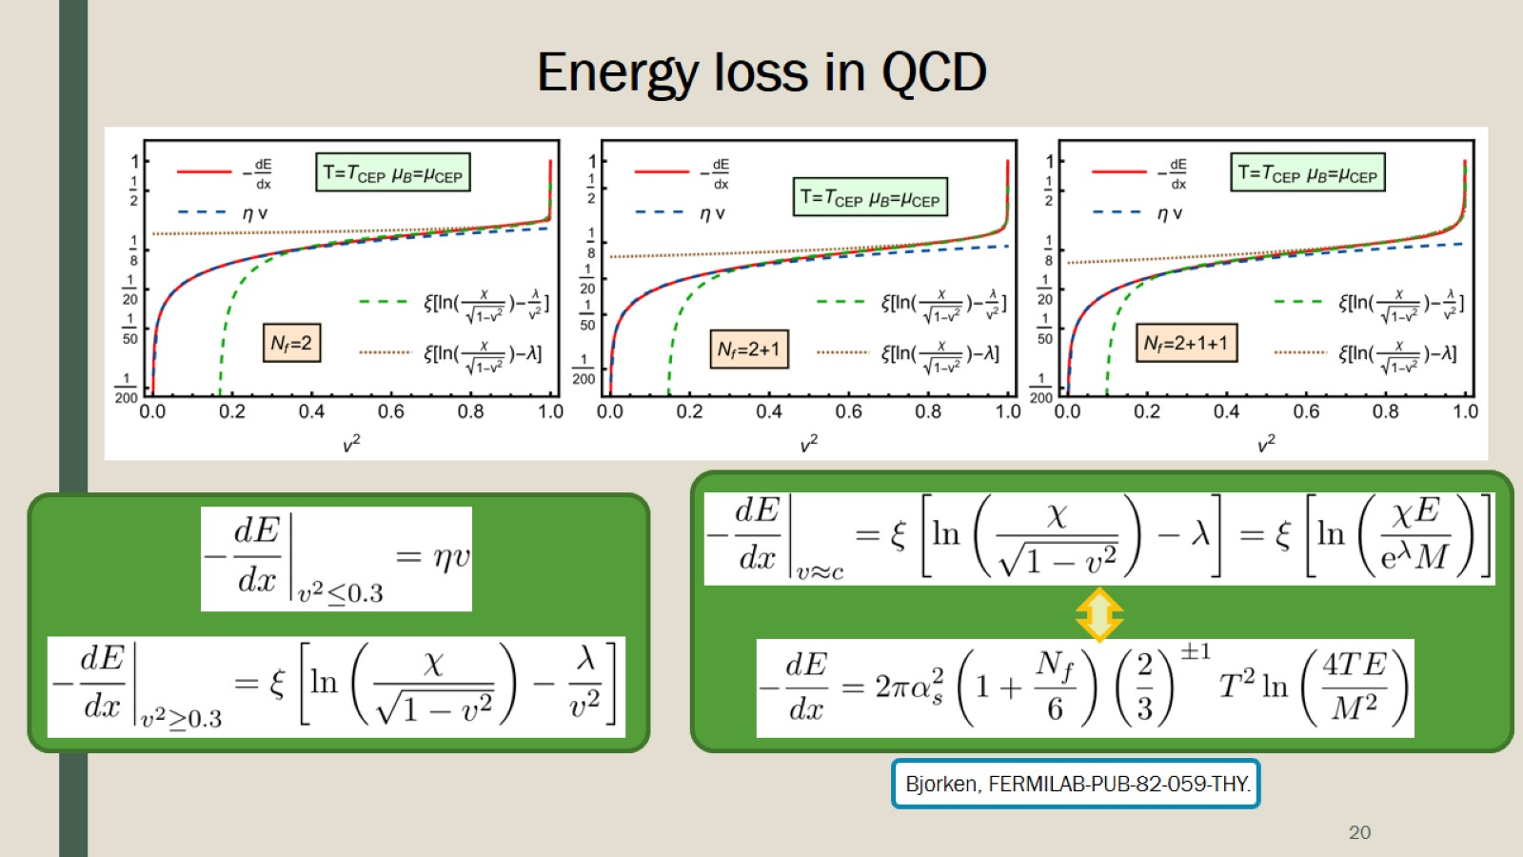
Energy loss in QCD

Slide 21
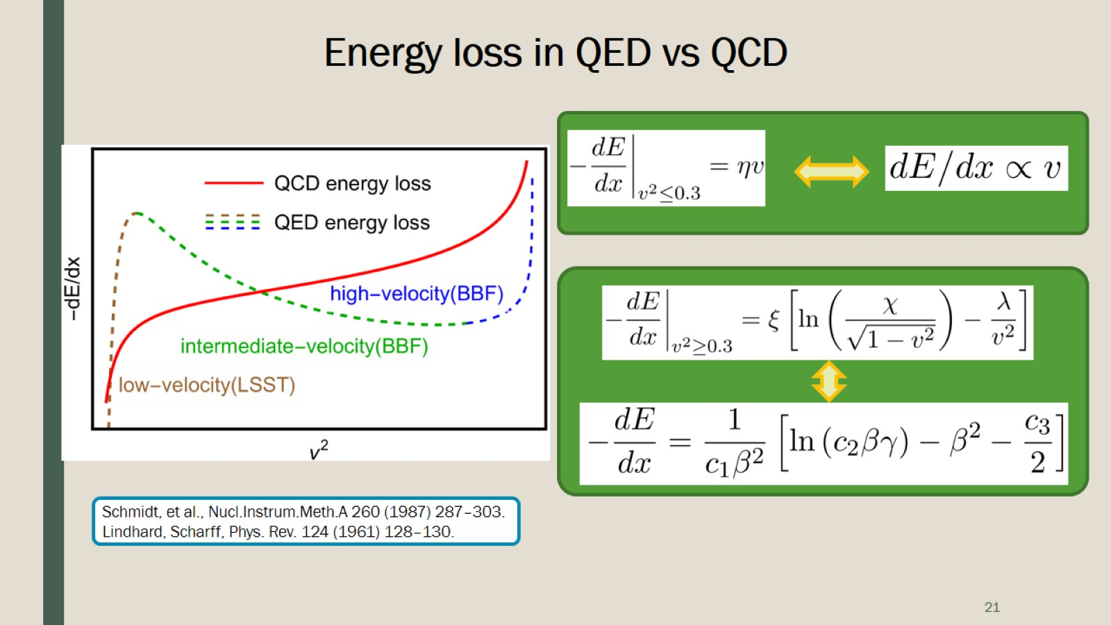
Energy loss in QED vs QCD

Slide 22
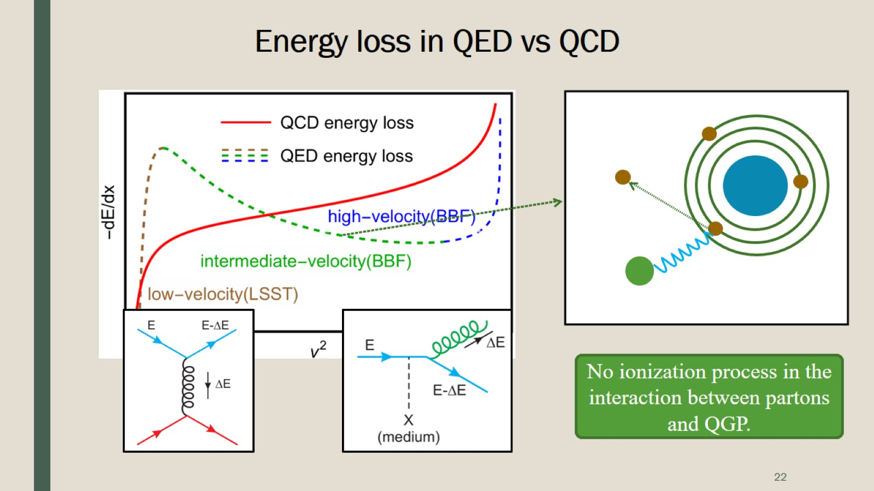
Energy loss in QED vs QCD

Slide 23
