Slide 1

Left-right splitting of elliptic flow in heavy ion collisions:
TRENTo-3D + CLVisc
相对论重离子碰撞中椭圆流分裂行为的研究
Fan Xiang
Phys.Rev.C 112 (2025) 4, 044906
第十一届粒子所“青年之星”2025年度学术论坛, 2025 年 11 月 27 日

Slide 2
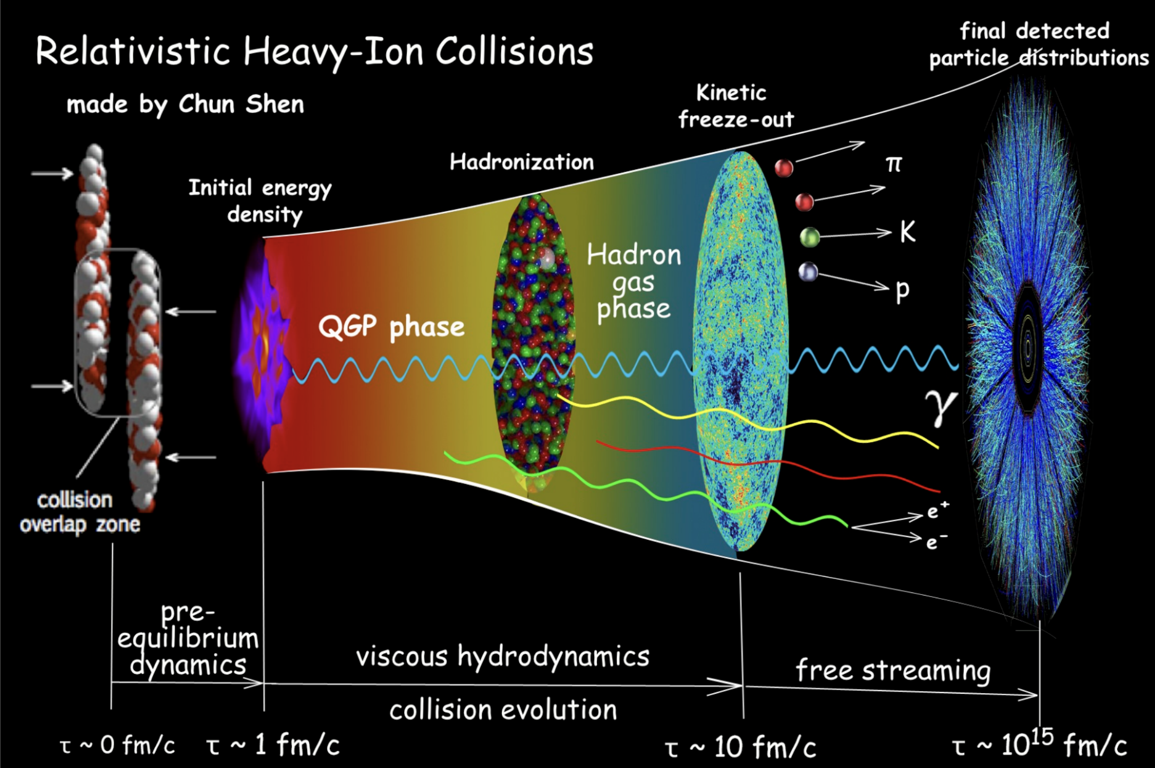
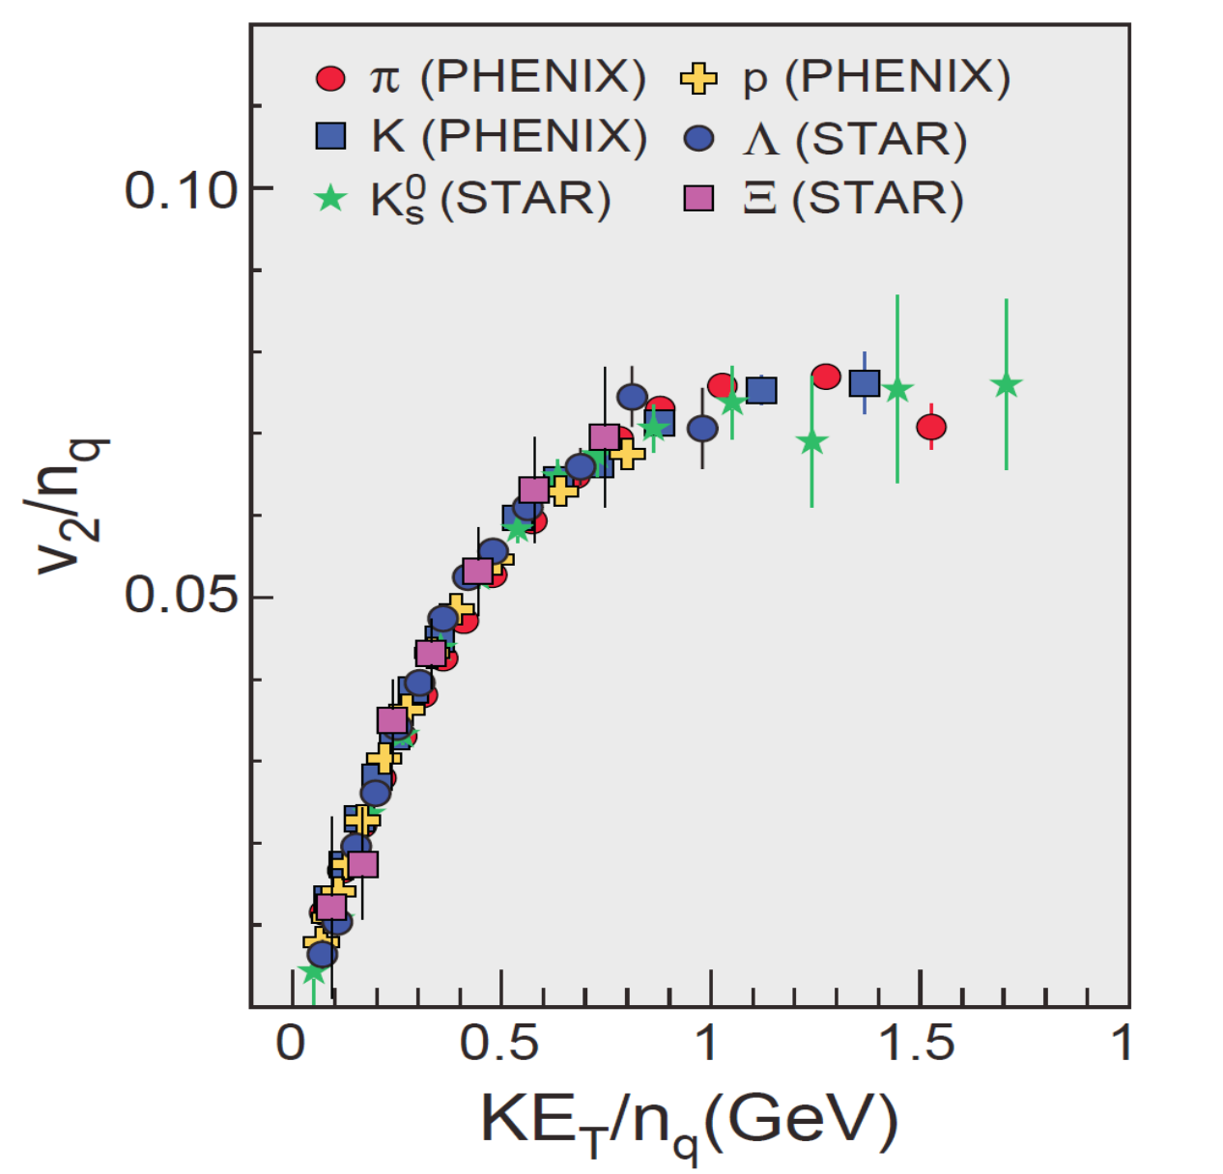
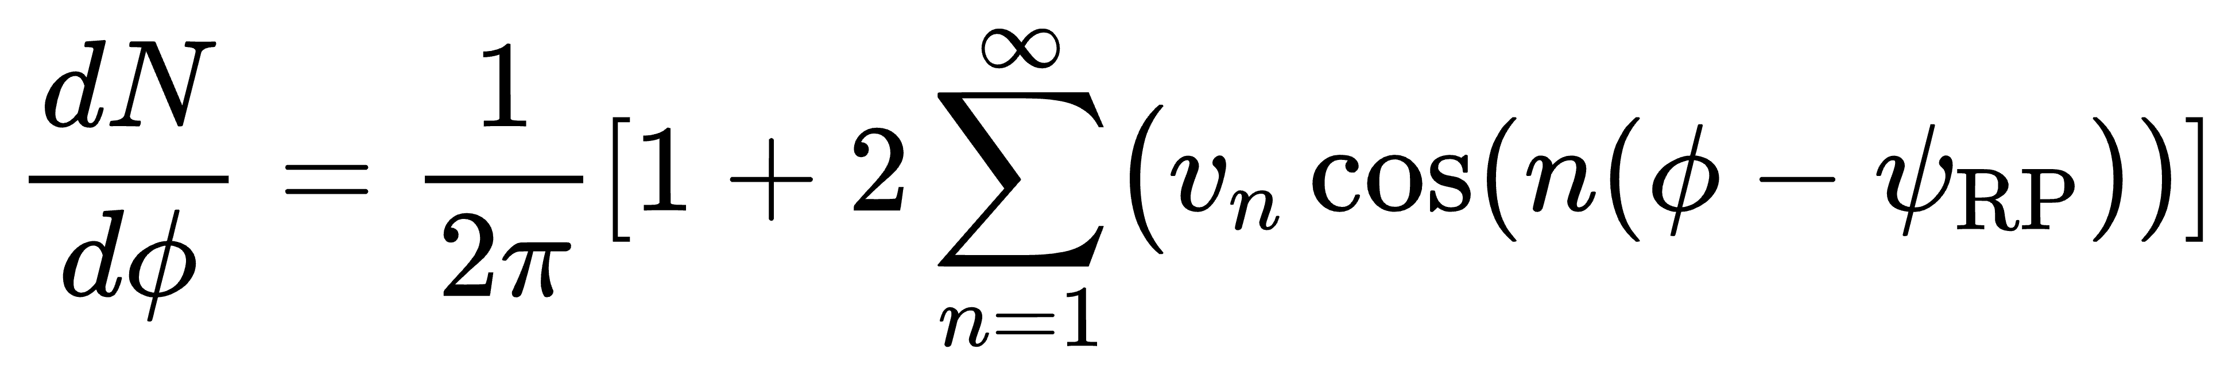
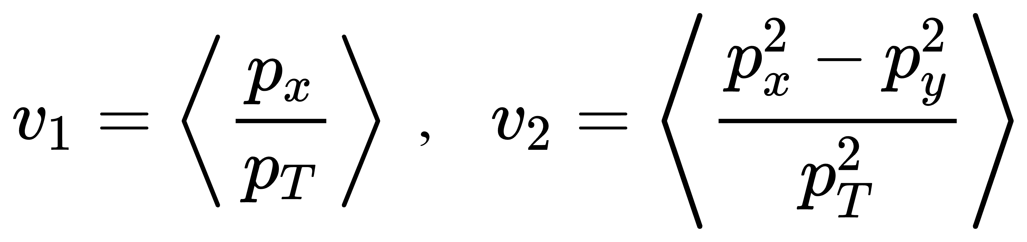
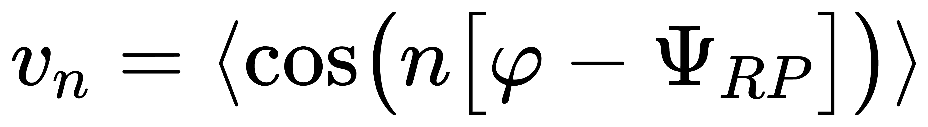
Anisotropic Flow in Heavy-Ion Collisions
EB field
...
U. Heinz and R. Snellings. Ann. Rev. Nucl. Part. Sci., 63:123–151, 2013

Slide 3
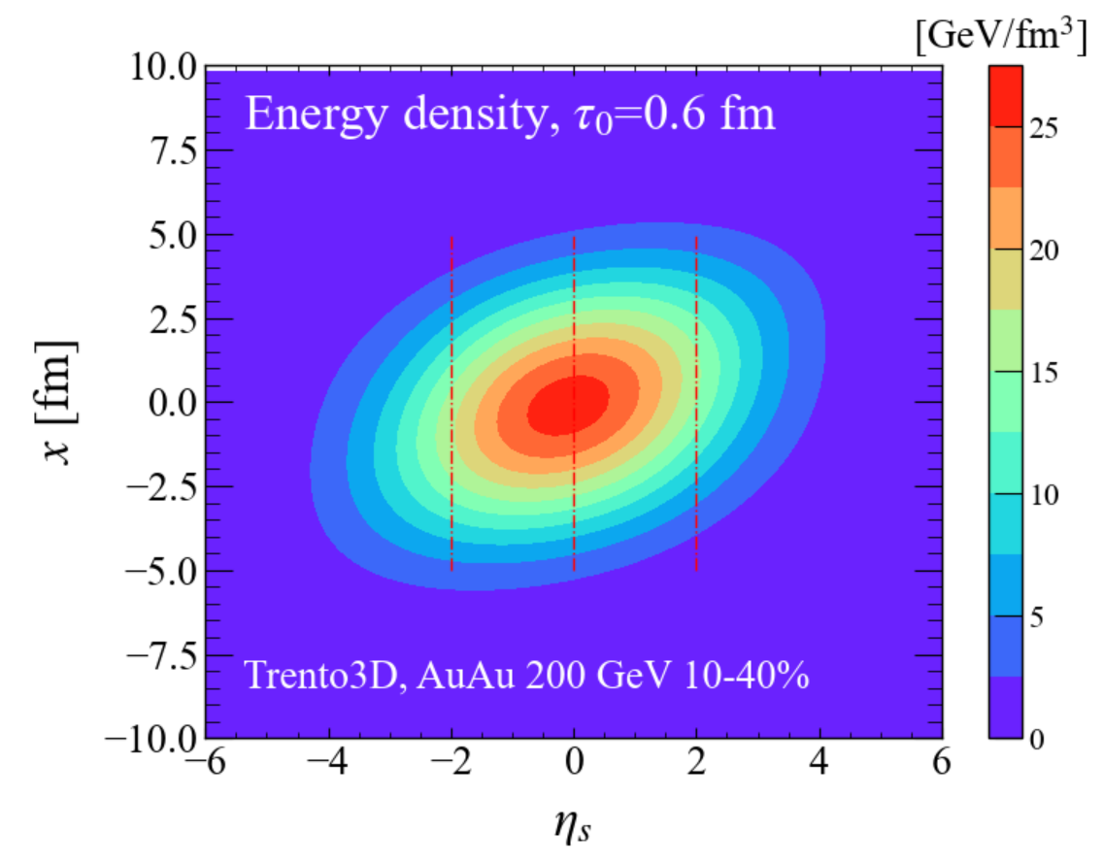
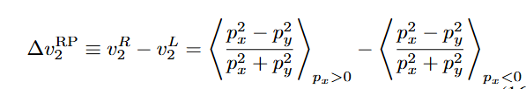
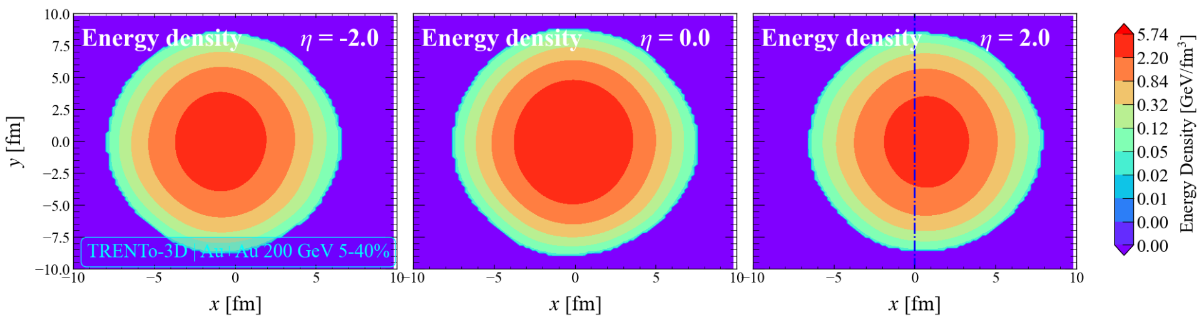
Why does ∆v₂ arise?
1.Transverse energy-density asymmetry of the QGP；
2. Initial vorticity
Phys.Rev.C 106 (2022) 5, 054910；Phys.Rev.C 106 (2022) 4, 044907；arXiv: 2108.12735
p_{x2}
<p_{x1>}
Three questions:
1.How can ∆v₂ be calculated in momentum space?
2.How can a realistic three-dimensional initial QGP distribution be generated?
3.What physical aspects of the QGP initial state does ∆v₂ probe?

Slide 4

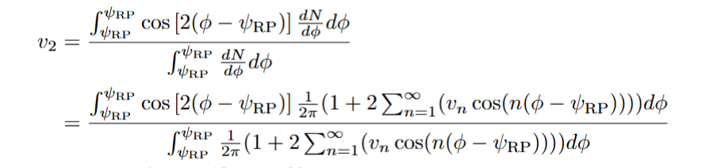



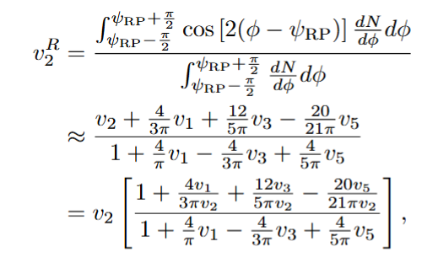
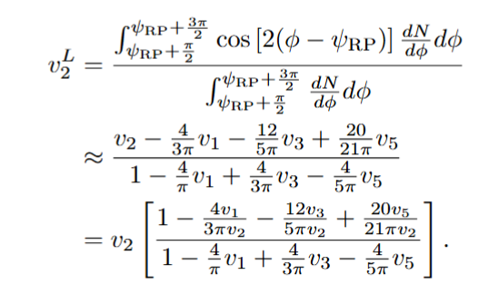
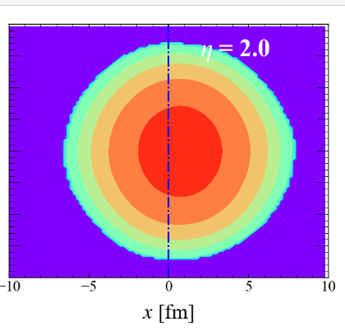
Question 1: Theoretical calculation of ∆v₂
S. A. Voloshin, A. M. Poskanzer, and R. Snellings, Landolt-Bornstein, 23:293–333, 2010.
Particle spectrum：
Elliptic flow v₂：
v₂ from the left and right sides of the reaction plane:
L
R
STAR, The STAR Event Plane Detector, arXiv: 1912.05243

Slide 5
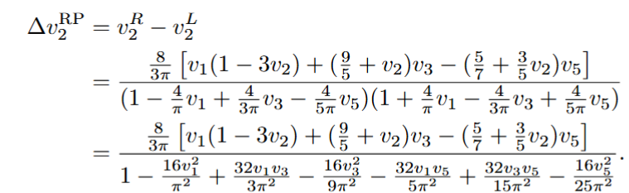

Question 1: Theoretical calculation of ∆v₂
L
R
Leading order contribution
Chao Zhang and Zi-Wei Lin. Left-right splitting of elliptic flow due to directed flow in heavy ion collisions. Phys. Rev. C, 106(5):054910, 2022. （AMPT）
T. Parida and S. Chatterjee. Splitting of elliptic flow in a tilted fireball. Phys. Rev. C, 106(4):044907, 2022. (Optical Glauber Model + Music)

Slide 6
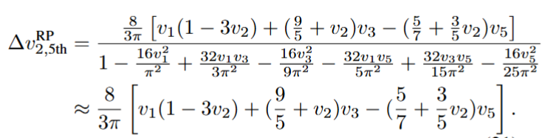
Question 1: Theoretical calculation of ∆v₂
L
R
v₁, v₃, v₅ ...
Ze-Fang Jiang, Xiang Fan, Duan She, Ben-Wei Zhang et.al , Phys.Rev.C 112 (2025) 4, 044906

Slide 7

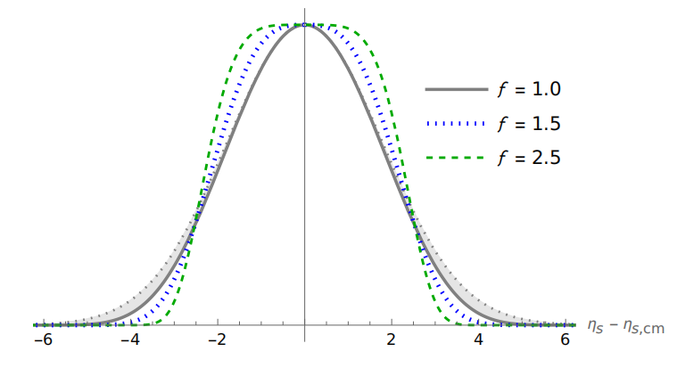
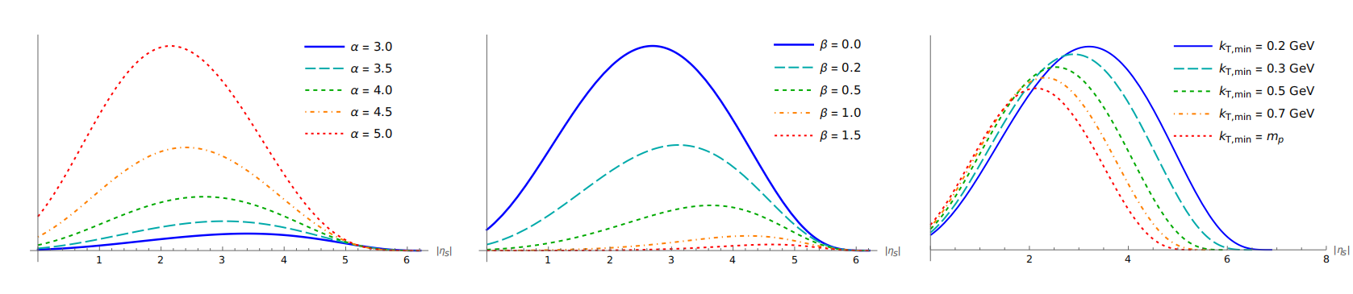
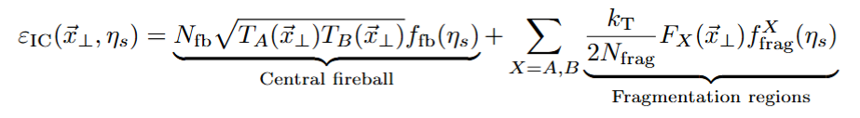
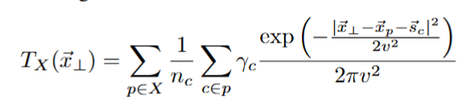
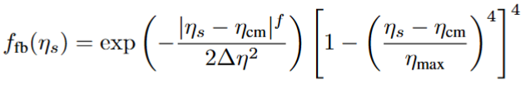

Question 2: initial condition
Derek Soeder, Weiyao Ke, J. F. Paquet, and Steffen A. Bass. arXiv: 2306.08665.
Initial energy density ：
Includes nucleon
thickness functions：
central region：
fragmentation region：

Slide 8
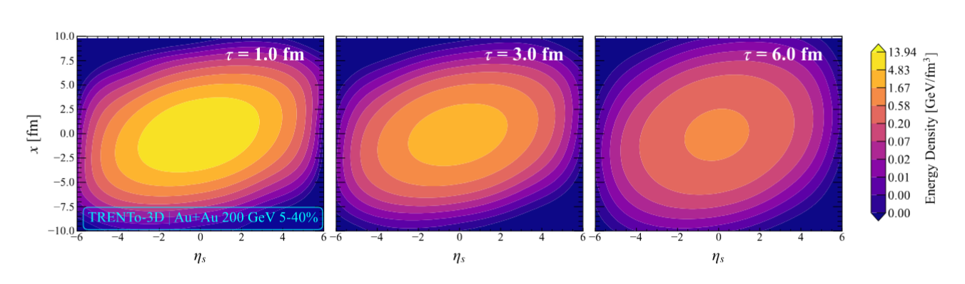
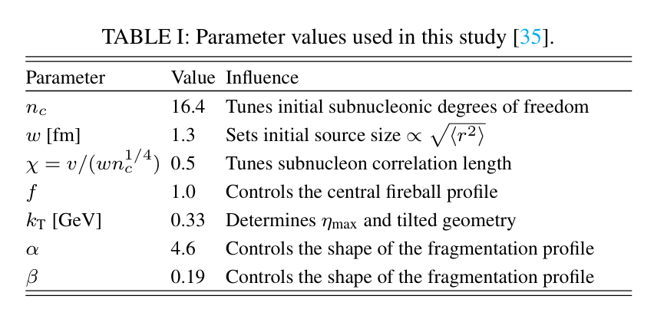
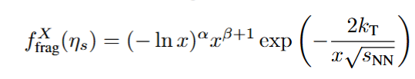
Question 2: initial condition
Derek Soeder, Weiyao Ke, J. F. Paquet, and Steffen A. Bass. arXiv: 2306.08665.
Xiang-Yu Wu, Guang-You Qin, Long-Gang Pang, and Xin-Nian Wang. Phys. Rev. C, 105(3):034909, 2022.
Initial energy density ：
Includes nucleon
thickness functions：
central region：
fragmentation region：

Slide 9
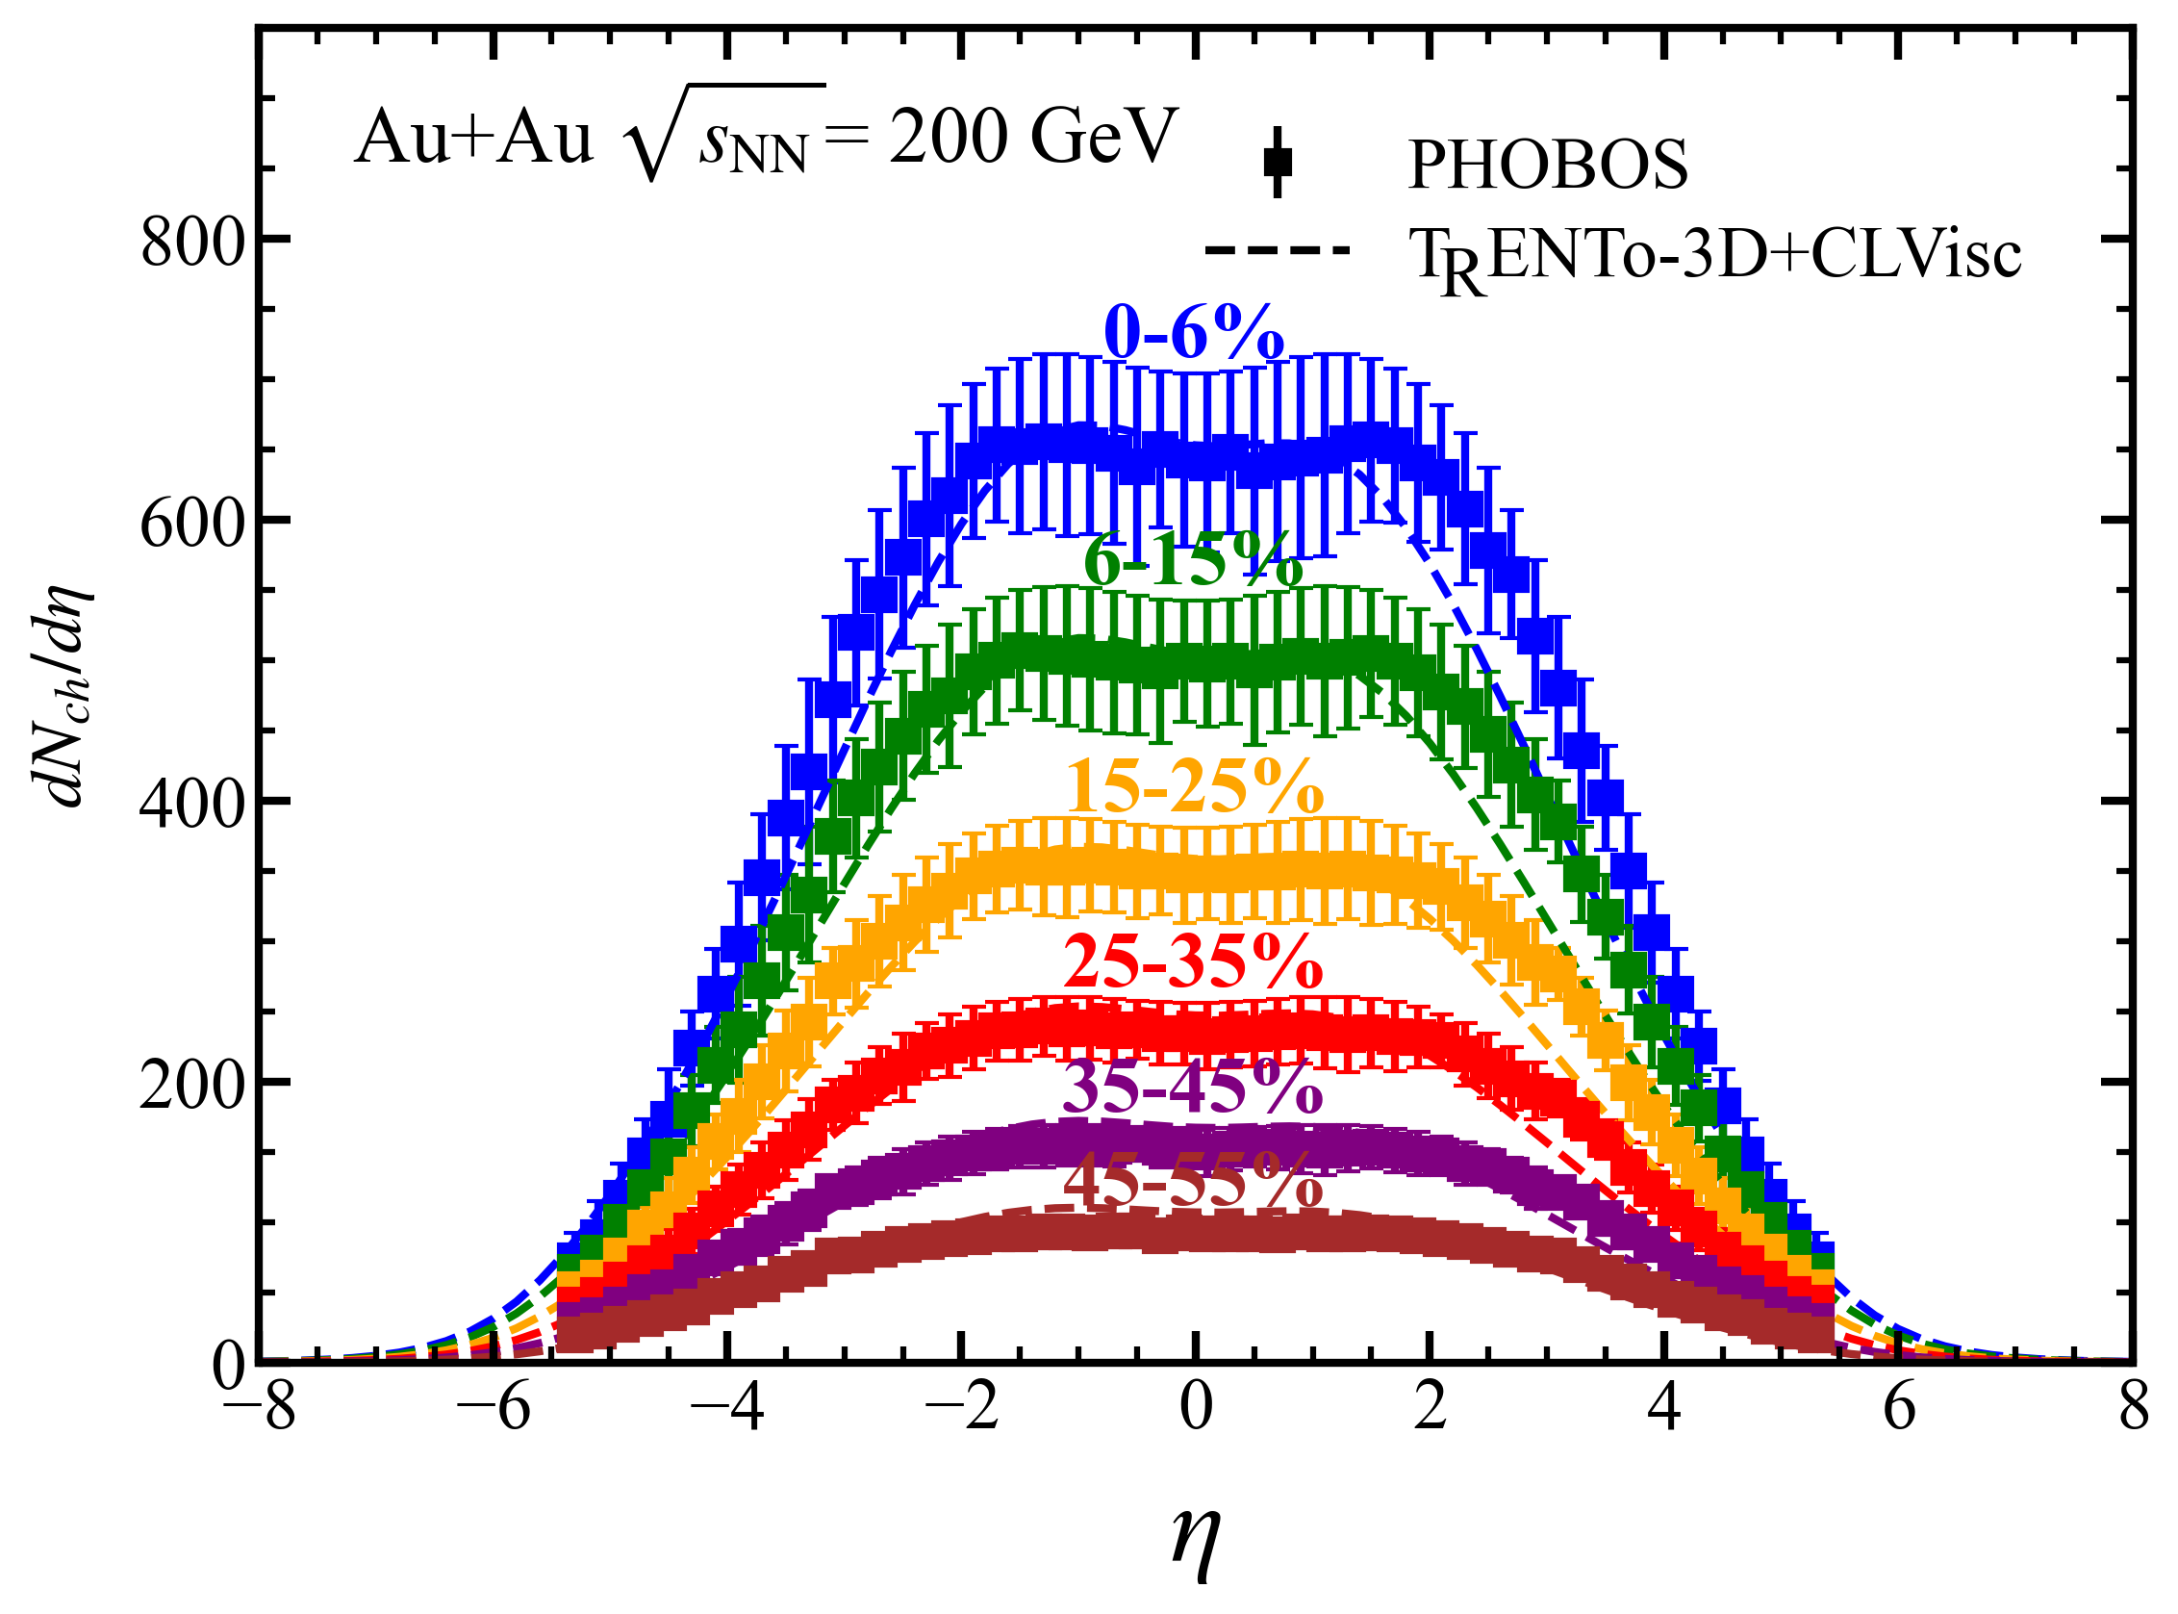
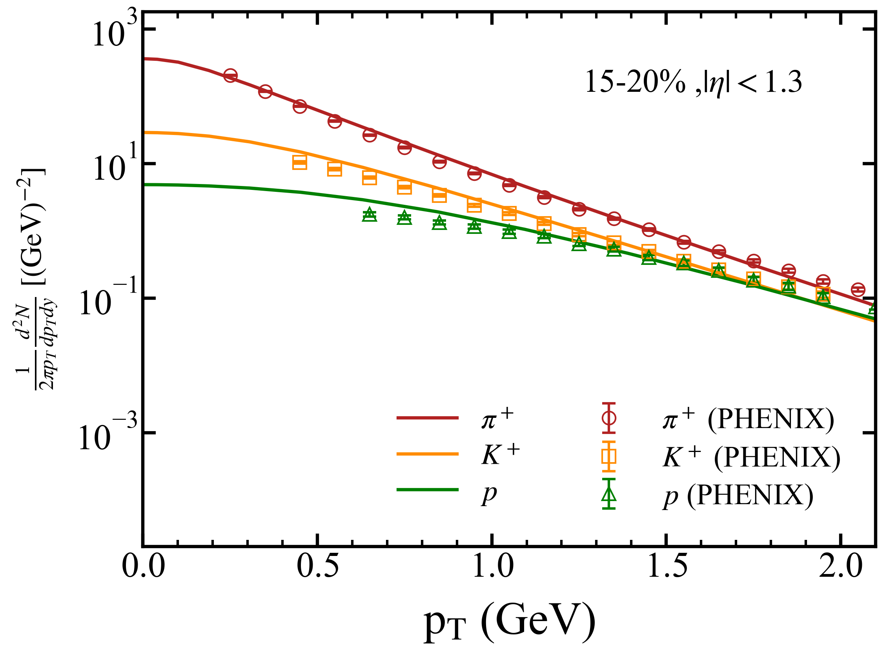
+ CLVisc Hydrodynamic
Derek Soeder, Weiyao Ke, J. F. Paquet, and Steffen A. Bass. arXiv: 2306.08665.
Xiang-Yu Wu, Guang-You Qin, Long-Gang Pang, and Xin-Nian Wang. Phys. Rev. C, 105(3):034909, 2022.
Hydrodynamic simulations with Bayesian-calibrated TRENTo3D parameters and CLVisc evolution
provide a good description of the PHOBOS and PHENIX data.

Slide 10
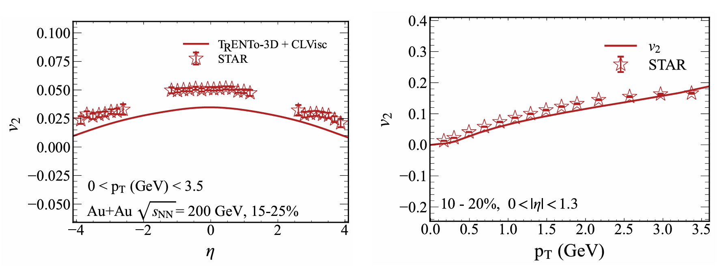

+ CLVisc Hydrodynamic
Derek Soeder, Weiyao Ke, J. F. Paquet, and Steffen A. Bass. arXiv: 2306.08665.
Xiang-Yu Wu, Guang-You Qin, Long-Gang Pang, and Xin-Nian Wang. Phys. Rev. C, 105(3):034909, 2022.
STAR, Phys. Rev. C, 72:014904, 2005.
Hydrodynamic simulations using Bayesian-calibrated
parameters combined with CLVisc evolution

Slide 11
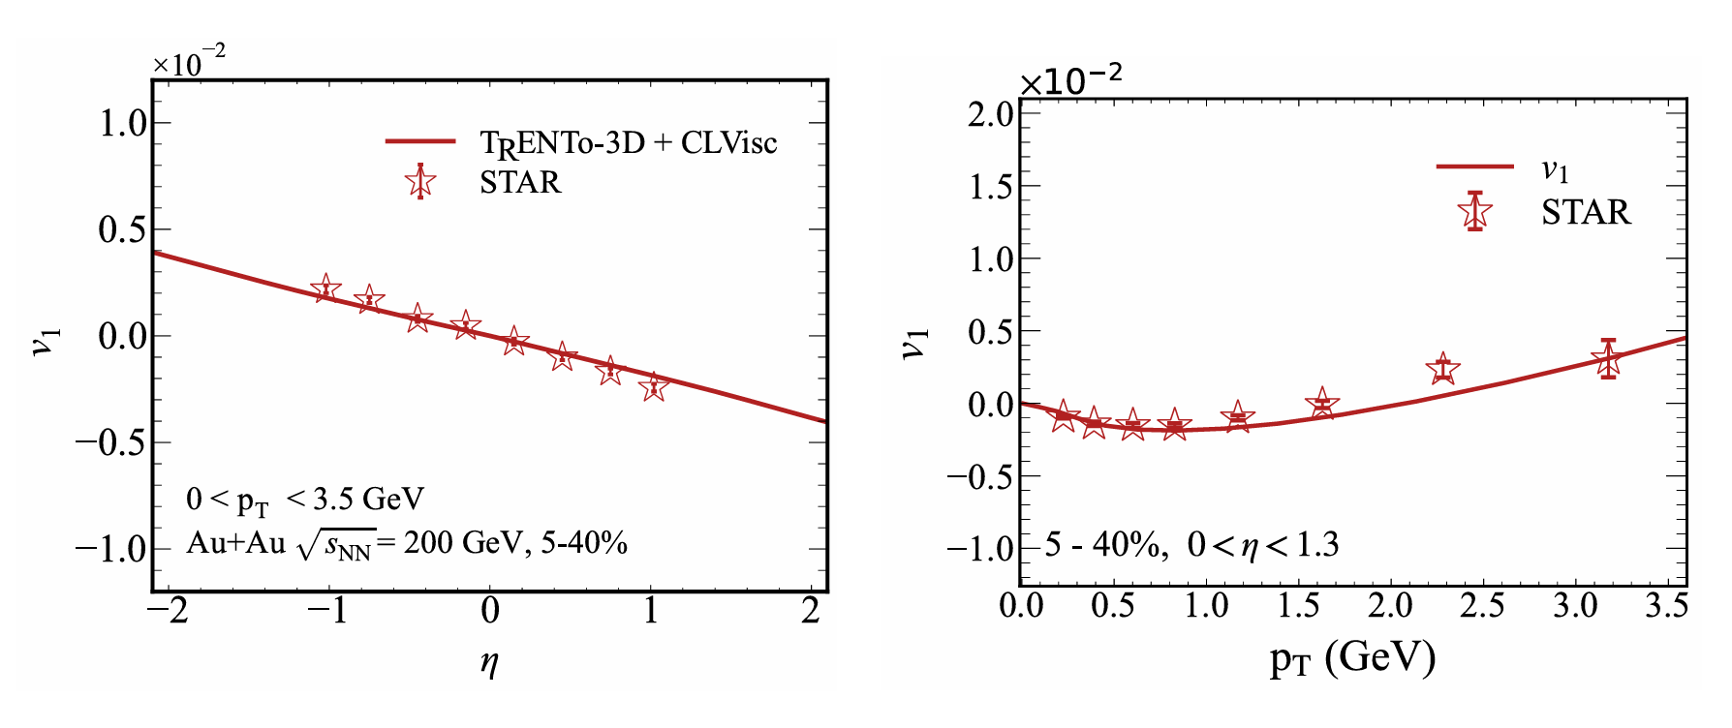


+ CLVisc Hydrodynamic
STAR, Phys. Rev. Lett., 112(16):162301, 2014.
directed flow $v_{1}\left(η\right)$
directed flow $v_{1}\left(p_{T}\right)$
The developed + CLVisc framework successfully describes directed flow distributions.

Slide 12
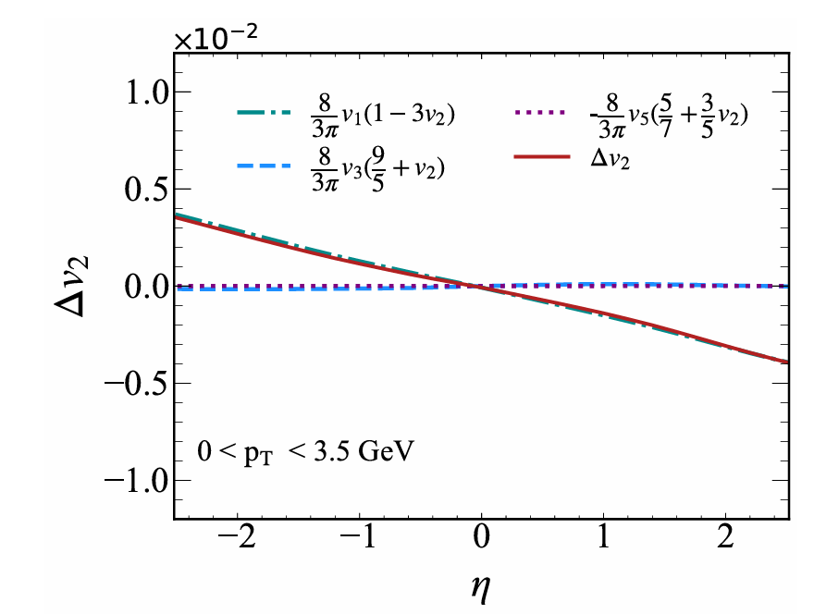
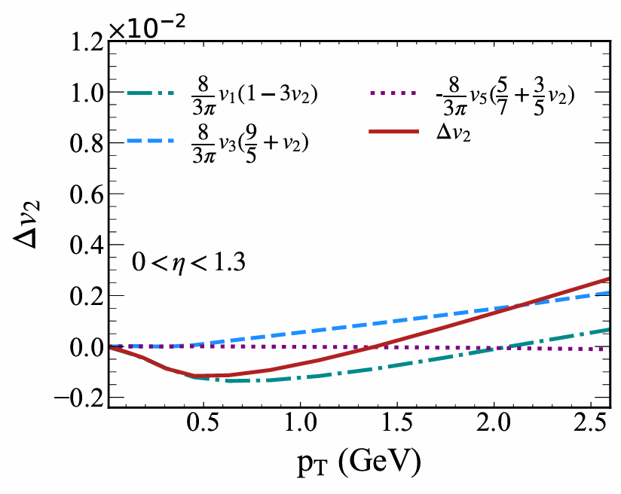
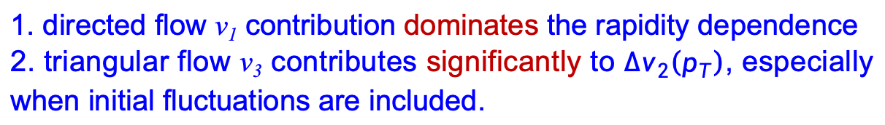
Question 3: Factors influencing elliptic flow splitting
1. directed flow v₁ contribution dominates the rapidity dependence
2. triangular flow v₃ contributes significantly to ${∆v}_{2}\left(p_{T}\right)$, especially when initial fluctuations are included.

Slide 13
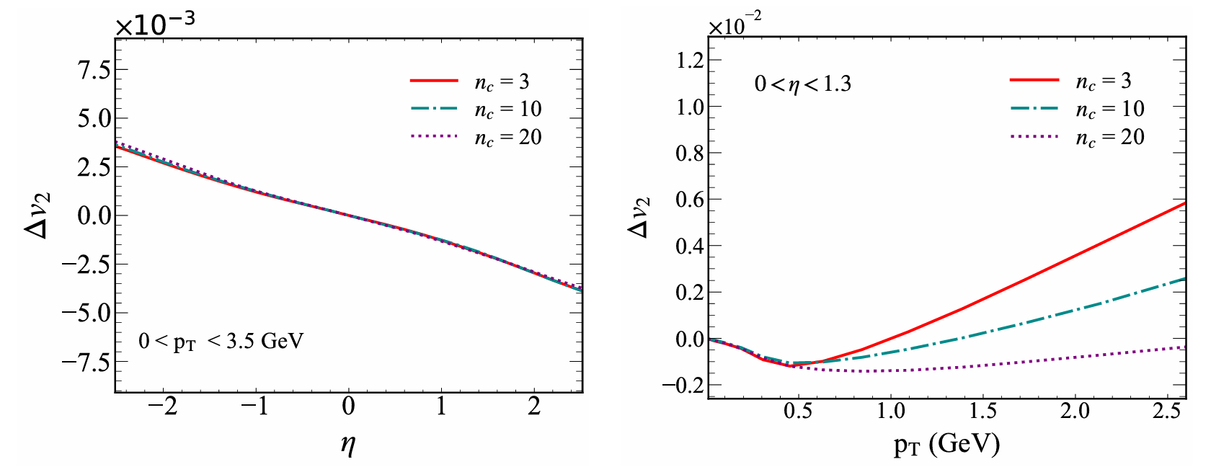
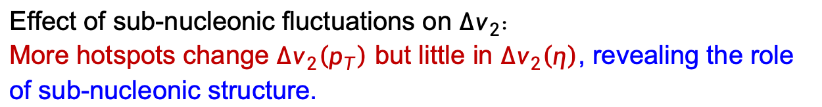
Question 3: Effect of sub-nucleonic fluctuations on ∆v₂
Effect of sub-nucleonic fluctuations on ${∆v}_{2}$：
More hotspots change ${∆v}_{2}\left(p_{T}\right)$ but little in ${∆v}_{2}\left(η\right)$, revealing the role of sub-nucleonic structure.
O. G. Montero, S. Schlichting, and Jie Zhu. Effects of sub-nucleonic fluctuations on the longitudinal structure of heavy-ion collisions. arXiv: 2501.14872

Slide 14
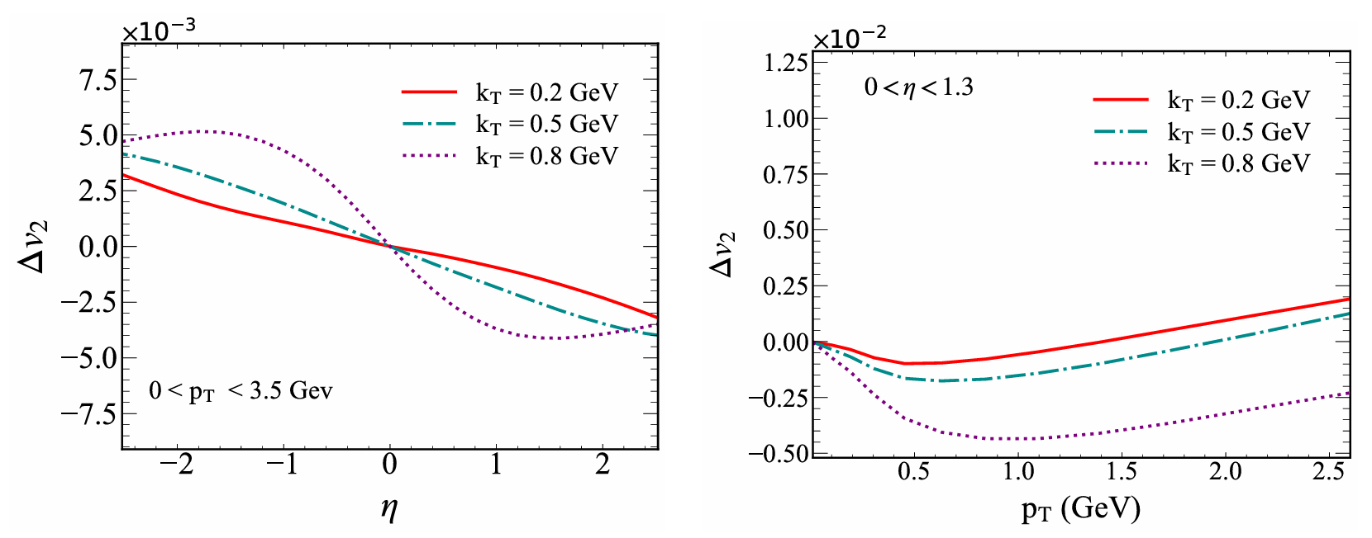
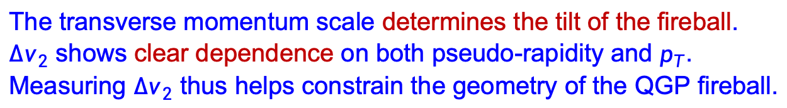
Question 3: Effect of transverse momentum scale on ∆v₂
The transverse momentum scale determines the tilt of the fireball.
${∆v}_{2}$ shows clear dependence on both pseudo-rapidity and $p_{T}$.
Measuring ${∆v}_{2}$ thus helps constrain the geometry of the QGP fireball.

Slide 15
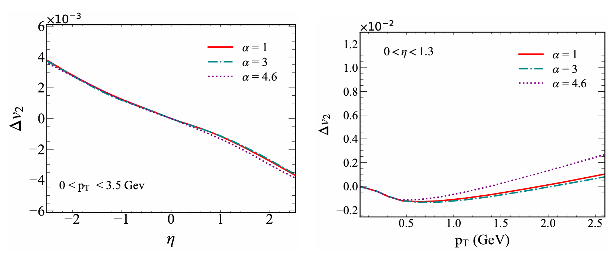
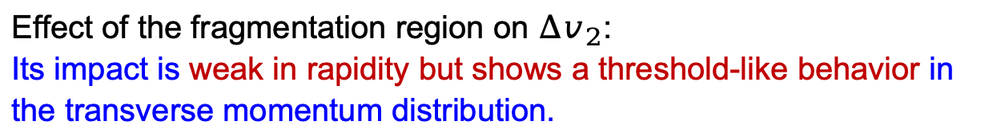
Question 3: Effect of the fragmentation region on ∆v₂
Effect of the fragmentation region on ${∆v}_{2}$:
Its impact is weak in rapidity but shows a threshold-like behavior in the transverse momentum distribution.

Slide 16
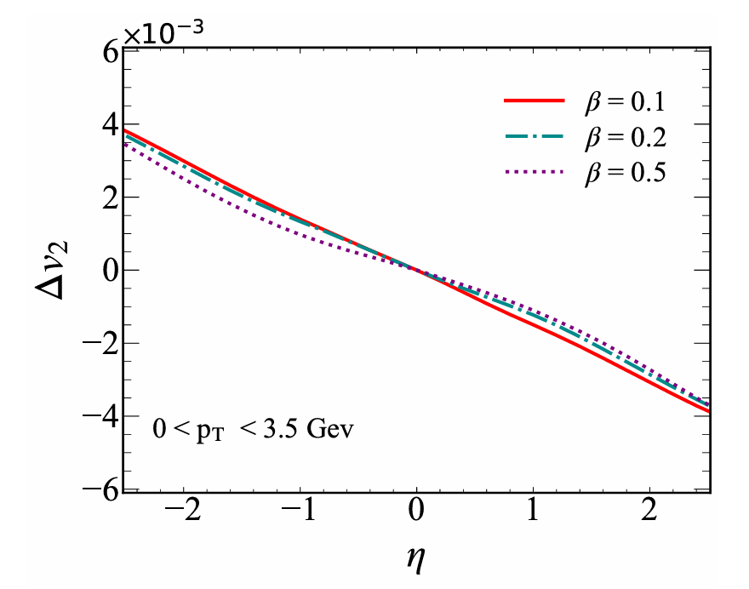
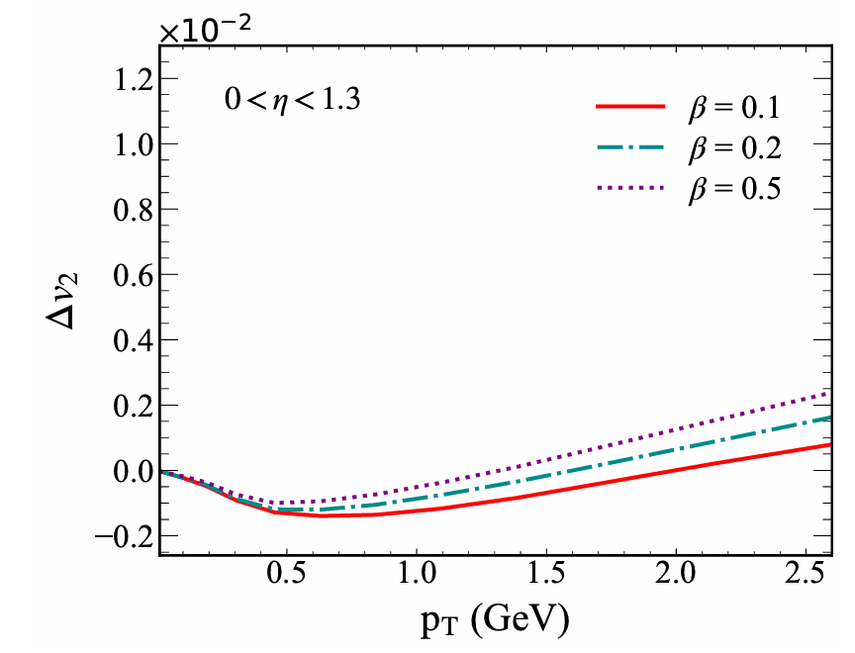
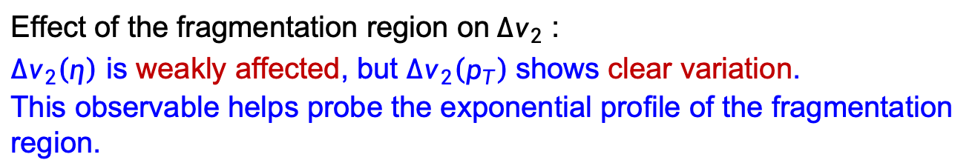
Question 3: Effect of the fragmentation region on ∆v₂
Effect of the fragmentation region on${∆v}_{2}$ :
${∆v}_{2}\left(η\right)$ is weakly affected, but ${∆v}_{2}\left(p_{T}\right)$shows clear variation.
This observable helps probe the exponential profile of the fragmentation region.

Slide 17
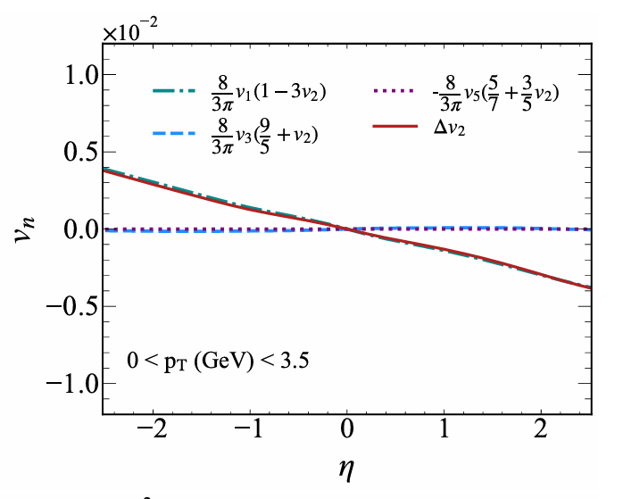
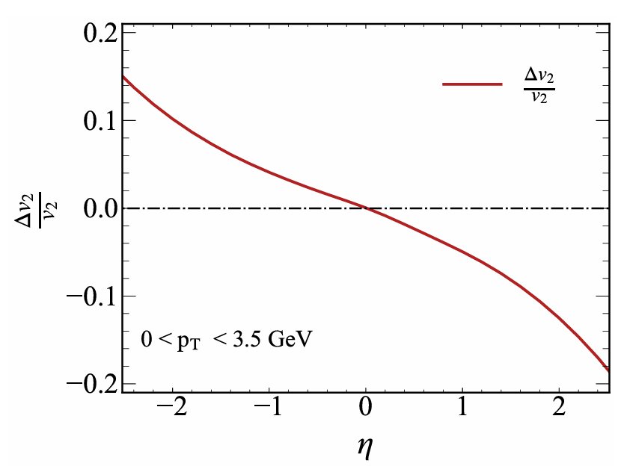
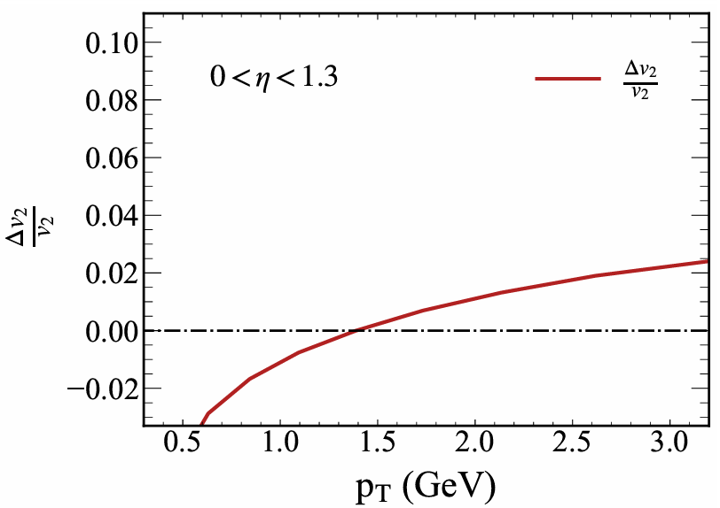
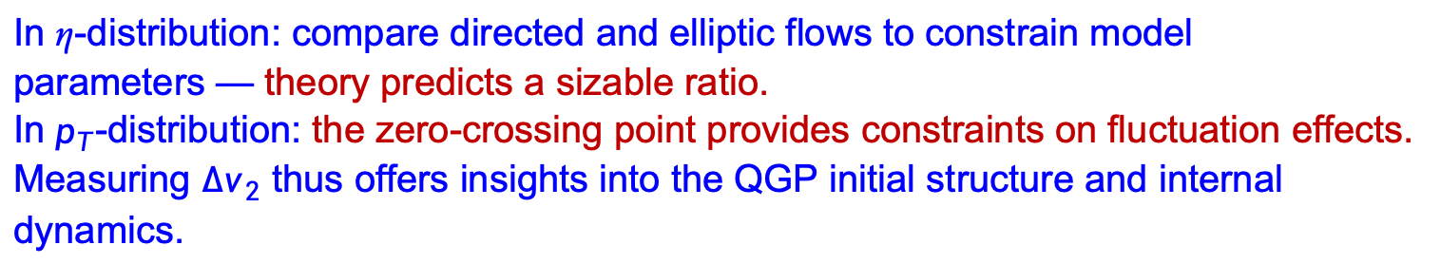
Question 3: Proposed observable: elliptic-flow-splitting ratio $∆v_{2}/v_{2}$
In η-distribution: compare directed and elliptic flows to constrain model parameters — theory predicts a sizable ratio.
In $p_{T}$-distribution: the zero-crossing point provides constraints on fluctuation effects.
Measuring ${∆v}_{2}$ thus offers insights into the QGP initial structure and internal dynamics.

Slide 18
Summary and outlook
Summary
Developed the TRENTo3D + CLVisc framework to explore correlations among flow harmonics.
Investigated key factors affecting elliptic flow splitting to understand the QGP initial-state structure .
Outlook
Apply this framework to study global polarization of hyperons.
Extend the analysis to heavy-flavor particle elliptic-flow splitting using transport models.
Extend TRENTo-3D to lower energies with net-baryon distributions to study elliptic flow splitting between protons and antiprotons.

Slide 19
Thank you

Slide 20
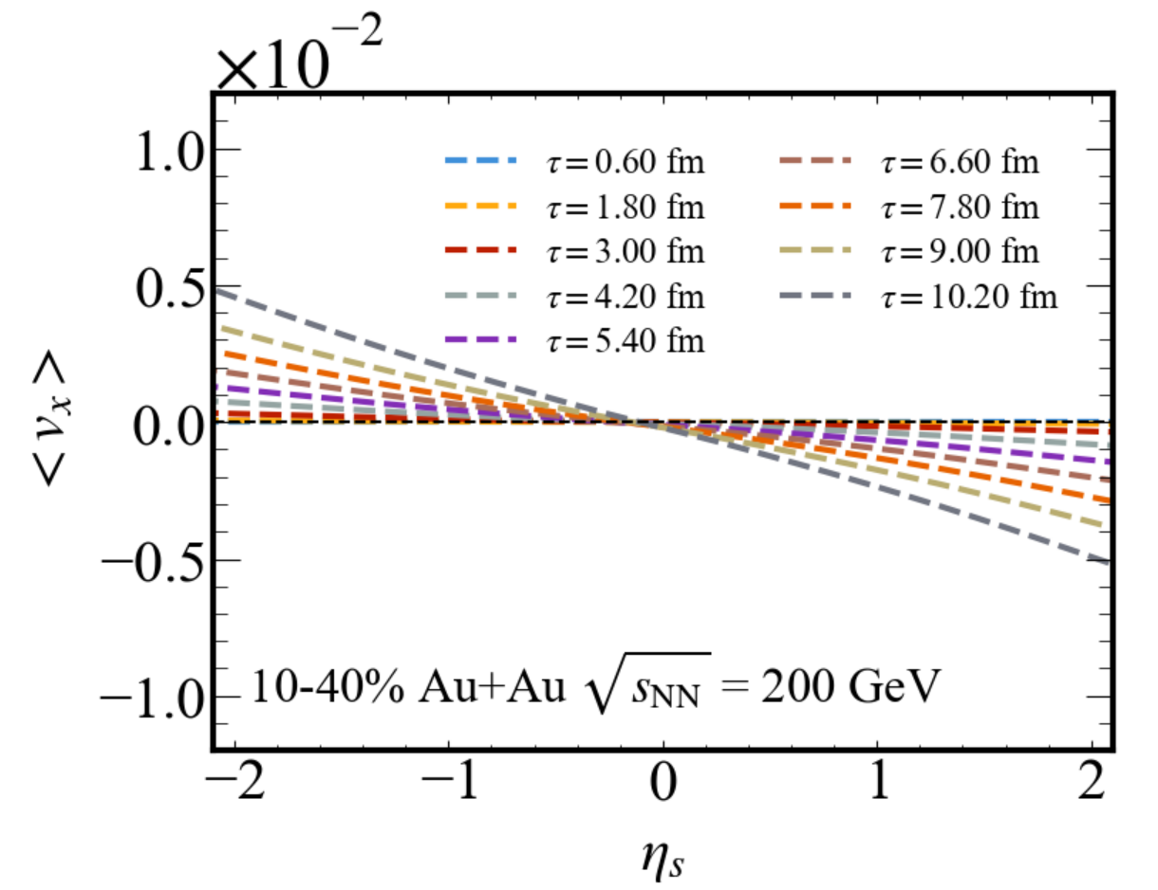
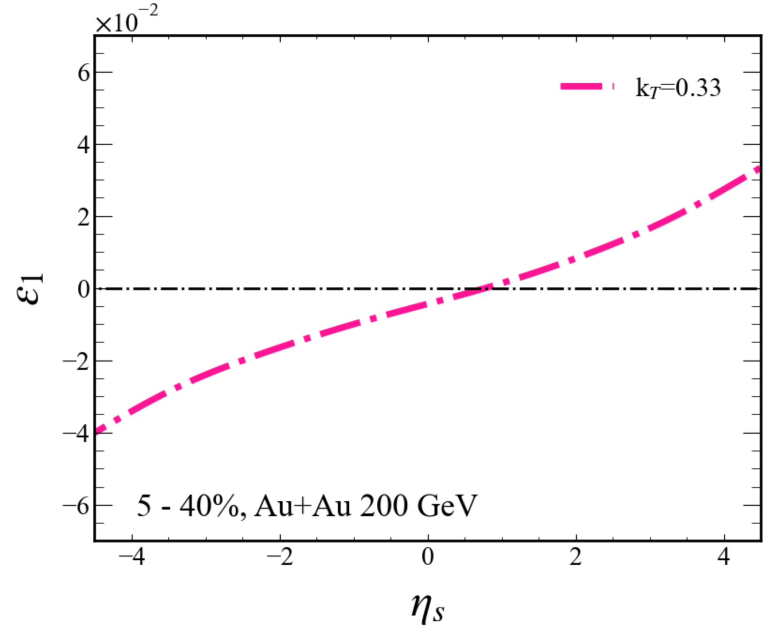
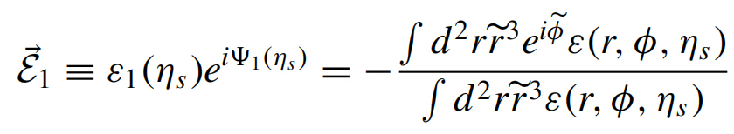
+ CLVisc Hydrodynamic
First-order eccentricity of the medium
Evolution of the velocity field <v_{x}>
The energy density from TRENTo3D initialization reproduces the behavior responsible for directed flow.

Slide 21
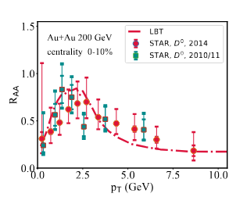
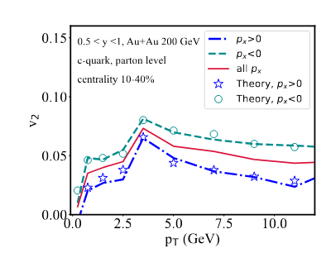
LBT + CLVisc Hydrodynamic

