Slide 1
Ds Elliptic flow as evidence of the sequential hadronization mechanism in the hot QCD medium
Zi-Xuan Xu¹, Jiaxing Zhao^{2,3}, Wei Dai⁴, Ben-Wei Zhang¹, Pengfei Zhuang⁵ | Kang Jin-Wen (康锦文)
 | Central China Normal University Helmholtz Research Academy Hesse for FAIR Frankfurt University China University of Geosciences, Wuhan Tsinghua University
2025-11-27 arXiv: 2510.16299

Slide 2
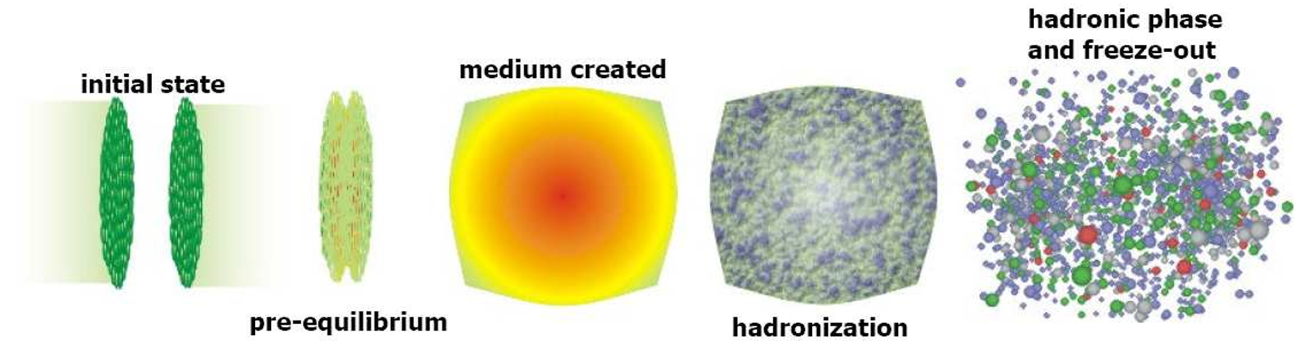
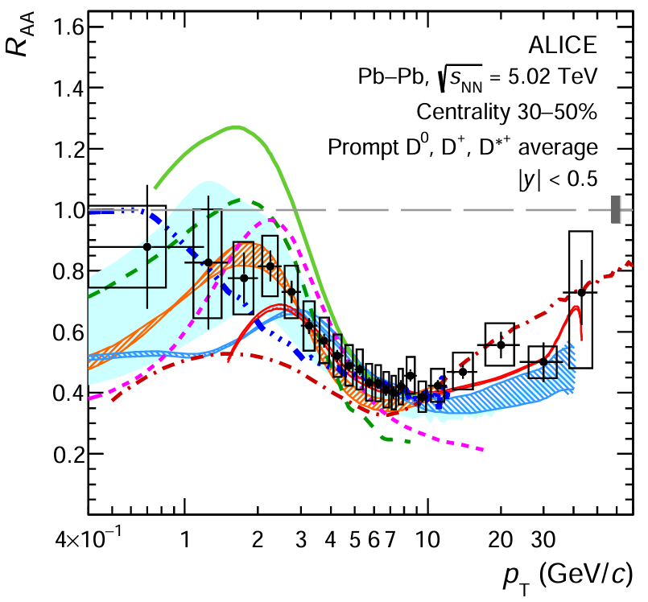
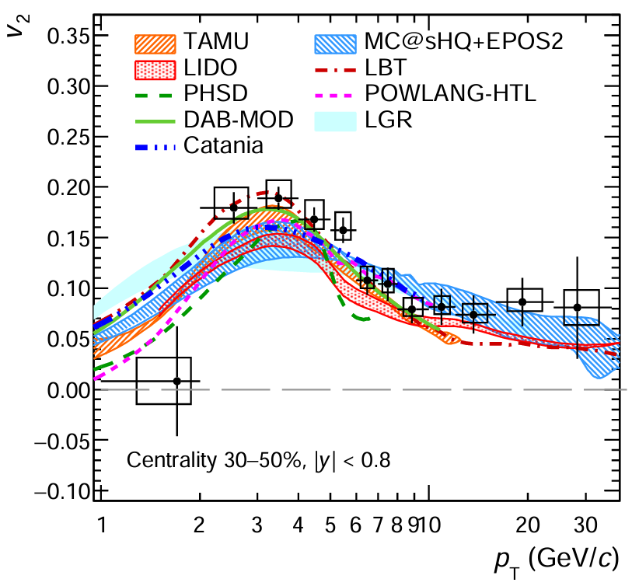
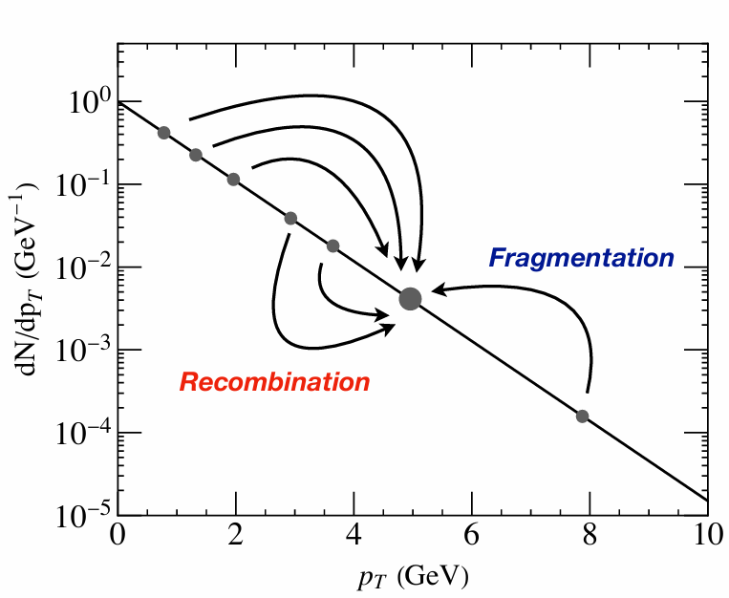
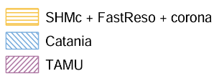
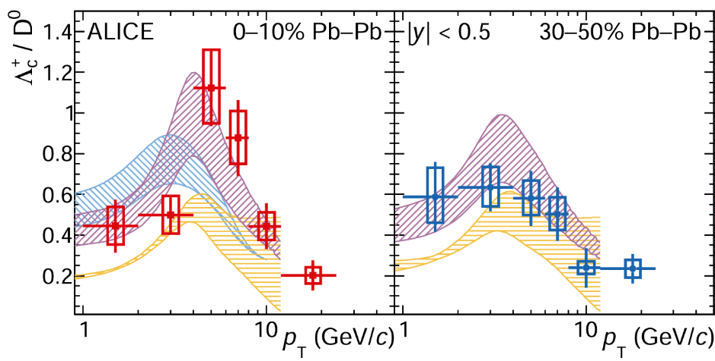

Introduction
All hadronize at the same time !
?
Heavy flavor can be a nice probe to study hadronization:
Produced by initial hard scattering
HQ mass $m_{Q}≫T_{QGP}$ number conservation
Few excited states
The direct and feed-down contributions can be well separated in experiments
Hadronization in the hot QCD medium shows a huge difference compared to the vacuum case.
JHEP 01 (2022), 174
CATANIA Phys. Lett. B 821 (2021), 136622; Eur. Phys. J. C 78 (2018) no.4, 348
Duke Phys. Rev. C 92 (2015) no.2, 024907; Phys. Rev. C 88 (2013), 044907
Nantes Phys. Rev. C 79 (2009), 044906
PHSD Phys. Rev. C 92 (2015) no.1, 014910; Phys. Rev. C 93 (2016) no.3, 034906
TAMU Phys. Lett. B 655 (2007), 126-131; Phys. Lett. B 795 (2019), 117-121
... ...
Phys.Lett.B 839 (2023) 137796

Slide 3
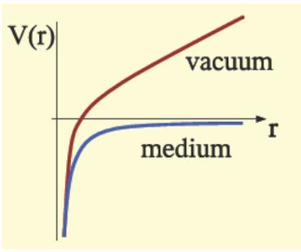
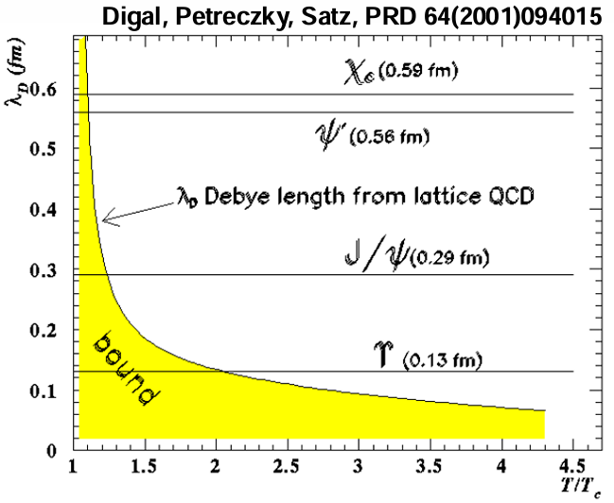
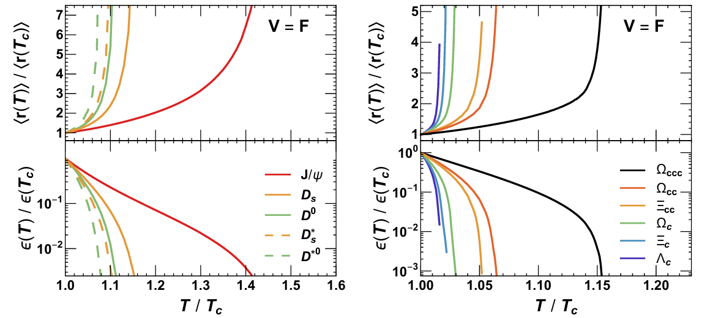

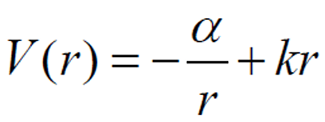
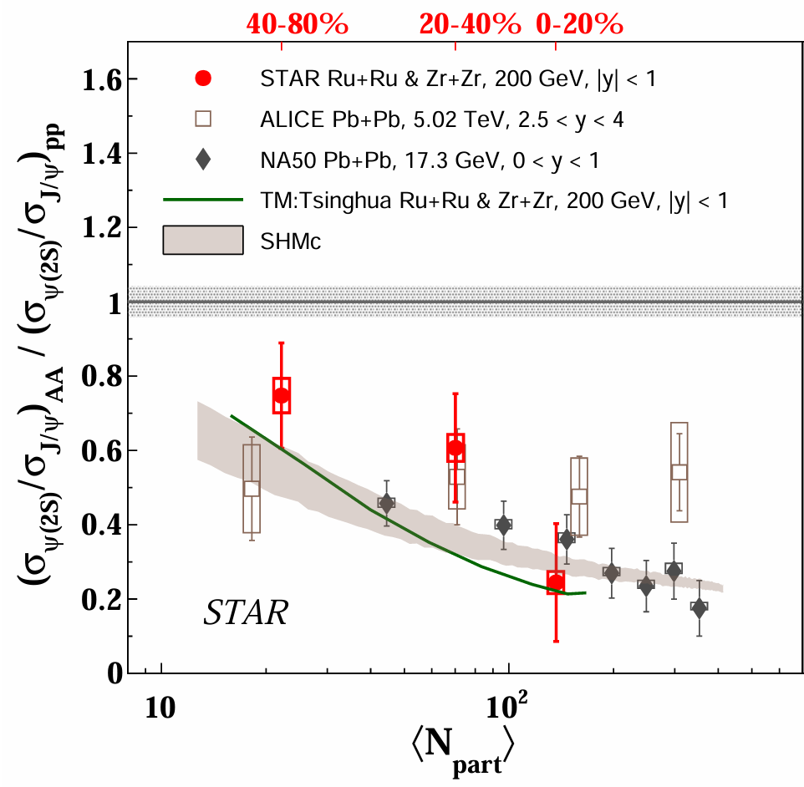
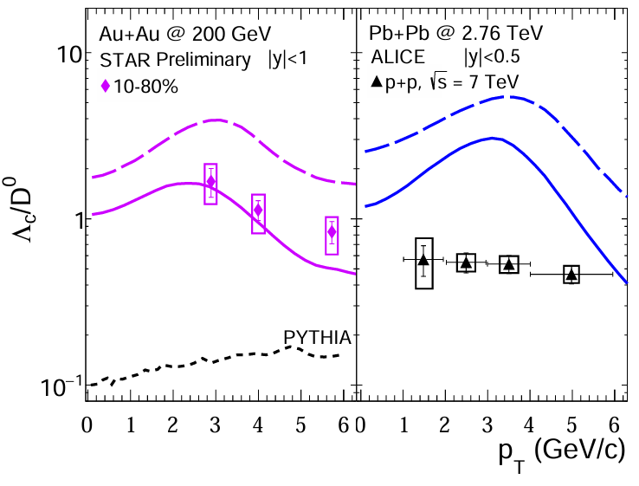

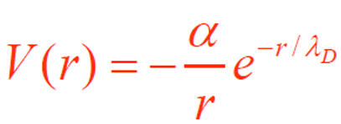

Motivation
Considering a more realistic picture ——
Sequential hadronization inspired by charmonium
hadronization sequence ( by Zhuang et al. ) :
In vacuum : $q\overline{q}$ interaction described by Coulomb + linear potential –
In medium : confinement term vanishes, Coulomb term is color screened beyond a Debye length –
R. Averbeck in Quark Matter 2025
Nucl. Phys. A 1005 (2021), 121898
Excited states
Gaussian widths
Coalescence & fragmentation fraction
… …
A stronger signal remains to be found.
quarkonia exhibit different binding energies and radii
arXiv:2509.12842
arXiv:1805.10858

Slide 4
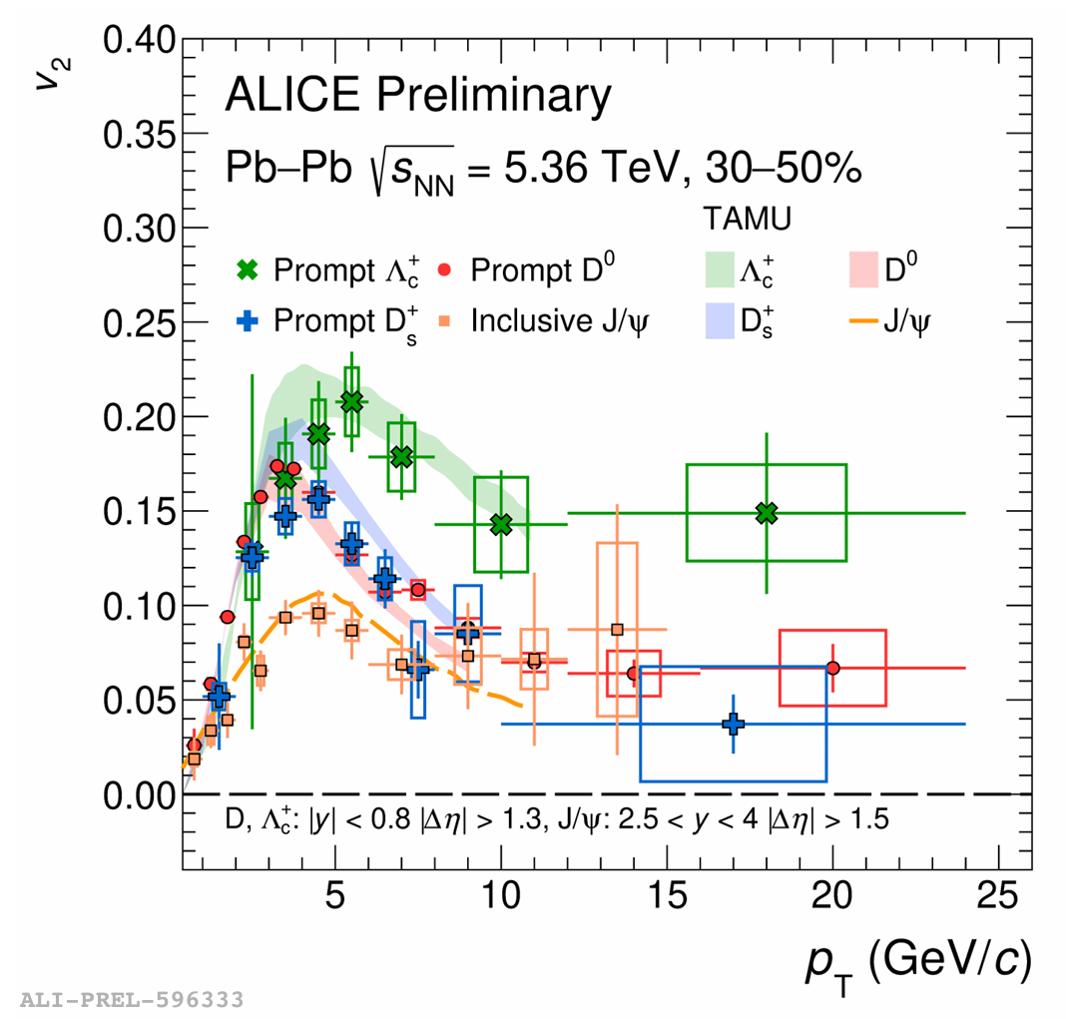
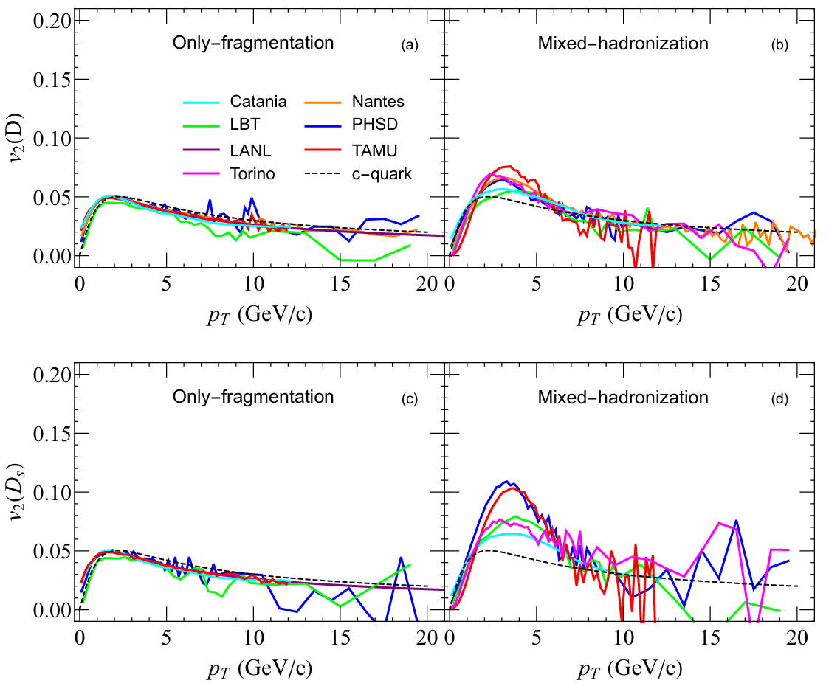

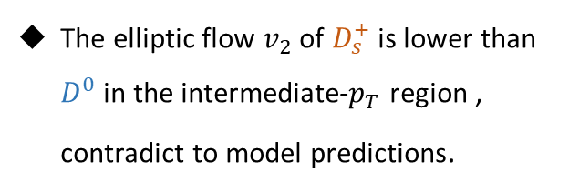



Motivation
$$D^{0}$$
Phys. Rev. C 109 (2024) no.5, 054912
The elliptic flow $v_{2}$ of $D_{s}^{+}$ is lower than $D^{0}$in the intermediate-$p_{T}$ region , contradict to model predictions.
C
$$\overline{u}$$
$$D_{s}^{+}$$
C
$$\overline{s}$$
arXiv:2505.13892 in Quark Matter 2025

Slide 5
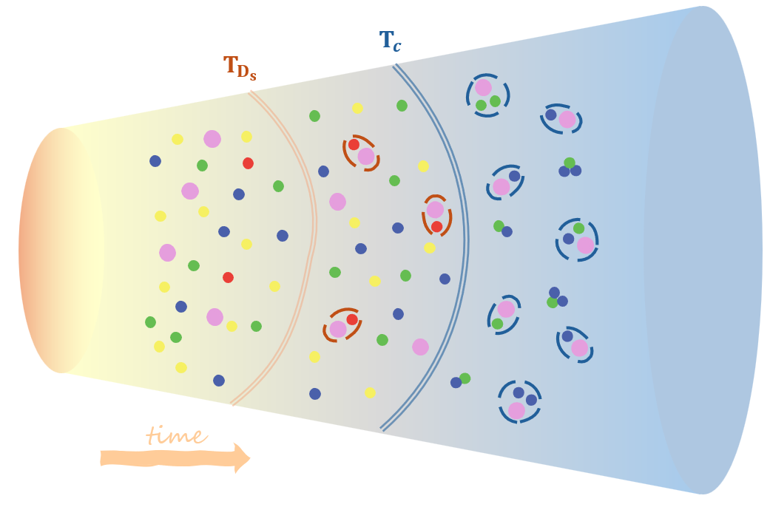


How to consider Sequential Coalescence ?
$$D^{0}$$
C
$$T_{A}$$
$$T_{c}$$
$$\overline{u}$$
$$D_{s}^{+}$$
Assuming $D_{s}$ coalesce before other hadrons at a temperature $T_{A}=1.2 T_{c}$
All of other partons hadronize on a separate hypersurface at $T_{c}$
C
$$\overline{s}$$

Slide 6
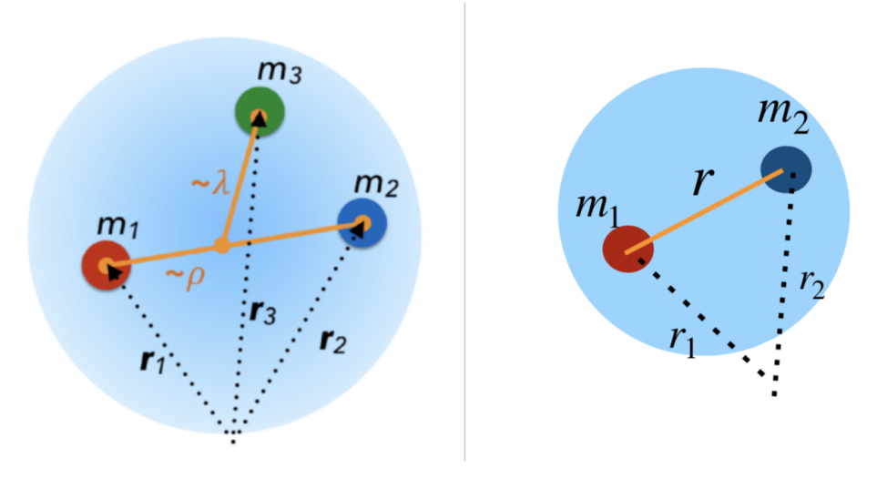
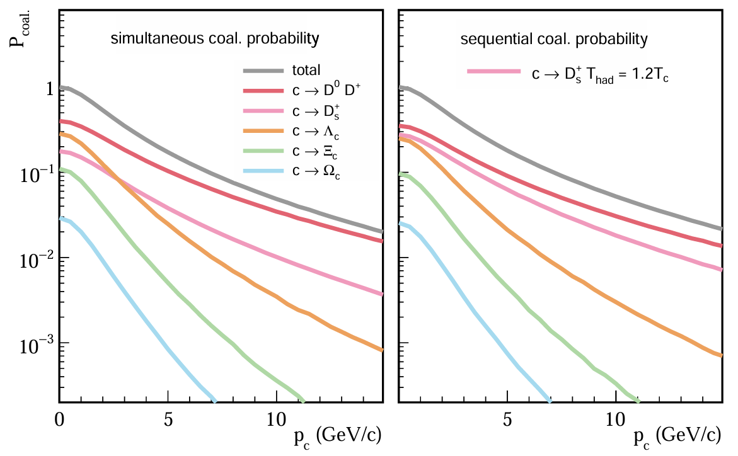
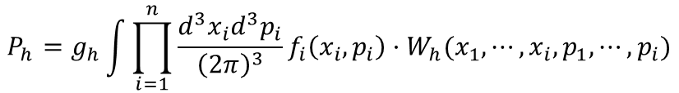
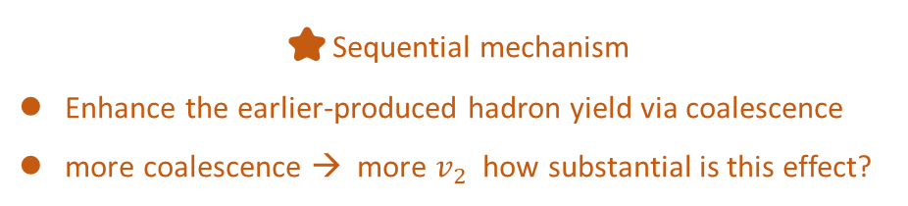
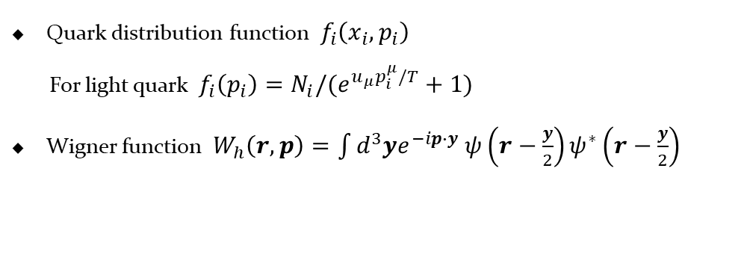
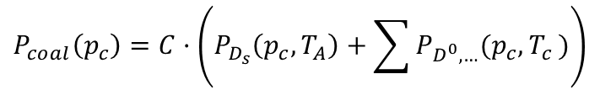
Coalescence Hadronization
The total sequential coalescence probability:
$C$ normalize the total coalescence probability when $P_{c}→0$
$$P_{coal}\left(p_{c}\right)=C·\left(P_{D_{s}}\left(p_{c},T_{A}\right)+\sum{P_{D^{0},…}(p_{c}{,T}_{c})}\right)$$
The momentum distribution of hadrons produced from coalescence:
$$P_{h}=g_{h}\int{\prod_{i=1}^{n}{\frac{d^{3}x_{i}d^{3}p_{i}}{{\left(2π\right)}^{3}}}}f_{i}\left(x_{i},p_{i}\right)·W_{h}(x_{1},⋯,x_{i},p_{1},⋯,p_{i})$$
Quark distribution function $f_{i}\left(x_{i},p_{i}\right)$
For light quark $f_{i}\left(p_{i}\right)=N_{i}/(e^{u_{μ}p_{i}^{μ}/T}+1)$
Wigner function $W_{h}\left(r,p\right)=\int{d^{3}ye^{−ip∙y} ψ\left(r−\frac{y}{2}\right)ψ^{∗}\left(r−\frac{y}{2}\right)}$
⭐Sequential mechanism
Enhance the earlier-produced hadron yield via coalescence
more coalescence → more $v_{2}$ how substantial is this effect?

Slide 7
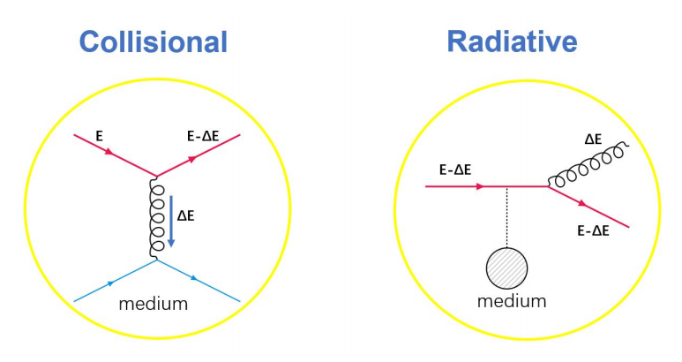
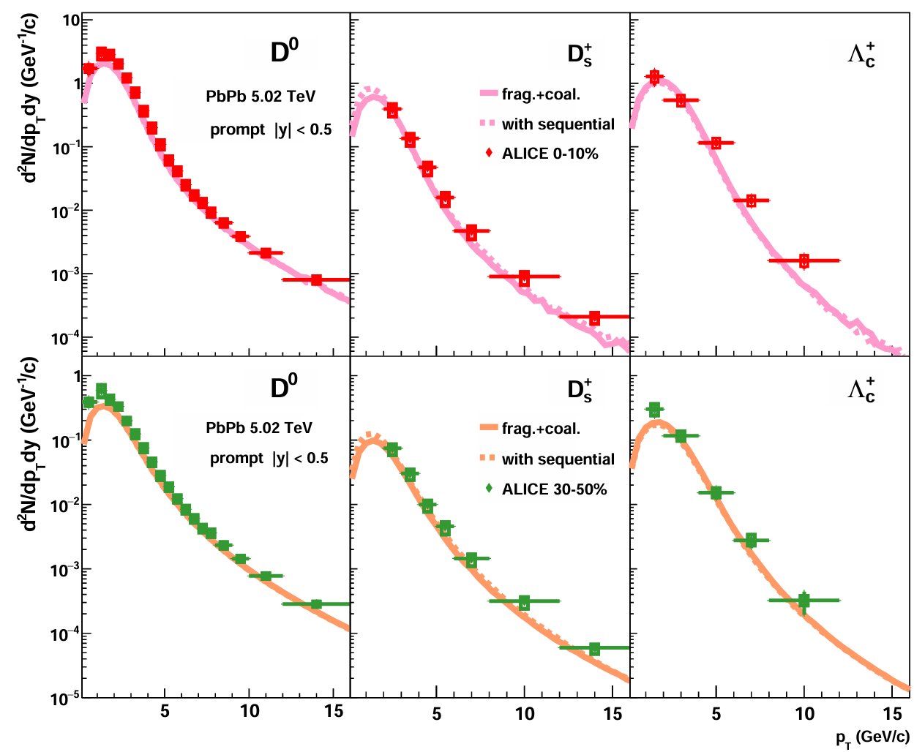
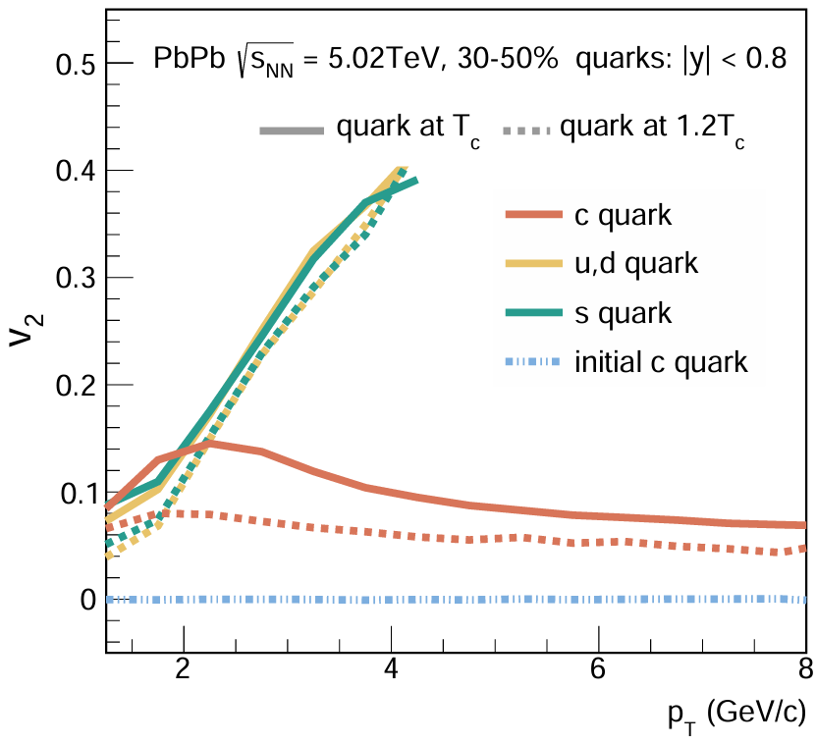
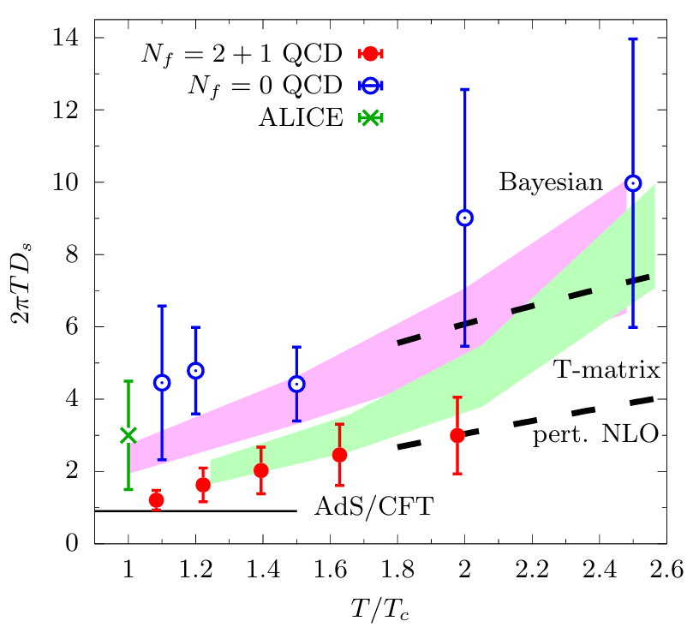

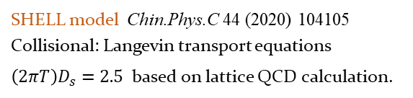

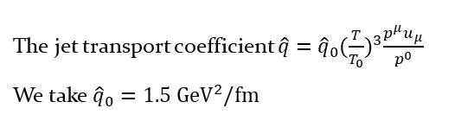


Methodology & Parton-level elliptic flow
Initial momentum and position:
Higher-twist approach is implemented to describe the medium-induced gluon radiation:
Hadronization:
FONLL JHEP 10 (2012) 137
Monte Carlo Glauber model EPJC 72 (2012) 1896
Simultaneous & sequential coalescence plus Peterson fragmentation function:
$$\frac{dN_{g}}{dxdk_{⊥}^{2}dt}=\frac{2α_{s}C_{A}P\left(x\right)\hat{q}}{πk_{⊥}^{4}}\sin^{2}(\frac{t−t_{i}}{2τ_{f}}){(\frac{k_{⊥}^{2}}{k_{⊥}^{2}+x^{2}M^{2}})}^{4}$$
In-medium evolution:
The jet transport coefficient $\hat{q}={\hat{q}}_{0}{(\frac{T}{T_{0}})}^{3}\frac{p^{μ}u_{μ}}{p^{0}}$
We take ${\hat{q}}_{0}=1.5 {GeV}^{2}/fm$
$$𝒟_{c→H}∝\frac{1}{z{[1−\frac{1}{z}−\frac{ε}{1−z}]}^{2}}$$
charm-quark fragmentation fraction
Eur.Phys.J.C 76 (2016) 7, 397
Hydrodynamic information:
(3+1)D CLVisc hydro
Phys.Rev.C 97 (2018) 6, 064918
PRL 130 (2023) no.23, 231902
SHELL model Chin.Phys.C 44 (2020) 104105
Collisional: Langevin transport equations
$\left(2πT\right)D_{s}=2.5$ based on lattice QCD calculation.
Earlier-produced hadron obtain a smaller $v_{2}$

Slide 8
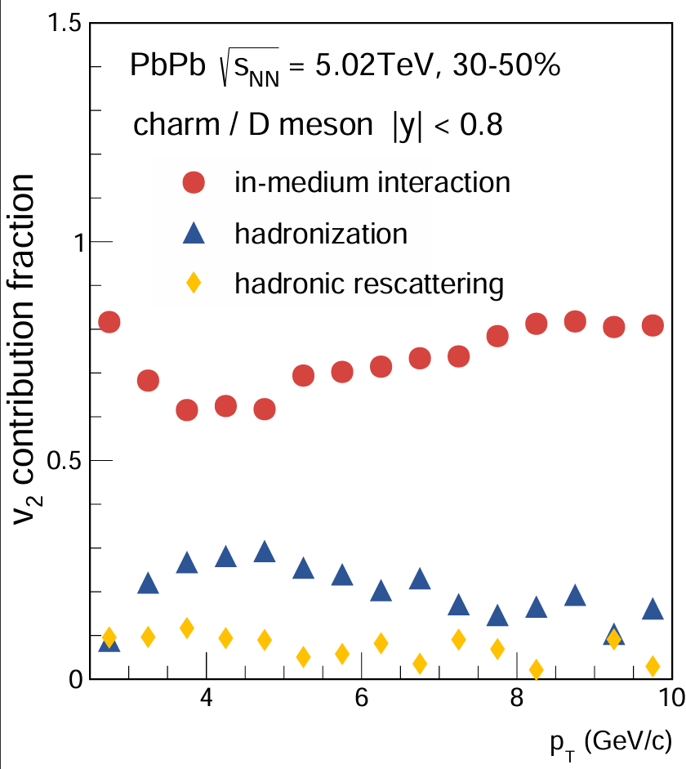
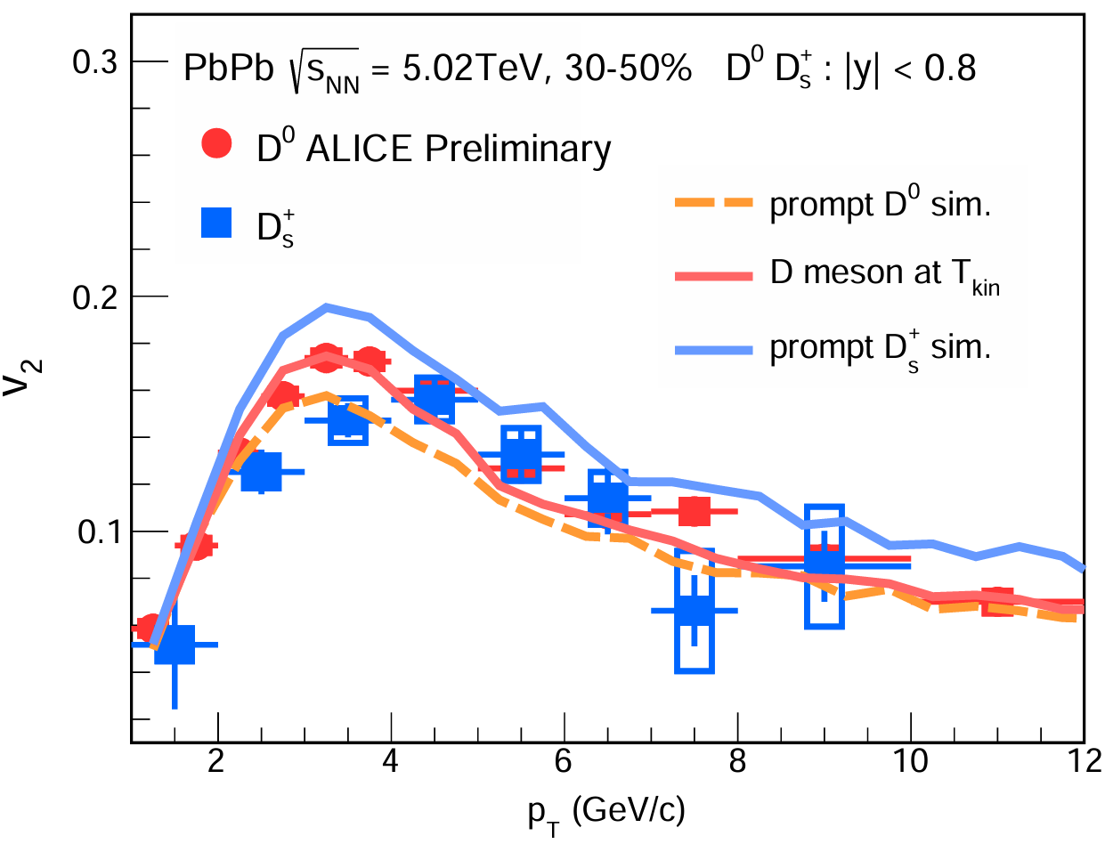
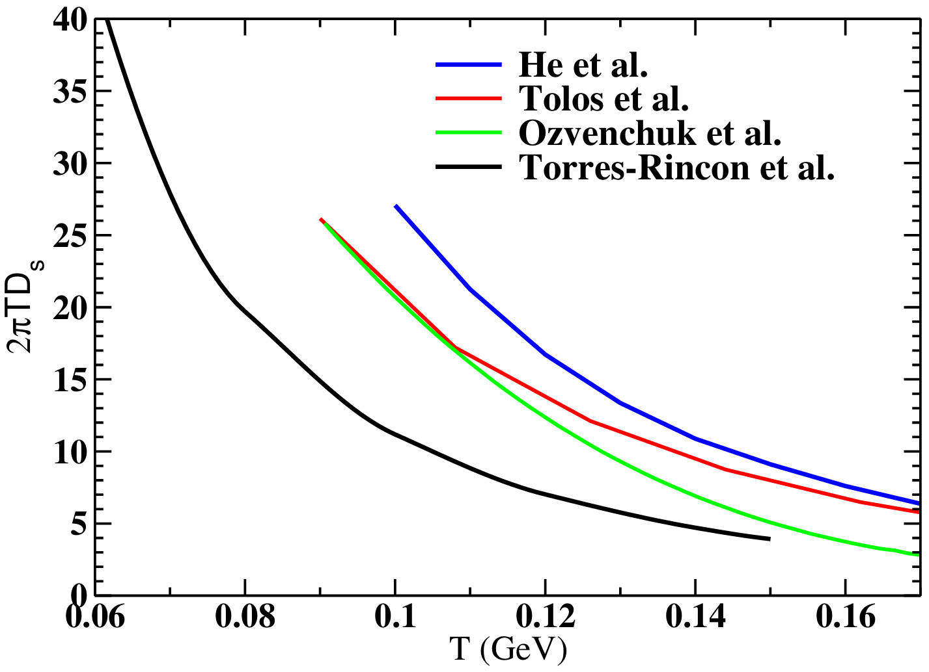
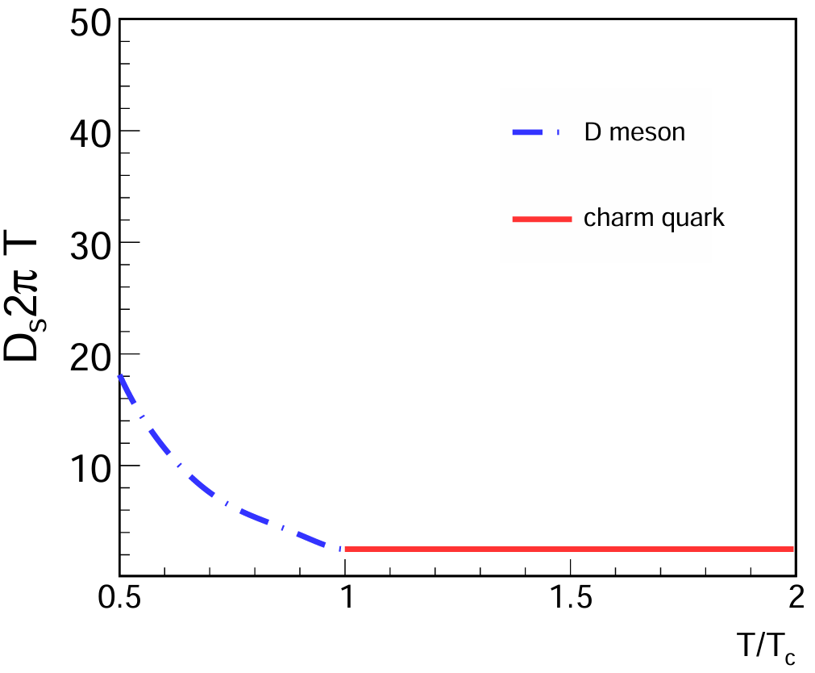
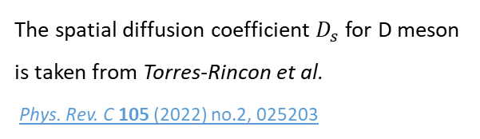

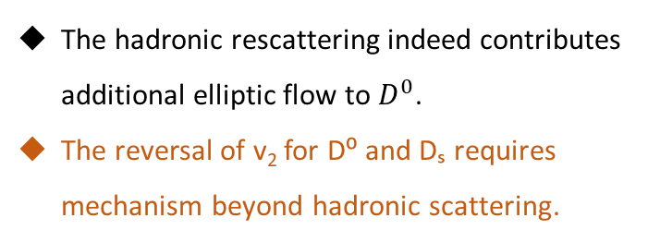


HF Hadronic rescattering
D-meson hadronic rescattering is realized in Langevin simulation:
$$dx_{j}=\frac{p_{j}}{E}dt$$
$$dp_{j}=−Γ\left(p\right)p_{j}dt+\sqrt{κdt}ρ_{j}$$
The fluctuation-dissipation relationship:
$$κ=2ΓET=\frac{2T^{2}}{D_{s}}$$
The spatial diffusion coefficient $D_{s}$ for D meson is taken from Torres-Rincon et al.
Phys. Rev. C 105 (2022) no.2, 025203
The hadronic rescattering indeed contributes additional elliptic flow to $D^{0}$.
The reversal of v₂ for D⁰ and Dₛ requires mechanism beyond hadronic scattering.
Phys. Rept. 1129-1131 (2025), 1-53

Slide 9
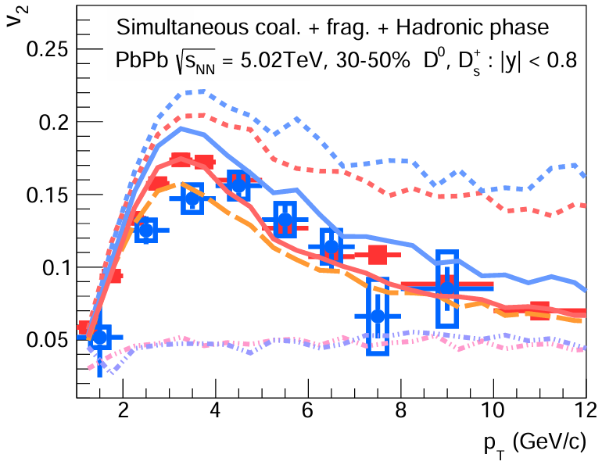
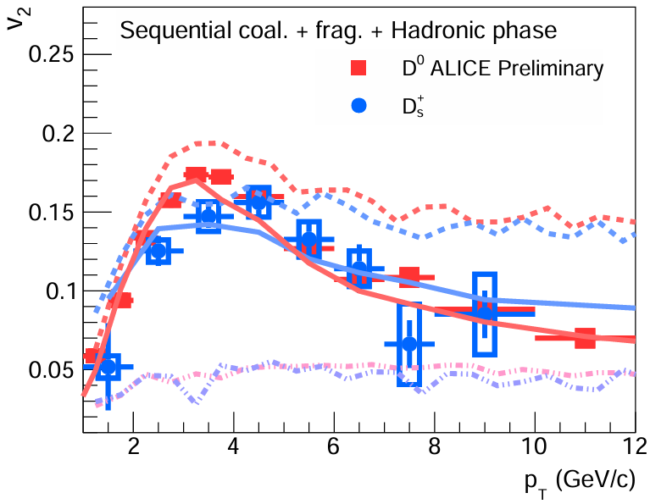
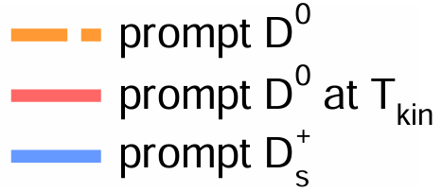
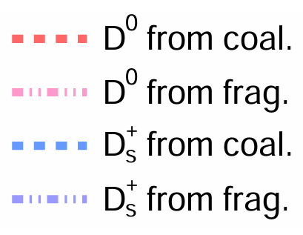


Sequential & simultaneous coalescence + Hadronic phase
Conventional simultaneous case -
The coalescence mechanism dominates the contribution to the elliptic flow at lower and intermediate-$p_{T}$.
Simultaneous coalescence leads to
$v_{2}$ ($D^{0}$) < $v_{2}$ ($D_{s }$)
After considering sequential mechanism -
The coalescence contribution for $v_{2}$ of $D_{s}$ drops dramatically after considering sequential mechanism.
Sequential scheme reproduces the ALICE measurements.
The reverse of such a $v_{2}$ hierarchy is observed
$v_{2}$ ($D^{0}$) > $v_{2}$ ($D_{s }$)

Slide 10
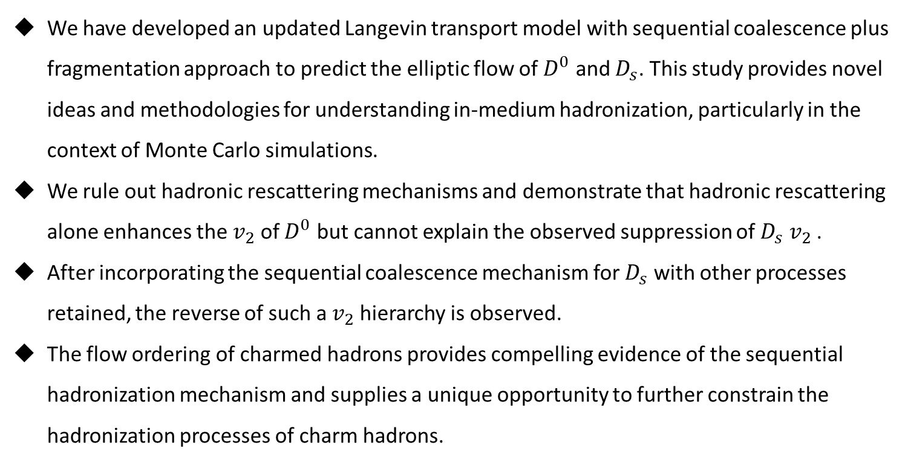
Summary
We have developed an updated Langevin transport model with sequential coalescence plus fragmentation approach to predict the elliptic flow of $D^{0}$ and $D_{s}$. This study provides novel ideas and methodologies for understanding in-medium hadronization, particularly in the context of Monte Carlo simulations.
We rule out hadronic rescattering mechanisms and demonstrate that hadronic rescattering alone enhances the $v_{2}$ of $D^{0}$ but cannot explain the observed suppression of $D_{s}$ $v_{2}$ .
After incorporating the sequential coalescence mechanism for $D_{s}$ with other processes retained, the reverse of such a $v_{2}$ hierarchy is observed.
The flow ordering of charmed hadrons provides compelling evidence of the sequential hadronization mechanism and supplies a unique opportunity to further constrain the hadronization processes of charm hadrons.

Slide 11
Thank you

Slide 12
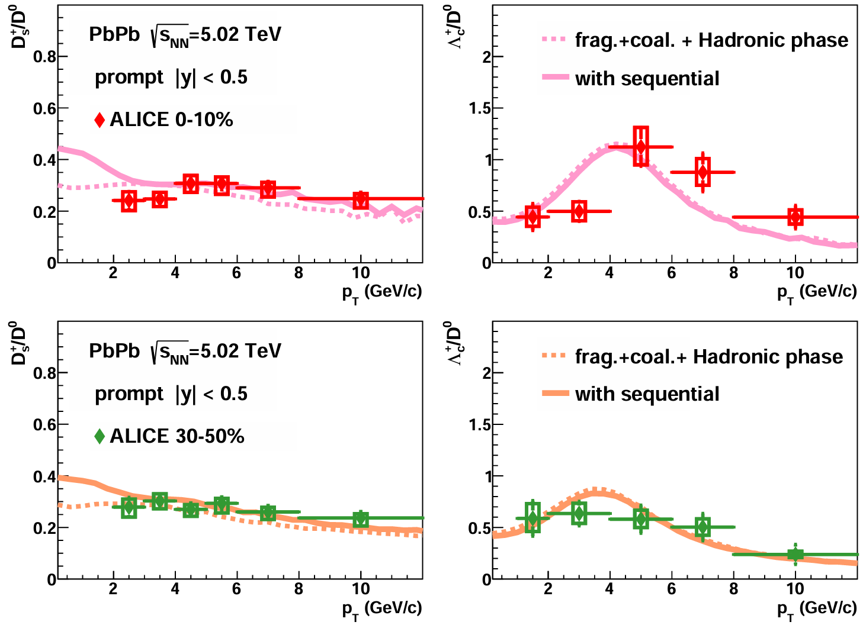
Backup

Slide 13
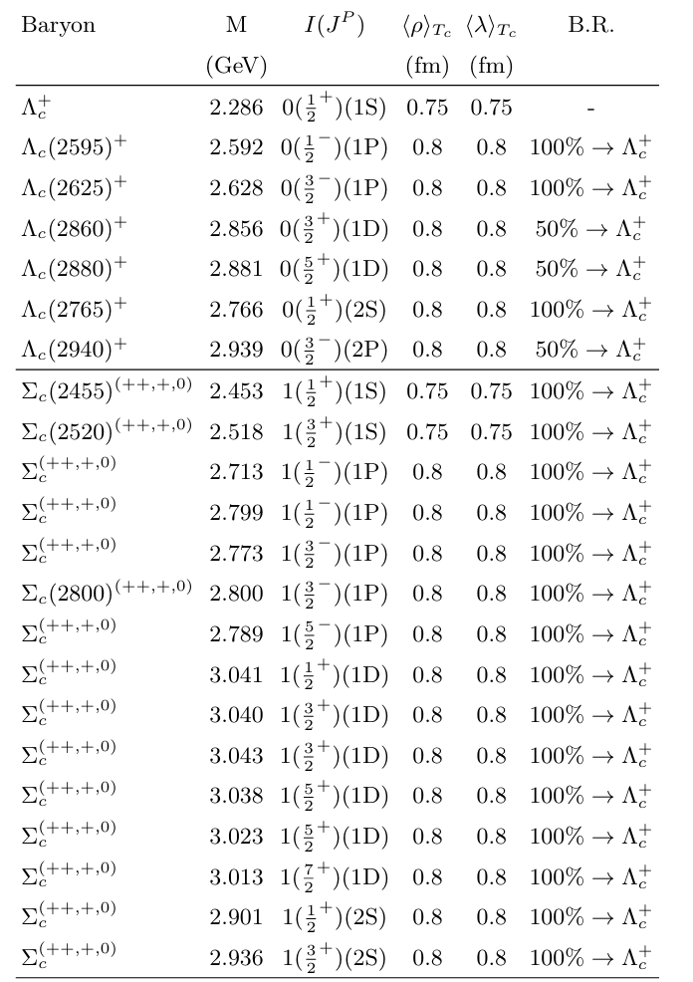

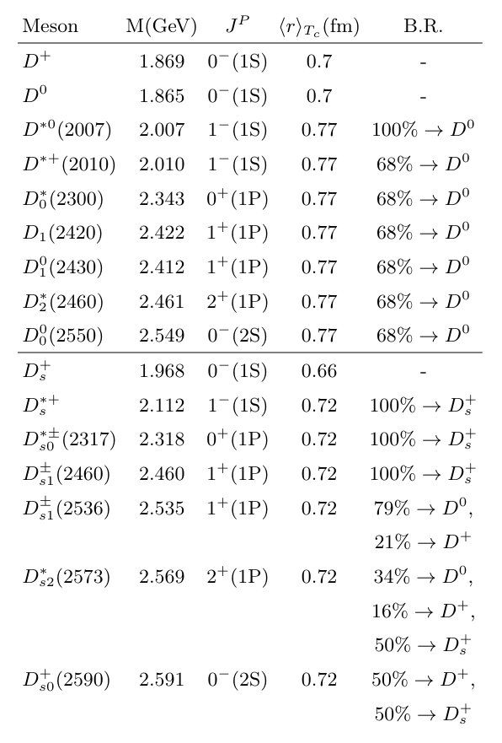
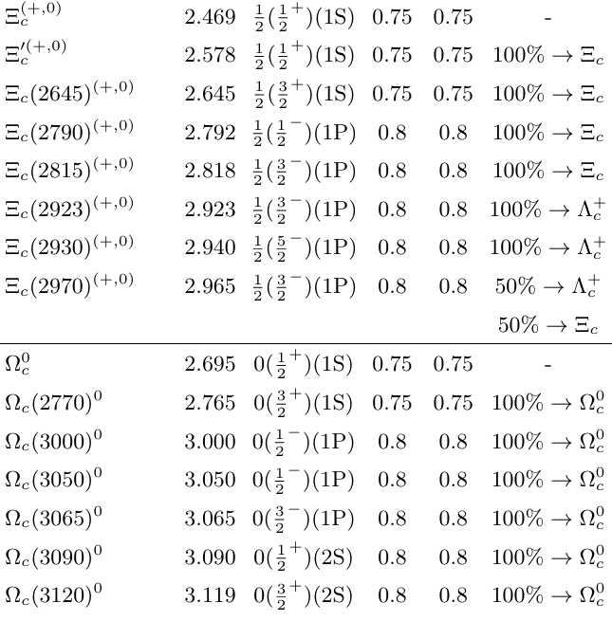
Backup

Slide 14
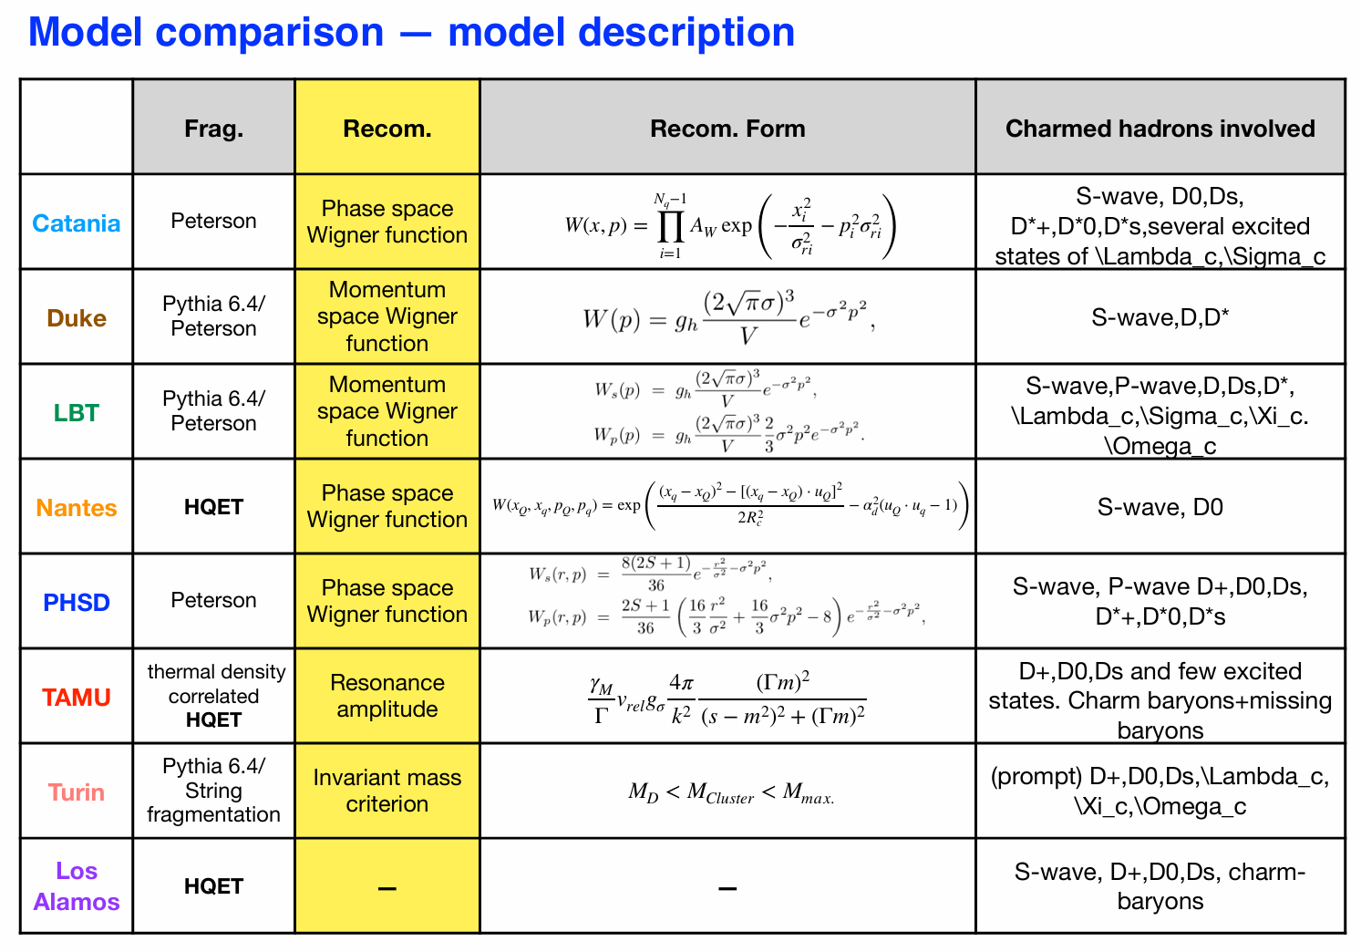

Slide 15
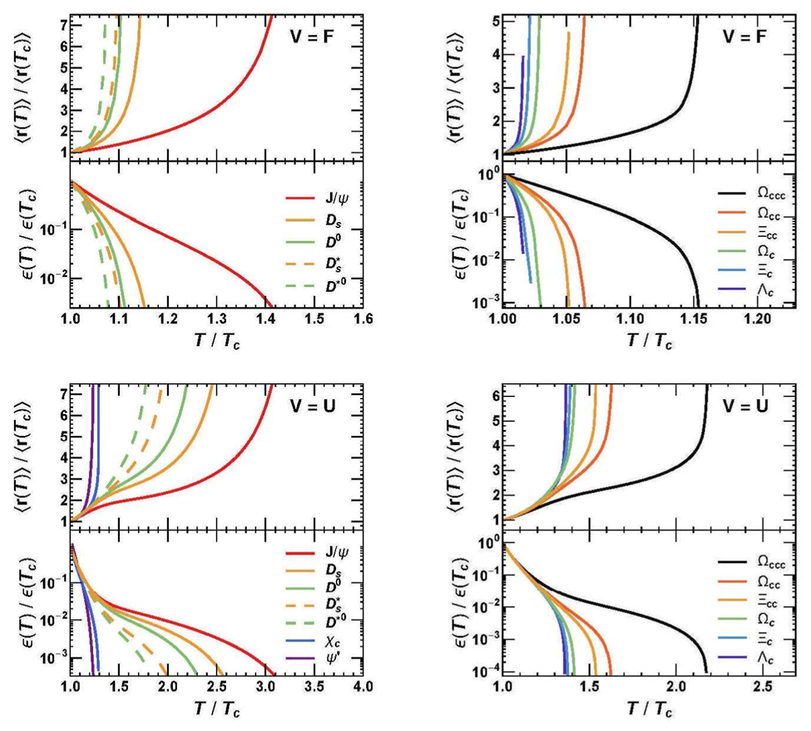

Slide 16

Backup

Slide 17




Sequential & simultaneous coalescence + Hadronic phase
D-meson hadronic rescattering is realized in Langevin simulation:
$$dx_{j}=\frac{p_{j}}{E}dt$$
$$dp_{j}=−Γ\left(p\right)p_{j}dt+\sqrt{κdt}ρ_{j}$$
The fluctuation-dissipation relationship:
$$κ=2ΓET=\frac{2T^{2}}{D_{s}}$$
The spatial diffusion coefficient $D_{s}$ for D meson is taken from Torres-Rincon et al.
Phys. Rev. C 105 (2022) no.2, 025203
Conventional simultaneous case -
The hadronic rescattering indeed contributes additional elliptic flow to $D^{0}$.
The coalescence mechanism dominates the contribution to the elliptic flow at lower and intermediate-$p_{T}$.
Simultaneous coalescence leads to
$v_{2}$ ($D^{0}$) < $v_{2}$ ($D_{s }$)
After considering sequential mechanism -
The coalescence contribution for $v_{2}$ of $D_{s}$ drops dramatically after considering sequential mechanism.
Sequential scheme reproduces the ALICE measurements.
The reverse of such a $v_{2}$ hierarchy is observed
$v_{2}$ ($D^{0}$) > $v_{2}$ ($D_{s }$)
Phys. Rept. 1129-1131 (2025), 1-53

