Slide 1




Manipulating Nonlocal Spin Correlations
in Polarized Electron-Positron Annihilation
Hong-wei Zhang (张宏伟)
Collaboration: Xu Cao (曹须), Tai-fu Feng (冯太傅)
2026.3
第五届强子与重味物理理论与实验联合研讨会 Hebei university & Institute of Modern Physics, Chinese Academy of Sciences

Slide 2
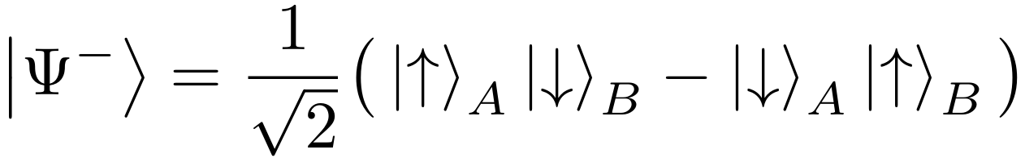

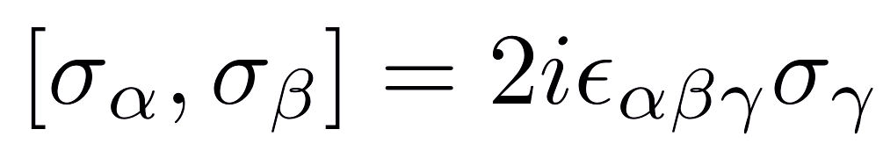
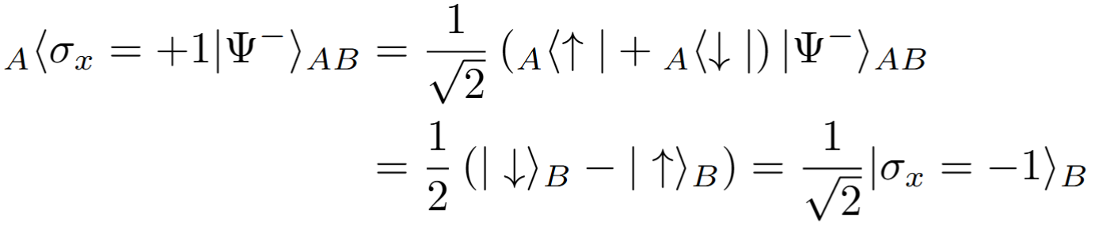
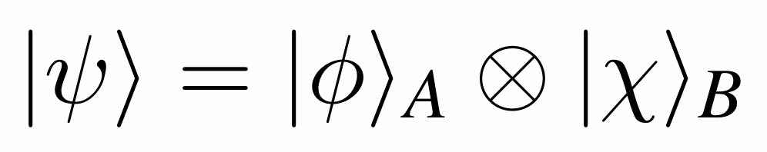
Einstein-Podolsky-Rosen (EPR) Paradox
Can Quantum-Mechanical Description of Physical Reality be Considered Complete?
Einstein A, B Podolsky and N. Rosen, Phys. Rev. 47, 777 (1935)
Realism: Every element of physical reality must have a counterpart in a complete physical theory.
Locality: Events separated by a spacelike interval are not causally connected.
Bohm situation
Bohm, D. (1951), Quantum Theory
Quantum Entanglement
The quintessential phenomenon of QM introduced by Schrödinger in response to the EPR paper.
Spin-singlet state:
Schrödinger, E. (1935), Journal of Modern Physics
Local measurement on A:
Definition:
An entangled state cannot be expressed in the form of a product.
Example for σx⊗1 :

Slide 3
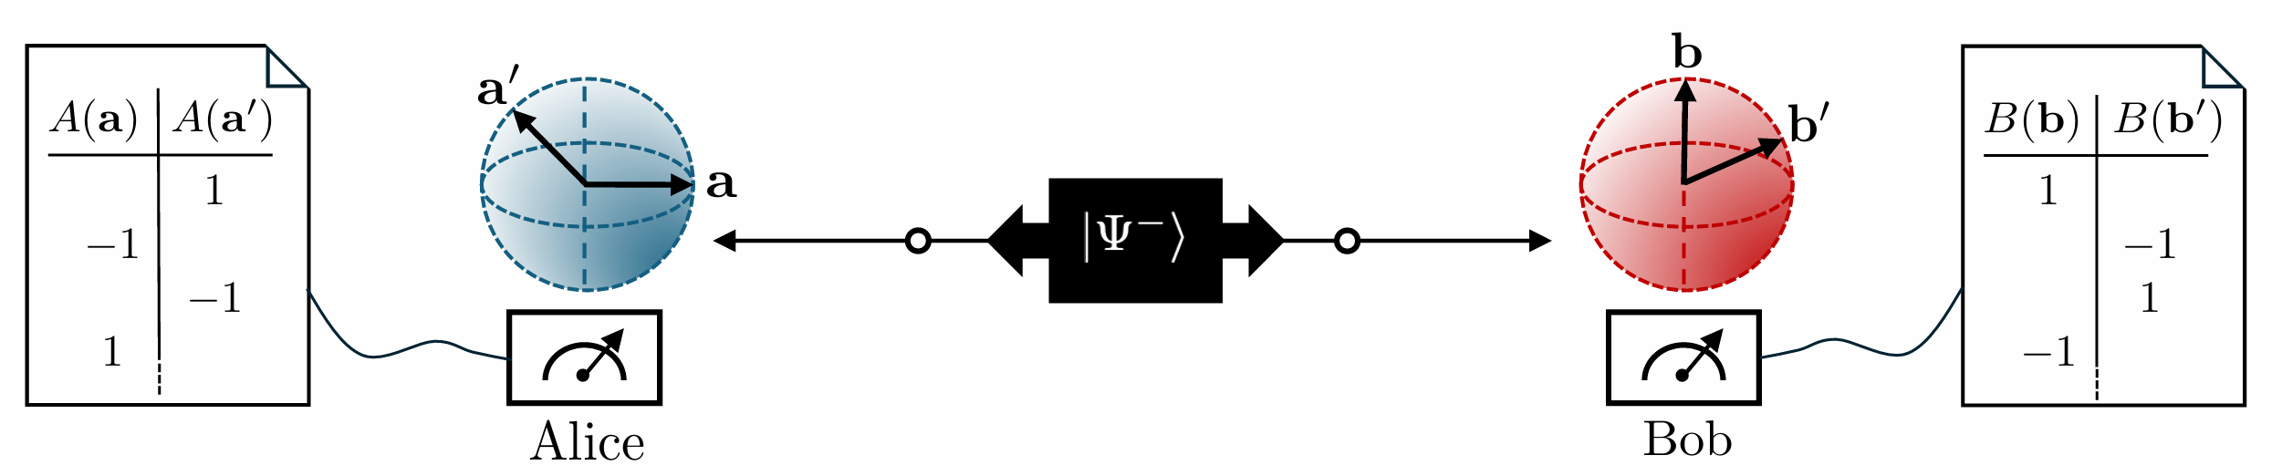
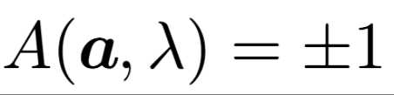
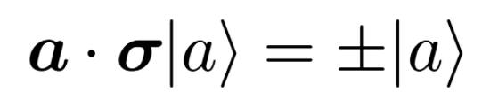
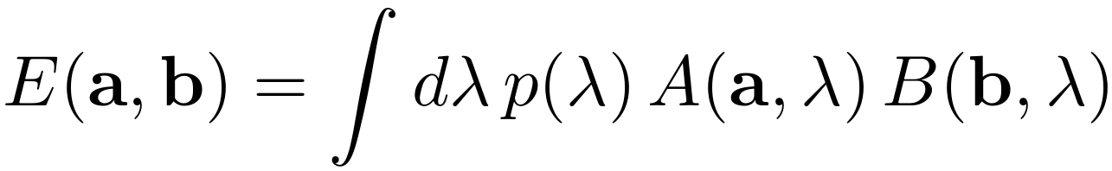
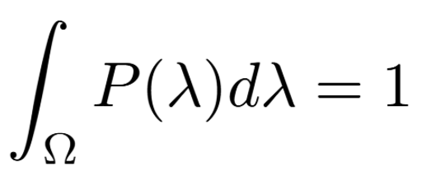
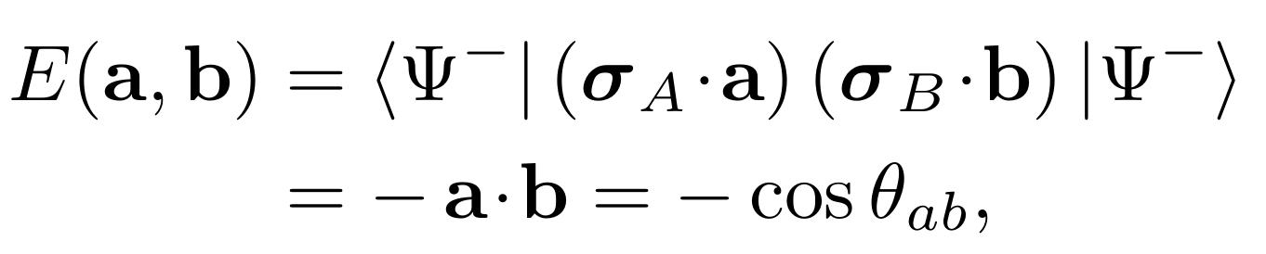
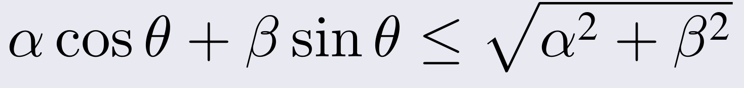
Bell’s Theorem
Einstein-Podolsky-Rosen-Bohm Test
J. S. Bell, Physics Physique Fizika 1, 195 (1964).
Local hidden variable theory
Quantum mechanics
Predetermined value
Classical ensemble frame
Local realism (Bell-CHSH inequality)
No predetermined values
Basic assumption
Nonlocality (inequality violation)
J. F. Clauser, M. A. Horne, A. Shimony, and R. A. Holt,Phys. Rev. Lett. 23, 880 (1969).

Slide 4
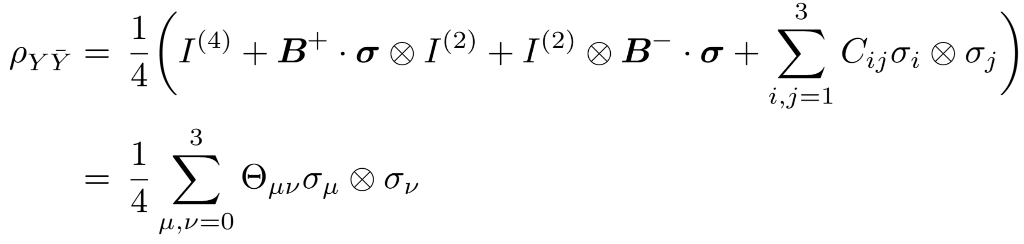
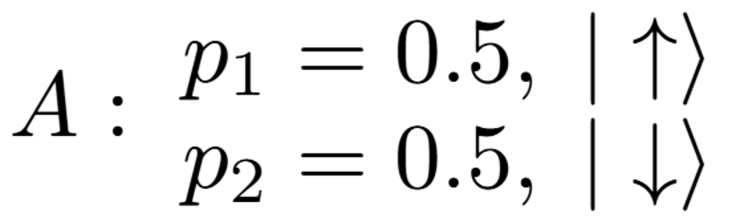

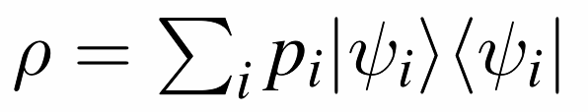
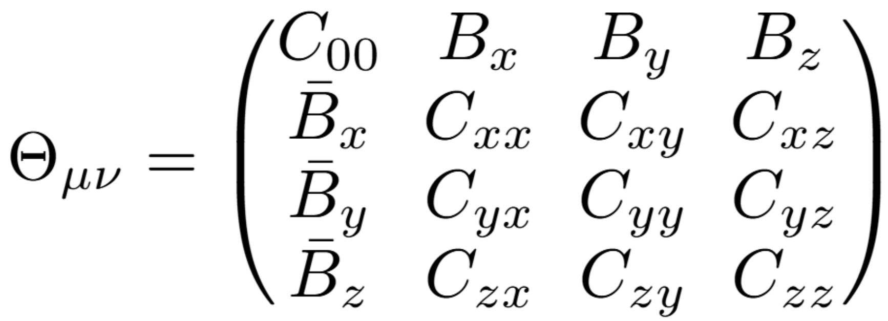
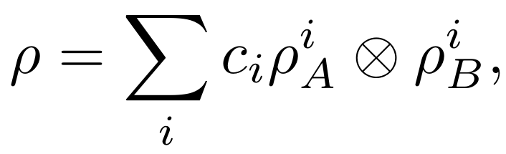

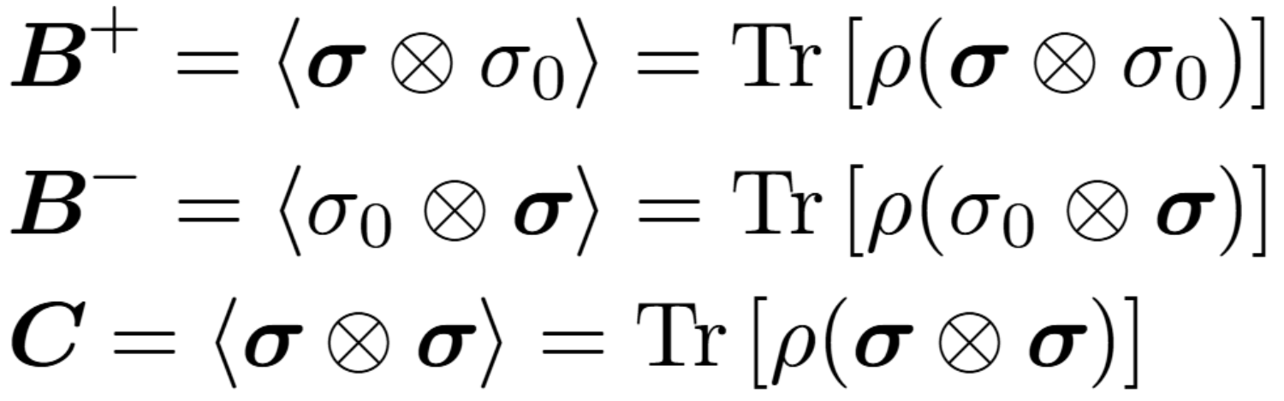
Spin Density Matrix (SDM)
2-Qubit
Elliot Leader, Spin in Particle Physics;
U. Fano, Rev. Mod. Phys. 55, 855 (1983)
Mixed State
How to identify state of subsystem?
Classical randomness is unavoidable
Density operator:
Introducing the “incoherent superposition”
The coefficient matrix:
Separability of general state
R. F. Werner, Phys. Rev. A 40, 4277 (1989).
Bloch vector & correlation tensor:

Slide 5
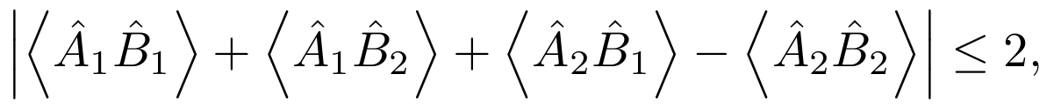



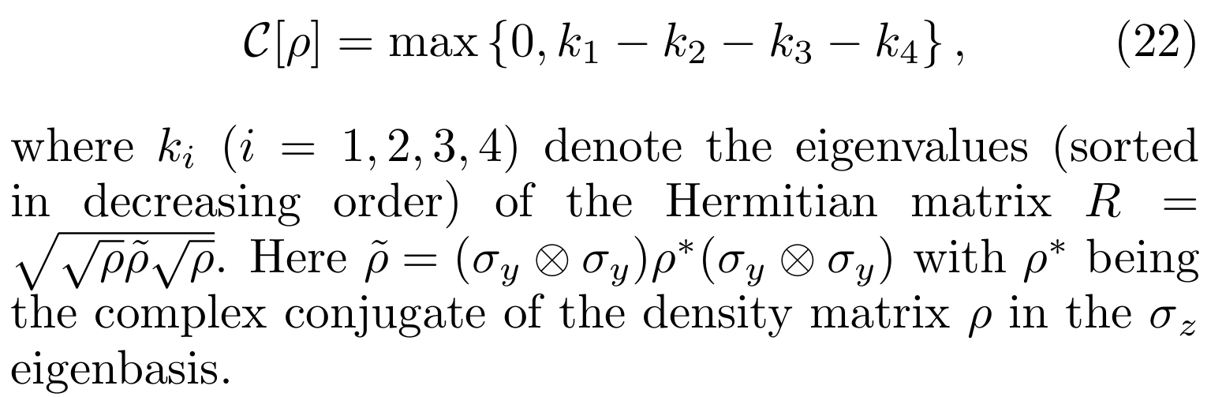
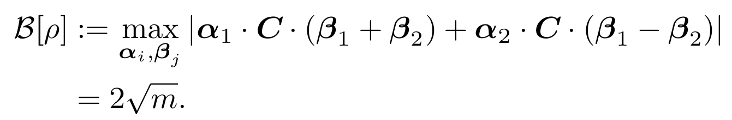
Quantification for Quantum Correlations
CHSH parameter
CHSH inequality
Local measurement
Wootter’s concurrence
Definition
Optimization on global sphere
W. K. Wootters, Phys. Rev. Lett. 80, 2245 (1998).
M. Horodecki, P. Horodecki, and R. Horodecki, Phys.Lett. A 223, 1 (1996).

Slide 6
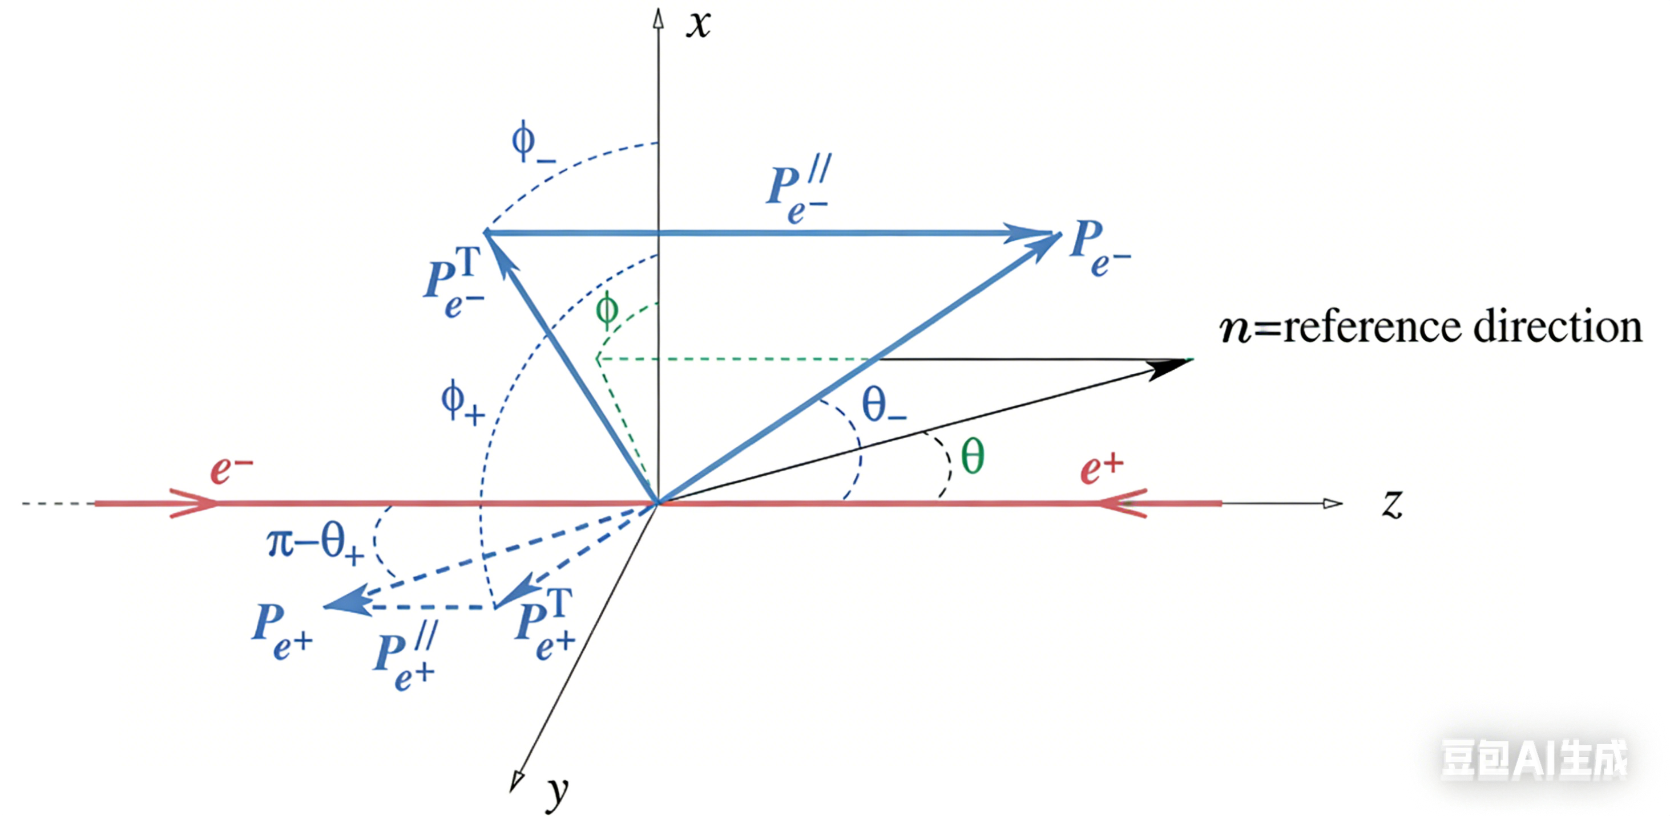
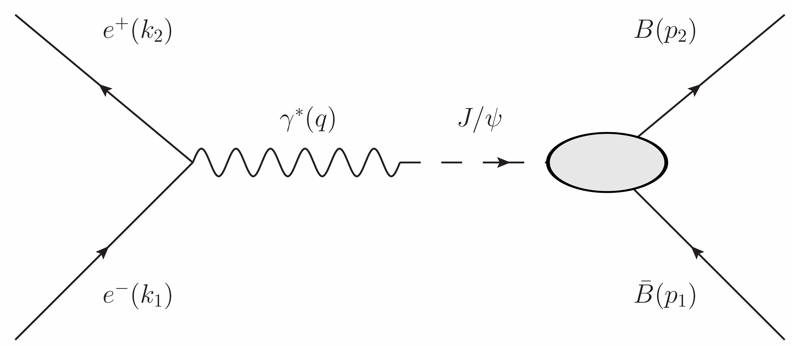
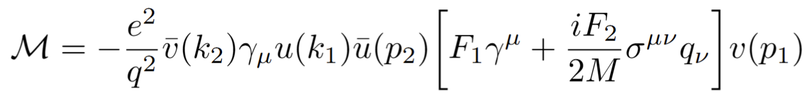
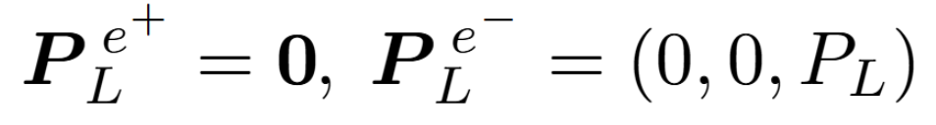
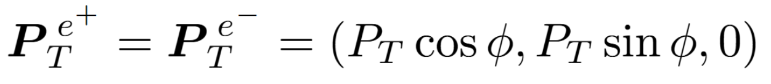
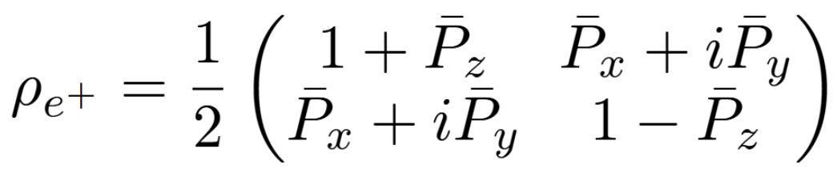
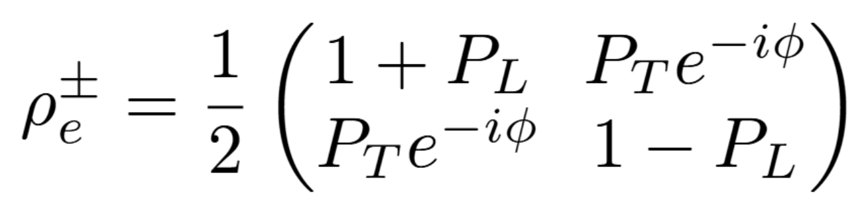
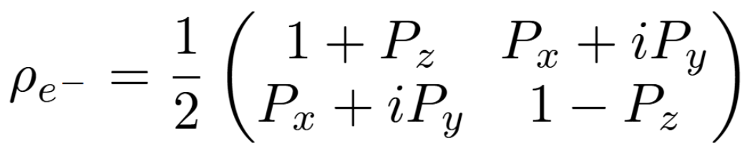
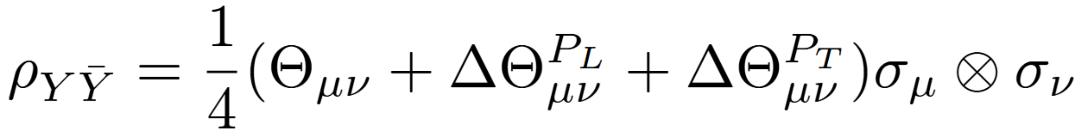
Polarization Decomposition of Beams
Electron-positron annihilation
G. Moortgat-Pick et al. Physics Reports 460(2008)131
Polarized electron/positron beam:
Longitudinal polarization:
Transverse polarization:

Slide 7
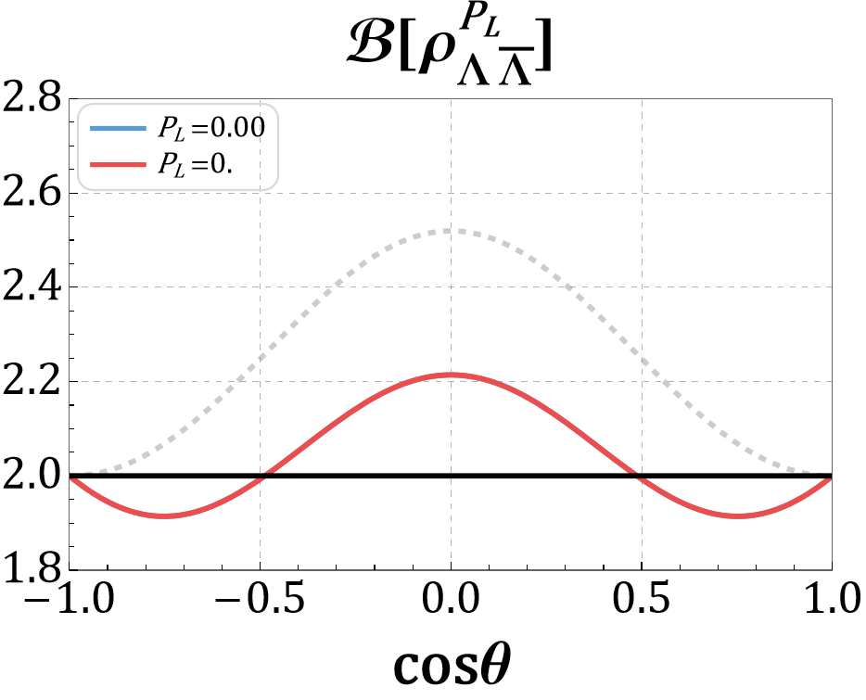
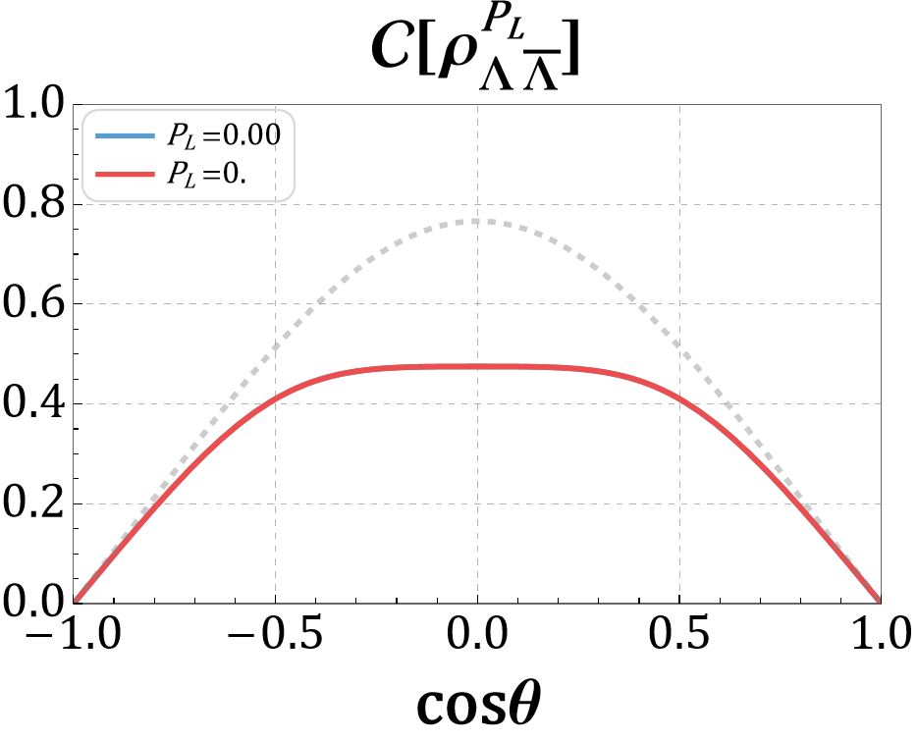
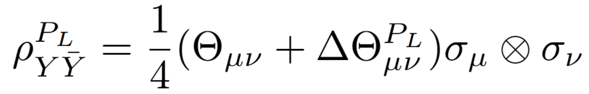
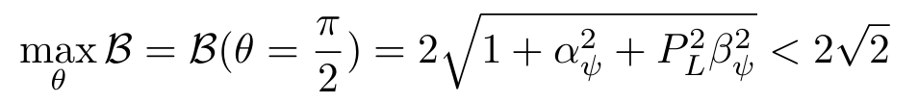
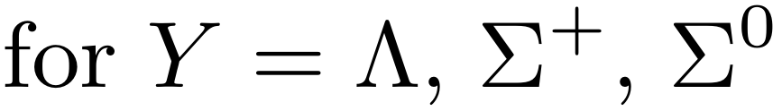
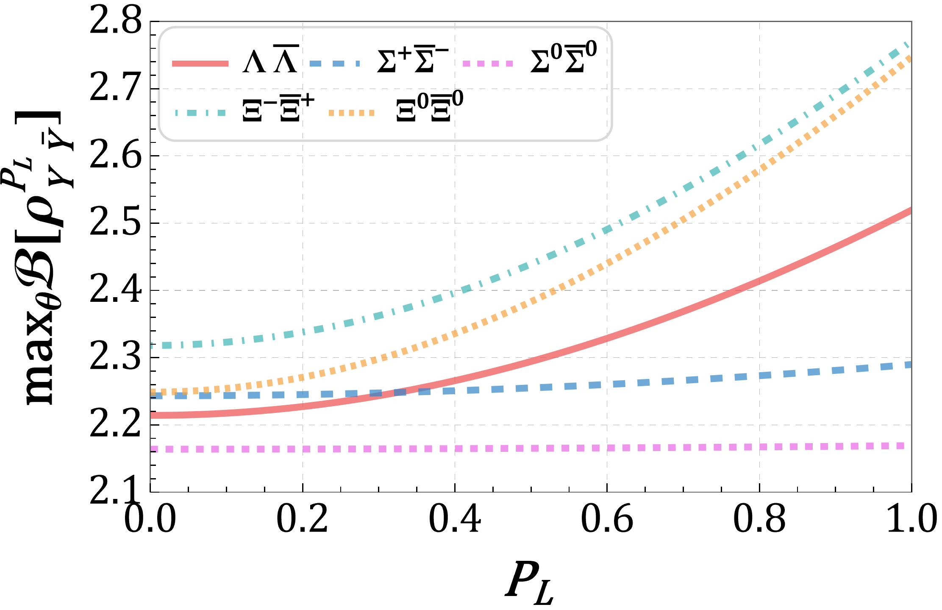
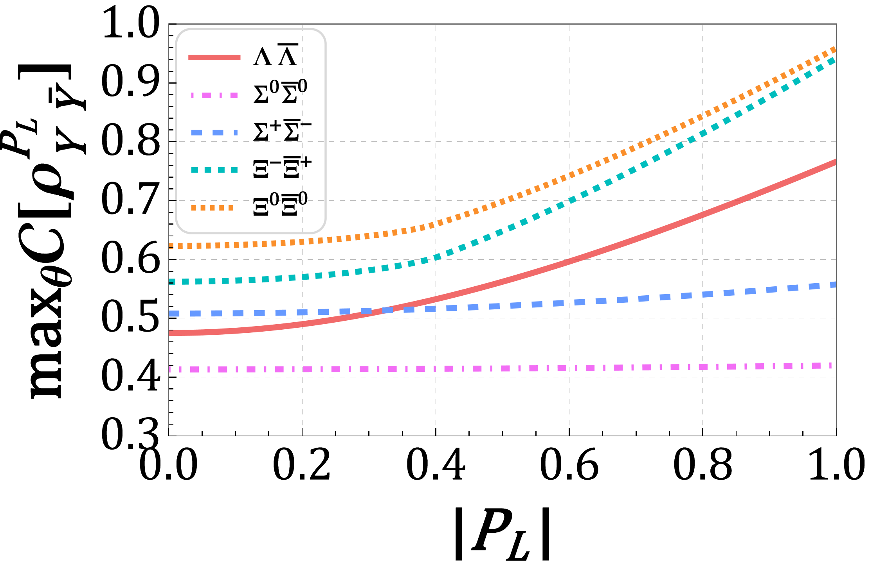
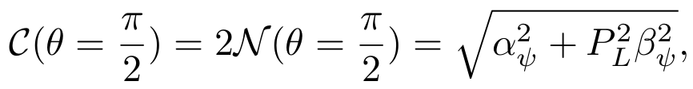
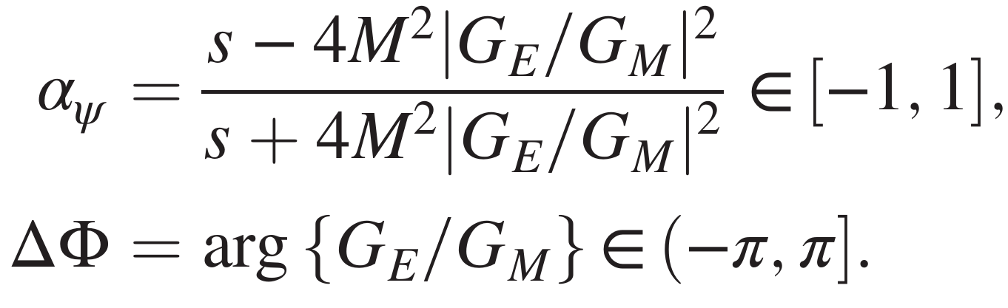
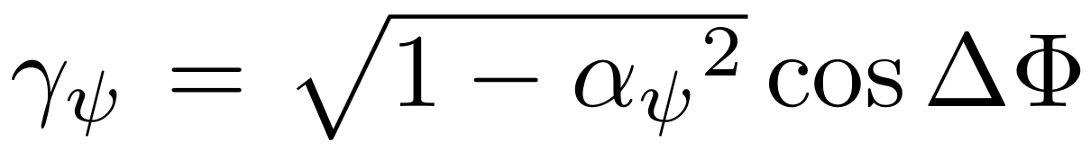
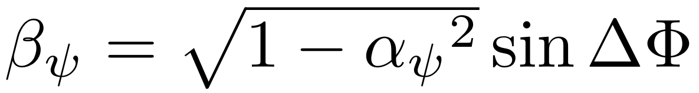
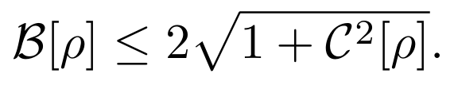
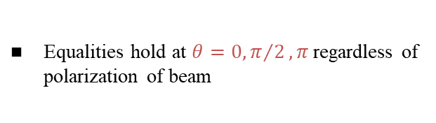
Longitudinal Beam Polarization
SDM:
Largest violation:
Largest concurrence:
EMFFs:
Zhang et al., arXiv:2602.10389 (2026)
Hierarchy structure:
Equalities hold at $θ=0, π/2, π$ regardless of polarization of beam
Bell nonlocality = Entanglement

Slide 8
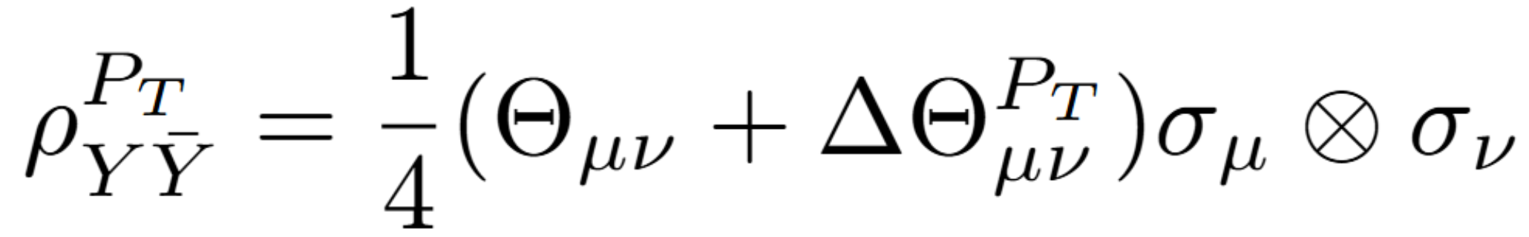
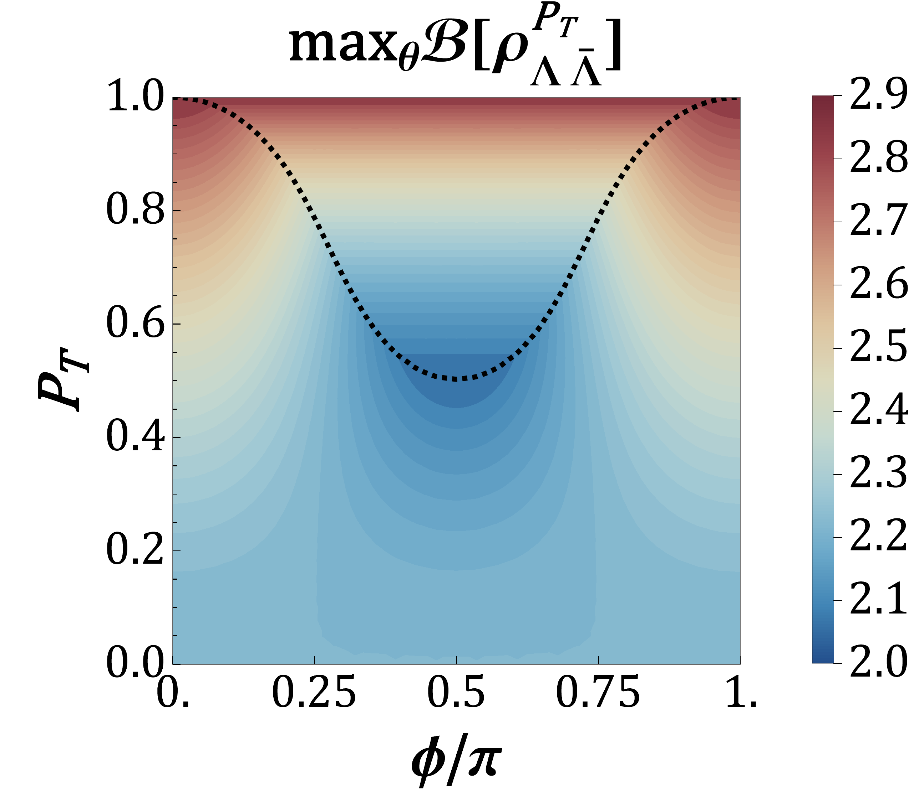
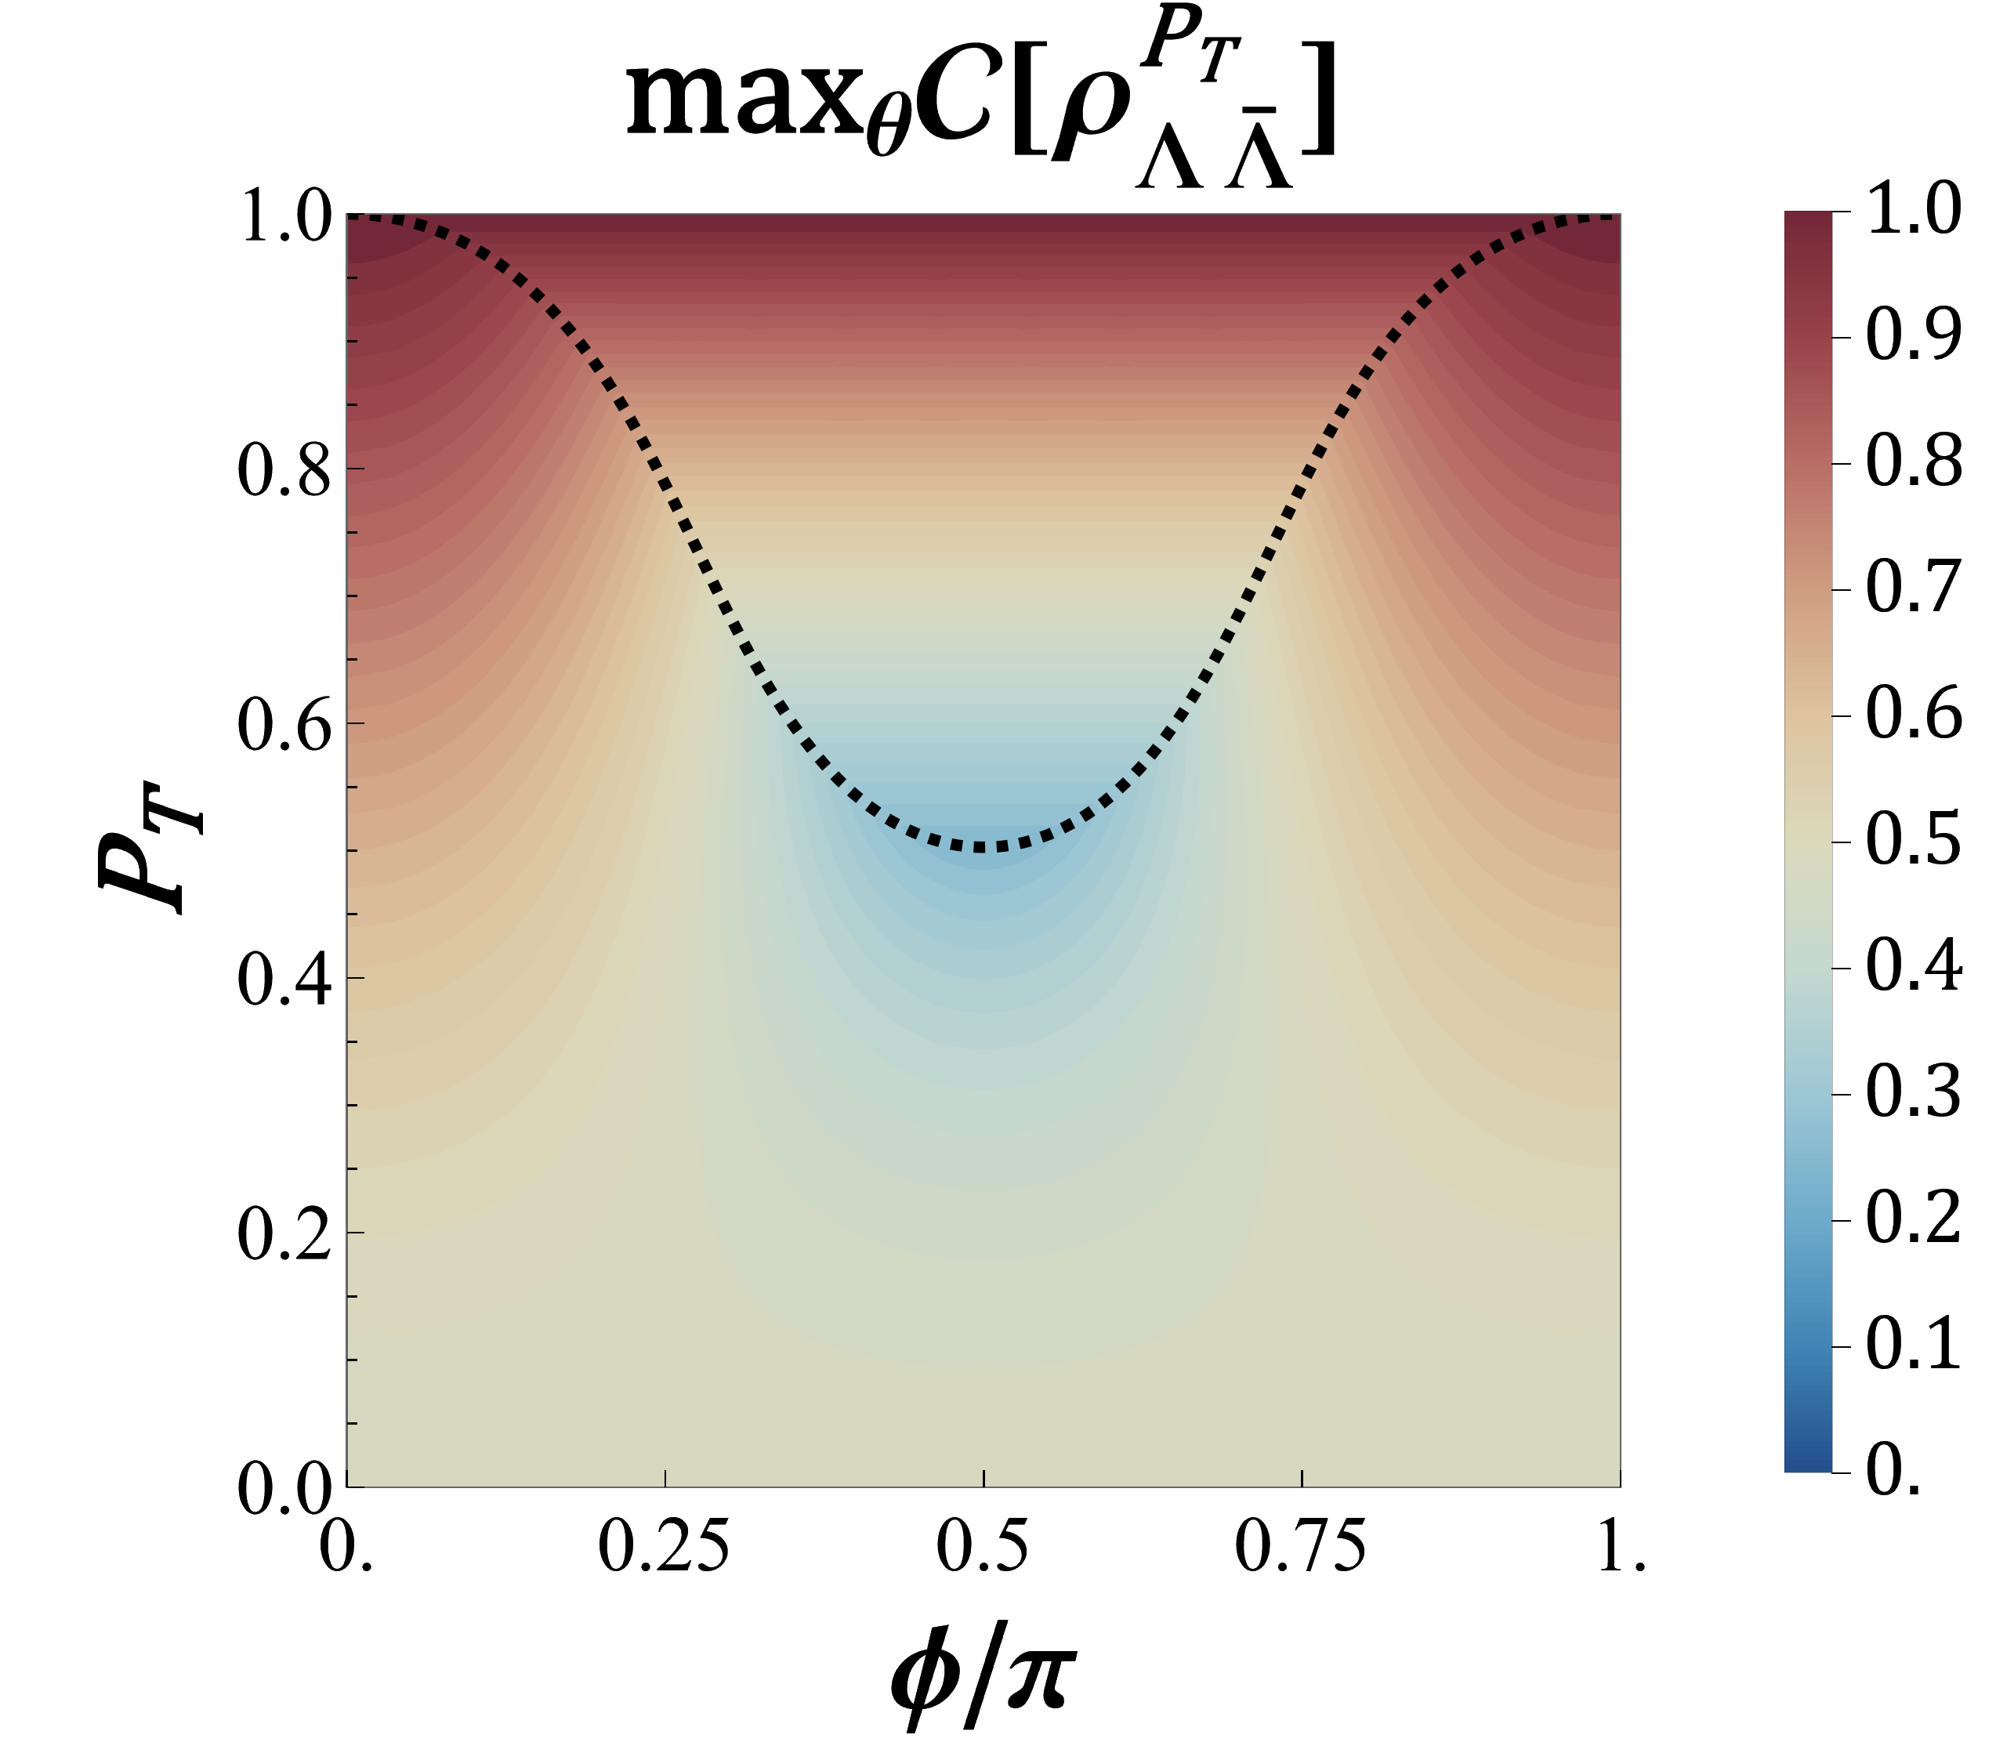
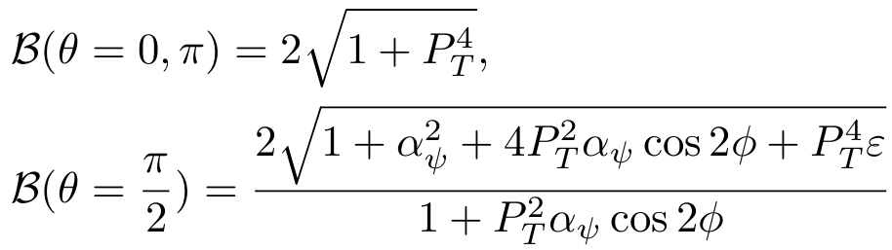
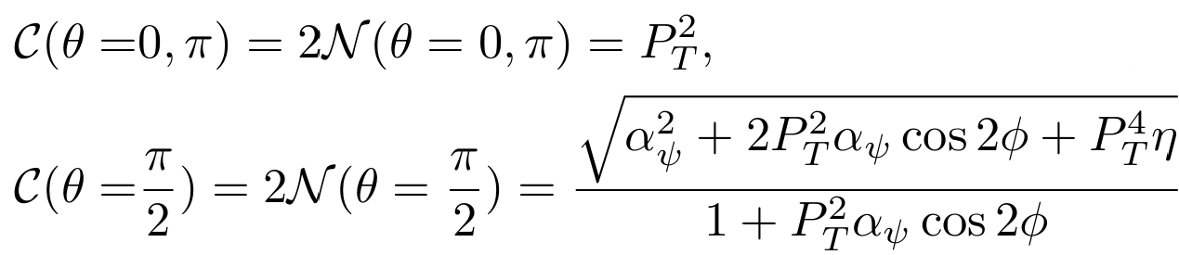
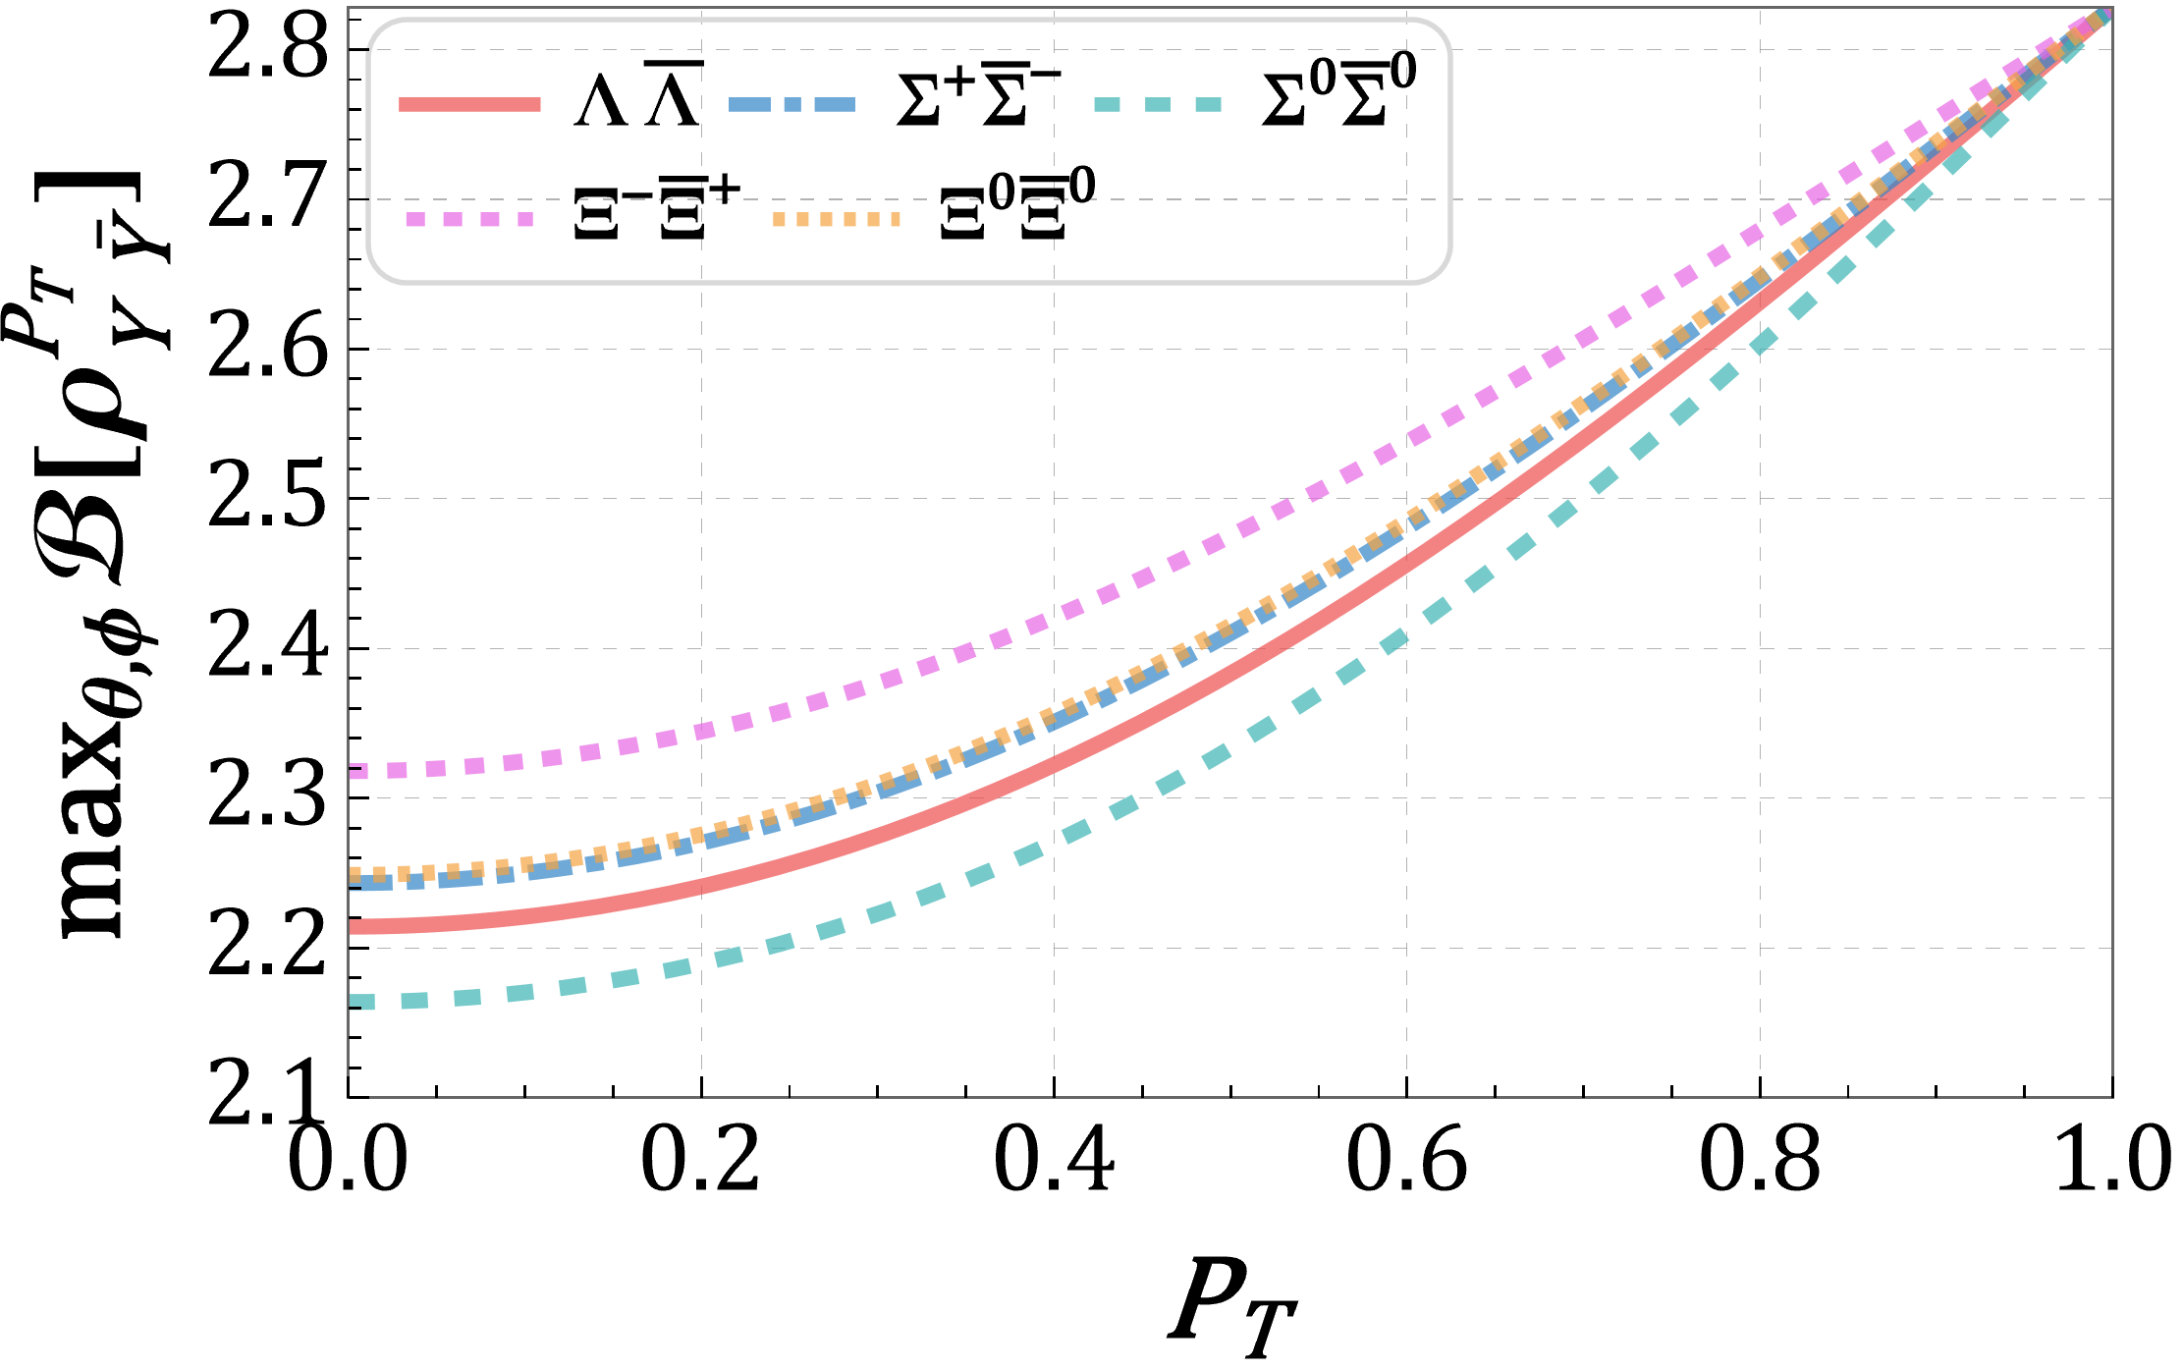
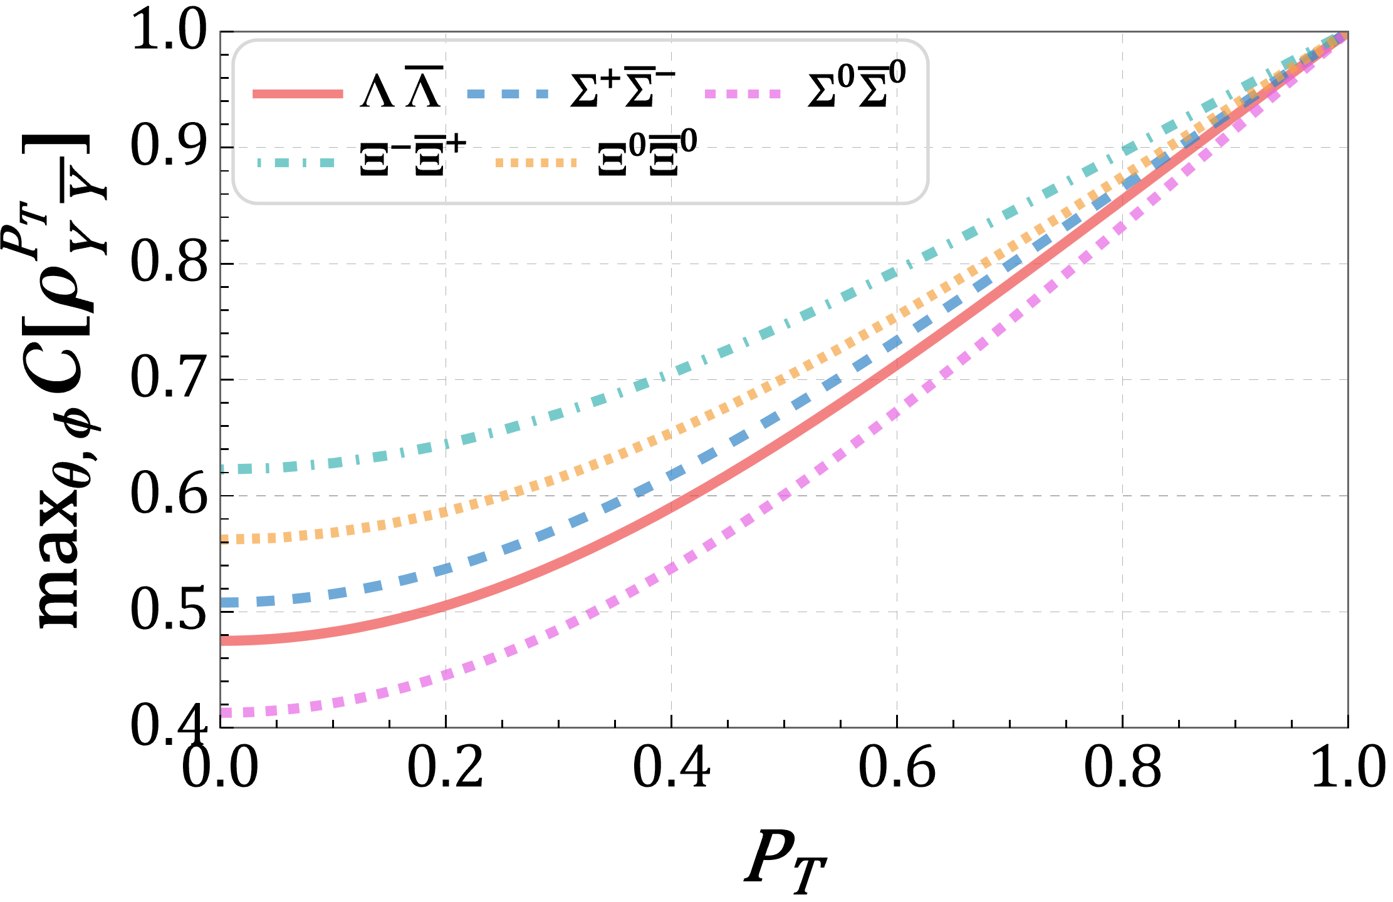


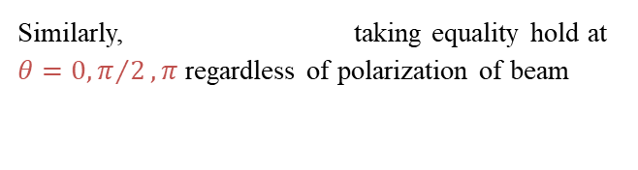
Transverse Beams Polarization
SDM:
Largest violation occurs at:
Up:
Down:
Largest entanglement occurs at:
Up:
Down:
Diff:
Similarly, taking equality hold at $θ=0, π/2, π$ regardless of polarization of beam
Zhang et al., arXiv:2602.10389 (2026)
Bell nonlocality = Entanglement

Slide 9






Maximal Entanglement
Why the maximal entangled state can be prepared under transverse polarization of beams?
Maximal entanglement pure state
Constraint of EMFFs:
Constrained by polarization:
Combining the hierarchy structure:
2-Norm of polarization:
EMFFs:
$α_{ψ},β_{ψ},γ_{ψ}$ are three real parameters in hyperons weak decay satisfying $α_{ψ}^{2}+β_{ψ}^{2}+γ_{ψ}^{2}=1$
T. D. Lee and C. N. Yang, Phys. Rev. 108, 1645 (1957)

Slide 10


Hyperon Decay as Entanglement Redistribution
Li et al., arXiv:2602.10398 (2026)
Entanglement redistribution:
Entanglement auto-distillation in part of the phase space and decreases in the rest
Incompletely lost of entanglement:
Effect of transverse polarization of hyperon
H.-L. Feng et al., Phys. Rev. D 112, 036020 (2025).

Slide 11
Conclusion
Summary and Perspective
Longitudinal Polarization
Stable and monotonically increasing correlations with the enhanced polarization degree;
Cannot achieve maximal entanglement and CHSH inequality violation.
Transverse Polarization
The monotonic dependence on the polarization degree of correlations is regulated by the azimuthal angle;
Can achieve maximal entanglement and CHSH inequality violation.
Thank you!

Slide 12








Backup
Qubit
Von Neumann Entropy
How to identify state of subsystem?
Classical randomness is unavoidable
Definition
Entanglement entropy
Density operator:
Introducing the “incoherent superposition”
Entanglement of Formation
Ambiguity of mixed state:
Density operator lose the information about the initial constituent pure states.

Slide 13





Backup
Chosen rest helicity frame:
For hyperon:
For anti-hyperon:
The inner parameters in SDM includes:
$α_{ψ},β_{ψ},γ_{ψ}$ are three real parameters in hyperons weak decay satisfying $α_{ψ}^{2}+β_{ψ}^{2}+γ_{ψ}^{2}=1$
E. Perotti, G. Fäldt, A. Kupsc, S. Leupold, and J. J.Song, Phys. Rev. D 99, 056008 (2019)
N. Salone, P. Adlarson, V. Batozskaya, A. Kupsc, S. Le-upold, and J. Tandean, Phys. Rev. D 105, 116022(2022)
X. Cao, Y.-T. Liang, and R.-G. Ping, Phys. Rev. D 110,014035 (2024)
T. D. Lee and C. N. Yang, Phys. Rev. 108, 1645 (1957)

Slide 14






Backup
Alternative perspectives for hierarchy structure
Longitudinal Polarization
Transverse Polarization
The $θ^{∗}$ is defined as critical scattering angles where the CHSH parameter
The $minP_{T}$ is defined as minimal $P_{T}$ required to achieve across full $θ$ range

Slide 15








Backup
separable state
}>{
LHV range
The azimuthal angle for the minimum is fixed:
The $θ_{Sep}$ is defined as scattering angles where the system is separable with fixed $P_{T}$ and $φ^{∗}$

