Slide 1


Factorization formula connecting the $Λ_{b}$ LCDA in QCD and boosted HQET
施瑀基
2026年3月29日
Cooperated with Zeng Jun
2602.14187

Slide 2
Outline
Motivation
Heavy baryon LCDA
Factorization: QCD LCDA to HQET LCDA
QCD LCDA in tail region

Slide 3
Motivation

Slide 4
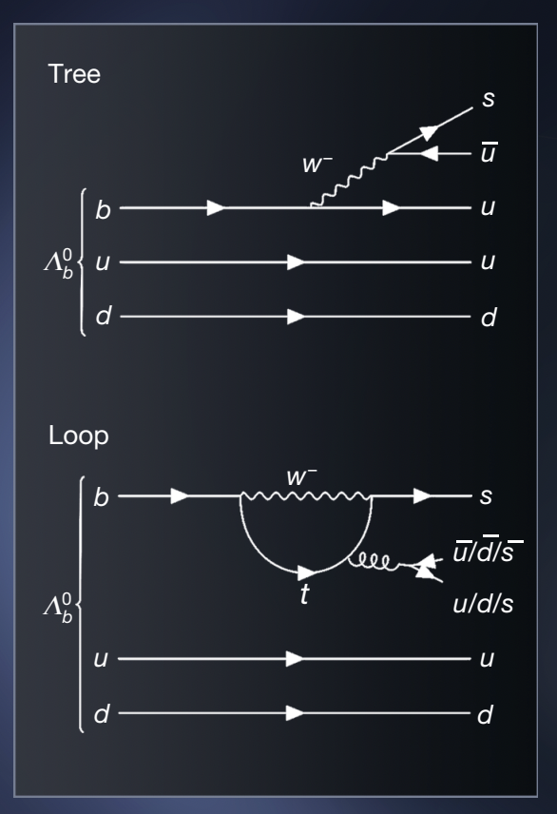
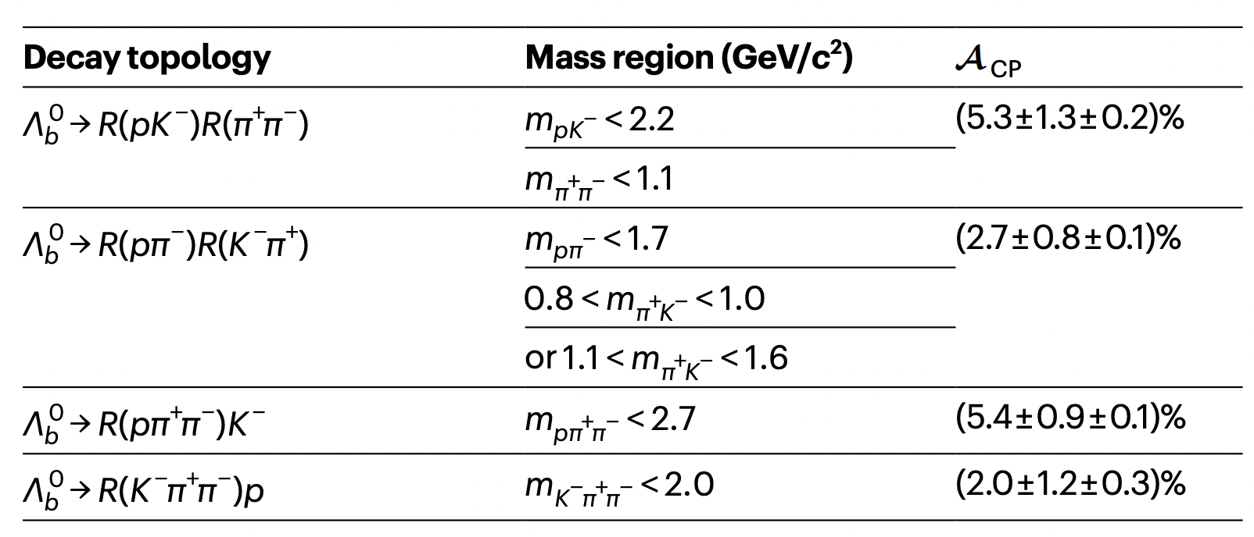
LCDA is a crucial input parameter for exclusive decays
  Observation of CP symmetry breaking in heavy baryon decays
Nature 643, no.8074, 1223-1228 (2025)
Heavy baryon decays have attracted increasing interest owing to the search for CP violation
Precision calculations are therefore necessary
LCDA is a crucial input parameter for inclusive/exclusive processes in high-energy

Slide 5
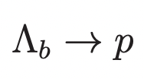
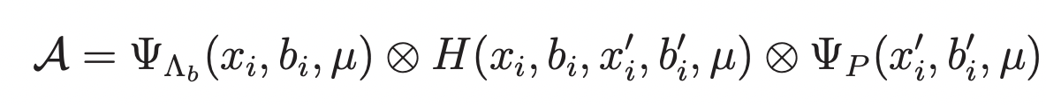

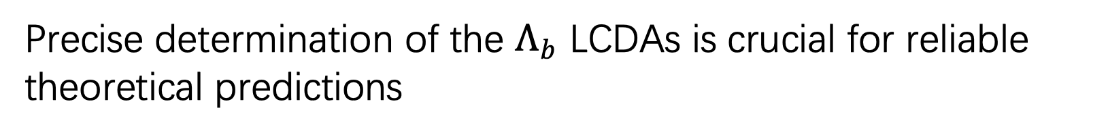

LCDA is a crucial input parameter for exclusive decays
QCD factorization (QCDF)
soft-collinear effective theory (SCET)
perturbative QCD (PQCD)
light-cone sum rules (LCSR)
Use $Λ_{b}$ LCDA as inputs
For example, PQCD calculation for:
$Λ_{b}$ LCDA
Hard kernel
Proton LCDA
Precise determination of the $Λ_{b}$ LCDAs is crucial for reliable theoretical predictions

Slide 6
Heavy baryon LCDA

Slide 7
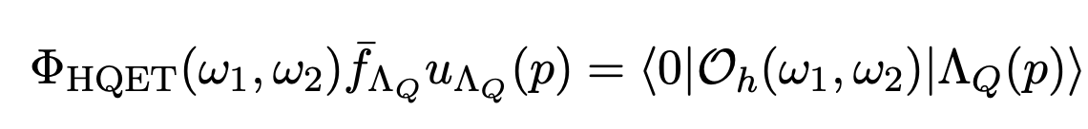
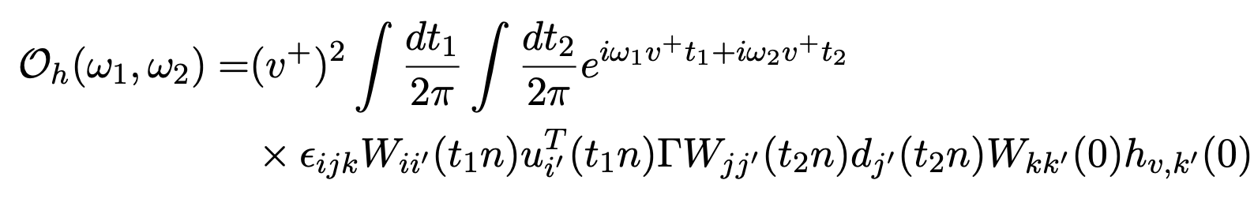
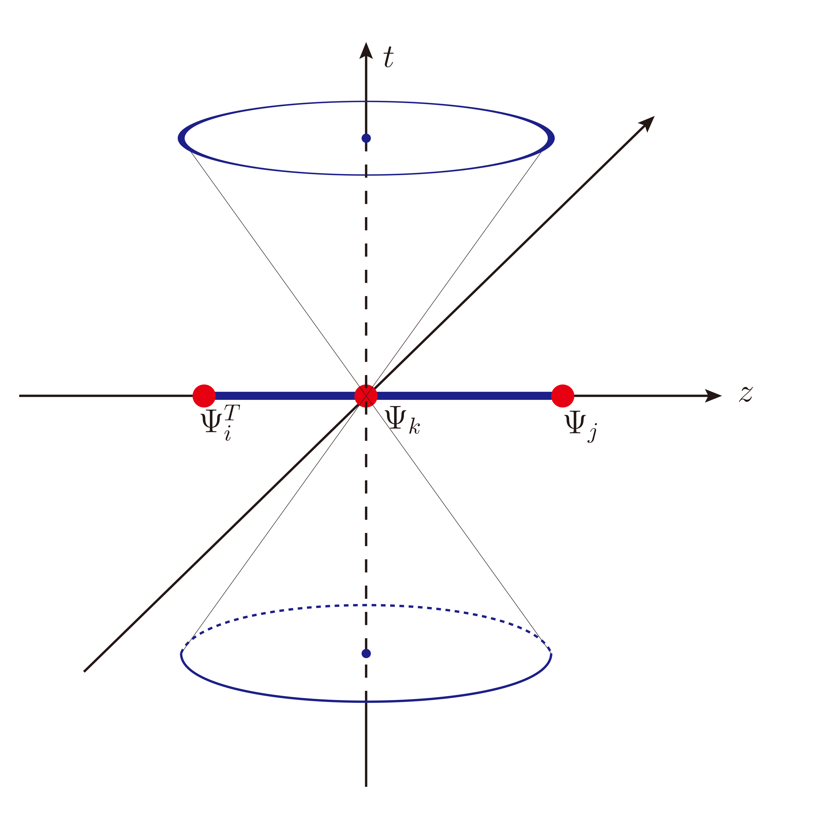
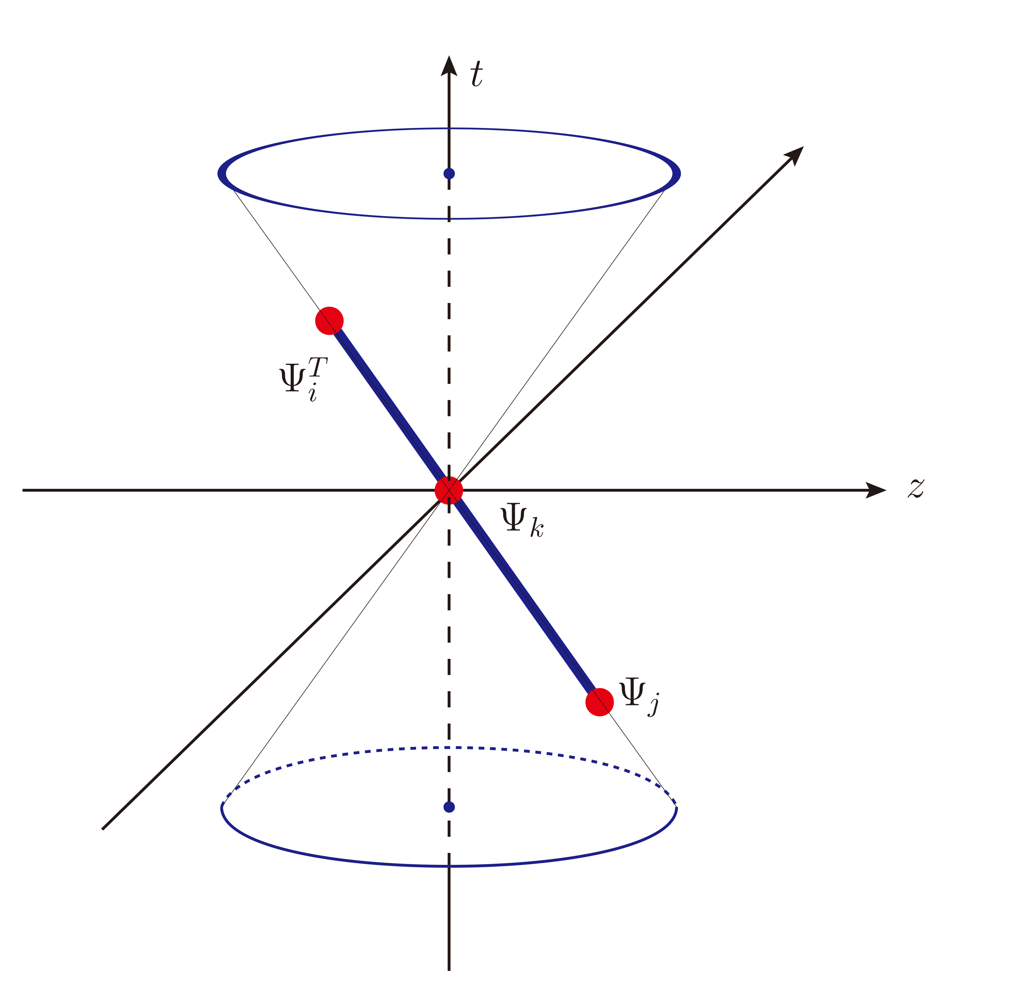

Lattice calculation for $Λ_{b}$ LCDA
Light-cone definition in the heavy quark limit:
Light-cone quantity cannot be calculated directly on lattice
Space-like DA (Quasi-DA)
Matching
Realize the lattice calculation
Large Momentum Effective Theory (LaMET)

Slide 8
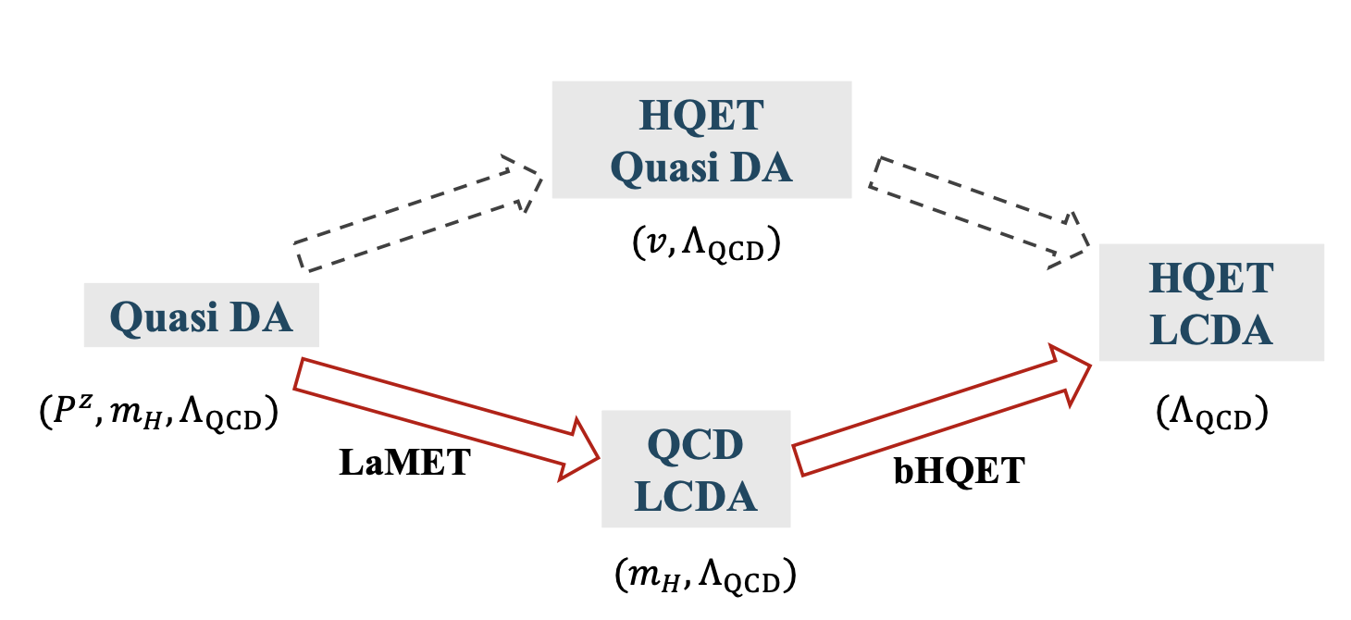

Two-step matching scheme
However, lattice QCD cannot handle the effective heavy quark field $h_{v}$
To obtain the $Λ_{b}$ LCDA in HQET, a two-step matching scheme is proposed
X. Y. Han, J. Hua, X. Ji, C. D. Lü, W. Wang, J. Xu, Q. A. Zhang and S. Zhao,
Phys. Rev. D 111, no.11, L111503 (2025)
X. Y. Han et al. [Lattice Parton], Phys. Rev. D 111, no.3, 034503 (2025)
One uses the heavy quark field in QCD for Lattice calculation
Matching to the boosted HQET
The same as the case of light baryon LCDA
For heavy meson:
M. Beneke, G. Finauri, K. K. Vos and Y. Wei
JHEP 09, 066 (2023)
Z. F. Deng, C. Han, W. Wang, J. Zeng and J. L. Zhang
JHEP 07, 191 (2023) doi:10.1007
QCD LCDA in the boosted frame

Slide 9
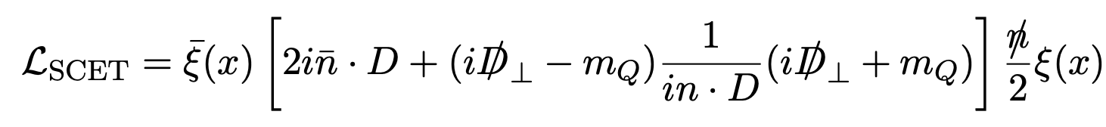
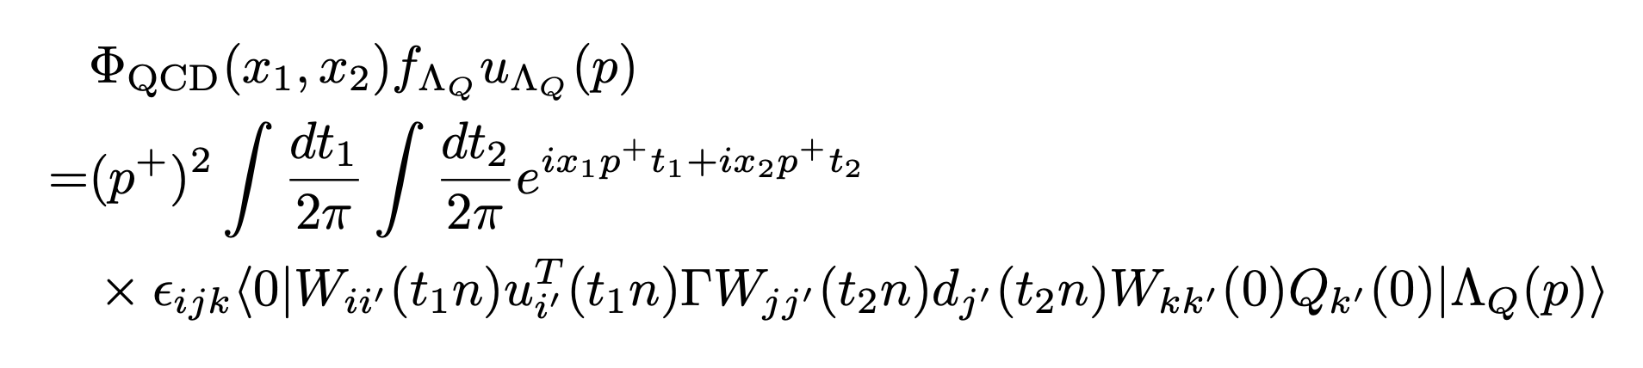
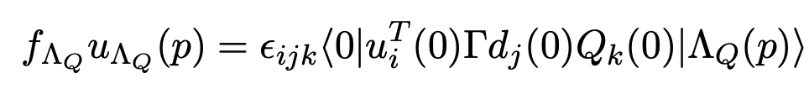
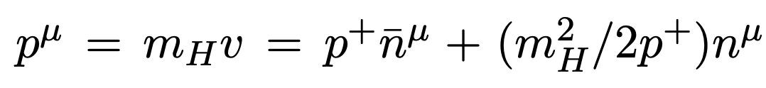
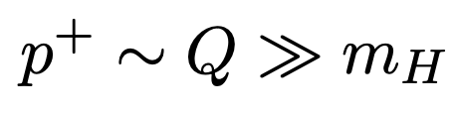

Leading twist $Λ_{b}$ LCDA in QCD
In the boosted frame, the Leading twist QCD LCDA is described by massive SCET
Definition of QCD LCDA :
Decay constant:
Baryon momentum:

Slide 10
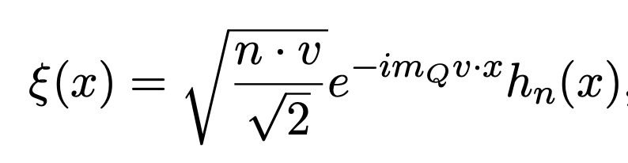

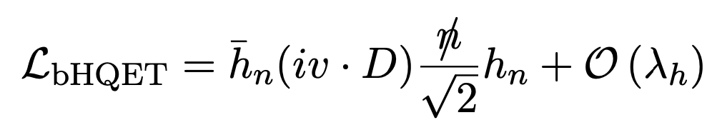
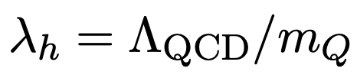

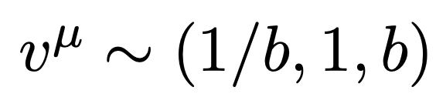

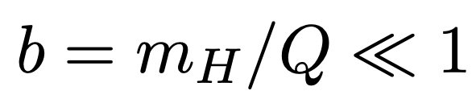
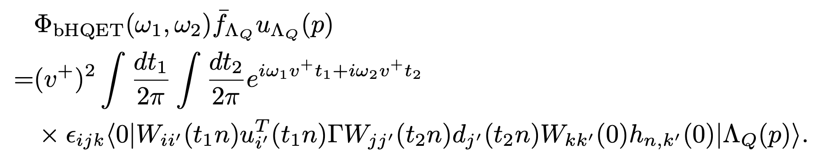

Leading twist $Λ_{b}$ LCDA in bHQET
In the boosted frame, the Leading twist HQET LCDA is described by bHQET
The Lagrangian of bHQET can be derived from that of massive SCET by the redefinition of the collinear field
Heavy quark momentum:
boost parameter :
Definition of bHQET LCDA :

Slide 11
Factorization: QCD LCDA to HQET LCDA

Slide 12


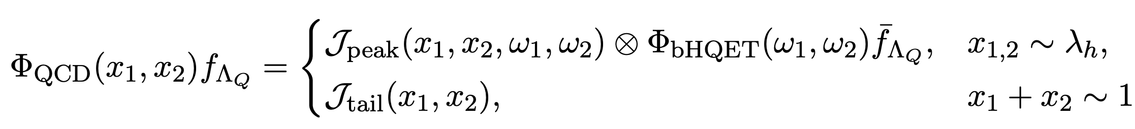

Factorization from QCD LCDA to HQET LCDA
Peak region:
Small momentum fraction
Tail region:
Large momentum fraction
Factorization formula:
QCD LCDA does not match the form of the bHQET LCDA in the tail region
Main task is to matching for the jet function in the peak region:

Slide 13
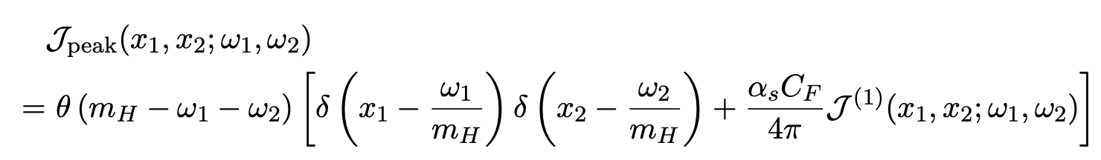
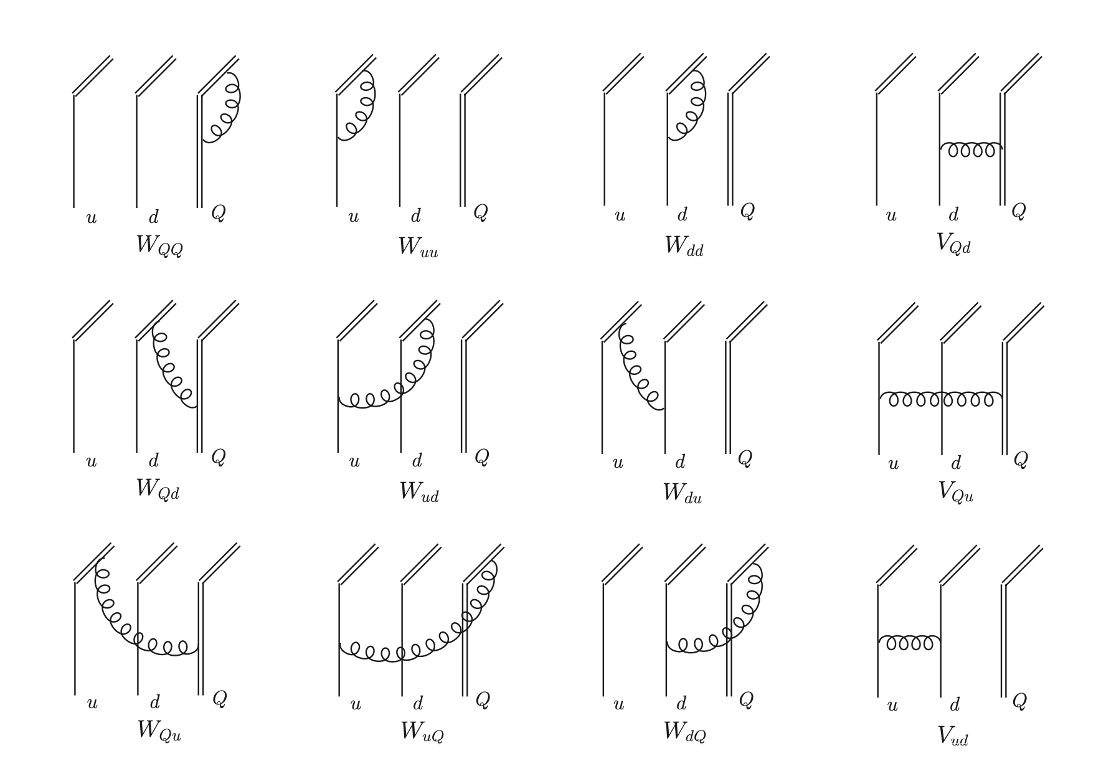
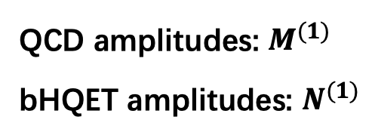
One-loop calculation for QCD and bHQET LCDA
One-loop correction to the jet function
QCD amplitudes: $M^{(1)}$
bHQET amplitudes: $N^{(1)}$

Slide 14
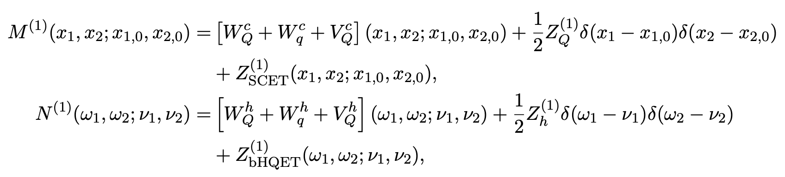
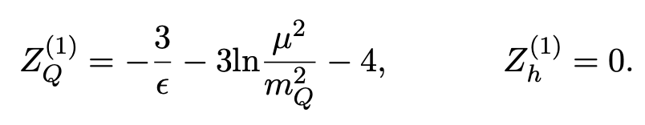
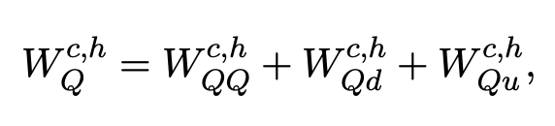
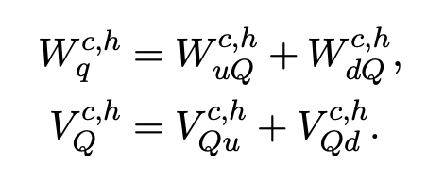
One-loop calculation for QCD and bHQET LCDA
Field renormalization
Actually, not all the diagrams contribute to the matching kernel

Slide 15
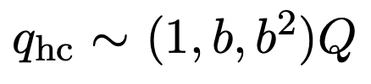
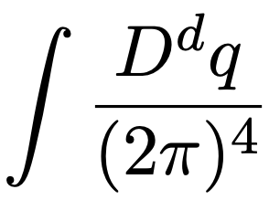

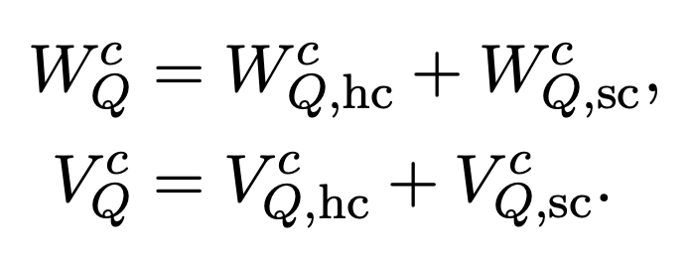


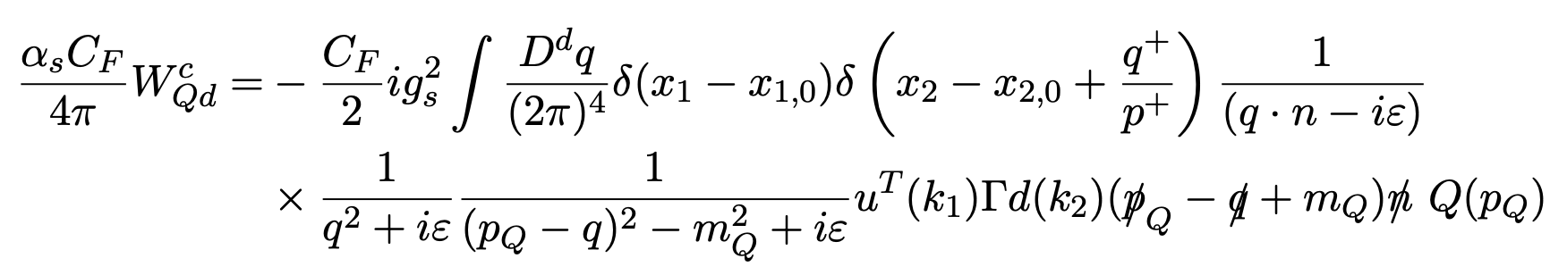
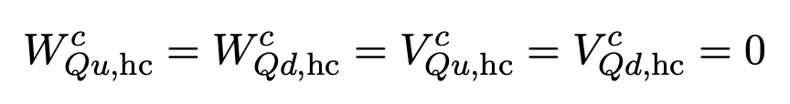
Method-of-regions
The integration of loop momentum can be separated into integrations in the hard-collinear region and the soft-collinear region
hard-collinear
soft-collinear
Separate the QCD amplitudes:
All diagrams containing a gluon linking the light-quark and heavy-quark sec- tors yield vanishing hard-collinear amplitudes

Slide 16
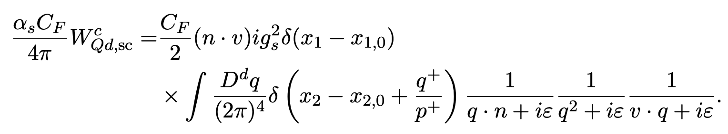
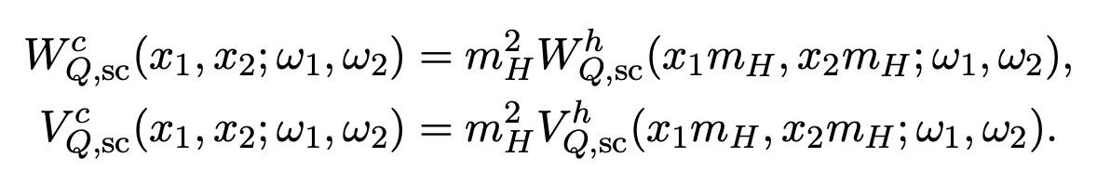
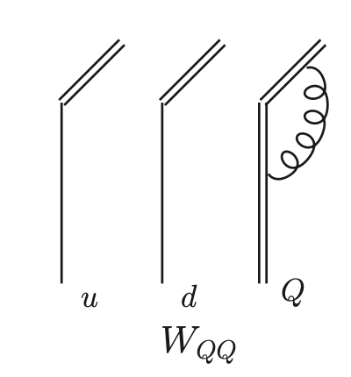
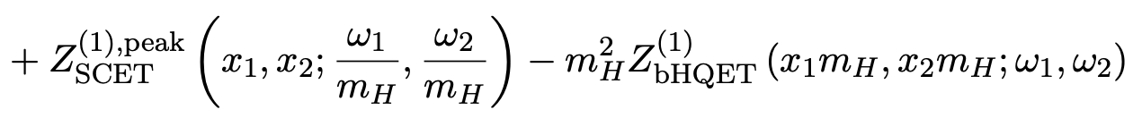
Method of regions
The soft-collinear part is
which is exactly equivalent to the corresponding bHQET amplitude:
Only one heavy quark virtual diagram contributes to the matching
The UV part of other diagrams are also necessary

Slide 17
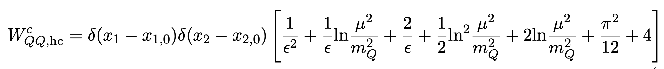

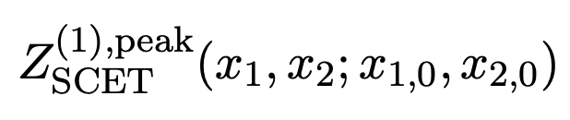
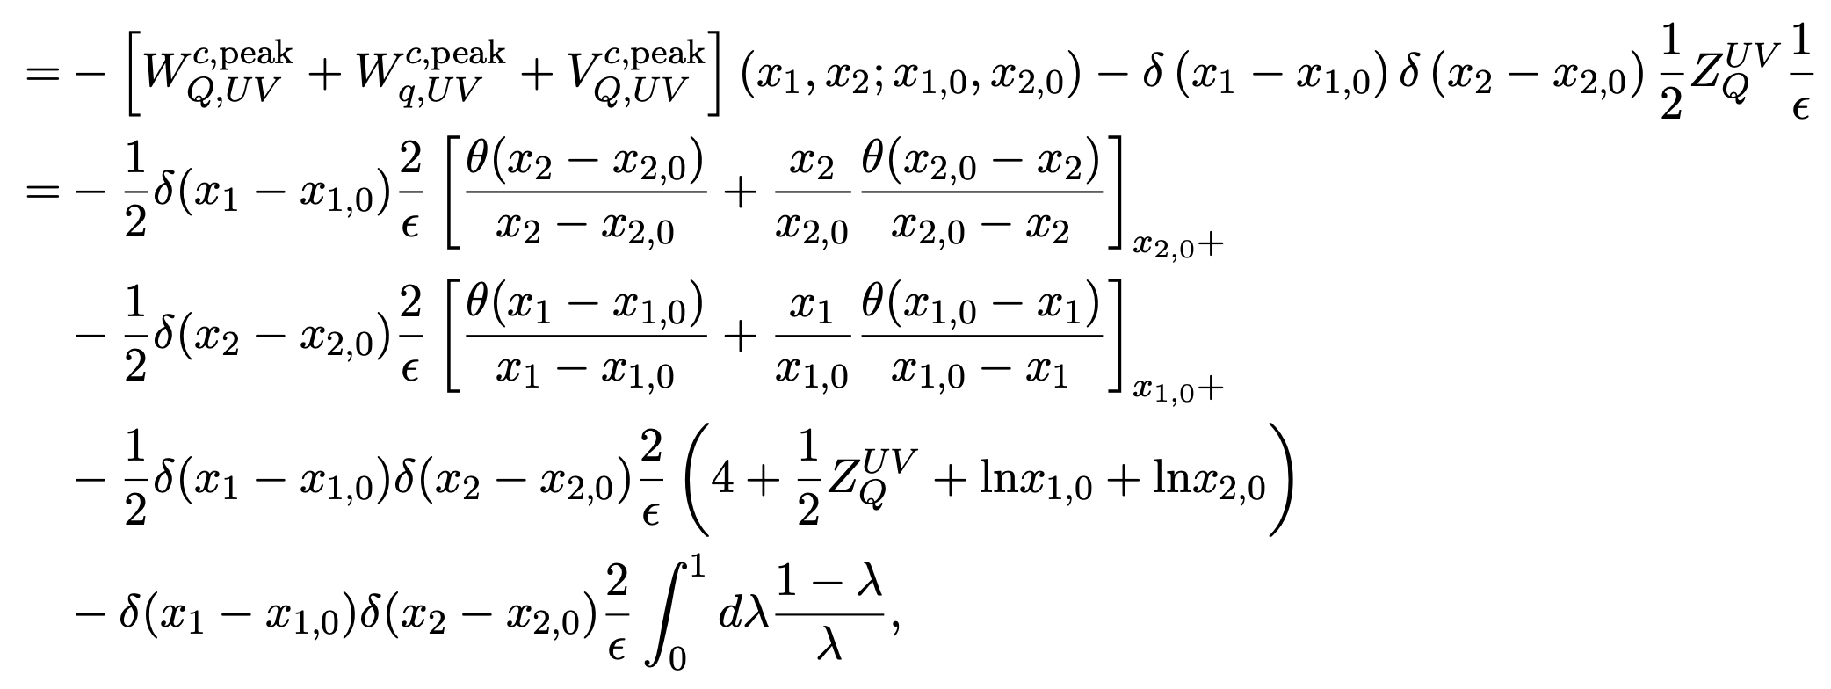
One-loop result for QCD LCDA
Renormalization factor (UV part) in the peak region limit

Slide 18
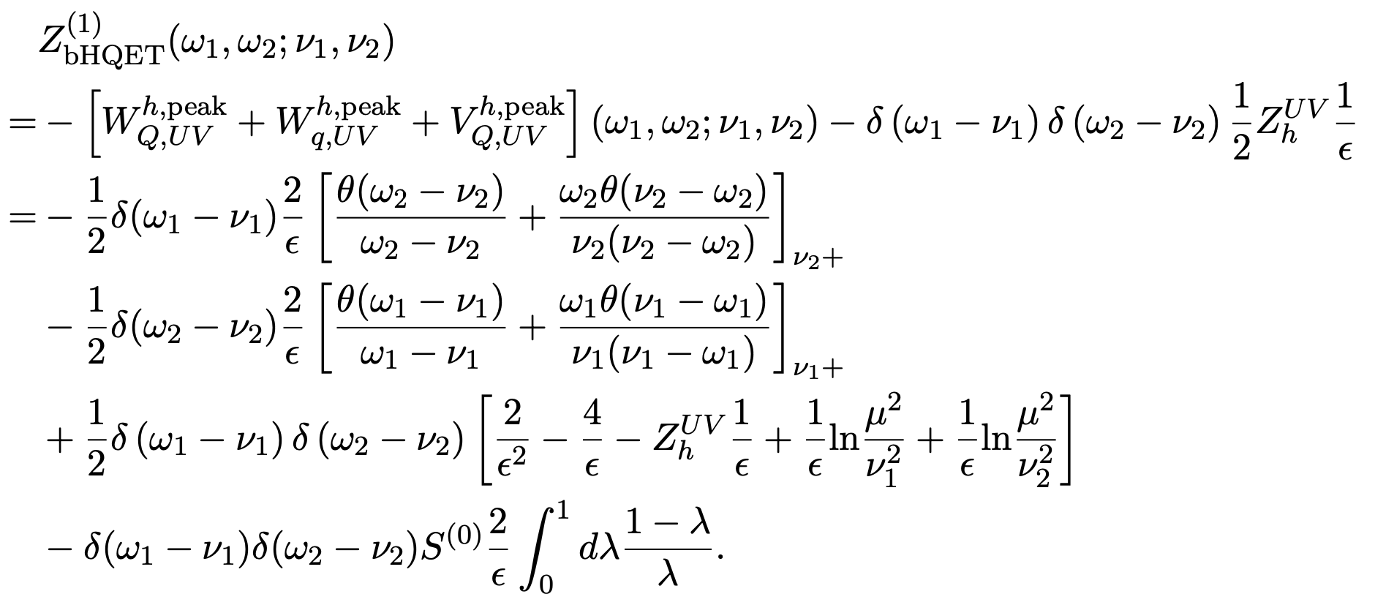
One-loop result for bHQET LCDA
The Renormalization factor of bHQET amplitude:

Slide 19
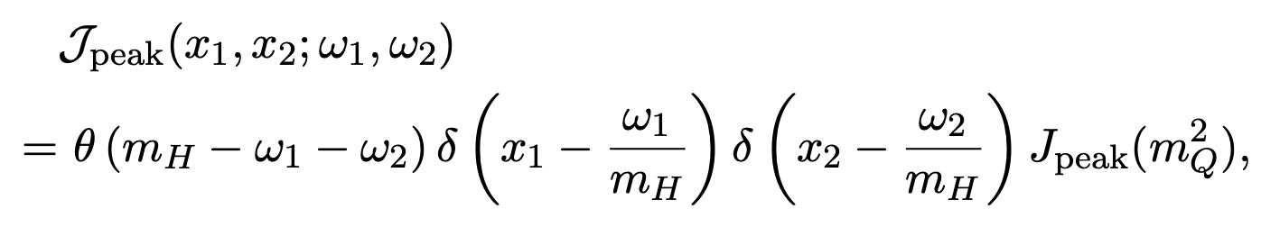
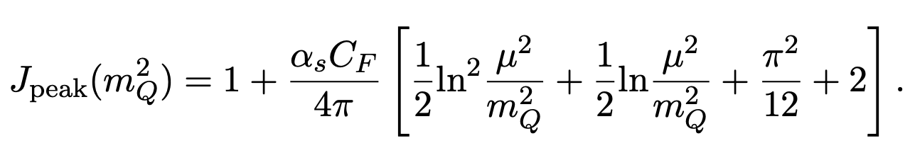
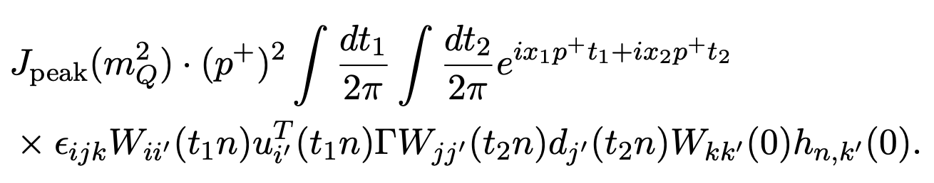
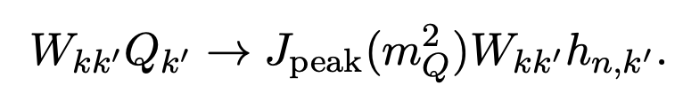

The jet function in the peak region
This result is the same as that of B meson
The locality of $J_{peak}$ with respect to the momentum fractions to all orders in perturbation theory
$J_{peak}$ serves as a matching coefficient that connects the SCET collinear quark field to the bHQET field

Slide 20
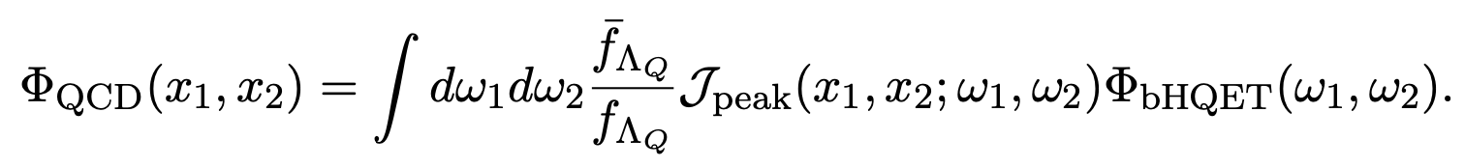
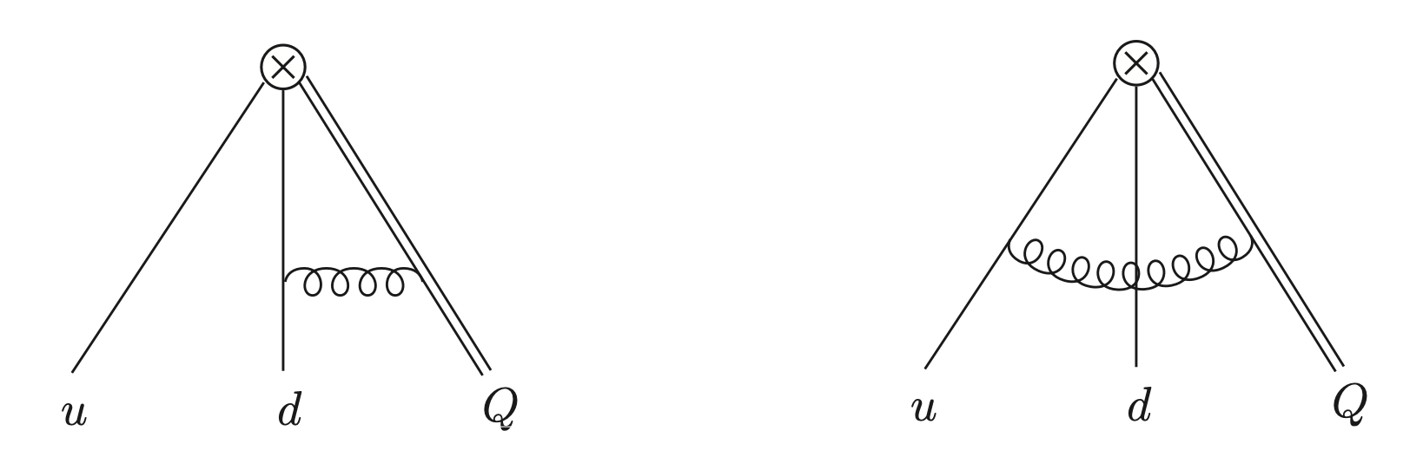
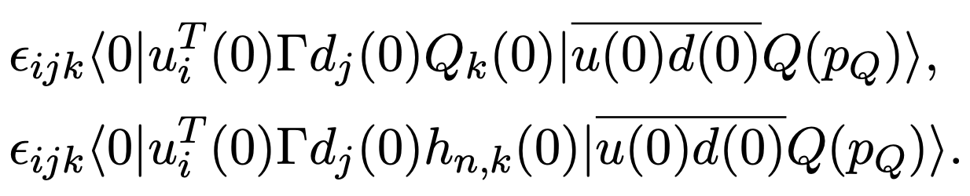
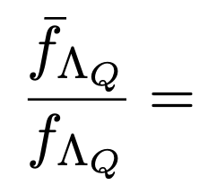

Local matching: the decay constant
Diagrams for matching the local operators:
Matching the matrix elements of local operators while replacing the external baryon state with free quark states:

Slide 21
QCD LCDA in tail region

Slide 22









Tail region
The tail region of the QCD LCDA and be can be calculated perturbatively
Tail region:
=0 since
At one-loop level:
$$M^{(1)}∝$$
$$→0$$
or
The complete asymptotic behavior in tail region can only be determined by including
two-loop contributions.

Slide 23



Tail region
Boundary regions:
Amplitudes with a single delta function survive in the boundary region
The radiative tail of the $Λ_{b}$ HQET LCDA
T. Feldmann and D. Vladimirov, JHEP 07, 108 (2025)
Consistent:

Slide 24

Conlusion
We established a factorization framework connecting the $Λ_{b}$ baryon QCD LCDA and bHQET LCDA, enabling non-perturbative extraction from lattice QCD.
We computed one-loop corrections and derived a universal jet function with logarithmic structure identical to that of heavy mesons.
Full asymptotic behavior of the $Λ_{b}$ QCD LCDA in the tail region requires two-loop calculations, while boundary behavior agrees with existing results.
This work provides a foundation for lattice QCD determination of $Λ_{b}$ LCDA and precision phenomenology of heavy baryon weak decays.

