Slide 1

Radiative decay and charge radius of heavy-light meson systems
侯文正
South China Normal University
Cooperate with 梁剑, 华俊, 桂龙成
Based on arXiv: 2602.07829

Slide 2
Motivation
Radiative decays:
The experimental results are relatively few.
LQCD can calculate partial decay width。
Charge radius and magnetic moment:
The charge radius and magnetic moment are important components in the study of hadronic structure.
It can be used as an input parameter and a result reference for phenomenological models
1

Slide 3

Radiative decay of $D_{ }^{∗+}→{D_{ }^{+}}_{ }^{ }γ,D_{ }^{∗0}→D_{ }^{0}γ$ and $D_{ s}^{∗}→D_{ s}^{ }γ$
Electromagnetic radius and magnetic moments of $D_{ }^{∗+}, D_{ }^{+} ,D_{ s}^{∗}$and $D_{ s}^{ }$mesons

Slide 4
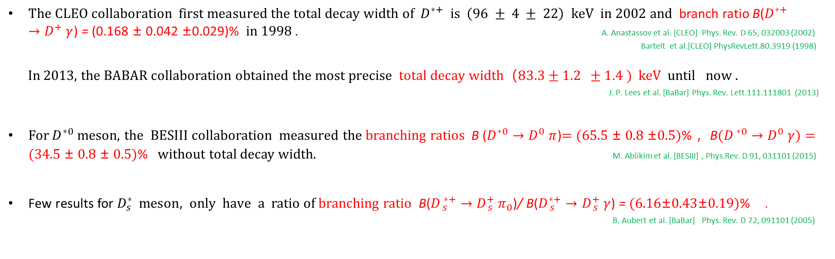
Background-exp
$The CLEO collaboration first measured the total decay width of{ D}_{ }^{∗+} is \left(96 ± 4 ± 22\right) keV in 2002 and$branch ratio B($D_{ }^{∗+}→{D_{ }^{+}}_{ }^{ }γ$) = (0.168 ± 0.042 ±0.029)% in 1998 . A. Anastassov et al. [CLEO] Phys. Rev. D 65, 032003 (2002)
Bartelt et al.[CLEO] PhysRevLett.80.3919 (1998)
In 2013, the BABAR collaboration obtained $\text{the} \text{most} \text{precise} total decay width（83.3±1.2 ±1.4 ) keV$ until now .
J. P. Lees et al. [BaBar] Phys. Rev. Lett.111.111801 (2013)
For $D^{∗0}$ meson, the BESIII collaboration measured the branching ratios B ($D_{ }^{∗0}→{D_{ }^{0}}_{ }^{ }π$)= (65.5 ± 0.8 ±0.5)% ，B$(D_{ }^{ ∗0}→{D_{ }^{0}}_{ }^{ }γ)$ = (34.5 ± 0.8 ± 0.5)% without total decay width. M. Ablikim et al. [BESIII] , Phys.Rev. D 91, 031101 (2015)
Few results for ${D_{s}^{∗}}_{ }^{ } meson, only have a$ratio of branching ratio B($D_{ s}^{ ∗+}→{D_{ s}^{+}}_{ }^{ }π_{0}$)/ B($D_{ s}^{∗+}→{D_{ s}^{+}}_{ }^{ }γ$) = (6.16±0.43±0.19)% . B. Aubert et al. [BaBar] Phys. Rev. D 72, 091101 (2005)
3

Slide 5
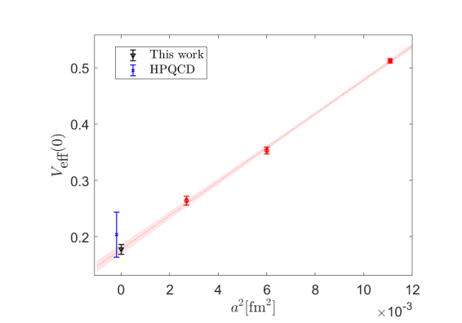
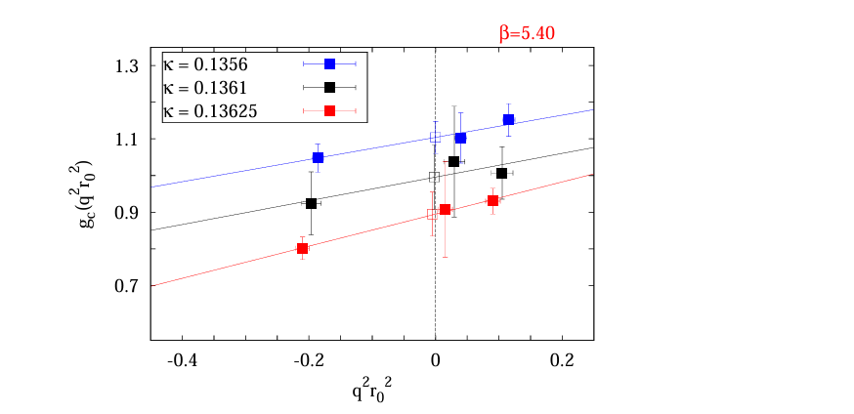
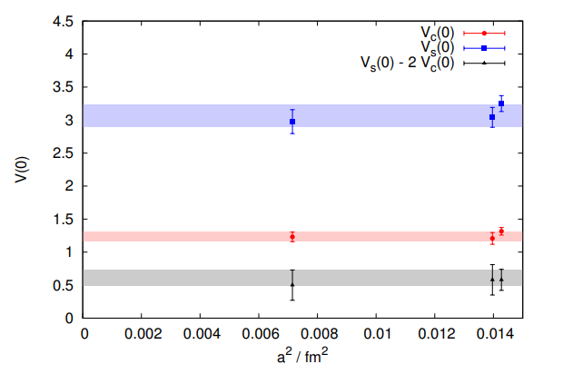
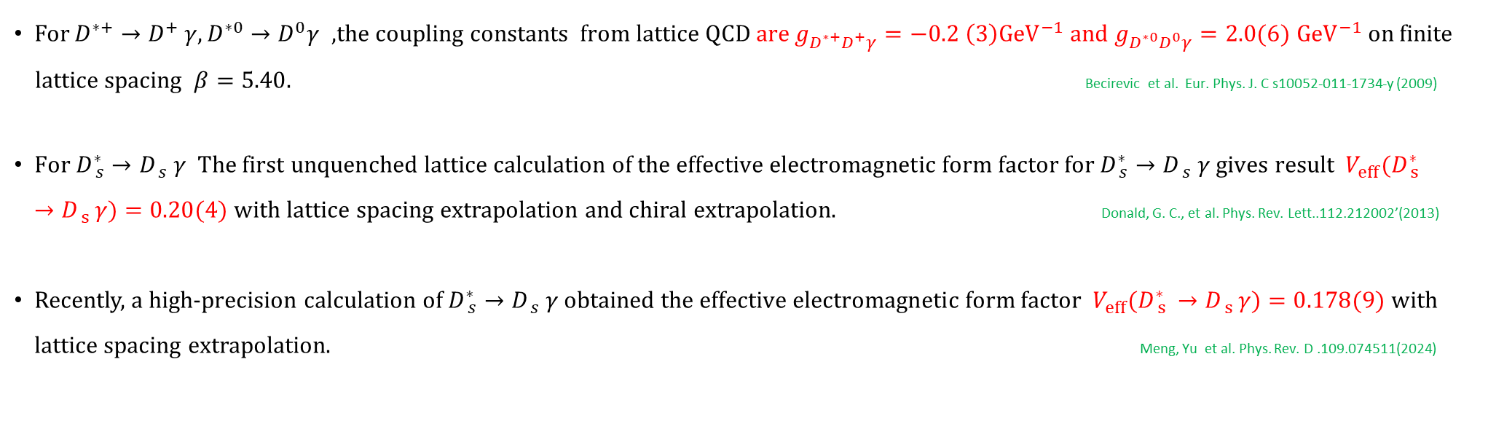
Background-Lat
For $D_{ }^{∗+}→{D_{ }^{+}}_{ }^{ }γ,D_{ }^{∗0}→D_{ }^{0}γ$ ,the coupling constants from lattice QCD are $g_{D^{∗+}D^{+}γ}=−0.2 \left(3\right){GeV}^{−1}$ and $g_{D^{∗0}D^{0}γ}=2.0(6)$ ${GeV}^{−1}$ on finite
lattice spacing $β=5.40$. Becirevic et al. Eur. Phys. J. C s10052-011-1734-y (2009)
$\text{For} D_{ s}^{∗}→{D_{ s}^{ }}_{ }^{ }γ The first unquenched lattice calculation of the effective electromagnetic form factor for D_{ s}^{∗}→{D_{ s}^{ }}_{ }^{ }γ gives result V_{eff}(D_{ s }^{∗}→D_{ s }^{ }γ)=\text{0.20(4)}$ with lattice spacing extrapolation and chiral extrapolation. Donald, G. C., et al. Phys. Rev. Lett..112.212002’(2013)
Recently, a high-precision calculation of $D_{ s}^{∗}→{D_{ s}^{ }}_{ }^{ }γ$obtained $the effective electromagnetic form factor{ V}_{eff}(D_{ s }^{∗}→D_{ s }^{ }γ)=0.178($9) with lattice spacing extrapolation. Meng, Yu et al. Phys. Rev. D .109.074511(2024)
3

Slide 6
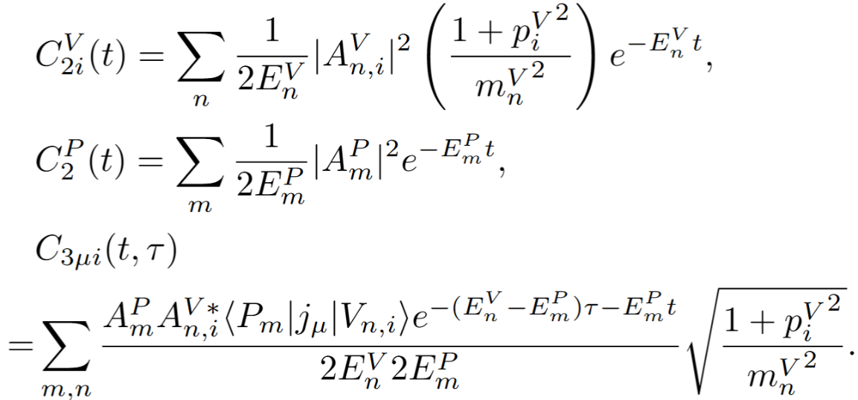
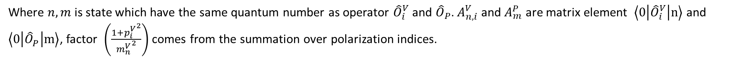
Formula
Insert complete set in correlation function and time and space translation $O_{ }(\vec{x},t)={e^{\hat{H}t}e^{−i\hat{p}\vec{x}}O}_{ }(0,0)e^{−\hat{H}t}$ $e^{i\hat{p}\vec{x}}$ , get
Where $n,m$ is state which have the same quantum number as operator ${\hat{O}}_{i}^{V}$ and ${\hat{O}}_{P}$. $A_{n,i}^{V}$ and $A_{m}^{P}$ are matrix element $\left\langle 0\left|{\hat{O}}_{i}^{V}\right|n\right\rangle$ and $\left\langle 0\left|{\hat{O}}_{P}^{ }\right|m\right\rangle$, factor $\left(\frac{1+{p_{i}^{V}}^{2}}{{m_{n}^{V}}^{2}}\right)$ comes from the summation over polarization indices.
4

Slide 7
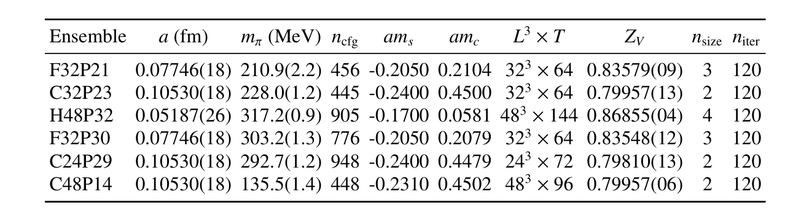
Numerical setup
Z.-C. Hu et al. (CLQCD), Phys. Rev. D 109, 054507(2024). Meng, Yu et al.PhysRevD.109.074511(2024)
We performed our calculation using five (2+1)-flavor Clover fermion gauge ensembles generated by the CLQCD collaboration.
To improve the signal quality of the two- and three-point functions, gaussian smearing to the fermion sources and APE smearing to the gauge links are used.
Three set current insertion times are used on each ensemble.
5

Slide 8
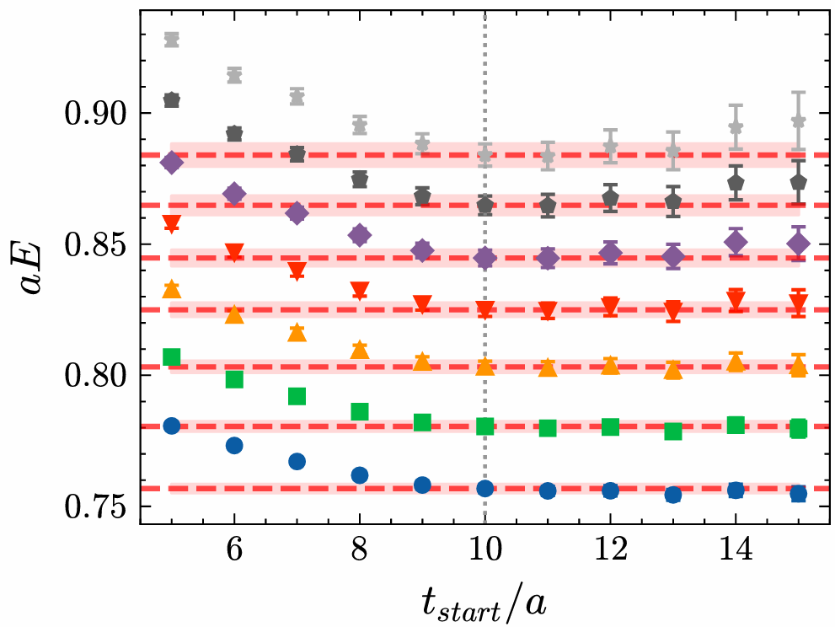
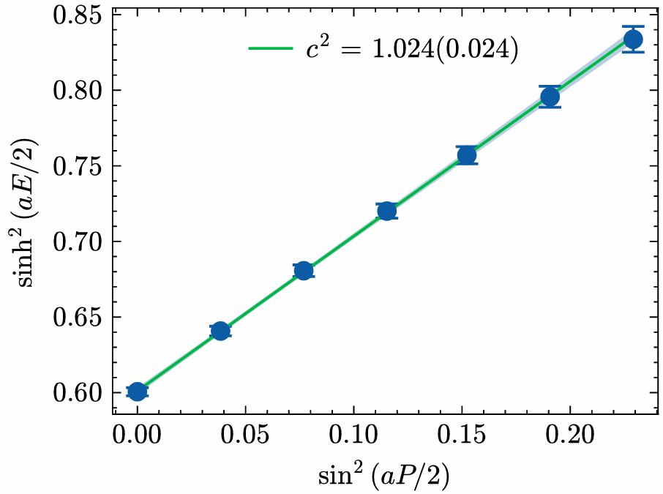
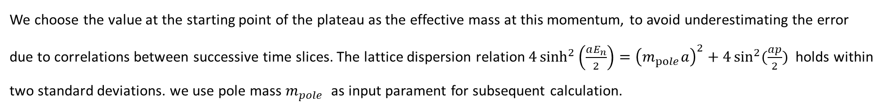
Results
Results for $D^{ }$meson on ensemble F32P21
We choose the value at the starting point of the plateau as the effective mass at this momentum, to avoid underestimating the error due to correlations between successive time slices. The lattice dispersion relation $4\sinh^{2}\left(\frac{aE_{n}}{2}\right)={\left(m_{pole}a\right)}^{2}+4\sin^{2}{(\frac{ap}{2}})$ holds within two standard deviations. we use pole mass $m_{pole}$ as input parament for subsequent calculation.
6

Slide 9
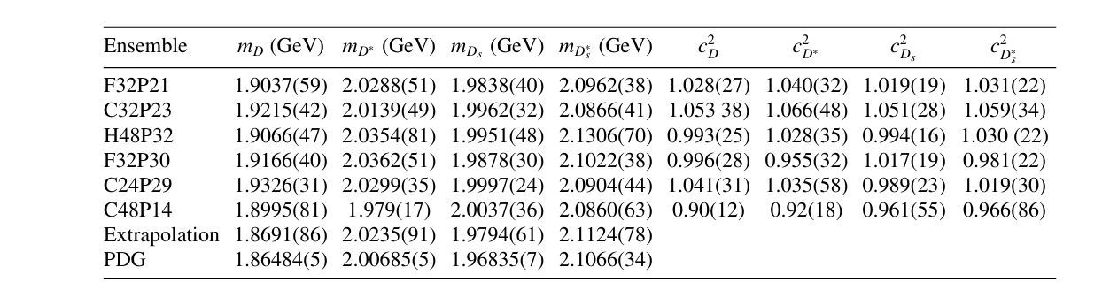
Results
$m\left(a^{2},m_{π}^{2}\right)=m\left(0,m_{π,phy}^{2}\right)+{Aa}^{2}+B(m_{π}^{2}−m_{π,phy}^{2})$
$n_{\text{size}}$ denotes the smearing radius in lattice units, while $n_{iter}$ is the number of smearing iterations. The last two columns show the $c^{2}$ from fitting for D and $D^{∗}$ mesons.
7

Slide 10
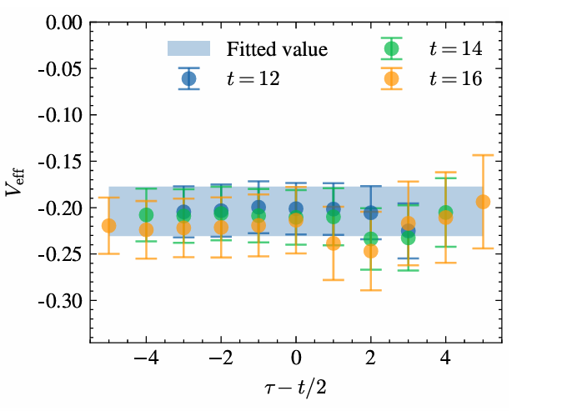
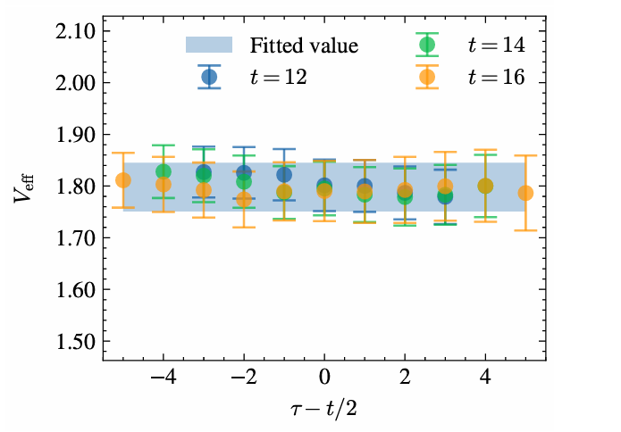
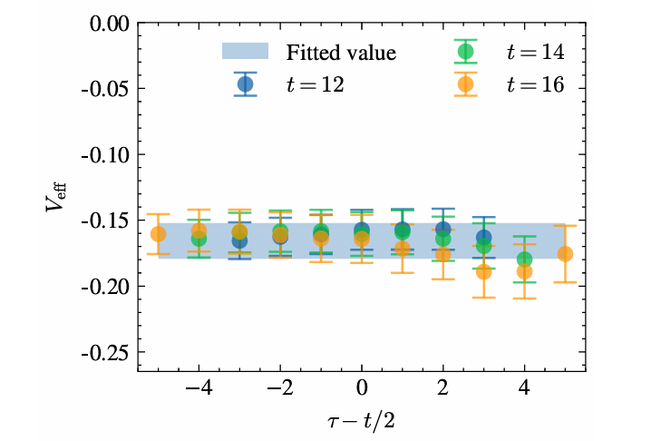

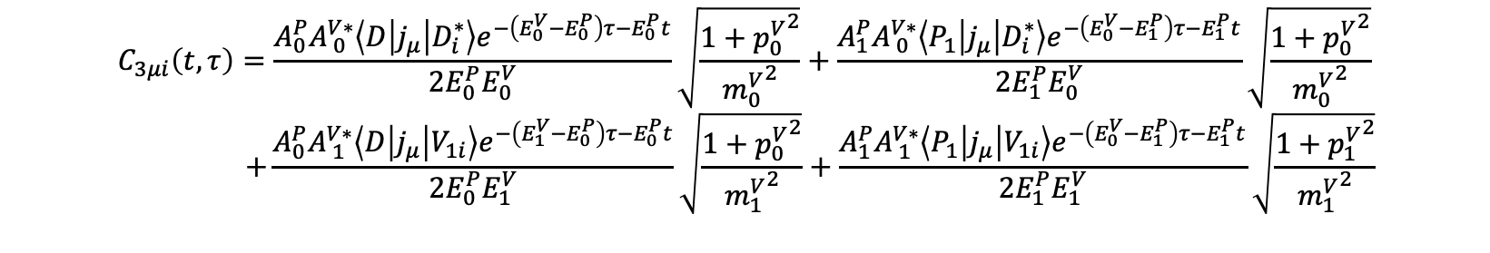
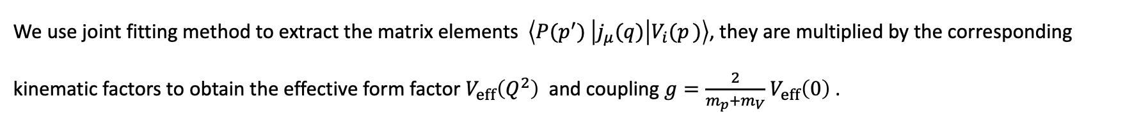
Results
We use joint fitting method to extract the matrix elements $\left\langle {P(p_{ }^{′})}^{ }\left|j_{μ}(q)\right|V_{i}(p_{ })\right\rangle$, they are multiplied by the corresponding kinematic factors to obtain the effective form factor $V_{eff}\left(Q^{2}\right)$ and coupling $g=\frac{2}{m_{p}+m_{V}}$ $V_{eff}\left(0\right)$ .
$$C_{3μi}\left(t,τ\right)=\frac{A_{0}^{P}A_{ 0}^{V∗}\left\langle D\left|j_{μ}\right|D_{i}^{∗}\right\rangle e^{−\left(E_{0}^{V}−E_{0}^{P}\right)τ−E_{0}^{P}t}}{2E_{0}^{P}E_{0}^{V}}\sqrt{\frac{{{1+p}_{0}^{V}}^{2}}{{m_{0}^{V}}^{2}}}+\frac{A_{1}^{P}A_{ 0}^{V∗}\left\langle P_{1}\left|j_{μ}\right|D_{i}^{∗}\right\rangle e^{−\left(E_{0}^{V}−E_{1}^{P}\right)τ−E_{1}^{P}t}}{2E_{1}^{P}E_{0}^{V}}\sqrt{\frac{{{1+p}_{0}^{V}}^{2}}{{m_{0}^{V}}^{2}}}$$
$$+\frac{A_{0}^{P}A_{ 1}^{V∗}\left\langle D\left|j_{μ}\right|V_{1i}\right\rangle e^{−\left(E_{1}^{V}−E_{0}^{P}\right)τ−E_{0}^{P}t}}{2E_{0}^{P}E_{1}^{V}}\sqrt{\frac{{{1+p}_{0}^{V}}^{2}}{{m_{1}^{V}}^{2}}}+\frac{A_{1}^{P}A_{ 1}^{V∗}\left\langle P_{1}\left|j_{μ}\right|V_{1i}\right\rangle e^{−\left(E_{0}^{V}−E_{1}^{P}\right)τ−E_{1}^{P}t}}{2E_{1}^{P}E_{1}^{V}}\sqrt{\frac{{{1+p}_{1}^{V}}^{2}}{{m_{1}^{V}}^{2}}}$$
$$\left\langle D\left|j_{μ}\right|D_{i}^{∗}\right\rangle =\frac{2V_{eff}\left(Q^{2}\right)}{m_{D}+m_{D^{∗}}}ε_{μiαβ}p^{′α}p^{β}$$
Results for $D^{∗+}$and $D^{∗0}$ at ${{\left(Qa\right)}^{2}}^{ }=0.0682$ and $D_{s}^{∗}$at ${{\left(Qa\right)}^{2}}^{ }=0.0685$on ensemble F32P21
8

Slide 11
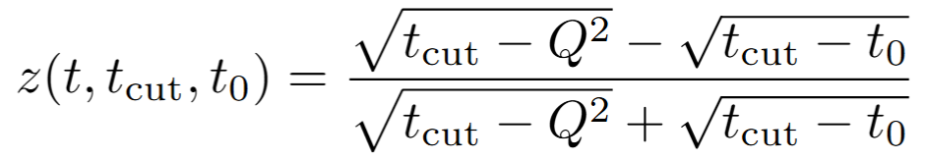
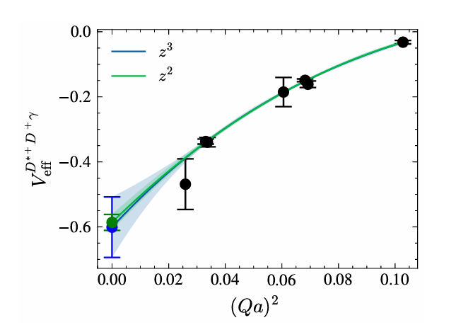
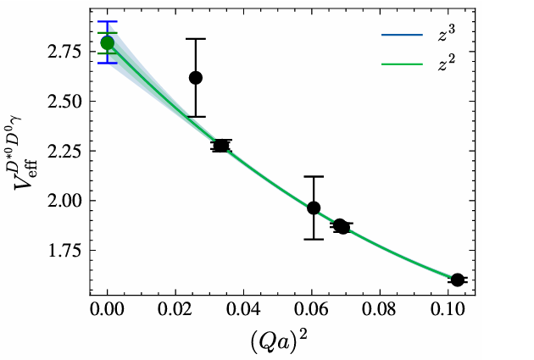
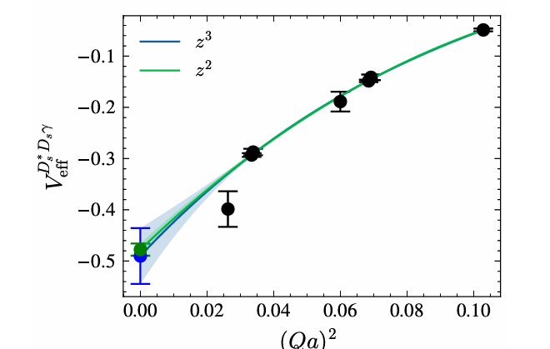
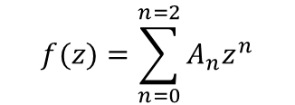
Results
Then extrapolated to $Q^{2}=0$ using the model-independent z-expansion method.
Richard J. Hill, Gil Paz, Phys.Rev.D82:113005,(2010)
$$f(z)=\sum_{n=0}^{n=2}{A_{n}z^{n}}$$
Where $t_{cut}={\left(m_{D}+m_{π}\right)}^{2},t_{0}=t_{cut}(1−\sqrt{1+\frac{Q_{max}^{2}}{t_{cut}}})$
Results for $D^{∗+}$,$D^{∗0}$ and $D_{s}^{∗}$at ensemble F32P21
9

Slide 12
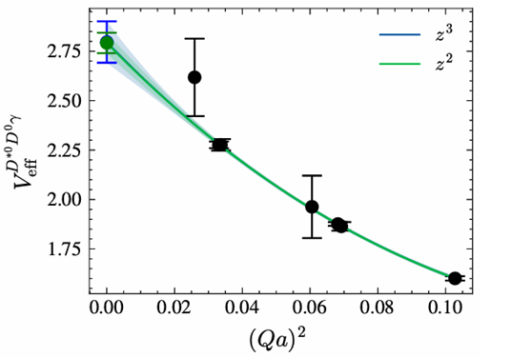
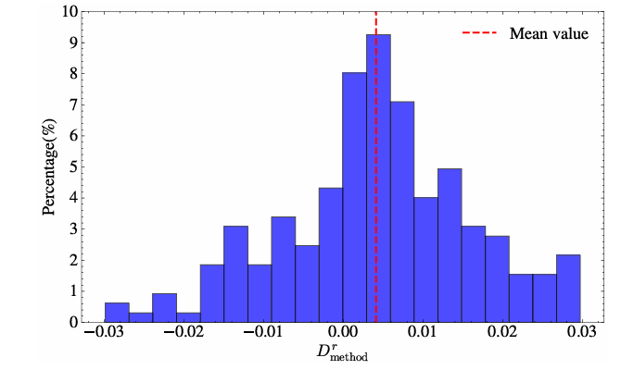
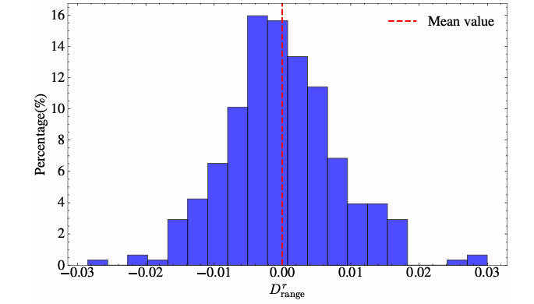
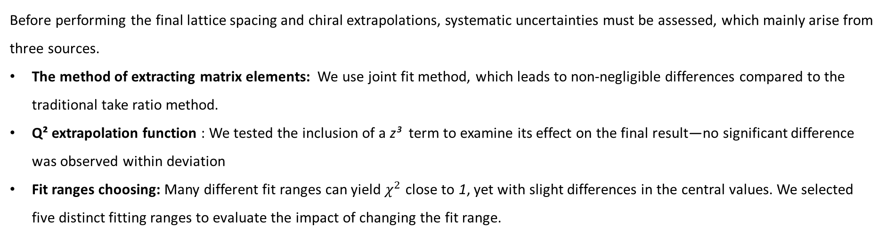
Results
Before performing the final lattice spacing and chiral extrapolations, systematic uncertainties must be assessed, which mainly arise from three sources.
The method of extracting matrix elements: We use joint fit method, which leads to non-negligible differences compared to the traditional take ratio method.
Q² extrapolation function : We tested the inclusion of a z³ term to examine its effect on the final result—no significant difference was observed within deviation
Fit ranges choosing: Many different fit ranges can yield $χ^{2}$ close to 1, yet with slight differences in the central values. We selected five distinct fitting ranges to evaluate the impact of changing the fit range.
10

Slide 13
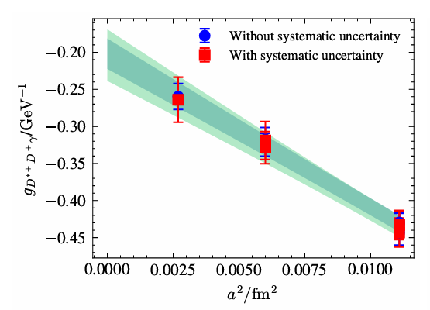
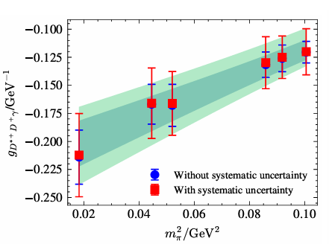
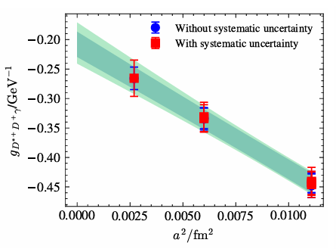
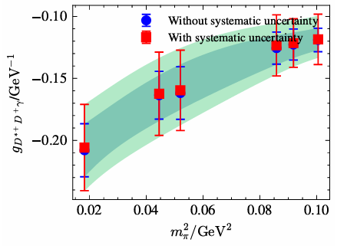
Results
The final physical result was obtained after performing calculations on a total of six ensembles with different pion masses and lattice spacings, followed by corresponding extrapolations.
$V_{eff}\left(a^{2},m_{π}^{2}\right)=V_{eff}\left(0,m_{π,phy}^{2}\right)+{Aa}^{2}+B(m_{π}^{2}−m_{π,phy}^{2})$
$$V_{eff}\left(a^{2},m_{π}^{2}\right)=V_{eff}\left(0,m_{π,phy}^{2}\right)+{Aa}^{2}+B\left(m_{π}^{2}−m_{π,phy}^{2}\right)+C\left(m_{π}^{2}ln(m_{π}^{2})−m_{π,phy}^{2}ln(m_{π,phy}^{2})\right)$$
We did not observe the significant effect of the $ln$ term in this extrapolation.
11

Slide 14
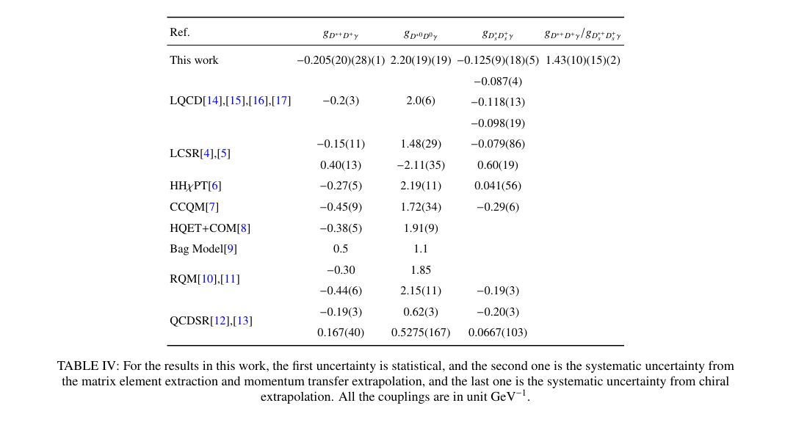
Results
Finally get results
Decay widths derived from our results are $Γ_{D^{∗+}→D^{+}γ}$=0.255(97) keV, $Γ_{D^{∗0}→D^{0}γ}$=29.4(7.2) keV and $Γ_{D^{∗+}→D^{+}γ}$=0.102(34) keV. And branching ratio B($D_{ }^{∗+}→{D_{ }^{+}}_{ }^{ }γ$) = 0.3(1) % , which is significantly lower than experimental value 1.7(5) % .
12

Slide 15

Radiative decay of $D_{ }^{∗+}→{D_{ }^{+}}_{ }^{ }γ,D_{ }^{∗0}→D_{ }^{0}γ$ and $D_{ s}^{∗}→D_{ s}^{ }γ$
Electromagnetic radius and magnetic moments of${ D}_{ }^{∗+}, D_{ }^{+} ,D_{ s}^{∗}$and $D_{ s}^{ }$mesons

Slide 16
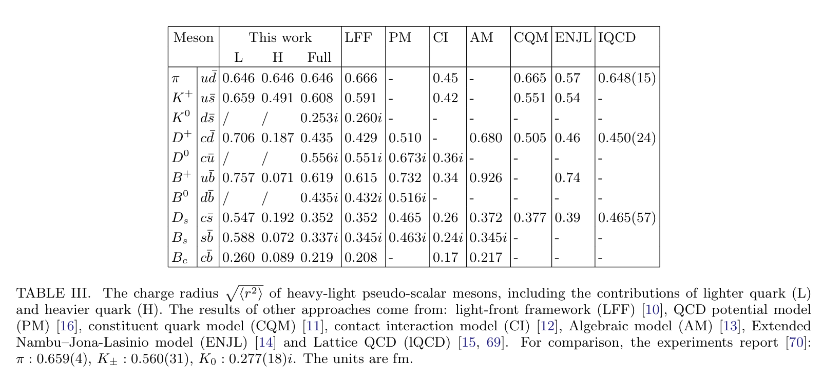
Background-Th, Ph
The study of charm-light mesons charge radius is challenging experimentally due to their large masses and short lifetimes. Various approaches, including phenomenological models and non-perturbative methods have been used to predict their charge radius.
Xu, Yin-Zhen , JHEP07(2024)118
13

Slide 17
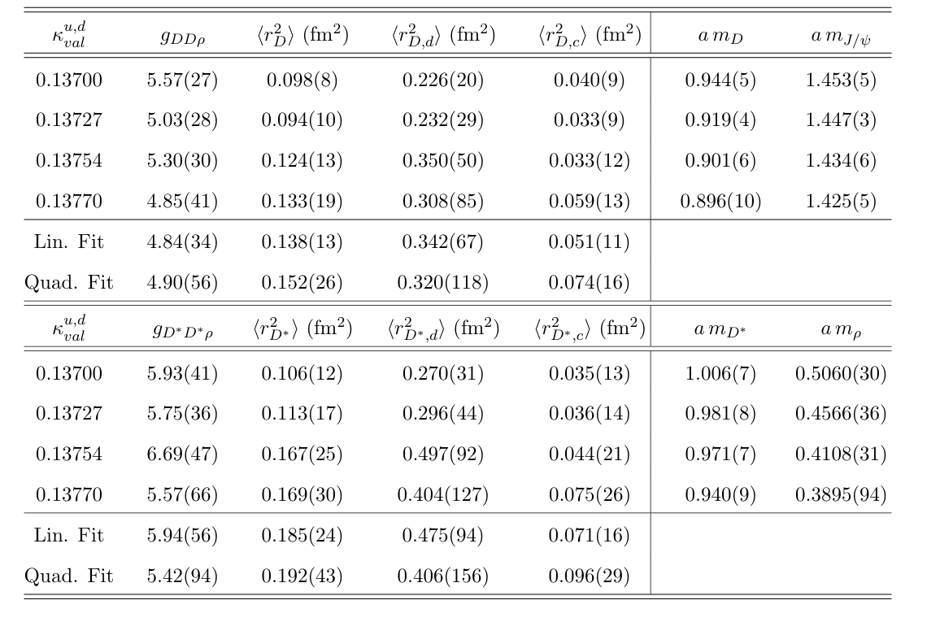
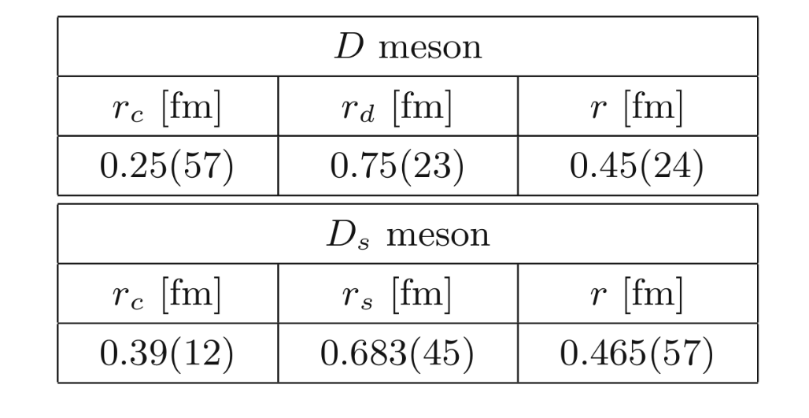
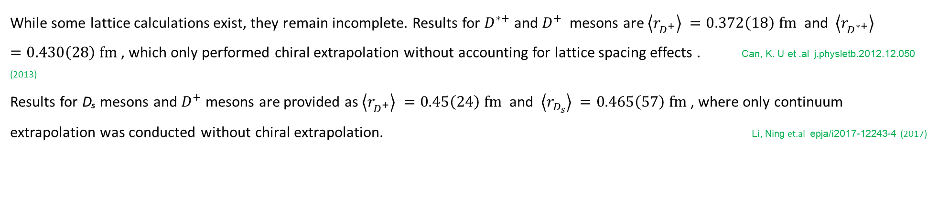
Background-lat
While some lattice calculations exist, they remain incomplete. Results for $D^{∗+}$ and ${D^{+}}^{ }$ mesons are $\left\langle r_{D^{+}}^{ }\right\rangle =0.372\left(18\right) fm^{ }$ and $\left\langle r_{D^{∗+}}^{ }\right\rangle =0.430\left(28\right) fm^{ }$, which only performed chiral extrapolation without accounting for lattice spacing effects . Can, K. U et .al j.physletb.2012.12.050 (2013)
Results for Dₛ mesons and $D^{+}$ mesons are provided as $\left\langle r_{D^{+}}^{ }\right\rangle =0.45\left(24\right) fm^{ }$ and $\left\langle r_{D_{s}^{ }}^{ }\right\rangle =0.465\left(57\right) fm^{ }$, where only continuum extrapolation was conducted without chiral extrapolation. Li, Ning et.al epja/i2017-12243-4 (2017)
14

Slide 18
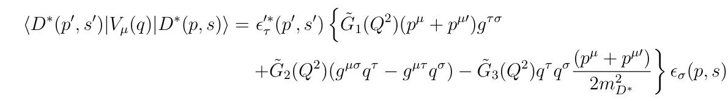

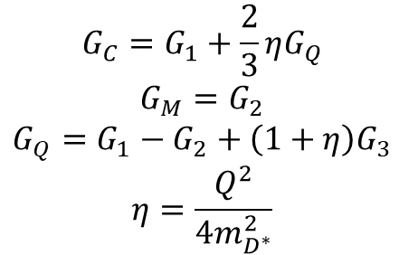
Formula
The form factor can be obtained by decomposing the matrix elements.
For pseudoscalar meson
$$\left\langle D\left(p\right)\left|V^{u}\left(q\right)\right|D(p^{′})\right\rangle ={\left(p+p^{′}\right)}^{u}G_{C}(Q^{2})$$
For vector meson
$$G_{C}=G_{1}+\frac{2}{3}ηG_{Q}$$
$$G_{M}=G_{2}$$
$$G_{Q}=G_{1}−G_{2}+\left(1+η\right)G_{3}$$
$$η=\frac{Q^{2}}{4m_{D^{∗}}^{2}}$$
Define charge radius
$$r^{2}=−6\frac{∂G_{C}}{∂Q^{2}}{\left.​\right|}_{Q^{2}=0}$$
15

Slide 19
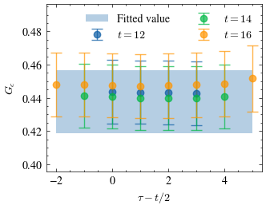
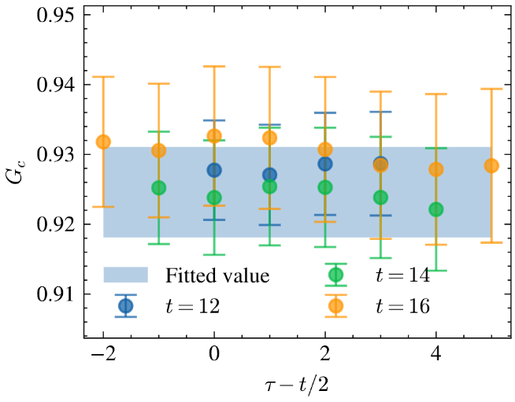
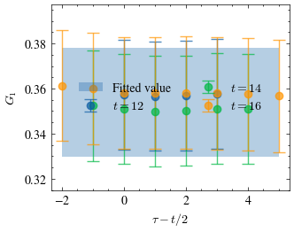
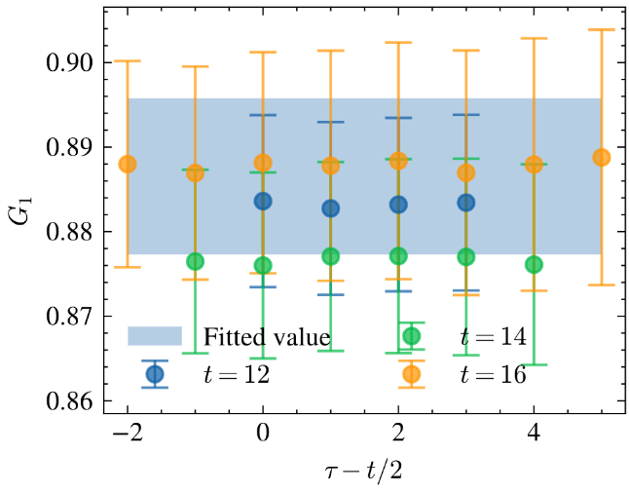
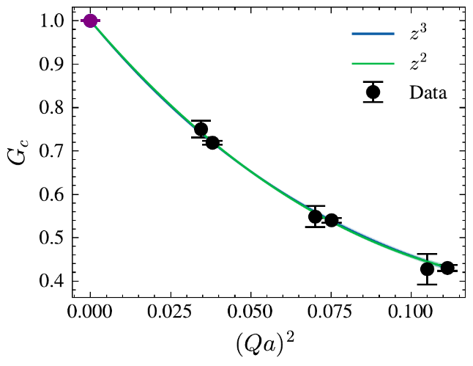
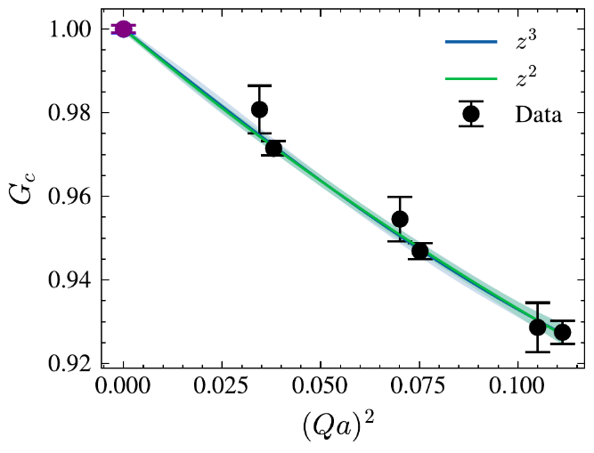
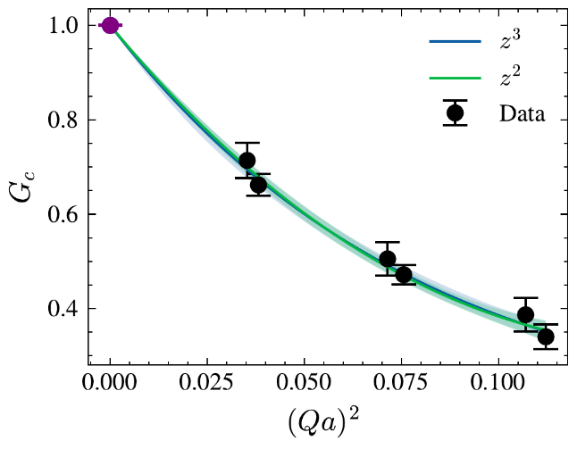
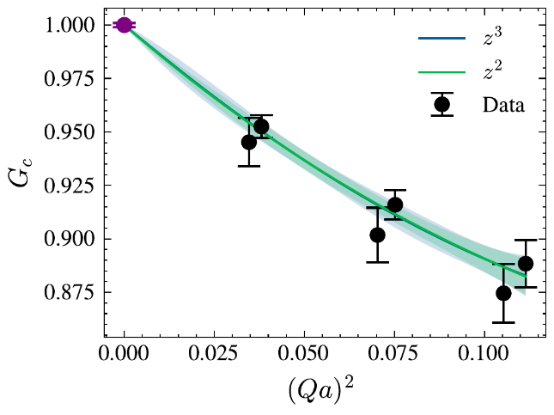








Preliminary results
$$D^{l} {(Qa)}^{2}=\text{0.11134}$$
$$D^{c} {(Qa)}^{2}=\text{0.11134}$$
$D^{∗l}$ ${(Qa)}^{2}=\text{0.11216}$
$D^{∗c}$ ${(Qa)}^{2}=\text{0.11216}$
$$D^{l} \text{z}\text{−}\text{expansion}$$
$D^{c}$ z-expansion
$D^{∗l}$ $\text{z}\text{−}\text{expansion}$
$D^{∗c}$ $\text{z}\text{−}\text{expansion}$
16

Slide 20
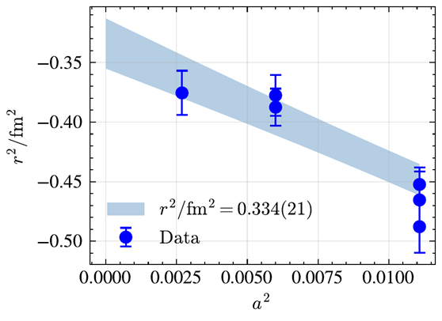
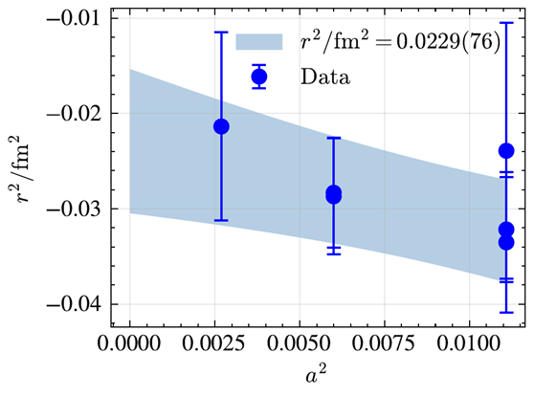
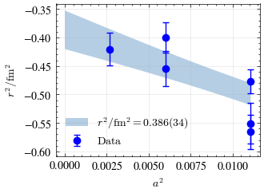









Preliminary results
$$D^{l}$$
$$D^{c}$$
$$D^{∗l}$$
$$D^{∗c}$$
16

Slide 21



2017 work used a=0.085, 0.067 fm
300MeV Wilson-Clover twisted-mass -ETMC
Eur. Phys. J. A (2017) 53: 56
2012 a=0.09 fm 300-700 MeV Clover
Phys.Lett.B 719 (2013) 103-109
Preliminary result | $$r_{l}^{2}$$ | $$r_{c}^{2}$$ | $$r_{ }^{2}$$ | $$r_{ }^{ }$$ | $${G_{Ml}}_{ }^{ }$$ | $${G_{Mc}}_{ }^{ }$$ | $${G_{M}}_{ }^{ }$$
$$D^{∗+}$$ | $$0.386(34)$$ | $$0.034(13)$$ | $$0.151(11)$$ | $$\text{0.389(15) }$$ | $$\text{3.69(37) }$$ | $$\text{1.55(17) }$$ | $$\text{2.26(17)}$$
$$D_{s}^{∗}$$ | $$0.243(28)$$ | $$0.0464(94)$$ | $$0.111(12)$$ | $$\text{0.335(17)}$$ | $$\text{3.51(22) }$$ | $$\text{1.70(10) }$$ | $$\text{2.303(99)}$$
$$D^{+}$$ | $$0.334(21)$$ | $$0.0229(76)$$ | $$\text{0.1266(86)}$$ | $$\text{0.355(12)}$$
$$D_{s}^{ }$$ | $$0.209(18)$$ | $$0.0219(63)$$ | $$\text{0.0845(72)}$$ | $$\text{0.290(13)}$$
18

Slide 22

Summary
After a comprehensive consideration of the systematic uncertainty from the lattice calculation , Our results for the $g_{D_{ }^{∗+}→{D_{ }^{+}}_{ }^{ }γ}$ is improved eight times compared to previous studies, while the precision for $g_{D_{ }^{∗0}→D_{ }^{0}γ}$ was improved three times. However, by comparing the calculated width of the branches and the total width obtained from the experiment, the obtained value B($D_{ }^{∗+}→{D_{ }^{+}}_{ }^{ }γ$) = 0.3(1) % , which is significantly lower than experimental value 1.7(5) % measured in 1998. We hope that future experimental measurements will provide more clues.
We get preliminary results of charge radii of $D_{ }^{∗+}, D_{ }^{+} ,D_{ s}^{∗}$and $D_{ s}^{ }$and magnetic moments of $D_{ }^{∗+},D_{ s}^{∗}$with high precision ,besides we also estimate deviation brought by different fit range and method. This reveals a part of the quark structure and can be compared with other theoretical calculation results or used as input for a phenomenological model.
19

Slide 23
Thanks

Slide 24












Preliminary results
$$D_{s}^{s} {(Qa)}^{2}=\text{0.07474}$$
$$D_{s}^{c} {(Qa)}^{2}=\text{0.07474}$$
$D_{s}^{∗s}$ ${(Qa)}^{2}=\text{0.07554}$
$D_{s}^{∗c}$ ${(Qa)}^{2}=\text{0.07554}$
$$D_{s}^{s} \text{z}\text{−}\text{expansion}$$
$D_{s}^{c}$z-expansion
$$D_{s}^{∗s} \text{z}\text{−}\text{expansion}$$
$$D_{s}^{∗c} \text{z}\text{−}\text{expansion}$$
16

Slide 25












Preliminary results
$$D_{s}^{s}$$
$$D_{s}^{c}$$
$$D_{s}^{∗s}$$
$$D_{s}^{∗c}$$
16

Slide 26














Preliminary results
$$D_{s}^{∗s} {(Qa)}^{2}=\text{0.037952}$$
$$D_{s}^{∗c} {(Qa)}^{2}=\text{0.037952}$$
$D^{∗l}$ ${(Qa)}^{2}=\text{0.037946}$
$D^{∗c}$ ${(Qa)}^{2}=\text{0.037946}$
$$D_{s}^{∗l} \text{z}\text{−}\text{expansion}$$
$D_{s}^{c}$ z-expansion
$D^{∗l}$ $\text{z}\text{−}\text{expansion}$
$D^{∗c}$ $\text{z}\text{−}\text{expansion}$
16

Slide 27












Preliminary results
$$D^{∗l}$$
$$D^{∗c}$$
$$D_{s}^{∗c}$$
$$D_{S}^{∗c}$$
16

