Slide 1

Identify the two-pole structures from an SU(3) flavor filter
Ying-Bo He
Center for Joint Quantum Studies & Department of Physics Tianjin University
Based on: YBH, X.H.Liu, L.S. Geng, F.K. Guo, J.J. Xie, Phys.Rev.D 113 (2026) 5, L051501

Slide 2
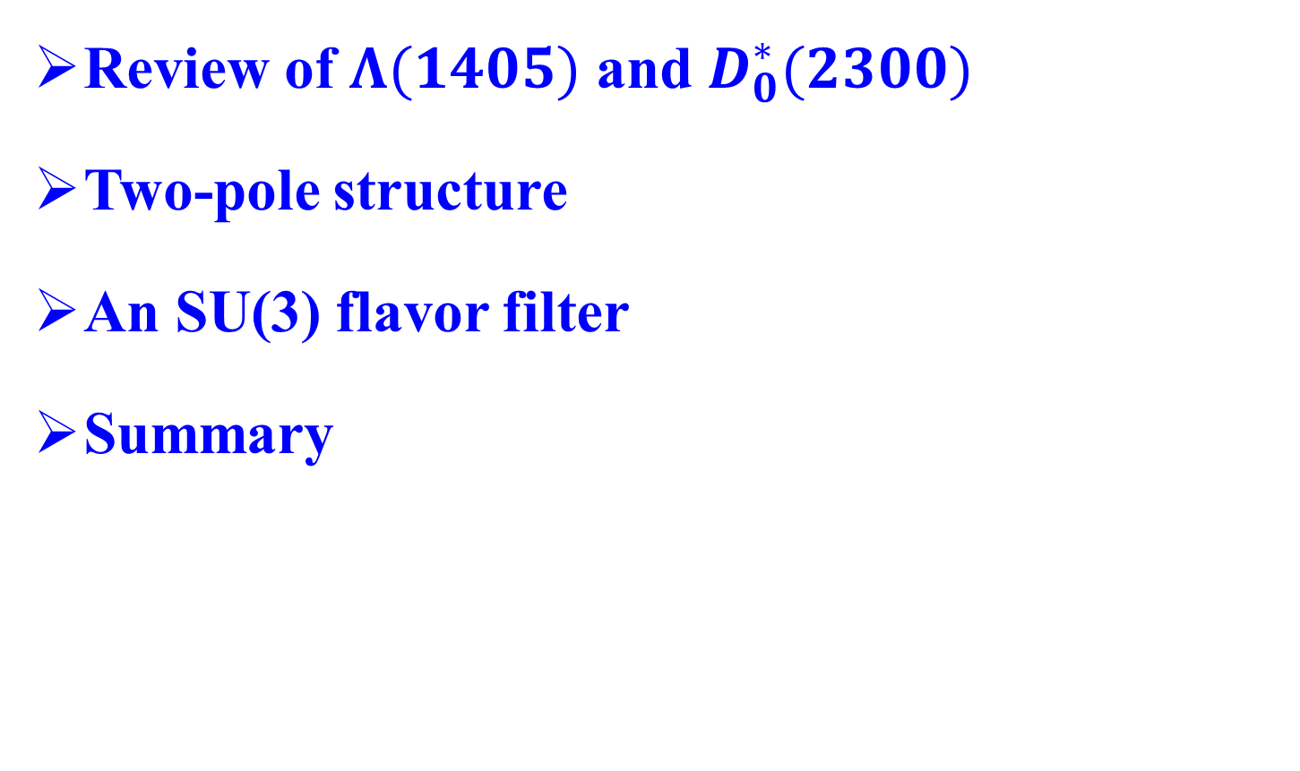
Outline
Review of $Λ(1405)$ and $D_{0}^{∗}(2300)$
Two-pole structure
An SU(3) flavor filter
Summary
Notes:
Firstly a review of lambda1405,
We will focus on the the two pole structure

Slide 3


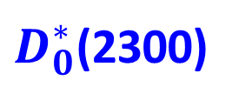
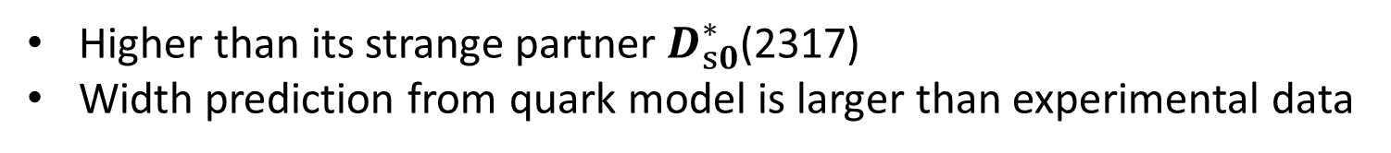
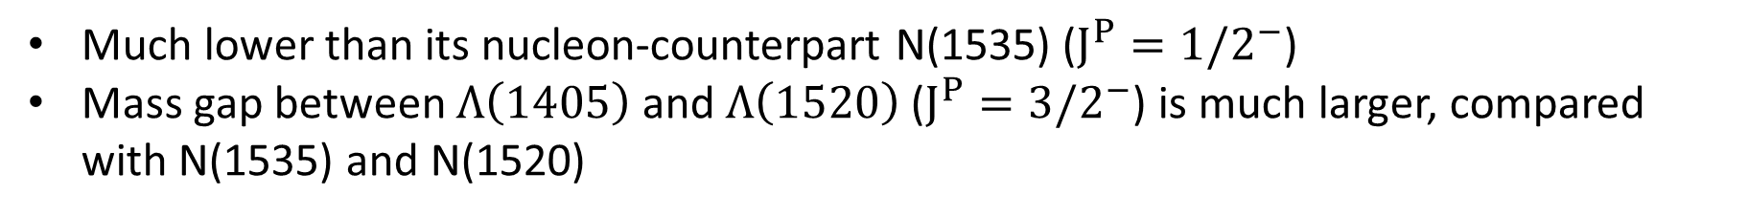
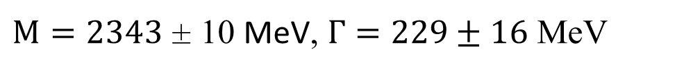
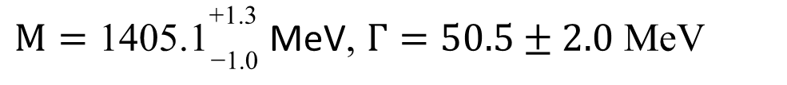
Puzzles in the quark model
𝚲(𝟏𝟒𝟎𝟓):
$$I\left(J^{P}\right)=0(1/2^{−})$$
$M={\text{1405.1}}_{\text{−1.0}}^{\text{+1.3}}$ MeV, $Γ=50.5±2.0$ MeV
Quark model classification: a uds P-wave excitation
Much lower than its nucleon-counterpart N(1535) ($J^{P}=1/2^{−}$)
Mass gap between $Λ\left(1405\right)$ and $Λ\left(1520\right)$ ($J^{P}=3/2^{−}$) is much larger, compared with N(1535) and N(1520)
?
$D_{0}^{∗}$(2300)
$$I\left(J^{P}\right)=1/2(0^{+})$$
$M=2343$ ± 10 MeV, $Γ=229±16$ MeV
Quark model classification: a $c\overline{q}$ P-wave excitation
Higher than its strange partner $D_{s0}^{∗}$(2317)
Width prediction from quark model is larger than experimental data
?

Slide 4

𝚲(𝟏𝟒𝟎𝟓): Dynamically generated state
𝚲(𝟏𝟒𝟎𝟓): Dynamically generated from the $πΣ−\overline{K}N$ coupled channel interaction in UChPT. (Hadronic molecule)
$$T=V+VGT$$
Bethe-Salpeter equation
𝚲(𝟏𝟒𝟎𝟓): two resonance poles
Kaiser, Siegel, Weise, NPA594, 325(1995)
Kaiser, Wass, Weise, NPA612, 297(1997)
Oset & Ramos, NPA635, 99(1998)
Oller, Oset, Ramos, PPNP45, 157(2000)
Oller & Meissner, PLB500, 263(2001)
……
“first exotic hadron”
Notes:
The modern and popular theory concerning the $\Lambda(1405)$ is mainly based on the coupled-channel theory with the chiral SU(3) symmetry in consideration, i.e., the chiral unitary approach~\cite{Kaiser:1995eg,Oset:1997it,Oller:2000fj,Lutz:2001yb}. In this theory, the $\Lambda(1405)$ is interpreted as a dynamically generated state, or a meson-baryon molecular state.
Its story is much longer than the X3872, some people call it the first exotic hdaron

Slide 5



Two-pole Structure
Understanding with group theory
Weinberg-Tomozawa (WT) term dominates the interaction
Decomposed into group irreducible representations
GB Octet
Baryon Octet
attractive
In the SU(3) basis
SU(3) C-G
Symmetry breaking parameter
SU(3) limit
physical limit
$m_{0}=368$ MeV
attractive
$M_{0}=1151$ MeV
$a_{0}=−2.148$
Notes:
The two-pole structure of the $\Lambda(1405)$ can be well understood by means of the SU(3) flavor symmetry and group theory
The WT potential can also be given in a basis of the SU(3) states, and the corresponding coefficient matrix then diagonalizes as
We do not expect dynamic poles in these representations.

Slide 6
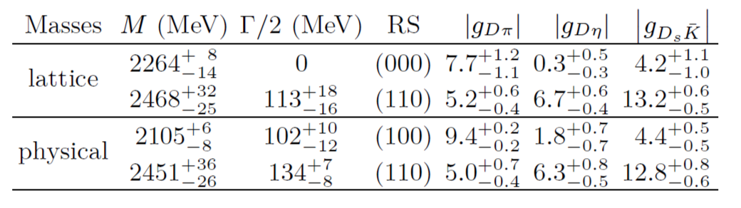

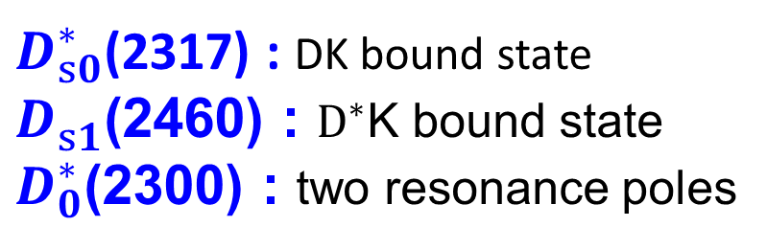
$D_{0}^{∗}$(2300) : Dynamically generated state
$D_{0}^{∗}$(2300) : Dynamically generated from the $DΦ$ coupled channel interaction in UChPT. (Hadronic molecule)
Feng-Kun Guo et al., Phys.Lett.B 641 (2006) 278-285
Feng-Kun Guo et al., Phys.Lett.B 647 (2007) 133-139
Miguel Albaladejo et al., Phys.Lett.B 767 (2017) 465-469
$D_{s0}^{∗}$(2317) : DK bound state
$D_{s1}^{ }$(2460) : $D_{ }^{∗}$K bound state
$D_{0}^{∗}$(2300) : two resonance poles
Notes:
The modern and popular theory concerning the $\Lambda(1405)$ is mainly based on the coupled-channel theory with the chiral SU(3) symmetry in consideration, i.e., the chiral unitary approach~\cite{Kaiser:1995eg,Oset:1997it,Oller:2000fj,Lutz:2001yb}. In this theory, the $\Lambda(1405)$ is interpreted as a dynamically generated state, or a meson-baryon molecular state.
Its story is much longer than the X3872, some people call it the first exotic hdaron

Slide 7
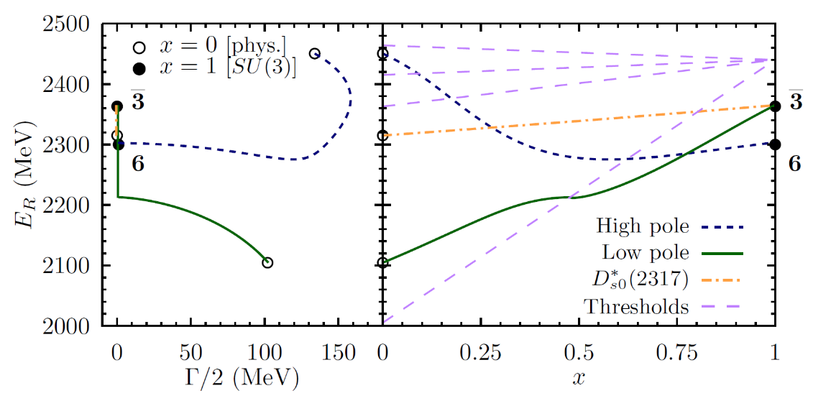

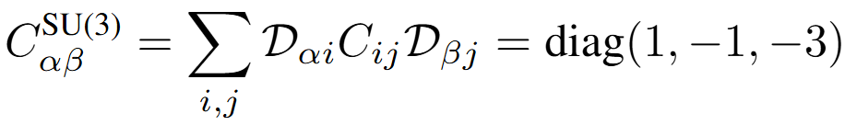
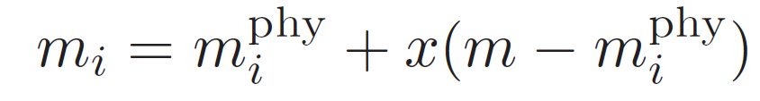



Two-pole Structure
Understanding with group theory
The interaction at LO and NLO
Decomposed into group irreducible representations
Charmed meson
GB Octet
attractive
physical limit
SU(3) limit
In the SU(3) basis, the coefficient of the LO potential:
SU(3) C-G
Lower pole: bound state in SU(3) limit
Higher pole: virtual state in SU(3) limit
Symmetry breaking parameter
attractive
$m_{0}=490$ MeV
$M_{0}=1950$ MeV
$a_{0}=−1.88$
Notes:
The two-pole structure of the $\Lambda(1405)$ can be well understood by means of the SU(3) flavor symmetry and group theory
The WT potential can also be given in a basis of the SU(3) states, and the corresponding coefficient matrix then diagonalizes as
We do not expect dynamic poles in these representations.

Slide 8
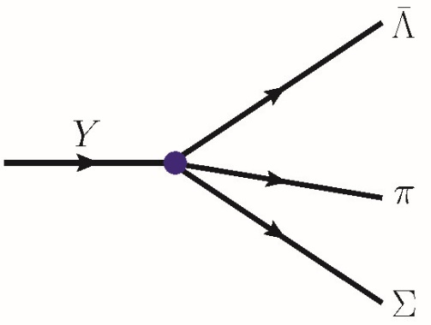
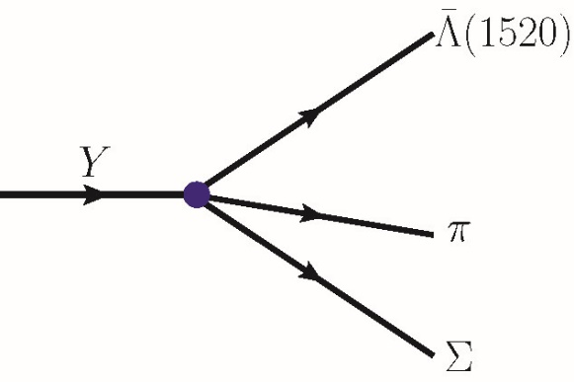
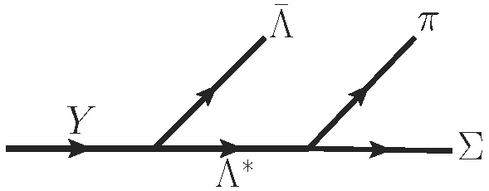
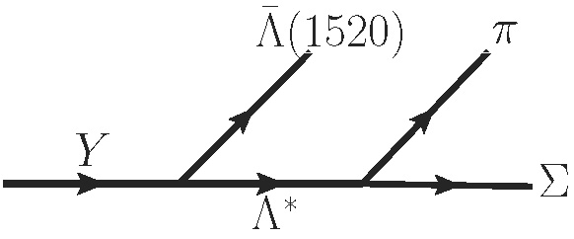
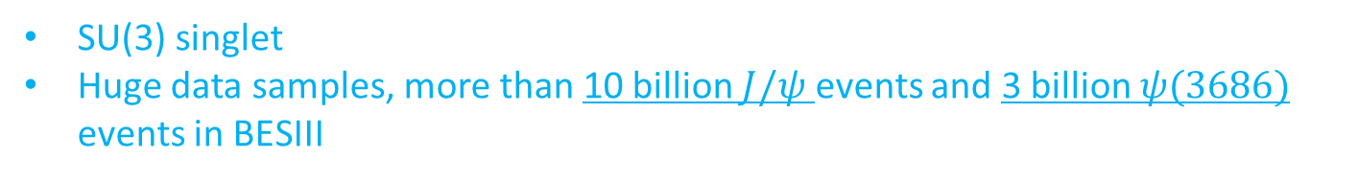


An SU(3) flavor filter on 𝚲(𝟏𝟒𝟎𝟓)
Phys.Rev.D 113 (2026) 5, L051501
Singlet
Octet
Singlet
Singlet
$Σπ$ produced from an SU(3) octet $Λ^{∗}$
$Σπ$ produced from an SU(3) singlet $Λ^{∗}$
SU(3) symmetry requirement
Y: A heavy quarkonium state $J/ψ$, $ψ\left(3686\right)$, $χ_{cJ}$, $Υ(ns)$…
SU(3) singlet
Huge data samples, more than 10 billion $J/ψ$ events and 3 billion $ψ(3686)$ events in BESIII
$Λ(1520)$:generally supposed to be SU(3) singlet with $J^{P}=3/2^{−}$
Notes:
We can take advantage of the SU(3) symmetry to separate the two poles
the corresponding measurements would be accessible in current experiments.

Slide 9
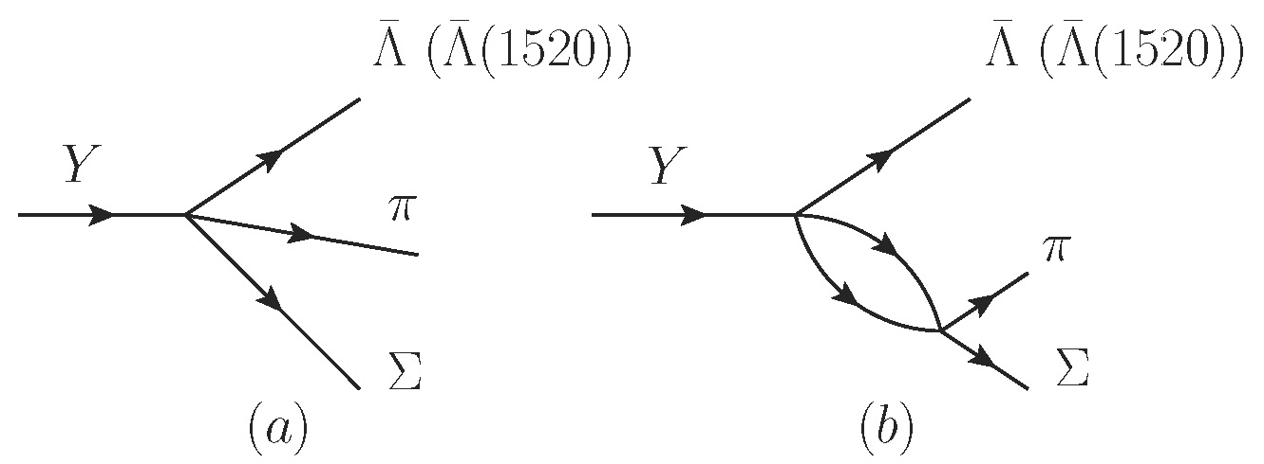



Formalism
Unitary model
+
$$Φ$$
$$B$$
Primary step
FSI
Four coupled channels
$$ΦB:πΣ, \overline{K}N, ηΛ, KΞ$$
Adopt the same subtraction constants as those in [Jido et al., NPA725, 181(2003)]
Notes:
The meson-baryon FSI will be treated with the chiral unitary approach,
the two 1405 poles will show up as dynamically generated states in the coupled-channel dynamics.

Slide 10
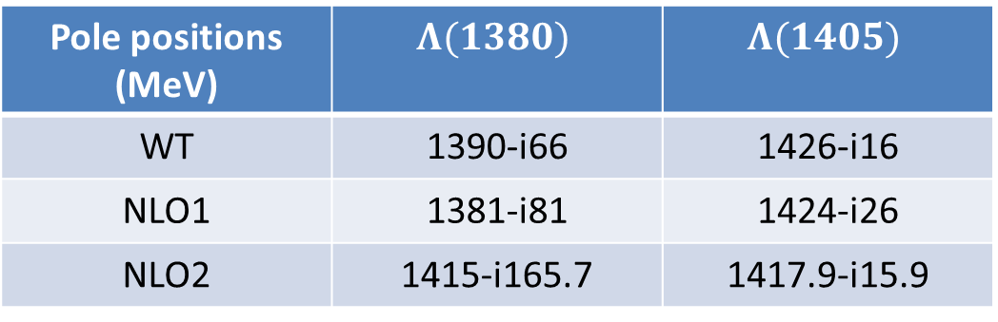

NLO Contributions
Pole positions (MeV) | $$Λ(1380)$$ | $$Λ(1405)$$
WT | 1390-i66 | 1426-i16
NLO1 | 1381-i81 | 1424-i26
NLO2 | 1415-i165.7 | 1417.9-i15.9
Ikeda, Hyodo, Weise, NPA881, 98(2012)
Guo, Kamiya, Mai, Meissner, PLB846,138264(2023)
Octet pole
$$J/ψ→\overline{Λ}Σπ$$
Singlet pole
$$J/ψ→\overline{Λ}(1520)Σπ$$

Slide 11
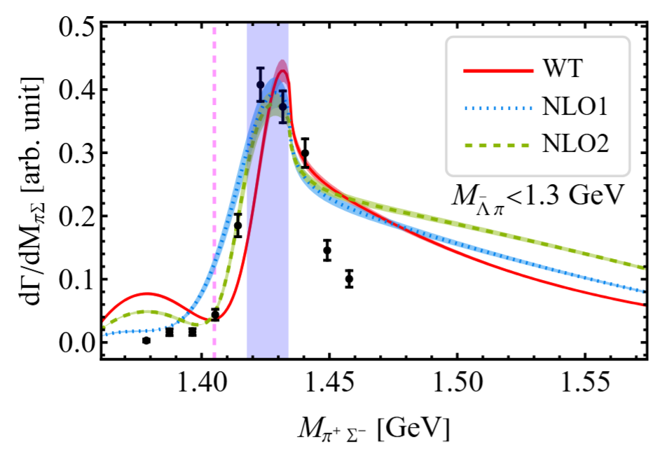
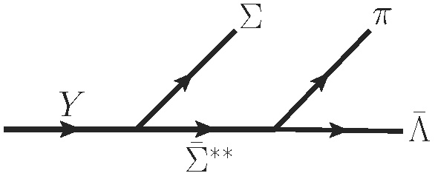



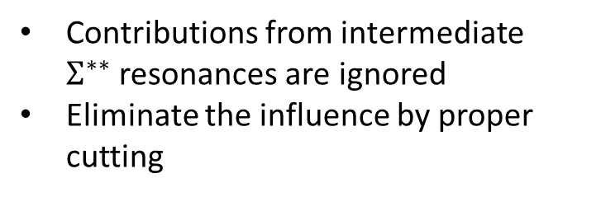
Data & Model
1405 MeV
Contributions from intermediate $Σ^{∗∗}$resonances are ignored
Eliminate the influence by proper cutting
Dalitz plots of $J/ψ→\overline{Λ}Σπ$
$Σ(1385)$?
$Λ(1405)$ region
BESIII, arXiv:2306.10319

Slide 12
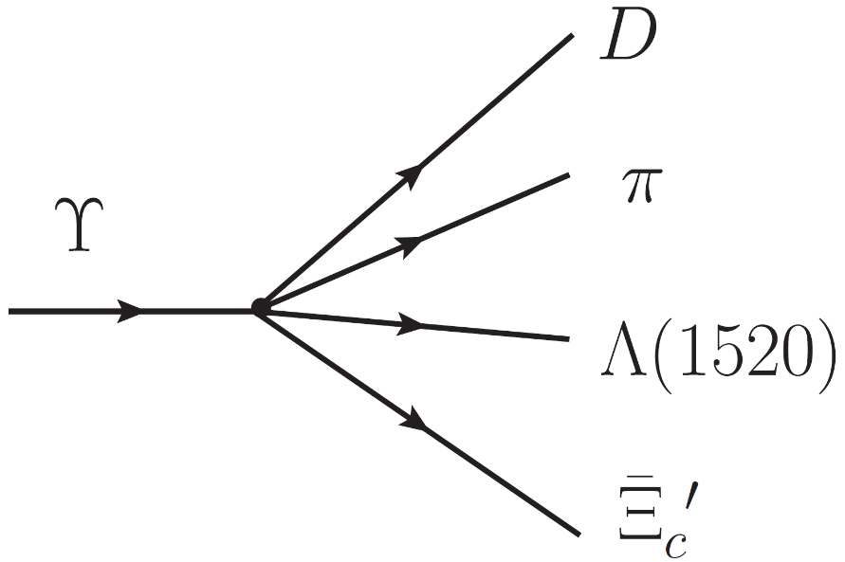
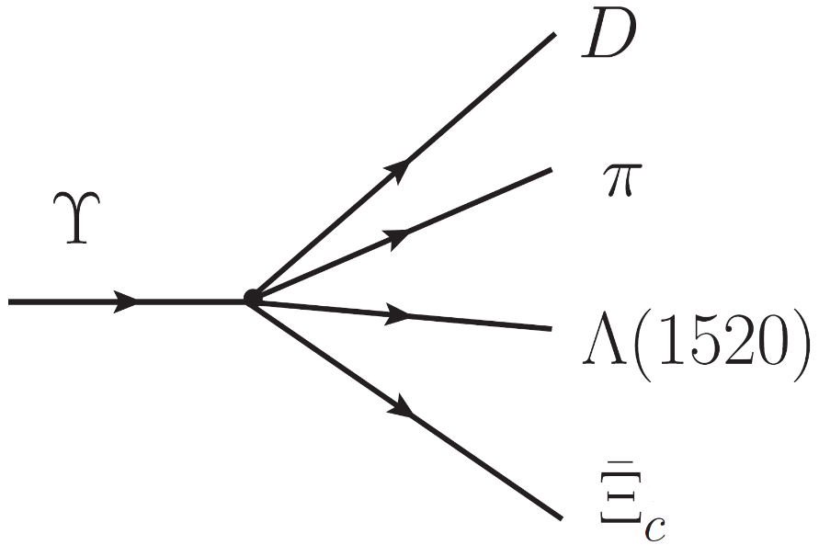
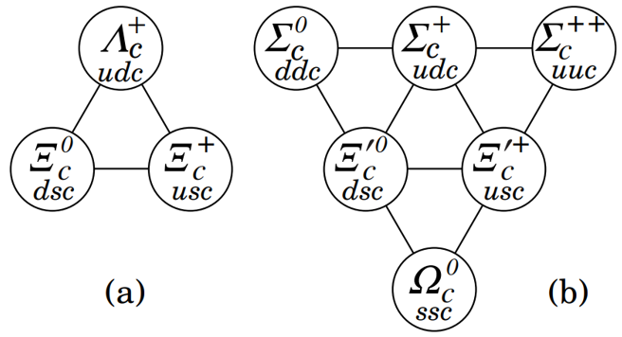


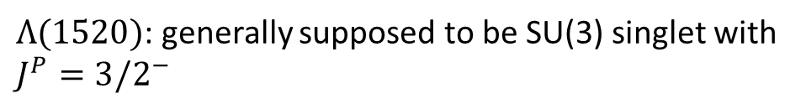
An SU(3) flavor filter on $D_{0}^{∗}(2300)$ in strong decay
Sextet
Antitriplet
Singlet
Singlet
Antisextet
Triplet
$Dπ$ produced from an SU(3) sextet $D^{∗}$
$Dπ$ produced from an SU(3) antitriplet $D^{∗}$
SU(3) symmetry requirement
ϒ: bottonium, SU(3) singlet
$Λ(1520)$: generally supposed to be SU(3) singlet with $J^{P}=3/2^{−}$
Charmed baryons antitriplet and sextet
Notes:
We can take advantage of the SU(3) symmetry to separate the two poles
the corresponding measurements would be accessible in current experiments.

Slide 13
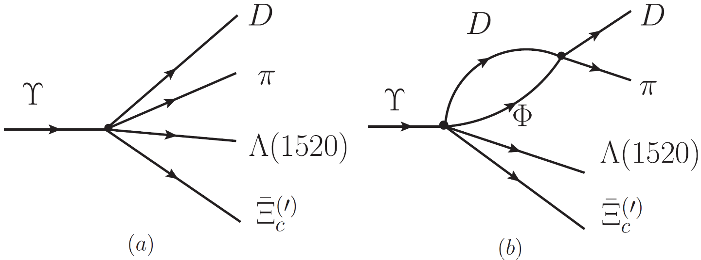
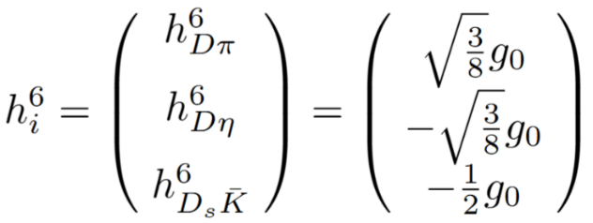
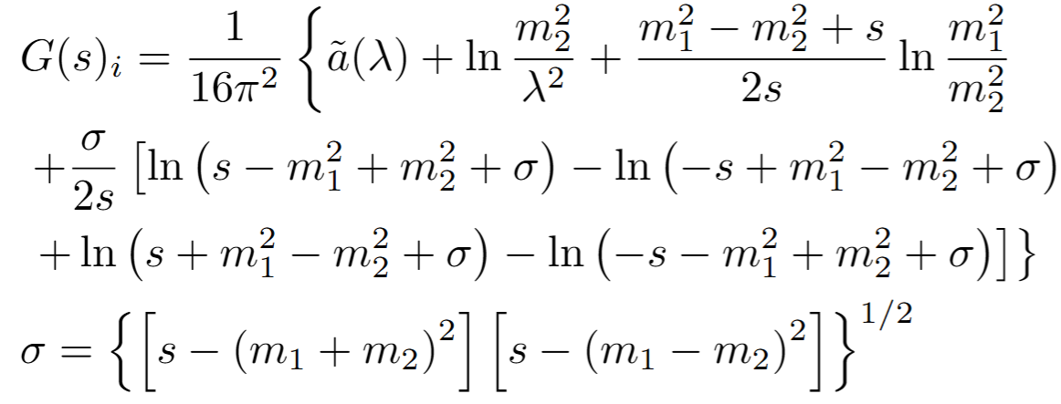



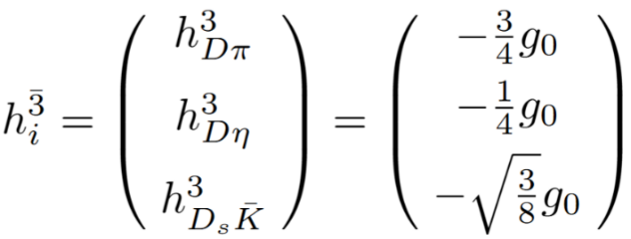
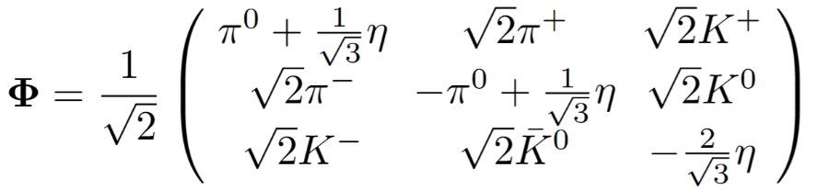
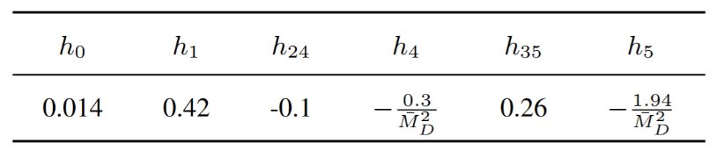
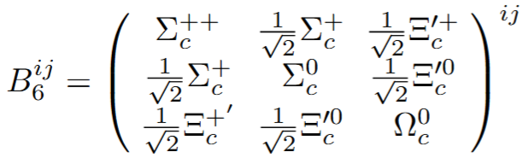
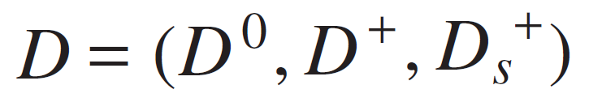


Formalism
Unitary model
+
Primary step
FSI
Tree level amplitude
The relative strength for
three $DΦ$ channels
Flavour structure
Phys.Lett.B 767 (2017) 465-469
Notes:
The meson-baryon FSI will be treated with the chiral unitary approach,
the two 1405 poles will show up as dynamically generated states in the coupled-channel dynamics.

Slide 14
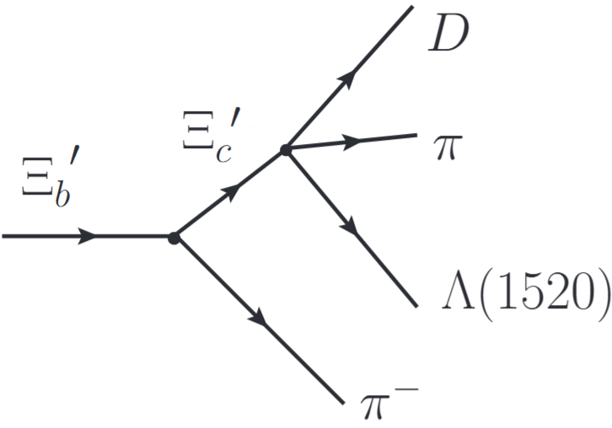
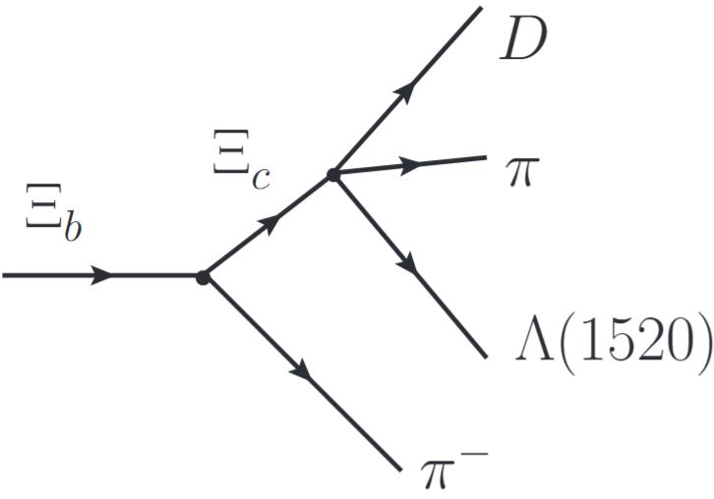
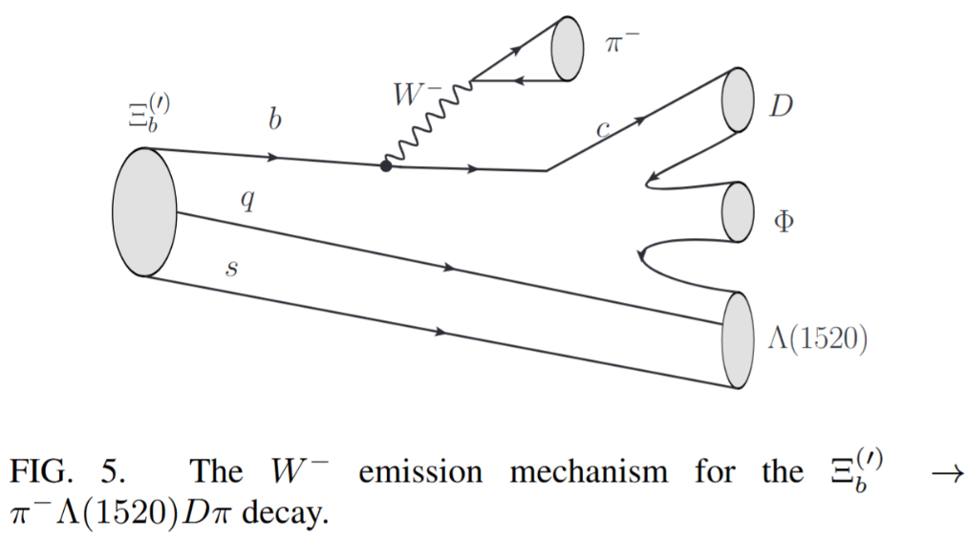


An SU(3) flavor filter on $D_{0}^{∗}(2300)$ in weak decay
Sextet
Antitriplet
Sextet
Antitriplet
Sextet
Antitriplet
$Dπ$ produced from an SU(3) sextet $D^{∗}$
$Dπ$ produced from an SU(3) triplet $D^{∗}$
Notes:
We can take advantage of the SU(3) symmetry to separate the two poles
the corresponding measurements would be accessible in current experiments.

Slide 15
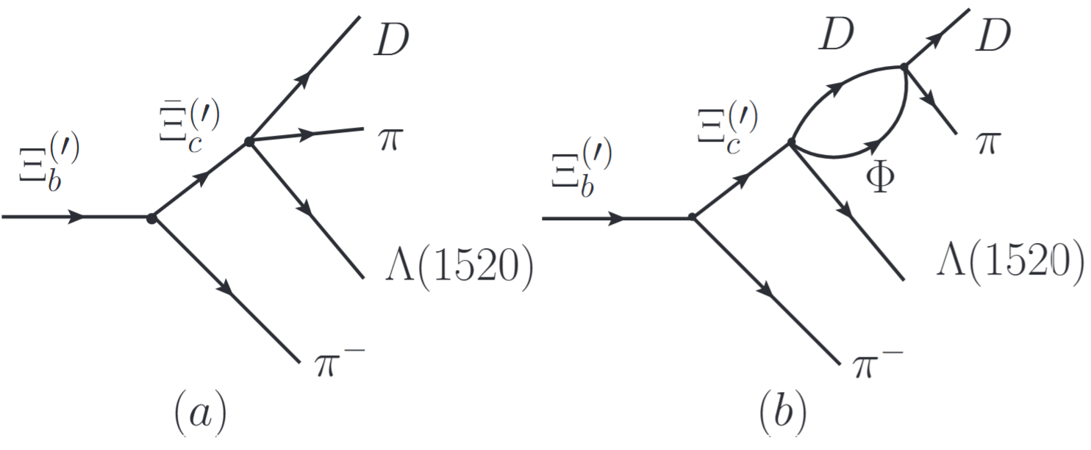
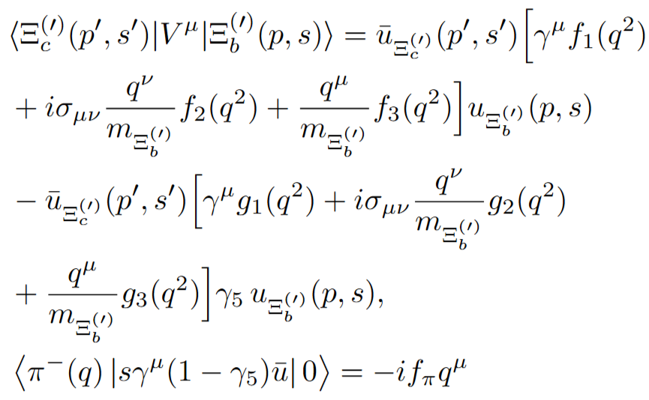
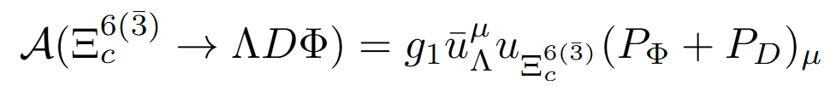
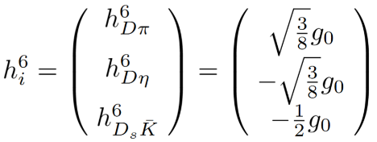


Formalism
+
Primary step
FSI
The weak vertex
The strong vertex
The relative strength for three $DΦ$ channels
Hong-Wei Ke et al.,
Phys.Rev.D 109 (2024) 7, 073006
Notes:
The meson-baryon FSI will be treated with the chiral unitary approach,
the two 1405 poles will show up as dynamically generated states in the coupled-channel dynamics.

Slide 16
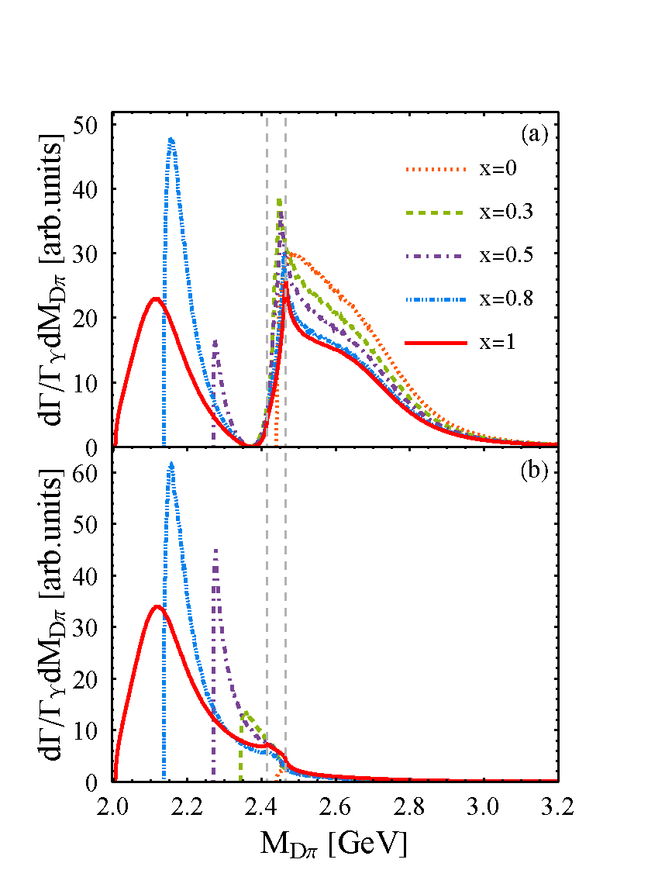






An SU(3) flavor filter
Symmetry breaking parameter “x”
$D_{0}^{∗}(2451)$
Sextet production process
Antitriplet production process
$D_{0}^{∗}(2100)$
$m_{0}=490$ MeV
SU(3) limit
physical limit
$M_{0}=1950$ MeV
Notes:
As $x$ increases, the two octet poles begin to separate, and finally evolve into the $\Lambda(1405)$ and $\Lambda(1680)$ states in the physical limit. As expected, the lower singlet pole does not appear in the $\pi\Sigma$ spectrum when $x=0$ due to the flavor symmetry constraint. It is also because that the singlet pole mass is lower than the threshold ($m_0+M_0$) in the SU(3) limit. As $x$ increases, the flavor symmetry is broken and the singlet pole begins to emerge. However, even in the physical limit, the lower pole $\Lambda(1380)$ is still insignificant compared with the higher pole $\Lambda(1405)$
On the other hand, for the $J/\psi\to \Bar{\Lambda}(1520)\Sigma\pi$ decays, the lower pole $\Lambda(1380)$ is more significant compared with the higher pole in the physical limit, and the higher pole $\Lambda(1405)$ behaves as a small dip due to the destructive interference, which can be seen from Fig.~\ref{Jpsi-Lambda}(b). As a result, we can filter out the $\Lambda(1380)$ state in such a process.

Slide 17
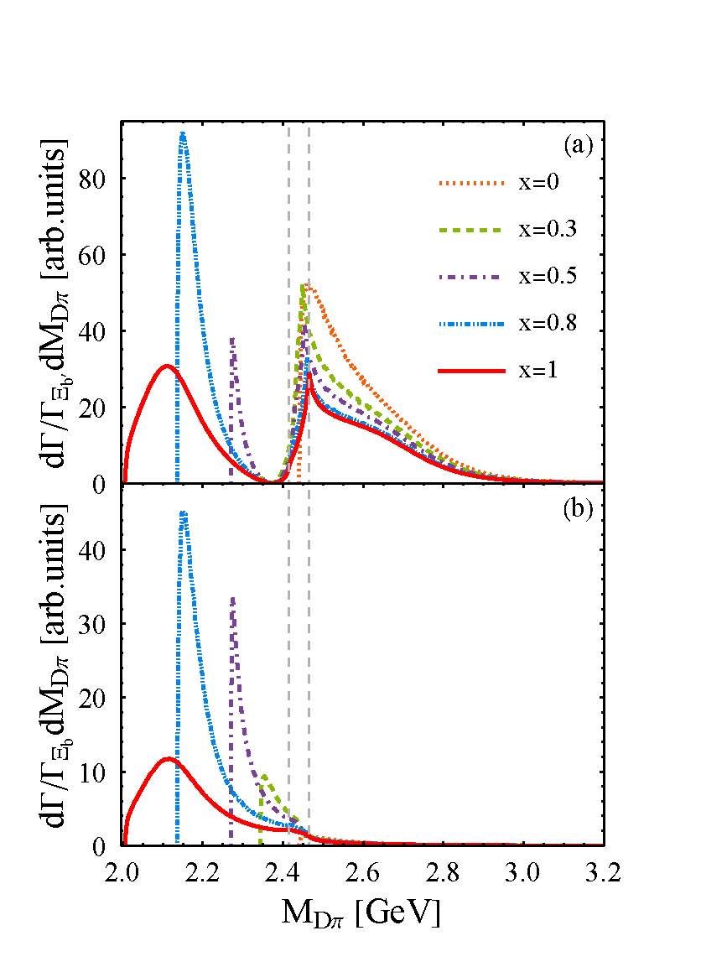




An SU(3) flavor filter
Symmetry breaking parameter “x”
Sextet production process
$D_{0}^{∗}(2451)$
Antitriplet production process
$D_{0}^{∗}(2100)$
$m_{0}=490$ MeV
SU(3) limit
physical limit
$M_{0}=1950$ MeV
Notes:
As $x$ increases, the two octet poles begin to separate, and finally evolve into the $\Lambda(1405)$ and $\Lambda(1680)$ states in the physical limit. As expected, the lower singlet pole does not appear in the $\pi\Sigma$ spectrum when $x=0$ due to the flavor symmetry constraint. It is also because that the singlet pole mass is lower than the threshold ($m_0+M_0$) in the SU(3) limit. As $x$ increases, the flavor symmetry is broken and the singlet pole begins to emerge. However, even in the physical limit, the lower pole $\Lambda(1380)$ is still insignificant compared with the higher pole $\Lambda(1405)$
On the other hand, for the $J/\psi\to \Bar{\Lambda}(1520)\Sigma\pi$ decays, the lower pole $\Lambda(1380)$ is more significant compared with the higher pole in the physical limit, and the higher pole $\Lambda(1405)$ behaves as a small dip due to the destructive interference, which can be seen from Fig.~\ref{Jpsi-Lambda}(b). As a result, we can filter out the $\Lambda(1380)$ state in such a process.

Slide 18
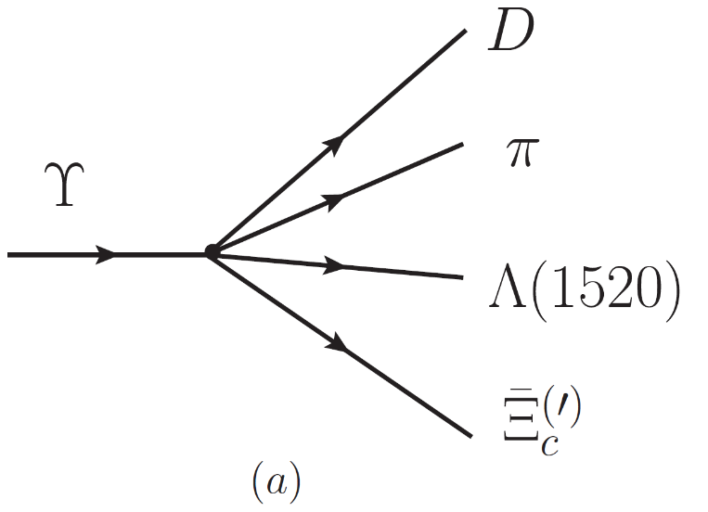
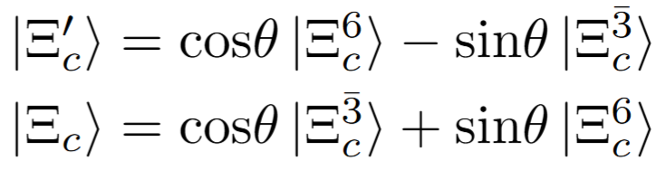


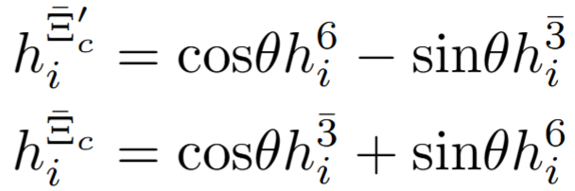
Mixing angle
Effects of the mixing angle ${\text{θ}}_{c}^{ }$ of $Ξ_{c}^{′}$ and $Ξ_{c}^{ }$ in strong decay
Coefficient in ${\tilde{V}}_{i}$ without ${\text{θ}}_{c}^{ }$
Coefficient in ${\tilde{V}}_{i}$ with ${\text{θ}}_{c}^{ }$

Slide 19
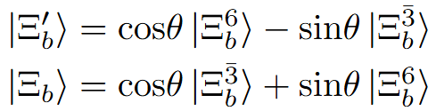
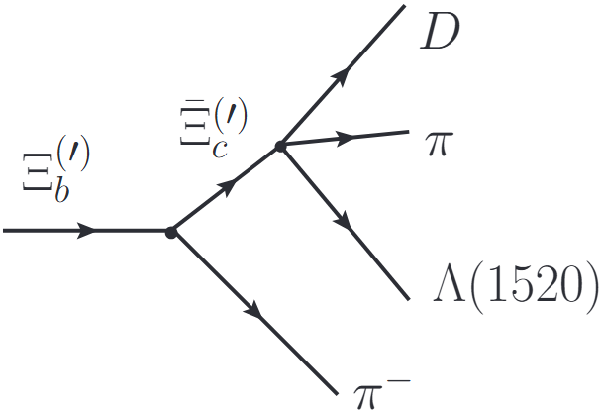
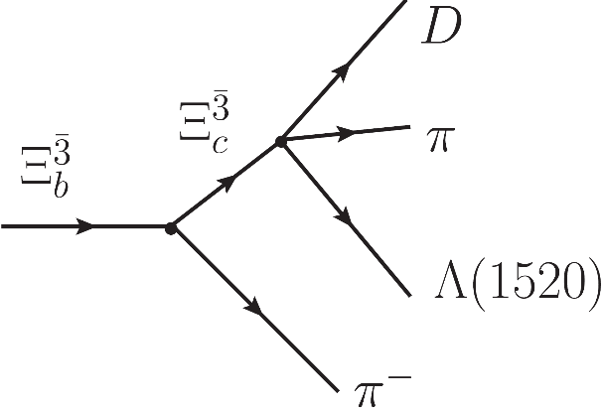
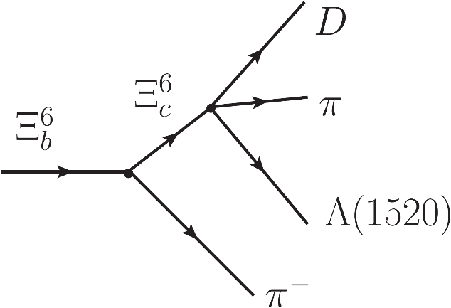
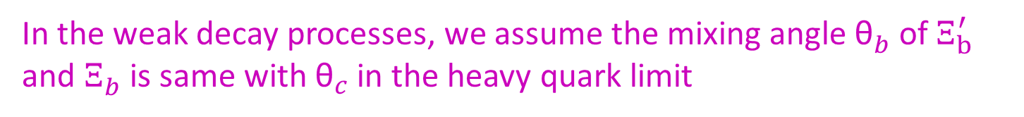
Formalism
In the weak decay processes, we assume the mixing angle ${\text{θ}}_{b}^{ }$ of $Ξ_{b}^{′}$ and $Ξ_{b}^{ }$ is same with ${\text{θ}}_{c}^{ }$ in the heavy quark limit
=
+

Slide 20


An SU(3) flavor filter
$Dπ$ invariant mass distribution with mixing angle ${\text{θ}}_{ }^{ }$

Slide 21


An SU(3) flavor filter
$Dη$ and $D_{s}\overline{K}$ invariant mass distribution with mixing angle ${\text{θ}}_{ }^{ }$

Slide 22

Summary
An SU(3) flavor filter is proposed to identify the two-pole structure of $Λ(1405/1380)$ and $D_{0}^{∗}\left(2100/2451\right)$.
The two poles are dynamically generated from different irreducible representations.
We provide a theoretically feasible experimental scheme for the direct observation of the possible flavor-sextet meson in the invariant mass spectrum.
Thanks!

Slide 23

Formalism
Unitary model
Coefficient in ${\tilde{V}}_{i}$

Slide 24




Parameters of the model
For $J/ψ$ decays, branching fractions of four channels $\overline{Λ}Σπ$, $\overline{Λ}N\overline{K}$, $\overline{Λ}Λη$ and $\overline{Σ}N\overline{K}$ are used for the fitting
For $ψ(3686)$ decays
Braching fractions of $J/ψ$ decay modes
PDG 2022

Slide 25





NLO Contributions
Pseudoscalar meson octet scattering off light baryon octet
$$WT$$
$$Born term$$
$$NLO contact$$
Ikeda, Hyodo, Weise, NPA881, 98(2012)
Guo, Kamiya, Mai, Meissner, PLB846,138264(2023)
Scheme 1: Born terms + NLO contact terms (NLO1)
Scheme 2: NLO contact terms (NLO2)

