Slide 1
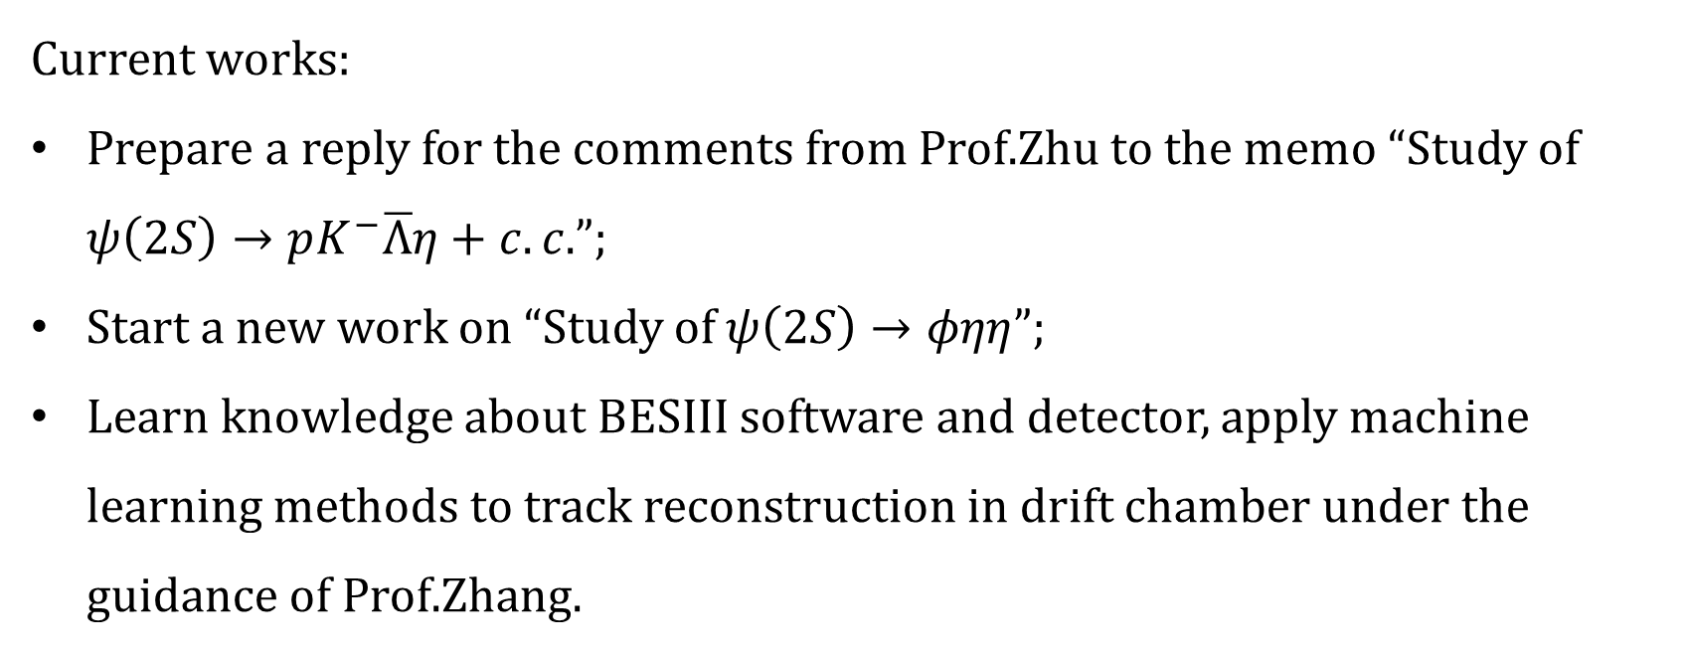
Current works:
Prepare a reply for the comments from Prof.Zhu to the memo “Study of $ψ\left(2S\right)→pK^{−}\overline{Λ}η+c.c.$”;
Start a new work on “Study of $ψ\left(2S\right)→φηη$”;
Learn knowledge about BESIII software and detector, apply machine learning methods to track reconstruction in drift chamber under the guidance of Prof.Zhang.

