Slide 1
RoceV2 on Trigger Core Board
10 GbE & 40 GbE Implementation
Sheng Dong
dongsheng@ihep.ac.cn

Slide 2
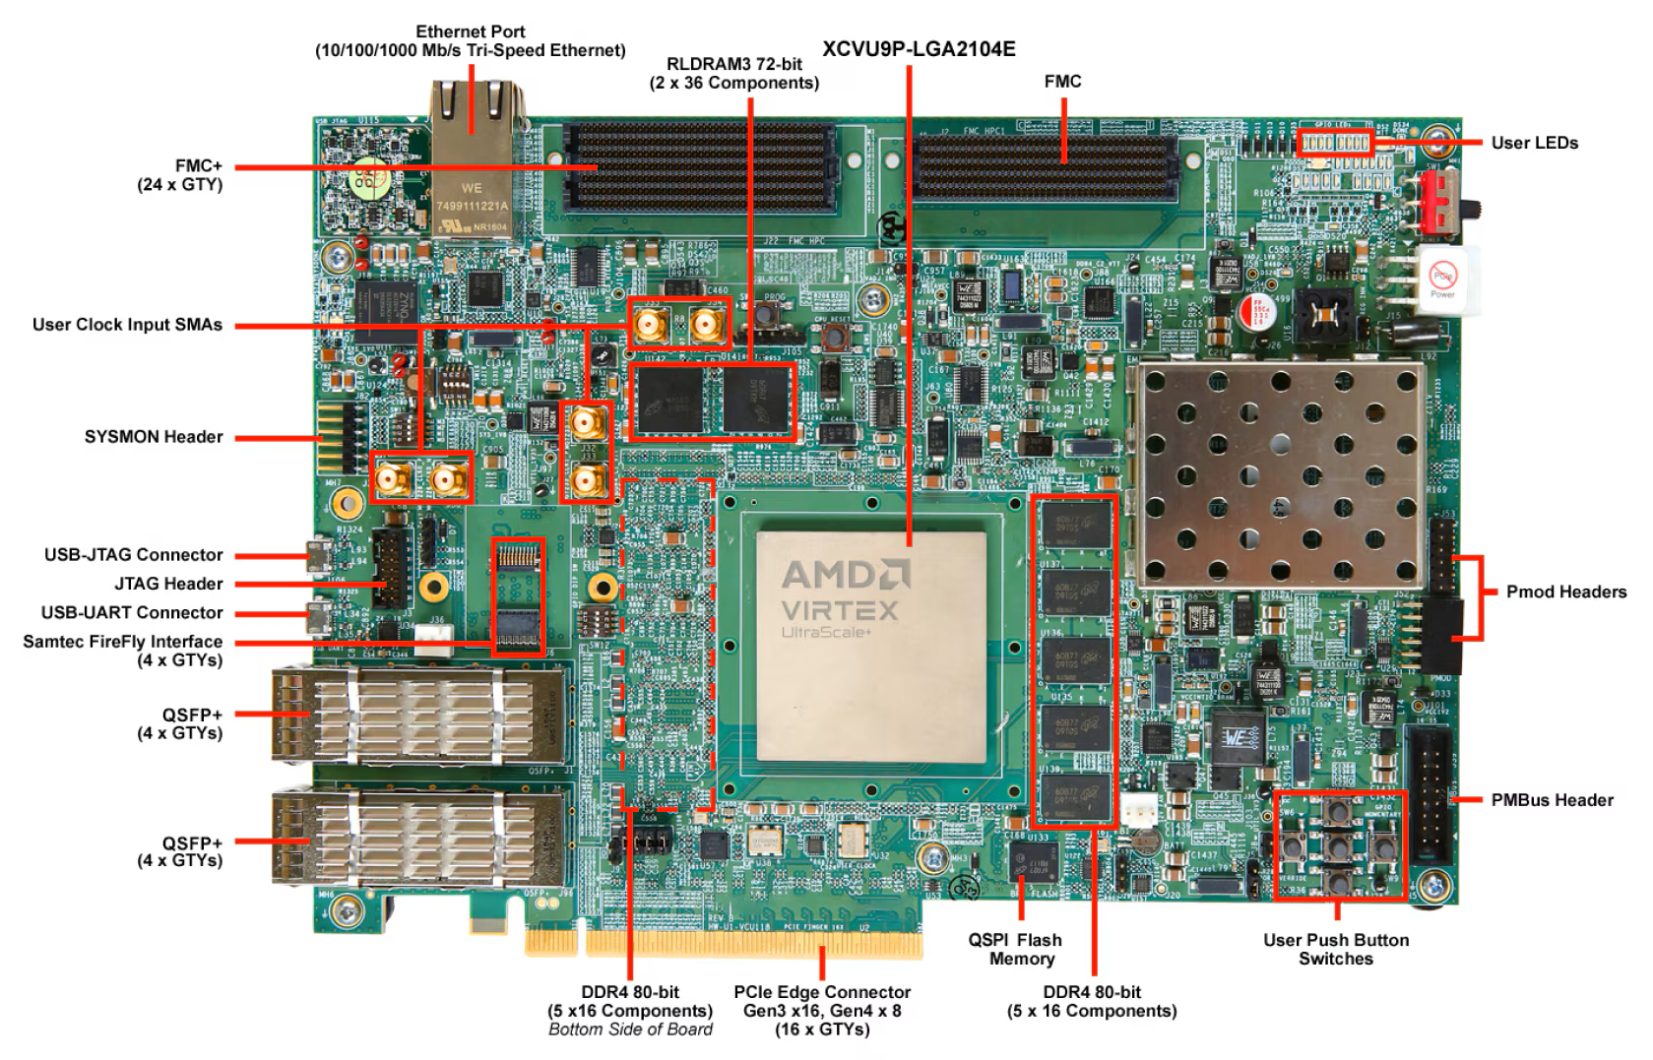
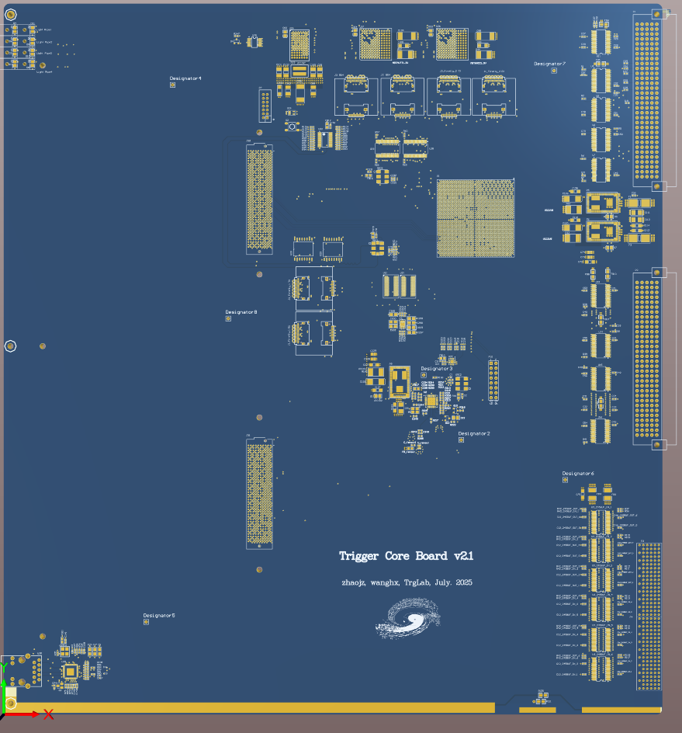
RDMA FW Porting: VCU118 -> Trigger Core Board (TCB)
4x TX/RX Firefly
In order to truly apply RDMA in experimental scenarios...
Background:
BESIII Digital and Intelligent Upgrade Project
The plan is to transmit all raw detector data to trigger algorithm research.
FPGA Architecture: Virtex UltraScale+
Interface: QSFP28
IP: CMAC
UltraScale+ GTY (32.75Gb/s)
Link verified: 10G/25G/100G
Approximately 93% of the maximum actual bandwidth
FPGA Architecture: Kintex UltraScale
Interface: Firefly -> QSFP28 via MPO
IP: 40G/50G Ethernet Subsystem
UltraScale GTH (16.3Gb/s)

Slide 3
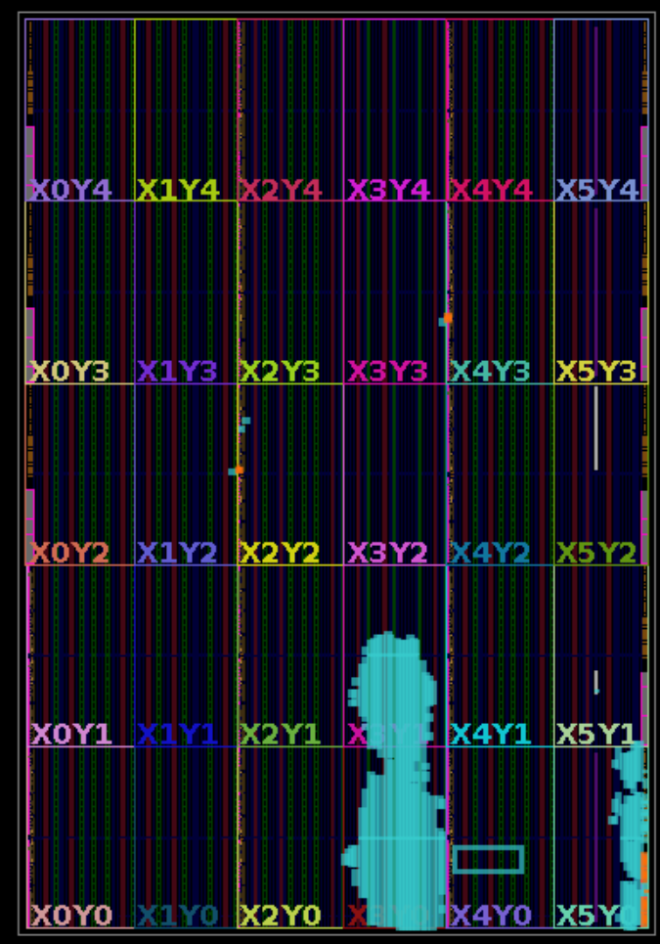
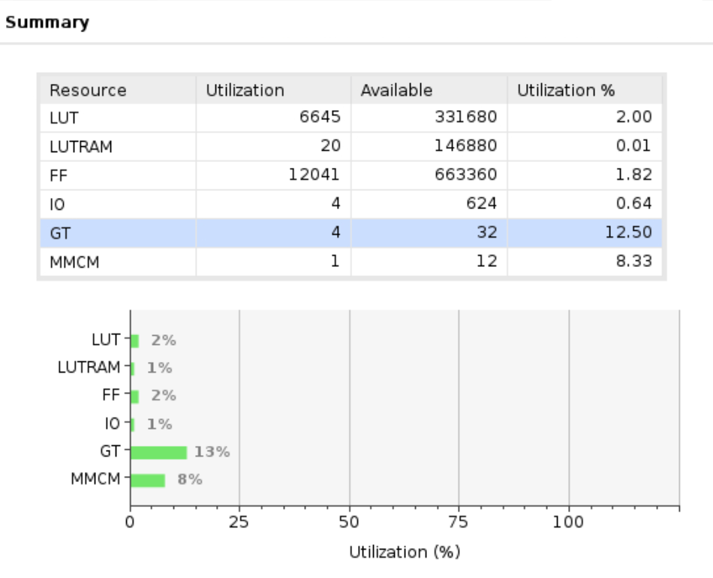
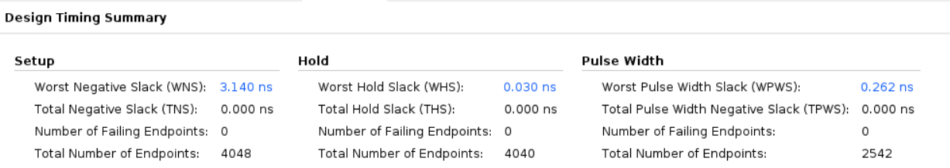
10 GbE RDMA FW on TCB Implemented
Utilization and timing look fine.
Testing can begin once the new PCB board verification is finished.
  Power supply and clocks
The ultimate goal is to implement 40G RDMA on the TCB.
Utilization
Utilization
Timing

Slide 4
Backup

Slide 5
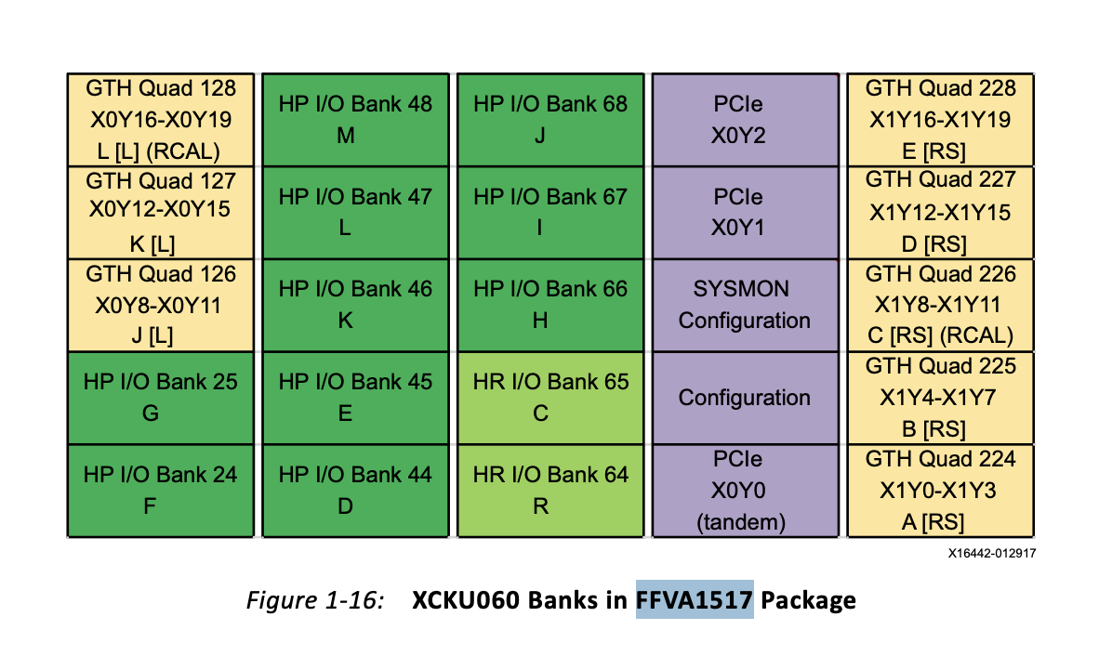
UG575

Slide 6
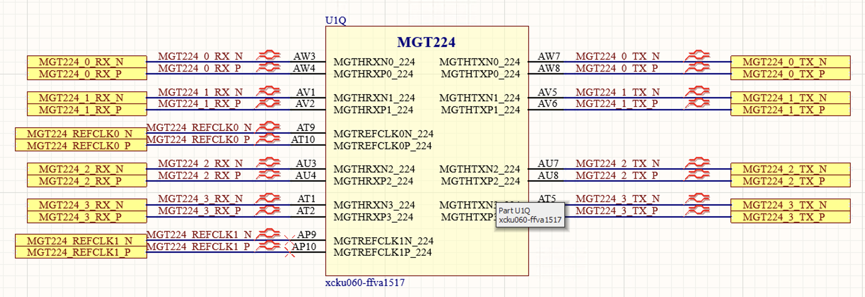

Slide 7
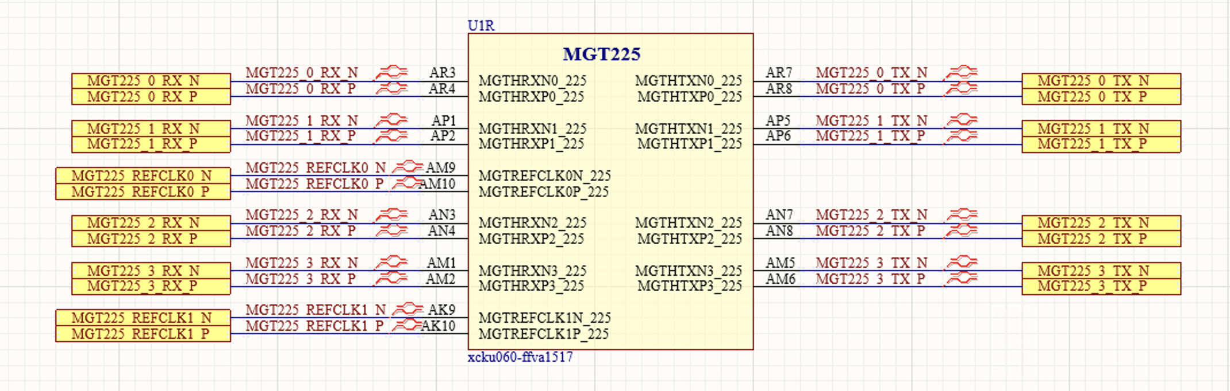

Slide 8
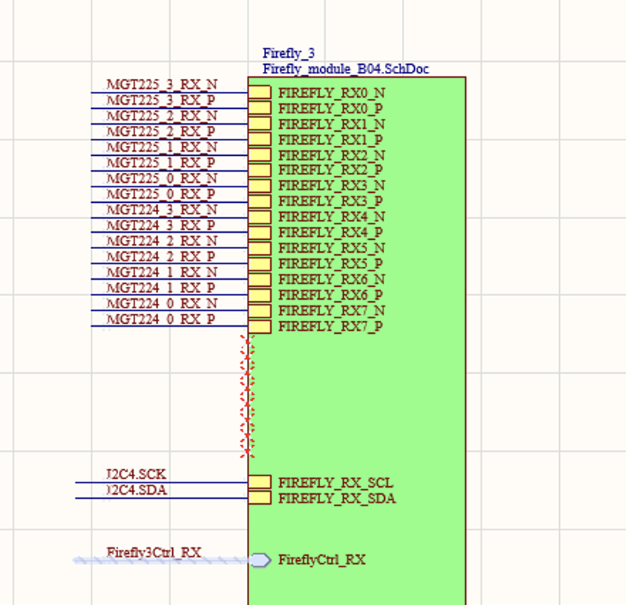
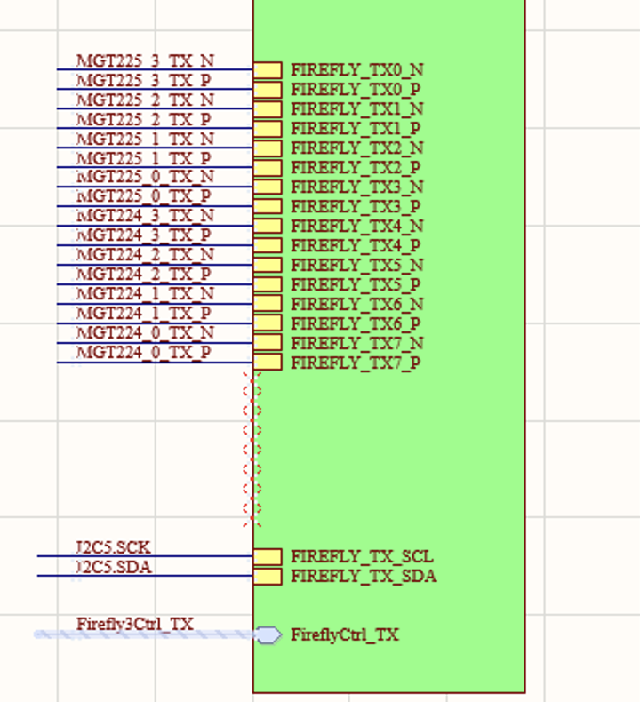
Warning: the index of MGT channel number is different with the index of firefly channel number !!!

Slide 9
