Slide 1
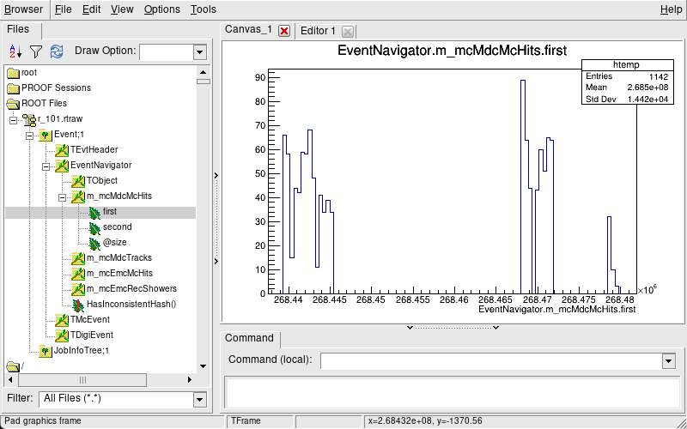
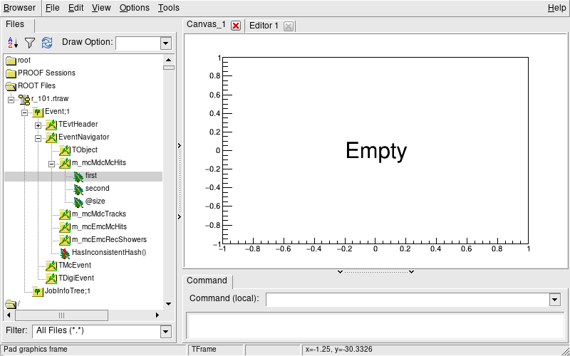
used the same input data
706’s mcMdcHits
712’s mcMdcHits
possible reasons
1.BOSS712 wasn’t set up correctly (unlikely, because official examples run normally).
2.Data transmission was interrupted somewhere in 712 (unlikely, because I tested with high-momentum particles and the signal was there).
3. There might be a cut condition in the 712 environment that removes all background particles (this is suspicious).

Slide 2
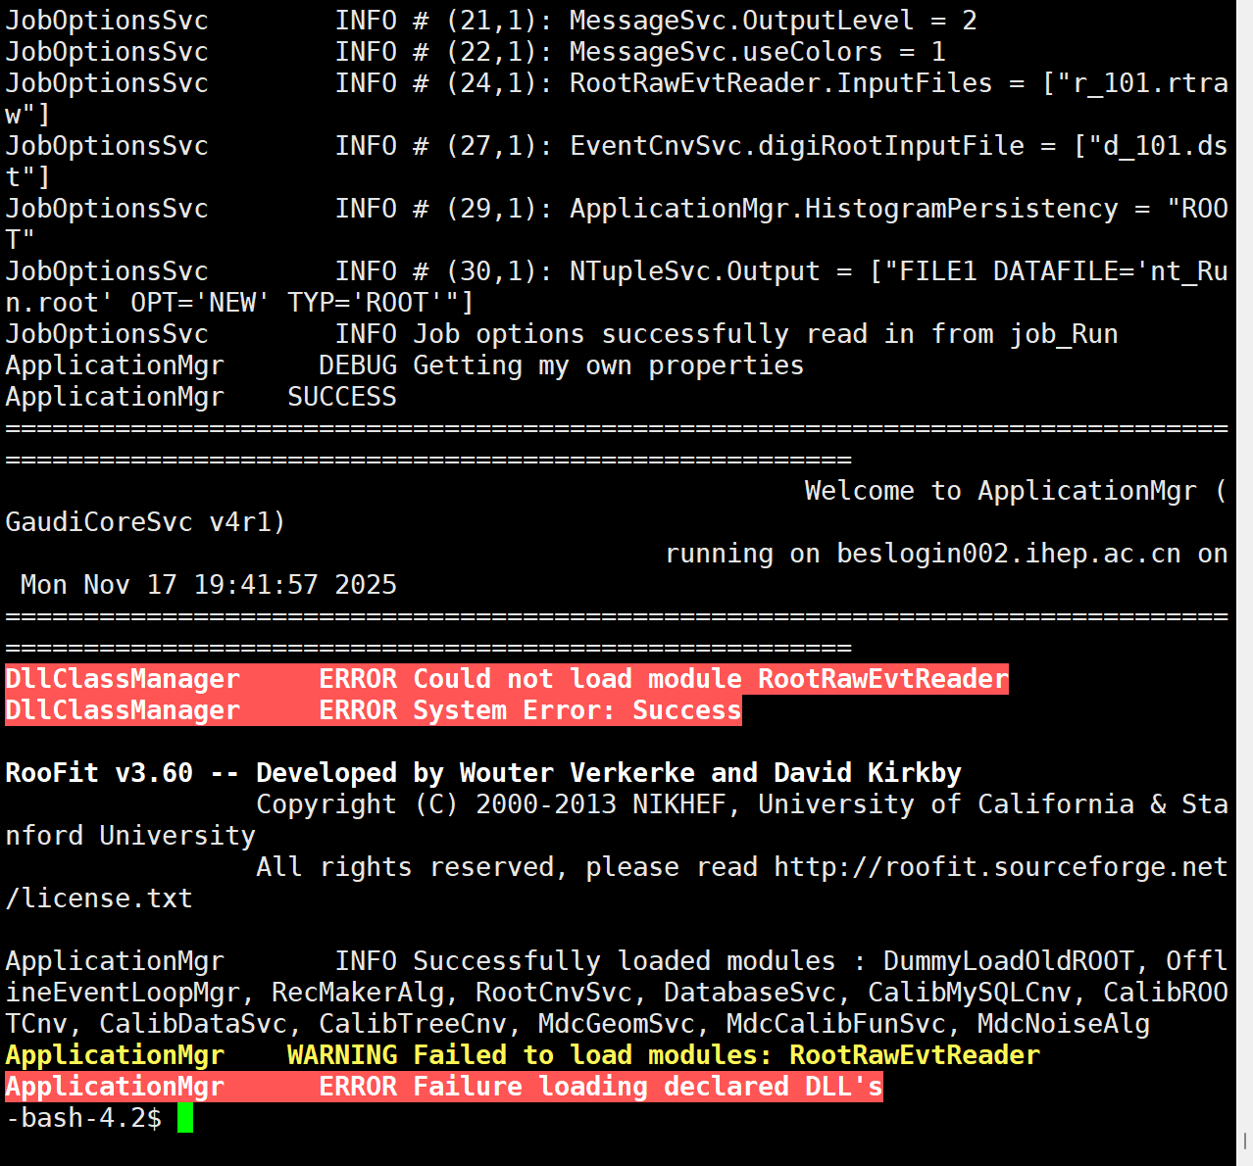
the problem about the RootRawEvtReader package
There’s an problem when calling it.
I discussed this with Teacher Deng offline.
She said that after version 706, this package wasn’t compiled or tested successfully in a certain updated version.
She will fix this bug and send me a new package. I’m now waiting for her email.

