Slide 1
Holographic energy correlators for confining theories
2025.11.20

Slide 2
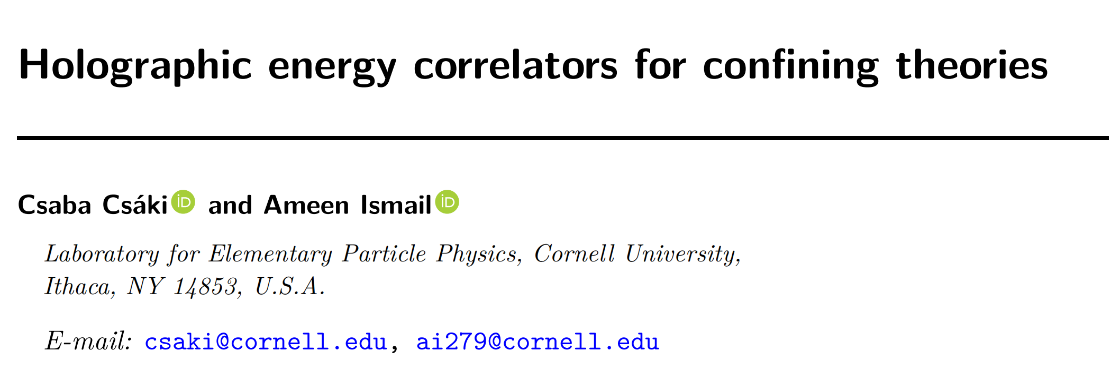
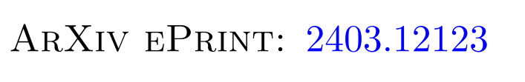

Slide 3
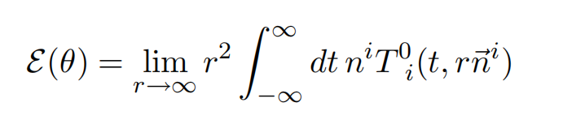
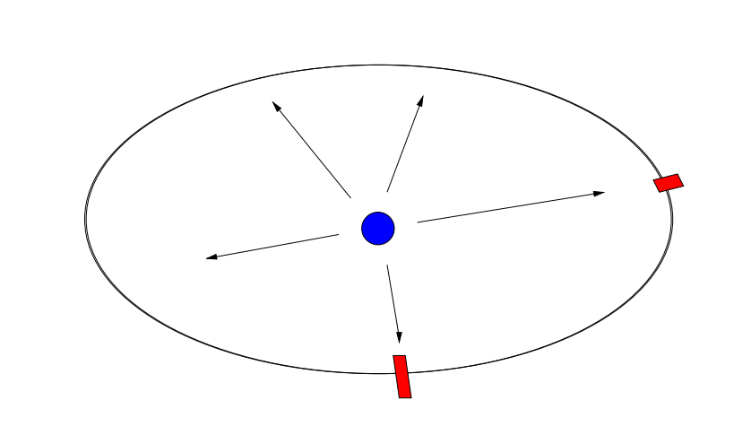
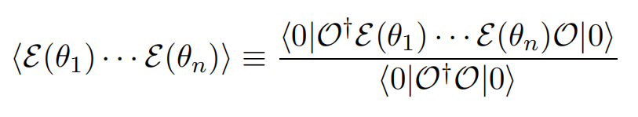
Introduction
Measure the energy deposited in a calorimeter placed very far away from the interaction point in a collider experiment
Correlation functions of
the energy flow operators

Slide 4
Introduction
The degree of angular separation between the two energy flow operators corresponds to the transverse momentum.
The two-point correlator in particular provides a very clean view of the confinement transition.
small angular ↔ low-energy, scaling as a power law characteristic of free hadrons
larger angular↔ high-energy, nearly constant,with a logarithmic running corresponding to asymptotically free quarks

Slide 5
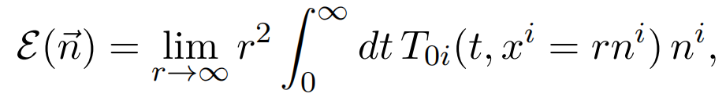
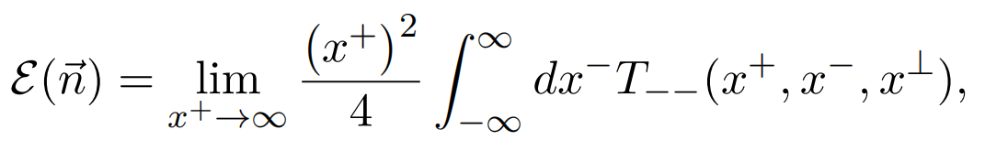
Holography for conformal colliders
we should take the large r limit while holding t − r constant and sending t + r → ∞
It is useful to express the energy flow operators in terms of lightcone coordinates
massless excitations in CFT
x⊥=x^{1,2}

Slide 6
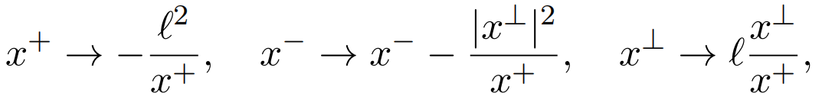

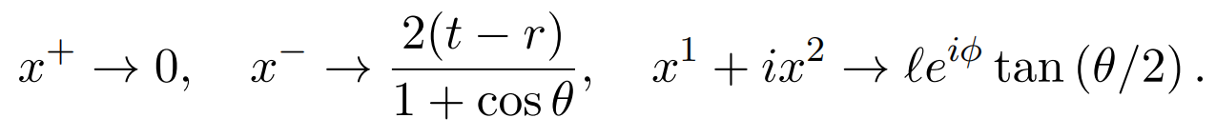
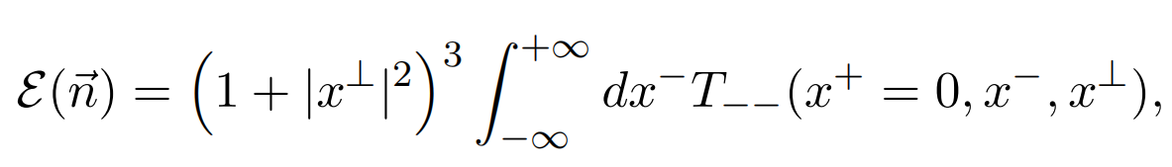
Holography for conformal colliders
Perform a conformal transformation to avoids dealing with the large r limit
It maps the celestial sphere to the (x1, x2) plane at x⁺ = 0.

Slide 7
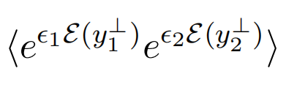
Holography for conformal colliders
To study energy correlators, we consider perturbing the CFT action by
This effectively inserts the exponentiation of the energy flow operator, in the CFT path integral
One can then take derivatives of the path integral with respect to ϵ1,2 to compute correlation functions.

Slide 8
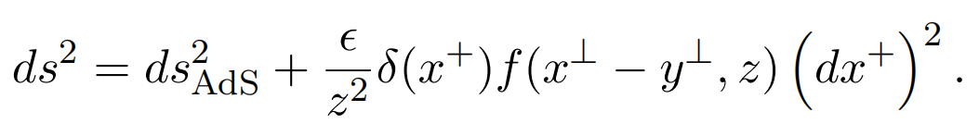

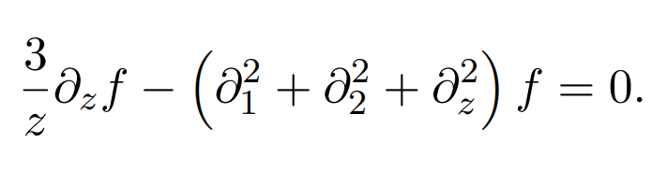
Holography for conformal colliders
In the dual theory, the insertion of T₋₋ acts as a source for the ++ component of the graviton.
Boundary condition:
The full Einstein equations: linear

Slide 9
Holography for conformal colliders
Computing correlators in AdS/CFT
Consider a scalar perturbation which correspond to exciting a bulk scalar field ϕ on the AdS side
EoM:
Integrating across the delta function, we can calculate the discontinuity:

Slide 10
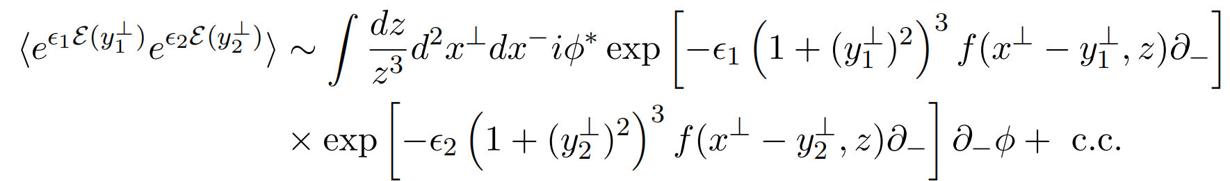
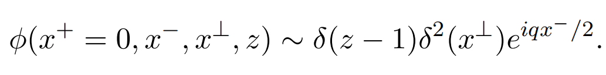
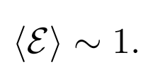

Holography for conformal colliders
Compute the holographic action and expand at leading order in the
shockwaves to extract correlation functions
spherically symmetric

Slide 11
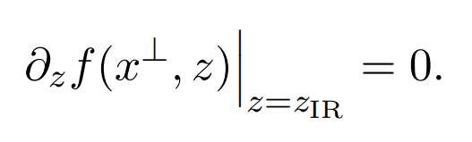
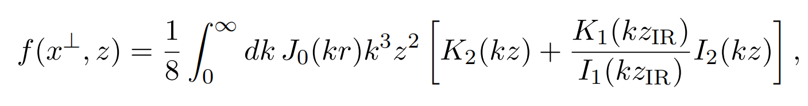

Energy correlators with an IR brane
Present calculation of energy correlators
The metric and equation of shockwave take the same form but with additional boundary condition

Slide 12
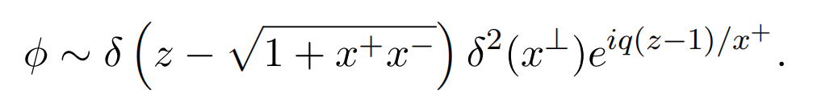

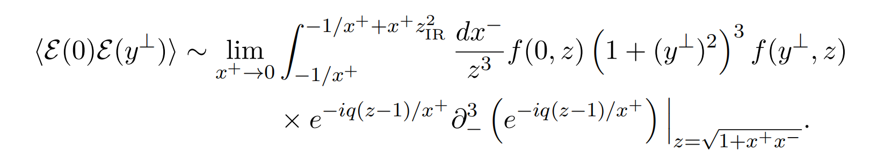
Energy correlators with an IR brane
1. The wavefunction for the source:
2. It is essential to be careful about the relative order of the x⁺→ 0 limit and the integration.（The theory has a mass gap, energy flows to future timelike infinity）
only for large q

Slide 13
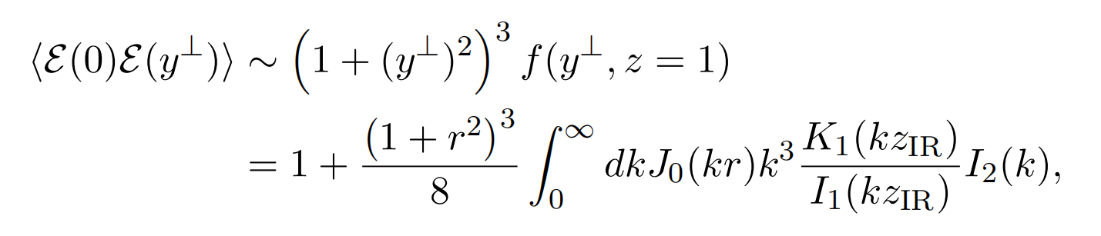
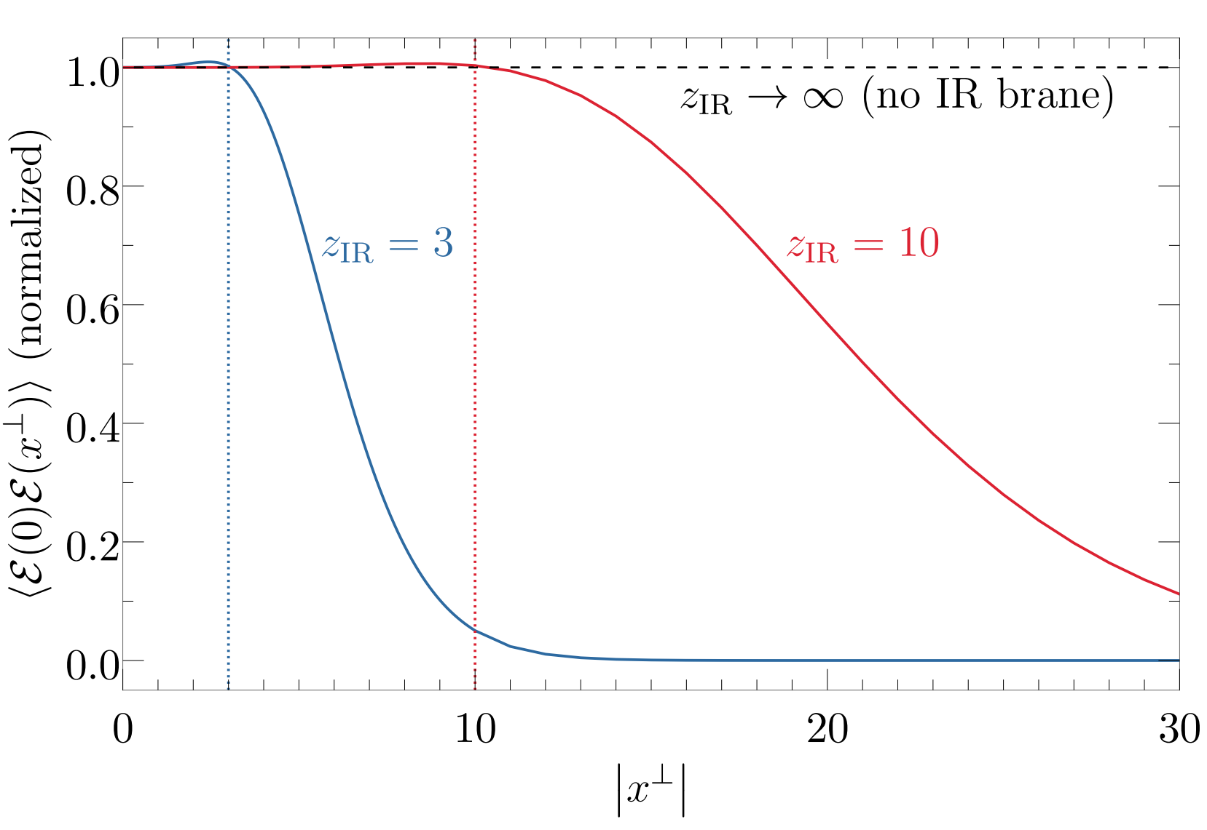
Energy correlators with an IR brane
For r ≪ z_{IR} we probe energies higher than the confinement scale, so the two-point correlator is constant, characteristic of a strongly-coupled CFT.
The correlator falls off for r ≫ z_{IR} exponentially.

Slide 14
Discuss
1. Revealed a transition between the constant correlator of a strongly-coupled CFT at high energy scales to an exponential falloff below the confinement scale.
2. The short-distance behavior of correlator is approximately constant. In QCD, on the other hand, one observes a running characteristic of asymptotically free quarks.
3.The exponential decay at large distances is not awared in QCD energy correlators.

