Slide 1

$$Λ^{+}→φπ^{0}p$$
邹世明
2025/11/21

Slide 2
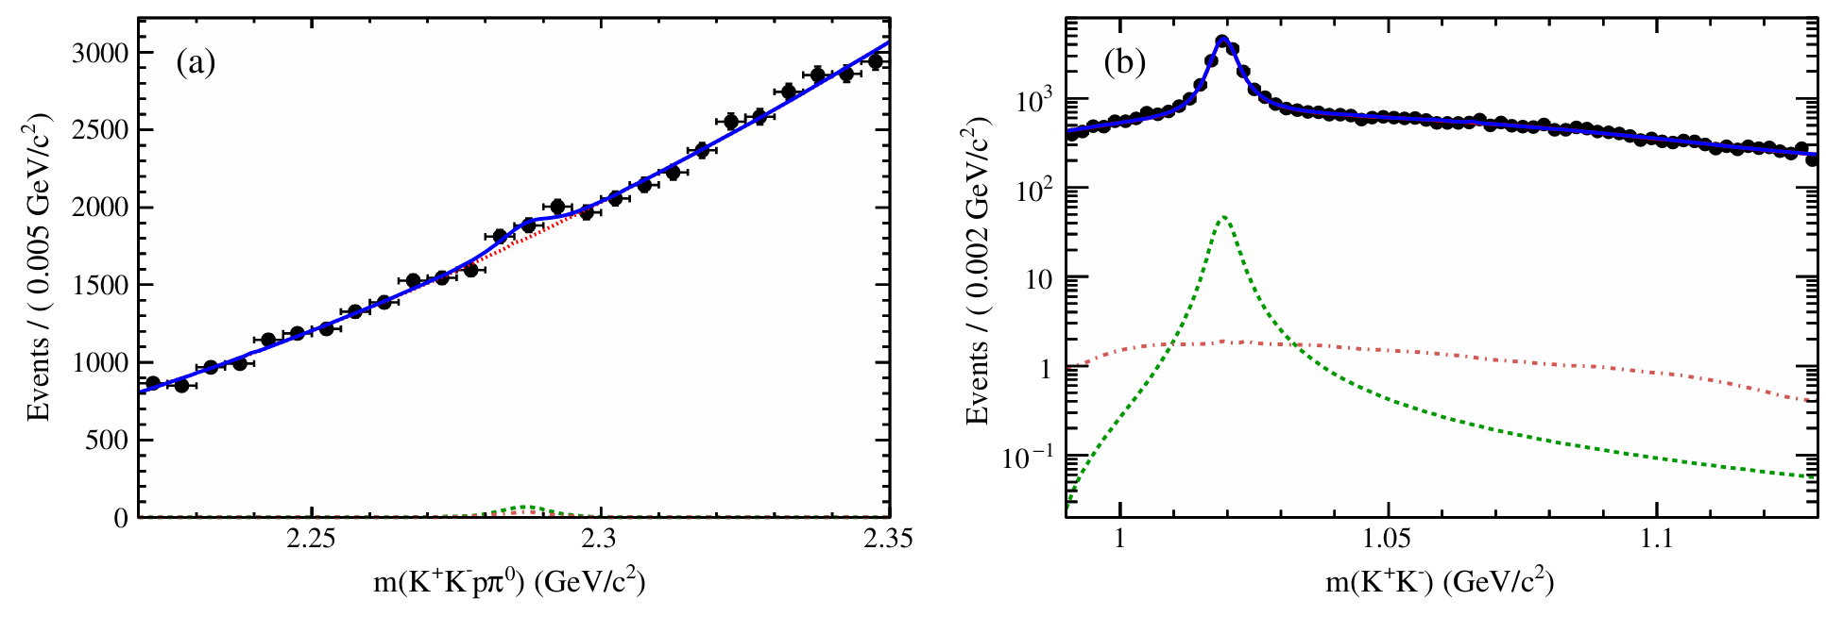
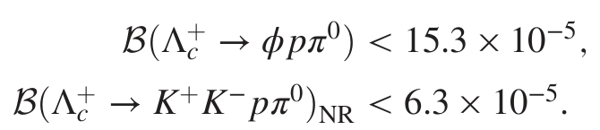
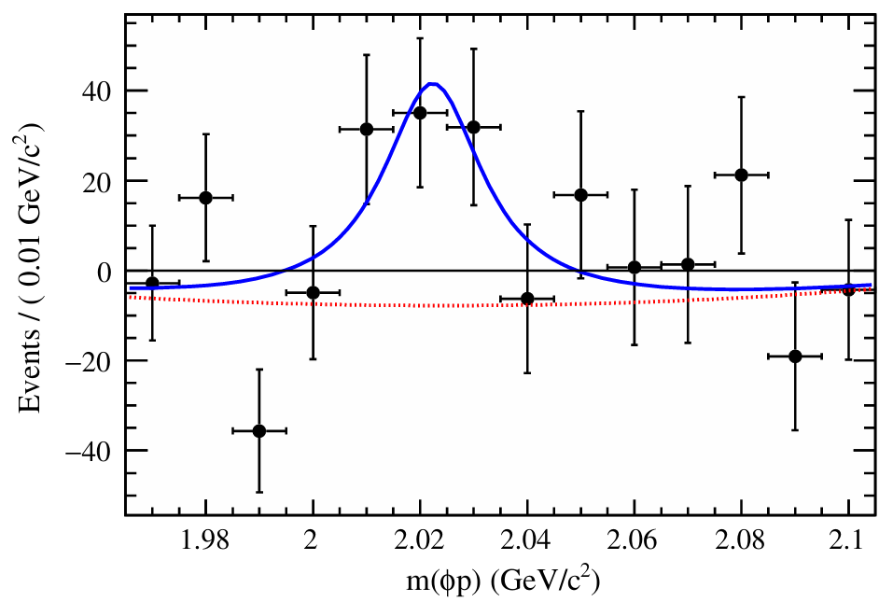
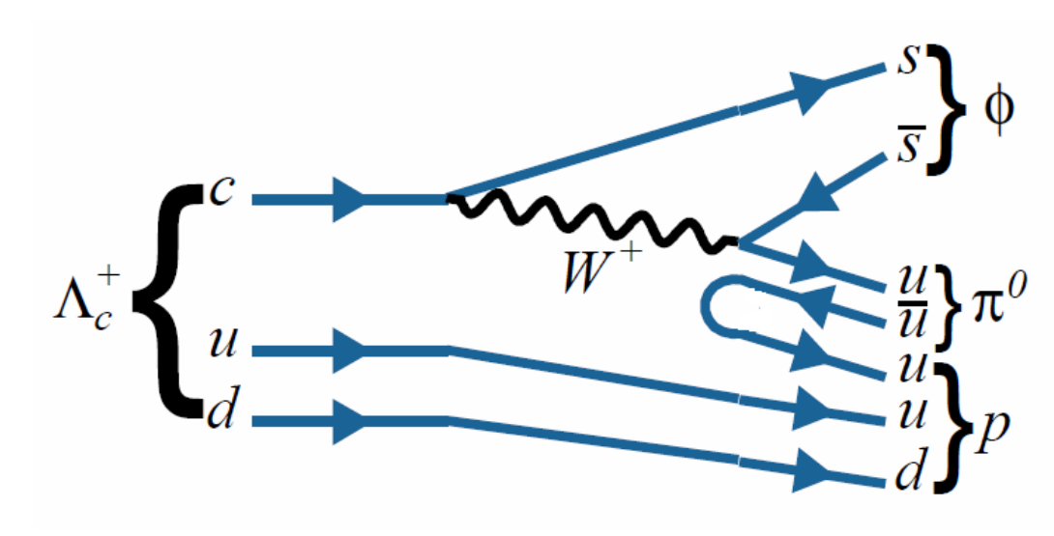
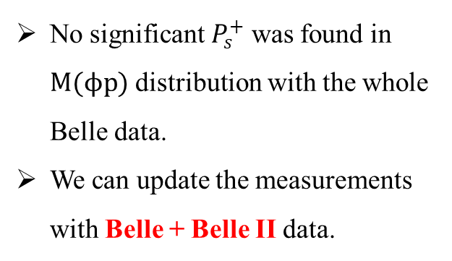
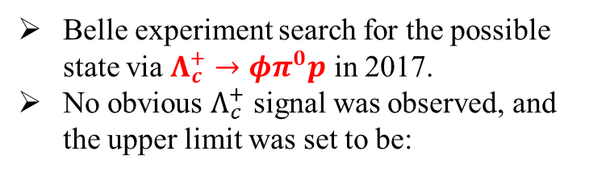
Motivation
Whether a hidden strangeness pentaquark $P_{s}^{+}$ , where the $c\overline{c}$ pair in $P_{c}^{+}$ is replaced by an $c\overline{c}$ pair, exists?
Belle experiment search for the possible state via $Λ_{c}^{+}→φπ^{0}p$ in 2017.
No obvious $Λ_{c}^{+}$ signal was observed, and the upper limit was set to be:
No significant $P_{s}^{+}$ was found in $M(ϕp)$ distribution with the whole Belle data.
We can update the measurements with Belle + Belle II data.
PHYSICAL REVIEW D 96, 051102(R) (2017)

Slide 3
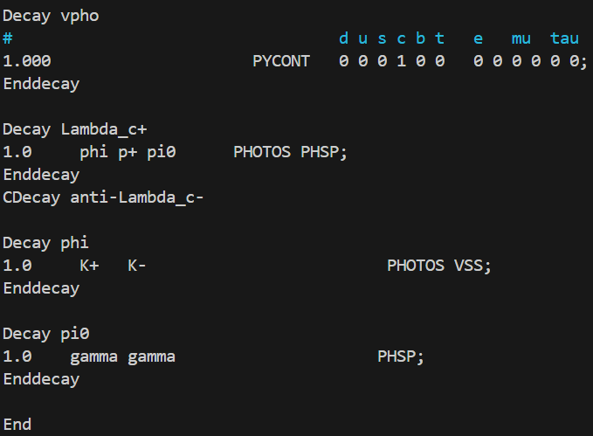
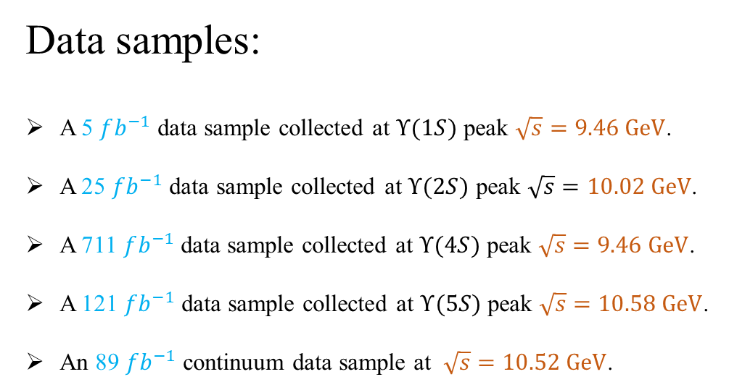
Data samples and MC simulation
Data samples:
A 5 $fb^{−1}$ data sample collected at $Υ(1S)$ peak $\sqrt{s}=9.46 GeV$.
A 25 $fb^{−1}$ data sample collected at $Υ(2S)$ peak $\sqrt{s}=10.02 GeV$.
A 711 $fb^{−1}$ data sample collected at $Υ(4S)$ peak $\sqrt{s}=9.46 GeV$.
A 121$fb^{−1}$ data sample collected at $Υ(5S)$ peak $\sqrt{s}=10.58 GeV$.
An 89 $fb^{−1}$continuum data sample at $\sqrt{s}=10.52 GeV$.
MC simulation:
More Belle II data
……
The Belle MDST samples are converted into Belle II data format using b2bii in basf2 release-08-01-05.

Slide 4
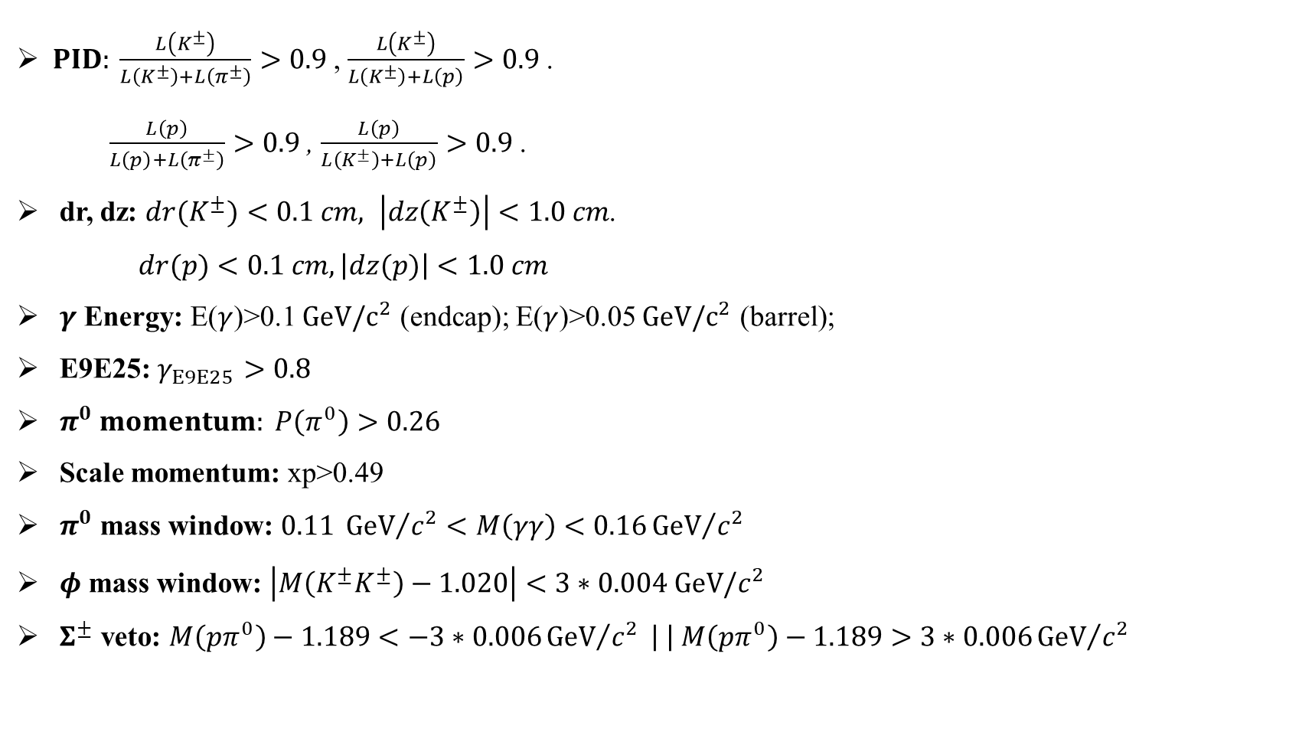
Selection criteria
$PID: \frac{L\left(K^{±}\right)}{L\left(K^{±}\right)+L\left(π^{±}\right)}>0.9$, $\frac{L\left(K^{±}\right)}{L\left(K^{±}\right)+L\left(p\right)}>0.9$.
$\frac{L\left(p\right)}{L\left(p\right)+L\left(π^{±}\right)}>0.9$, $\frac{L\left(p\right)}{L\left(K^{±}\right)+L\left(p\right)}>0.9$.
dr, dz: ${dr(K}^{±})<0.1 cm, \left|dz\left(K^{±}\right)\right|<1.0 cm$.
$dr(p)<0.1 cm, \left|dz(p)\right|<1.0 cm$
$γ$ Energy: E($γ$)>0.1 $GeV/c^{2}$ (endcap); E($γ$)>0.05 $GeV/c^{2}$ (barrel);
E9E25: $γ_{E9E25}>0.8$
$π^{0} momentum: P\left(π^{0}\right)>0.26$
Scale momentum: xp>0.49
$π^{0}$ mass window: $0.11 {GeV}/{c^{2}}<M\left(γγ\right)<0.16{GeV}/{c^{2}}$
$φ$ mass window: $\left|M\left(K^{±}K^{±}\right)−1.020\right|<3∗0.004 GeV/c^{2}$
$Σ^{±}$ veto: $M\left(pπ^{0}\right)−1.189<−3∗0.006{GeV}/{c^{2}} \left| \right| M\left(pπ^{0}\right)−1.189>3∗0.006{GeV}/{c^{2}}$

Slide 5
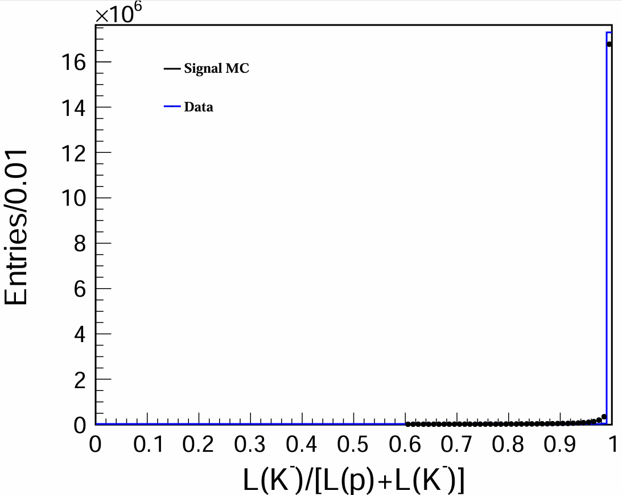

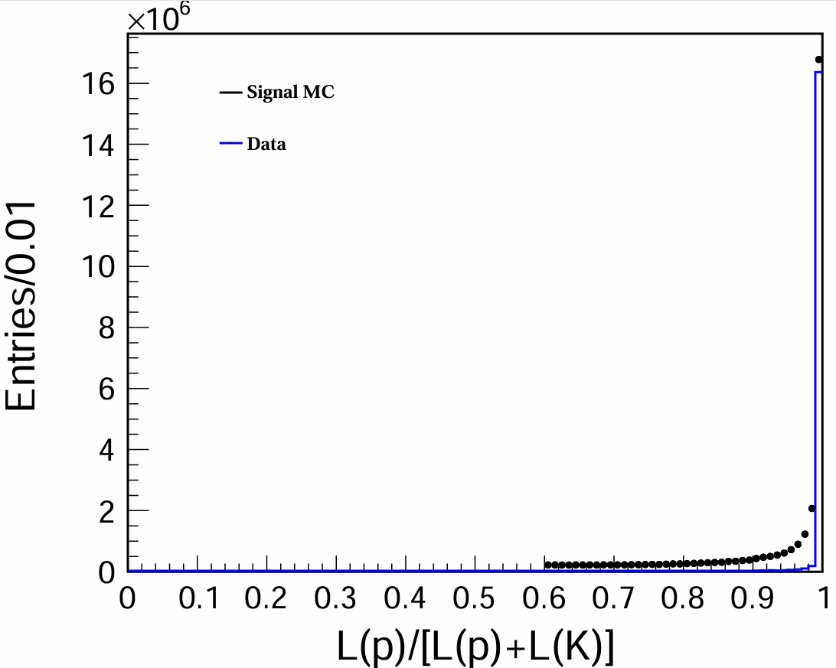
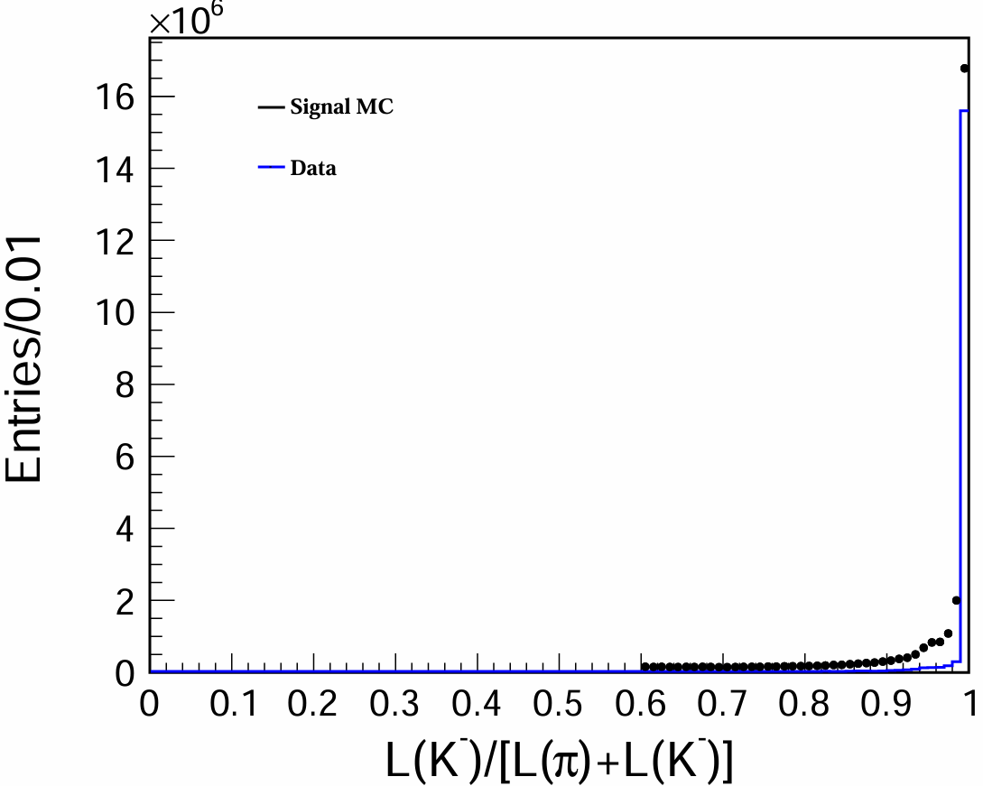

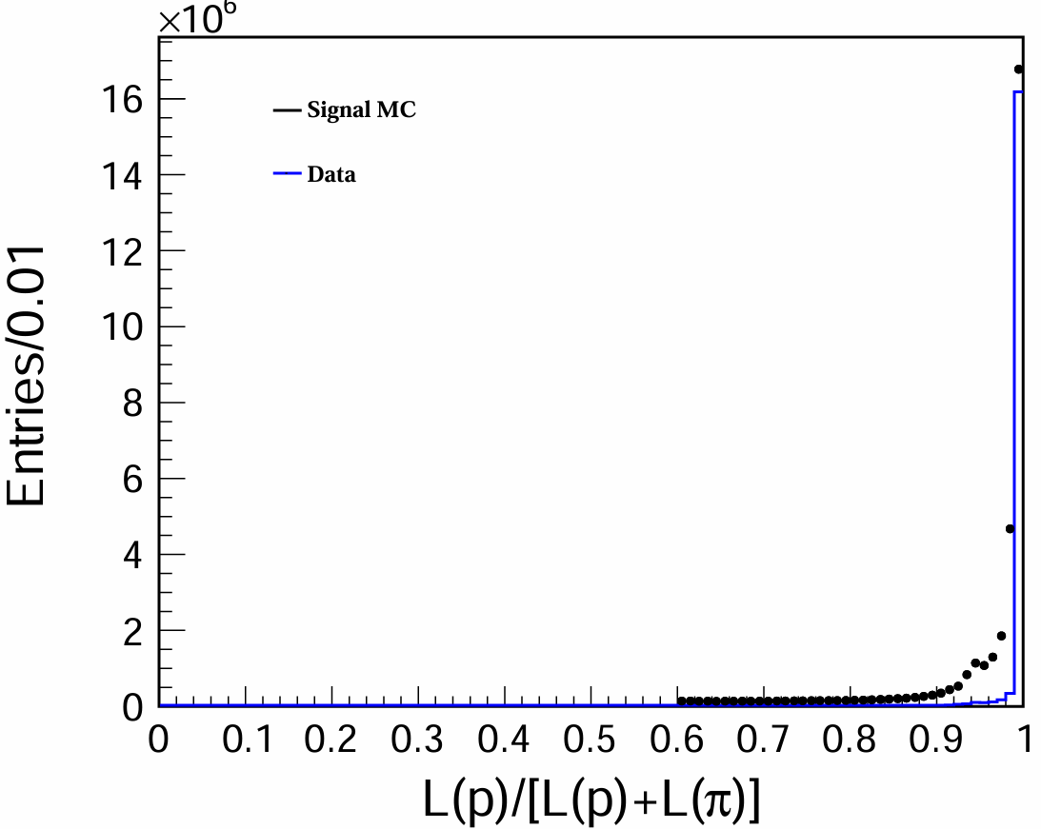

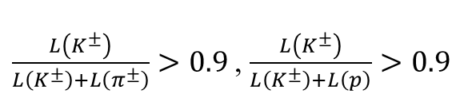
PID distribution
$\frac{L\left(K^{±}\right)}{L\left(K^{±}\right)+L\left(π^{±}\right)}>0.9$, $\frac{L\left(K^{±}\right)}{L\left(K^{±}\right)+L\left(p\right)}>0.9$
$\frac{L\left(p\right)}{L\left(p\right)+L\left(π^{±}\right)}>0.9$, $\frac{L\left(p\right)}{L\left(K^{±}\right)+L\left(p\right)}>0.9$

Slide 6
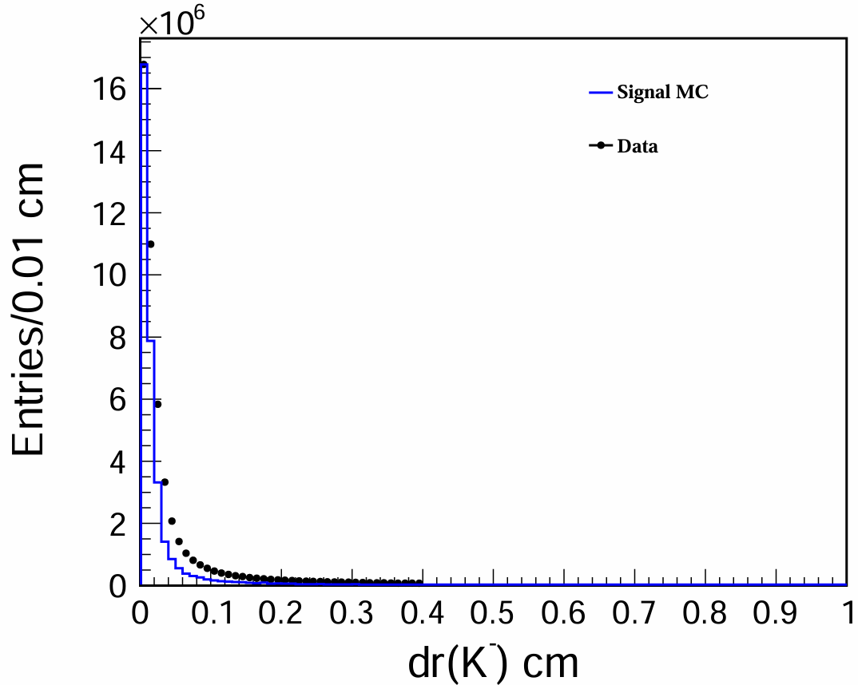
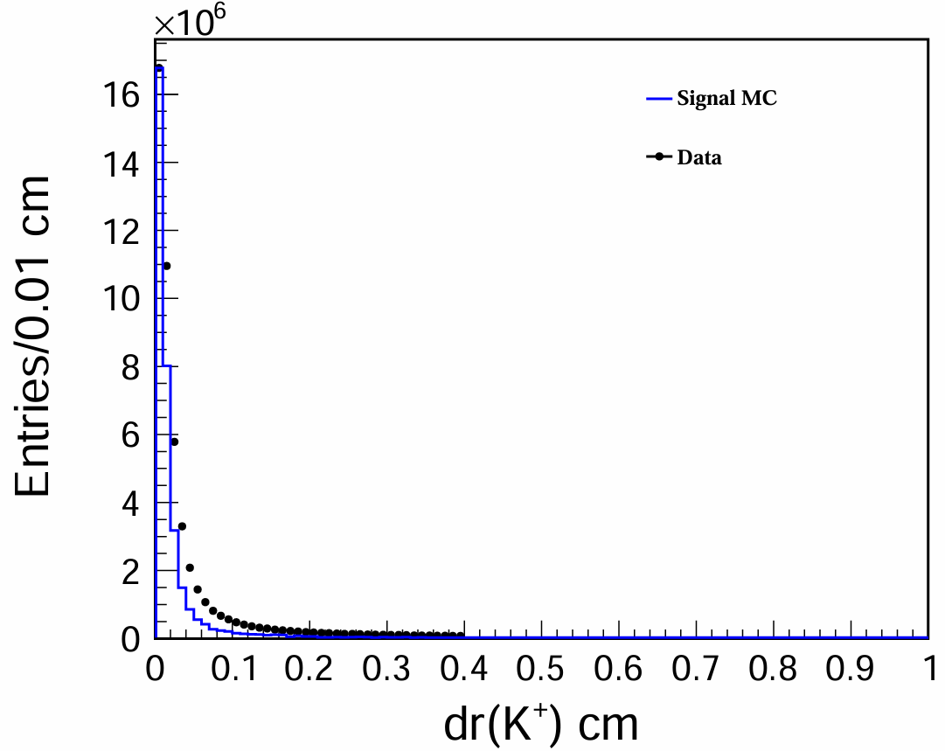
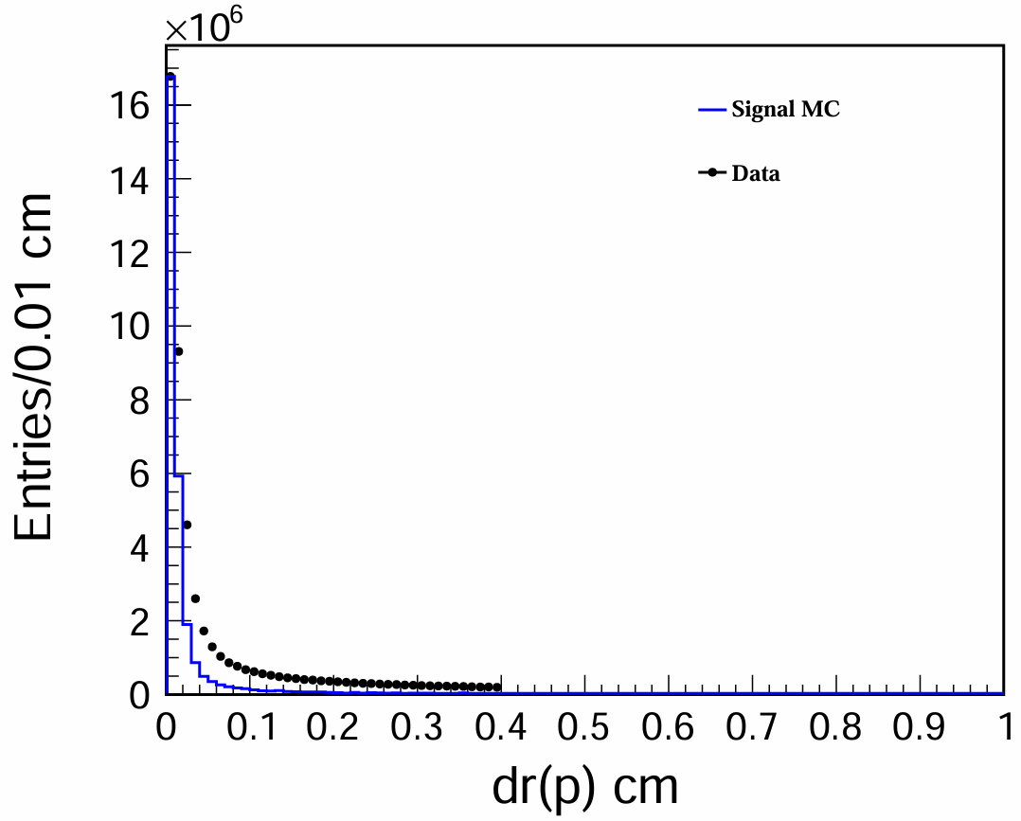
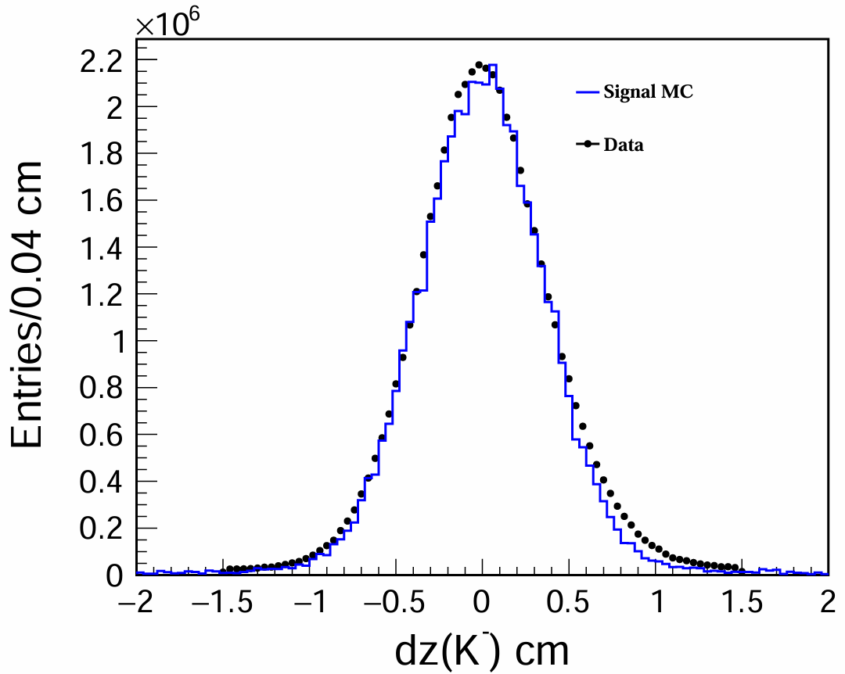
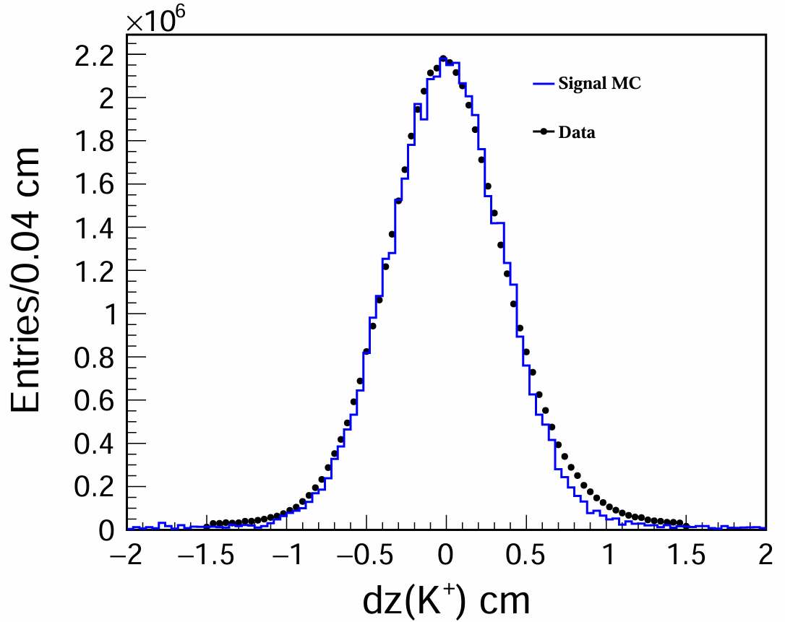
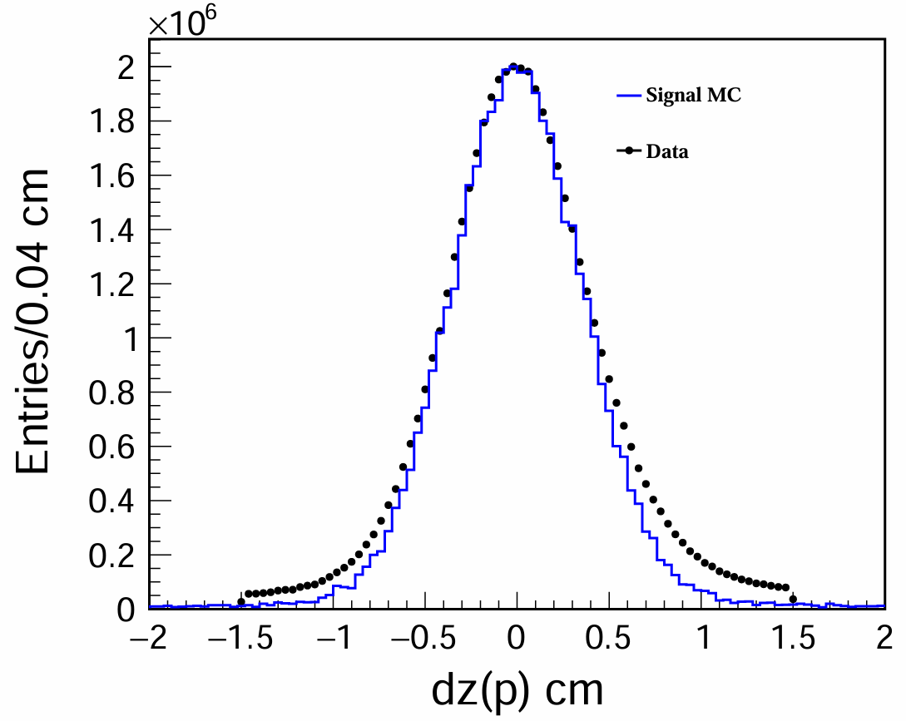
dr and dz distribution
All the charged tracks are required to have dr<0.1 cm and |dz|< 1 cm.

Slide 7
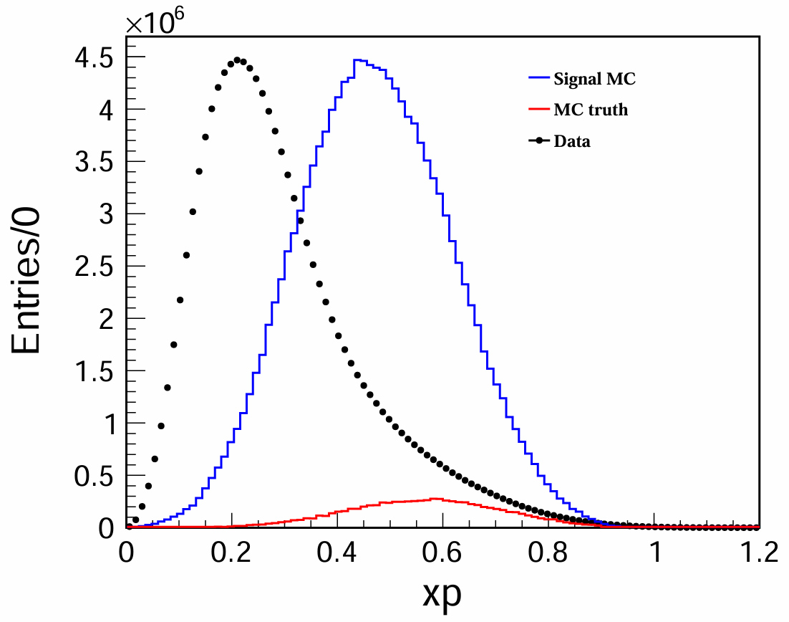
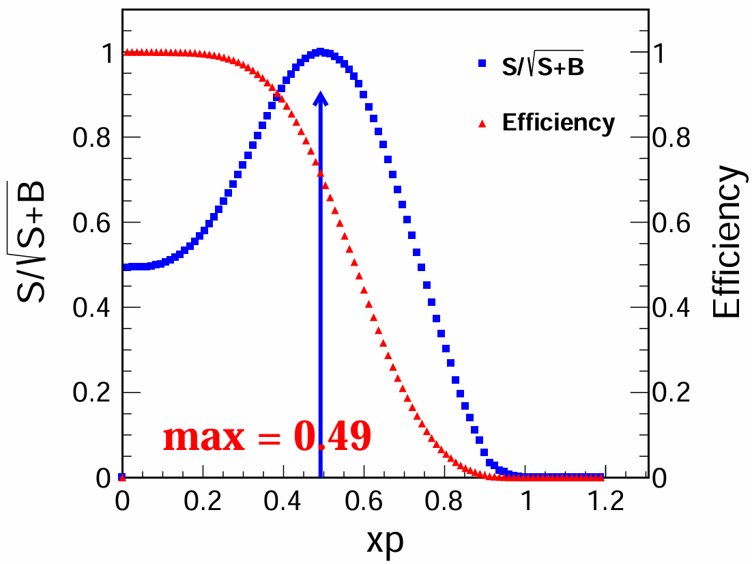
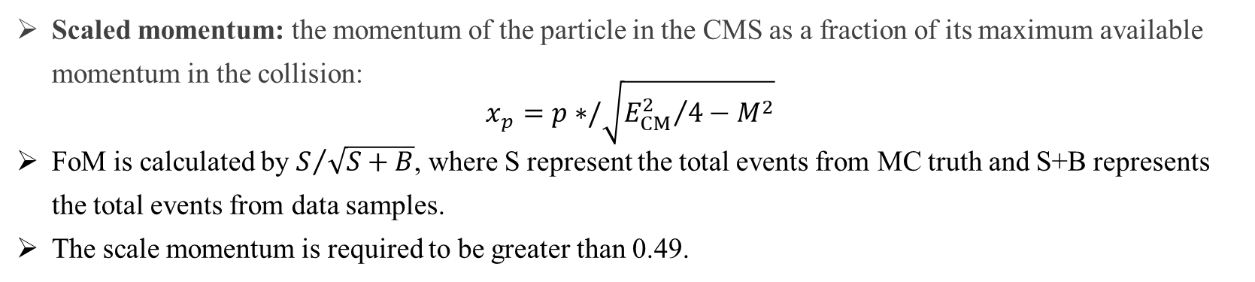
Scale momentum distribution
Scaled momentum: the momentum of the particle in the CMS as a fraction of its maximum available momentum in the collision:
$$x_{p}=p∗/\sqrt{{E_{CM}^{2}}/4−M^{2}}$$
FoM is calculated by $S/{\sqrt{S+B}}$, where S represent the total events from MC truth and S+B represents the total events from data samples.
The scale momentum is required to be greater than 0.49.

Slide 8
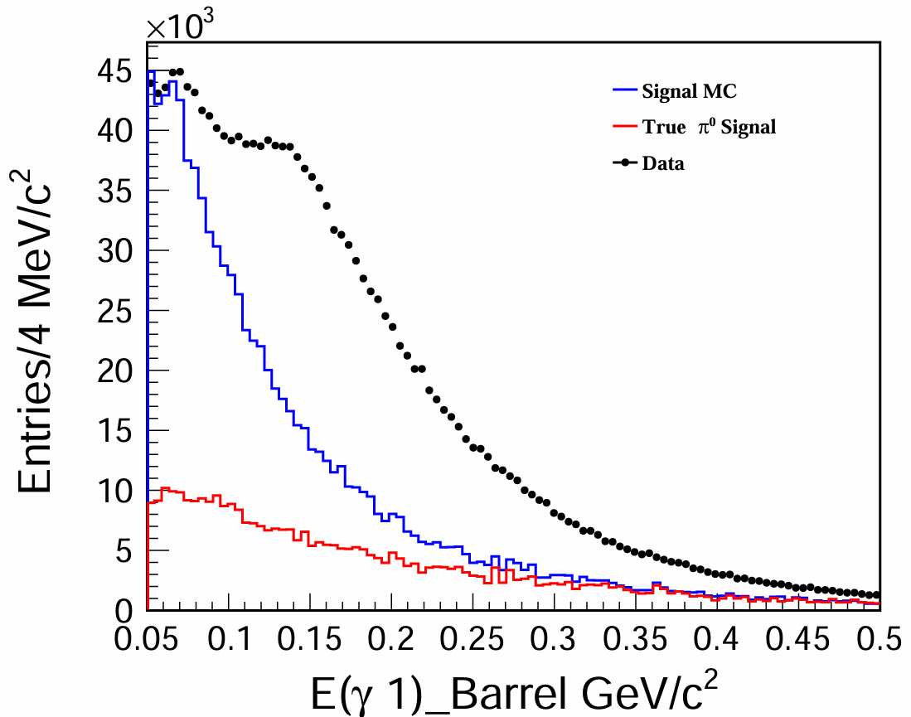
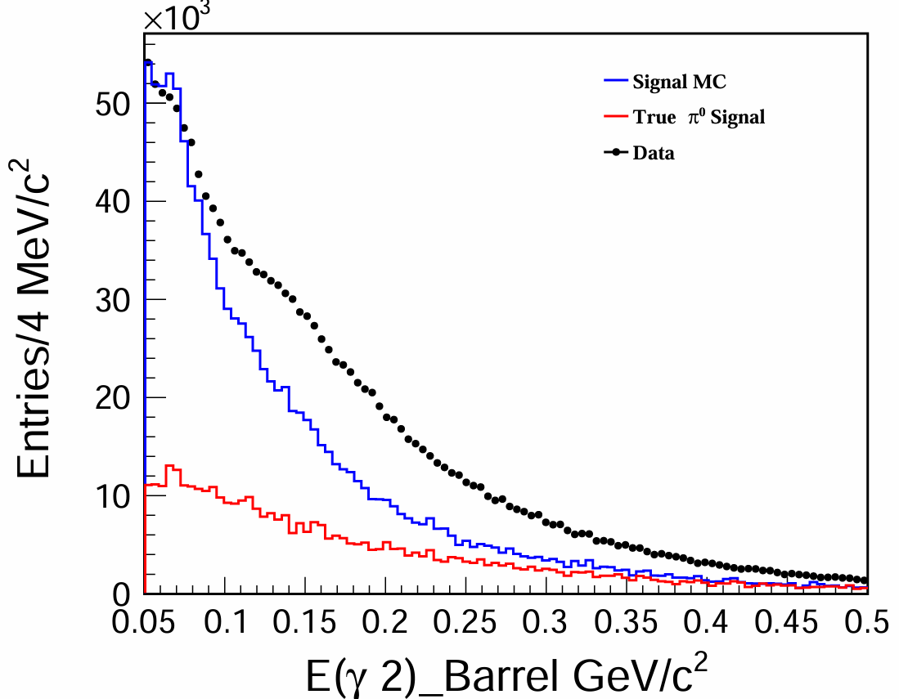
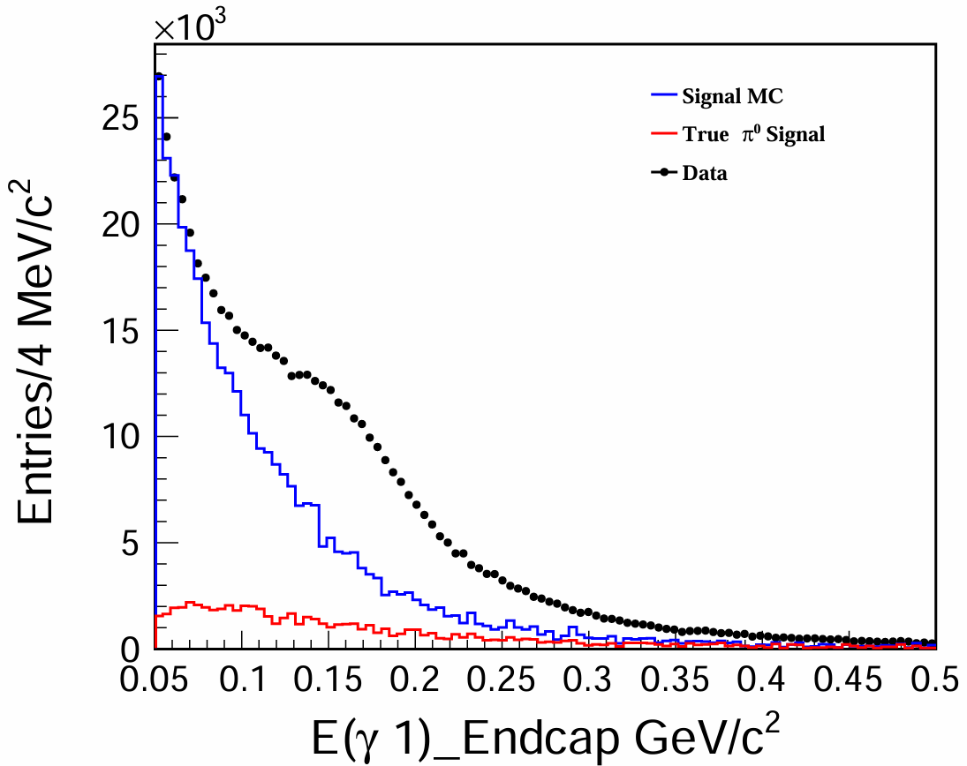
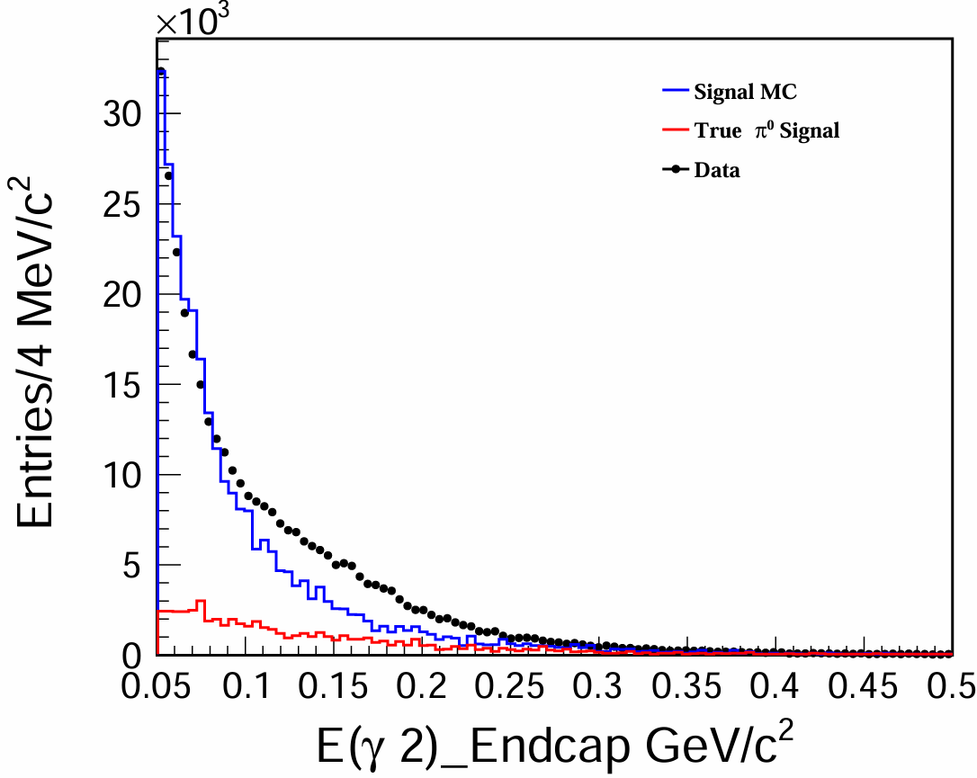


Energy distribution of photons
E($γ$)>0.05 $GeV/c^{2}$ (barrel)
E($γ$)>0.1 $GeV/c^{2}$ (endcap)

Slide 9
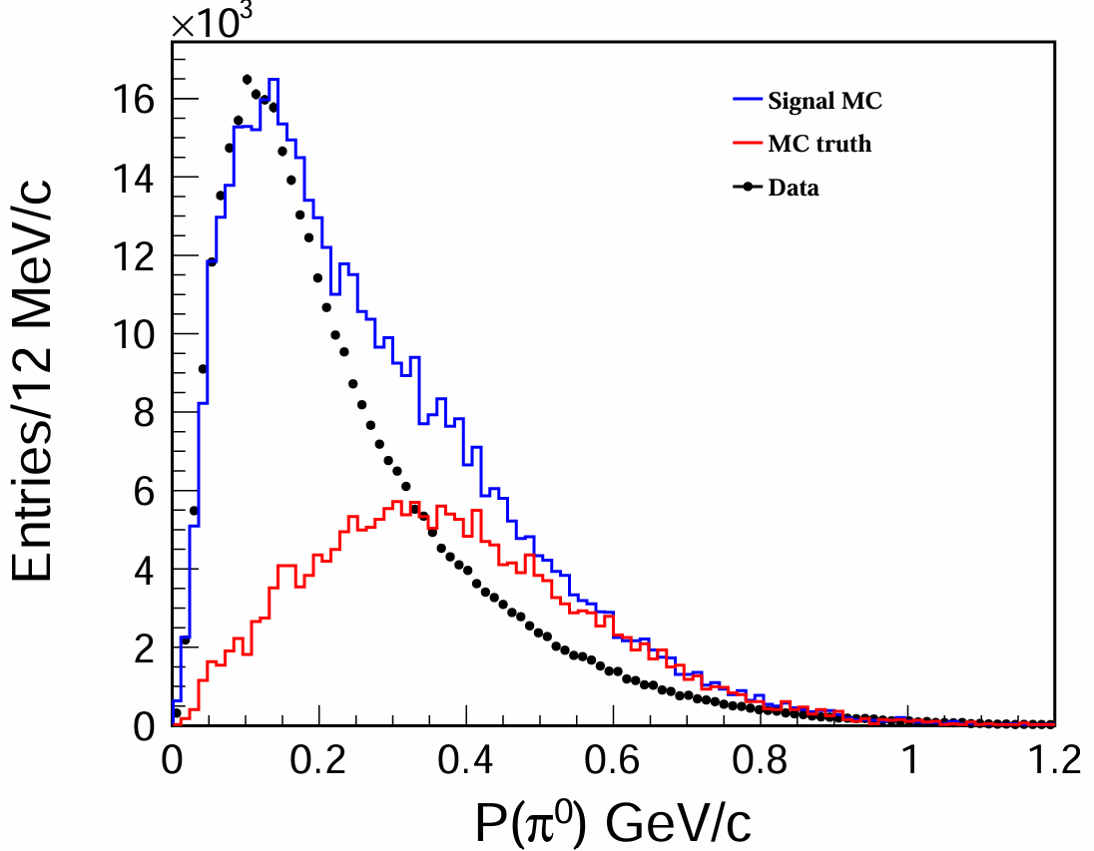
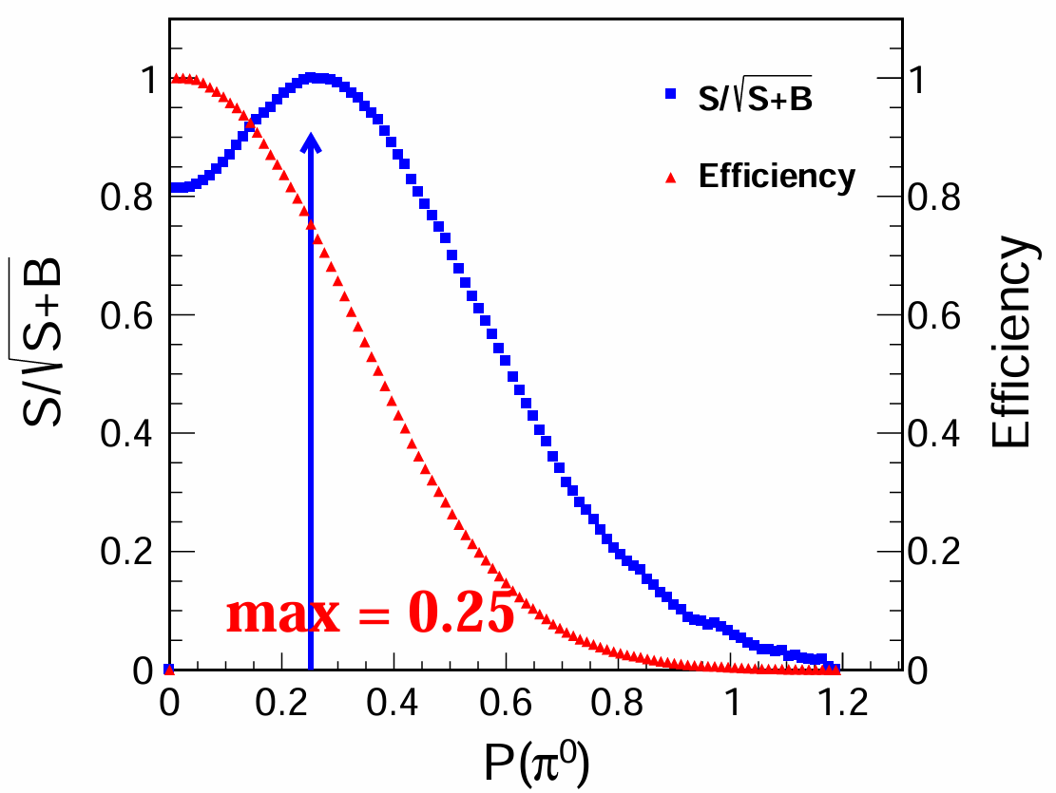
Momentum distribution of $π^{0}$
The momentum of $π^{0}$ is required to be higher than 0.25 GeV/c in order to reduce the fraction of mis-reconstructed events.

Slide 10
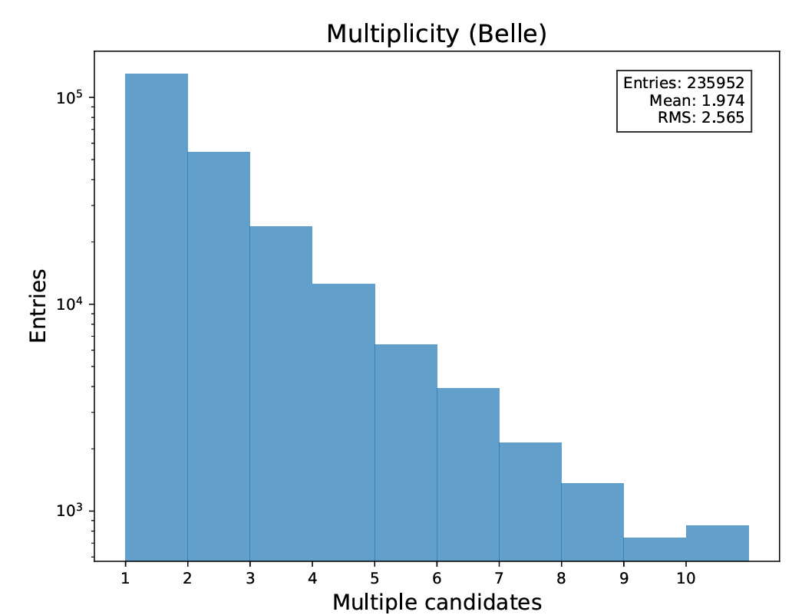
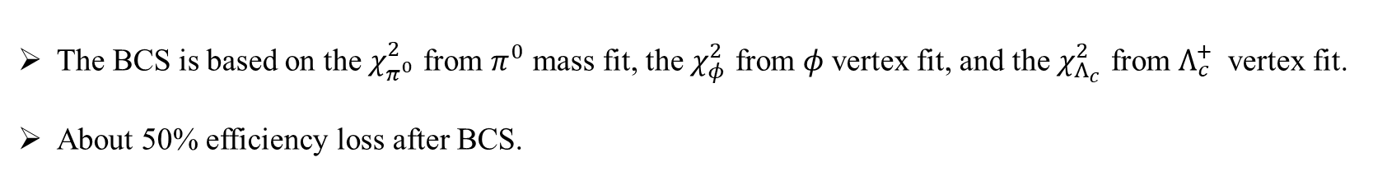
Best candidate selection (BCS)
The BCS is based on the $χ_{π^{0}}^{2}$ from $π^{0}$ mass fit, the $χ_{φ}^{2}$ from $φ$ vertex fit, and the $χ_{Λ_{c}}^{2}$ from $Λ_{c}^{+}$ vertex fit.
About 50% efficiency loss after BCS.

Slide 11
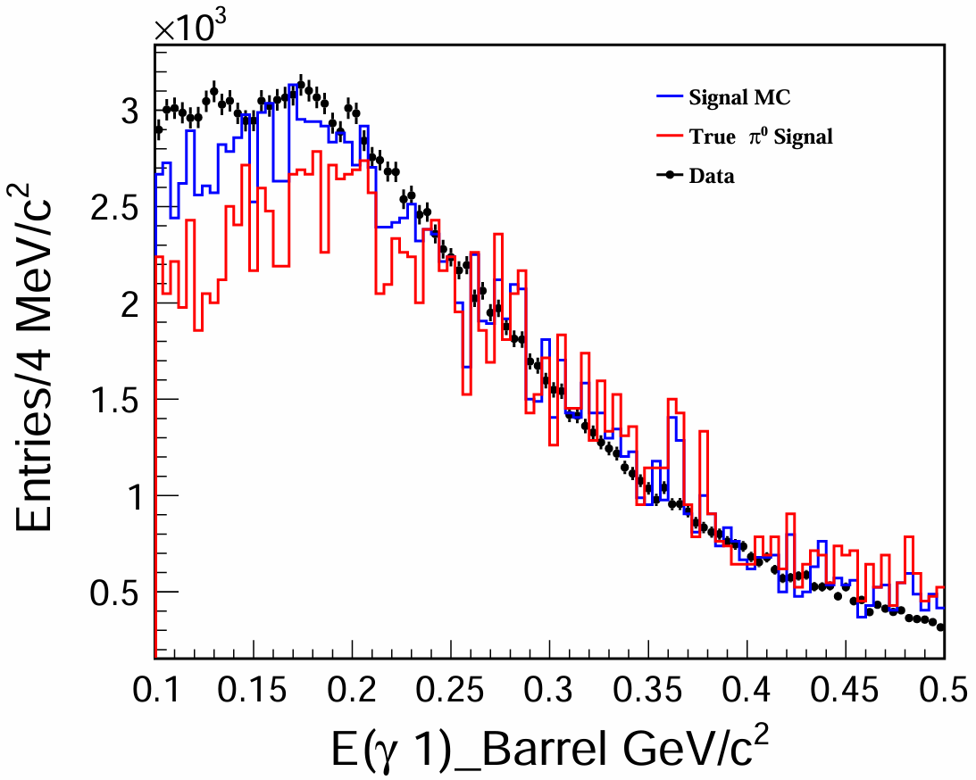
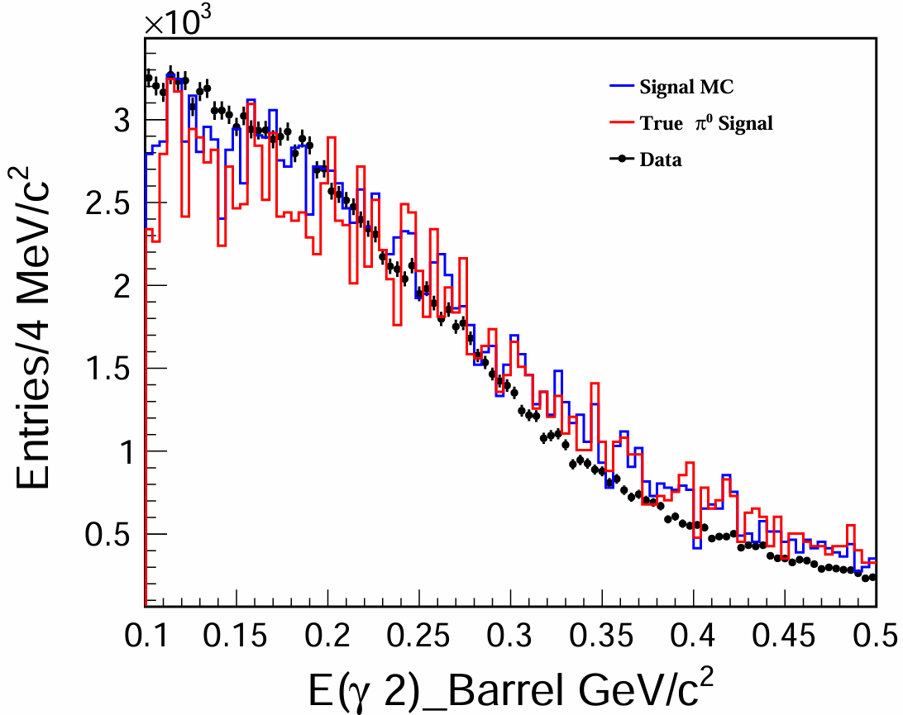
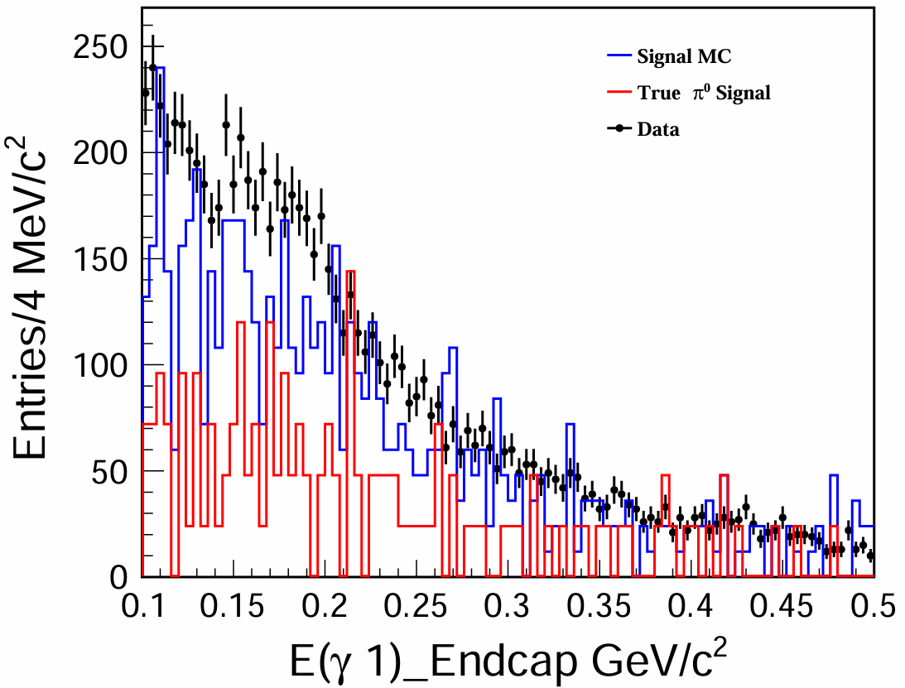
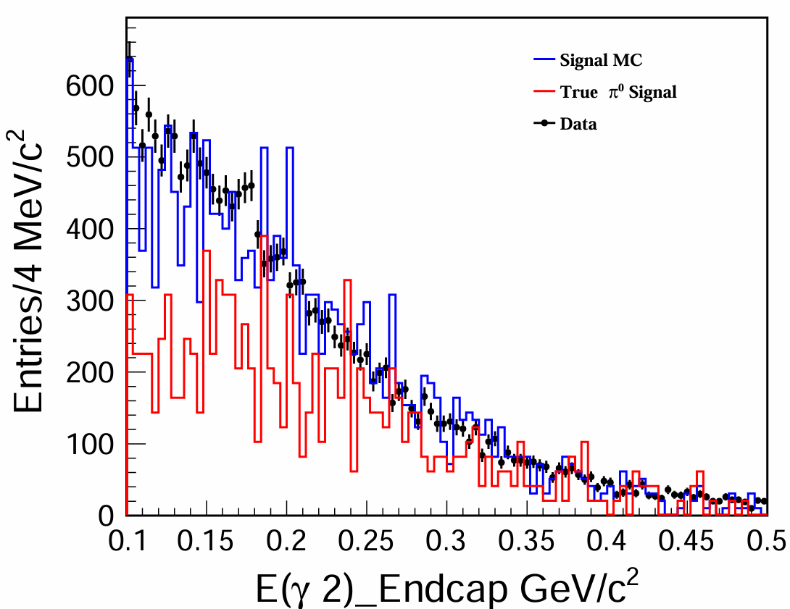
Energy distribution of photons after BCS

Slide 12
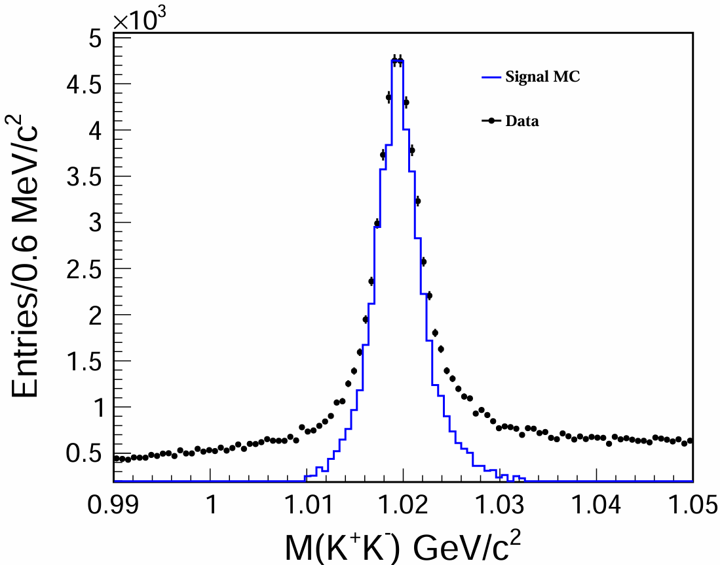
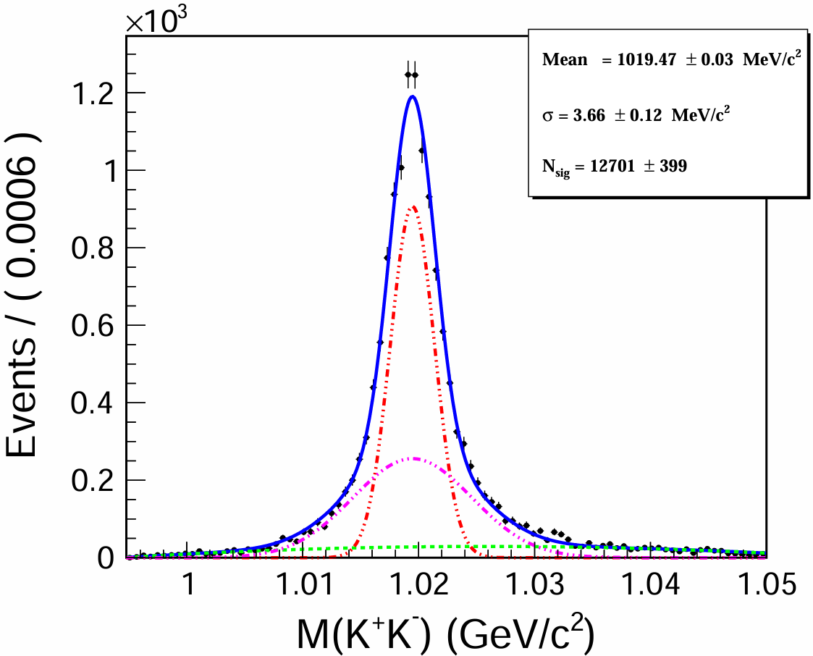
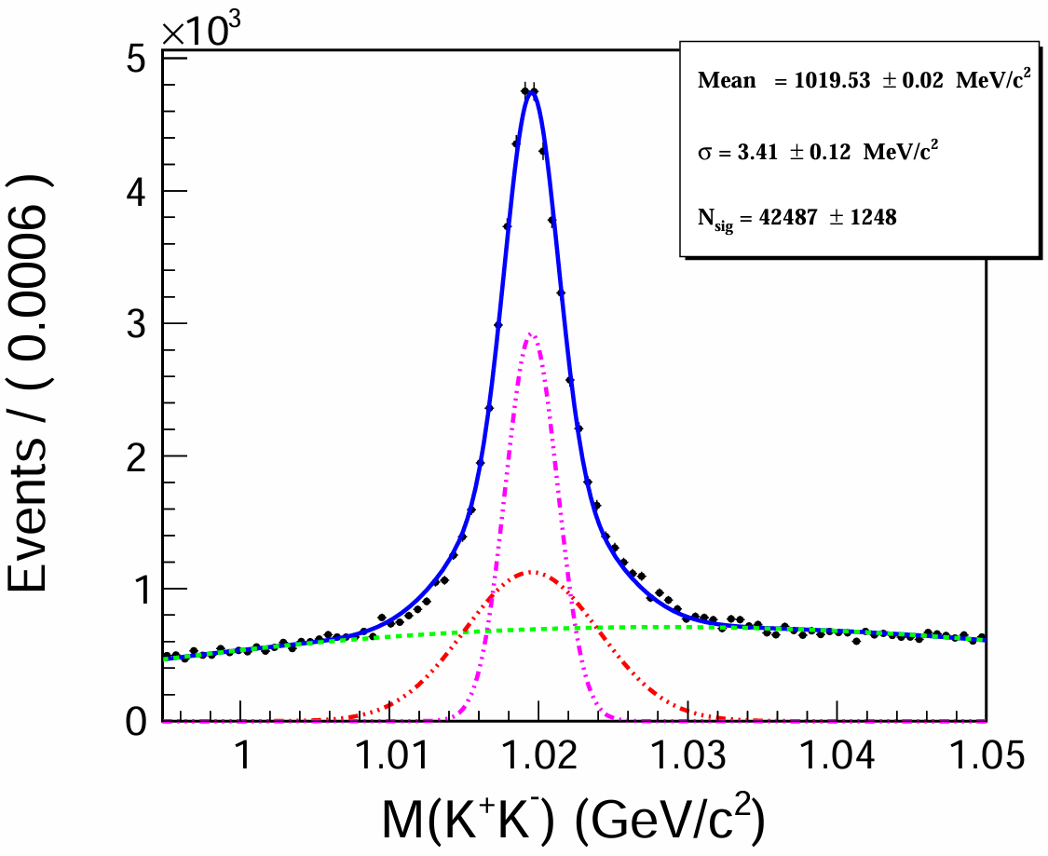
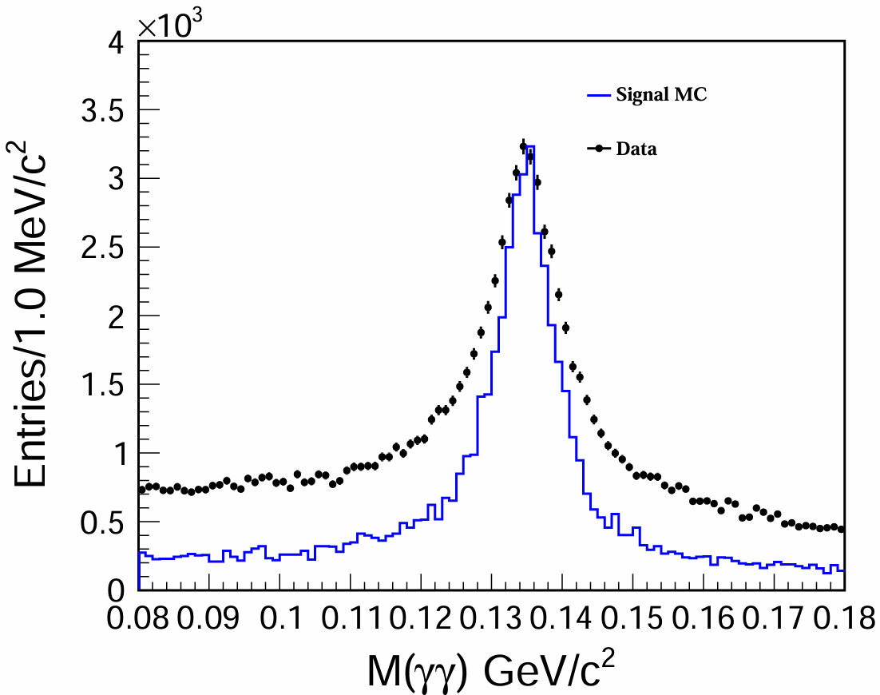
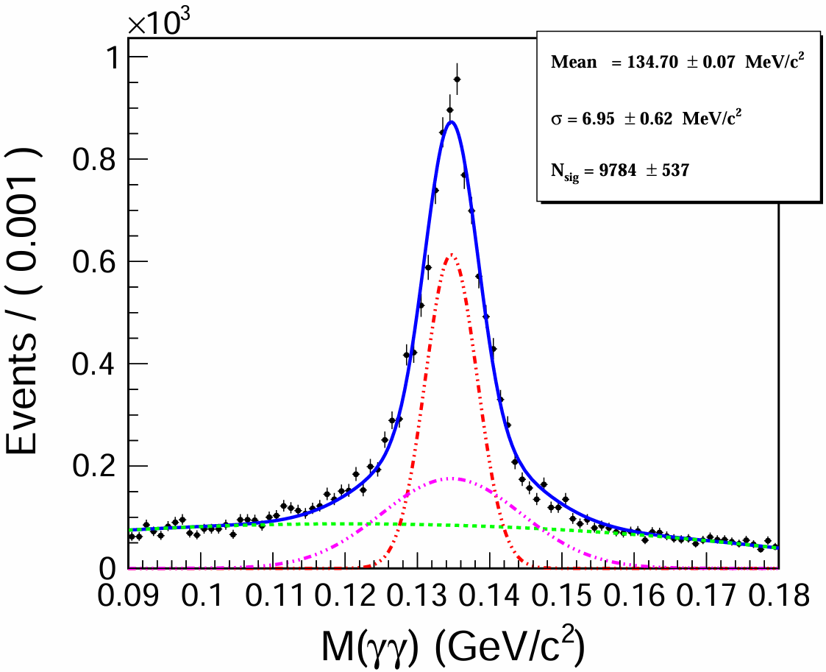
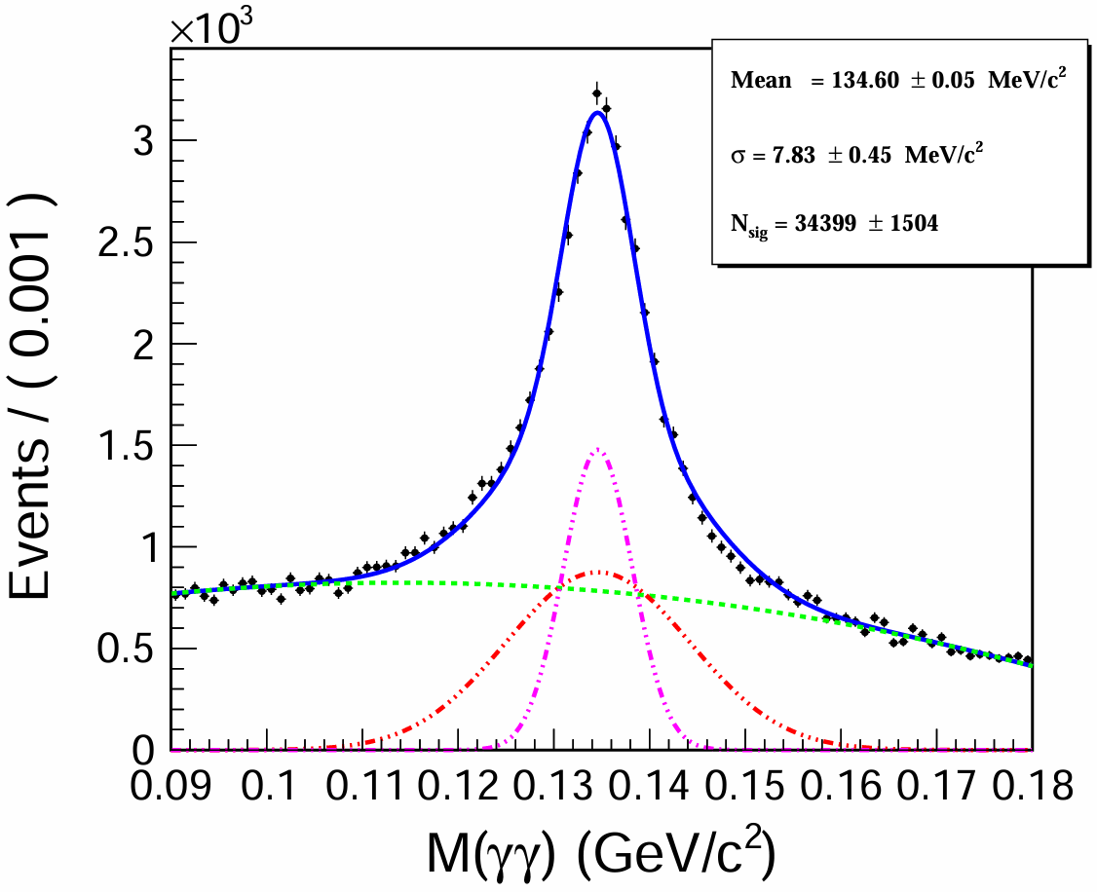
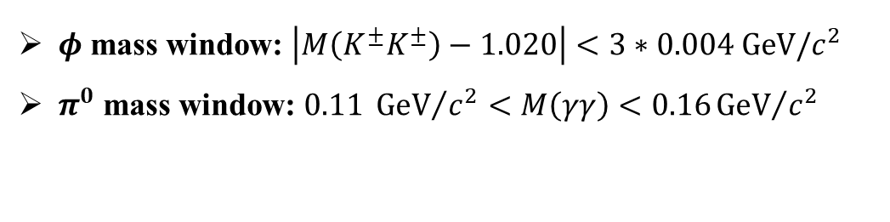
Invariant mass distribution of $φ$ and $π^{0}$
Signal MC
Belle data
Signal MC
Belle data
$φ$ mass window: $\left|M\left(K^{±}K^{±}\right)−1.020\right|<3∗0.004 GeV/c^{2}$
$π^{0}$ mass window: $0.11 {GeV}/{c^{2}}<M\left(γγ\right)<0.16{GeV}/{c^{2}}$

Slide 13
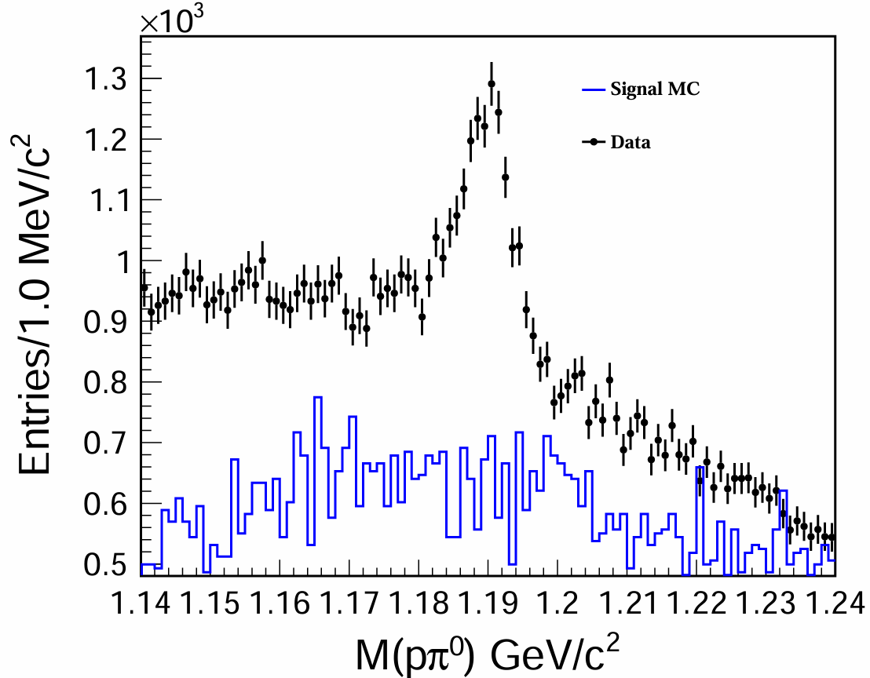
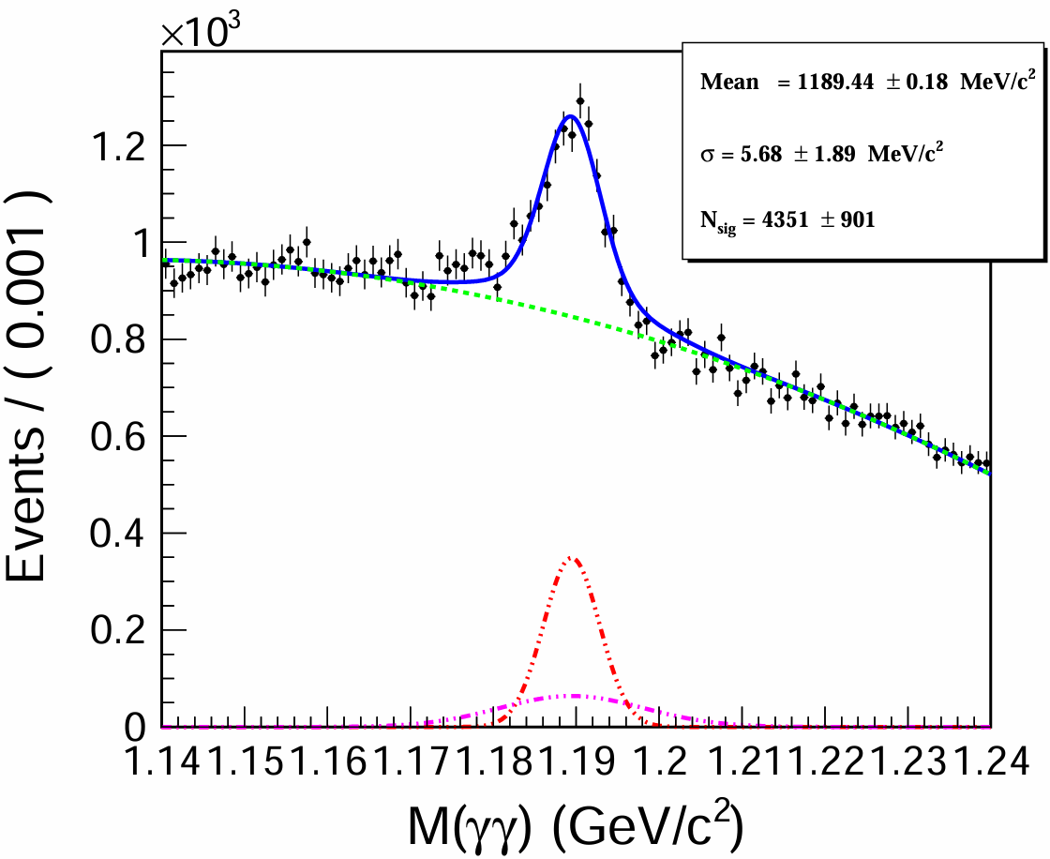


$Σ^{±}$ veto
The decay $Λ_{c}^{+}→{[Σ}^{+}→pπ^{0}]φ$ has the same final state as the signal decay and is Cabibbo-favored.
The events in the mass region of 1.17-1.21 ${GeV}/{c^{2}}$ are rejected.

Slide 14
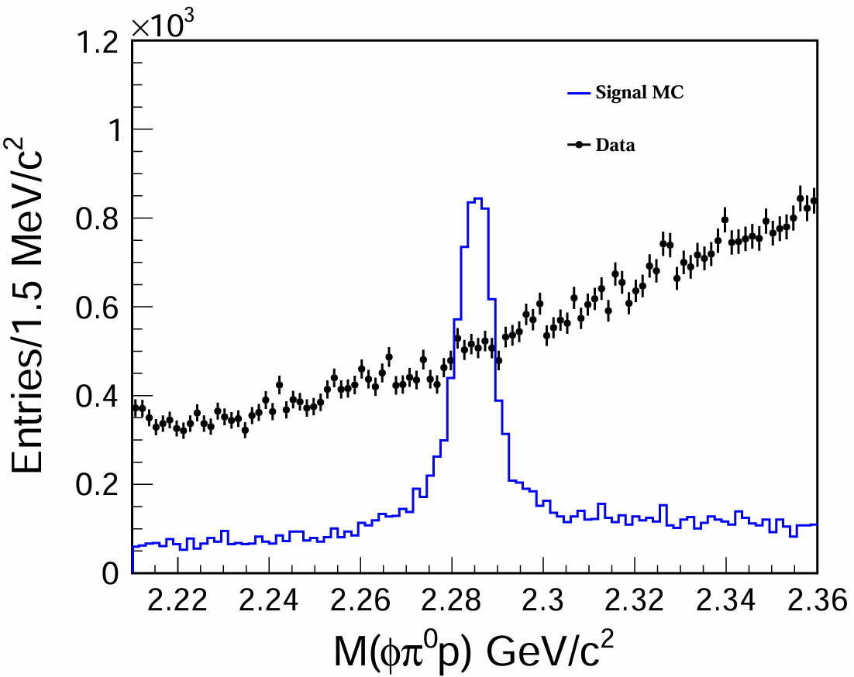
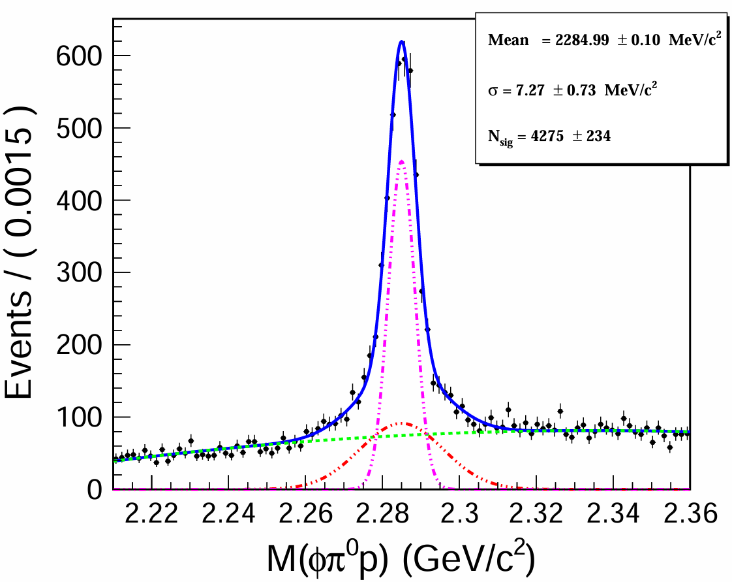
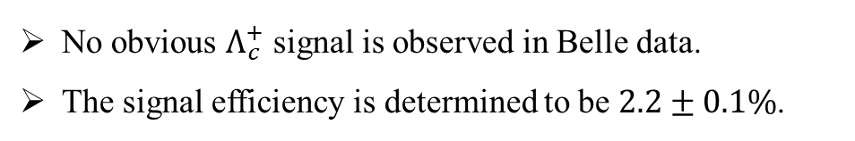
$M(φπ^{0}p)$ distribution
No obvious $Λ_{c}^{+}$ signal is observed in Belle data.
The signal efficiency is determined to be $2.2±0.1\%$.

Slide 15
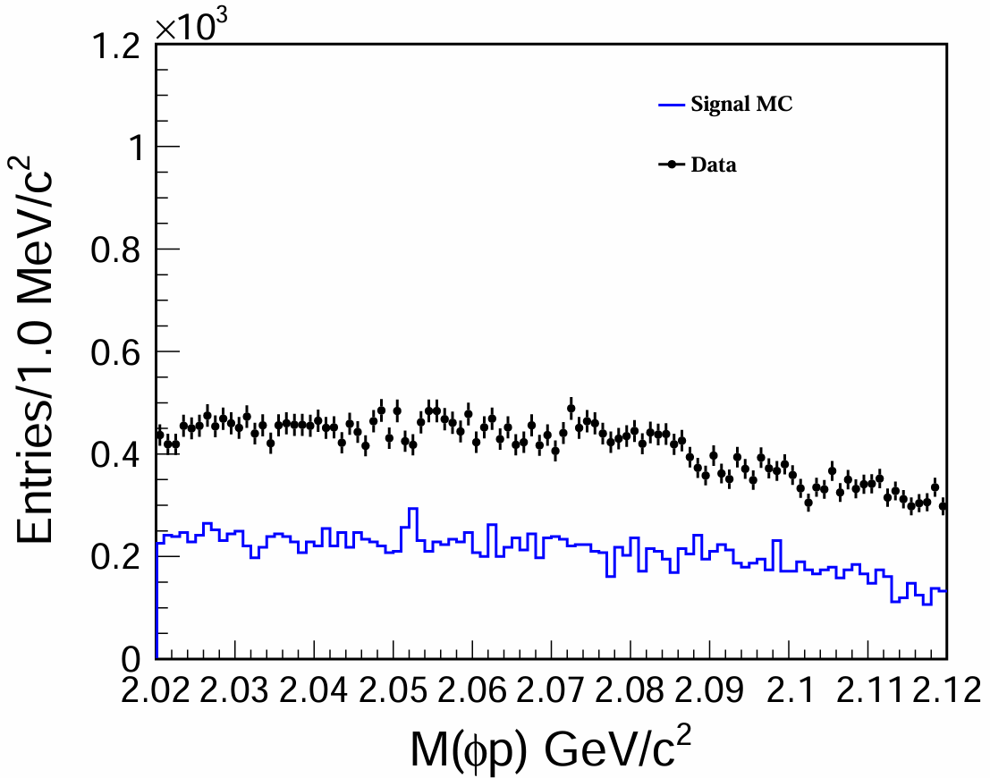

$M(φp)$ distribution
Next to do:
Analyze the generic MC.
Background study.
Optimize the selection criteria.
Run the Belle II MC and data.
No obvious possible $P_{s}^{+}$ signal.

