Slide 1
Gamma-ray emission from W51 region
Songzhan Chen, Zhe Li,
on behalf of the LHAASO collaboration
Institute of High Energy Physics(IHEP), CAS

Slide 2
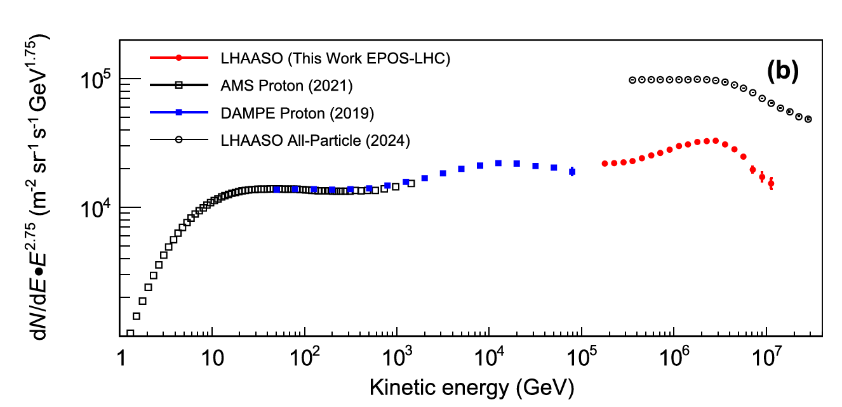
Galactic CRs and the Origin
CRs with energy up to several PeV originate Galactic sources.
SNRs has long being important CR accelerator candidates due to energy budget and DSA acceleration mechanism.
Question：if SNR can accelerate CR up to PeV？
LHAASO coll. 2025

Slide 3
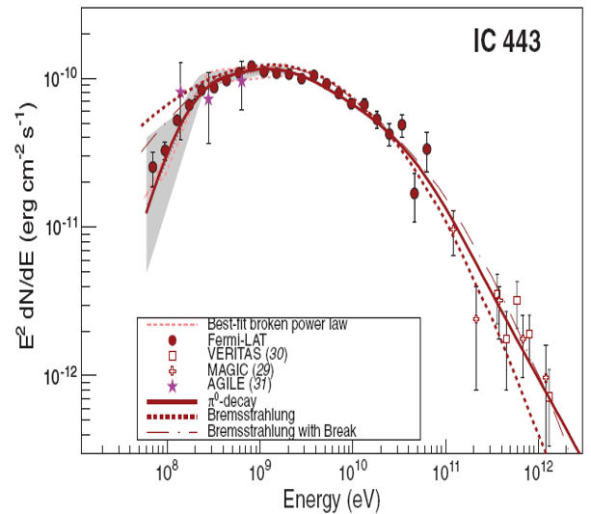
Questions for SNR γ-ray observations
If the emission is from SNR? (PWN? Other?)
If the emission mechanism is Hadronic? (Leptonic?)
If the emission beyond 100 TeV? (maximum energy?)
SNR ~10 ky
UHE SNR is crucial to identify SNR as PeVatron.
Fermi-LAT coll. 2013

Slide 4
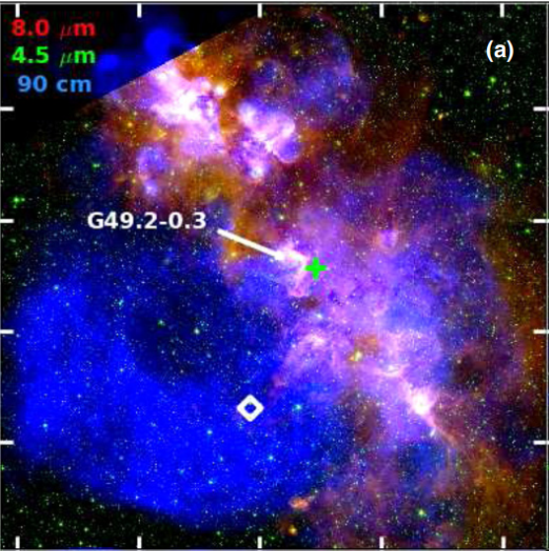
W51 region: SNR+enough gas target
SNR W51C: ~5.5 kpc, 30k yr
Evidences for the interaction between the shock driven by W51C and the molecular cloud associated with W51B.
  Detection of OH masers at 1720 MHz
  Detection of shocked CO clumps and atomic gas in the adjacent region between W51C and W51B
W51A
cloud
PWN
W51B
W51C
Brogan+ 2013

Slide 5
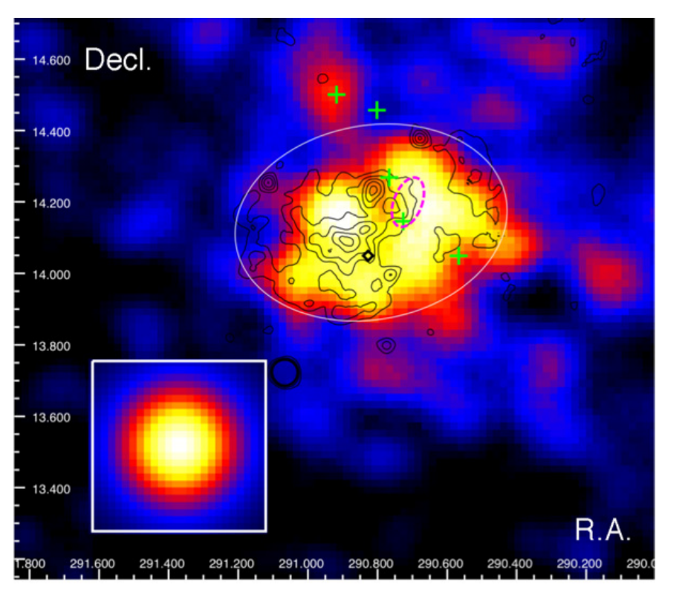
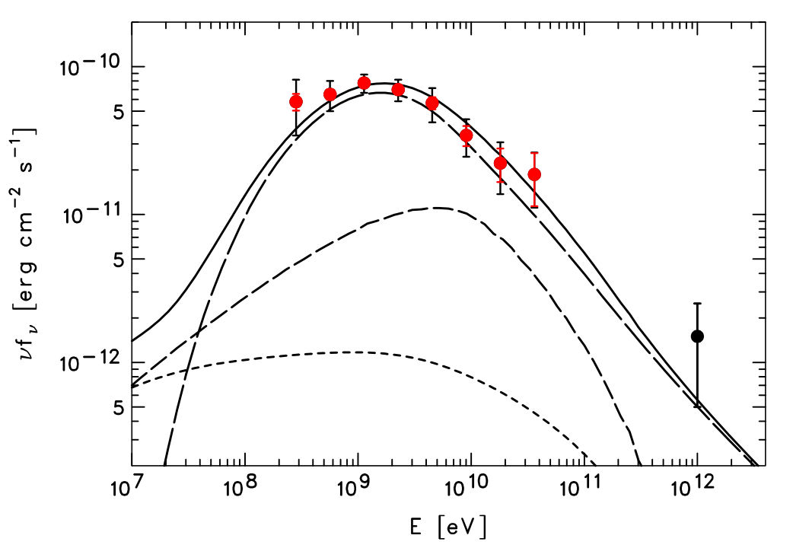
W51@GeV: hadronic emission
Fermi-LAT detect a π₀ decay bump around GeV, indicate the gamma-ray emission is Hadronic.
cloud
shocked CO clumps
PWN
W51C
Fermi-LAT coll. 2009

Slide 6
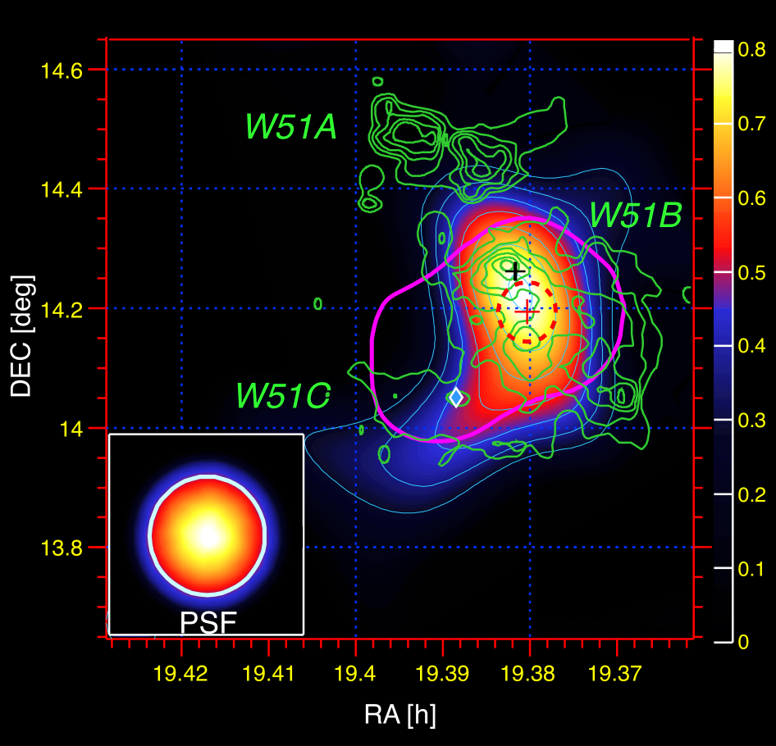
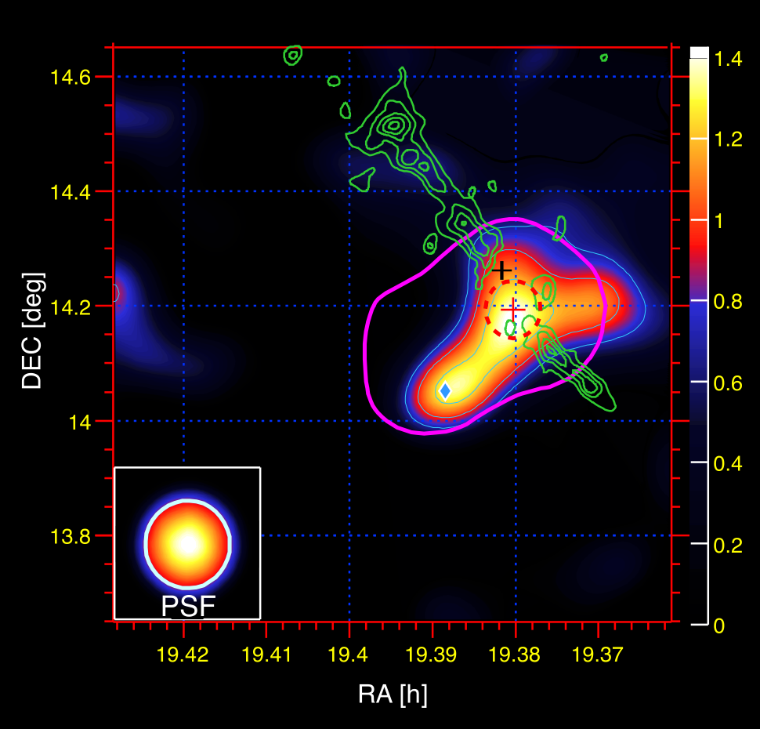
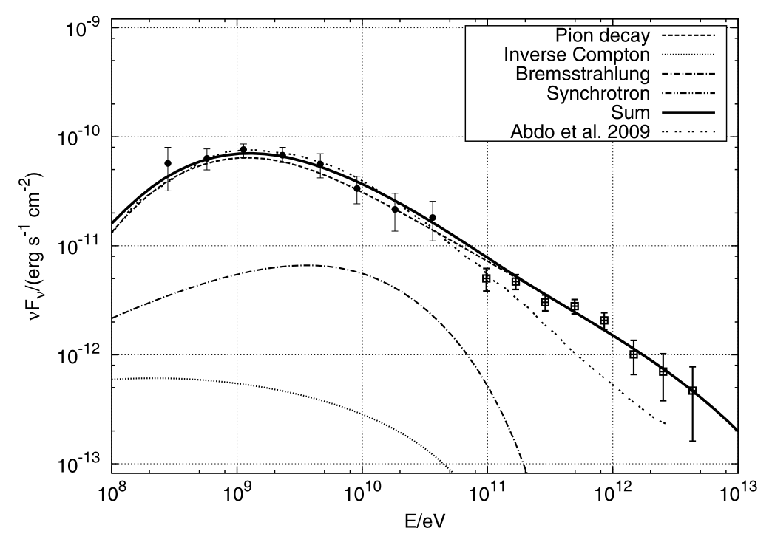
W51 @TeV: SNR + PWN
MAGIC extend the observation up to 5 TeV.
PWN contributes ~20% of flux
cloud
0.3-1TeV
>1TeV
PWN
MAGIC coll. 2012

Slide 7
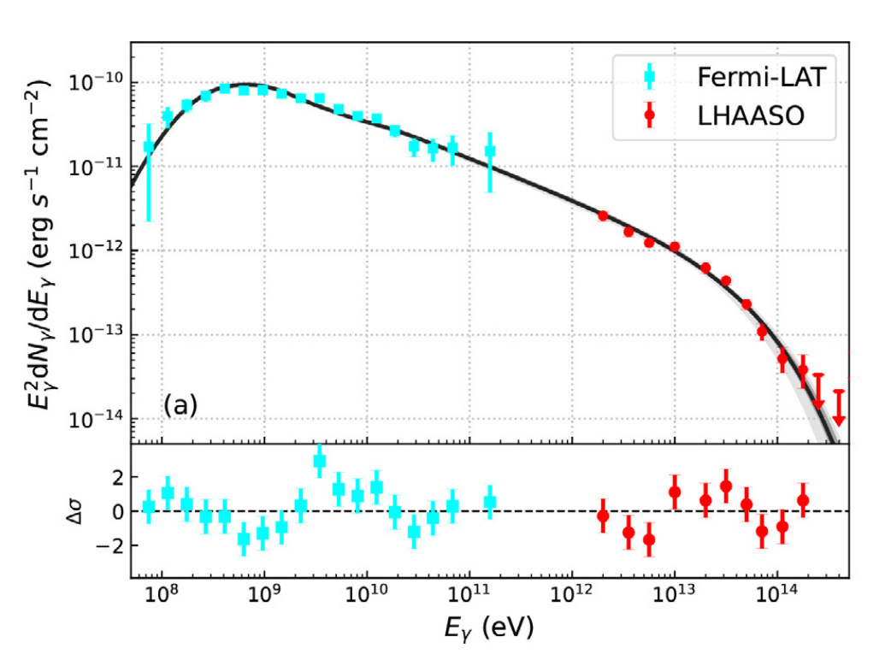
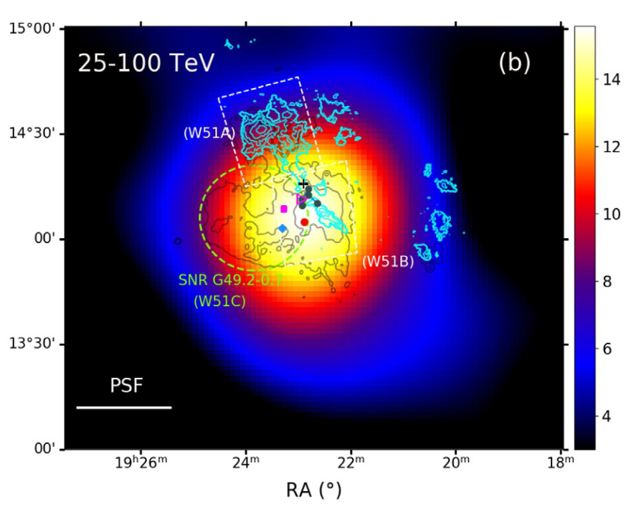
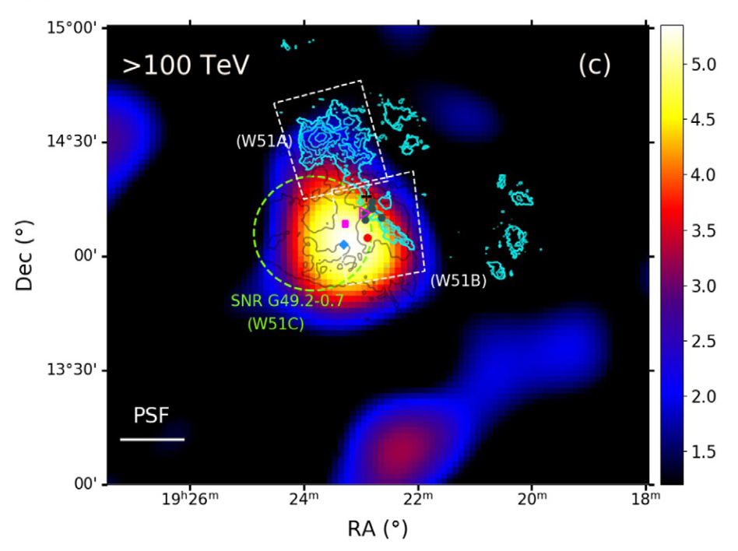
W51 @2-200TeV: UHE+SED cutoff
LHAASO extend the observation up to 200 TeV.
Find SED cutoff at 61 TeV
cloud
PWN
LHAASO coll. 2024

Slide 8
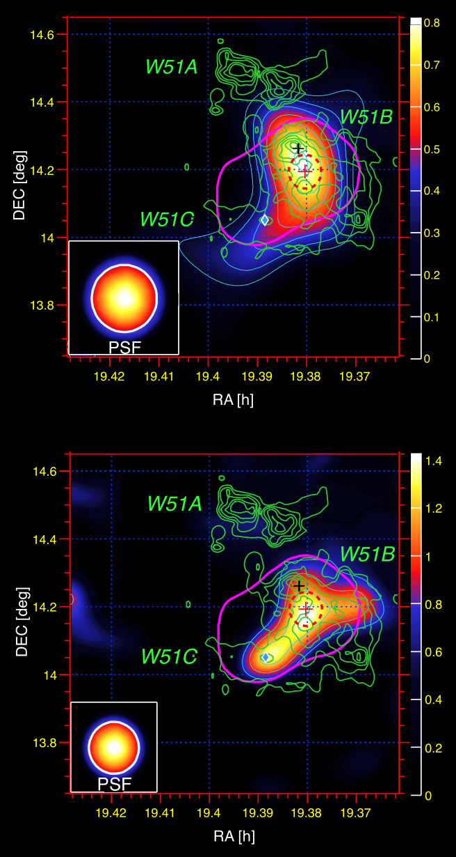
Maps at different energies
0.3-1TeV
2-10 GeV
W51C
>1TeV
Fermi-LAT coll. 2009
MAGIC coll. 2012
LHAASO coll. 2024

Slide 9
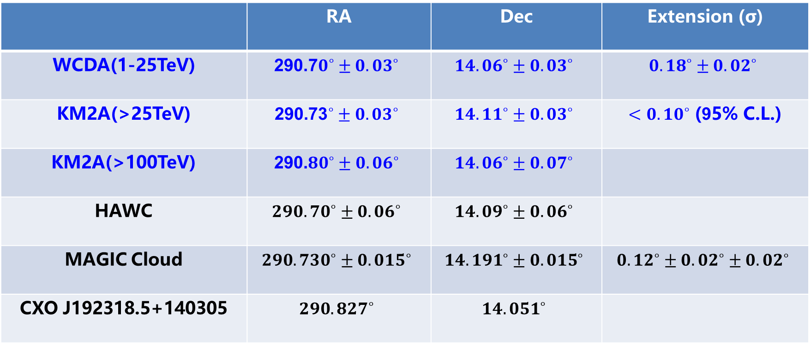
Gamma-ray emission Position and extension
 | RA | Dec | Extension (σ)
WCDA(1-25TeV) | $${\text{290}\text{.}\text{7}0}^{∘}±{0.03}^{∘}$$ | $${14.06}^{∘}±{0.03}^{∘}$$ | $${0.18}^{∘}±{0.02}^{∘}$$
KM2A(>25TeV) | $${\text{290}\text{.}\text{73}}^{∘}±{0.03}^{∘}$$ | $${14.11}^{∘}±{0.03}^{∘}$$ | ${<0.10}^{∘}$ (95% C.L.)
KM2A(>100TeV) | $${\text{290}\text{.}80}^{∘}±{0.06}^{∘}$$ | $${14.06}^{∘}±{0.07}^{∘}$$
HAWC | $${290.70}^{∘}±{0.06}^{∘}$$ | $${14.09}^{∘}±{0.06}^{∘}$$
MAGIC Cloud | $${290.730}^{∘}±{0.015}^{∘}$$ | $${14.191}^{∘}±{0.015}^{∘}$$ | $${0.12}^{∘}±{0.02}^{∘}±{0.02}^{∘}$$
CXO J192318.5+140305 | $${290.827}^{∘}$$ | $${14.051}^{∘}$$

Slide 10
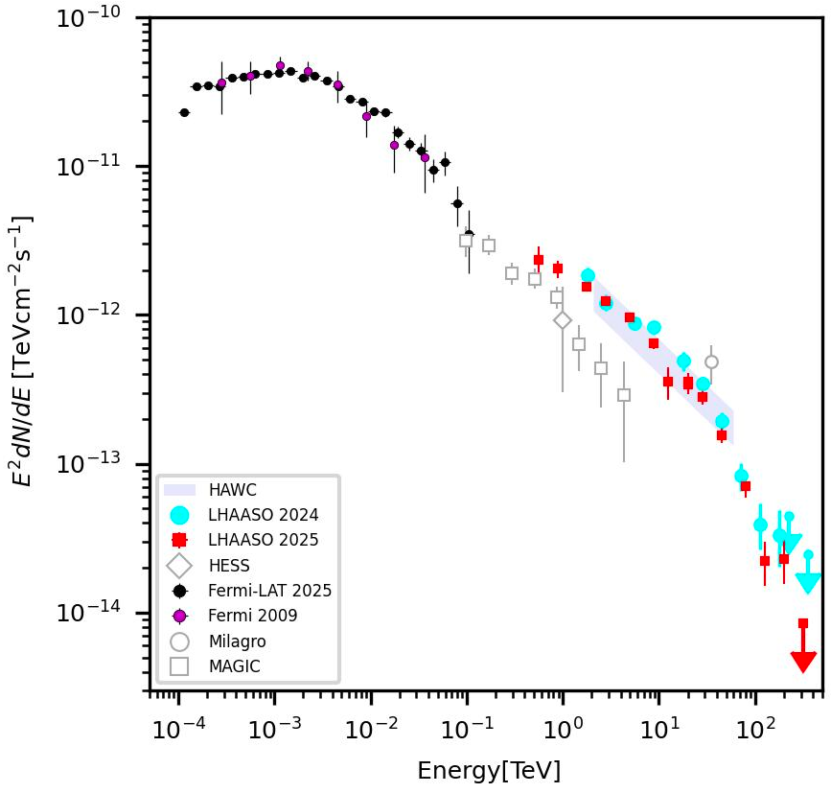
Wide energy SED
Updated Fermi-LAT SED up to 0.1 TeV
Updated LHAASO SED down to 0.5 TeV
LHAASO flux is higher than MAGIC at >1 TeV
Preliminary

Slide 11
Discussion 1: SED
Preliminary
One component Vs Two components?
Precise measurement at 0.1-0.5 TeV with wide FOV is crucial in the future

Slide 12
Discussion 2: PWN contribution
>1TeV
The PWN contribution would dominate at high energy?
LACT and ASTRI high angular resolution observation at >10 TeV is crucial in the future

Slide 13
Discussion 3：origin of particles
Direct interaction of SNR W51C with gas
Or CRs that escaped from the SNR shock at early stages
Or both?
W51A
PWN
W51B
W51C

Slide 14
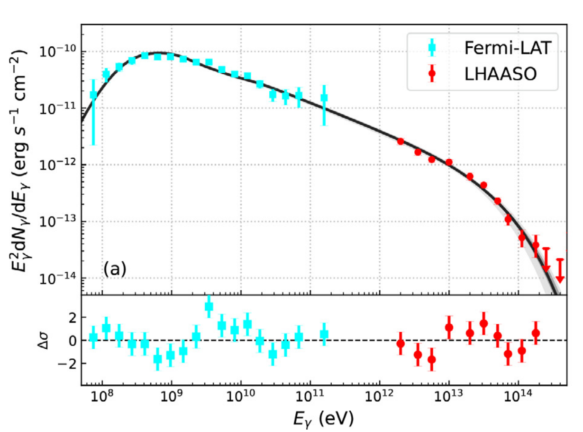

Discussion 4：SNR budget
The E_{cut} of proton is ~400 TeV.
3.6% of the SNR W51c explosion energy, in agreement with the standards SNR paradigm

Slide 15
Summary
The gamma-ray spectrum of W51C detected from sub GeV to 200 TeV. UHE gamma-ray emission is discovered in an interacting SNR (with π₀-decay bump).
In the hadronic emission model the maximum Proton energy should be up to PeV with Ecut around 400 TeV, which can be interpreted with the standards SNR paradigm
However, definitive conclusion still need Precise SED and morphology measurement in the future.
Thank you!

