Slide 1
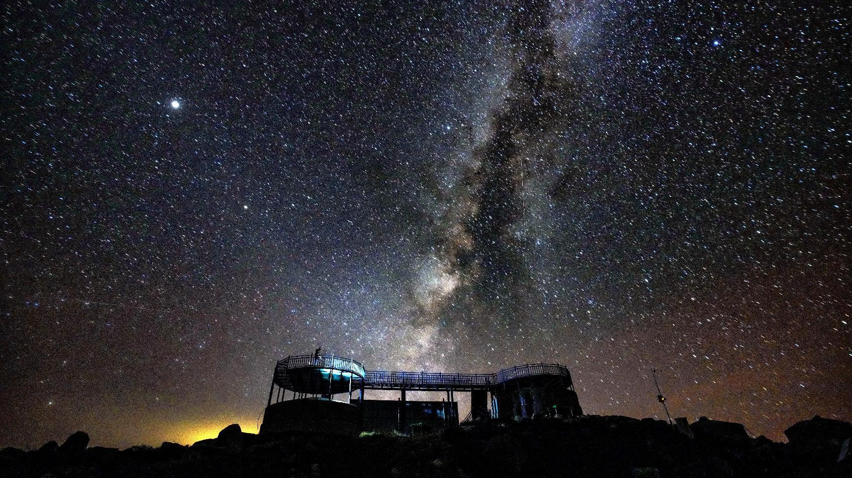



The Symposium of Ultra-High-Energy Gamma Rays from Supernova Remnants and the Origin of Galactic Cosmic Rays
Pulsar Wind Nebulae as Extreme Particle Accelertors
Ruoyu Liu
Nanjing University
01.03.2026，Yuxi，China

Slide 2
outline
A brief overview of PWNe observed in the gamma-ray band
LHAASO reveal PWNe as electron PeVatron
- Crab Nebula
- PSR J1849-0001
- Boomerang Nebula
Do PWNe accelerate PeV protons?
Conclusion

Slide 3
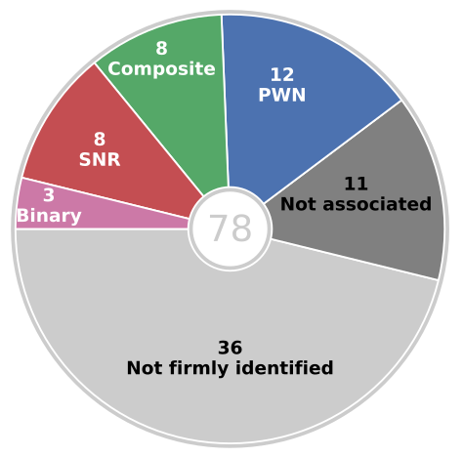
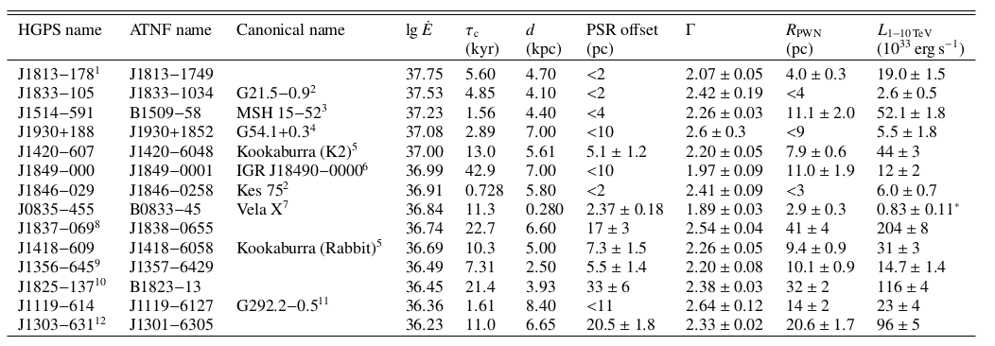
Pulsars as Counterparts of VHE gamma-ray sources
Pulsars – the most commonly potential counterparts of detected VHE gamma-ray emitter
14 firmly identified PWNe by HESS
HESS Coll. 2018, A&A
We have presented the third catalog of steady gamma-ray emitters detected by HAWC using 1523 days of data. The catalog consists of 65 sources, including two blazars. The most abundant source class among the potential counterpart of HAWC sources in the Galactic plane is pulsars (56). —— 3HWC (HAWC Coll. 2020, ApJ)
Among the 47 sources not yet identified, most of them (36) have possible associations with cataloged objects, notably PWNe and energetic pulsars that could power VHE PWN. —— HGPS

Slide 4
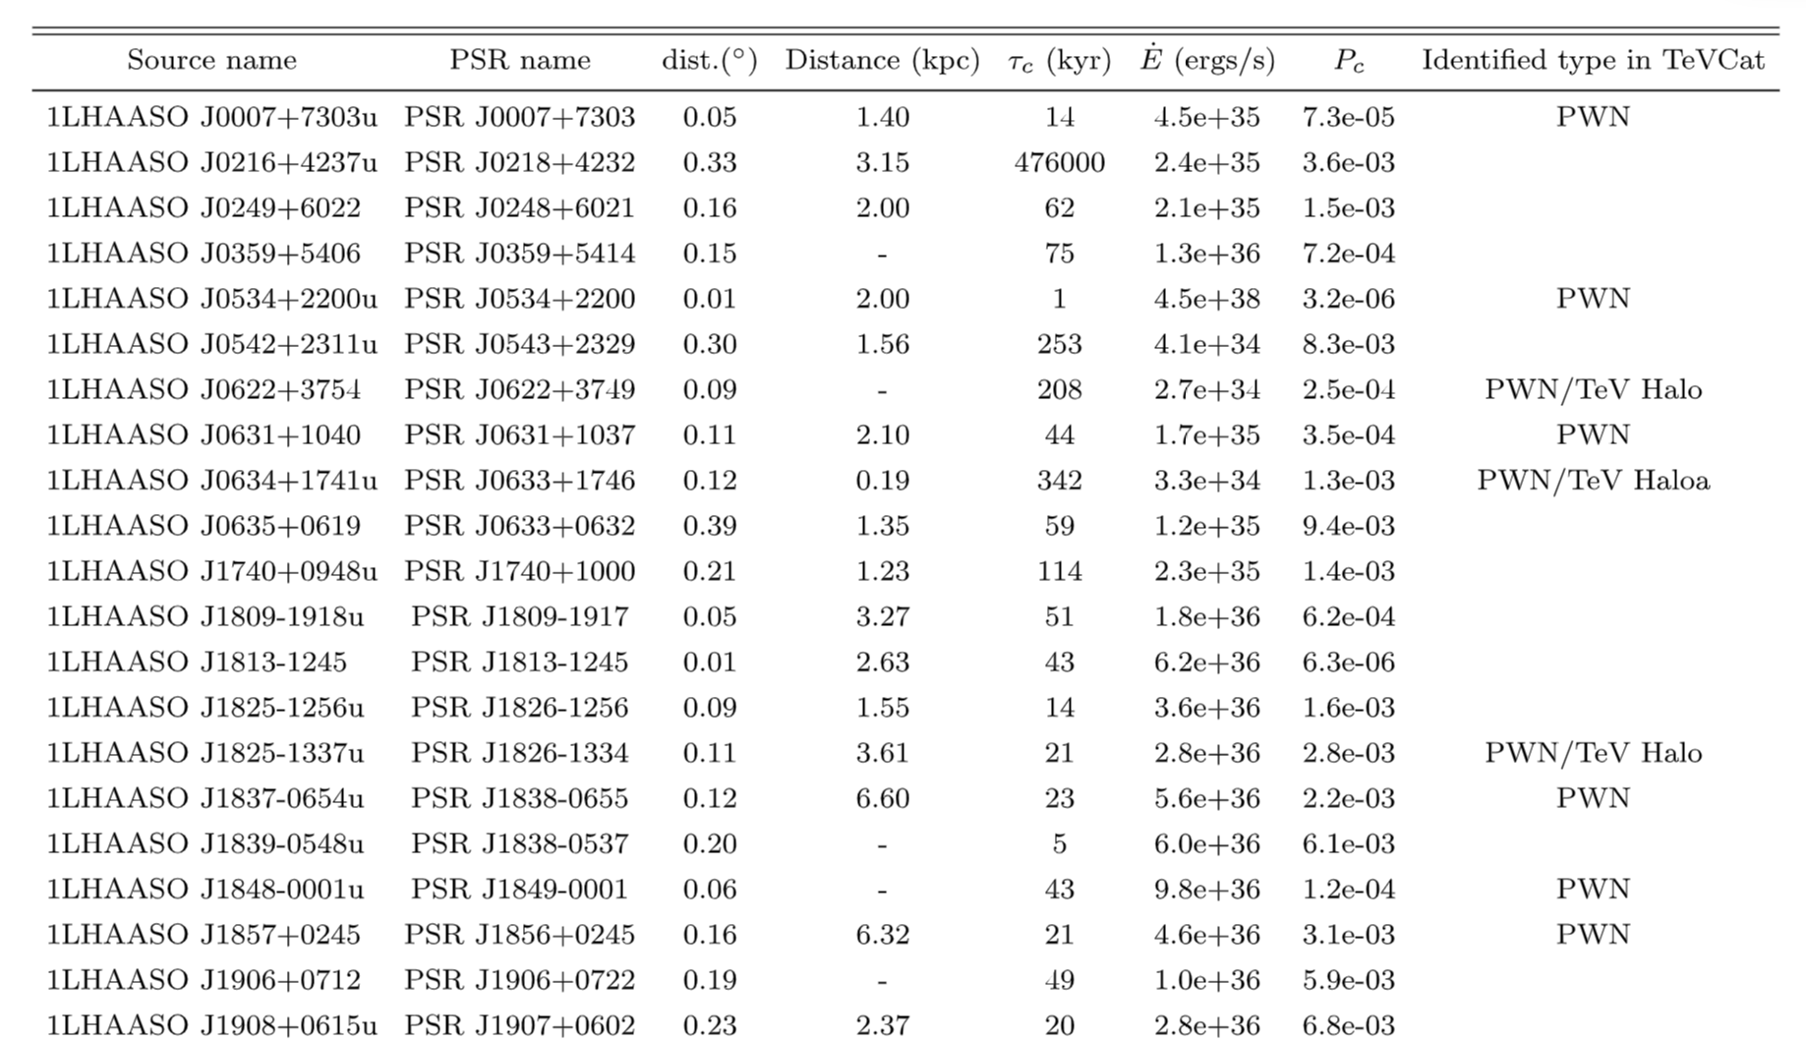
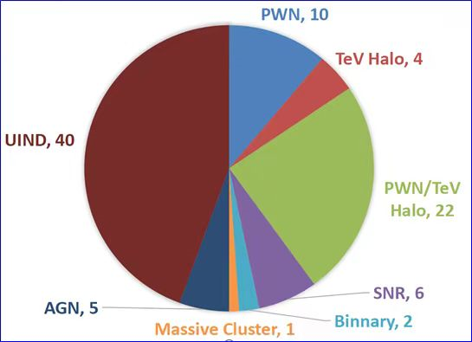
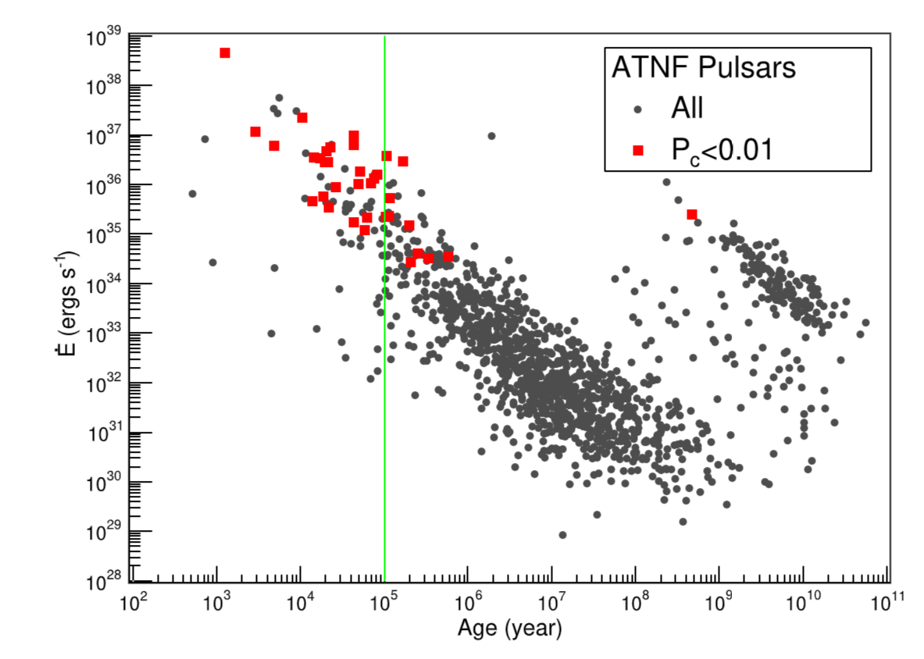
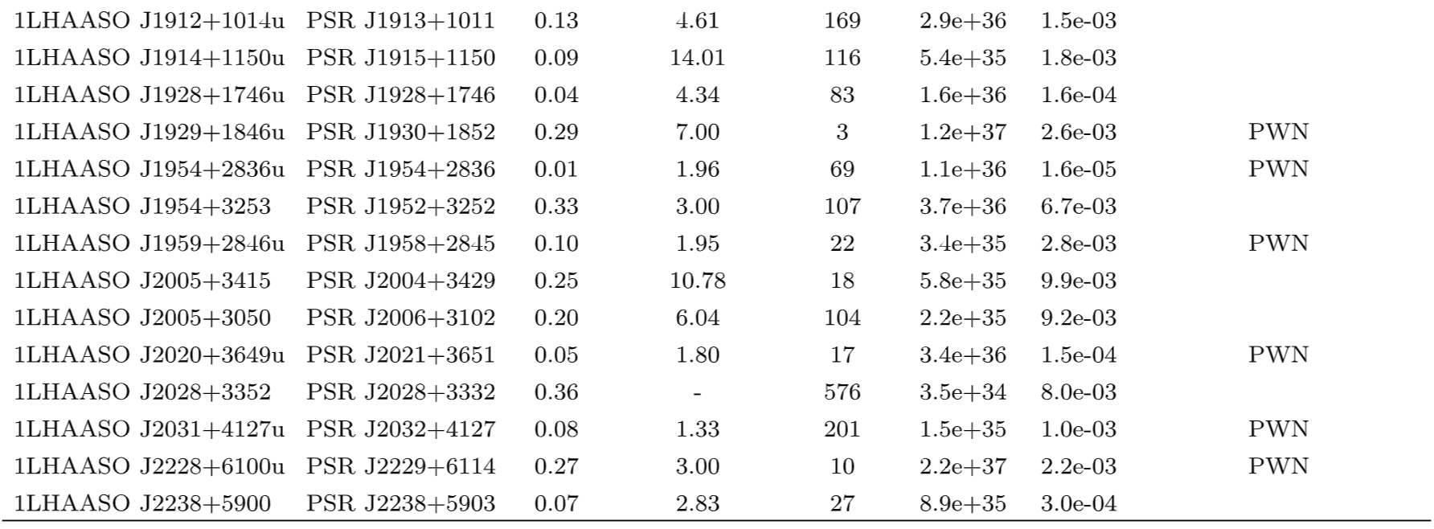
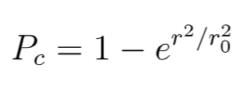

1LHAASO Catalogue
35 sources associated with pulsars with $\dot{E}>1034erg/s$ at a chance probablity <1% (65 have ≥1 pulsar within 0.5 deg)
|b − b_{c}| < 2.5◦ & |l − l_{c}| < 10◦
LHAASO Coll. 2024, ApJS

Slide 5
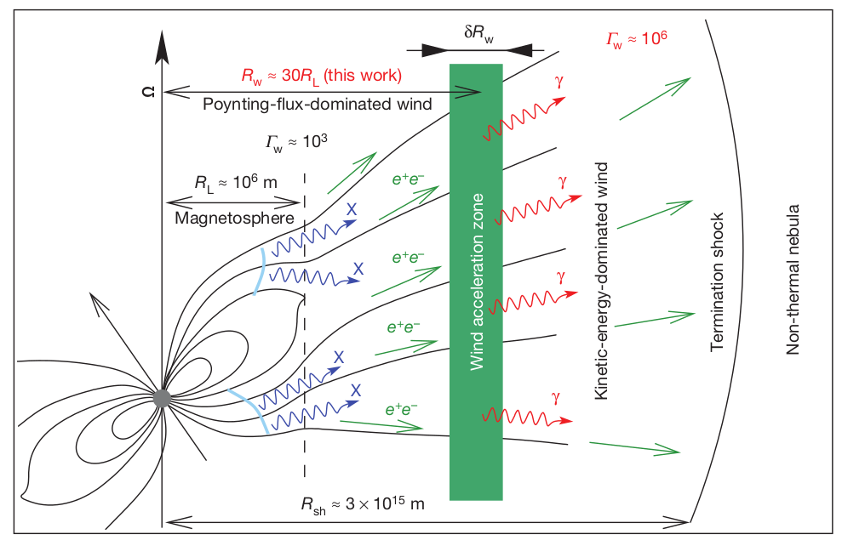
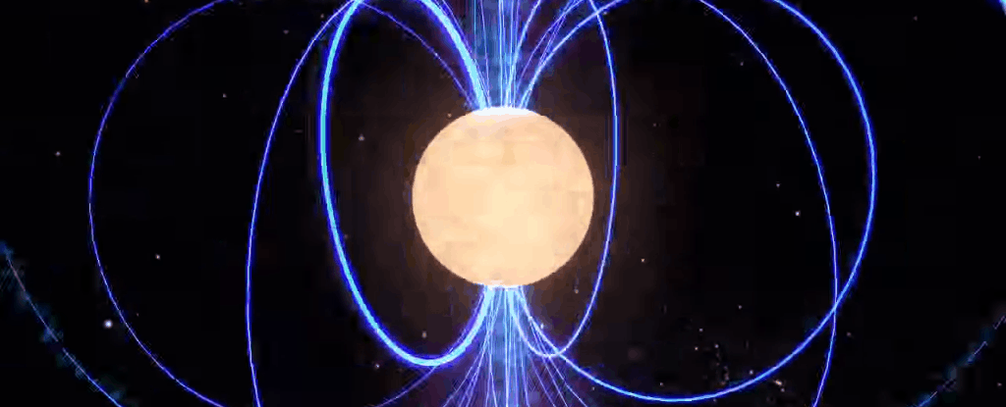


Pulsar and Pulsar Wind
Pulsars: highly magnetized, fast-rotating neutron star
Aharonian et al. 2012, Nature
n: braking index (1<=n<=3)
τ₀: initial spin-down timescale
L_{s,0}: initial spin-down luminosity
Rotational energy → electromagnetic energy → kinetic energy

Slide 6
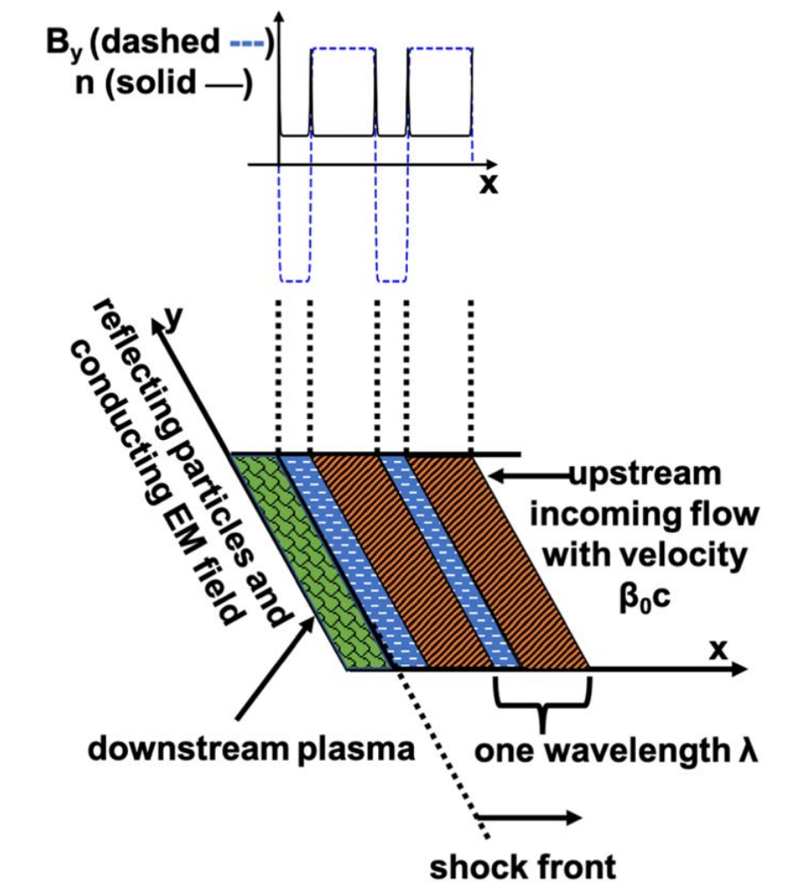
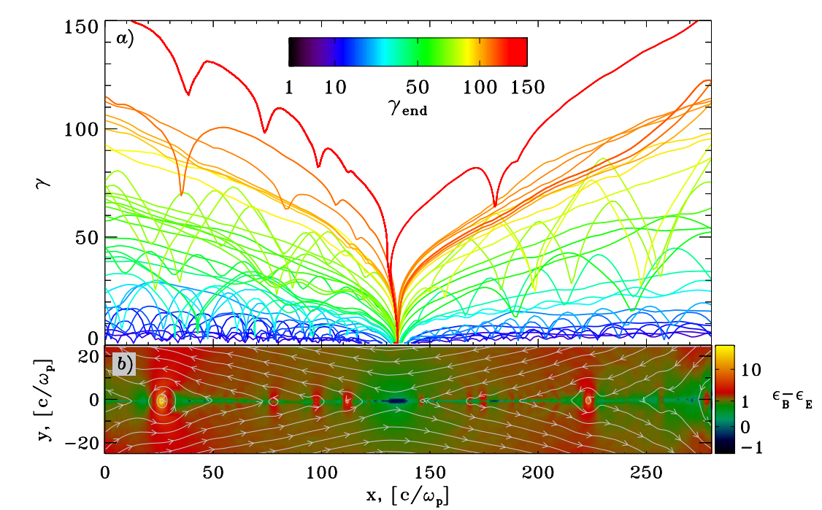
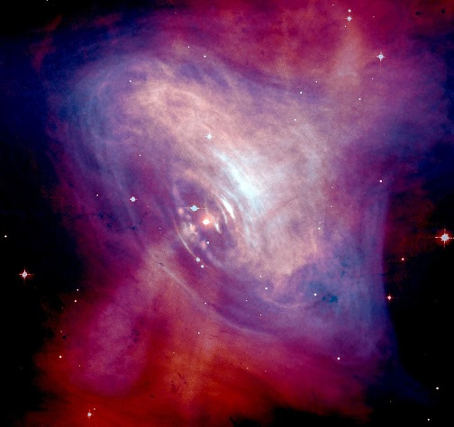
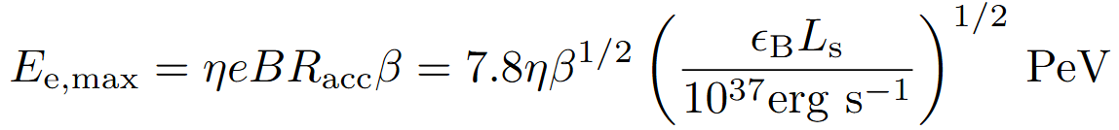
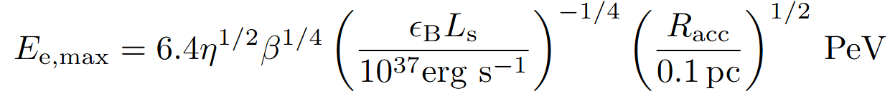
Particle acceleration in PWN
PWNe are powered by rotation energy of pulsars
Fermi-type acceleration processes
X-points electric field
Rotational energy of pulsars →
electromagnetic energy →
kinetic energy →
Particle energy
Sironi & Spitkovsky 2014
Lu et al. 2021
Maximum particle energy
B_{acc}²/8π=ε_{B}L_{s}/4πR_{acc}²c
Limit from Electric Potential
η: acceleration efficiency
= E_{eff} /B
Limit from Synchrotron Cooling
Composite X-ray/Optical Image
Credit: NASA/ESA

Slide 7
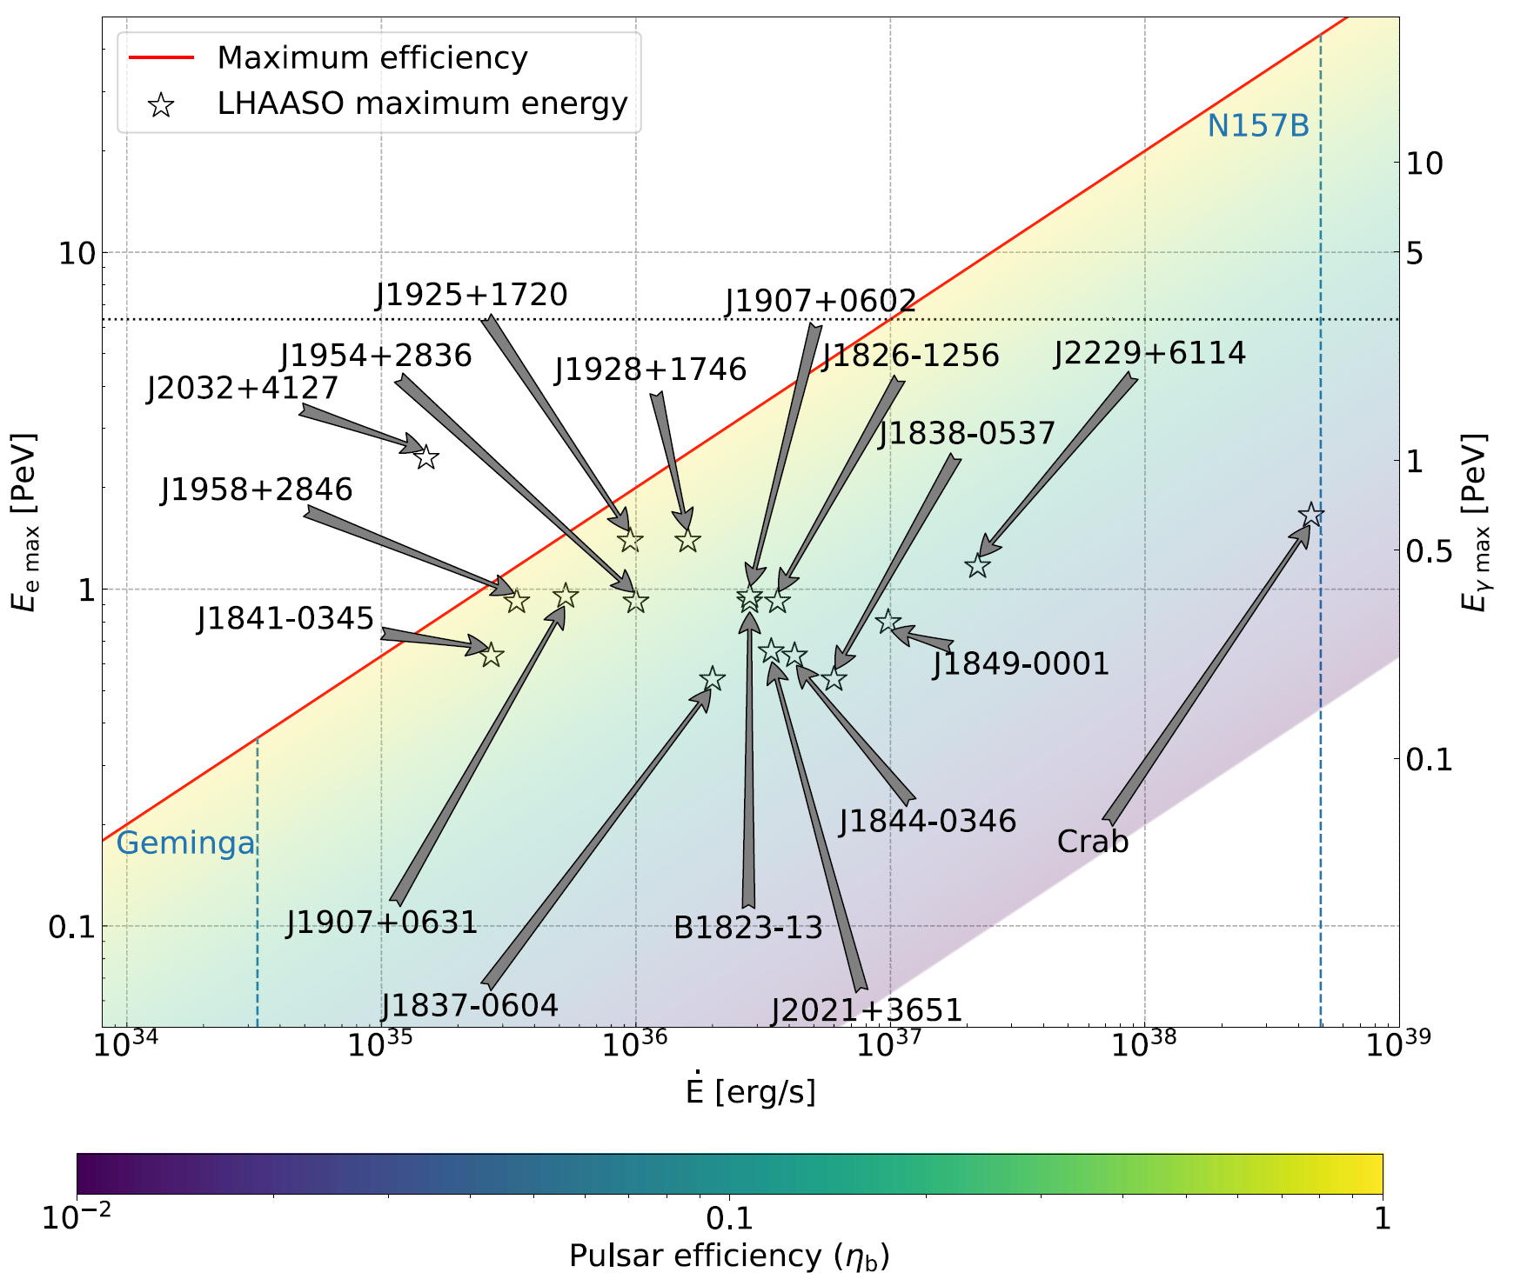
de Oña Wilhelmi et al. 2022

Slide 8
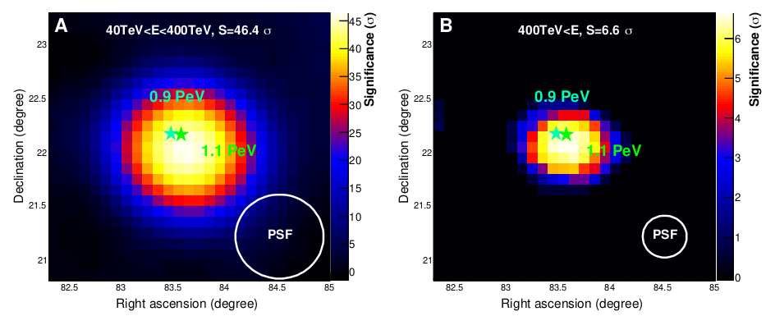
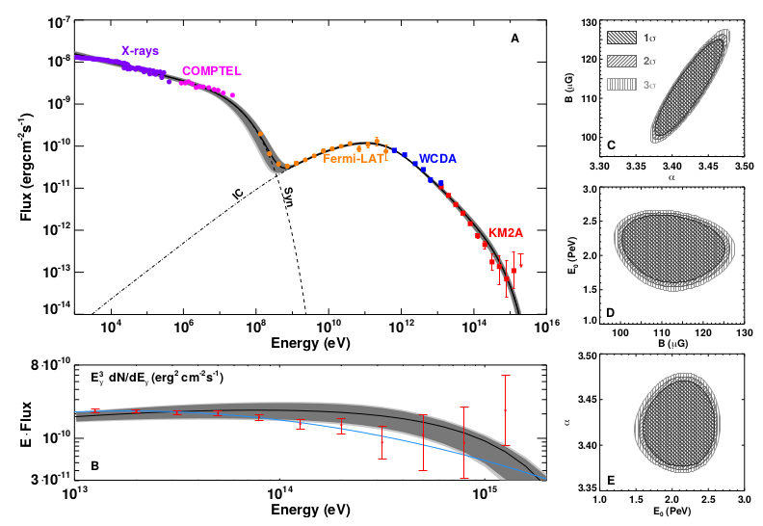
Crab Nebula: the first detected PeV gamma-ray emitter
For the standard one-zone model: η>0.16
(cf. η ~10⁻⁴-10⁻³ for typical SNR shock)
$${\dot{W}}_{e,PeV}=2×{10}^{36}{\left(B/100μG\right)}^{2}erg/s$$
LHAASO Coll. 2021, Science, 373, 425

Slide 9
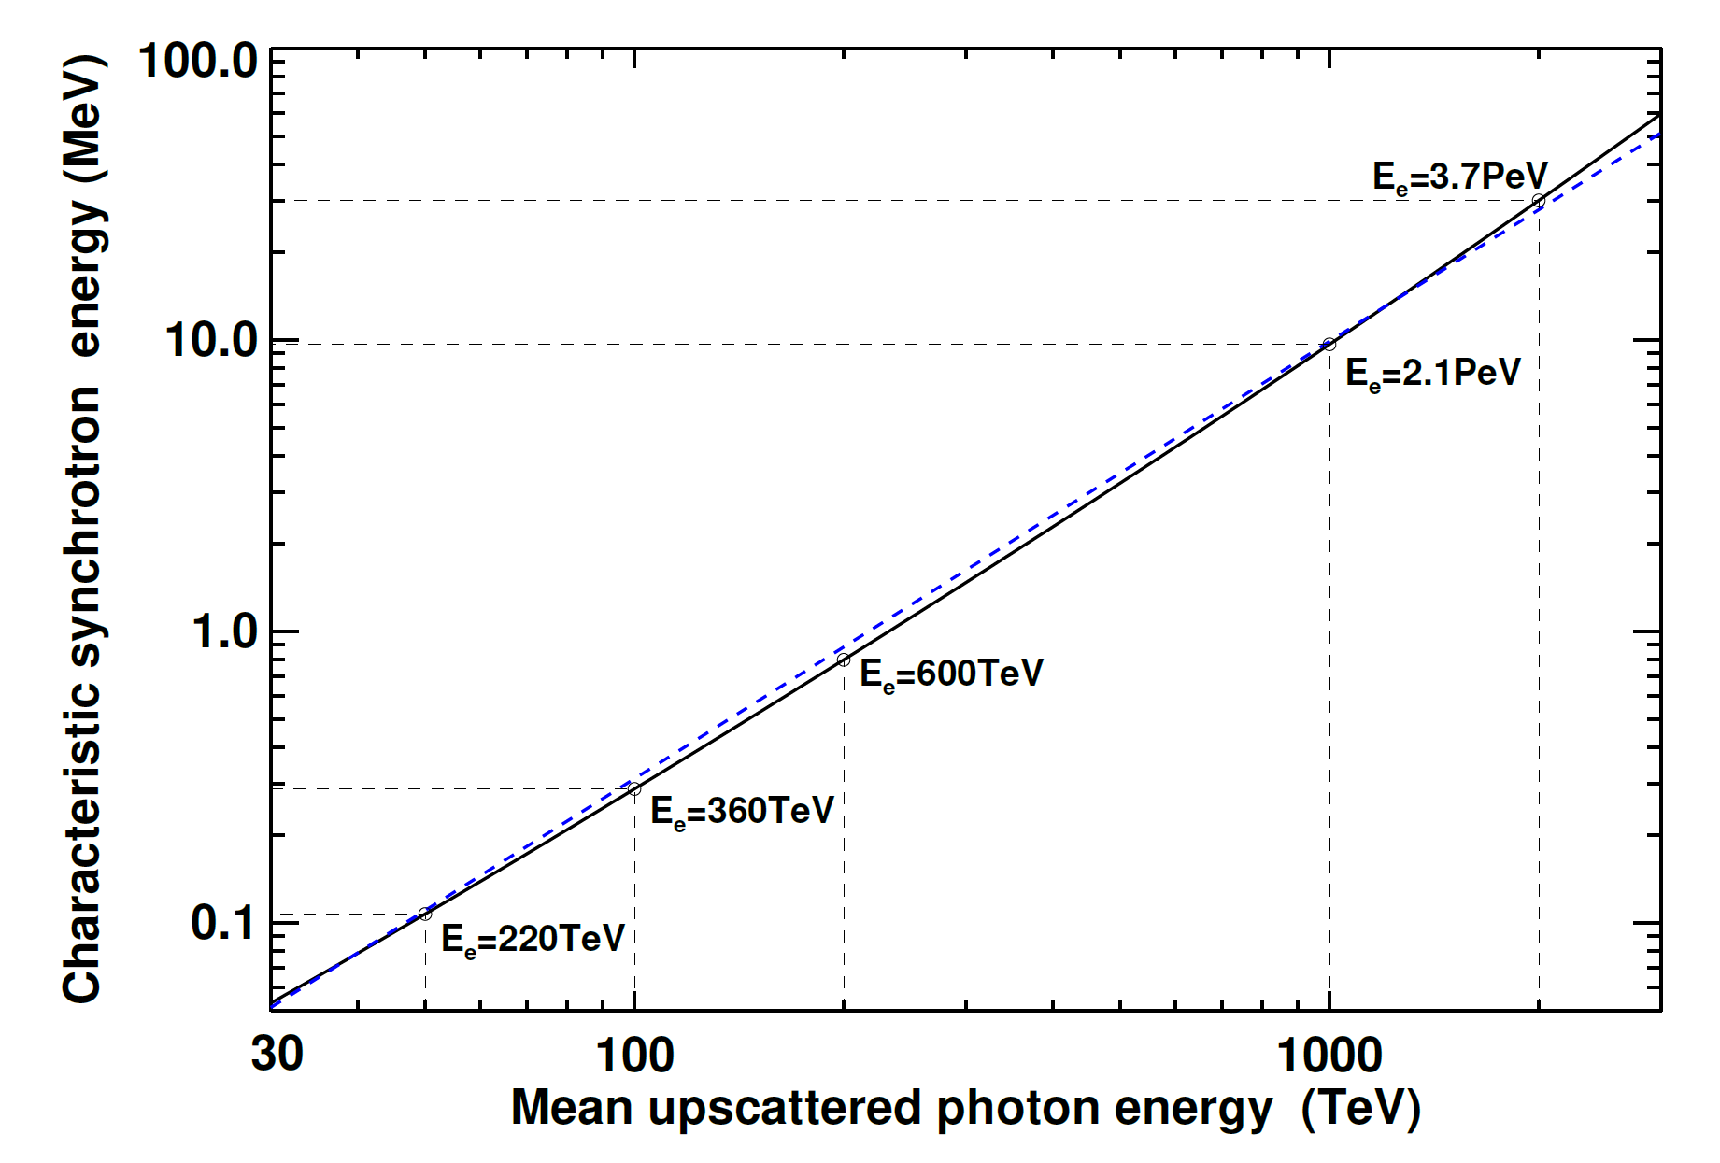
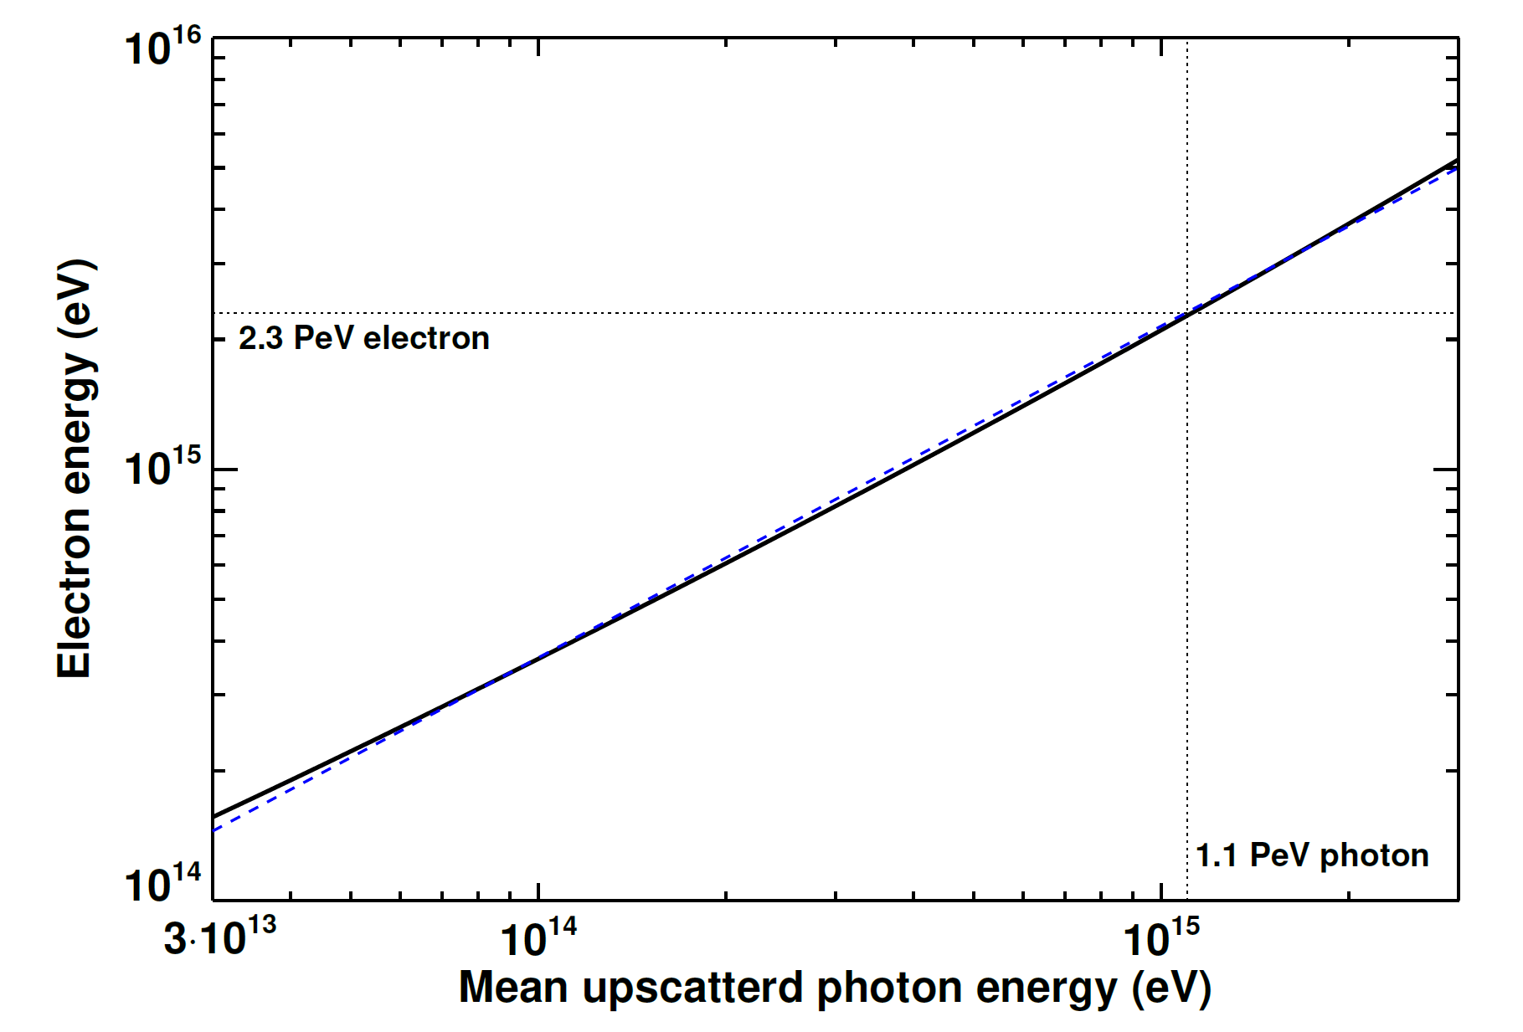

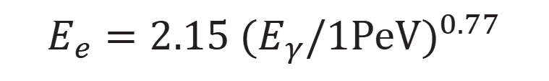
typical relation between synchrotron photon energy and IC photon energy (scattering off CMB)
typical energy of electrons producing gamma-ray photons by upscattering CMB photon
$$E_{e}=2.15 {(E_{γ}/1PeV)}^{0.77}$$
however, MeV-GeV emission may arise from flares during which B is significantly enhanced

Slide 10
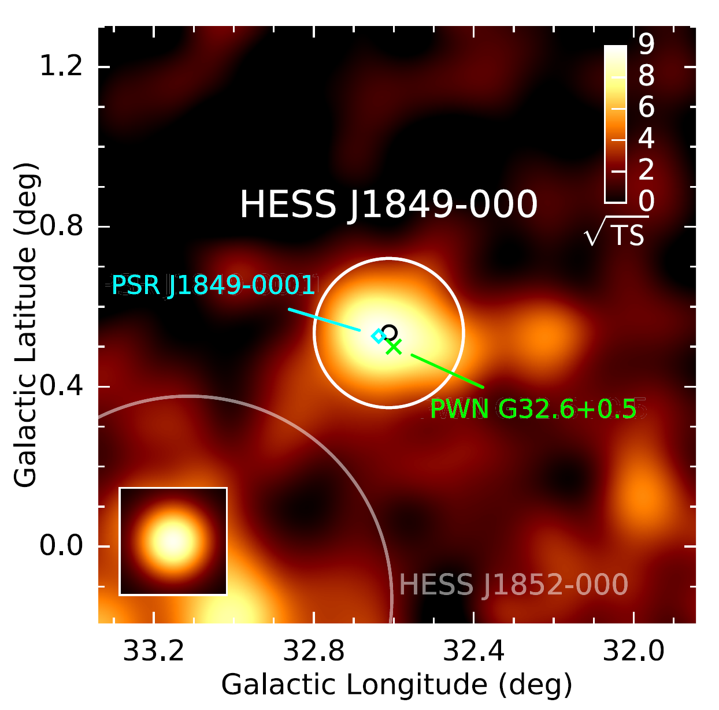
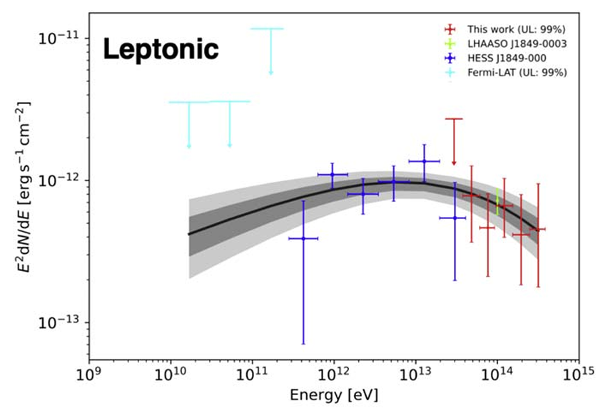
A second example: PSR J1849-0001
Crab Pulsar is special in terms of its high spindown power and young age
PSR J1849-0001，P=38.5ms, L_{s}=9.8x10³⁶erg/s，d~7kpc
HESS Coll. 2018
HESS Coll. 2018
ASγ Coll. 2023

Slide 11
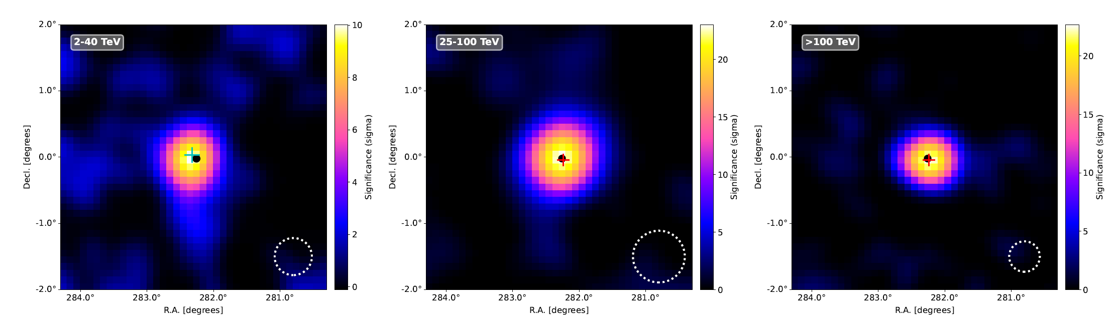
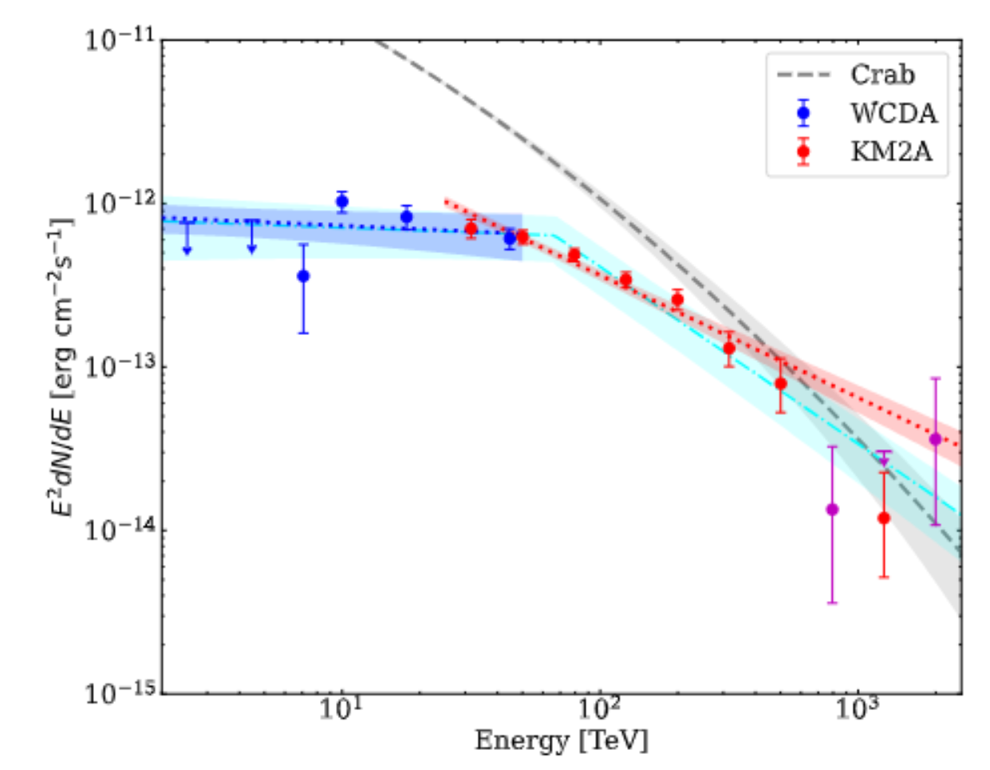
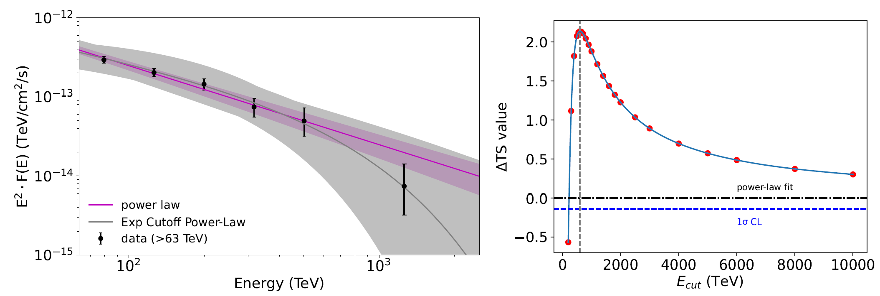
2PeV photon
LHAASO Coll. 2026, Nature Astronomy, accepted
34σ above 25 TeV, 24σ above 100 TeV
α₁=2.06+/-0.08, α₂=3.08+/-0.10, E_{b}=66.5+/-7.9 TeV

Slide 12
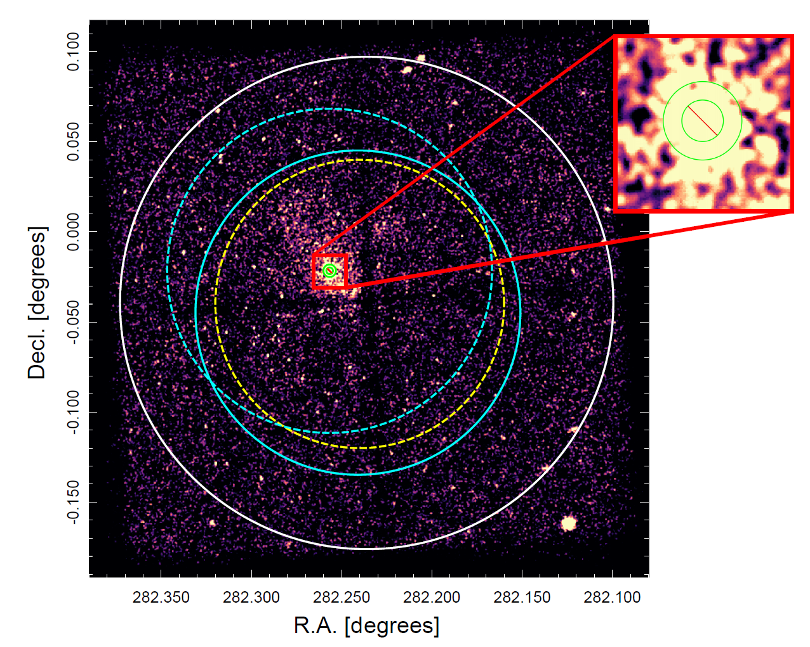
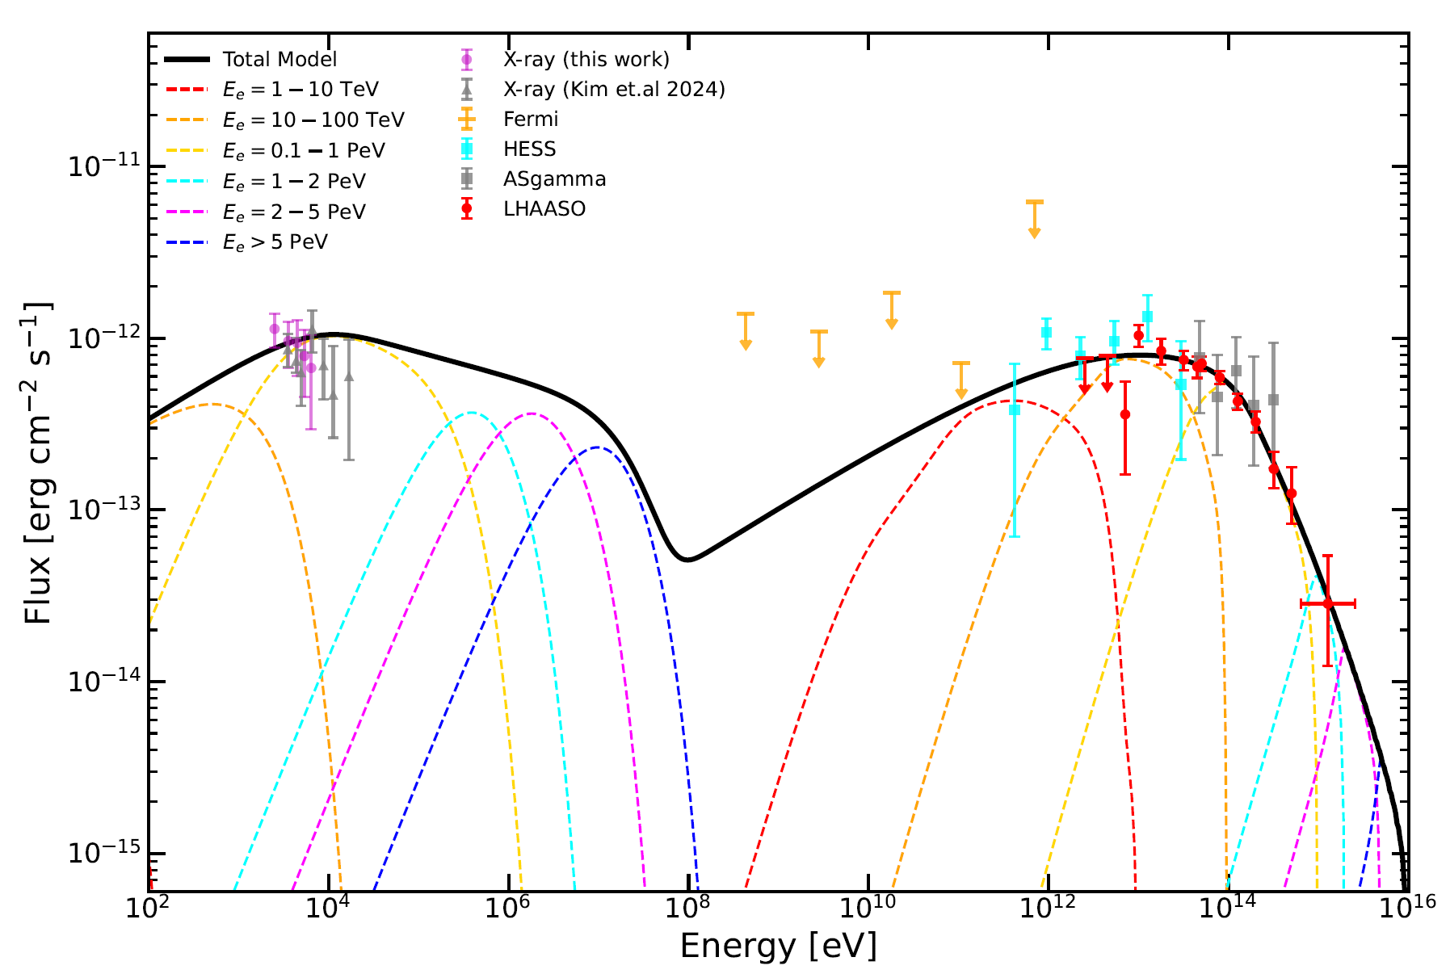
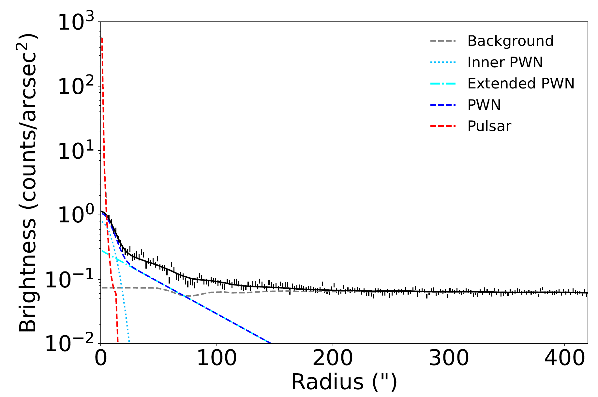

Combining Chandra and LHAASO observations
High-resolution X-ray map by Chandra reveals the structure:
compact inner nebula +
diffuse outer nebula
inner nebula 8.3” or 0.3 pc
upper limit of TS
One-zone model SED fitting shows B≈3μG
Δs≈1, cooling break?
cooling timescale of E_{e,br} = 9kyr -> true age may be younger

Slide 13
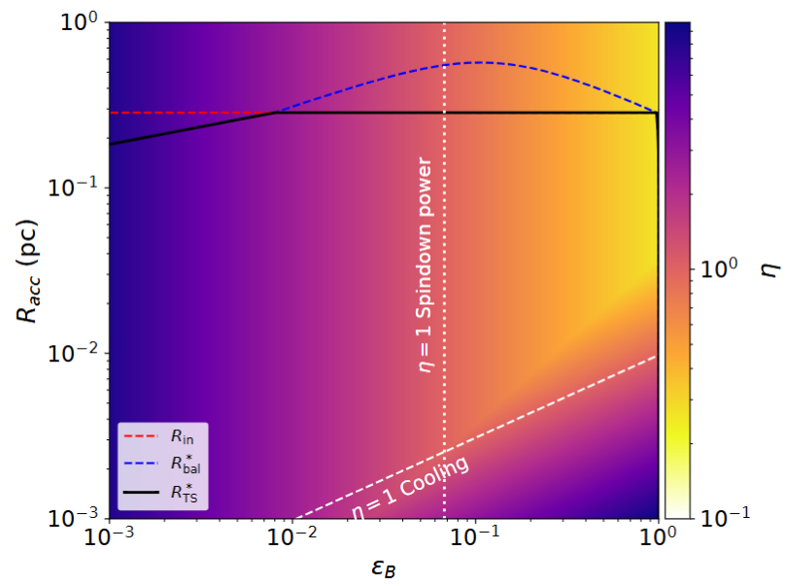
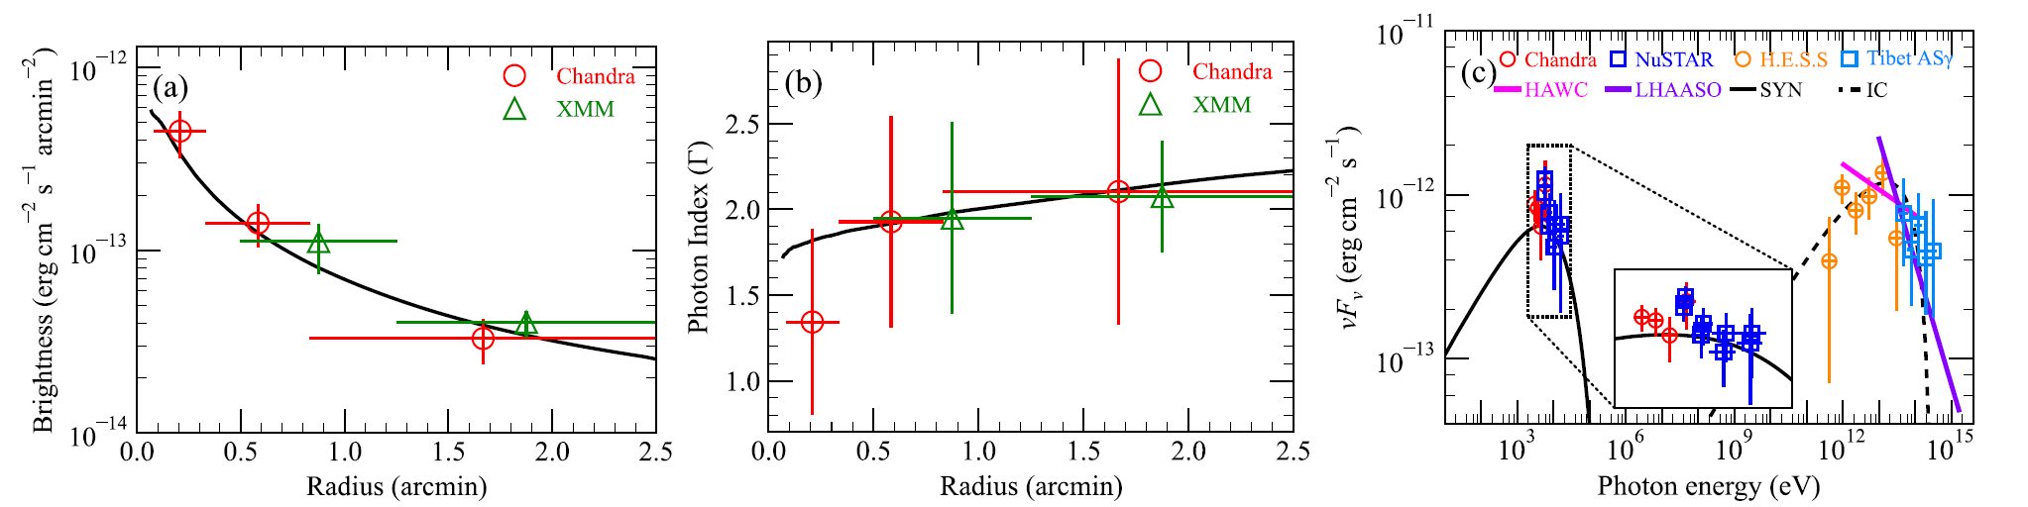
TS is a widely disucssed acceleration zone of PWN but not the only possibility
(e.g., reconnection at upstream; shock due to inhomogeneity in wind)
using constraint from kinematic
Kim et al. (2024) suggested ε_{B}~0.004 at TS by modeling radial profiles and SED with the 1D dynamical model
at/beyond TS: strong current generation, non-ideal MHD regime
at upstream: wind can be more magnetized, but η>0.27 is still needed even for ε_{B} → 1, already stronger than η>0.16 in Crab Nebula

Slide 14
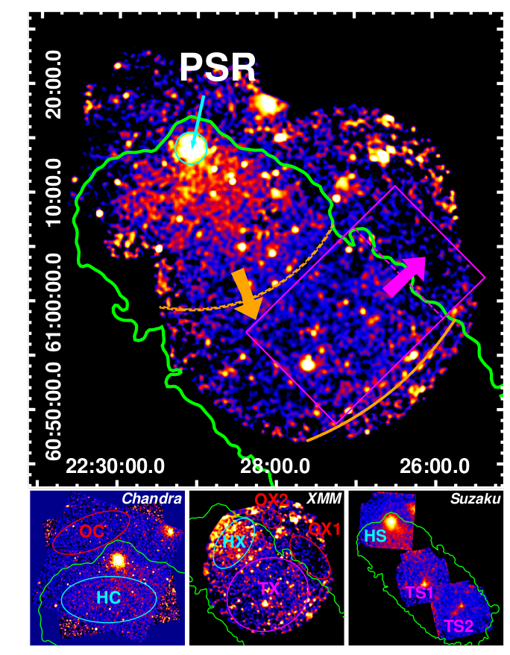
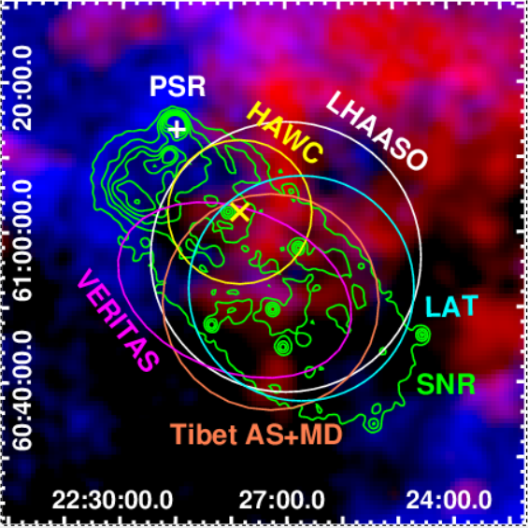
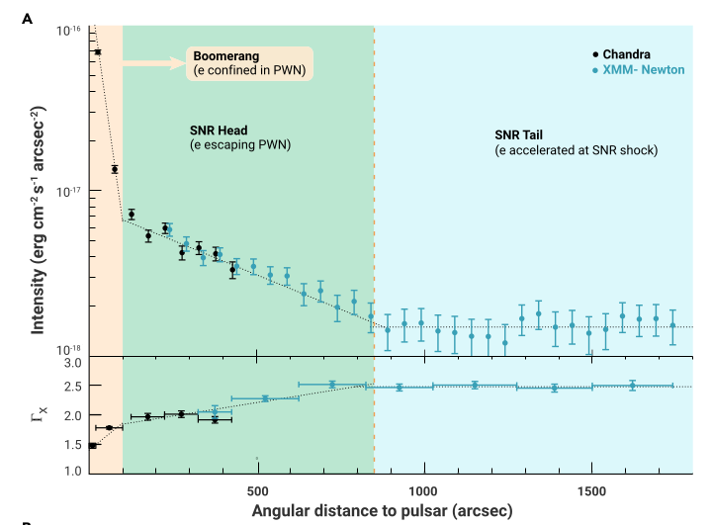
Boomerang Nebula
PSR J2229+6114, t_{c}=10kyr, L_{s}=2.2e37erg/s
Blue: Atomic (HI) Cloud
Red: Molecular Cloud
Green: Radio Contour
Ge, RYL et al. 2021

Slide 15
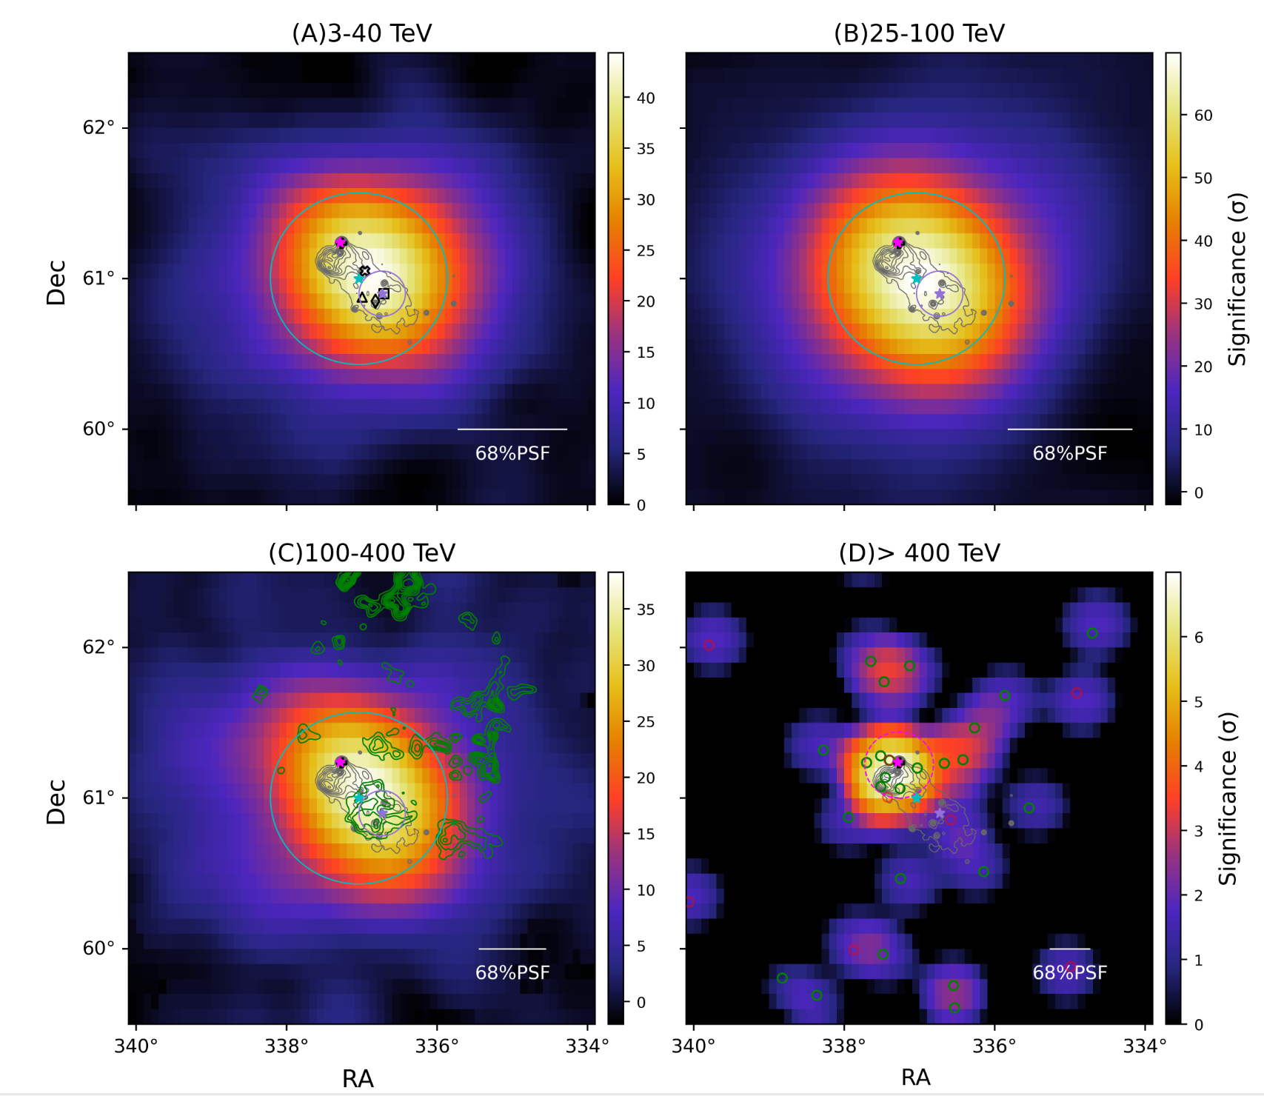
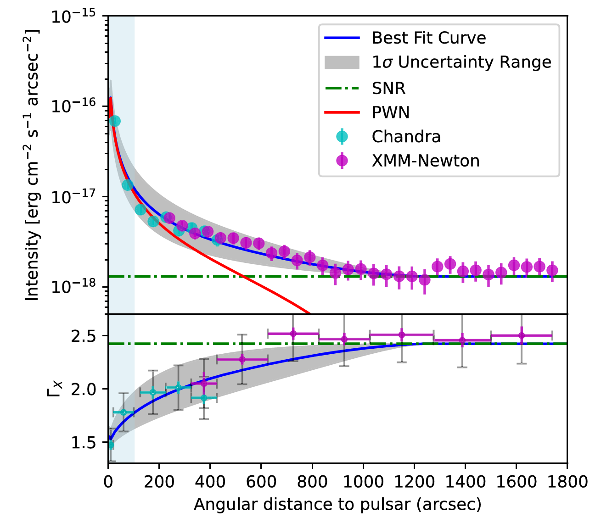
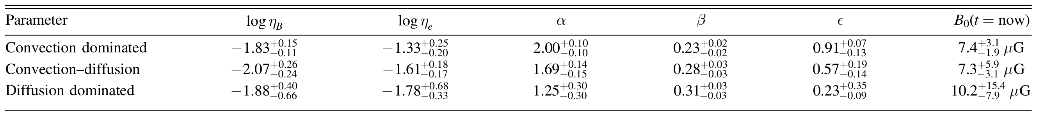

Chen, RYL, et al. 2024

Slide 16
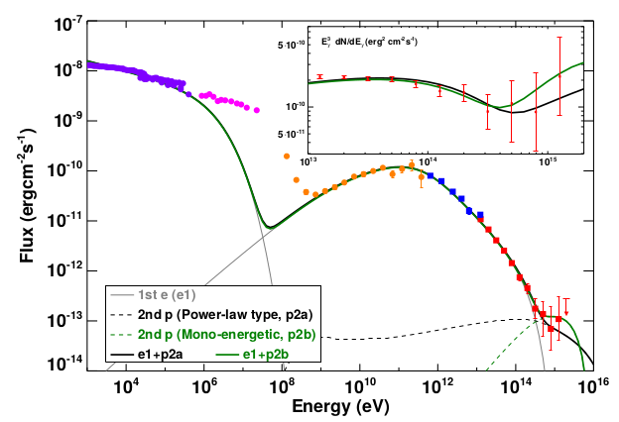
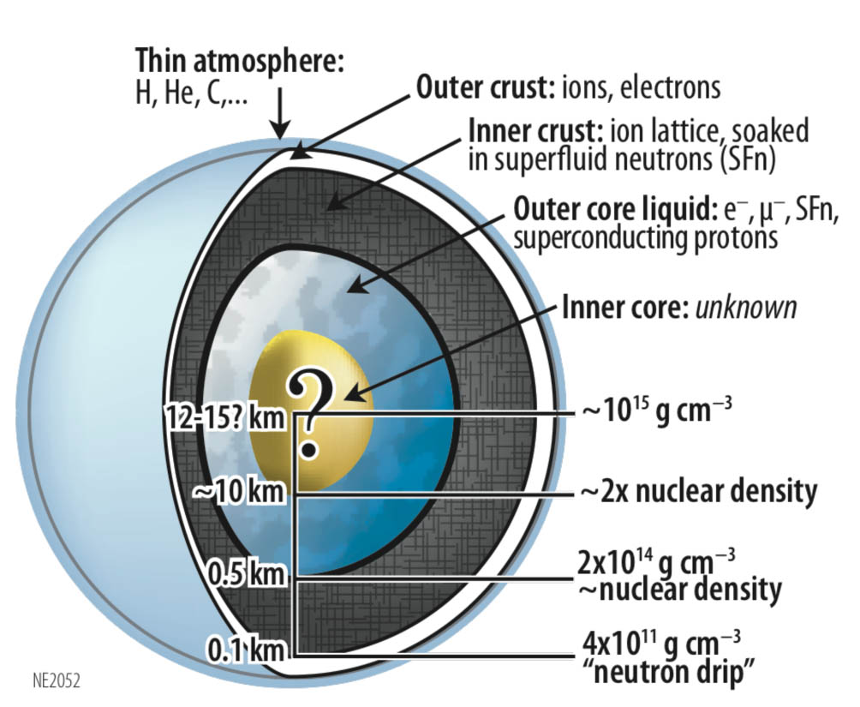
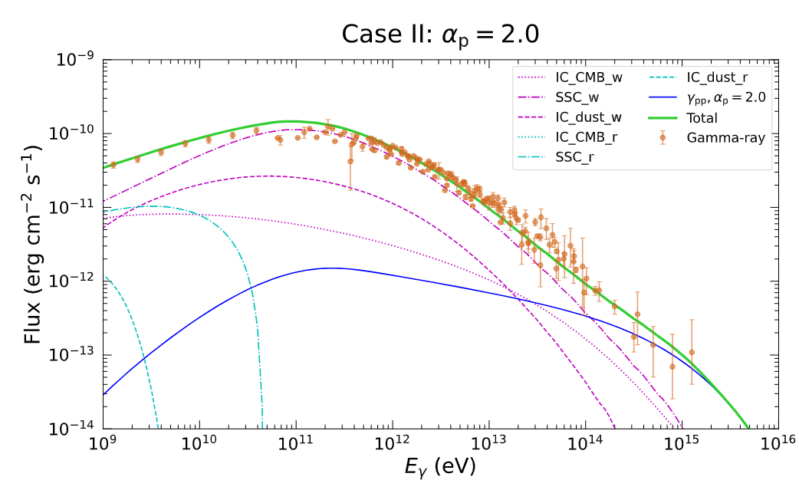
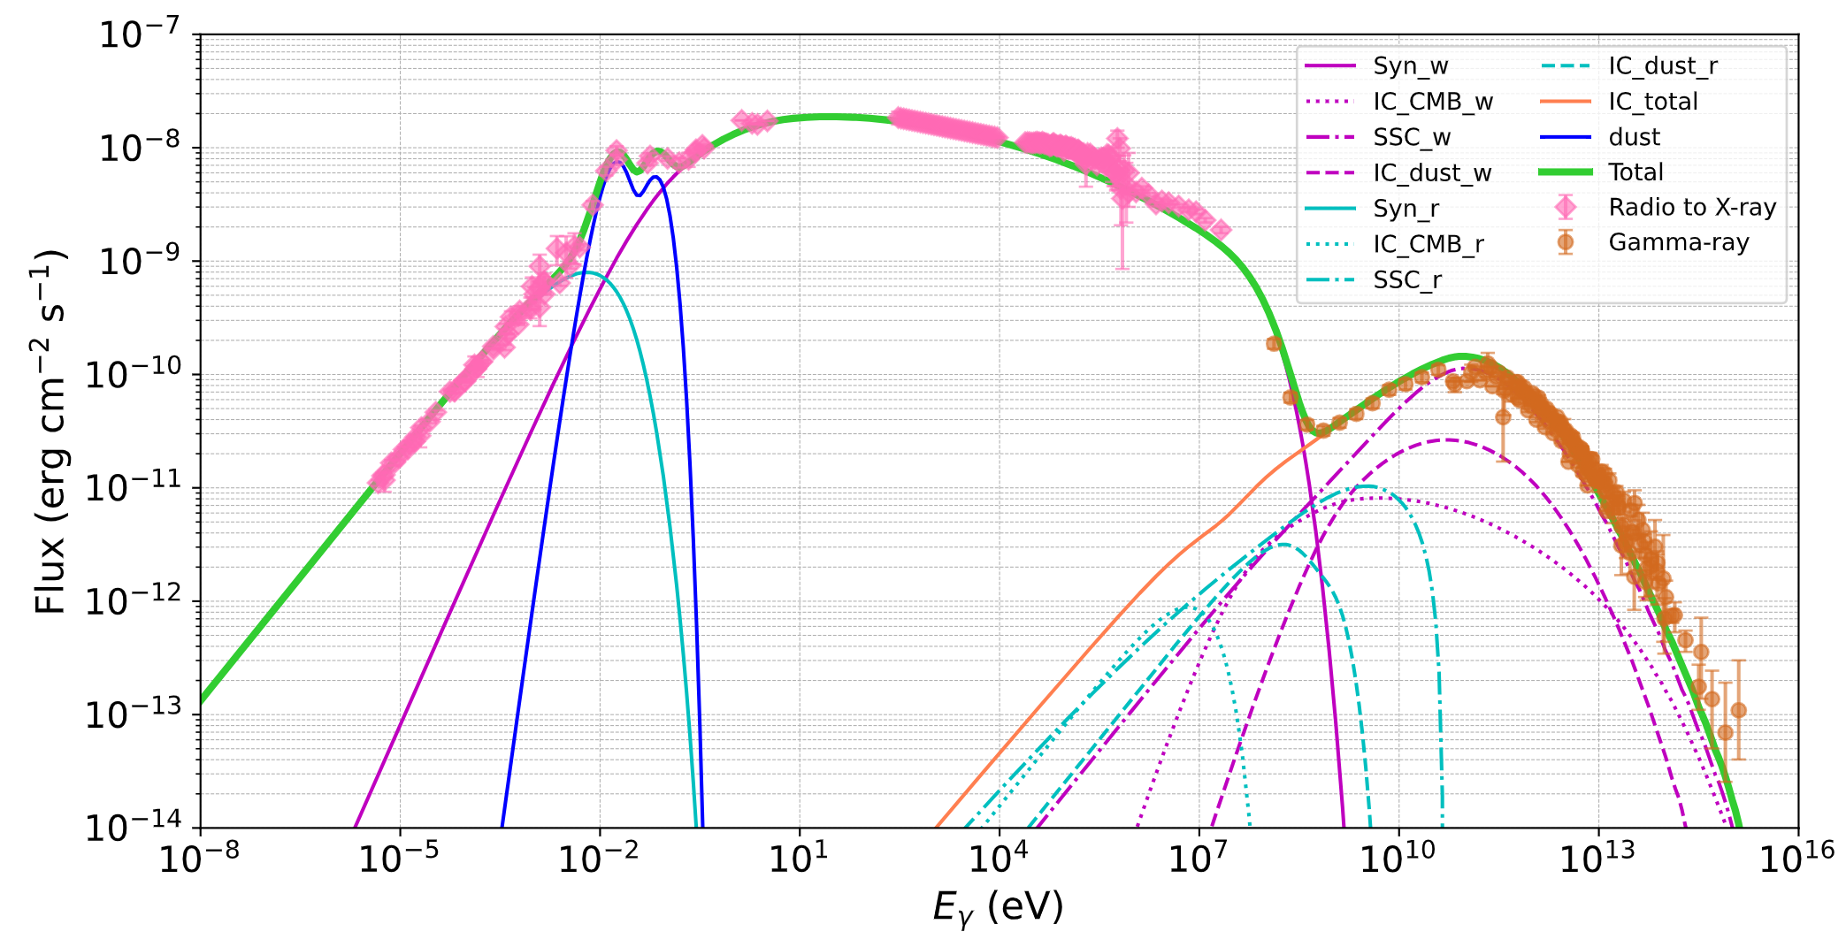
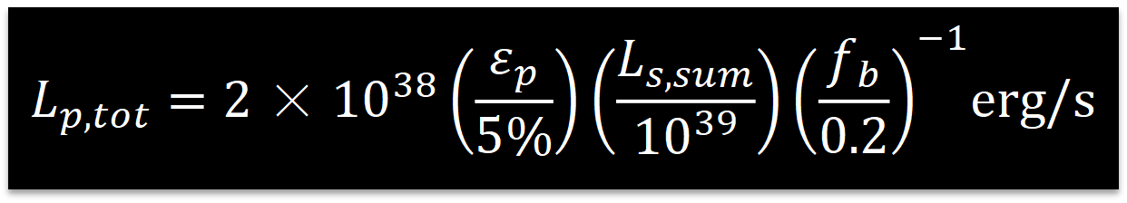
Are PWNe proton acceelrators (and PeV CR sources)?
protons (ions) can be accelerated if they enter the acceleration zone
where are they from?
for young, isolated pulsars, baryons may be loaded from the surface of neutron stars (extraction by elecric field), or fallback disk
Cheng et al. 1990
Atoyan & Aharonian 1996
Amato et al. 2003
......
relax condition ε_{e}+ε_{B}=1
5% of spindown energy goes into protons
sum of spindown power of detected Galactic pulsars with L_{s}>10³⁷erg/s: 10³⁹erg/s
$$L_{p,tot}=2×{10}^{38}\left(\frac{ε_{p}}{5\%}\right)\left(\frac{L_{s,sum}}{{10}^{39}}\right){\left(\frac{f_{b}}{0.2}\right)}^{−1}erg/s$$
Liang, RYL et al. 2025

Slide 17
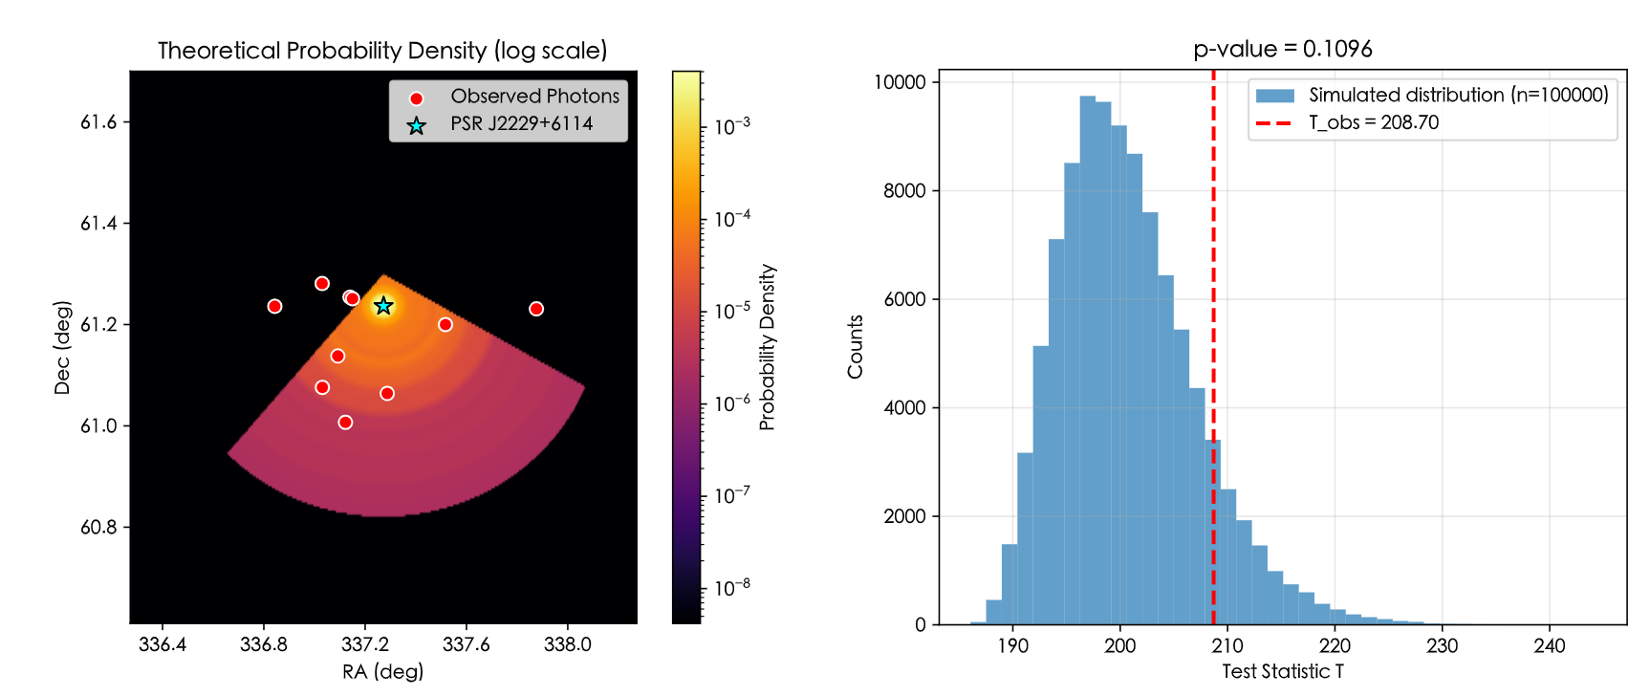
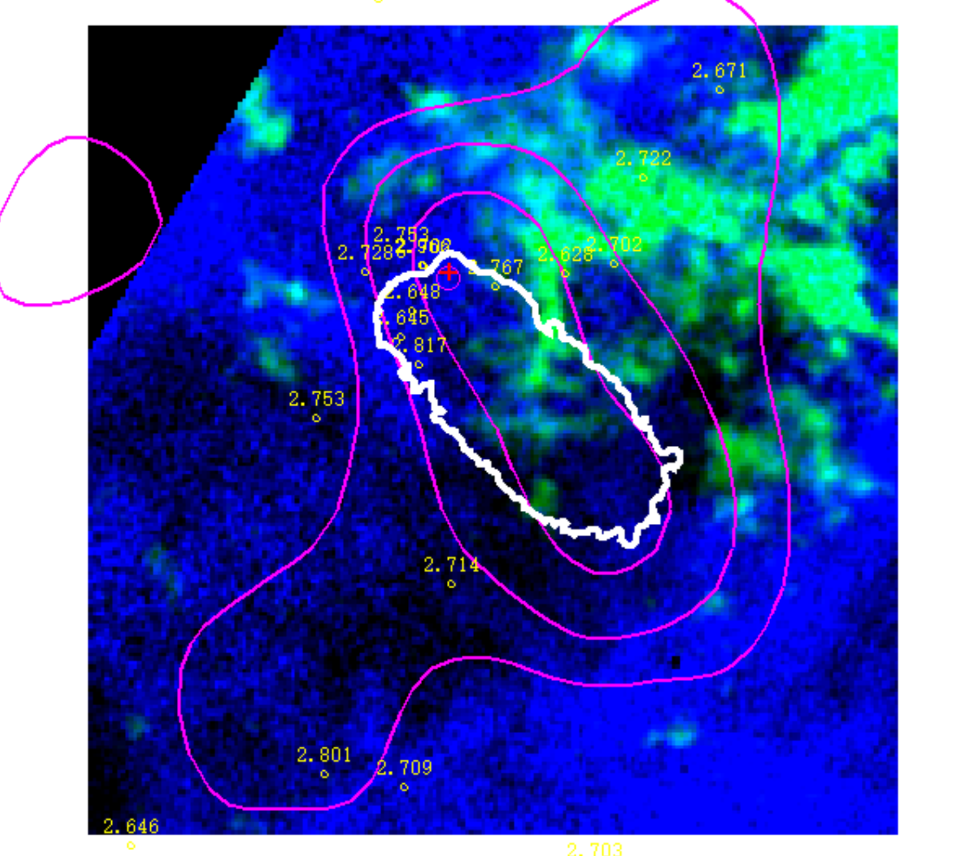
Boomerang Nebula provided us a chance to test the hadronic origin
chance probability of >400 TeV photons having the same origin of X-ray emission is 0.11
cannot rule out; more statistics or better angular resolution can help

Slide 18
Summary
PWNe are the most numerous TeV gamma-ray sources in Galaxy
Particle acceleration efficiency close to unity (η~0.1-1) or even beyond unity if the acceleration zone is weakly magnetized
- Crab Nebula: 1.1 PeV (1.4 PeV)
- PSR J1849-0001：2 PeV
- Boomerang: 800 TeV
Acceleration site: TS is promising accelerator but not favorable for PeV (low σ, ε_{B}=σ/(σ+1)); alternative candidate site is upstream (high σ)
If protons are loaded in pulsar winds, they are likely accelerated to ~1PeV (for pulsars of L_{s} >10³⁷erg/s); energy budget ~10% CR flux above PeV
Future: higher-resolution image by large IACT array (LACT, CTA, ASTRI-Mini); neutrinos PWNe (stacking analysis by 30km³ HUNT)
Thank you ！

Slide 19
Backup Slides

Slide 20
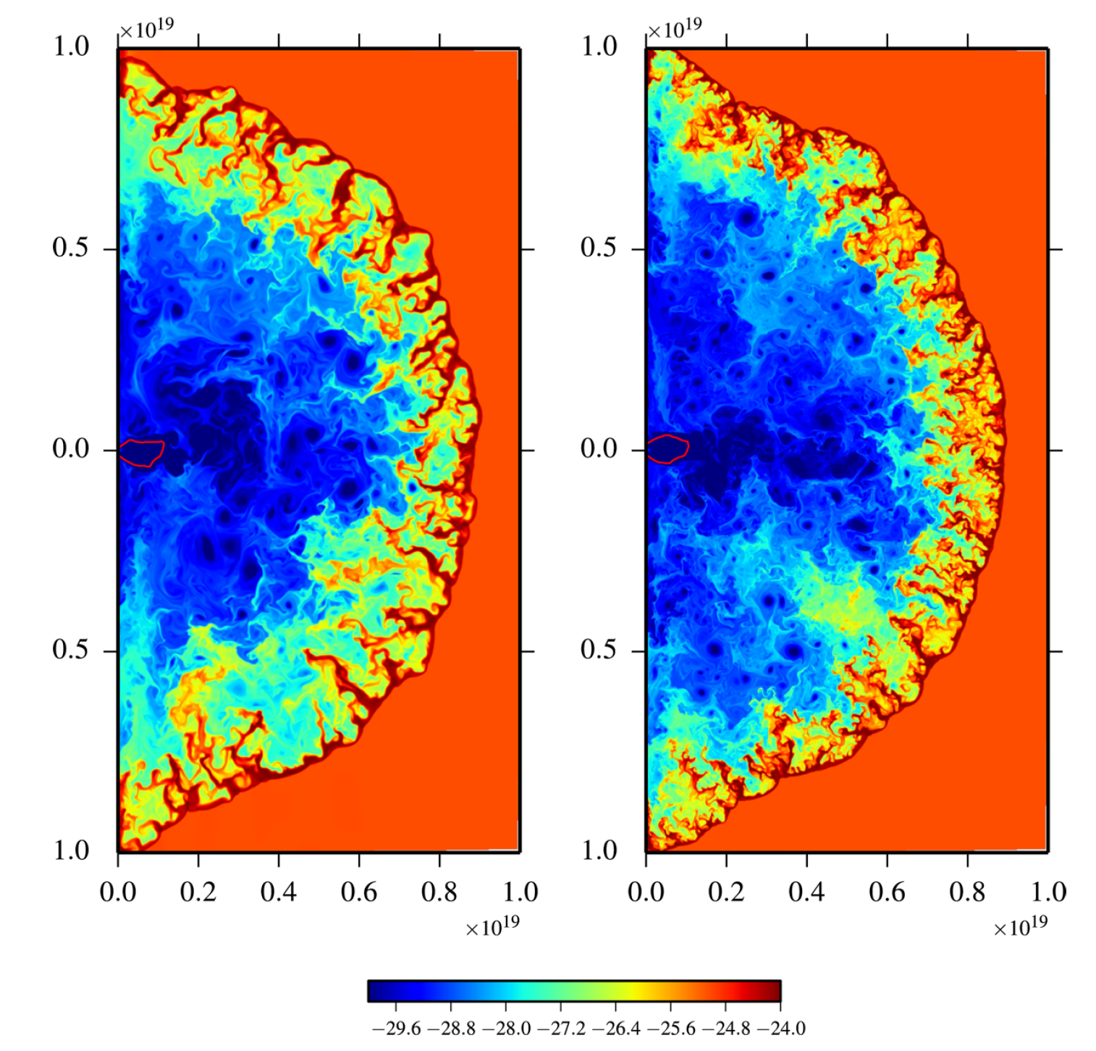
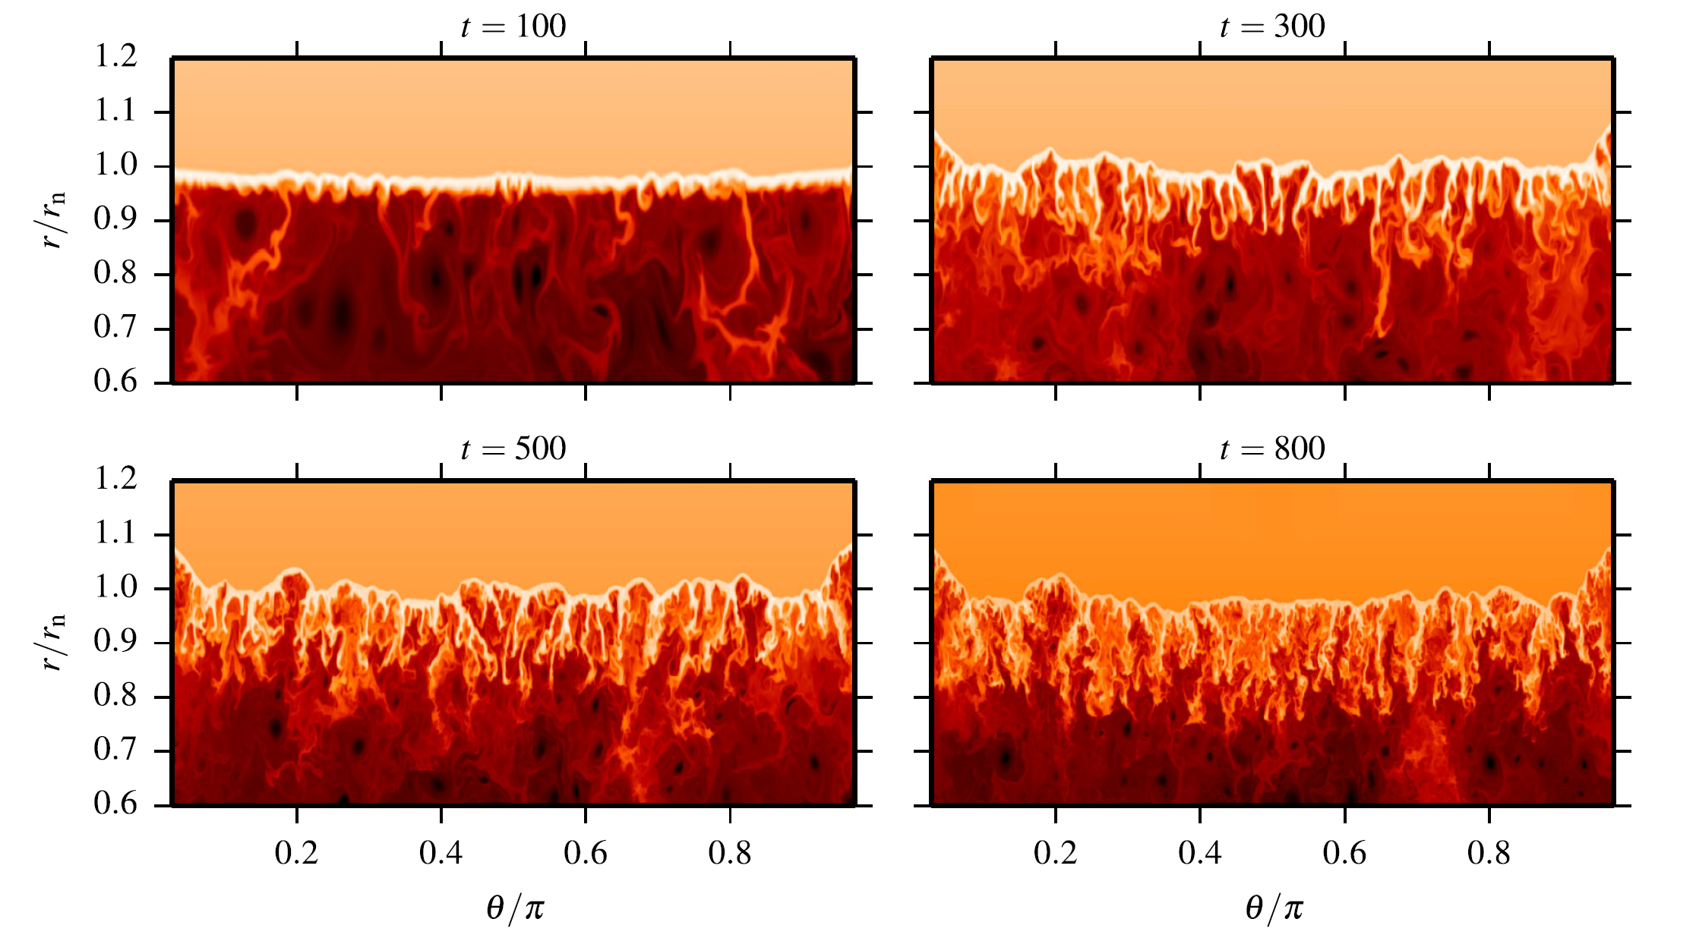
RT instability providing target for pp collisions
Porth et al. 2014, MNRAS

Slide 21
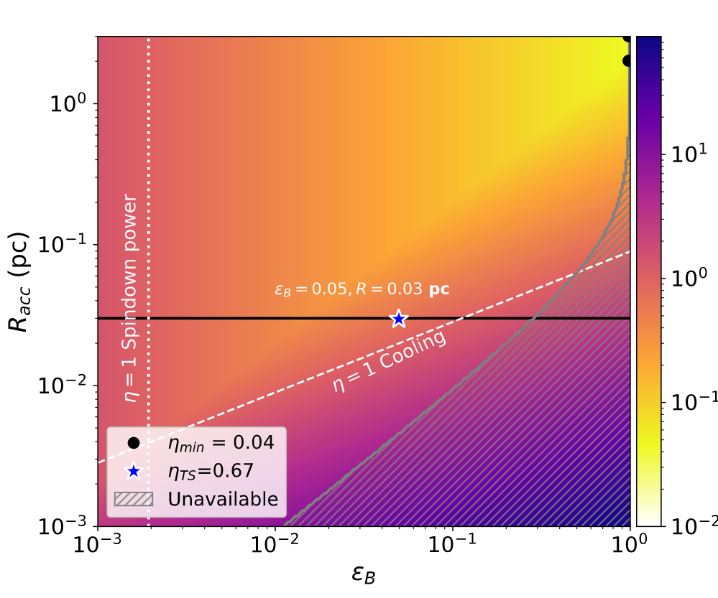
We may do the same for Crab Nebula

