Slide 1
Detection of microquasar at UHE by LHAASO
Speaker: Cong Li
licong@ihep.ac.cn
LHAASO Collaboration

Slide 2
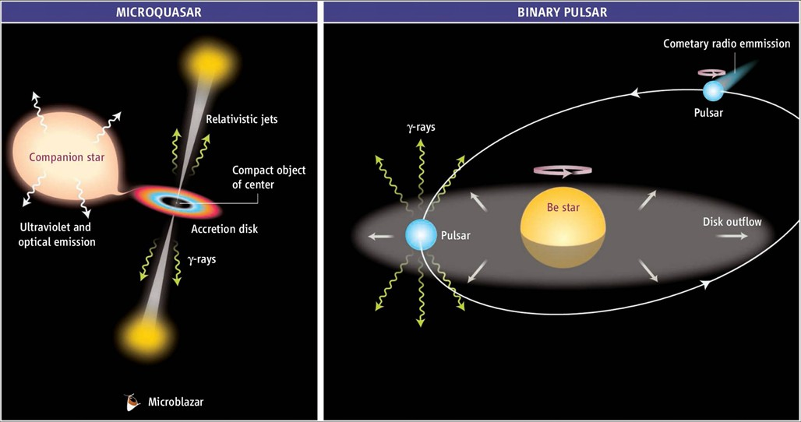
TeV Binary
Binary is a very important kind of TeV source, characterized with unique properties .
colliding-wind binary system

Slide 3
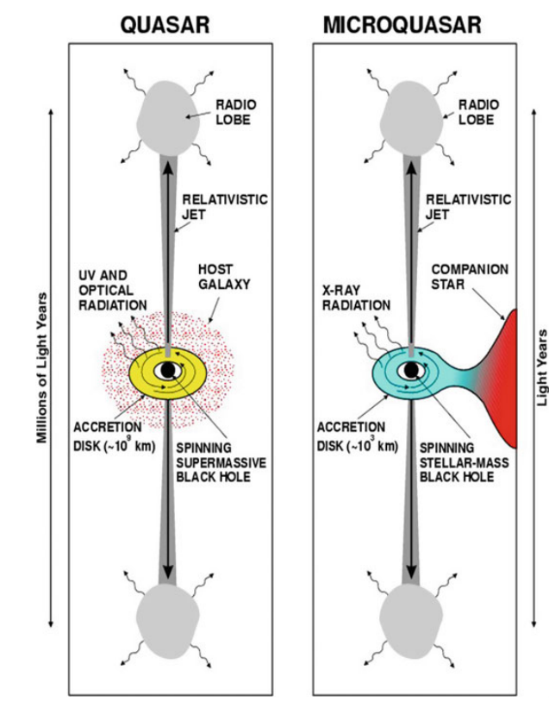
Microquasar
Microquasar has very similar properties as quasar. They both have jets, accretion disk and so on.
Unique characteristics for micro-quasar:
Orbital modulation.
Fast change of status.
Possible detection at UHE.

Slide 4
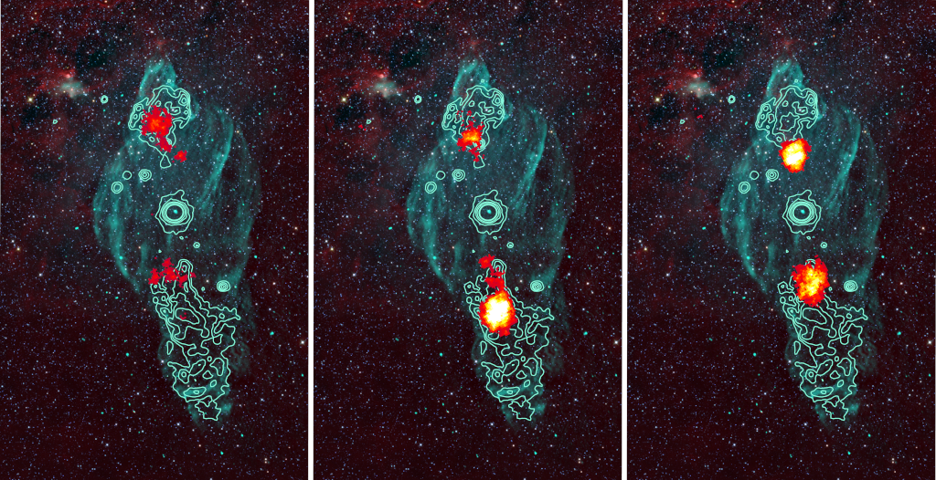
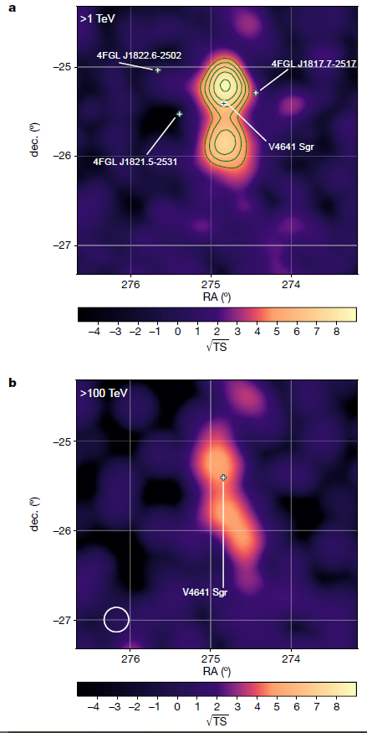
Microquasar “halo”
HAWC 2024
UHE(>100TeV) emission associated with microquasars were detected by HAWC,HESS and LHAASO recently;

Slide 5

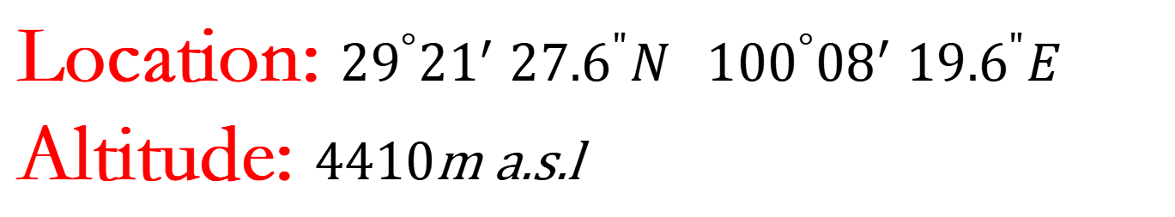
Location: ${29}^{°}{21}^{′}$ ${27.6}^{"}N{ 100}^{°}{08}^{′} {19.6}^{"}E$
Altitude: 4410m a.s.l

Slide 6
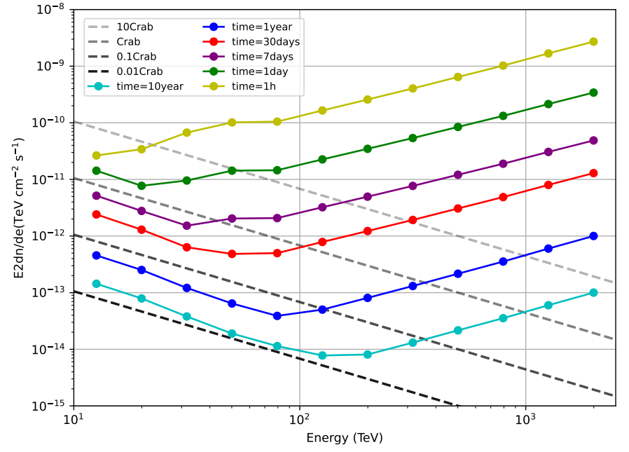

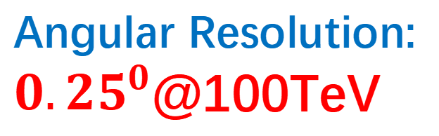
Performance of KM2A
Energy Resolution:
$20\%$@100TeV
Angular Resolution:
${0.25}^{0}$@100TeV
Rejection Power:
1.e-4@100TeV

Slide 7
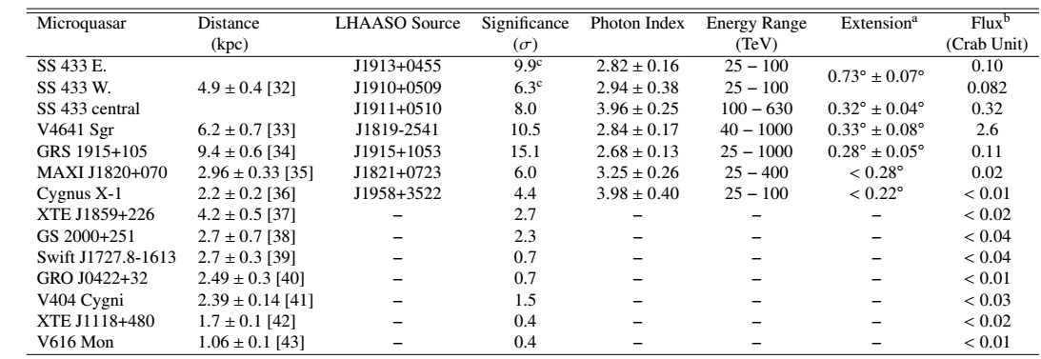
UHE emission around microquasars
LHAASO 2025

Slide 8
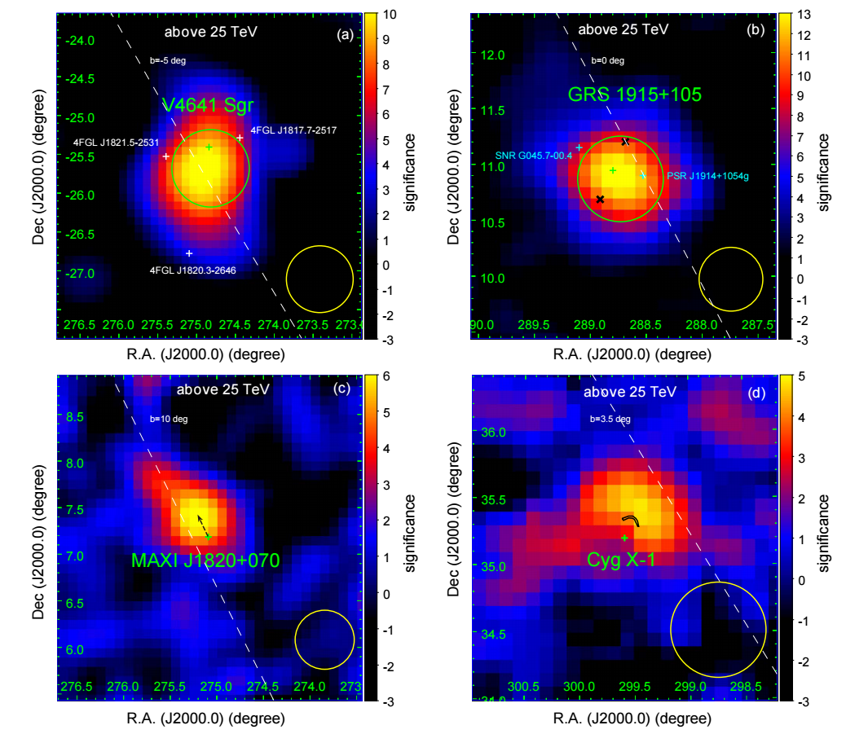
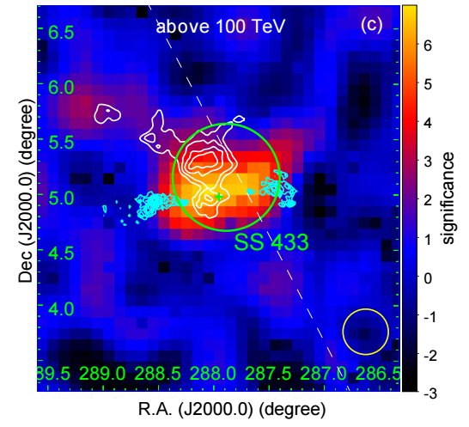
Three of them are extended ;
The emission center is slightly offset from binary;
The UHE emission maybe correleated with the jet of microquasar;

Slide 9
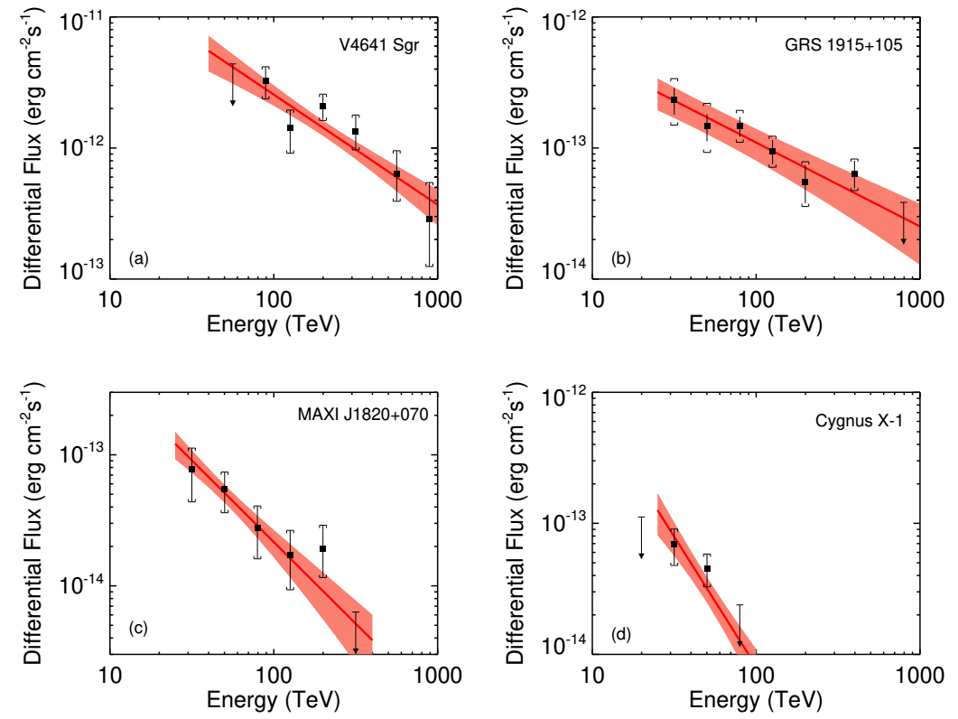
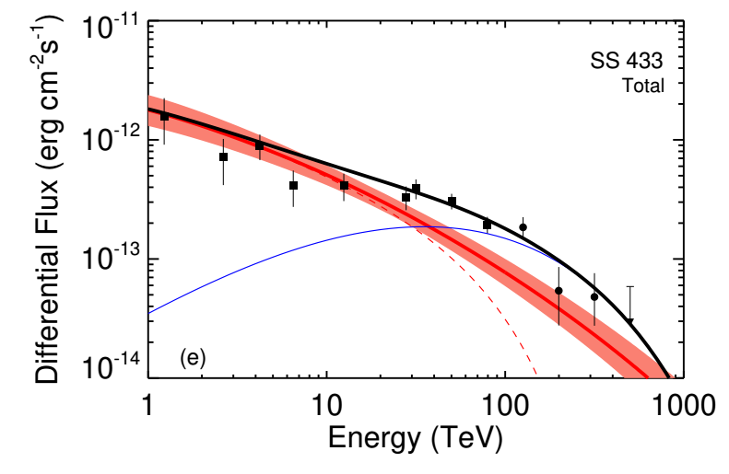
For almost all sources, expcept for Cygnus X-1, the spectrum extends beyond 100TeV, domenstrating powerfull acceleration ability.

Slide 10
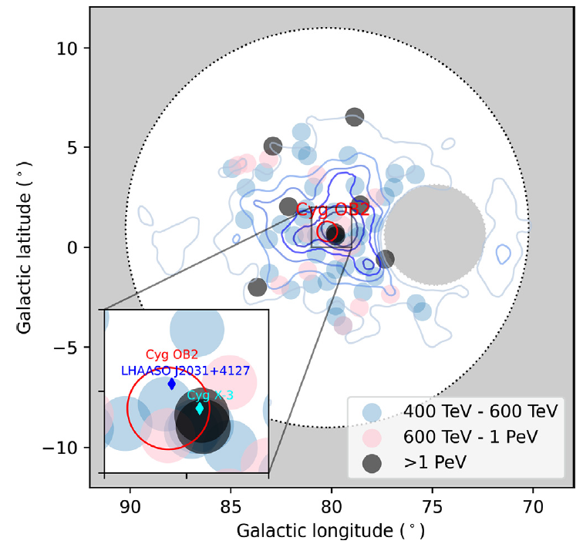
UHE emission from the central binary system?
From previous work, 7 out of the 66 photons with energy >400 TeV and 2 out of 8 with energy > 1PeV are located inside a compact region with a radius of about 0.5 degree. This excess in the core region is about 5–10 times higher than expectation of bubble.
LHAASO 2025

Slide 11
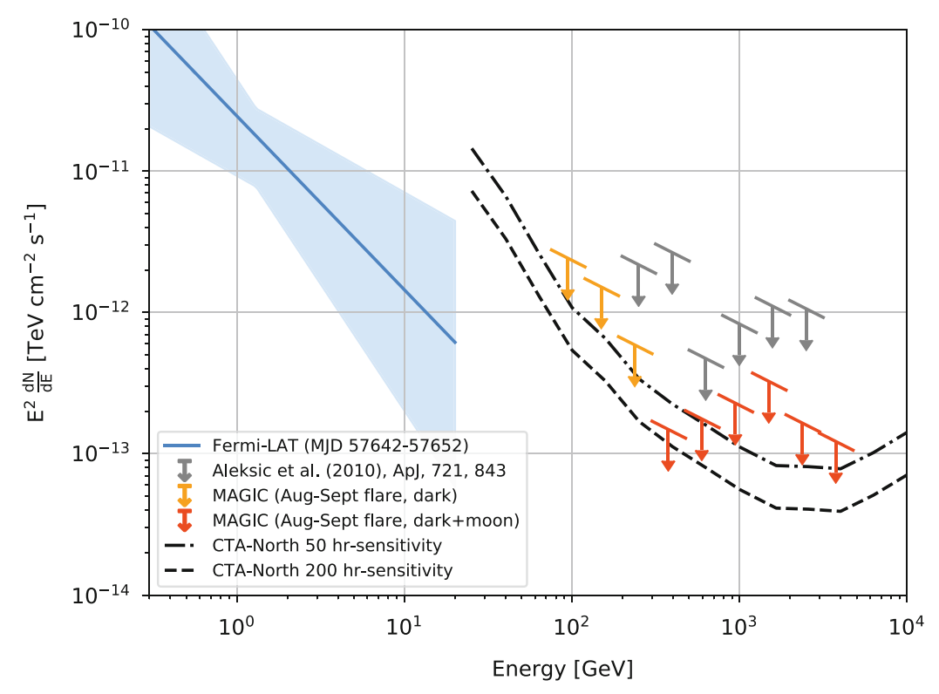
Historical puzzle: Cygnus X-3
1.PeV signals were declared by many experiments at 1980s;
2.Not confirmed by future more sensitive detectors;
1983 APJ

Slide 12
LHAASO data analysis
Data:
KM2A: Half array(299days)+three-quarter array(218days)+full array(1064days)
Official data cut(from crab performance paper)
CR background estimation：
Direct integration method
Region with distance less than 10deg from Galactic plane are masked
Analysis method:
A 3D likelihood fitting framework is developed

Slide 13
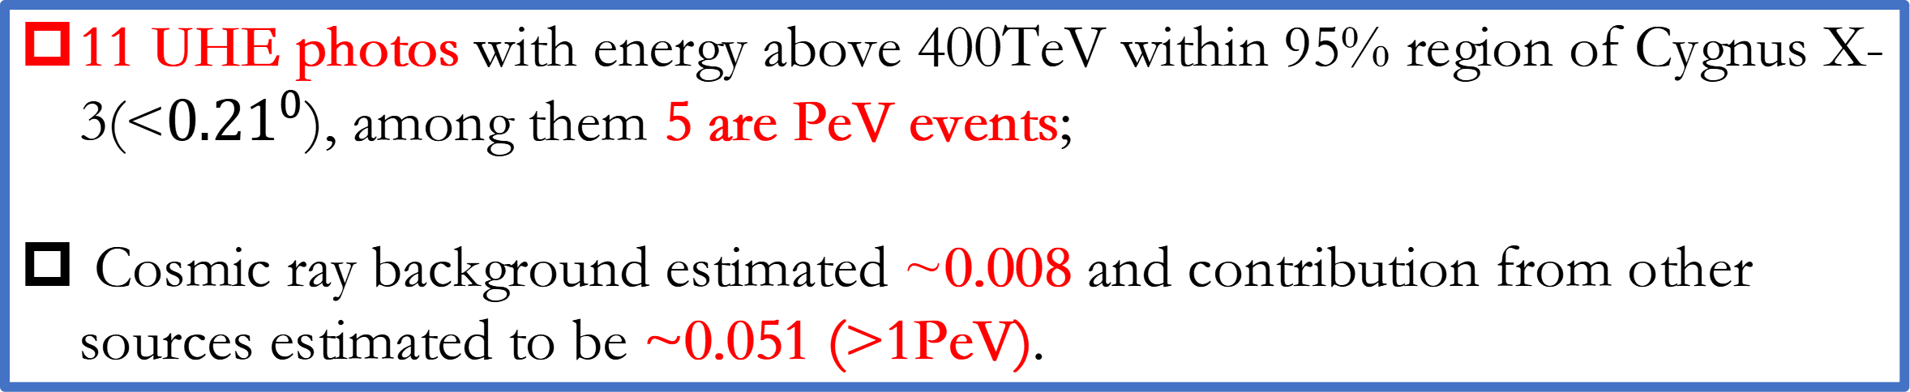
Significance
A point source is detected positionally coincident with Cygnus X-3 at a significance of 9.6 sigma assuming stable flux;
11 UHE photos with energy above 400TeV within 95% region of Cygnus X-3(<${0.21}^{0}$), among them 5 are PeV events;
Cosmic ray background estimated ~0.008 and contribution from other sources estimated to be ~0.051 (>1PeV).

Slide 14
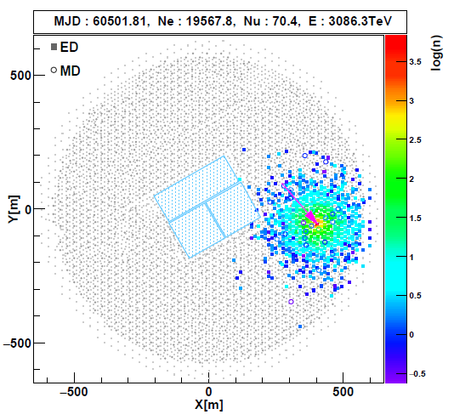
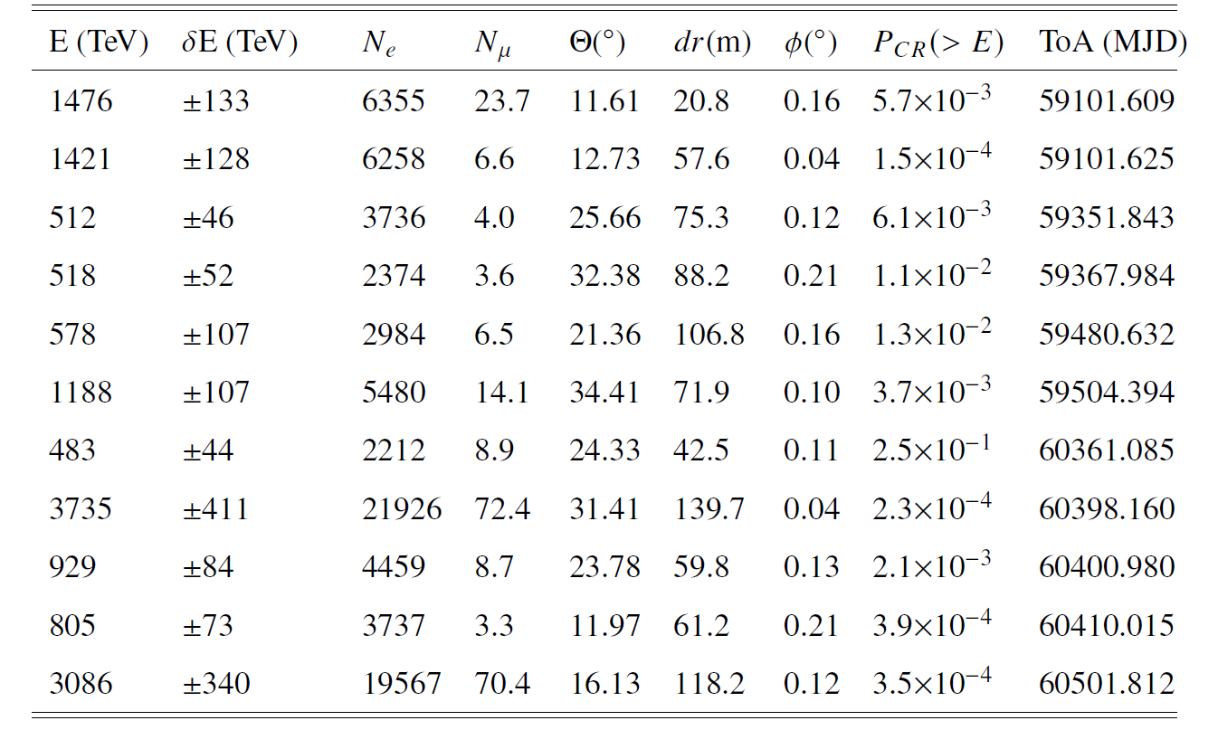
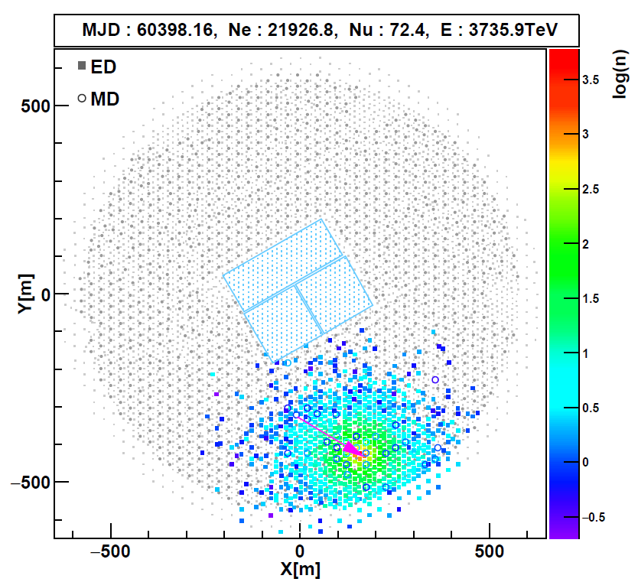
UHE Photons (>400TeV)

Slide 15
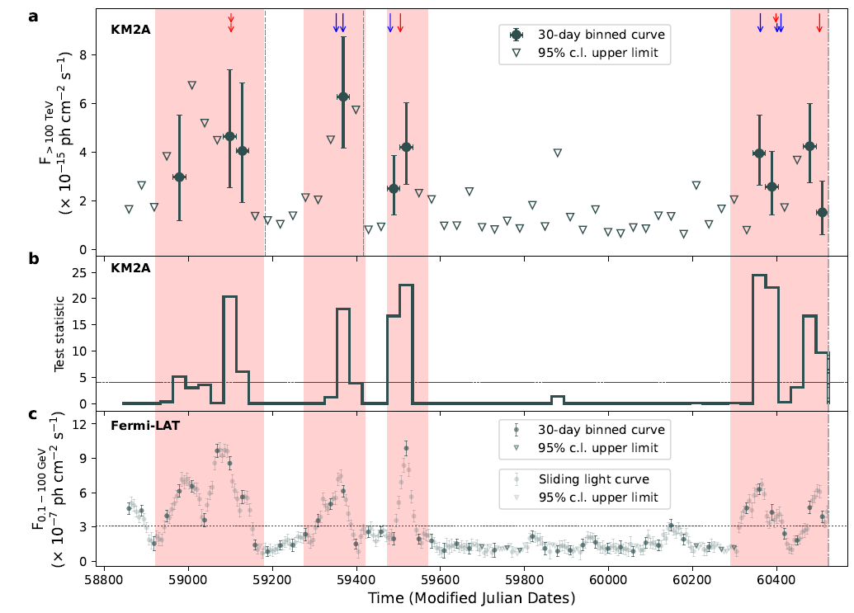

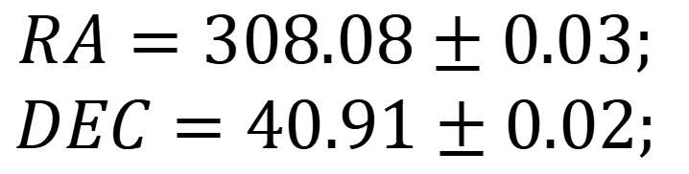
UHE Flares
$$RA=308.08±0.03;$$
$$DEC=40.91±0.02;$$
Divide the data into two parts according to GeV states. Ratio of exposure time: 1:1.6.
$$∆TS=75\sim 8.6 σ$$
Variability test:
H0: Constant flux;
H1: Change of flux at two states.
Flaring UHE emission with time coincidence with GeV flares.
3. Firmly identification of source.

Slide 16
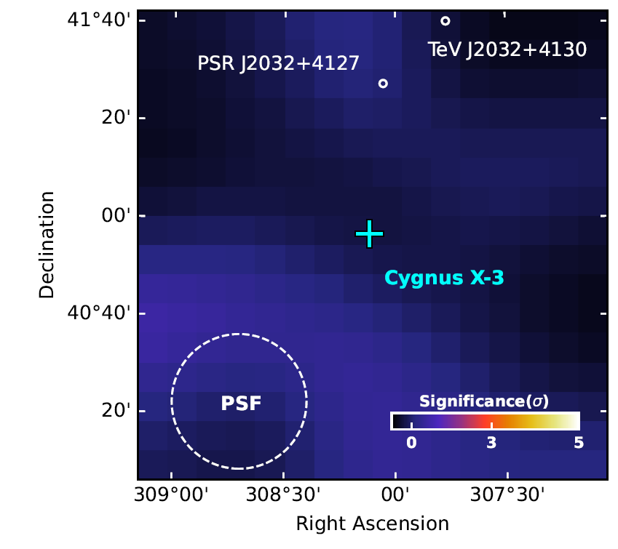
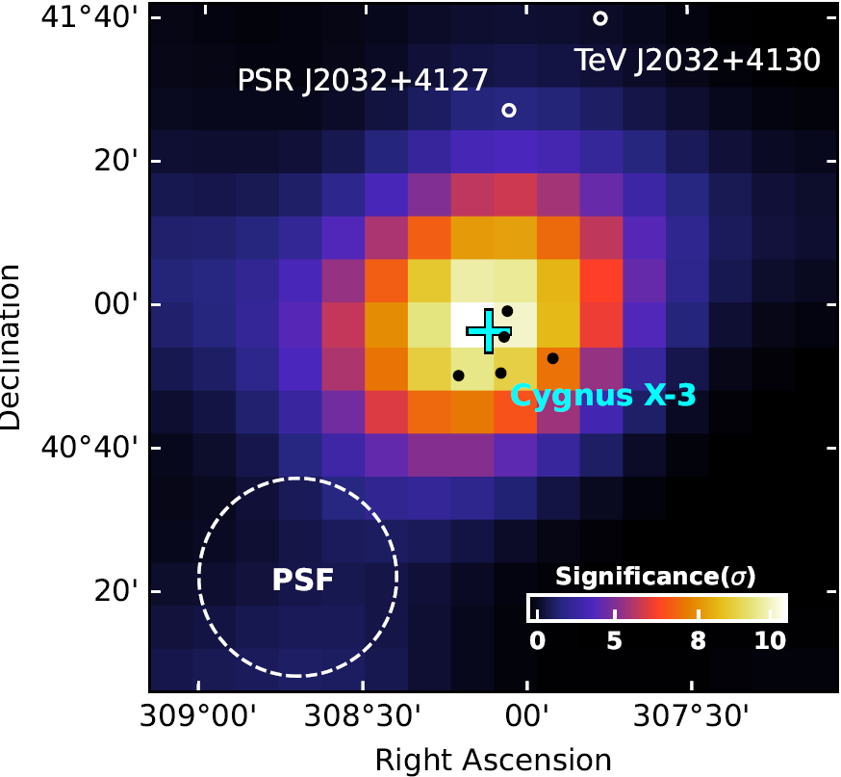
Significance Map
No residual signal at quiescent state verifies the reliability of background model.
Difference between quiescent and active states demonstrates the variability nature.

Slide 17
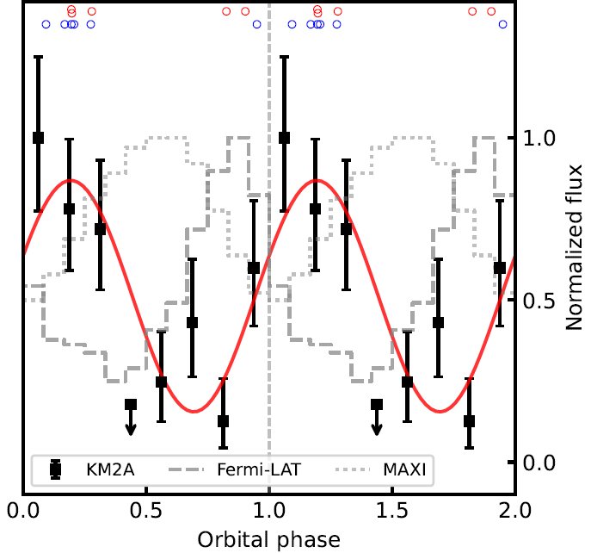
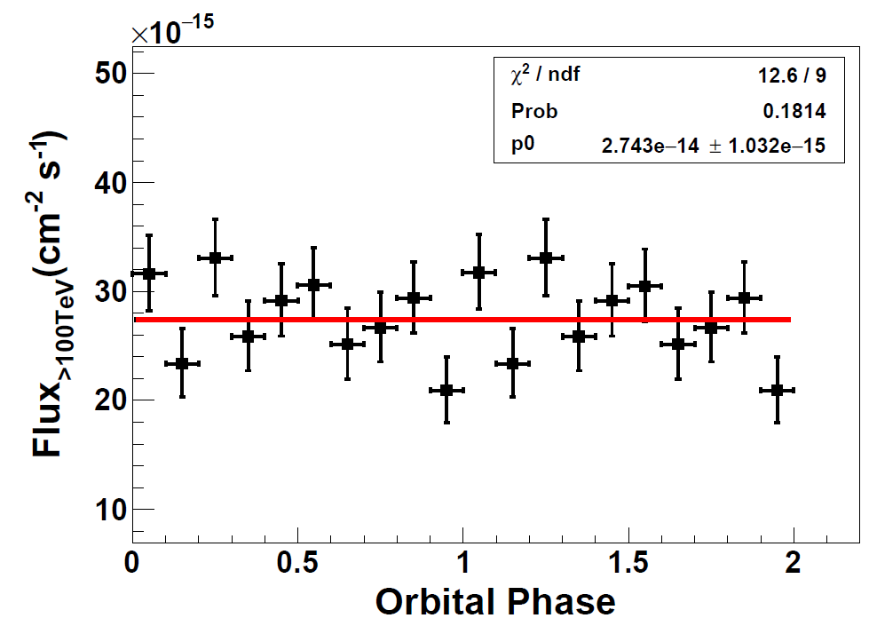

Modulation with orbital phases
The significance for variability: $3.5σ\sim 3.2σ$(post trials).
Comparison between cosine function and constant function. $∆TS=15.24σ\sim 3.3σ$.

Slide 18
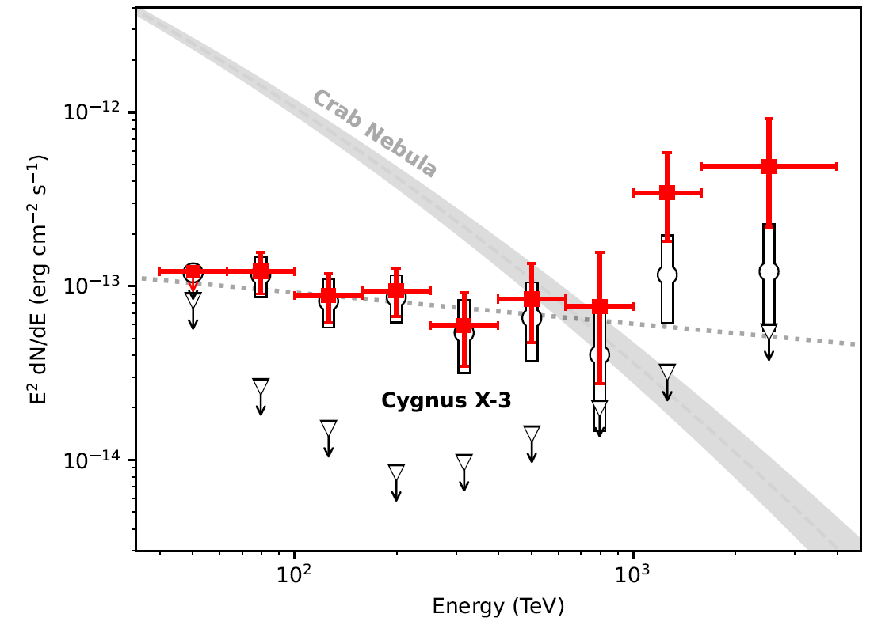
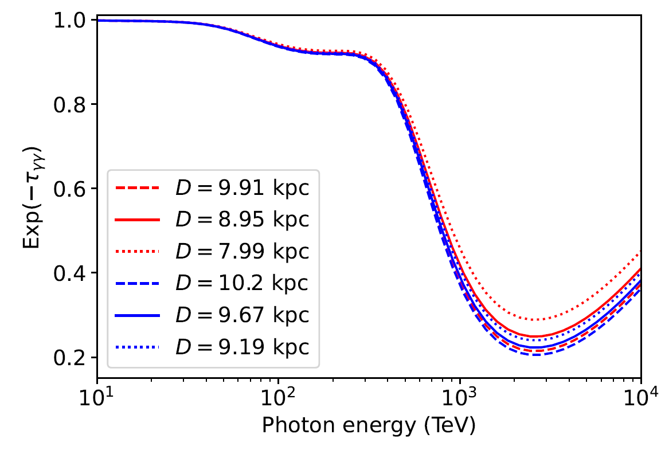
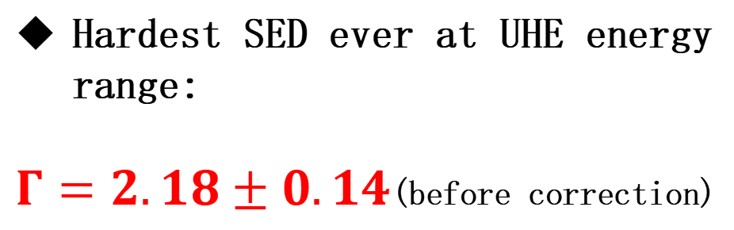
Spectrum
Hardest SED ever at UHE energy range:
$Γ=2.18±0.14$(before correction)

Slide 19
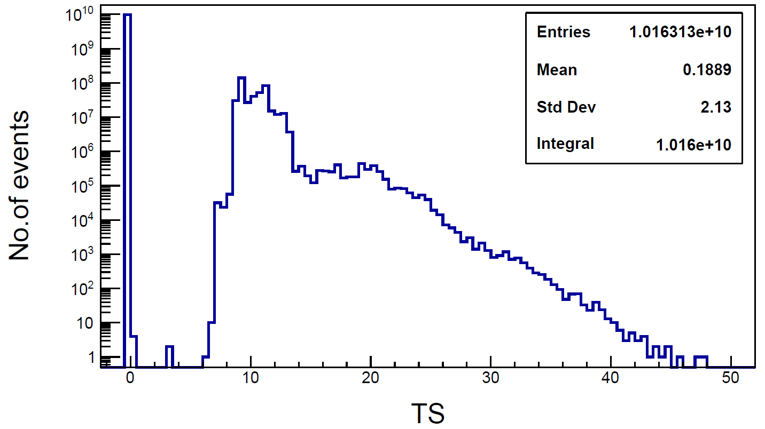
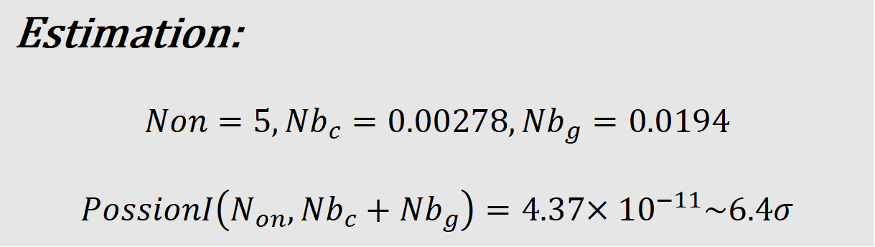
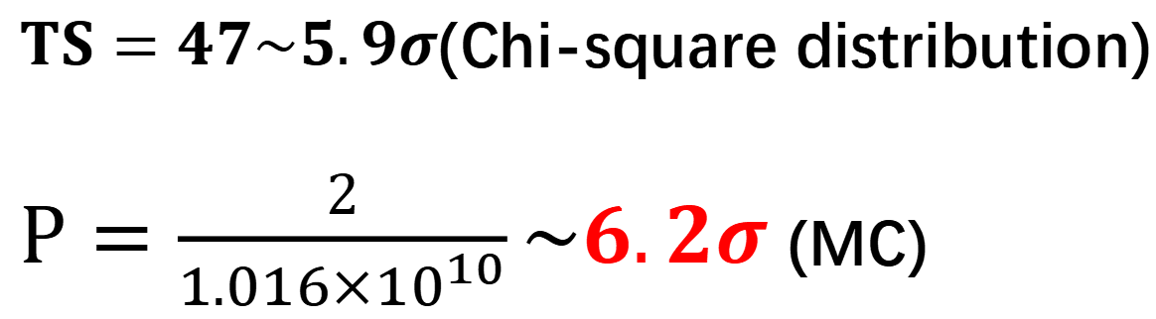
First PeV Gamma-Ray Source
$TS=47\sim 5.9σ$(Chi-square distribution)
$P=\frac{2}{{1.016×10}^{10}}\sim 6.2σ$(MC)
Estimation:
$$Non=5,{Nb}_{c}=0.00278,{Nb}_{g}=0.0194$$
$$PossionI\left(N_{on},{Nb}_{c}+{Nb}_{g}\right)=4.37{×10}^{−11}\sim 6.4σ$$

Slide 20

Leptonic or Hadronic?
Hillas criterion:
It is impossible for electrons to be accelerated to PeV within binary system, and protons are allowed to be accelerated to 100 PeV.
Synchrotron cooling limit:
Combine synchrotron cooling and the Hillas criterion

Slide 21
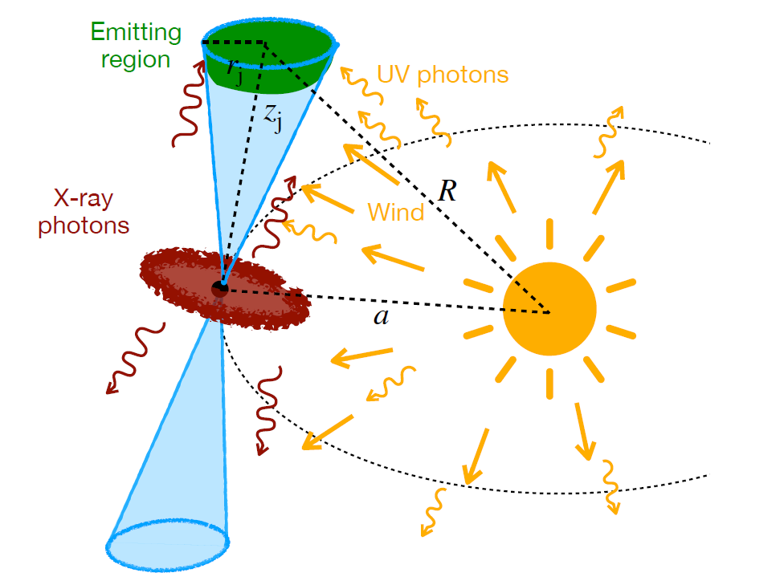
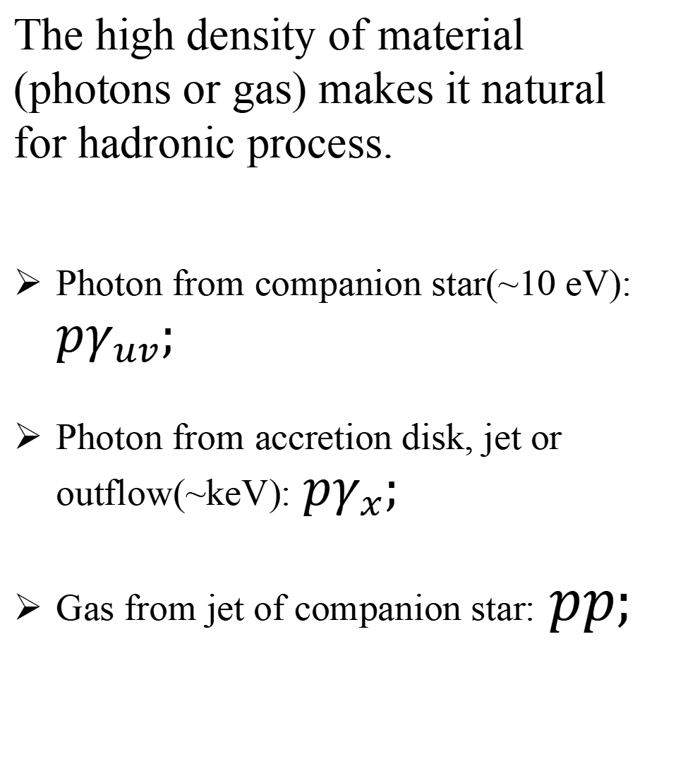
Physical Scenario
The high density of material (photons or gas) makes it natural for hadronic process.
Photon from companion star(~10 eV): $pγ_{uv};$
Photon from accretion disk, jet or outflow(~keV):$pγ_{x};$
Gas from jet of companion star:$pp;$

Slide 22
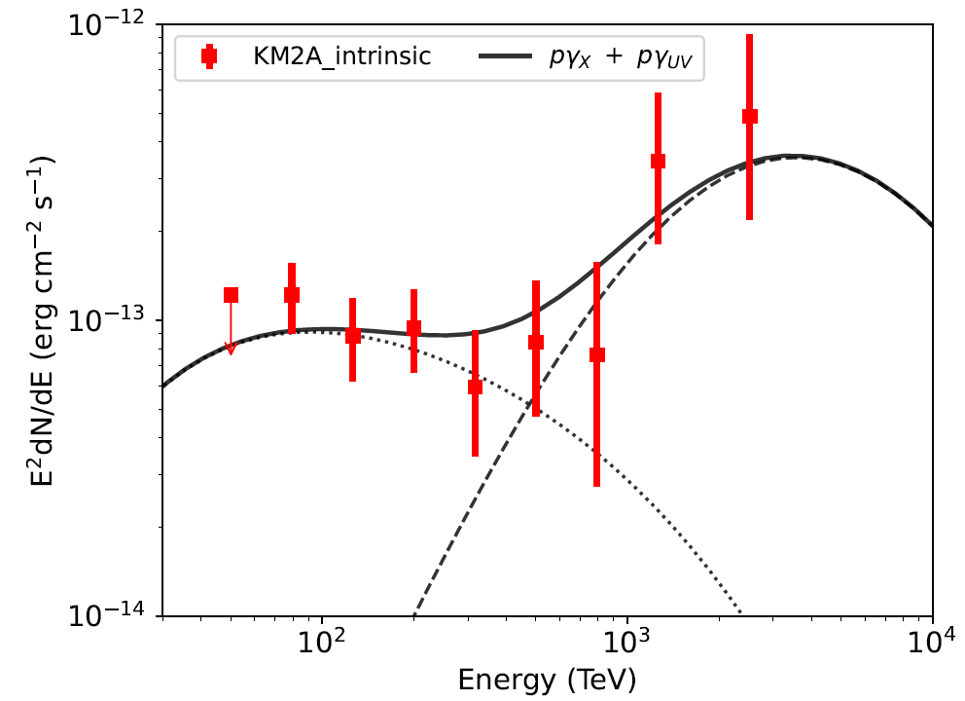
Model Fitting
$E_{t}\sim 10eV,\text{interaction} \text{angle} \text{θ} \text{= }\text{90}\text{◦},E_{p}\sim 10PeV,E_{γ}\sim 1PeV$
Protons need to be accelerated at least to 10 PeV.
Direct evidence for accelerating cosmic rays beyond “knee” in our galaxy.

Slide 23
Conclusion
Identification of first variable UHE gamma-ray source, suggesting the gamma-ray is from the central system ;
Identification of first PeV gamma-ray source, with energy up to to 3.7 PeV;
Almost rule out the leptonic model and favors a hadronic scenario.
More multi-wavelength data are theoretical works are needed!

Slide 24
Any question?
licong@ihep.ac.cn

Slide 25
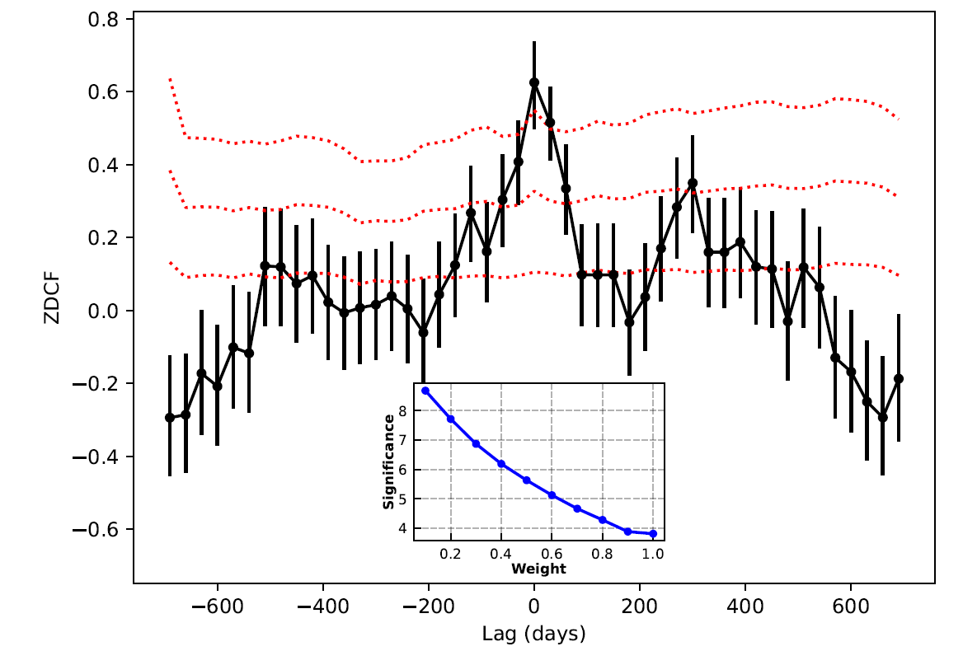
TeV-GeV Correlation
Preliminary

Slide 26
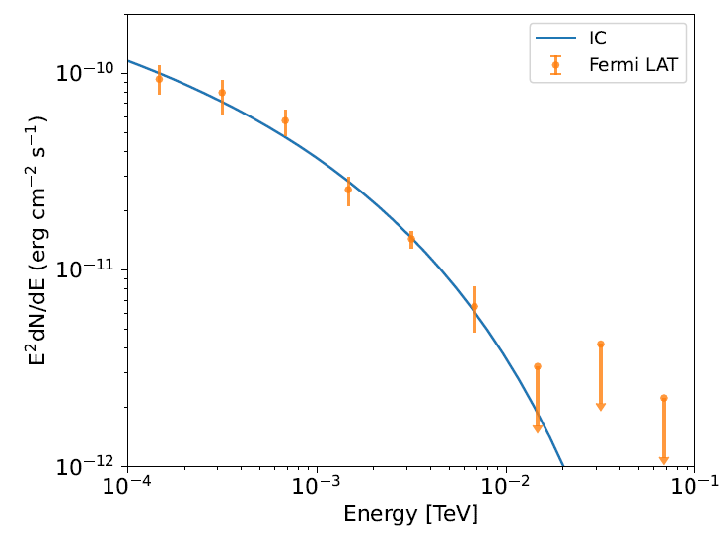
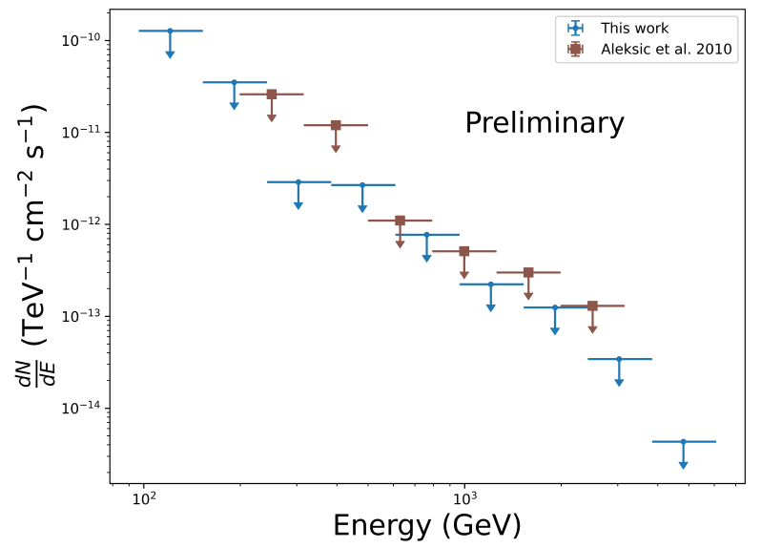
Multiwave Observation
GeV emission is explained by anisotropy of IC process, the spectrum of electron has a cut-off around 25GeV.
No TeV emission detected now, which may caused by physical reason or sensitivity of detector.
FERMI
MAGIC 2025ICRC

