Slide 1
Recent LHAASO Results on Cosmic-Ray Proton and Helium Spectra and Future Plans
Shoushan Zhang
on behalf of the LHAASO collaboration
Institute of High Energy Physics
SNR Symposium, Yuxi, Yunnan, Feb 26 – Mar 2, 2026

Slide 2
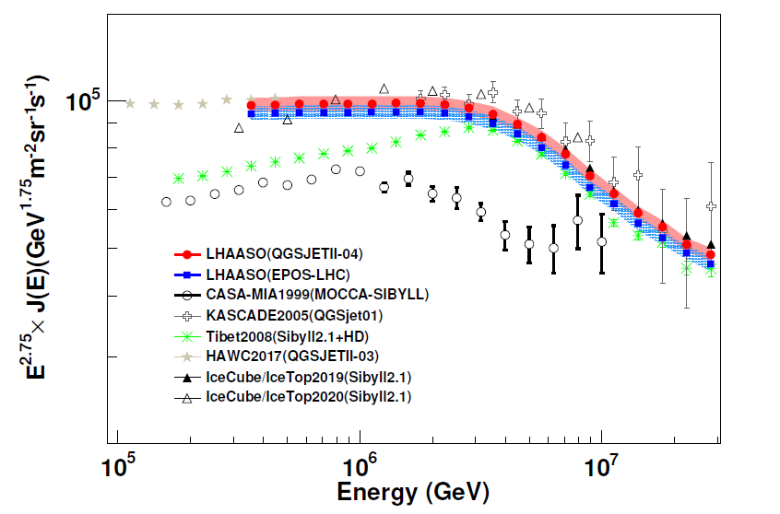
All particle energy spectrum
Cosmic rays
The all-particle knee, first identified in 1959, has been measured with increasing precision by subsequent experiments, with LHAASO providing the latest and most accurate results
The maximum cosmic-ray acceleration energy depends on the source and is also related to the particle charge Z
Individual energy spectra play am important role to solve the origin of cosmic rays
Proton knee, helium knee, iron knee …
The knee indicates the energy limit for cosmic ray acceleration by astrophysical sources
LHAASO Collaboration, PRL, 132, 131002 (2024)
Notes:
LHAASO has accurately measured all particle energy spectrum and composition around the knee.
From the correlation between the all particle energy spectrum and mean logarithm mass at the knee, the knee is contributed by the light component.
You can see here, the proton knee and the all particle knee. The all particle knee is dominate by the proton knee.

Slide 3
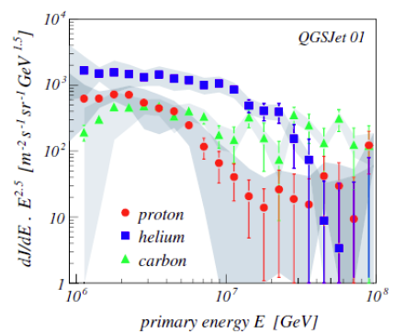
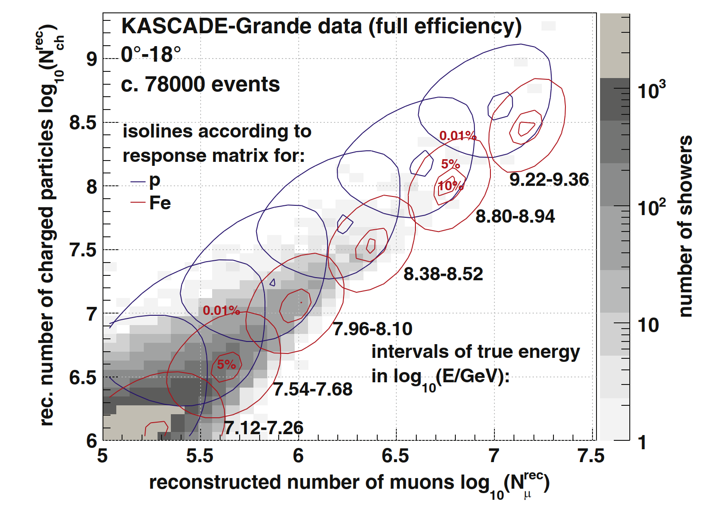
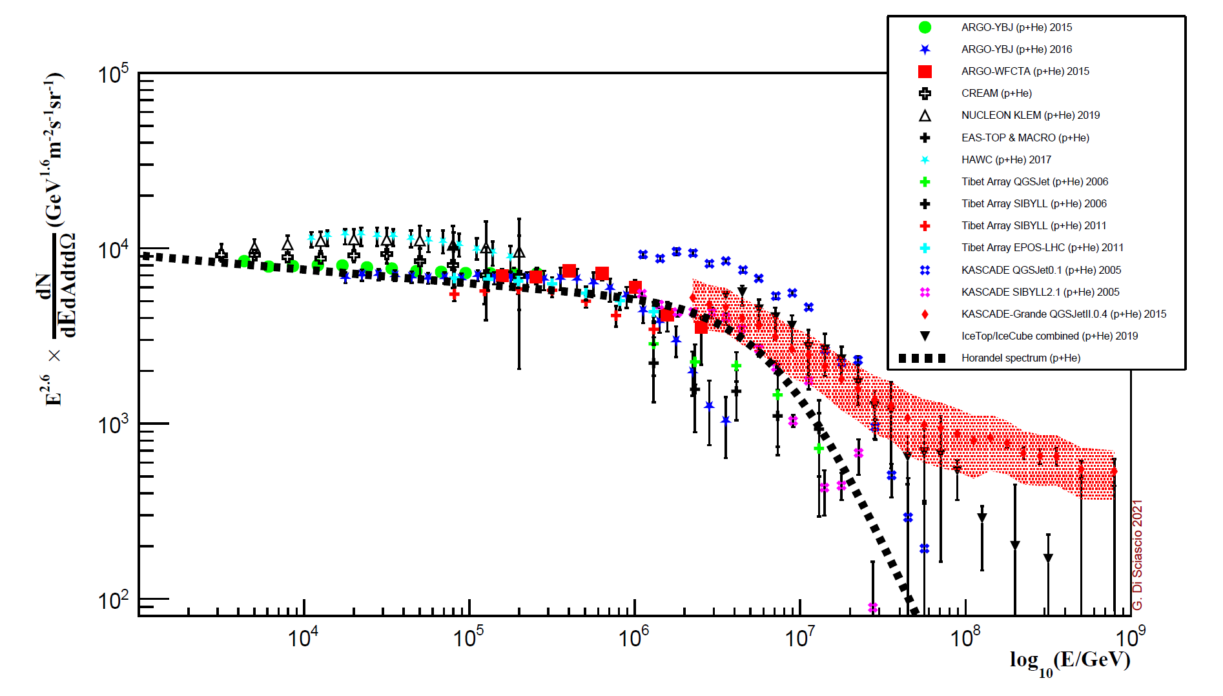
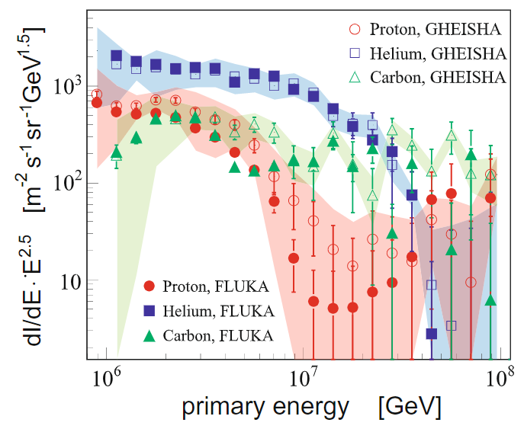
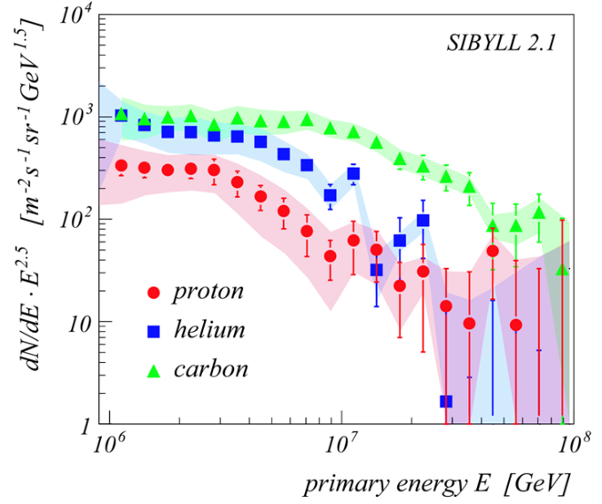
KASCADE experiment
Altitude： 110m
Unfolding： μ and electron matrix
The results strongly depend on the hadronic interaction models
Individual components of CRs energy spectrum measurement are very important, but not easy.
2005年
+GHEISHA
Proton + helium
2009年
2005年
+GHEISHA
QGSJet01
Appl. Sci. 2022, 12, 705.
Notes:
Previous ground-based array experiments, such as KASCADE, have resolved the single component energy spectrum of cosmic rays through the unfolding method. But its results strongly depend on the hadronic interaction models. You can see QGSJet and SYBLL, big difference.
Individual components of CRs energy spectrum measurement are very important, but not easy.

Slide 4
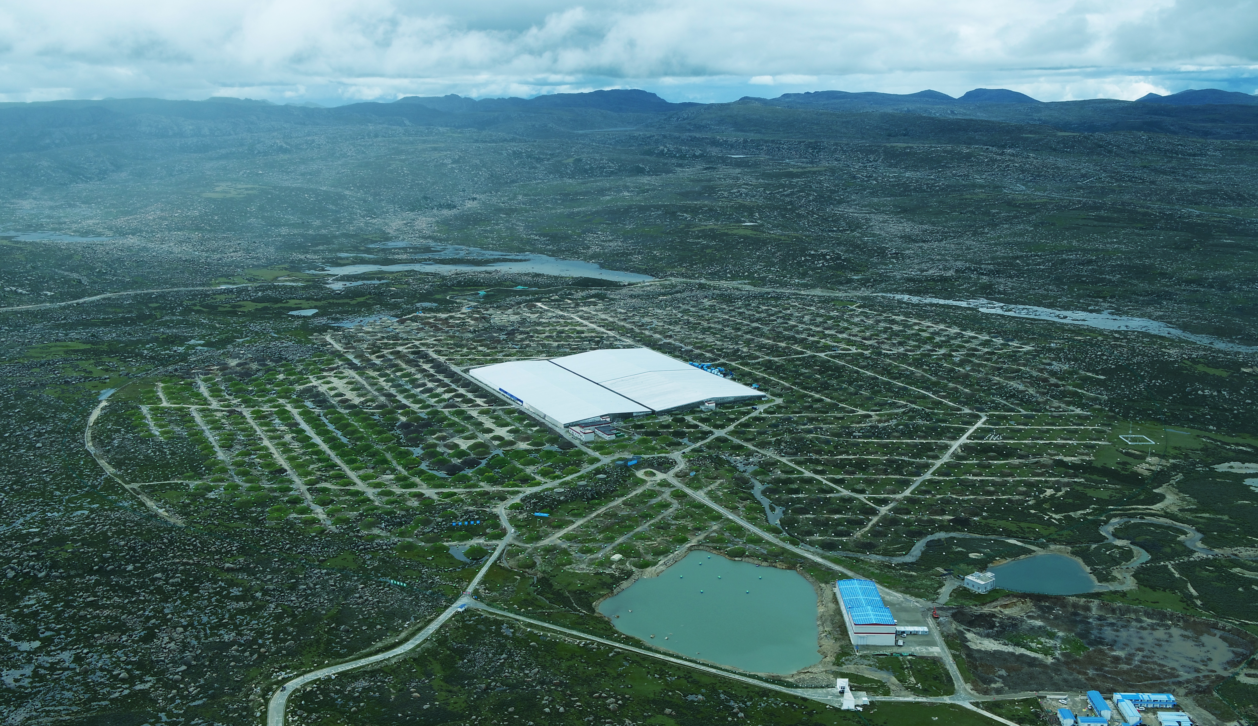
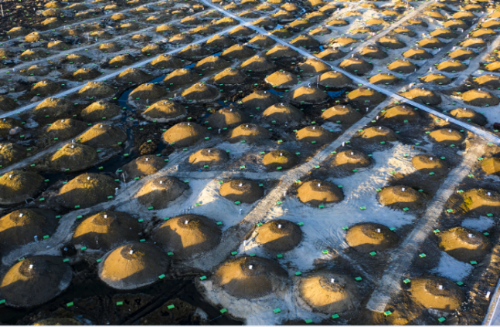
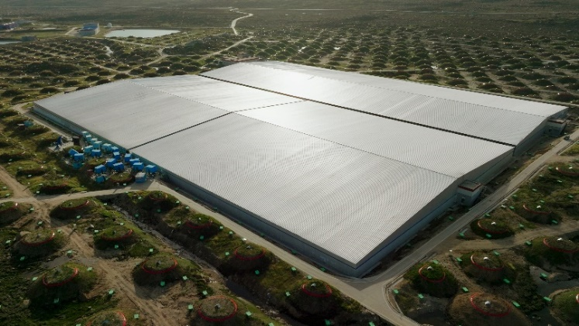
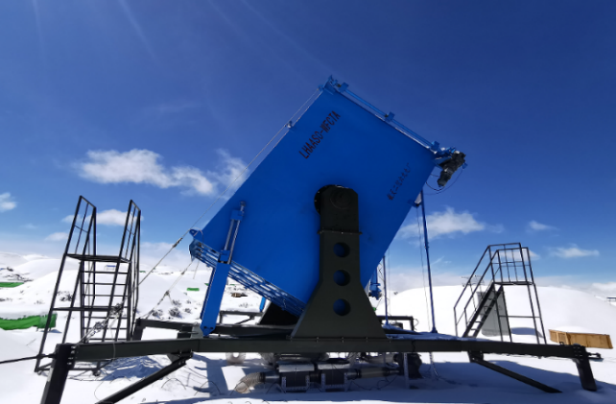
LHAASO
Altitude: 4410 m
Ideal site to measure the cosmic ray energy in the knee region: the air shower development reaches its maximum for vertical showers at around 1 PeV
KM2A: muon detector and scintillator detector array
WCDA: water Cherenkov detector array
WFCTA: wide field Cherenkov telescope array
5216 EDs
18 telescopes
3120 cells
1188 MDs
Notes:
高海拔宇宙线观测站（LHAASO），位于四川甘孜州稻城海子山，海拔: 4410 m，是“膝区”宇宙线测量的理想位置，测量精度高
于2021年7月全面建成，2023年5月通过国家验收。拉索阵列的中心是水切伦科夫探测器阵列(WCDA)，外围是闪烁体探测器阵列和缪子探测器阵列，还有18台广角切伦科夫望远镜。整个阵列的面积是1.3平方公里。

Slide 5
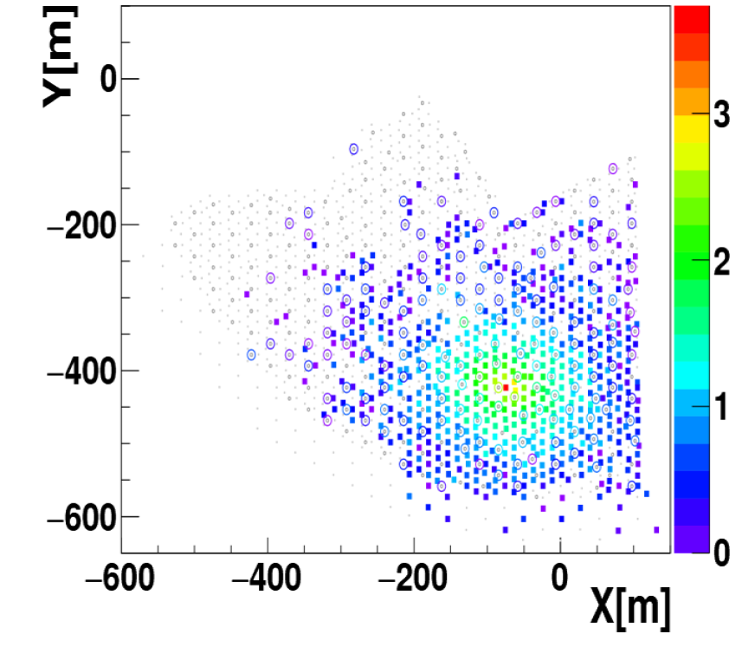
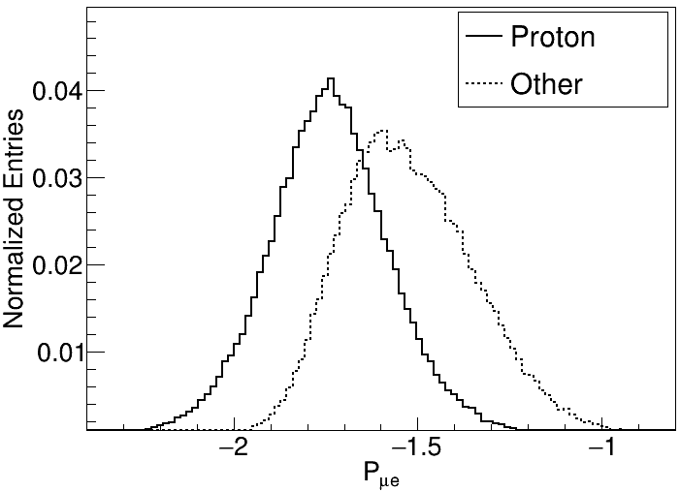
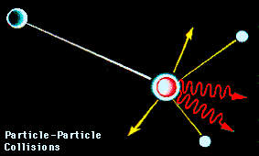
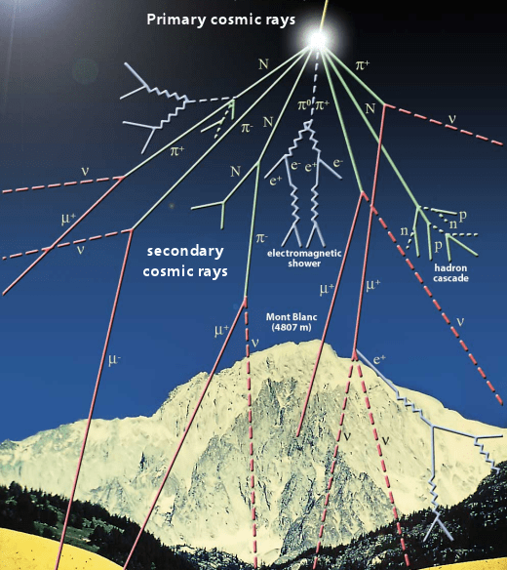
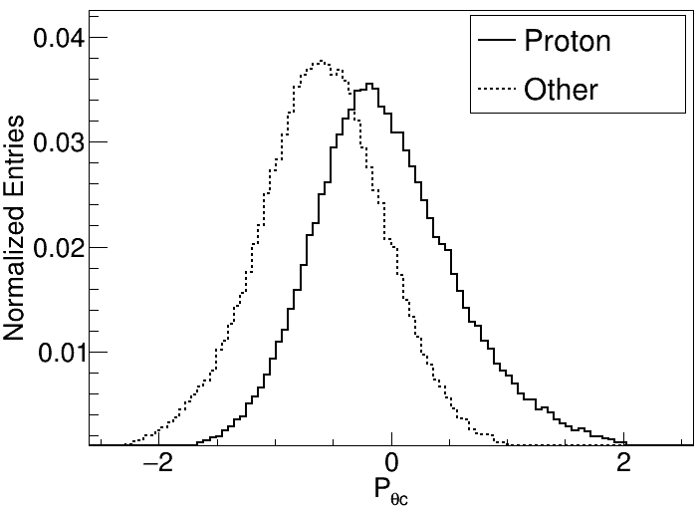
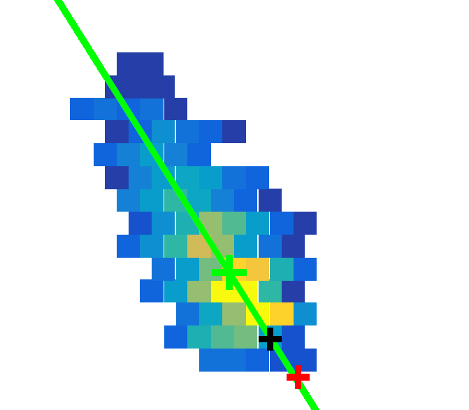

Hybrid Detection of EAS
Cosmic Ray H，He …
KM2A
Muon information
Relate to Xmax
WFCTA
Source
$$θ_{c}$$
e±，γ，μ，Č，…
Centroid
Notes:
宇宙线从外太空进入地球，首先和大气中的原子核发生多次碰撞，引发广延大气簇射，产生非常多的次级粒子，次级粒子中有正负电子、缪子、切伦科夫光等。KM2A测量的缪子信息是非常好的成分区分变量，望远镜测量的切伦科夫光像，像的质心和粒子方向的角距离，也是很好的成分鉴别变量。

Slide 6
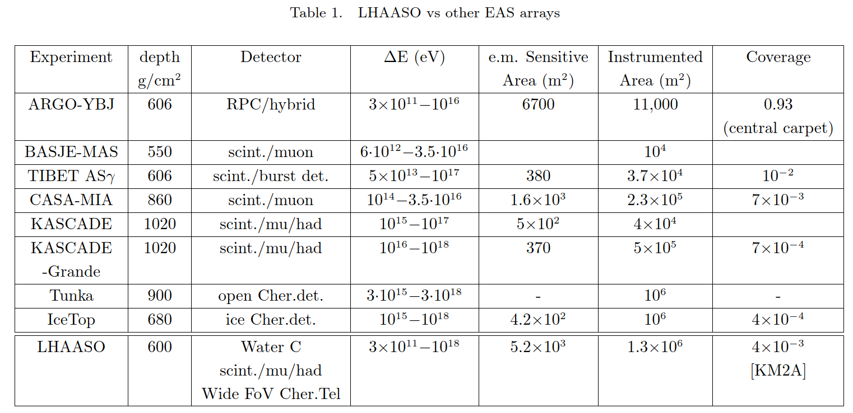
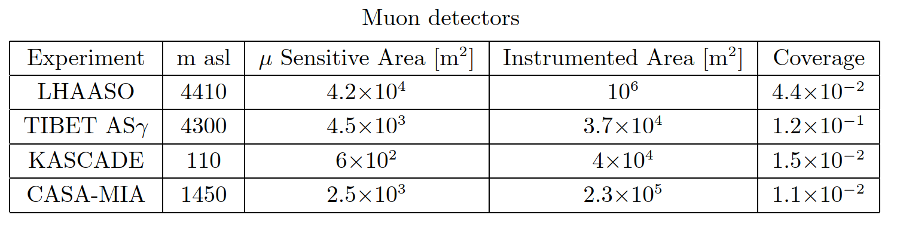
Notes:
The muon sensitive area of LHAASO is the largest in the world, and thus has the strongest component discrimination ability in the knee region.

Slide 7
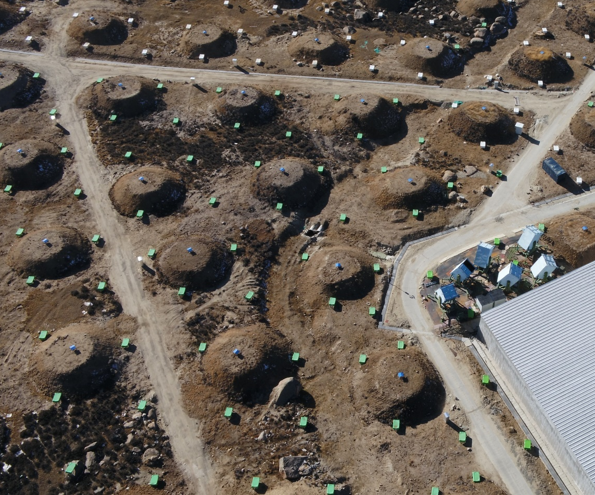
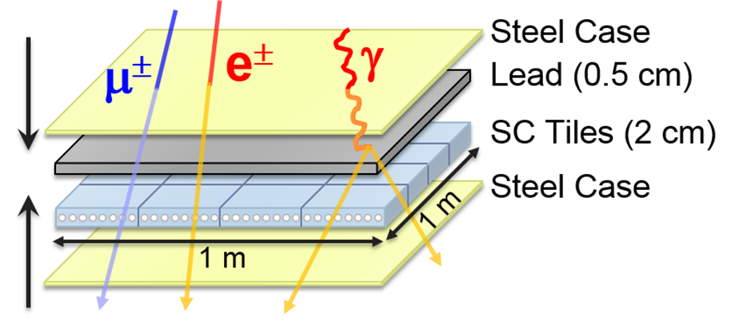
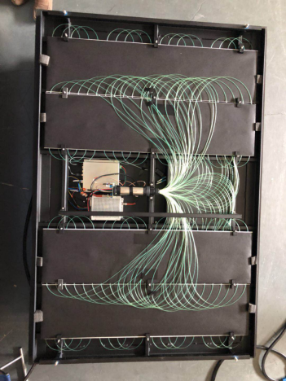
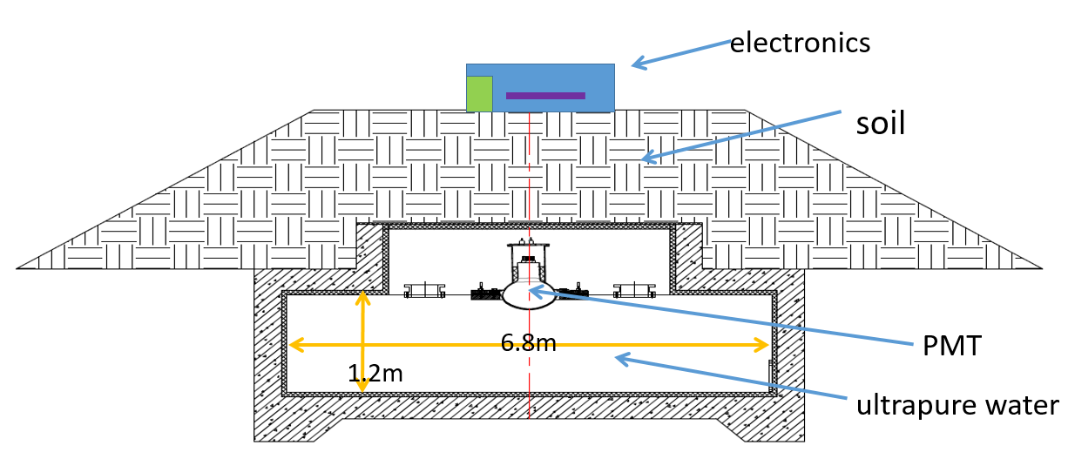
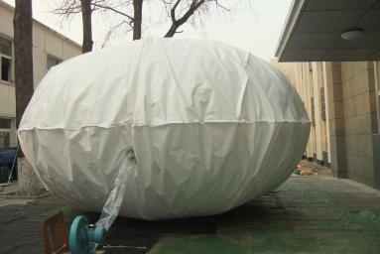
KM2A: 1.36 (km)²
5195 EDs
1 m² each
15 m spacing
1188 MDs
36 m² each
30 m spacing
30 m
15 m
Inner View of one ED
μ±
Muon detector（MD）
Notes:
This soil bag is a muon detector. A water bag is buried underground and covered by about 2.5 meters of soil. The spacing between muon detectors is about 30 meters. This small square is a scintillator detector with a spacing of about 15 meters.

Slide 8
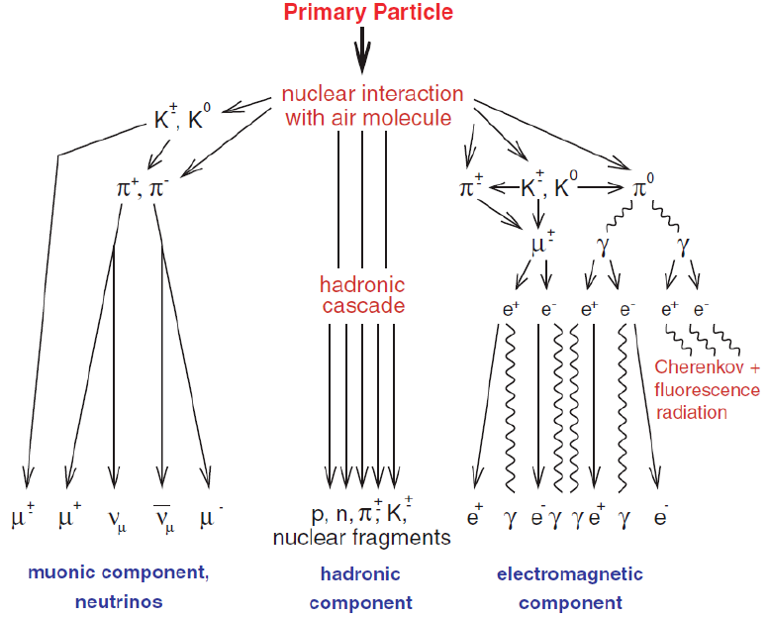
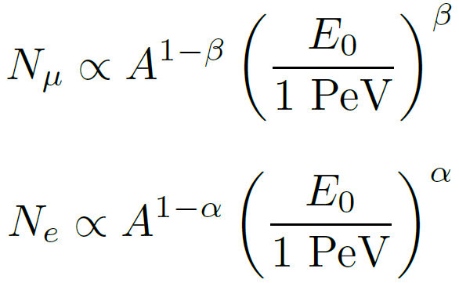
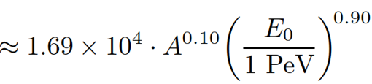
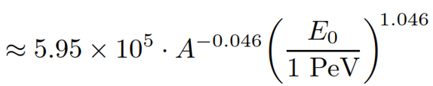
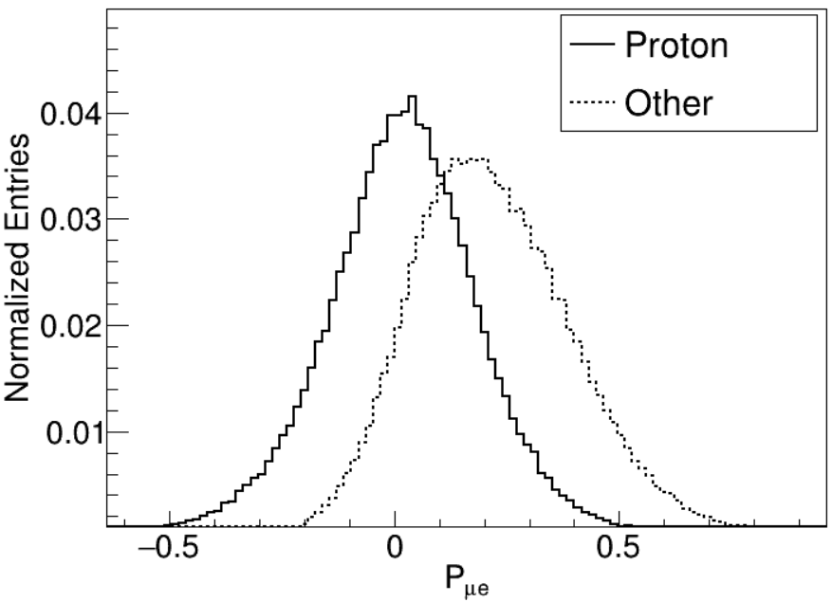
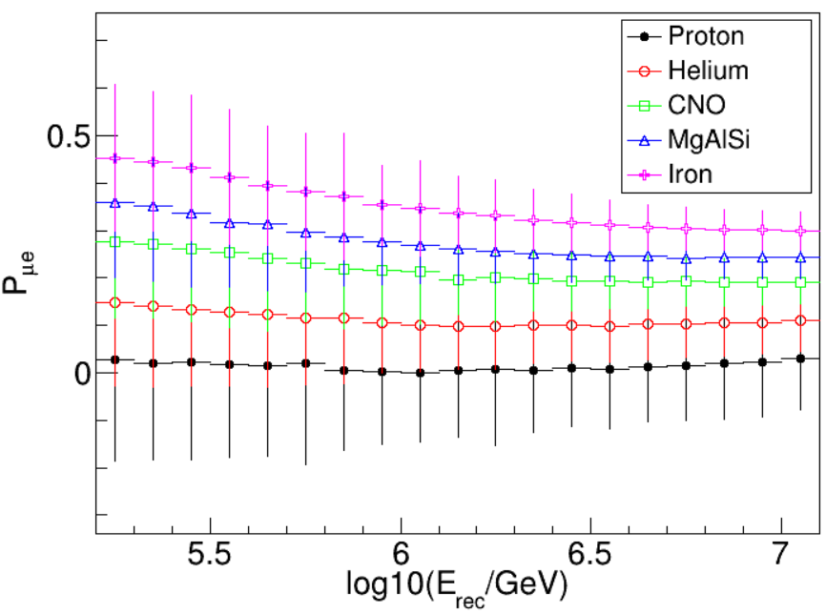

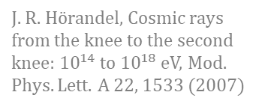
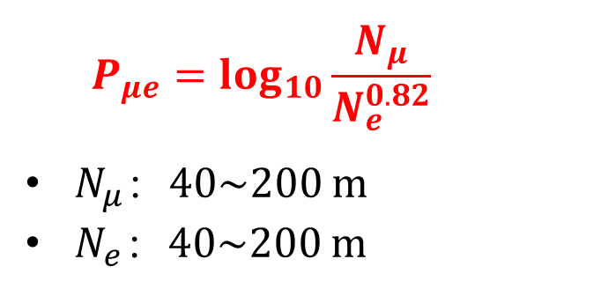
Component sensitive parameters: $P_{μe}$
Muons and electromagnetic particles in EAS
J. R. Hörandel, Cosmic rays from the knee to the second knee: ${10}^{14}$ to ${10}^{18}$ eV, Mod. Phys. Lett. A 22, 1533 (2007)
$$\log_{10}\left(E\right):5.2\sim 7.1⁡$$
$$P_{μe}=\log_{10}{\frac{N_{μ}}{N_{e}^{0.82}}}$$
$N_{μ}$：40~200 m
$N_{e}$：40~200 m
Notes:
Muon content is a powerful component discriminator. We define the parameter of Pue, the ratio of muon density to electromagnetic particle density in the shower, which is almost independent of the shower energy. You can see in this plot, solid line is proton and dash line is other components. If cut here, we can obtain pure proton samples.

Slide 9

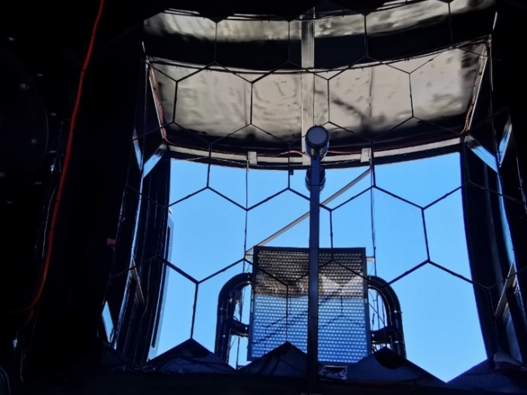
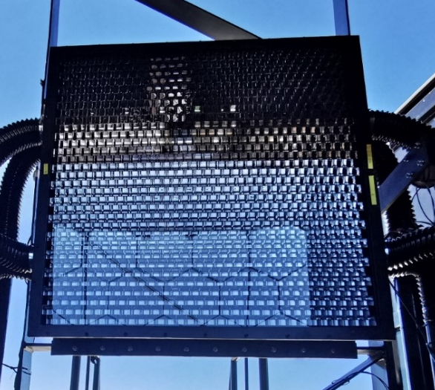


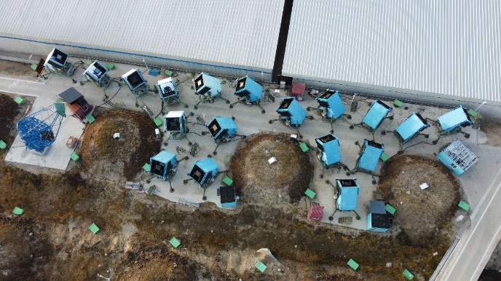
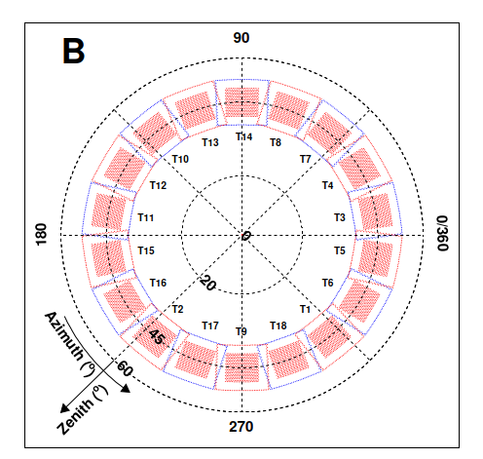
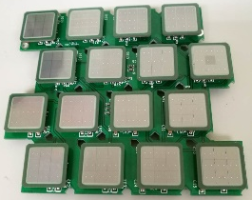
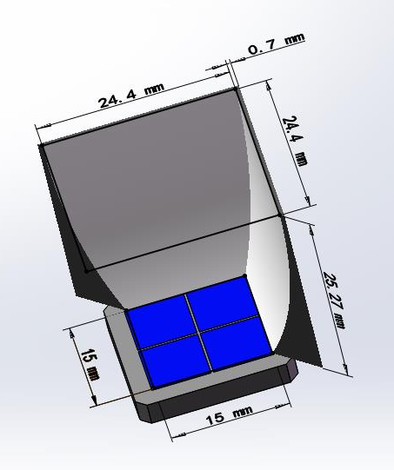
Wide Field of View Cherenkov Telescope (WFCTA)
~5 m² spherical mirror
Camera: 32×32 SiPMs array
FOV:
Pixel size:
Telescope parameters:
18 tels are pointed at a zenith angle of 45° cover azimuth angle from 0°to 360°
Mirror
SiPM camera
18 Telescopes
SiPM and Winstone cone
Notes:
Eighteen wide-field-of-view Cherenkov telescopes are designed for cosmic ray measurements. The diameter of the mirror is about 2.3 m. The SiPM camera is used. So, our Cherenkov telescopes can operate during moon nights, even on the full moon night.
This is very important to increase the observation time for such kind of Cherenkov telescopes.

Slide 10
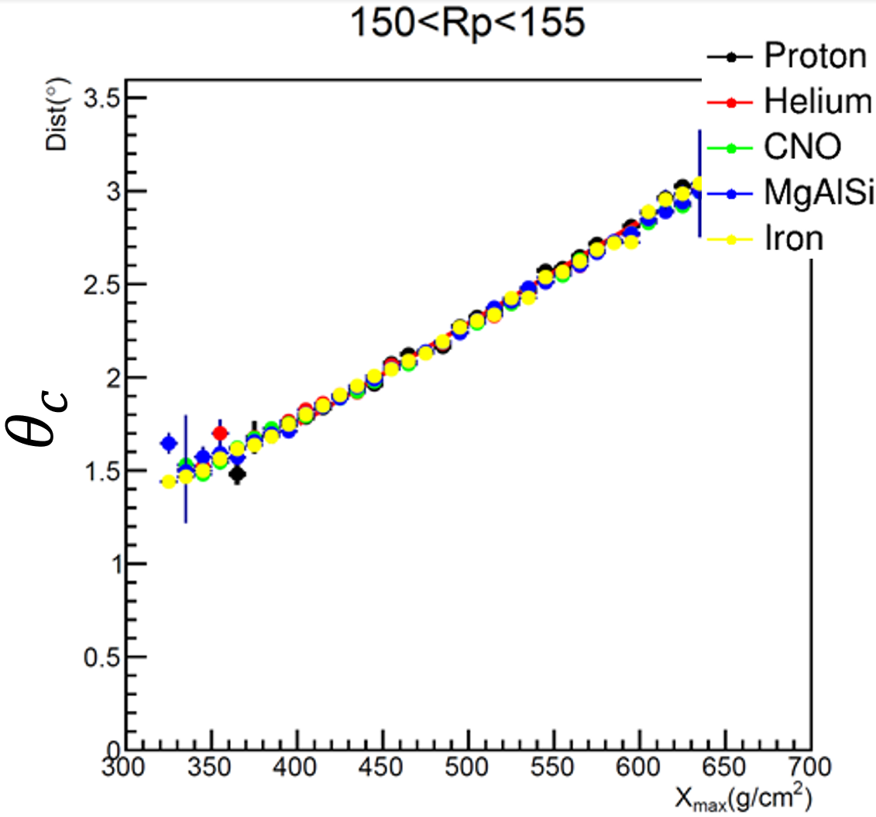
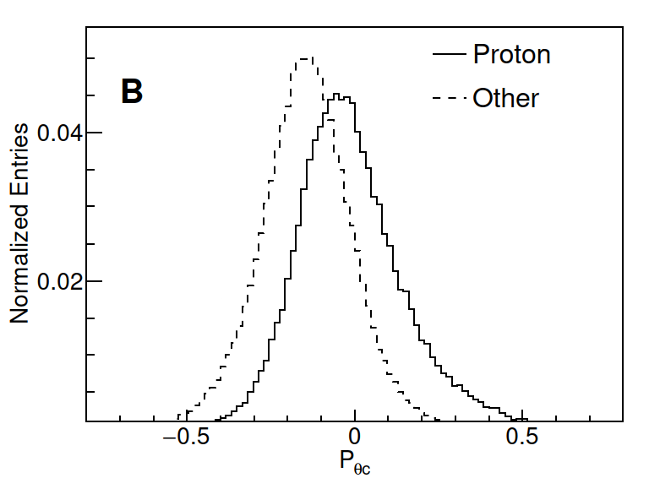
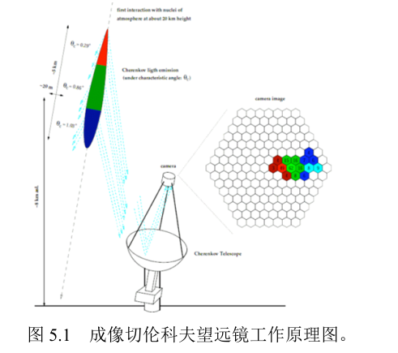


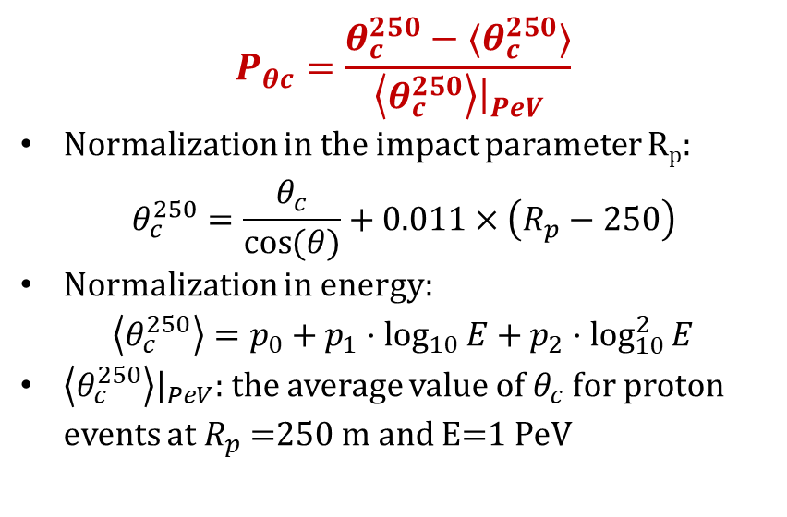
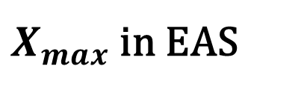
Component sensitive parameters: $P_{θc}$
$X_{max}$ in EAS
shower
Cherenkov Image
SDP
$$θ_{c}$$
$$P_{θc}=\frac{θ_{c}^{250}−⟨θ_{c}^{250}⟩}{\left\langle θ_{c}^{250}\right\rangle {\left.​\right|}_{PeV}}$$
Normalization in the impact parameter R_{p}:
$$θ_{c}^{250}=\frac{θ_{c}}{\cos{(θ)}}+0.011×\left(R_{p}−250\right)$$
Normalization in energy:
$$\left\langle θ_{c}^{250}\right\rangle =p_{0}+p_{1}⋅\log_{10}{E+p_{2}⋅\log_{10}^{2}{E}}$$
$\left\langle θ_{c}^{250}\right\rangle {\left.​\right|}_{PeV}$: the average value of $θ_{c}$ for proton events at $R_{p}$ =250 m and E=1 PeV
Shower direction
$$θ_{c}$$
Long axis ~ to SDP
Centroid
Notes:
The angular distance between the centroid of the image and the shower direction is related to the Xmax.
Proton showers produce deeper Xmax than other components.
Xmax is a good mass sensitivity parameter, so, we define angular distance as one of the component discriminators and normalize it using Rp and shower energy.

Slide 11
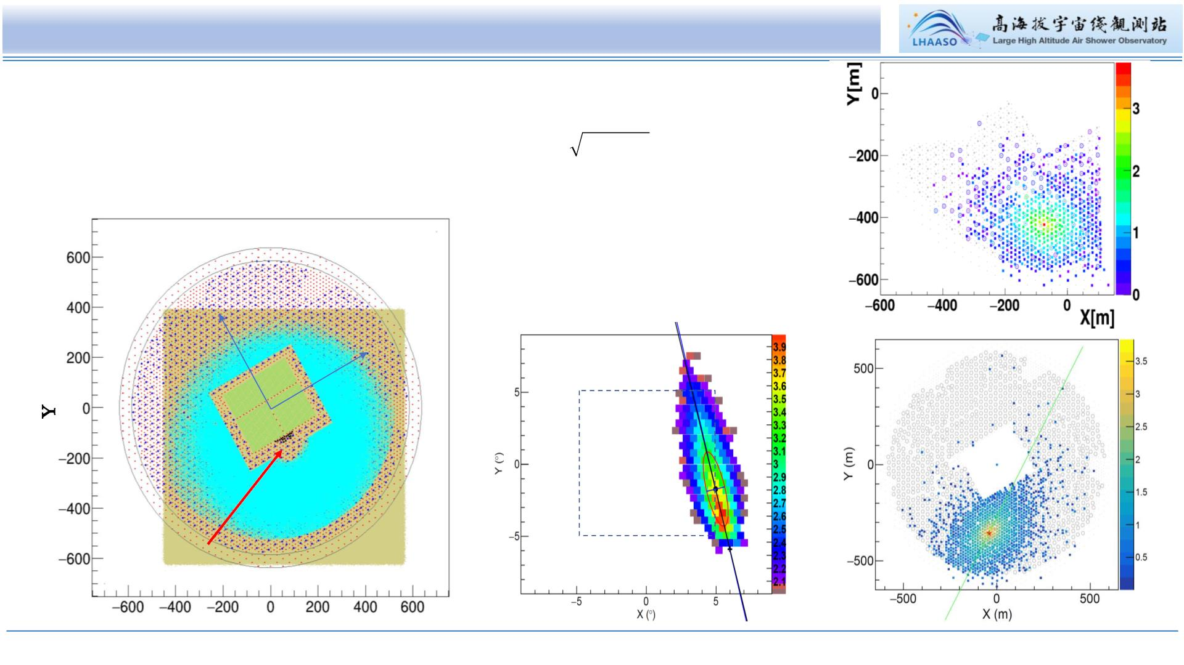
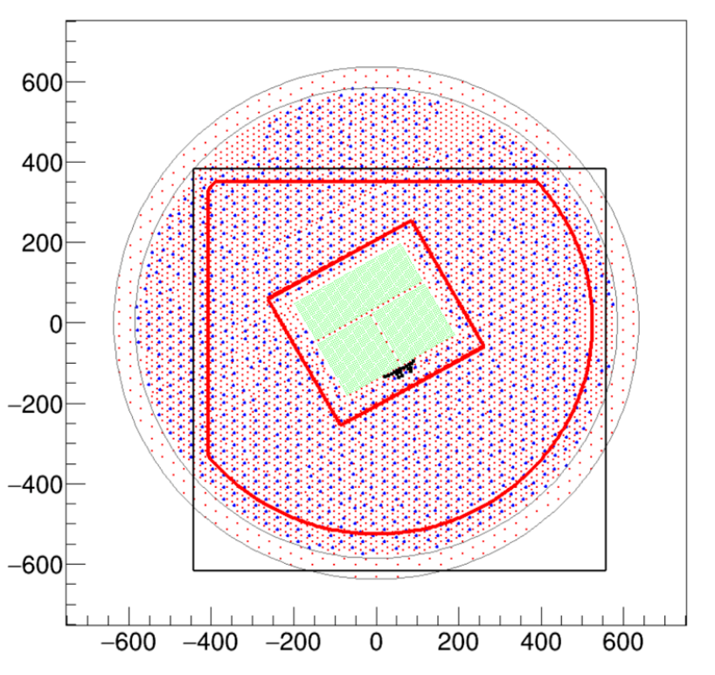
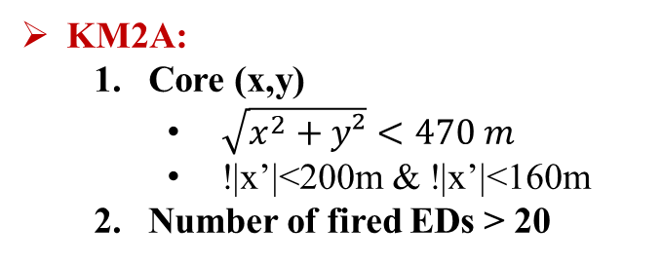
Hybrid Measurement of CR Showers around the Knee
WFCTA: Cherenkov telescopes
Number of pixels：Npix≥6
FoV: 10°× 10° out of 16°× 16° for the centroid of the image
R_{p}: 180 – 310 m
KM2A:
Core (x,y)
$\sqrt{x^{2}+y²}<470 m$
!|x’|<200m & !|x’|<160m
Number of fired EDs > 20
KM2A
measures
μ-content
KM2A
KM2A
Y’
X’
KM2A
measures
shower
GEO
WCDA
Y(m)
WCDA
WFCTA
WFCTA
image
X (m)
46
Notes:
Cuts for High quality shower measurement: For Cherenkov telescopes require at least 6 fired pixels in each image. FoV: 10°× 10° out of 16°× 16° for the centroid of the image to contain full image in the camera，impact parameter Rp range from 150 – 300 m，KM2A：Number of fired EDs > 20，core location at least 50 m away from the edge of the KM2A detector array. Muon contents in KM2A and shower core and direction reconstructed by EDs of KM2A.

Slide 12
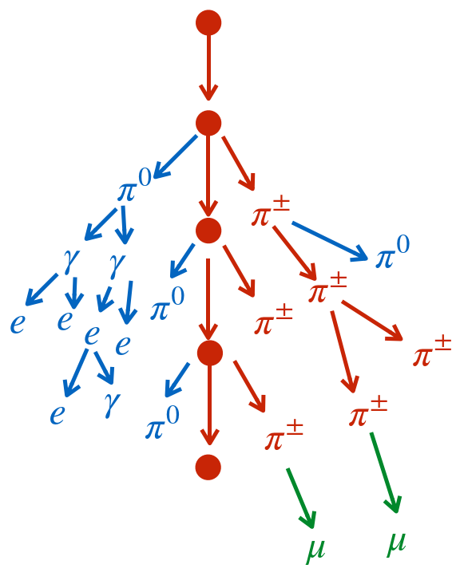
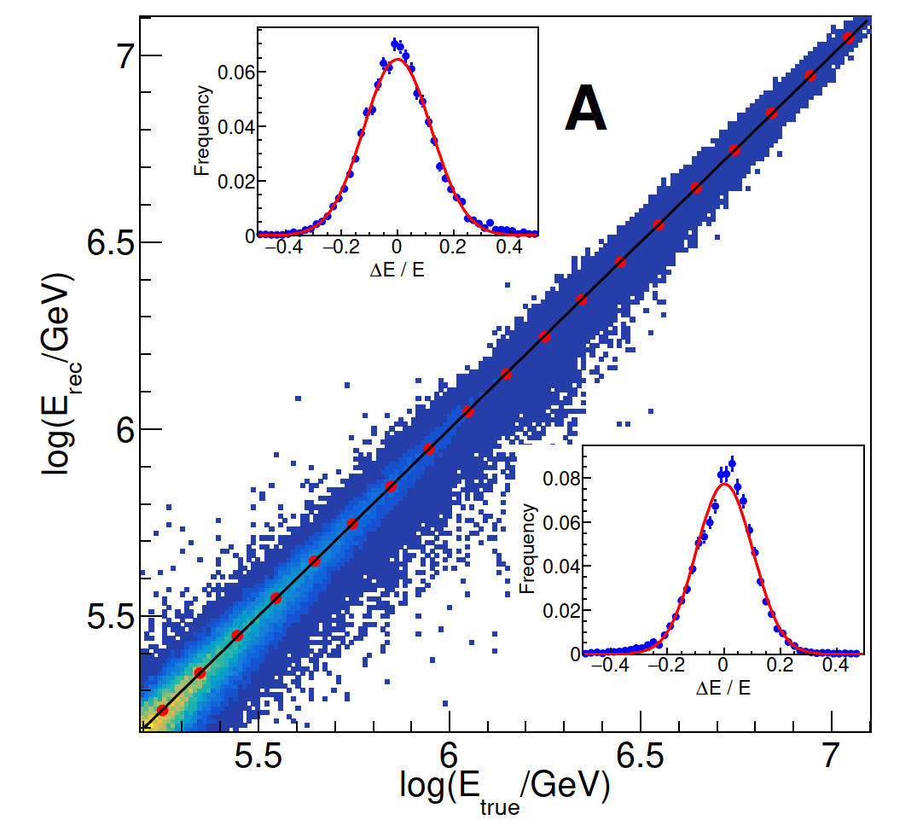
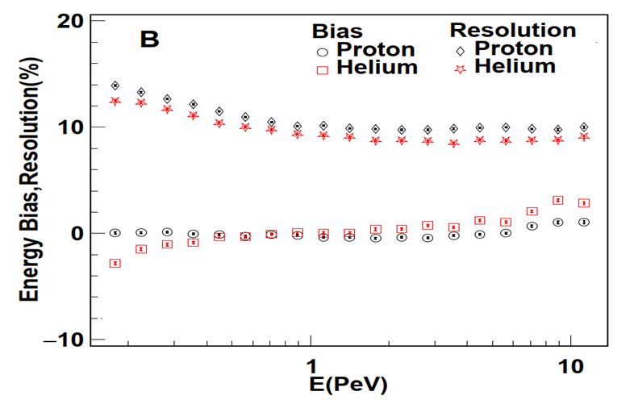
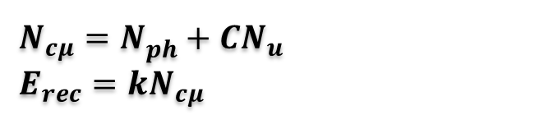
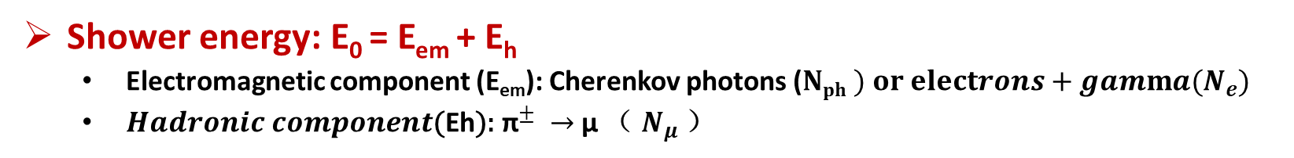
Energy Reconstruction
Shower energy: E₀ = E_{em} + E_{h}
Electromagnetic component (E_{em}): Cherenkov photons ($Nph ) or electrons+gamma{(N}_{e})$
${Hadronic component\text{(}\text{E}\text{h}\text{):} \text{π}}^{±} →$ μ （ $N_{μ}$）
$$N_{cμ}=N_{ph}^{}+CN_{u}^{}$$
$E_{rec}=kN_{cμ}$
• Energy Resolution：<15%
• Systematic Bias：<2%
Cosmic Ray P，He…
Atmosphere atomic nuclei
Notes:
These cosmic rays induce air showers which contain two component: electromagnetic component and hadronic component.
We use Cherenkov photons and Number of muons to reconstruction shower energy.
Cherenkov photons represent electromagnetic component, while muon content represents hadronic component.
The energy resolution is less than 15% and gradually improves with increasing energy, remaining constant above 1 PeV.
The systematic bias of reconstruction energy is less than 2%.

Slide 13




Light component (H+He) Selection
$$\frac{P/He(after select)}{P/He(before select)}$$
Purity>90% @ 1PeV
Light Selection efficiency
Heavy Selection efficiency
Dual cutting is applied to keep the same ratio of Proton and Helium before and after the composition selection;
Purity ($ε^{l}=\frac{N_{select}^{L}}{N_{select}^{L}+N_{select}^{H}}$) : ~90% @ 1PeV, Most of the contaminations come from CNO
Selection efficiency ($η^{l}=\frac{N_{select}^{L}}{N_{all}^{L}}$ ) : 60%.

Slide 14


Light component (H+He) measurement
Data set：2021.10-2022.4
Total time after good weather selection: ~1,000 hour
Aperture: ~70,000 $m^{2}sr$
The light component energy spectra from 0.16 PeV to 13 PeV were measured with high precision by LHAASO
Hardening: around 1 PeV
Knee: around 3 PeV
Phys. Rev. Lett. - Accepted 6 February, 2026
DOI: https://doi.org/10.1103/d838-49gt

Slide 15






Proton Selection
CNO, MgAlSi, Iron dominant region
Selection criteria at one energy bin
Dash line: selection criteria
( )
Purity ($ε^{l}=\frac{N_{select}^{L}}{N_{select}^{L}+N_{select}^{H}}$) : ~90% @ 1PeV
Most of the contaminations come from Helium
Selection efficiency ($η^{l}=\frac{N_{select}^{L}}{N_{all}^{L}}$ ) : 25%.
15
Notes:
Proton Shower selection uses the parameters of shower maximum depth and muon content we defined before.
The purity is more than 90% with a selection efficiency of 25%. You can see, the contamination dominates by Helium.

Slide 16

Proton energy spectrum measured by LHAASO in the knee region
CR protons around the knee have been identified with high purity for the first time, and their energy spectrum has been precisely measured from 0.16 to 13 PeV by LHAASO.
LHAASO purity: ~90%, above 100TeV
Direct measurement (e.g. DAMPE) purity: 99% - 95%, below 100TeV
KASCADE and ICETOP: Unfolding method, no purity provided.
LHAASO Coll., Science Bulletin 70 (2025)
Notes:
Cosmic ray proton spectrum from a few TeV to tens of PeV (upper panel). A factor of E2.75 is multiplied to the fluxes, allowing a detailed comparison between measurements in entirely different energy domains. Proton spectra reported by the space-borne ISS-CREAM, DAMPE, CALET, and NUCLEON and ground-based GRAPES-3, ICETOP, and KASCADE detectors and the LHAASO all-particle spectrum are plotted together with the proton spectrum measured in this work by LHAASO. Here we show three proton energy spectra based on
different hadronic models. All error bars represent the statistical errors. The shaded band represents the overall systematic uncertainty, excluding that introduced by the hadronic interaction models. The center of the shaded band corresponds to the results from the EPOS-LHC model. The systematic uncertainty introduced by the hadronic interaction models can be referenced by the differences among the three energy spectra. To clearly see how those measurements are connected over a wider energy range starting from 1 GeV, the spectra by AMS-02, DAMPE and LHAASO (proton spectrum and all-particle spectrum) are plotted in the lower panel. AMS-02 and DAMPE have a good overlap around 103 GeV, and the gap between DAMPE and LHAASO around 0.1 PeV should be covered by the two experiments shortly, allowing a complete description of the spectrum without suffering from a relative energy scale difference between experiments.

Slide 17


Proton energy spectrum measured by LHAASO in the knee region
Hardening: appears in 100 TeV-400TeV, with index change ∆γ=~0.2
Softening (knee): ~3.3 PeV with index change ∆γ=~−1
Knee
Proton （EPOS）
Data set is the same with light component
2021.10-2022.4
Total time after good weather selection: ~1,000 hour
Aperture: ~70,000 $m^{2}sr$
LHAASO Coll., Science Bulletin 70 (2025)
Notes:
Cosmic ray proton spectrum from a few TeV to tens of PeV (upper panel). A factor of E2.75 is multiplied to the fluxes, allowing a detailed comparison between measurements in entirely different energy domains. Proton spectra reported by the space-borne ISS-CREAM, DAMPE, CALET, and NUCLEON and ground-based GRAPES-3, ICETOP, and KASCADE detectors and the LHAASO all-particle spectrum are plotted together with the proton spectrum measured in this work by LHAASO. Here we show three proton energy spectra based on
different hadronic models. All error bars represent the statistical errors. The shaded band represents the overall systematic uncertainty, excluding that introduced by the hadronic interaction models. The center of the shaded band corresponds to the results from the EPOS-LHC model. The systematic uncertainty introduced by the hadronic interaction models can be referenced by the differences among the three energy spectra. To clearly see how those measurements are connected over a wider energy range starting from 1 GeV, the spectra by AMS-02, DAMPE and LHAASO (proton spectrum and all-particle spectrum) are plotted in the lower panel. AMS-02 and DAMPE have a good overlap around 103 GeV, and the gap between DAMPE and LHAASO around 0.1 PeV should be covered by the two experiments shortly, allowing a complete description of the spectrum without suffering from a relative energy scale difference between experiments.

Slide 18


A hardening feature is found bellow the knee.
The direct measurement results such as DAMPE, CALET, ISS-CREAM, further confirm the existence of the hardening before the knee.
<0.4PeV
0.4-3PeV
Notes:
Compared to the spectral index measurements around several tens of TeV obtained from direct measurements such as those by DAMPE, CALET, and ISS-CREAM, the existence of spectral hardening before the knee is further confirmed.

Slide 19

Helium energy spectrum measured by LHAASO in the knee region
Helium lies between p and CNO, so event-by-event discrimination of helium from other particles near the knee is challenging
Methodology:
Helium = Light component - proton
We use the same dataset and energy-reconstruction method for the proton and light-component spectra to avoid introducing additional systematic uncertainties in the helium measurement
H+He
He
H
Phys. Rev. Lett. - Accepted 6 February, 2026
DOI: https://doi.org/10.1103/d838-49gt

Slide 20

Helium energy spectrum measured by LHAASO in the knee region
H+He
The Helium energy spectra from 0.16 PeV to 13 PeV were measured with high precision by LHAASO
Clear hardening emerges at about 1.1 PeV
Knee: around 7 PeV
He
H
Double broken power law：

Slide 21

All-particle knee is dominate by the proton knee
All particle
Knee: ~3.67 PeV
γ1 = -2.74±0.005
γ2 = -3.13±0.005
Proton
Knee: ~3.3 PeV
γ2 = −2.51±0.03
γ3 = −3.5±0.2
The all-particle knee is dominate by the proton knee
Notes:
LHAASO has accurately measured all particle energy spectrum and composition around the knee.
From the correlation between the all particle energy spectrum and mean logarithm mass at the knee, the knee is contributed by the light component.
You can see here, the proton knee and the all particle knee. The all particle knee is dominate by the proton knee.

Slide 22

Wideband spectrum of proton and helium
The abundance of protons overtake helium again at around 0.7 PeV
The H/He ratio crosses unity twice within the energy range of 0.16–13 PeV.
The crossing at 0.7 PeV shows that protons once again become the dominant component of cosmic rays, which is somewhat unexpected given the significant hardening of the helium spectrum previously observed in space-based measurements.
A second crossing occurs at E ∼5 PeV, where the helium flux exceeds the proton flux once more
H/He
Phys. Rev. Lett. - Accepted 6 February, 2026
DOI: https://doi.org/10.1103/d838-49gt

Slide 23

Wideband spectrum of proton and helium
The knee reflects the maximum acceleration energy of the sources and shows a rigidity dependence.
The hardening of the proton spectrum occurs around 0.1 PeV, while the hardening for helium occurs around 1.1 PeV, and these hardening features do not exhibit rigidity dependence. This may be related to the superposition of multiple source classes with differing acceleration powers.

Slide 24
Wideband spectrum of proton and helium
A potential explanation could be the existence of multiple groups of cosmic ray sources with varying acceleration limits, as indicated by their maximal cosmic ray energies.
Compact object
Originated?
e.g. microquasar
SNR originated?

Slide 25
Systematic uncertainties of proton spectrum
Systematic uncertainties on flux | Systematic uncertainties on flux
Hadronic model | ≤ 15%
Composition model | ~7%@3PeV
Different purity | ≤ 2%
SiPM camera calibration | ≤ 2%
Background light | ≤ 2%
Absolute Humidity | ≤ 1%
Air pressure | ≤ 1%
Total | ~17 %
Systematic uncertainties on Energy Scale | Systematic uncertainties on Energy Scale
SiPM camera calibration | ~1.5%
Mirror reflectivity Calibration | ~1%
Nμ Calibration | ~1%
Absolute Humidity (water vapor) | ~1%
Aerosol | ~2%
Air pressure | ~0.5%
Hadronic model | ~1.4%
Total | ~4%
Notes:
Here, we list all the systematic sources in the table. The total systematic uncertainties on flux are about 17%, while the total systematic uncertainties on the energy scale are about 4%.

Slide 26

Systematic uncertainty of light component and helium
The total systematic uncertainty on the energy measurement is about 4% for light component and helium energy spectra
Systematic uncertainties on flux

Slide 27
Summary & Outlook
CR proton, helium and light component around the knee have been precisely measured from 0.16 to 13 PeV by LHAASO
Measuring CR Spectra of individual species around knees is a big step towards understanding the knee feature and its origin.
The next plans of LHAASO
To understand the absolute energy scale of cosmic rays, a joint analysis by LHAASO and DUMPE is in progress and is expected to be completed in this year.
To measure the iron spectrum, including the bump around 400 TeV and the knee.
Achieving high-precision measurements of protons and helium at even higher energies.

Slide 28


A joint analysis by LHAASO and DUMPE
To understand the absolute energy scale of cosmic rays, a joint analysis by LHAASO and DUMPE is in progress and is expected to be completed by the end of this year.

Slide 29





Helium
Proton
DAMPE (2019)
DAMPE (2021)
Bump：~13.6 TeV for Proton and ~34.4 TeV for Helium
Charge Z dependent？
The ratio of Proton bump and Helium bump is 2.5 ± 0.8
Iron spectra from 100 TeV to several PeVs will be measured by LHAASO and can answer the question clearly.
Six telescopes are pointed at a zenith angle of 8° to lower the energy threshold of KM2A and WFCTA.
588
6877
LHAASO iron spectra expectation
29
Notes:
We also plan to measure the iron spectrum from 100 TeV to several PeVs, which can answer the question raised by Dump experiment:
whether the bumps of proton and helium below 100TeV depends on Charge Z.

Slide 30
Thanks !

Slide 31
Helium energy spectrum measured by LHAASO in the knee region
H+He
The Helium energy spectra from 0.16 PeV to 13 PeV were measured with high precision by LHAASO
Clear hardening emerges at about 1.1 PeV
Knee: around 7 PeV
He
H
Double broken power law：

Slide 32


Slide 33



Eq. 3：Two broken power laws
Proton （EPOS）
E_{h} = 365 ± 20
E_{k} = 3.2±0.3
γ1 = −2.67± 0.01
γ2 = −2.51±0.02
γ3 = −3.5±0.1
χ²/n.d.f. = 9.9/11
Eq. 3
Preliminary
Eq. 4：A broken power law + an exponential cutoff
Eq. 4
E_{h} = 436 ± 22
E_{cut} = 5.1 ± 0.3
γ1 = −2.66 ± 0.02
γ2 = −2.29 ± 0.05
χ²/n.d.f. = 27.1/13
Eq. 3：
Eq. 4：
Notes:
the entire spectrum does not follow a simple ‘knee’ shape feature.

Slide 34


Slide 35



Slide 36


