Slide 1
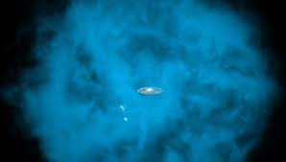
Galactic/Extragalactic Cosmic Rays
Gaisser, Front.Phys.(Beijing) 8 (2013) 748-758
Galactic /Extragalactic CR Spectrum
knee
second knee
Galaxy
ankle
Galactic Halo

Slide 2
Origins of the CR
The SNR Paradigm
Galactic SNR, well motivated as a Galactic CR sources, are the preferred option for powering the spectrum all the way up to the knee proton energy (10^{15.5} eV)
However, even if SNR accelerate CRs up to the proton knee, a new source class is needed to fill the energy gap between 10¹⁷ eV and 10¹⁸ eV
Taylor et al., Nature volume 531, pages 43–44 (2016)

Slide 3
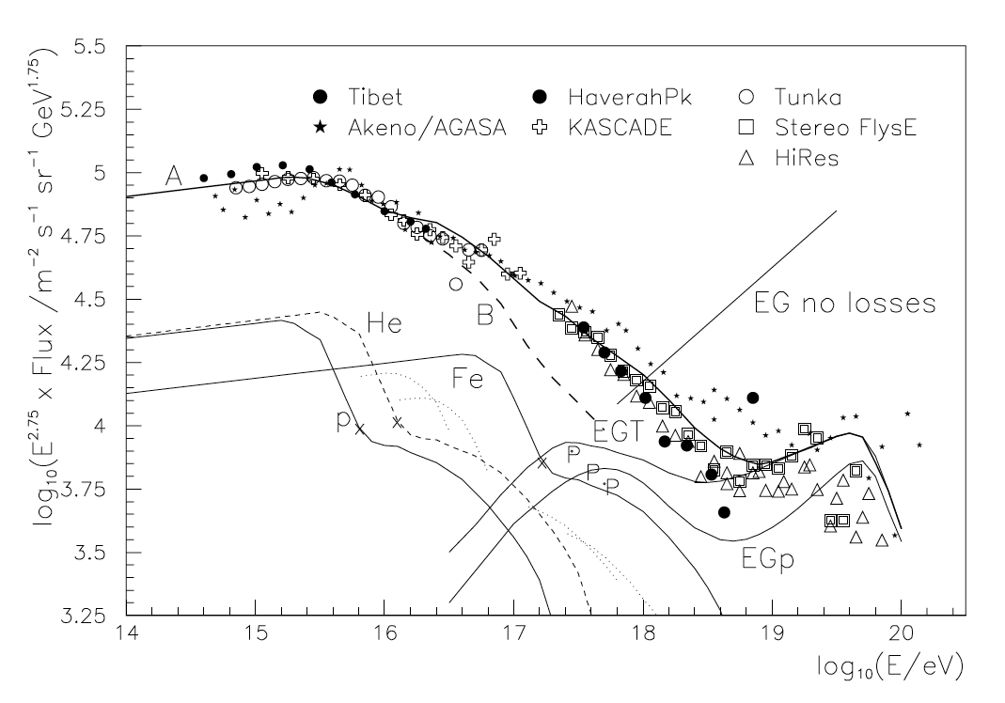
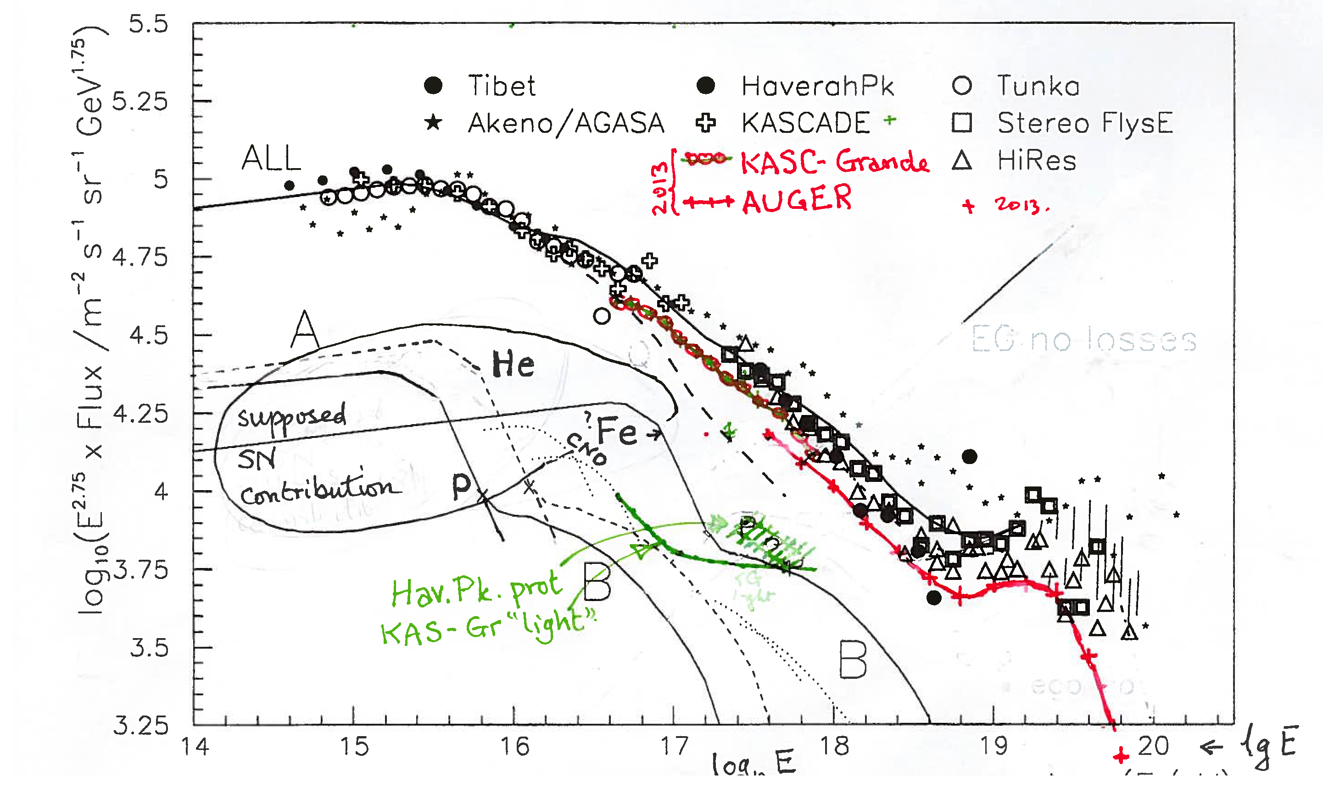
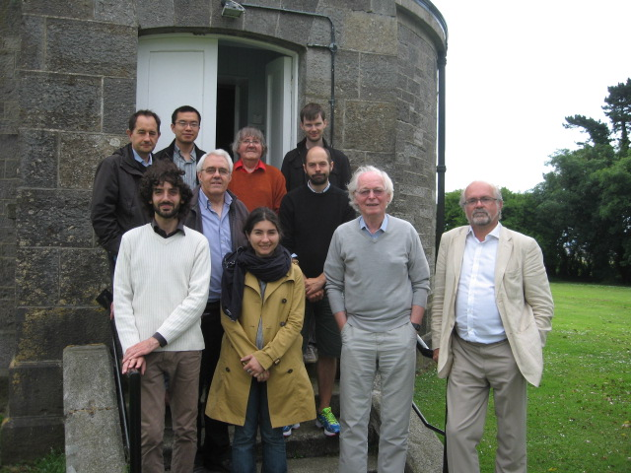
Original Plot (2005)
The Need for a Population B
Revised Plot (2014)
Hillas, 2005 Nucl. Part. Phys. 31 R95. (2005)

Slide 4

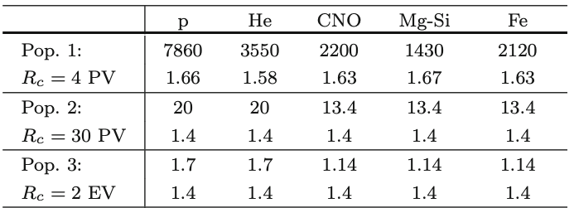
Pop A Pop 1
Pop B Pop 2
Pop C Pop 3
Hillas-Type 3 Population Fit to the Transition Region
Realisation of Hillas 3 Populations Scenario
Galactic
Extragalactic?
Gaisser, Front. Phys., 2013, 8(6): 748–758 (2013)

Slide 5

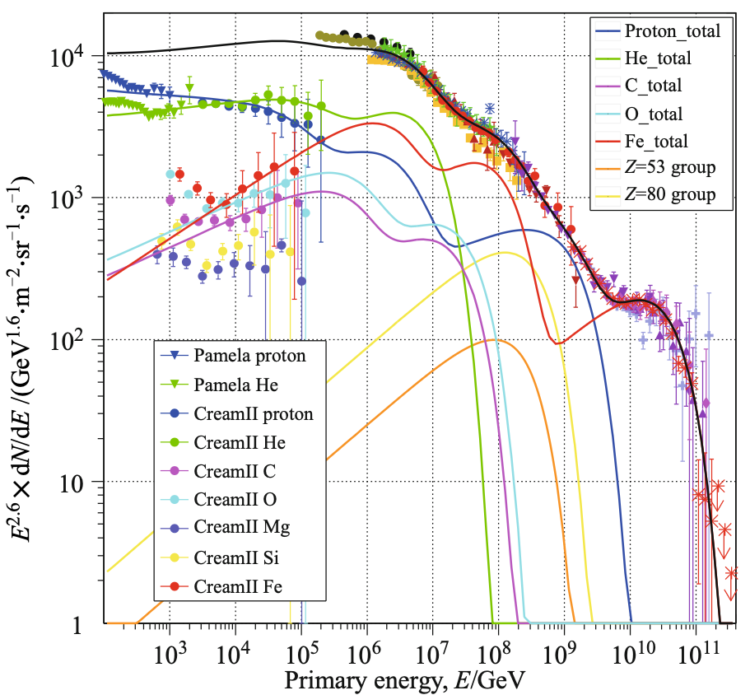
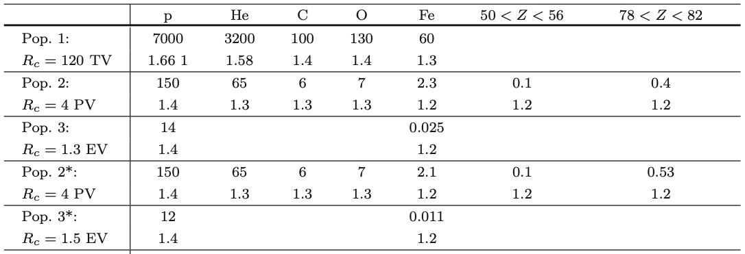
Pop A Pop 1
Pop B Pop 2
Pop C Pop 3
Gaisser-Type 3 Population Fit to the Transition Region
Alternative 3 Population Scenario
Pop 1
Pop 2
Pop 3
Note: Pop A and Pop B max energy lowered by ~10-30 relative to Hillas’ proposed scenario
Gaisser, Front. Phys., 2013, 8(6): 748–758 (2013)
Note the Pop 2 proton component needs revising in light of recent LHAASO results:
LHAASO Collaboration: 2511.05013

Slide 6
Constraints on at What Energy the Onset of Population B can Occur
CR Composition Evolution
Only two clear light-heavy-light-heavy “cycles” in composition observed in data between the knee and the highest energies.
This places a strong constraint on the spacing of the energy onset in dominance of the new spectral components
(SIBYLL)
(SIBYLL)
(SIBYLL)
Gaisser, Front. Phys., 2013, 8(6): 748–758 (2013)
Kampert et al. Astropart. Phys. 35 10 660-678 (2012)
To be updated with LHAASO Coll., PRL 132, 131002 (2024)

Slide 7
Hillas & Gaisser-Type Population B Candidates:
Proton Spectrum
Composition
Extreme Supernovae (Type IIn): Hillas-Type Pop B
Ekanger et al., 2602.06410
Christofari et al., Astropart. Phys. 123 102492 (2020)
Zirakashvilli et al., Astropart. Phys. 78 28–34 (2016)
Proton Spectrum
Composition
Supernovae in Massive Star Clusters:
Gaisser-Type Pop B
Vieu et al., MNRAS 519, 136–147 (2023)

Slide 8
The Power Needs of Gaisser-Type Population B
Gaisser, Front. Phys., 2013, 8(6): 748–758 (2013)

Slide 9
Particle Accelerator Limits
[AM Hillas (1984)]
[Lovelace et al. (1976)]

Slide 10
Gaisser-Type Population B Candidates:
Microquasars
E (eV)
Kaci et al., 2510.01369
Aharonian et al., 2602.08223
Star Cluster Winds
Morlino et al., MNRAS 504, 6096–6105 (2021)
LHAASO Coll., Science Bulletin 69 (2024) 449–457
Nie et al., 2602.07620

Slide 11
Kascade-Grande
Population C Onset: Evidence for a Light Hard Spectrum
heavy
A subdominant component of light CRs is seen ≳10¹⁷ eV (”light ankle”)
light
LHAASO-IceTop
Apel et al., Phys. Rev. D 87, 081101 (2013)
A recent reanalysis of the Kaskade-Grande data with updated hadronic models finds the same feature (though at somewhat lower energies)
Kang et al., PoS ICRC2025 (2025) 297
Aharonian et al., 2602.08223

Slide 12
The Source Evolution Scenario for the >10^{17.7}eV CRs
CR p
Extragalactic photon
e
e
SFR evolution scenario
no evolution scenario
Liu et al., Phys.Rev.D 94 043008 (2016)

Slide 13
The Origin of Protons Below the Ankle
SFR evolution scenario
no evolution scenario
Note- IGRB contribution from cascade losses rather independent of source spectra
New upper limit once (resolved and unresolved) points sources removed
Liu et al., Phys.Rev.D 94 043008 (2016)

Slide 14
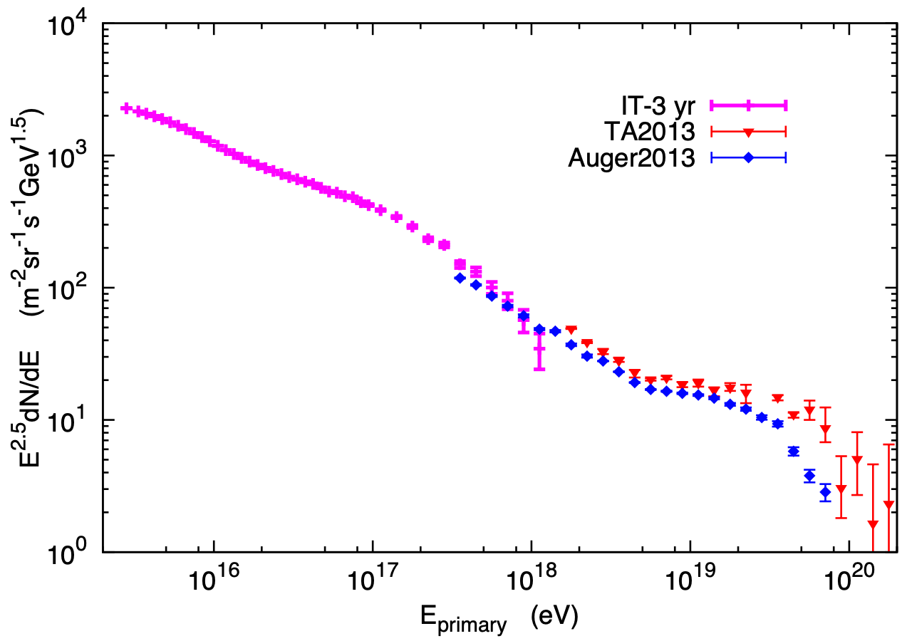
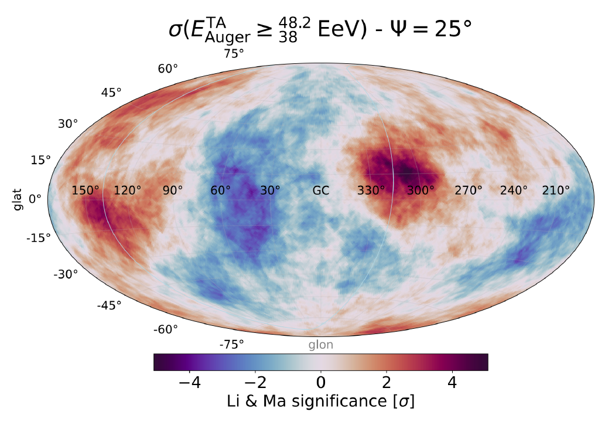
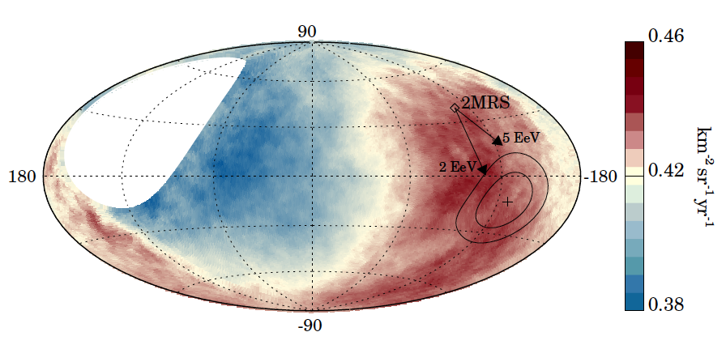
The Halo Imprint on the Extragalactic CRs
Gupta ApJ, 756 (2012)
Anisotropy
Auger Coll., Science Vol 357, Iss. 6357 1266-1270 (2017)
Caccianiga et al., Auger & TA Coll. PoS (ICRC2023) 521
Andrew Taylor

Slide 15
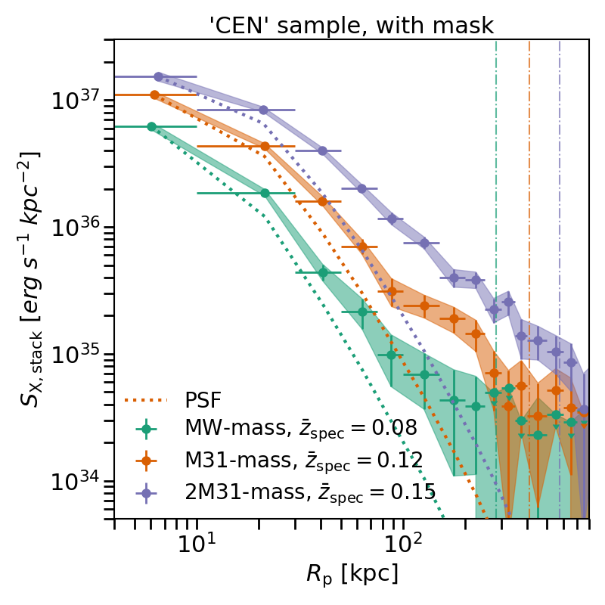
Large Thermal Pressure in Galactic Haloes
Large Hot Halo
Faerman ApJ, 893 (2020)
consistent with stacked measurement results:
Heesen A&A, 670 (2023)
Gupta ApJ, 756 (2012)
X-ray emission
Bregman et al. ApJ 928 (2022)
Zhang et al. for the eRosita collaboration- A&A (2024)

Slide 16
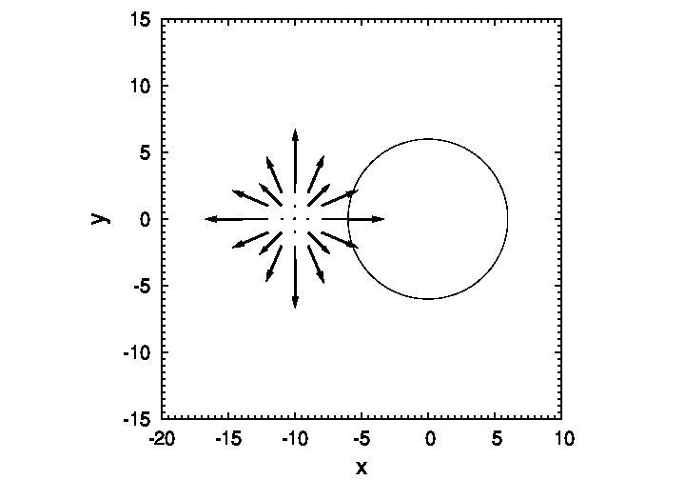
What “Arrives” is Not Necessarily What is Observed
Cosmic ray source
Reduced diffusion coefficient inside bubble region
Arrows depict the CR current in different cell regions
(D_{out}/D_{in} = 5 adopted for animation)

Slide 17
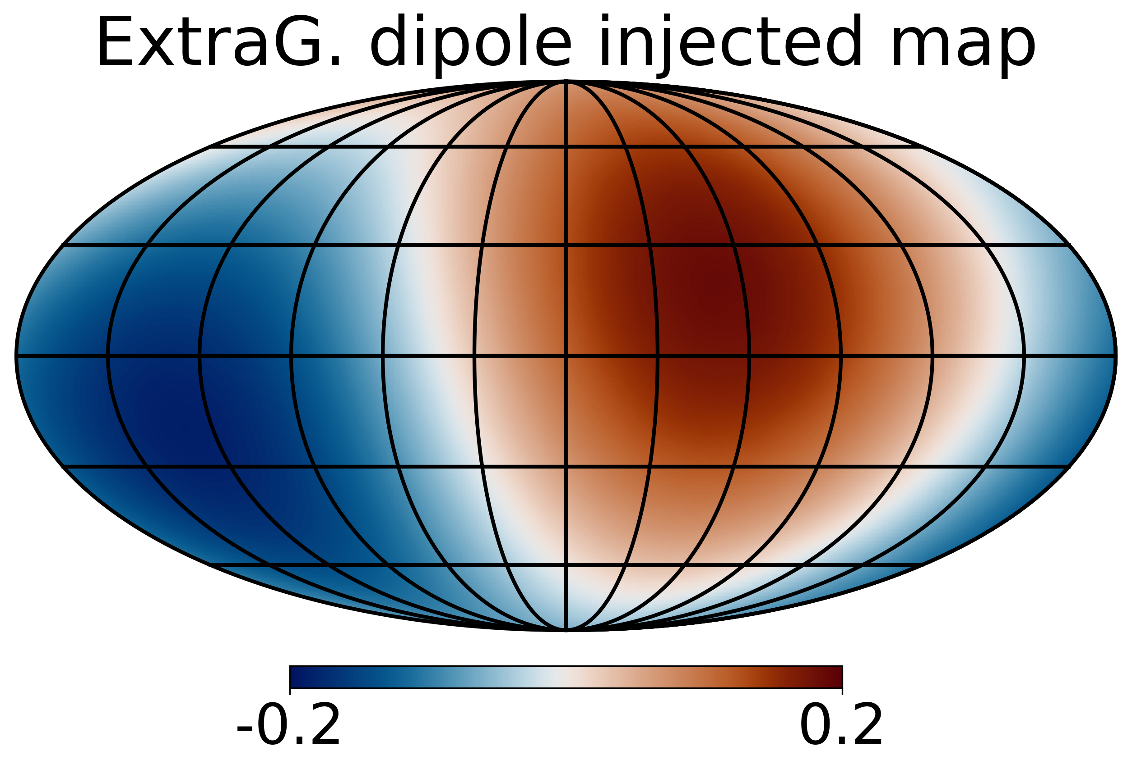
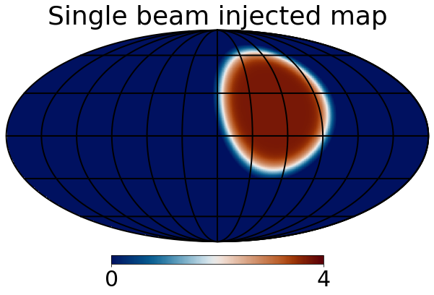
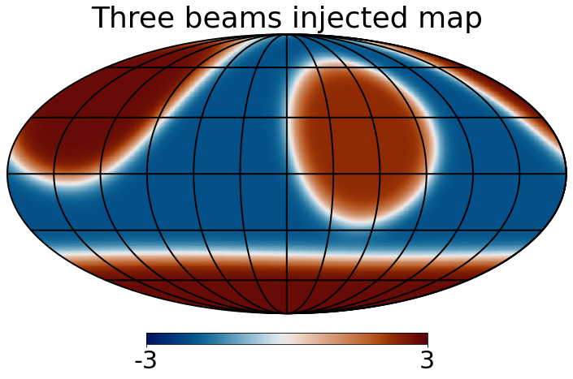
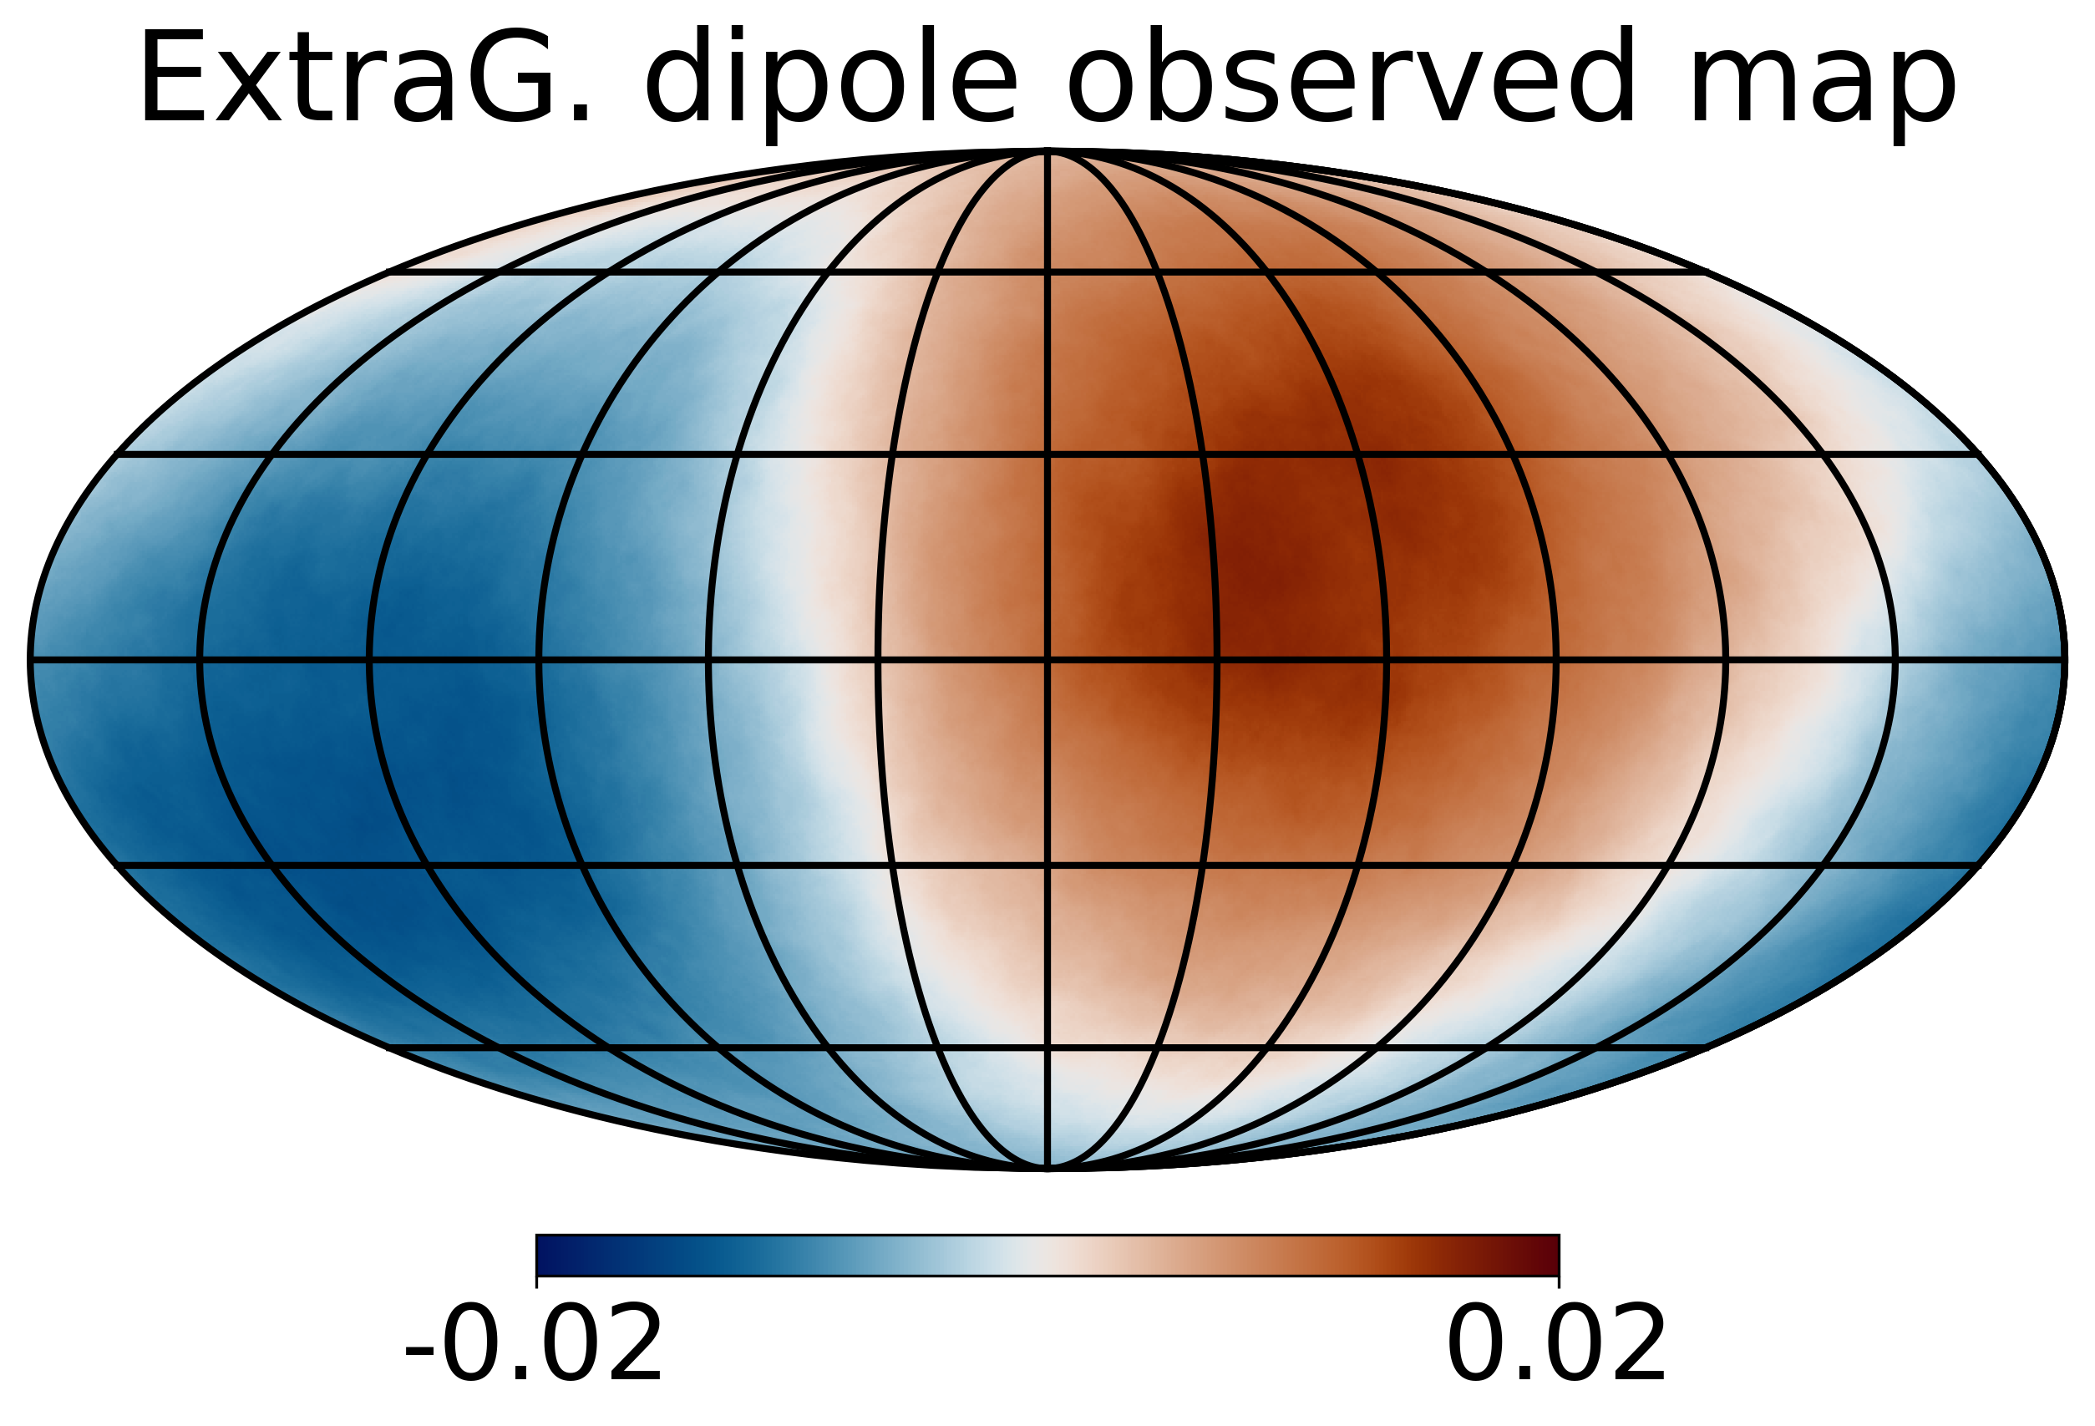
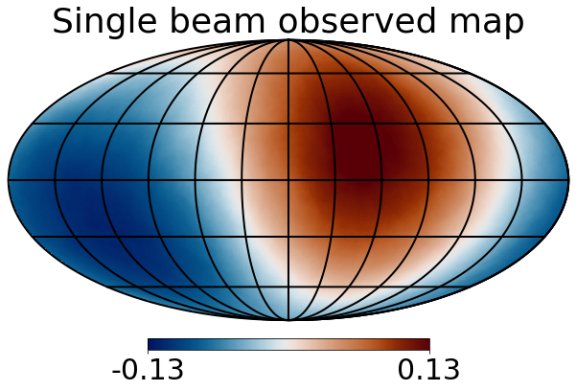
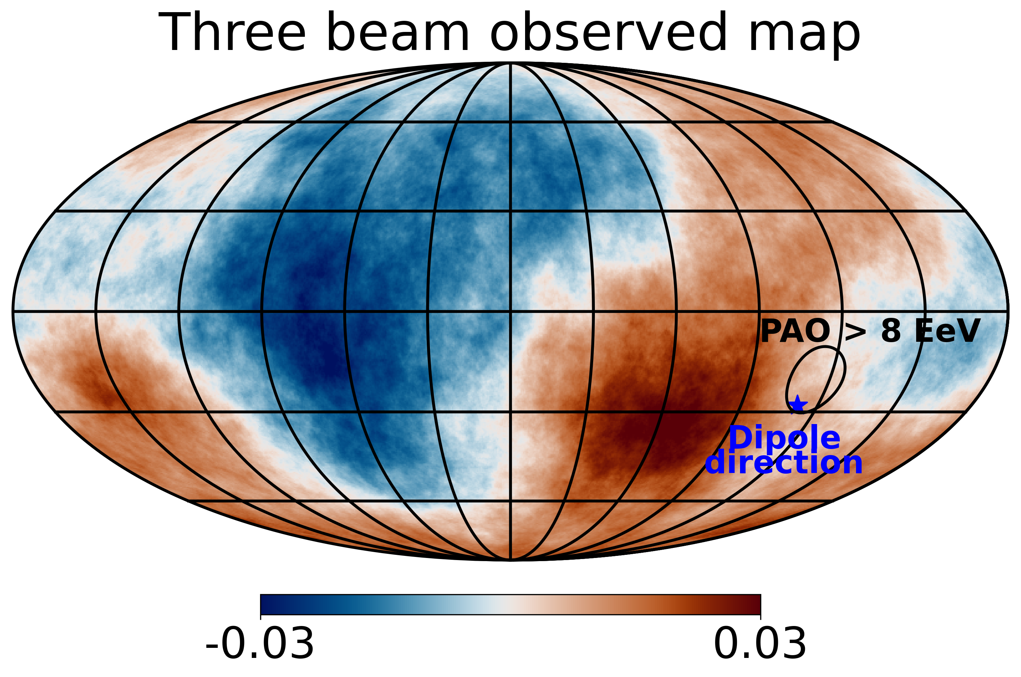
Injected and Observed Maps
Injected:
Observed:
Shaw et al., MNRAS, Vol. 543, Iss. 4 (2025)

Slide 18
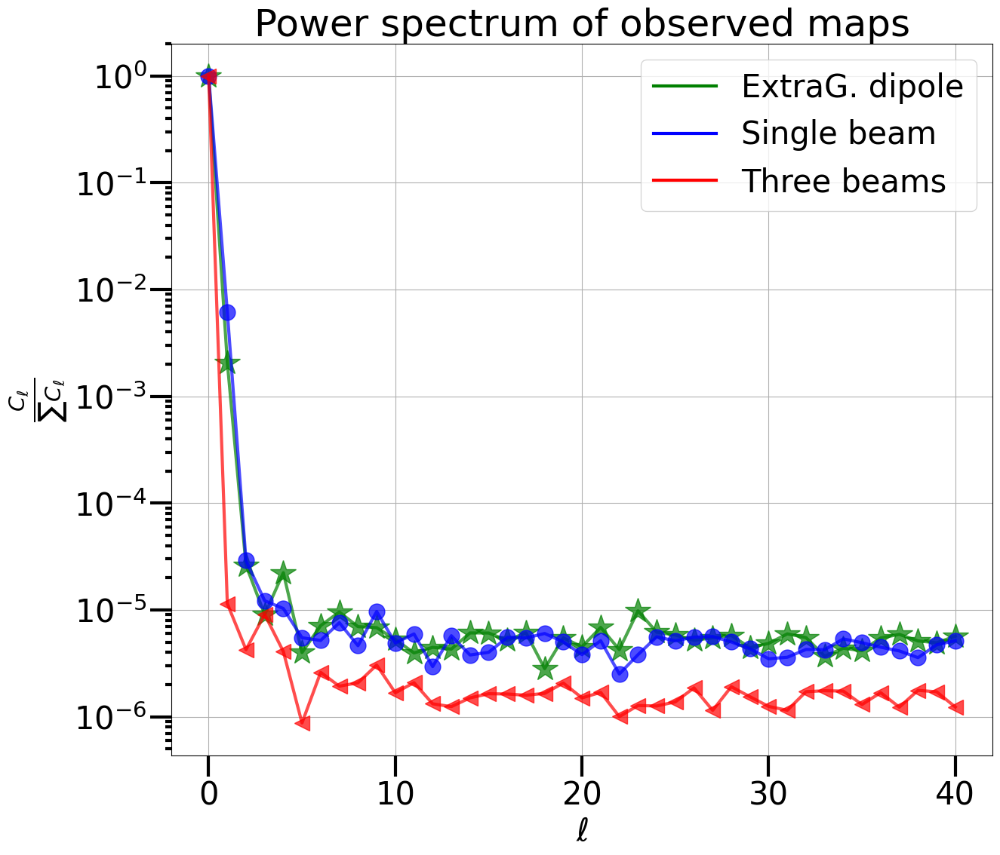
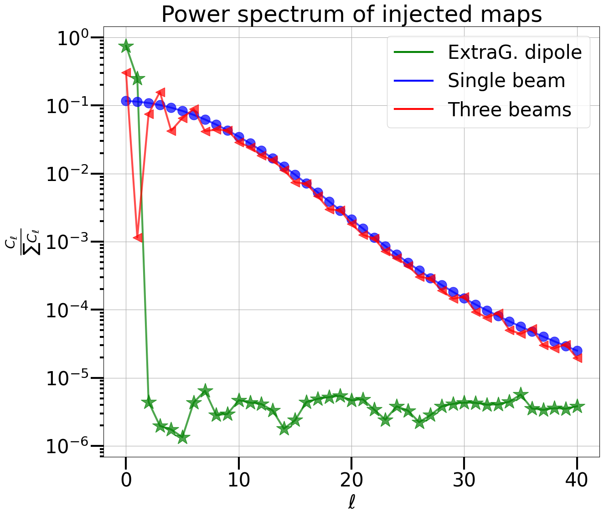
Power Spectra of Observed Maps
Shaw et al. (in prep.)
Shaw et al., MNRAS, Vol. 543, Iss. 4 (2025)

Slide 19
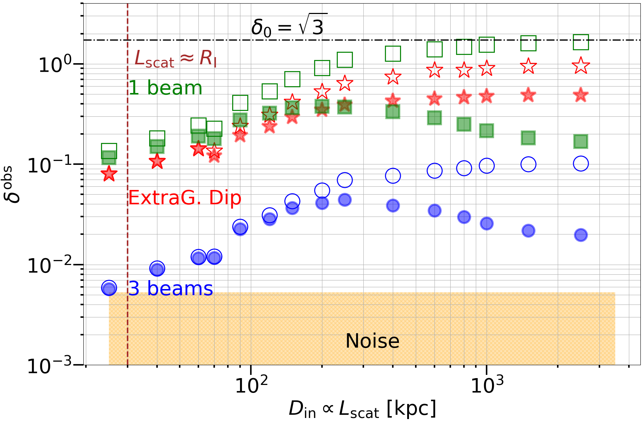
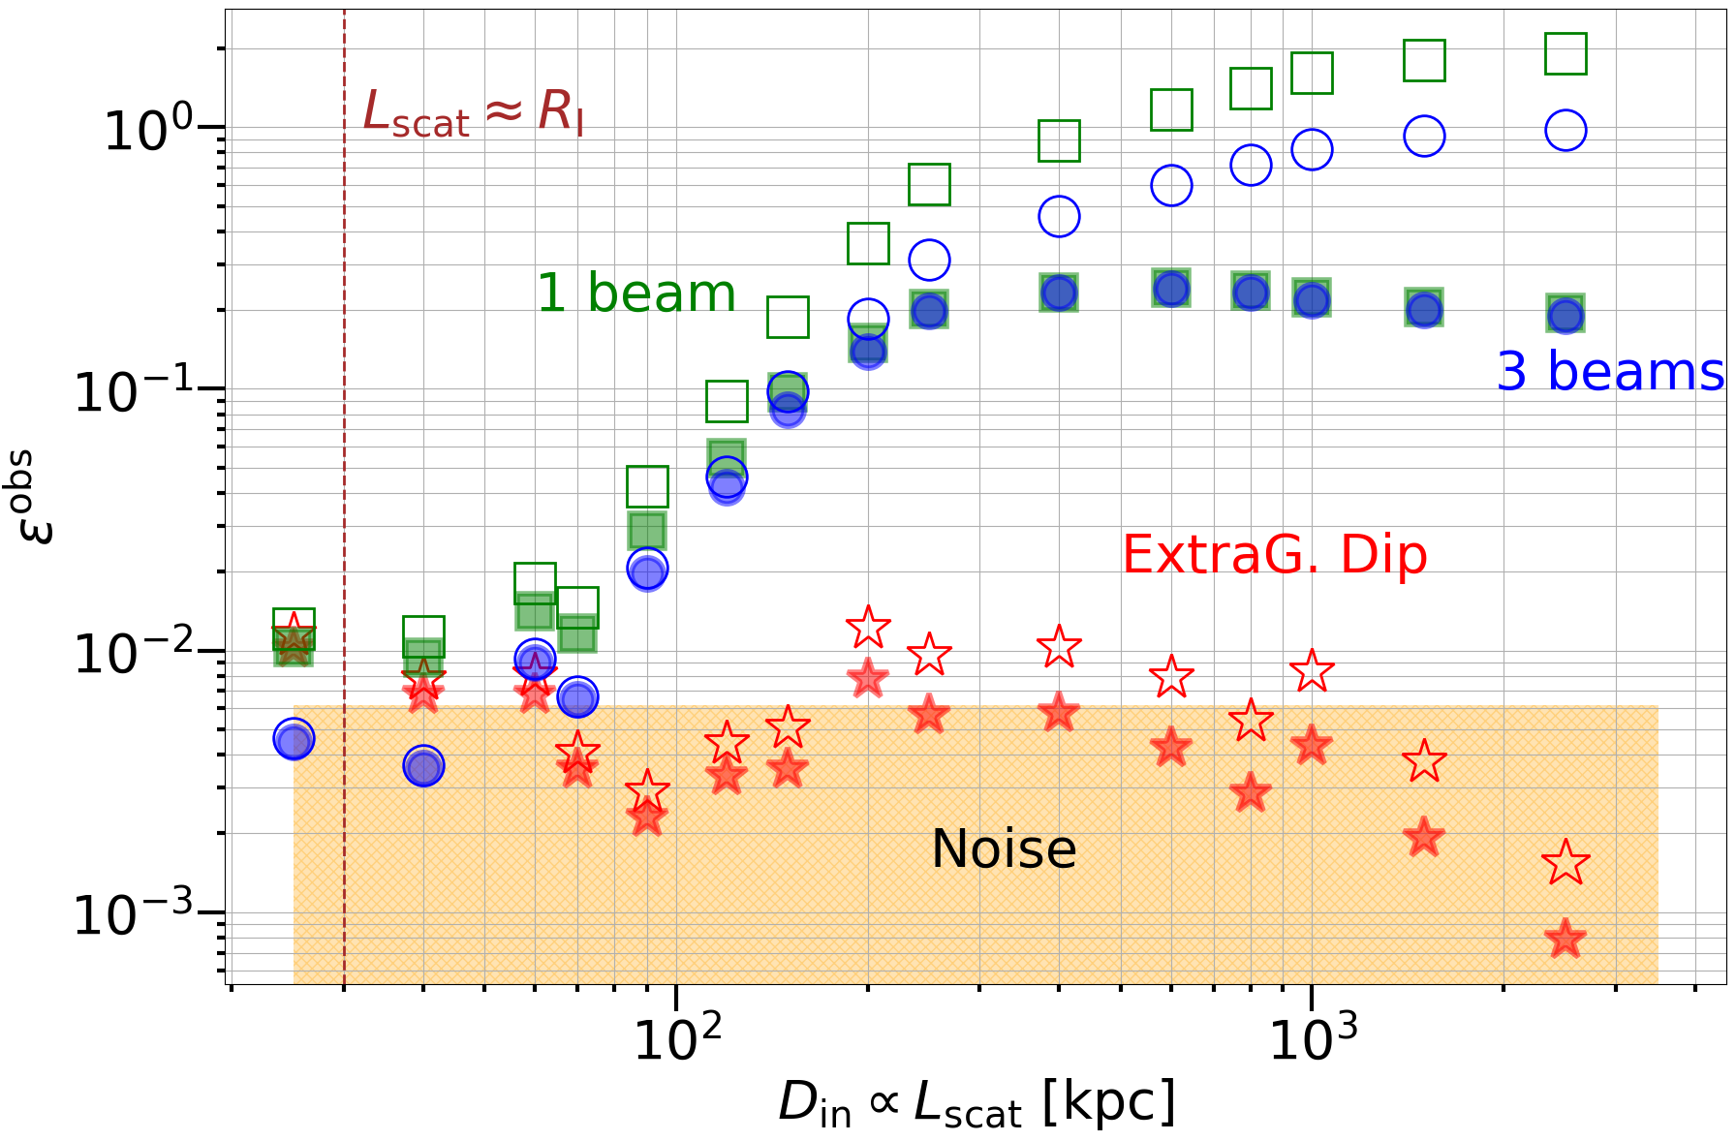
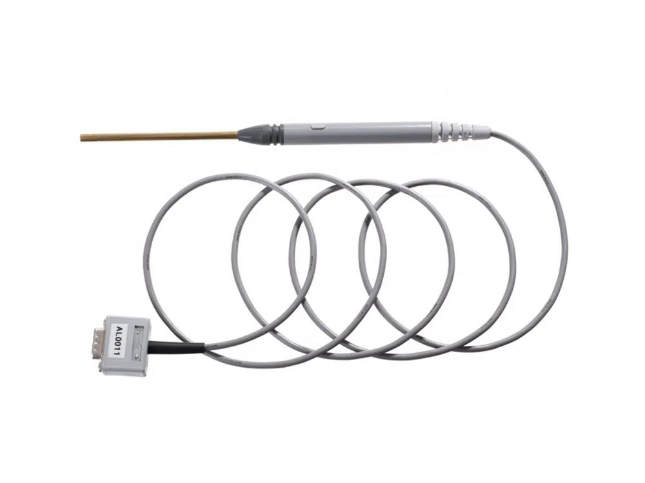
The Importance of Measuring the Quadrupole Moment at EeV Energies
Shaw et al., MNRAS, Vol. 543, Iss. 4 (2025)
Dipole Evolution
Quadrupole Evolution
Hall Probe
Anisotropy measurements can operate as a Hall probe for measuring the magnetic field characteristics of the halo region

Slide 20
Conclusions
A Galactic ”Population B” source class seems required, either to bridge knee-ankle gap or (pre)knee-knee gap, and CR composition data allow its E_{max} to be constrained
The transition to “Population C” (Extragalactic) occurs between 10¹⁷ eV and 10^{18.5} eV, with current data preferring a lower energy transition in this energy range
New gamma-ray observations are shedding fresh light on “Population B” source candidates
The “Population C” sources should not have a strong positive source evolution (local?)
Secondary signatures from CR energy losses in the Galactic halo can be used to probe particle propagation in the halo
The magnetisation of the Galactic halo can have implications for the penetration of ”Population C” CRs into the halo, which can be tested

Slide 21

What “Arrives” in Not Necessarily What is Observed
Cosmic ray source
Reduced diffusion coefficient inside bubble region
(D_{out}/D_{in} = 5 adopted for animation)

Slide 22
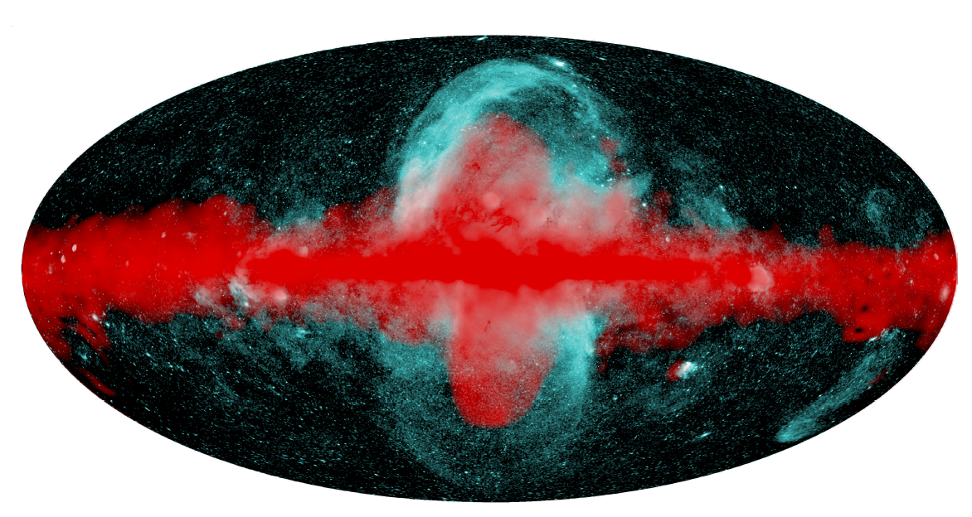
The Fermi/eROSITA Bubbles
2 Galactic gamma-ray emitting bubbles exist out to ~8 kpc above and below the Galactic plane
These appear to be enshrouded in larger hot X-ray emitting bubbles, out to ~14 kpc
Predehl et al. Nature 588 (2020)
These results appear to indicate that non-thermal particle transport in the Milky Way halo, at least from the Galactic center region, possesses an advective component
Andrew Taylor

Slide 23

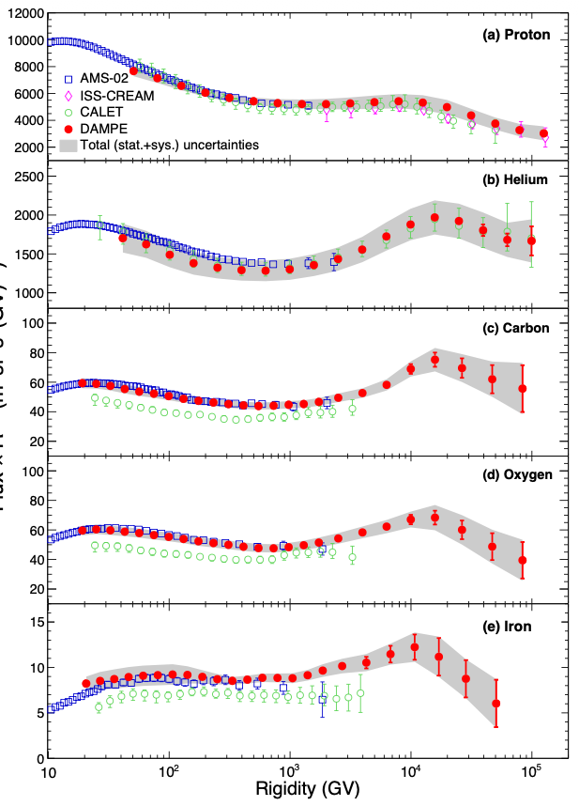
Gaisser-Type Population B Candidates:
Microquasars
DAMPE Coll. 2511.05409
Kaci et al., 2510.01369

Slide 24
Neutrinos as a Probe of Origin of Protons Below the Ankle
Ahlers et al. Phys.Rev.D 72 023001 (2005)
Ahlers et al. Phys.Rev.D 79 083009 (2009)

Slide 25
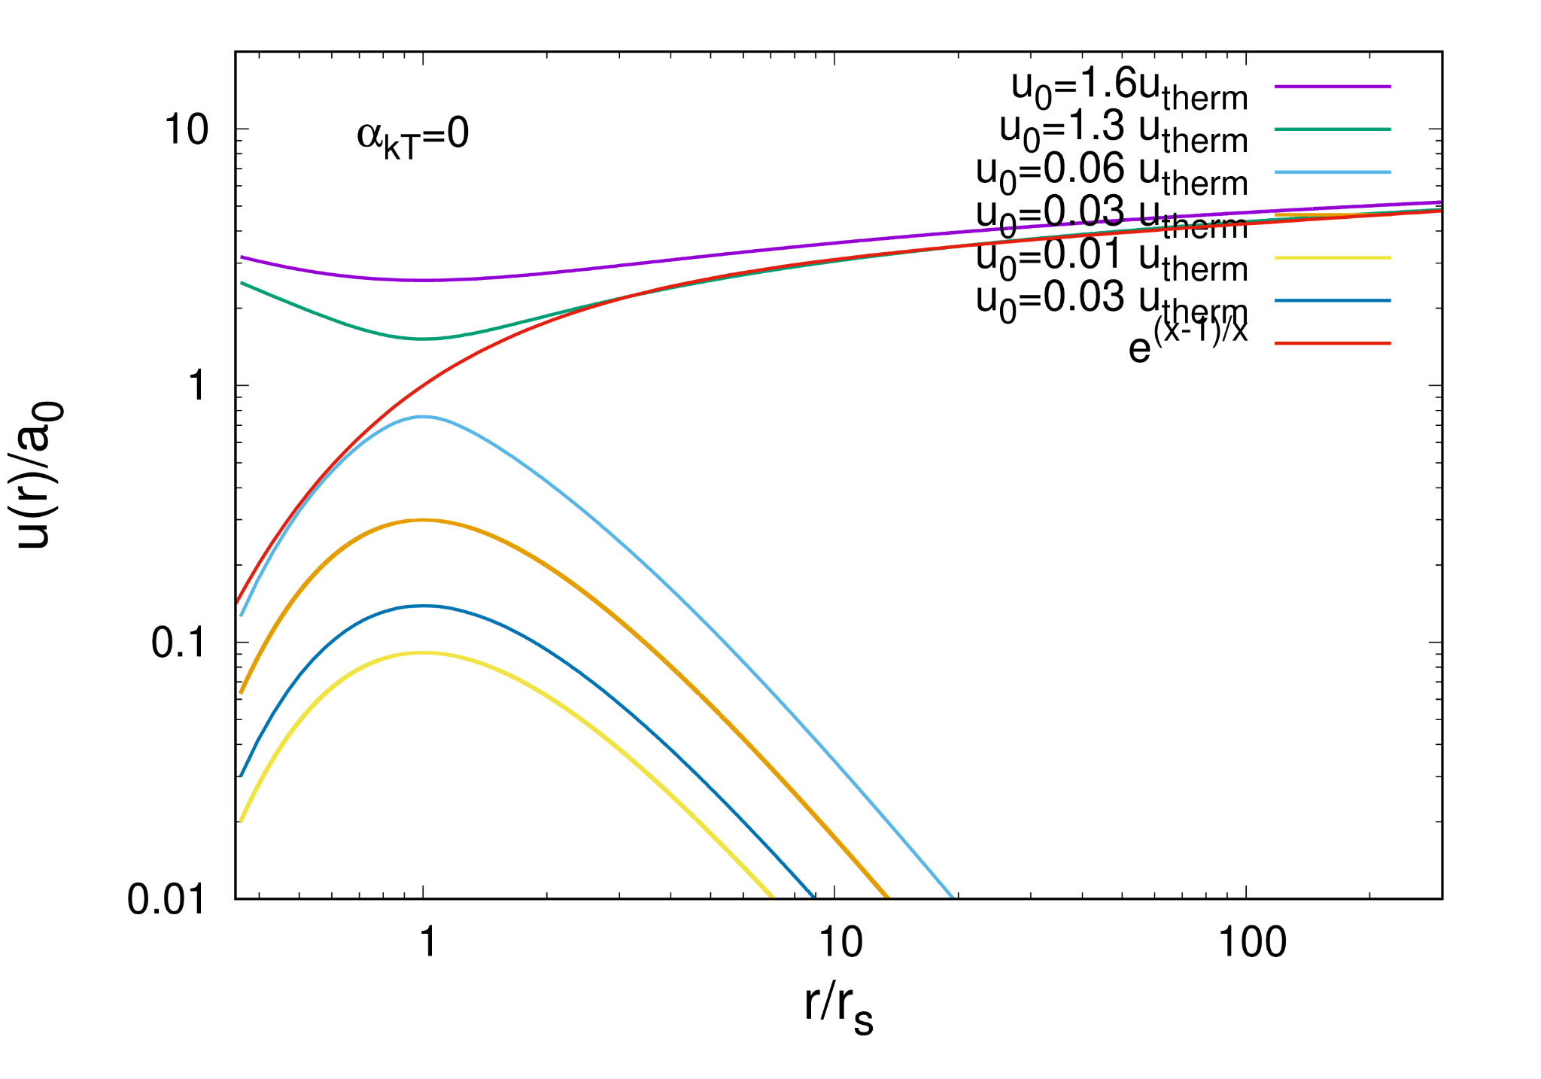
Thermally Driven Outflows: 1/r (Point Source) Potential
Density
Mass Continuity
Momentum Continuity
Velocity
For a spherically symmetric (isothermal) thermally driven outflow

Slide 26
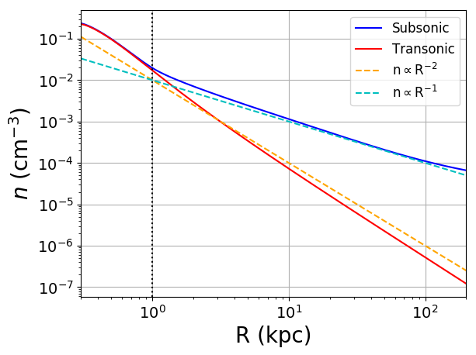
Why Consider Slow Outflows?
Although King function was adopted in eROSITA analysis, result is also consistent with hydrostatic equilibrium expectations for hot gas
These profiles are consistent with expectations of the halo gas being in hydrostatic equilibrium
Prochaska et al. MNRAS 485 (2019)
Hydrostatic equilibrium scenario,
Supersonic wind scenario,

Slide 27
Power Spectra of Injected Maps
Shaw et al., MNRAS, Vol. 543, Iss. 4 (2025)

Slide 28
Are there Secondary Signatures of Galactic CR in the Galactic Halo Environment?

Slide 29
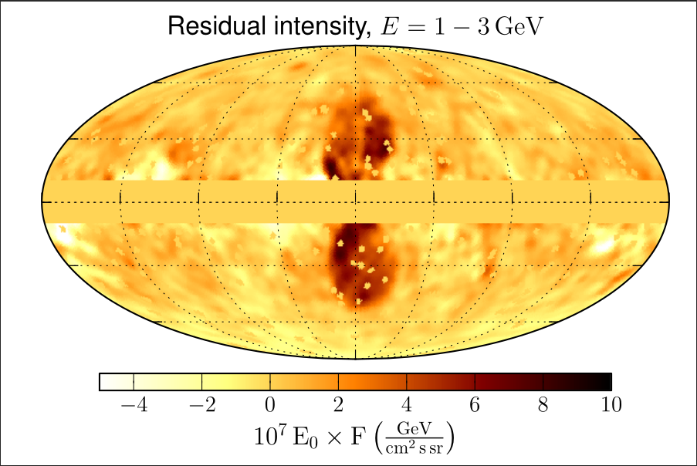
The Fermi/eROSITA Bubbles
2 Galactic gamma-ray emitting bubbles exist out to ~8 kpc above and below the Galactic plane
These appear to be enshrouded in larger hot X-ray emitting bubbles, out to ~14 kpc
Ackermann et al. ApJ 793 (2014)
These results appear to indicate that non-thermal particle transport in the Milky Way halo, at least from the Galactic center region, possesses an advective component
Andrew Taylor

Slide 30
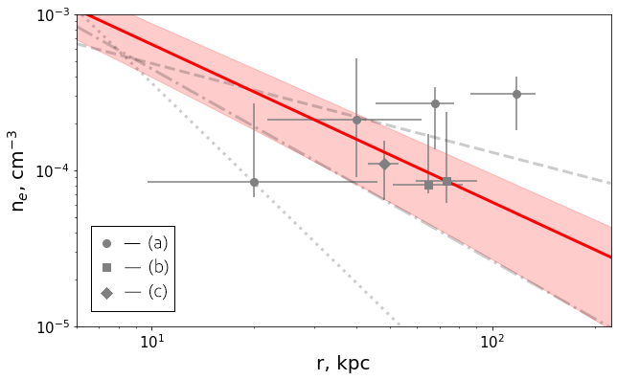
Large Thermal Pressure in Galactic Haloes
X-ray observations of bright AGN indicate the
presence of a hot local absorber.
More recently, the ram pressure stripping of satellite
galaxies + emission from the hot absorber have been
collectively used to probe the halo gas density.
Large Hot Halo
Ram pressure stripping
Zhang et al., 2511.17313
Gupta ApJ, 756 (2012)
X-ray emission
Faerman ApJ 835 (2017), Martynenko MNRAS, 511 (2022)
King function
Bregman et al. ApJ 928 (2022)
Zhang et al. for the eRosita collaboration- A&A (2024)

Slide 31
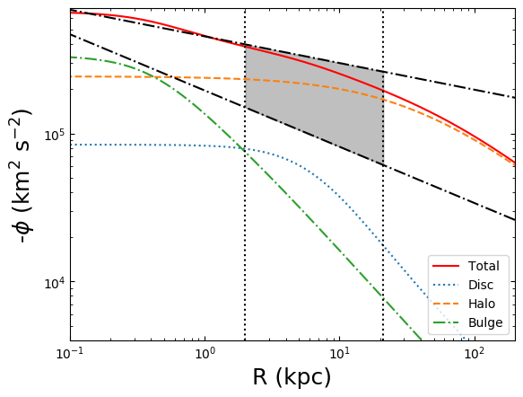
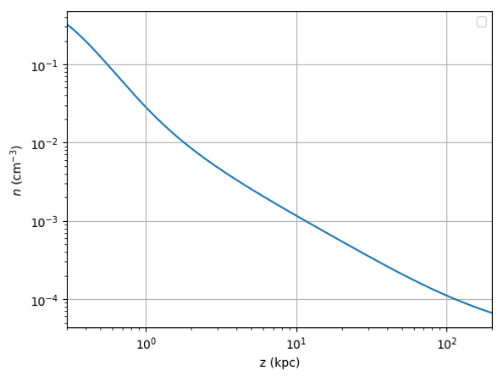
Inputs for Hydrodynamical Simulations
The Galactic potential
Tourmente et al. MNRAS, Vol 518, Iss. 4, (2023)
Gas Density Distribution
Thermal gas temperature
For hydrodynamical simulations, gas density was started off with a hydrostatic equilibrium distribution
Assumed a heating process exists throughout the simulation volume that keeps the gas hot (with an isothermal temperature)
Isothermal temperature distribution adopted
Andrew Taylor

Slide 32
Inputs for Hydrodynamical Simulations
The Galactic potential
Gas Density Distribution
Prochaska et al. MNRAS 485 (2019)
Thermal gas temperature
For hydrodynamical simulations, gas density was started off with a hydrostatic equilibrium distribution
Assumed a heating process exists throughout the simulation volume that keeps the gas hot (with an isothermal temperature)
Isothermal temperature distribution adopted
Andrew Taylor

Slide 33
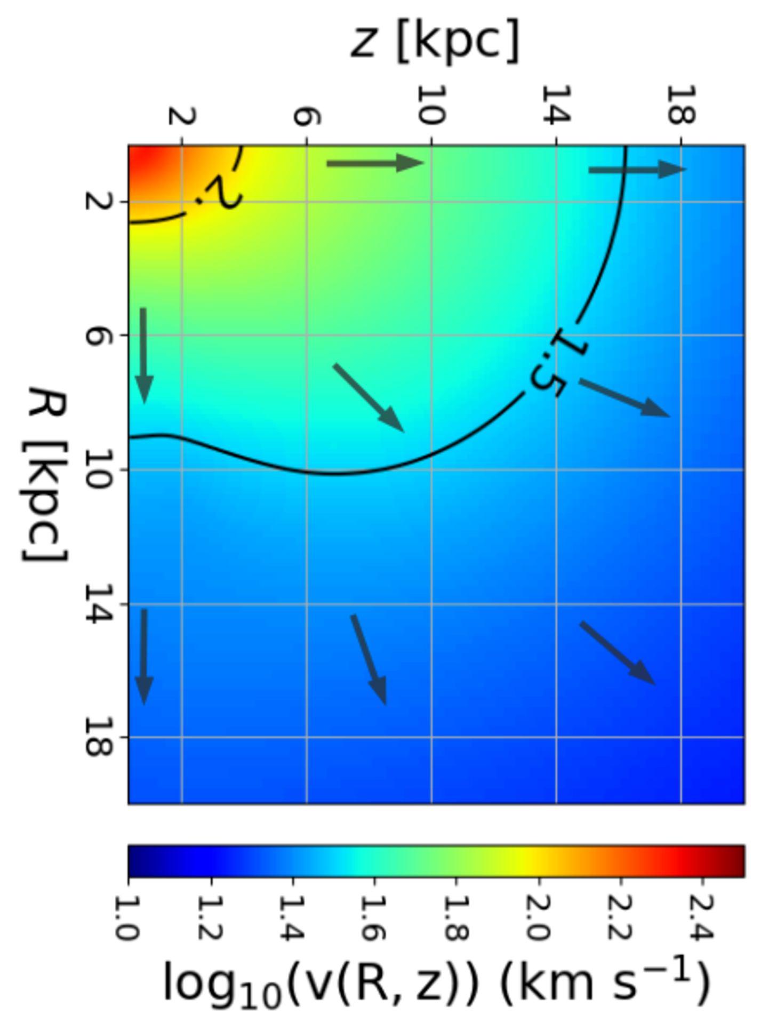
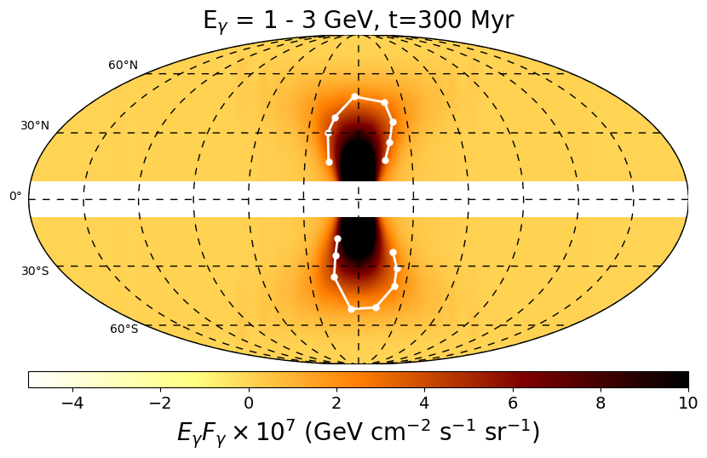
Subsonic Outflow Result for Isothermal Gas Using PLUTO
Resultant 2D velocity field simulation
Tourmente et al. MNRAS, Vol 518, Iss. 4, (2023)
Tourmente et al., 2507.20893
Galactic center source
velocity profile
halo gas
Gas Density Distribution
Gamma-Ray Skymap
Simulation results assuming constant source injection term present at the Galactic center
Andrew Taylor

Slide 34
Secondary to Primary Cosmic Rays as a Probe of Galactic Halo Size (B/C)- LIMITATIONS
(thanks for C. Li for preparing these plots!)
Thanks to C. Li for these plots
Hopkins et al, MNRAS 516 (2022) 3, 3470-3514
….the “halo size” does not really represent the scale-length of e.g. the magnetic energy or free-electron density profile; rather, the “halo size” in these models is more accurately defined as the volume interior to which CRs have an order-unity probability of scattering “back to” the Solar position.
Shizuo Kakutani
“A drunk man will eventually find his way home, but a drunk bird may get lost forever.”
Andrew Taylor

Slide 35
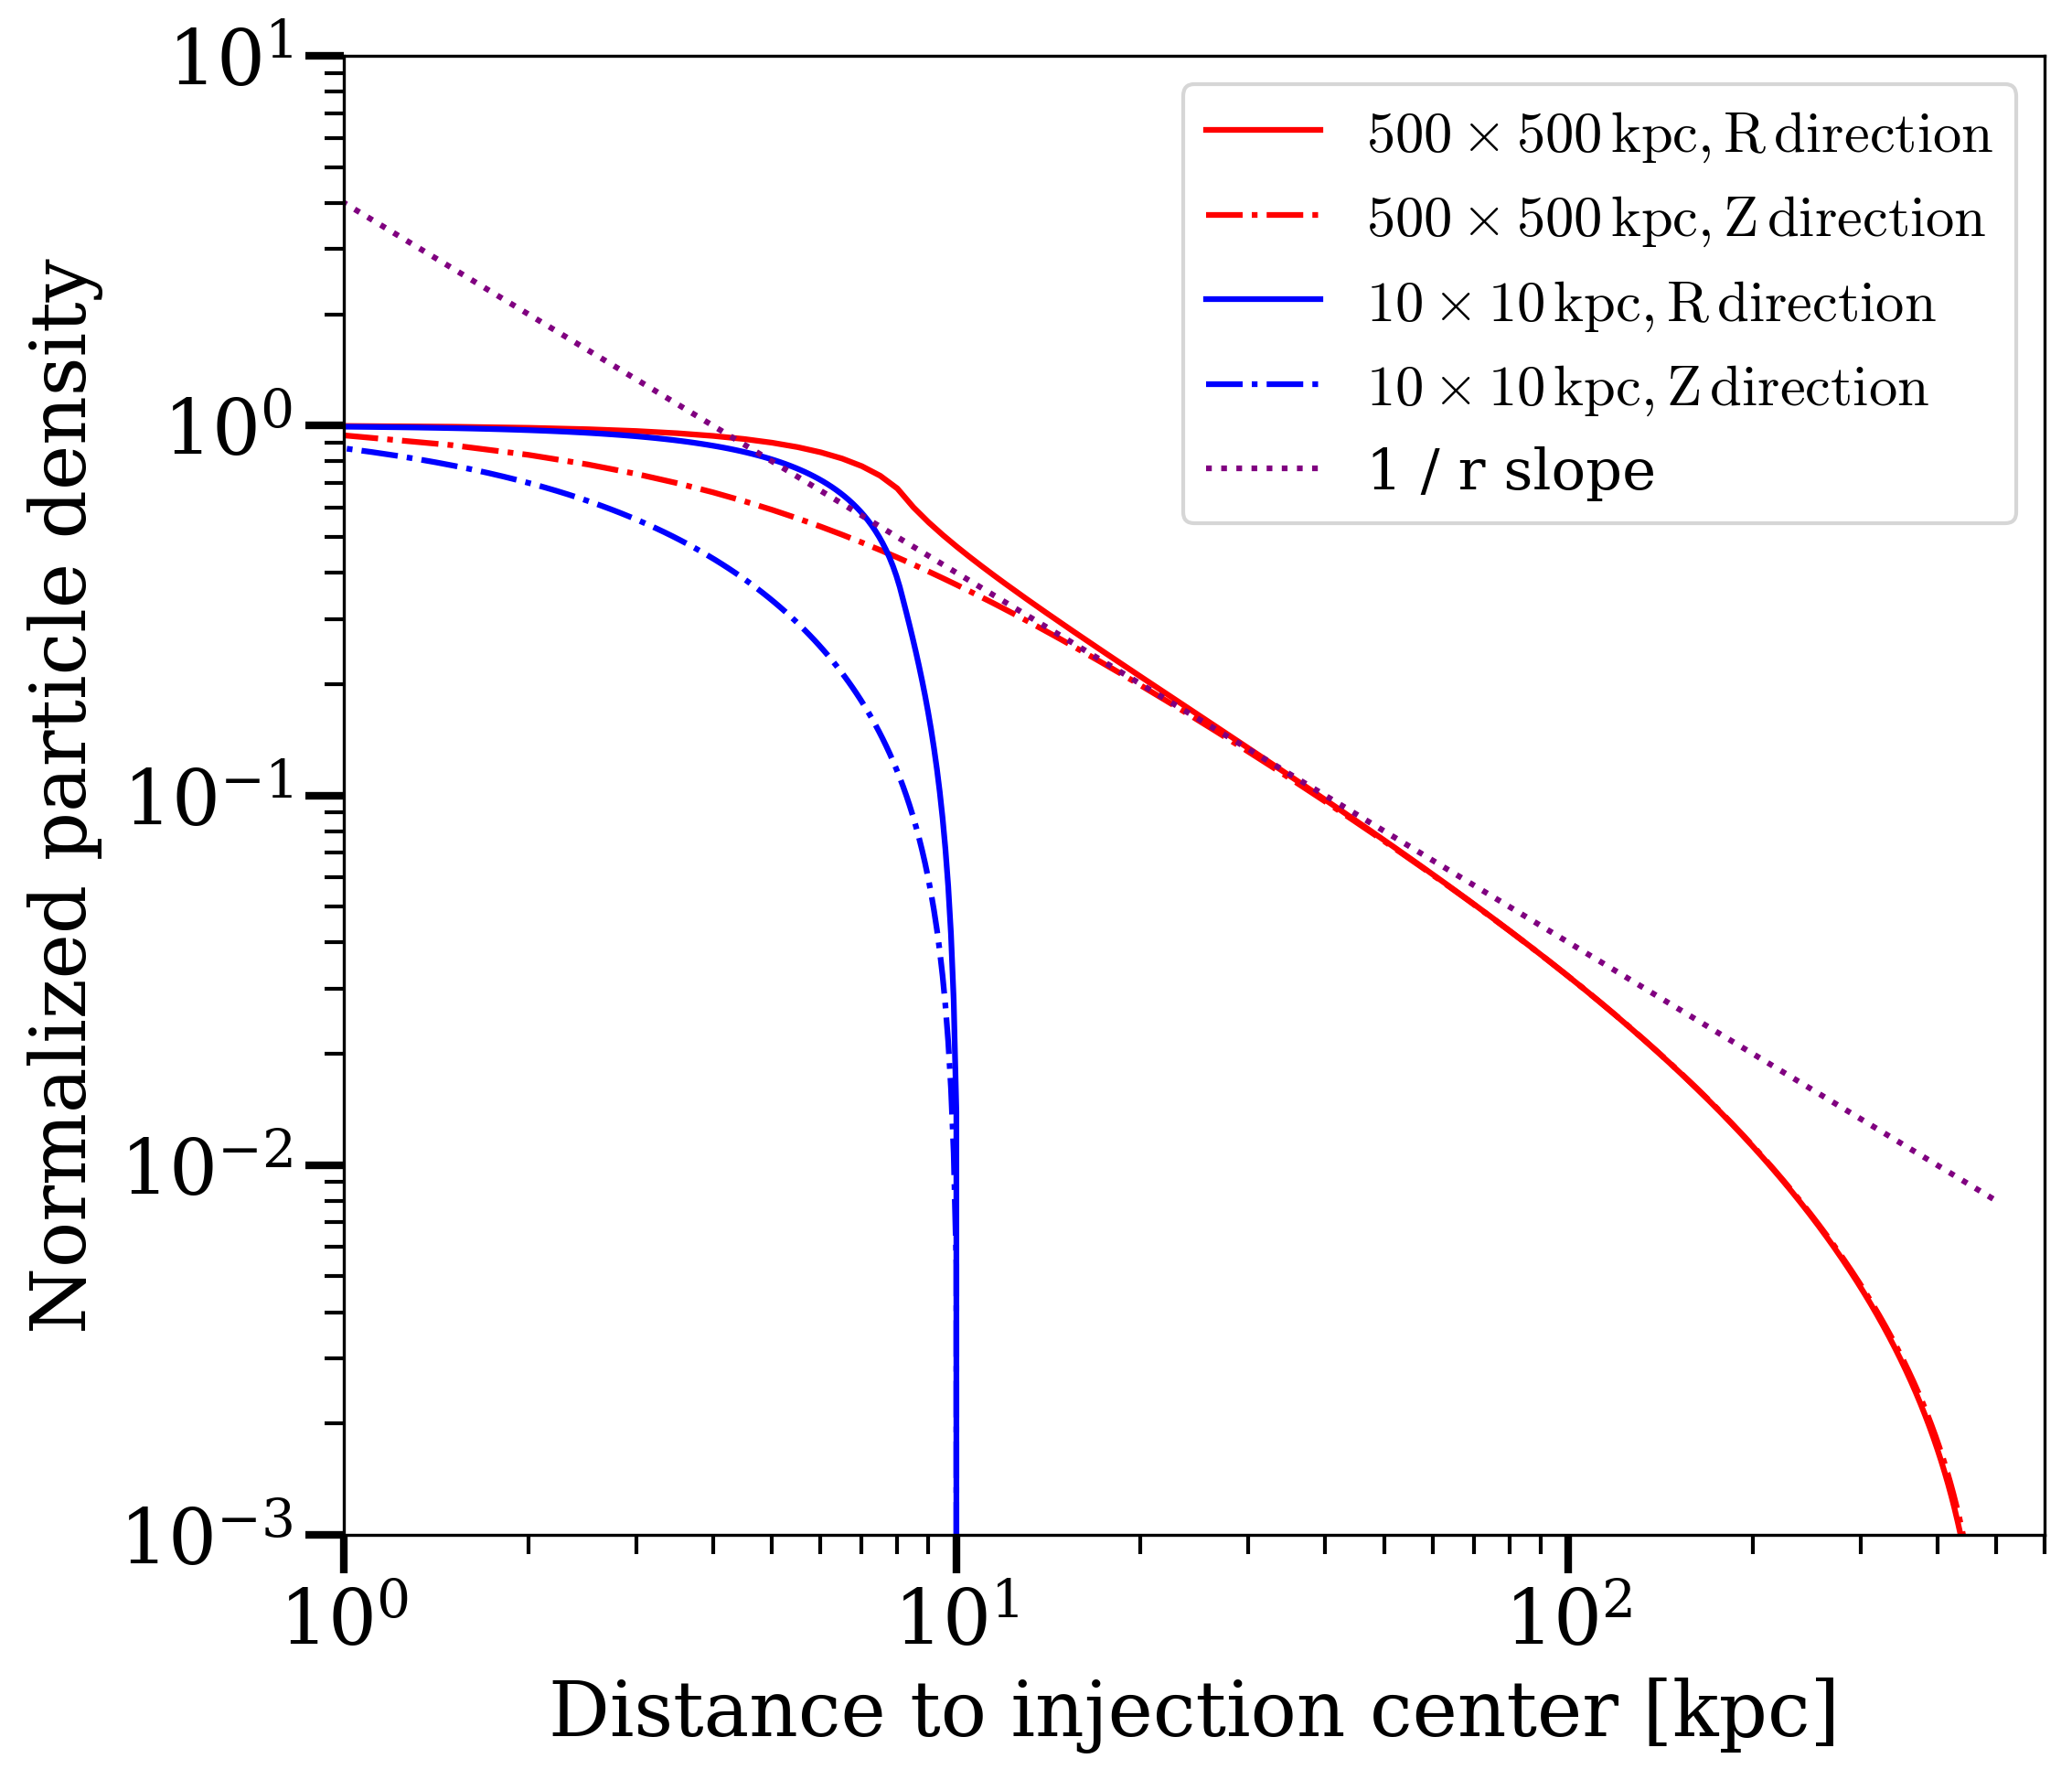
Secondary to Primary Cosmic Rays as a Probe of Galactic Halo Size (B/C)- LIMITATIONS
(thanks for C. Li for preparing these plots!)
Thanks to C. Li for these plots
Hopkins et al, MNRAS 516 (2022) 3, 3470-3514
Andrew Taylor

Slide 36
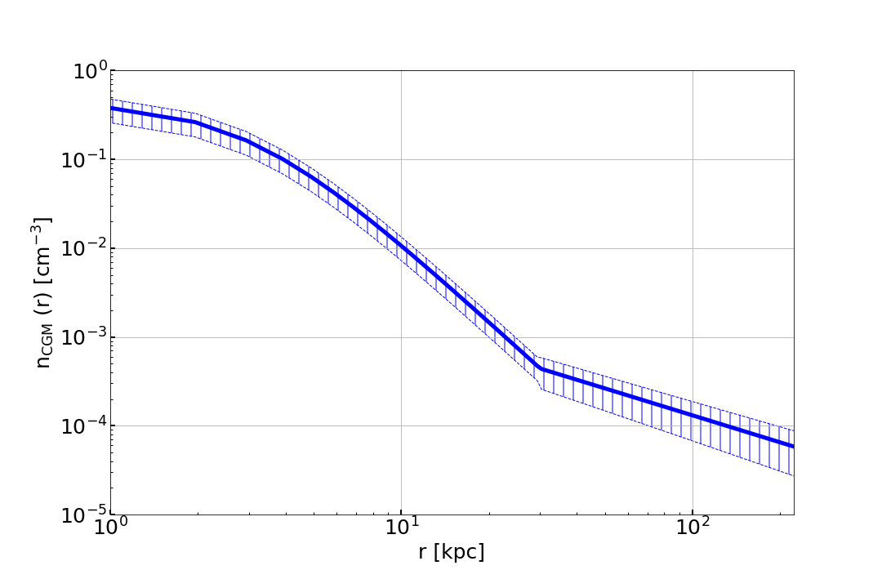
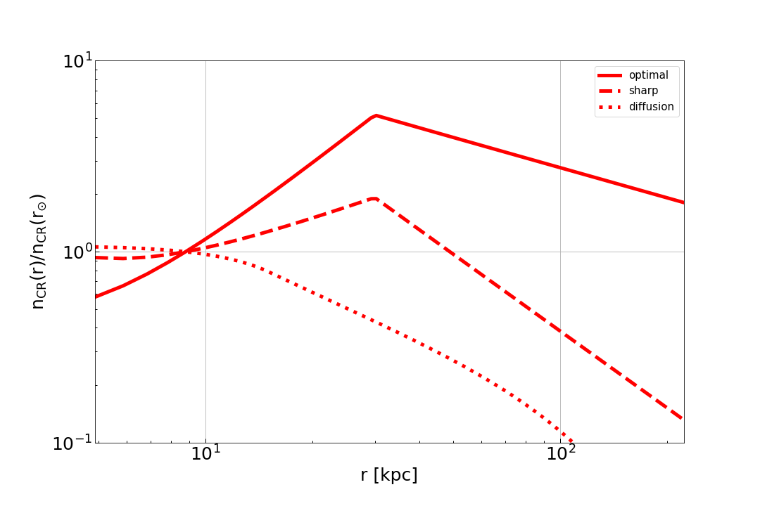
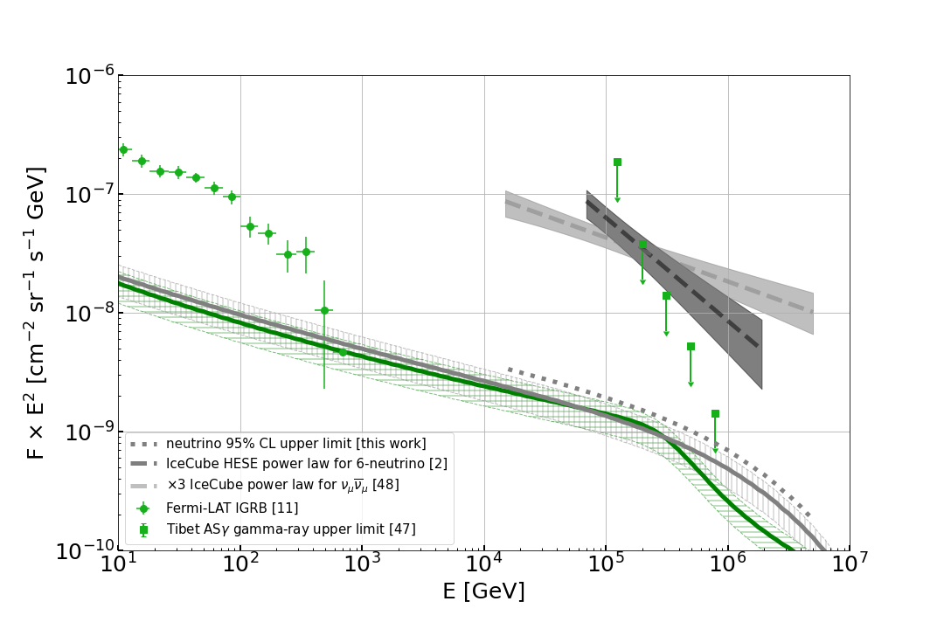
Neutrino Emission from the Galactic Halo?
Gas Density Distribution
CR Distribution
Kalashev et al., JCAP 03 (2023) 053
Halo Neutrino Flux (Diffusive Case)
Understanding the CR transport process in the halo is key for these results
In this case, the circumgalactic neutrino flux contribution is comparable with the Galactic-disk contribution.
Andrew Taylor

Slide 37
Probes of CR Escaping Nearby Galactic Haloes
Evidence for Diffuse Gamma-Rays Emission from M31’s Galactic Halo
Suggests that emission extends out to tens of degrees (100s kpc)
Evidence that the escape of CRs from the Galaxy is not dictated solely by diffusive transport
Karwin et al., ApJ 880:95 48pp (2019)
Moskalenko paper
Andrew Taylor

Slide 38
Probes of CR Escaping Nearby Galactic Haloes
Evidence for Diffuse Gamma-Rays Emission from M31’s Galactic Halo
Suggests that emission extends out to tens of degrees (100s kpc)
Evidence that the escape of CRs from the Galaxy is not dictated solely by diffusive transport
Karwin et al., ApJ 880:95 48pp (2019)
Moskalenko paper
Andrew Taylor

Slide 39
How Might the Galactic Halo Effect The Arrival of “Population C” CR?
“Population C” CR source

Slide 40
The Importance of Measuring the Quadrupole Moment at EeV Energies
Transition ”energy” for which halo becomes thin
Shaw et al., MNRAS, Vol. 543, Iss. 4 (2025)
Note the difference in growth rates of dipole and quadrupole amplitude with L_{scat}

Slide 41
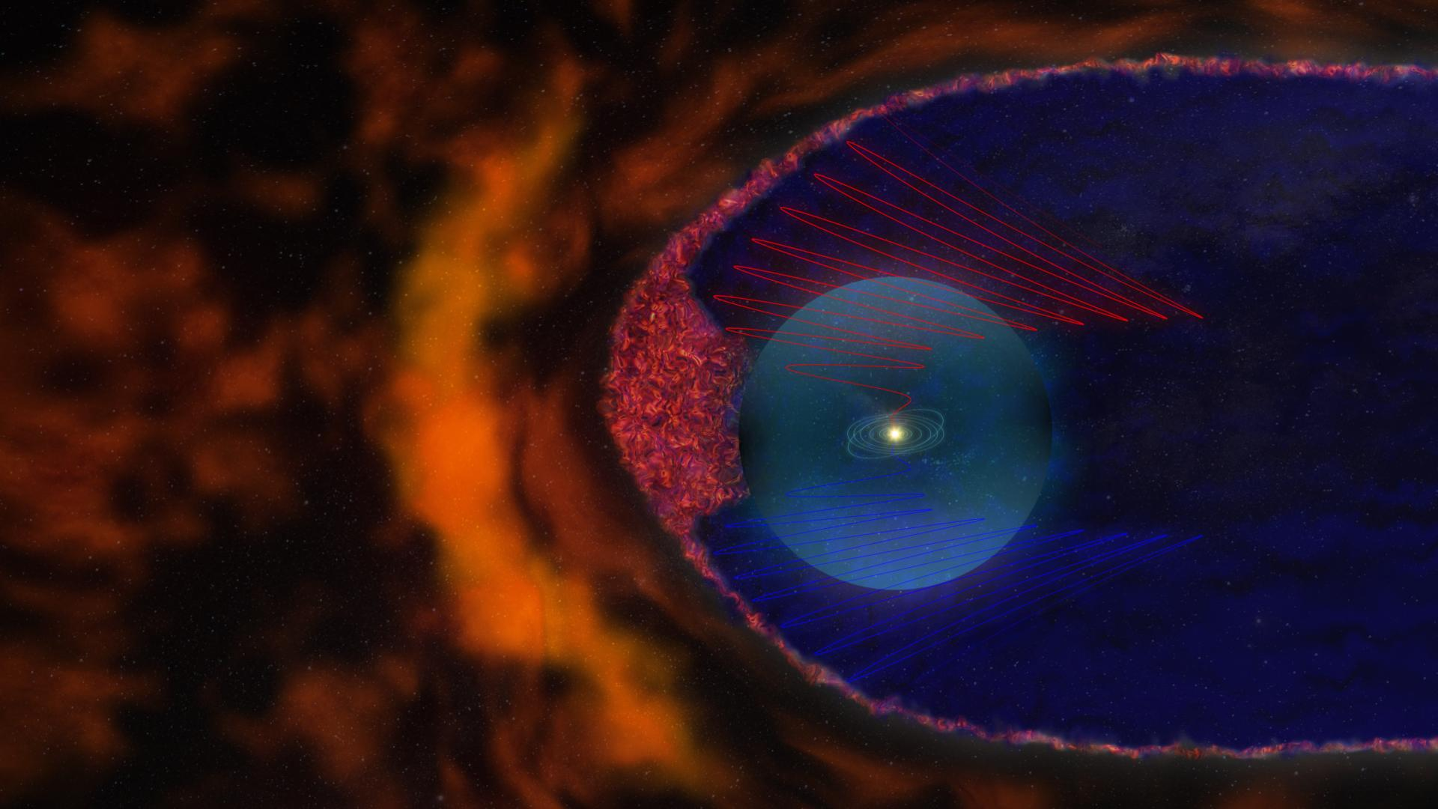
Galactic/Extragalactic Cosmic Ray Transition
An Analogy Between
Gaisser, HAP Workshop, KIT (2015)
Heliosphere
Galactic Halo
Extragalactic
Galaxy
Galactic Halo
Heliosphere

Slide 42
Origins of the CR Spectrum?
CR p
Extragalactic p (~3x10⁻⁷ cm⁻³)
K. Brecher, G. R. Burbidge, ApJ 174 (1972) 253
V. L. Ginzburg, Astro. and Space Phys., Vol. 4, p.167 (1972)
A.W. Strong, Nucl.Part.Phys.Proc. 297-299 (2018) 165-170
Back in the 1970s, there was a debate about whether all CRs could be extragalactic. Subsequent diffuse gamma-ray observations, however, constrained such a scenario.
π
Gaisser, Front.Phys.(Beijing) 8 (2013) 748-758

Slide 43
Can Constraints be Placed on Population C?

Slide 44
Universality of Cascade Spectra
e⁻
Aharonian et al., Astrophys.J.Lett. 423 (1994) L5-L8
Berezinsky Phys.Rev.D 94 (2016) 2, 023007
e⁻
e⁻
e⁻
e⁺
e⁺
e⁺
e⁺
e⁻
e⁺
Regardless of where the energy is injected (ie independent of source z), the arriving flux possesses a universal shape
44

Slide 45
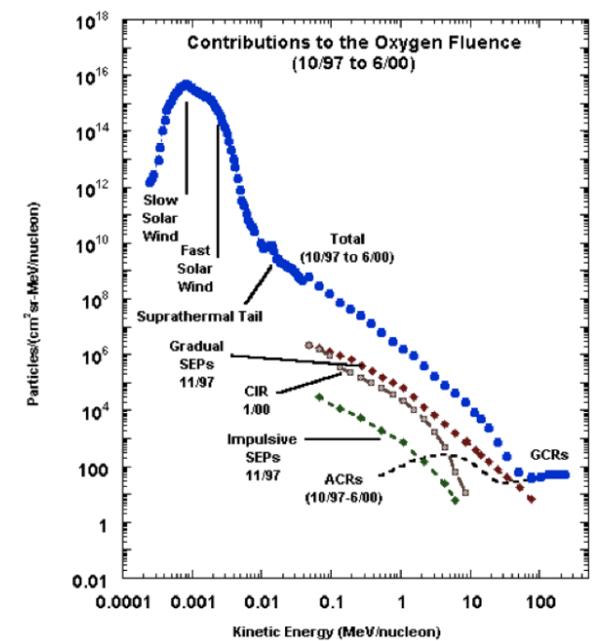
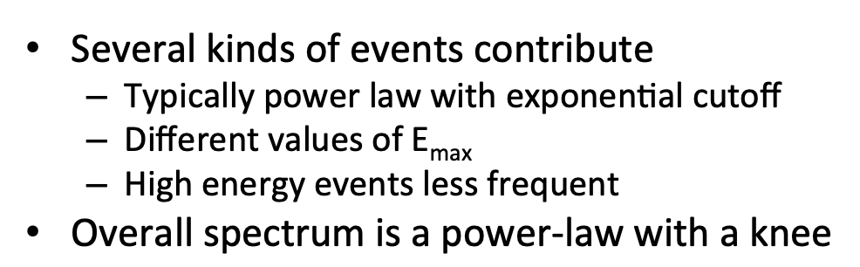
Galactic/Extragalactic Cosmic Rays
An Anology with the Transition from the Heliospheric to Galactic CR Spectrum
Gaisser, Front.Phys.(Beijing) 8 (2013) 748-758
Galactic /Extragalactic
Heliospheric/Galactic
Gaisser, HAP Workshop, KIT (2015)

Slide 46
Origins of the CR Spectrum?
CR p
Extragalactic p
K. Brecher, G. R. Burbidge, ApJ 174 (1972) 253
V. L. Ginzburg, Astro. and Space Phys., Vol. 4, p.167 (1972)
A.W. Strong, Nucl.Part.Phys.Proc. 297-299 (2018) 165-170
Back in the 1970s, there was a debate about whether all CRs could be extragalactic. Subsequent diffuse gamma-ray observations, however, constrained such a scenario.
π
Isotropic Gamma-Ray Background
1 GeV Flux Expected for Model:
1 GeV Diffuse Flux:
Ackermann et al., Astrophys.J. 799 (2015)

Slide 47
Features in the CR Spectrum
knee
second knee
ankle
Gaisser, Front.Phys.(Beijing) 8 (2013) 748-758

Slide 48
Population B…But Whose Population B?

Slide 49
Constraints on at What Energy the Onset of Population B can Occur
CR Composition Evolution
Only two clear light-heavy-light-heavy “cycles” in composition observed in data between the knee and the highest energies.
This places a strong constraint on the spacing of the energy onset in dominance of the new spectral components
(SIBYLL)
(SIBYLL)
(SIBYLL)
Gaisser, Front. Phys., 2013, 8(6): 748–758 (2013)
Kampert et al. Astropart. Phys. 35 10 660-678 (2012)

