Slide 1
Progress in LACT and Future Plans
Shoushan Zhang
on behalf of LACT working group
Institute of High Energy Physics
SNR Symposium, Yuxi, Yunnan, Feb 26 – Mar 2, 2026

Slide 2

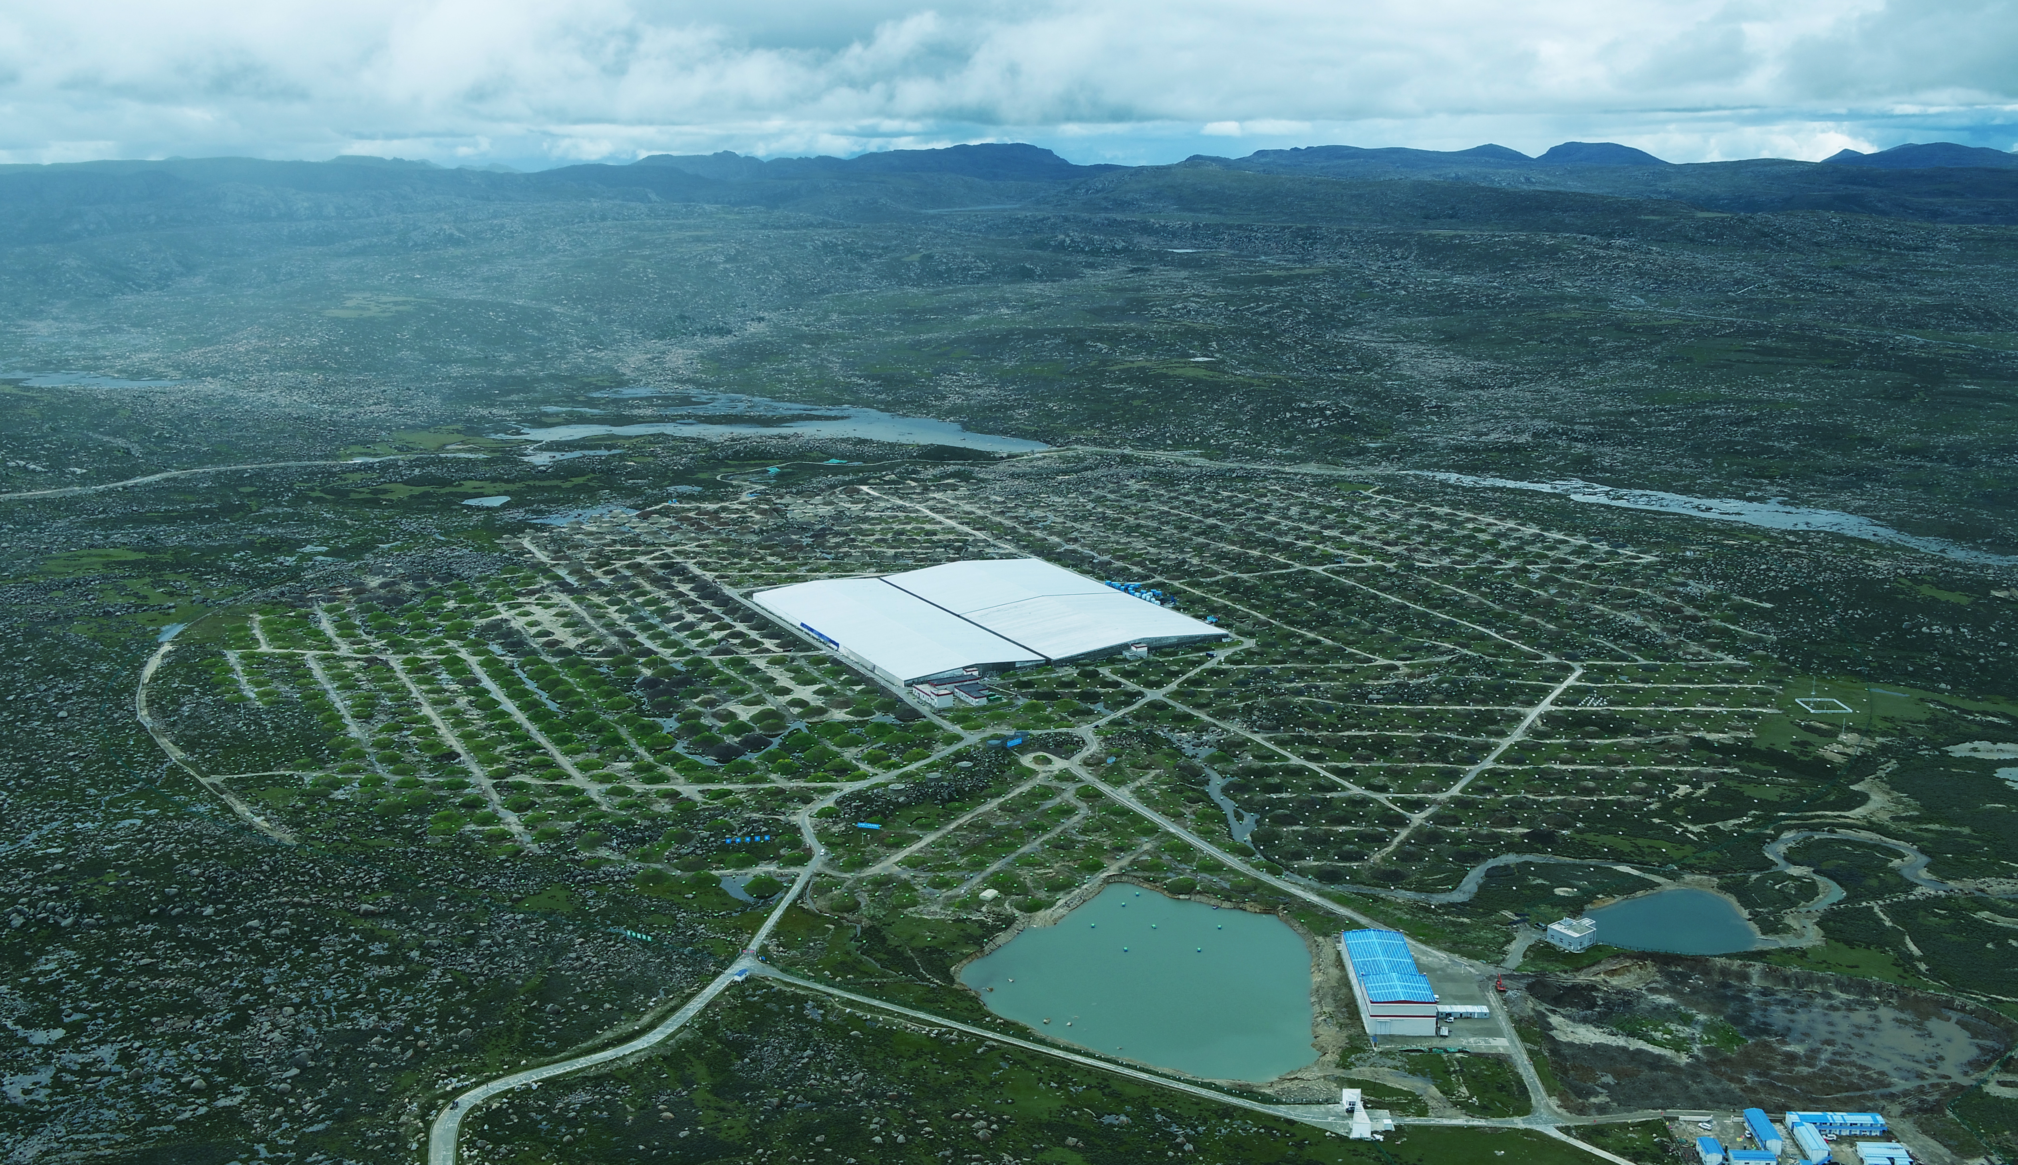
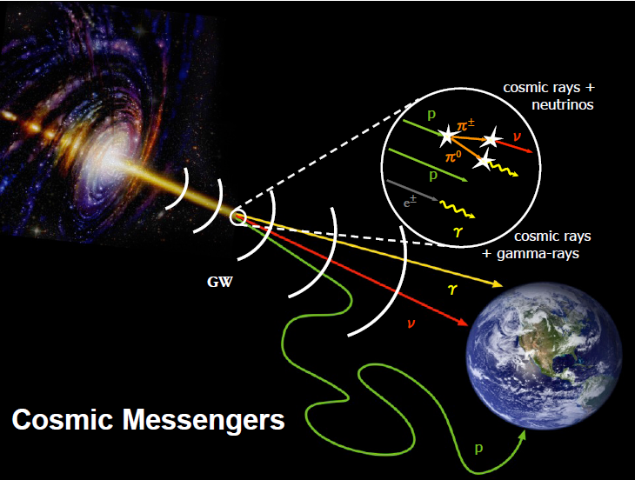
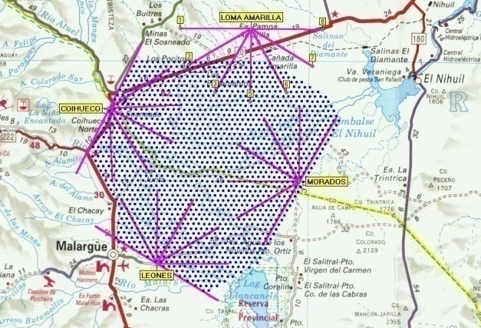
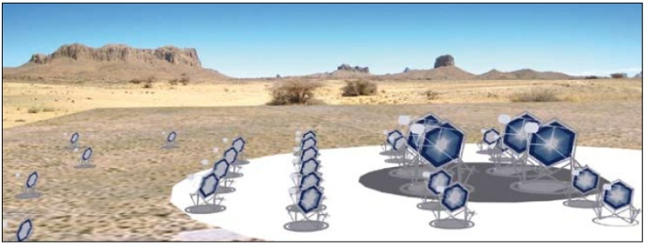
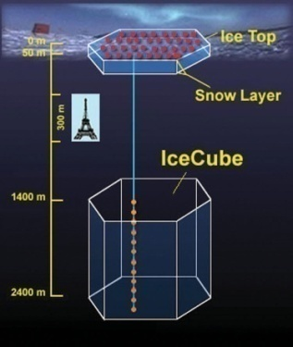
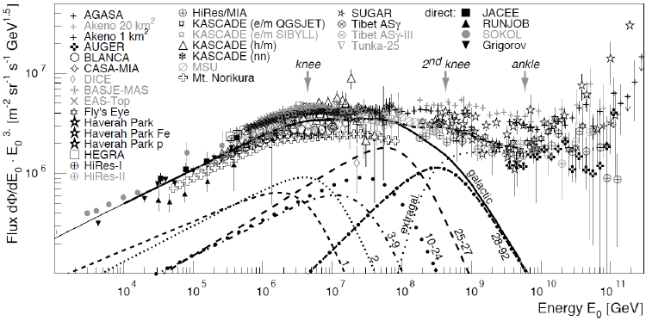
The LACT mission focuses on gamma-ray astronomy
LHAASO
50km
CTA
Multi-messenger
EHE CR Astronomy
TA, AUGER
JEM-EUSO
VHE/UHE γ Astronomy
Particle detector array:
LHAASO, HAWC, Asγ, SWGO…
Cherenkov telescope array:
HESS，MAGIC, LACT, CTA…
Origin of CRs
A century-old
mystery
CR Features
AMS02,Iss-CREAM,DAMPE,LHAASO……
5km
VHE/UHE Neutrinos
IceCube，KM3net
ARIANA ……
in space
on the ground
Notes:
The LACT mission focuses on gamma-ray astronomy, to explore the origin of CRs which is A century-old mystery
I start introducing LHAASO from here. As you know, the origin of the cosmic rays is a century-old mystery. Scientists use multi-messenger and design different types of detector arrays to discover the mystery, such as gamma ray detector arrays, neutrino detector arrays and extreme high energy CRs detector arrays. In addition, cosmic ray energy spectra features, such as knees are very important features for solving the puzzle.

Slide 3
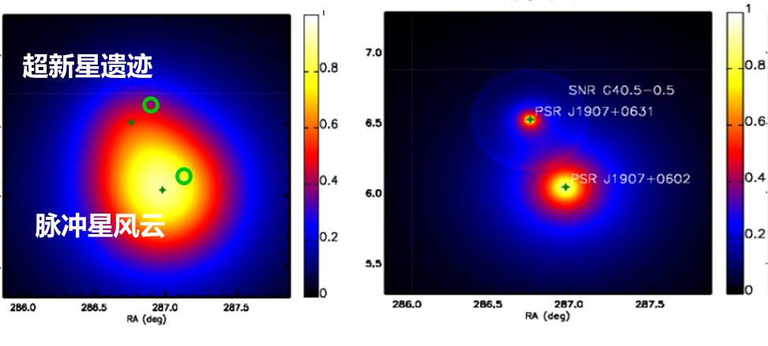
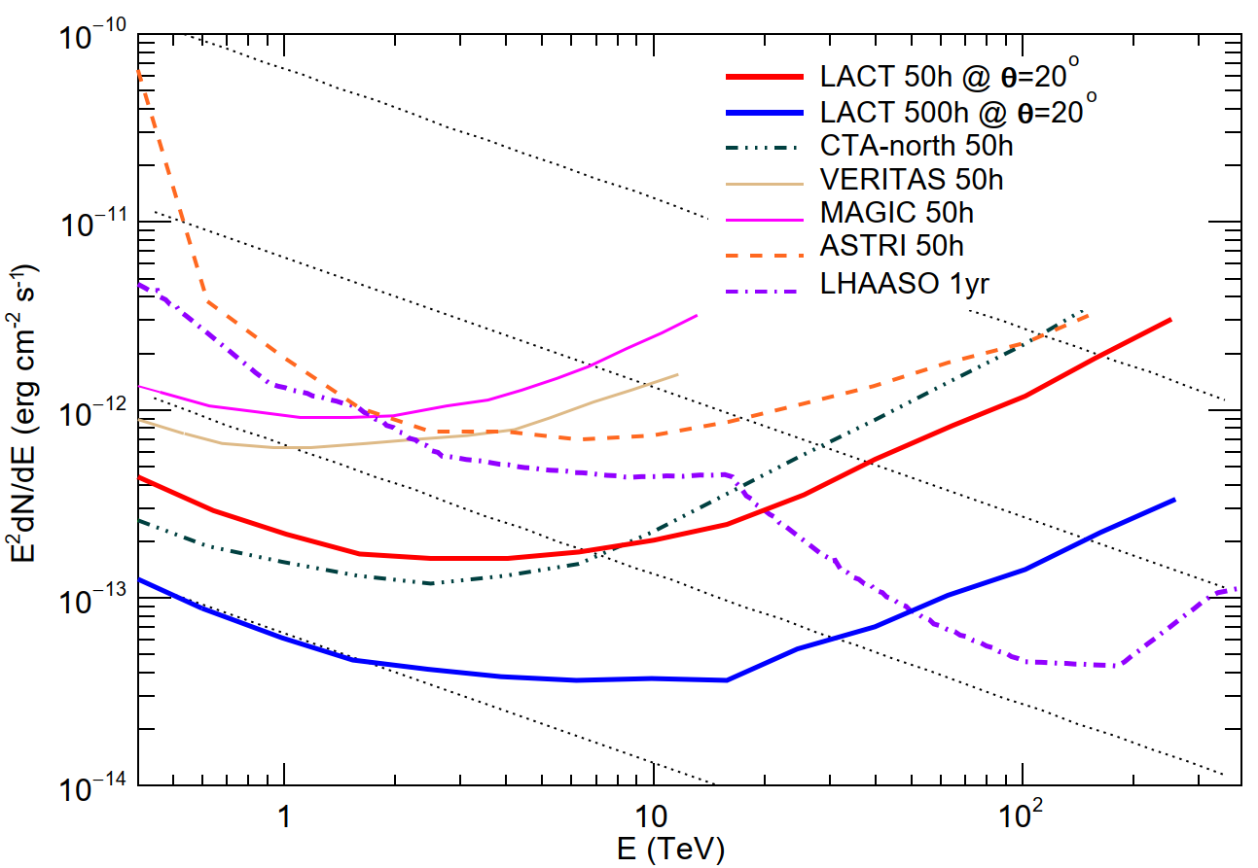
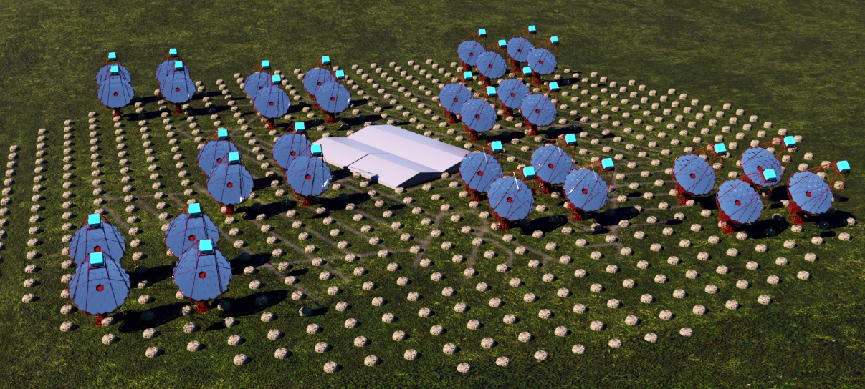
LACT: Next generation UHE IACT array
3
Large Array of Cherenkov Telescopes（LACT）
  Next generation of Image Atmosphere Cherenkov Telescope experiment
  32 telescopes built on LHAASO site
  Angular resolution
    LACT: < 0.05° @ > 10 TeV
    LHAASO: ~0.2° @ > 100 TeV
  LHAASO MD array provides excellent γ/p discrimination
  Matching the LHAASO sensitivity with 500 hr/yr
  To identify the gamma ray sources in PeVatrons and measure their morphology in details.
LACT project started construction in Jnuary 2025 and the full array will be completed by 2028
Sensitivity of point source
(SNR)
One prototype
on LHAASO site
(PWN)
0.01 CU
1
3

Slide 4
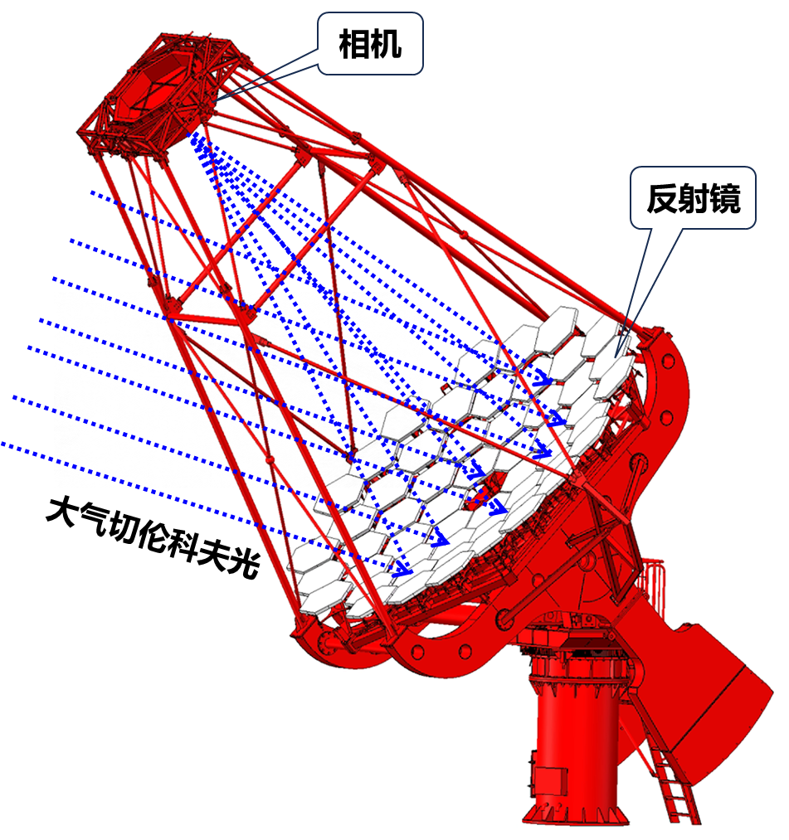
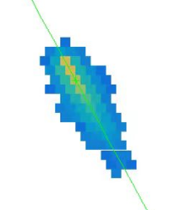
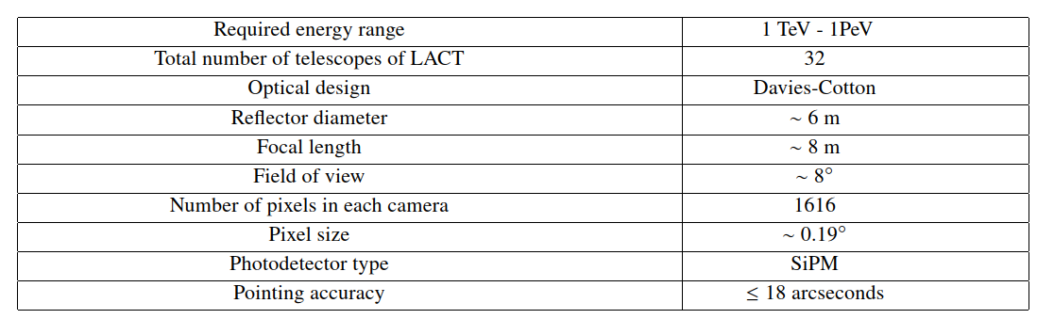
LACT: an Image Atmospheric Cherenkov Telescope
Davies-Cotton mirror
Alt-azimuth mount
SiPM camera
Readout electronics system
Slow control system
Data acquisition system
Calibration system
SiPM Camera
f=8m
Mirror
Atmospheric Cherenkov light
D=6m
Alt-azimuth mount
4
Notes:
Here, I list some parameter LACT. Energy range from 1 TeV – 1PeV, mirror diameter is about 6 m, field of view of each telescope is 8 degree, each camera has 1616 pixels, pixel size is about 0.2 degree.

Slide 5
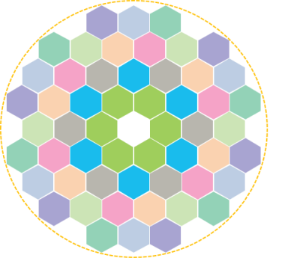
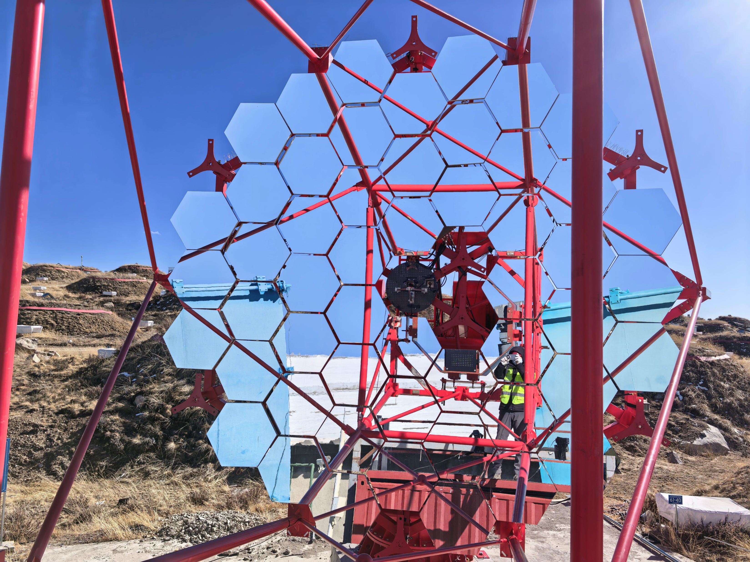
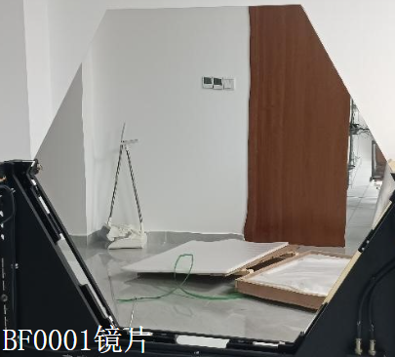
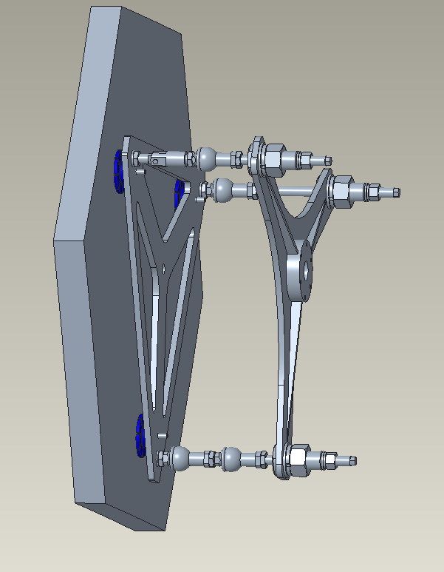
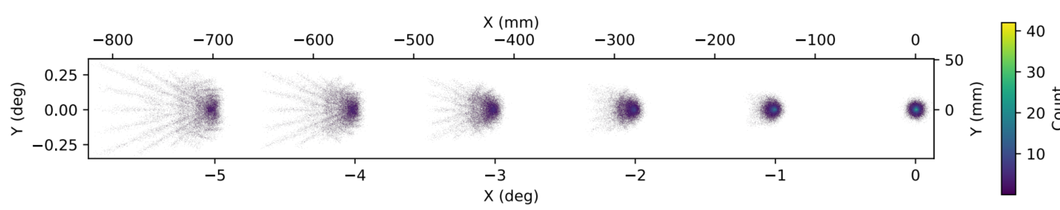
Mirror
Davies-Cotton design
  Consist of 54 hexagonal spherical mirror facets
  Diameter：~6 m
  Effect area：~24 ㎡
  Spot （>80% energy）： <25.8 mm
  Curvature radius of facet: 16 m
800 mm
A mirror facet
5
Notes:
Davies-Cotton design is applied in our mirror system.
Each mirror consist of 54 hexagonal spherical mirror facets
The diameter of mirror is about 6m
This the picture of one mirror facet prototype.

Slide 6
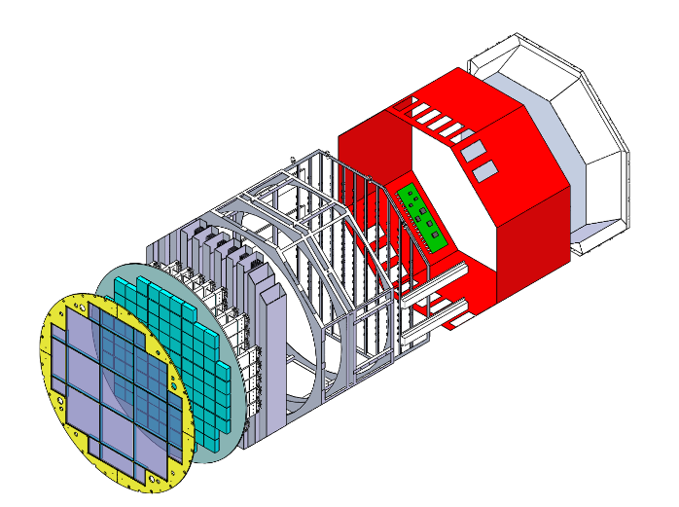
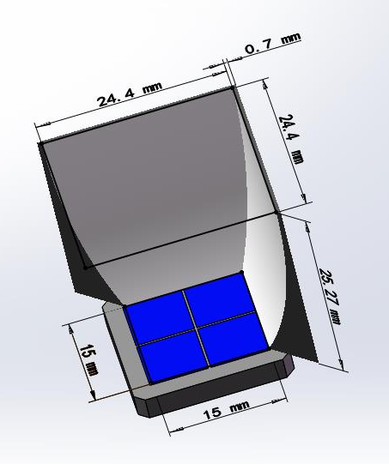
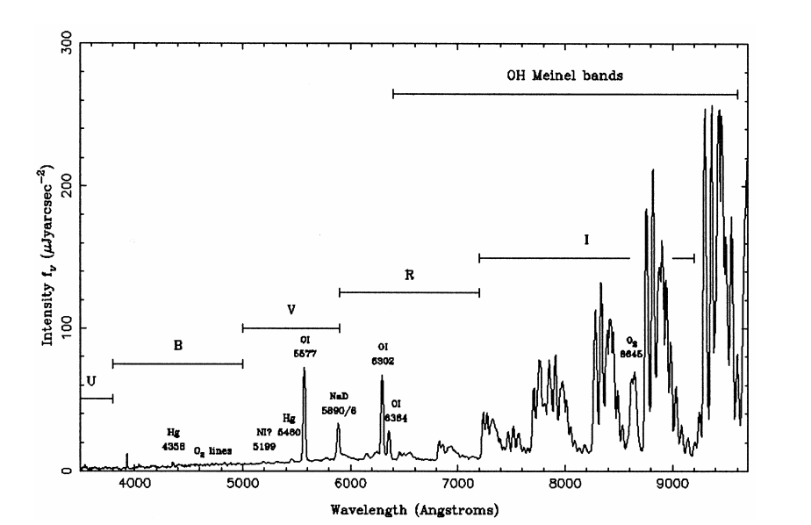
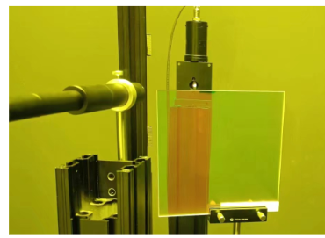
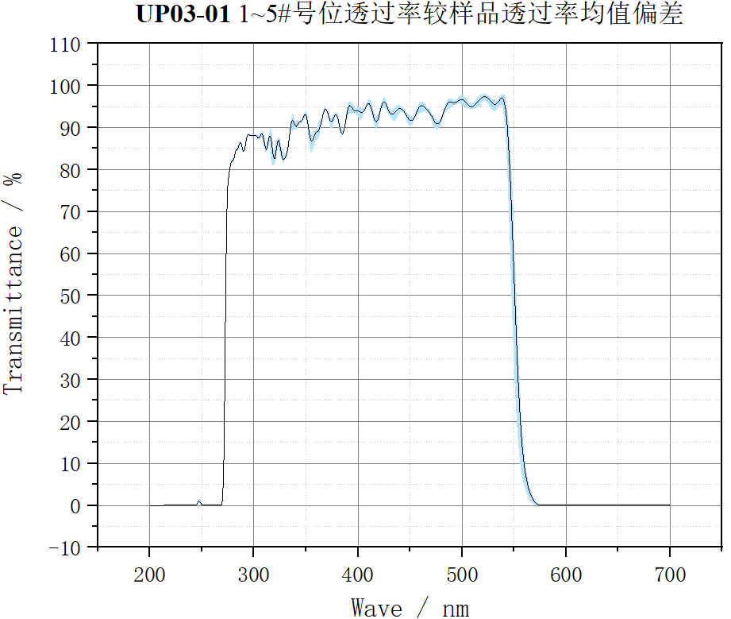
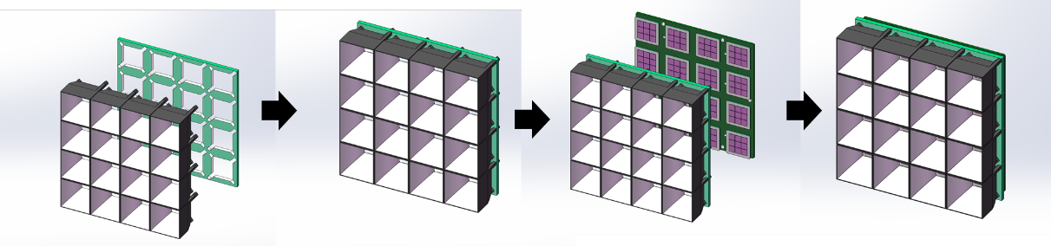
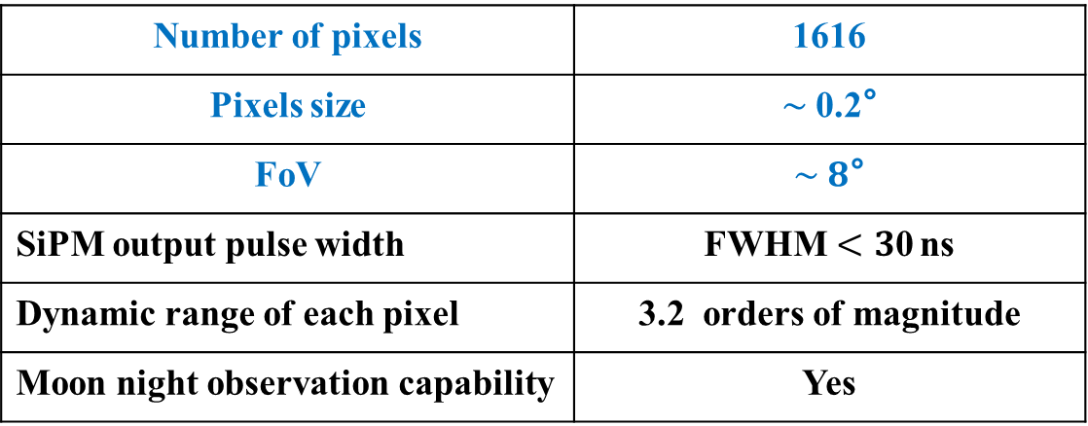
SiPM camera
A prototype in Chengdu
Number of pixels | 1616
Pixels size | $\sim$0.2°
FoV | $\sim 8$°
SiPM output pulse width | FWHM$<3$0 ns
Dynamic range of each pixel | 3.2 orders of magnitude
Moon night observation capability | Yes
Optical
filter
SiPM array
Readout Electronics
Power supply
Trigger board
Night sky background light
~550nm
310 mm
Performance of an optical filter prototype
310
mm
SiPM and Winstone cone
sub-array
6
Notes:
SiPM camera will be used. So, the telescopes can work on the moon night, increasing the duty cycle by about twice.
The optical filters are used to block the night sky background light with wavelength higher than 550nm to improve the signal to noise ratio of the camera.

Slide 7
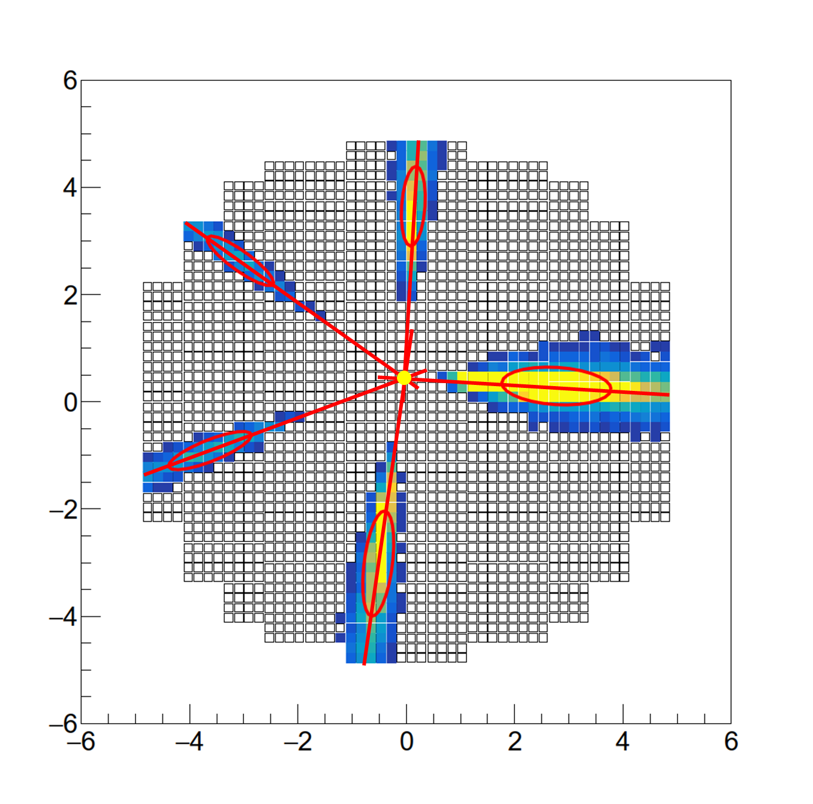
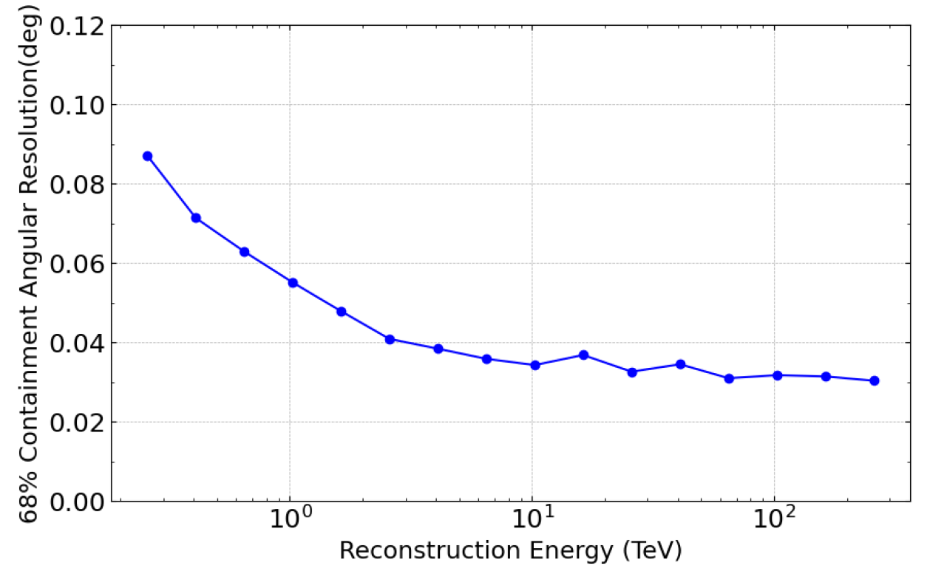
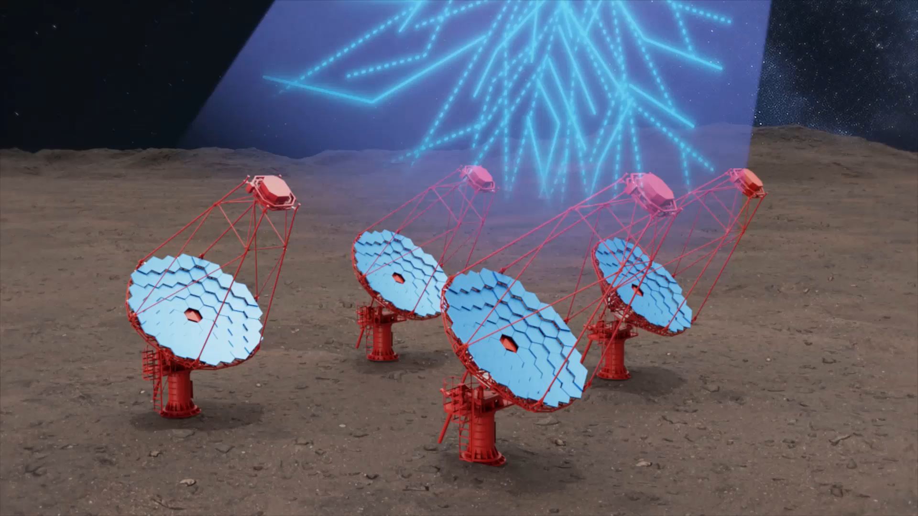
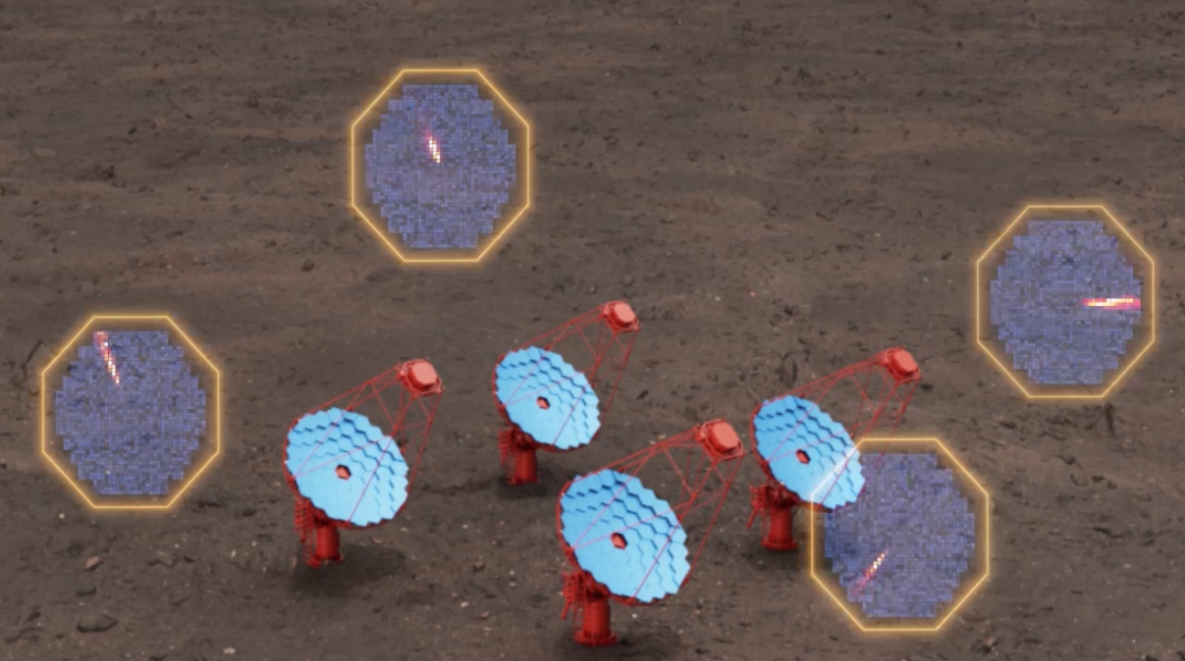
LACT： Stereoscopic Observation
Angular resolution：<0.05° @ E> 2TeV
≥ 4 telescopes
空间立体成像测量系统

Slide 8
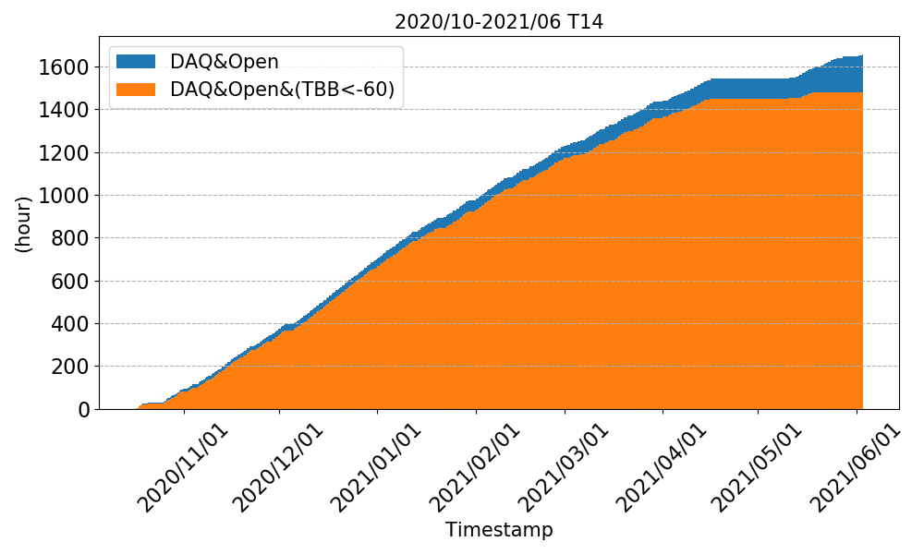
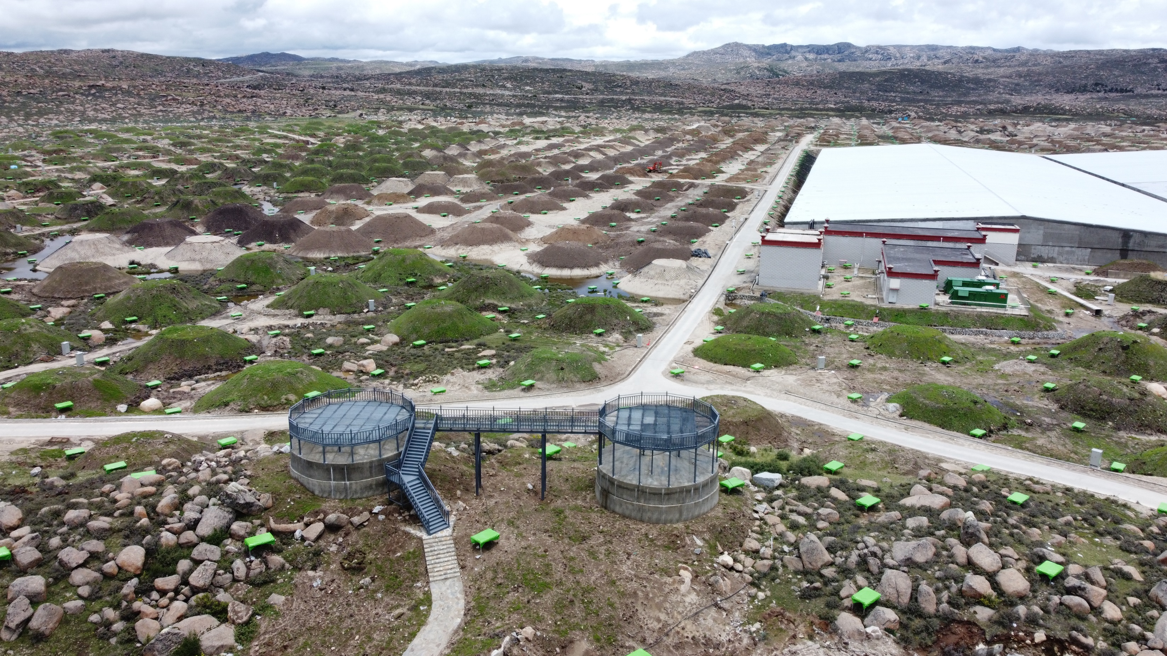
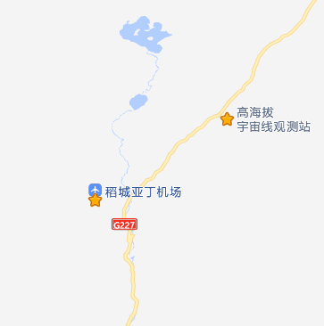
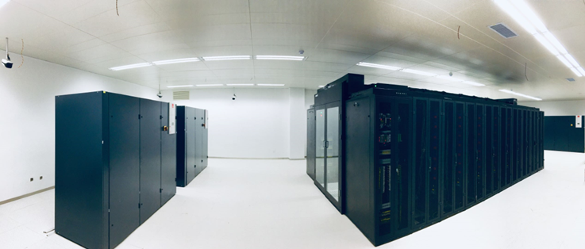
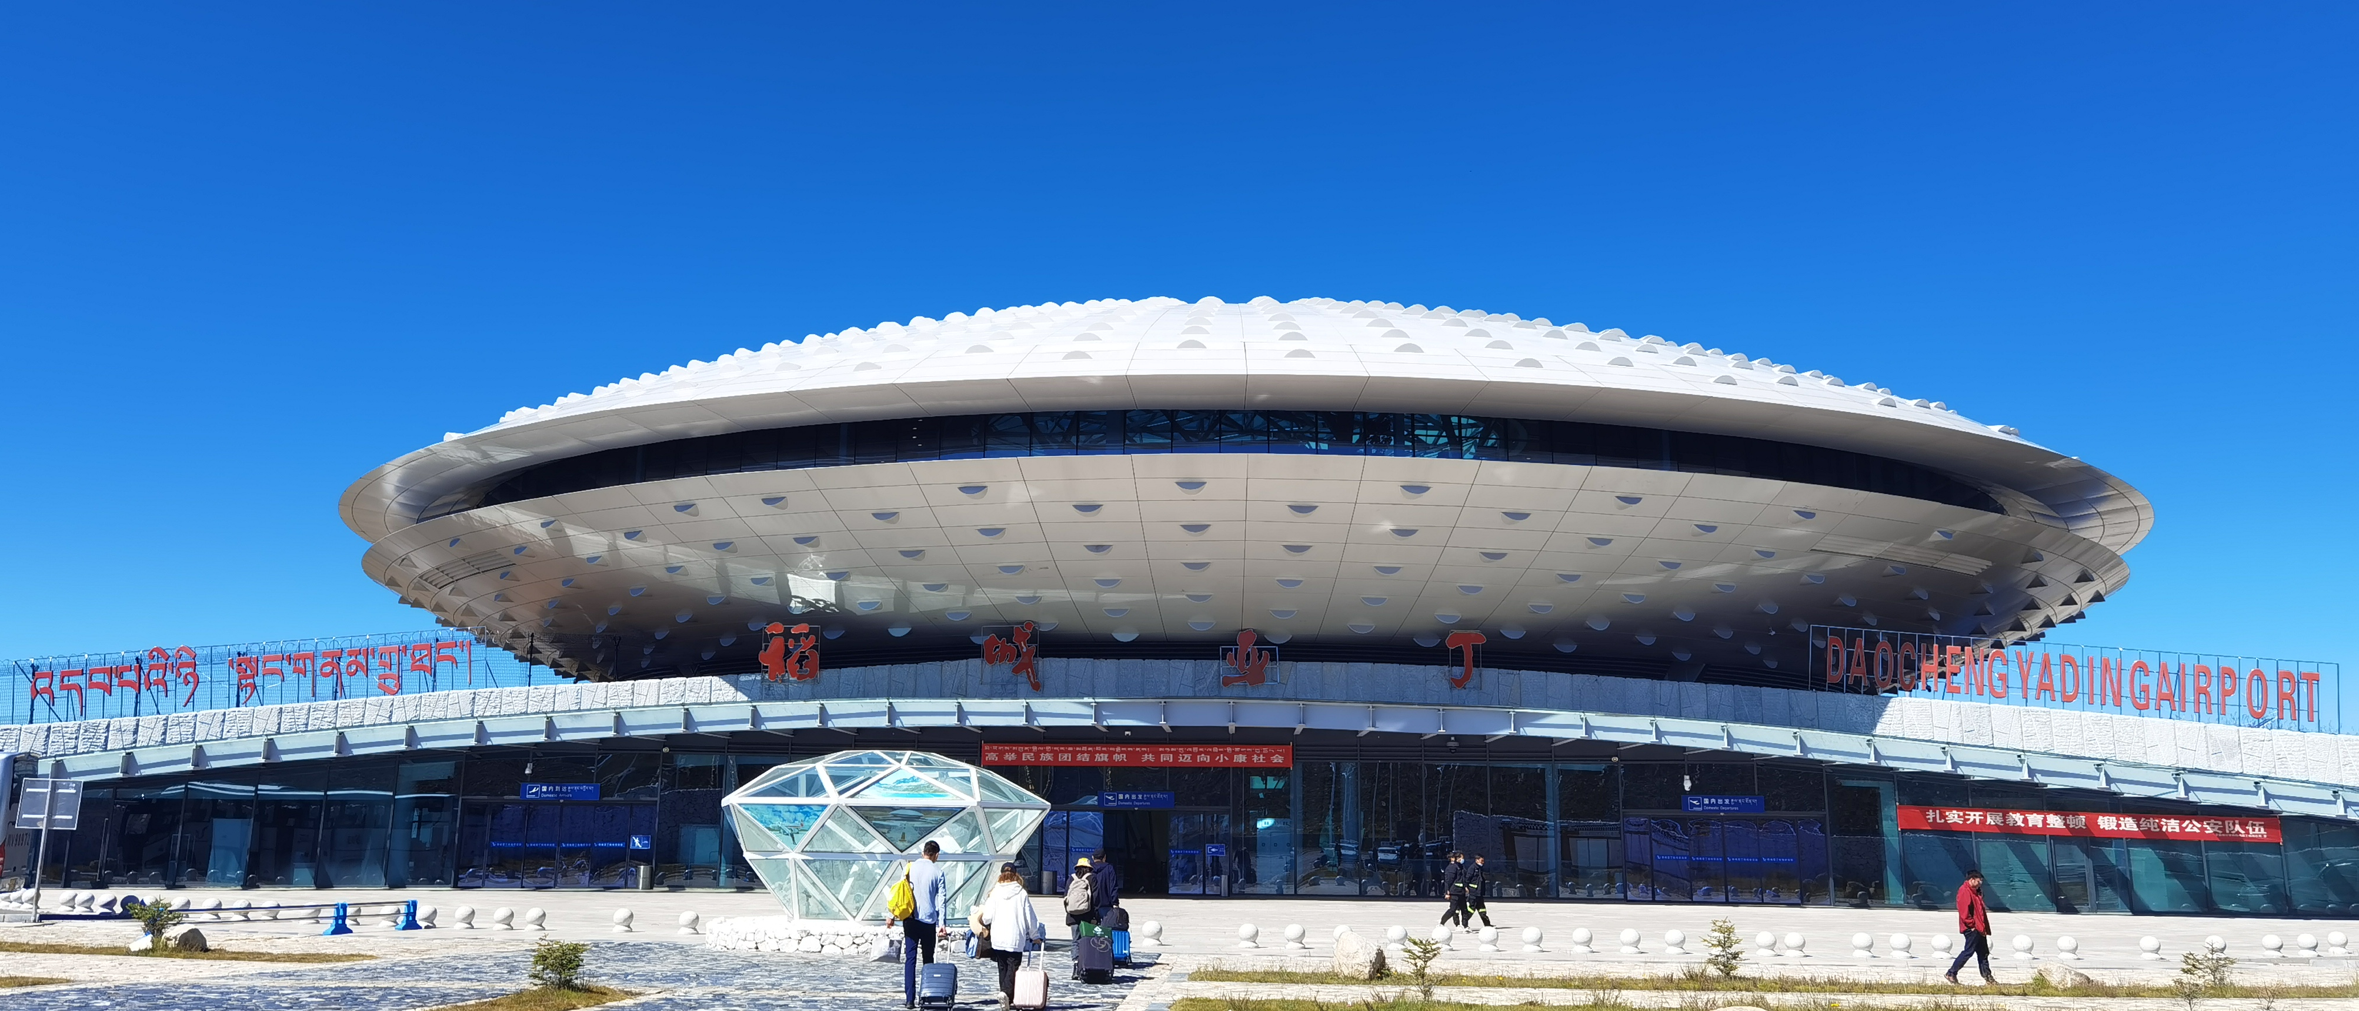
Advantages of the LHAASO site: mature infrastructure
Altitude: 4410 m
>50 km from Daocheng County: very low city background light
Annual cumulative observation time: > 1400 h/year
The site already has: power supply, network, computing, data center etc.
Daocheng Base provides excellent logistical support
Convenient transportation: 15 km away from Daocheng Airport
LHAASO Cherenkov telescope
observation time
LHAASO
Computing & data center
~15 km
Airport
Full power backup power supply
8
Notes:
LHAASO already has good infrastructure，such as power supply, network, computing, data center etc.
The transportation is also very convenient : 15 km away from Daocheng Airport
The site is 50 km from Daocheng County: very low city background light.
Annual cumulative observation time can reach to more than 1400 hours

Slide 9
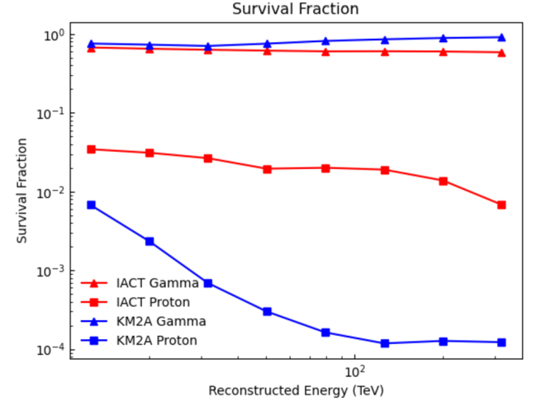
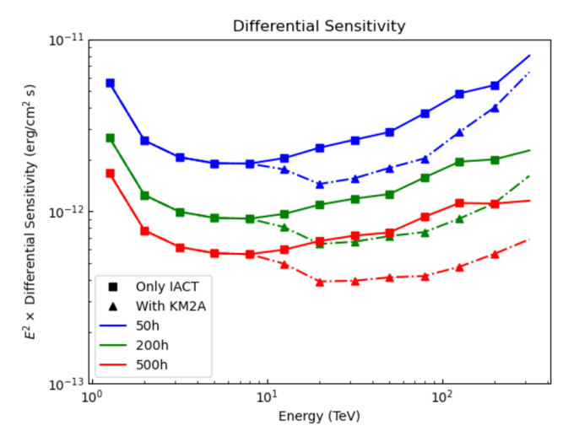
Advantages of the LHAASO site: muon information
The joint reconstruction of LACT and LHAASO muon detector array can increase the sensitivity of LACT by 1.6 times, especially for extended sources and long exposure time.
7×10⁻¹²
4×10⁻¹²
8 telescopes, zenith angle=20°
Sensitivity of extended source
Zhipeng Zhang, Ruizhi Yang, Shoushan Zhang et al., Journal of High Energy Astrophysics 43 (2024) 280–285
9
Notes:
Here I show you the performance of the joint reconstruction of LACT and LHAASO muon detector array.
The sensitivity of LACT can be increased by 1.6 times, especially for extended sources and long exposure time.

Slide 10
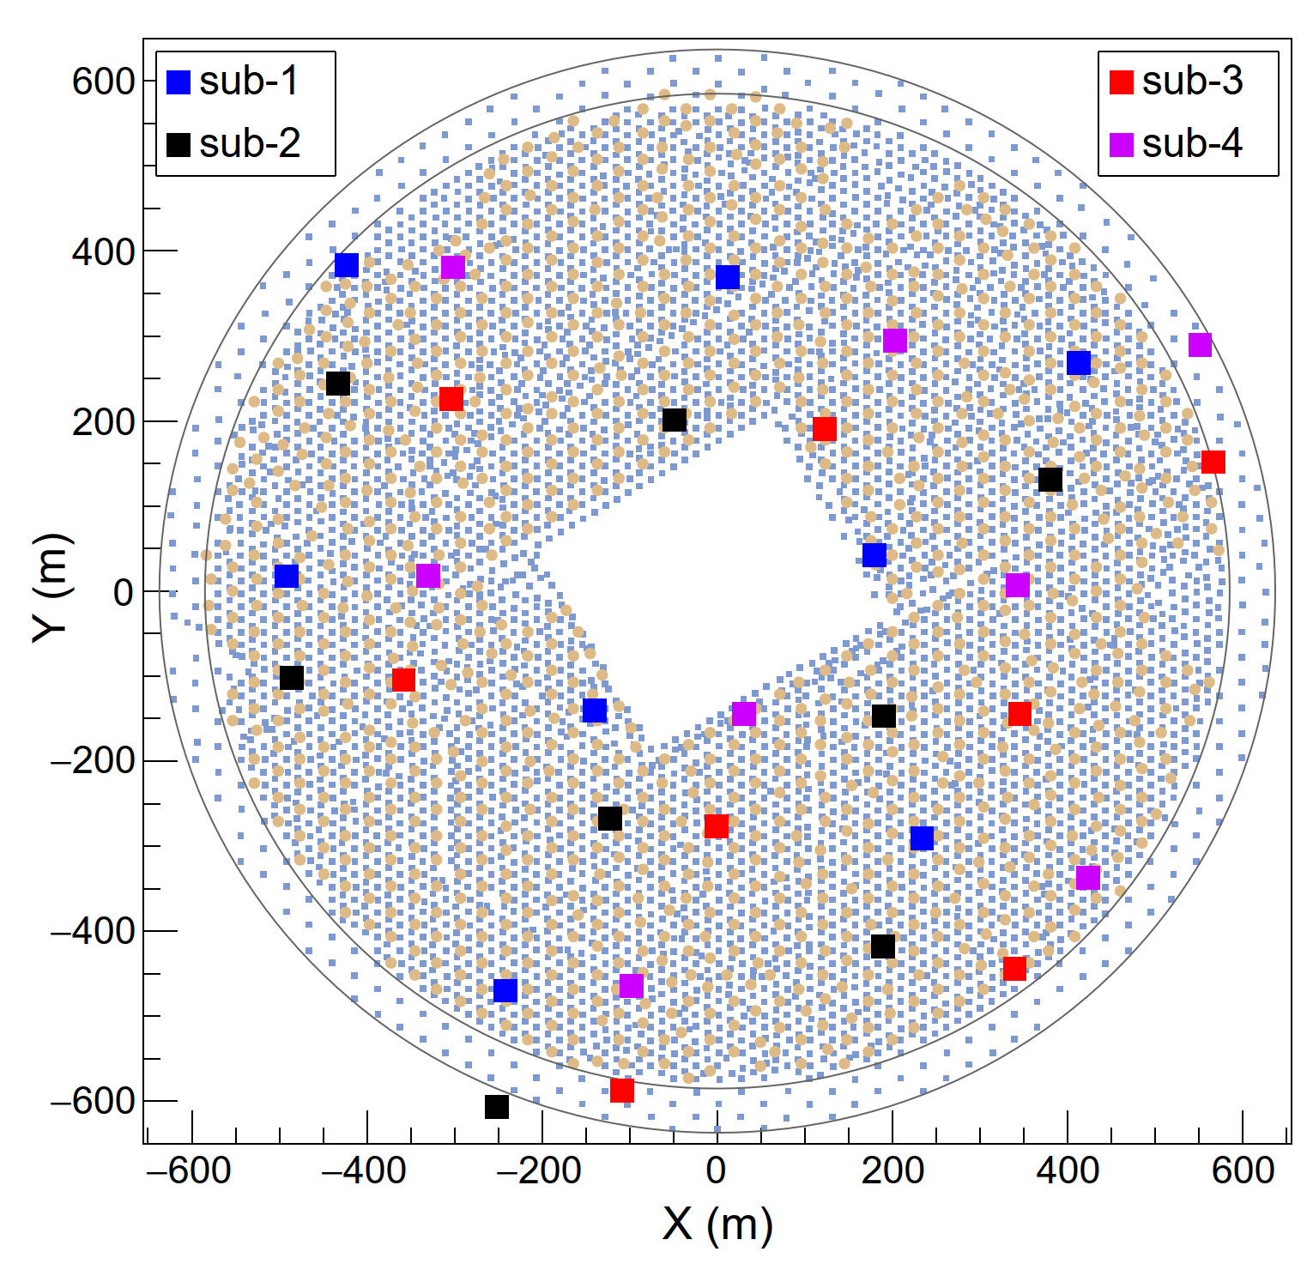
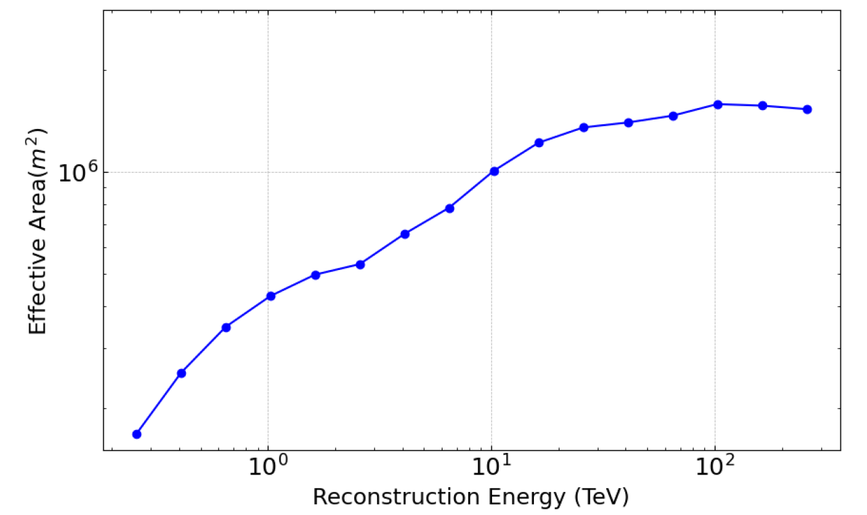
LACT: Small zenith angle observation mode
32 telescopes on site
  Placed in the gap between muon detectors
  Close to the road for easy construction
Small zenith angle (zenith<50°) observations for lower energy thresholds
Collection area:
1 km² @ 10TeV
Angular resolution:
<0.06° @ >1TeV
Threshold Energy: ~200GeV
1
2
50h
3
120-200m
4
500h
6
0.01 CU
5
350-450m
8
0.01 CU
7
Sensitivity of point source
1.6 km²
1 km²
Notes:
Here is the array of 32 telescopes on LHAASO site. Telescopes will be placed in the gap between muon detectors and also close to the road for easy construction.
In the small zenith angle observation mode, 32 telescopes point to the same source during the observation.
Here show you the sensitivity. 50 hours and 500 hours. Angular resolution is less than 0.06 degree at the energy higher than 1TeV. And the collection area is about 1 km² at 10 TeV， 1.6 km2 at 100 TeV.

Slide 11
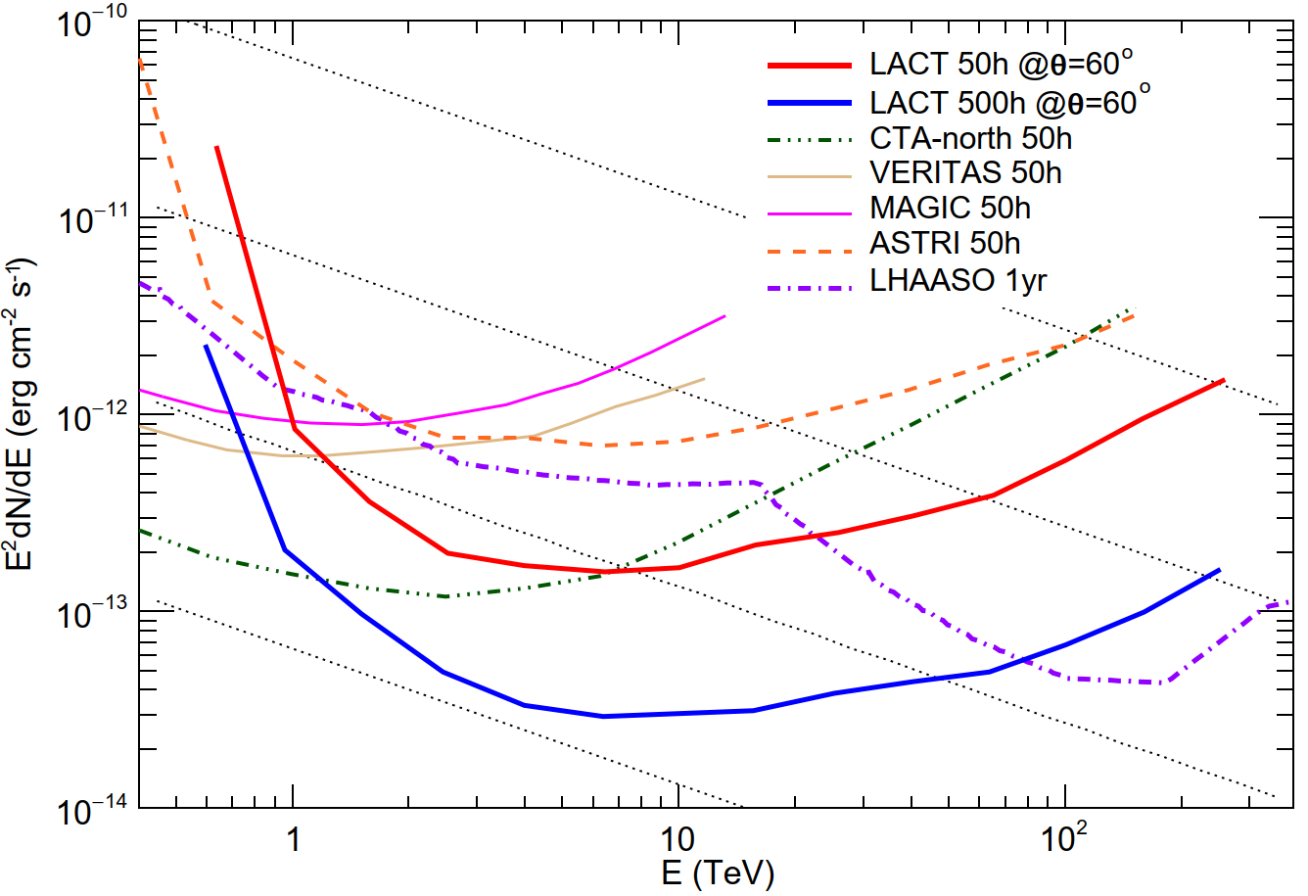
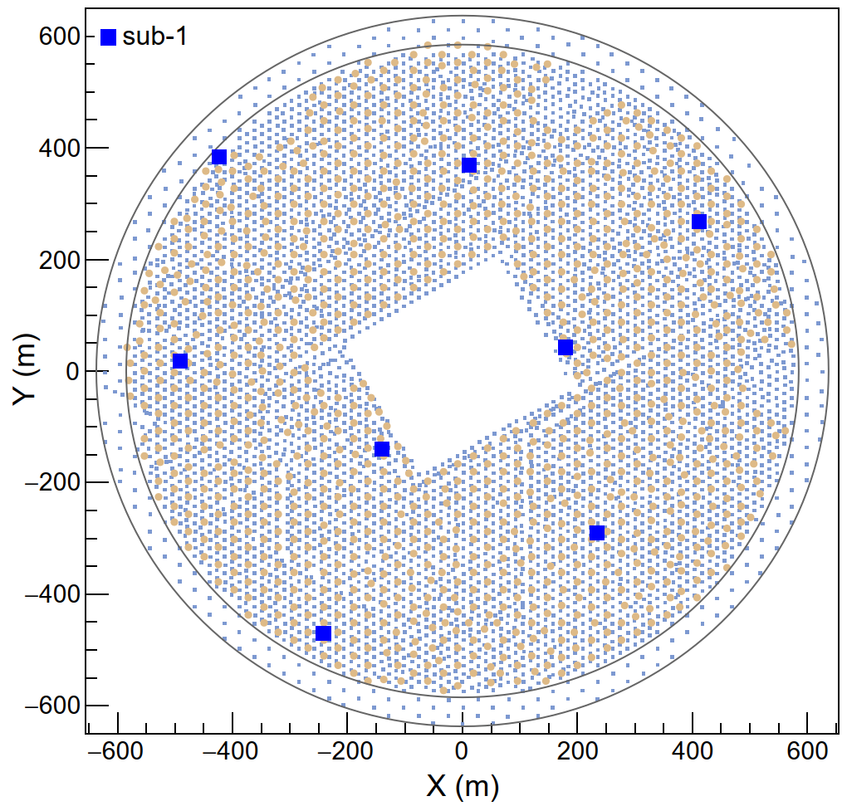
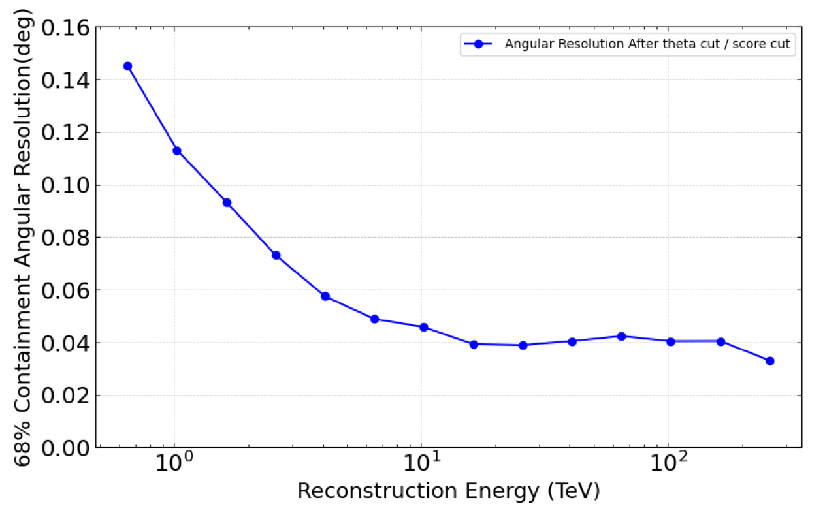
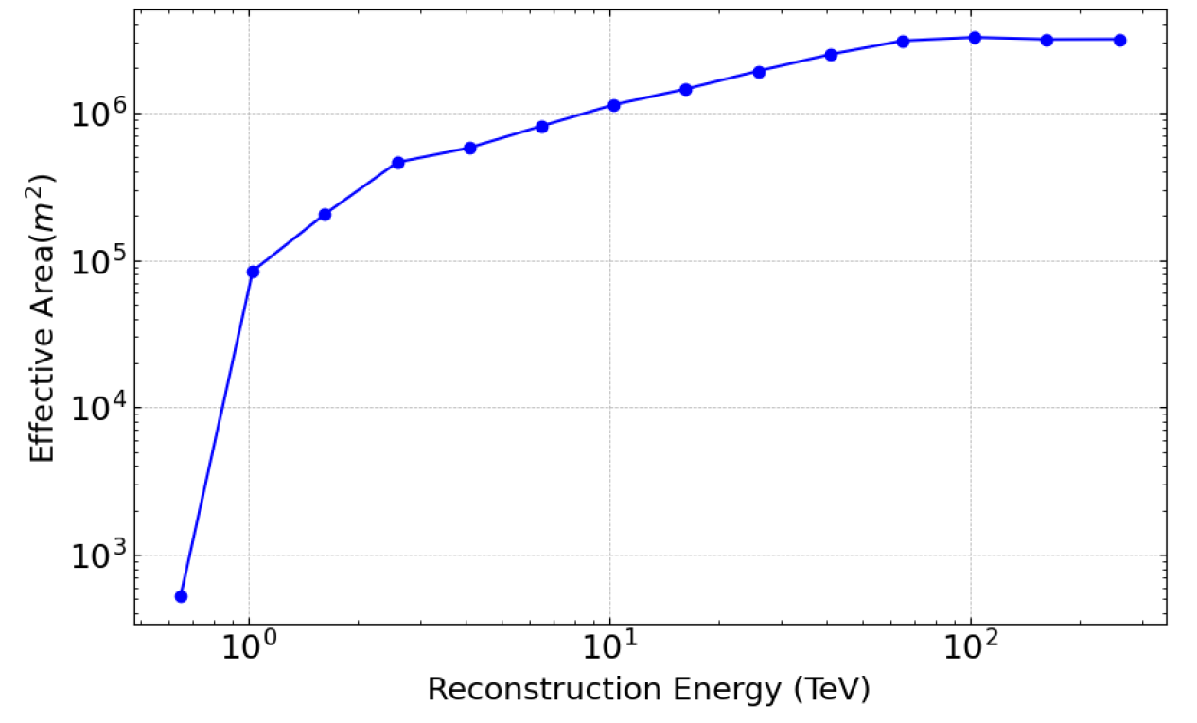
LACT: Large zenith angle observation mode
Large zenith angle (zenith: 50°-70°) observations for ultra-high energy events
8 telescopes: divide into 4 groups, each has 8 telescopes, can observe 4 UHE sources at the same time
Getting larger collection area:
3 km²@ 100TeV
Higher Threshold Energy：
~1TeV
Angular resolution:
<0.06° @ >4TeV
50h
500h
0.01 CU
Sensitivity of point source
3 km²
Notes:
In the large zenith angle observation mode, we only use 8 telescopes for each source observation.
Here is the sensitivity. In 500 hours of deep observation, the sensitivity is almost the same as LHAASO at around 100 TeV .
In the large zenith angle observation mode, we will get larger collection area and also good angular resolution at higher energy.
So, 32 telescopes, we have 4 groups of 8 telescopes. Each group observe one source and 4 group can observe 4 sources at the same time.

Slide 12
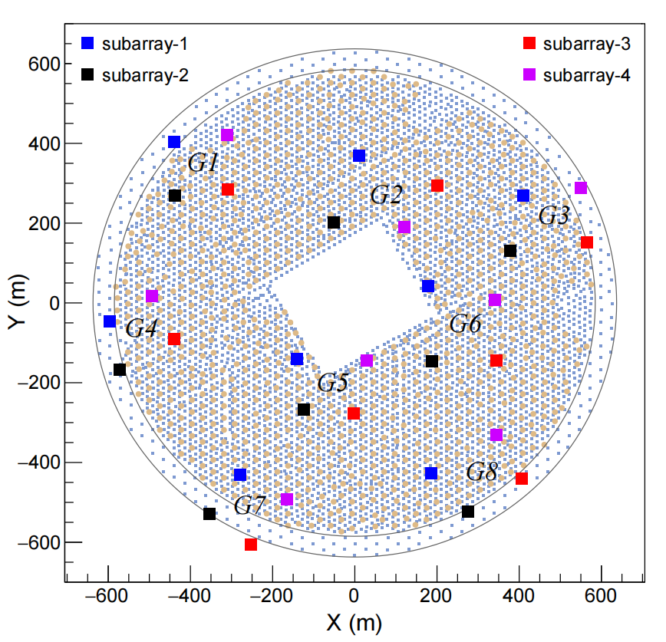
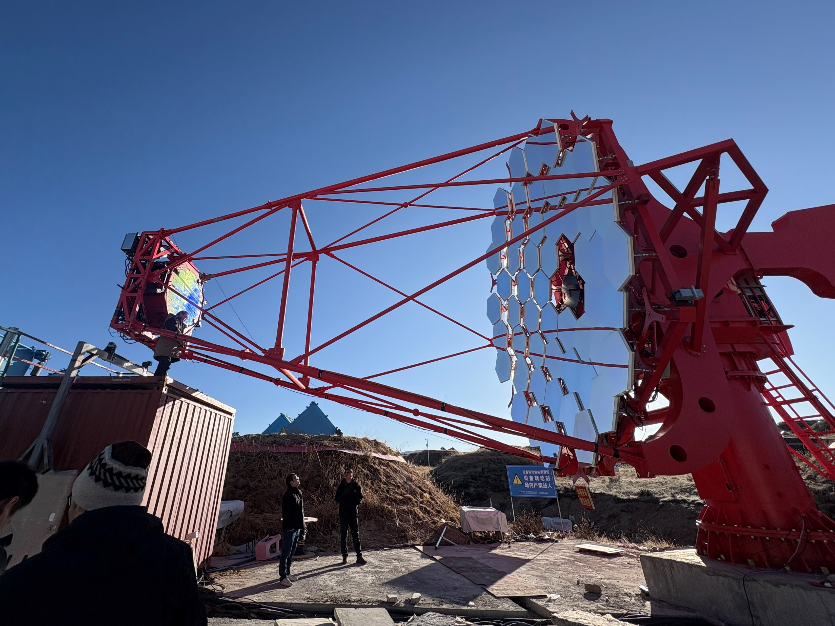
LACT first telescope (prototype)
The first telescope (without camera) was installed in April, 2025

Slide 13
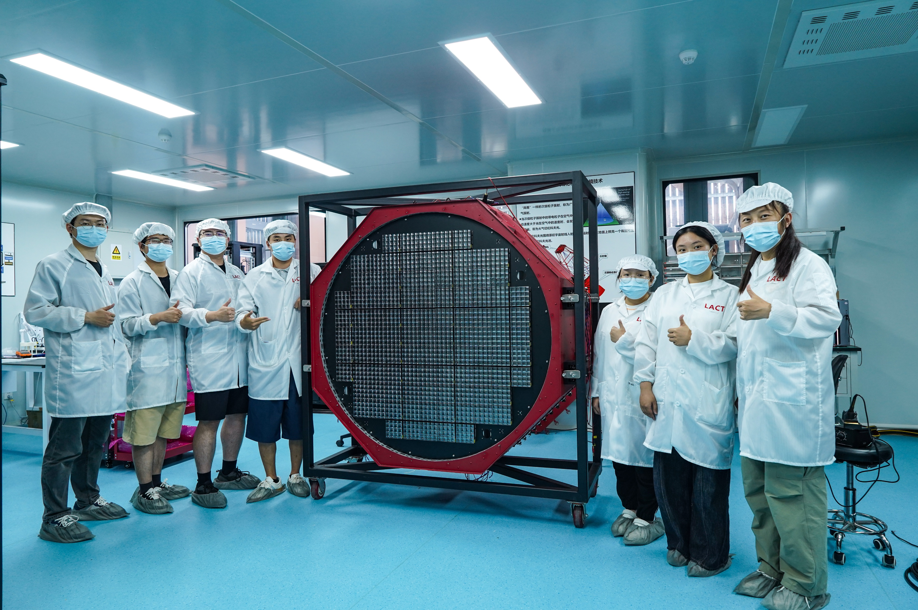
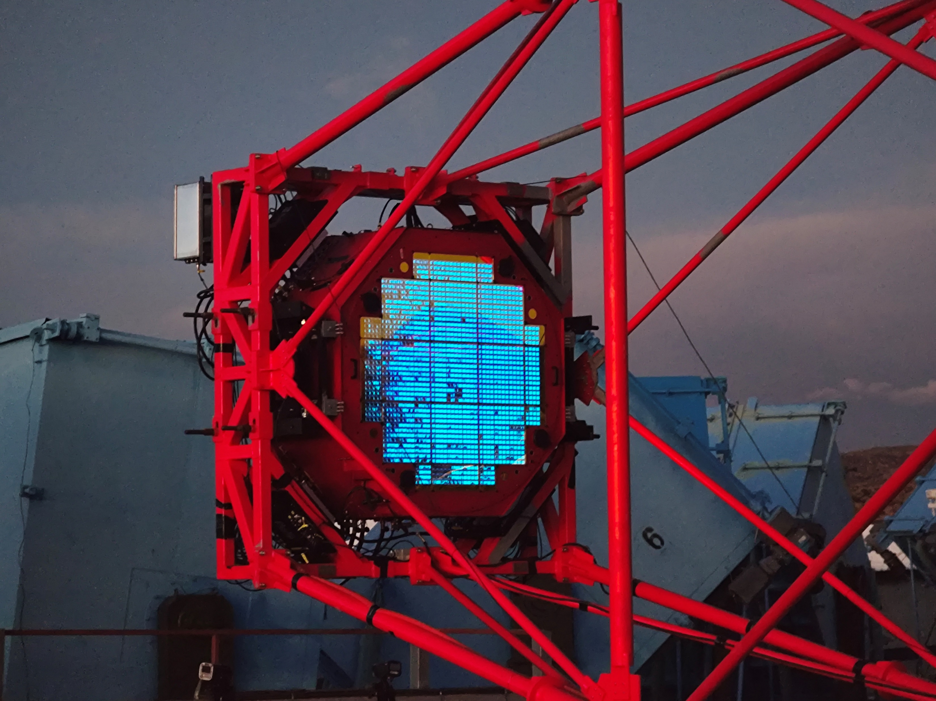
LACT first telescope (prototype)
Frist camera
  Performance was measured in the lab before being shipped to the LHAASO site.
  Being shipped to the LHAASO site on January 21, 2026
  and began observations on January 26, 2026.

Slide 14
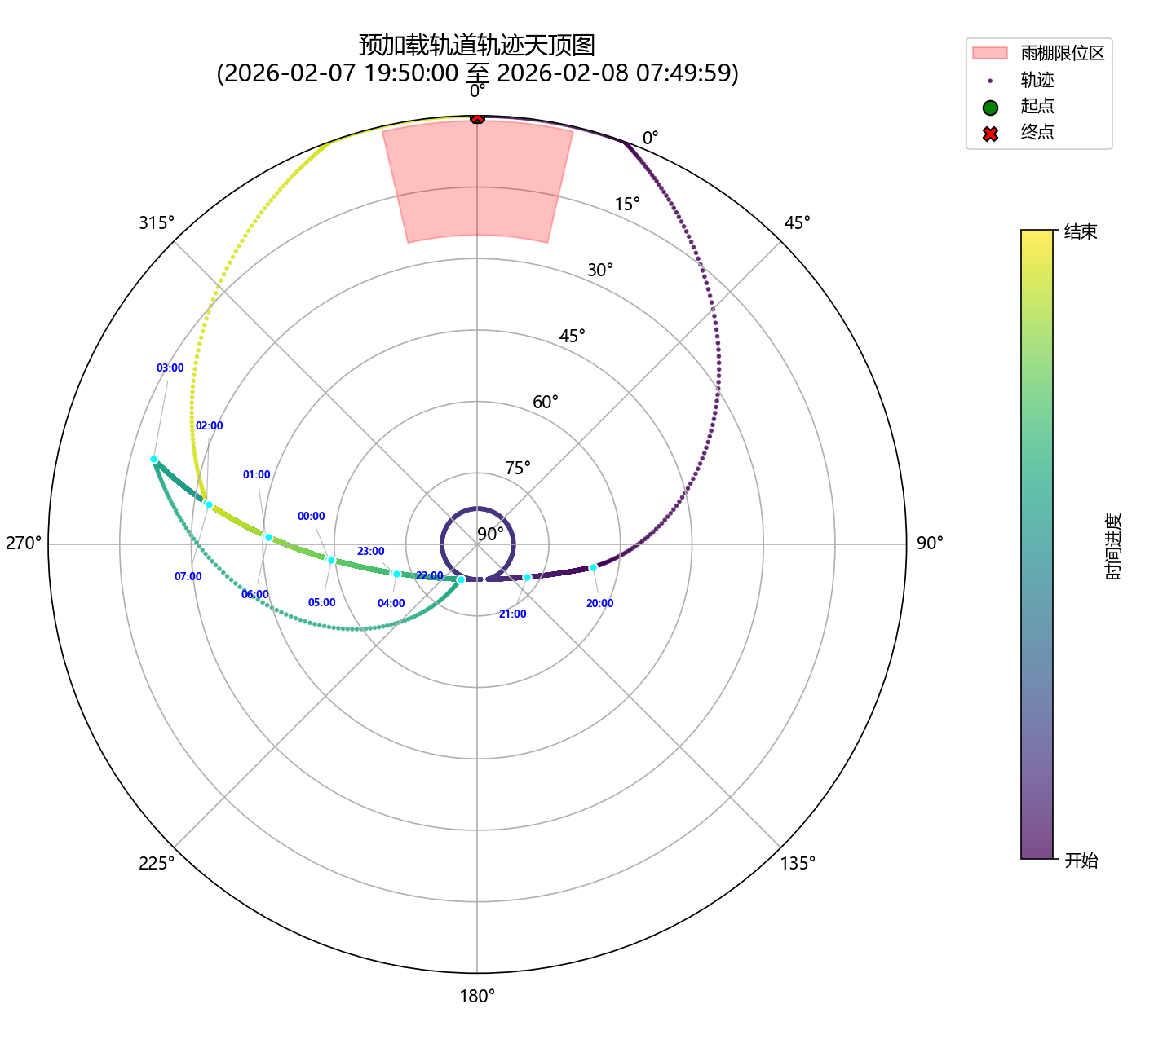
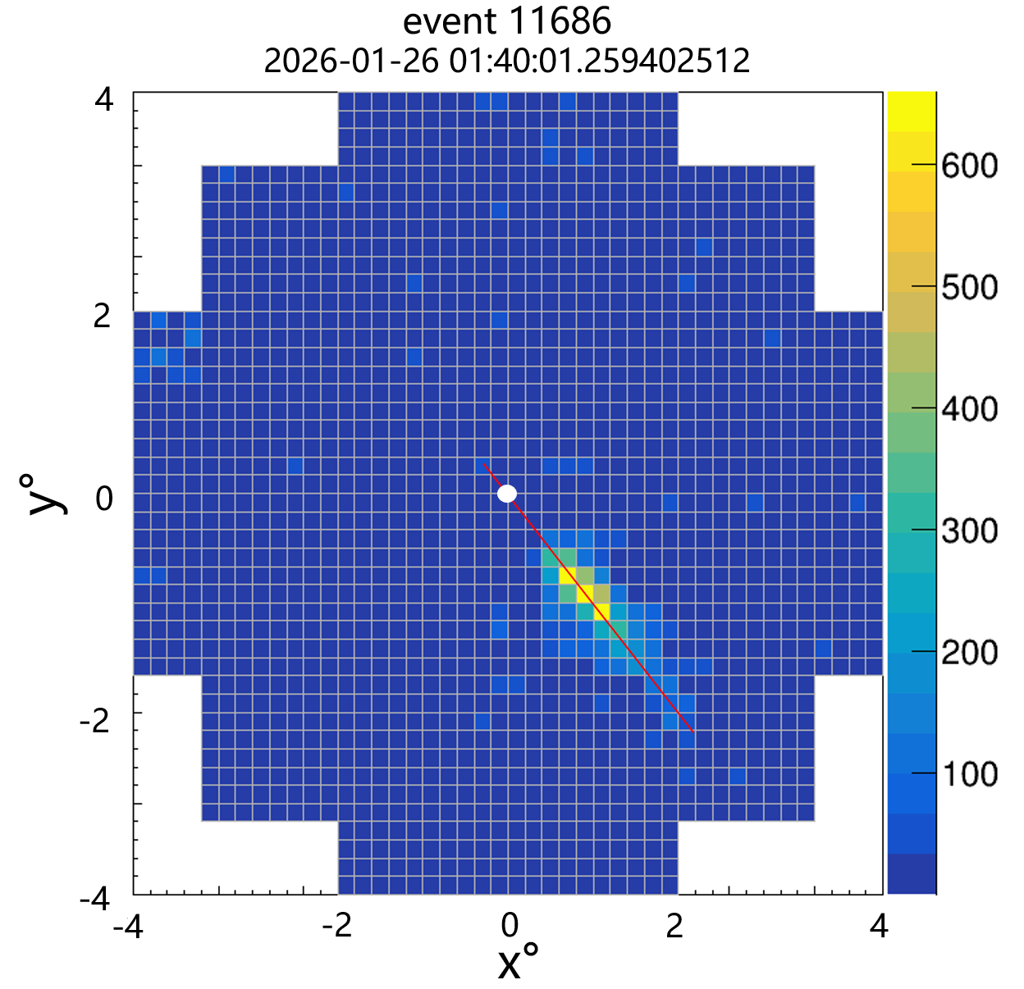
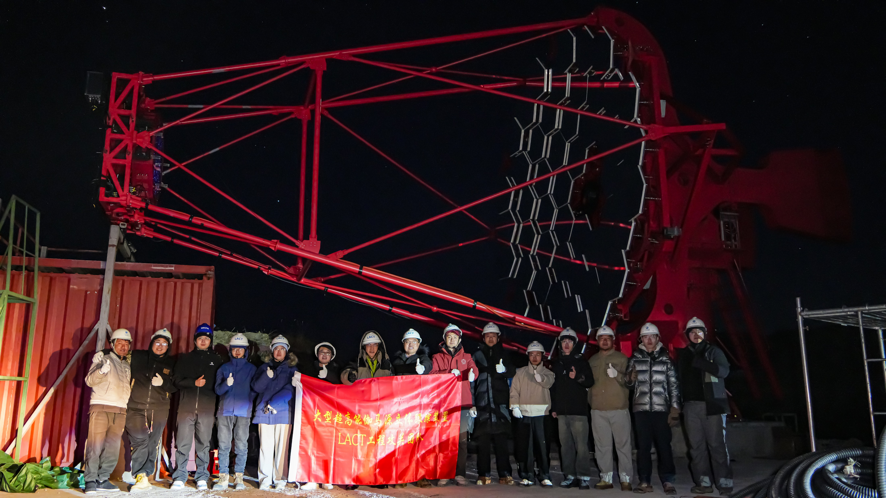
LACT first telescope (prototype)
Tracking Crab

Slide 15
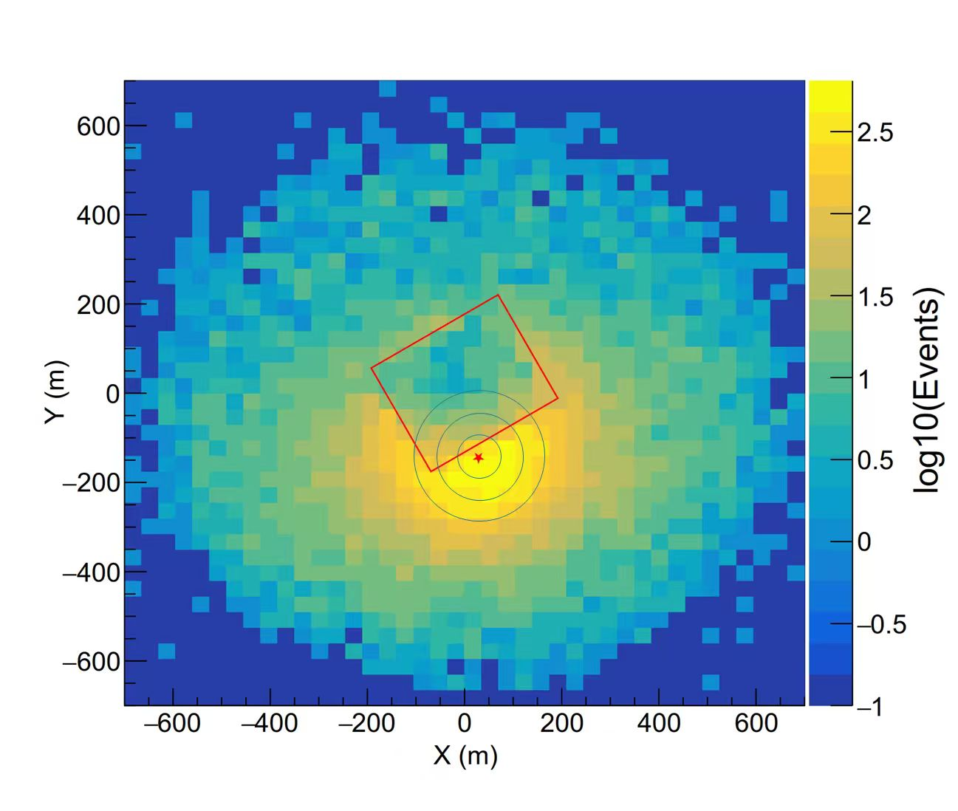
LACT first telescope and KM2A coincident events
About 20,000 coincident events were recorded on January 26, 2026.
Continued data collection and in-depth analysis are underway.
LACT first telescope
Shower core location distribution

Slide 16
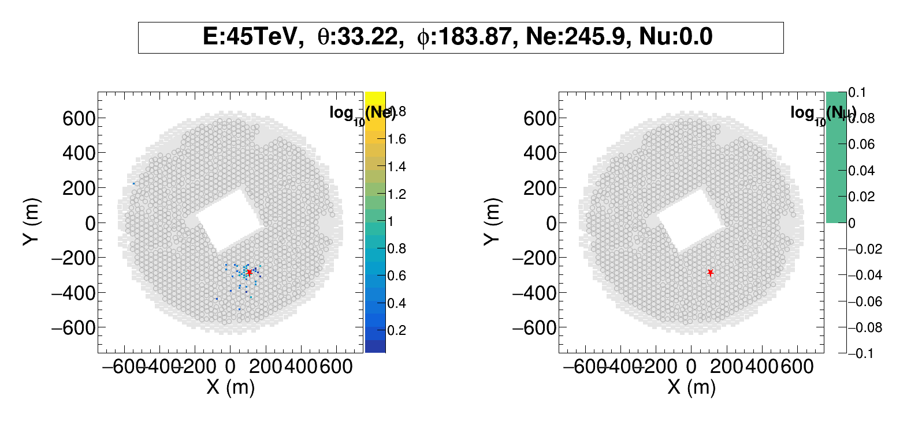

Gamma-like event
Source: Crab
×
Scintillator detector
muon detector

Slide 17


Cosmic ray like event
Source: Crab
Scintillator detector
muon detector
×

Slide 18


LACT second telescope（ Design-finalized telescope ）
Assembly started on January 28, 2026, at the Tianfu Cosmic-Ray Research Center
Shipment to LHAASO site is planned in April 2026
The second telescope will begin participating in the observations in September 2026

Slide 19



LACT construction plans
Phase I（4 tels）will be completed by the end of 2026
Phase II (8 tels) will be completed by May 2027
The full array will be completed by the end of 2028
V4641
Black hole
Massive star
LACT expectation：4 tels, 1y (279 h)，θ=55° - 75°
30 TeV ~ 100 TeV
> 100 TeV

Slide 20

LACT expectation： Microquasar V4641
V4641
Binary system
Zenith angle：55° - 75°
2026.9 – 2027.6：279 h
  2026.10.02 - 2026.11.01
  2027.02.20 - 2027.05.30
LACT
LHAASO
Black hole
Massive star
LACT expectation：4 tels, 1y (279 h)
LHAASO measurement
(~3.4 y)
3 TeV ~ 30 TeV
30 TeV ~ 100 TeV
> 100 TeV
20

Slide 21
Summary and outlook
LACT：32 telescopes will be built at the LHAASO site
  LACT 500-hour sensitivity is comparable to LHAASO one-year sensitivity around 50 TeV, with an angular resolution better than 0.05° above 10 TeV
  The LHAASO muon array provides excellent gamma-hadron discrimination, thereby significantly enhancing the sensitivity of LACT
The first telescope was completed and became operations on January 26, 2026
  More than 200,000 coincident events have been observed, and detailed analysis is ongoing
  Based on the test results of first telescope, the optimized design was completed
The second telescope—the design-finalized model—is scheduled to be completed and to begin operations by July 2026
Phase I（4 tels）will be completed by 2026, Phase II (8 tels) will be completed by May 2027, and the full array will be completed by 2028.

Slide 22
Thank you！

