Slide 1
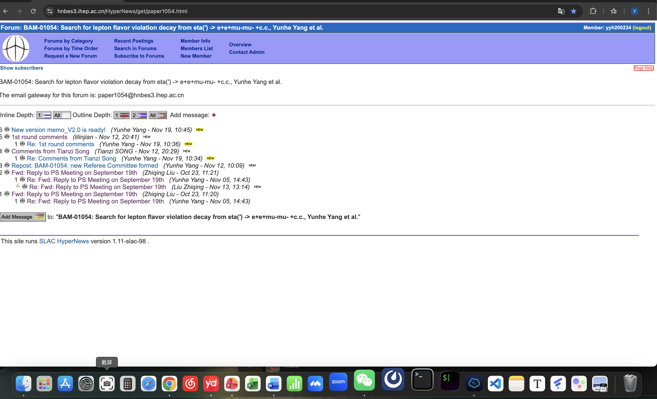
CLFV
Finish two reply.

Slide 2
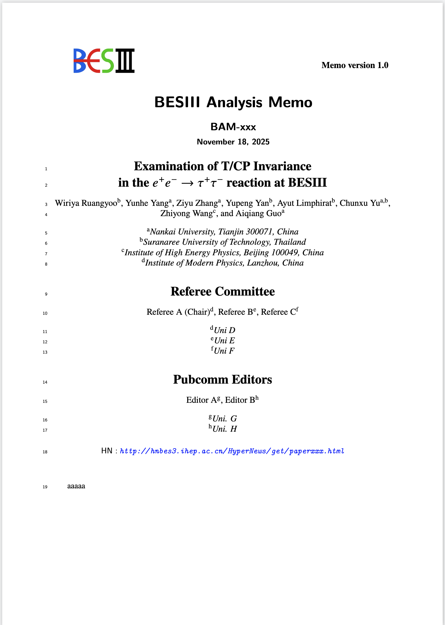
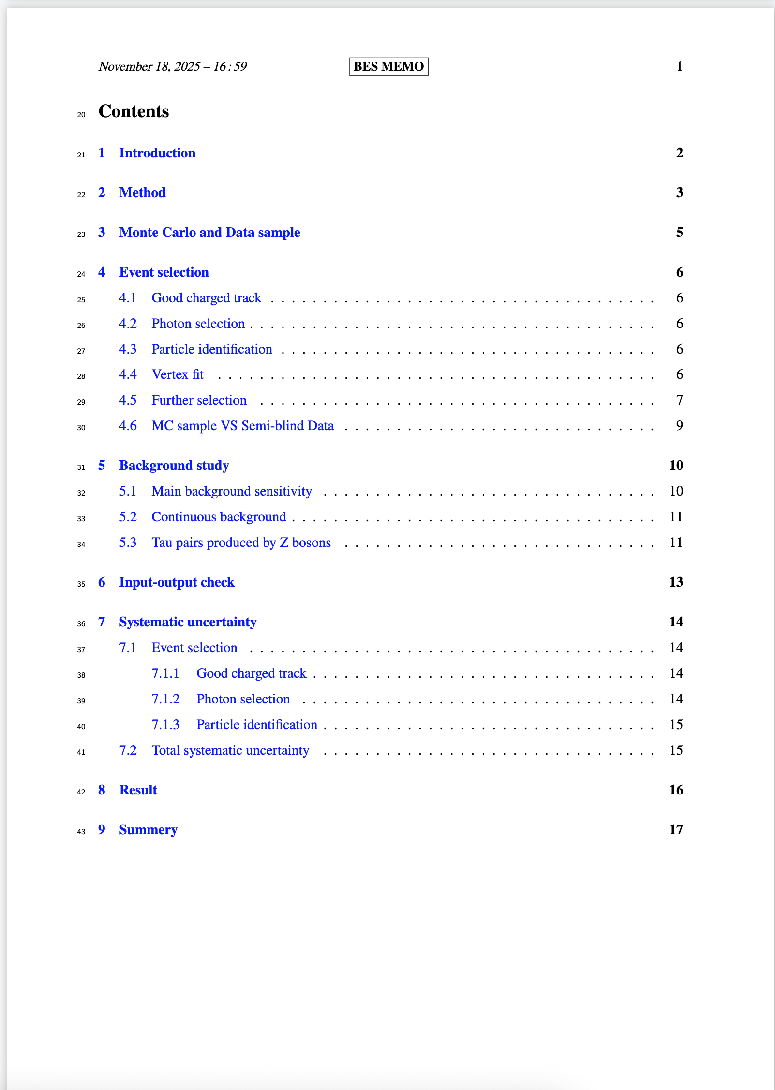
CPV
The “Background study” finish.
Adding references .

