Slide 1

Study of $ψ\left(3686\right)→φηη$
Zhuang Xinyu
Nankai University
2025.11.25

Slide 2
Outline
Motivation
Decay chain
Data sets and MC simulation
Initial event selection criteria
Other event selection criteria
Topology analysis
2-body combinations
Next to do

Slide 3
Motivation

Slide 4
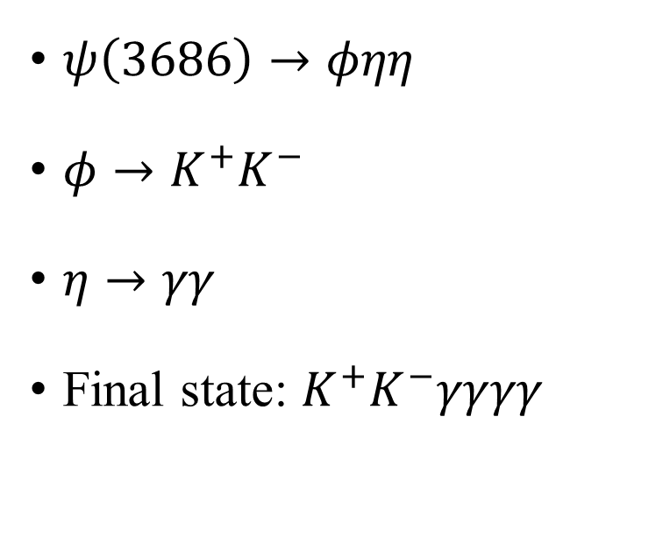
Decay Chain
$ψ\left(3686\right)→φηη$
$φ→K^{+}K^{−}$
$η→γγ$
Final state: $K^{+}K^{−}γγγγ$

Slide 5
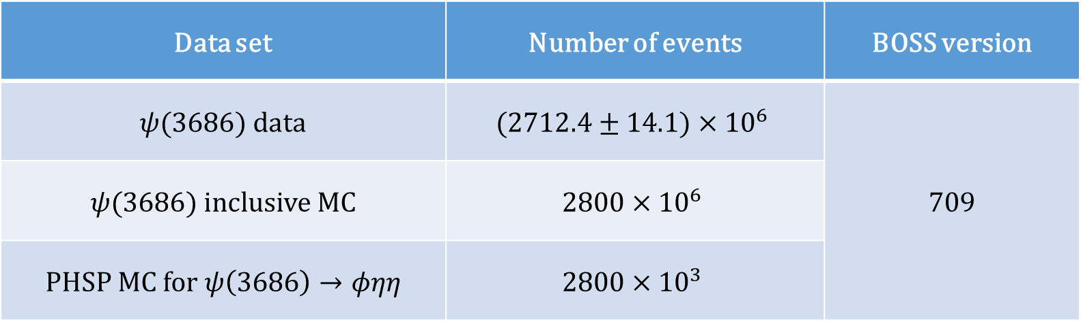
Data Sample and MC Simulation
Data set | Number of events | BOSS version
$ψ(3686)$ data | $$(2712.4±14.1)×{10}^{6}$$ | 709
$ψ(3686)$ inclusive MC | $$2800×{10}^{6}$$
PHSP MC for $ψ\left(3686\right)→φηη$ | $$2800×{10}^{3}$$

Slide 6

Initial Event Selection Criteria
Charged tracks:
$\left|V_{xy}\right|<1 cm, \left|V_{z}\right|<10 cm$ (not from $\overline{Λ}/Λ$ decay)
$\left|cosθ\right|≤0.93$
$N_{good}=2, N_{charge}^{tot}=0$
PID:
$N_{K^{+}}=1, N_{K^{−}}=1$
The tracks are assigned to the particle type with the highest confidence level
Good photons:
$0≤TDC≤14$
Barrel: $E>25 MeV, \left|cosθ\right|<0.8$
End cap: $E>50 MeV, 0.86<\left|cosθ\right|<0.92$
$N_{γ}≥4$
Vertex fit:
The $K^{+}K^{−}$ pair is fitted to a common vertex
$η$ reconstruction:
Combining pairs of photons by kinematic fit with $η$ mass constraint
$χ_{η}^{2}<20, N_{η}≥2$
Kinematic fit:
4-momentum conservation constraint (4C) + $η$ mass constraint (1C×2) kinematic fit under hypothesis of $ψ\left(3686\right)→φηη$

Slide 7
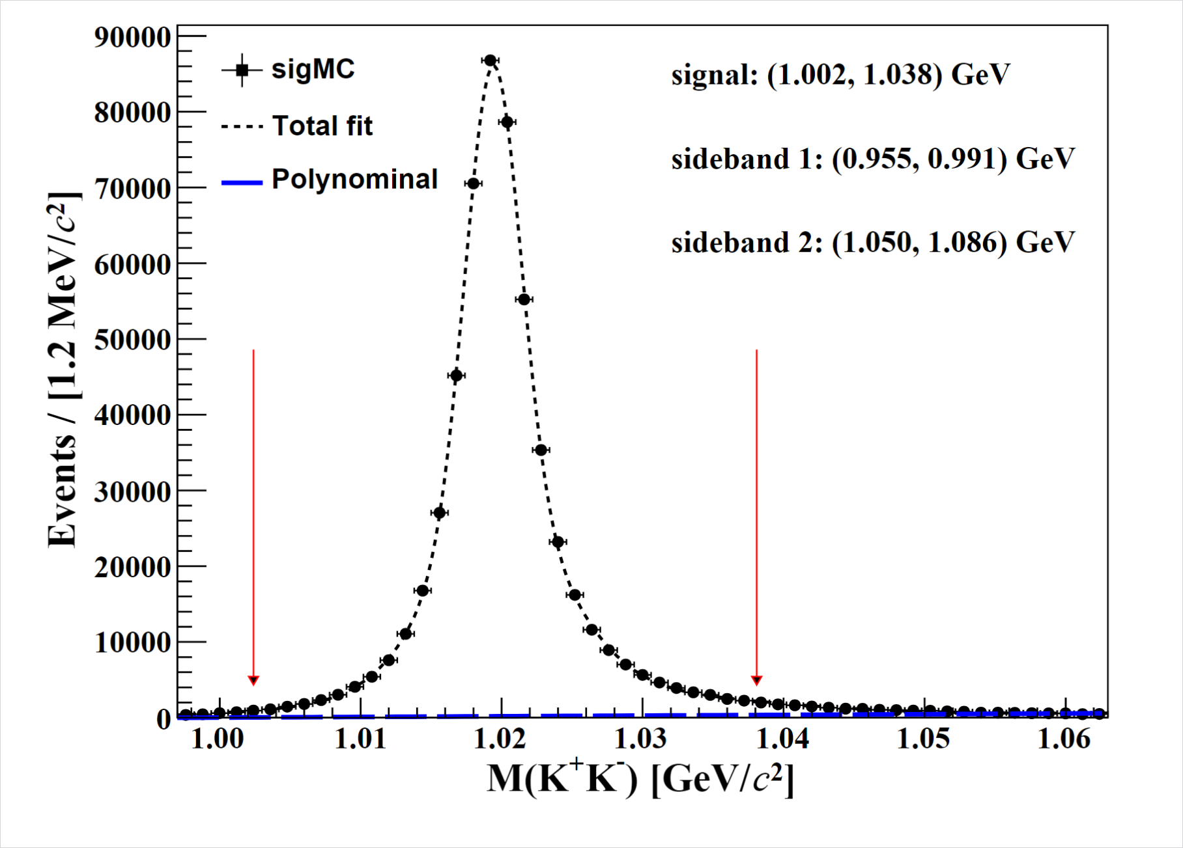
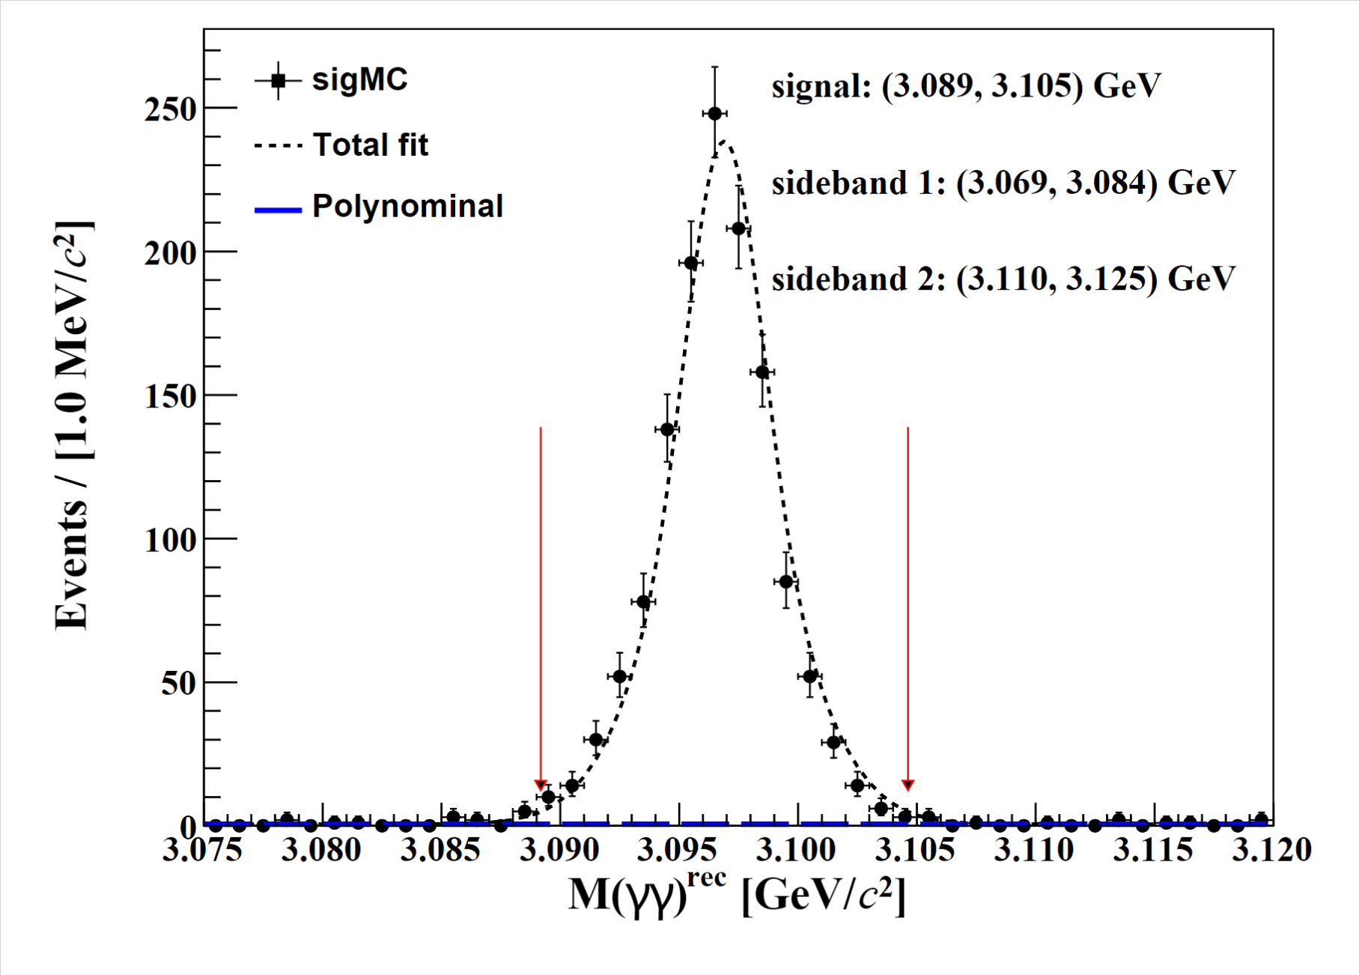
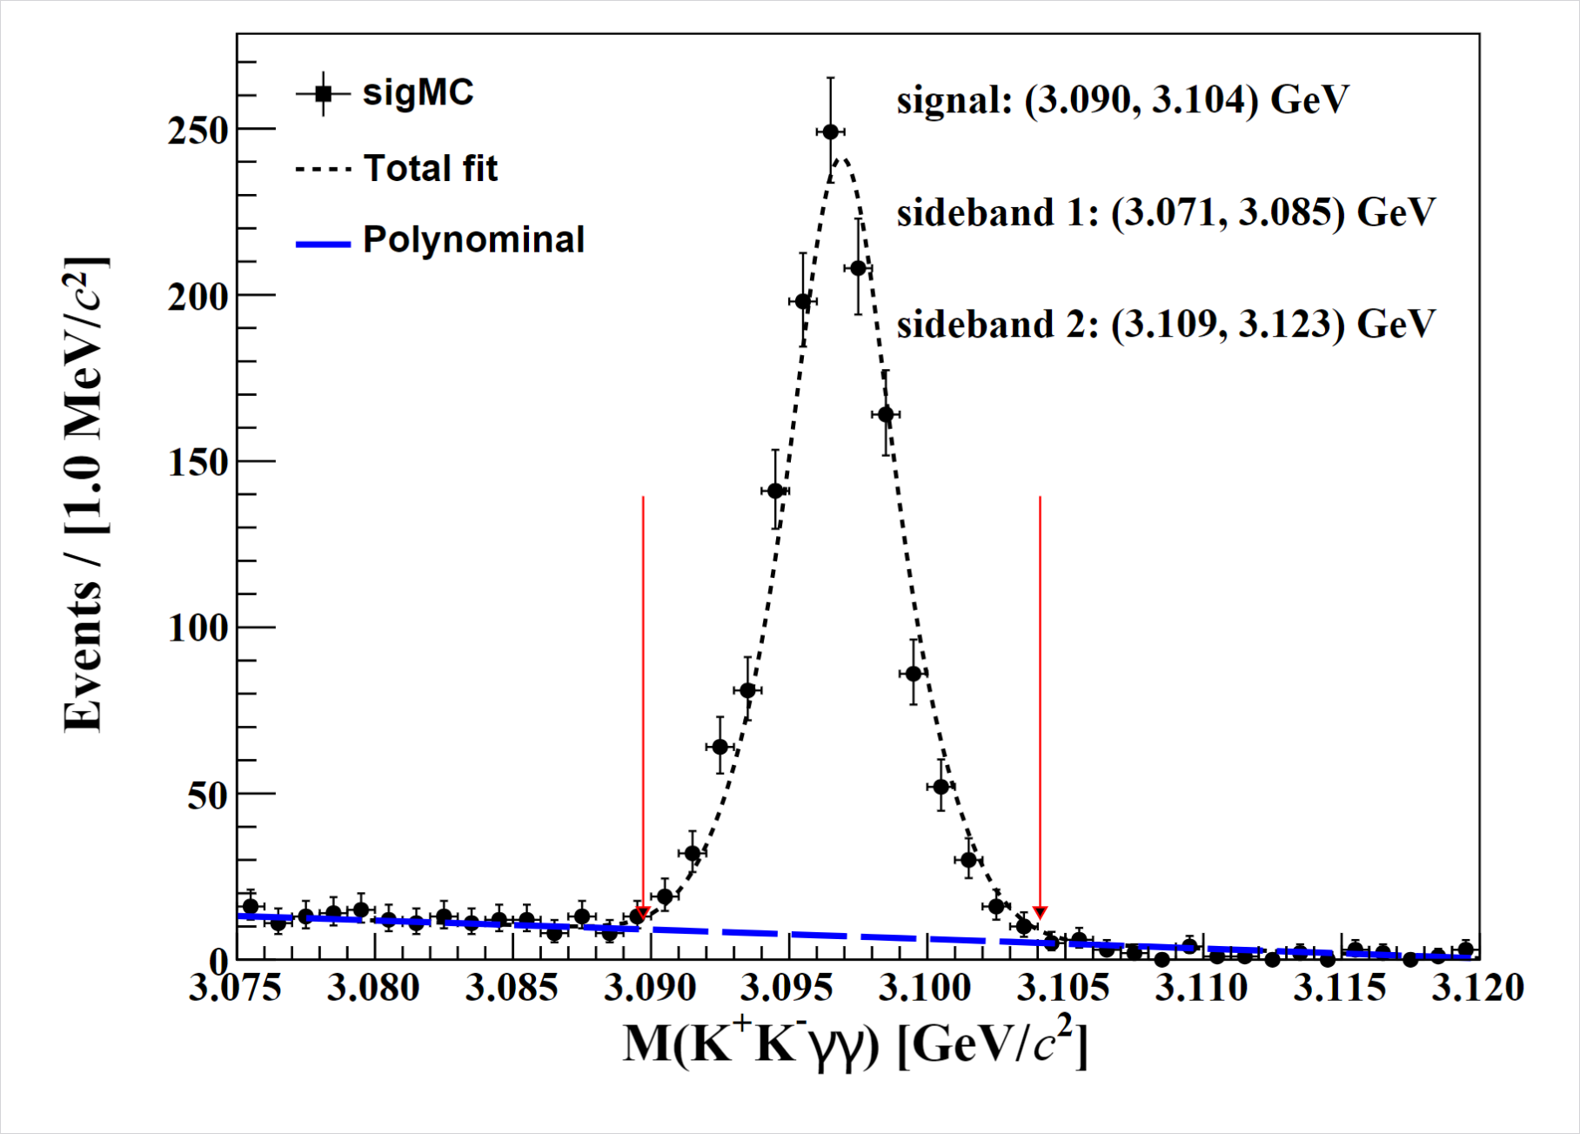
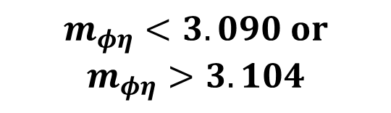

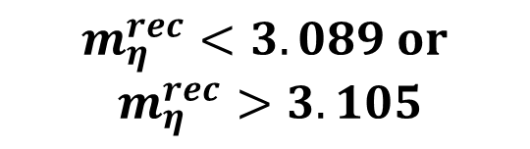
Other Event Selection Criteria
$$m_{η}^{rec}<3.089 or$$
$$m_{η}^{rec}>3.105$$
$$m_{φη}<3.090 or$$
$$m_{φη}>3.104$$
$$1.002< m_{φ}<1.038 GeV$$

Slide 8
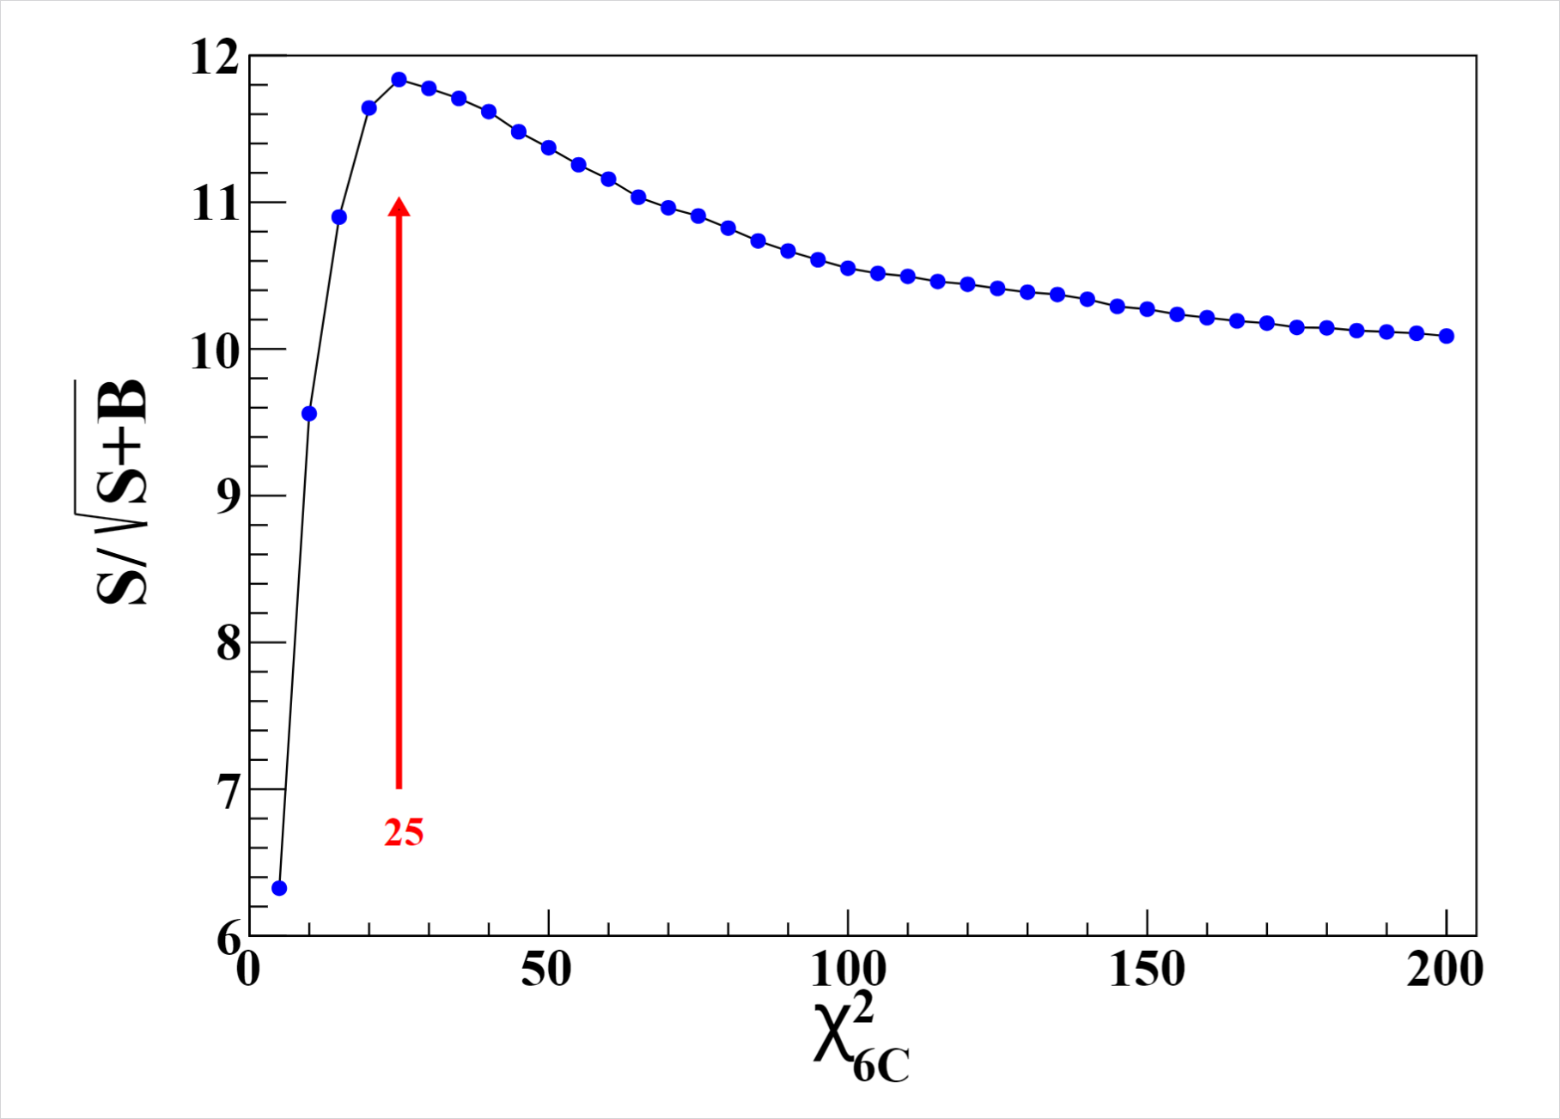


Other Event Selection Criteria
$$FOM=\frac{S}{\sqrt{S+B}}$$
$$χ^{2}<25$$

Slide 9
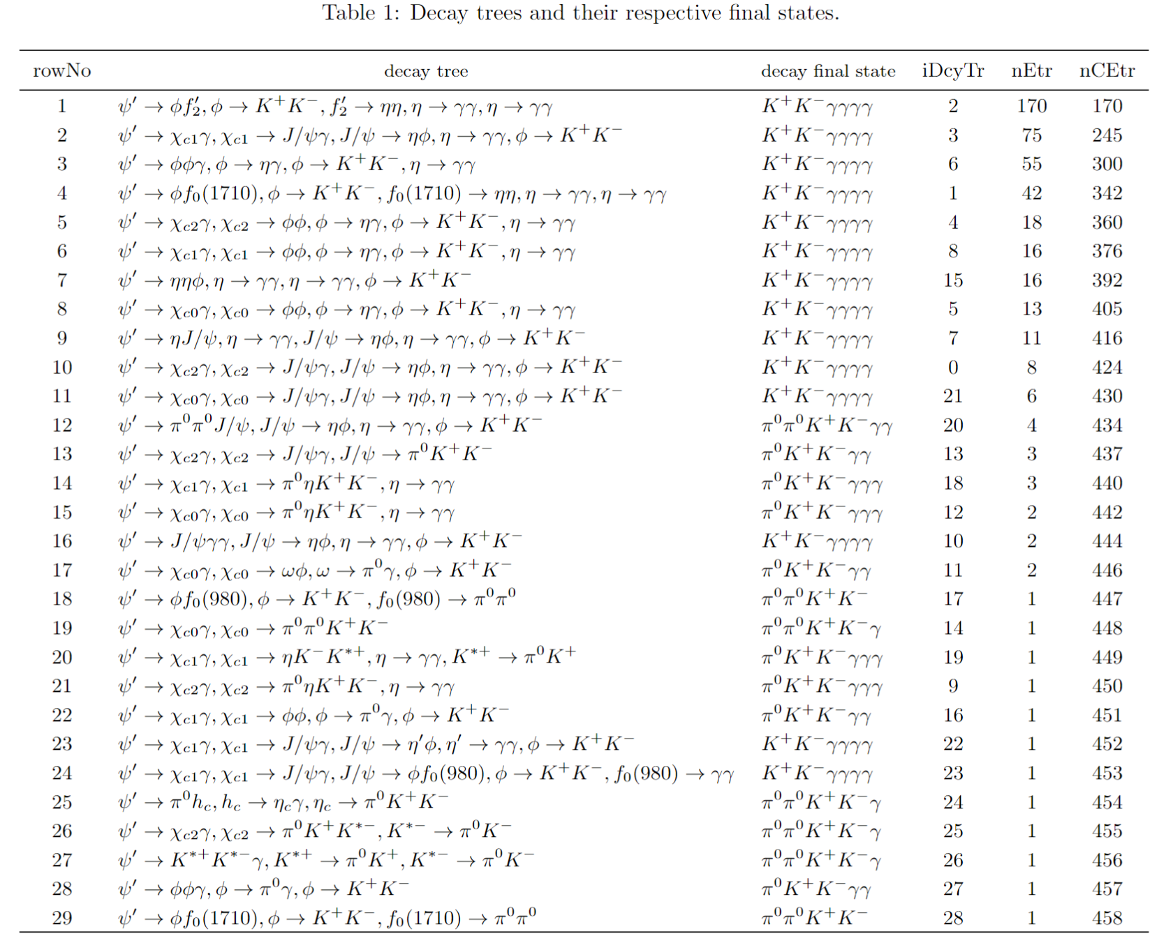
Topology Analysis

Slide 10
