Slide 1



ITk strip hybrid and module production
Weiguo Lu（陆卫国）
On behalf of the ATLAS ITk China group
MOST ATLAS Detector Upgrade Project
IHEP, 5 Dec. 2025

Slide 2
Outline
Introduction
Production Flow
Assembly
Qualification Control
Wire-bonding
Electrical test
Progress and Status
Progress of the whole Collaboration
Local status and risks at IHEP
Summary

Slide 3
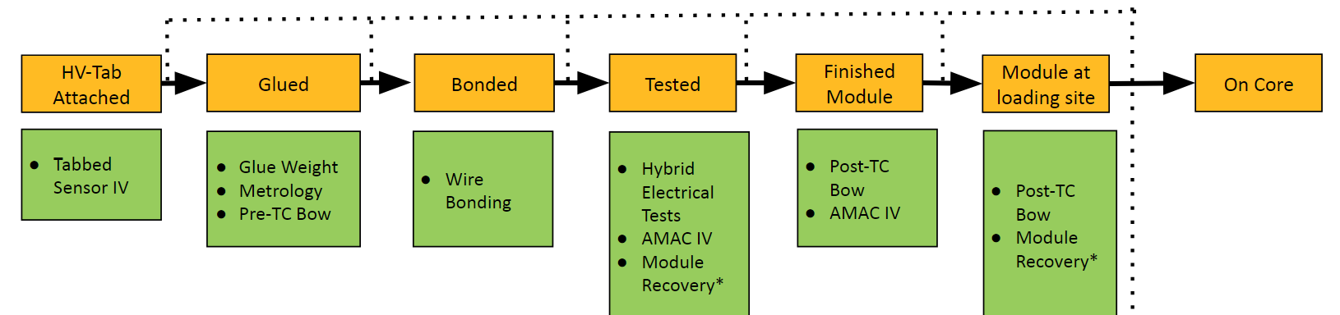
Module QC
Modules transitioned through a variety of stages and QC tests to ensure a working module
Modules Visually inspected at each stage
Visual inspection tests uploaded only if there is a problem
Modules can move to the failed stage at any point
Descoping
Tests/procedure not providing useful data are removed from the QC chain
Glue weight , Pre-TC Bow…
Grading
Some module metrology are out of the spec but believed installable, new Grade B
Limbo stage for EBD modules with hopeful recovery

Slide 4
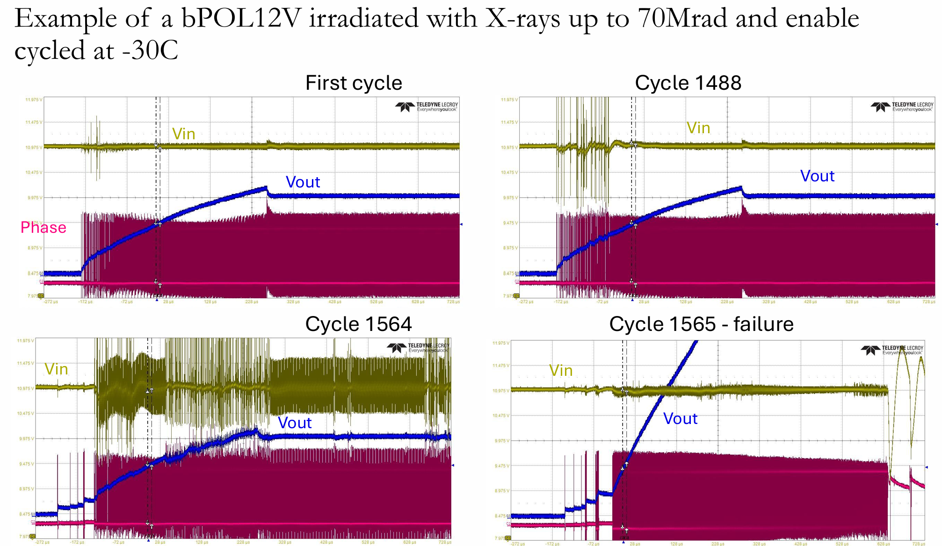
bPOL issue
Two kinds of failure modes
A “gradual” failure
A “sudden” failure
Tests and simulations to understand the reason
Tests to determine the radiation level reachable
Verify if can be used reliably below ~5Mrad, 10Mrad…
Corrective solutions
Modify the powerboard
Modify the chip bPOL12V itself, new fabrication
Keep the current rate and no ramping up for ITk production

Slide 5
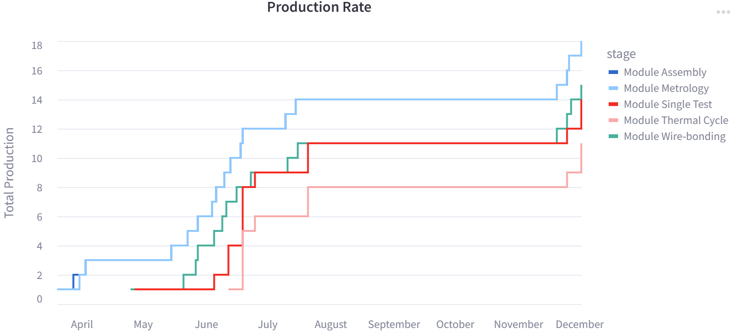
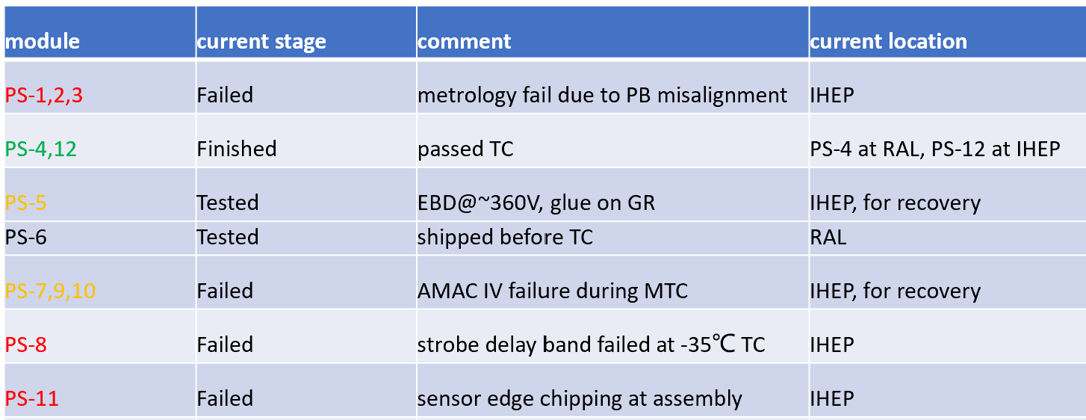
Module Production @ IHEP
Assembly Progress
Hybrids — 65
Pre-production Modules (PPC + Pre-series) — 5 + 15
Production Modules — 4 all passed
PPC not included in the plot
Short halt due to lack of glue from August to November

Slide 6
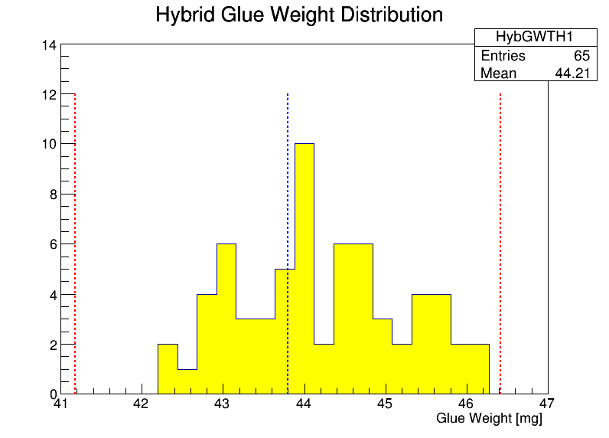
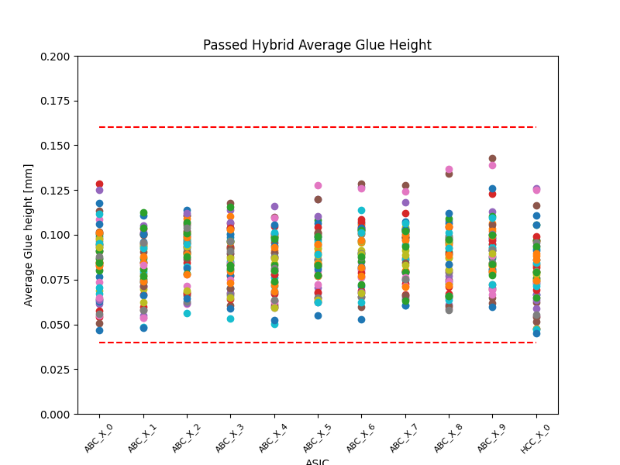
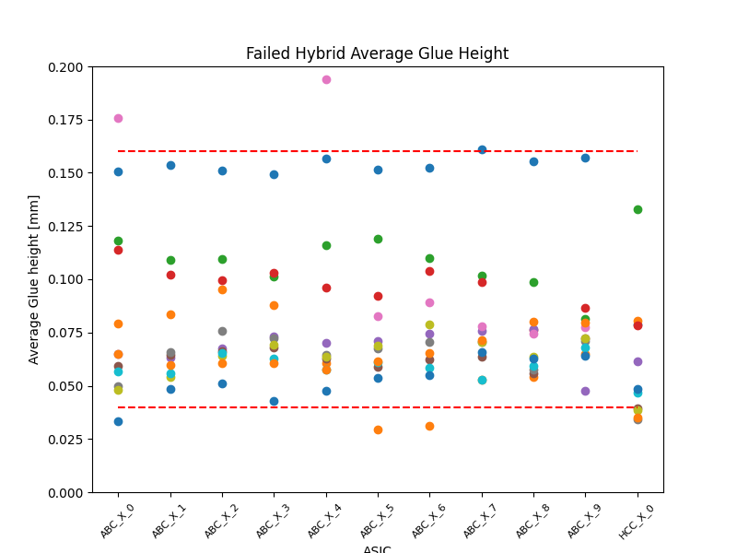
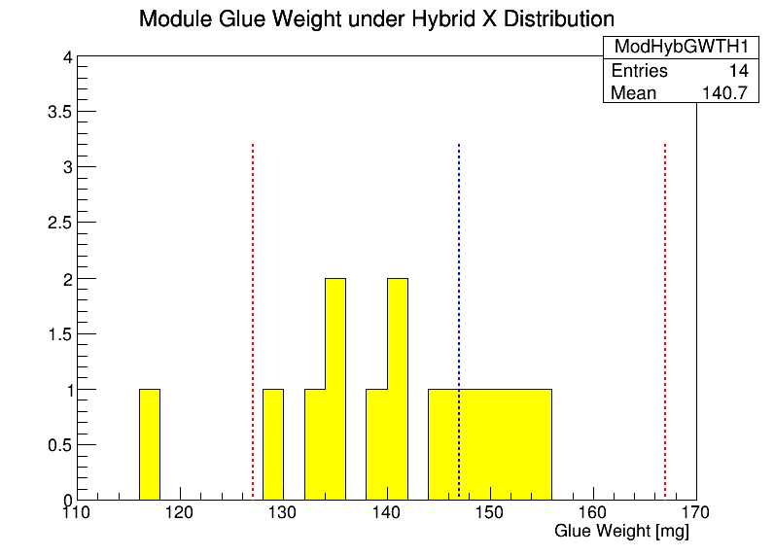
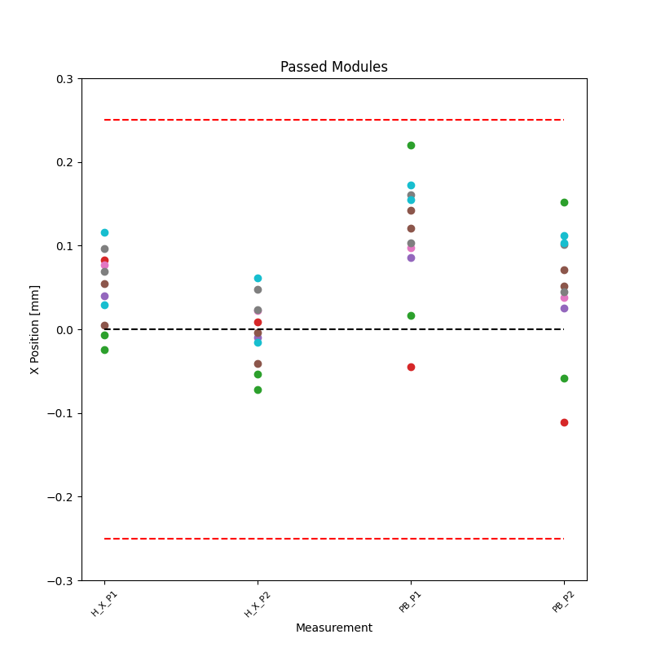
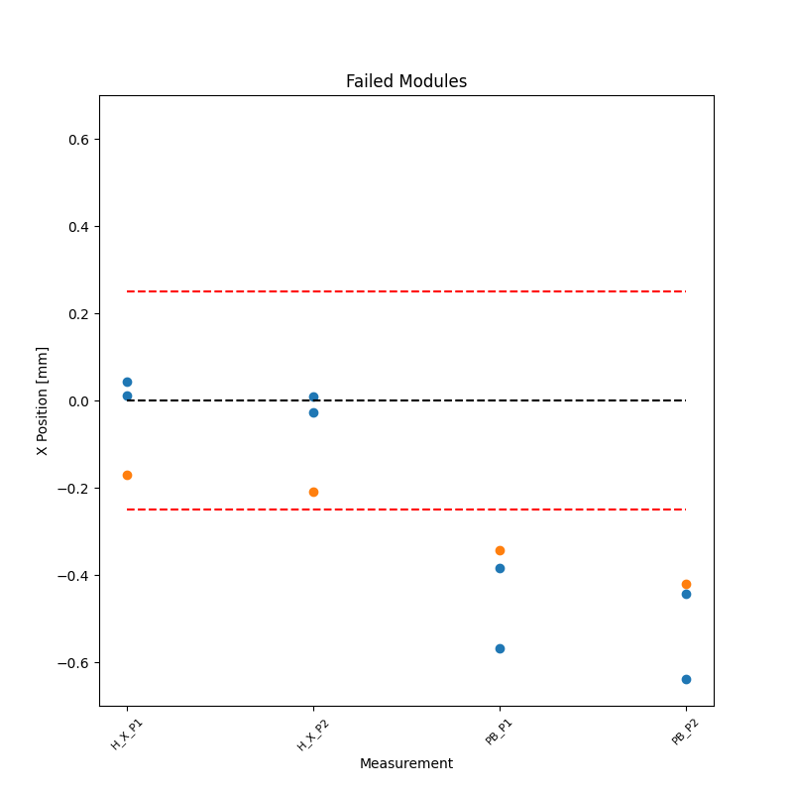
Qualification Control
Hybrid
module

Slide 7
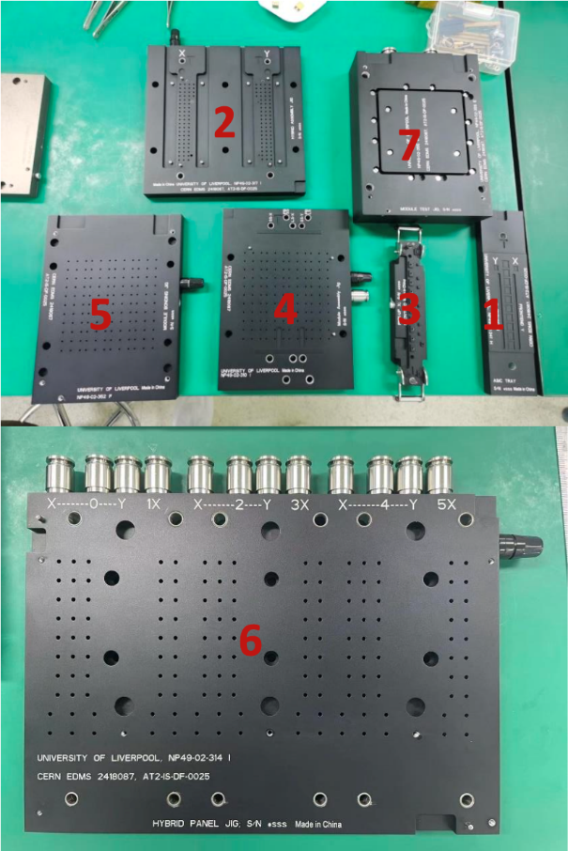
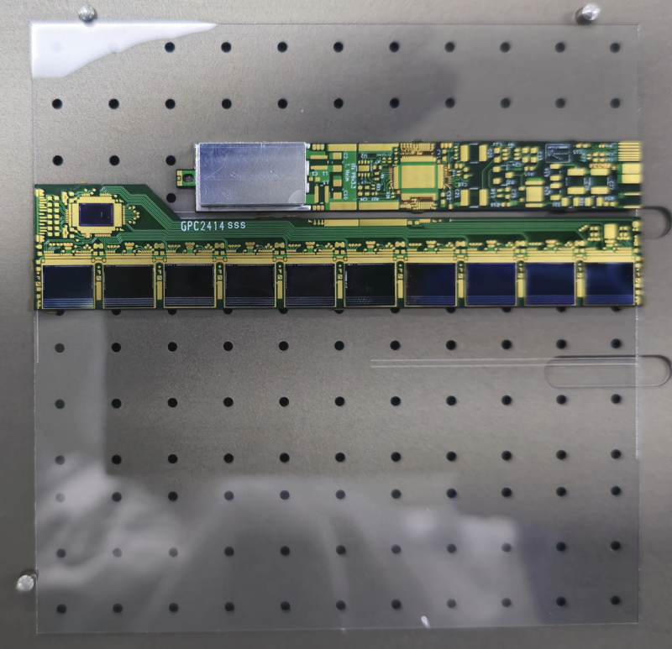
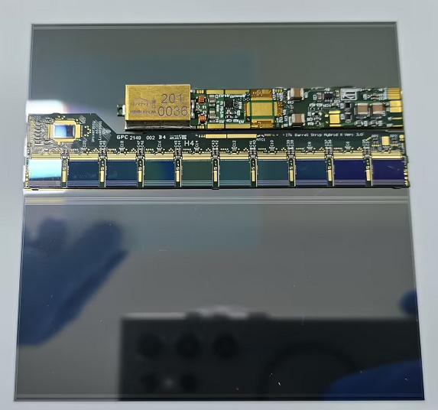
Production Tools
A couple of new tools made in China
1. ASIC tray
2. Hybrid assembly Jig
3. Pickup tool
4. Module assembly Jig
5. Module bonding Jig
6. Hybrid panel Jig
7. Module test Jig
Performed the quality check for all tools
Training with dummy parts
Glass dummy
Mechanical dummy

Slide 8
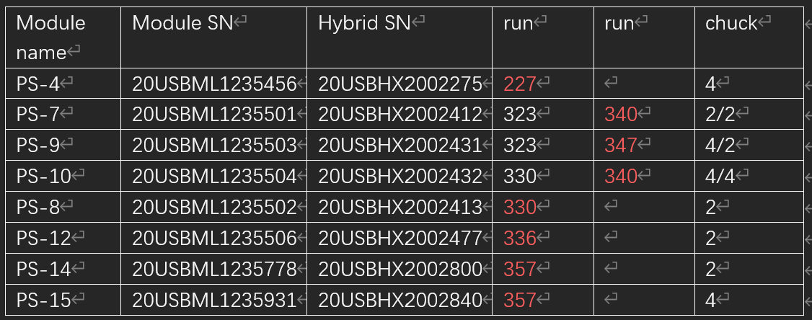
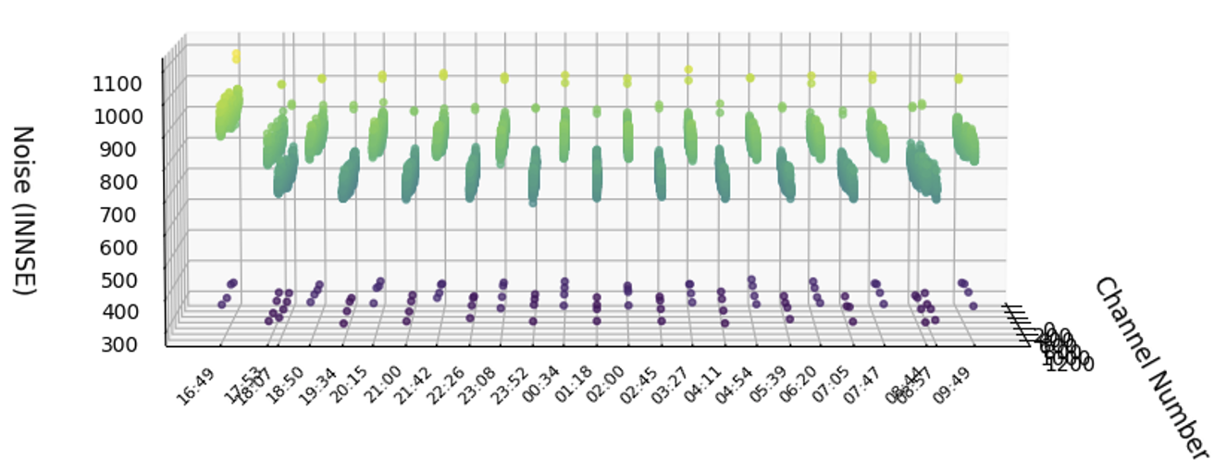
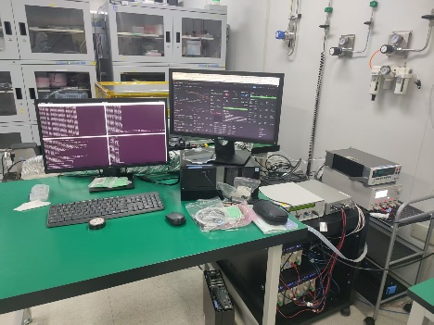
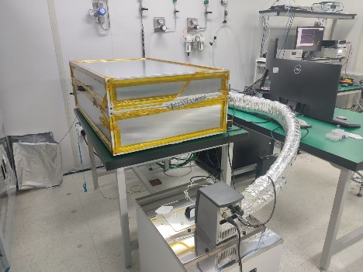
Coldjig improvement
The noise was higher at some chucks during the Pre-series production
The test results were analyzed to investigate the reason
A lot of efforts contributed to the setup improvement
Re-assemble of the chucks
Re-organize the layout of the system
Better grounding and shielding
The MTC is now working as expected
The noise of all chucks below ~1000e-
PS-4 away chuck4 227

Slide 9
Potential Difficulties-assemble
Flex Thickness Variability Cripples Assembly Efficiency
Root Cause：Attaching interposers to hybrids & PBs induces major batch-to-batch flex thickness variation
Compounding Problem：Thickness is also non-uniform within each flex piece
Operational Consequence：Requires tooling recalibration for every single batch
Final Impact：Severely reduces assembly efficiency and introduces unavoidable process errors
Current Production Bottleneck & Proposed Solution
Capacity Limit : The current lab vacuum system can only support the assembly of 3 modules per week.
Throughput Goal: To increase the production rate, we need to assemble 2 modules simultaneously.
Key Requirement: This parallel processing necessitates an additional, dedicated vacuum system to sustain the operation.

Slide 10
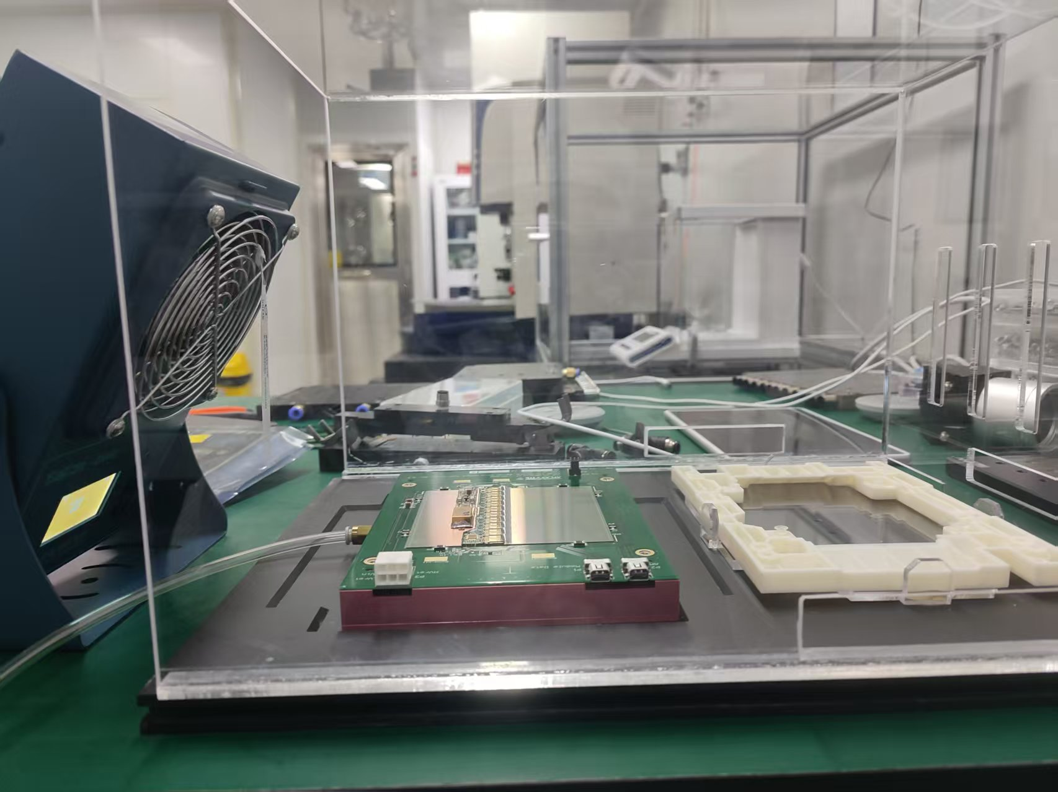
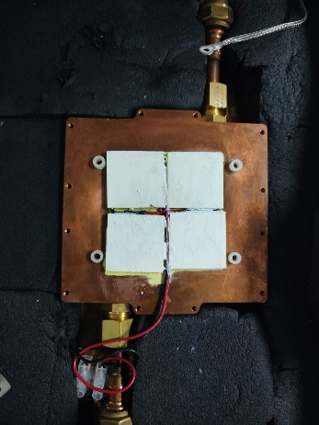
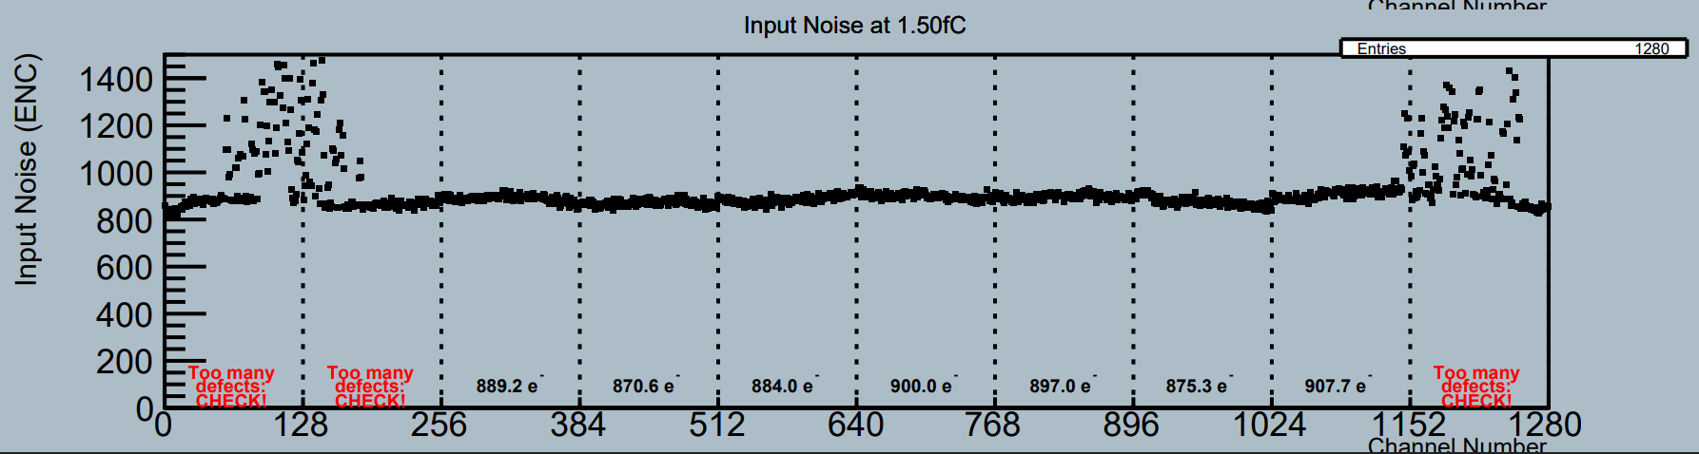
Potential Difficulties-test
Deionization
The static charge accumulated at the suction cup position
Influence the noise measurement of the module
A lot of time needed to remove the SCN
Degradation of Coldjig
Aging of key parts of the system
e.g. the humidity sensor
The compressed air machine maintenance

Slide 11
Summary
ITk strip barrel module production is challenging
IHEP passed site qualification and enter Production phase
Efforts made on QC including SOP development
Produced several modules which makes production flow much smoother
Difficulties ahead and mitigation methods on way
Thanks

Slide 12
Back up

Slide 13
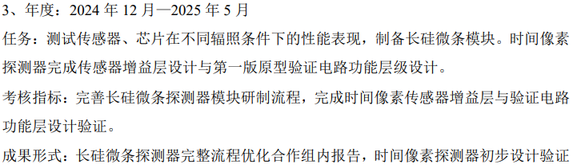
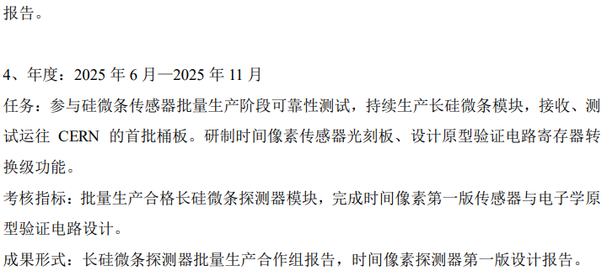
plan

Slide 14
Outline
Introduction
Production Flow
Assembly
Qualification Control
Wire-bonding
Electrical test
Progress and Status
Summary

Slide 15
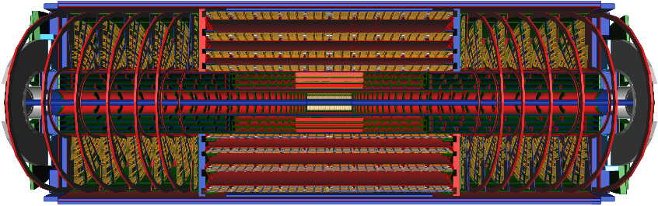
ITk Detector
Barrel
Endcap
HL-LHC upgrade
All silicon tracker
Barrel-Stave-SS/LS module
Endcap-Petal-R0/R1/R2/R3/R4/R5 module
SS module

Slide 16
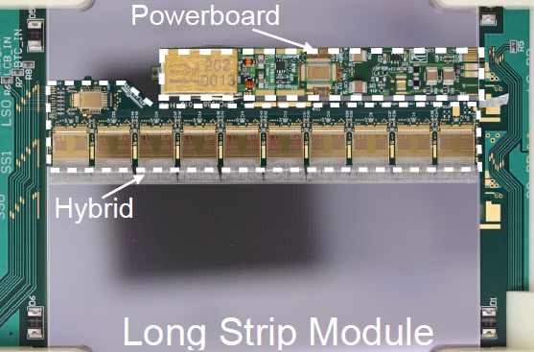
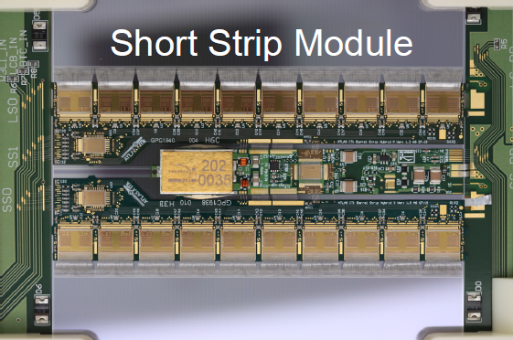
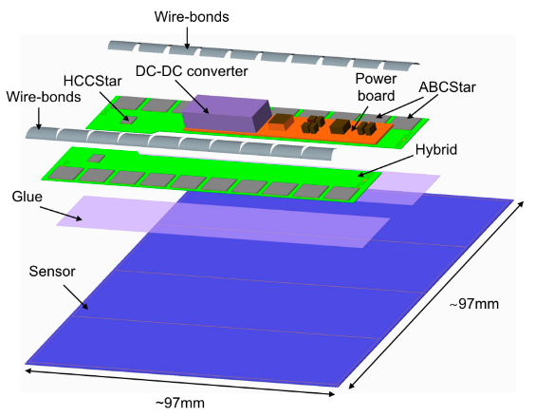
Barrel Module
Sensor
Size : 97mm✖97mm
Strip length LS: 48.2 mm / SS: 24.1 mm
Pitch :75.5um
Hybrid
ABCStar: ATLAS front-end Binary read-out Chip
HCCStar: Hybrid Controller Chip
Powerboard
AMAC: monitor and control
bPOL12V: low-voltage regulation
linPOL12V: both voltages for AMAC
HVmux: high-voltage switching
Glue for mechanical fixing
Wire-bonding for electrical connection

Slide 17
Outline
Introduction
Production Flow
Assembly
Qualification Control
Wire-bonding
Electrical test
Progress and Status
Summary

Slide 18
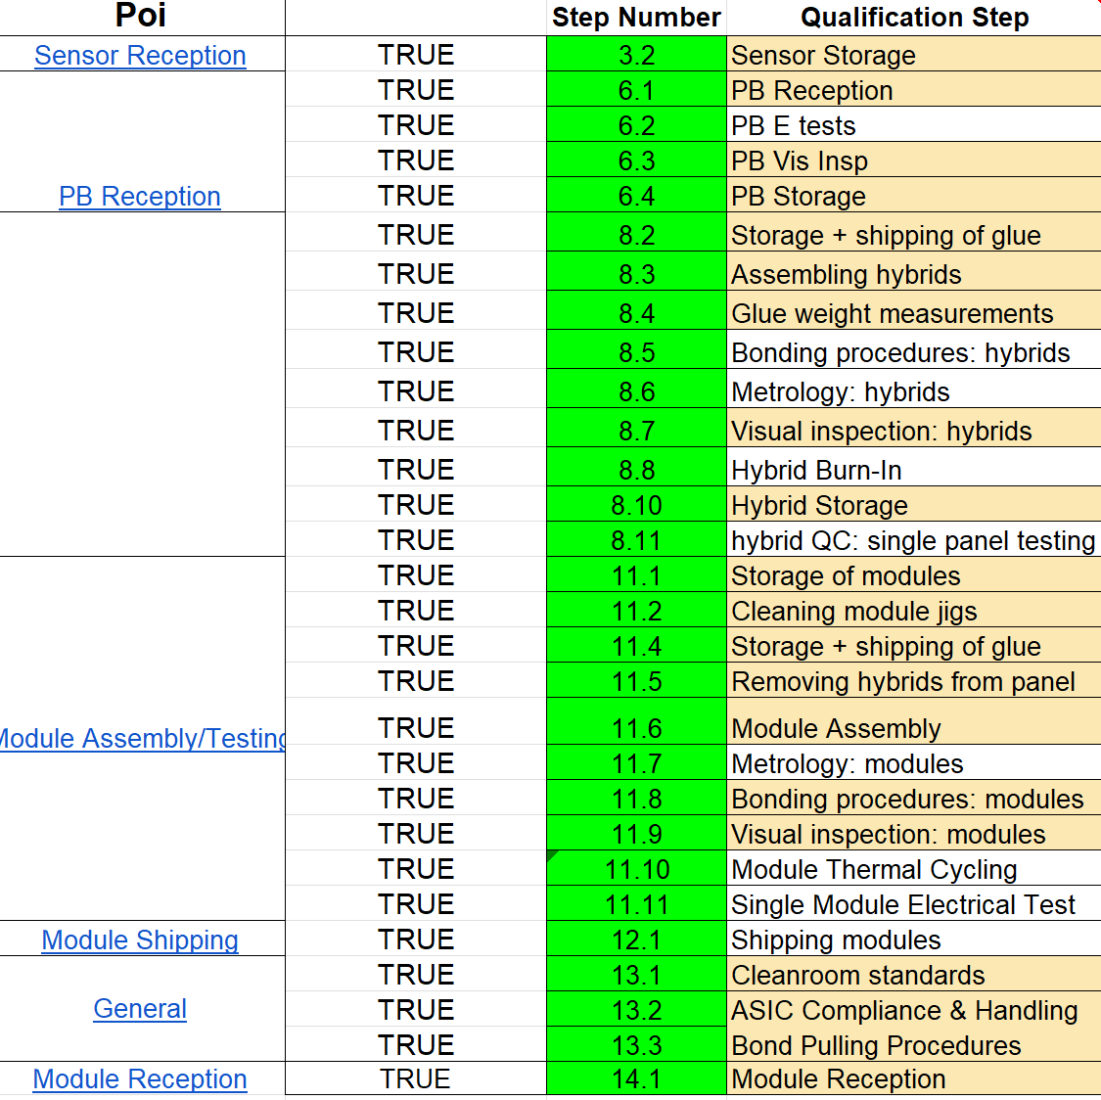
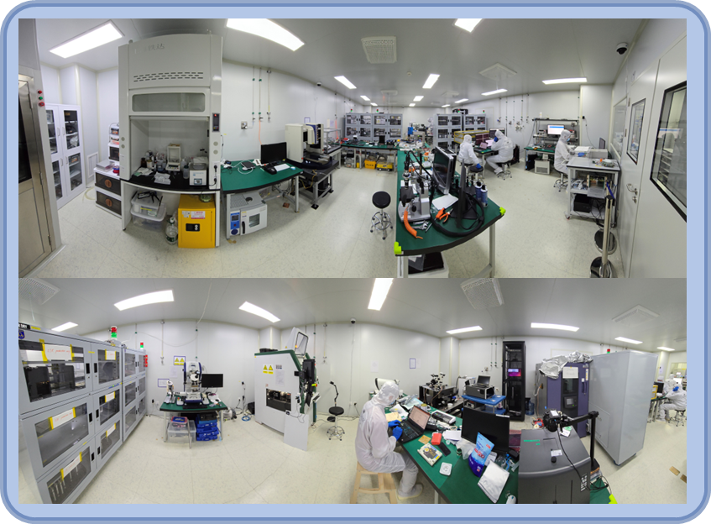
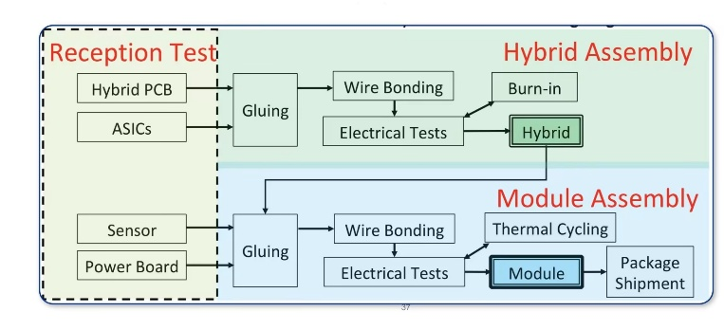
Production Flow
Module Production
Hybrid Assembly
Module Assembly
Quality Control (QC)
Site Qualifications
IHEP have been qualified for all 29 QC steps in barrel module production
Finished the Pre-Production and started production
E-test area
Gluing area
Bonding area

Slide 19
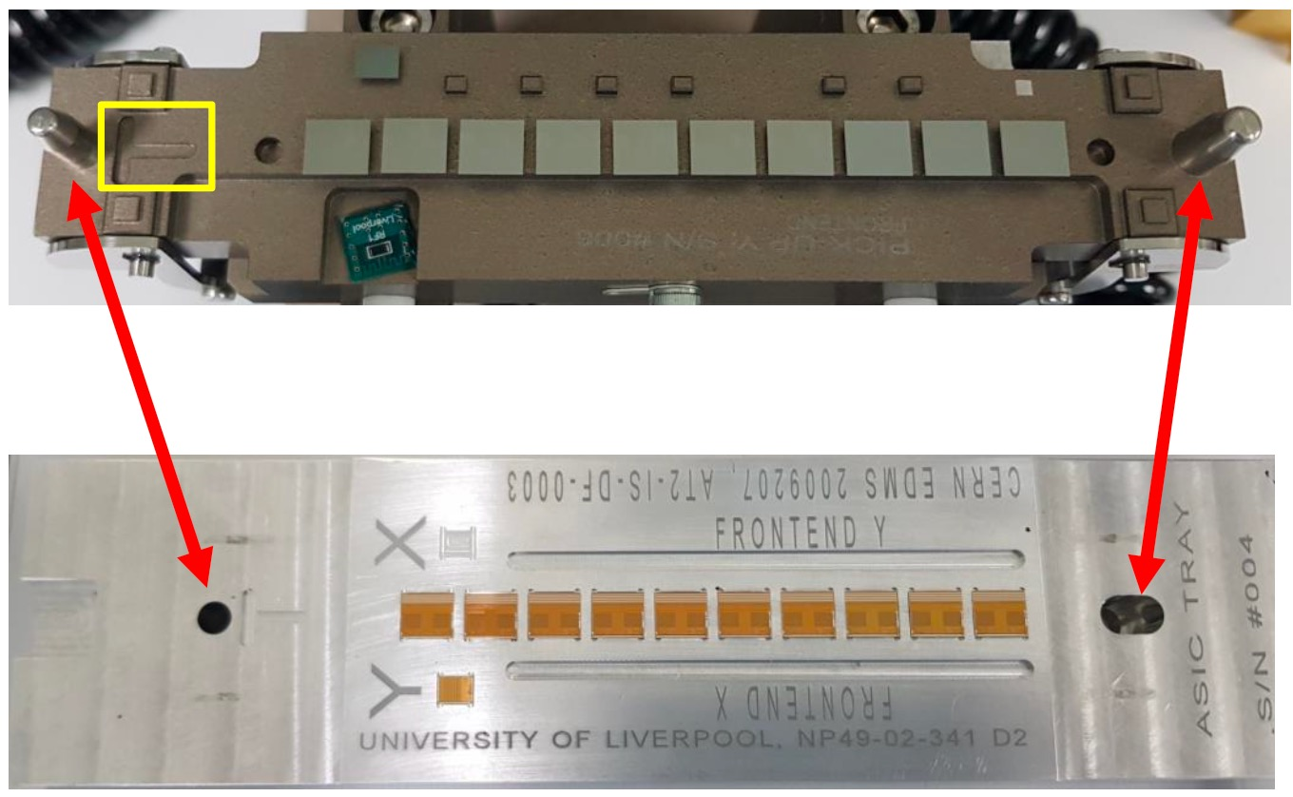
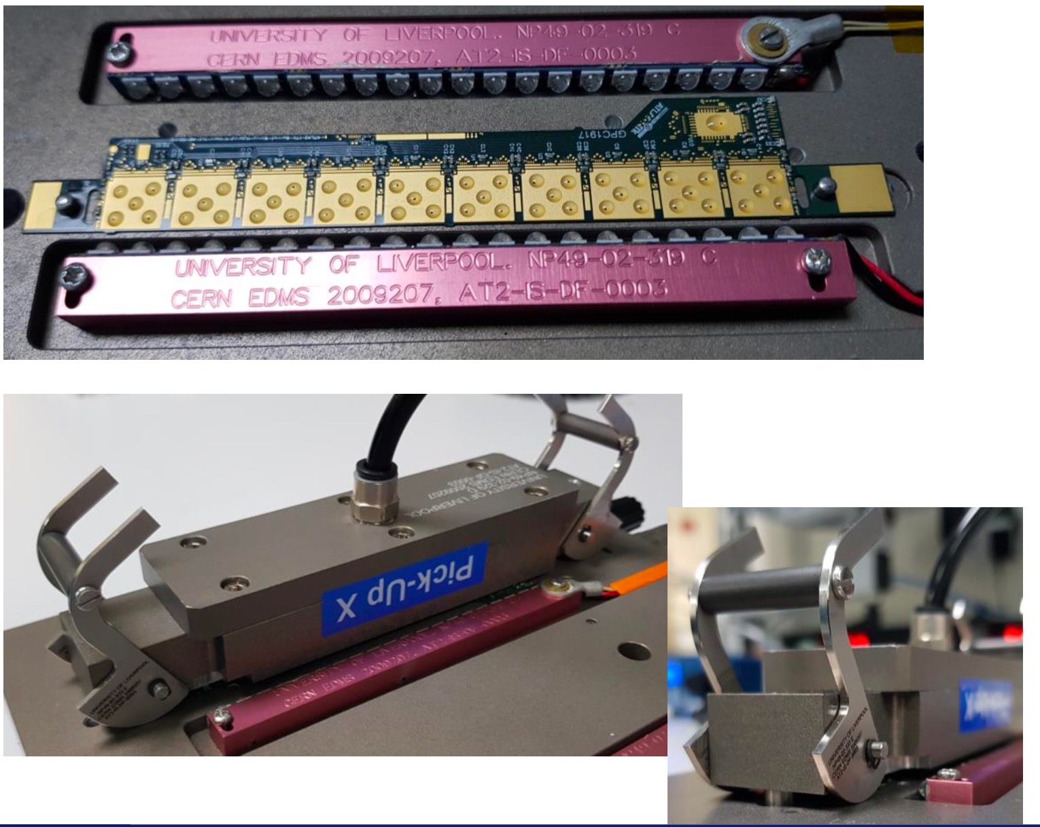
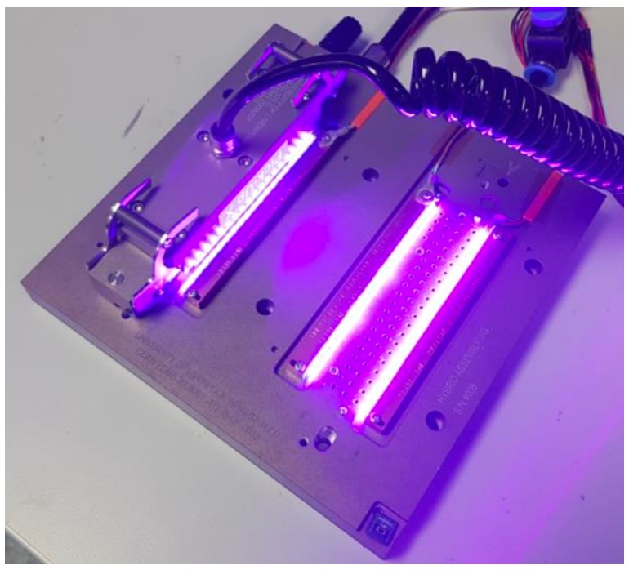
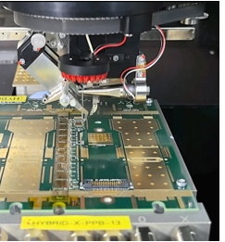

Hybrid Assembly
Pick up ASICs and
alignment
Apply UV glue on hybrid and ASIC attachment
using dot pattern
UV glue curing
Wire bonding
Procedures
ASICs attachment
ASICs adhesive: UV-curable glue (Loctite 3525)
Glue coverage controlled by weight and thickness
Wire-bonding
Hesse Bondjet BJ820
25µm diameter aluminum wires
Electrical connection between ASICs and hybrid flex (as well as hybrid and test panel)

Slide 20
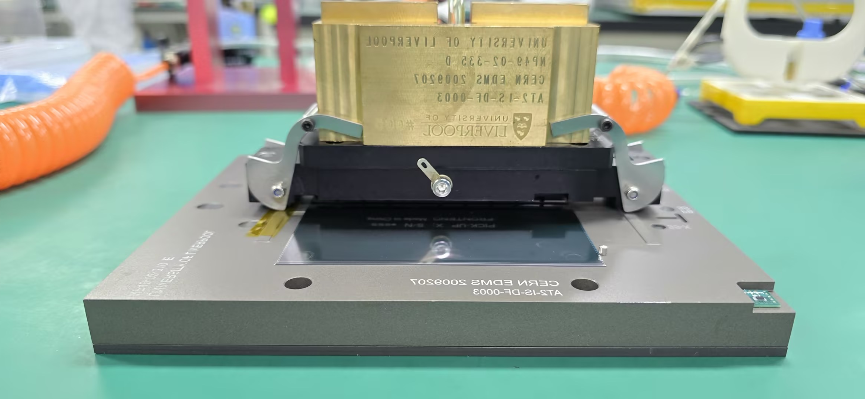
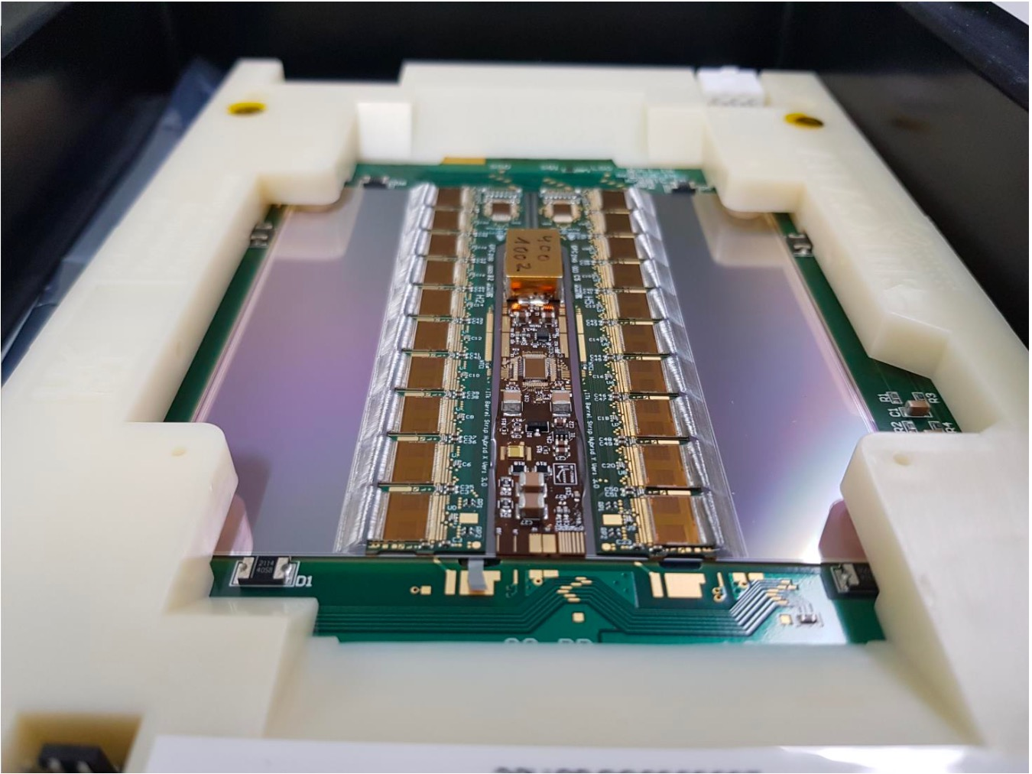

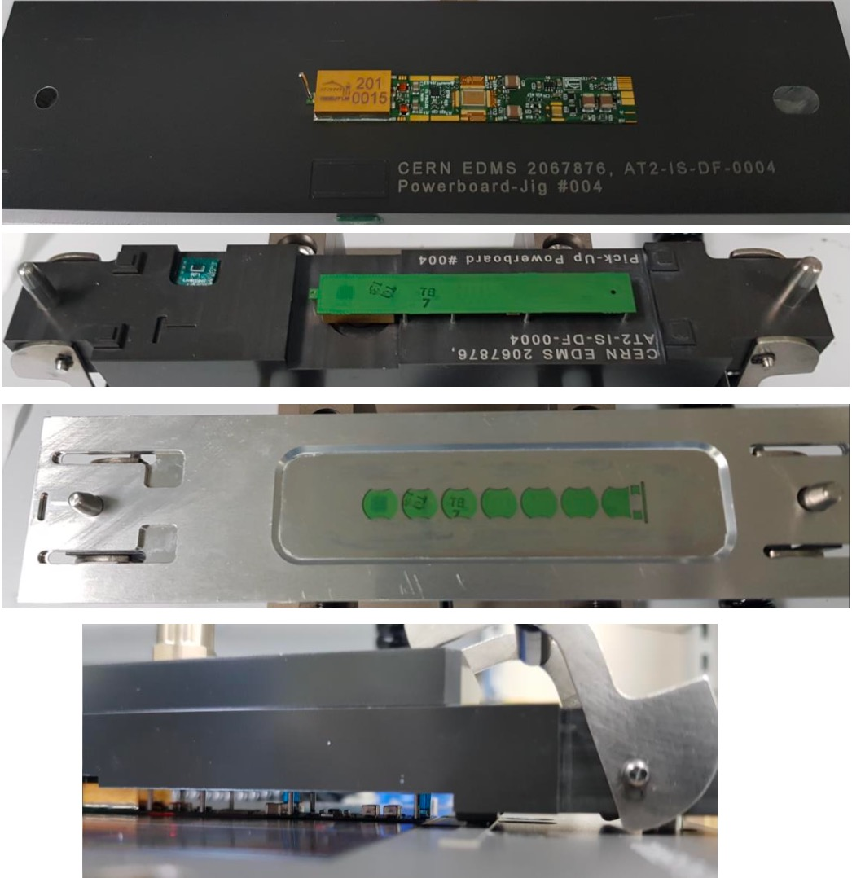
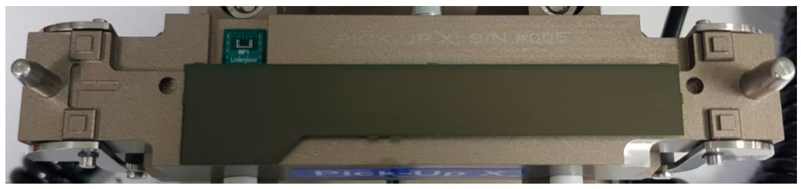
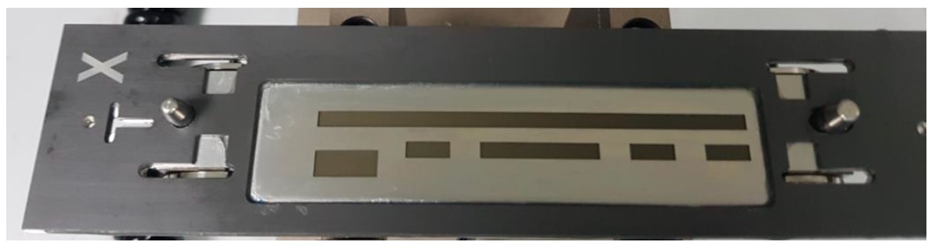
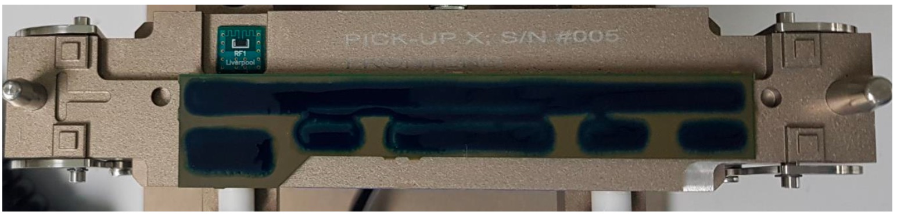
Module Assembly
Dispense glue on stencil for
hybrid
Dispense glue on stencil for
PB
Glue curing for hybrid and PB
Wire bonding
Procedures
Hybrid / Powerboard attachment
Hybrid and PB adhesive: Epoxy (True Blue)
Wire-bonding
Hesse Bondjet BJ820
256 Al wires in 4 rows per ABCStar chip at Front-end
Hybrid to powerboard wire-bonding
Module to test frame wire-bonding

Slide 21
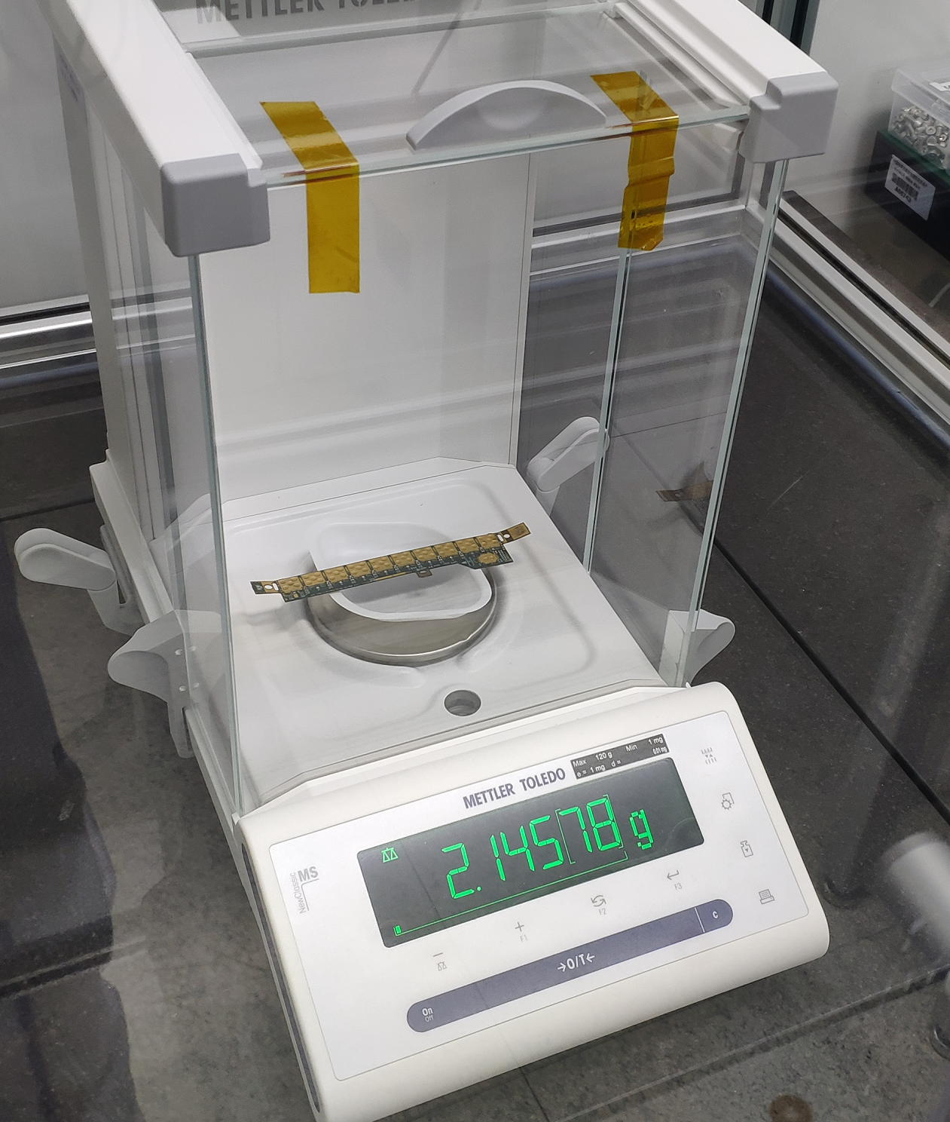
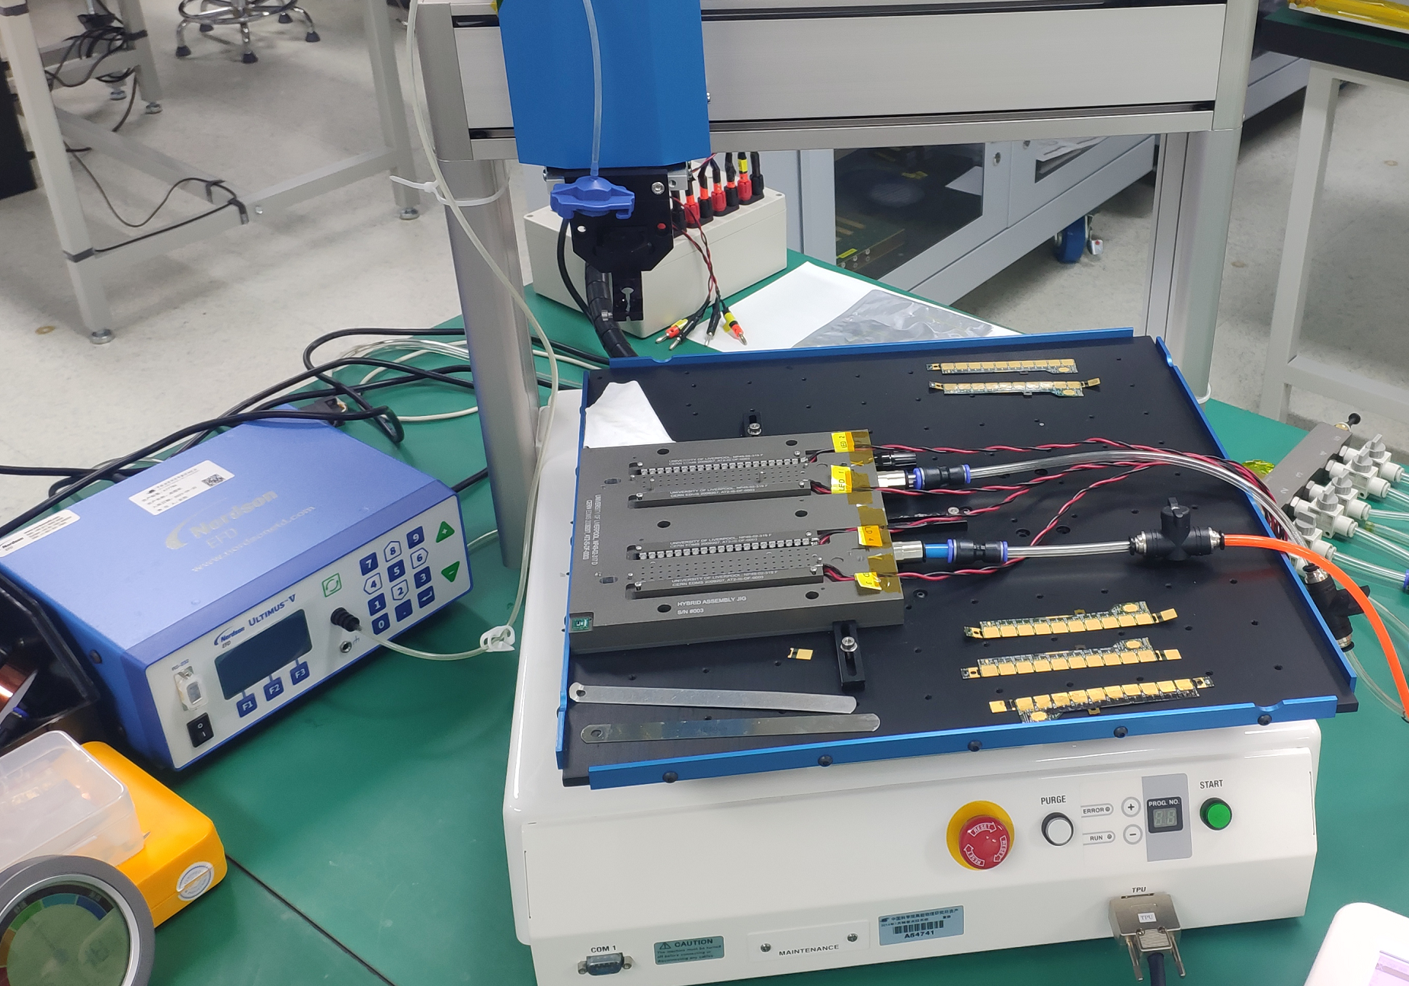
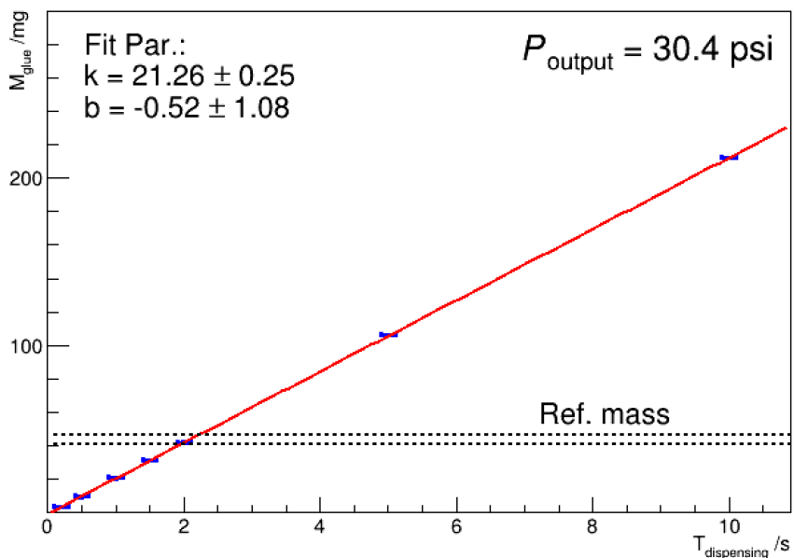
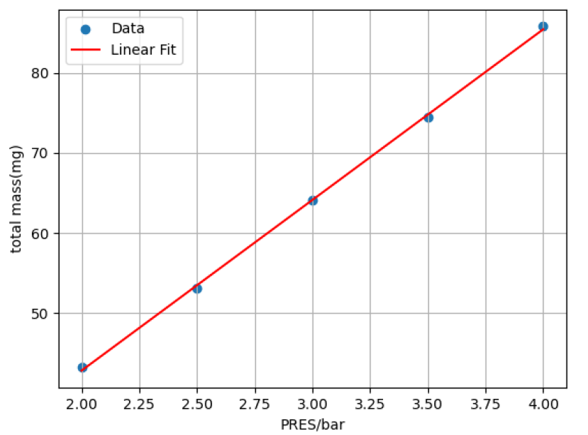
Qualification Control
Glue Weight
ASICs-to-hybrid glue dispensing by a 3-Axis E Series Automated Fluid Dispensing Robot
Weighting with a digital scale
43.80±2.62 mg for ASIC adhesive weight
Calibration with dispensing time and air pressure
A Mettler digital scale
A Norson dispenser + JANOME robot

Slide 22
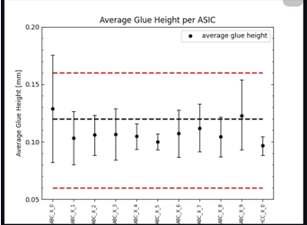
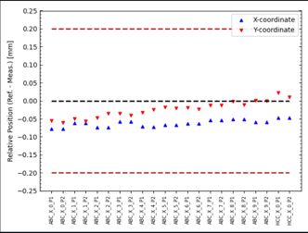
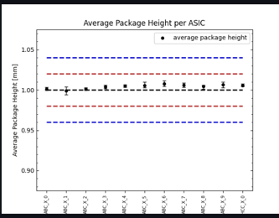
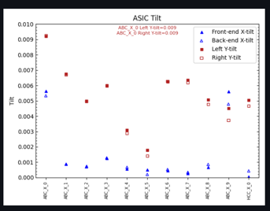
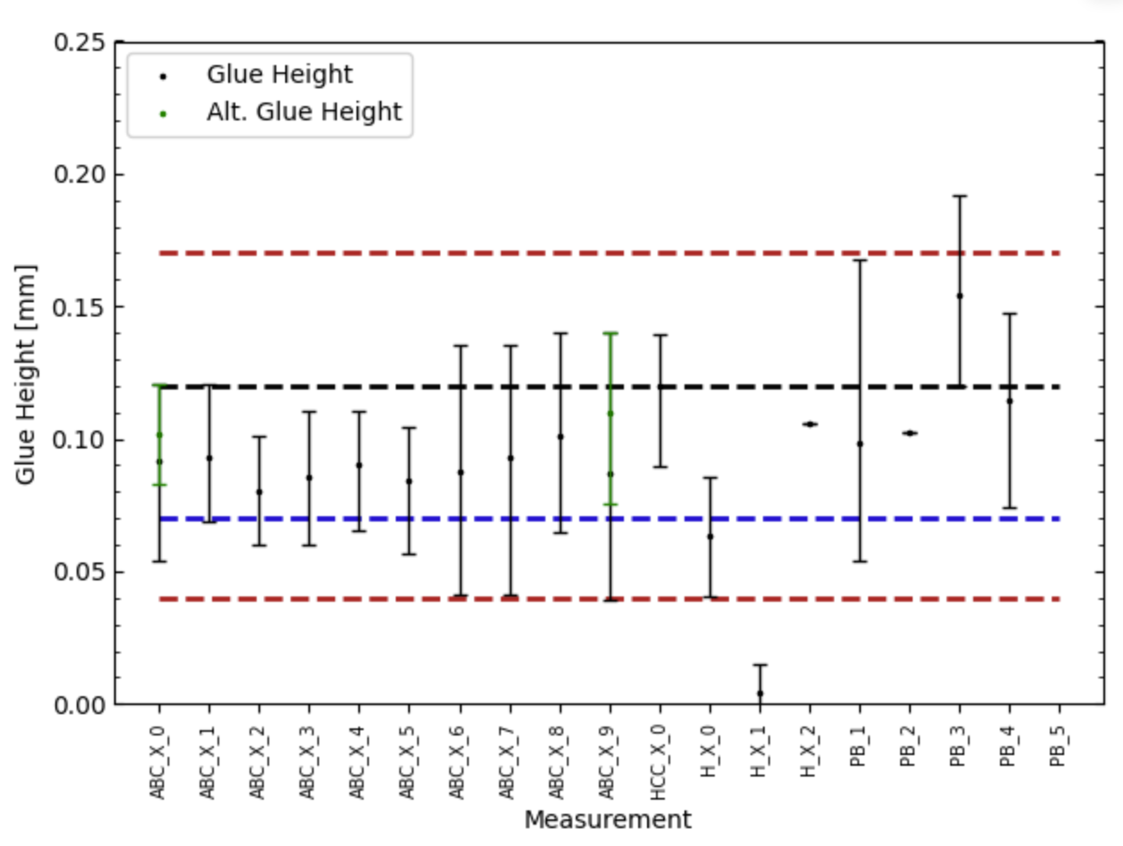
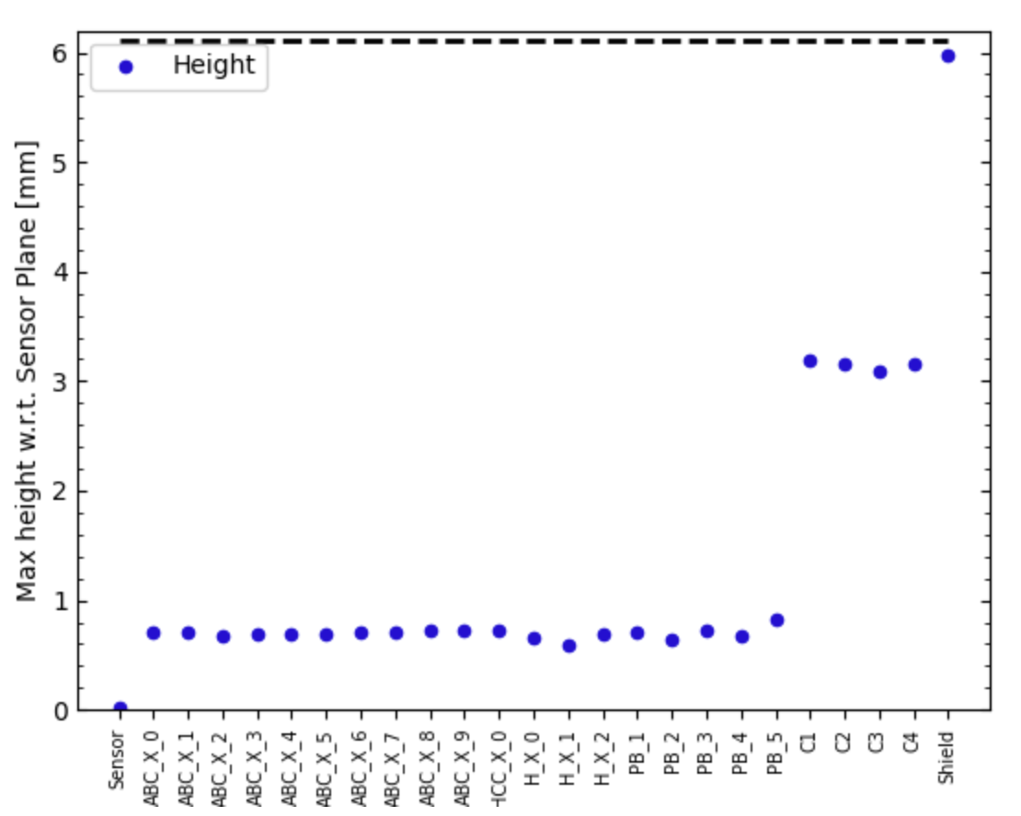
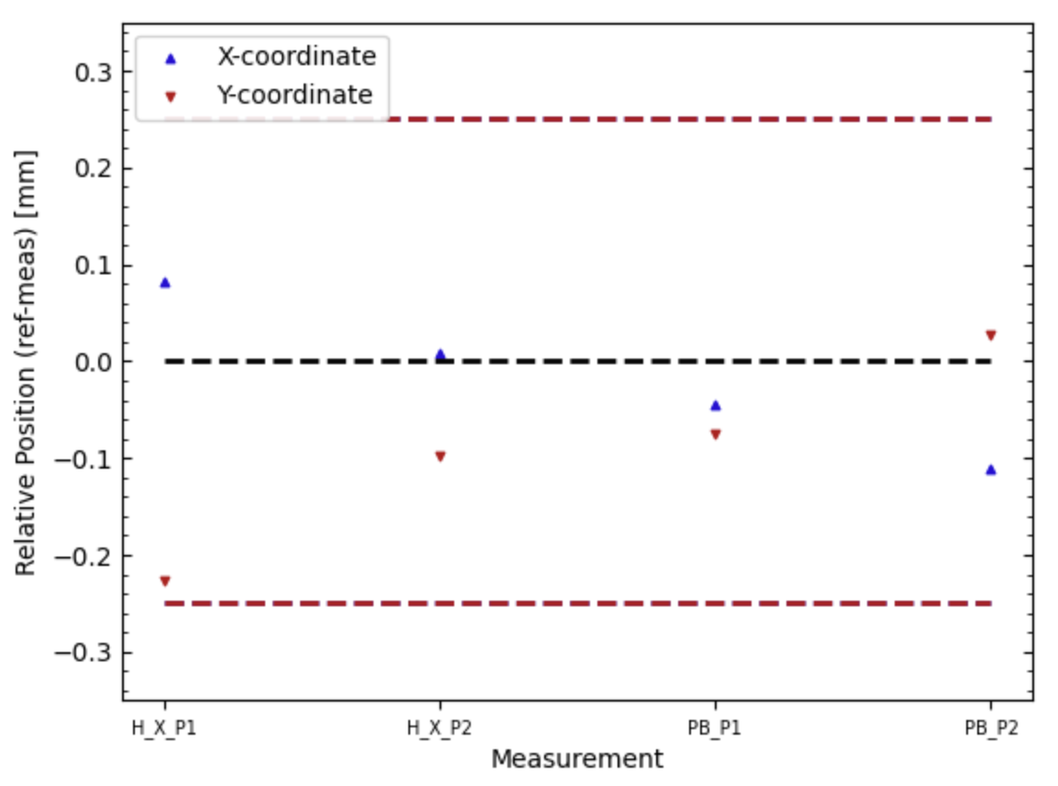
Qualification Control
Metrology
Geometric positioning of characteristics
ASIC glue height: 120 +40/-60μm
ASIC xy-placement: within +/-200μm
ASIC flatness: Tilt ≤ 0.025
Hybrid package thickness: 0.84±0.04mm
Module bow between -50μm and +150μm
Glue height
ASIC relative position
Total package height
ASIC tilt
Glue height
Maximum height
Relative position

Slide 23




Qualification Control
Visual Inspection
Check hybrid flex
Defects
Check ASICs
Integrity of surface and edges
Cleanness on bonding pads
Check Sensor
Any scratches, marks and debris
Integrity of edge
broken sensor
Check bond-wires
A Keyence digital microscope
Suction cup marks
ASICs
sensor
FE wire-bondings
Long scratch

Slide 24







Wire Bonding
Module wirebonding
Front end – four columns of pads with 75.5um pitch
Yield of the electronics channel >99%
Bonder Hesse BJ 820
Nordson Dage 4000Plus
Pull test every month to optimize the bonding parameters
Pull force > 8g
Peel break (4/5) < 10%
Variation of different surfaces

Slide 25



Electrical Test
Reception of sensor and powerboard
Required to ensure the quality
Powerboard
alive and functionality test
Sensor
IV test based on single module test system

Slide 26









Electrical Test
Hybrid Burn-in
The hybrids are required to be burned in before using for module assembly
100（20） hours running to check hybrid operation stability at ~40 ℃
Voltage and current of AMAC, temperature of AMAC and hybrid are monitored by InfluxDB/Grafana
Hybrid burn-in performs cycles of ITSDAQ Full Test
Pedestal Trim
Strobe Delay
Three Point Gain
Response Curve
Noise Occupancy

Slide 27



Electrical Test
Module Thermal Cycling
Prior to Stave/Petal assembly and evaluate each module to determine if it should go forward to Stave/Petal assembly
Temp/Humidity/LV/HV/interlock/data readout
Each module undergoes electrical and thermal quality control (QC) testing
Thermal-cycled 10 times (-35℃ ~ +20℃, +20℃ ~ -35℃)
AMAC IV scan (0, -550V)
ITSDAQ Full Test carried at -350V performed at -35℃ and +20℃ each cycle
2 hours HV stability measurement and Open Channel Search test is performed at -10V

Slide 28



IHEP SOP
IHEP ATLAS-ITK Standard Operating Procedure
Environment real time monitoring of cleanroom
Temperature and humidity
Dust Particle
Local production operation guidance
Local production statistics and report
Production database interaction

