Slide 1


Status of high-voltage power supply and flex tails
Kun Hu¹，Chuijiang Meng¹， Heng Tian¹， Lei Fan²，Zhijun Liang²
1.Shandong University (SDU)
2.Institute of High Energy Physics (IHEP)
12-05-2025

Slide 2
outline
Flex tail Plan
High voltage R&D
Test in China
Test at CERN

Slide 3
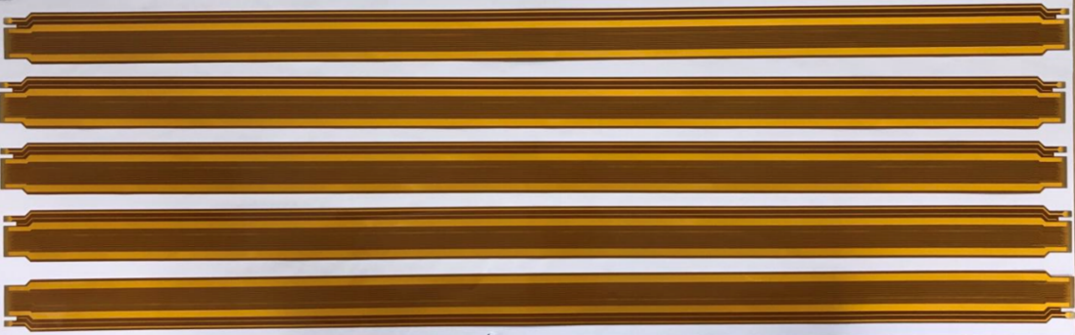
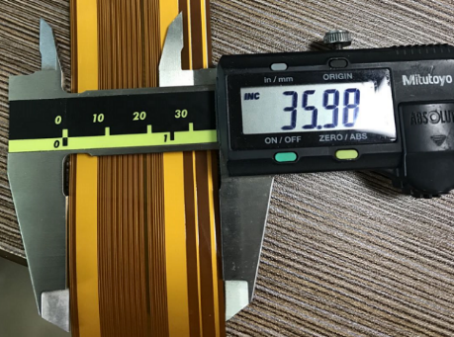
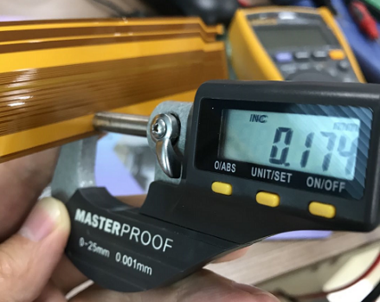
FT plan
Status & Plan：
After 54 Flex Tail production for module demonstrator, they are still under test. In between, I have talked with Lucia about the FTs several times.
Currently, the exact length of all FTs have not yet been determined, the discussions are ongoing. It should happen soon.
caliper
micrometer

Slide 4
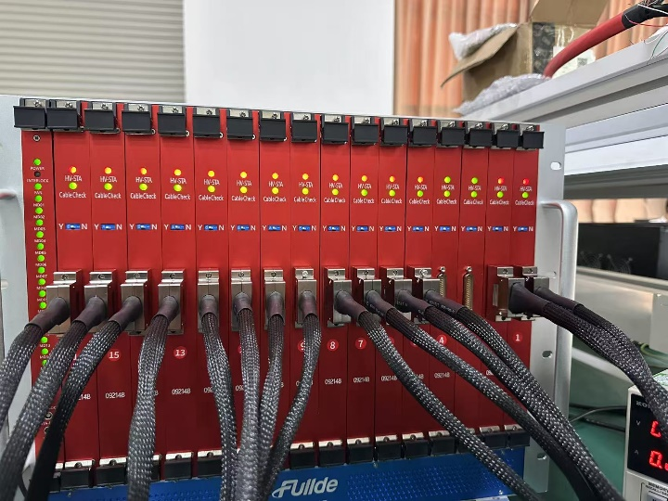
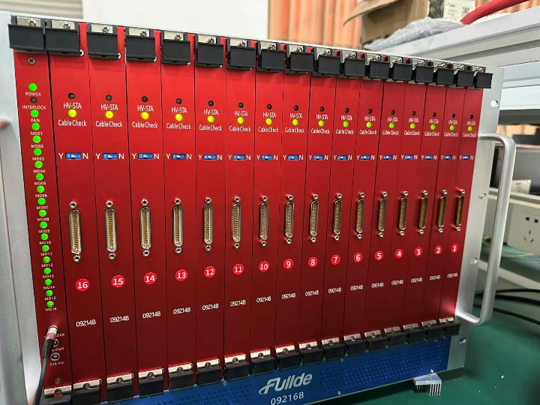
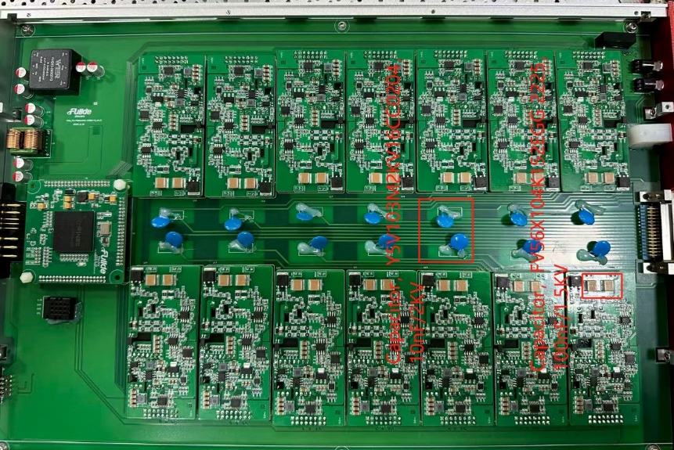
HV PS in China
In pre-production stage, two HV crates were produced in Fude factory this summer, following the bidding and specification documents:
Temperature cycling and aging test
Control and monitoring communication tests
Output voltage and current tests
Protection tests
Interlock functionality test
LED indicators test
Quality inspection of inside of Supply components
Efficiency test.
CS2505001
CS2505002

Slide 5
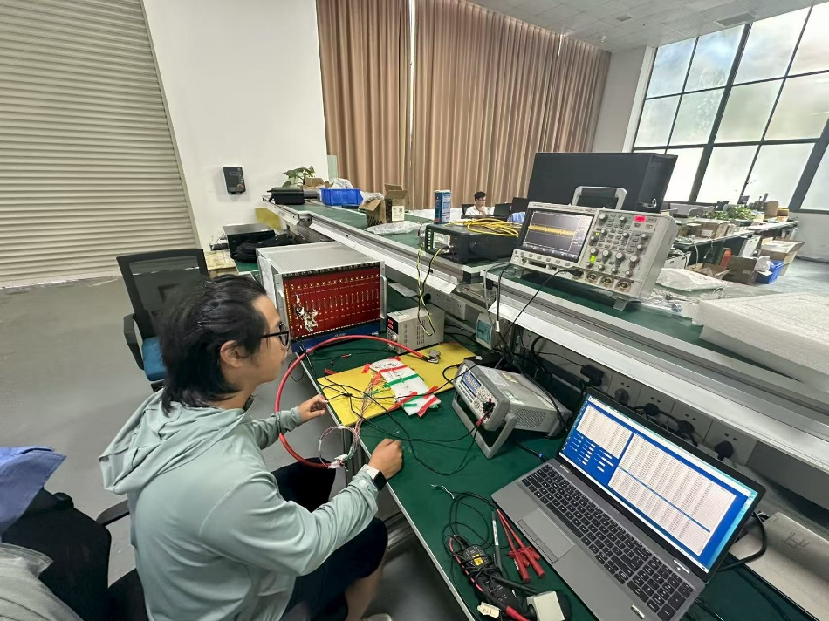
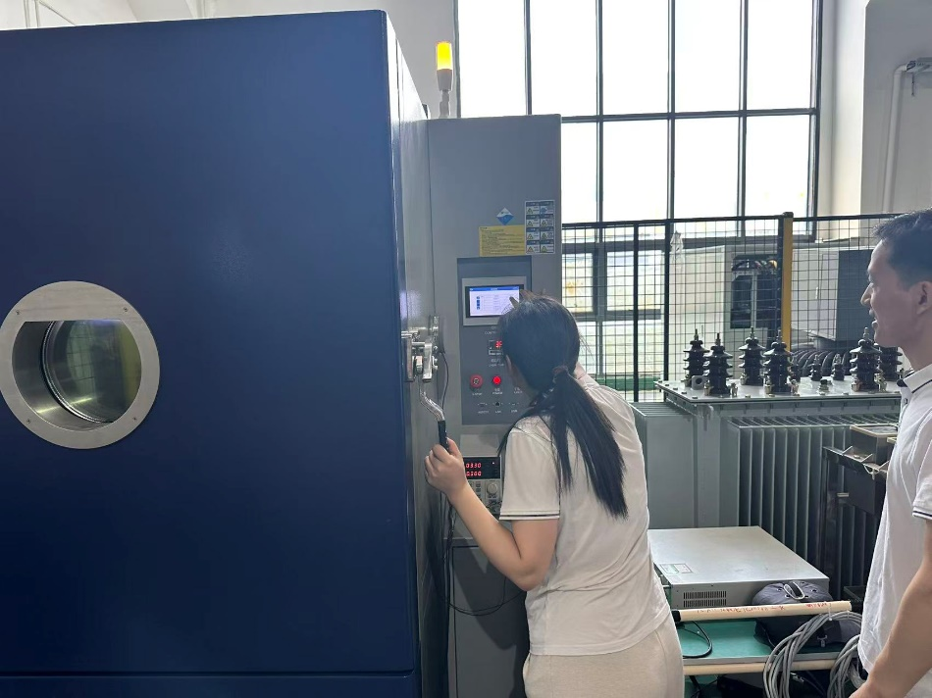
Setup in factory
Main equipment:
Temperature machine
For temperature cycling
Digit multimeter: KEYSIGHT 34461A
For voltage measurement
Picoammeter: Tonghui TH2691A
For current measurement
Oscilloscope: Keysight DSOX3014A
For voltage ripple & up/down speed
Loading :300K and 10M resistors
Test environment
Temperature cycling
Temperature cycling test was done from July 10th to July 11th
Aging tests was done at room temperature from July 12th to August 17th
FAT was done from August 18th to August 23rd

Slide 6
Test summary in China
 | Results
Voltage | √
Current | √
Aging | √
Interlock | √
Protection | √
Safe loop | √
LED | √
Ramp up/down | √
DCS | √
Size | √
Components check | √
Efficiency | ×
Heat dissipation | ×
All parameters of the high-voltage power supply have been tested.
Except for efficiency, all other parameters meet the requirements.
The test data has been uploaded to the database.

Slide 7
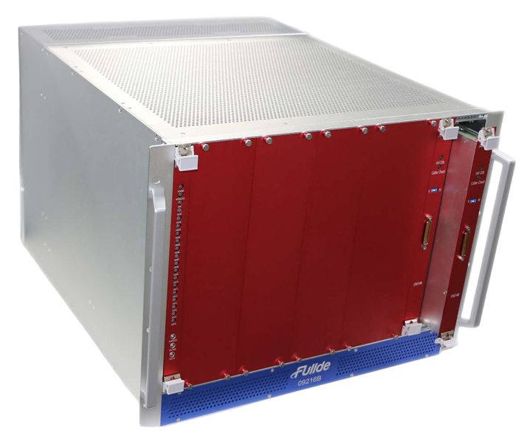
Test at CERN
Tests carried out at CERN follows the specification documents:
Voltage and current control and monitoring tests;
Protection test;
Interlock test;
LED indicators test;
OPC-UA control and monitoring communication tests.(wait for Filipe)
20WCSP02511001
20WCSP02511002

Slide 8
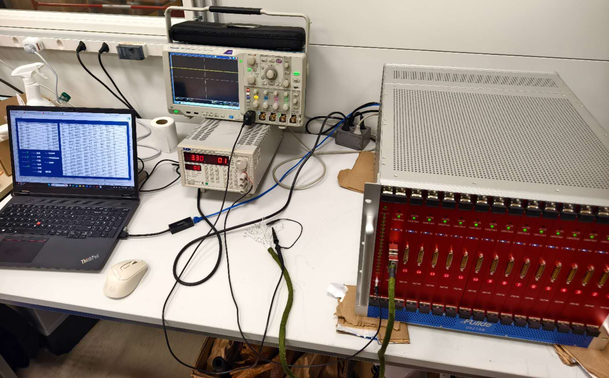
Test environment @CERN
Main equipment:
Digit multimeter: KEYSIGHT U1252B
For voltage measurement
Picoammeter
For current measurement
Oscilloscope:Tektronix DPO 5104B
For voltage ripple & up/down speed
Loading :291.6K resistor(300k in China)

Slide 9
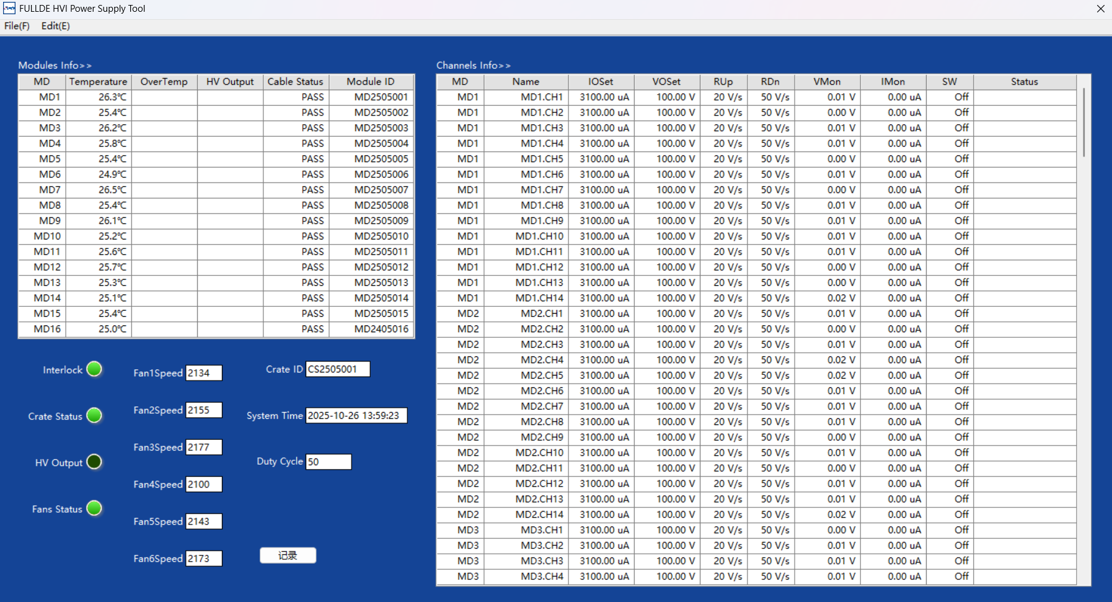
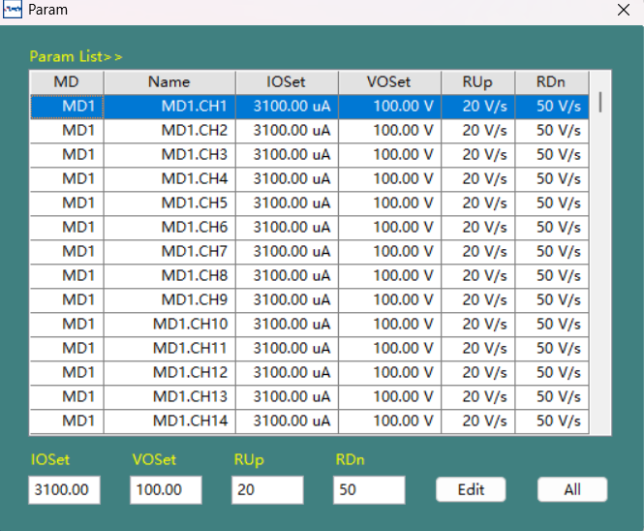
Control & monitoring
HV crates can be controlled and communicated.
Status, temperature, fans speed and crate id can be monitored
Output ,protection threshold value and ramp up/down speed can be set.

Slide 10
Voltage & current tests
Serial_number_module | channel | voltage_setup_value_V | voltage_test_value_V | current_test_value_uA | voltage_monitor_value_V | current_monitor_value_uA | voltage_precision_V | current_accuracy_percentage | current_resolution_nA
20WMDP025110016 | 1 | 50 | 49.86 | 170.99 | 50.06 | 171.53 | 0.14 | 0.32 | 100
20WMDP025110016 | 1 | 100 | 99.87 | 342.49 | 100.03 | 342.85 | 0.13 | 0.11 | 100
20WMDP025110016 | 1 | 200 | 199.89 | 685.49 | 200.04 | 687.56 | 0.11 | 0.30 | 100
20WMDP025110016 | 1 | 300 | 299.93 | 1028.57 | 300.05 | 1031.59 | 0.07 | 0.29 | 100
20WMDP025110016 | 1 | 400 | 399.86 | 1371.26 | 400.02 | 1374.35 | 0.14 | 0.23 | 100
20WMDP025110016 | 1 | 500 | 499.97 | 1714.57 | 500.06 | 1716.26 | 0.03 | 0.10 | 100
20WMDP025110016 | 1 | 600 | 599.87 | 2057.17 | 600.01 | 2060.38 | 0.13 | 0.16 | 100
20WMDP025110016 | 1 | 700 | 699.4 | 2398.49 | 700.03 | 2398.89 | 0.6 | 0.02 | 100
20WMDP025110016 | 1 | 800 | 799.50 | 2741.77 | 800.03 | 2739.96 | 0.5 | 0.07 | 100
20WMDP025110016 | 1 | 900 | 899.92 | 3086.15 | 900.04 | 3090.56 | 0.08 | 0.14 | 100
The accuracy of the output voltage is better than 0.6V.
The accuracy percentage of current monitoring is better than 5%.
The resolution of current monitoring is 100nA.
No abnormal output channels.

Slide 11
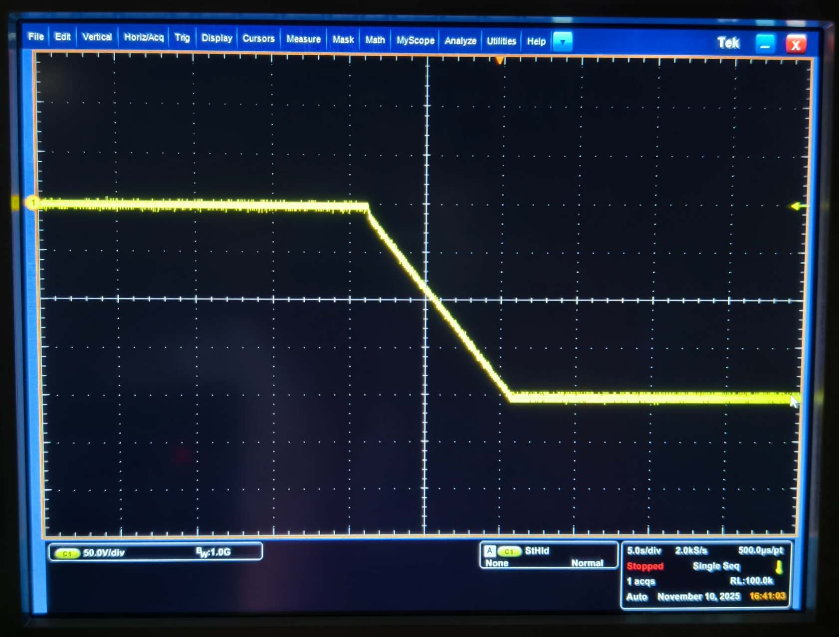
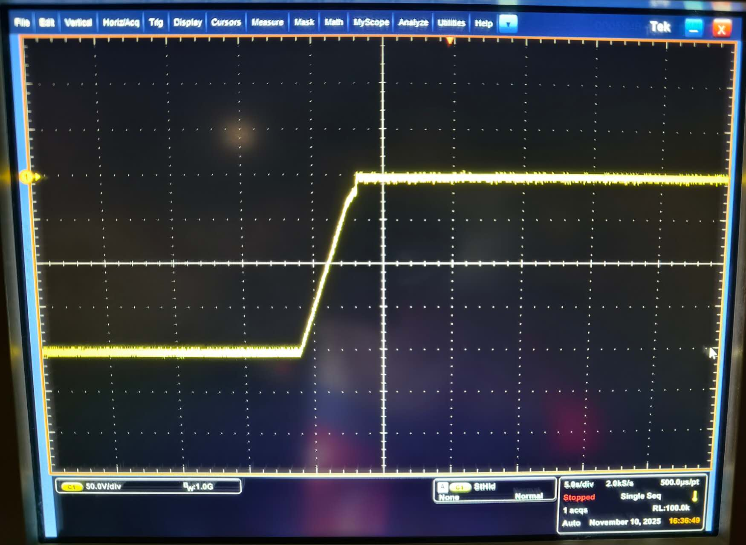
Voltage & current tests
20V/s Ramp up
50V/s Ramp down
Ramp up/down speed is correct.

Slide 12
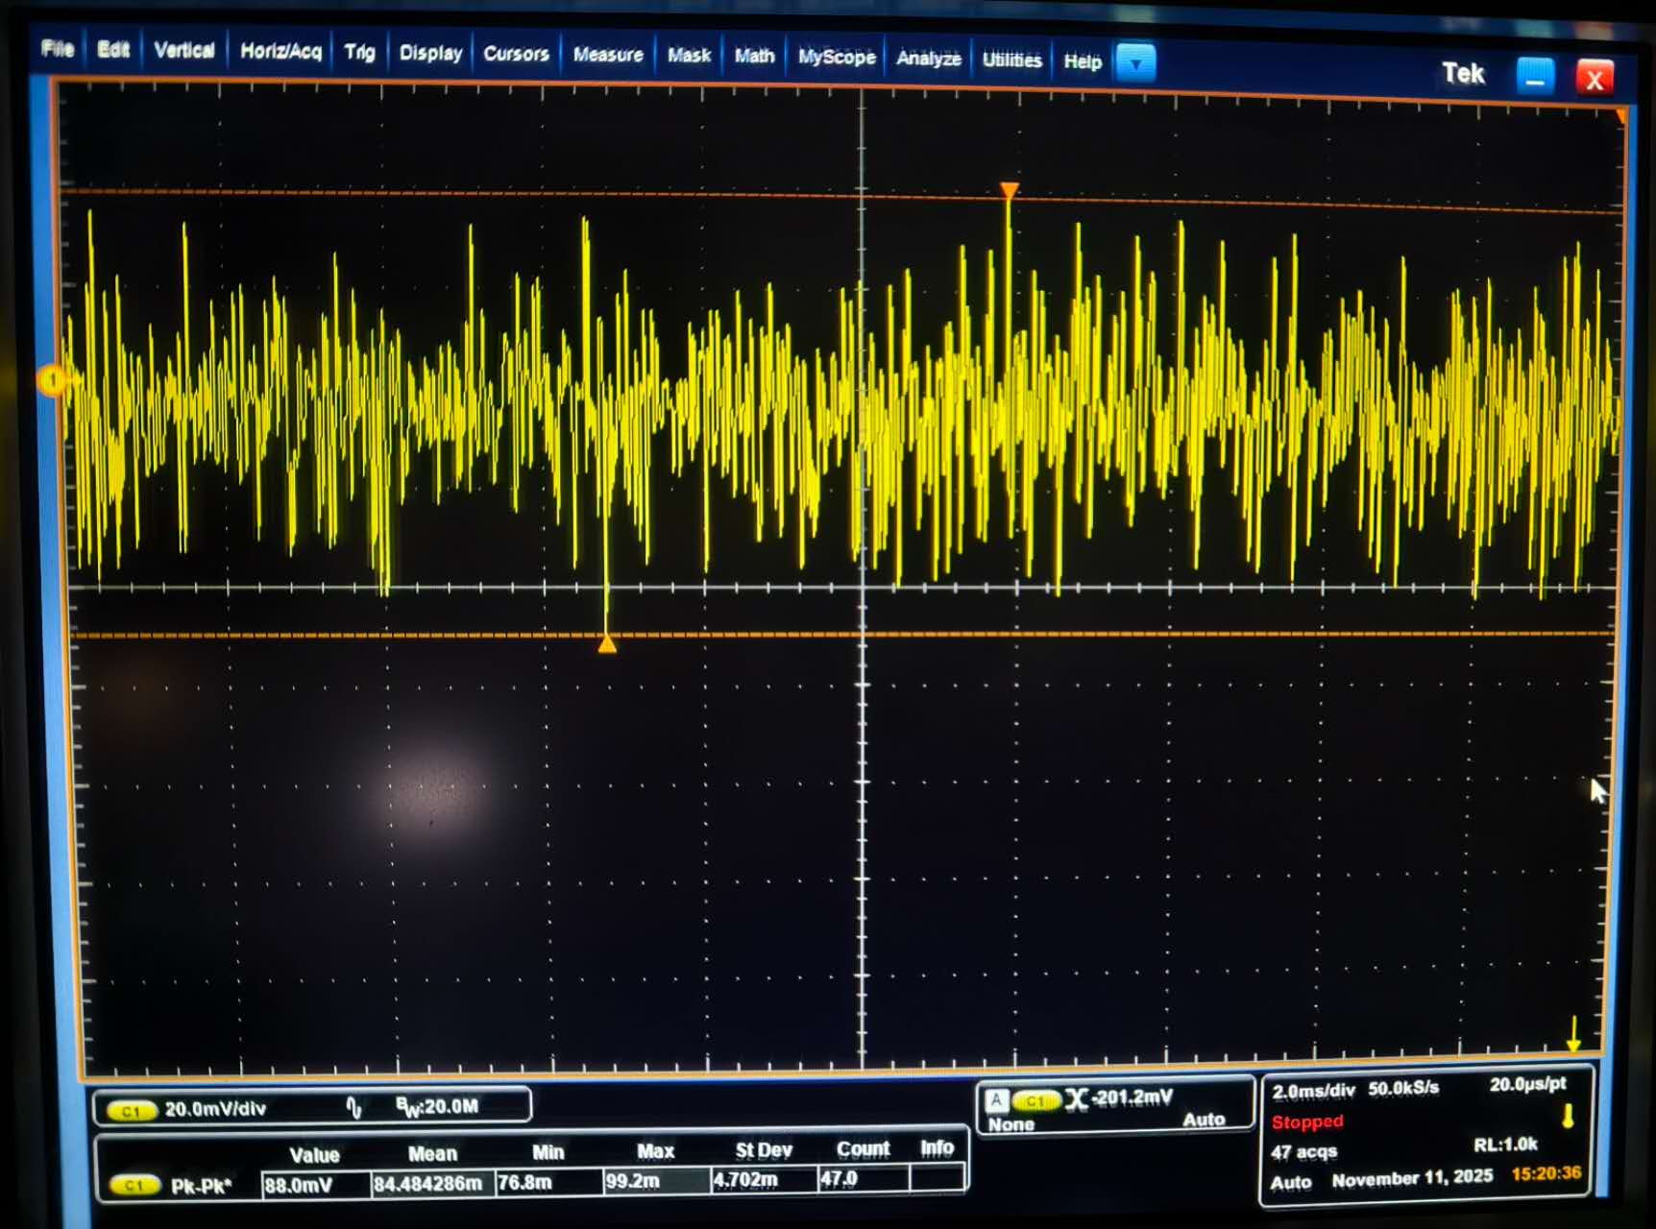
Voltage & current tests
Voltage Ripple
80mv-90mv

Slide 13
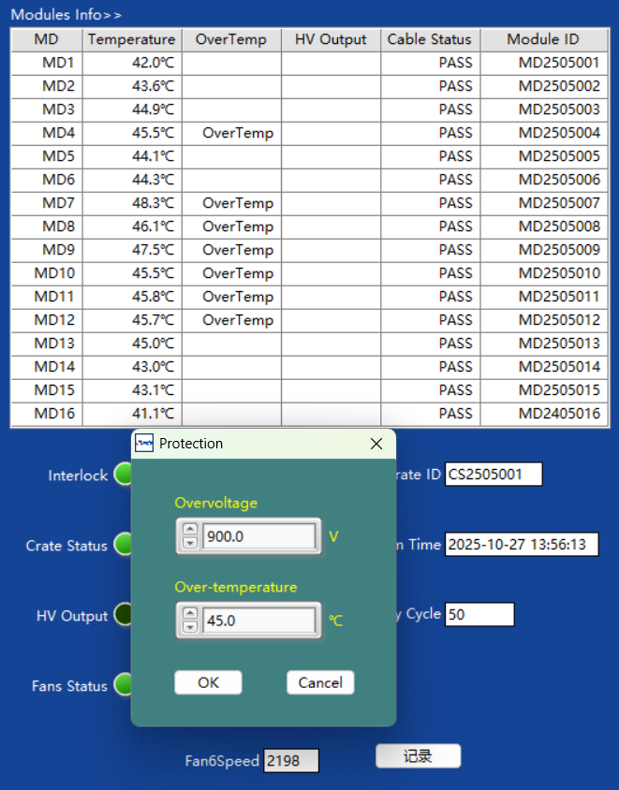
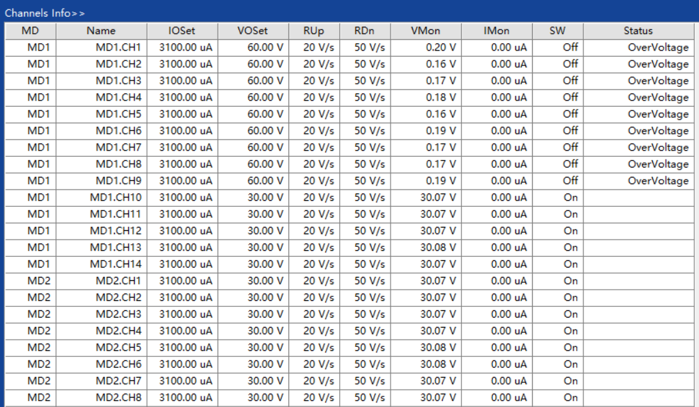
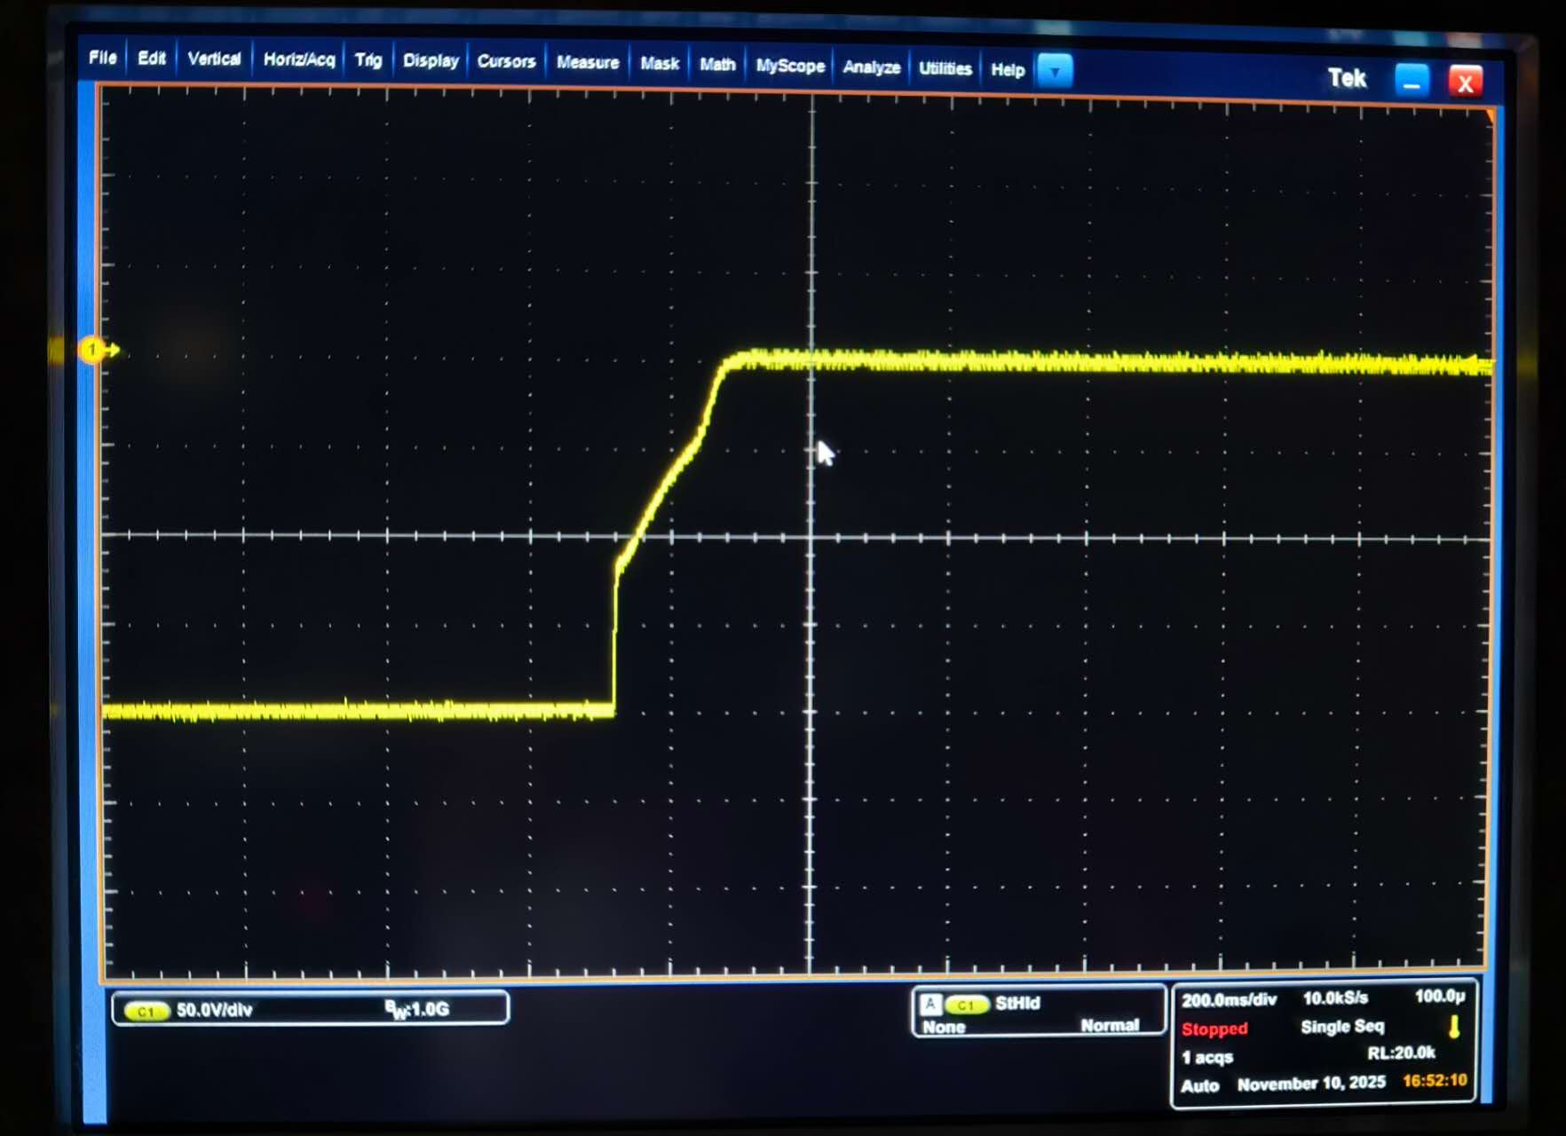
Protection tests
The thresholds for voltage, current, and temperature can be set correctly by software.
The protection function is normal. When protection occurs, the output voltage will be 0V.
The protected information can be monitored by software.

Slide 14
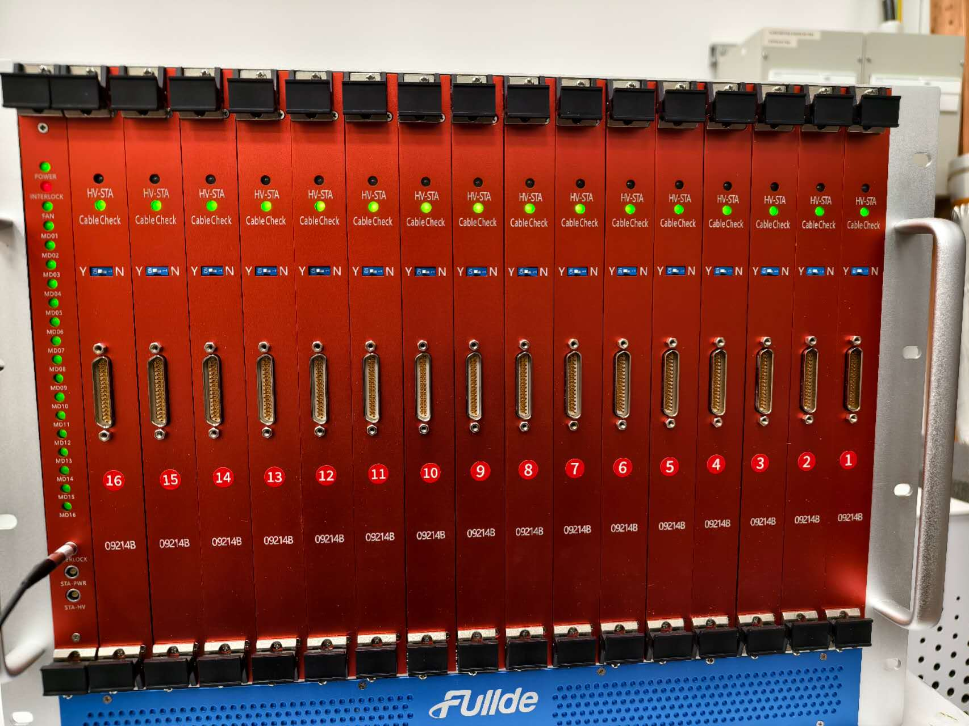
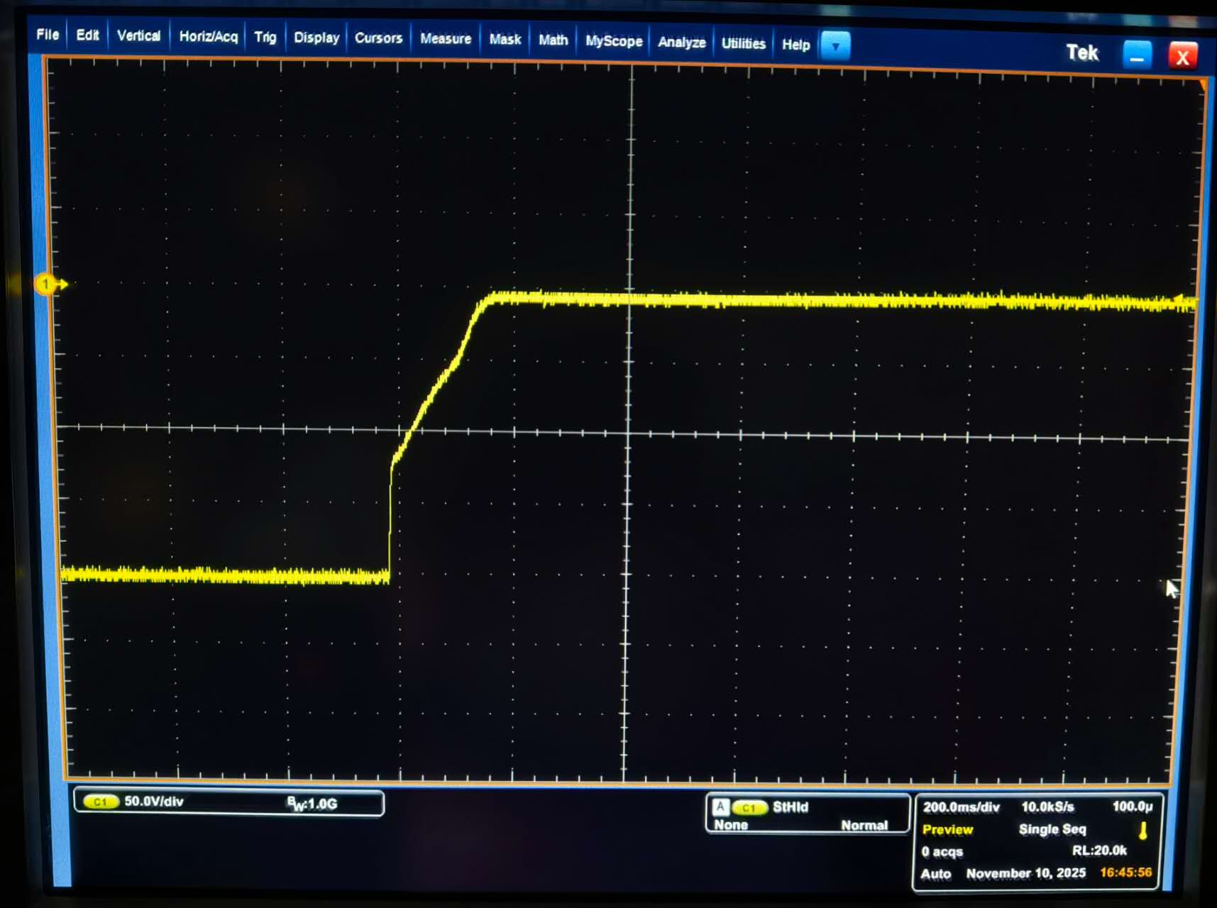
Interlock functionality test
Interlock function is normal. Interlock output can show the HV PS
status correctly.
When interlock occurs, the output voltage will be 0V.

Slide 15
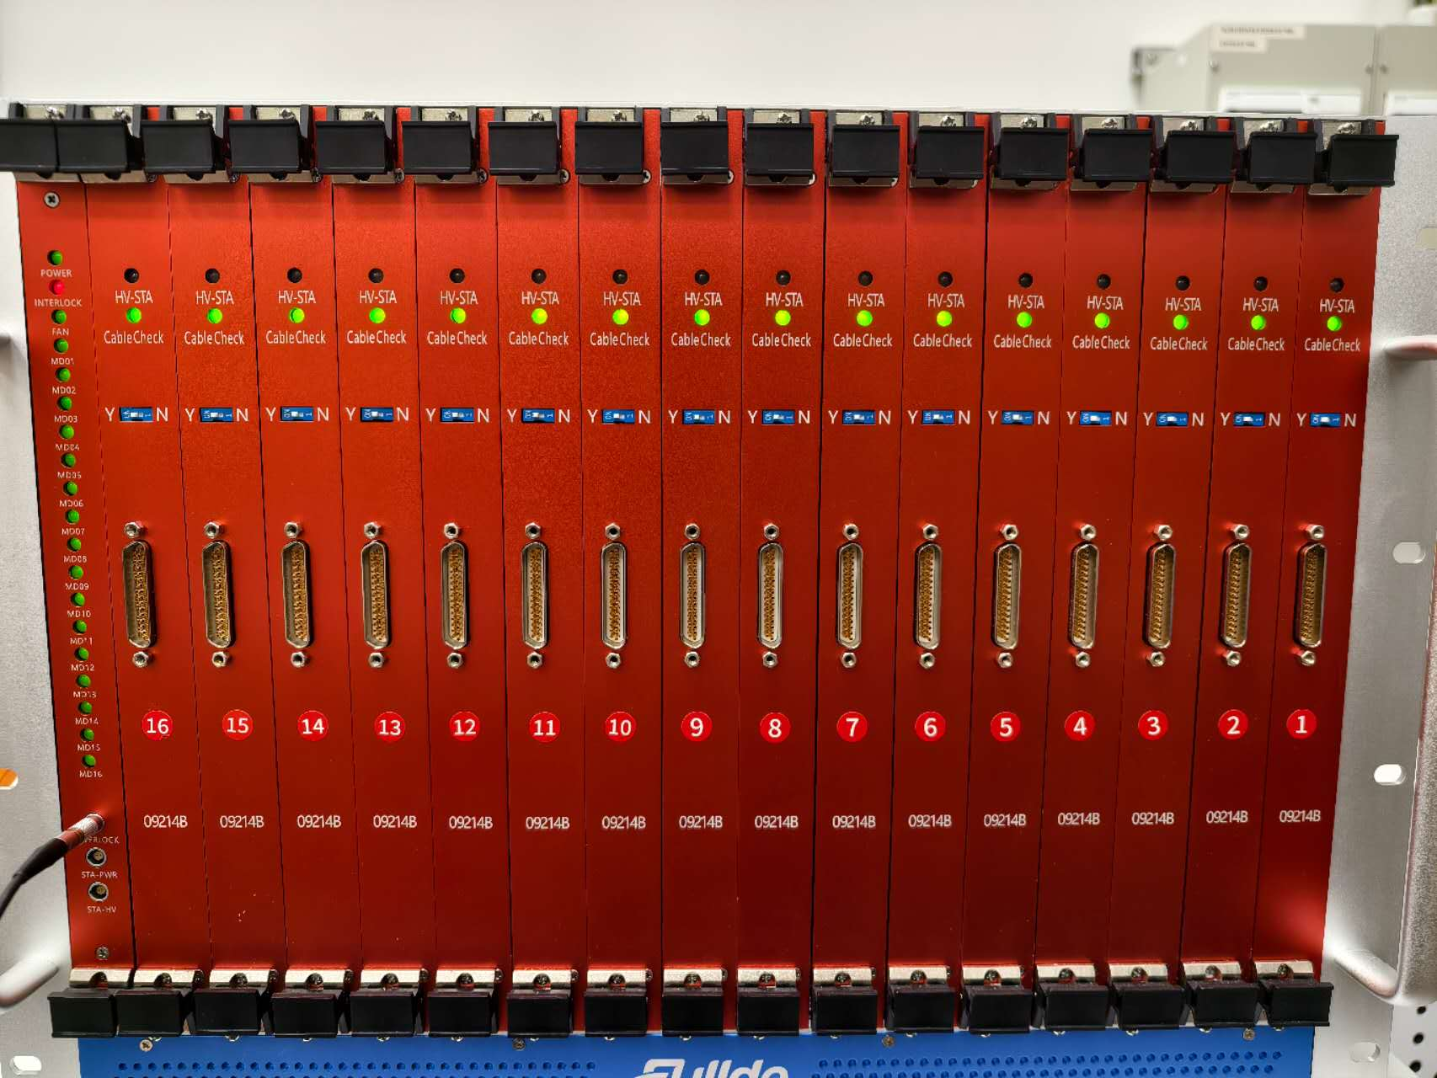
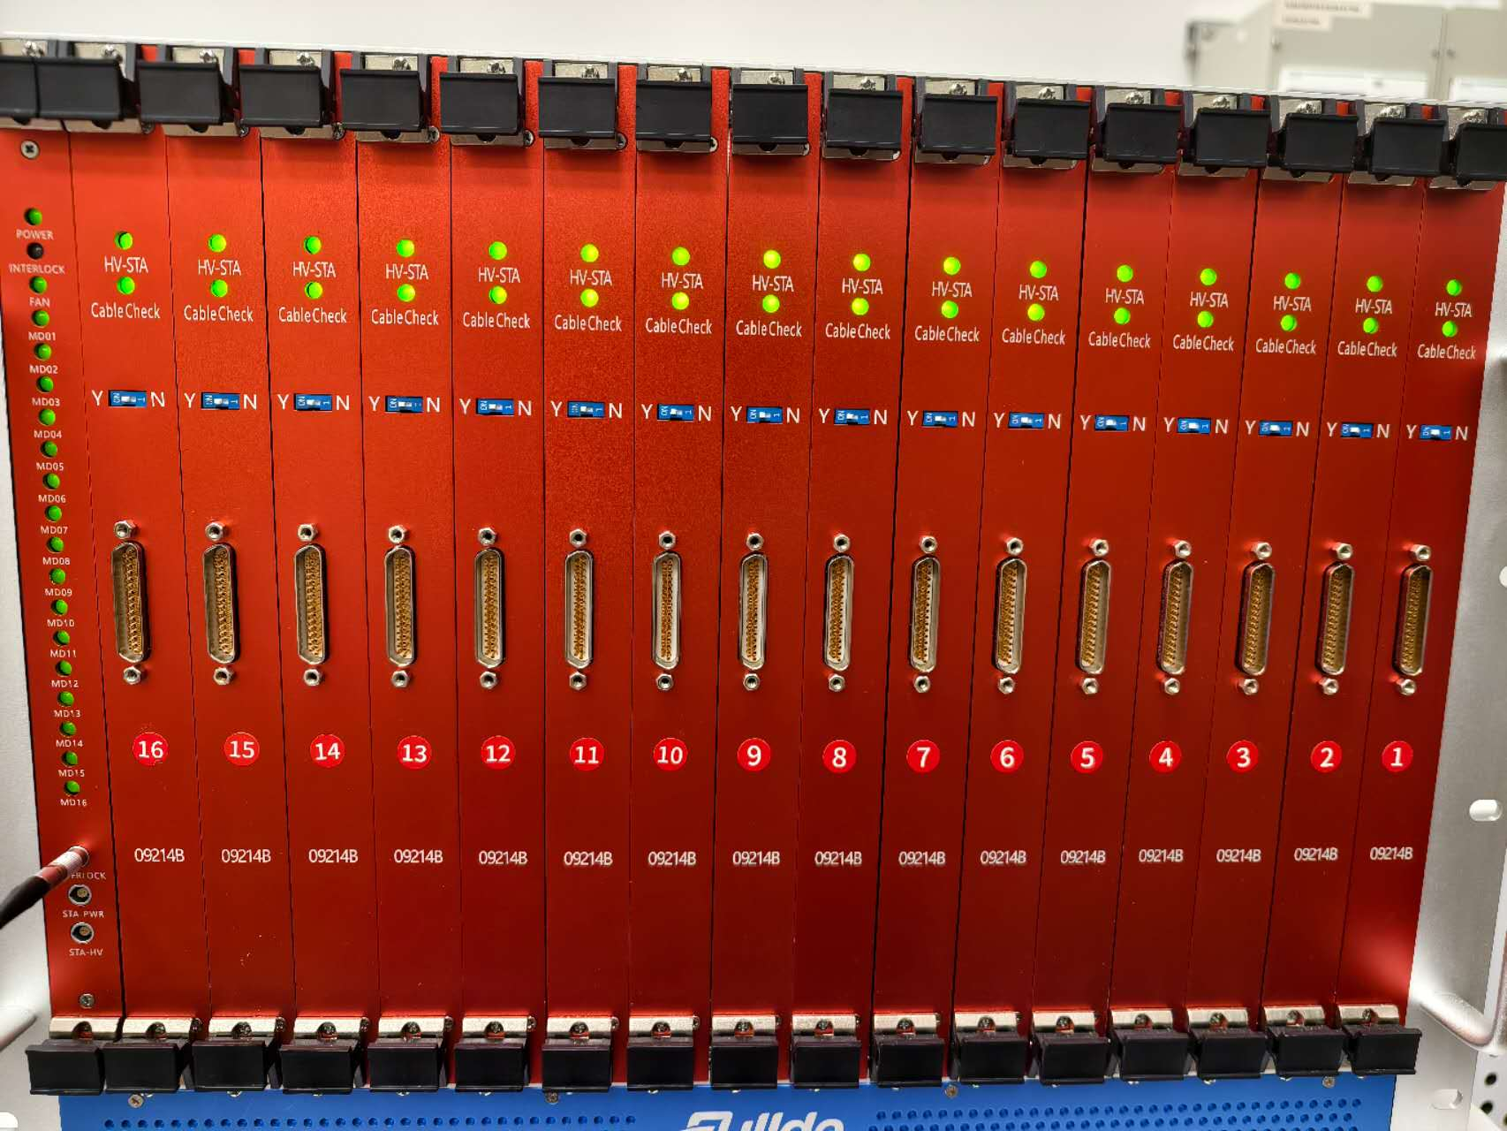
LED indicators test
LED can show status of the power supply correctly.

Slide 16
Conclusion
 | Results
Voltage | √
Current | √
Aging | √
Interlock | √
Protection | √
Safe loop | √
LED | √
Ramp up/down | √
DCS | √
Size | √
Components check | √
Efficiency | ×
Heat dissipation | ×
At CERN
In China
 | Results
Voltage | √
Current | √
Interlock | √
Protection | √
LED | √
Ramp up/down | √
The OPC-UA control and monitoring communication tests require the use of CERN’s in-house control software, which can only be carried out after Mr. Filipe returns from his vacation.
16

Slide 17
Plans
The two crates are planned to be formally delivered to CERN and put into use in early December.
Complete and further develop the functionalities of CERN’s in-house high-voltage control software.
The final production expects to be started next May.

Slide 18
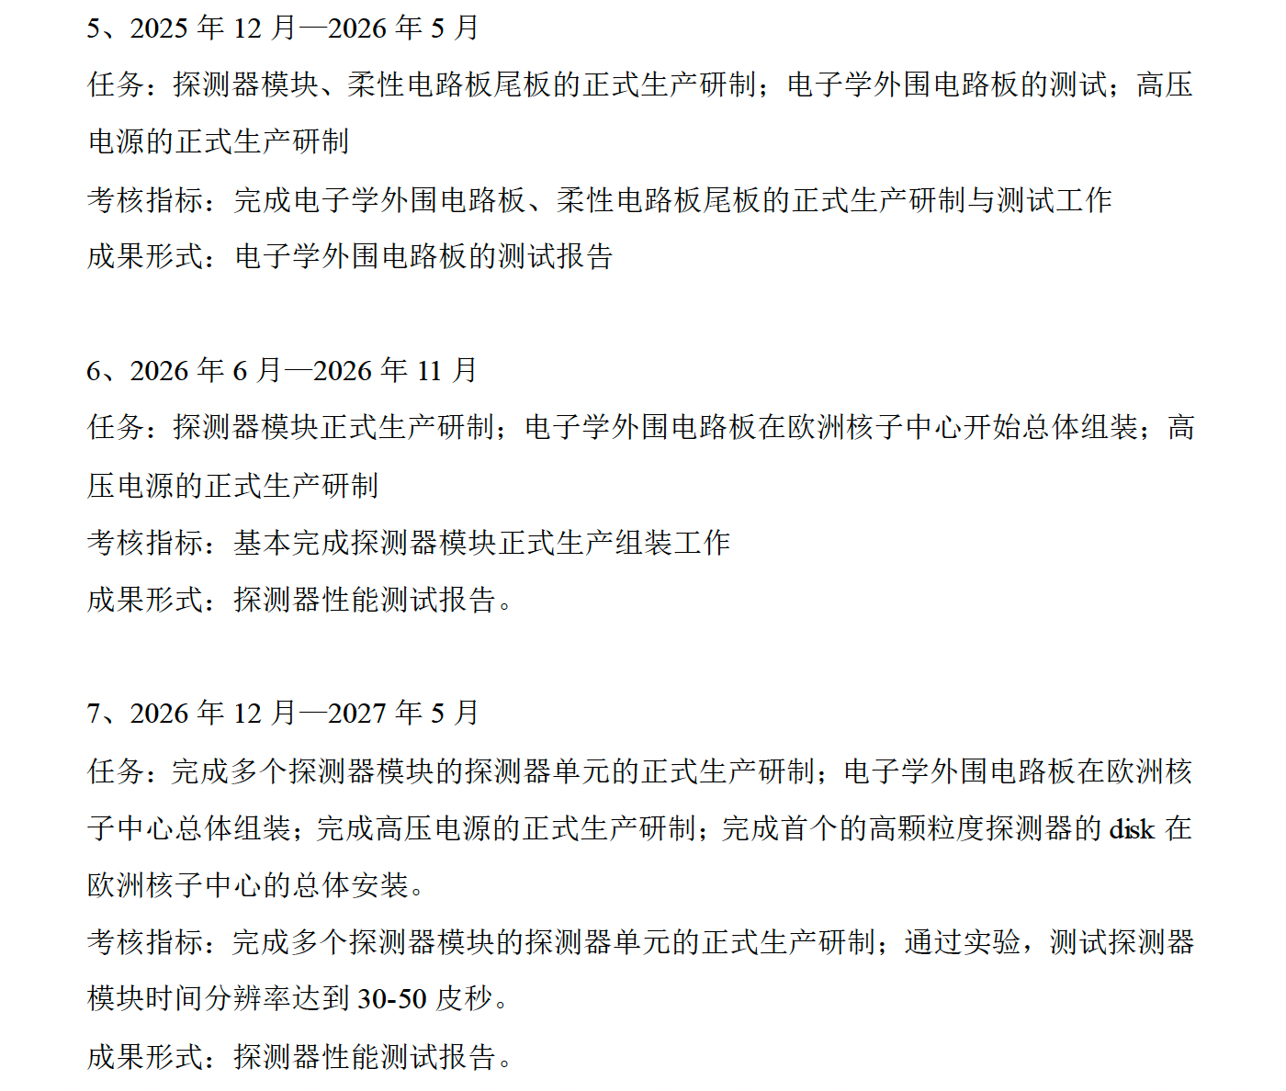
Challenges
Flex Tail：
There still have some discussions to determine the final exact length of all FTs. It expects to be done at the end of year. So it will follow the time table.
High Voltage PS：
So far most of specifications passed the test in Chinese factory and at CERN. Although the efficiency and dissipation don’t pass according to the specifications, it doesn’t have an effect on the application for the LGAD. The specifications will be revised. HGTD collaboration agreed to update the HV specifications.

Slide 19
Thank you for your listening!

