Slide 1
A FPGA-based DAQ system for RPC cosmic ray test
Jiaxuan Li
On behalf of USTC RPC lab
Dec 5th, 2025

Slide 2
Outline
Introduction
FPGA-based DAQ system design
Performance of the TDC with the signal generator
DAQ test with RPC detector
Summary

Slide 3
Introduction

Slide 4
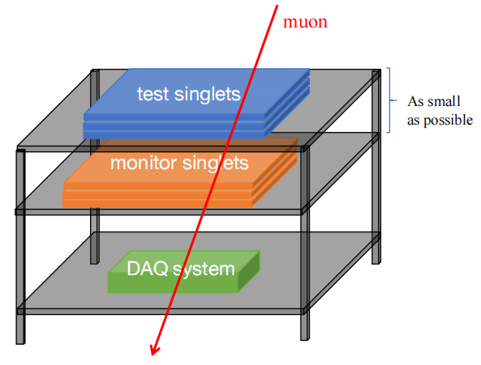
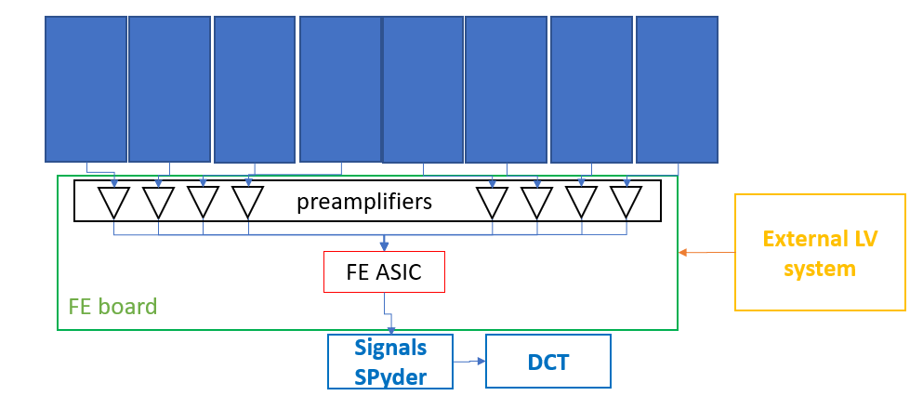
Introduction
Phase II upgrade: next-generation Resistive Plate Chambers
< 300 ps time resolution
1 cm spatial resolution
> 95% detection efficiency
Cosmic ray test in RPC production
monitor singlets
test singlets
Advantages
monitor singlets are very close together → a better triggering rate (try to accept all hit angles)
can operate the test singlets easliy
DAQ design goals
144 channels per board
TDC function with 100 ps time resolution
three trigger modes: external/self/master-slave

Slide 5
FPGA-based DAQ system design
2025 CLHCP

Slide 6
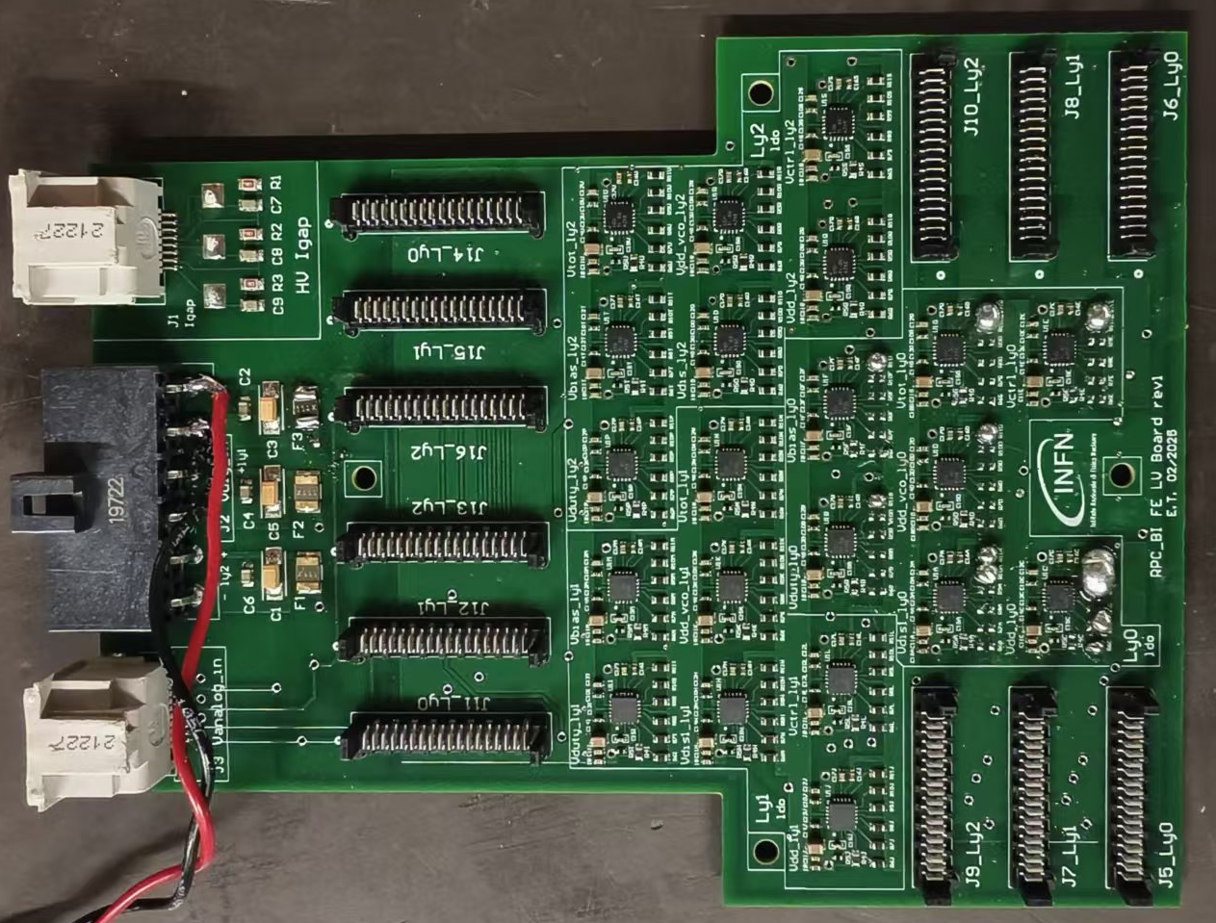
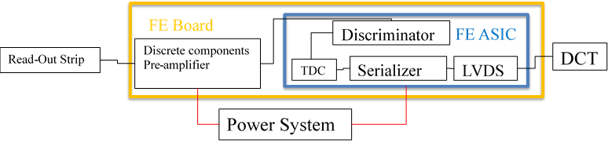
Overall signals system
DAQ:
Located or directly on the chamber or maximum at 3.5m distance, connected with 18 FEBs.
Signals ‘’spyder’’ board
Front-end board
Backup solution: without TDC
Amplifier and discriminator
20 pins connect with spyder board
68 pins cables
Differential BC_clock cable
Signals ‘’spyder’’ board
The Signals ‘’spyder’’ board is an adaptor board with 4 connectors.
Located directly within the service boxes of the detector
It couples in a single 68 pins cable the signals of 3 FEBs of a readout panel column
20 pins cables
FEBs eta1 layer 0
FEBs eta1 layer 1
Low voltage board
FEBs eta1 layer 2
Low voltage board
Power supply for FE
Vth / Vdigital / Vamp / Vpol
PC software
TDC data transmission
Online monitor

Slide 7
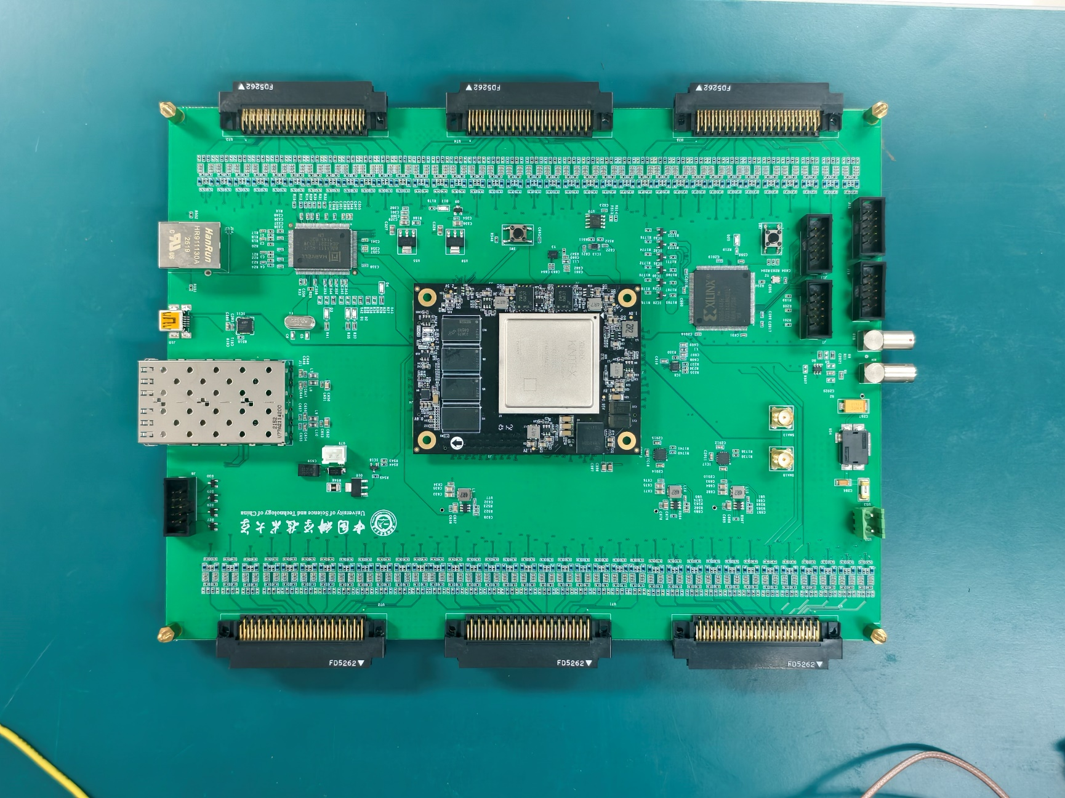
DAQ hardware design
Receive data from FE board
18 FE boards = 144 channels in total.
Integrates 144 channels polarization circuitry. Capable of receiving signals from baseline or backup FE
Xilinx KINTEX UltraScale: XCKU060
Central processing and control Manchester decoder or TDC
JTAG
Clock buffer
40 MHz LVDS clock output from FPGA.
Split into 2 channels,
then further distributed into 18 channels.
SFP
UART
CPLD:XC95144XL
Processes 18 fast_or signals from FE board.
Ethernet
Other
Temperature sensor, SMA, buttons, fan, cascading signals between two boards, and etc.

Slide 8
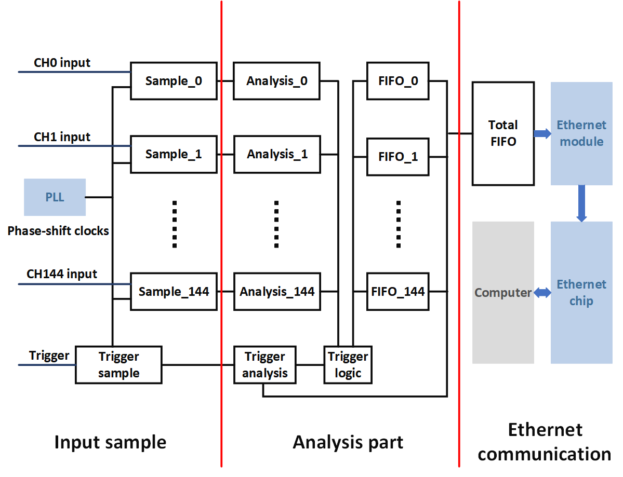
TDC principle diagram
Input sample part
Phase shift sampling clock: 500MHz
8 bit thermometer code
Analysis part
8 bit → 3 bit fine count
Analyze edges
Trigger logic
External/self/master-slave
Ethernet communication part
Transfer the data to the total FIFO
Gigabit Ethernet

Slide 9
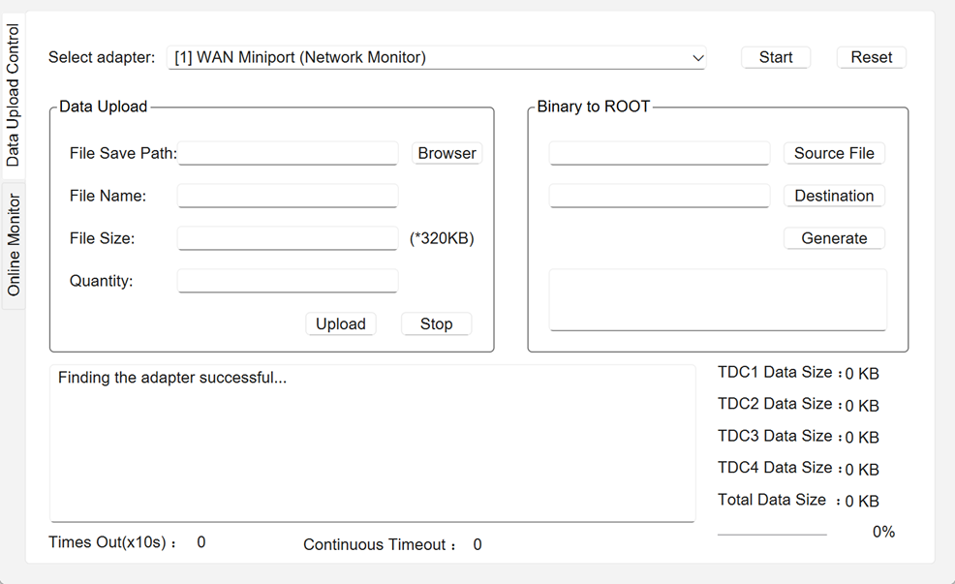
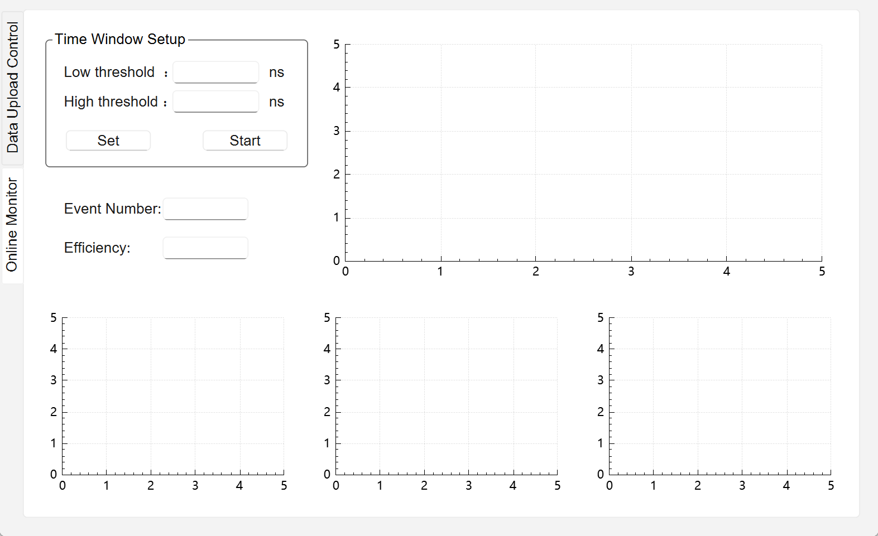
Software interface
🟦 DAQ data-taking functions
Ethernet-based raw data reception
Stable binary streaming from 4 TDC modules
File saving with size/quantity display
🟧 Online monitor (in progress)
Time-window configuration
Live hit map / efficiency / pulse-width display
Event counter and efficiency display
🟩 Binary → ROOT conversion
One-click generation of ROOT files
Supports large continuous runs
Used for offline analysis
🟪 Status
✔ Data-taking functions fully verified
✔ Binary-to-ROOT conversion operational
⏳ Online monitor being tested

Slide 10
Performance of the TDC with the signal generator
2025 CLHCP

Slide 11
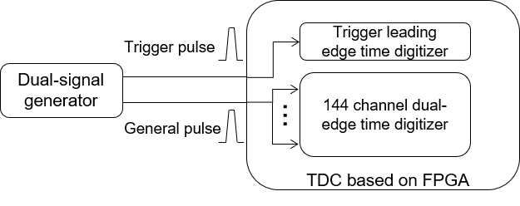
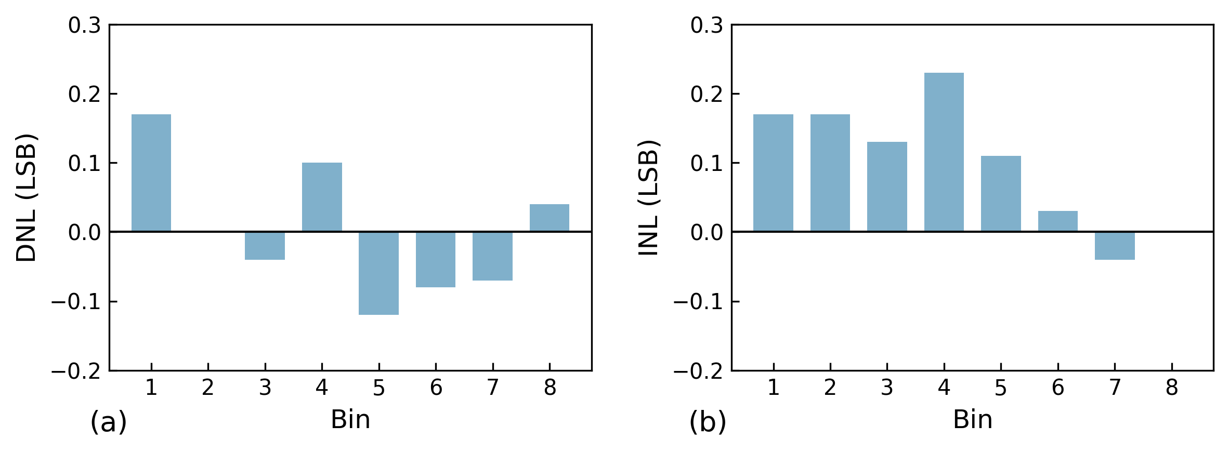
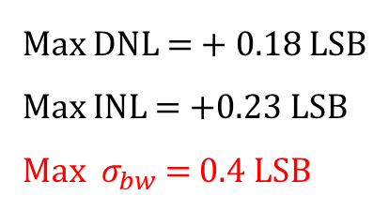
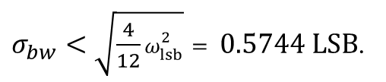
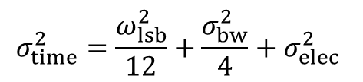
Performance: DNL & INL
Test setup
Two pulse signals as trigger and stop
Standard deviation is the time resolution
Test results: DNL & INL
General Pulse Width: 2 – 21 ns Trigger delay: 400 ns
$$σ_{time}^{2}=\frac{ω_{lsb}^{2}}{12}+\frac{σ_{bw}^{2}}{4}+σ_{elec}^{2}$$
$σ_{bw}<\sqrt{\frac{4}{12}ω_{lsb}^{2}}= 0.5744 LSB$.
Max DNL = + 0.18 LSB
Max INL = +0.23 LSB
Max $σ_{bw}$ = 0.4 LSB
Result: The impact of bin width variation on resolution is non-dominant compared to quantization error, indicating that the linearity performance of the TDC is well within acceptable limits.

Slide 12
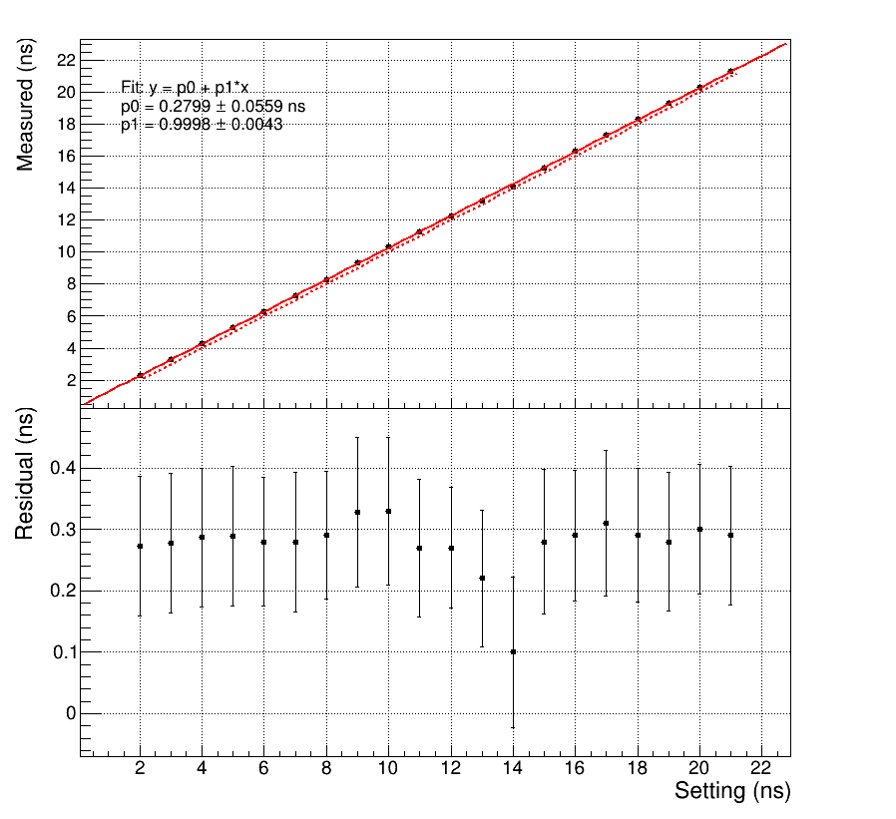
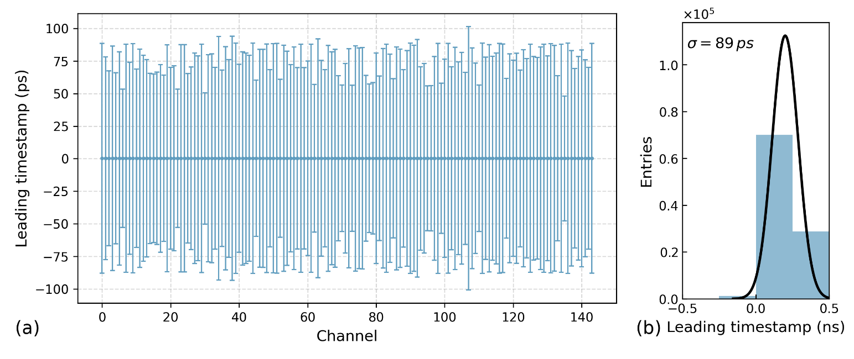
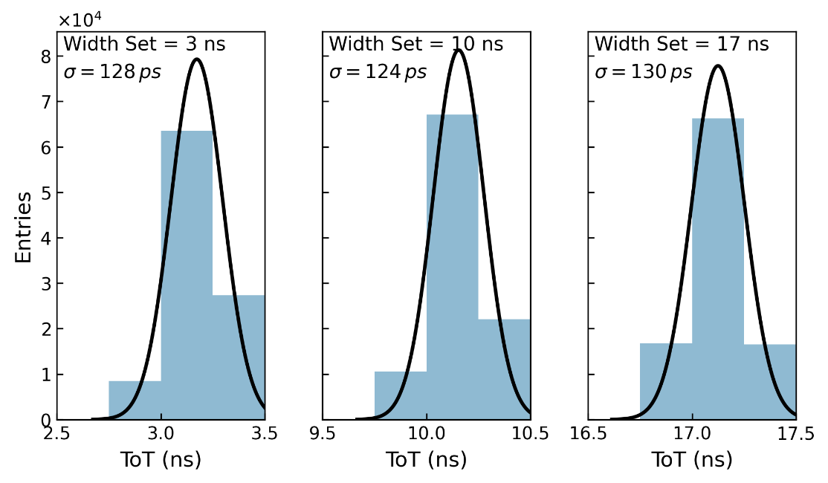
Performance: time resolution
Test results: time resolution
(c)
Each channel’s mean value shows uniformity after applying the correction.
All channels achieved a time resolution of 89 ps.
FPGA-based TDC attains sub-100 ps time resolution and 2 ns dead time over 144 channels.
(d)

Slide 13
DAQ test with RPC detector
2025 CLHCP

Slide 14
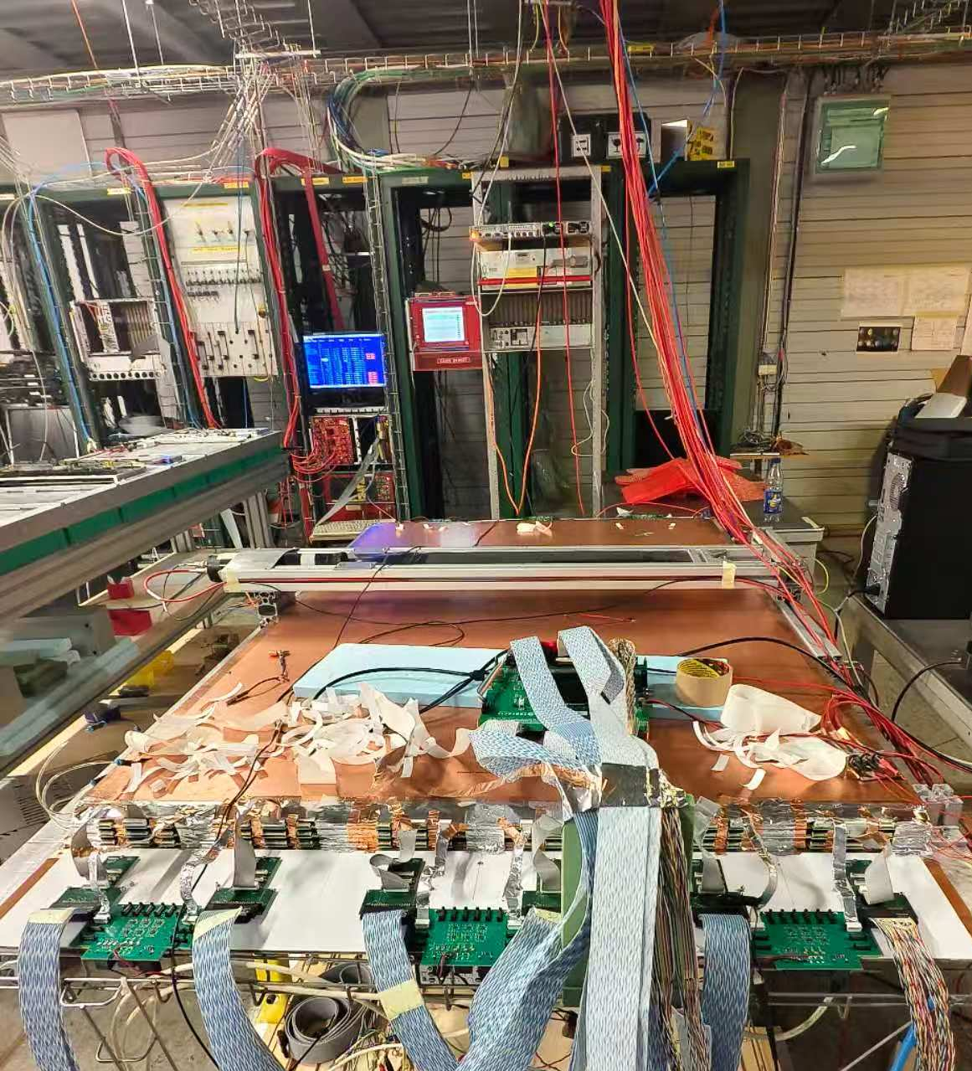
Performance with RPC detector: setup
Triplet BIS RPC
HV control
2 scintillators
2 scintillators
2 DAQ boards
6 FEEs
Spyder board
Low voltage board
Trigger System: two scintillators operate in coincidence to generate the external trigger signal.

Slide 15
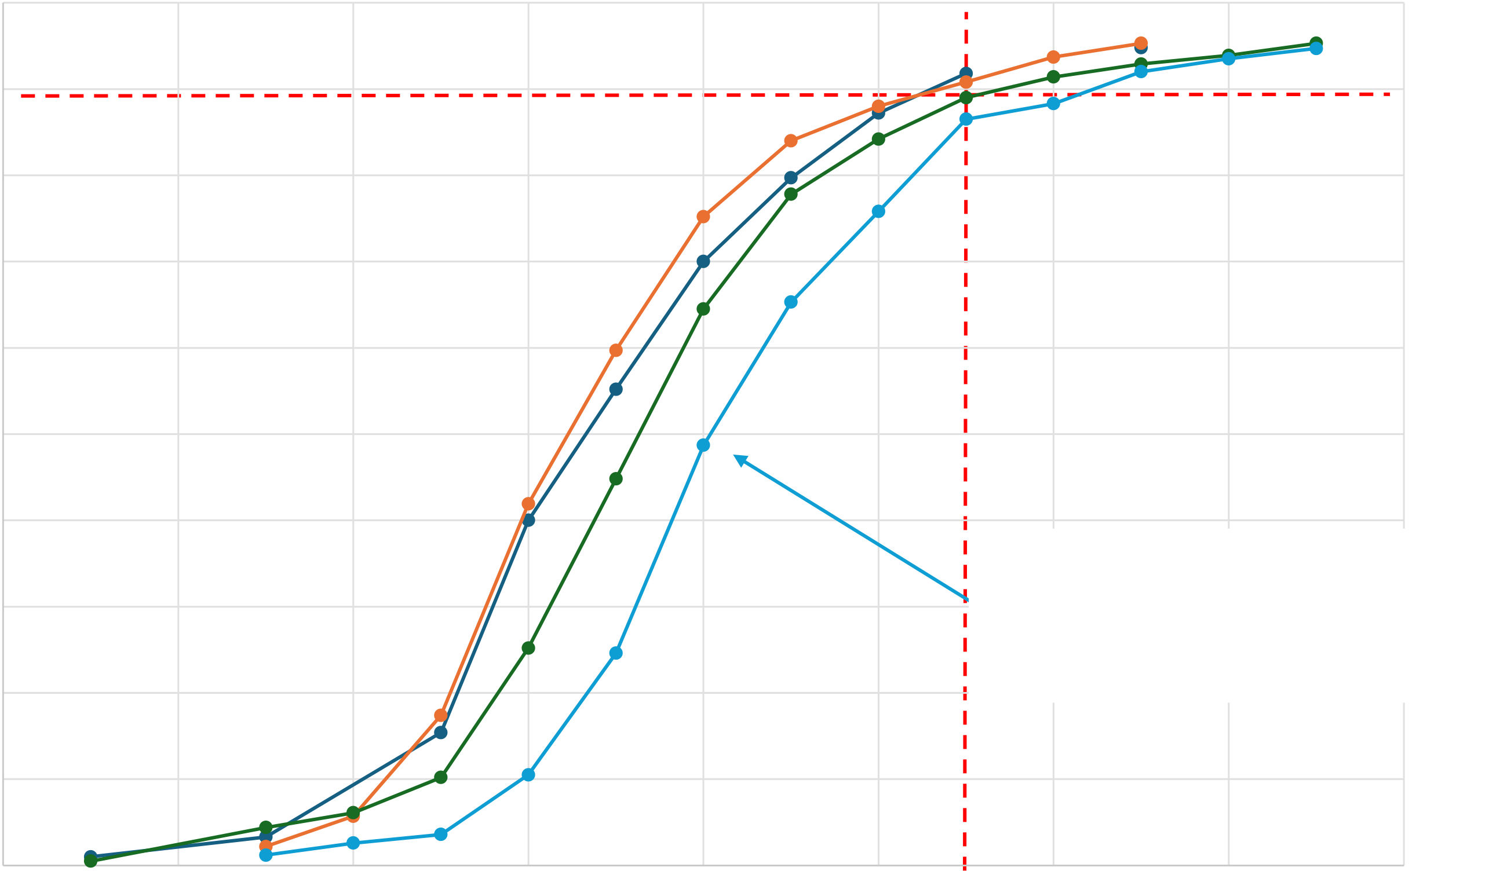
Performance with RPC detector: efficiency curve
100
The measurements were taken after improving the Faraday cage, with updated FE parameters.
90
80
Efficiency taken with the Dis_OR and all the cable plugged to the DAQ in operation and grounded together
Vth = 2.1V Vamp = 1.45V
Efficiency (%)
70
60
50
Efficiency measured in the same condition but using the USTC DAQ
Vth = 2V Vamp = 1.4V
40
30
•
First efficiency curve measured
using the USTC DAQ entirely
Without the Faraday cage
Efficiency measured in the same condition but using the USTC DAQ
Vth = 1.9V Vamp = 1.4V
20
•
Vth = 1,8V Vamp = 1,2V
10
0
4500
4700
4900
5100
5300
5500
5700
5900
6100
HV (V)
Notes:
Without the Faraday cage, the noise level is high, requiring a higher threshold and resulting in reduced efficiency. After adding the Faraday cage, the noise is significantly suppressed, allowing the use of a lower threshold. The measured efficiency matches the observations from the oscilloscope and is consistent with expectations.

Slide 16
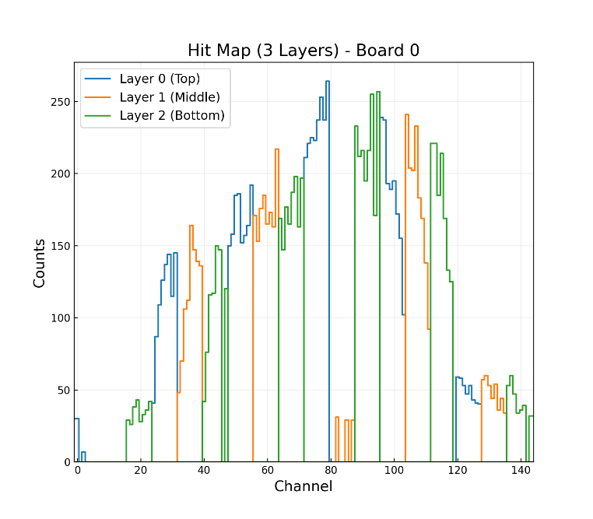
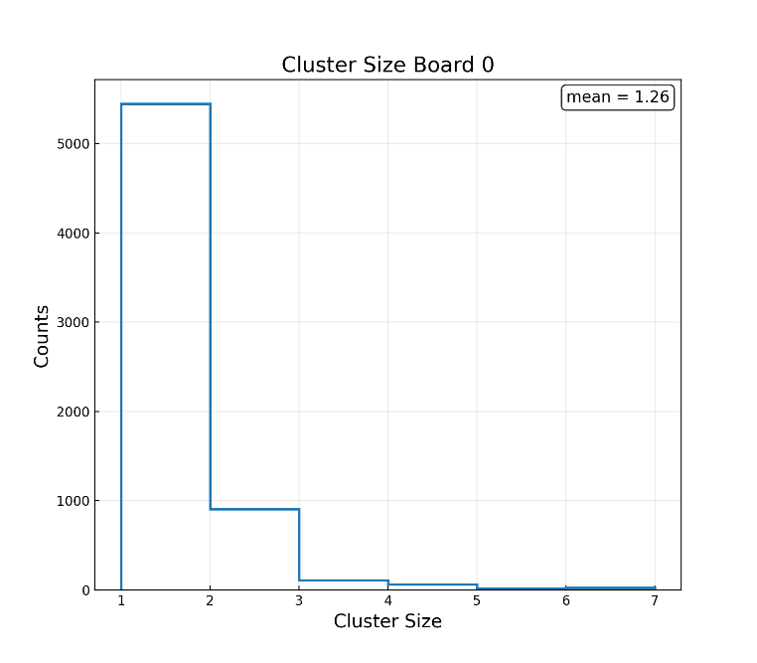
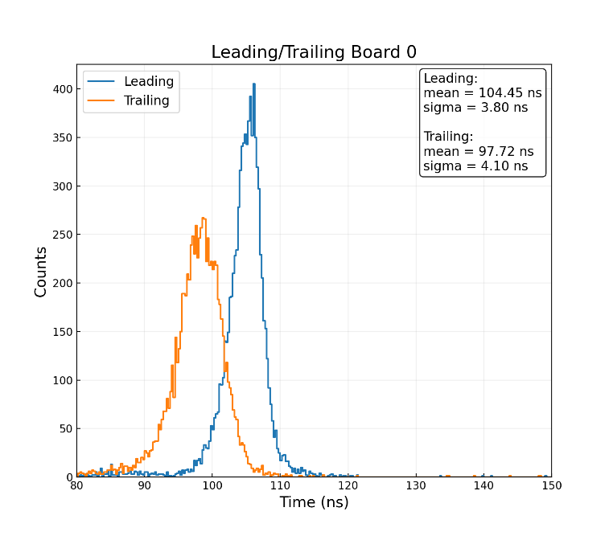
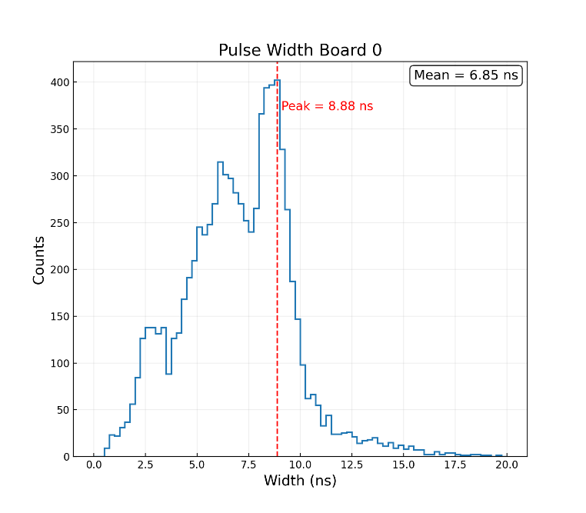
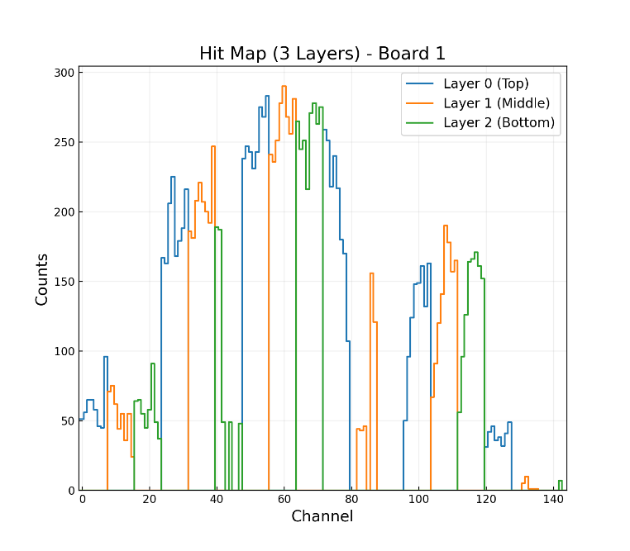
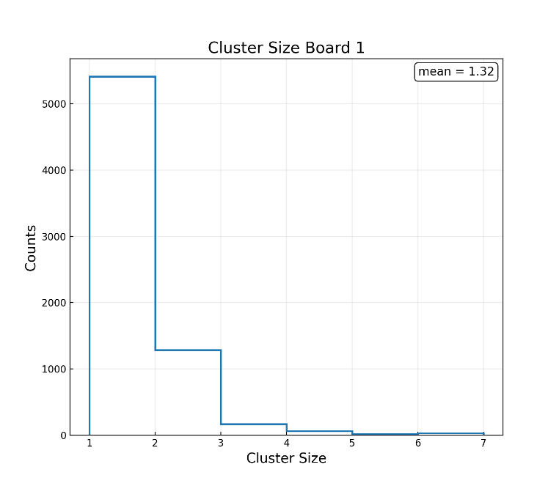
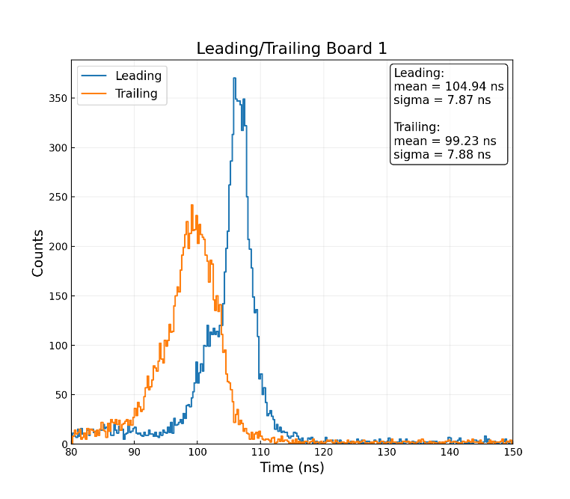
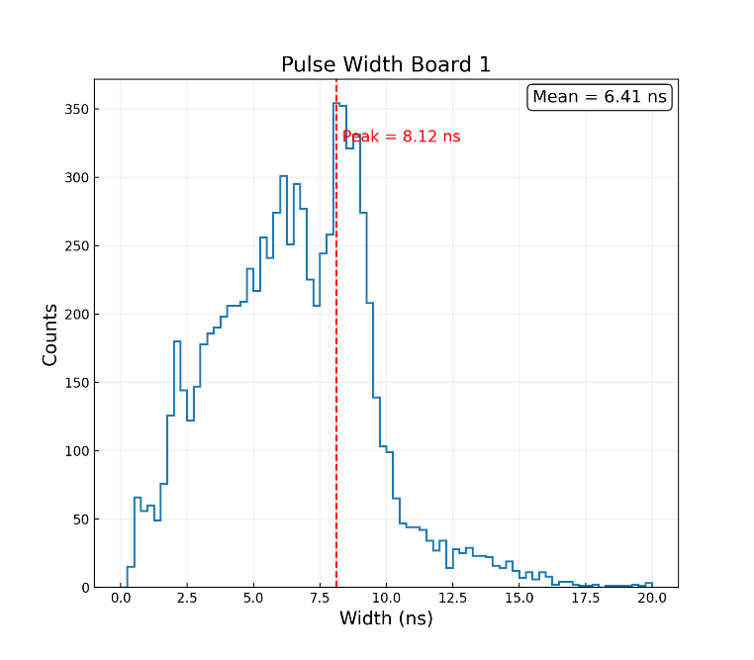
Performance with RPC detector: results
Hit map matches the setup, with scintillators placed at the indicated positions.
Pulse widths are 5–10 ns and the cluster-size mean is about 1.3.

Slide 17
Summary
2025 CLHCP

Slide 18
Summary
DAQ module: TDC key functions have been verified.
Readout system: full-chain test completed.
Software: Data acquisition works stably; the online monitor still needs full validation.
Next step:
Verify self-trigger modes.
Complete event matching and perform position reconstruction analysis.
Finalize the online monitor features.
Thank you!

Slide 19
Back up
2025 CLHCP

Slide 20
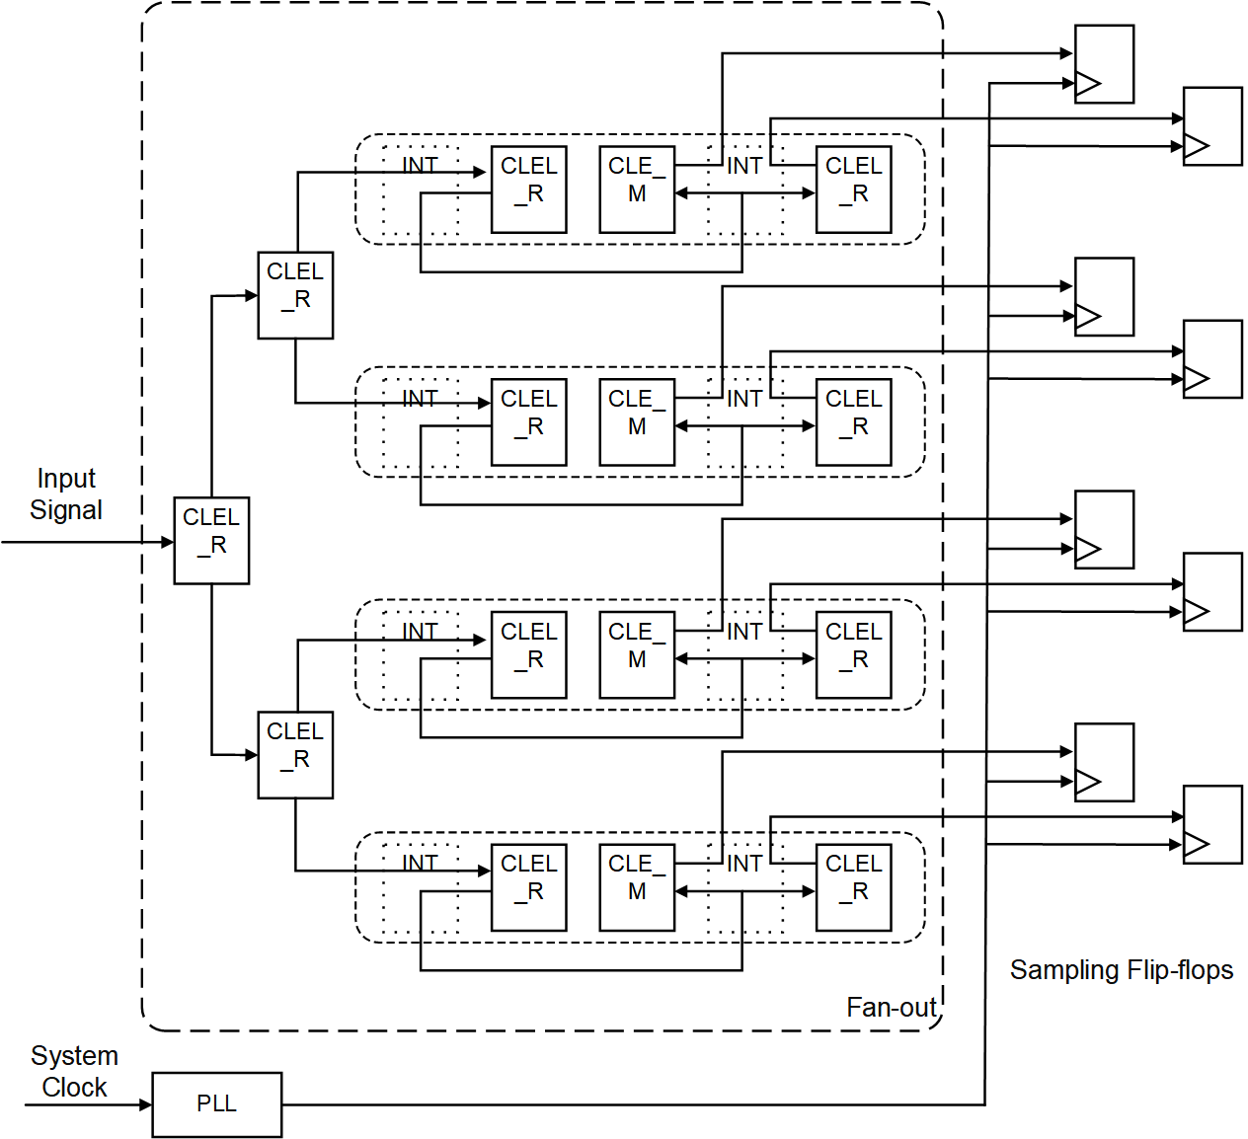
Architecture of data sampling
A pulse signal following fan-out is captured simultaneously by eight flip-flops driven by eight uniform phase-shifted clocks.
Flip-flops | First Level Fan-out Delay (ps) | Second Level Fan-out Delay (ps) | Third Level Fan-out Delay (ps) | Total Delay (ps)
1 | 305 | 239 | 370 | 914
2 | 305 | 239 | 363 | 907
3 | 305 | 140 | 403 | 848
4 | 305 | 140 | 365 | 810
5 | 268 | 189 | 370 | 827
6 | 268 | 189 | 404 | 861
7 | 268 | 294 | 403 | 965
8 | 268 | 294 | 365 | 927
Table 1. Path delays from signal input to flip-flops

Slide 21
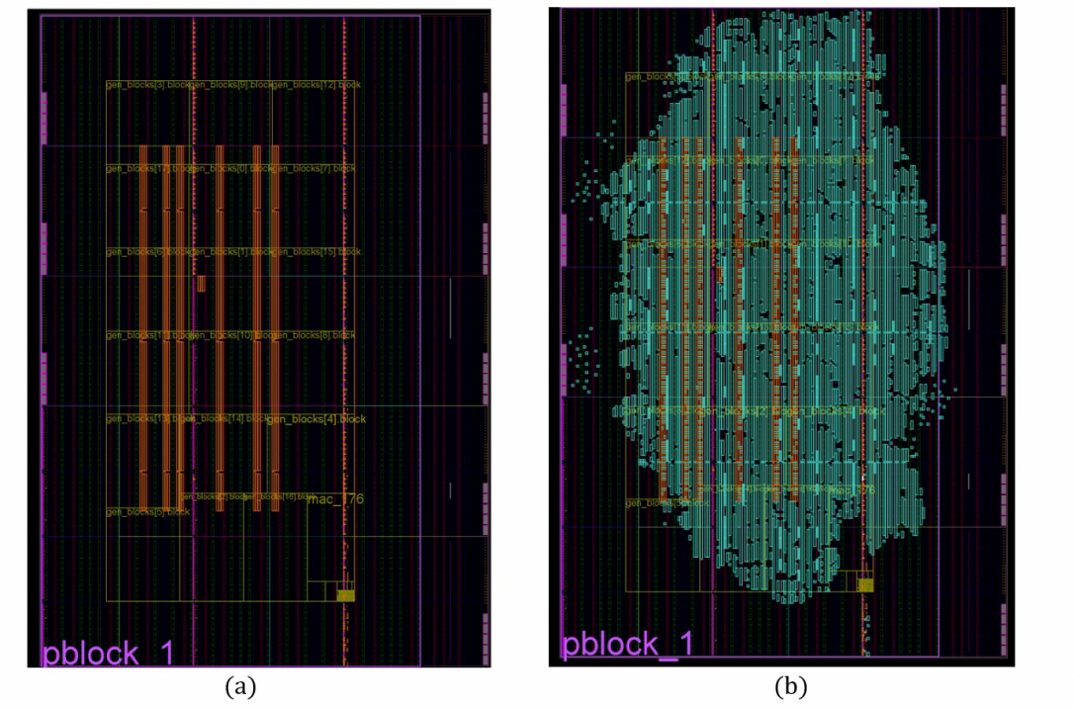
Post-synthesis and implementation
Resource | Utilization | Available | Utilization %
LUT | 51497 | 331680 | 15.53
LUTRAM | 312 | 146880 | 0.21
FF | 122876 | 663360 | 18.52
BRAM | 166 | 1080 | 15.37
IO | 319 | 520 | 61.35
BUFG | 14 | 624 | 2.24
MMCM | 2 | 12 | 16.67
Table 2. The summary of resource utilization.

Slide 22
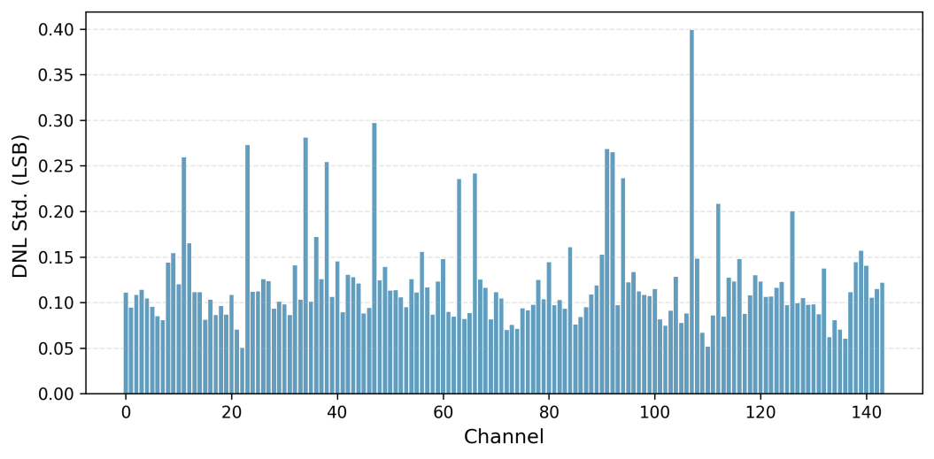
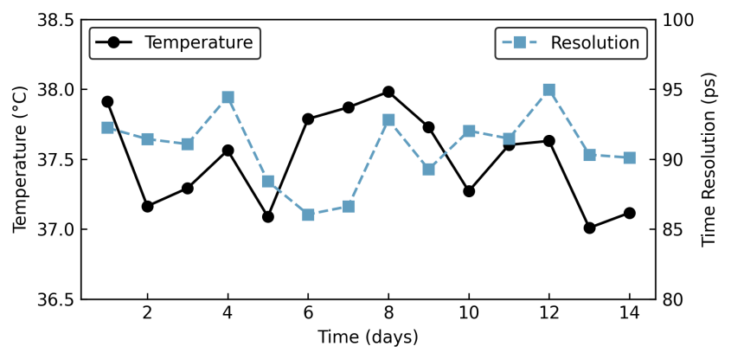
Result
The standard deviations of the time bin width for each TDC channel.
Temperature and time resolution over 14-day continuous operation.

Slide 23
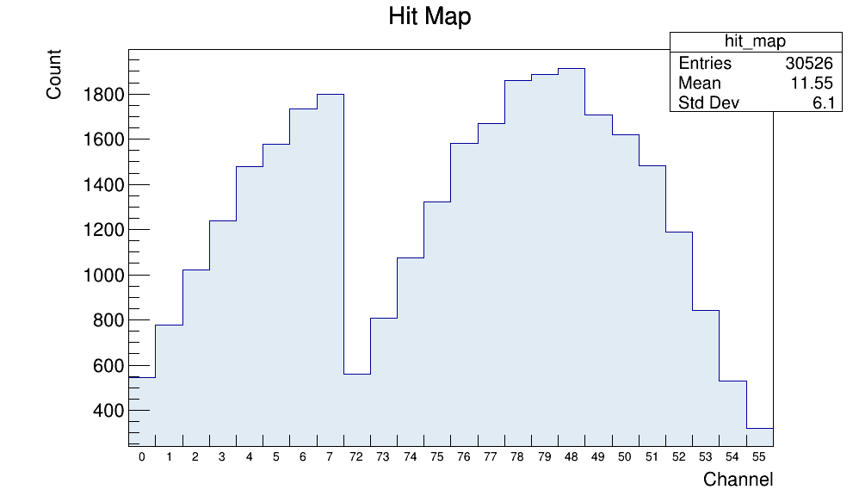
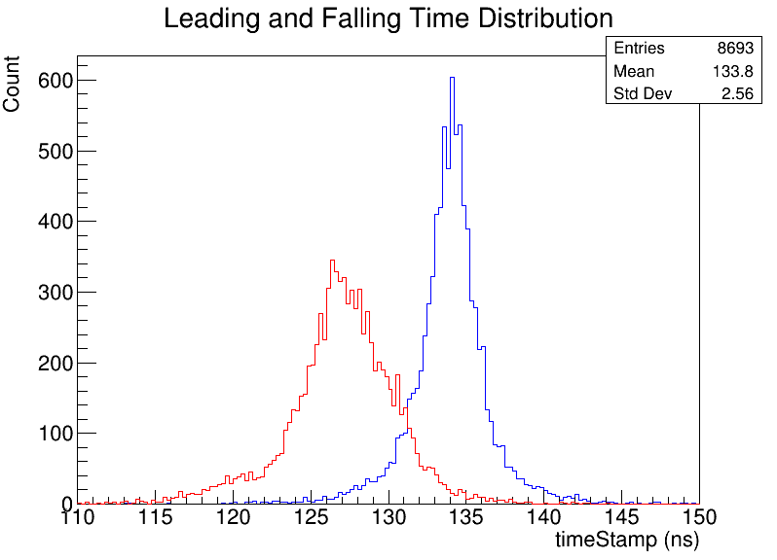
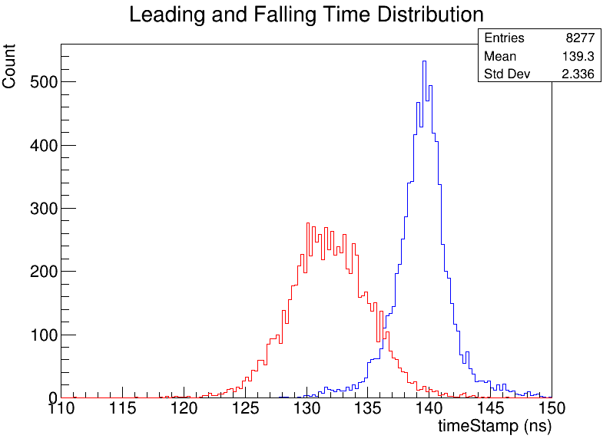
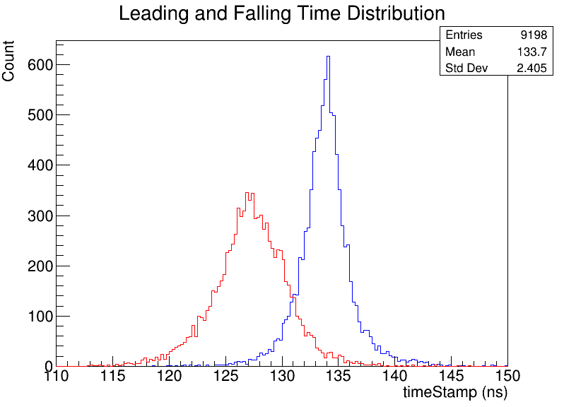
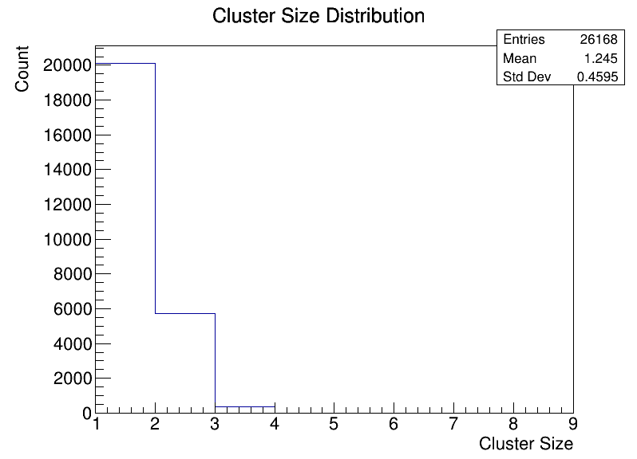
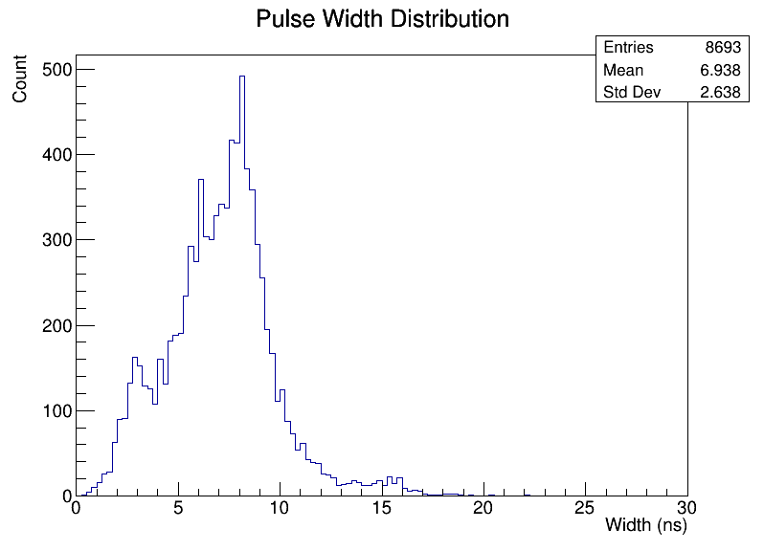
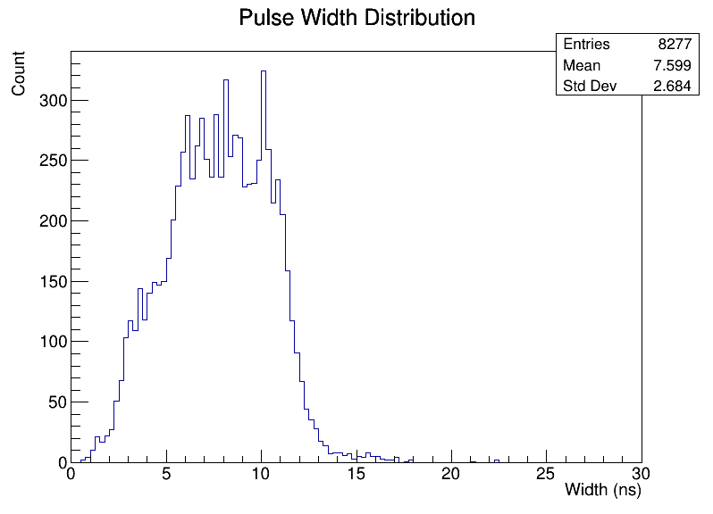
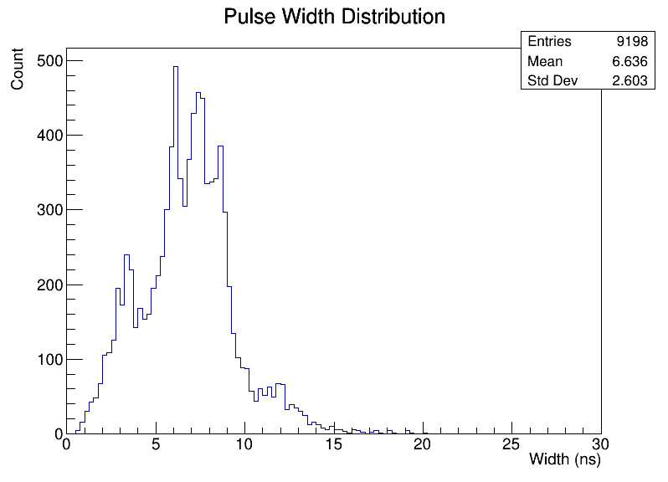
Performance with RPC detector: results
ch 0-7
ch 48-55
ch 72-79
Hit map matches the setup, with scintillators placed at the indicated positions.
Leading time resolution are less than 100ps.
Pulse widths are 5–10 ns and the cluster-size mean is 1.24.

