Slide 1



Symmetry Breaking: From QED to Reduced QED
Adnan Bashir
Department of Integrated Sciences
University of Huelva, Huelva, Spain
Institute of Physics and Mathematics
University of Michoacán, Morelia, Michoacán, Mexico
International Conference on Symmetry Breaking Phenomena in
Quantum Field Theory, May 15-19, Hefei, China

Slide 2
Materials and their properties
Graphene is a single layer of carbon atoms arranged in a two-dimensional, hexagonal honey-comb lattice. It is the thinnest, strongest, and lightest material, being 100–300 times stronger than steel while remaining flexible, transparent, and an excellent conductor of heat and electricity.
High-temperature superconductors are materials that exhibit zero electrical resistance at relatively "warm" temperatures. Unlike conventional superconductors requiring expensive helium cooling, these can be cooled by liquid nitrogen which is significantly cheaper.
Dirac and Weyl semimetals are 3D quantum materials with gapless electronic band structures where conduction and valence bands touch at specific points (nodes) rather than having a bandgap. They offer ultrahigh charge carrier mobility.
Quantum spin liquids are an exotic phase of matter where magnetic spins do not freeze into an ordered pattern, even at absolute zero temperature, due to strong quantum fluctuations and geometric frustration.

Slide 3
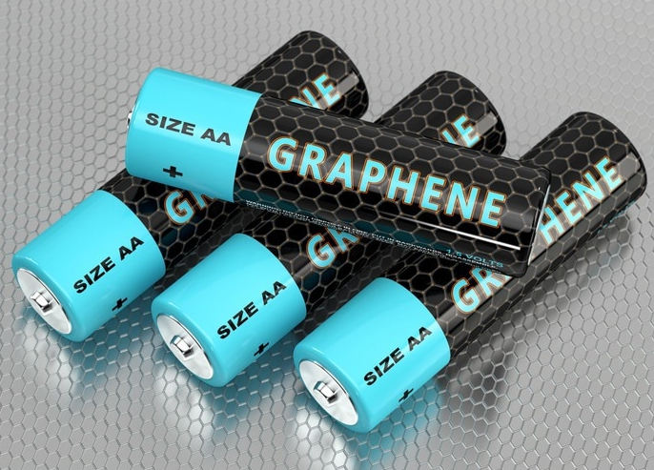

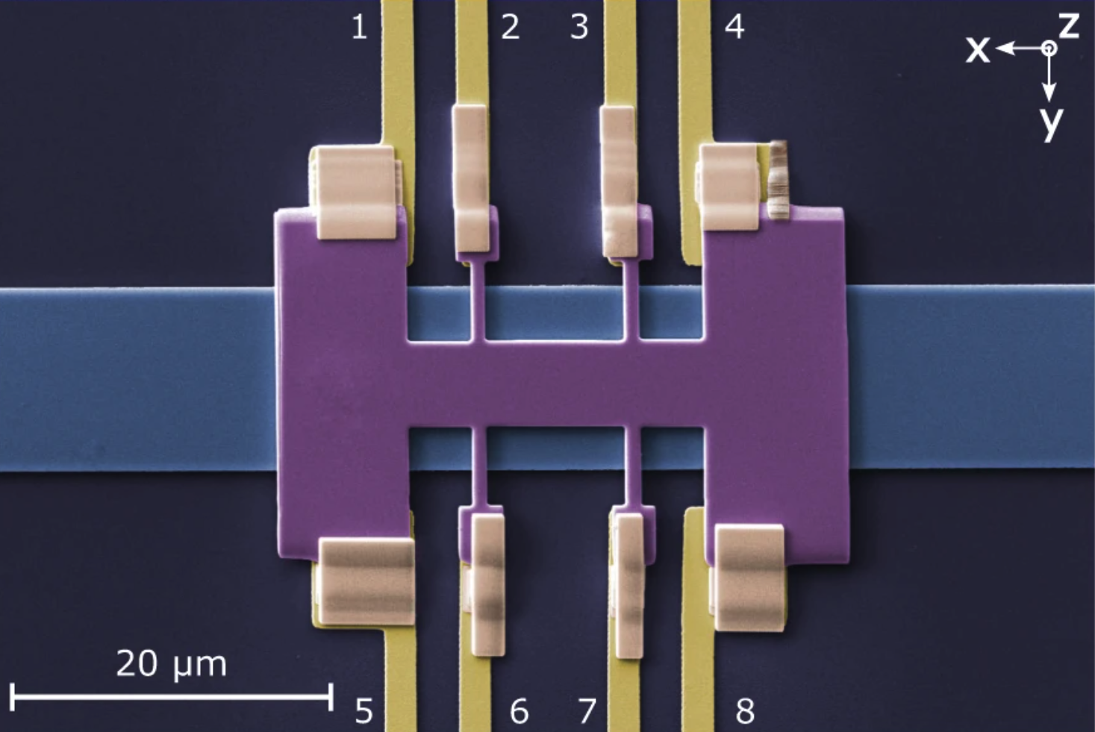
From materials to prototypes and technology
Graphene
High Temperature superconductors
Weyl Semimetals
A graphene battery can be light, durable and suitable for high capacity energy storage, as well as shorten charging times.
High temperature superconductors offer new way to propel levitated trains - like the Maglev trains that "float" above the track in Japan and Shanghai, China
Dirac and Weyl semi-metals: High mobility transistor devise using Weyl semi-metals.

Slide 4
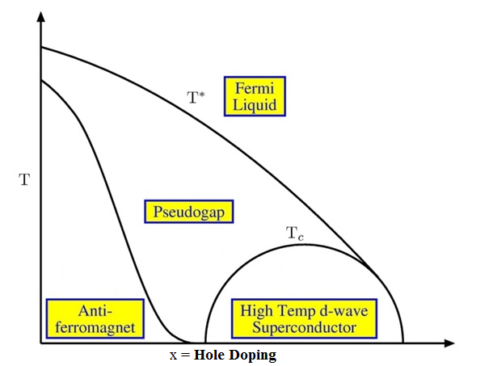
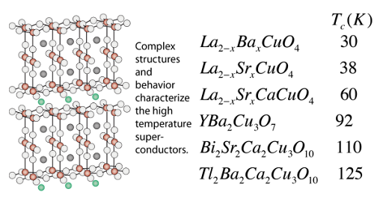
Understanding materials ➞ quantum field theory
Modern materials can drive technology: Graphene, high temperature superconductors.
Their behavior cannot be understood within the framework of conventional solid-state physics. Remarkably, many of these systems are best described using ideas from quantum field theory.
2+1-dimensional quantum electrodynamics (QED₃) plays an important role in describing some of these systems, e.g., high temperature superconductors, their properties and phase diagram.

Slide 5
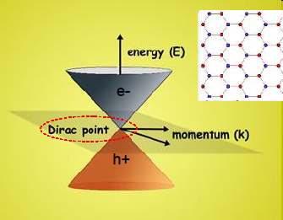
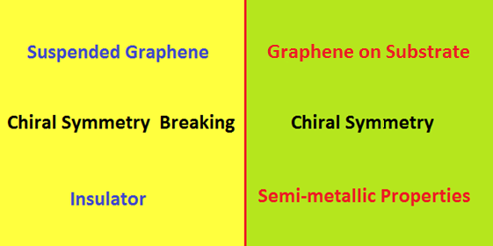
Materials and quantum electrodynamics
In several quantum condensed-matter systems, interactions can
become strong and perturbation theory is an unreliable tool.
The effective interaction strength in suspended Graphene is:
Strong interaction exists between electrons and holes at Dirac points.
Can the Coulomb collapse occur? Can QED vacuum breakdown?
For Graphene on substrate, effective coupling is
where κ is large dielectric constant.
Therefore, the system is now in weak coupling regime and quantum electrodynamics recovers
its perturbative vacuum.

Slide 6
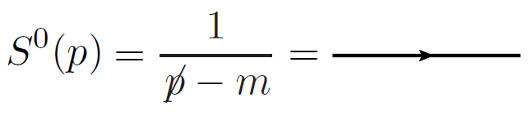
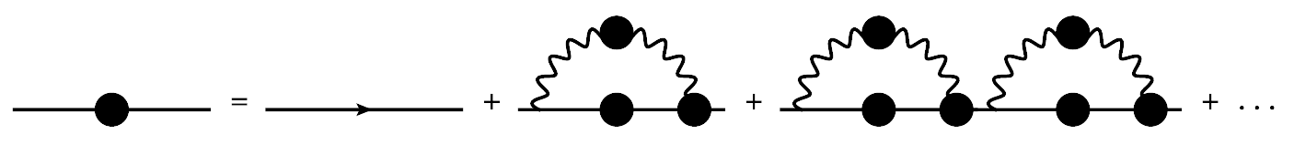
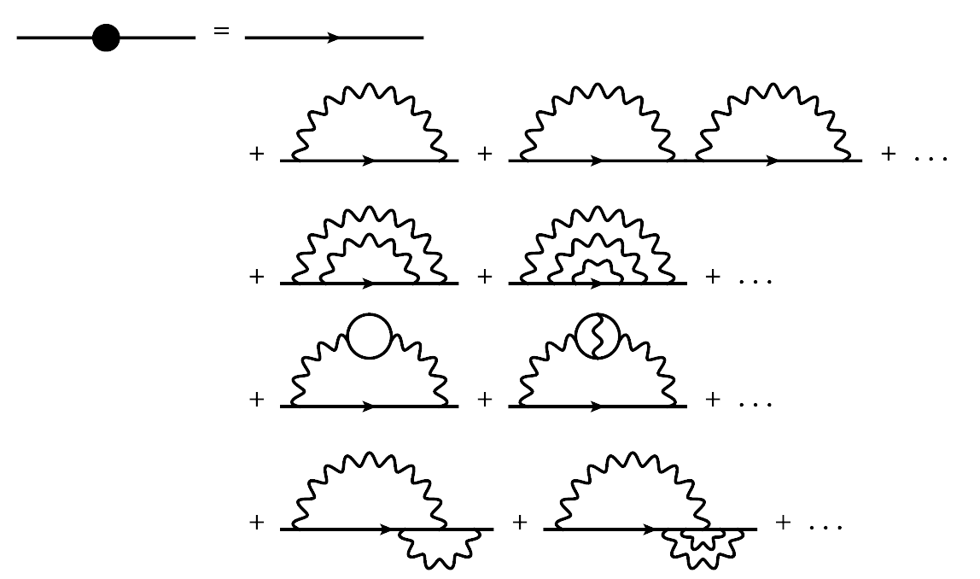
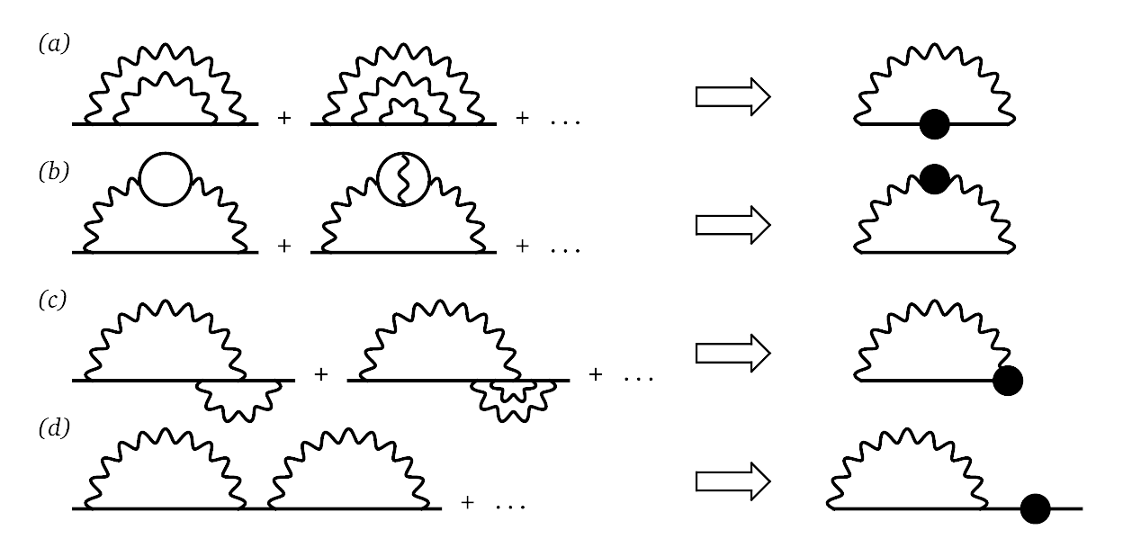
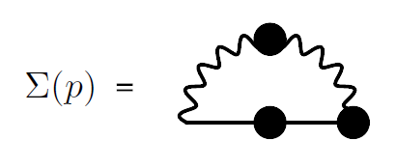
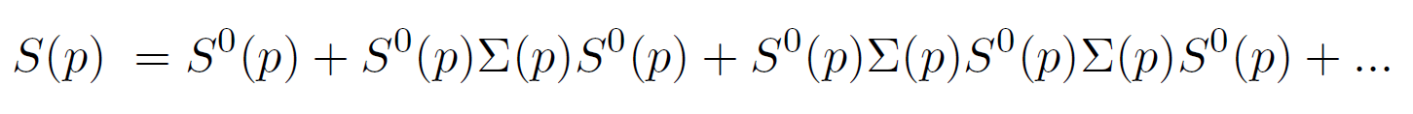
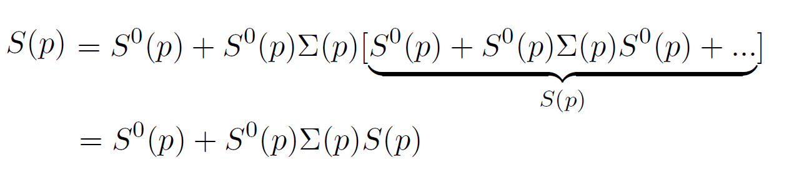
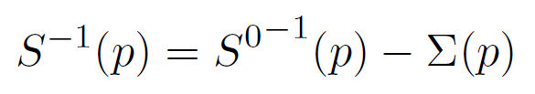
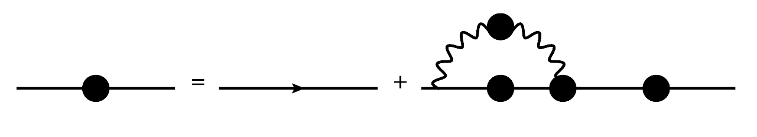
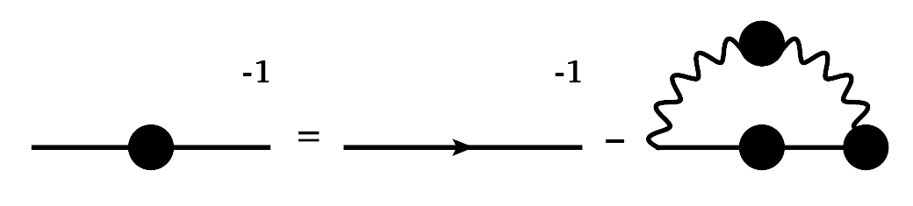
QED and the Schwinger-Dyson equations
Bare
The last blob can again be expanded:
The Electron Propagator
Define self-energy as:
It can be written in a compact form:
The perturbative series can be summed up:
The gap equation

Slide 7
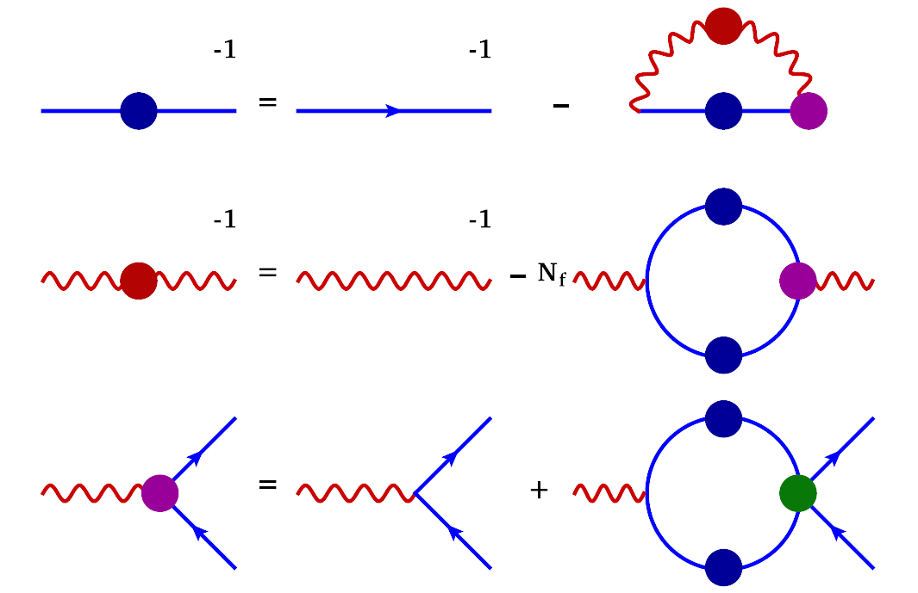
QED and the Schwinger-Dyson equations
Bare
The last blob can again be expanded:
The Electron Propagator
Define self-energy as:
The perturbative series can be summed up:
Perturbation theory and non-perturbative dynamics

Slide 8
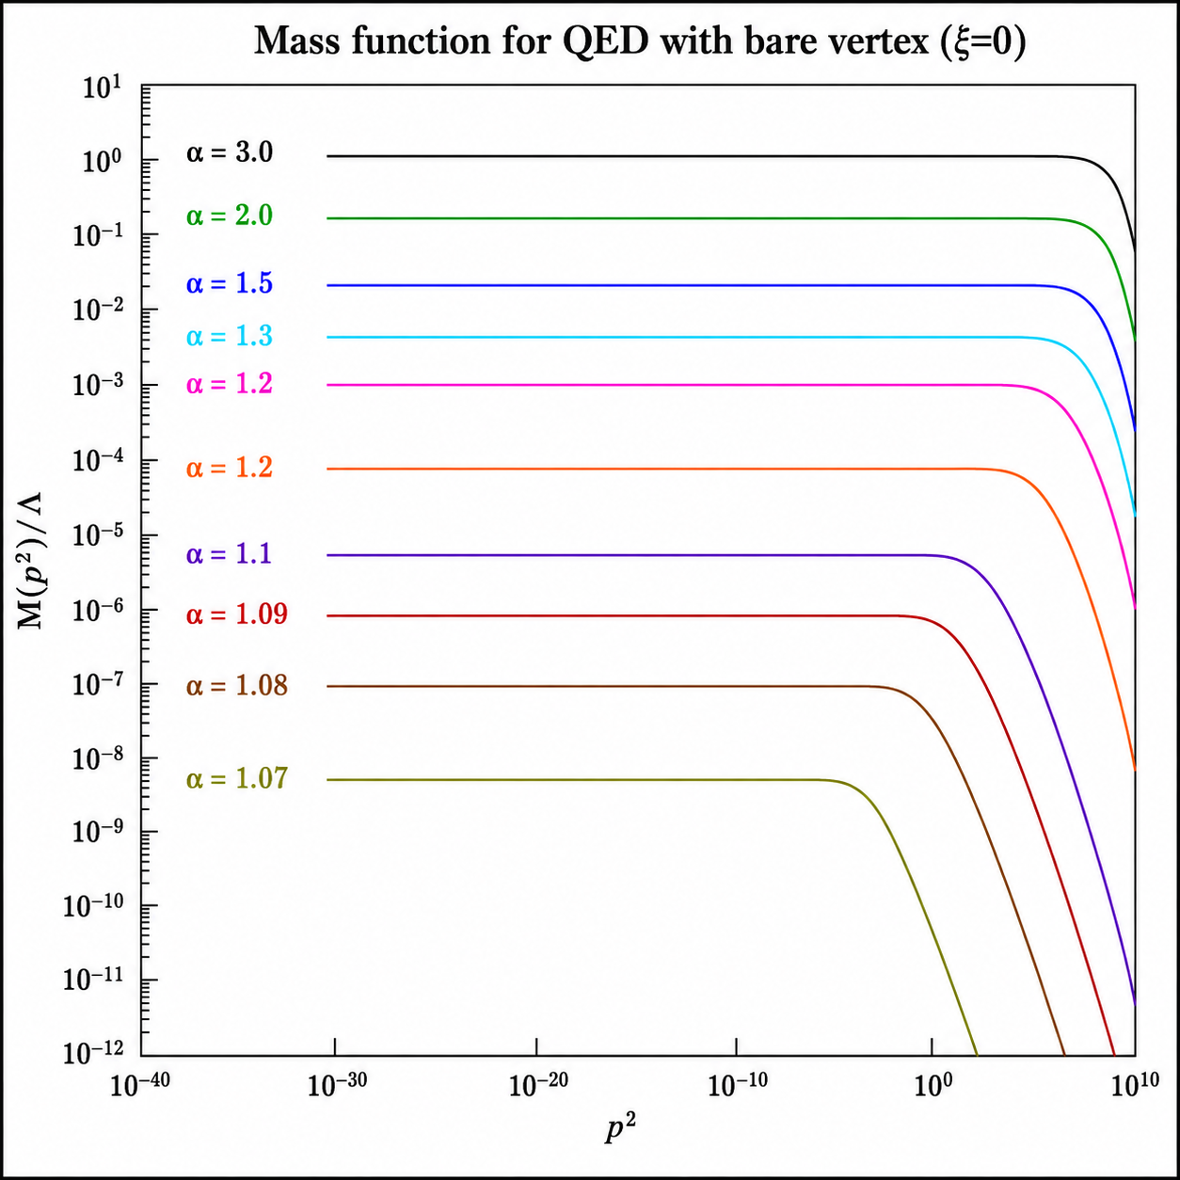
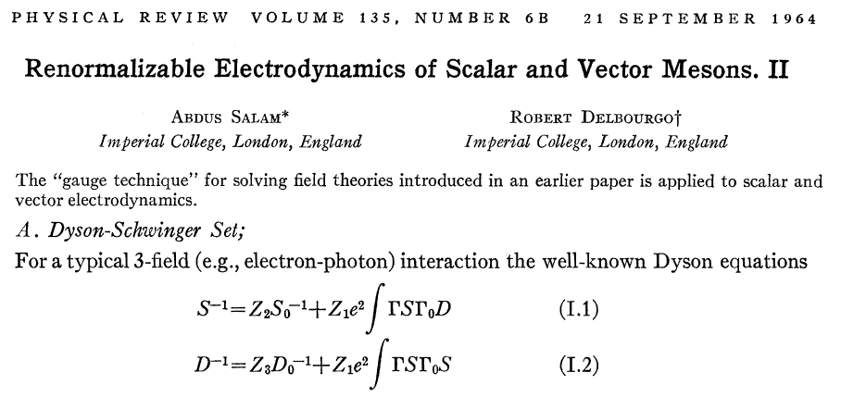

QED – chiral symmetry breaking
Gauge Technique – Non Perturbative Solutios
A. Salam, R. Delbourgo, Phys. Rev. 135 (1964) 6, B1398.
DCSB - Non-perturbative QED
P.I. Fomin, V.A. Miransky, Phys. Lett. B64 (1976) 166-168.
DCSB – Non-abelian Gauge Theories
V. Miransky, V. Gusynin, Y. Sitenko, Phys. Lett. B100 (1981) 157
DCSB – MT Model - Vector Mesons
P. Maris, P. Tandy, Phys. Rev. C60 (1999)
SDE: electron propagator

Slide 9
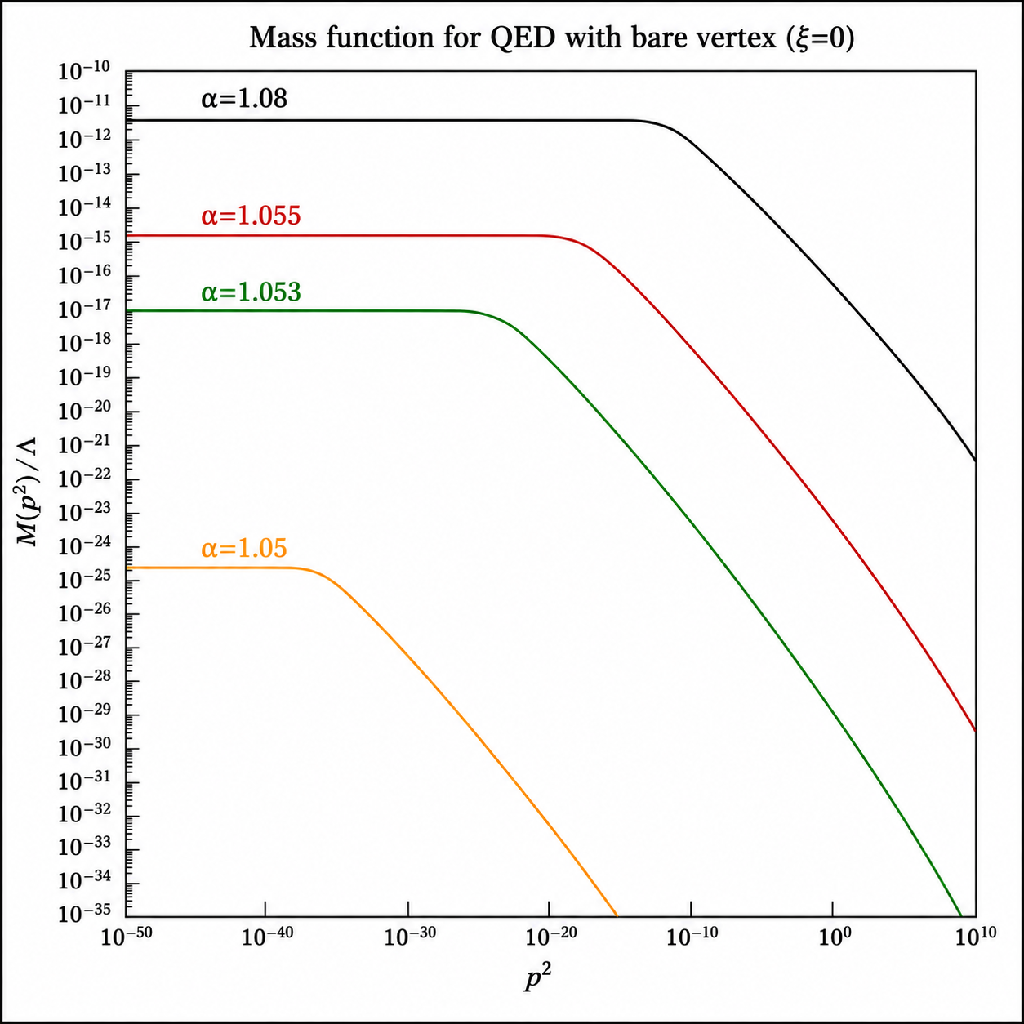
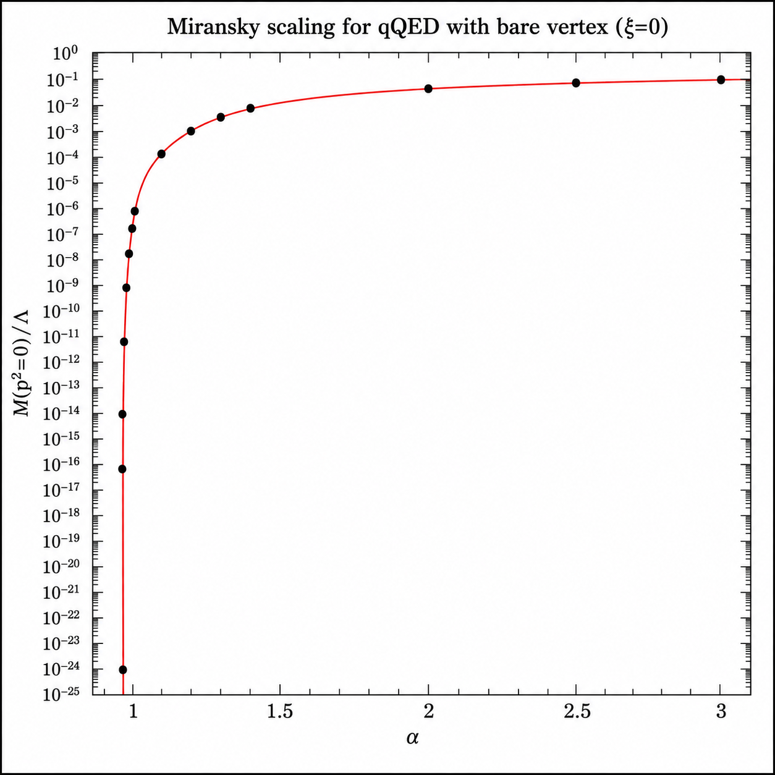
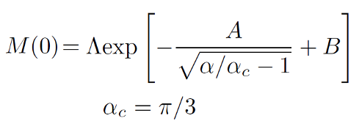
Critical coupling and Miransky scaling

Slide 10
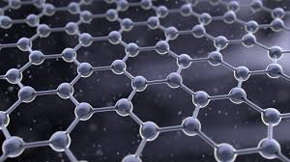
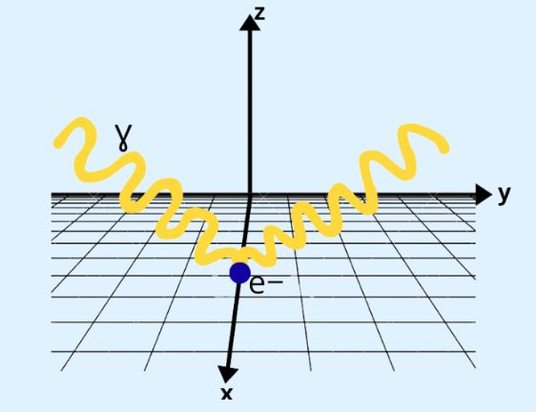
Reduced QED and graphene
Electrons in graphene are confined to a two-dimensional sheet, but the electromagnetic field propagates in the surrounding three-dimensional space, the basis of reduced QED.
The question is whether Coulomb interactions can dynamically generate a fermion mass gap.
This establishes a connection between reduced QED, graphene, and dynamical chiral symmetry breaking (DCSB).
In fact, reduced QED emerged largely as an effective framework
to describe the low-energy electronic properties of graphene
and related Dirac materials.
We have studied reduced QED: electron-photon interaction vertex, DCSB, Miransky scaling and its gauge-independence in the following articles:
A. Ashraf, F. Akram, J. Aslam, D. Rodríguez, AB, L. Albino, arXiv:2605.14122 [hep-th]
V. M. Banda, AB, L. Albino, D. Rodríguez, Phys. Rev. D 108 (2023) 9, 096036
L. Albino, AB, A.J. Mizher, A. Raya, Phys. Rev. D 106 (2022) 9, 096007

Slide 11
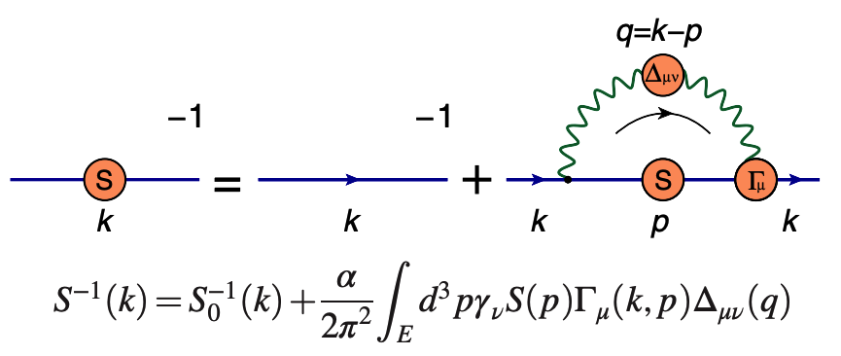

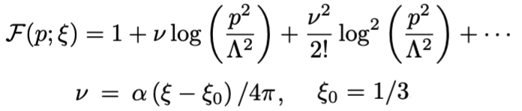
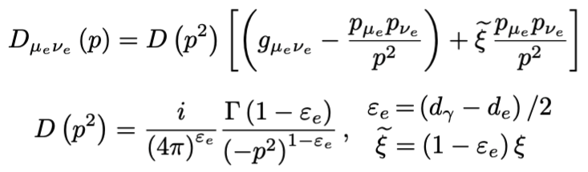

The gap equation of reduced QED
The gap equation of reduced QED is:
General form of the electron propagator is:
Massless wavefunction renormalization in the leading logarithm approximation is:
In reduced brane d_{e}, the photon propagator is:
It corresponds to the multiplicatively renormalizable power law from:
V. M. Banda, AB, L. Albino, D. Rodríguez, Phys. Rev. D 108 (2023) 9, 096036

Slide 12
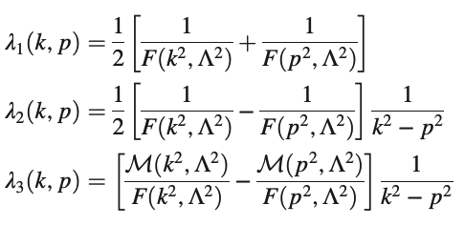
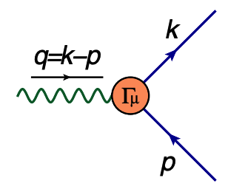




The electron-photon interaction vertex
The electron-photon vertex is represented by:
The transverse part is constrained by:
It satisfies the Ward-Takahashi identity:
It suggests the following vertex decomposition:
The ultraviolet finite transverse part can be expanded out in terms of eight basis vector
structures.
Defining t=k+p, we write longitudinal part as:

Slide 13
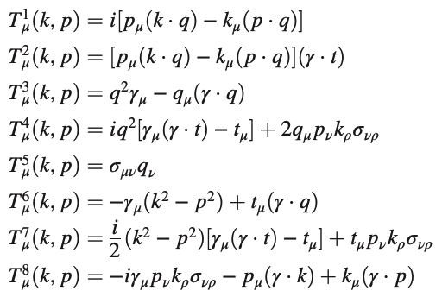
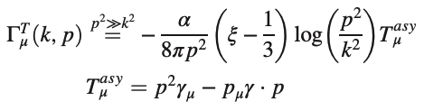


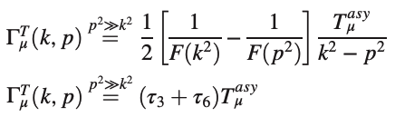


One-loop electron-photon vertex
A conventional choice of the basis vectors is:
We compute 1-loop transverse electron-photon vertex in the kinematic limit p² >> k² >> m²
1-loop massless electron propagator yields:
It suggests a possible connection:
where:

Slide 14
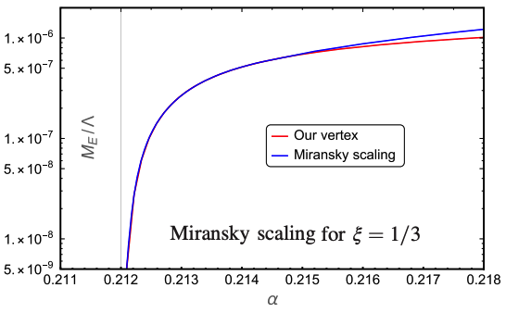


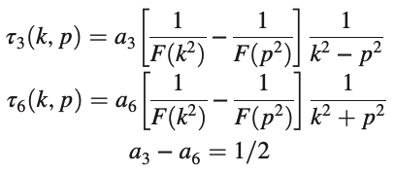
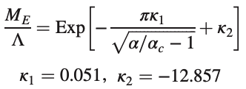

Vertex construction and mass generation
Multiplicative renormalizability constraints
guide us to the following truncation vertices:
Symmetry breaking exhibits Miransky scaling:
One choice is:

Slide 15
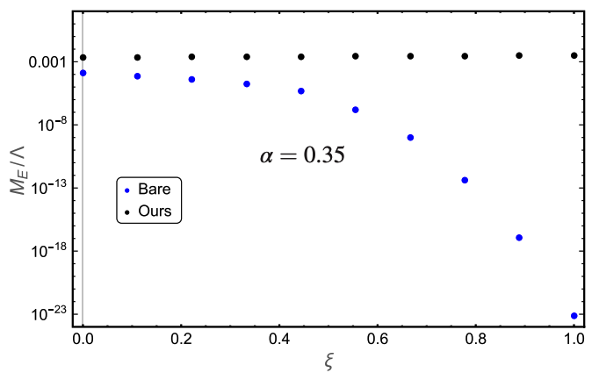
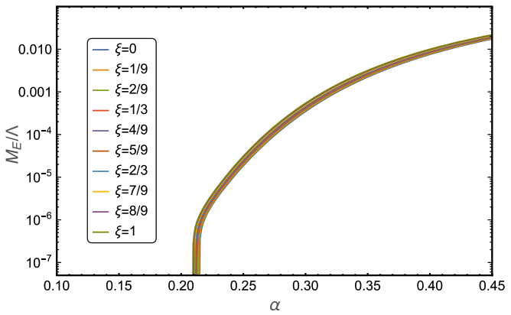
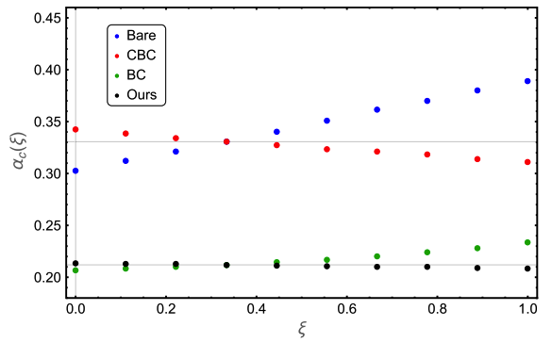

On the gauge invariance of mass generation
We expect the critical coupling for the dynamical mass generation to be gauge-independent:
gauge invariance
gauge invariance
V. Banda, AB, L. Albino, D. Rodríguez, Phys. Rev. D 108 (2023) 9, 096036

Slide 16
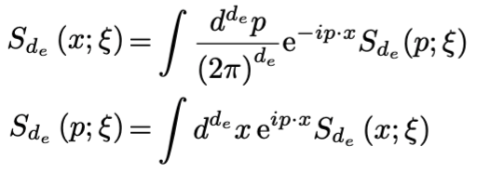
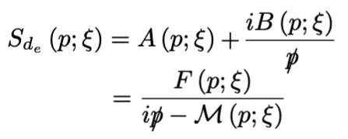




LKF transformations for the electron propagator
An ansatz for the interaction vertex and study of gauge-invariance of observables expects the electron-photon vertex transforms according to the LKF transformations on variation of gauge.
These propagators are related through the Fourier transformations:
Coordinate-space based LKF transformations are easier to study for the electron propagator:
LKF transformations for reduced QED:
where, for
A. Ashraf, F. Akram, J. Aslam, D. Rodríguez, AB, L. Albino, arXiv:2605.14122 [hep-th]

Slide 17
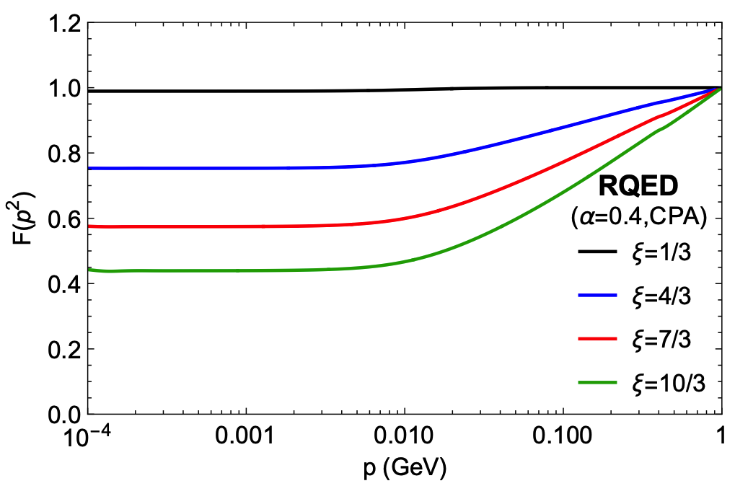
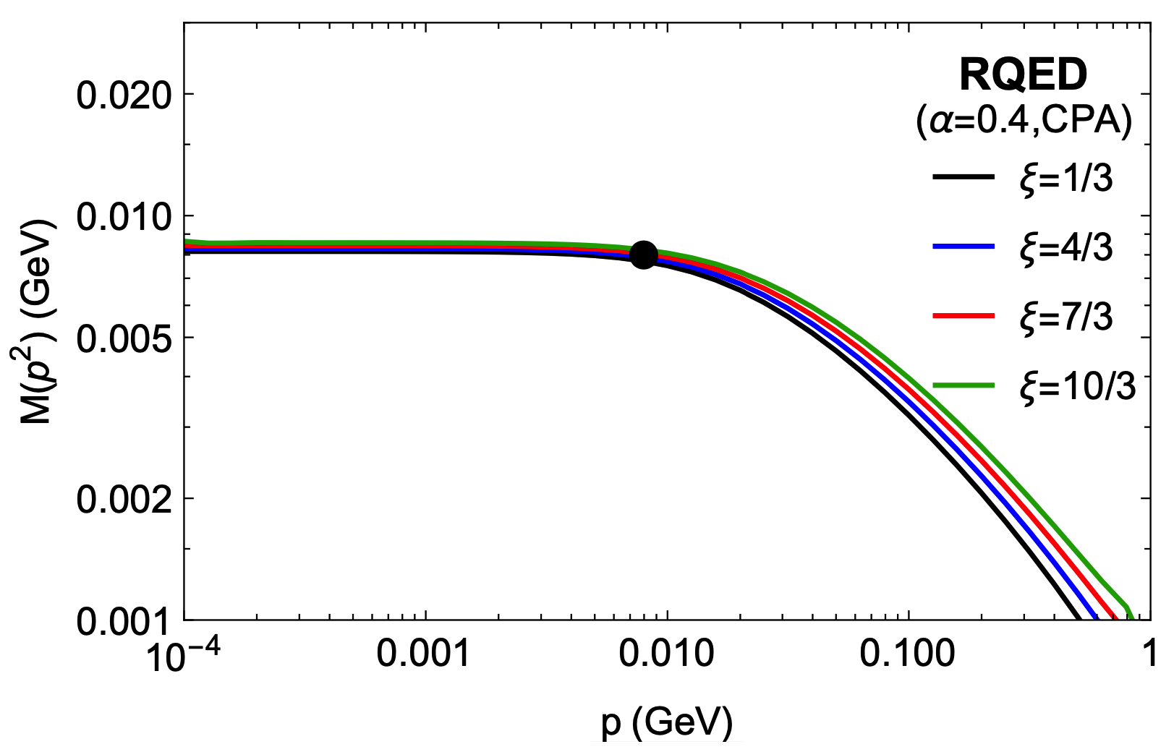
Gauge transformed propagator
LKF transformed wavefunction renormalization,
with the starting gauge as 𝜉=1/3.
LKF transformed mass function, with the starting gauge as 𝜉=1/3.
A. Ashraf, F. Akram, J. Aslam, D. Rodríguez, AB, L. Albino, arXiv:2605.14122 [hep-th]

Slide 18
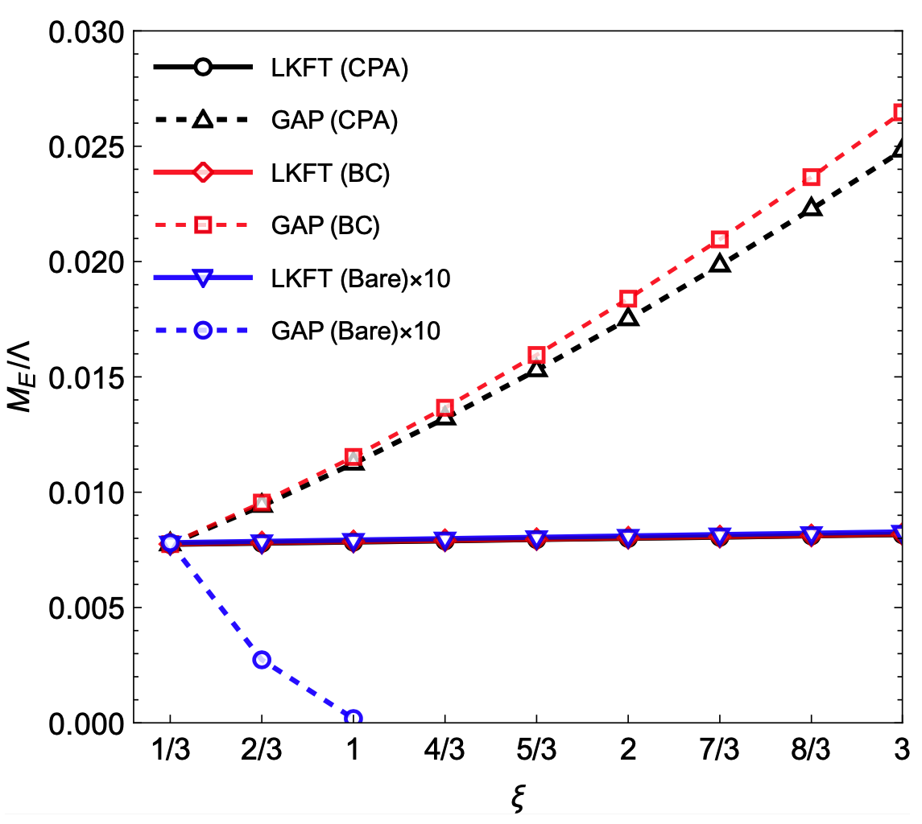
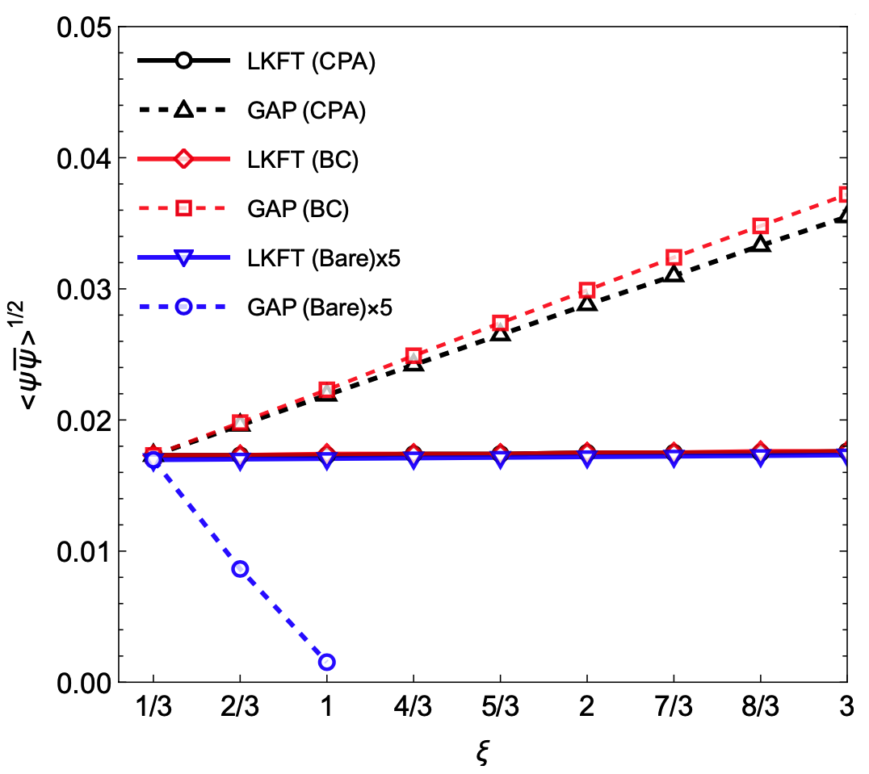
On the gauge invariance of observables
Gauge-dependence of the Euclidean pole mass.
Gauge-dependence of the condensate.
A. Ashraf, F. Akram, J. Aslam, D. Rodríguez, AB, L. Albino, arXiv:2605.14122 [hep-th]

Slide 19
Summary and outlook
Modern quantum materials such as graphene and Dirac semimetals can be effectively described using concepts from quantum field theory.
Reduced QED provides a natural framework for studying electrons confined to two dimensions interacting through electromagnetic fields propagating in three dimensions
Schwinger–Dyson equations were used to investigate dynamical chiral symmetry breaking and electron mass generation in strongly interacting systems.
The role of the electron–photon interaction vertex, multiplicative renormalizability, Miransky scaling, and gauge invariance was emphasized.
A. Ashraf, F. Akram, J.M. Aslam, D. Rodríguez-Tzintzun, AB, L. Albino, arXiv:2605.14122 [hep-th]
V. M. Banda-Guzmán, AB, L. Albino, D. Rodríguez-Tzintzun, Phys. Rev. D 108 (2023) 9, 096036
L. Albino, AB, A.J. Mizher, A. Raya, Phys. Rev. D 106 (2022) 9, 096007

Slide 20
Summary and outlook
Landau–Khalatnikov–Fradkin transformations were employed to study the gauge dependence of propagators and physical observables.
The results highlight the importance of gauge-consistent nonperturbative approaches for understanding strongly correlated quantum materials.
Extend the Schwinger–Dyson equation framework in reduced QED to more realistic descriptions of Dirac materials and strongly correlated condensed-matter systems.
Explore the connection between chiral symmetry breaking and experimentally observable quantities such as energy gaps, transport properties, and optical responses in graphene-like materials.
Develop predictive nonperturbative tools capable of describing emergent phenomena in reduced-dimensional quantum materials where perturbation theory may not provide the complete picture.

Slide 21
Thank you for your attention

