Slide 1
Determining the NJL Coupling and AMM in Magnetized QCD Matter via Machine Learning
Zigeng Ding
Anhui University of
Science and Technology
Based on arXiv:2603.29269
with Fan Lin and Xinyang Wang
1

Slide 2
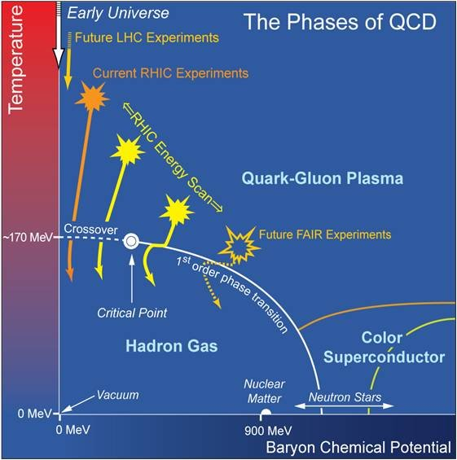
Phase Diagram and Phase Structure of QCD Matter
Extremely high temperature
In the early universe, matter existed at extremely high temperatures.
Extremely high density
Inside neutron stars, matter exists in an extremely high-density environment.
2

Slide 3
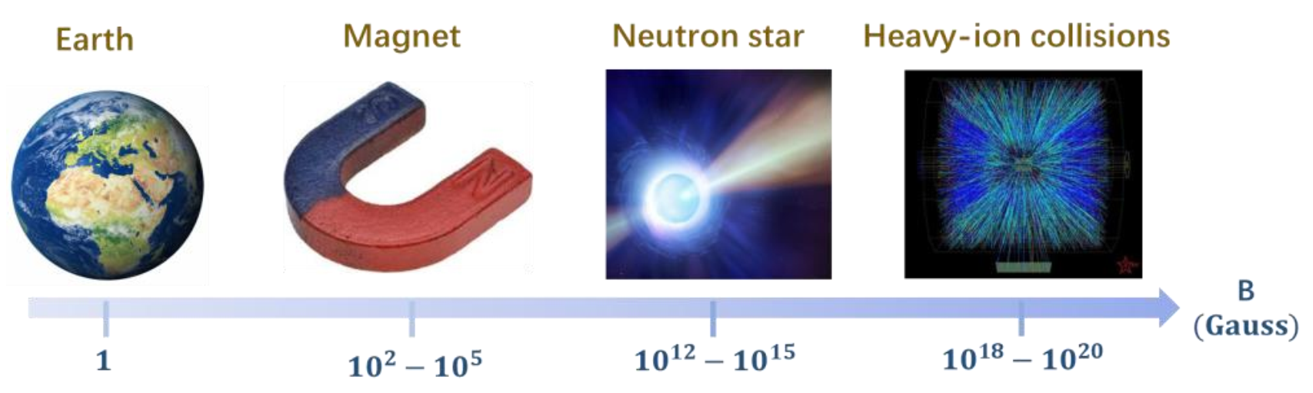
Phase Structure of QCD Matter under Strong Magnetic Field
Extremely strong magnetic field
On neutron stars and magnetars: 10¹² – 10¹⁵ Gauss
In non-central heavy-ion collisions: 10¹⁸ – 10²⁰ Gauss
Effects of QCD matter in Strong Magnetic Fields:
Magnetic catalysis (MC) V. P. Gusynin, V. A. Miransky, and I. A. Shovkovy, Phys. Rev. Lett. 73, 3499 (1994)
Inverse magnetic catalysis (IMC) G. S. Bali et al. Phys. Rev. D. 86, 071502 (2012)
3

Slide 4
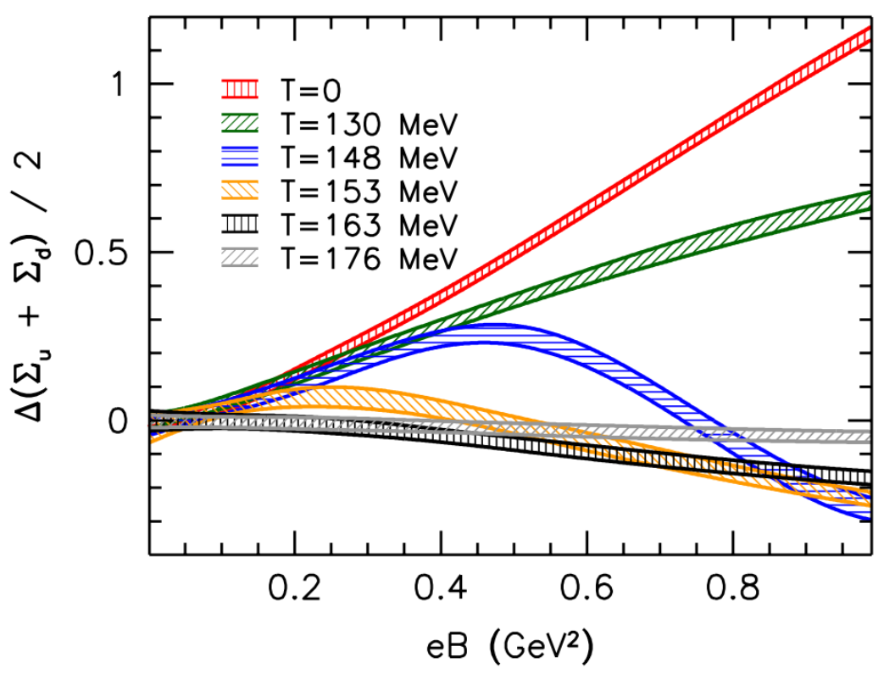
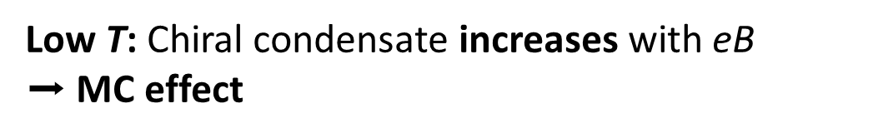
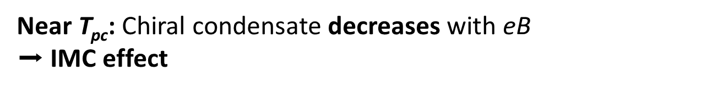
Magnetic catalysis and Inverse magnetic catalysis
Low T: Chiral condensate increases with eB
$➡$ MC effect
Near T_{pc}: Chiral condensate decreases with eB
$➡$ IMC effect
G. S. Bali et al. Phys. Rev. D. 86, 071502 (2012)
4

Slide 5
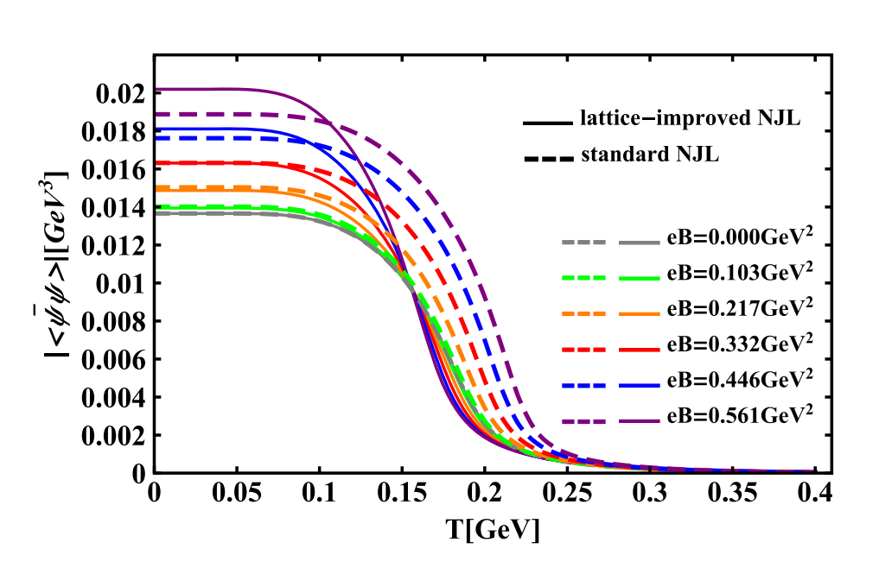
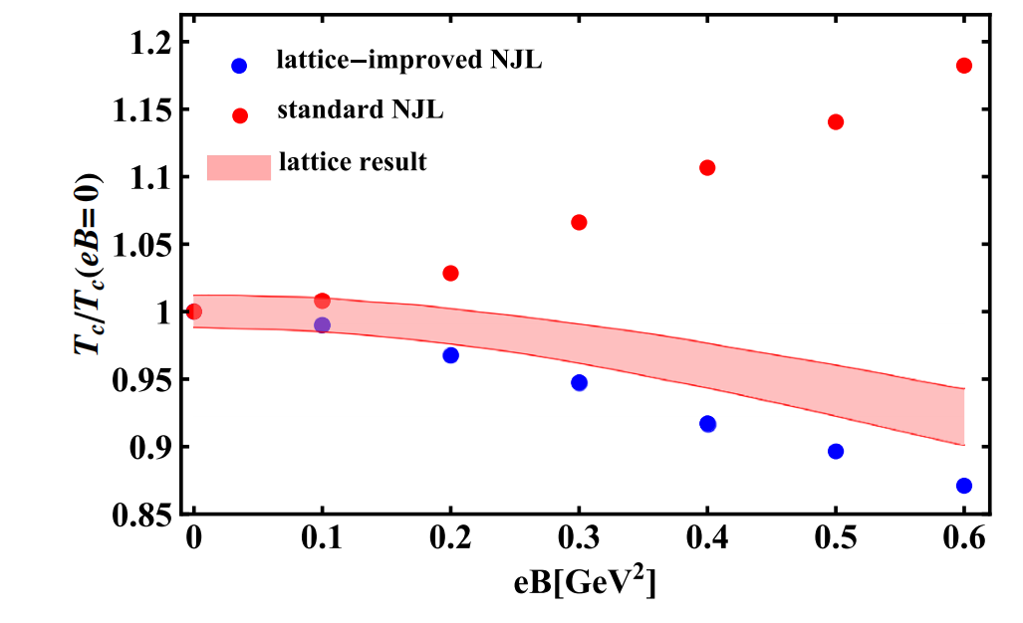
(Inverse) magnetic catalysis
magnetic-field-dependent coupling constant G
$$ℒ=\overline{ψ}\left(iγ^{μ}D_{μ}−\hat{m}\right)ψ+G\left[{\left(\overline{ψ}ψ\right)}^{2}+{\left(\overline{ψ}iγ^{5}τψ\right)}^{2}\right]$$
B. K. Sheng et al. Phys. Rev. D. 105, 034003 (2022)
5

Slide 6
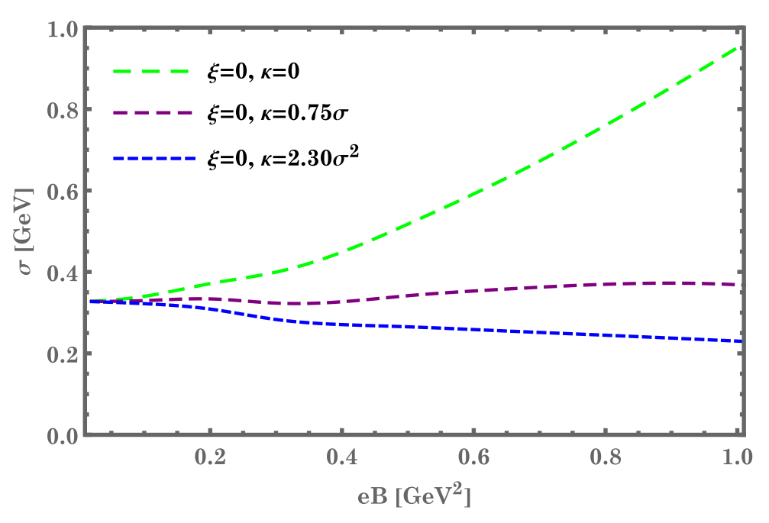



(Inverse) magnetic catalysis
Considering the effects of the anomalous magnetic moment (AMM) of quarks
$$ℒ=\overline{ψ}\left(iγ^{μ}D_{μ}−\hat{m}+\frac{1}{2}q_{f}κF_{μν}σ^{μν}\right)ψ+G\left[{\left(\overline{ψ}ψ\right)}^{2}+{\left(\overline{ψ}iγ^{5}τψ\right)}^{2}\right]$$
$κ=v_{1}σ$
?
$κ=v_{2}σ^{2}$
?
$$σ=−2G\left\langle \overline{ψ}ψ\right\rangle$$
F. Lin et al. Phys. Rev. D. 106, 016005 (2022)
6

Slide 7
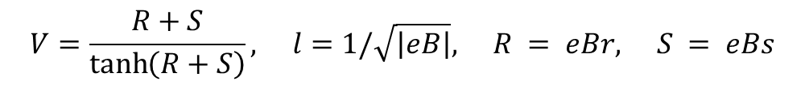



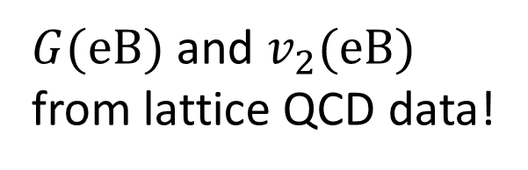
(Inverse) magnetic catalysis
the magnetic-field correction term $κ_{B}$ to the electron anomalous magnetic moment
$$κ_{B}=−\frac{α}{2π}⋅4m^{2}l^{2}\int_{0}^{∞}{\int_{0}^{∞}{e^{−\left(R+S\right)m^{2}l^{2}}\frac{\left[2\tanh\left(R\right)\tanh\left(S\right)−\tanh^{2}\left(R\right)\right]}{\left[\tanh\left(R\right)+\tanh\left(S\right)\right]}}\frac{\ln{V}}{V−1}}dRdS$$
$$V=\frac{R+S}{\tanh\left(R+S\right)}, l=1/\sqrt{\left|eB\right|}, R = eBr, S = eBs$$
$$κ_{B}∝m^{2}$$
$G(eB)$ and $v_{2}(eB)$
from lattice QCD data!
$$κ=v_{2}σ^{2}$$
$$v_{2}(eB)$$
F. Lin, M. Huang. Commun. Theor. Phys. 74, 055202 (2022)
7

Slide 8
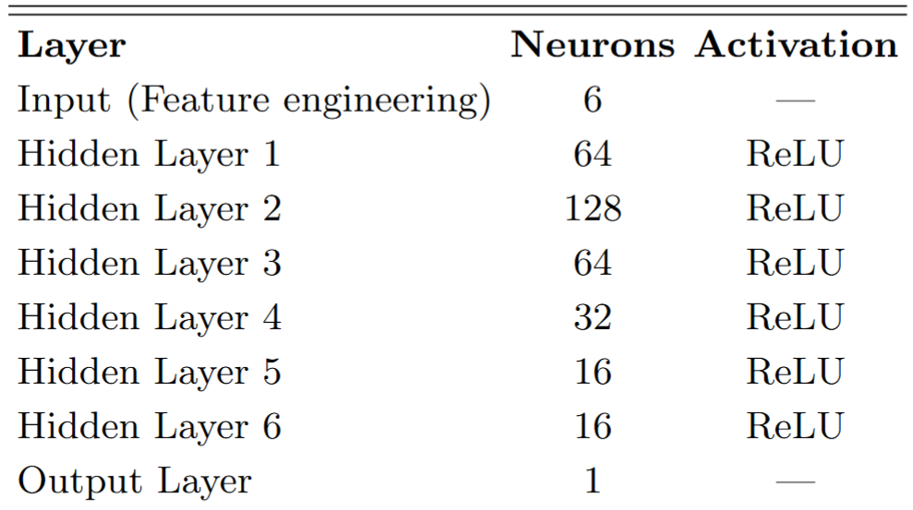

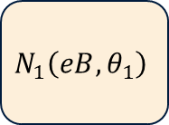
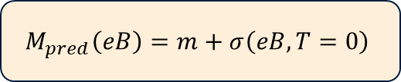


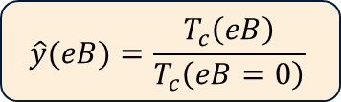



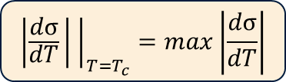
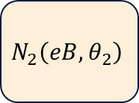

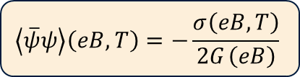
Neural Networks and Physics Solver
eB
$$N_{1}\left(eB,θ_{1}\right)$$
$$ΔG_{ }\left(eB \right)$$
$$G_{ }\left(eB \right)$$
eB²
+ $G_{0}$
eB³
$$\sqrt{eB}$$
$$N_{2}\left(eB,θ_{2}\right)$$
ln(eB)
$$Δv_{2}\left(eB \right)$$
$$v_{2}\left(eB \right)$$
sin(eB)
+ $v_{2}^{0}$
Gap equation:
$$\frac{∂Ω}{∂σ}=\frac{σ}{2G}−N_{c}\sum_{f,l,s}{\frac{\left|q_{f}B\right|}{2π}}\int_{−∞}^{+∞}{\frac{dp_{z}}{2π}}\left[1−2{\left(1+e^{βω_{f,l,s}}\right)}^{−1}\right]f_{Λ,q_{f}B}^{k_{z}}\frac{∂ω_{f,l,s}}{∂σ}=0, \frac{∂^{2}Ω}{∂σ^{2}}>0$$
$${\left|\frac{dσ}{dT} | \right|}_{T=T_{c}}=max\left|\frac{dσ}{dT}\right|$$
$$\hat{y}(eB)=\frac{T_{c}\left(eB\right)}{T_{c}\left(eB=0\right)}$$
$$M_{pred}\left(eB\right)=m+σ\left(eB,T=0\right)$$
$$\left\langle \overline{ψ}ψ\right\rangle \left(eB,T\right)=−\frac{σ\left(eB,T\right)}{{2G}_{ }\left(eB\right)}$$
8

Slide 9

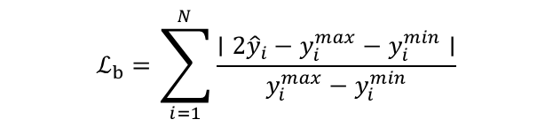

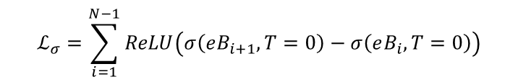
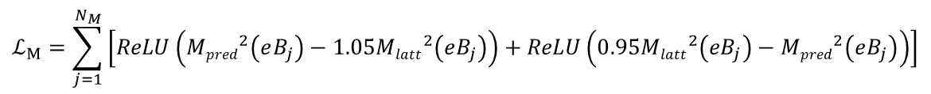
Loss Function
Data loss
$$ℒ_{M}=\sum_{j=1}^{N_{M}}{\left[\operatorname{ReLU}\left({Mpred}^{2}\left(eB_{j}\right)−1.05{Mlatt}^{2}\left(eB_{j}\right)\right)+ReLU\left(0.95{Mlatt}^{2}\left(eB_{j}\right)−{Mpred}^{2}\left(eB_{j}\right)\right)\right]}$$
$$ℒ_{b}=\sum_{i=1}^{N}{\frac{∣2{\hat{y}}_{i}−y_{i}^{max}−y_{i}^{min}∣}{y_{i}^{max}−y_{i}^{min}}}$$
Physic loss
$$ℒ_{QC}=\sum_{i=1}^{N−1}{\sum_{j}^{N_{lowT}}{\operatorname{ReLU}\left(\left\langle \hat{ψ}ψ\right\rangle \left(eB_{i},T_{j}\right)−\left\langle \hat{ψ}ψ\right\rangle \left(eB_{i+1},T_{j}\right)\right)}+\sum_{i=1}^{N−1}{\sum_{j}^{N_{highT}}{\operatorname{ReLU}\left(\left\langle \hat{ψ}ψ\right\rangle \left(eB_{i+1},T_{j}\right)−\left\langle \hat{ψ}ψ\right\rangle \left(eB_{i},T_{j}\right)\right)}}}$$
$$ℒ_{σ}=\sum_{i=1}^{N−1}{\operatorname{ReLU}\left(σ\left(eB_{i+1},T=0\right)−σ\left(eB_{i},T=0\right)\right)}$$
Total loss
$$ℒ_{total}=ℒ_{data}+ℒ_{physics}$$
$$ReLU(x)=max(0,x)$$
9

Slide 10

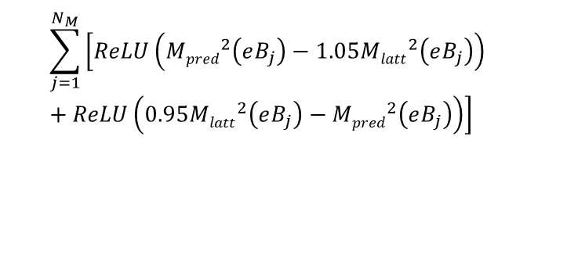














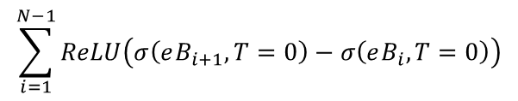
Training
Network
Physics solver
eB
$$N_{1}\left(eB,θ_{1}\right)$$
$$ΔG_{ }\left(eB \right)$$
Gap equation
$${\left|\frac{dσ}{dT} | \right|}_{T=T_{c}}=max\left|\frac{dσ}{dT}\right|$$
eB²
+ $G_{0}^{ }$
$$\hat{y}(eB)=\frac{T_{c}\left(eB\right)}{T_{c}\left(eB=0\right)}$$
eB³
$$G_{ }\left(eB \right)$$
eB
$$\sqrt{eB}$$
$$v_{2}\left(eB \right)$$
$$Mpred\left(eB\right)=m+σ\left(eB,T=0\right)$$
ln(eB)
+ $v_{2}^{0}$
sin(eB)
$$N_{2}\left(eB,θ_{2}\right)$$
$$Δv_{2}\left(eB \right)$$
$$\left\langle \overline{ψ}ψ\right\rangle \left(eB,T\right)=−\frac{σ\left(eB,T\right)}{{2G}_{ }\left(eB\right)}$$
Back-propagation
Data loss
$$\sum_{j=1}^{N_{M}}{\left[\operatorname{ReLU}\left({Mpred}^{2}\left(eB_{j}\right)−1.05{Mlatt}^{2}\left(eB_{j}\right)\right)+ReLU\left(0.95{Mlatt}^{2}\left(eB_{j}\right)−{Mpred}^{2}\left(eB_{j}\right)\right)\right]}$$
$$\sum_{i=1}^{N}{\frac{∣2{\hat{y}}_{i}−y_{i}^{max}−y_{i}^{min}∣}{y_{i}^{max}−y_{i}^{min}}}$$
$$ℒ_{total}=ℒ_{data}+ℒ_{physics}$$
Physic loss
$$\sum_{i=1}^{N−1}{\sum_{j}^{N_{lowT}}{\operatorname{ReLU}\left(\left\langle \hat{ψ}ψ\right\rangle \left(eB_{i},T_{j}\right)−\left\langle \hat{ψ}ψ\right\rangle \left(eB_{i+1},T_{j}\right)\right)}+\sum_{i=1}^{N−1}{\sum_{j}^{N_{highT}}{\operatorname{ReLU}\left(\left\langle \hat{ψ}ψ\right\rangle \left(eB_{i+1},T_{j}\right)−\left\langle \hat{ψ}ψ\right\rangle \left(eB_{i},T_{j}\right)\right)}}}$$
$$\sum_{i=1}^{N−1}{\operatorname{ReLU}\left(σ\left(eB_{i+1},T=0\right)−σ\left(eB_{i},T=0\right)\right)}$$
10

Slide 11
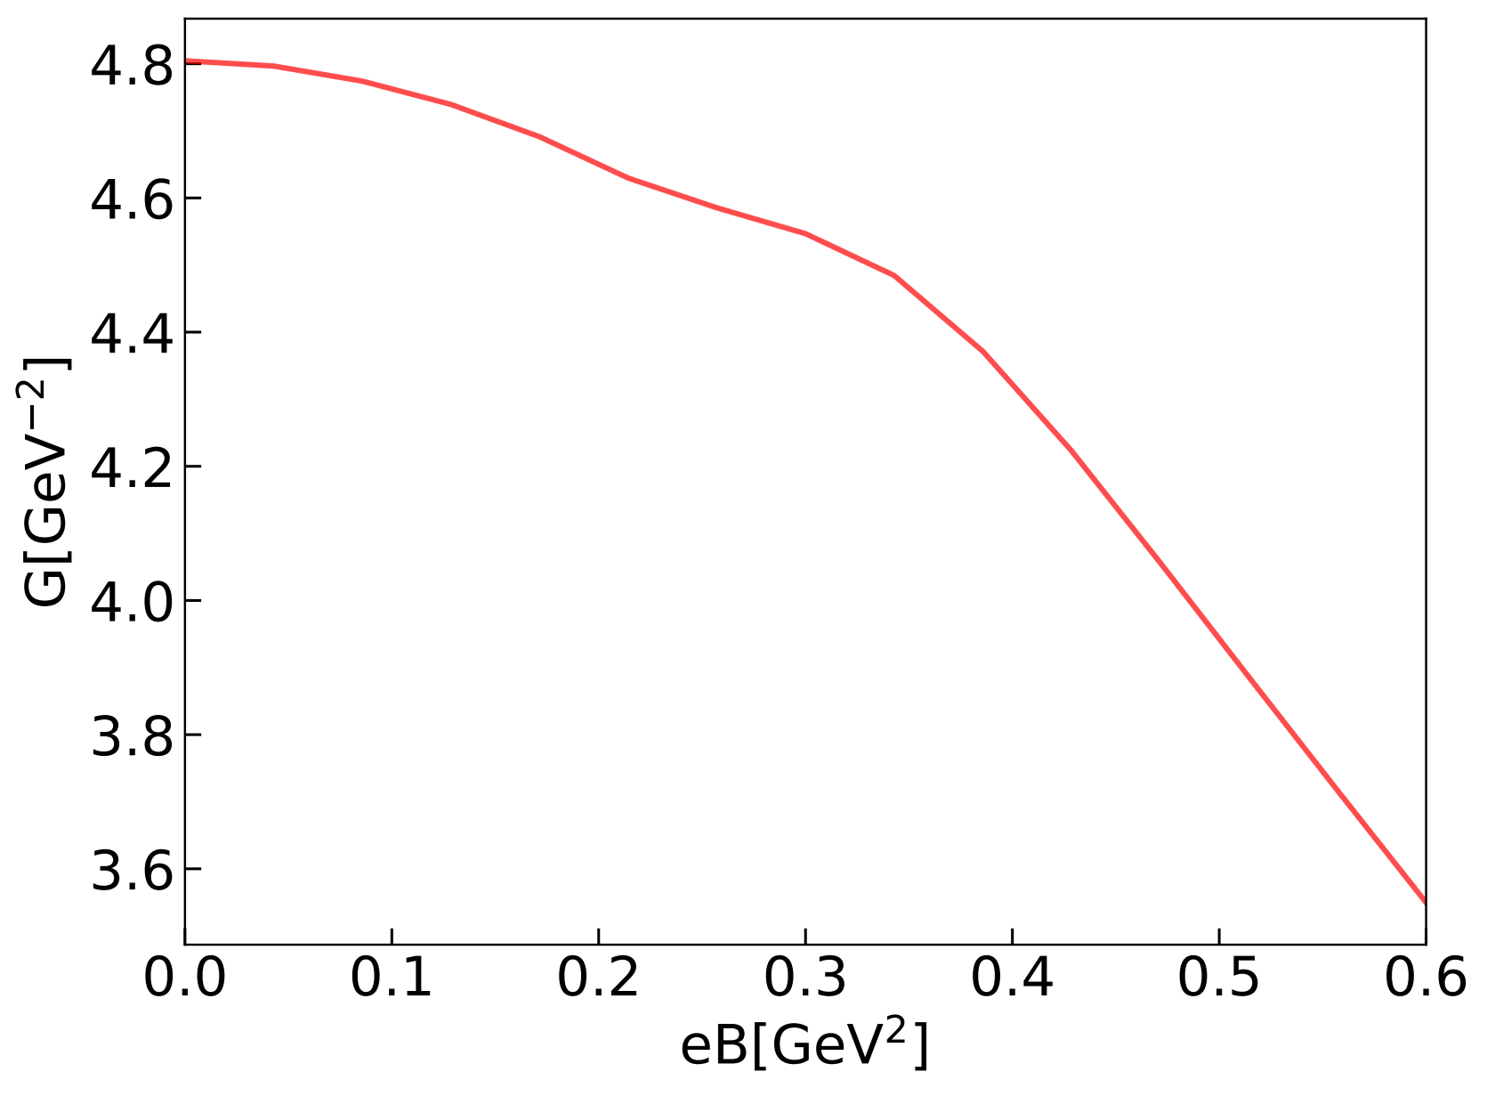
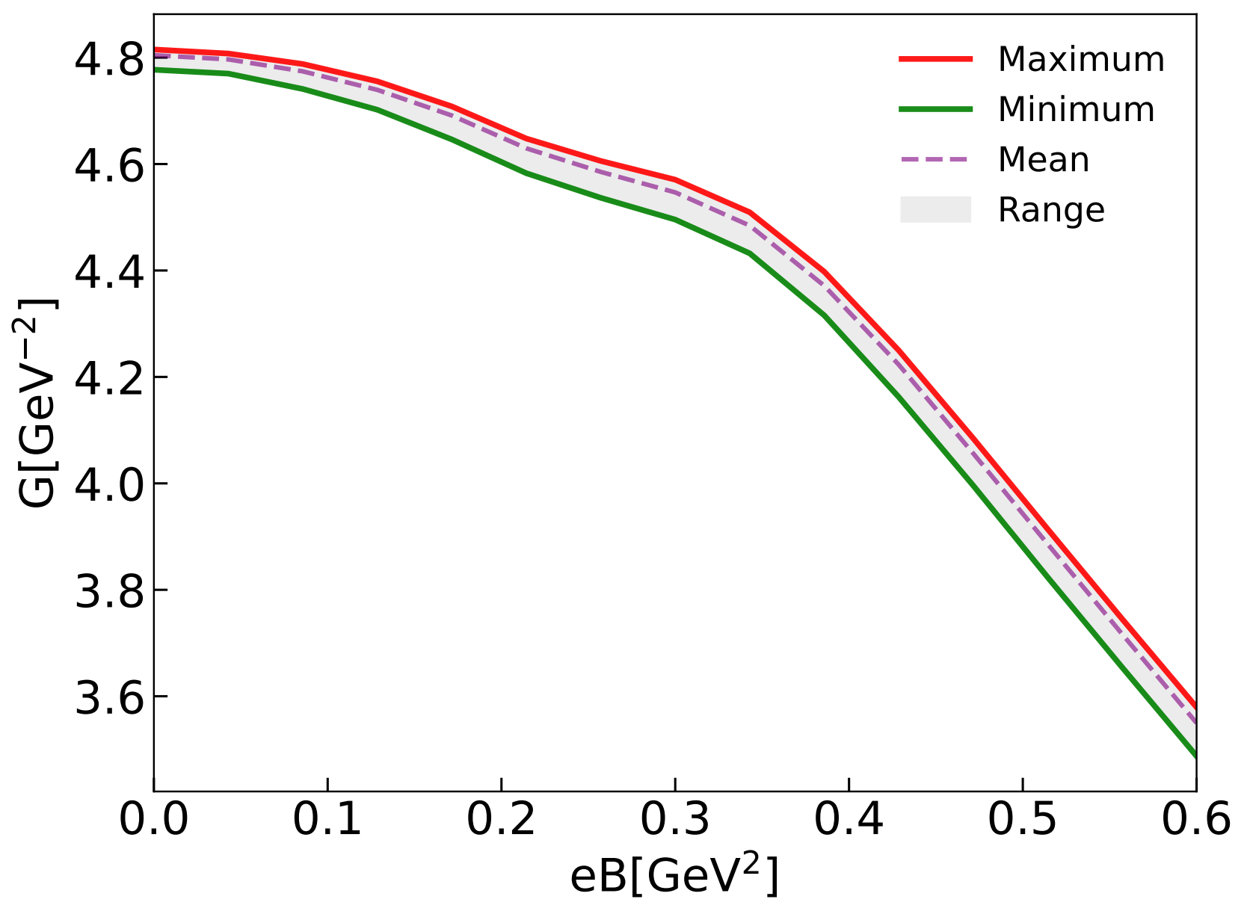
Results and Analysis
Neural network output G as a function of eB
11

Slide 12
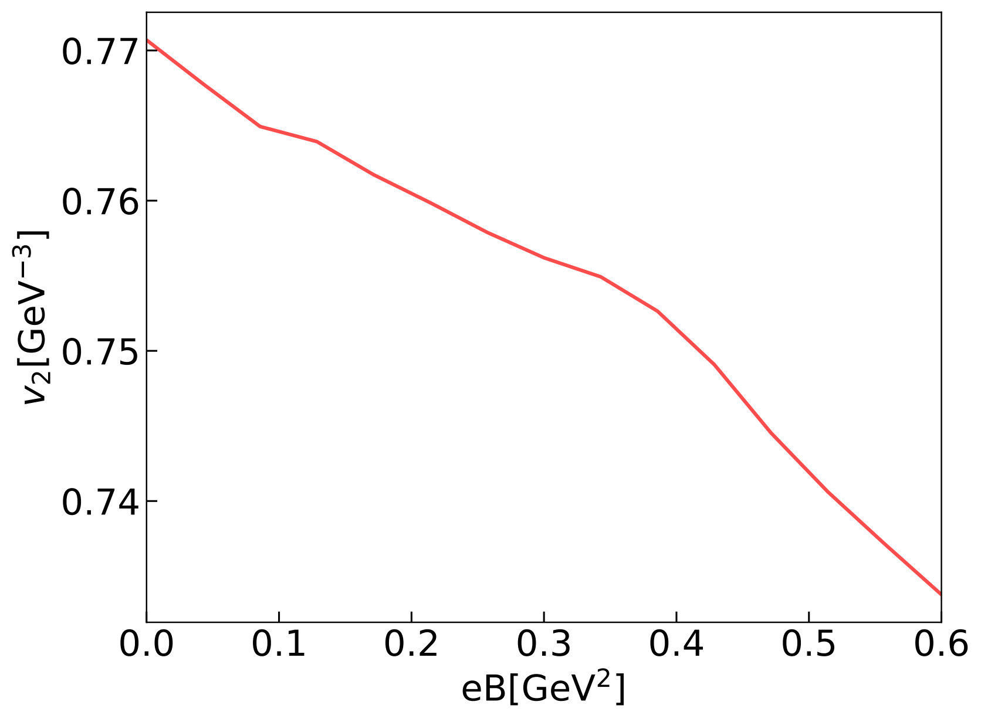
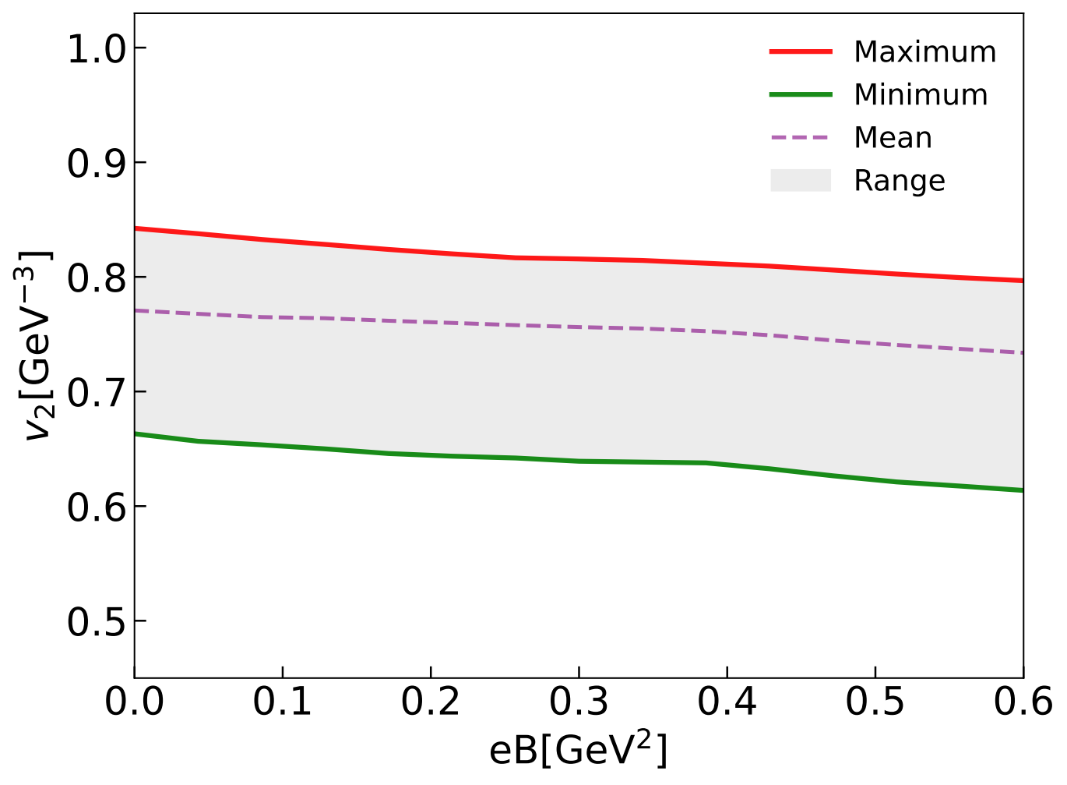
Results and Analysis
Neural network output v₂ as a function of eB
12

Slide 13
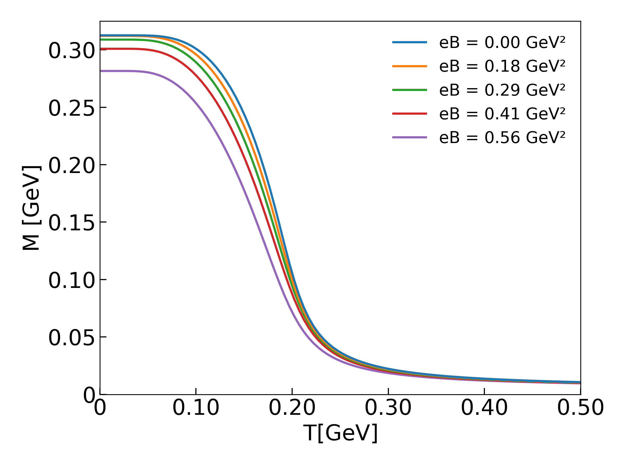
Results and Analysis
Constituent quark mass as a function of temperature for different eB
13

Slide 14
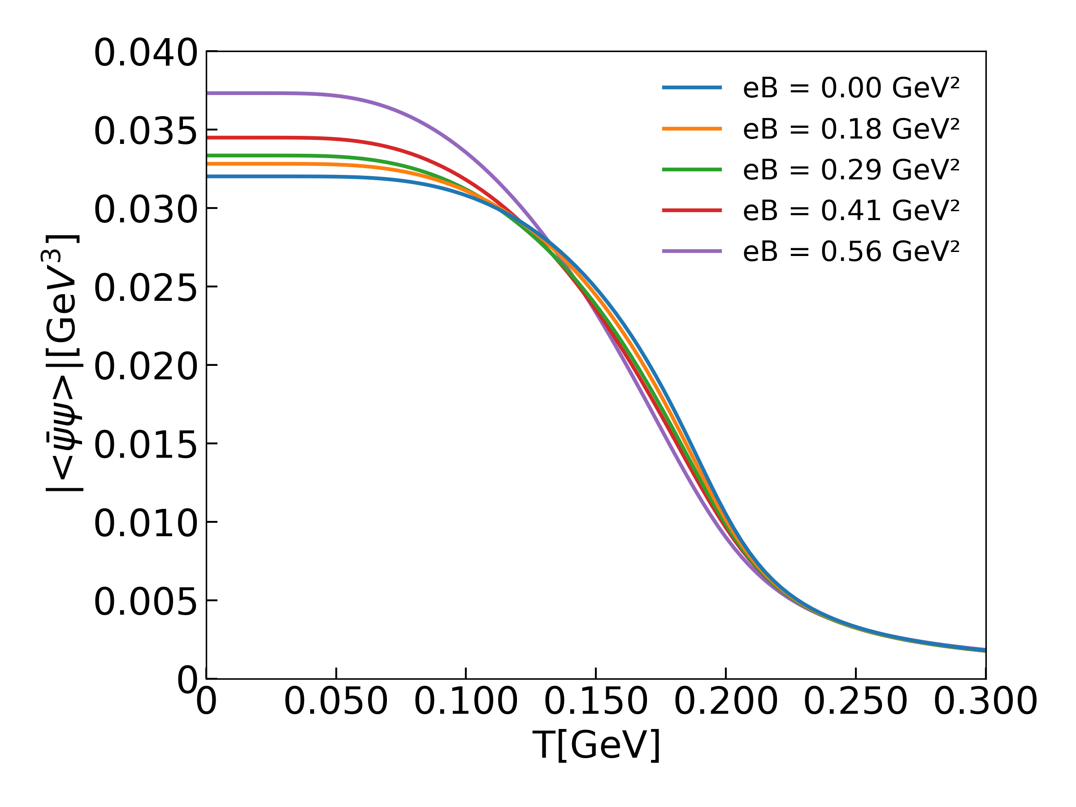
Results and Analysis
Chiral condensate as a function of temperature for different eB
14

Slide 15
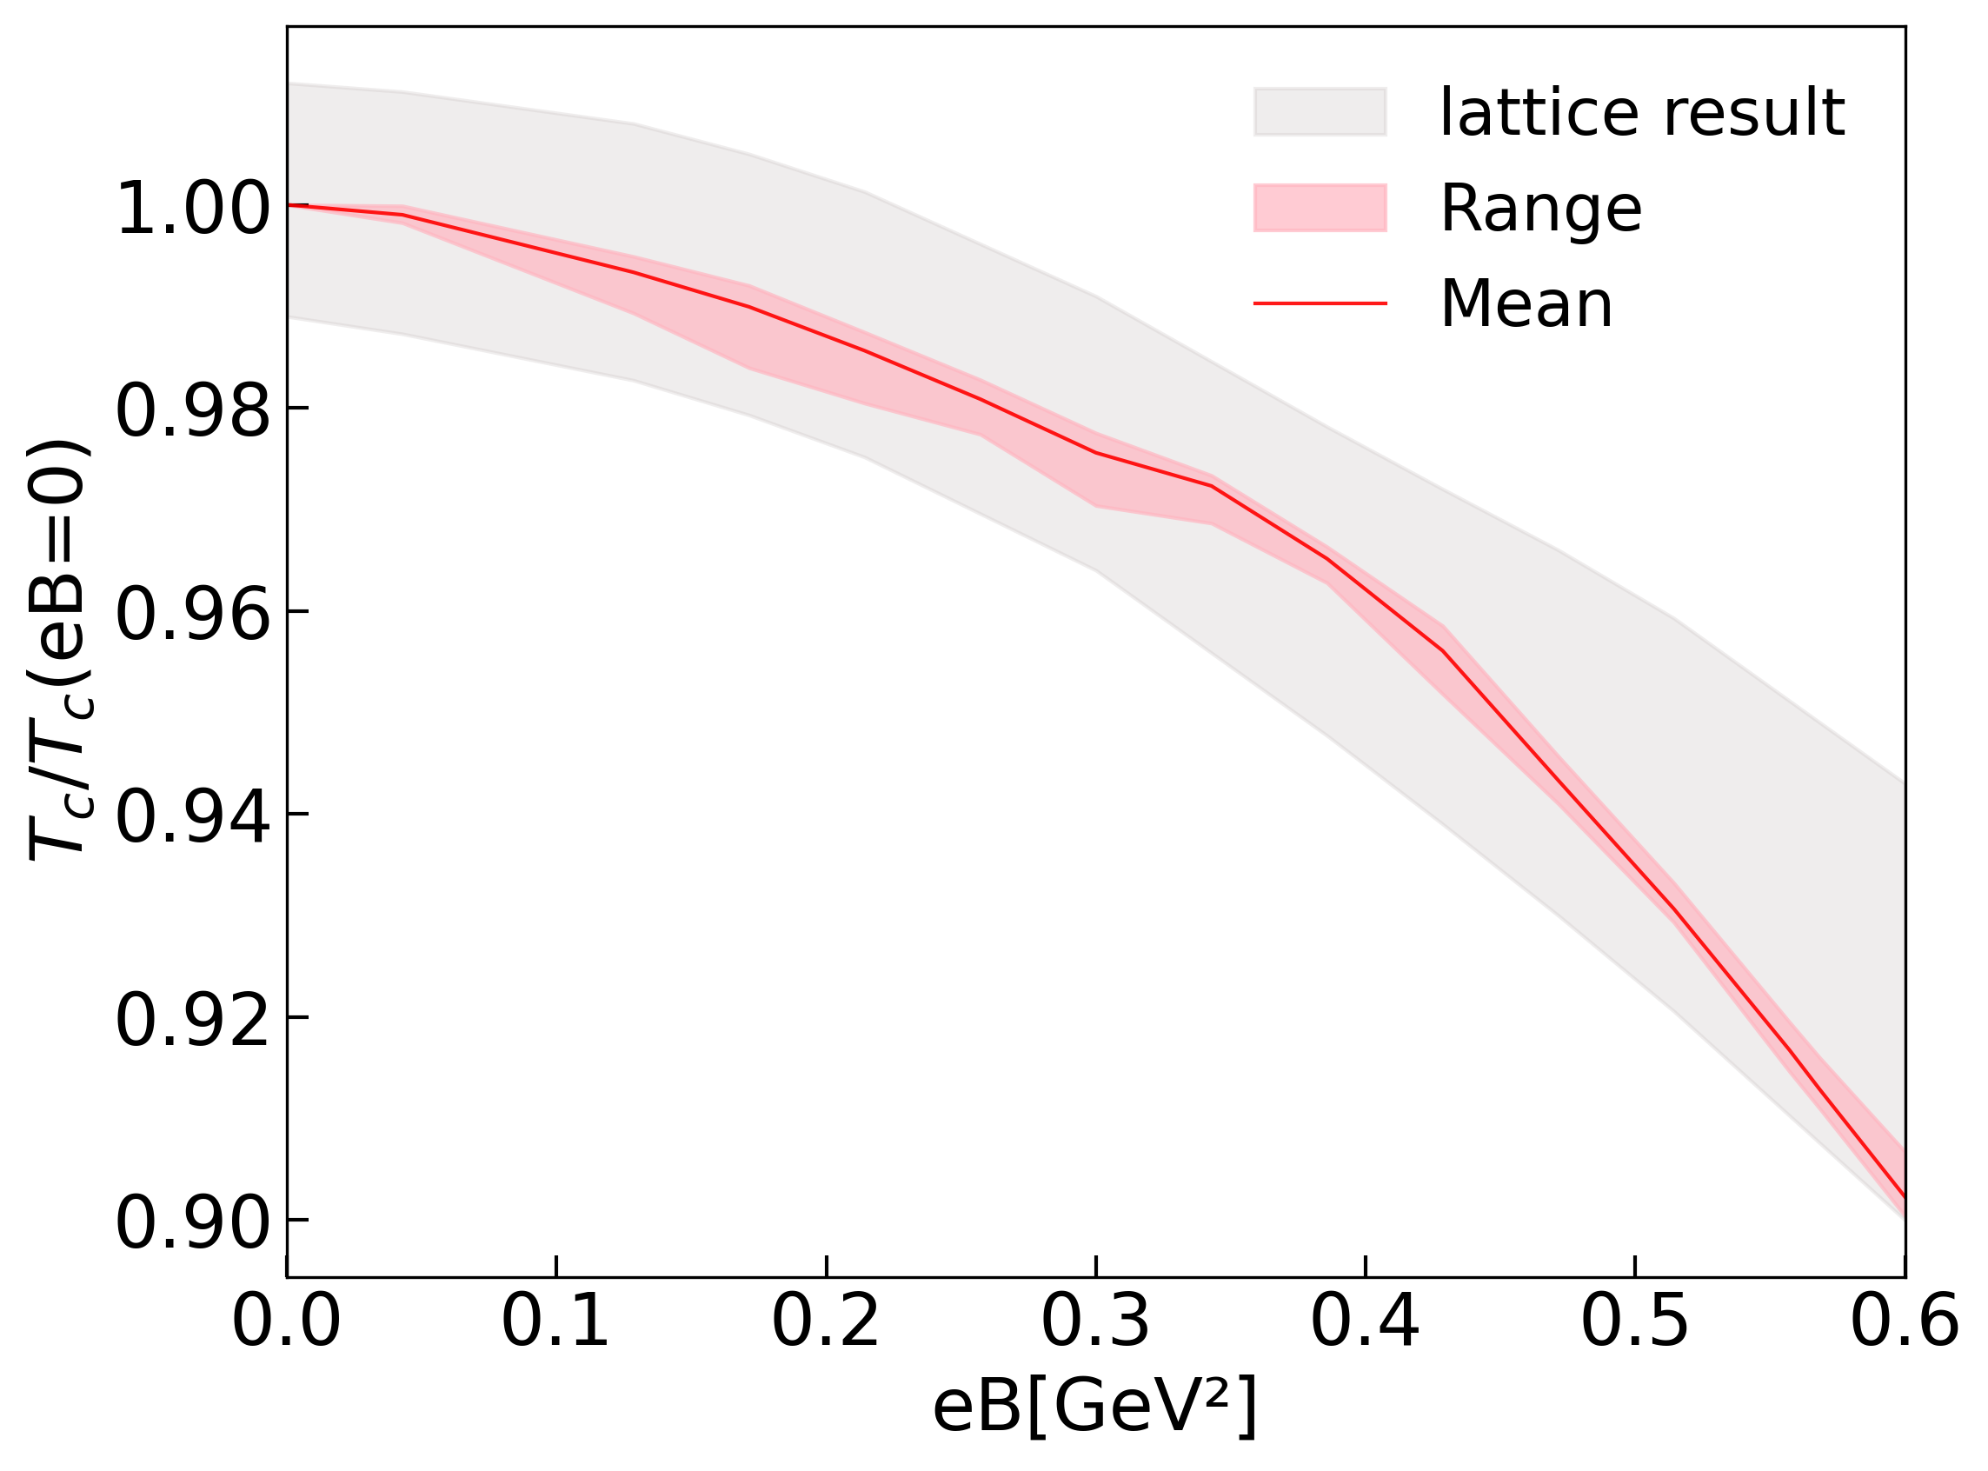
Results and Analysis
The normalized pseudocritical temperature as a function of eB
15

Slide 16
Summary and outlook
By parameterizing G(eB) and v₂(eB) with neural networks and embedding physical priors into the loss function, we successfully extract their magnetic-field dependence.
This differentiable inversion framework establishes a general paradigm for bridging the gap between first-principles calculations and phenomenological models.
The model currently used is still relatively simple, and the data used for training is not the most recent. Nevertheless, the pipeline we have developed is generalizable and can be applied to a wide range of inverse problems.
16

Slide 17
Thank You Very Much
for Your Attention!

