Slide 1


Effective Field Theory for Superconducting Phase Transitions
Zexin Yang（杨泽鑫）
Harbin Institute of Technology
Based on arXiv:2604.02133, Yanyan Bu, Zexin Yang
ZexinYang@stu.hit.edu.cn
and yzx1239762127@gmail.com
Notes:
Good afternoon, everyone. It is a great pleasure to be here., I am Yang zexin, a phD student from Harbin Institute of Technology. Today, I will present our work on constructing the Effective Field Theory for s-wave superconducting phase transitions using the Schwinger-Keldysh formalism based on the arxiv with my supervisor yanyan

Slide 2
contents
Introduction & Motivation
The EFT Framework
Collective Mode & Holographic
Sumary and Outlook
Notes:
The talk is organized as follows.
First, I will give an introduction and motivation. I will briefly review some basic points about superconductivity, and then explain why a more systematic EFT framework is needed.
Second, I will discuss the construction of the effective field theory.
Third, I will analyze collective modes in both the normal phase and the superconducting phase, and then present a holographic validation of the EFT coefficients.
Finally, I will summarize the main results and discuss possible future directions.

Slide 3
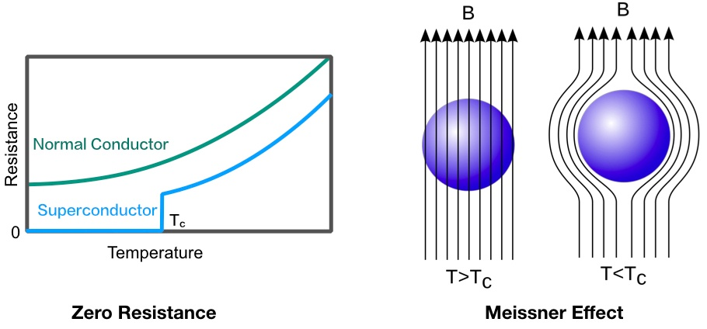
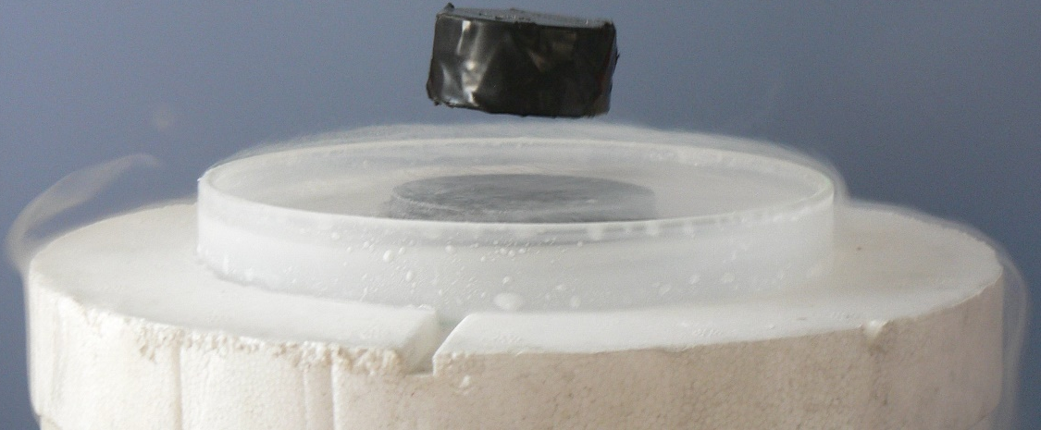
Introduction & Motivation
Zero direct current resistance: electric current can flow without dissipation
Meissner effect: magnetic fields are expelled from the bulk of the material.
Notes:
Let me start with some basic facts about superconductivity.
A superconductor is characterized by two phenomena. The first one is zero dc resistance: below a critical temperature $T_c$, an electric current can flow without dissipation. The second one is the Meissner effect: magnetic fields are expelled from the bulk of the material.

Slide 4


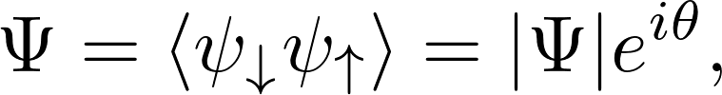



Introduction & Motivation
Ginzburg-Landau Theory
Low eneergy variables near :
charged condensate:
coupling with electromagnetic field:
GL free energy:
equation of motion:
Temperature dependence:
Notes:
Historically, one of the most important macroscopic descriptions of superconductivity is the Ginzburg-Landau theory.
From the modern point of view, the superconducting state is described by a complex order parameter,
Here, the amplitude $|\Psi|$ measures the strength of the condensate, while the phase $\theta$ describes the coherent phase of the condensate.
Therefore, the important low-energy degrees of freedom in a superconductor include the amplitude of the order parameter, its phase, and the electromagnetic field.
A key feature of superconductors is that the phase fluctuation does not remain as an independent gapless Goldstone mode.
Since the condensate is charged, it must couple to the electromagnetic field in a gauge-invariant way. This is described by the covariant derivative,
Ginzburg-Landau theory is an effective theory for equilibrium superconductors near the critical temperature.
Its central object is the GL free energy,
The coefficient $\alpha$ depends on temperature and changes sign at the critical temperature,
When $T>T_c$, $\alpha>0$, and the minimum of the free energy is at $\Psi=0$. This is the normal phase. When $T<T_c$, $\alpha<0$, and the free energy is minimized by a nonzero order parameter,
This describes the superconducting phase.
Anyway, By minimizing the GL free energy, one obtains the GL equation for the order parameter, together with the supercurrent equation.
GL theory successfully explains many macroscopic properties of superconductors, such as the coherence length, magnetic penetration depth, the Meissner effect, and the classification into type-I and type-II superconductors.

Slide 5
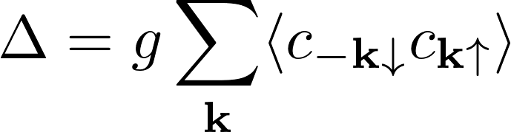
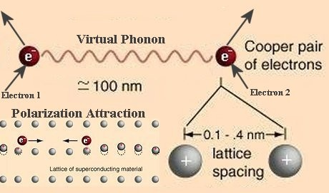
Introduction & Motivation
BCS Theory: an effective attractive interaction between electrons in the medium near the Fermi surface leads to the formation of Cooper pairs
BCS gap:
Ginzburg-Landau theory can be derived from
BCS theory near the critical temperature.
L.P. Gor’kov Microscopic derivation of the Ginzburg--Landau
equations in the theory of superconductivity(1959)
Notes:
The microscopic foundation of conventional superconductivity is provided by BCS theory.
The basic idea of BCS theory is that an effective attractive interaction between electrons in the medium near the Fermi surface leads to the formation of Cooper pairs. These pairs condense into a coherent macroscopic quantum state.
In momentum space, the reduced BCS Hamiltonian can be written schematically as where $g>0$ denotes the attractive interaction strength.
The superconducting gap is defined as opposite momentum and spin
This gap plays the role of the order parameter
An important result by Gor’kov is that the Ginzburg-Landau theory can be derived from BCS theory near the critical temperature. This shows that GL theory is not just a phenomenological model, but can emerge as the long-wavelength effective theory of the microscopic BCS model.

Slide 6
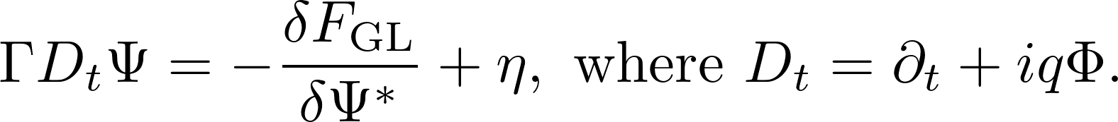

Introduction & Motivation
Time-Dependent Ginzburg-Landau Theory
TDGL extends GL theory to real-time relaxation near :
Success: describes order-parameter relaxation, captures leading dissipative behavior near .
Limitations: depending on phenomenological coefficients...
A. Schmid A time dependent Ginzburg–Landau equation and its applications to a problem of resistivity in the mixed state(1966)
L.P. Gor’kov and G.M. Eliashberg Extension of the Ginzburg-Landau theory equations for nonstationary problems(1968)
K.V. Grigorishin 1906.02097
A.V. Harbick and M.K. Transtrum 2410.20078
Notes:
A standard approach to real-time dynamics is the time-dependent Ginzburg-Landau theory, or TDGL.
TDGL extends the static GL theory by assuming that the order parameter relaxes toward the minimum of the GL free energy. one writes Dt is the gauge-covariant time derivative. Here, $\Gamma$ is a relaxation coefficient, and $\eta$ represents noise.
TDGL has been very useful in describing superconducting dynamics near $T_c$. It captures the leading dissipative relaxation of the order parameter and has many applications in superconducting fluctuations, transport, and vortex dynamics.
However, TDGL is still largely phenomenological. The dissipative coefficients and noise terms are usually introduced by hand. In many treatments, the dynamics is assumed to be, with white noise and only first-order time derivatives.
But in a general interacting many-body system, especially near a critical point, we may expect to describe more comprehensive effects. For example, there can be higher-order time derivatives, memory effects, colored noise, nonlinear electromagnetic response, and strong-coupling corrections.
Traditional TDGL does not provide a systematic principle to organize all these effects.
Therefore, we need a more general framework: a real-time effective field theory constrained by symmetries.

Slide 7
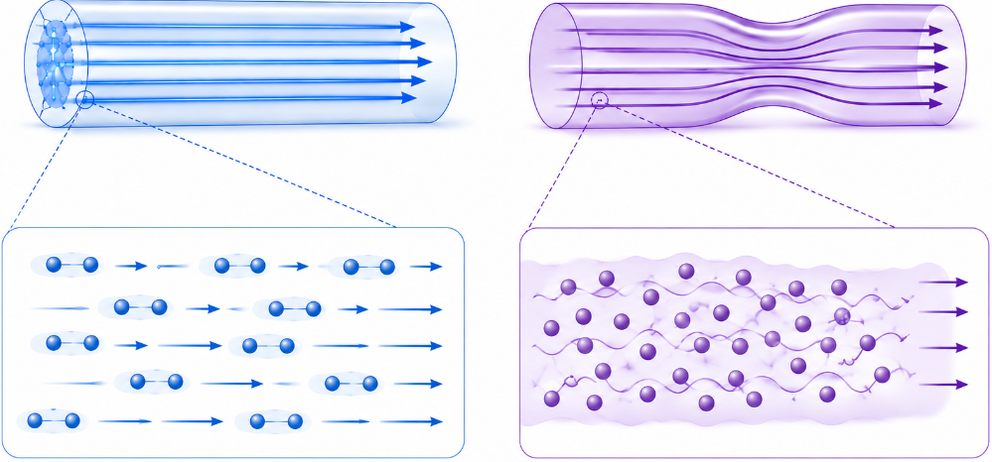
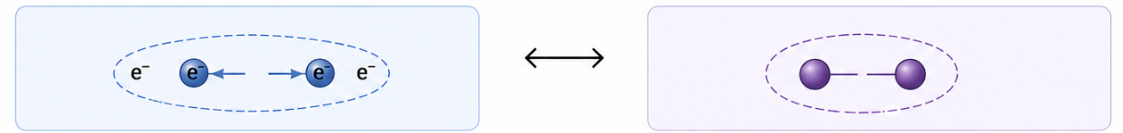
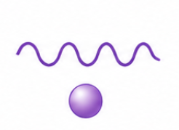




1906.02097
1906.02097
Introduction & Motivation
1906.02097
Superfluid EFT Superconductivity EFT
The “background” electromagnetic field elevated to a dynamic electromagnetic field $A_{μ}$
Global U(1) gauging Local U(1)
Why EFT?
Superconductivity & Superfluidity
Notes:
Superconductivity is a hot topic that has always attracted intense attention from theoretical physicists for decades.
On the other hand, when speaking of EFT, which was used to describe dissipative fluid, I think it is necessary to briefly introduce superfluild.
as two classic systems in the field of condensed matter, despite having different microscopic mechanisms, superfluids and superconductors are often discussed together due to their striking similarities in macroscopic effective theories, espectially for their near critical behaviours.
To understand our approach, it is helpful to think of a superconductor as a "Gauged Superfluid." at least in macroscopic scope.
In a superfluid, the system possesses a global U(1) symmetry.
The associated Goldstone mode (phase fluctuation) constitutes a physical excitation.
In a superconductor, however, we elevate the electromagnetic field $A_\mu$ from a background to a dynamical field; this is equivalent to "gauging" the electromagnetic field, thereby promoting the system's symmetry from global to local gauge symmetry.
As we shall see, this process of "gauging" fundamentally alters the physical properties: the Goldstone mode is “eaten" by the gauge field, thereby giving rise to the Higgs mechanism within a dissipative environment.

Slide 8
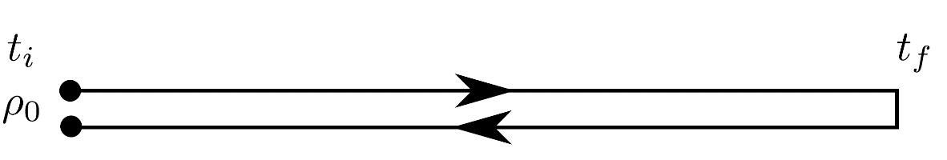


The SK Formalism
Consider the partition function of a system at temperature β:
Integrating out the ultraviolet degrees of freedom $φ$:
，$I_{EFT}$ is the EFT action we want.
Doubling the degrees of freedom can introduce dissipation:
${\hat{O}}_{r}(t)$ denotes the physical observable, while the auxiliary field ${\hat{O}}_{a}(t)$ represents the fluctuations of the observable.
For a quantum many-body system with a given initial state described by the density matrix${ ρ}_{0}$, the evolution of the density matrix is ​​given by:
Figure 1 Schwinger-Keldysh Contour
Glorioso P, Crossley M, Liu H. arXiv preprint arXiv:1812.08785, 2018.
The expected value of an observable $𝒪$ at time t is defined as
A. Kamenev, Field Theory of Non-Equilibrium Systems (2023)
Generating Functionals of Operators ${\hat{O}}_{1}\left(t\right),{\hat{O}}_{2}(t)$
Notes:
To describe real-time dynamics and dissipation, we must use the Schwinger-Keldysh contour. By integrating out high-energy, ultraviolet degrees of freedom—the microscopic matter fields —we obtained an effective action quantity for long-wavelength, low-frequency physical quantities.
Then We double the degrees of freedom: the "r" variables represent the physical observables, while the "a" variables represent the fluctuations. This doubling is not just a mathematical trick; it is the only way to consistently incorporate the Fluctuation-Dissipation Theorem into an action-based principle.

Slide 9
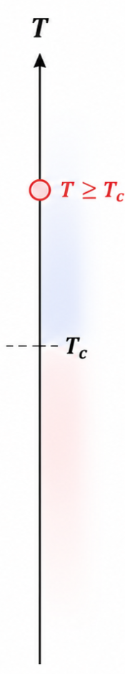

The EFT Framework
Physical Scenario:
Near critical area, slightly above the critical temperature
ignore the motion of the medium and temperature fluctuations
at distance and time scales much larger than the characteristic scale $l_{mfp}$
"Integrate out" the microscopic matter fields (e.g., medium microscopic structure), leaving
behind only the electromagnetic field $A_{μ}$and the order parameter $𝒪$.
Schwinger-Keldysh Formalism to EFT:
Real-time dynamics requires “double-path” time evolution
Symmetry constraints: KMS(a manifestation of the Fluctuation-Dissipation Theorem),
Chemical shift symmetry…
Notes:
Let’s define our physical regime. We focus on the area slightly above Tc​. We assume a static medium, ignoring temperature fluctuations to isolate the electromagnetic dynamics. Most importantly, we work in the hydrodynamic limit, where the spacetime scales are much larger than the mean free path lmfp​. In this limit, the "integrated out" matter fields leave behind a symmetry-constrained action for Aμ​ and the order parameter O

Slide 10

The EFT Framework
symmetry analysis:
Global U(1) symmetry
Chemical shift symmetry: In the normal phase (high-temperature regime), should be invariant under a time-independent diagonal shift of the diffusive fields:
The gauge-invariant quantities in transform as:
which motivates to introduce the following gauge-covariant derivative:
M. Crossley, P. Glorioso, and H. Liu,1511.03646
Notes:
The next step is to impose symmetries. This is the central principle of effective field theory.
We first recall the construction for a charged diffusive system or a superfluid-like system with a global $U(1)$ symmetry.
In addition, in the normal phase, the low-energy charge diffusion mode enjoys a so-called chemical shift symmetry. Roughly speaking, this means that the diffusive phase variables can be shifted by a time-independent function. This symmetry reflects the conservation of charge and strongly constrains the allowed terms in the EFT.
To make these constraints satisfied, we introduce gauge-invariant or gauge-covariant combinations of fields. These combinations are built from the phase variables and the external gauge fields. They are the natural building blocks of the EFT.
This ensures that the effective action is gauge invariant.
This 2 symmetries can provide some natural building blocks of effective action.

Slide 11
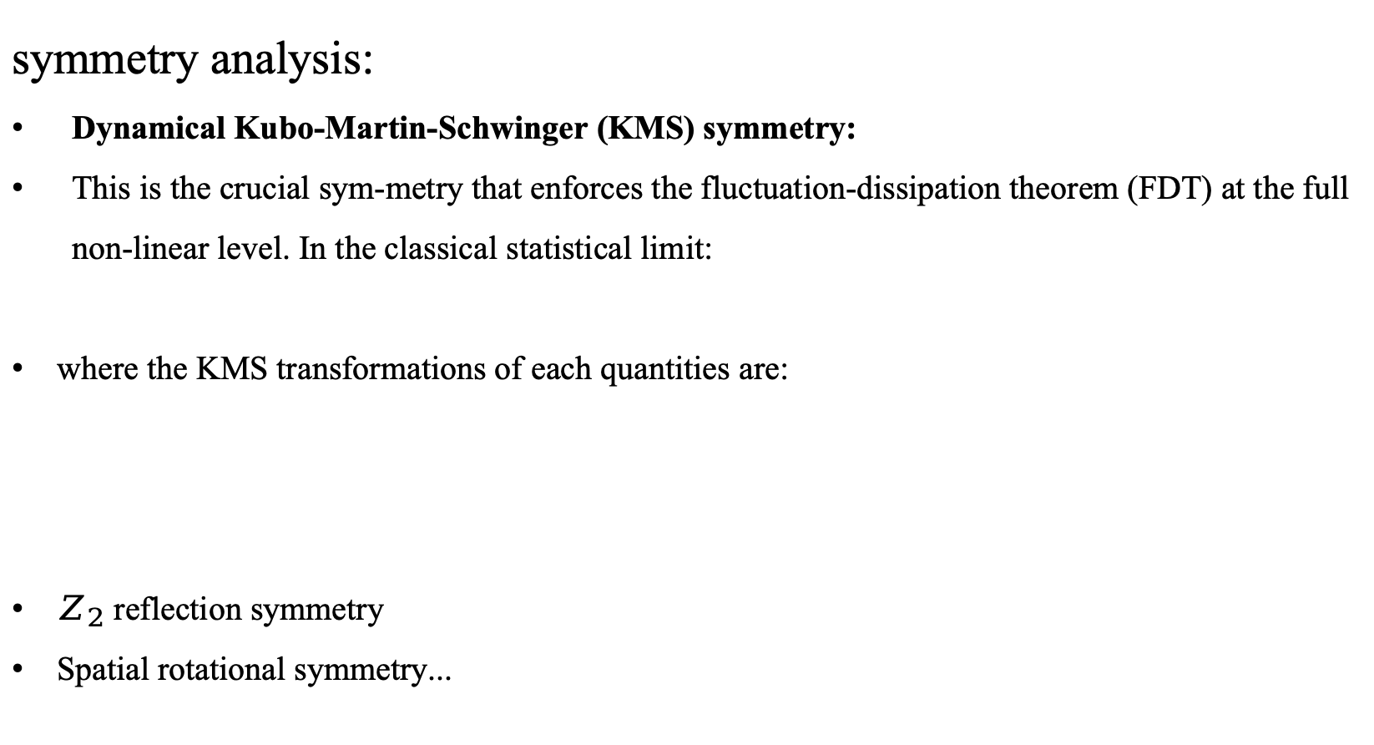
The EFT Framework
symmetry analysis:
Dynamical Kubo-Martin-Schwinger (KMS) symmetry:
This is the crucial sym-metry that enforces the fluctuation-dissipation theorem (FDT) at the full non-linear level. In the classical statistical limit:
where the KMS transformations of each quantities are:
$Z_{2}$ reflection symmetry
Spatial rotational symmetry...
M. Crossley, P. Glorioso, and H. Liu,1511.03646
Notes:
Besides gauge symmetry and chemical shift symmetry, the most important constraint in the Schwinger-Keldysh EFT is the dynamical KMS symmetry.
Physically, dynamical KMS symmetry is the real-time remnant of thermal equilibrium. It encodes the fluctuation-dissipation theorem at the level of the effective action.
In a dissipative system, noise and dissipation cannot be chosen independently. For example, if the order parameter has a relaxation coefficient, then the strength of the noise must be related to this coefficient. This relation is precisely the fluctuation-dissipation theorem.
In traditional TDGL, one often writes a noise term by hand, and then assumes a white-noise correlation.
But in the Schwinger-Keldysh EFT, both dissipation and noise arise from the same effective action. Their relation is enforced by dynamical KMS symmetry.
In the classical statistical limit, the KMS transformation acts on the $r$- and $a$-variables in a specific way, involving time reversal and an imaginary thermal shift proportional to $\beta$. Here $\beta=1/T$.
Together with other symmetries, such as spatial rotational symmetry and reflection symmetry, the dynamical KMS symmetry strongly restricts the possible terms in the EFT.
This is one of the main advantages of our approach: it gives a symmetry-based way to organize dissipation, fluctuations, and nonlinear response.

Slide 12
The EFT Framework
The Process of EFT construction:
Construct a superfluid EFT with global U(1) symmetry:
Arxiv: 2401.12294
Gauging global U(1) symmetry as local
Promote to a superconductor EFT:
Notes:
Now let me summarize the logic of the EFT construction.
Our strategy is to start from a Schwinger-Keldysh EFT for a system with a global $U(1)$ symmetry, which is closely related to the EFT of a superfluid or a charged diffusive system.
Then, to obtain the superconducting EFT, we gauge this global $U(1)$ symmetry. In other words, the electromagnetic field is promoted from a background source to a dynamical field.
Therefore, the superconducting EFT can be viewed as a gauged version of the superfluid EFT.
In our construction, the action is organized in a derivative expansion. The leading terms reproduce the usual TDGL-like dissipative dynamics. Higher-order terms then describe corrections beyond TDGL, such as inertial effects, wave-like behavior, nonlinear response, and colored noise.
So the standard TDGL equation is not abandoned. Instead, it appears as the leading-order limit of a more general Schwinger-Keldysh effective theory.

Slide 13
The EFT Framework
Cover TDGL(Diffusion Behavior):
Over TDGL(Introduce additional interaction higher-order time derivatives terms, involving wave-like behavior):
colored noise
wave-like behavior
Non-linear Response
Notes:
This is a core slide. While L0​ covers the standard diffusion behavior of TDGL, our framework introduces L1​, which contains higher-order terms.
The b2term introduces second-order time derivatives, which convert pure diffusion into wave-like behavior.
The a2,c0,c2a_2, c_0, c_2a2​,c0​,c2​ terms capture the non-linear response of the charge density and superfluid density.
The imaginary part of b2b_2b2​ leads to colored noise, meaning the system has a "memory" of its fluctuations, which is a hallmark of strongly coupled systems.
From the SK action, we can derive the stochastic equations of motion. A beautiful result here is the natural emergence of the Gorkov-Eliashberg anomalous term. In traditional literature, this term is often added by hand to ensure gauge invariance. In our EFT, it arises automatically from the symmetry requirements, proving the internal consistency of our framework.

Slide 14
The Stochastic formalism:
Gorkov-Eliashberg term
Notes:
Then, in the stochastic equations form, Let me now explain more explicitly how our EFT relates to the traditional TDGL theory.
At leading order, the EFT reproduces the diffusion-like relaxation of the order parameter. This corresponds to the standard TDGL structure, where the order parameter relaxes toward the minimum of the Ginzburg-Landau free energy.
However, our EFT contains more information than this leading equation.
First, higher-order time-derivative terms can appear. These terms give the order parameter an effective inertia. As a result, the dynamics is not purely diffusive; it can acquire wave-like or oscillatory behavior.
Second, the EFT contains nonlinear response terms. These terms describe how the charge density, current, and condensate respond nonlinearly to electromagnetic fields and to order-parameter fluctuations.
Third, the noise structure is more general. In standard TDGL, noise is usually taken to be white and Markovian. In our EFT, higher-derivative and complex coefficients can lead to colored noise and memory effects.
Another important point is the appearance of the Gor’kov-Eliashberg anomalous term. In older approaches, this term is often introduced to ensure gauge invariance in non-stationary superconducting dynamics. In our framework, it emerges naturally from the symmetry constraints of the EFT.
Therefore, our construction both covers TDGL and systematically extends it.

Slide 15

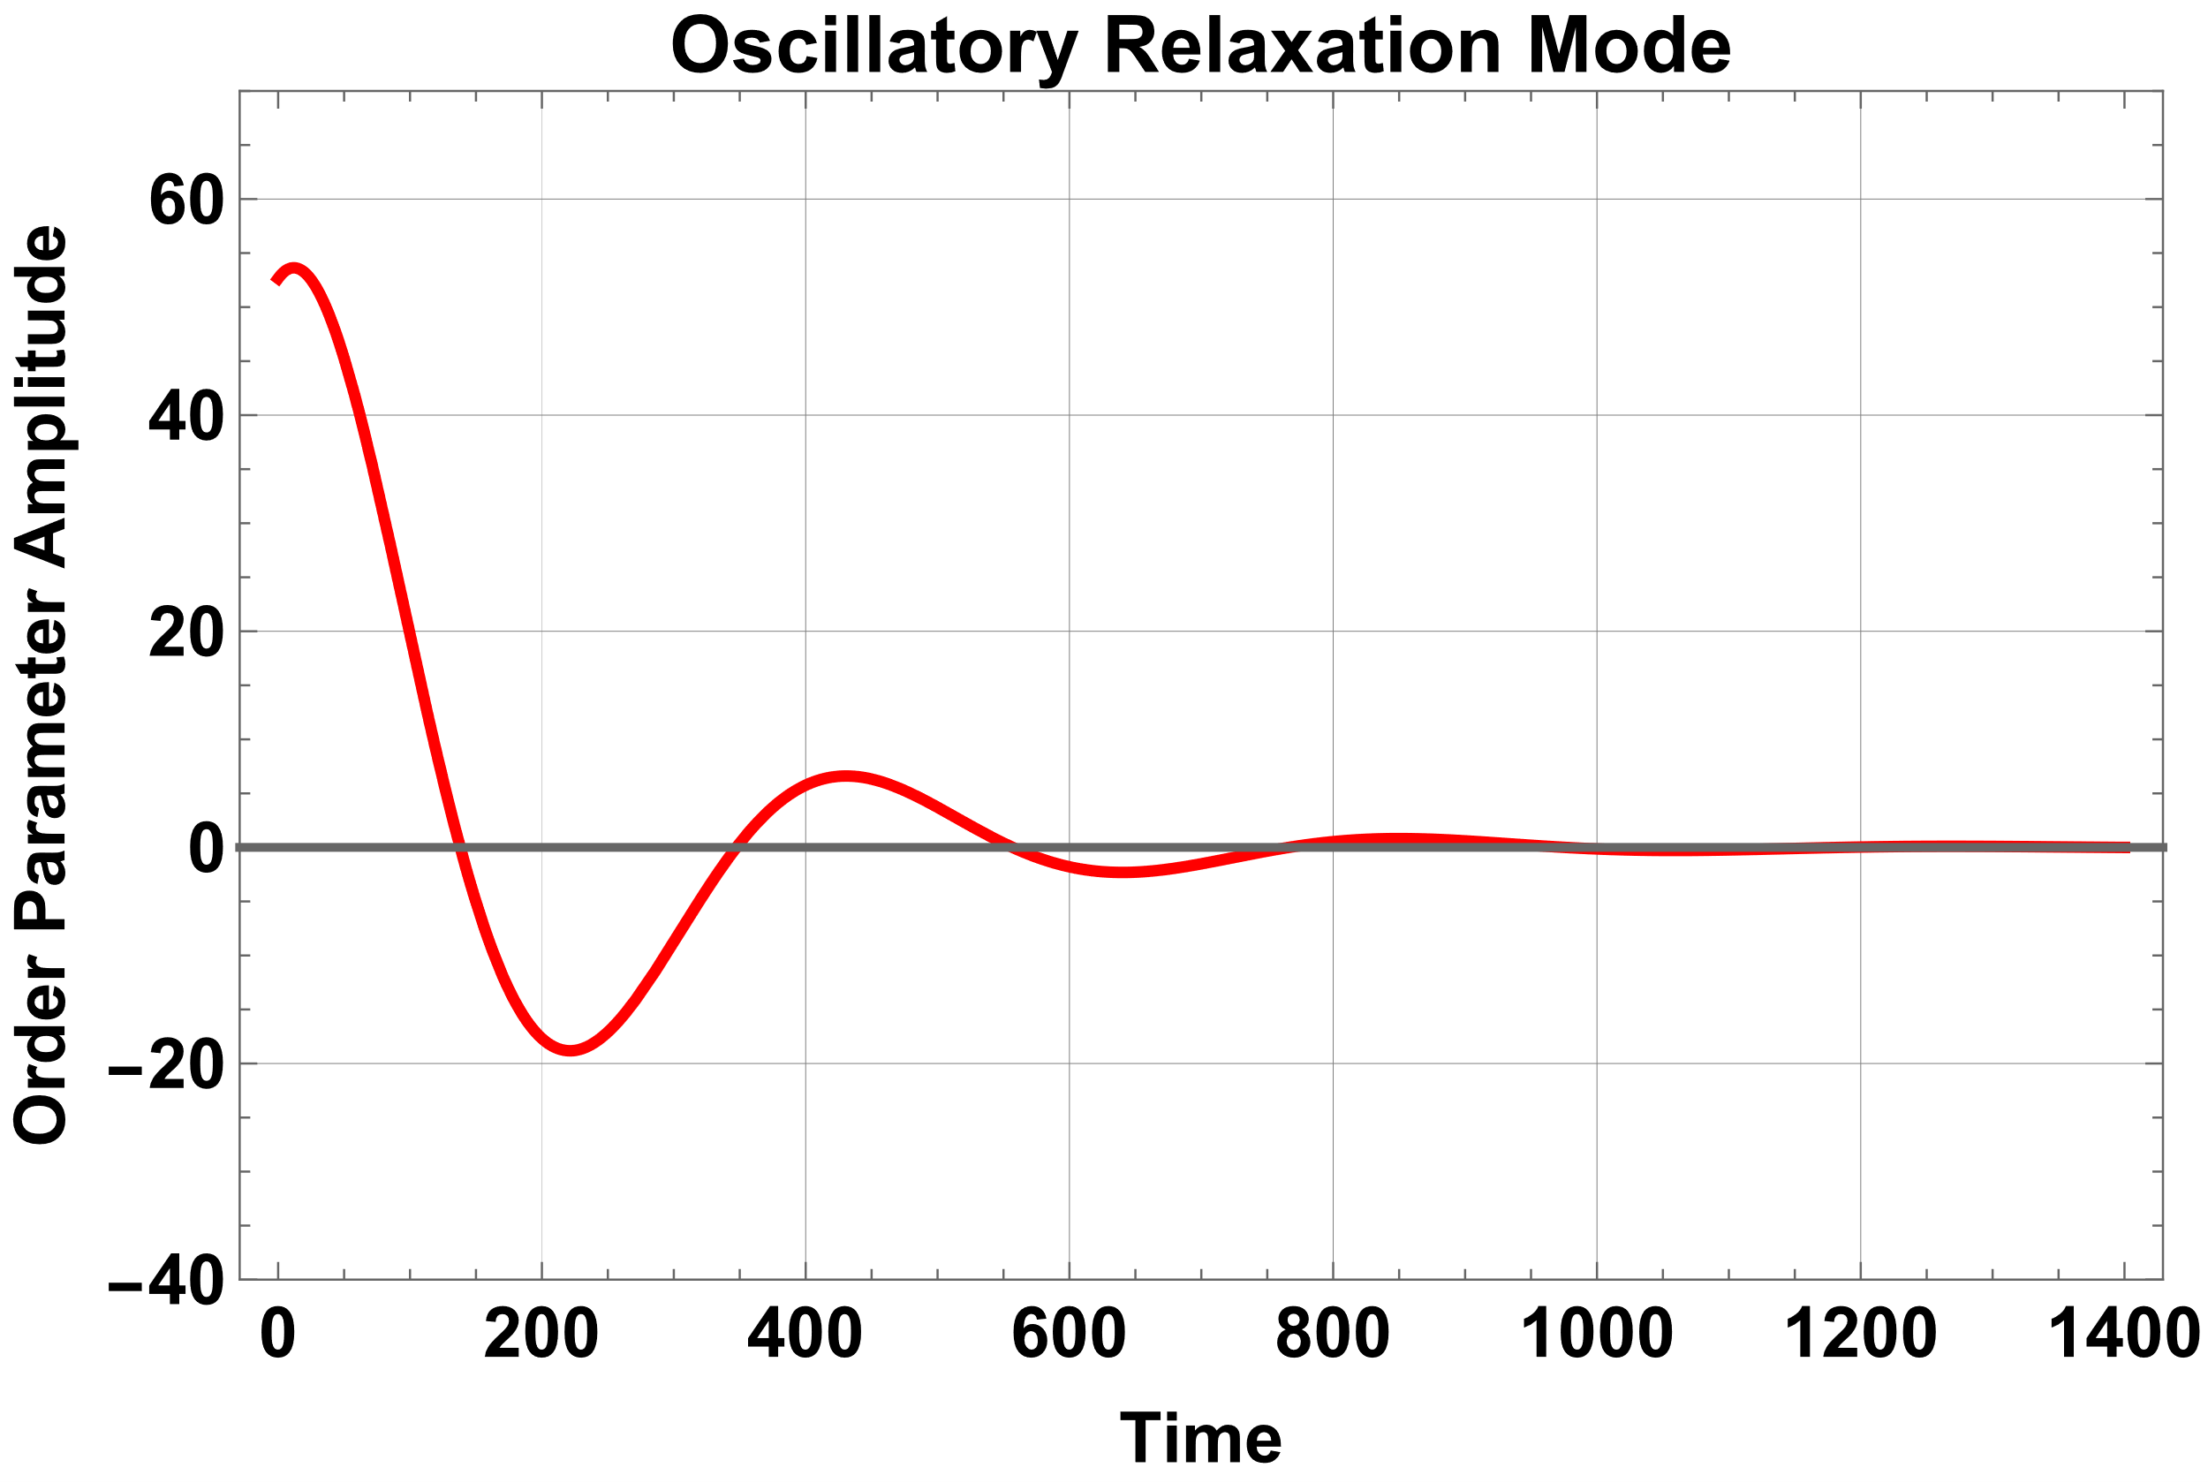
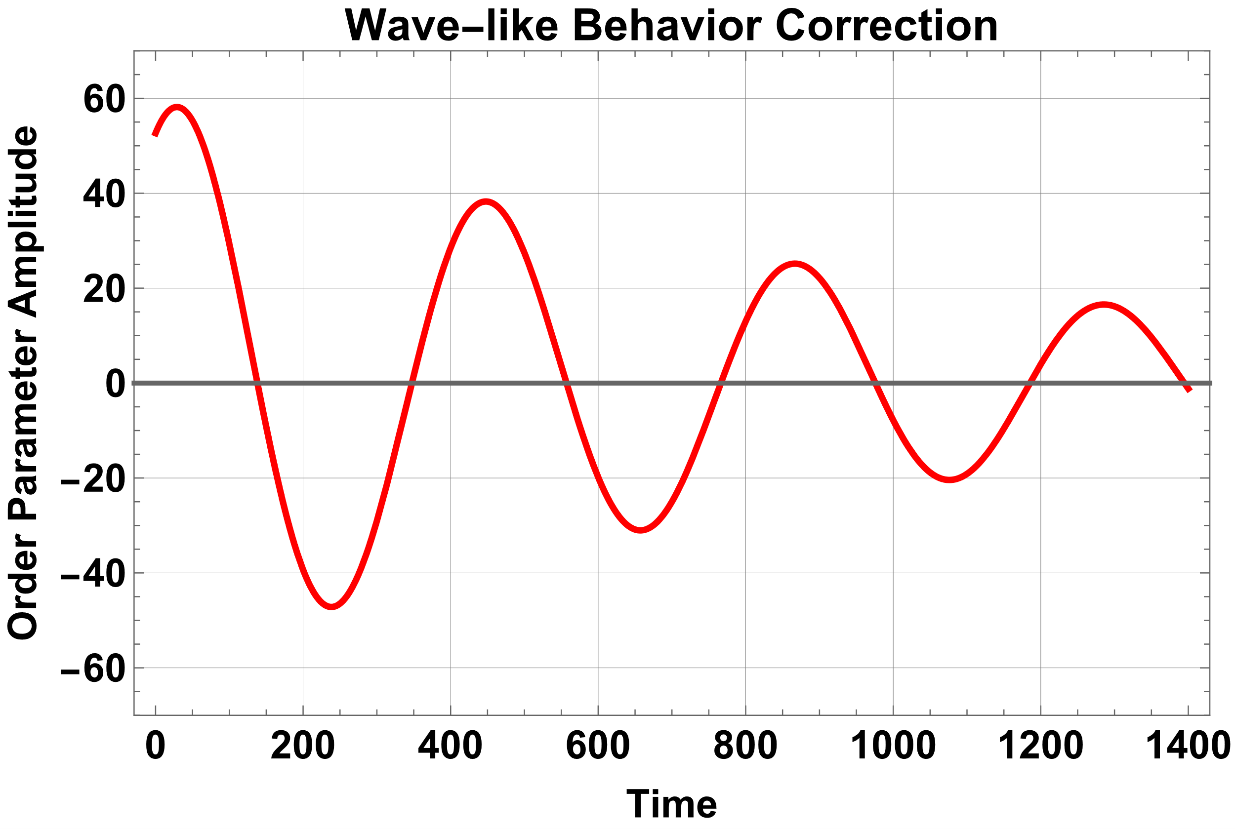
Collective Mode(1):
High-temperature phase in low frequency regime :
Y. Ahn, M. Baggioli, H.-S. Jeong and M. Matsumoto,2506.09461
Notes:
Let us now discuss the physical consequences of the EFT, starting from the high-temperature phase.
Above the critical temperature, the equilibrium value of the order parameter vanishes,
This is the normal phase. In this phase, there is no spontaneous symmetry breaking and no Meissner effect.
The collective modes include two main sectors.
The first sector is the electromagnetic sector. Since the medium is conducting and dissipative, electromagnetic waves are modified by the response of the medium.
The second sector is the order-parameter fluctuation. Even above $T_c$, the system can have superconducting fluctuations. Near the critical temperature, these fluctuations become slow and long-lived.
In the simplest TDGL description, the order parameter fluctuation is a purely relaxational mode. Its frequency is imaginary and describes exponential decay.
However, in our generalized EFT, the coefficients controlling the time evolution can be complex, and higher-order time derivatives can be included. Therefore, the order-parameter mode can show oscillatory relaxation, not just pure diffusion.
This is especially relevant for strongly coupled systems, where the relaxation dynamics is not necessarily Markovian.
Thus, already in the normal phase, our EFT predicts richer dynamics than standard TDGL.

Slide 16
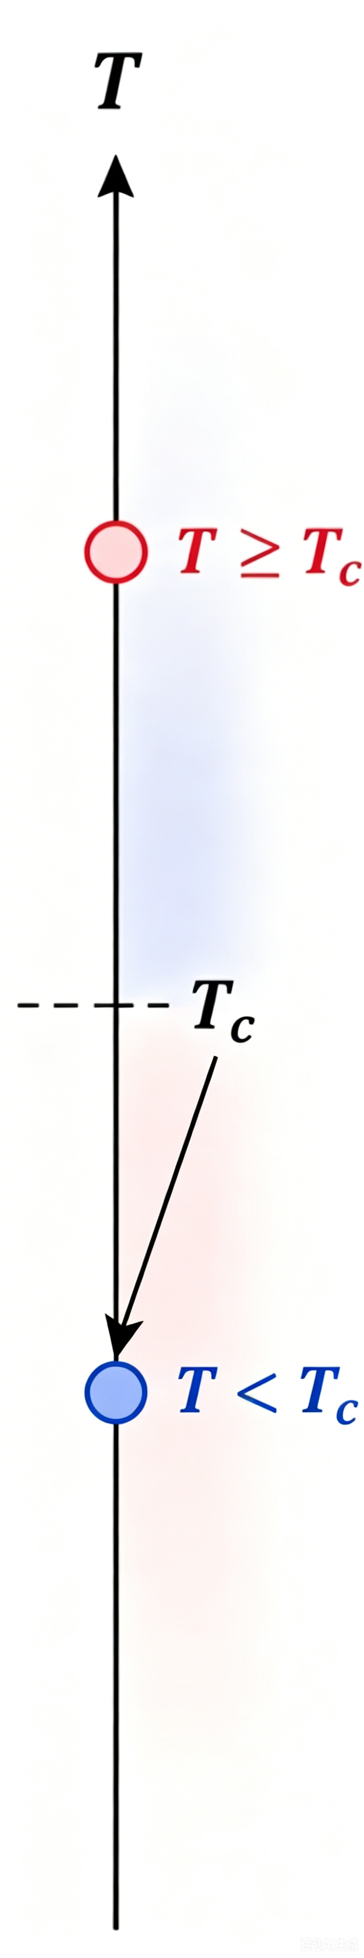
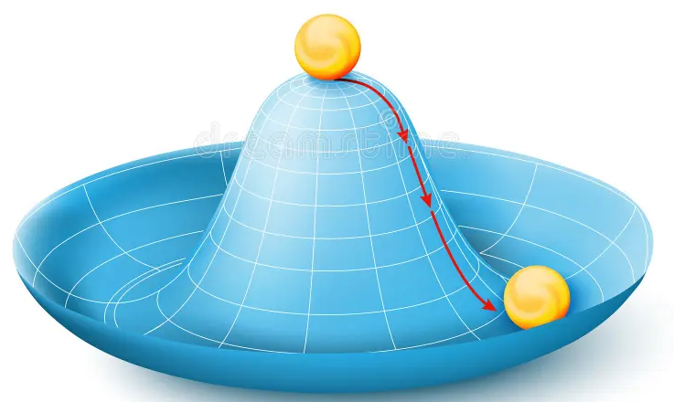
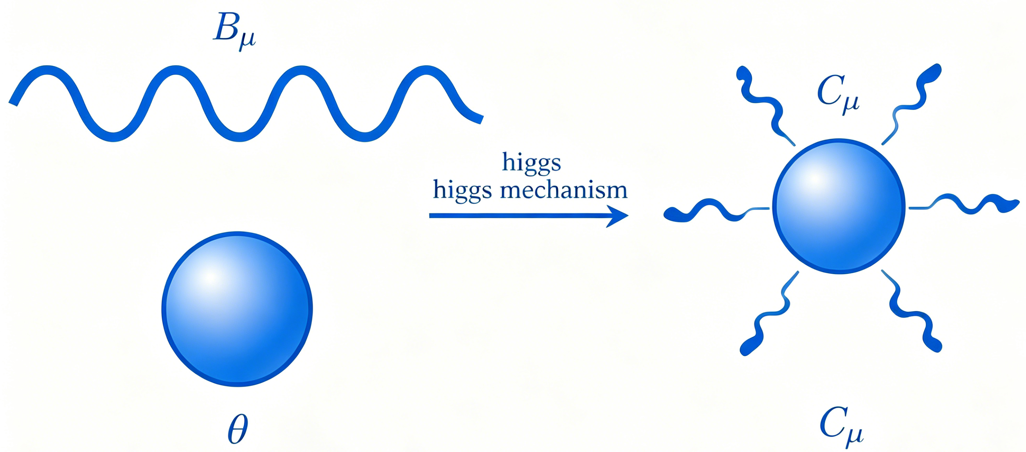
Collective Mode(2): Broken Phase
Low-temperature superconducting phase in low frequency regime:
The new ground state after symmetry breaking :
Higgs mechanism and new combination:
Notes:
When we cross TcT_cTc​, spontaneous symmetry breaking occurs. The order parameter acquires a vacuum expectation value ψ0\psi_0ψ0​. Here, the Higgs mechanism takes over: the phase fluctuation of the order parameter is "absorbed" by the gauge field, giving the photon a mass—this is the Meissner effect.
对比
Next, we go below the critical temperature.
In the superconducting phase, the order parameter develops a nonzero expectation value,
This means that the system enters the broken phase.
We can decompose the order parameter into amplitude and phase fluctuations,
Here $h$ is the amplitude fluctuation, often called the Higgs mode, and $\theta$ is the phase fluctuation.
For a neutral superfluid, the phase fluctuation would be a physical Goldstone mode. But for a superconductor, the $U(1)$ symmetry is gauged. Therefore, the phase mode can be absorbed into the gauge field by a gauge transformation.
The gauge-invariant combination is roughly
As a result, the gauge field acquires an effective mass. This is the Anderson-Higgs mechanism.
Physically, this mass is responsible for the Meissner effect: magnetic fields cannot penetrate deeply into the superconductor, and the penetration length is finite.
Therefore, the EFT naturally describes how the broken phase reorganizes the degrees of freedom: the phase mode disappears from the physical spectrum, the photon becomes massive, and the amplitude mode remains as a separate collective excitation.

Slide 17
Collective Mode(2): Broken Phase
Solutions at zero wave-vector:
near the critical regime, medium effects are finite:
Activate the $C_{0}$ terms to involve the effect of higher-order terms:
Activate the $b_{1} and b_{2}$ as complex-valued coefficients:
Notes:
Now let us look more carefully at the collective modes in the broken phase, especially near the critical point.
One might expect the amplitude fluctuation, or Higgs mode, to behave like an oscillating massive mode. However, near $T_c$, the situation is different.
Because the medium is dissipative and the order parameter is critically slow, the Higgs mode becomes strongly damped. In our analysis, near the critical regime, the Higgs mode is overdamped rather than a sharp propagating excitation.
This means that its frequency is dominated by an imaginary part. Physically, the fluctuation decays before it can complete a coherent oscillation.
When higher-order terms are included, the mode structure becomes richer. The second-order time-derivative terms can partially restore inertial behavior and produce wave-like corrections. If the coefficients are complex, the Higgs mode can also mix with the electromagnetic sector in a nontrivial way.
This is one of the important messages of our EFT: the fate of collective modes depends not only on the static GL potential, but also on the dissipative and higher-derivative terms in the real-time effective action.
Therefore, the Schwinger-Keldysh EFT provides a controlled way to study the Higgs mechanism in a dissipative environment.

Slide 18
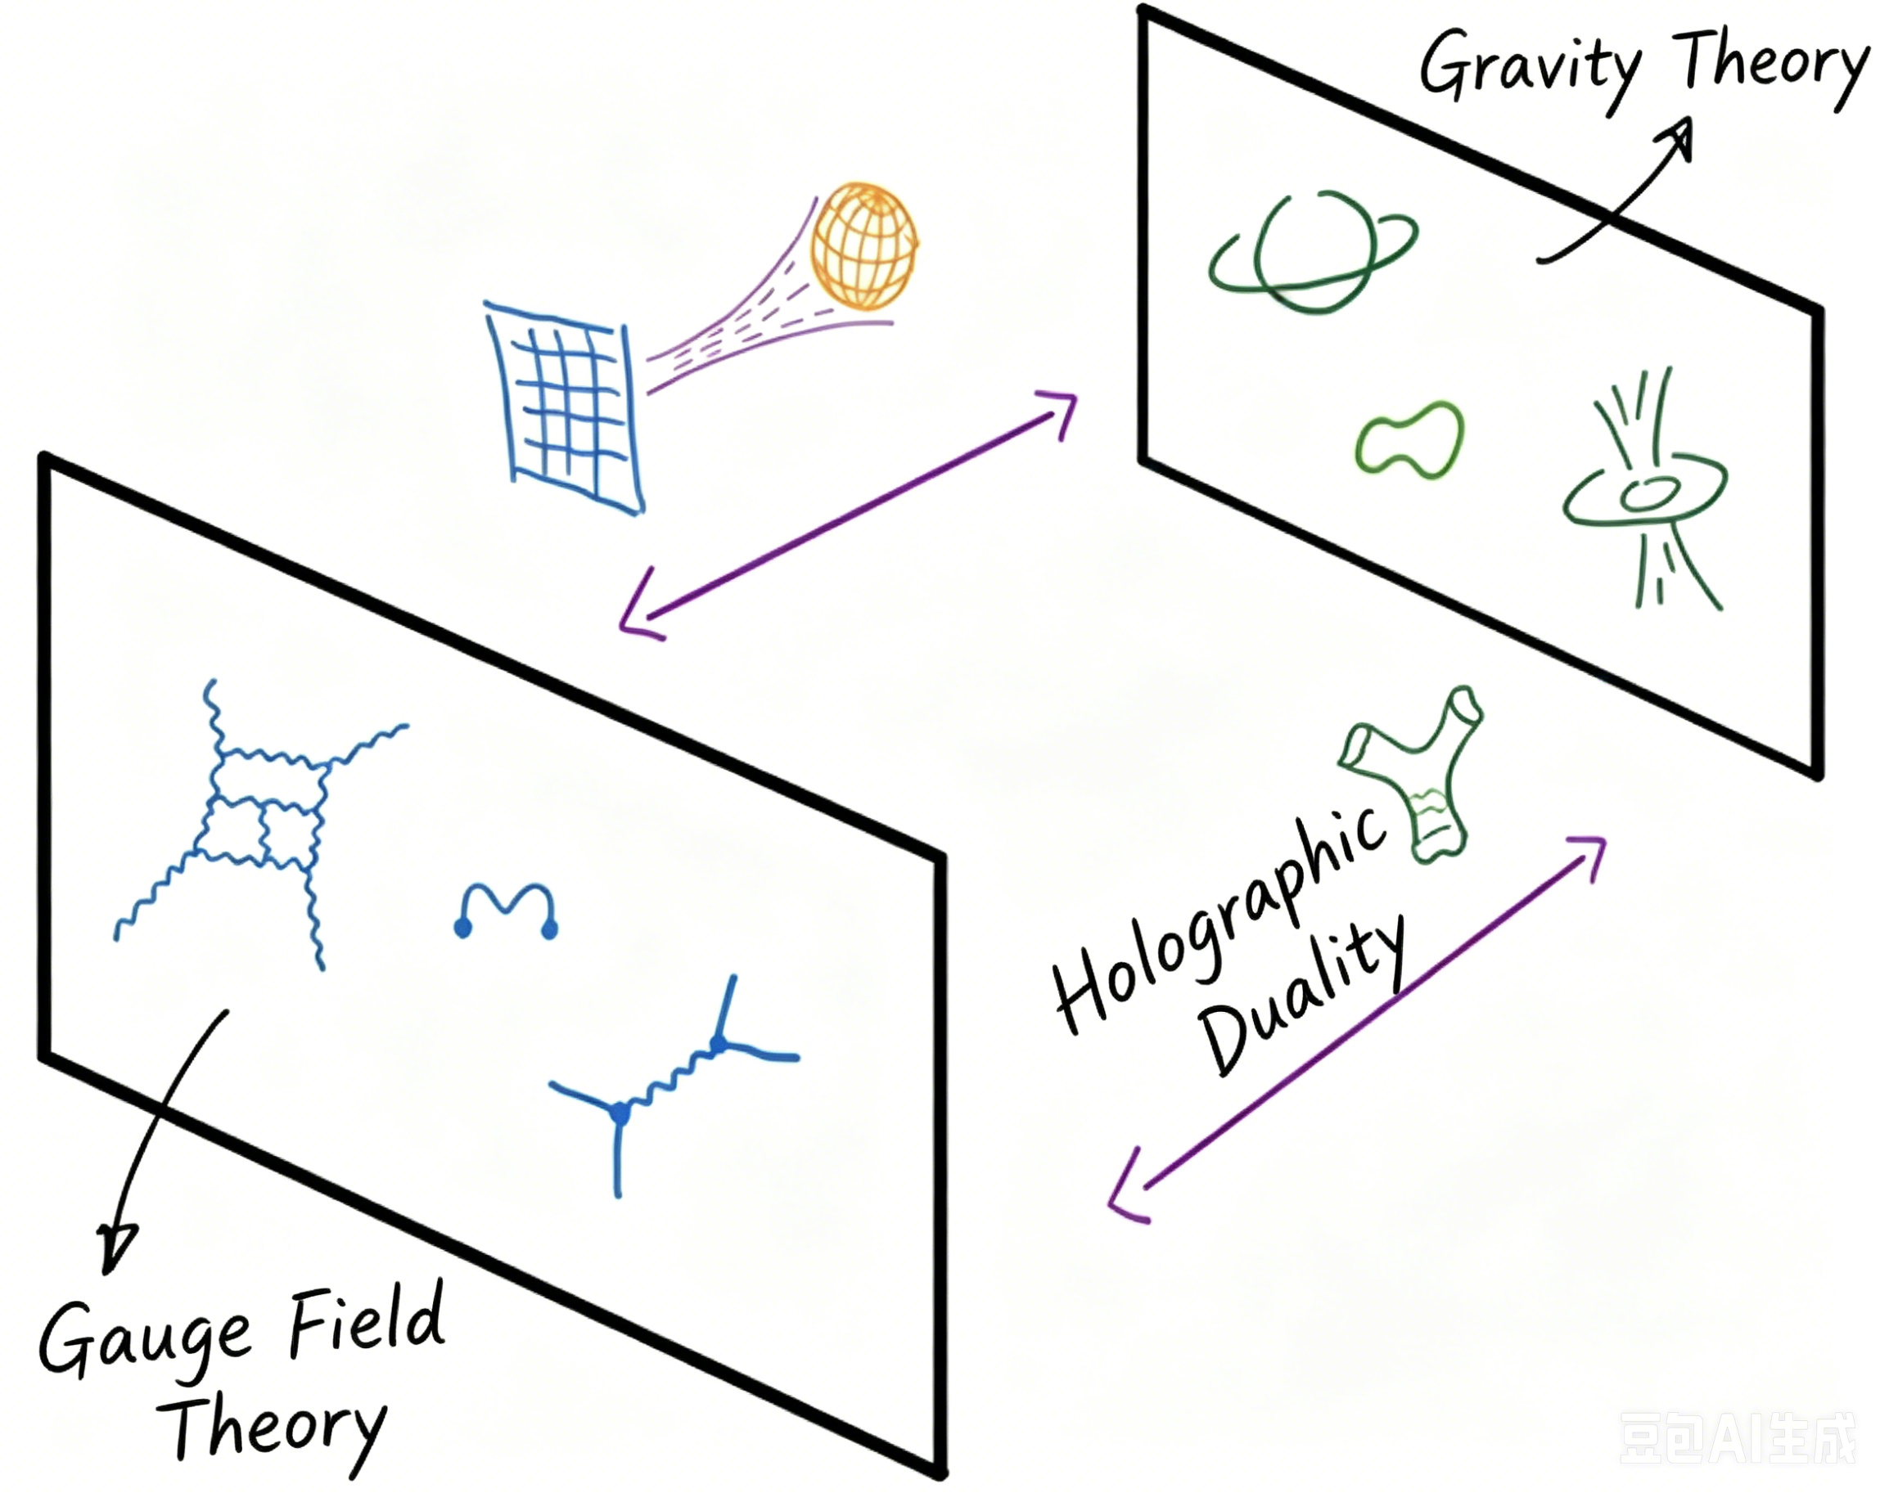
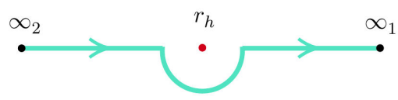
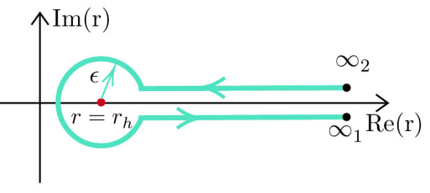
Lesson from Holographic Model
Holographic SK validation - A Microscope for Wilsonian Coefficients :
Holography dictionary:
total action for a minimal holographic superconductor is:
impose the mixed boundary condition:
holographic predictions for various coefficients of EFT action:
Notes:
Finally, let me discuss the holographic validation.
The EFT construction is based on symmetry and scale separation, so it determines the allowed structure of the effective action. However, the numerical values of the Wilsonian coefficients are not fixed by symmetry. They depend on the underlying microscopic theory.
To extract these coefficients in a strongly coupled system, we use a holographic superconductor model.
The bulk theory is a minimal Einstein-Maxwell-scalar system, or in the probe limit, a Maxwell-scalar theory in a black-hole background. The charged scalar field in the bulk is dual to the superconducting order parameter on the boundary, while the bulk gauge field is dual to the boundary electromagnetic current.
To make the boundary electromagnetic field dynamical, one imposes mixed boundary conditions. This is important because a superconductor requires a dynamical gauge field, not just an external source.
Using the holographic dictionary, we can compute real-time correlation functions and match them to the predictions of our EFT. In this way, holography acts as a microscope for the Wilsonian coefficients in the effective action.
A key result is that the holographic calculation supports the structure predicted by the EFT. Moreover, it can generate complex relaxation coefficients. The imaginary parts of these coefficients lead to oscillatory relaxation and colored-noise-like behavior.
This provides a concrete example showing that strongly coupled superconductors can go beyond the purely diffusive dynamics of conventional TDGL.

Slide 19
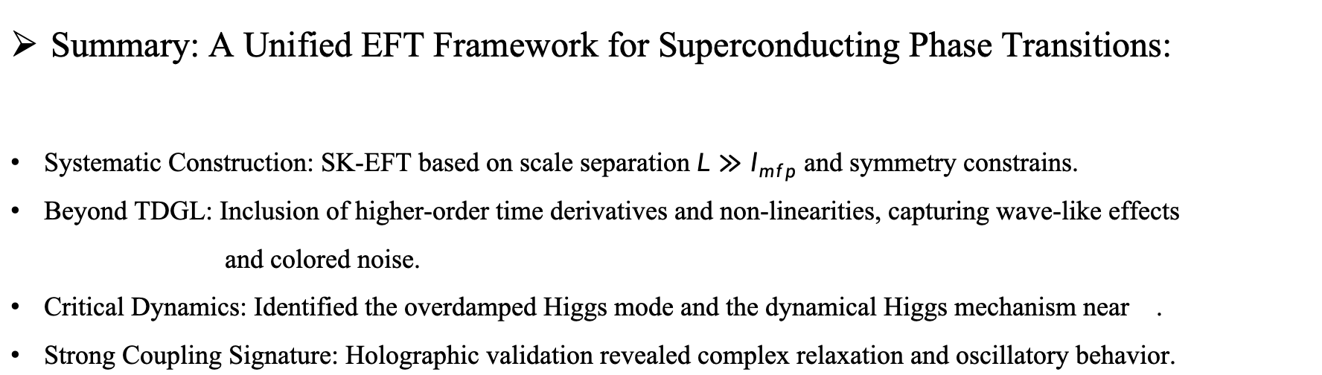
Summary and Outlook
Summary: A Unified EFT Framework for Superconducting Phase Transitions:
Systematic Construction: SK-EFT based on scale separation ${L≫l}_{mfp}$ and symmetry constrains.
Beyond TDGL: Inclusion of higher-order time derivatives and non-linearities, capturing wave-like effects
and colored noise.
Critical Dynamics: Identified the overdamped Higgs mode and the dynamical Higgs mechanism near .
Strong Coupling Signature: Holographic validation revealed complex relaxation and oscillatory behavior.
Notes:
let me summarize the key takeaways from our work.
Let me now summarize the main results.
First, we constructed a systematic Schwinger-Keldysh effective field theory for s-wave superconducting phase transitions. The construction is based on scale separation and symmetry constraints, including gauge invariance, Schwinger-Keldysh consistency conditions, and dynamical KMS symmetry.
Second, our EFT reproduces the traditional time-dependent Ginzburg-Landau theory at leading order. Therefore, TDGL is recovered as the low-frequency and long-wavelength limit.
Third, the EFT naturally goes beyond TDGL. It includes higher-order time derivatives, nonlinear response, colored noise, and possible memory effects. These terms are organized systematically in the derivative expansion.
Fourth, we analyzed collective modes near the superconducting transition. In the normal phase, order-parameter fluctuations can show generalized relaxation. In the broken phase, the phase mode is absorbed by the gauge field through the Anderson-Higgs mechanism, while the amplitude mode becomes overdamped near the critical point.
Finally, holographic calculations provide a strong-coupling validation of the EFT structure and allow us to extract Wilsonian coefficients. In particular, complex relaxation coefficients are a signature of nontrivial real-time dynamics beyond simple TDGL.

Slide 20
Summary and Outlook
Outlooks:
Vortex Dynamics and Turbulence: The evolution from the homogeneous state of a superconductor to complex topological structures.
Thermoelectric Effects: Incorporating stress-tensor couplings within the framework of Effective Field Theory
(EFT) to investigate thermal transport and thermal gradients.
Color Superconductivity: Extending this theoretical framework to high-density QCD matter found within neutron stars.
Non-relativistic Systems: Extending the theory to systems exhibiting Schrödinger symmetry (such as cold atomic systems).
Arxiv: 1207.3800, 1904.05497, 2208.14172, 2412.18320…
Arxiv: 0804.3972, 1301.1986, 1303.3472
Notes:
Let me end with several future directions.
The first direction is vortex dynamics and turbulence. Since our EFT is fully dynamical and gauge invariant, it provides a natural framework to study how a homogeneous superconducting state evolves into vortex configurations and possibly turbulent states, especially in type-II superconductors.
The second direction is thermoelectric effects. In the present work, we mainly focused on the order parameter and electromagnetic field, while keeping the background medium fixed. A natural extension is to couple the EFT to energy and momentum conservation, or equivalently to the stress tensor. This would allow us to study thermal transport, temperature gradients, and thermoelectric response.
The third direction is color superconductivity. Similar symmetry principles may be useful for describing high-density QCD matter, such as the matter inside neutron stars, where superconducting or superfluid phases may appear.
The fourth direction is non-relativistic systems, such as cold atomic gases. It would be interesting to extend the construction to systems with Schrödinger symmetry and compare the resulting dynamics with experiments in ultracold atoms.
In short, we believe that the Schwinger-Keldysh EFT provides a powerful and universal language for dissipative quantum phases, and superconductivity is a particularly important application.

Slide 21
Thank you for listening！
Your feedback will be highly appreciatied!
Arxiv：2604.02133
ZexinYang@stu.hit.edu.cn
and yzx1239762127@gmail.com
Notes:
Thank you very much for your time and attention. I look forward to your questions."

