Slide 1
$ρ$ mesons in finite magnetic field and finite temperature
Zhiyang Liu
Xi’an Jiaotong University
arXiv: 2605.00561

Slide 2
Outline
1
Background
2
Framework
3
Results
4
Summary

Slide 3
Outline
1
Background

Slide 4
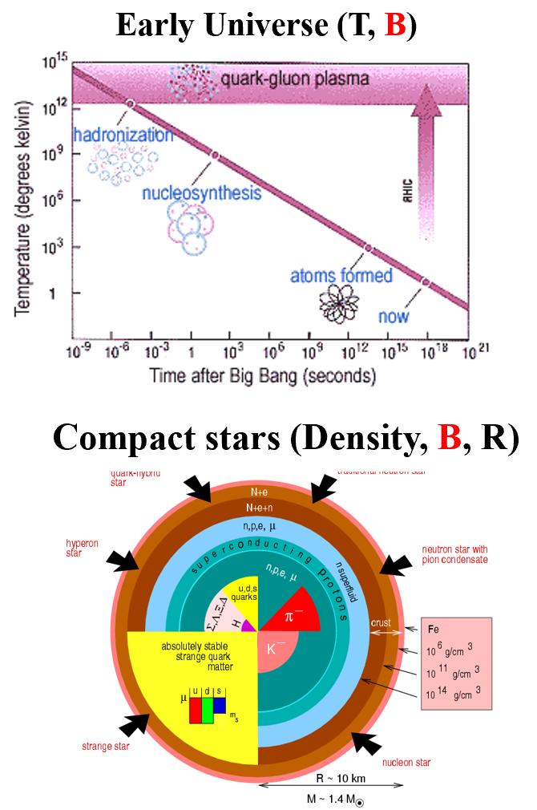
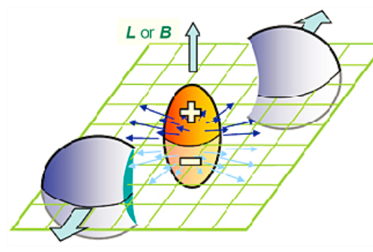
1
Background

Slide 5
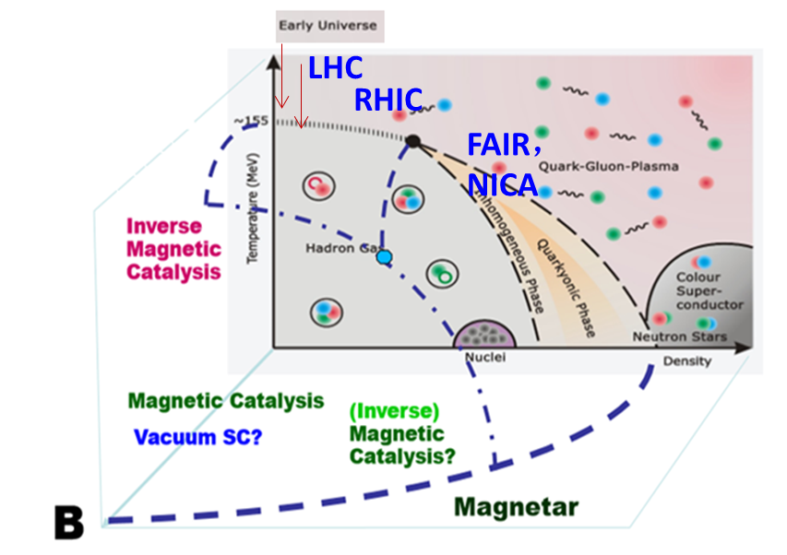

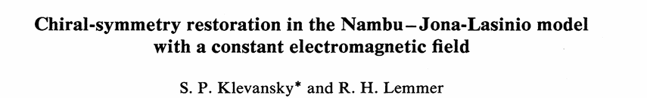
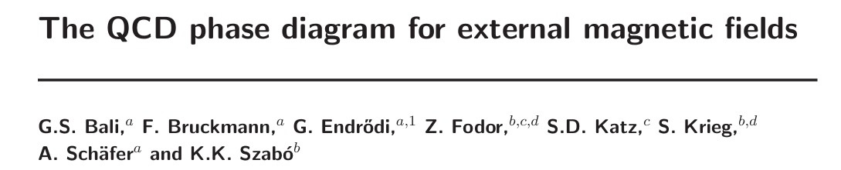
1
Background
Chiral Magnetic Effect (CME)
Magnetic Catalysis (MC)
Inverse Magnetic Catalysis (IMC)

Slide 6
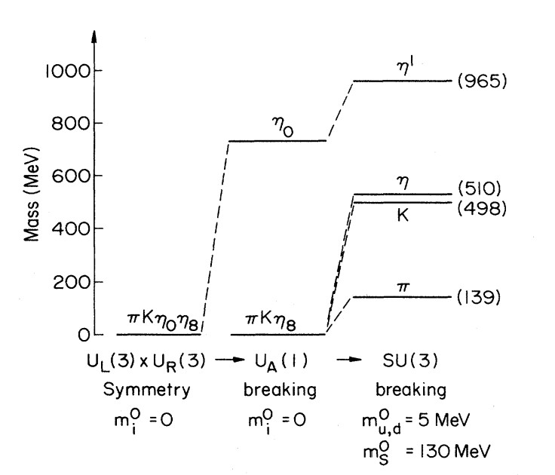
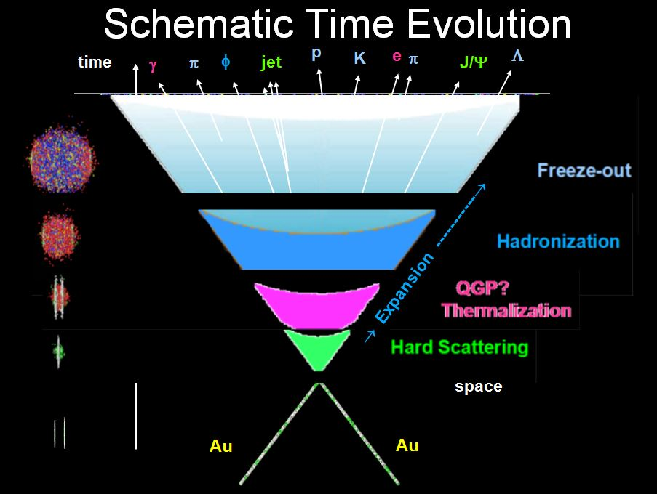
1
Background
Landau theory of phase transitions:
A continuous phase transition corresponds to spontaneous symmetry breaking/restoration.
Goldstone theorem:
If a continuous symmetry is spontaneously broken and no long-range forces are present, then there must exist massless Goldstone bosons.

Slide 7

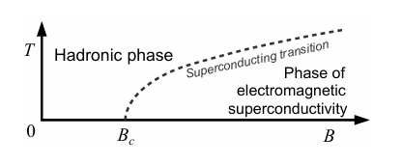

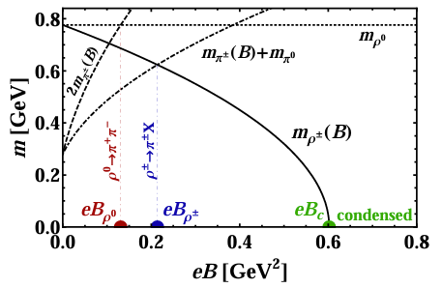
1
Background
No vacuum condensation in Lattice
[1]Phys. Rev. D 87, 094502 (2013).
[2]J. High Energy Phys. 05 (2017) 007.
[3]Phys. Rev. D 97, 034505 (2018).
[4]J. High Energy Phys, 2017(9), 1-27.
M. N. Chernodub, “Superconductivity of QCD vacuum in strong magnetic field,” Phys. Rev., vol. D82, p. 085011, 2010.

Slide 8
Outline
2
Framework

Slide 9
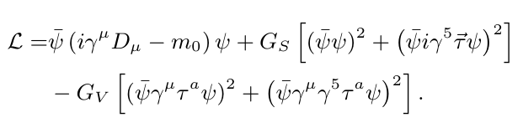








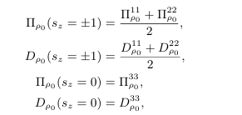

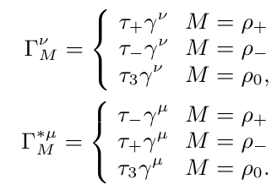




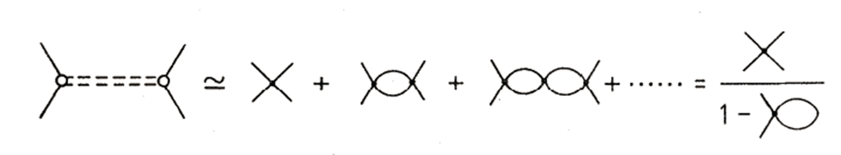

2.1
NJL model
RPA resummation

Slide 10

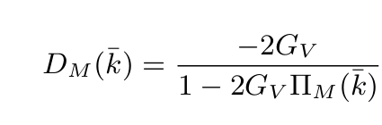
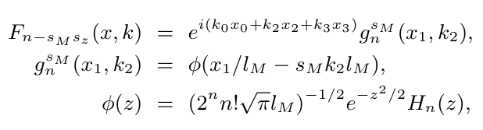


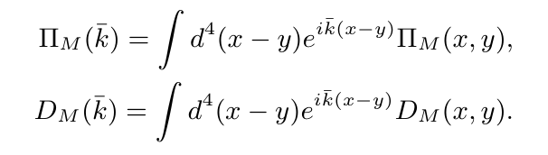

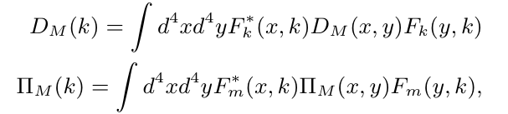



2.1
NJL model
Neutral
Charged

Slide 11


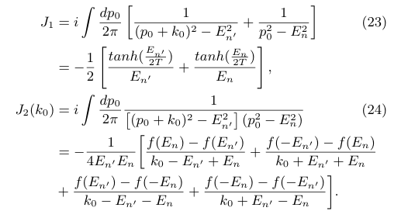
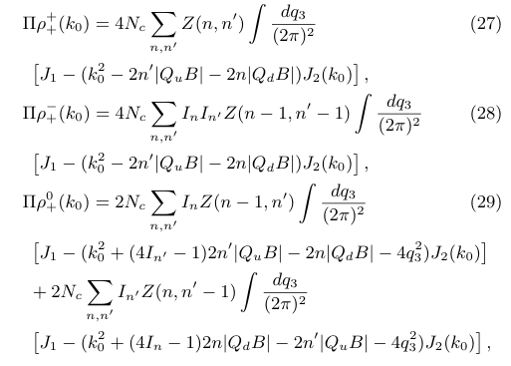


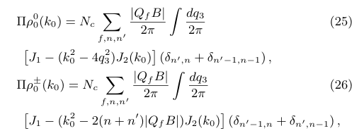



2.2
Analytical polarization function
Lowest landau level
Charged
Neutral

Slide 12








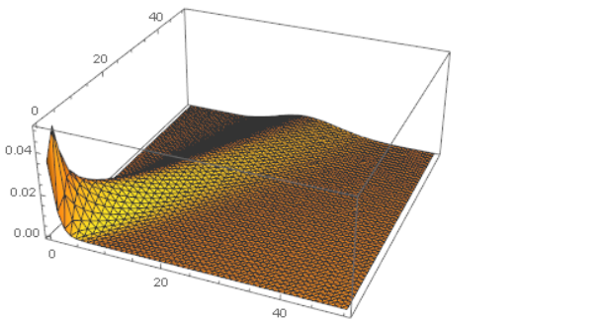
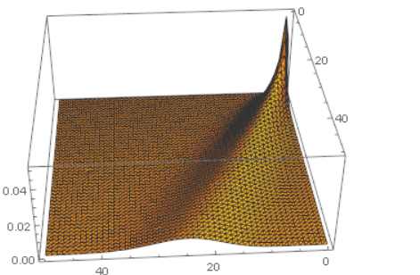

2.2
Analytical polarization function
Charged one-loop function
Negative binomial distribution

Slide 13
Outline
2.3
Equivalence between the Schwinger scheme and the Ritus scheme

Slide 14
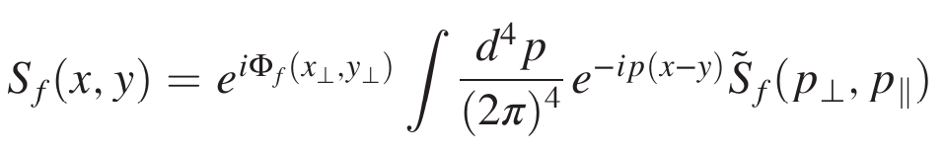

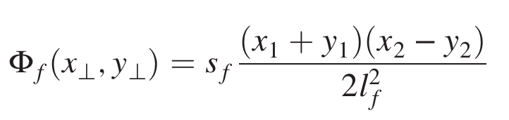
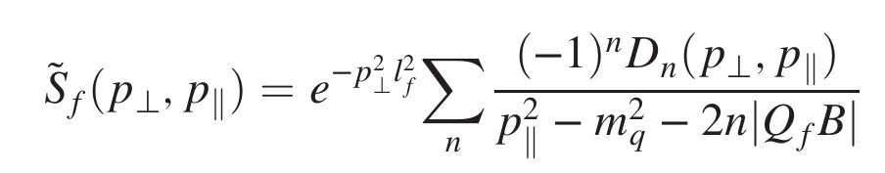

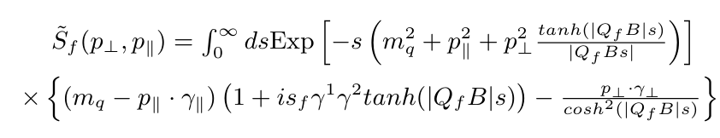
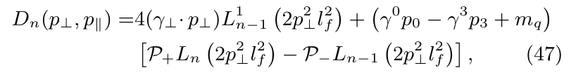


2.3
Equivalence
Schwinger propagator= Schwinger phase + translational propagator
Schwinger phase
Summation form

Slide 15
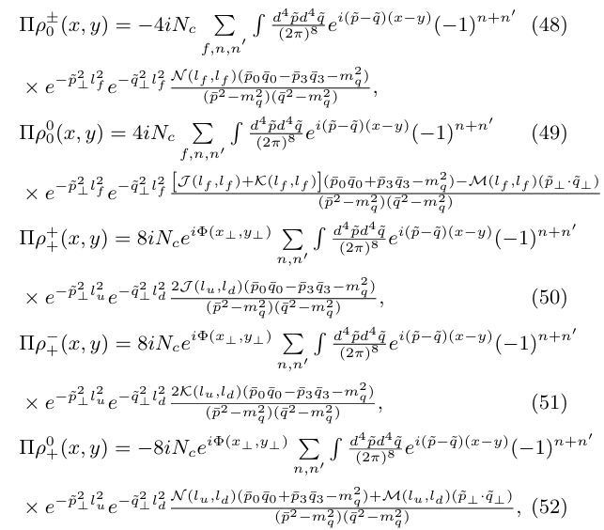


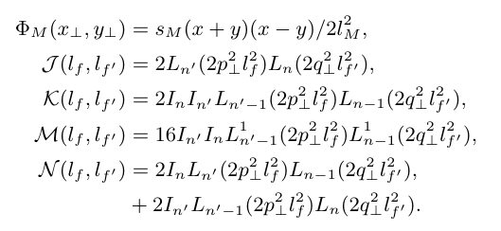

2.3
Equivalence

Slide 16
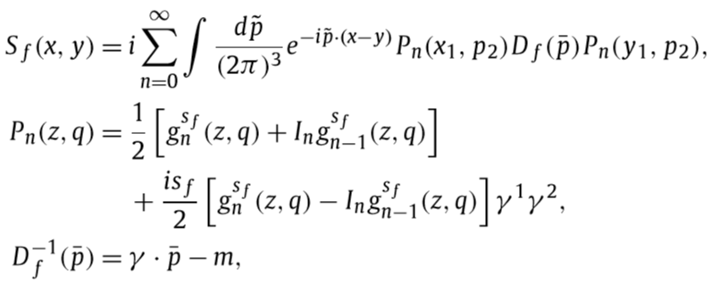








2.3
Equivalence
Ritus propagator = conserved Ritus momentum + Ritus transformation

Slide 17











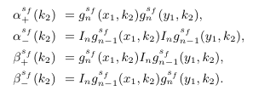


2.3
Equivalence

Slide 18
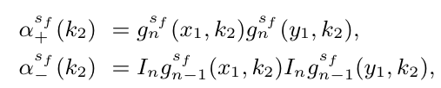
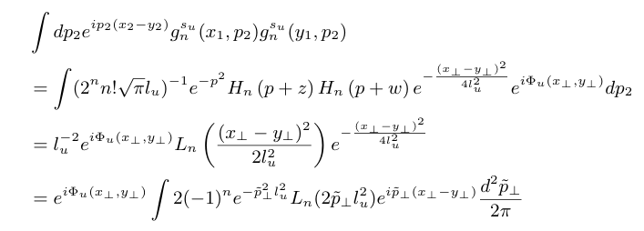
2.3
Equivalence
Same Landau level
Ritus form
variable substitution
integral
inverse integral
Schwinger phase
Schwinger form

Slide 19
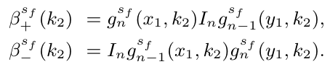
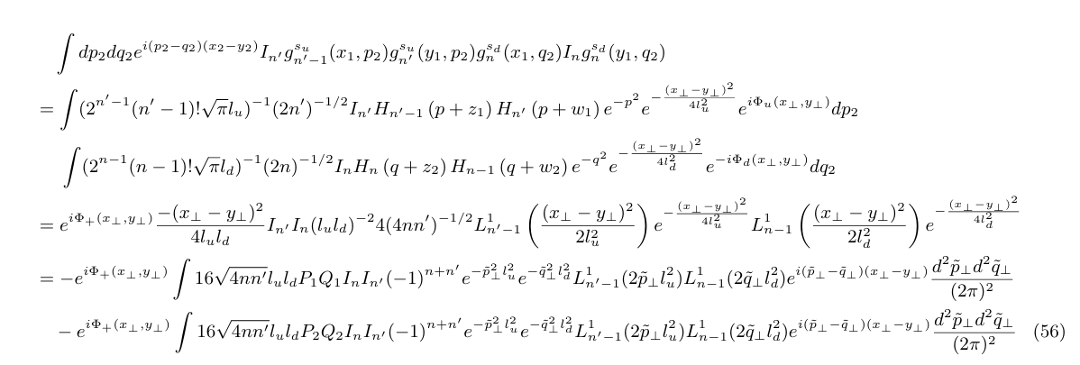

2.3
Equivalence
Different Landau levels
Ritus form
Schwinger phase
variable substitution
integral
inverse
integral
Schwinger form

Slide 20
Outline
3
Results

Slide 21
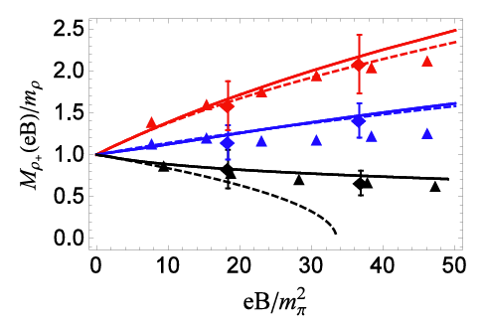

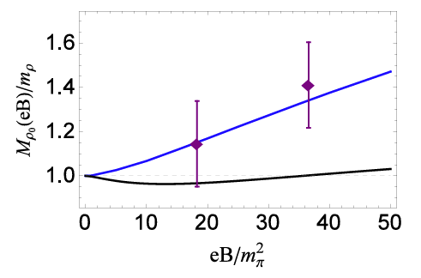



3.1
𝜌 meson solutions at T=0
Charged mesons
Neutral mesons
Lattice data:
E. Luschevskaya, O. Solovjeva, and O. Teryaev, J. High Energy Phys. 2017, 1 (2017).
G. S. Bali, B. B. Brandt, G. Endr˝odi, and B. Gl¨aßle, Phys. Rev. D 97, 034505 (2018).

Slide 22
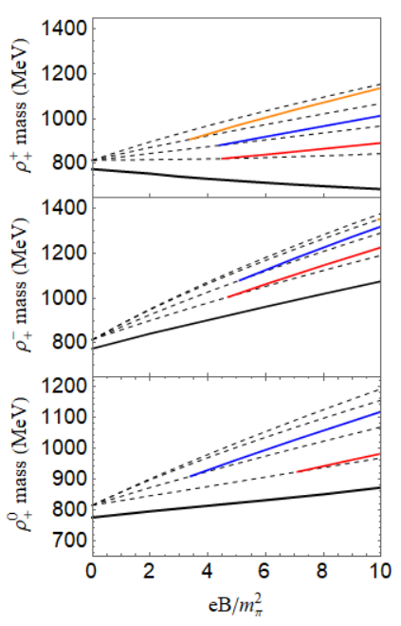
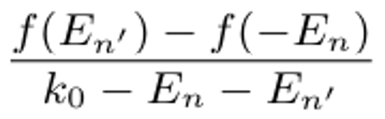
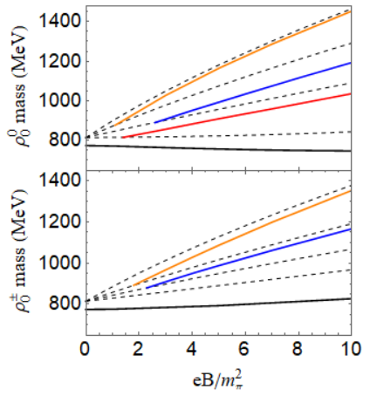


3.1
𝜌 meson solutions at T=0
Neutral $ρ$ energy level threshold
Charged $ρ$ energy level threshold

Slide 23
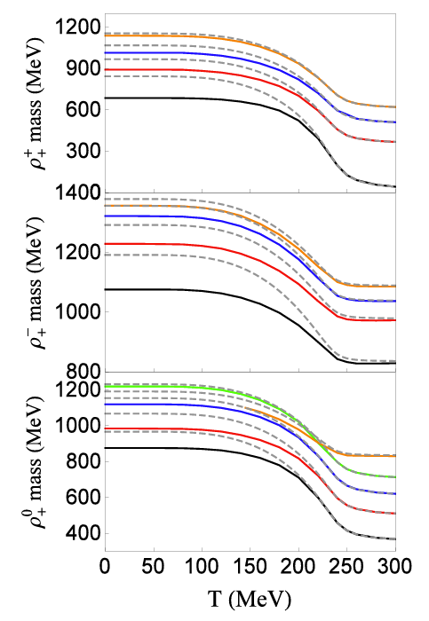

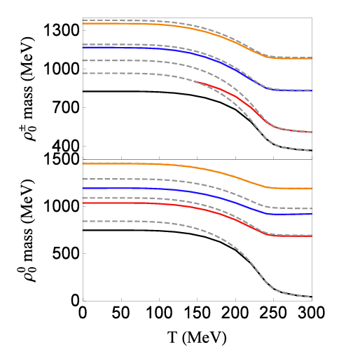
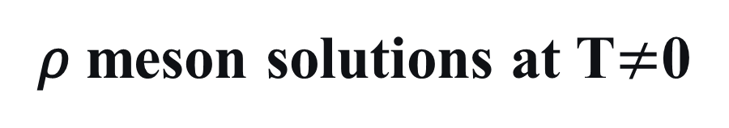

3.2
𝜌 meson solutions at T$≠$0
Neutral $ρ$ energy level threshold
Charged $ρ$ energy level threshold

Slide 24
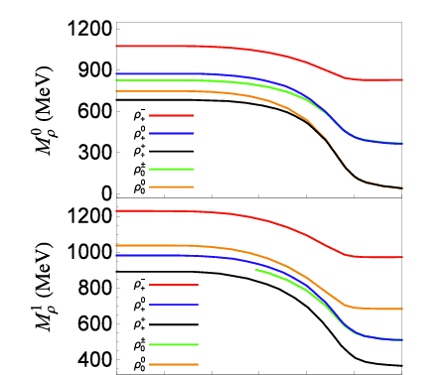
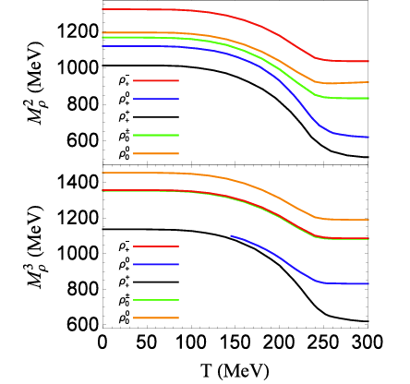
3.3
Degeneracy of the 𝜌 meson solutions

Slide 25
Outline
4
Summary

Slide 26
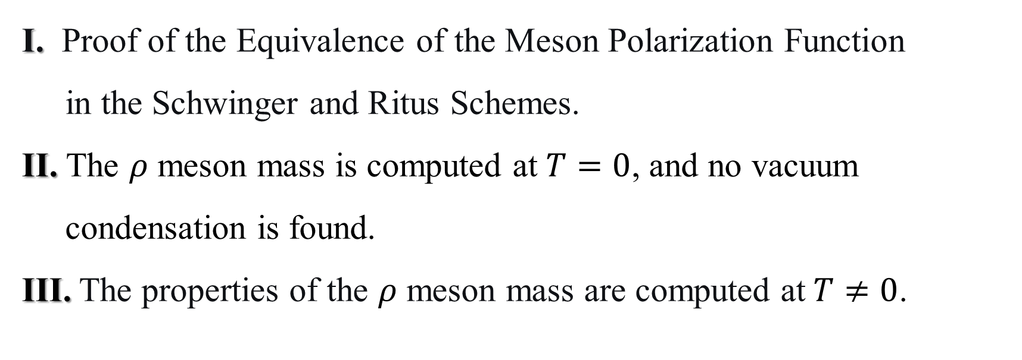
4
Summary
I. Proof of the Equivalence of the Meson Polarization Function
in the Schwinger and Ritus Schemes.
II. The $ρ$ meson mass is computed at $T=0$, and no vacuum
condensation is found.
III. The properties of the $ρ$ meson mass are computed at $T≠0$.

Slide 27
Thank you!

