Slide 1
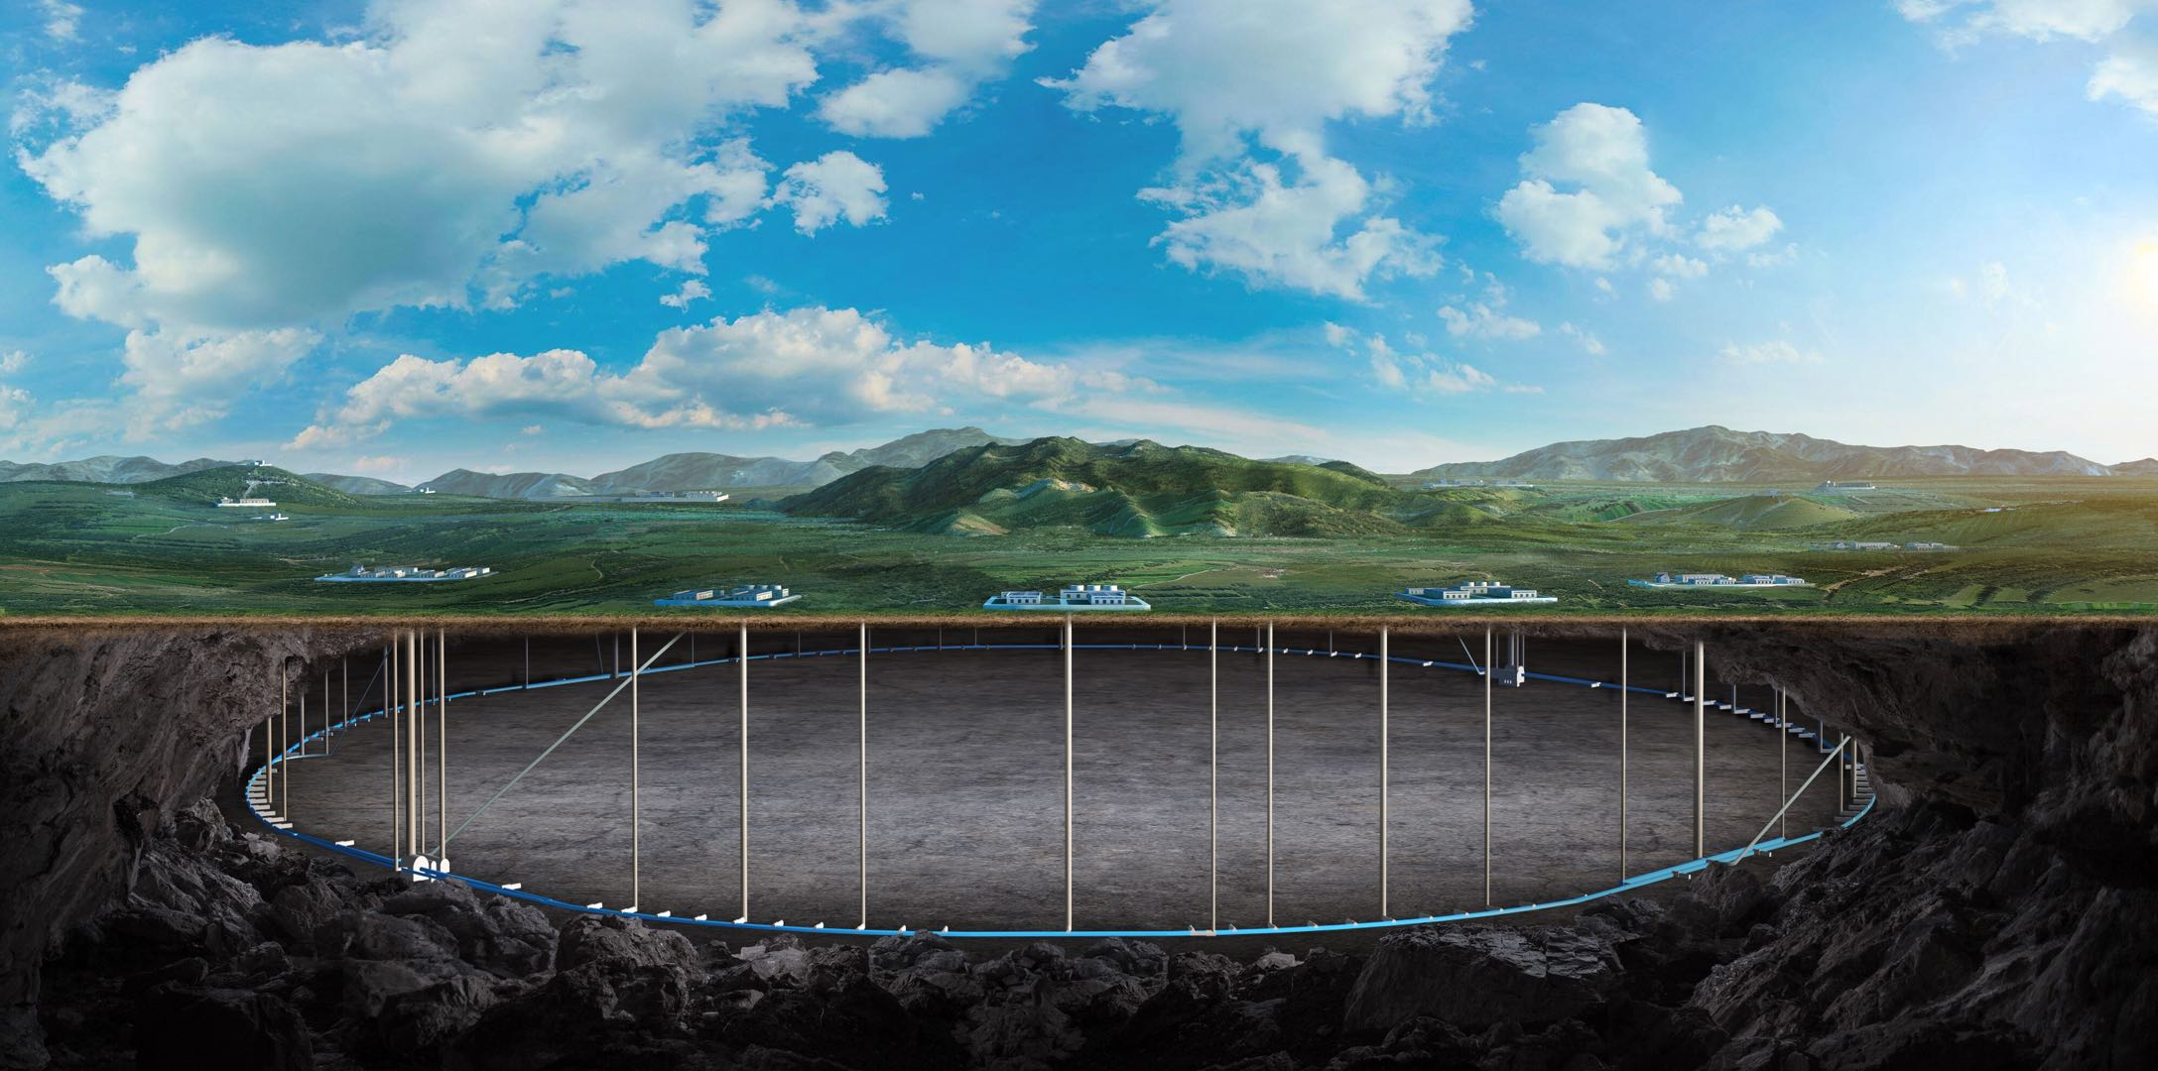


Studies of the tolerance to machine errors at all energies, with evaluation of the final emittance and energy spread for injection in the collider
Bin Wang
(on the behalf of the CEPC error correction team)
CEPC Day 2025.12.17

Slide 2
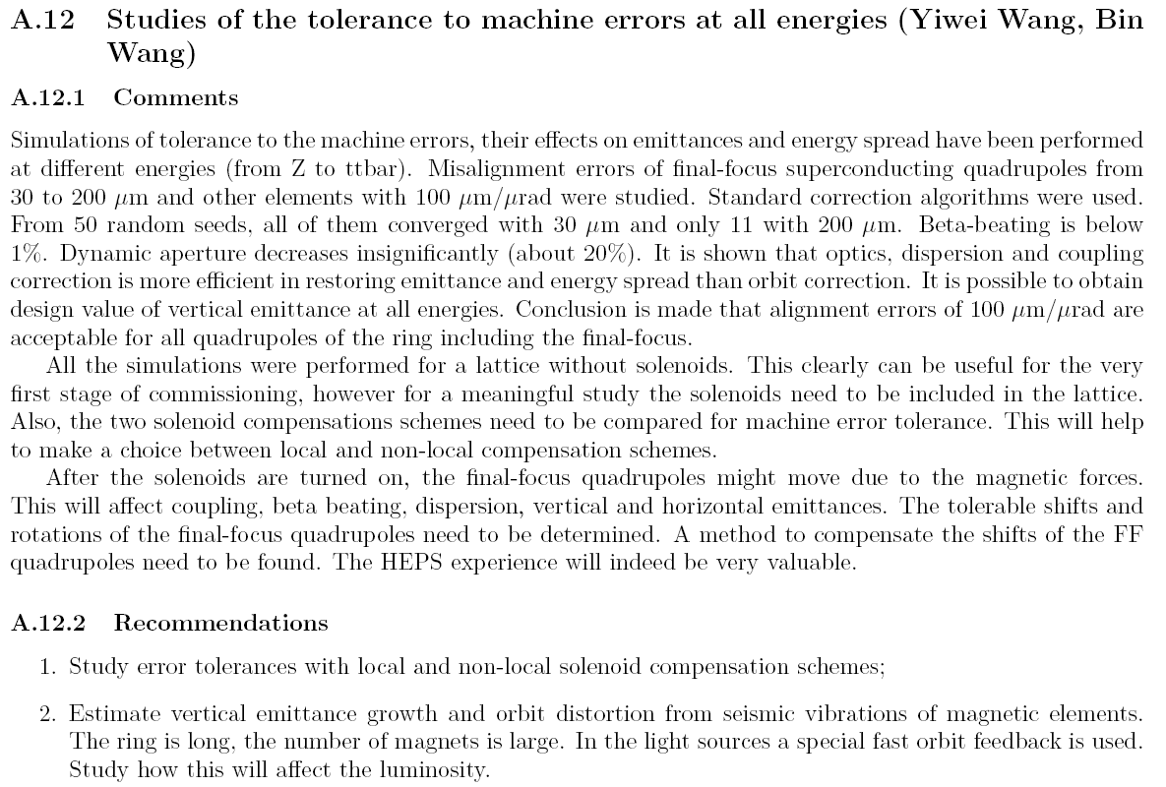
Responses to the 2025 IARC EDR review report
2

Slide 3
Responses to the 2025 IARC EDR review report
1. Study error tolerances with local and non-local solenoid compensation schemes;
[Reply] This study is currently underway. We will analyze the correction and its performance of a lattice with solenoids by systematically scanning across different magnet error scenarios.
2. Estimate vertical emittance growth and orbit distortion from seismic vibrations of magnetic elements. The ring is long, the number of magnets is large. In the light sources a special fast orbit feedback is used. Study how this will affect the luminosity.
[Reply] The vertical orbit distortion is mainly affected by two factors: the ground vibrations at the Interaction Points (IPs) and the ground motions in the arc region. With an estimated contribution of 4 nanometers from the ground vibrations at the IPs, based on the CERN vibration levels at the IP when situated 100 meters underground, and an additional 25 nanometers from the ground in the arc region—due to its length and the inevitable presence of mind-out areas even at a depth of 100 meters—the luminosity is expected to experience a reduction of approximately two percent. This is a roughly estimation. A multi-particle tracking initiative, including FOFB research, is set to commence.
3

Slide 4
Content
Update the tolerance study to machine errors at all energies
Progress of the correction to the Higgs lattice with solenoid
Summary and to do list

Slide 5
Comments in the IARC2025 meeting
Study of the tolerance to machine errors at all energies. The final emittance and energy spread is calculated with different error settings.
The misalignments of quadrupole magnets are set to be from 30 to 200 μm/μrad [30 50 100 150 200] μm/μrad, other errors are set to the values in the TDR.
50 random seeds (100 seeds of Higgs lattice) are generated for error correction. The emittance is calculated after closed orbit correction, dispersion correction and beta beating correction with coupling correction.

Slide 6
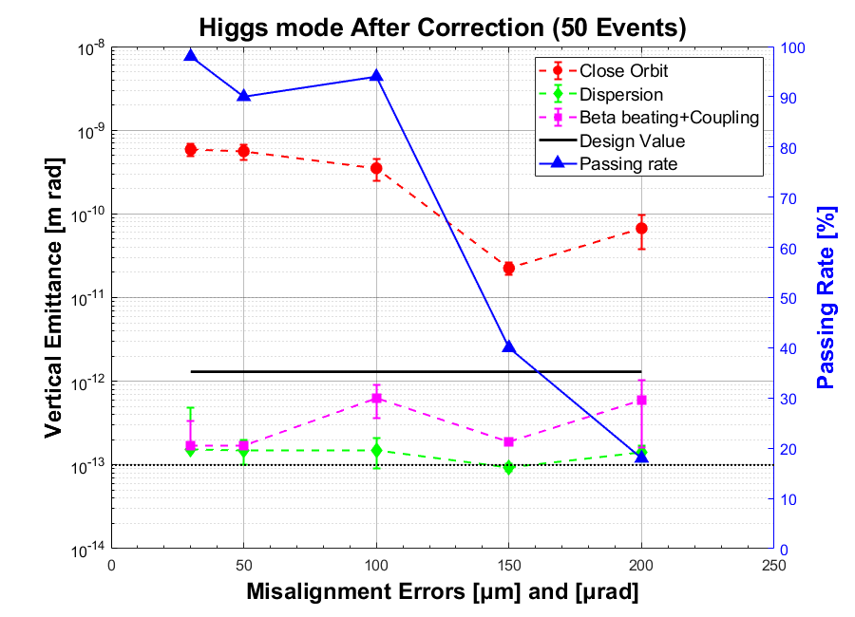
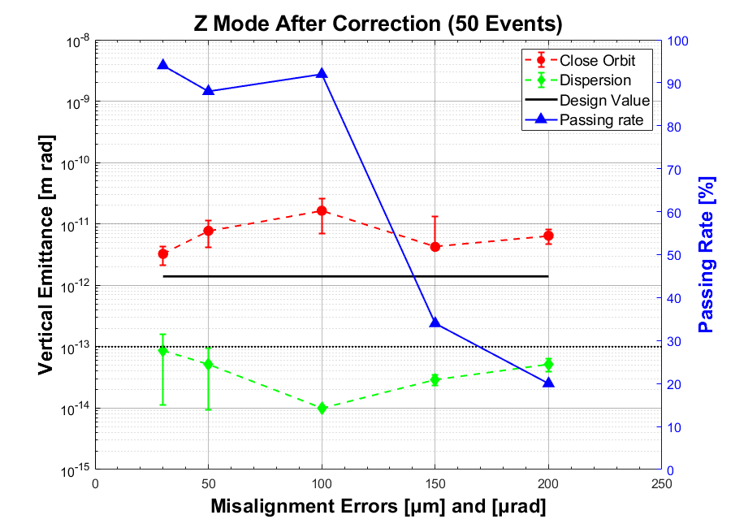
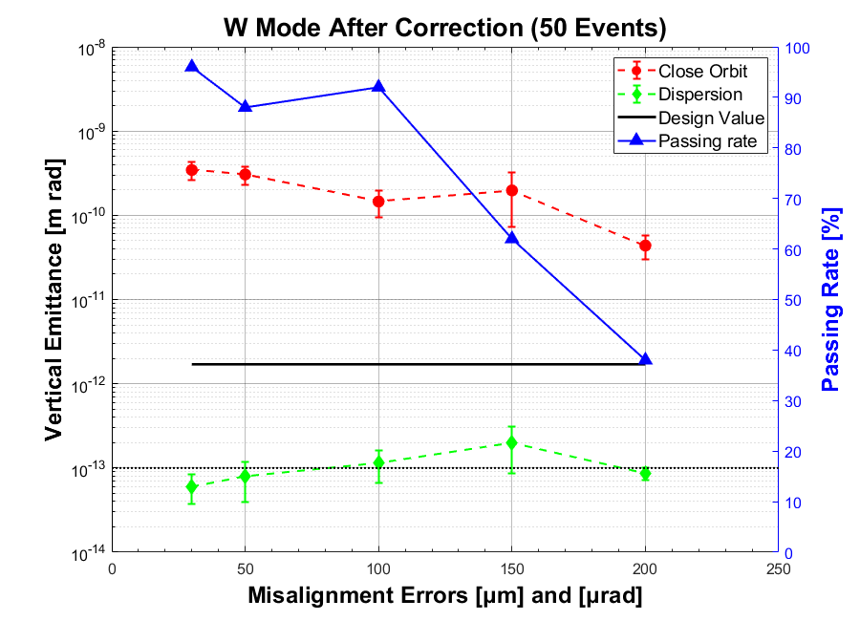
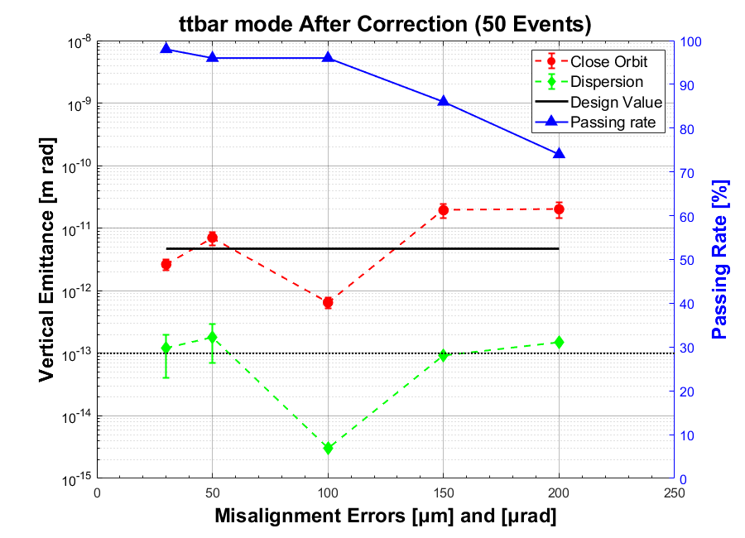
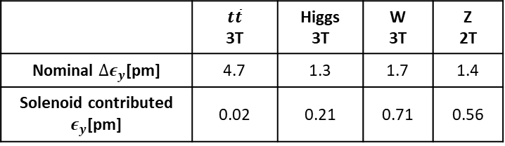
Correction Results of all energies (50 seeds)
* Correction results in 100 μm are referred to TDR result, the manual iteration and adjustment are included.
The tolerance of the misalignment of quadrupole magnets is considered for all four modes (Higgs, Z, W and ttbar modes), the results show that the vertical emittance of the survival seeds after dispersion correction are lower than their corresponding design values, while the passing rate decreases significantly as the misalignment error increases.
Vertical emittance contributions in the collider ring
Considering both correction performance and pass rate, the quadrupole magnet misalignment errors of 100 μm and 100 μrad in the TDR are acceptable.
 | $$t\overline{t}$$ 3T | Higgs 3T | W 3T | Z 2T
Nominal $∆ε_{y}$[pm] | 4.7 | 1.3 | 1.7 | 1.4
Solenoid contributed $ε_{y}$[pm] | 0.02 | 0.21 | 0.71 | 0.56

Slide 7
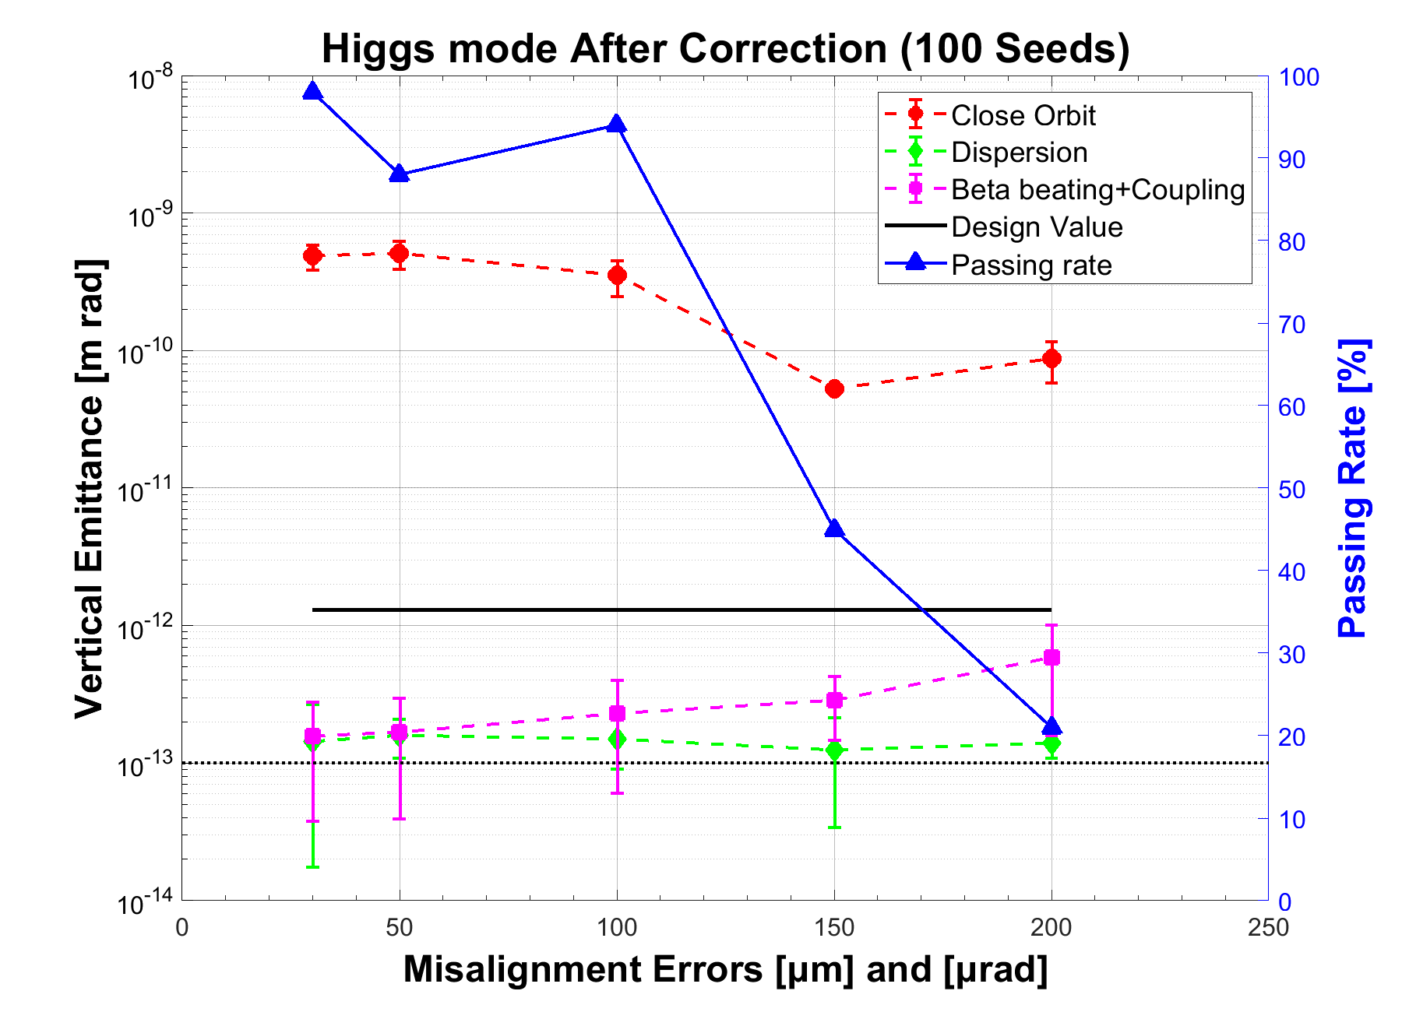
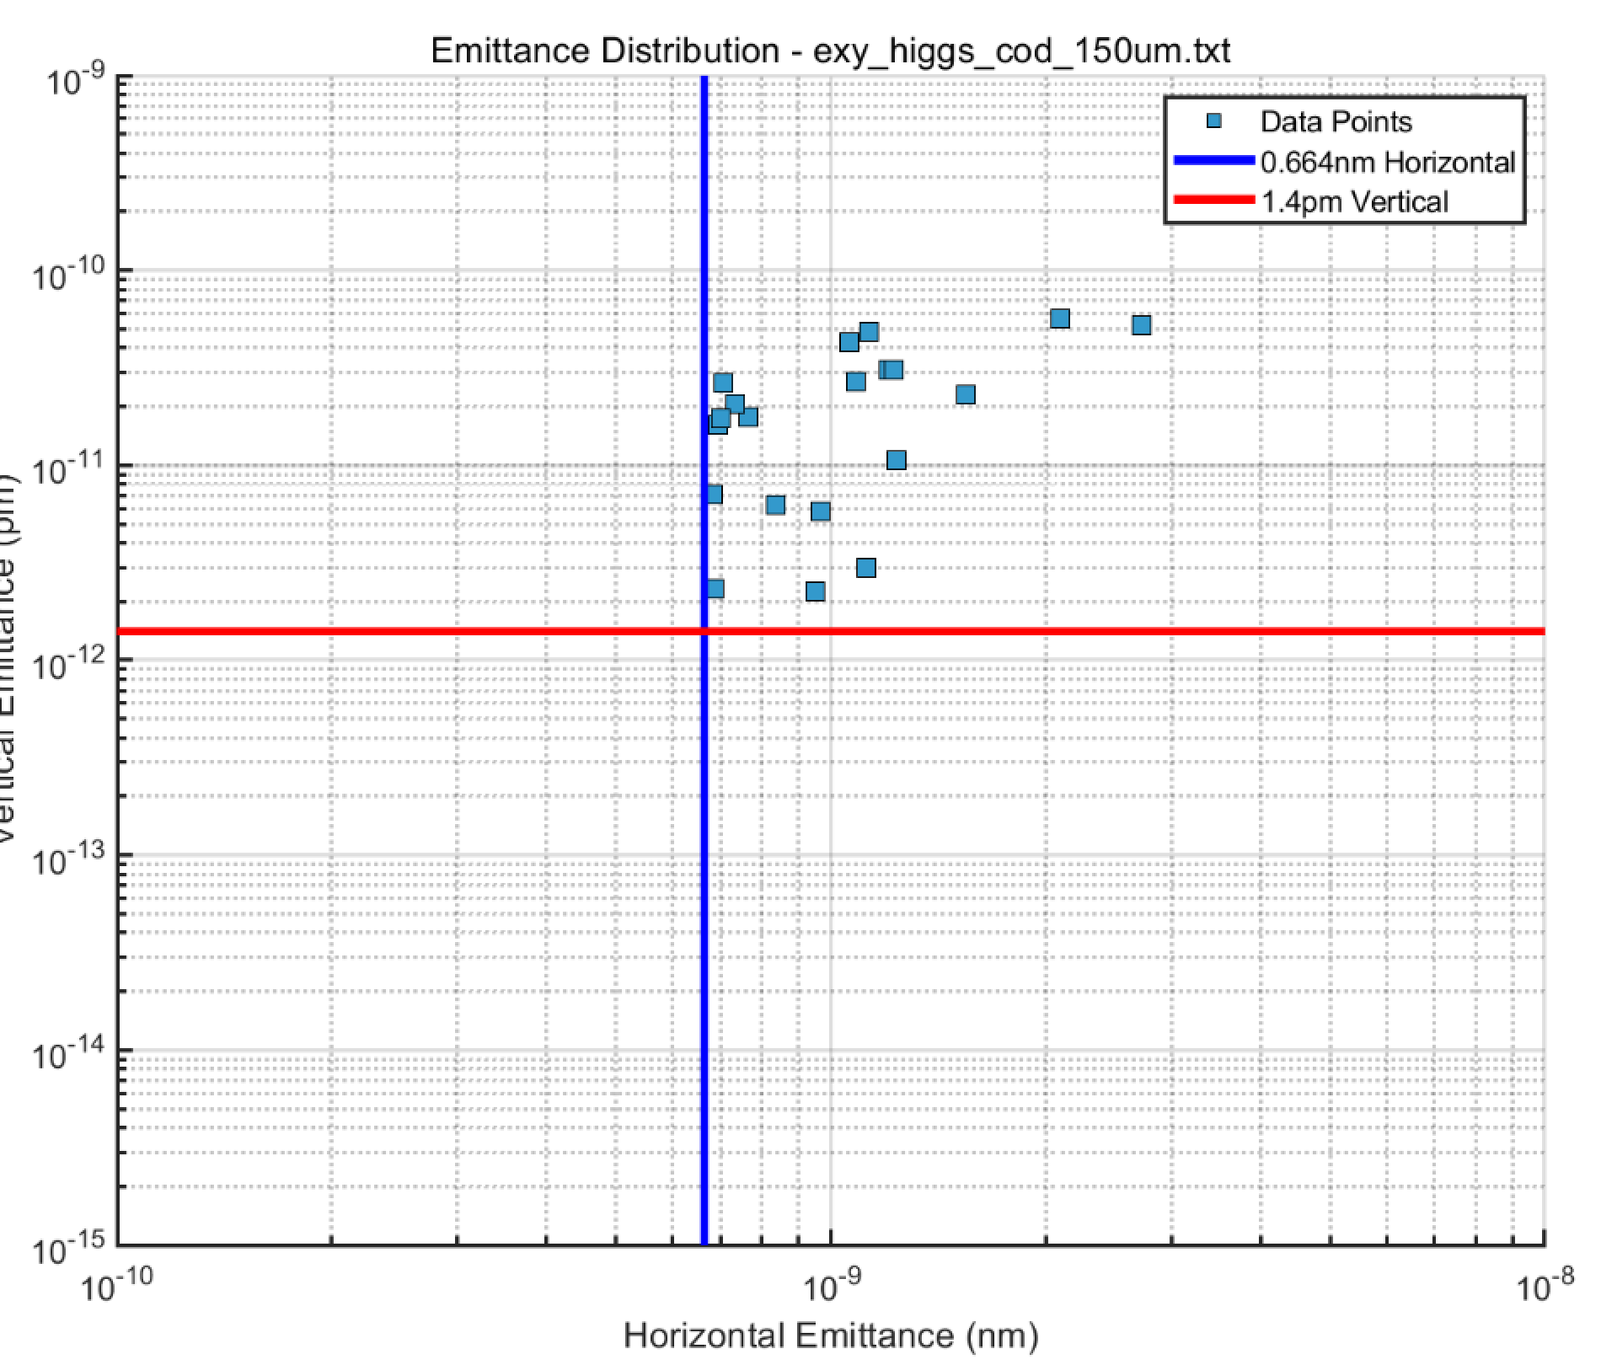
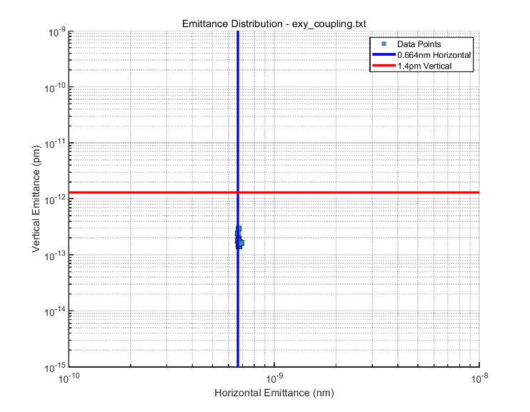
Correction Results of the Higgs lattice (100 seeds)
100 random seeds of Higgs lattices are used.
The vertical emittance after COD correction appears to decrease with increasing error because its horizontal emittance is particularly discrete.
Only COD correction
Beta beating + Coupling

Slide 8
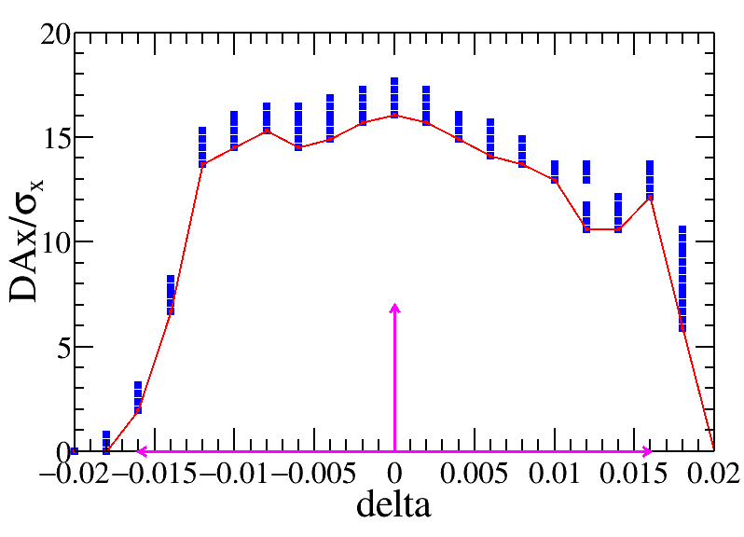
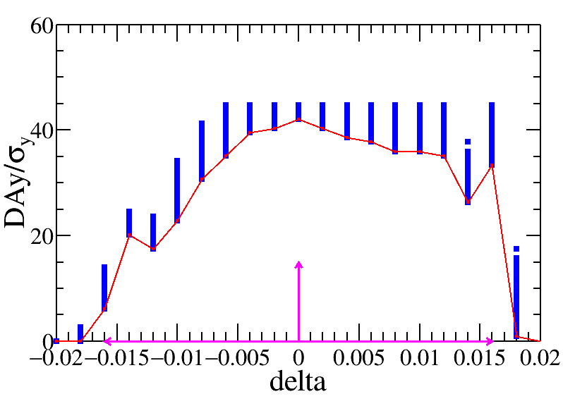
Status of the Correction to Higgs lattice with solenoid
Opti_higgs_256ARC-20IR-276family-newObjs-100slices-w-sol.sad
Bare lattice
Component | Δx (mm) | Δy (mm) | Δθ_{z} (mrad) | Field error
Dipole | 0.10 | 0.10 | 0.10 | 0.01%
Quadrupole | 0.10 | 0.10 | 0.10 | 0.02%
Sextupole | 0.10* | 0.10* | 0.10 | 0.02%
100 random seeds with magnet misalignment and field errors are generated for correction.
However, No lattice seed converges. The DA of the bare lattice with solenoid and beam-beam effect is tracked.
We are investigating this . For the future plan, we will first conduct a sensitivity analysis of the collision region magnets, as the sensitivity may change significantly after considering the solenoid.
Bare lattice

Slide 9
Summary and to do list
The tolerance of the misalignment of the quadrupole magnets is reported. We also update the result according to the comments in the IARC 2025 meeting.
The error correction to the Higgs lattice with solenoid did not yield ideal results, necessitating further detailed investigation.
Such as error sensitivity, decrease the misalignment of magnets in the IR region, and so on.

Slide 10
Summary and to do list
The tolerance of the misalignment of the quadrupole magnets is reported. We also update the result according to the comments in the IARC 2025 meeting.
The error correction to the Higgs lattice with solenoid did not yield ideal results, necessitating further detailed investigation, such as error sensitivity, decrease the misalignment of magnets in the IR region and so on.
Based on the IARC2025 comments, the 2026 work plan for error correction will be centered on addressing the error correction to the lattice with solenoid.

Slide 11
Thank you for your attention!

Slide 12
backup

Slide 13
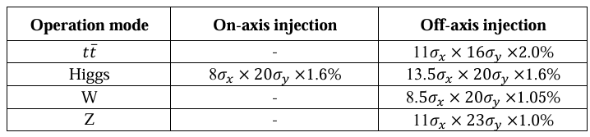
Dynamic aperture requirement
From Yiwei Wang
The dynamic aperture requirement comes from the injection parameters, beam lifetime for the top-up injection.
Considering: 3 sigma injection beam from booster (nominal booster emittance x and energy spread, 1% coupling for emittance x), 4 sigma circulated beam in collider, beam jitter due to kicker strength jitter are usually limit at the order of 10% sigma for circular accelerators.
All the particles from injection will survival w/ error, w/ jitter, w/o beam-beam as the particles located within the dynamic aperture.
E (GeV) | emitx_b (nm) | emitx_c (nm) | emity_b (pm) | emity_c (pm)
45.5 | 0.19 | 0.27 | 1.9 | 1.4
80 | 0.56 | 0.87 | 5.6 | 1.7
120 | 1.26 | 0.64 | 12.6 | 1.3
180 | 2.83 | 1.4 | 28.3 | 4.7

Slide 14
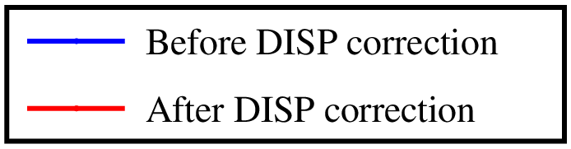
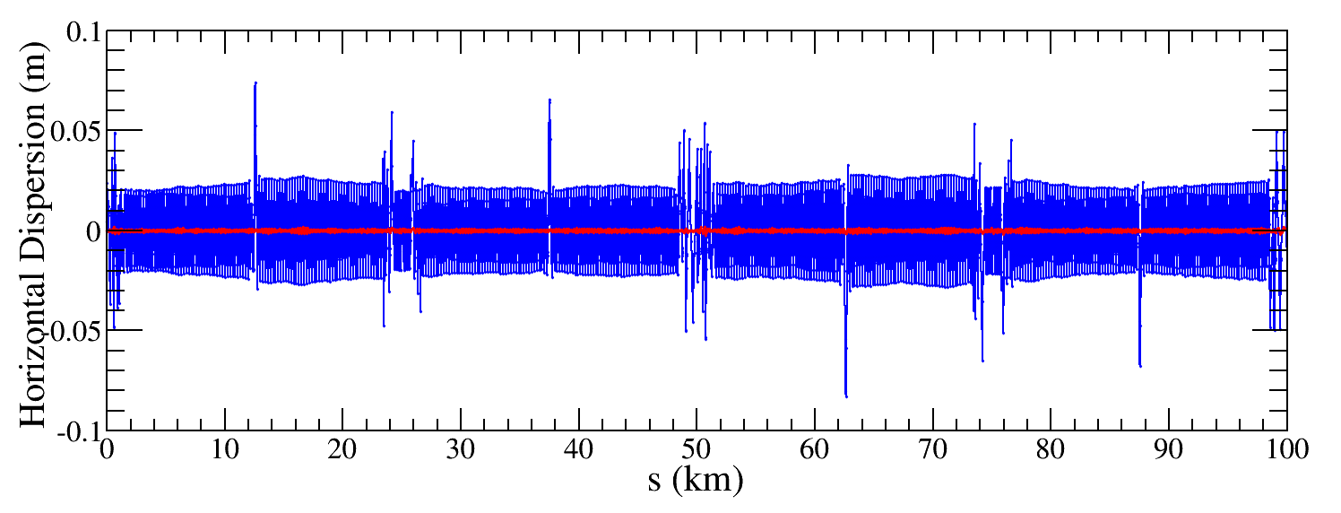
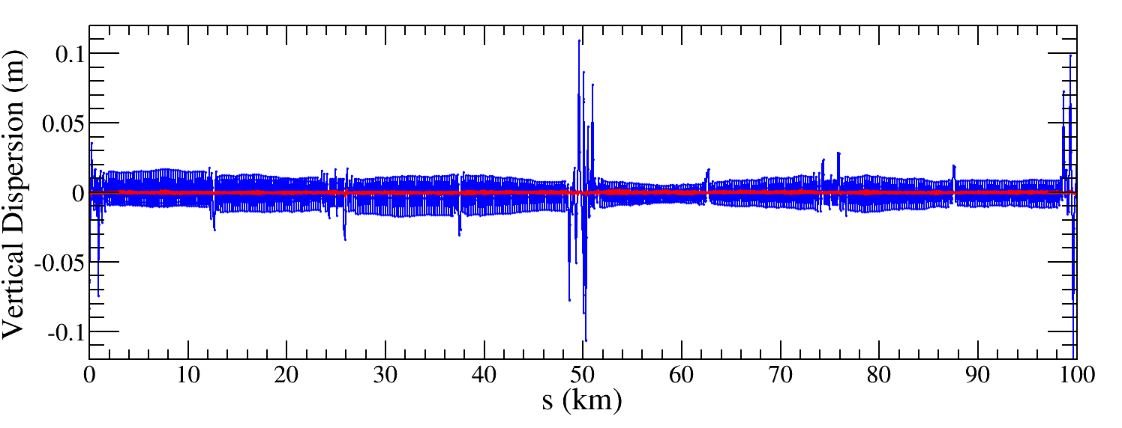
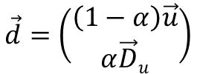
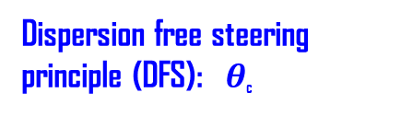
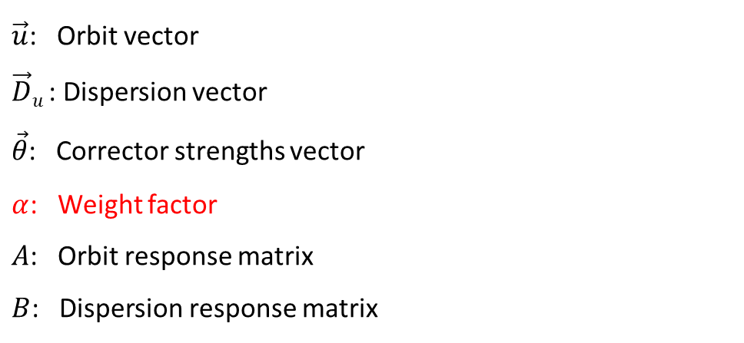


Dispersion correction
Dispersion free steering principle (DFS):$θ$_{c}
$$\vec{d}=\left(\begin{aligned}\left(1−α\right)\vec{u} \\ α\vec{D}u\end{aligned}\right)$$
M$=\left(\begin{aligned}\left(1−α\right)A \\ αB\end{aligned}\right)$
$$\vec{d}+M\vec{θ}=0$$
$\vec{u}$: Orbit vector
$\vec{D}u$: Dispersion vector
$\vec{θ}$: Corrector strengths vector
$α$: Weight factor
$A$: Orbit response matrix
$B$: Dispersion response matrix
Result of a Higgs lattice seed
The dispersion is corrected well, the RMS dispersion is about 1mm for all lattice seeds.

Slide 15
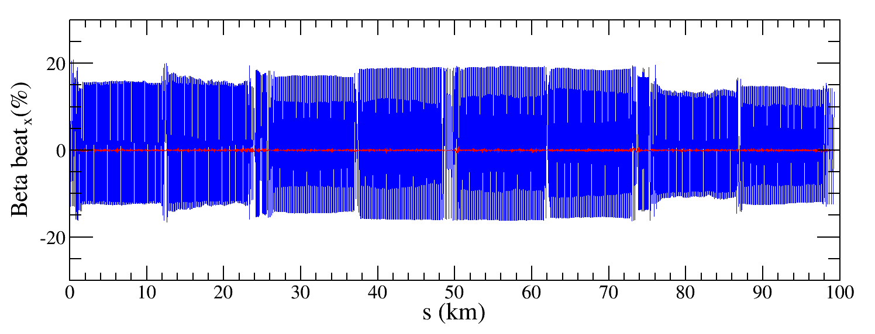
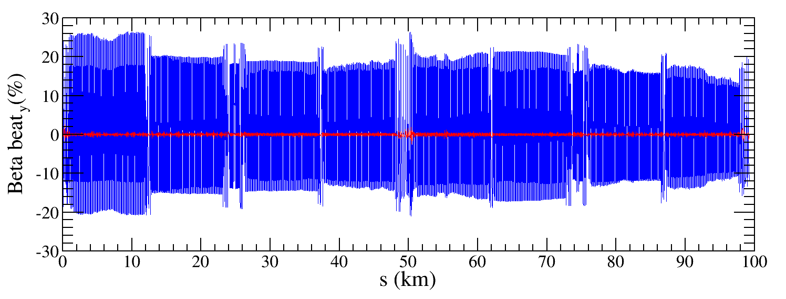

Beta-beating correction
Correct the beta functions with sextupoles on.
Based on AT LOCO: model based correction
Establish lattice model M_{mod}, multi-parameter fit to the orbit response matrix M_{meas} to obtain calibrated model:
Parameters fitted: K, KS …
Use calibrated model to perform correction and apply to machine.
Fit the dispersion at the same time.
Application to correct beta-beating, dispersion and coupled response matrix.
${∆β/β}_{rms}$ < 3%

Slide 16
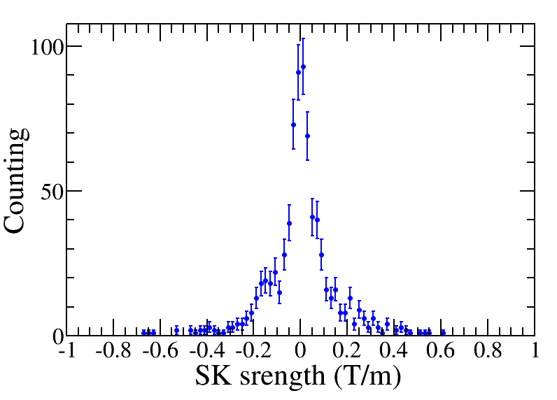

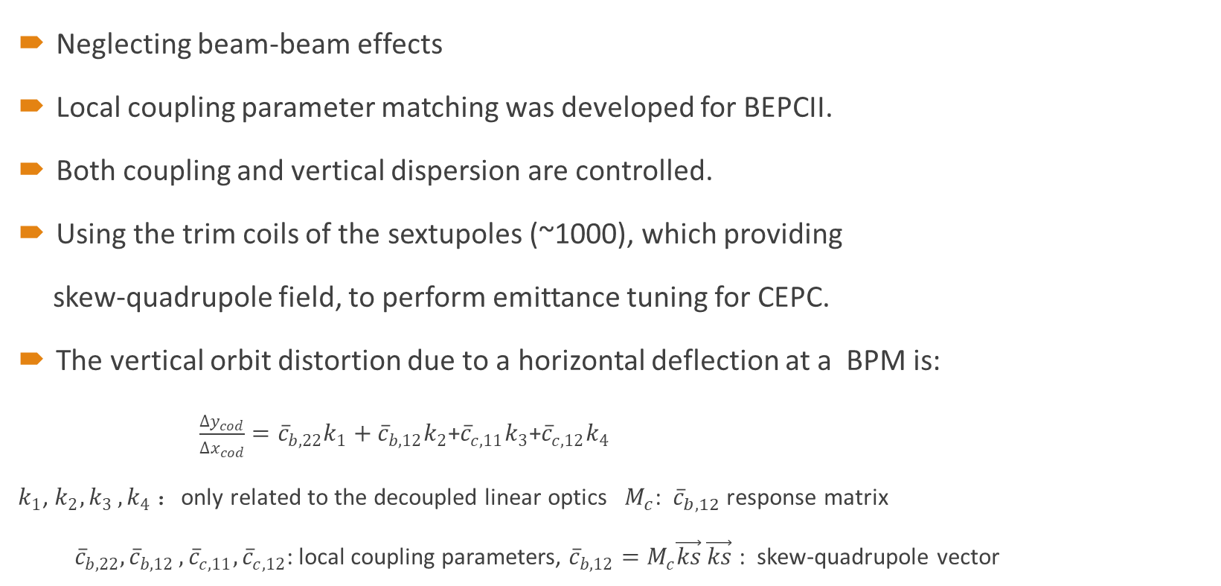
Coupling correction
Neglecting beam-beam effects
Local coupling parameter matching was developed for BEPCII.
Both coupling and vertical dispersion are controlled.
Using the trim coils of the sextupoles (~1000), which providing
skew-quadrupole field, to perform emittance tuning for CEPC.
The vertical orbit distortion due to a horizontal deflection at a BPM is:
$\frac{∆y_{cod}}{∆x_{cod}}={\overline{c}}_{b,22}k_{1}+{\overline{c}}_{b,12}k_{2}$+${\overline{c}}_{c,11}k_{3}$+${\overline{c}}_{c,12}k_{4}$
$k_{1}$, $k_{2}{,k}_{3},k_{4}$ ：only related to the decoupled linear optics $M_{c}$: ${\overline{c}}_{b,12}$ response matrix
${\overline{c}}_{b,22}{,\overline{c}}_{b,12},{\overline{c}}_{c,11},{\overline{c}}_{c,12}$: local coupling parameters, ${\overline{c}}_{b,12}=M_{c}\vec{ks}$ $\vec{ks}$ : skew-quadrupole vector
$ε_{y}$= $ε_{y0}+κε_{x}+γE^{2}{(D_{y}^{rms})}^{2}$
The emittance correction is evaluated to be 𝜖_{𝑥} = 0.666 nm and 𝜖_{𝑦} = 0.209 pm, the emittance ratio (𝜖_{𝑦}/𝜖_{𝑥} ) is 0.03%, which satisfies the design requirement.

Slide 17
Error assumptions and correction schemes
Software: SAD and Matlab-based accelerator toolbox (AT)
Closed-orbit distortion (COD) correction is performed with sextupoles off, then the sextupoles were turned on and the COD correction repeated.
The dispersion correction using dispersion free steering principle (DFS).
beta-beating correction (LOCO), coupling and vertical dispersion correction
The vertical emittance is calculated in each step of correction, and ‌only auto-corrected seeds were included in the performance evaluation‌.
‌Taking the Higgs mode correction as an example‌.
Component | Δx (mm) | Δy (mm) | Δθ_{z} (mrad) | Field error
Dipole | 0.10 | 0.10 | 0.10 | 0.01%
Quadrupole | 0.10 | 0.10 | 0.10 | 0.02%
Sextupole | 0.10* | 0.10* | 0.10 | 0.02%

Slide 18
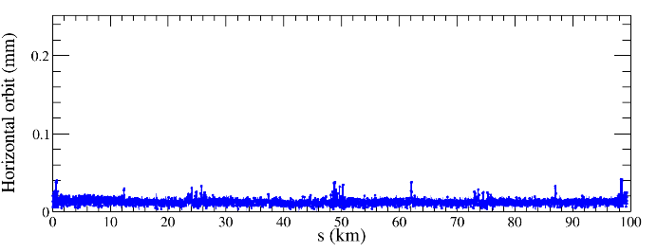
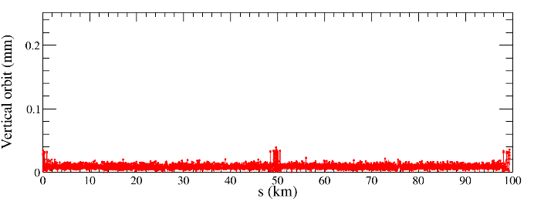
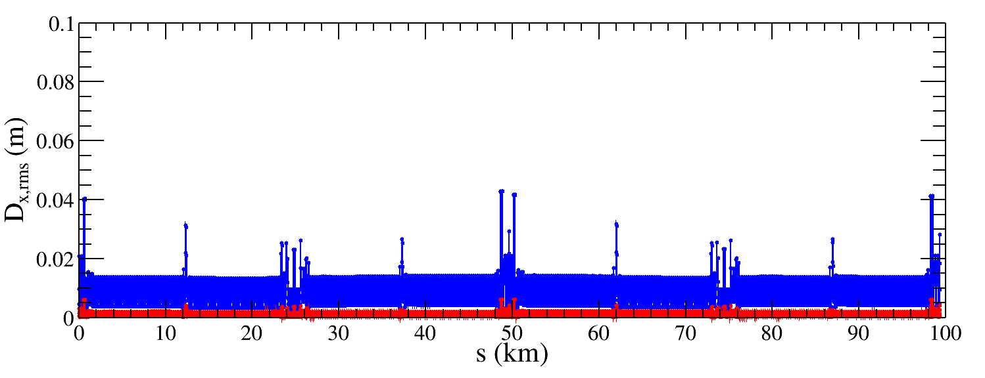
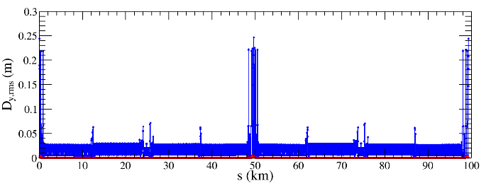
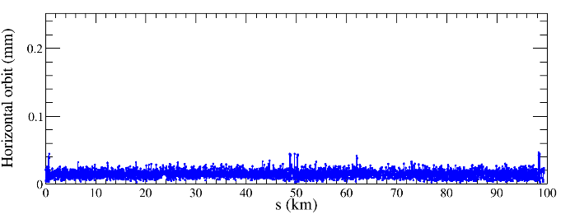
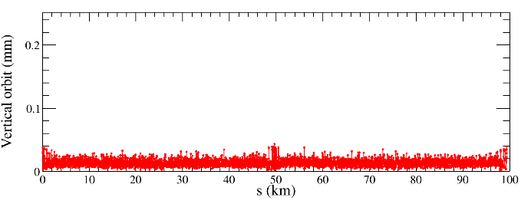
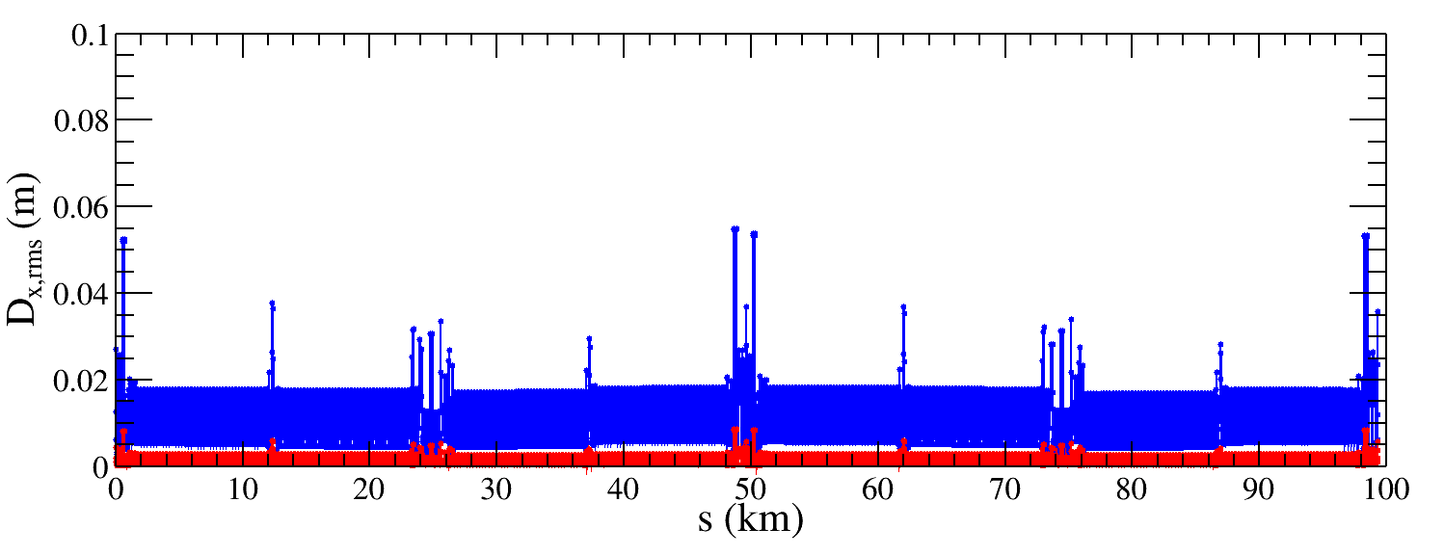
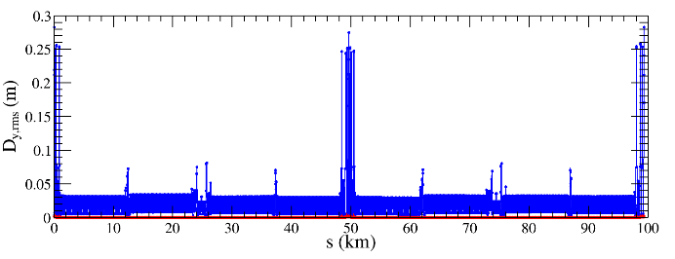
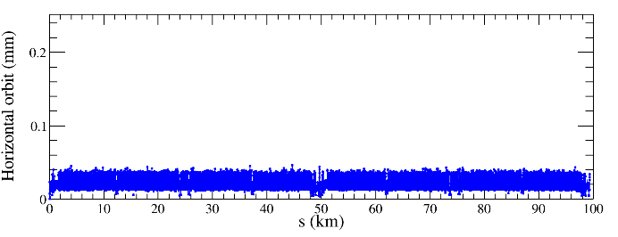
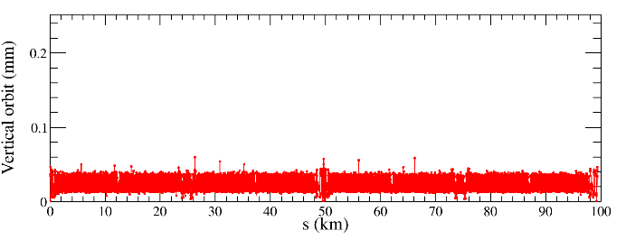
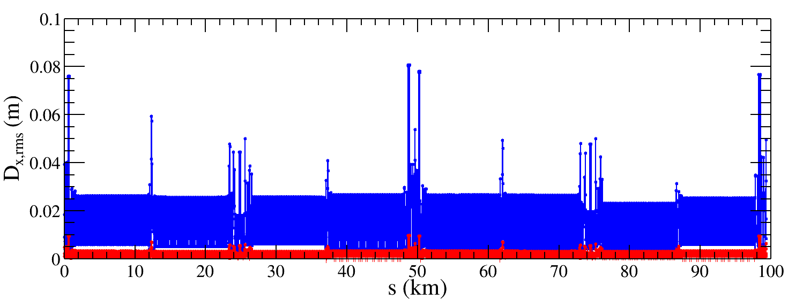
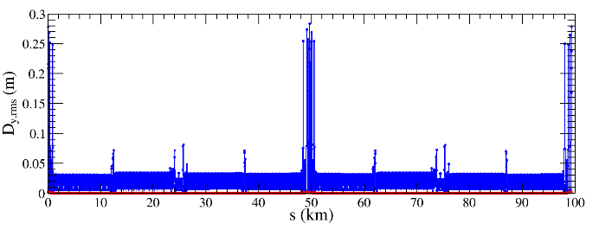
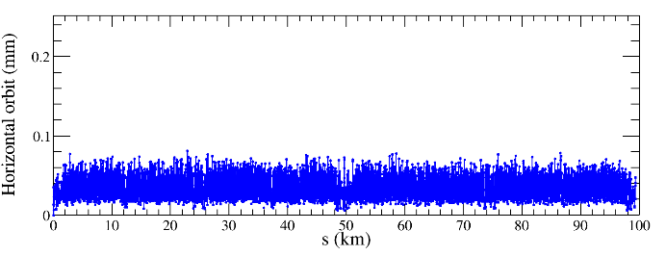
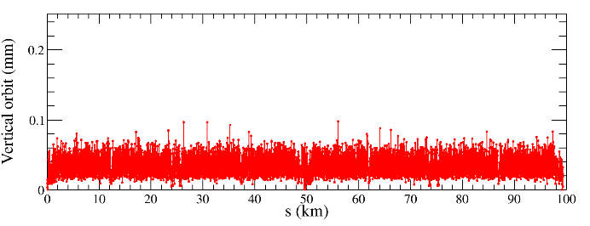
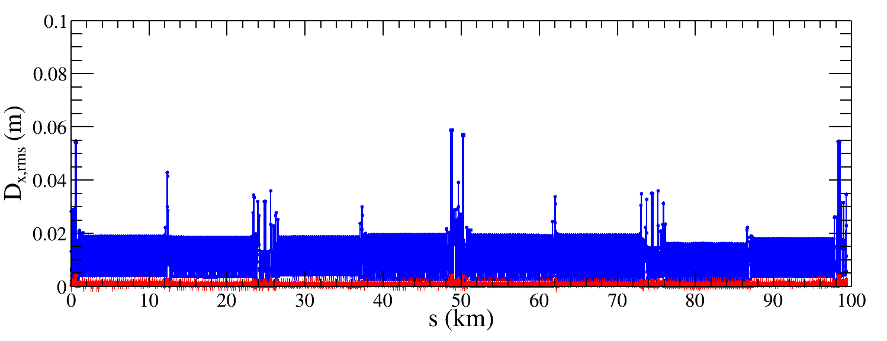
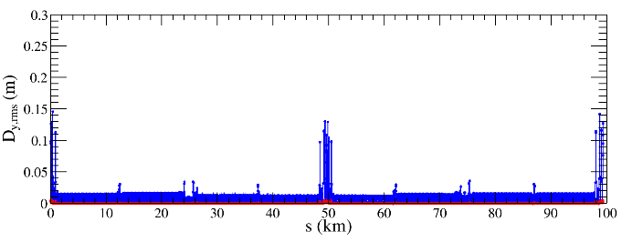
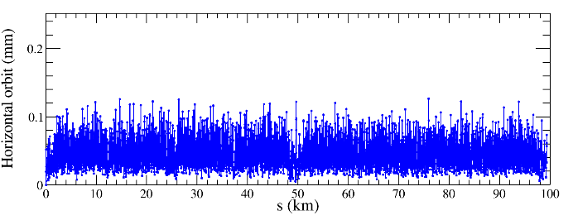
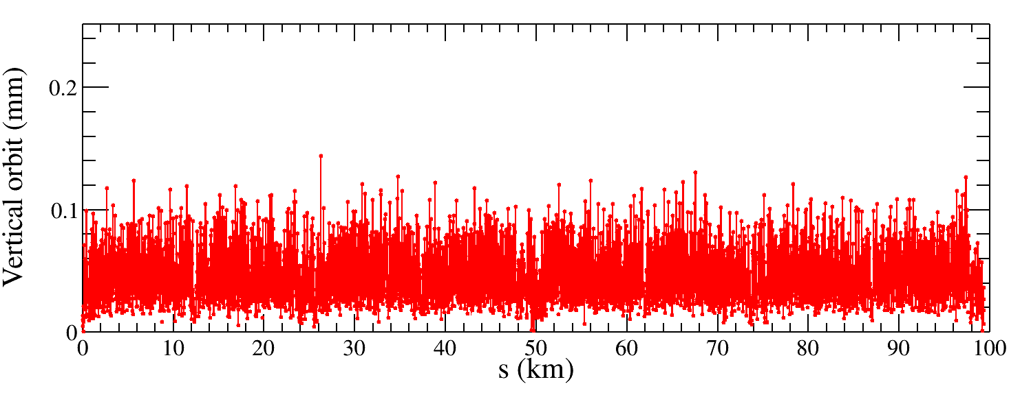
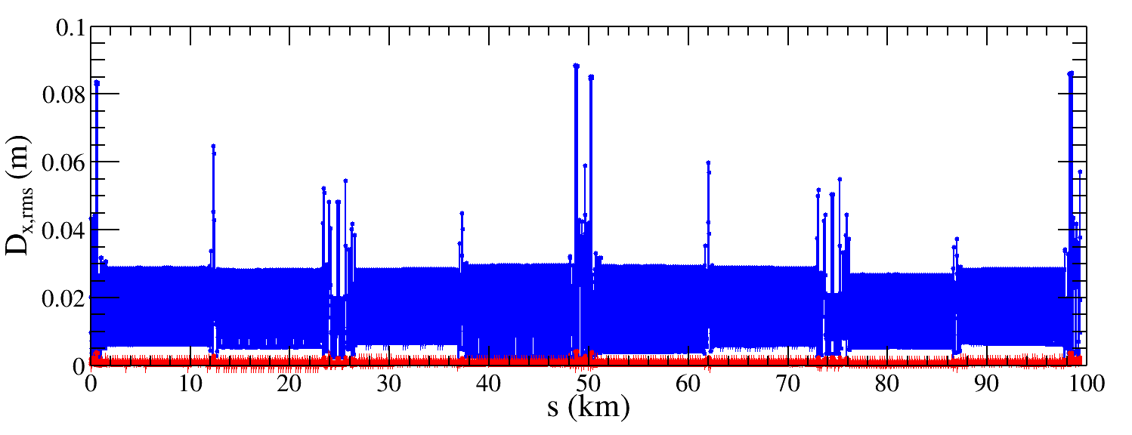
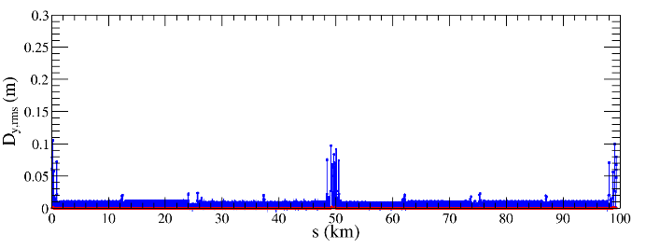
Correction Results of the Higgs lattice
Horizontal orbit
Vertical orbit
30 μm, 50 seeds converged
50 μm, 48 seeds converged
100 μm (TDR), 50 seeds converged with manual iteration.
150 μm, 21 seeds converged
200 μm, 11 seeds converged
As misalignment errors increase, the closed orbit exhibits growth while the converged rate decreases, dispersion after correction remains comparable.

Slide 19
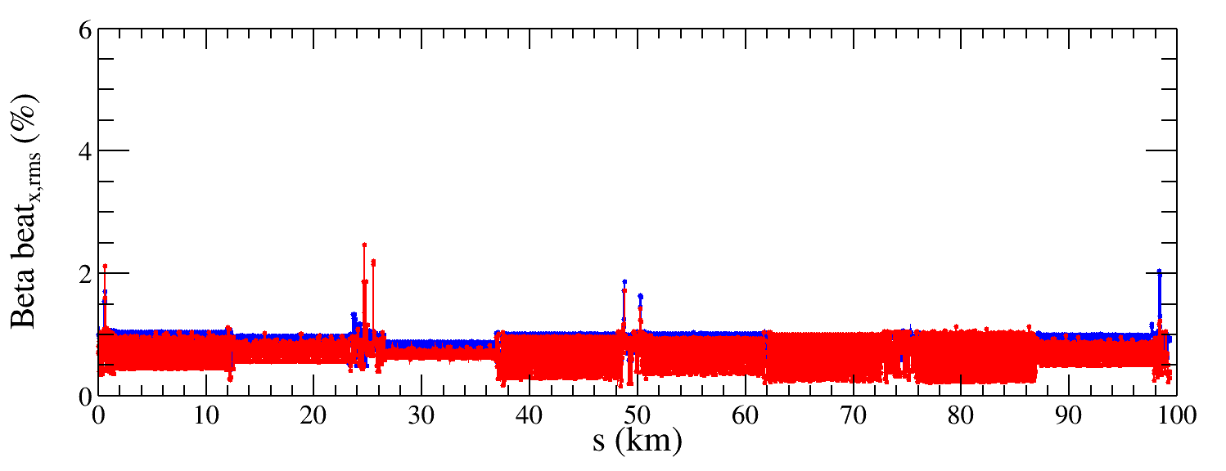
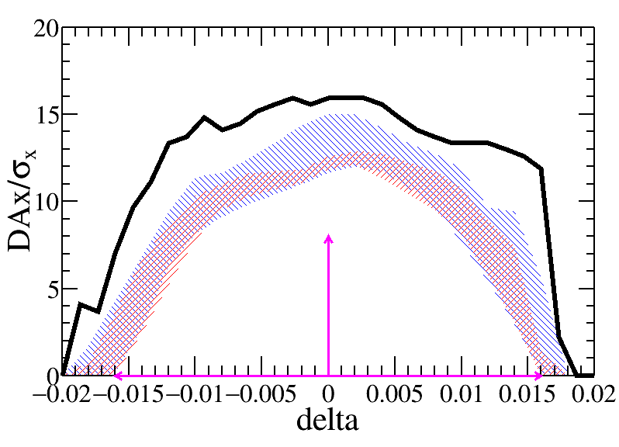
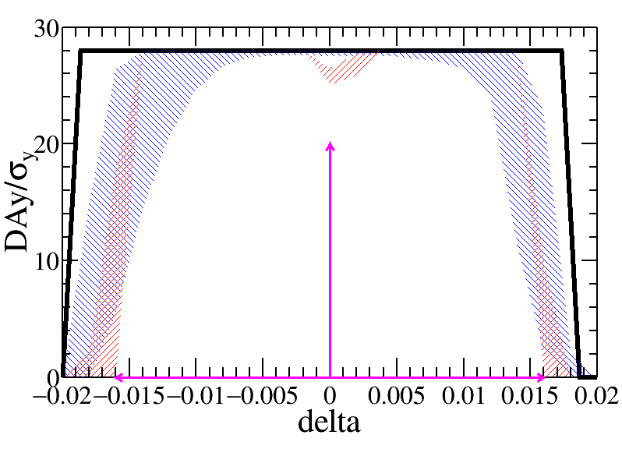
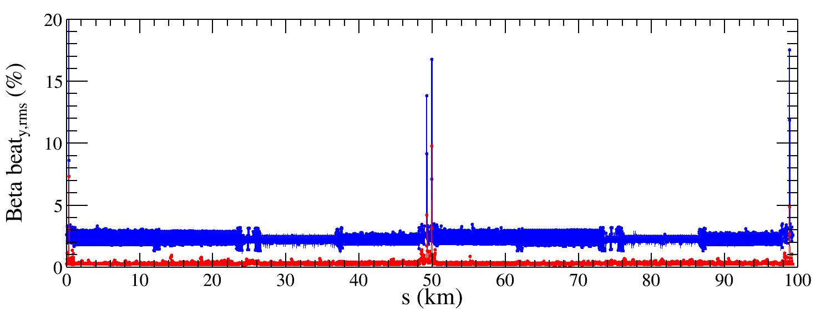
Update the beta beating correction
The beta-beating correction algorithm has been updated, achieving an obvious reduction in relative beta-beating compared with that in the TDR.
The RMS horizontal and vertical relative beta-beating after correction was decreased from 0.8% to 0.7% and from 2.8% to 0.4%, respectively.
The result shows that the dynamic aperture remains stable, while statistical fluctuations (colored bands) are further reduced, leading to more consistent correction results.
Blue: TDR result
Red: Current result
19

