Slide 1
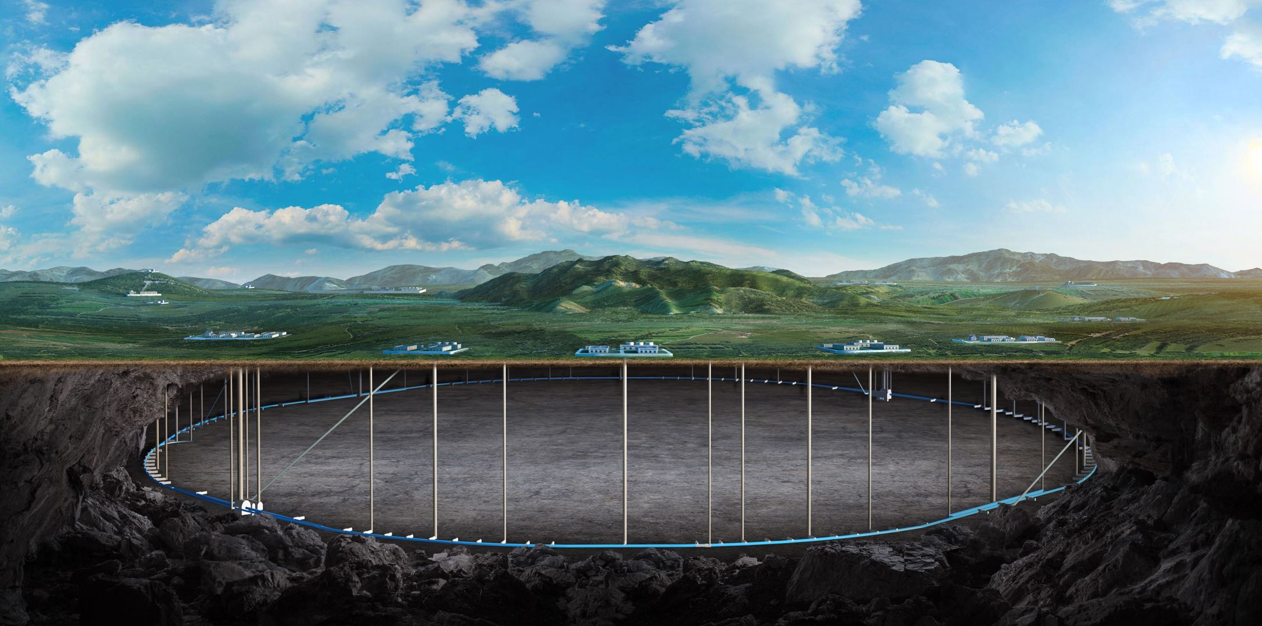


Simulation of injection at commissioning and orbit correction
Daheng Ji, Dou Wang(IHEP)
On behalf of CEPC Acc-Booster team

Slide 2
Content
Introduction
CEPC Booster First Injection and Orbit Correction
  Booster design and error set
  First Injection and orbit correction at commissioning simulation
Summary

Slide 3
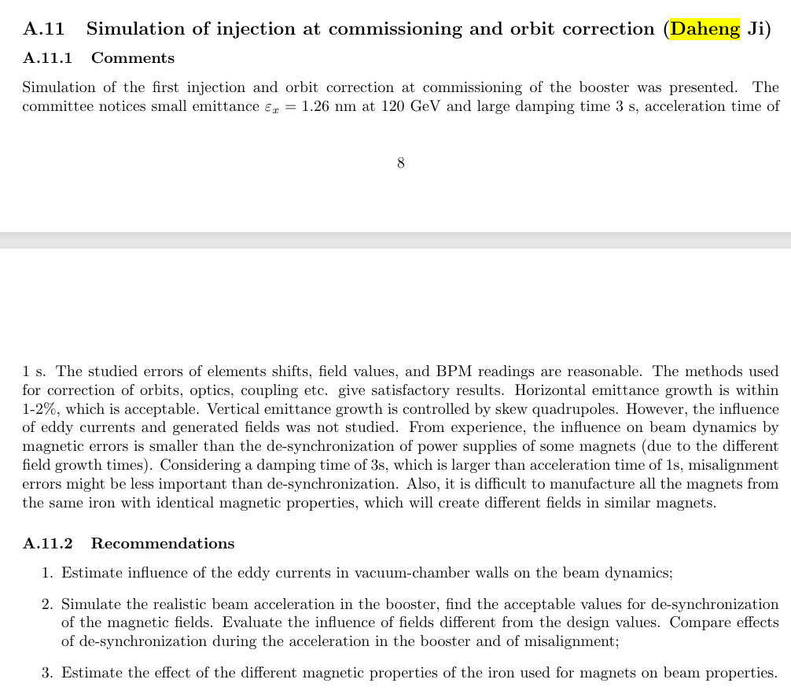
IARC2025
The eddy current effect and magnet energization desynchronization are mainly dynamic effects during the current ramping process. Currently, these two types of fields are simulated as magnetic field error effects in the simulation. In the next step, amplitude verification will be carried out in conjunction with the hardware system.
The influence of magnet materials from different types and batches has not yet been studied.

Slide 4
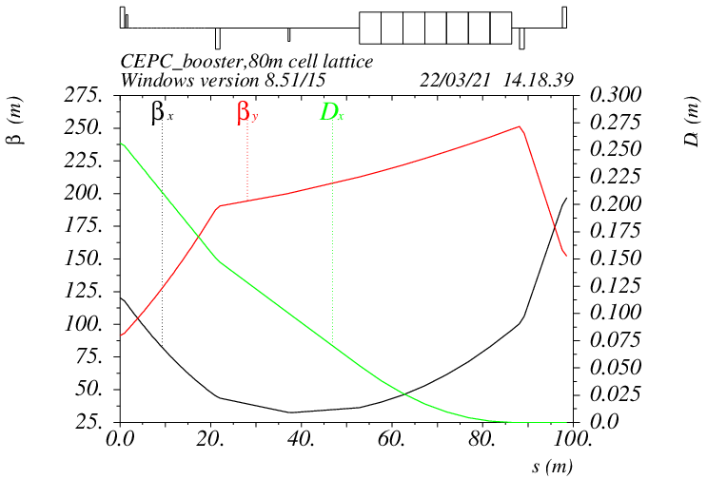
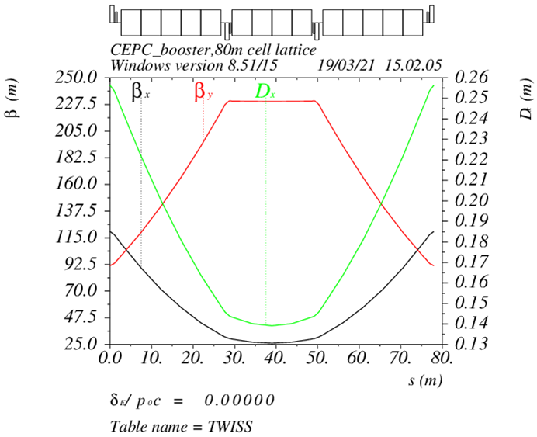
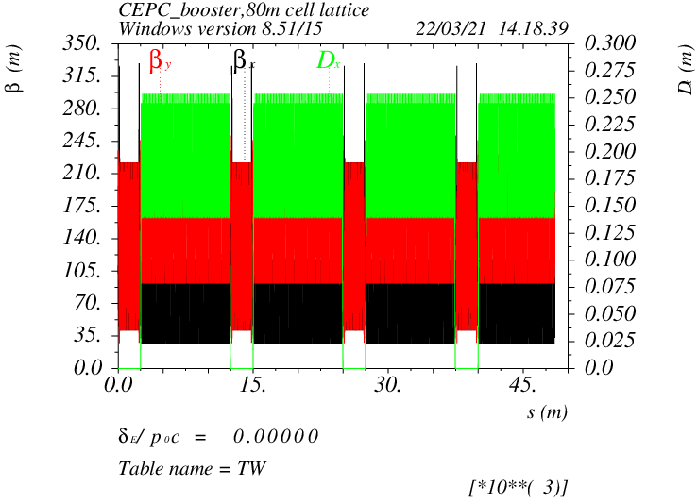
Booster Design
D. Wang, C. H. Yu, Y. M. Peng…
TME like structure (cell length=78m)
Interleave sextupole scheme
Emittance@120GeV=1.26nm
Overall idea: uniform distribution for the Q
Combined magnet (B+S) scheme possible
Phase advance/cell: 100° (H) / 28° (V)
Dispersion sup.
Arc cell
Half ring

Slide 5
Booster TDR parameters
D. Wang
Injection energy: 30GeV
Max energy: 180GeV
TME Type
Extraction
Injection
*Diameter of beam pipe is 56mm for re-injection with high single bunch current @120GeV.

Slide 6
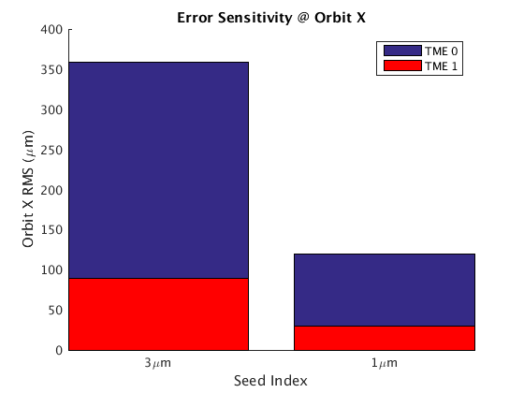
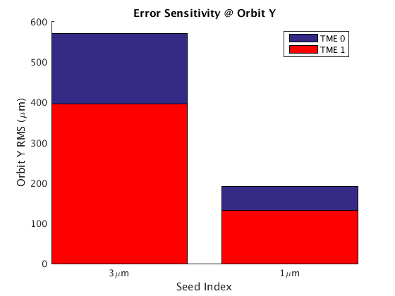
Error Set in Simulation
Simulation based on Accelerator Toolbox(AT) Code.
3σ cutoff | Dipole/Sextupole | Quadrupole
Transverse shift X/Y (μm) | 300(old:100) | 100
Longitudinal shift Z (μm) | 100 | 150
Tilt about X/Y (mrad) | 0.2 | 0.2
Tilt about Z (mrad) | 0.2 | 0.2
Nominal field | 1e-3/3e-4 | 2e-4
 | Accuracy (um) | Tilt (mrad) | Gain | Offset w/ BBA (um)
BPM(10Hz) | 0.1 | 10 | 5% | 30
BPM(TBT@1st Turn) | 300 | 10 | 5% | 300
  #BPM: 2408
  #Corrector: 2000
Dipole | Quadrupole
B1/B0 ≤ 2×10⁻⁴
B2/B0 ≤ 5×10⁻⁴ | B2/B1 ≤ 3×10⁻⁴
B3/B0 ≤ 2×10⁻⁵ | B3/B1 ≤ 2×10⁻⁴
B4/B0 ≤ 8×10⁻⁵ | B4/B1 ≤ 1×10⁻⁴
B5/B0 ≤ 2×10⁻⁵ | B5/B1 ≤ 1×10⁻⁴
B6/B0 ≤ 8×10⁻⁵ | B6/B1 ≤ 5×10⁻⁵
B7/B0 ≤ 2×10⁻⁵ | B7/B1 ≤ 5×10⁻⁵
B8/B0 ≤ 8×10⁻⁵ | B8/B1 ≤ 5×10⁻⁵
B9/B0 ≤ 2×10⁻⁵ | B9/B1 ≤ 5×10⁻⁵
B10/B0 ≤ 8×10⁻⁵ | B10/B1 ≤ 5×10⁻⁵
Simulations show that due to the improved uniformity of quadrupole magnet strength, the sensitivity of the beam to errors in the new design has been significantly optimized.

Slide 7
First Injection Commissioning
Recent simulation studies have been conducted on the initial beam commissioning of the CEPC Booster
  These studies can also serve as a reference for related research on the CEPC storage ring.
Simulation settings:
  Physical aperture: 56mm
  BPM Accuracy and offset: 300um
  Other error settings are the same as those in ordinary error correction simulations.
  The injection beam jitter and beam distribution are taken into account.
  Based on the AT (Accelerator Toolbox) program.
  Using the response matrices of orbit, trajectory, working point, and injection beam derived from theoretical models.
A similar correction process has already been applied to the HEPS (High Energy Photon Source) booster and storage ring.
  Multi-turn Trajectory Correction, Injection Beam Trajectory Correction
  Single-turn Trajectory Correction
0
10
100
500
1000
10000
stored
RF on
  Tune tuning,
  RF Phase tuning
TBT Optics Correction

Slide 8
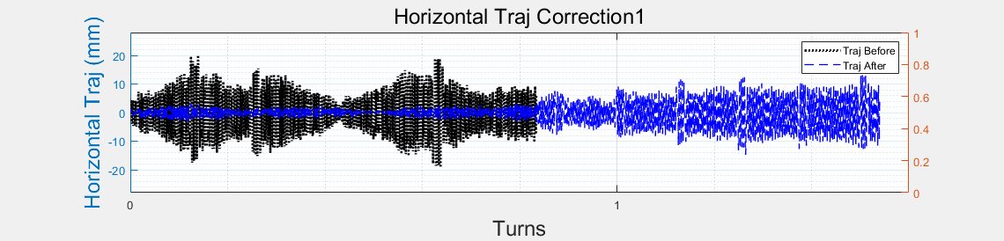
Single-turn and Multi-turn trajectory correction
  Multi-turn Trajectory Correction, Injection Beam Trajectory Correction
  Single-turn Trajectory Correction
0
10
100
500
1000
10000
stored
RF on
  Tune tuning,
  RF Phase tuning
TBT Optics Correction
Single-turn trajectory correction: Minimize the trajectory of the beam for the first 5 turns.
Multi-turn trajectory correction: Average the beam trajectory over more than 5 turns to obtain an approximate closed orbit and correct it.
Injection beam trajectory correction: Correct the coordinates of the injection beam at the injection point to reduce the oscillation of the injected beam.
Tune adjustment: Calculate (Phased-CFT) and adjust the working point using the beam over 50 turns.
RF parameters adjustment: Evaluate the beam energy variation with the average of the horizontal trajectory over each turn and adjust the RF parameters to reduce oscillation.
Optics correction: Based on ICA, PCA.

Slide 9
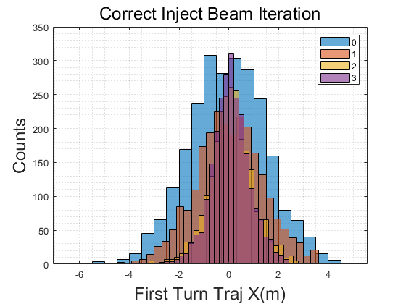
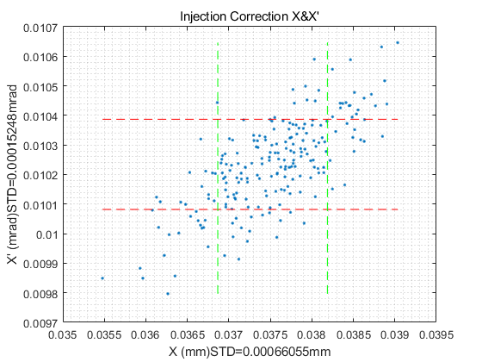
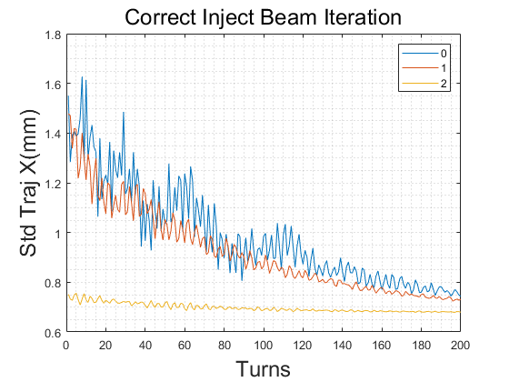
Injection beam trajectory correction
  Multi-turn Trajectory Correction, Injection Beam Trajectory Correction
  Single-turn Trajectory Correction
0
10
100
500
1000
10000
stored
RF on
  Tune tuning,
  RF Phase tuning
TBT Optics Correction
Single-turn trajectory correction: Minimize the trajectory of the beam for the first 5 turns.
Multi-turn trajectory correction: Average the beam trajectory over more than 5 turns to obtain an approximate closed orbit and correct it.
Injection beam trajectory correction: Correct the coordinates of the injection beam at the injection point to reduce the oscillation of the injected beam.
Tune adjustment: Calculate (Phased-CFT) and adjust the working point using the beam over 50 turns.
RF parameters adjustment: Evaluate the beam energy variation with the average of the horizontal trajectory over each turn and adjust the RF parameters to reduce oscillation.
Optics correction: Based on ICA, PCA.

Slide 10
Injection beam trajectory correction
  Multi-turn Trajectory Correction, Injection Beam Trajectory Correction
  Single-turn Trajectory Correction
0
10
100
500
1000
10000
stored
RF on
  Tune tuning,
  RF Phase tuning
TBT Optics Correction
Single-turn trajectory correction: Minimize the trajectory of the beam for the first 5 turns.
Multi-turn trajectory correction: Average the beam trajectory over more than 5 turns to obtain an approximate closed orbit and correct it.
Injection beam trajectory correction: Correct the coordinates of the injection beam at the injection point to reduce the oscillation of the injected beam.
Tune adjustment: Calculate (Phased-CFT) and adjust the working point using the beam over 10 turns.
RF parameters adjustment: Evaluate the beam energy variation with the average of the horizontal trajectory over each turn and adjust the RF parameters to reduce oscillation.
Optics correction: Based on ICA, PCA.

Slide 11
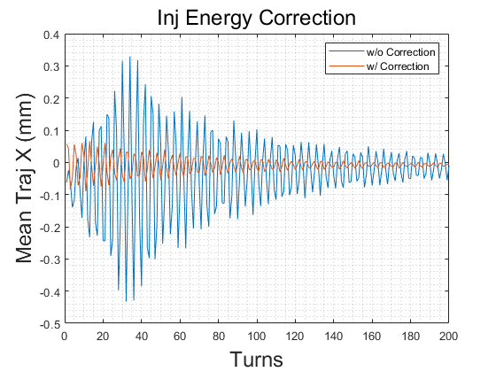
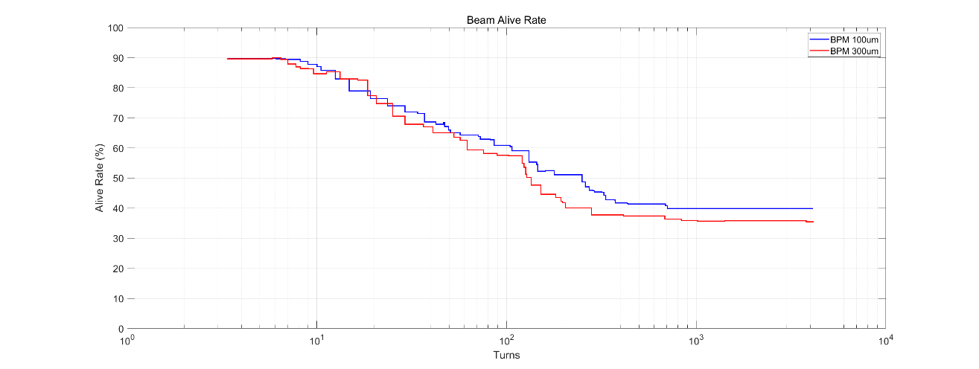
RF parameters adjustment
  Multi-turn Trajectory Correction, Injection Beam Trajectory Correction
  Single-turn Trajectory Correction
0
10
100
500
1000
10000
stored
RF on
  Tune tuning,
  RF Phase tuning
TBT Optics Correction
Single-turn trajectory correction: Minimize the trajectory of the beam for the first 5 turns.
Multi-turn trajectory correction: Average the beam trajectory over more than 5 turns to obtain an approximate closed orbit and correct it.
Injection beam trajectory correction: Correct the coordinates of the injection beam at the injection point to reduce the oscillation of the injected beam.
Tune adjustment: Calculate (Phased-CFT) and adjust the working point using the beam over 50 turns.
RF parameters adjustment: Evaluate the beam energy variation with the average of the horizontal trajectory over each turn and adjust the RF parameters to reduce oscillation.
Optics correction: Based on ICA, PCA.

Slide 12
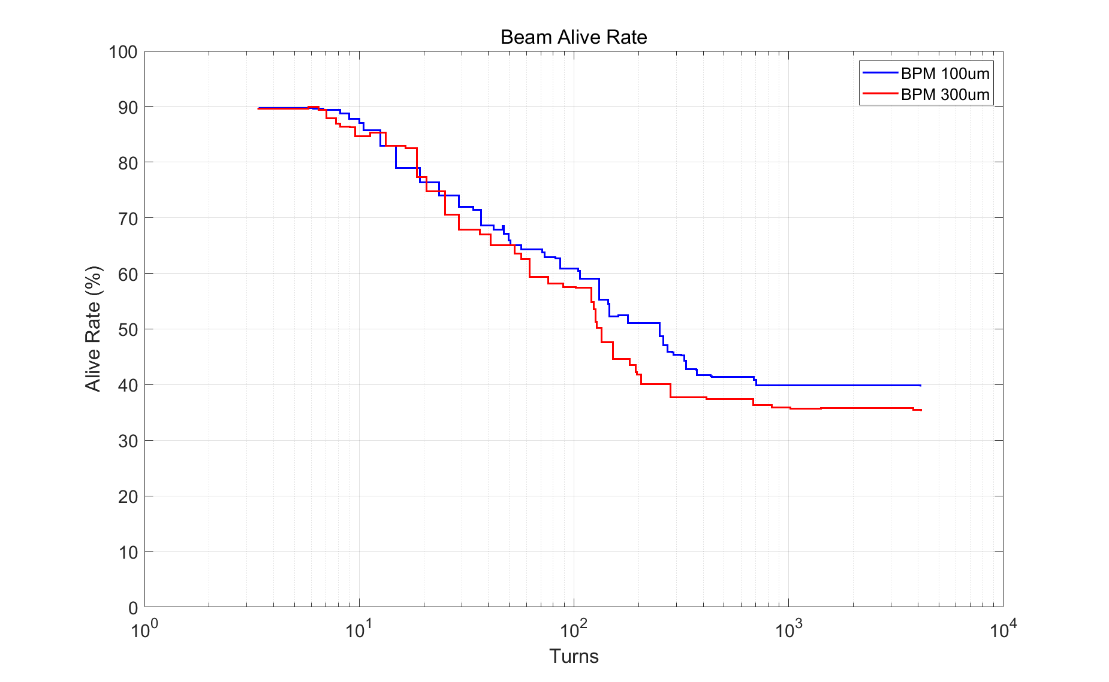
Particles survive rate
  Multi-turn Trajectory Correction, Injection Beam Trajectory Correction
  Single-turn Trajectory Correction
0
10
100
500
1000
10000
stored
RF on
  Tune tuning,
  RF Phase tuning
TBT Optics Correction
Results indicate that after correction, approximately 30% of the particles survive for more than 10,000 turns.
  BPM Noise 300 μm and 100 μm has little impact on the results.
  This can meet the needs of subsequent more detailed corrections
  The algorithm is still undergoing optimization.
The research still lacks many details, with some conditions such as more detailed physical apertures being updated and iterated.

Slide 13
Emittance growth @120GeV
Emittance growth at extraction energy should be controlled to make sure the injection efficiency to collider ring.
Horizontal emittance growth is very small.
Vertical emittance growth can be controlled by 8 skew quadrupoles and vertical dispersion correction.
- Coupling design goal: ≤ 1%
Trans. offset of com. Dipole (RMS) |  | 100um | 300um | 400um | 500um
Hor. Emit. growth (%) |  | <0.5 | <0.8 | <1.5 | <2
Coupling (%) | w/o coupling correction | 0.59 | 0.98 | 1.24 | 1.30
Coupling (%) | w coupling correction |  | 0.57 | 0.89 | 1.08

Slide 14
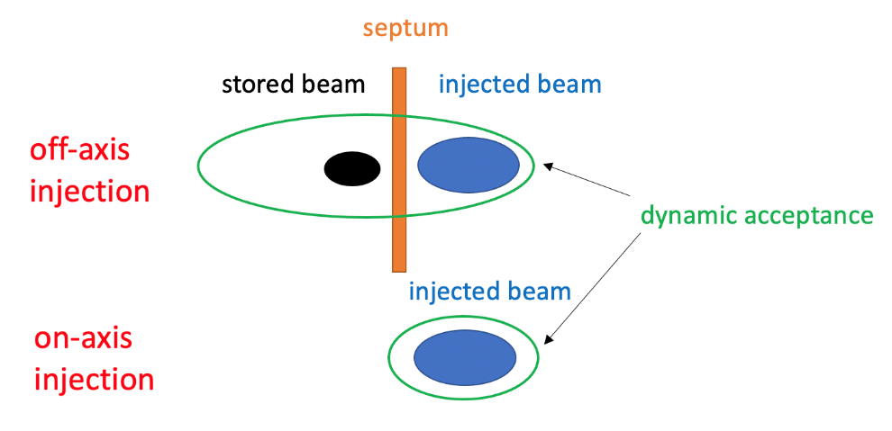
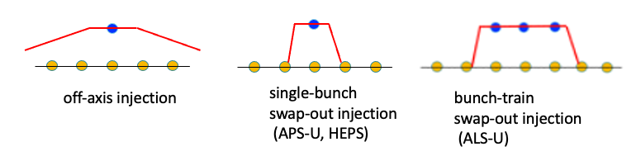
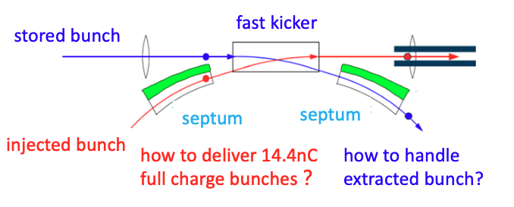
Swap-out injection: benefits and challenges
Benefits
  Greatly relax DA requirement
  Minimal perturbation to stored bunches
Challenges
  Ultra-fast kicker (nanosecond rise/fall time)
  Full-charge injector
    Beam accumulation necessary in the injector chain, to deliver ~15 nC bunch charge
    Demanding stable, high-charge operation
Swap-out injection is a viable solution for future colliders with a very small DA and maitaining a high beam polarization

Slide 15
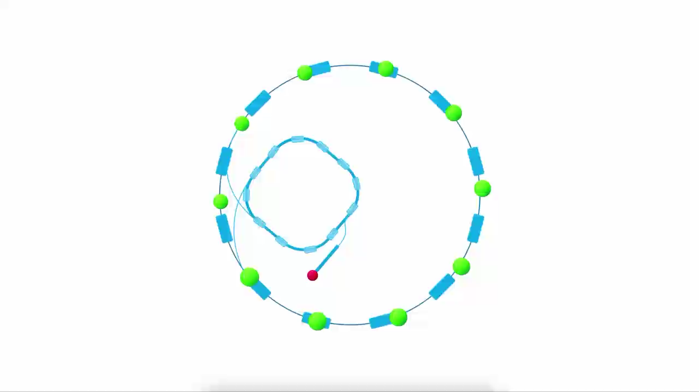
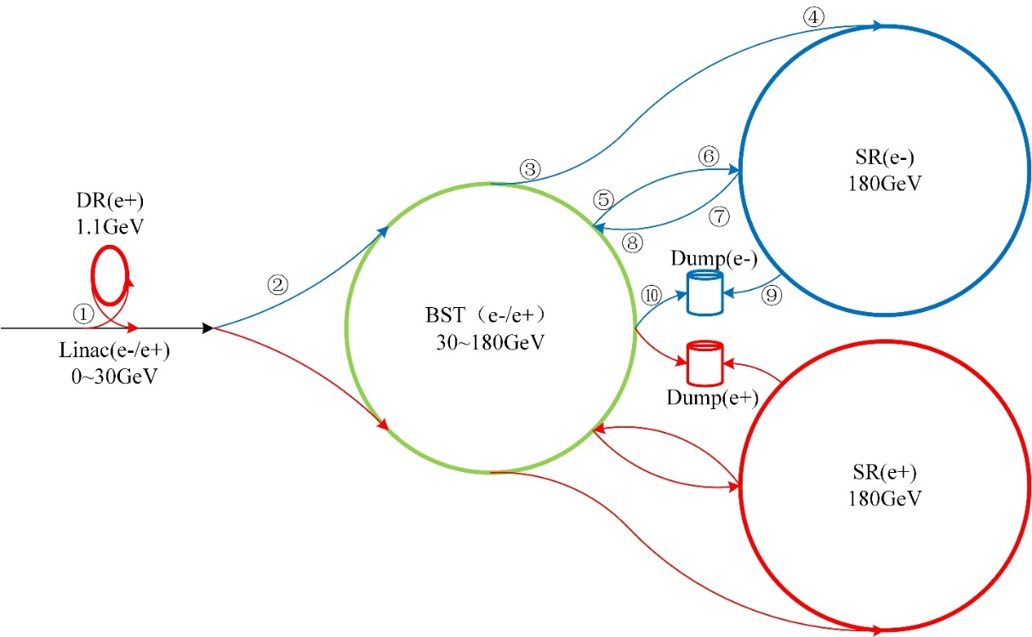
Injection scheme of HEPS
Swap-out injection, with bunch recycling in the booster as a full energy accumulator ring
  save ¾ costs relative to the scheme with a dedicated full-energy accumulator ring
  Decrease the bunch charge requirement of booster LE by ½, improving the reliability of booster design
CEPC injection & extraction systems
Note: similar injection scheme is adopted for CEPC at the Higgs energy

Slide 16
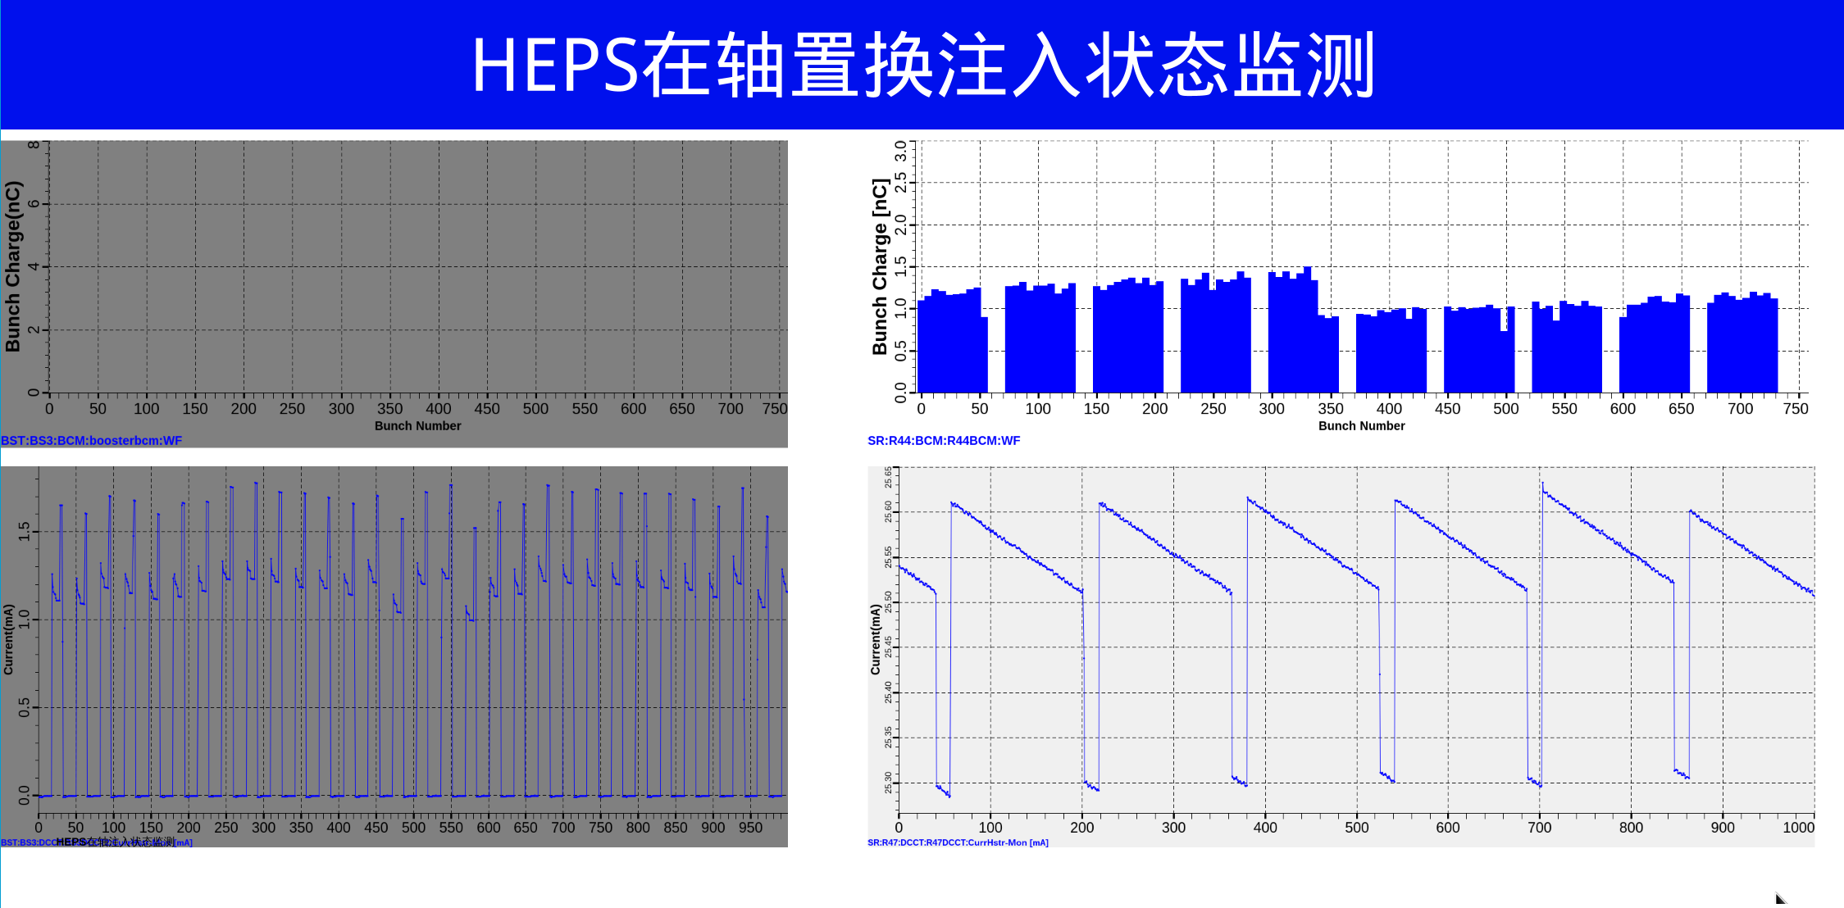
Swap-out injection in HEPS operation
HEPS Swap-out injection status monitor
Booster Bunch Current Monitor
SR Bunch Current Monitor
Booster DCCT
SR DCCT
Note: transmission efficiency yet to be fully optimized.

Slide 17
Summary
The simulation work for First Injection has been updated as follows:
  A dipole-sextupole combined magnet model is adopted, with the sextupole magnetic field included in the simulation from the initial stage.
  The BPM Noise is set to 300 μm.
  The tune correction program is updated, and tune correction starts after 10 turns.
The simulation results show that after correction, a beam survival rate of approximately 30% can be achieved after 10,000 turns, which meets the requirements for subsequent routine correction.
Combined with routine correction, the emittance and coupling growth of the beam at 120 GeV are not significant, and this can satisfy the injection requirements of the storage ring.

Slide 18
Thanks for your attention!

Slide 19
Back up

