Slide 1
CEPC instabilities at four energies including impedance budget (including all collimators) and electron cloud effects, and their limitation to luminosities
Wang Na, LIU YU DONG (presenter)

Slide 2
CEPC beam parameters (30MW)
Parameter [unit] | Higgs | Z | W | tt
Beam energy E_{k} [GeV] | 120 | 45.5 | 80 | 180
L_{max}/IP (10³⁴cm⁻²s⁻¹) | 5 | 115 | 16 | 0.5
Emittance (H/V) [nm/pm] | 0.64/1.3 | 0.27/1.4 | 0.87/1.7 | 1.4/4.7
Beam current [mA] | 16.7 | 803.5 | 84.1 | 3.3
Bunch number | 268 | 11934 | 1297 | 35
Bunch Population [10¹⁰] | 13 | 14 | 13.5 | 20
Momentum compaction α_{p} [10⁻⁵] | 0.71 | 1.43 | 1.43 | 0.71
Bunch length σ_{z} (natural/total) [mm] | 2.3/4.1 | 2.5/8.7 | 2.5/4.9 | 2.2/2.9
Energy spread (natural/total) [10⁻⁴] | 10/17 | 4/13 | 7/14 | 15/20
Betatron tune ν_{x}/ν_{y} | 445.10/445.22 | 317.10/317.22 | 317.10/317.22 | 445.10/445.22
Synchrotron tune | 0.049 | 0.035 | 0.062 | 0.078
Radiation damping [ms] | 44/44/22 | 816/816/408 | 150/150/75 | 14/14/7
Design queries
Small α_{p}
Short natural σ_{z}
Slow damping at low E_{k}

Slide 3
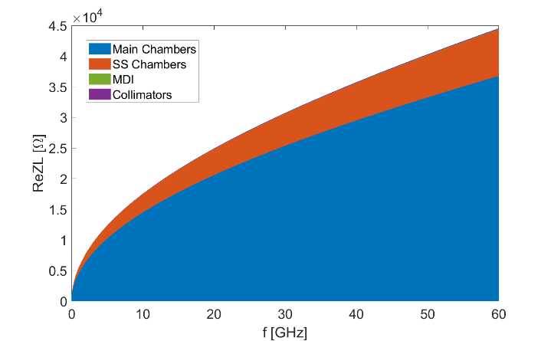
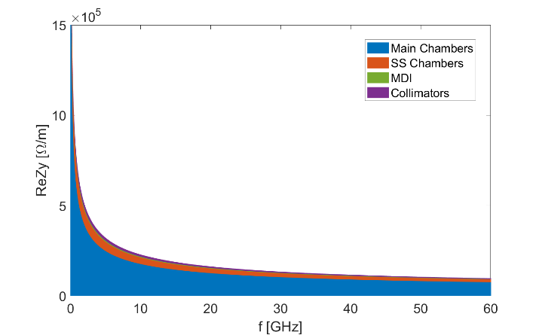
Impedance modeling
Impedance modeling of the key vacuum components has been evolving, some of the components, such as the collimators, electrostatic-separators, injection and extraction components are still under optimization and development
  Resistive wall, collimators, RF cavities, flanges, BPMs, bellows, gate valves, pumping ports, masks, IP chambers, electrostatic-separators, feedback kickers, taper transitions
Resistive wall impedance
  Considering different type of vacuum chambers: main vacuum chamber with NEG coating, IP chamber, collimators and stainless steel chamber ⇒ Contribution from the main vacuum chamber dominates both the longitudinal and transverse RW impedance (>80%)
Broadband effective impedance @σ_{z}=3mm
RW takes ~50% of the total Z||/n and the total k_{loss}, ~30% of the total ky @σ_{z}=3mm
Heat load deposition on the main chamber: ~15W/m @σ_{z}=8.7mm (P_{SR}=30MW/beam)
Components | Z||/n, mΩ | k_{loss}, V/pC | k_{y}, kV/pC/m
Main chamber | 6.1 | 355.7 | 11.3
SS chamber | 0.7 | 73.4 | 1.7
IP chamber | 6.9E-3 | 0.7 | 0.2
Collimators | 1.4E-2 | 1.4 | 0.6
RW Total | 6.8 | 431.2 | 13.8
Ring Total | 12.2 | 739.5 | 48.2
ReZL
ReZy

Slide 4
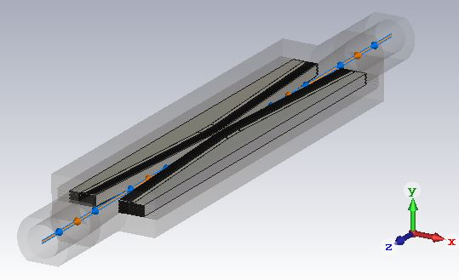
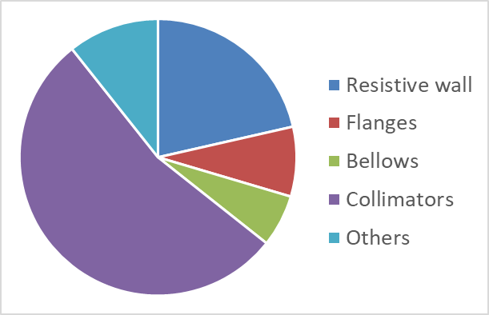
Impedance suppression of collimators
Collimator impedance optimizations
  Reducing taper angle
  Select appropriate beta function to reduce the impedance contribution
Reducing the number of collimators from the perspective of optimizing the collimation system design
Horizontal/Vertical:
SuperKEKB type collimator:
flattop=40mm
Half aperture=6~8mm
Taper angle=0.06
Sliding fingers for the RF shielding
Transverse impedance occupation for different elements (@rms bunch length of 3mm)
Preliminary design of the collimation system has 58 collimators for both background reduction in the detectors and machine protection from beam losses ⇒ Dominant contribution to the transverse impedance.

Slide 5
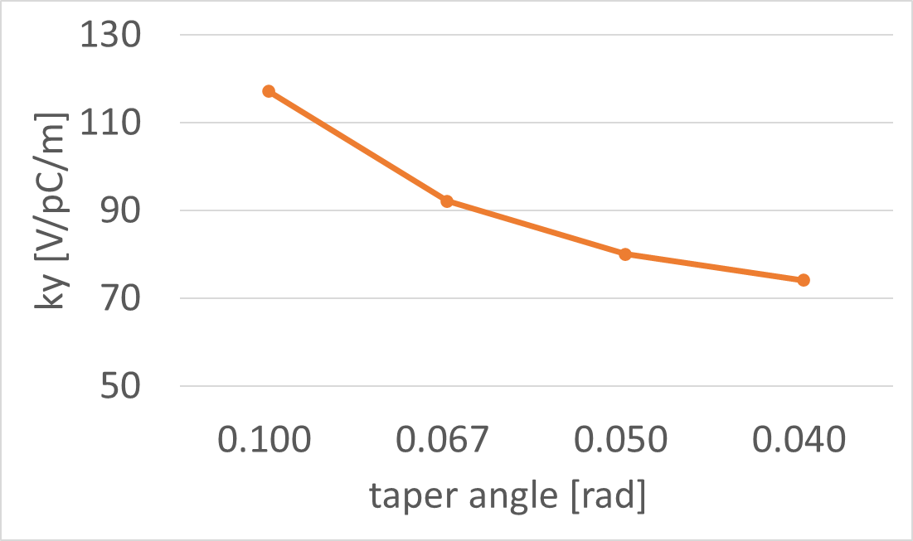
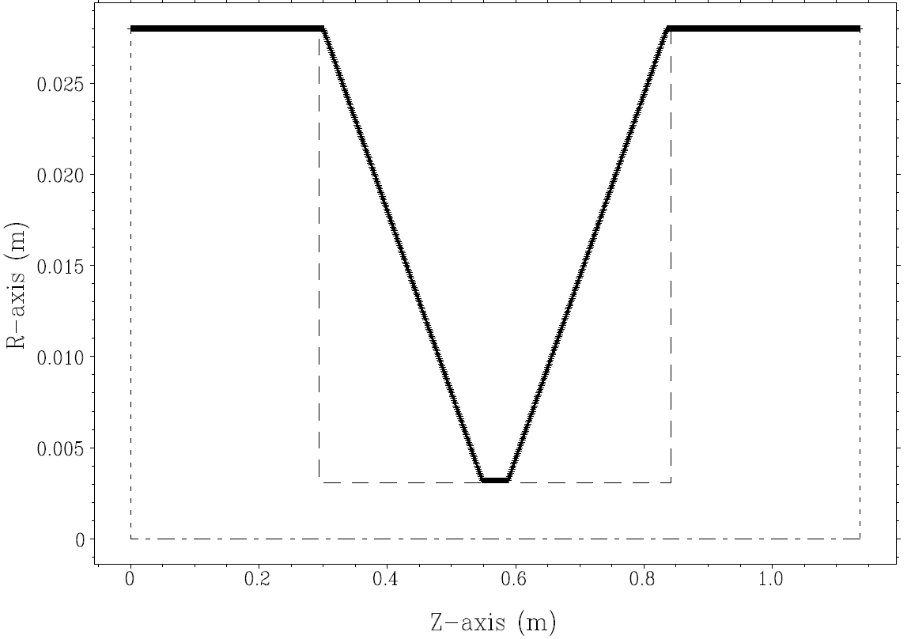
Dependence of the impedance on the taper angles
Circular collimator
  By decreasing the taper angle, the impedance of circular collimator can be reduced by 20%
Current case
taper angle
Evaluate with rms bunch length of 3mm

Slide 6
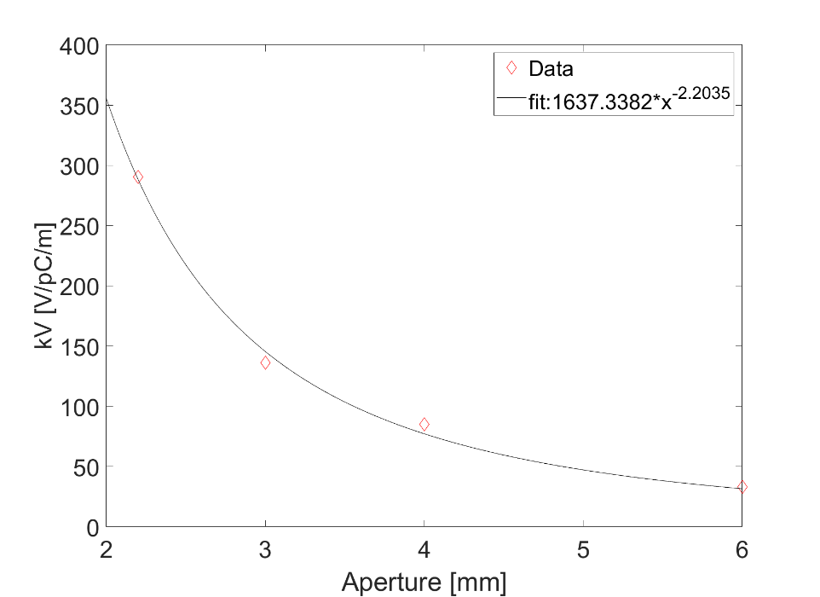

Dependence of impedance on beta function
Collimation design usually chose location with high β to have large beam size and high collimation efficiency ⇒ Roughly, if we take $Aperture∝\sqrt{βε}$ → Lower impedance & high beta function weighting
⇒ We have betatron weighted kick factor k_{y}$∝β∗$kV$∝β∗Aperture$^{-2.2} $∝β∗(\sqrt{βε})$^{-2.2} $∝β$^{-0.1}
⇒ Further impedance reduction by choosing proper β function may not easy.
Impedance without β weighting:
Aperture [mm] | kV [V/pC/m] | kH [V/pC/m]
2.2 | 290.5 | 43.7
3 | 136.2 | 21.6
4 | 85.2 | 15.9
6 | 33.1 | 8.4
Evaluate with rms bunch length of 3mm
kH and kV are not weighted by beta function
kV: kick factor in the direction of jaws

Slide 7
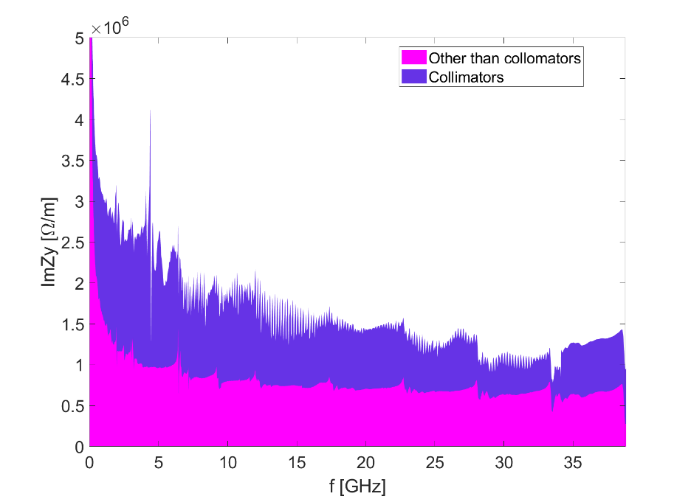
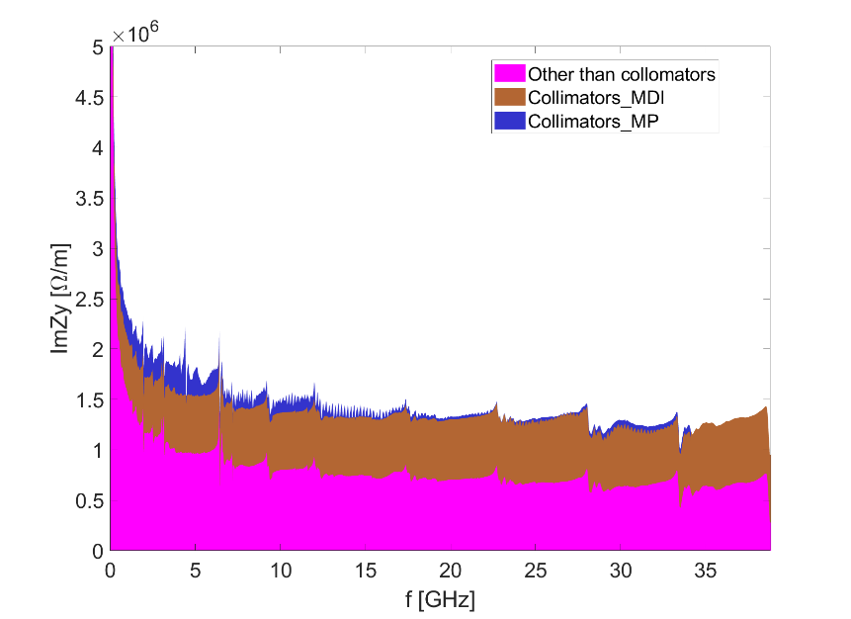
Impedance suppression of the collimator
Optimization of the collimation system provides the iterative version with total of 34 collimators
The transverse impedance contribution from the collimators is decreased by ~40%
The transverse impedance of the whole ring reduced by ~20%
Impedance budget
k_{y,coll}, kV/pC/m | 34.5
k_{y,total}, kV/pC/m | 64.2
Previous design
Current design with reduced num. of colls
Impedance budget
k_{y,coll}, kV/pC/m | 21.1
k_{y,total}, kV/pC/m | 50.8
Evaluate with rms bunch length of 3mm

Slide 8
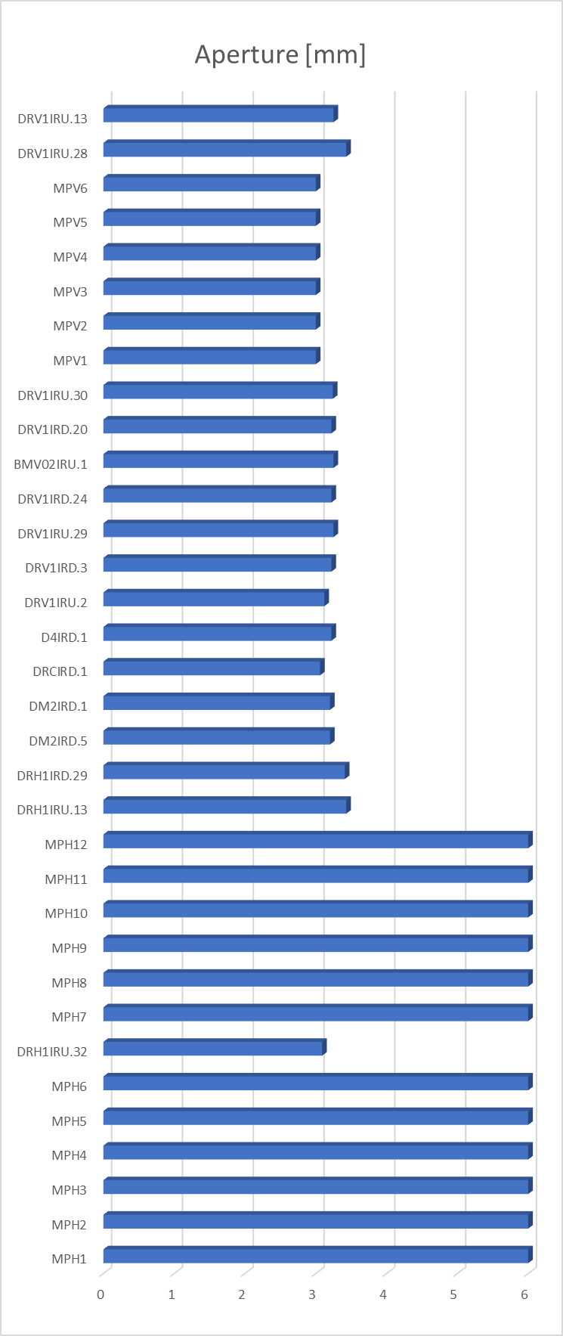
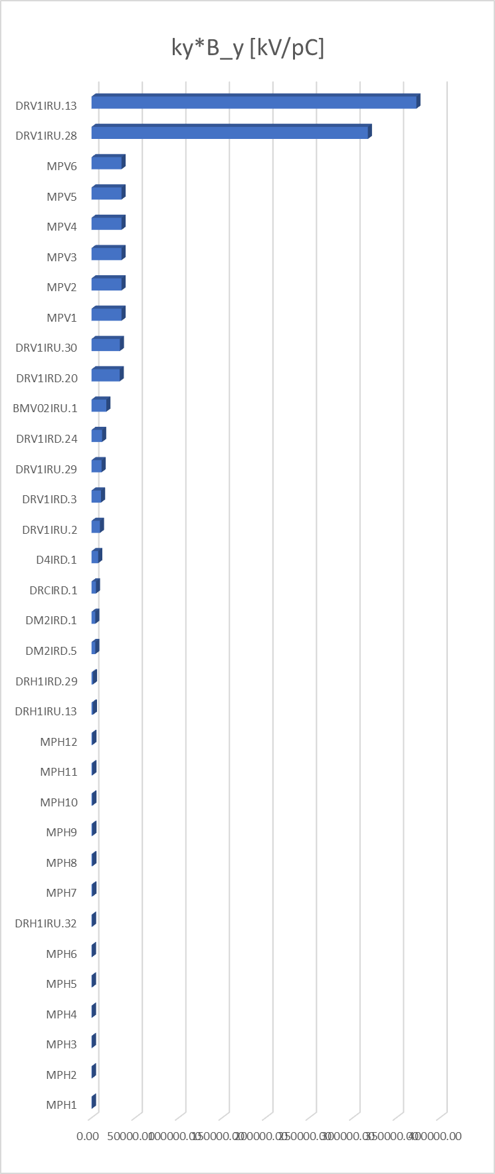
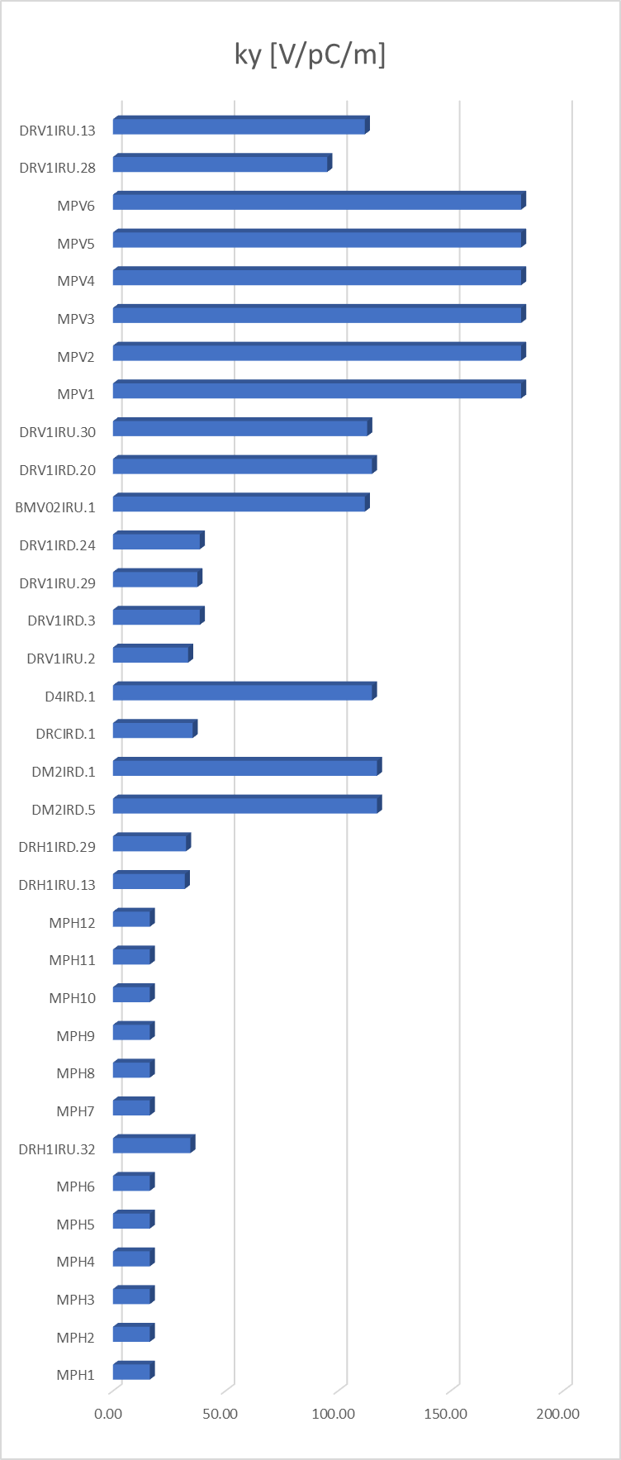
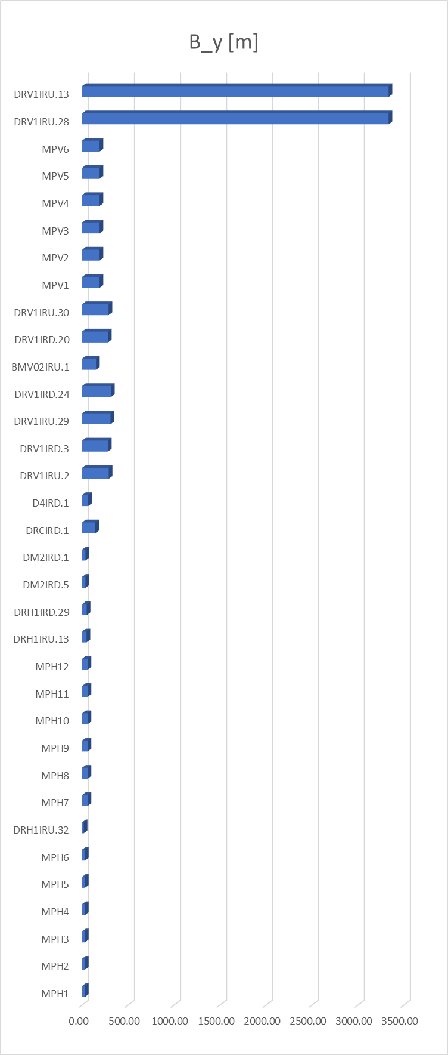
Collimator impedance contributions

Slide 9
Collimator impedance contributions
Dominant contributors to vertical impedance:
Vertical/circular collimators with high vertical beta function
Use nonlinear collimators as proposed in SuperKEKB is another candidate solution to further reduce the collimator impedance.
The collimation system design is currently undergoing continuous development and refinement.

Slide 10
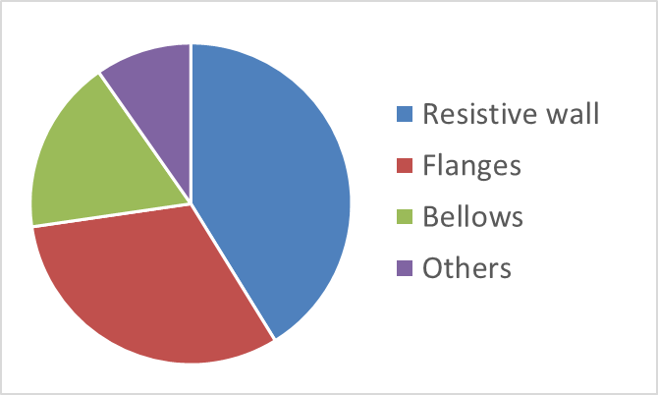
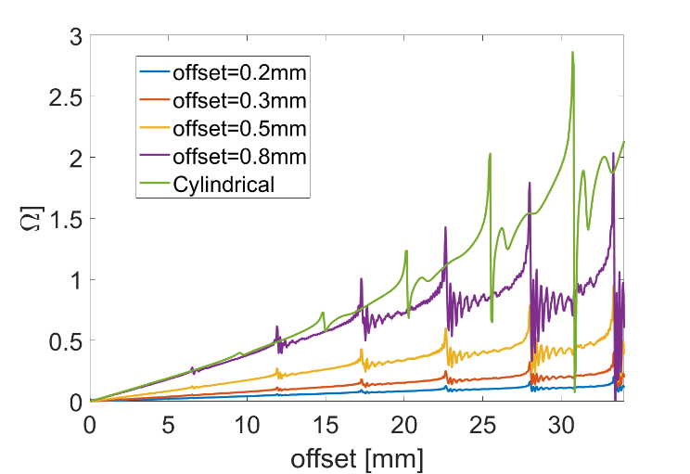
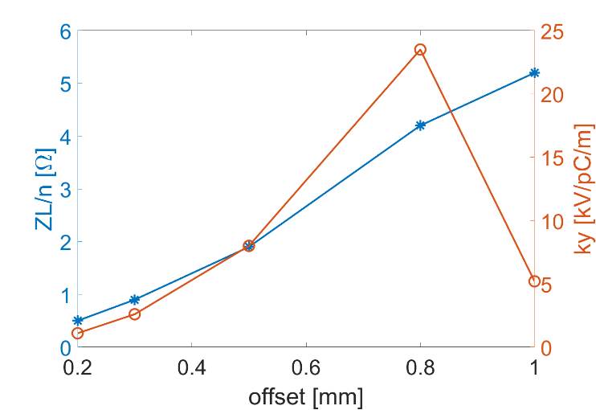
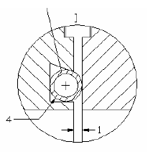
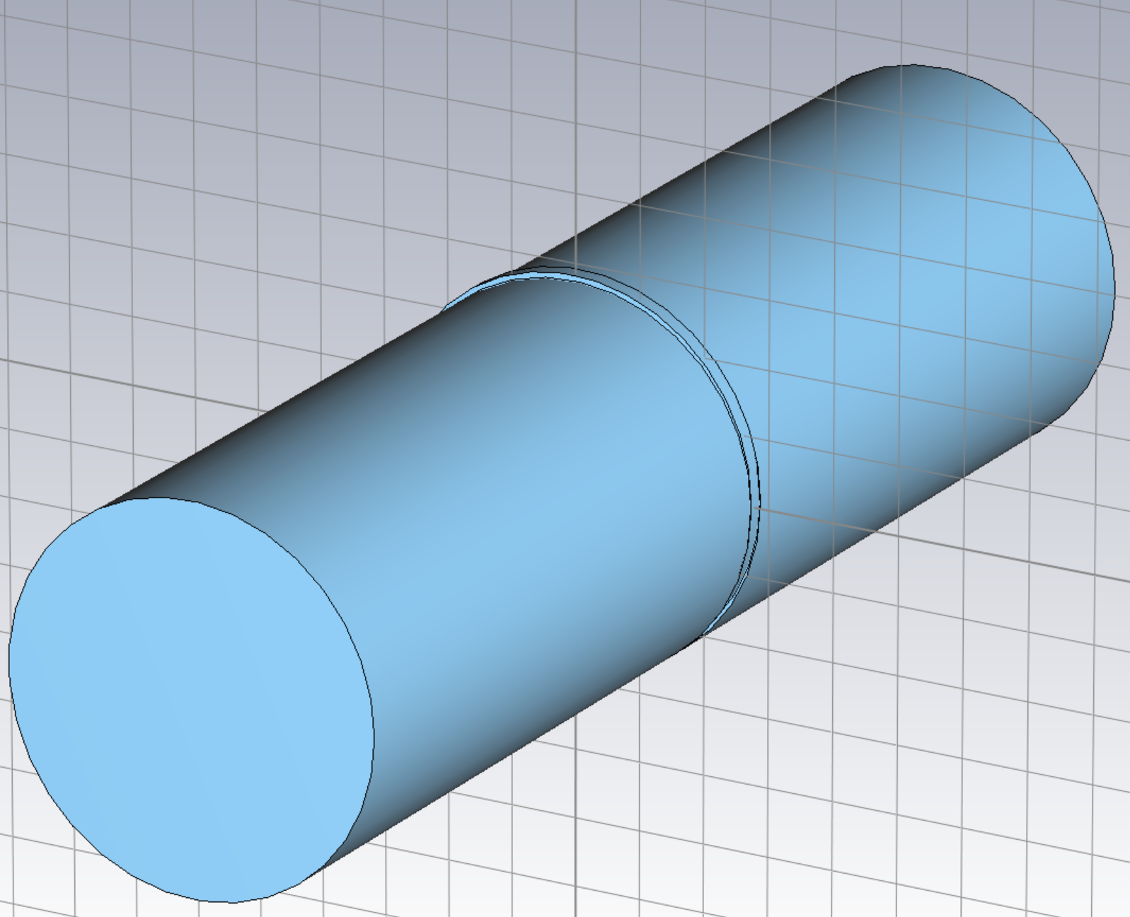
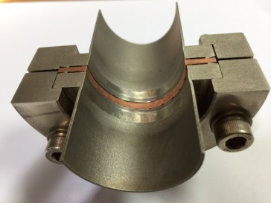
Flanges
Previous model
Adopted in BEPCII
One cylindrical gap:
width = 1mm
depth = 1mm
Cylindrical
Current model
Imaginary part of longitudinal impedance
Effective impedance with offset of the gasket
With the previous model, the flanges show the dominate contribution to the total longitudinal broadband impedance (nearly 1/3), due to the large quantity (~38k).
The dependence of impedance on the extent of construction or mounting errors are studied ⇒ The current model effectively reduces impedance with error tolerance constrained to <0.3 mm.
The edge of the flange facing the gasket need to be flat, to avoid bump or cavity structures at the connection.
Impedance is mainly contributed by the construction or mounting errors.

Slide 11
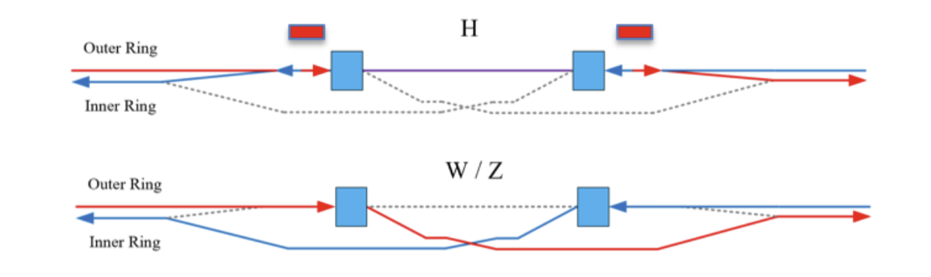
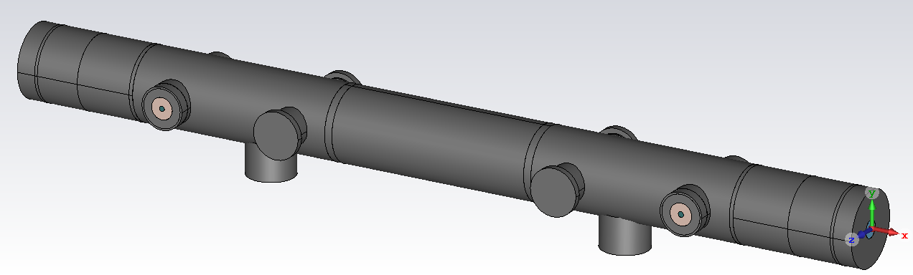
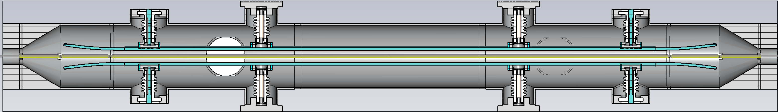
Electrostatic-separator
Electrostatic separators have been used extensively in the days when the e- and e+ sharing the vacuum chamber, because their ability to generate opposite beam deflections depending on the charge of the beam.
They are essential components for the CEPC, enabling the two beams to share the RF cavities.
The shearing scheme utilize both electrostatic-separator and bending magnets to deflect beams in the RF regions.
Key impedance aspects:
Rich of HOMs → could induce CBI ⇒ Further investigations and mitigations are needed.
High beam power loss → Water cooling is implemented in the design
Supporting parts and HV feedthroughs are included
Actual materials are considered

Slide 12
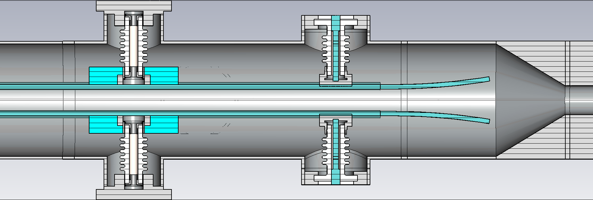
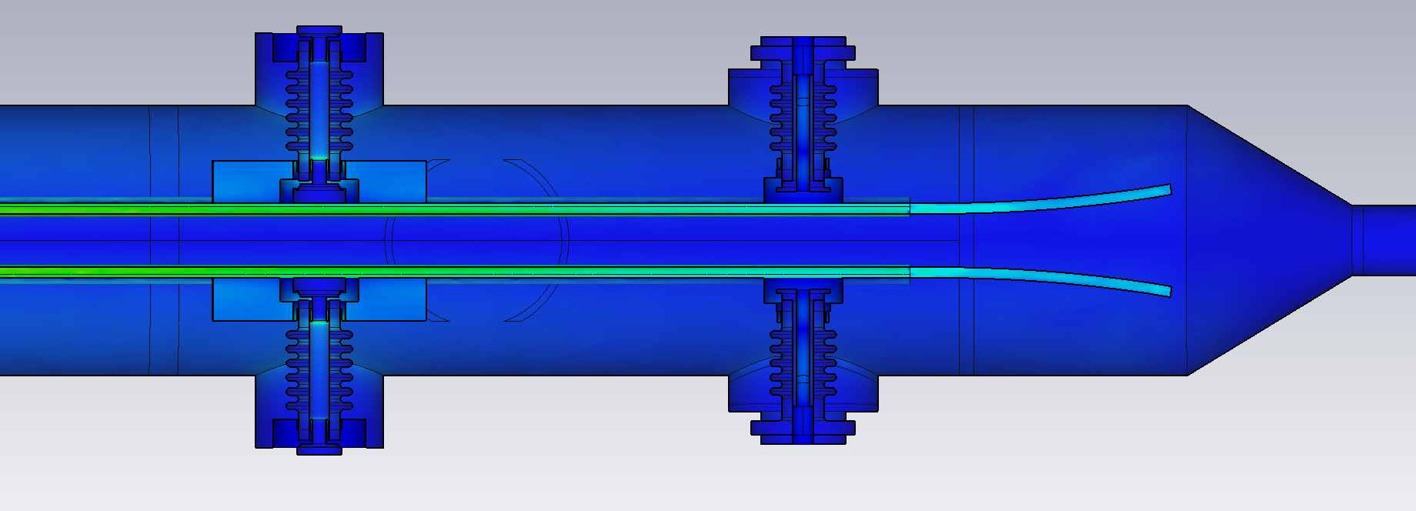
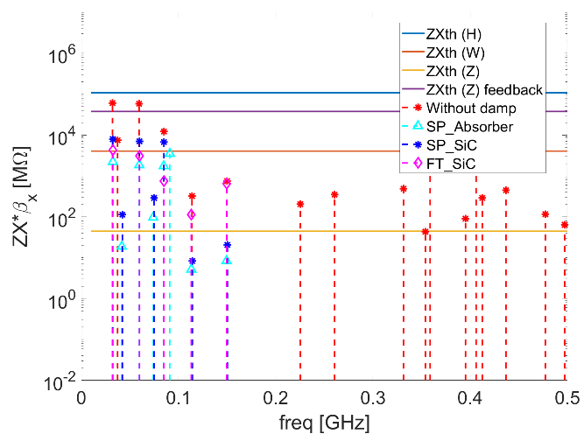
HOM damping with absorbing materials
Absorbing material:
  μr ~ 1 (Less influence to the magnetic field)
  High εr (high absorbing efficiency)
Location of absorbing material
  Different cases: around the feedthroughs or ceramic support, replace the ceramic support material
Supporting rods
Absorbers
feedthrough
electrodes
Primary studies show that the modes can be well damped by adding absorbers at the supporting rods or replace the support with SiC.
Considering the complexity of the terminal load, further bench impedance measurement is planned to verify the impedance suppression effect.

Slide 13
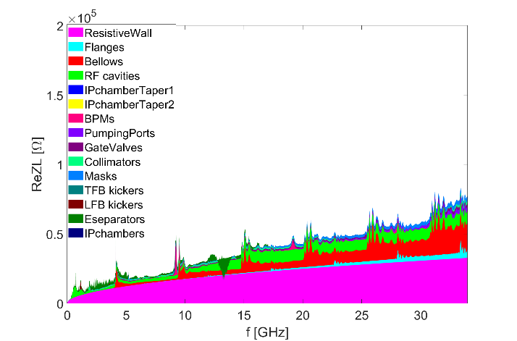
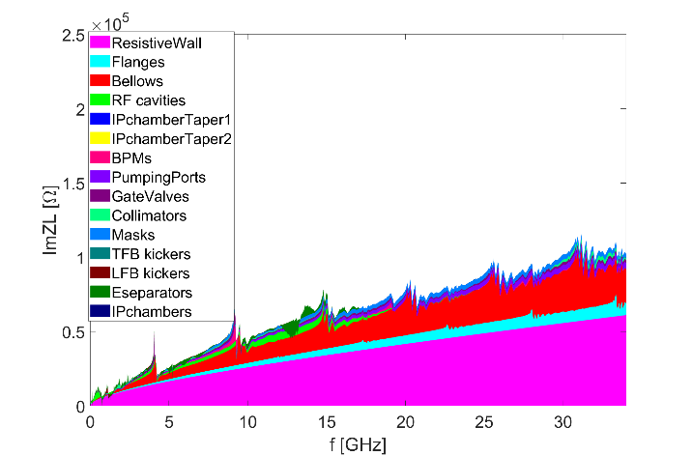
Summary on impedance budget
Effective impedance evaluated with σz=3mm
Components | Number | Z||/n, mΩ | L, nH | k_{loss}, V/pC | k_{y}, kV/pC/m
Resistive wall | - | 6.8 | 361.0 | 431.2 | 13.8
RF cavities | 60 | 0.5 | 24.8 | 101.2 | 0.5
Flanges | 37714 | 0.9 | 44.6 | 9.2 | 2.6
BPMs | 1808 | 0.04 | 2.0 | 9.5 | 0.2
Bellows | 15949 | 2.9 | 154.6 | 87.4 | 3.9
Gate Valves | 520 | 0.2 | 11.4 | 14.5 | 0.4
Pumping ports | 5316 | 0.3 | 18.4 | 2.3 | 0.2
Collimators | 34 | 0.1 | 6.9 | 22.2 | 21.1
Masks | 17757 | 0.5 | 24.6 | 19.5 | 0.8
Feedback kickers | 8 | -0.04 | -1.9 | 5.2 | 0.1
IP chambers | 2 | 0.004 | 0.2 | 0.3 | 2.9
Electro-separators | 20 | -0.1 | -5.4 | 34.5 | 0.1
Taper transitions | 48 | 0.04 | 2.3 | 2.5 | 0.09
Total |  | 12.2 | 643.4 | 739.5 | 48.2
Longitudinal impedance:
ReZL
ImZL

Slide 14
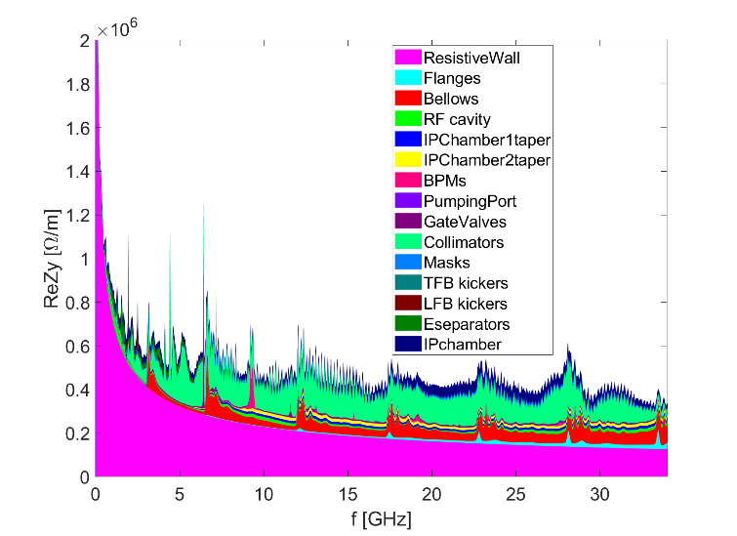
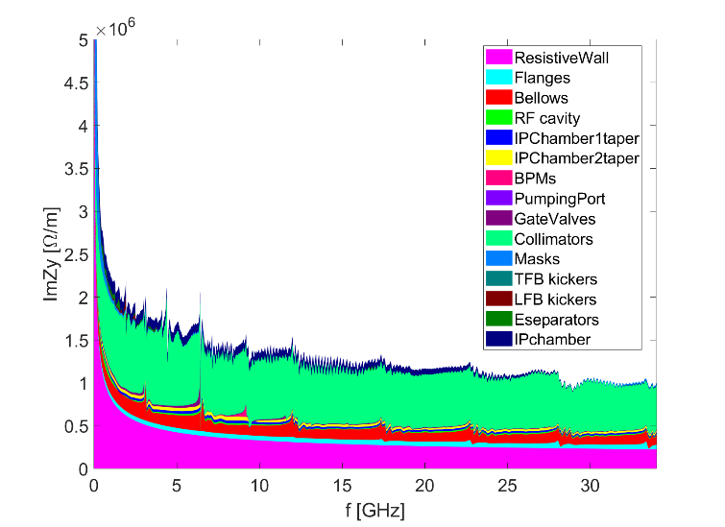
Summary on impedance budget
Effective impedance evaluated with σz=3mm
Components | Number | Z||/n, mΩ | L, nH | k_{loss}, V/pC | k_{y}, kV/pC/m
Resistive wall | - | 6.8 | 361.0 | 431.2 | 13.8
RF cavities | 60 | 0.5 | 24.8 | 101.2 | 0.5
Flanges | 37714 | 0.9 | 44.6 | 9.2 | 2.6
BPMs | 1808 | 0.04 | 2.0 | 9.5 | 0.2
Bellows | 15949 | 2.9 | 154.6 | 87.4 | 3.9
Gate Valves | 520 | 0.2 | 11.4 | 14.5 | 0.4
Pumping ports | 5316 | 0.3 | 18.4 | 2.3 | 0.2
Collimators | 34 | 0.1 | 6.9 | 22.2 | 21.1
Masks | 17757 | 0.5 | 24.6 | 19.5 | 0.8
Feedback kickers | 8 | -0.04 | -1.9 | 5.2 | 0.1
IP chambers | 2 | 0.004 | 0.2 | 0.3 | 2.9
Electro-separators | 20 | -0.1 | -5.4 | 34.5 | 0.1
Taper transitions | 48 | 0.04 | 2.3 | 2.5 | 0.09
Total |  | 12.2 | 643.4 | 739.5 | 48.2
Transverse impedance:
ReZy
ImZy

Slide 15
Impedance evolution
The longitudinal impedance is about stable, however, the transverse impedance varies mainly with the development of the collimation system.
We will keep tracking and control the impedance along with the hardware development.
2018
Elliptical cross section (CDR)
Circular cross section
More contributors included (TDR)
2021
2023_V1
More detailed chamber material, collimator (no.=18) updated, β weighing
2023_V2
Collimators for machine protection (no.=58), masks and feedback kickers included
More detailed collimator design (no.=58), RW and Electrostatic-separator updated
2024_V1
Evaluate with rms bunch length of 3mm
2024_V2
Collimator (no.=34) and flange updated

Slide 16
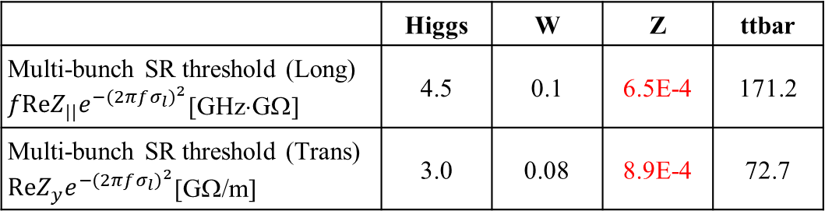
Rough estimations on single beam instabilities
Broadband imp. → beam distortion/centroid oscillation → bunch current threshold
Narrowband imp. → coupled bunch oscillation → restrict total beam current
luminosity
(beam energy loss→ heat load）
Impedance budget
Z||/n, mΩ | 12.2
k_{y}, kV/pC/m | 48.2
 | Higgs | W | Z | ttbar
Single bunch threshold (Long) Z||/n [mΩ] | 6.5 | 4.1 | 0.7 | 14.4
Single bunch threshold (Trans) k_{y} [kV/pC/m] | 69.7 | 40.2 | 12.4 | 109.8
Longitudinal distortion
Luminosity limitations
TMCI unstable
Evaluate with rms bunch length of 3mm
 | Higgs | W | Z | ttbar
Multi-bunch SR threshold (Long) $fReZ_{||}e^{−{(2πfσ_{l})}^{2}}$[GHz⋅GΩ] | 4.5 | 0.1 | 6.5E-4 | 171.2
Multi-bunch SR threshold (Trans) $ReZ_{y}e^{−{(2πfσ_{l})}^{2}}$[GΩ/m] | 3.0 | 0.08 | 8.9E-4 | 72.7
In the following, the instability studies are mainly focused on the Z energy.
Tight narrowband impedance requirements for Z (at least ~two orders higher for the other energies)

Slide 17
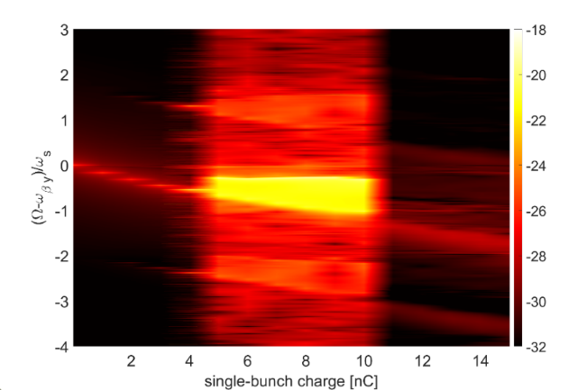
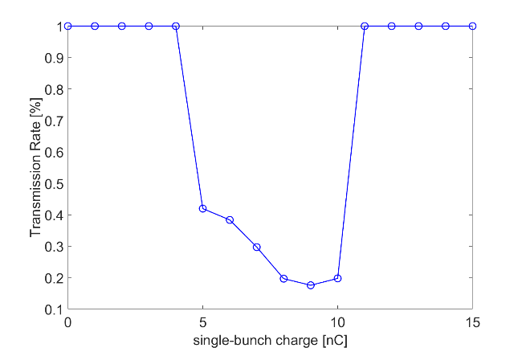
Single bunch instabilities with reduced impedance
Courtesy of H.S. Xu
The TMCI for Z is investigated with simulations
  The bunch charge is restricted to 5 nC (much lower than the design value of 22.4 nC)
  Need high chromaticity and feedback damping, and further impedance mitigation.
Transverse oscillation modes vs. bunch charge
Transmission rate vs. bunch charge

Slide 18
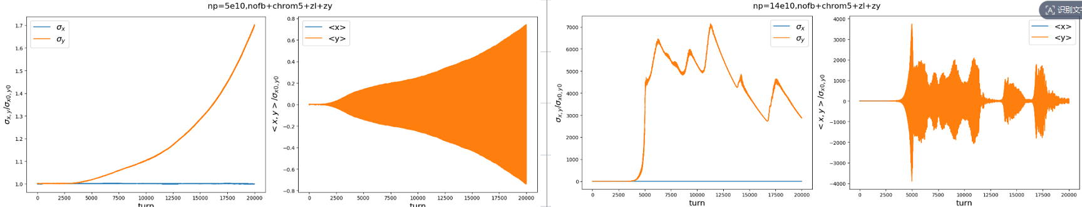
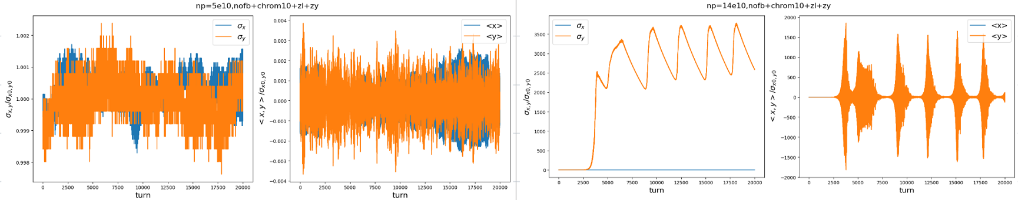
Mitigation with chromaticity and FB
Courtesy of Z.Y. Li, Y. Zhang
Two bunch charge cases are tested: Ne=5E10, 14E10(22.4nC), theoretical studies underway.
1) Only chromaticity Qy’~5 (half ring)
2) Only chromaticity Qy’~10 (half ring)

Slide 19
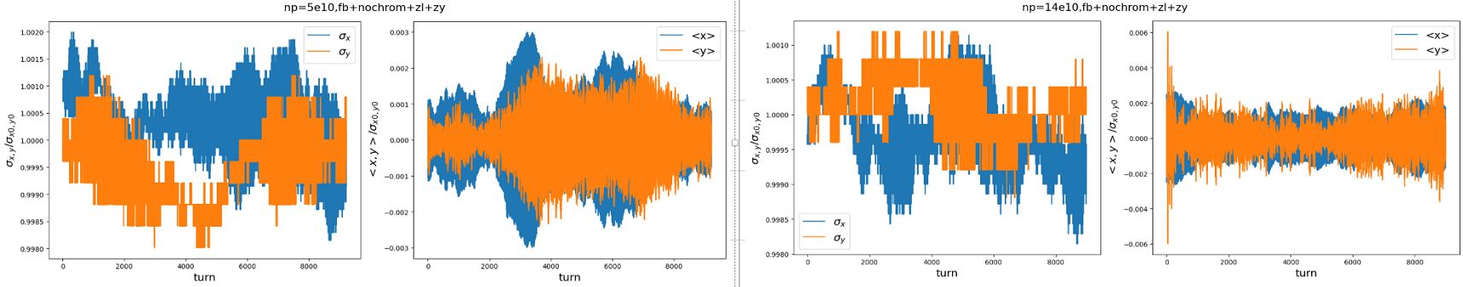
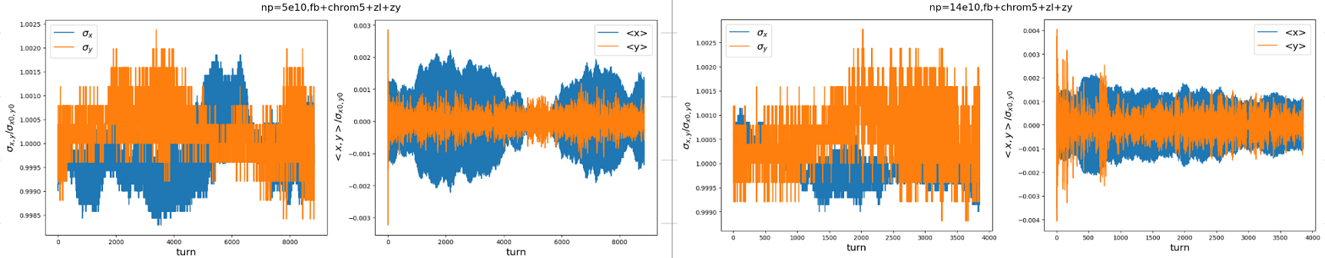
Mitigation with chromaticity and FB
Courtesy of Z.Y. Li, Y. Zhang
3) With B-by-B feedback (damp rate ~0.05)
4) With B-by-B feedback (damp rate ~0.05) and Qy’~5 (half ring)

Slide 20
Influence of impedance on Beam-beam interaction
Y. Zhang et al., PRST-AB, 8, 074402 (2005)
K. Ohmi et al., PRL 119, 134801 (2017)
Y. Zhang et al., PRAB 23, 104402 (2020)
Y. Zhang et al., PRAB 26, 064401 (2023)
C.T. Lin et al., PRAB 25, 011001 (2022)
Multiparticle tracking simulations are performed with IBB
  Strong-strong beam-beam interaction
  Linear Arc Map with SR radiation, localized beam-beam kick
  Support large Piwinski angle collision, beamstrahlung effect, multiple bunches/multiple IPs
  Longitudinal +transverse impedance
Eigen mode analysis
  Beam-Beam cross wake
  Discretization of longitudinal phase space distribution with PWD
  Synchrotron-betatron motion described by transfer matrix
  Linear eigenvalue issue
Horizontal plane:
  Coherent X-Z instability due to large Piwinski angle.
  Influenced by Horizontal impedance and potential well distortion from longitudinal impedance
Vertical plane:
  Transverse mode coupling instability, enhanced with combination of impedance and beam-beam

Slide 21
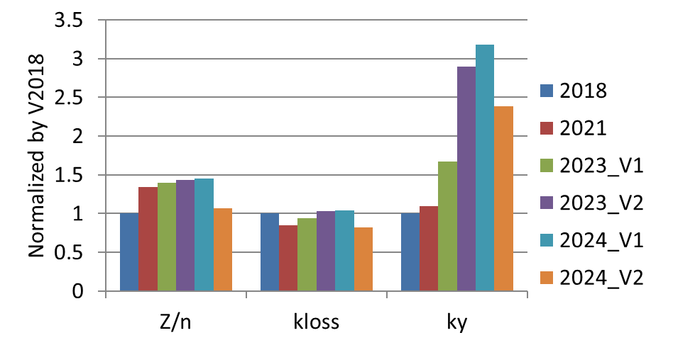
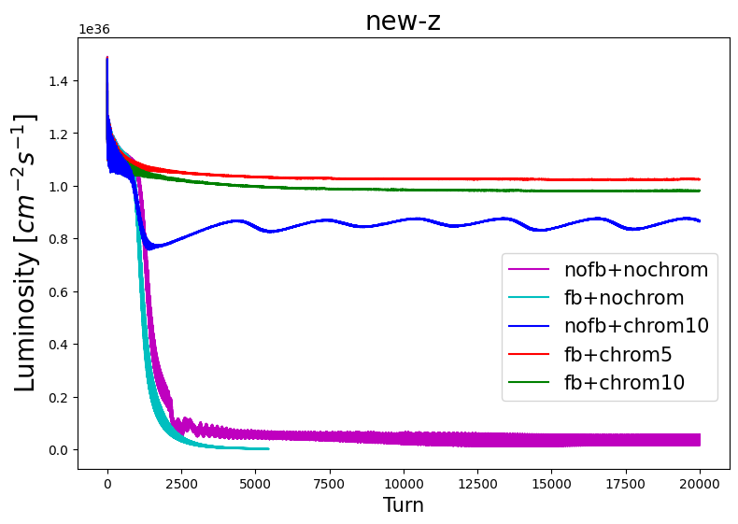
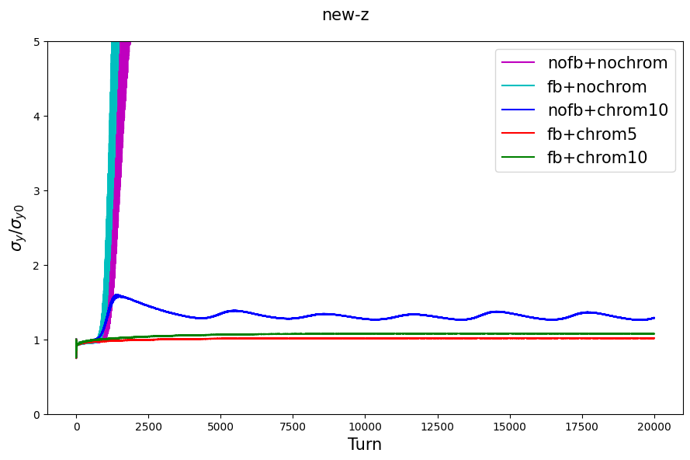
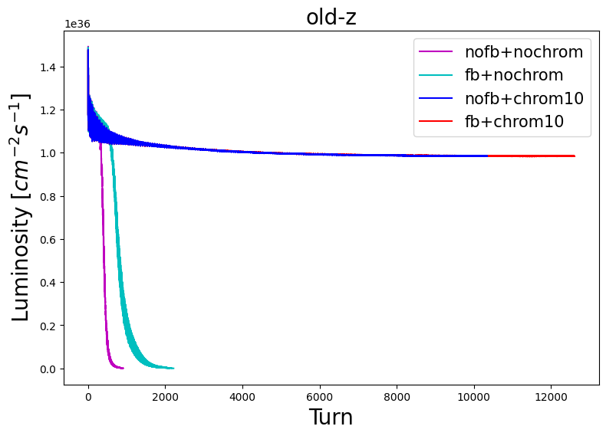
Update simulations with reduced impedance (Z)
Courtesy of Z.Y. Li, Y. Zhang
With design bunch intensity (Ne=14E10)
  Only feedback can not stabilize the beam.
  Only Qy’~10, the beam will dynamically stable at luminosity around 0.8x10³⁶cm⁻²s⁻¹.
  Beam-beam stable at 1x10³⁶cm⁻²s⁻¹ with FB and Qy’~5.
  Further impedance reduction is preferred (~20% lower, collimator optimizations, nonlinear collimator, …).
Evaluate with rms bunch length of 3mm
Impedance 2024-V2
Impedance 2024-V2
Impedance 2023-V1

Slide 22
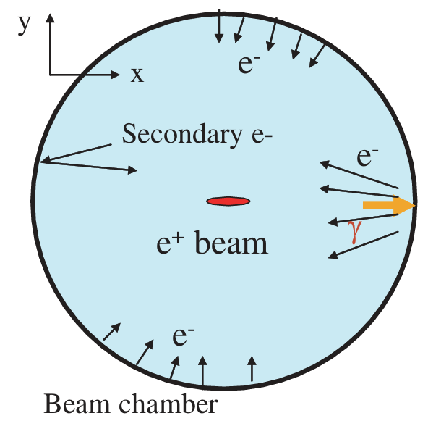
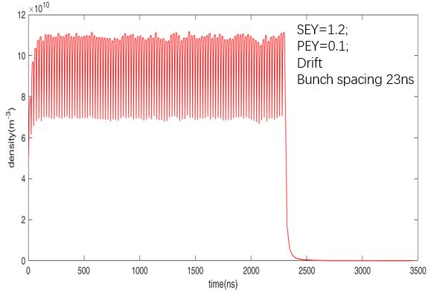
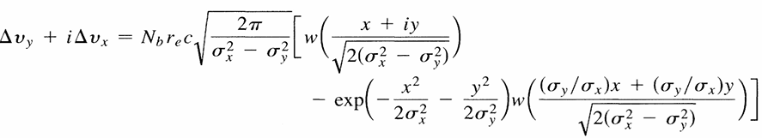
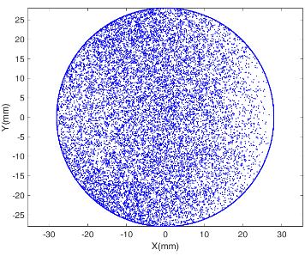
Model of the EC accumulation
Source:
Synchrotron radiation on wall=>photon electron
Photon electron on wall=> secondary electron
All the electrons trapped by the beam and accumulation to produce the cloud
Action betwen the electons and bunch：
PRL VOL 75, NO 8, 1995
Between the kicks, the photoelectrons drift with bunch spacing!
Space charge maybe including in the action!
Magnetic field also be considered if in the dipole or quadruple!
With all the action, the EC will in an status of balance with density, ρ
Detailed process was done by simulation.

Slide 23
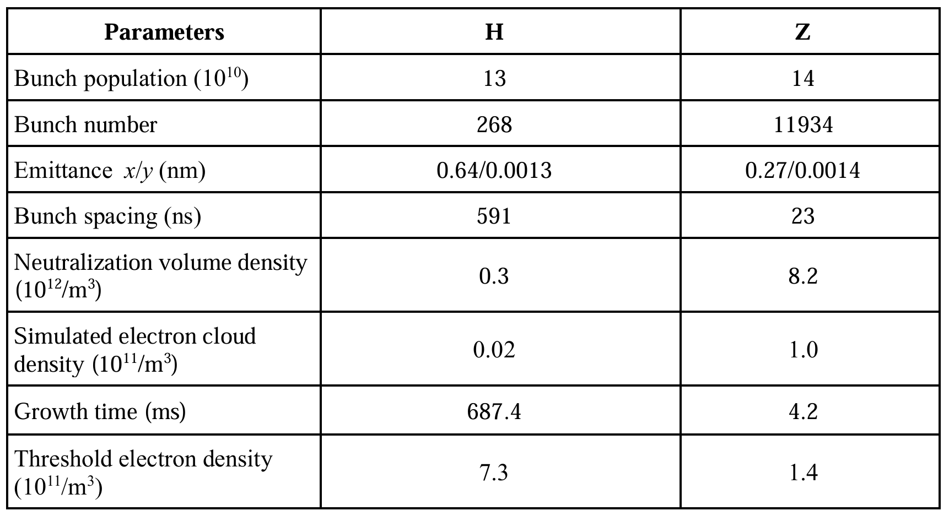
Estimation threshold for EC

Slide 24
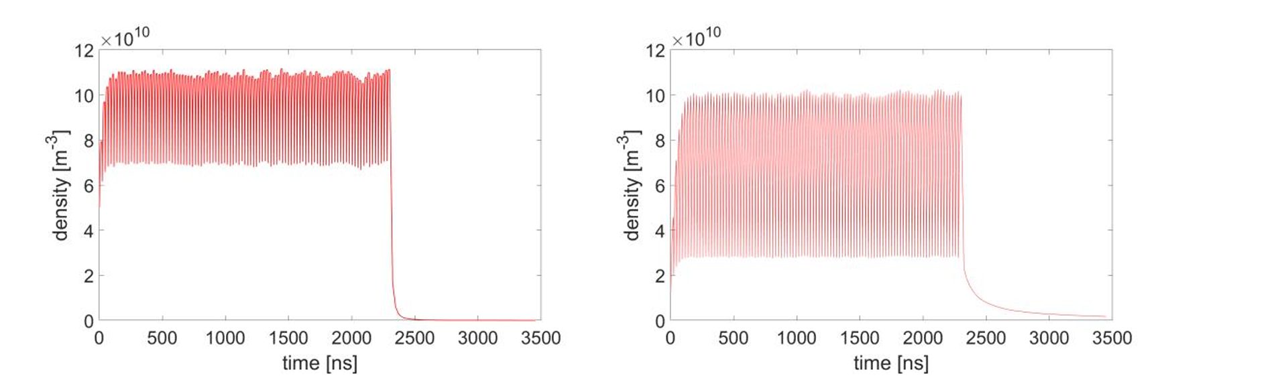
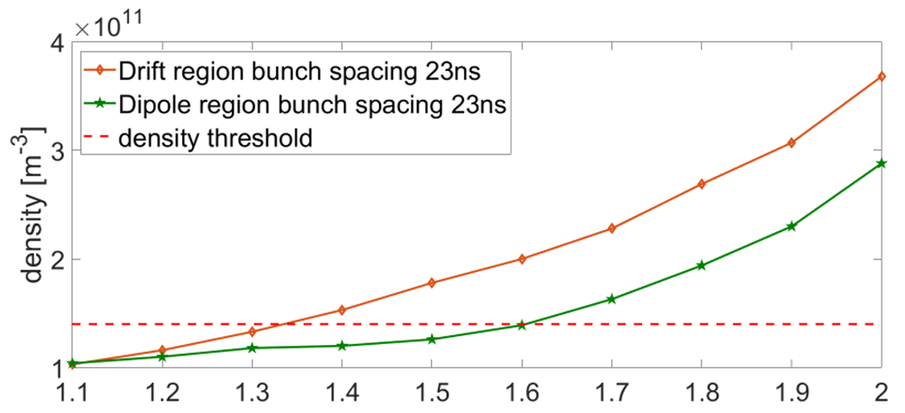
Simulation on EC Density
Z mode
drift space
SEY~1.2
Z mode
Dipole
SEY~1.2

Slide 25
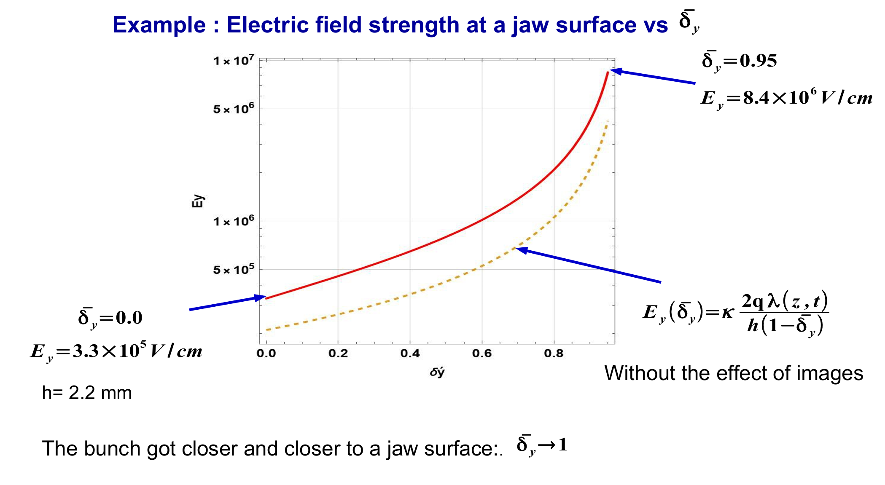
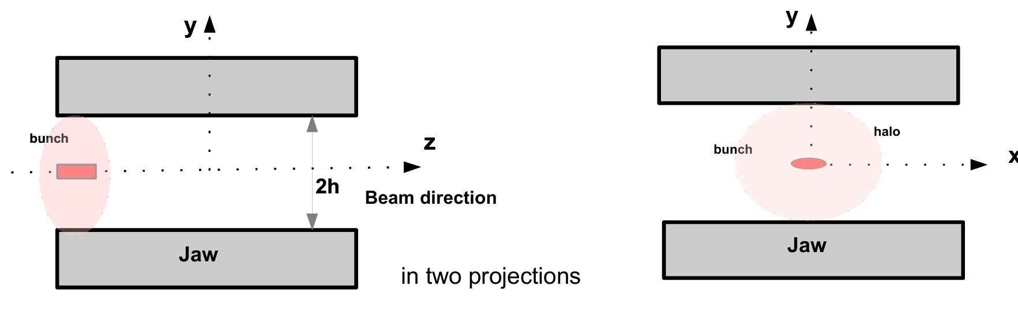
New source of EC (Boris Levchenko, SINP MSU)
Field emission from collimators
?
That means Ey~33MV/m!

Slide 26

Serous problem?
The amount of Ne is very sensitive to the quality of the collimator surface characterized by the parameter β !

Slide 27
Aperture of CEPC collimator
名称 | 距IP (m) | X半孔径(mm) | Y半孔径(mm)
APT_2771 | 11748.52435 | 3 | 28
APT_2810 | 12027.70841 | 3 | 28
APT_2833 | 12370.10786 | 28 | 3
APT_4283 | 21038.99896 | 28 | 3
APT_4293 | 21093.61577 | 28 | 3
APT_6865 | 36969.84323 | 3 | 28
APT_6890 | 37316.24267 | 28 | 3
APT_6956 | 38038.18305 | 3 | 28
APT_11521 | 49655.66327 | 28 | 3
APT_11532 | 49655.77327 | 28 | 3
APT_29852 | 62007.06708 | 3 | 28
APT_29876 | 62348.69421 | 28 | 3
APT_29931 | 62911.56091 | 3 | 28
APT_30782 | 67797.96566 | 28 | 3
APT_30792 | 67856.38248 | 28 | 3
APT_33860 | 86513.96962 | 3 | 28
APT_33896 | 86787.35146 | 3 | 28
APT_33921 | 87133.7509 | 28 | 3
APT_35712 | 97743.06639 | 28 | 3
APT_35722 | 97821.18938 | 28 | 3
APT_38002 | 99466.68453 | 28 | 3
APT_38013 | 99466.79453 | 28 | 3
APT_4267 | 20931.26533 | 4 | 28
APT_4275 | 20984.38214 | 4 | 28
APT_11495 | 49655.40327 | 4 | 28
APT_11507 | 49655.52327 | 4 | 28
APT_30756 | 67639.71523 | 4 | 28
APT_30764 | 67694.33204 | 4 | 28
APT_37978 | 99466.44453 | 4 | 28
APT_37988 | 99466.54453 | 4 | 28
APT_51046 | 99602.02646 | 4 | 28
Collimator surface treatments maybe necessary to restrict the electron field emission!

Slide 28
Summary for EC
Without considering the electron field emission, SEY lower than 1.3 is adequate to mitigate the electron cloud instability in the Z pole operation mode. With the application of NEG coating to the inner surface of the beam pipe, it becomes feasible to maintain the maximum SEY below 1.1 after beam scrubbing.
The contribution from electrons of field emission (new source of EC) need to be further verified.

