Slide 1
CEPC instrumentation and feedback status
随艳峰
2025.12.18

Slide 2
Outline
EDR progress
Beam position monitor （BPM）system
Synchrotron radiation light measurement
Beam feedback system
Luminosity tuning system
Beam Instrumentation device design
Radiation-resistant cable for BPM

Slide 3
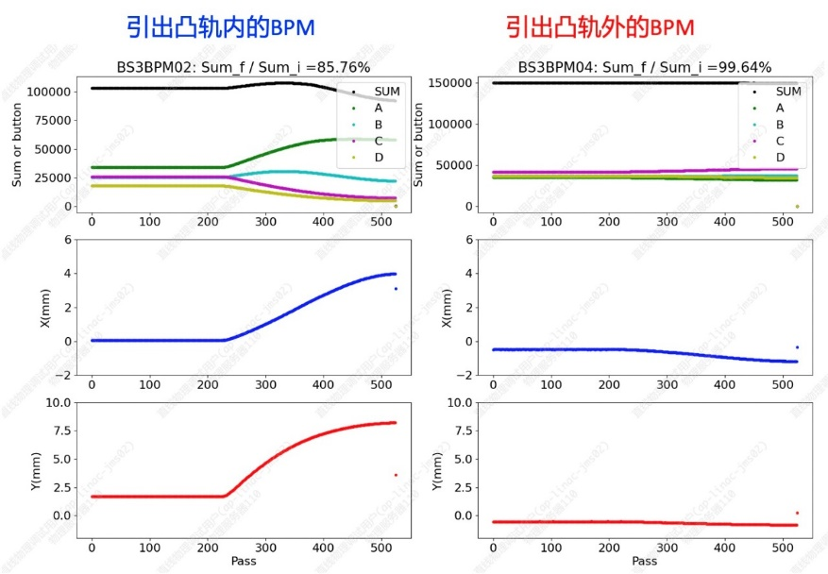
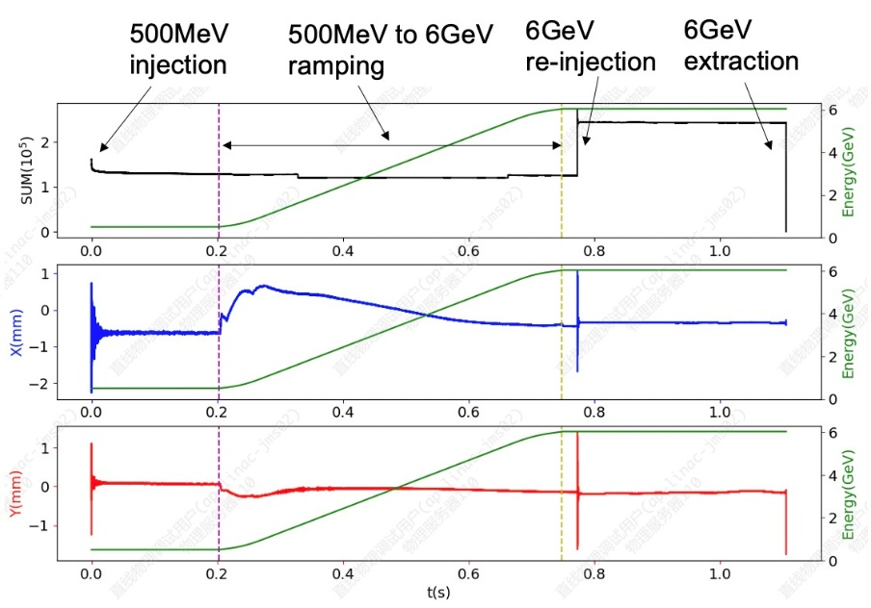
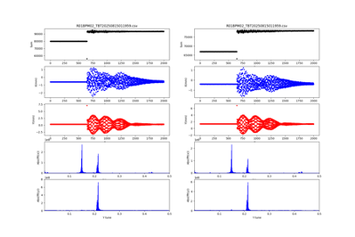
BPM 电子学优化
数字BPM信号处理器的在线束流运行和测试
TBT信号的应用
PV 1024 waveform(TBT128→TBT256 →TBT1024)
FTP 100w圈数据 文件模式
增强器引出、回注、低能注入到高能引出整个周期
增强器引出调试
低能注入到高能引出整个周期束流状态监测
增强器回注效率监测

Slide 4
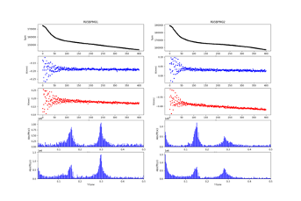
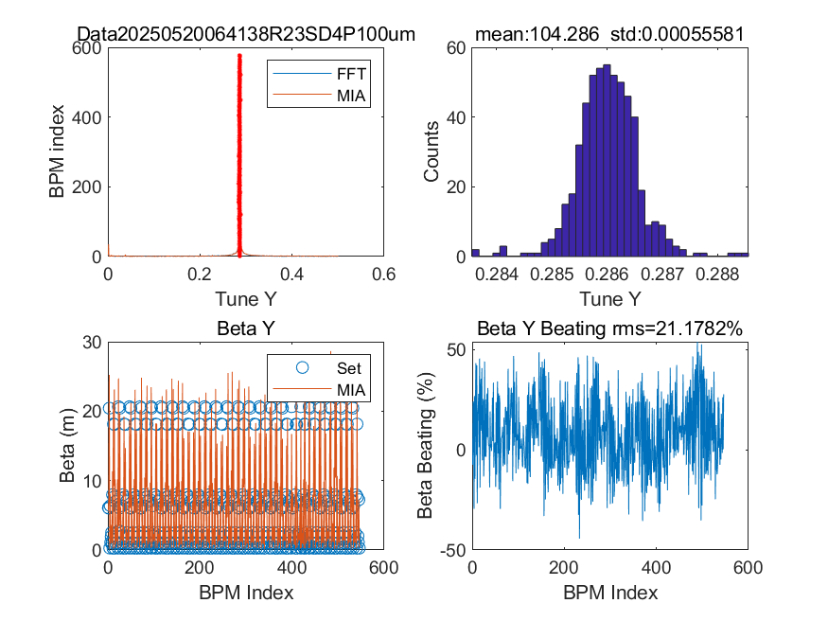
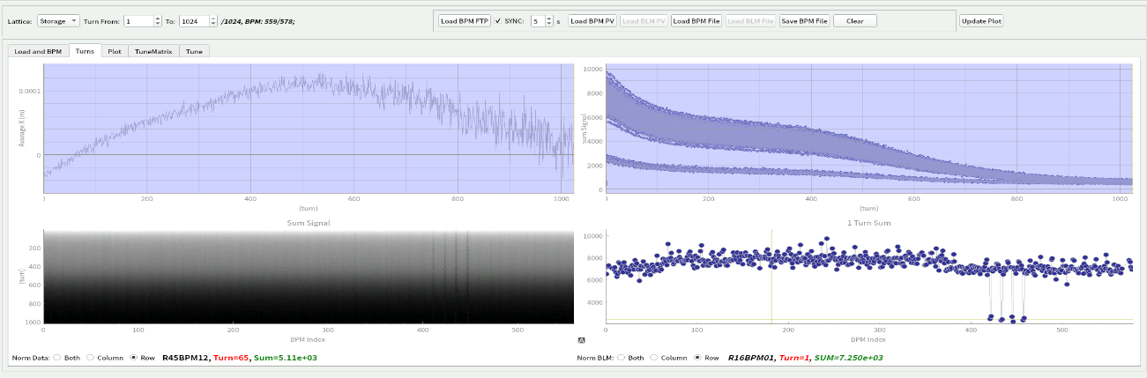
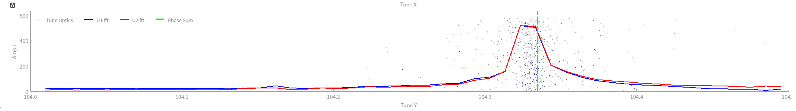
BPM 电子学优化
S数字BPM信号处理器的在线束流运行和测试
TBT信号的应用(储存环)
初期调束
TBT轨迹校正、多圈TBT轨迹平均近似闭轨
横向残余振荡
注入束调整、Kicker调整
纵向残余振荡：全部BPM的水平单圈轨迹的平均值
注入束能量调整、高频腔相位调整
工作点测量
包络函数、相移计算

Slide 5
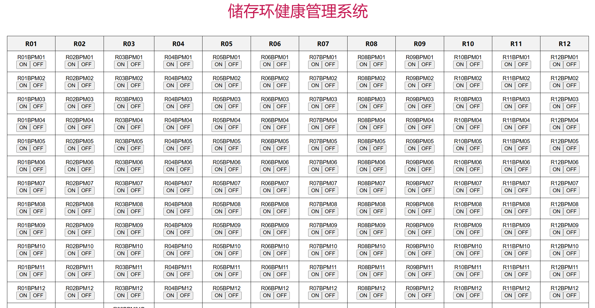

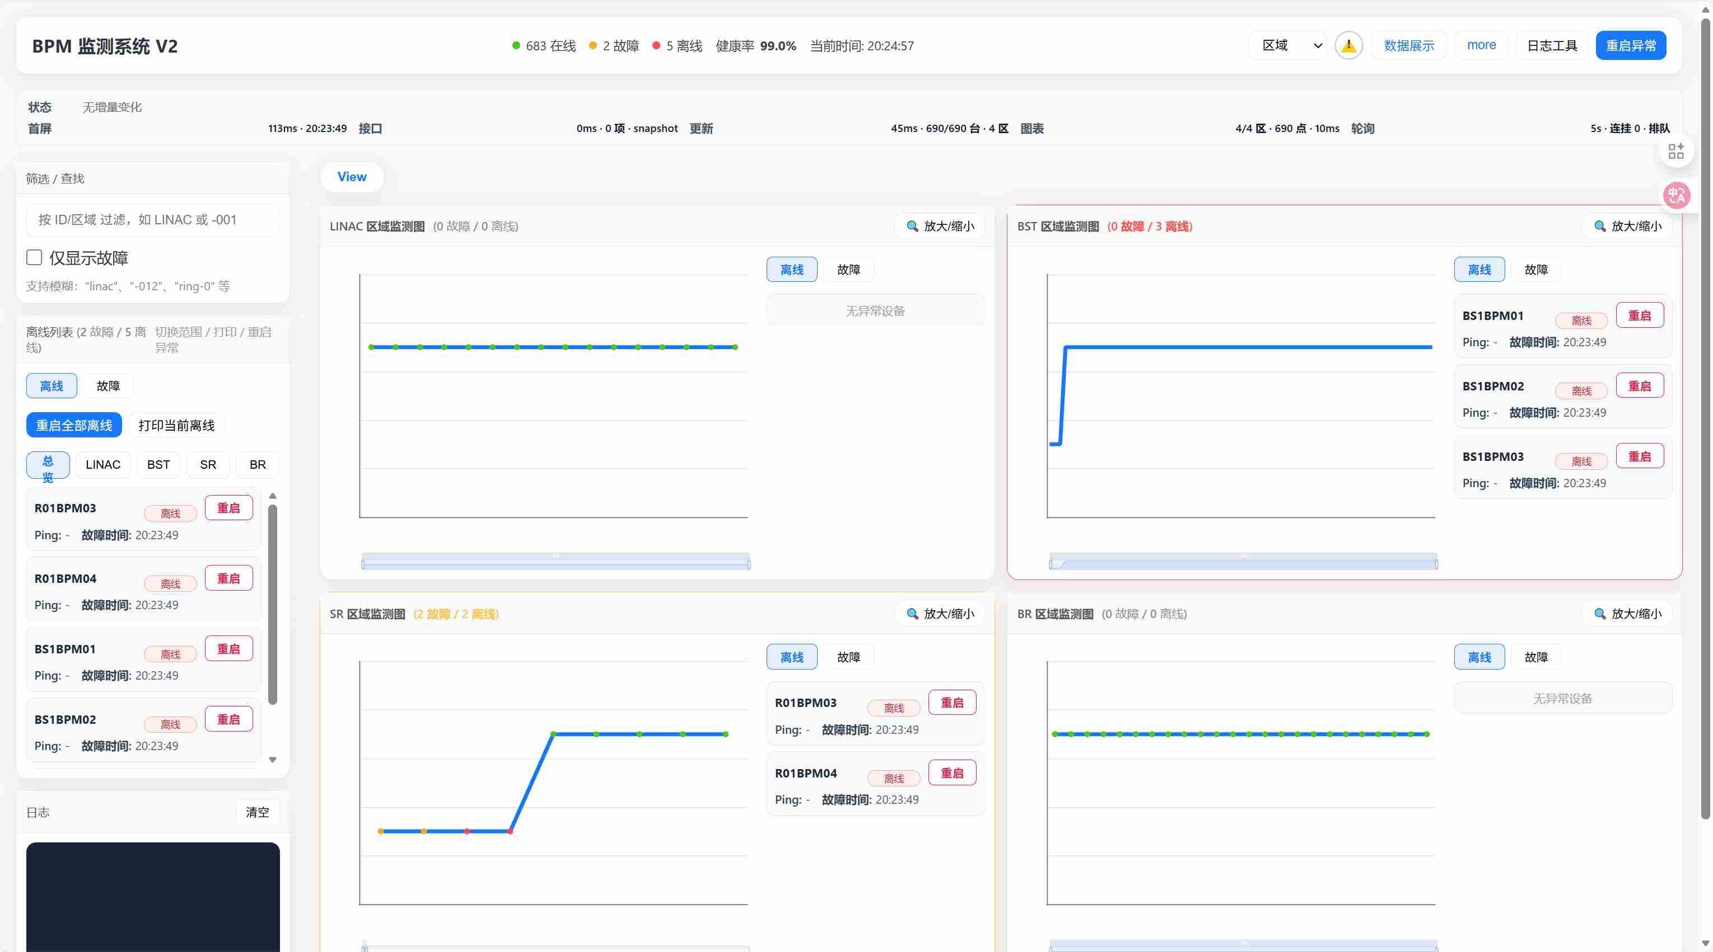
BPM 电子学优化
数字BPM电子学健康管理系统
🌍 状态监控：分区可视化，在线 / 故障 / 离线数实时呈现
📊 设备参数采集：采集位置（X/Y/Z）、PLL 锁相、CPU 使用率、温度等参数；
⚙ 运维操作：异常设备行直达 “重启” 按钮，支持单设备 / 区域批量重启、PDU 电源控制
🕒 历史数据追溯：CSV 格式存储历史快照，支持按设备 / 时间范围查询，支持数据导出归档
🚨 智能告警闭环：设备状态变化即时通过企业微信通知，故障原因精准判定，定时推送汇总报表

Slide 6
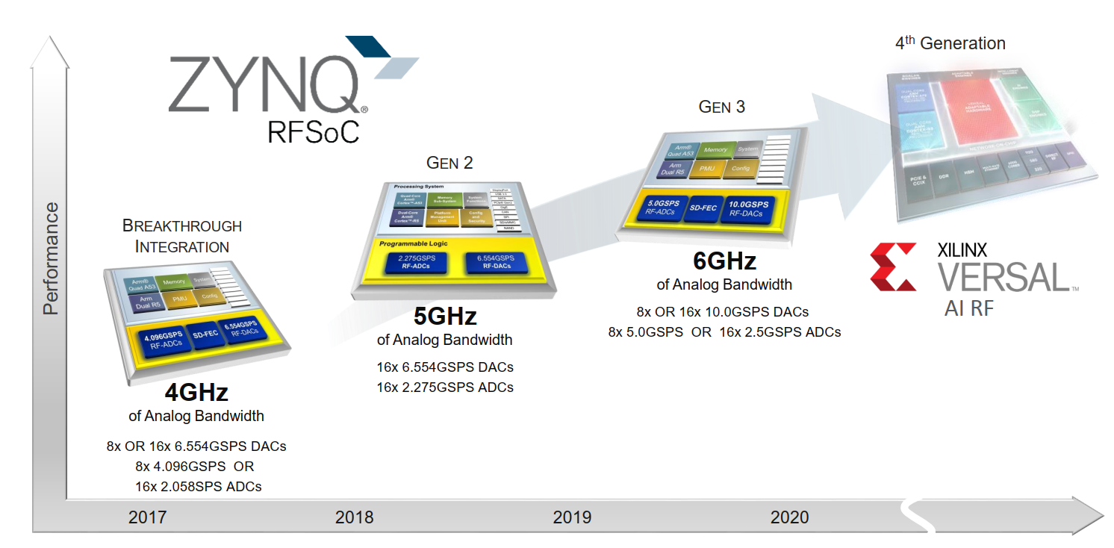
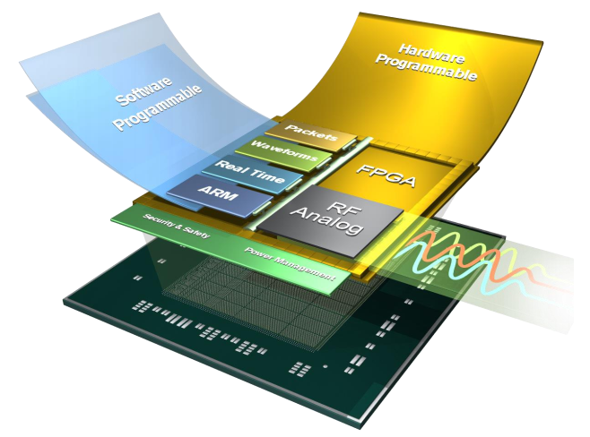
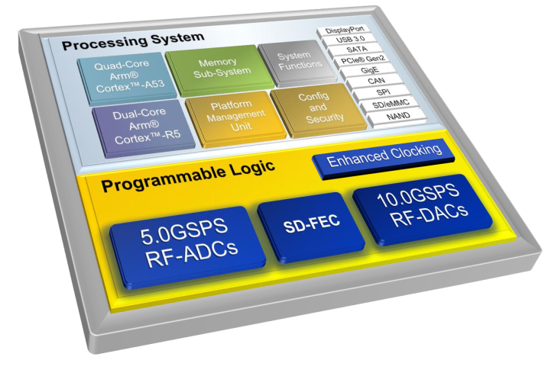
5G direct-RF Sampling in next generator BPM processor
New platforms give rise to new BPM processor

Slide 7
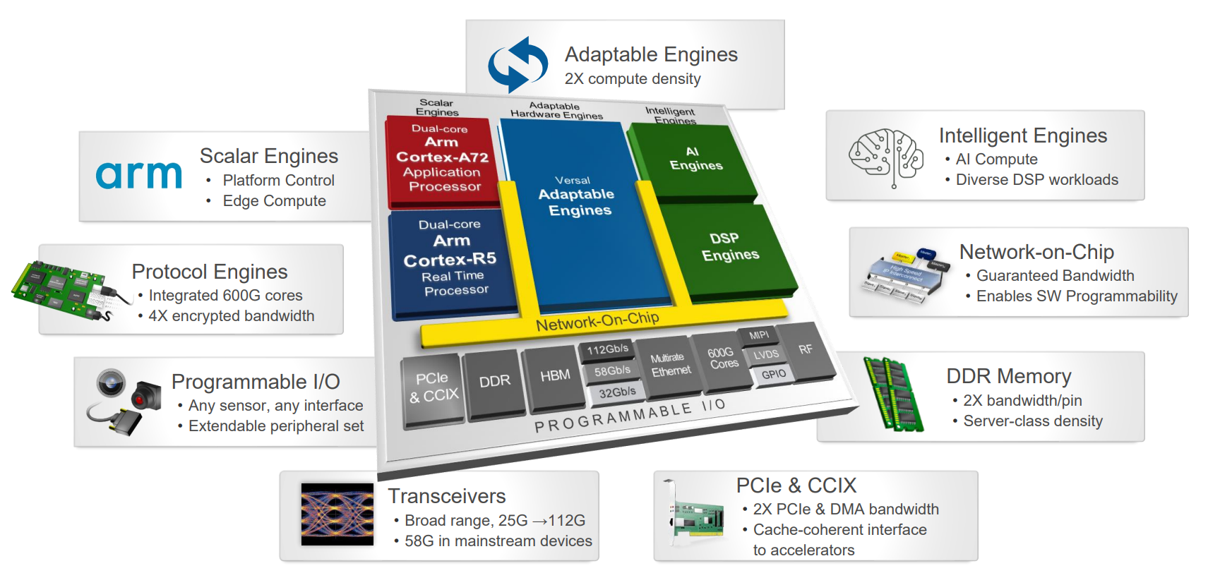
AI FPGA in new generator BPM system
How to correlate multi-dimensional beam data in real time and accurately predict beam evolutionary trends？
Focuses on improving beam prediction accuracy and timeliness by optimizing machine learning models based on AI FPGA
Unlike computer-based machine learning, it also explores extracting key information from massive beam data to optimize model parameters
AI FPGA latency(us) && GPU/CPU latency(ms)
AI FPGA is “hardware tailored and modified for specific AI tasks”, e.g.: BPM
Xilinx AI FPGA

Slide 8
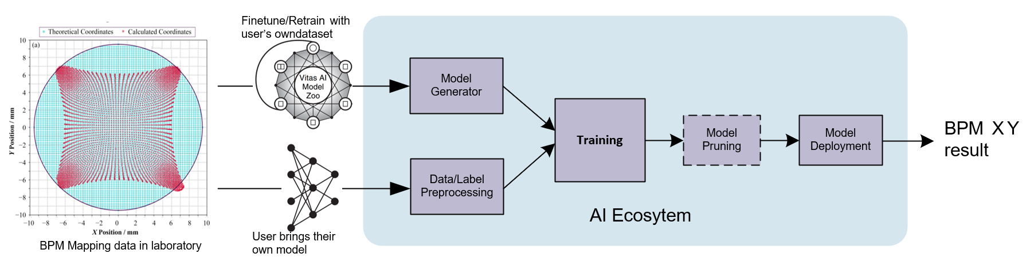
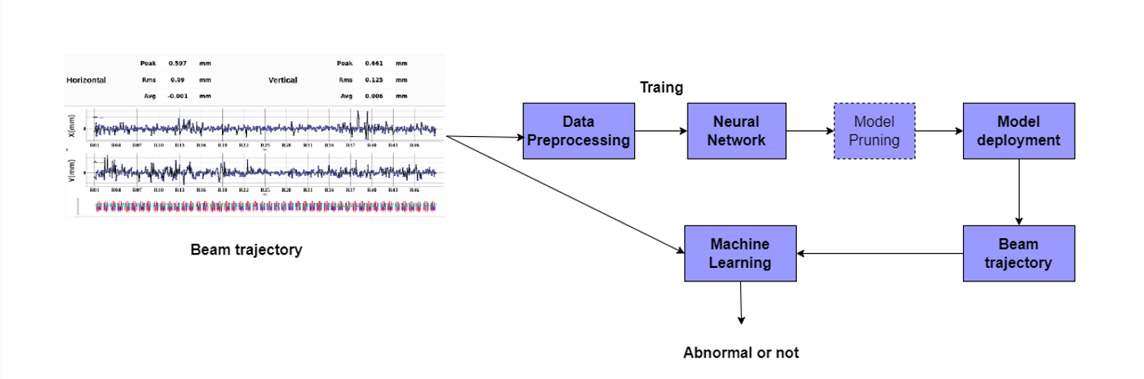
AI FPGA in new generator BPM system
Machine Learning Process Flow Diagram for BPM-based Mapping Data
Machine Learning Process Flow Diagram for Anomaly Monitoring Based on Beam Trajectory

Slide 9
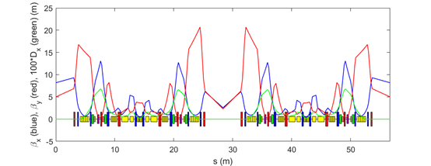
同步光截面测量：X射线测量束线
光源点选择
Reasons for Source Point selection ：
（1）β_{y} is larger
Beneficial for vertical beam size measurement.
（2）Horizontal dispersion is small
Energy spread contribution to the total horizontal beam size is negligible, which is suitable for emittance measurement.
（3）Upstream straight is allocated for RF cavity
No waste of ID resources.
（4）Close to the straight (1mrad)
X ray can be directed out of the tunnel through reserved port on sawtooth wall.
In the first dipole after straight
1mrad from dipole front edge
Source point
Straight for RF Cavity
Parameters:
Source point | β_{x}(m） | β_{y}(m） | η_{x}(m） | $ε$_{x}(pm) | Coupling | $ε$_{y}(pm) | $σ$_{x}($μ$m) | $σ$_{y}($μ$m)
R39 BLG1 1mrad | 1.19 | 19.9 | 8.19e⁻⁵ | 34.2 | 10% | 3.42 | 6.4 | 8.3

Slide 10
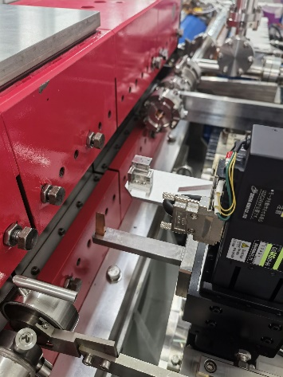
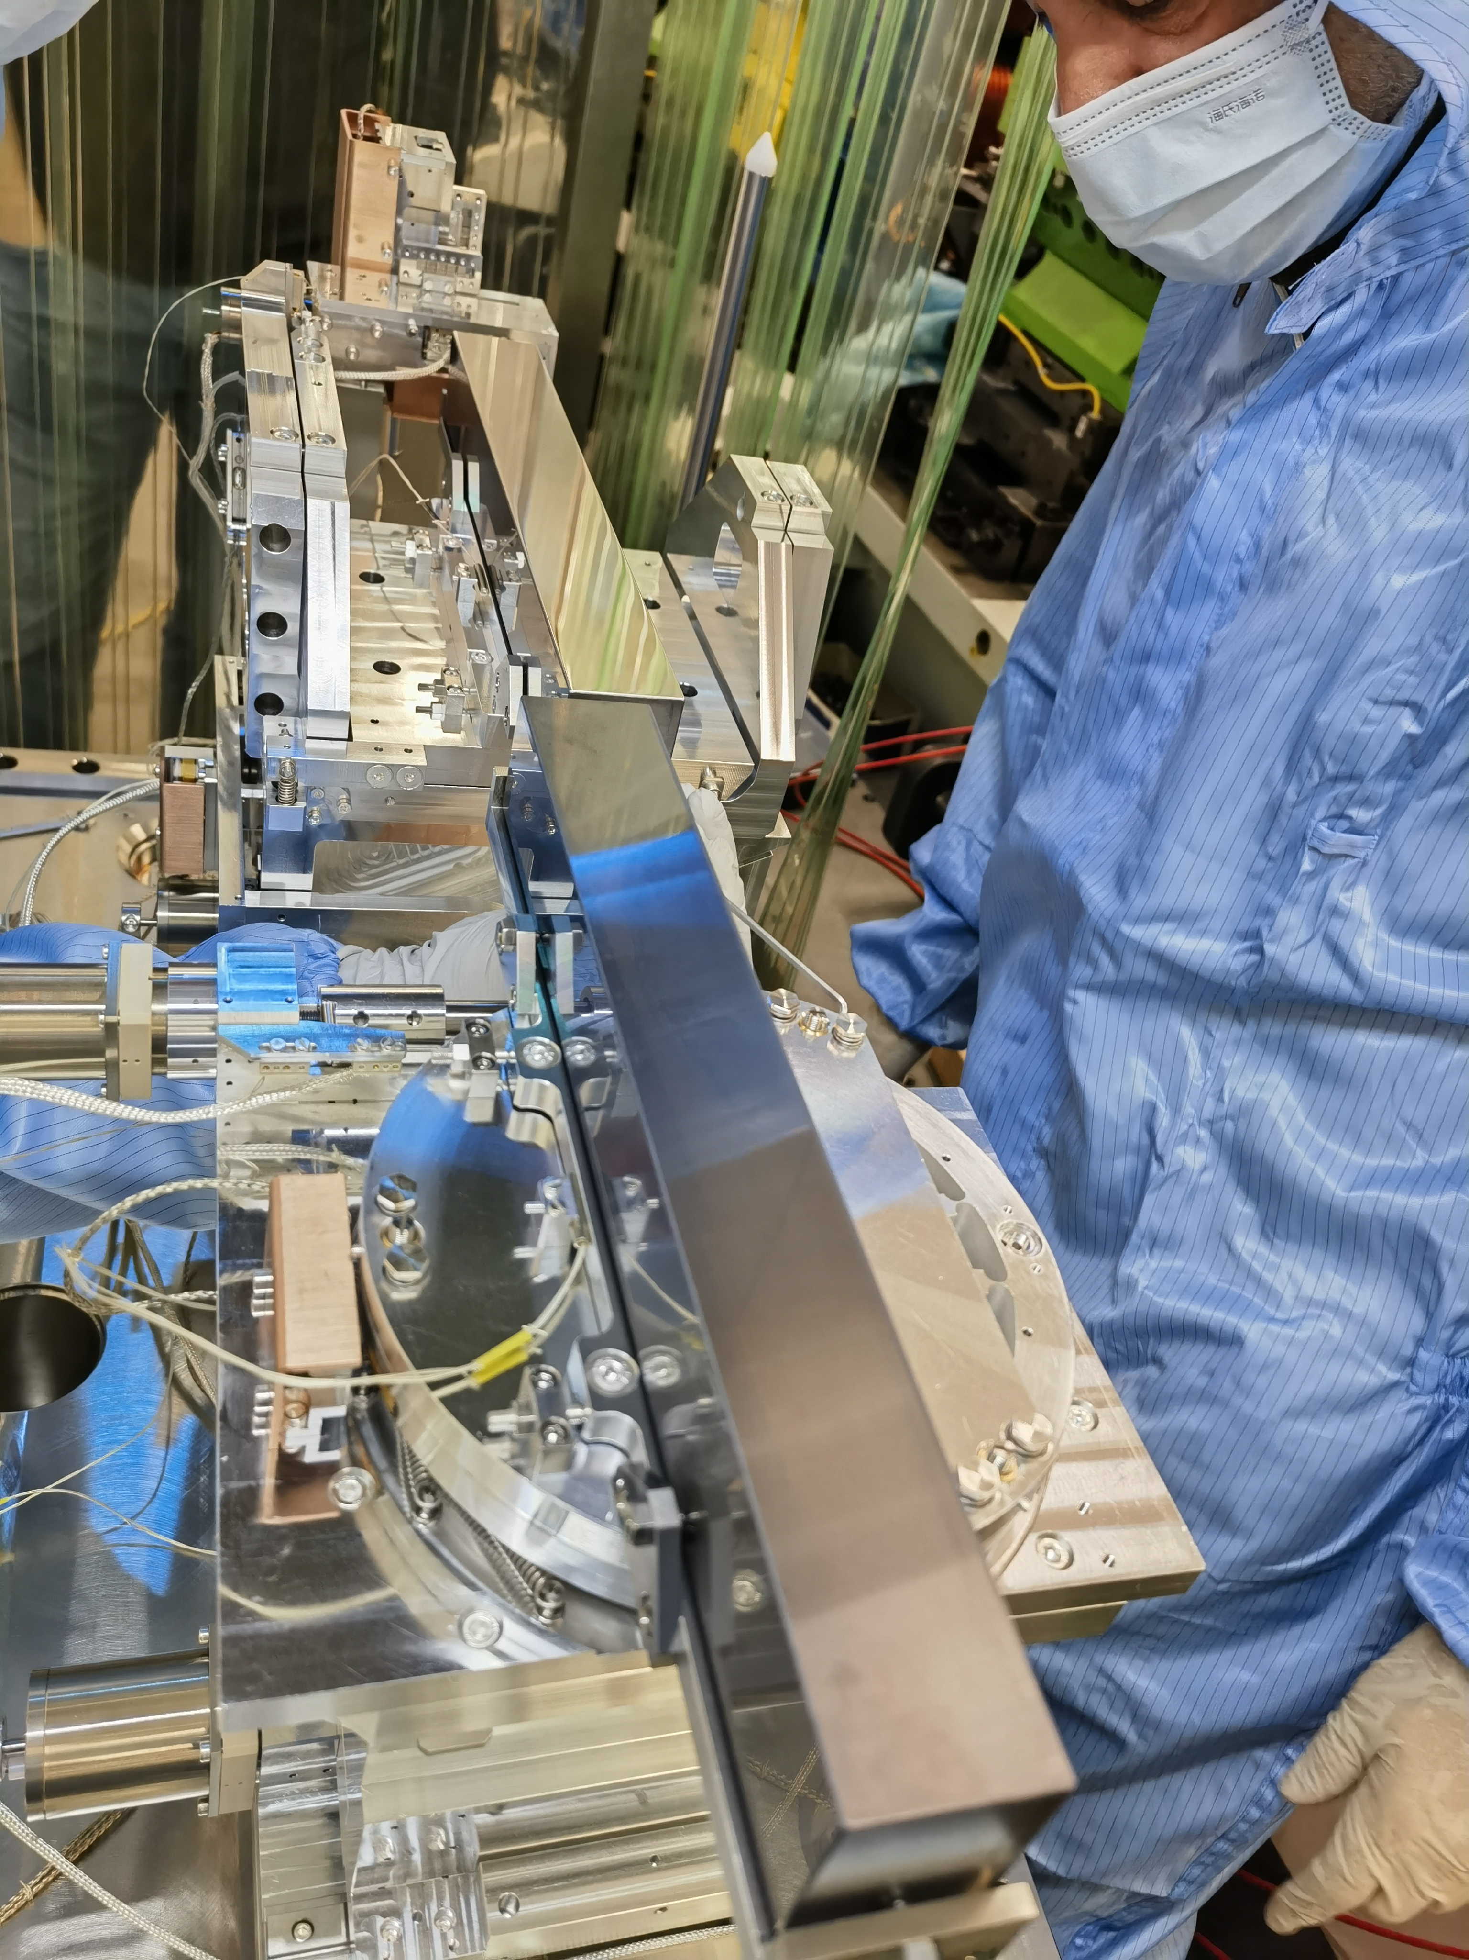
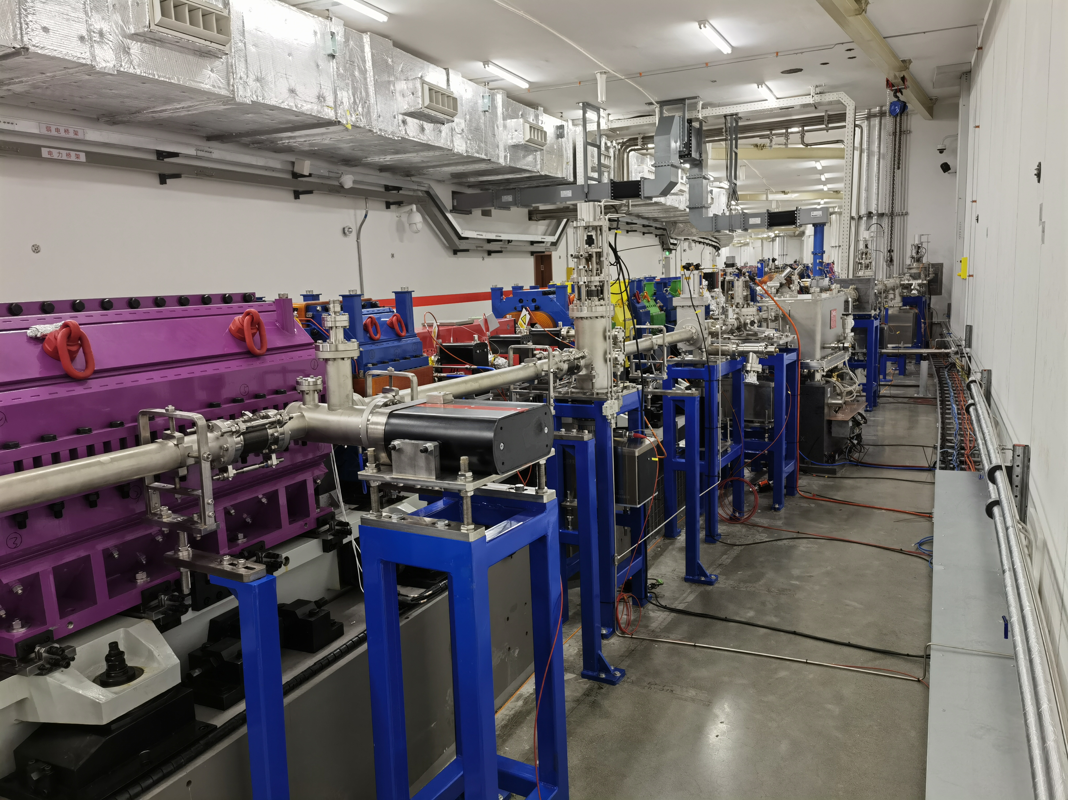
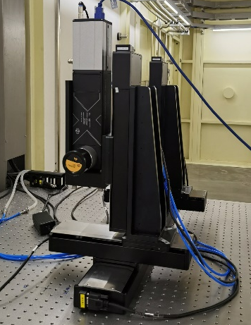
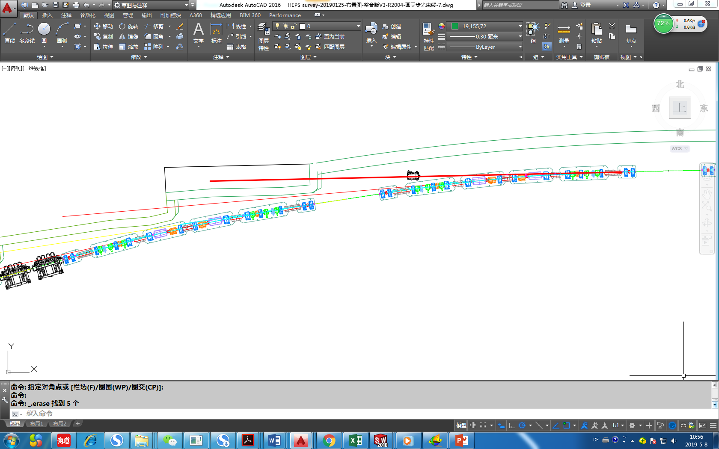

同步光截面测量： 储存环X光束线
X射线测量束线设备布局
CVD Diamond
window
Aperture
KB mirror chamber
Pinhole
VFM
Copper Attenuator
HFM
Al window
Dipole source
0 m
Pinhole
5.78 m
KB mirror
18 m
Front End
X ray Camera
36 m
X-ray
Hutch
Beam direction

Slide 11
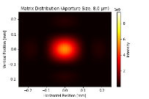
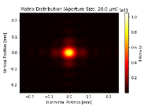
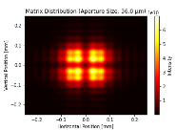




同步光截面测量：小孔成像
X-Ray Pinhole Camera
Pinhole to Source : d = 5.78 m
Pinhole to detector: D = 30.22 m
Magnification: M = D/d= 5.224
Pinhole size: A = 20 μm
Diffraction
dominated
Geometrical
dominated
Optimum pinhole size
Spatial resolution* of pinhole camera is a balance between diffraction and geometrical contribution of pinhole size.
Diffraction contribution:
$$Sdiff=\frac{\sqrt{12}}{4π}\frac{λD}{A}$$
Geometrical contribution:
$$Saperture=\frac{A}{\sqrt{12}}\frac{(D+d)}{d}$$
Total PSF:
$Σ_{0}^{2}$ = $S_{diff}^{2}$ + $S_{aperture}^{2}$+ $S_{camera}^{2}$
Optimum pinhole size：
$$A_{0}^{2}=\frac{\sqrt{12}}{4π}\frac{λdD}{d+D}$$
X ray camera
4X Microscope
Bending
Magnet
Movable
Pinhole
Al window
CVD diamond
window
Be
window
Cu Attenuator
d: 5.78 m
D: 30.22 m
*Cyrille Thomas, Guenther Rehm, and Ian Martin. X-ray pinhole camera resolution and emittance measurement[J]. 2010, 13(2): 022805.

Slide 12

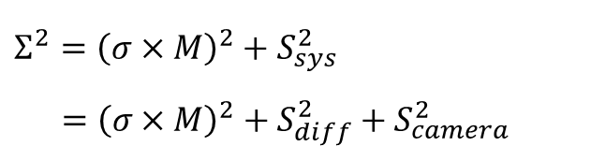
同步光截面测量：小孔成像
Pinhole imaging
Point Spread Function(rms PSF):
Rms image size
Real rms beam size
Magnification
rms PSF
$$Σ^{2}={\left(σ×M\right)}^{2}+S_{sys}^{2} \\ ={\left(σ×M\right)}^{2}+S_{diff}^{2}+S_{camera}^{2}$$
Diffraction contribution
Spatial resolution of x-ray camera
S_{diff} = 26.7 μm
S_{camera} = 3 μm
Total rms PSF:
S_{sys} = 26.87 μm
Total rms PSF at Source:
S_{sys} /Mag. = 5.14 μm
Total PSF is the quadratic sum of diffraction, and camera resolution

Slide 13
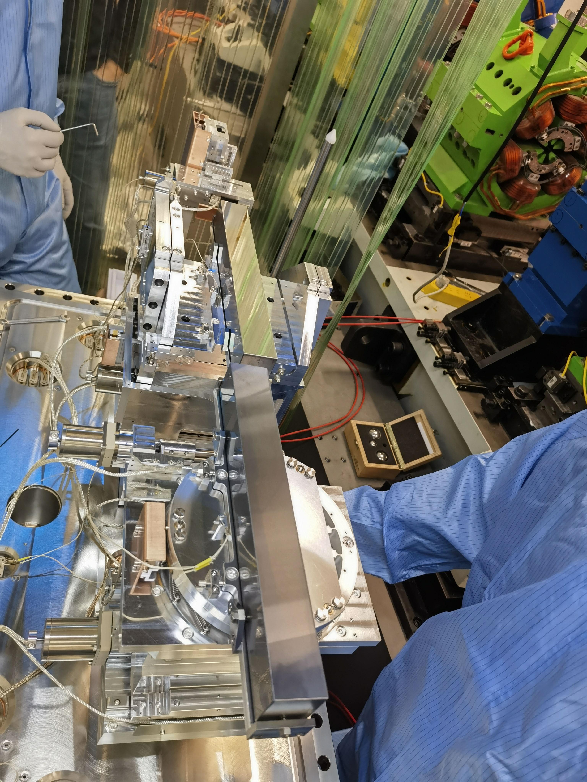
同步光截面测量：KB镜系统
KB mirrors imaging
KB parameters:
KB mirrors installation:
 |  | VFM | HFM
1 | Mirror shape | Elliptical cylinder
2 | Source distance : p | 18 m | 18.36 m
3 | Focus distance : q | 18 m | 17.64 m
4 | Magnification: M | 1 | 0.96
4 | Grazing incidence angle : θ | 2.5 mrad
5 | Substrate size | 320×40×40 mm³
6 | Substrate Material | Si
7 | Coating | Pt
8 | Coating area | 300×10 mm²
9 | Slope error（RMS） | < 50 nrad
10 | Roughness（RMS） | < 0.2 nm
Aperture
VFM
HFM
X ray camera
20X Microscope
Bending
Magnet
Movable
Pinhole
KB mirror
Al window
VFM
HFM
Be
window
Cu Attenuator
CVD diamond
window
Aperture
p: 18 m
q: 18 m
d: 5.78 m
D: 30.22 m

Slide 14
同步光截面测量：KB镜系统
KB mirrors imaging
Point Spread Function(rms PSF):
Rms image size
Real rms beam size
Magnification
rms PSF
Diffraction contribution
Mirror slope error contribution
Spatial resolution of x-ray camera
S_{diff} = 0.39 μm
S_{slope} = 1.8 μm
S_{camera} = 0.8 μm
Total rms PSF:
S_{sys} = 2.01 μm
Total PSF is the quadratic sum of diffraction, slope error contribution and camera resolution

Slide 15
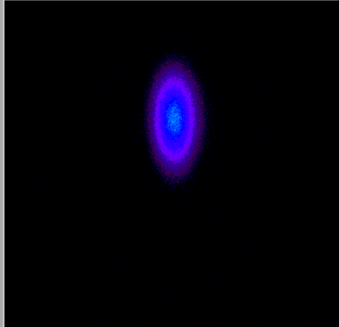
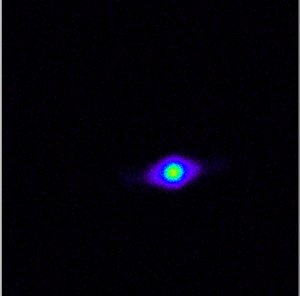
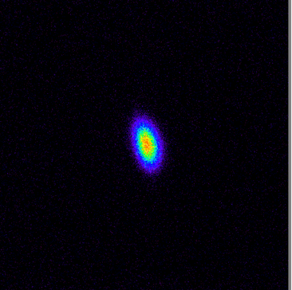
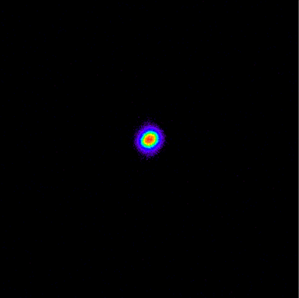
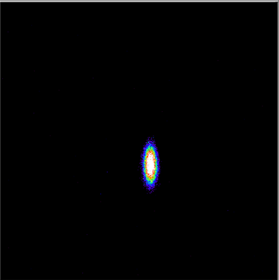
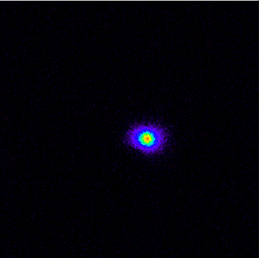
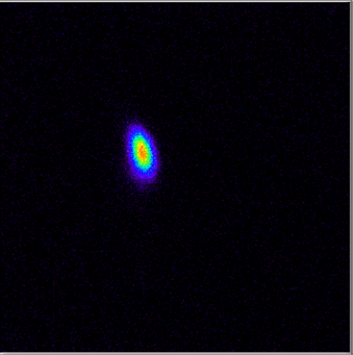
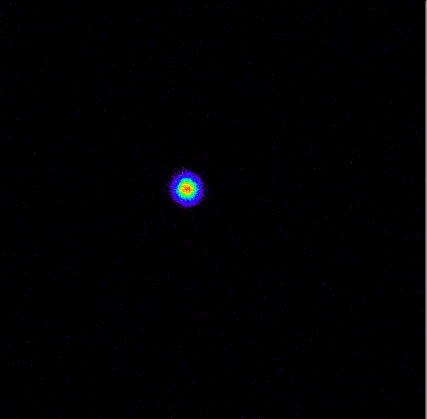








同步光截面测量
测量结果
Pinhole
$σ_{x}$= 23.7 um $σ_{y}$ = 50.7 um
$σ_{x}$= 18.5 um $σ_{y}$ = 16.4 um
$σ_{x}$= 15 um $σ_{y}$ = 28.1 um
$σ_{x}$= 12.2 um $σ_{y}$ = 11.9 um
4X
4X
4X
4X
2024.9.23
2025.1.24
2025.5.14
2025.9.4
KB
$σ_{x}$= 22.5 um $σ_{y}$ = 50.8 um
$σ_{x}$= 19.2 um $σ_{y}$ = 15.7 um
$σ_{x}$= 14.7 um $σ_{y}$ = 26.8 um
$σ_{x}$= 12.1 um $σ_{y}$ = 12.3 um
4X
20X
20X
20X

Slide 16
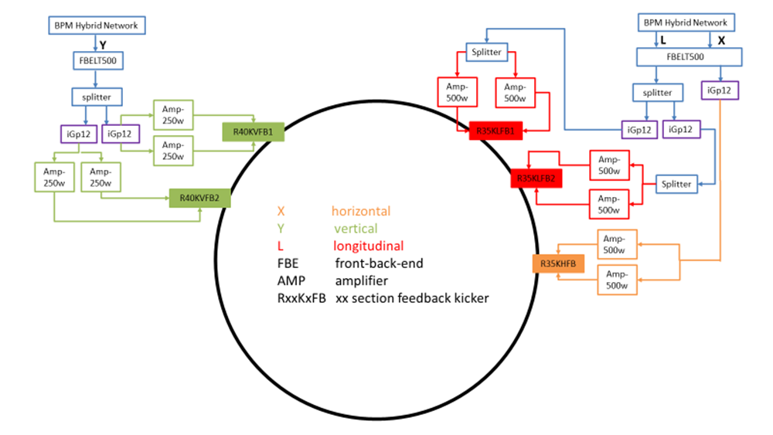
Feedback system test in HEPS
For the HEPS storage ring feedback system, to suppress all possible coupled-bunch instability modes, the system bandwidth must be at least half of the RF frequency, ~83.3 MHz. The maximum power required by the feedback system is directly influenced by the shunt impedance of the kicker.
The single-bunch​ beam test has been completed successfully, while the multi-bunch​ tests remain pending.

Slide 17
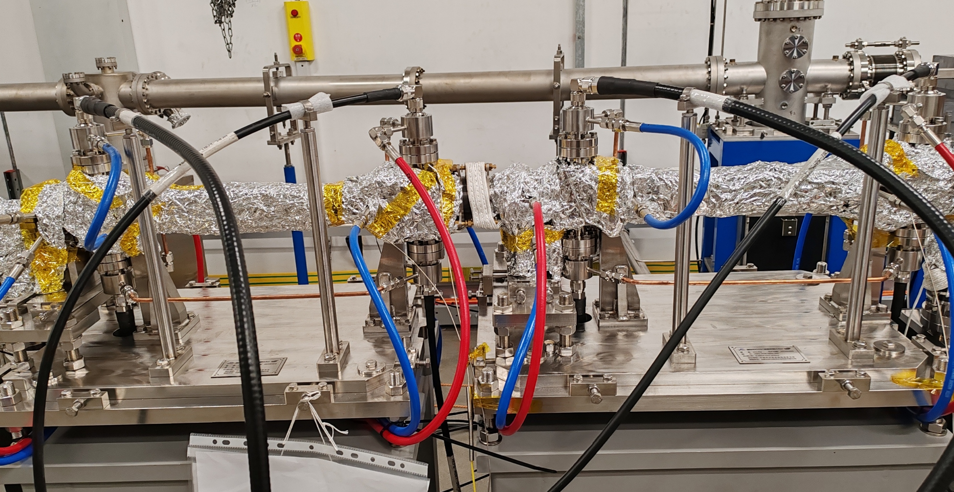
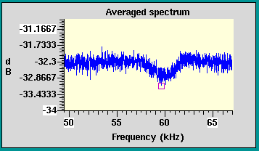
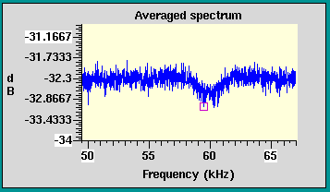
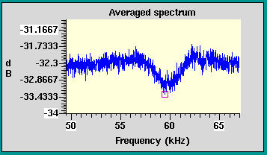
Validate the feasibility of using multiple feedback kickers to enhance damping capability at HEPS
For a large accelerator like CEPC, with strong coupling instabilities, the shunt impedance provided by a single feedback kicker is limited by factors such as the dynamic aperture. Therefore, multiple kickers are required to enhance the damping capability.
At HEPS, the Y-direction feedback system employs two kickers in series. We observed phenomena using two kickers separately at approximately 100 mA. As shown in the figure below, the notch tune in the spectrum of data using a single kicker is similar, while the notch tune using two kickers is significantly deeper. This demonstrates that this method has enhanced the damping effectiveness..
The Y-direction feedback at HEPS uses two kickers in series
Only use kicker1
Only use kicker2
Use both kicker1 and kicker2

Slide 18
The integration of feedback system with machine learning
The damping time must be shorter than the growth time of the instability.
The data acquisition time (multi-turn oscillation) and processing by the feedback system will occupy a large part of the damping time,for rings with larger circumferences such as the CEPC.
Therefore, machine learning will be applied to the acquisition of beam oscillation signals in the feedback system of CEPC to address the issues above.
Using traditional feedback methods, the time taken for data acquisition will occupy at most 2/3 of the damping time.
0.33ms/turn
2 turns
0.66ms
CEPC Damping Time 1ms

Slide 19
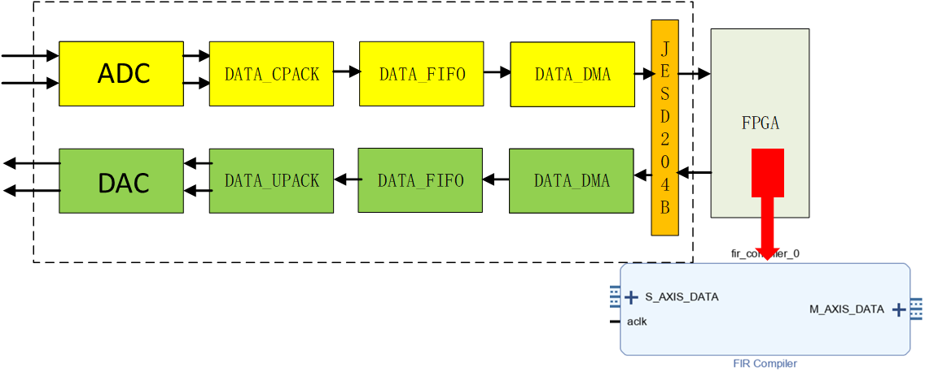
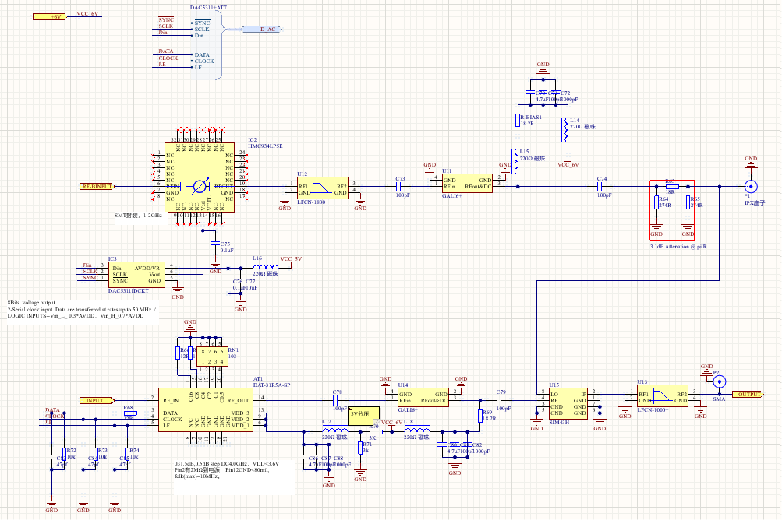
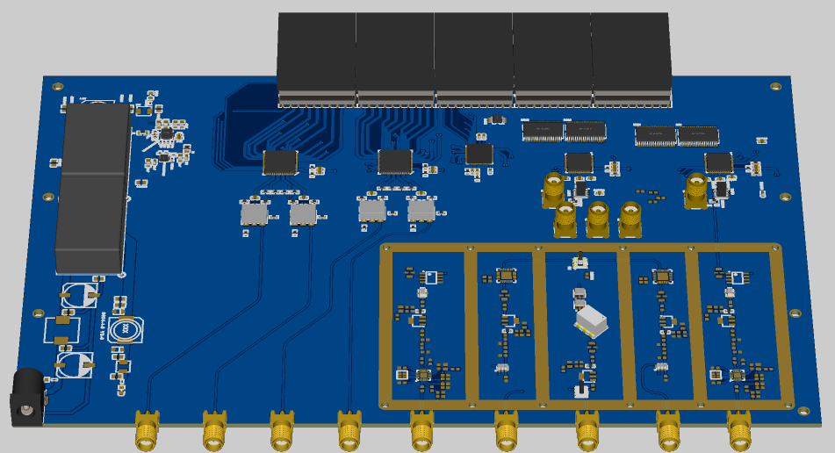
Progress of Front-End Electronics Design
Chip selection and schematic drawing have been completed, along with the implementation of each module's functions.
Front-End Circuit: The signal has an adjustable attenuator (ATT) of 31.5 dB, an LNA gain of 21.8 dB, and a down-conversion phase shifter with an adjustable phase from 0 to 400°.
A/D and D/A Circuit: LVDS, 500 MSPS
Clock Module and Power Module Design
Design FIR Filter Algorithm Using ISE
Front-End Schematic Design
PCB Layout and Routing

Slide 20
FOFB Architecture of HEPS
“Ring-Star-Ring” structure
Construct a BPM ring consisting of 12 BPMs for each BPM station
Connecting 3 BPM rings to 1 FOFB unit.
Link all 16 FOFB units to 1 large FOFB ring.
Connecting 1 FOFB unit to 3 FC PSC units.

Slide 21
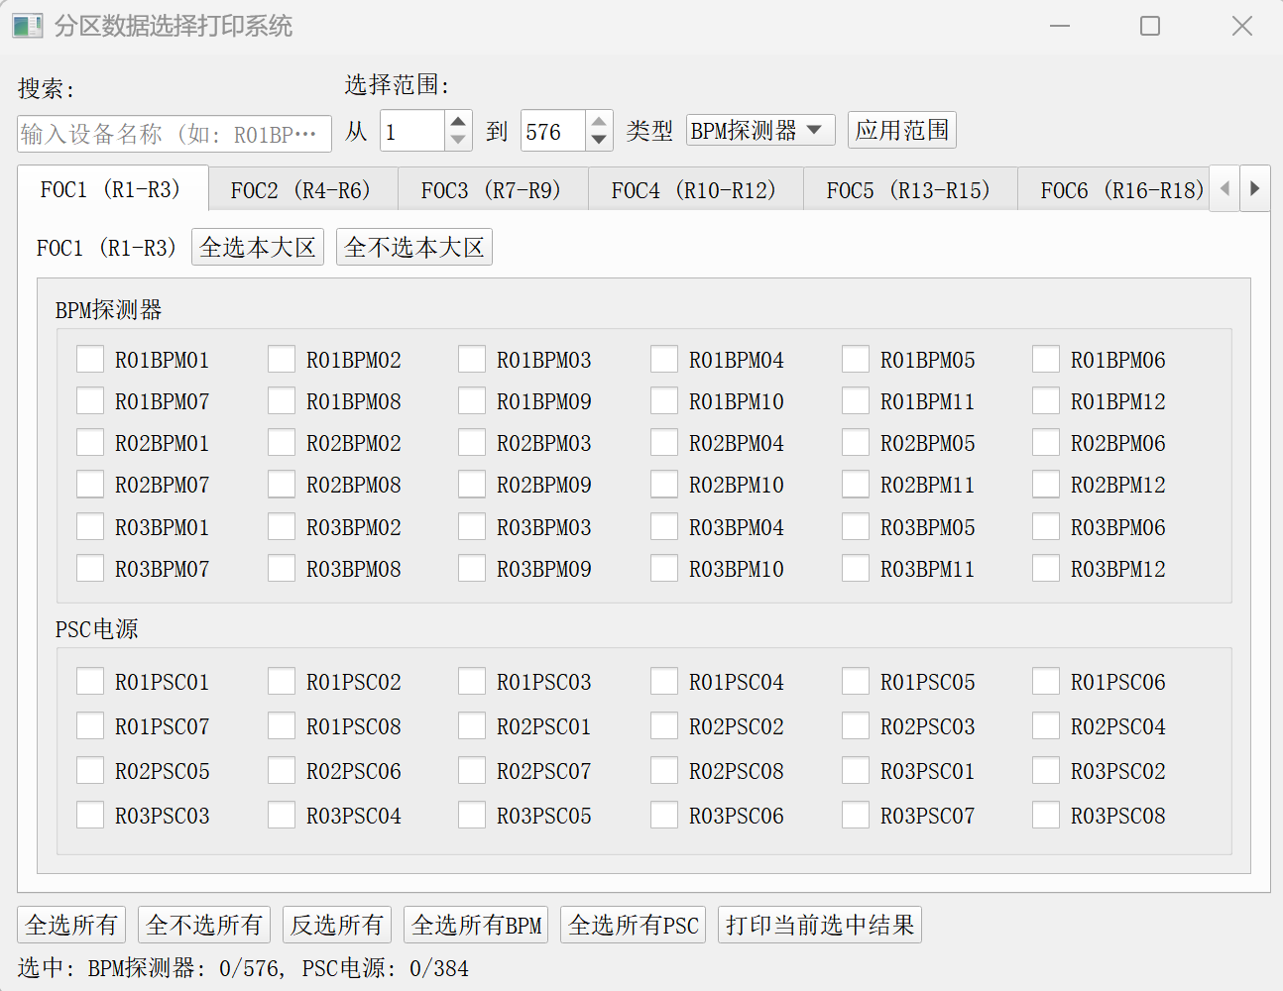
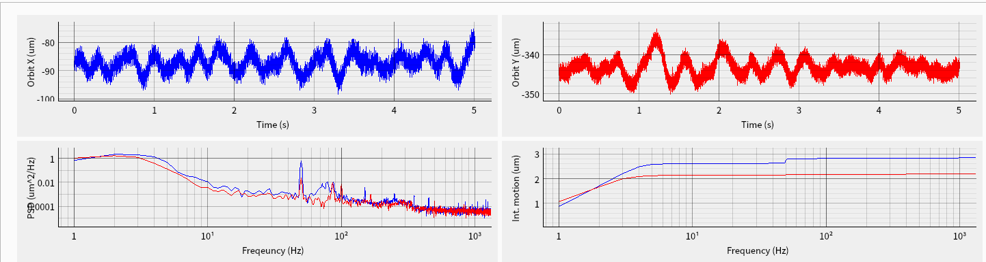
FOFB system commissioning
Commissioning with beam(2025.08.26~2025.08.27)
Work objectives
FOFB data acquisition function verification.
FOFB system open-loop response testing.
Testing result
Integrate the FOFB data acquisition function into the FOFB software, and the all BPMs and PSCs acquisition data can be freely selected according to the requirement.
5-second BPM data can be plotted separately in the time and frequency domain using beam tuning software. The image results are consistent with the actual situation

Slide 22
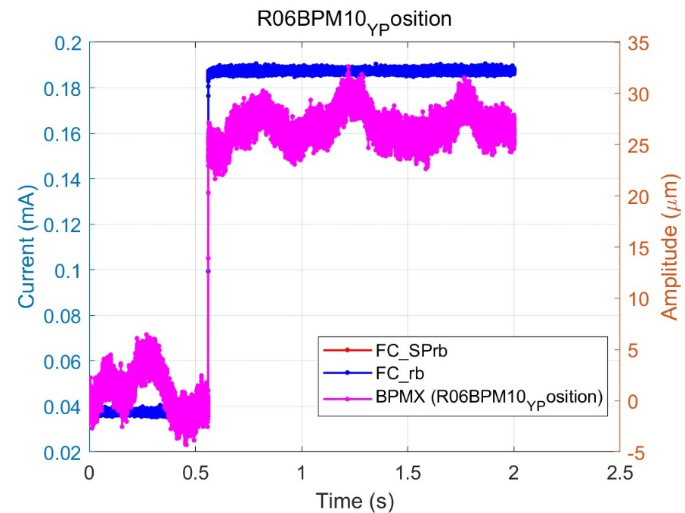
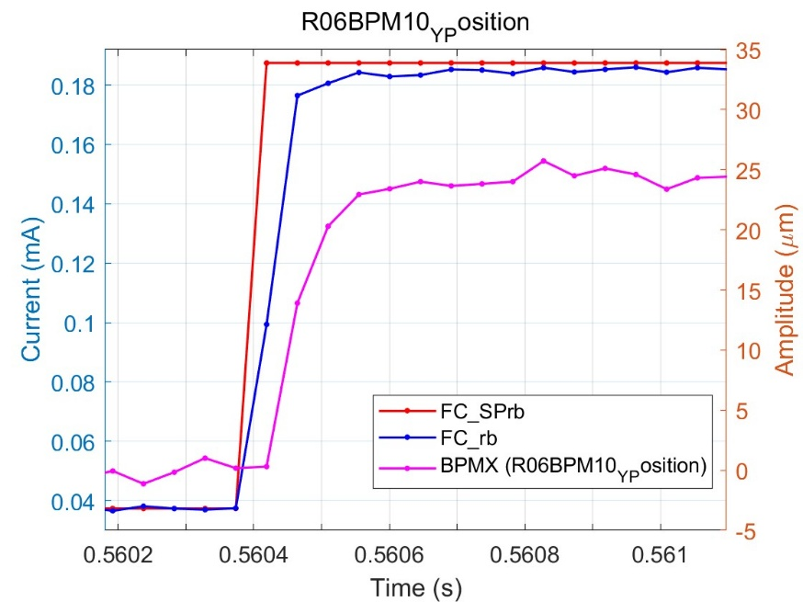
FOFB system commissioning
Commissioning with beam (2025.08.26~2025.08.27)
Experimental Procedure
﻿ Set a ± 0.15A step change for one PSC through optical fiber, and observe the position change of each BPM.
Testing result
The delay of most BPM is approximately between 5-6 FA cycles, which is between 225-270us. Some BPMs also have high latency, about 8-10 FA cycles, and the power supply is slower than BPM about 2 sampling points.

Slide 23
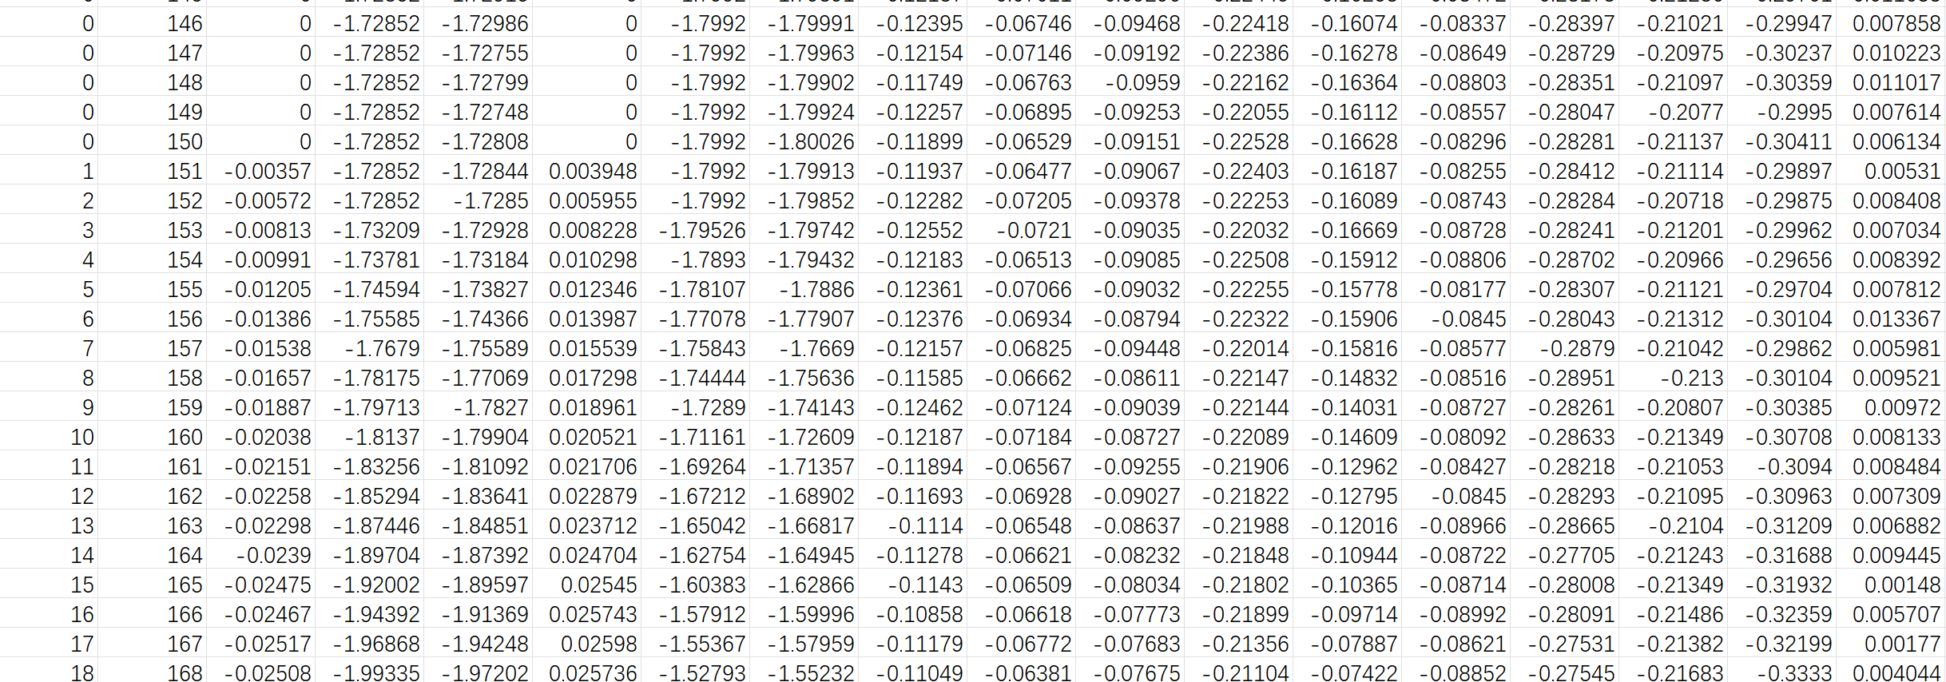
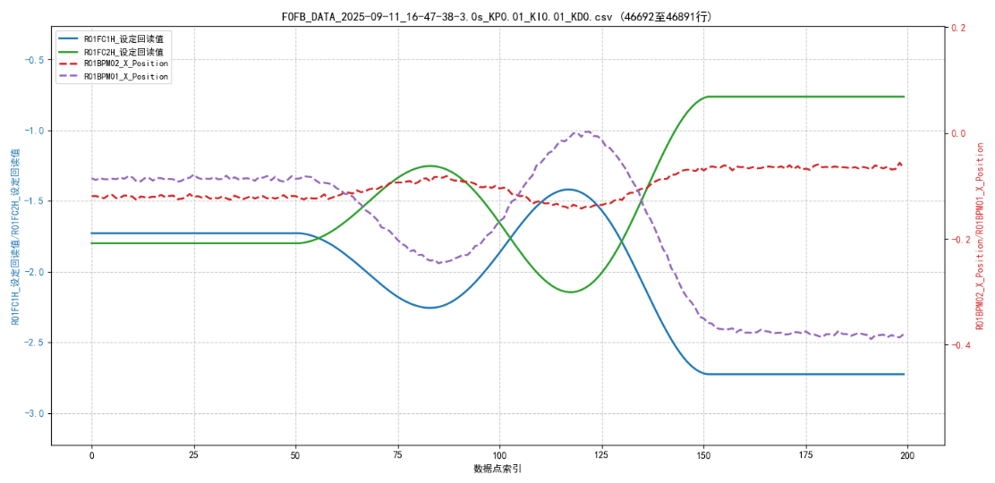
FOFB system commissioning
Commissioning with beam(2025.09.11)
Beam current: 15mA; BPM selected: R01BPM01 and R01BPM02; FC selected: R01FC1H \ R01FC2H \ R48FC3H \ R48FC4H.
Fixed 100 steps running mode; the limit of PSC amplitude setting is ± 6A; and save FOFB data synchronously during each test running.
A few sets of PID parameters are testing, and expected results not obtained, more experiments are needed.
Based on the results of FOFB testing, the FOFB algorithm and the correct FC current setting values are verified.

Slide 24
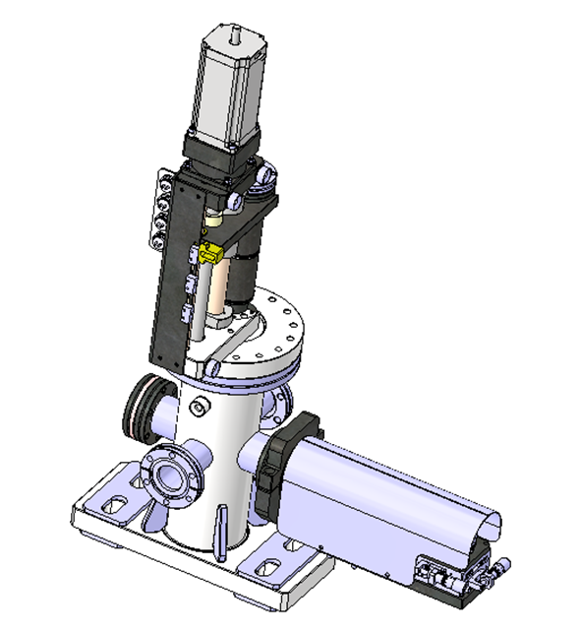
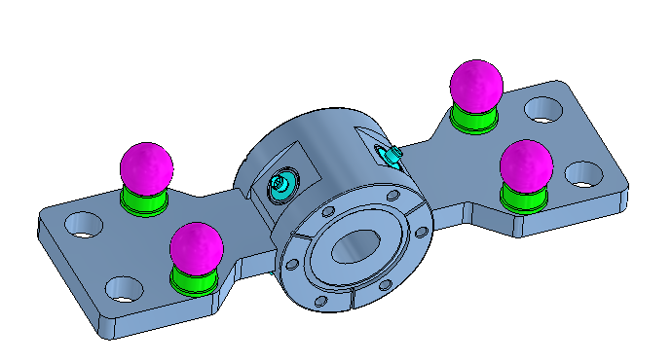


BI component-types and quantities
Location | Hardware types | Quantity
Linac | 10 | 244
Booster | 6 | 2418
Collider | 7 | 7134
Transport lines | 5 | 86

Slide 25


Radiation-Resistant Cable for BPM
Courtesy of Guangyi Tang
SiO2 RF cable Assemblies By AMT（安胜达）

Slide 26


Radiation-Resistant Cable for BPM
组织有需求的系统与江苏安胜达航天科技有限公司技术沟通
感谢关注！

