Slide 1

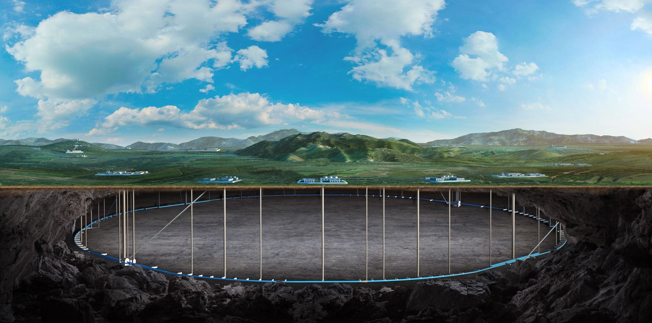

Cable Selection Process and developing plan
On behalf of Detector magnet team
Dec 2025 CEPC DAY

Slide 2
Content
Cable selection process
Pre-CDR, CDR to Ref-TDR
Superconducting cable developing progress
Alternative solutions
HTS option
Source of Funds
Summary

Slide 3

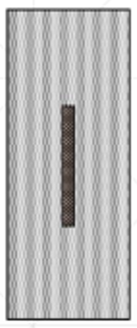
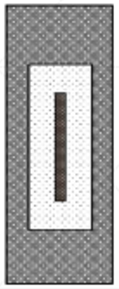
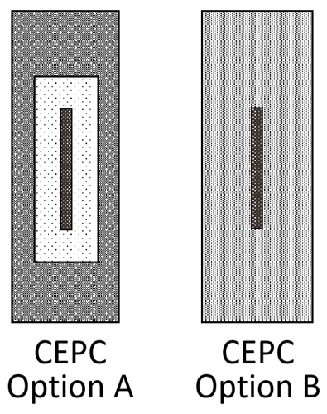
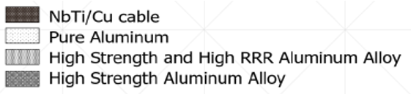
Cable selection process
22*68 mm²
22*56 mm²
75*23 mm²
22*56 mm²
1
2
3
Pre-CDR
CDR
Ref-TDR
2015
2018
2024
August
2024
October
2025

Slide 4
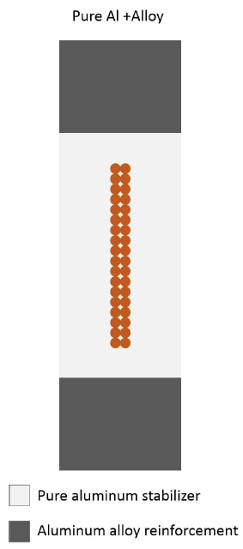
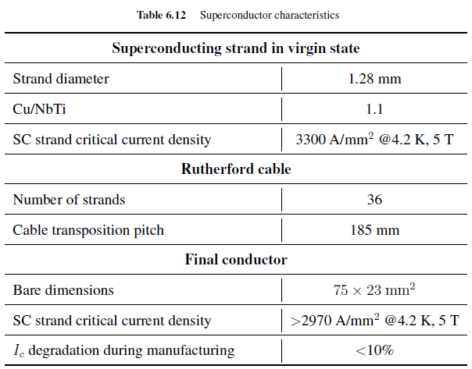
Pre-CDR
6.7.2.4 Superconducting Conductor
The conductor design is similar to that of CMS [96]. As the forces induced in the conductor by the magnetic and thermal loads are beyond the yield stress of pure aluminum, a mechanical strengthening is envisaged. This consists of a superconducting Rutherford cable, which is sheathed in a stabilizer and mechanically reinforced. A cross-sectional view of the superconductor is shown in Fig. 6.57. Two aluminum alloy profiles are welded by electron beam to the central conductor stabilizer, which is made of high purity aluminum.
Figure 6.57 Cross section of solenoid conductor.
2015

Slide 5
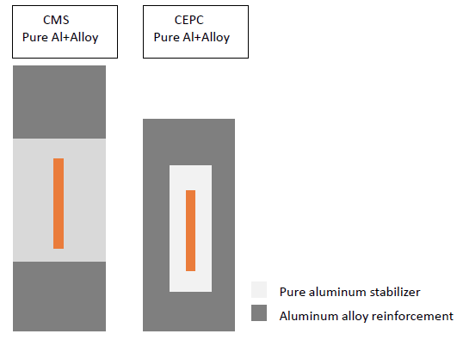
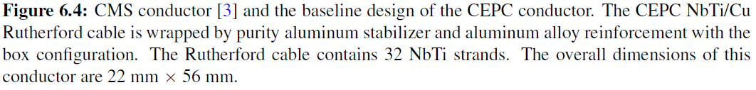
CDR
6.2 SUPERCONDUCTING COIL SYSTEM
The CEPC solenoid conductor baseline design is the box configuration, based on the self supporting conductor design of the CMS detector magnet, composed of NbTi Rutherford cable, pure aluminum stabilizer and aluminum alloy reinforcement.
The CMS conductor is fabricated by e-beam welding aluminum alloy to the coextruded high purity Al/superconducting cable insert, whereas the CEPC conductor is fabricated by coextrusion of all components. The configuration is shown in Figure 6.4. The Rutherford cable contains 32 NbTi strands. All magnet finite element analysis has been with this conductor with overall dimensions of 22 mm*56 mm.
2018

Slide 6
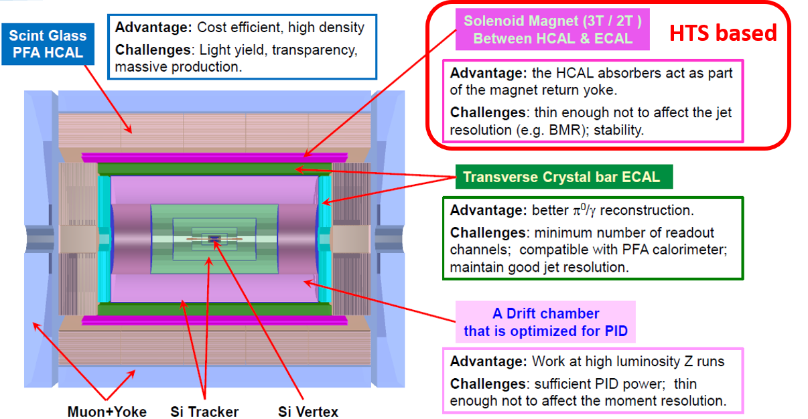
Ref-TDR
For a period of time, LTS solution and HTS solution were developed in parallel, with the HTS solution taking precedence.
The 4th Conceptual Detector Design: The solenoid magnet locates between Hcal and Ecal, HTS option.
The Ref-Detector Design:
22*68 mm²
22*56 mm²
2023
October
2024
August
2024
October
2025

Slide 7

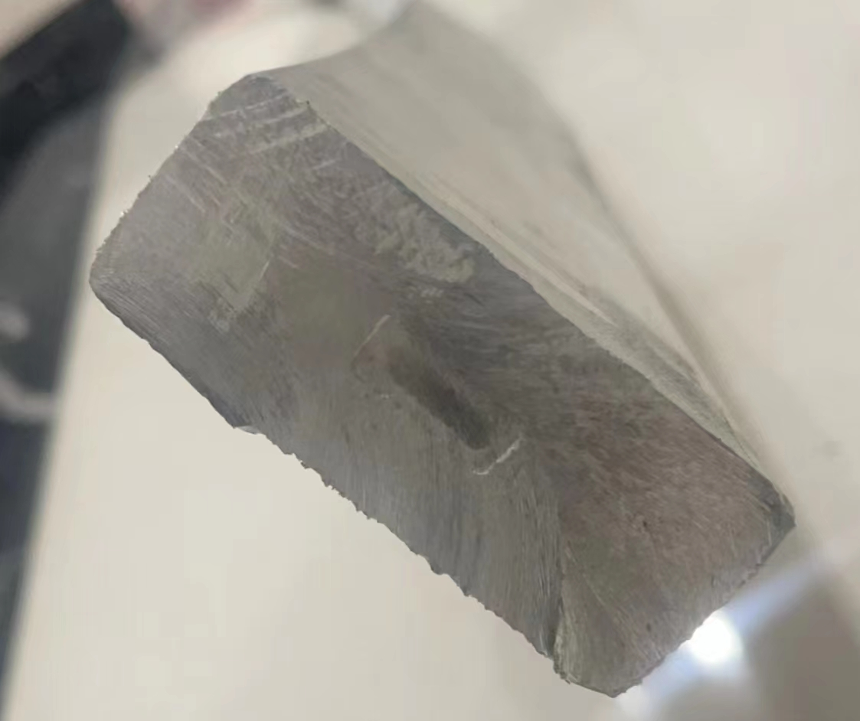
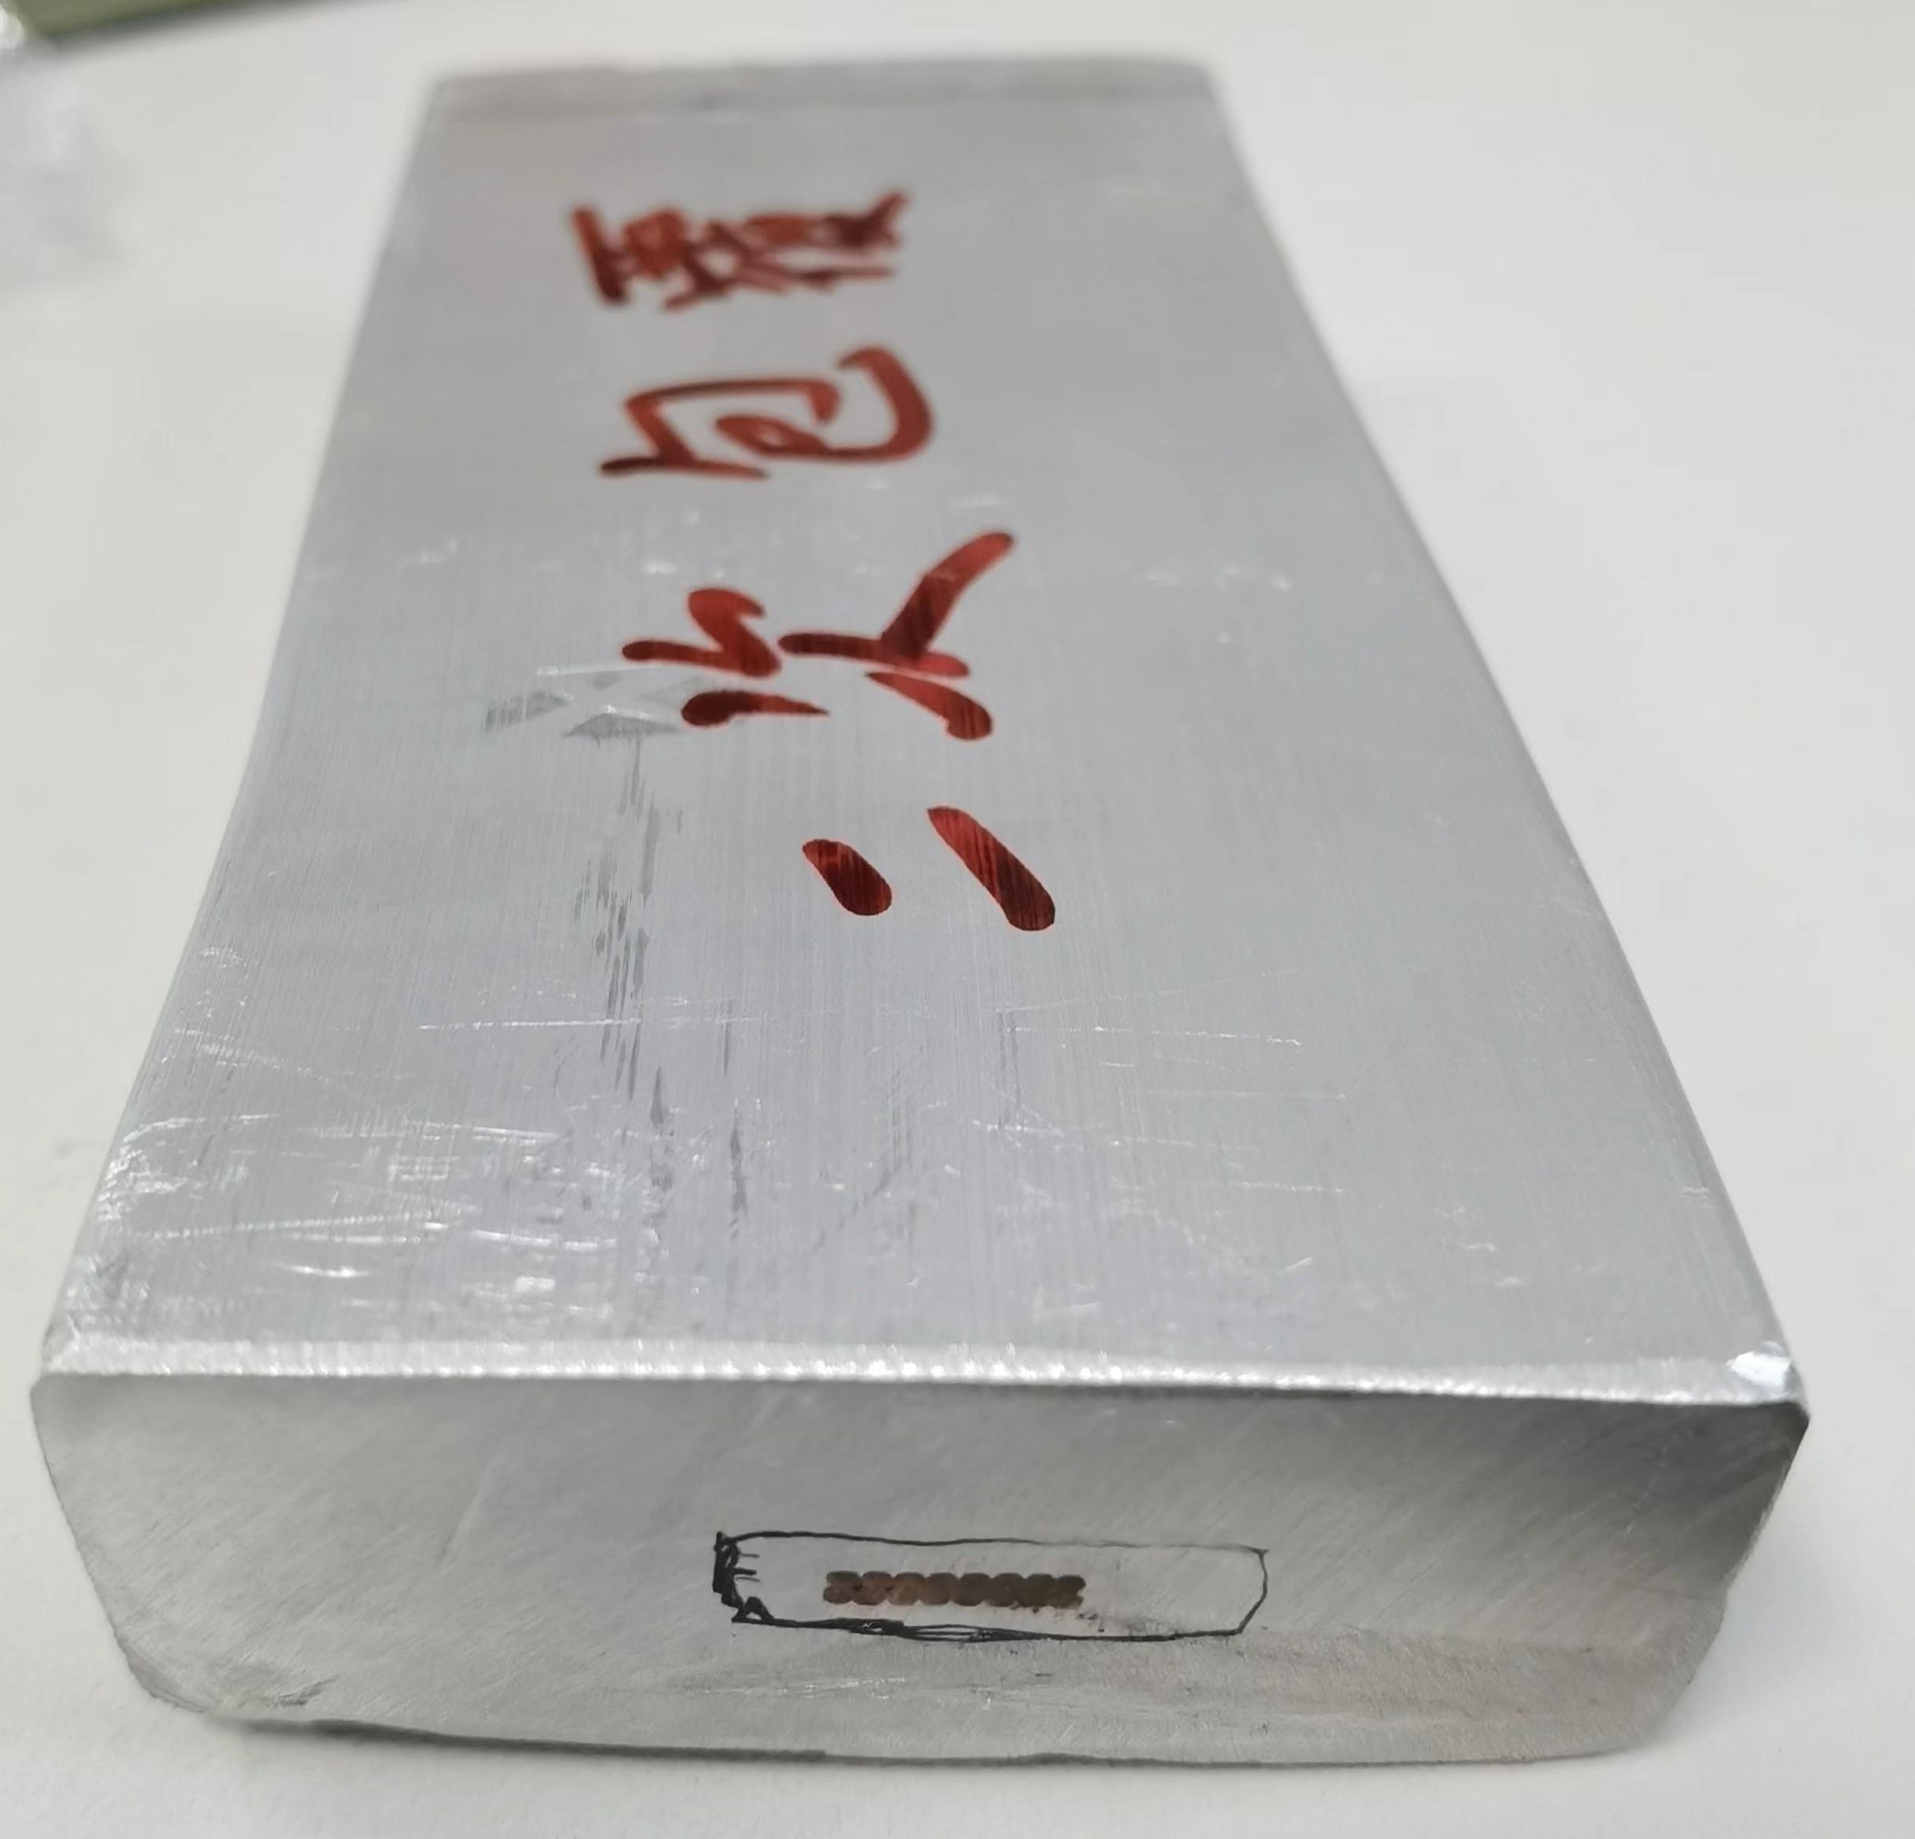
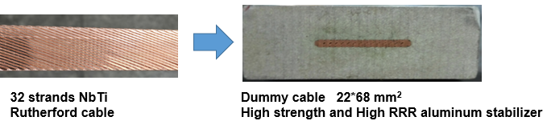
Ref-TDR
Two options
Plan A
Secondary co-extrusion with aluminum alloy (6061)
16 strands Rutherford cable as the first co-extrusion step, and developed the secondary co-extrusion dummy cable at the year 2022.
Aluminium stabilized cable
Dummy cable 56*22mm
Pure aluminum + Copper cable
Box superconductor 56*22mm
Pure aluminum + NbTi cable
Plan B
Single co-extrusion with high-strength and high RRR aluminum
Cold-working (reduce the cross section by 20% to increase the strength)
Cu Rutherford Cable

Slide 8
Ref-TDR
Why choose Option B?
 | Option A | Option B
Advantage | Small size, save radial space; High strength | 1. Simple process, mature first co-extrusion process;
Disadvantage | 1. Complex process, two co-extrusion process. | 1. Need high strength doped pure aluminum; 2. Large radial size.
22*68 mm²
Mature first co-extrusion process;
Some progress has been made in high strength and high RRR aluminum stabilizer (50 kg sample);
Difficulties were encountered in the secondary co-extrusion with aluminum alloy process.
2024
August
2024
October

Slide 9
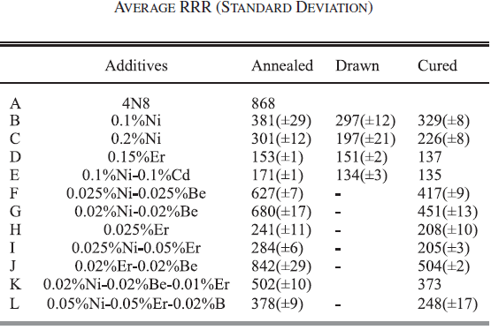
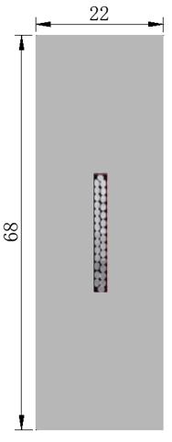
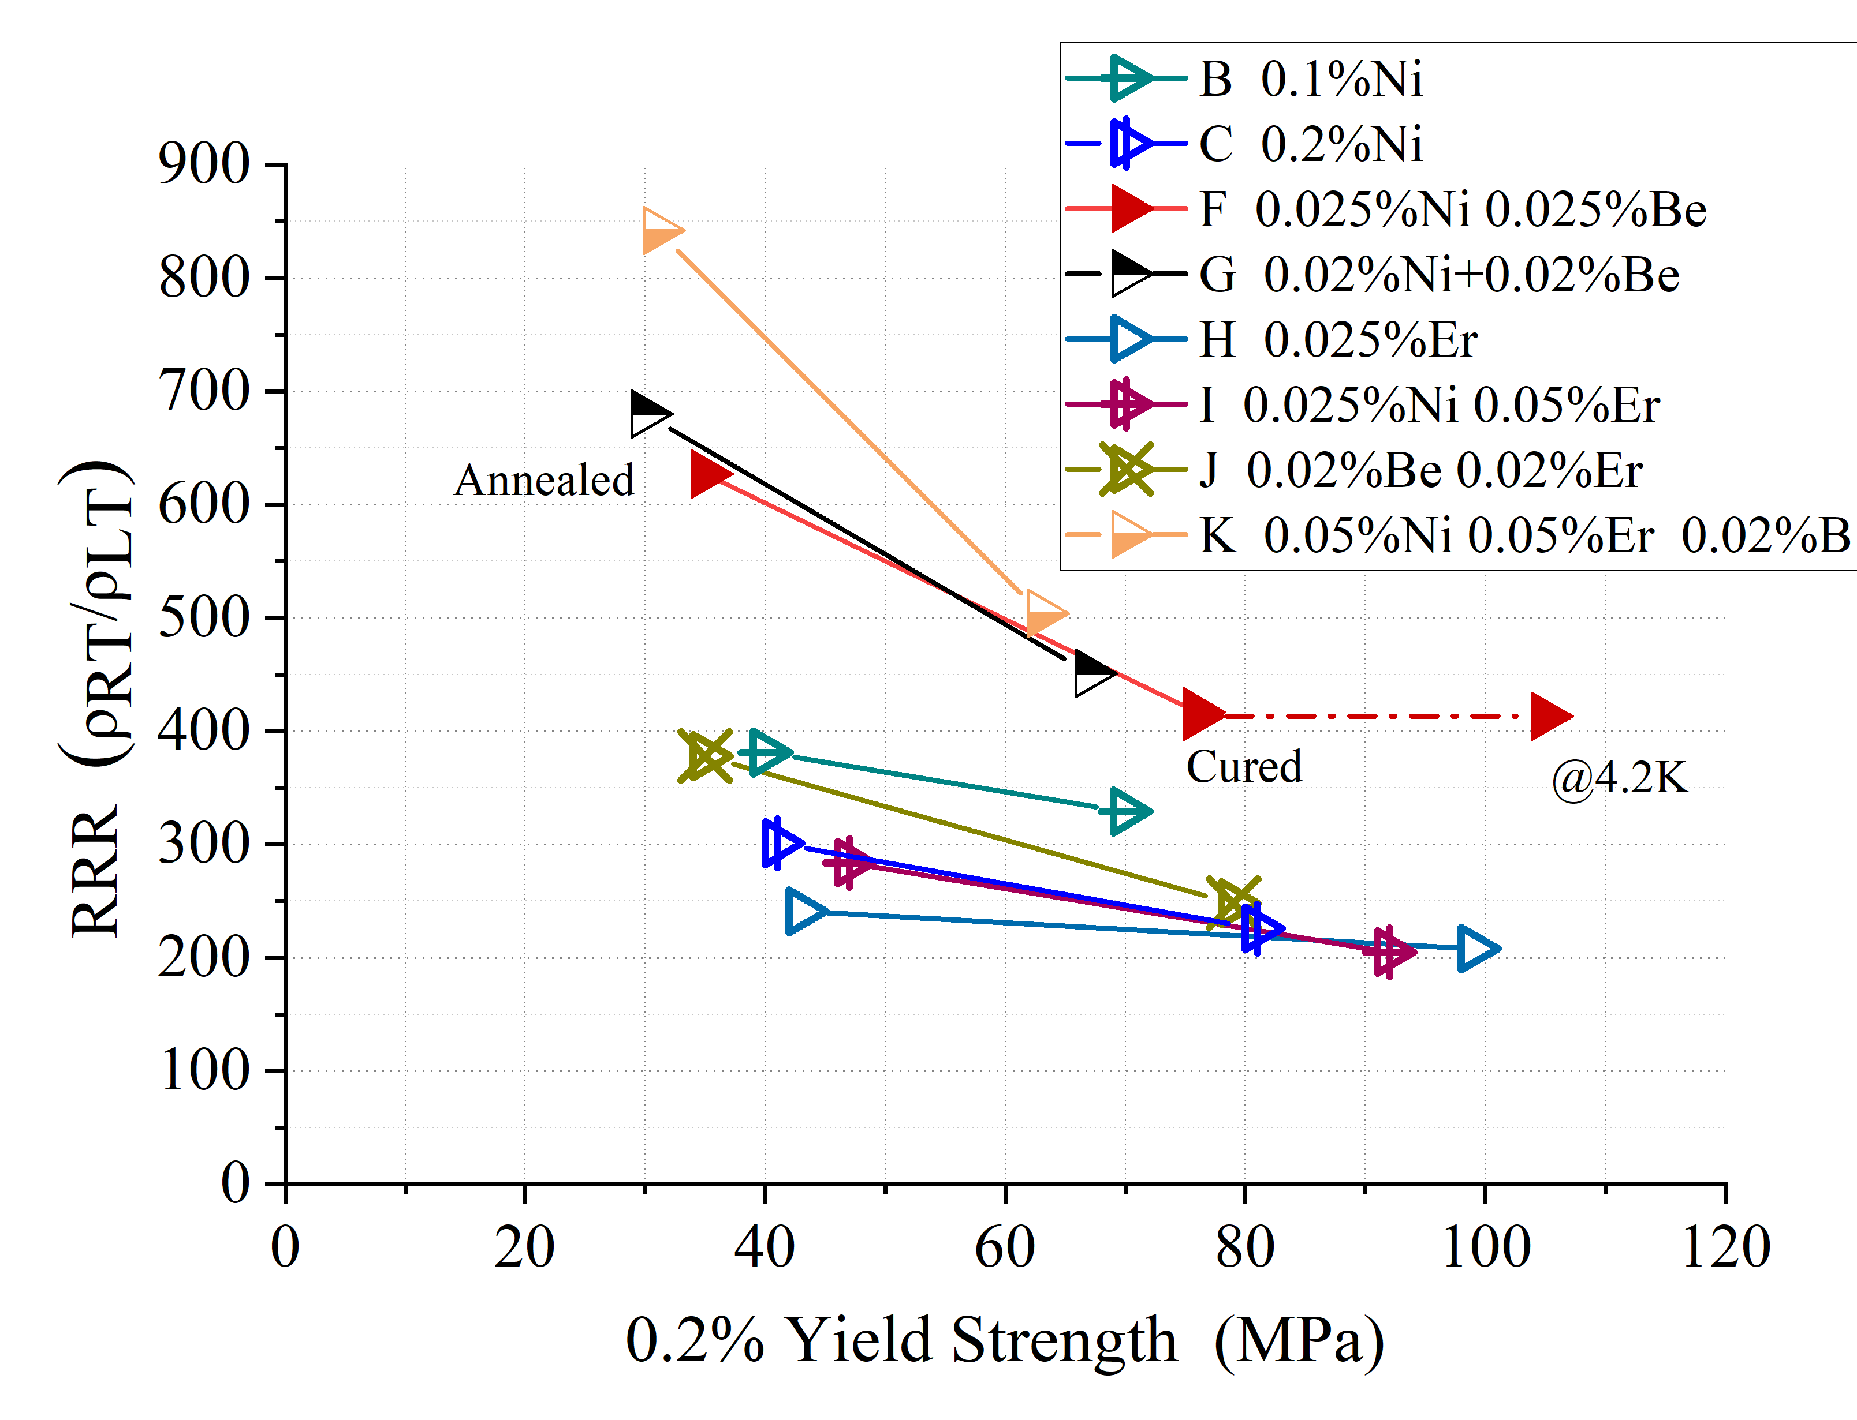
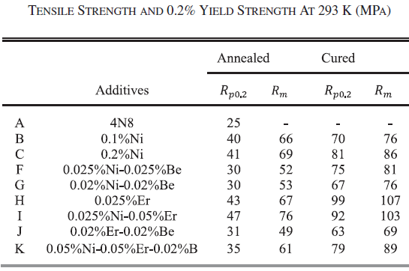
Ref-TDR
Some progress has been made in high strength and high RRR aluminum stabilizer (50 kg sample)
Yield strength > 100 MPa@4.2K, 74 MPa at room temperature, RRR value > 400
Poisson’s ratio | 0.33/0.34
Young modulus | See the curve
Thermal expansivity | 14.23×10⁻⁶ K⁻¹
4.2KRp_{0.2} | 105MPa
NbTi Rutherford cable
High strength and High RRR Al stabilizer

Slide 10
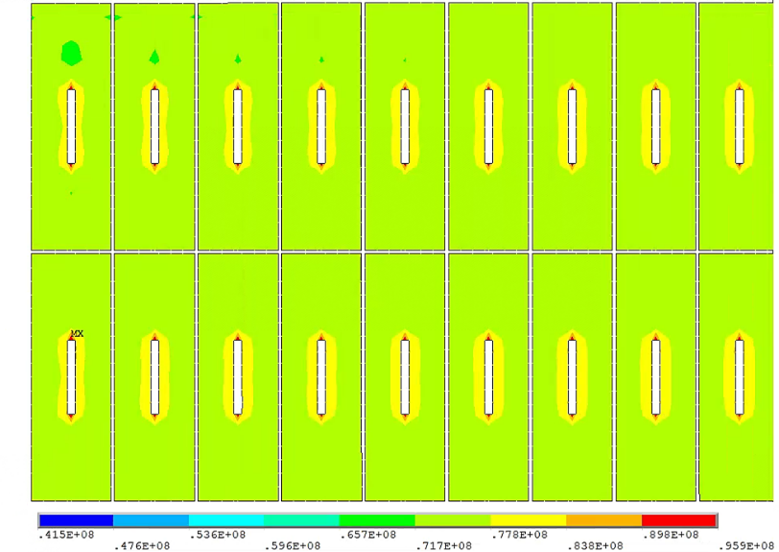
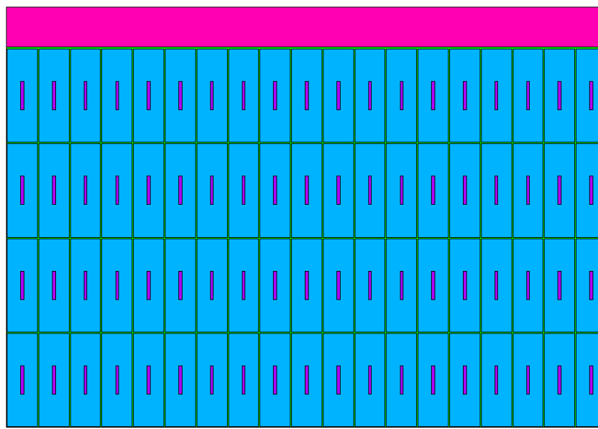
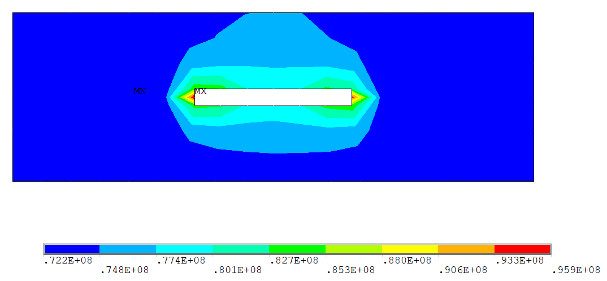
Ref-TDR
Stress analysis
IDRC comments: The maximum von mise stress on the aluminum stabilizer (96MPa) is close to the yield strength of the material (105MPa). The safety margin is less than 1/3 of 0.2% yield strength.
Material | Von Mises stress (MPa)
Coil at 4.2 K
Aluminum stabilizer | 4.4-86.1
SC cable | 174-243
Al alloy support | 4.6-36.2
Coil at 4.2 K, energized
Aluminum stabilizer | 41.5-95.9
SC cable | 54.9-221
Al alloy support | 43.2-87.4
Coil structure

Slide 11
Ref-TDR
Why reactivate Box-type conductor?
The 5-meter prototype cable based on 16-core cables has been developed at April 2025, giving us confidence.
Although a 10-meter-class Al–Ni-based prototype cable (option B) was completed in 2024, Toly pointed out that cold-working a cable of such large cross-section would require very large rolling equipment; with the current budget and available machinery there is no suitable solution.
From the standpoint of stress-design optimization, meeting the stress-design requirements calls for either a larger cable cross-section or a higher-strength material.
22*68 mm²
22*56 mm²

Slide 12
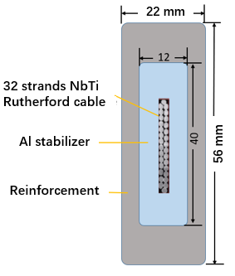
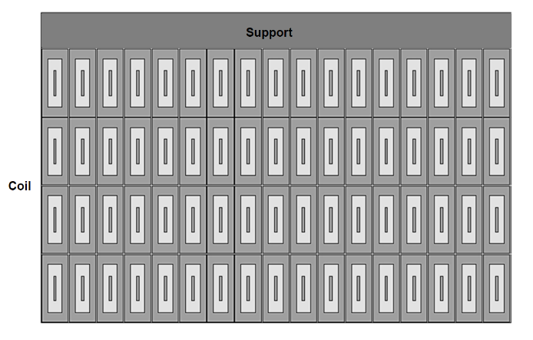
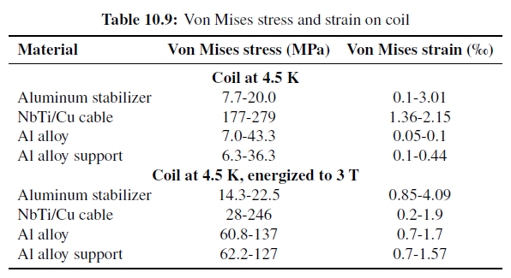
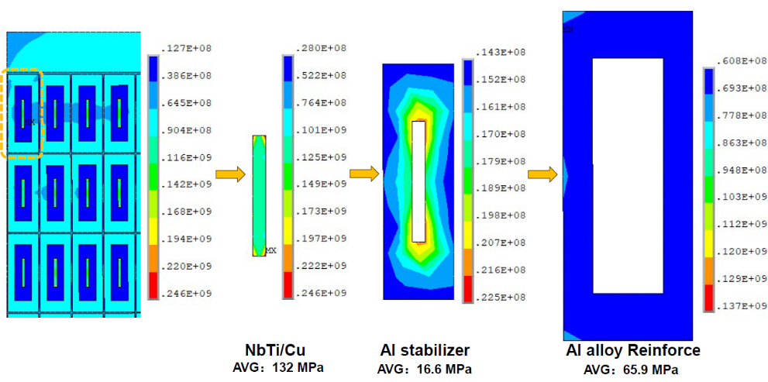
Physical design
Box conductor
Secondary co-extrusion Box-type conductor
Figure 10.4
Figure 10.3
Figure 10.20

Slide 13
Physical design
Box conductor
The maximum and average Von Mises stresses of each material of the conductor in the maximum stress turn:
Maximum stress in each coil material remains within allowable limit, providing sufficient safety margins for stable coil operation. We have at least 1/3 safety margin.
Materials | Maximum Von mise/MPa | Average Von mise/MPa | Rp0.2@4.2K/MPa | Allowable stress@4.2K/MPa | Safety margin 1-Max Stress/Rp0.2
NbTi/Cu | 246 | 132 | >500 | 300 | 50.8%
4N8 Al stabilizer | 22.5 | 16.6 | ~34 | 22.7 | 33.8%
Aluminum alloy | 137 | 65.9 | >350 | 233 | 60.8%

Slide 14
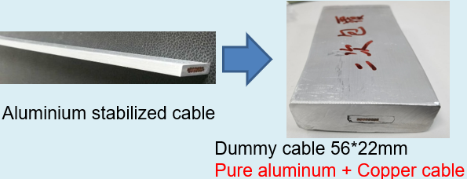
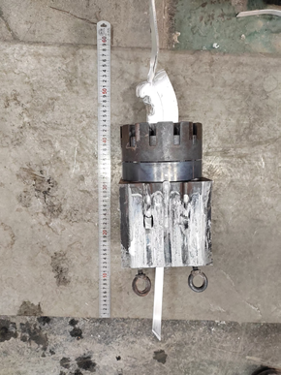
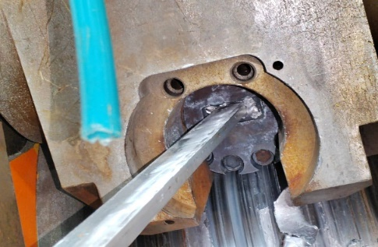
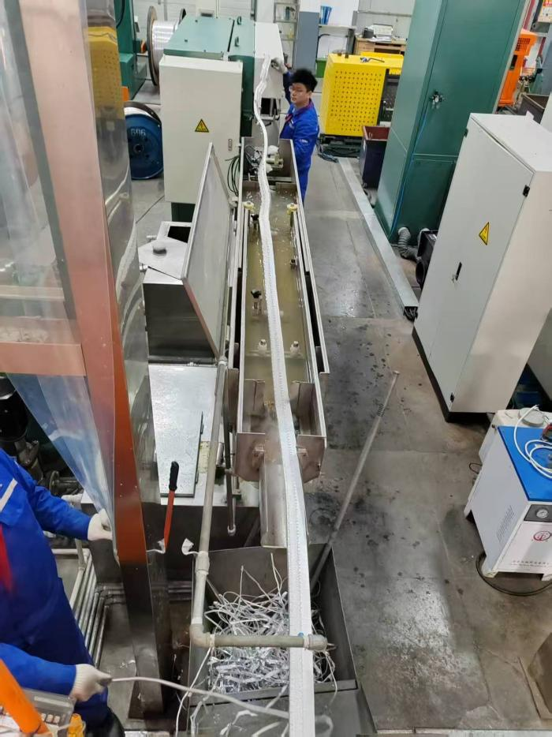
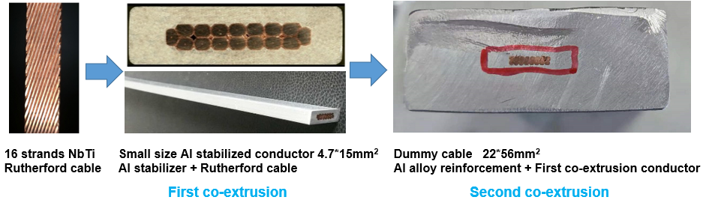
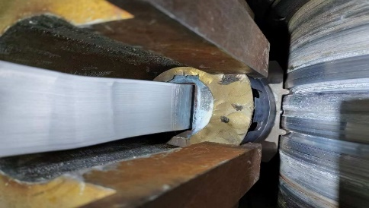
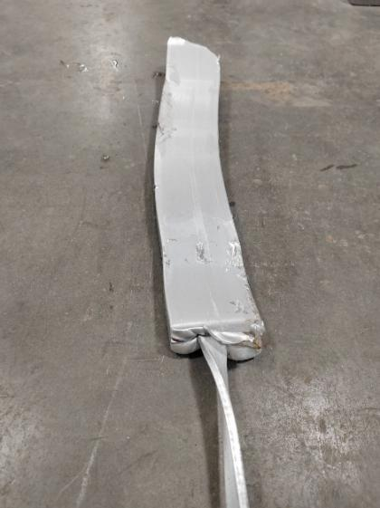
Superconducting cable developing progress
Box-type Conductor developing progress:
16 strands copper Rutherford cable as the first co-extrusion step, and developed the secondary co-extrusion with 1100 pure aluminum dummy cable at the year 2022.
4th conceptual detector
Short sample with 16-core NbTi Rutherford cable and secondary co-extrusion with 6061 aluminum alloy at year 2023.
The 5-meter cable based on 16-core NbTi Rutherford cable and secondary co-extrusion with 6061 aluminum alloy has been developed at April 2025
NbTi Rutherford cable 16 strands
First co-extrusion
pure Aluminum
+Rutherford cable
Second co-extrusion with Aluminum alloy

Slide 15
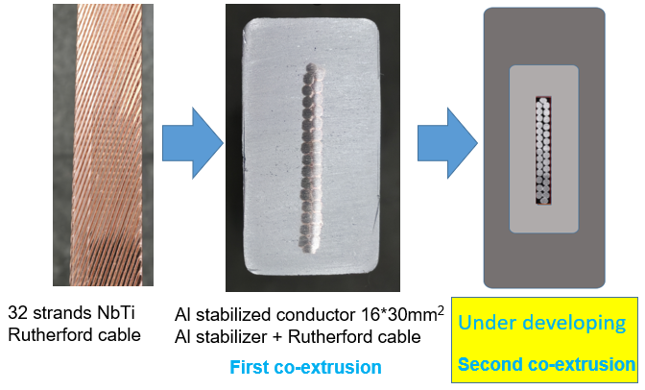
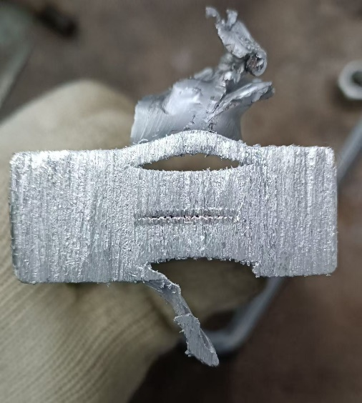
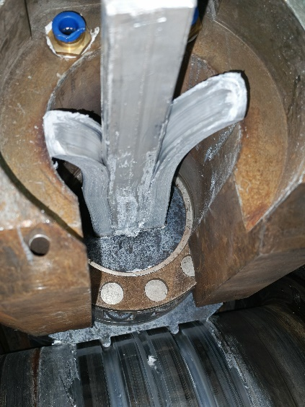
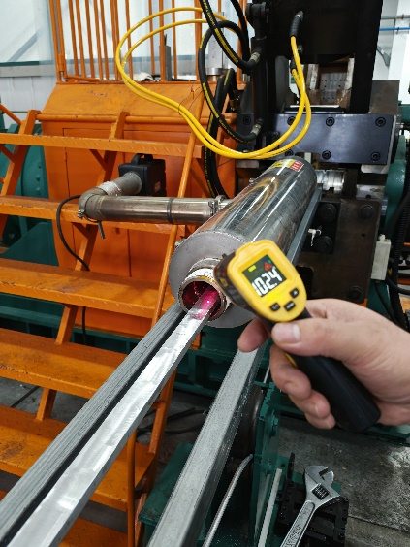
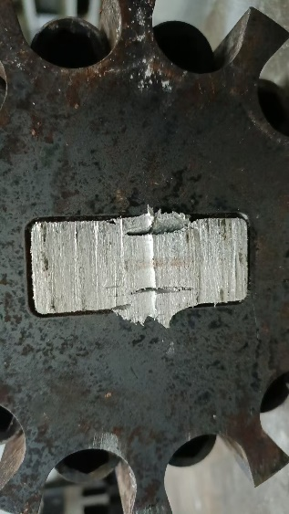
Superconducting cable developing progress
Box-type Conductor developing :
Full size Box-type Super-conductor development:
The 32 strands LTS Rutherford cable was developed and finished the first co-extrusion process. Now we are doing the last and difficult step secondary co-extrusion.
Continuously improving the process, such as core wire preheating, size adjustment and mold optimization.
May to Oct 2025
2025-10-21

Slide 16
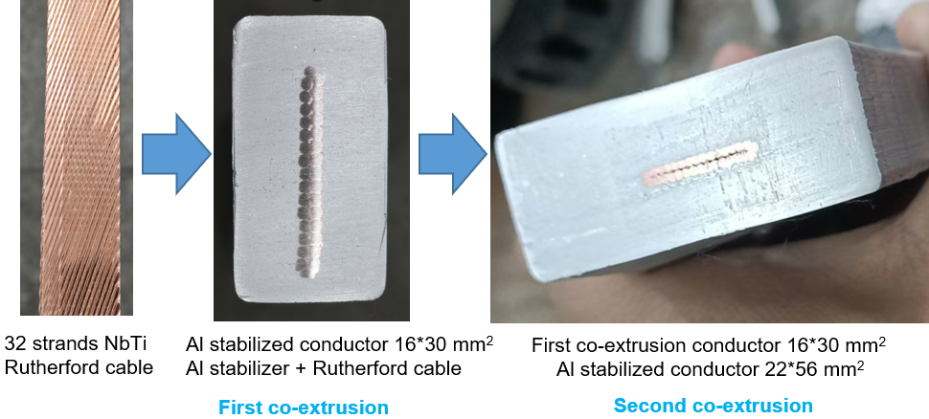
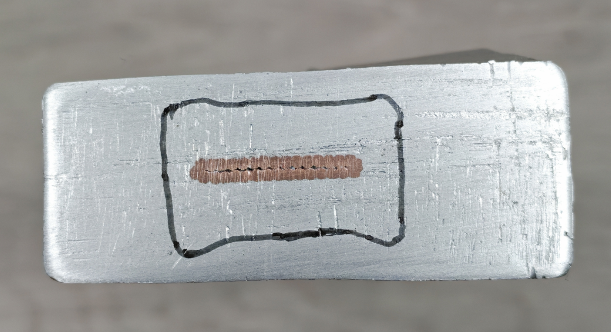
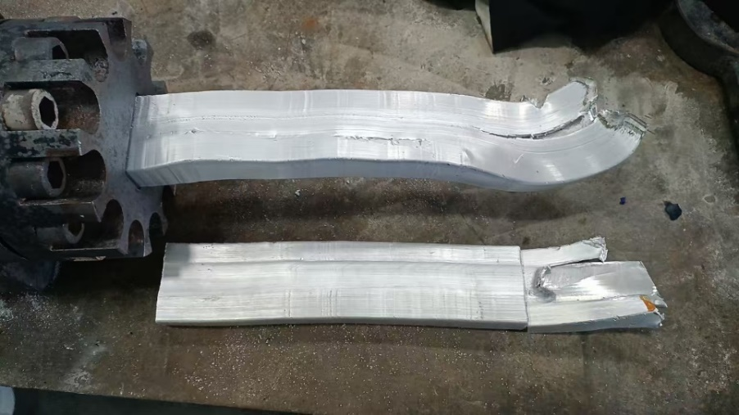
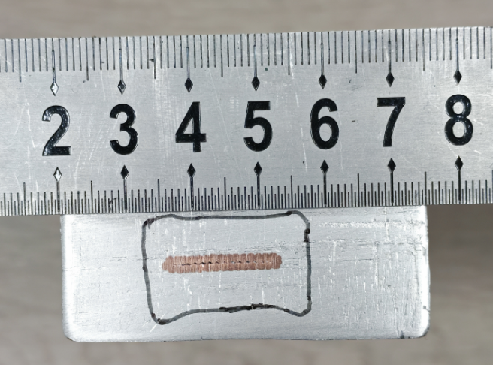
Superconducting cable developing progress
0.5 m full size Box-type Super-conductor sample was developed at 2025-11-22
The core aluminum-coated cable 16 × 30 mm²;
Pre-heating 550℃, 4.5r/min；
The first optimized 22 × 56 mm² secondary co-extrusion mold is used.
During the cable processing, excessive material overflow caused mold blockage, resulting in aluminum coating interruption.
Adjust the co-extrusion machine and optimize the extrusion mold to develop longer cable.
2025-11-22

Slide 17
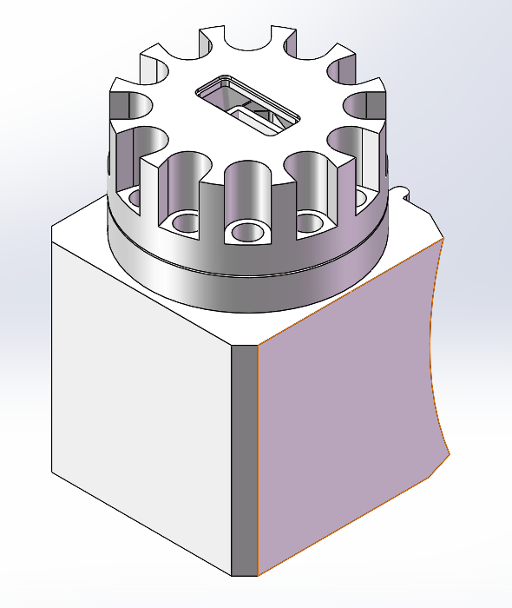
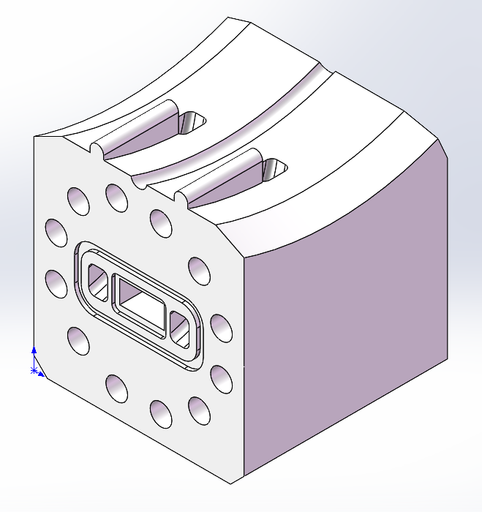
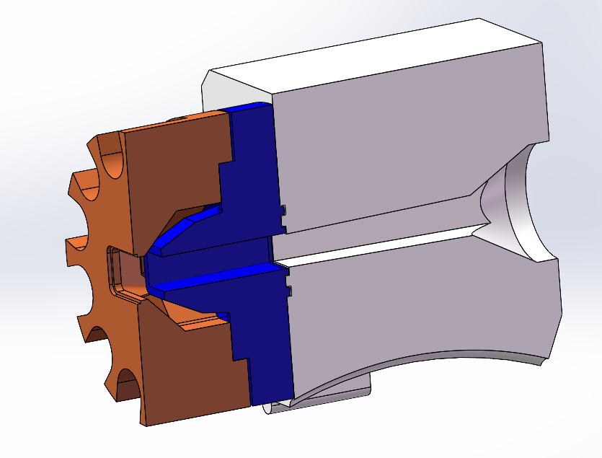
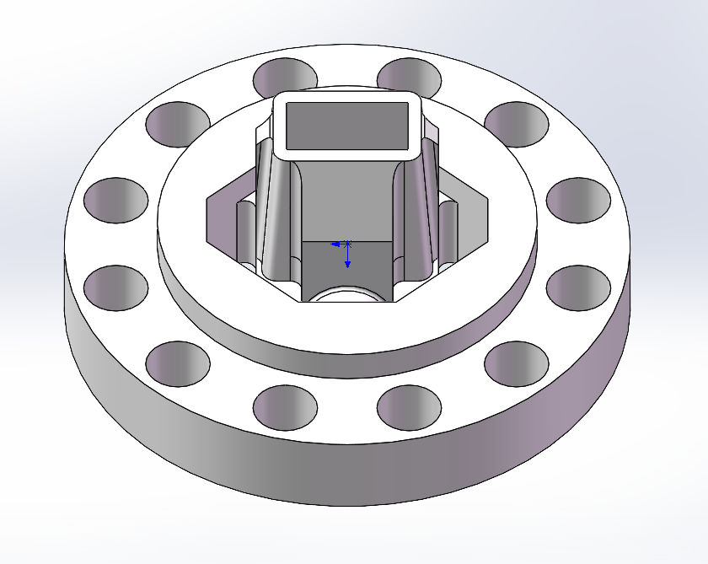
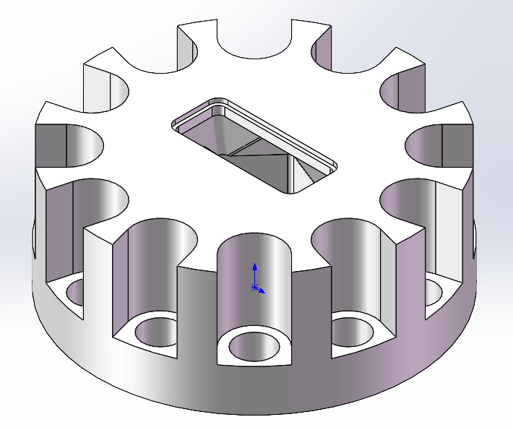
Superconducting cable developing progress
Optimize the extrusion mold to develop longer sample.
Perform 3D modeling of the mold;
analyze the causes of aluminum coating failure ；
optimize and adjust the mold accordingly.

Slide 18
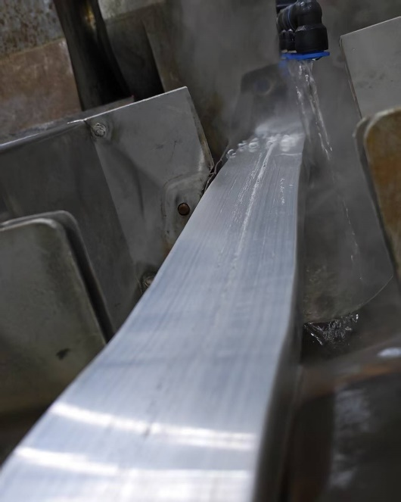
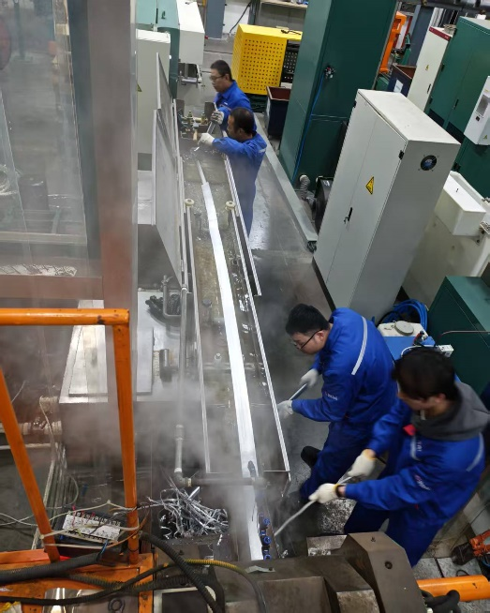
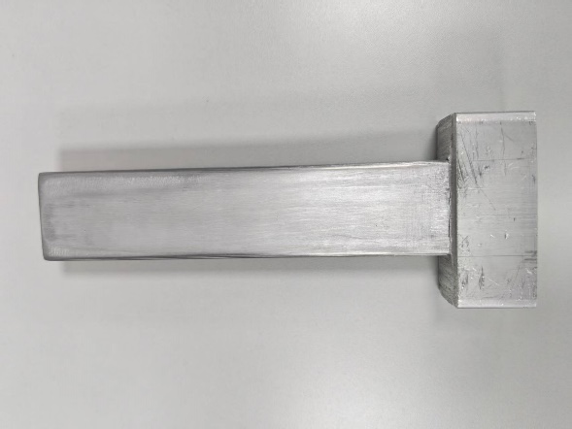
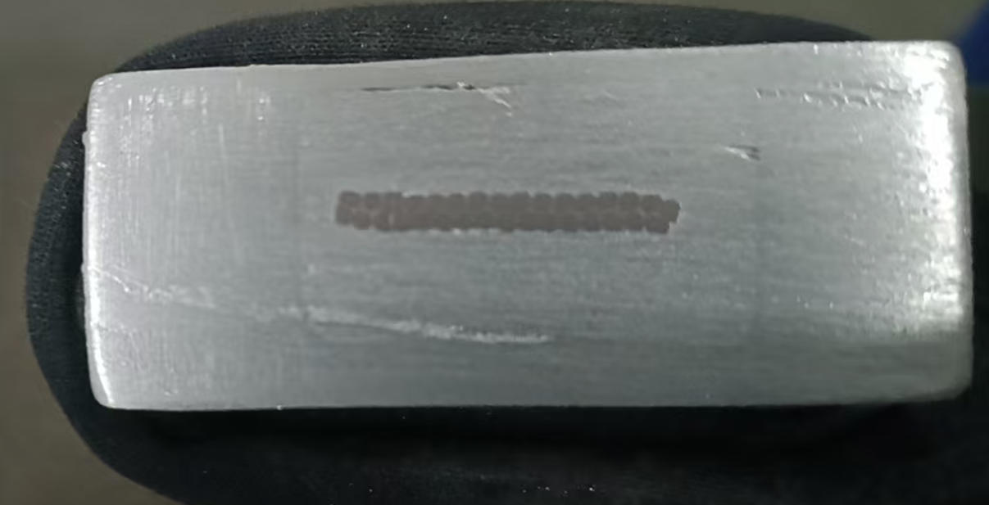
Superconducting cable developing progress
5 m full size Box-type dummy cable was developed at 2025-12-13
The copper Rutherford cable is used;
First aluminum-coated cable 16 × 30 mm²;
Optimized 22 × 56 mm² secondary co-extrusion mold is used.
A 5-meter-long cable was developed, using copper wire instead of superconducting wire inside. All aspects went smoothly, and the reason for only producing 5 meters is that the core wire is only 5 meters long.
Next, we will use the 20 meter aluminum coated cable we previously produced for full-size cable processing.
2025-12-13

Slide 19
Superconducting cable developing progress
Box-type Conductor developing plan:
2025 Full size Box-type Super-conductor sample:
We are doing:
Adjust the co-extrusion machine and optimize the extrusion mold to develop longer sample.
Continuously optimizing these processes:
mold optimization; core wire preheating
2026
100 meters full size Box-type Super-conductor development;
Address the issue of process stability.

Slide 20
Working plan in TDR
Full-size Aluminum stabilized superconducting conductor development
1.5km Cable processing
Short sample
100 m
2025
2026
2027
2028
2029
Validation experiments for mechanical suspension structure and cooling structure
Scaled model coil design
Processing, Assembly, and Testing of Model Coil

Slide 21
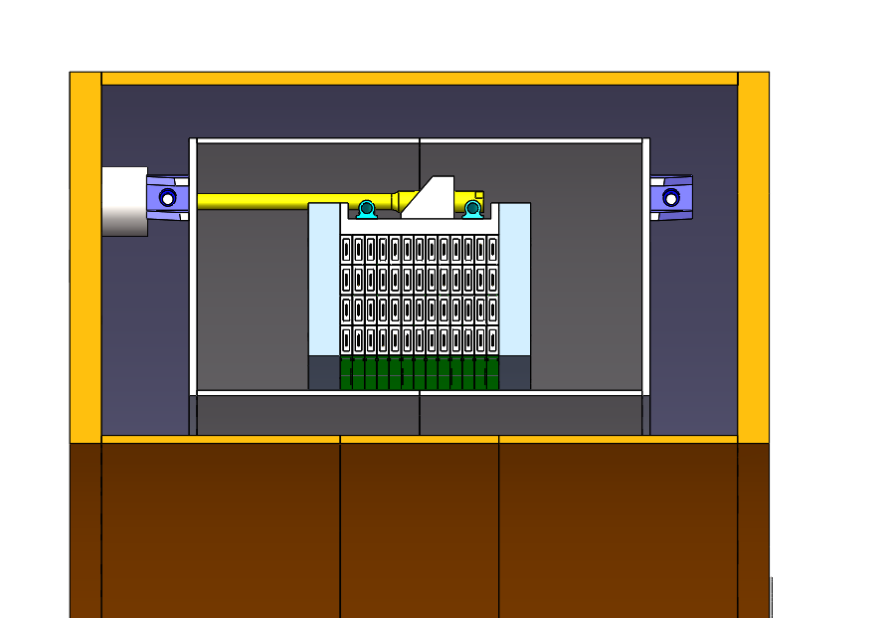


Scaled model coil
Model coil design
Full size conductor，300 m per layer, total 1.5 km;
4 layers * 13 turns, same diameter with CEPC

Slide 22




Alternative Solutions
Yield stress@4.2K
Alternative solutions for superconducting conductors
High strength Al stabilizer | NbTi | 5083 Al alloy
105 MPa | >300 MPa | 500 MPa
Option B: single co-extrusion cable.
Increasing the radial dimension of the cable can reduce the stress on the aluminum stabilizer.
Limited by the current aluminum-coating equipment, the maximum radial size of the cable can only reach 68 mm.
Cable structure | 56*22 mm² | 56*28 mm² | 68*22 mm² | 80*22 mm²
Coil at 4.2 K
Aluminum stabilizer | 5.5-88.3 | 4.3-89.5 | 4.4-86.1 | 3.9-86.3
SC cable | 172-242 | 174-245 | 174-243 | 174-243
Al alloy |  | - | -
Support | 5.65-36.3 | 4.2-36 | 4.6-36.2 | 3.9-35.8
Coil at 4.2 K, energized
Aluminum stabilizer | 47-103 | 44.7-102 | 41.5-95.9 | 36.5-92.6
SC cable | 20.9-208 | 31.3-211 | 54.9-221 | 73.1-214
Al alloy | - | - | -
Support | 49.5-115 | 46.9-104 | 43.2-87.4 | 37.5-74

Slide 23


Alternative Solutions
Solutions for superconducting conductors
Welded-structure aluminum stabilized conductor
This cable design enhances mechanical strength by welding aluminum alloy onto both sides. Its structure closely similar to the configuration used in the CMS experiment.
Electron-beam welding requires an extremely large vacuum chamber.
We have already cooperated with manufacturers to produce short cable samples.

Slide 24







HTS option
High Temperature Superconducting (HTS) R&D is also needed for a long time plan.
Aluminum stabilized Stacked REBCO Tape Cable (ASTC) development.
By continuously optimizing and improving the process, the degradation of critical current is controlled less than 10%.
Ic=700A
Ic=900A
2025-06-17
2025-11-12
10 HTS tapes inside

Slide 25

Application Prospects of HTS cable

Slide 26






Source of Funds
Nuclear Fusion
Stellarator and Tokamak
HTS
Detector Magnets
(Baby)IAXO
LTS
The Aluminum-stabilized conductor is currently under negotiation.
项目名称 | 项目类型 | 角色 | 起止时间 | 直接经费 （万元）
三维高温超导线圈关键技术预研 | 中国科学院国际合作局全球共性挑战专项 | 参与 | 2024/1/1-2027/12/31 | 130
Applied by USTC, IHEP get 0.4 million Yuan RMB
20% management fee and a 13% tax need to be deducted.
铝稳定体高温超导叠型电缆的仿星器结构线圈加工与测试
Fermilab: mu2e
PANDA experiment at FAIR
CERN: ALICE-3
Alice-3 detector upgrade

Slide 27

Source of Funds

Slide 28
Costs on different R&D stages
LTS R&D |  | Time | Costs (million RMB) | Contents
Box type conductor |  | 2025 | 0.69 | Get the support from Henan
100 m Box type conductor |  | 2026 | 1 | Long cable development, optimize the cable performance;
Conductor test |  | 2026 | 1.5 | Critical current test; mechanical test; RRR value test; Bonding face; Cable joint
Model coil | 1.5km conductor processing | 2026 | 3.5 | Scaled model coil, 300 m per layer, total 4 layers
Model coil | Coil | 2027 | 1 | Coil support, winding, vacuum epoxy impregnation
 | Current leads | 2027 | 1 | 20 kA current leads
 | Cryostat | 2027 | 0.6 | Thermal shield, vacuum cryostat, suspend system
 | Valve box and temperature sensors | 2028 | 0.7 | Valve box, temperature sensors and monitoring, liquid helium monitoring
 | Test experiments | 2028 | 0.5 | Based on the existing liquid helium recovery testing platform
 | Power source and quench protection | 2028 | 0.3 | Borrow 20 kA power source and quench protection system.
 | Total | 2026-2028 | 7.6
HTS R&D | Time | Costs (million RMB) | Contents
ASTC conductor | 2025-2026 | 0.7 | Get the support from Henan
REBCO tape | 2026 | 0.8 | Long cable development
ASTC | 2027-2028 | 0.7 | Cable processing
Conductor test | 2026-2028 | 0.6 | Critical current test; mechanical test; Cable joint
Quench protection study | 2027-2028 | 1.5 | 0.9 million equipment, glass fiber, cryostat, sensors

Slide 29
Summary
The cable selection process:
Due to progress and stress considerations, the cable selection has undergone iterations.
The current cable solution may still not be the final choice.
We will develop a full size cable sample this year (2025) and 100 m long cable next year (2026).
Alternative solutions
Single co-extrusion with high strength pure aluminum stabilizer;
CMS like cable.
We need more funds on aluminum stabilized LTS and HTS conductors.

Slide 30
Thank you!
Dec, 2025, CEPC DAY

