Slide 1
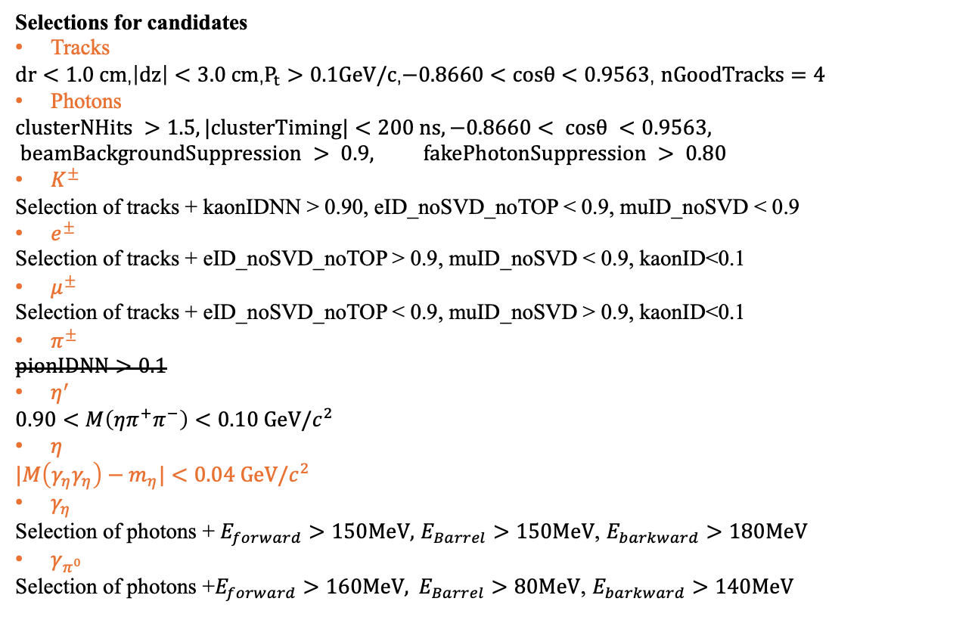
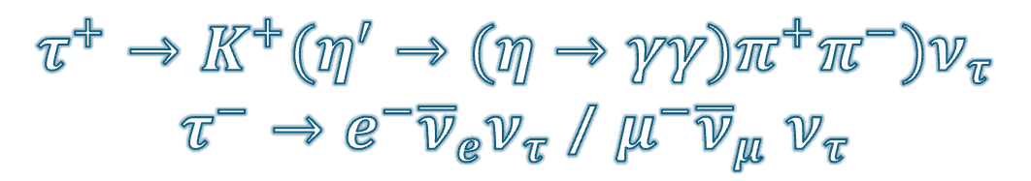
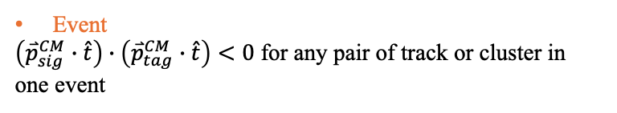
$$τ^{+}→K^{+}(η^{′}→(η→γγ)π^{+}π^{−})ν_{τ}$$
$τ^{−}→e^{−}{\overline{ν}}_{e}ν_{τ}$ / $μ^{−}{\overline{ν}}_{μ}$ $ν_{τ}$
Selections for candidates
Tracks
$dr<1.0 cm$,$\left|dz\right|<3.0 cm$,$P_{t}>0.1GeV/c$,$−0.8660<cosθ<0.9563$, $nGoodTracks=4$
Photons
$$clusterNHits >1.5, |clusterTiming|<200 ns, −0.8660< cosθ <0.9563, beamBackgroundSuppression > 0.9, fakePhotonSuppression > 0.80$$
$K^{±}$
Selection of tracks + kaonIDNN > 0.90, eID_noSVD_noTOP < 0.9, muID_noSVD < 0.9
$e^{±}$
Selection of tracks + eID_noSVD_noTOP > 0.9, muID_noSVD < 0.9, kaonID<0.1
$μ^{±}$
Selection of tracks + eID_noSVD_noTOP < 0.9, muID_noSVD > 0.9, kaonID<0.1
$π^{±}$
$$pionIDNN>0.1$$
$η^{′}$
$$0.90<M\left(ηπ^{+}π^{−}\right)<0.10 GeV/c^{2}$$
$η$
$$|M\left(γ_{η}γ_{η}\right)−m_{η}|<0.04 GeV/c^{2}$$
$γ_{η}$
Selection of photons + $E_{forward}>150MeV,$ $E_{Barrel}>150MeV$, $E_{barkward}>180MeV$
$γ_{π^{0}}$
Selection $\text{of} \text{photons}\text{ +}E_{forward}>160MeV, E_{Barrel}>80MeV\text{,} E_{barkward}>140MeV$
Event
$\left({\overset{⃑}{p}}_{sig}^{CM}∙\hat{t}\right)∙\left({\overset{⃑}{p}}_{tag}^{CM}∙\hat{t}\right)<0$ for any pair of track or cluster in one event

Slide 2
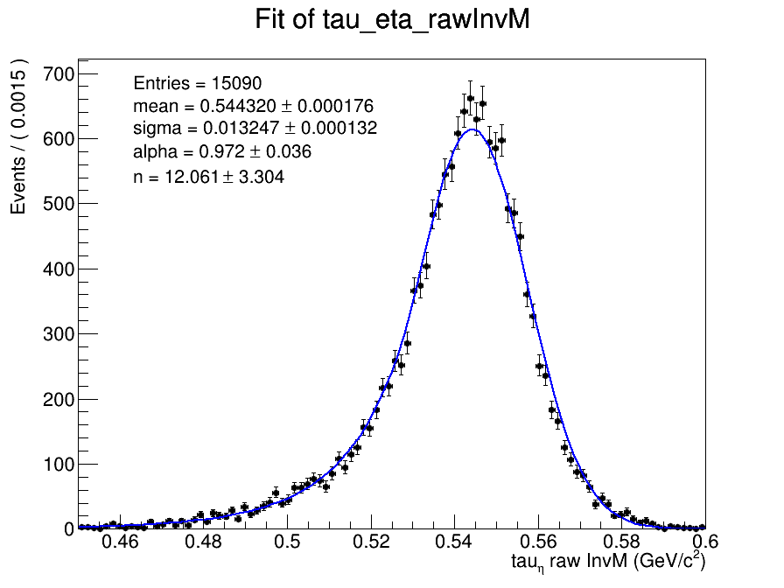
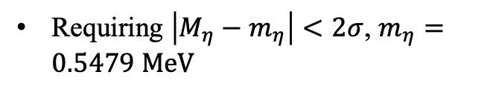
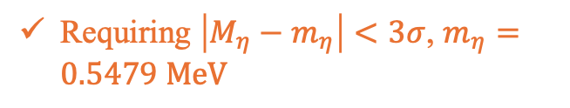
Optimization of eta’s mass window
Requiring $\left|M_{η}−m_{η}\right|<2σ$, $m_{η}=0.5479 MeV$
FOM=0.0114 +/- 0.0005
eff=0.0774 +/- 0.0007
还是选择了3倍sigma作为质量窗
Requiring $\left|M_{η}−m_{η}\right|<3σ$, $m_{η}=0.5479 MeV$
FOM=0.0113 +/- 0.0004
eff=0.0848 +/- 0.0007

Slide 3

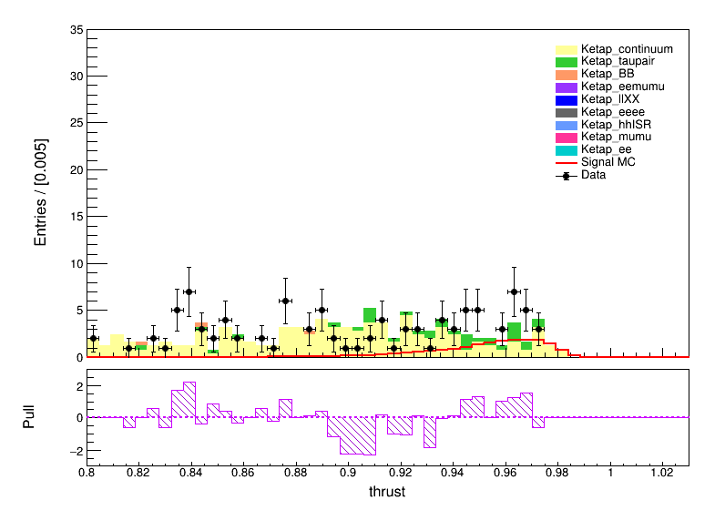
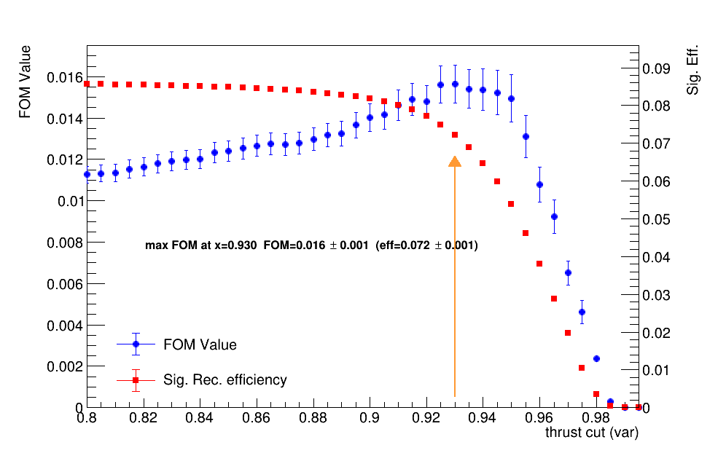
Comparison our selections with previous BARBAR’s
From previous BarBar’s paper:
要不要加这个cut呢？（暂时没加）

Slide 4
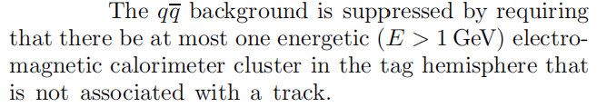
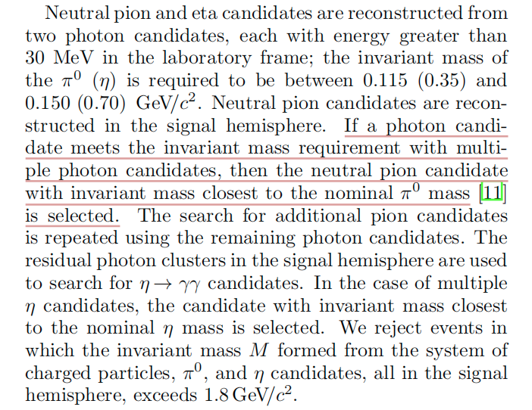
Comparison our selections with previous BARBAR’s
不太明白啥意思
这里是想对中性的粒子都做运动学拟合吗？然后选取最好的那个粒子？

Slide 5
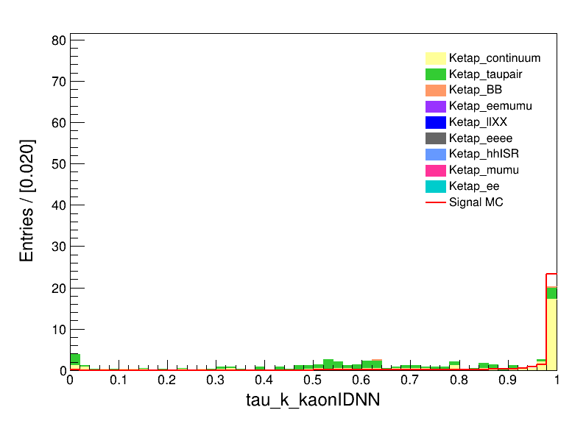
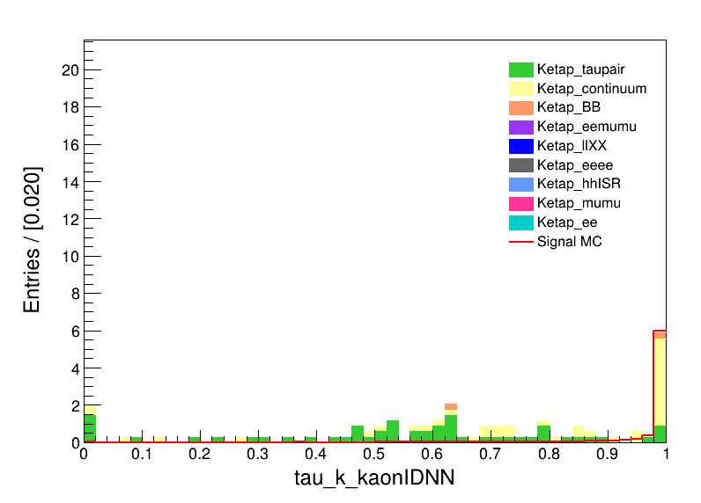

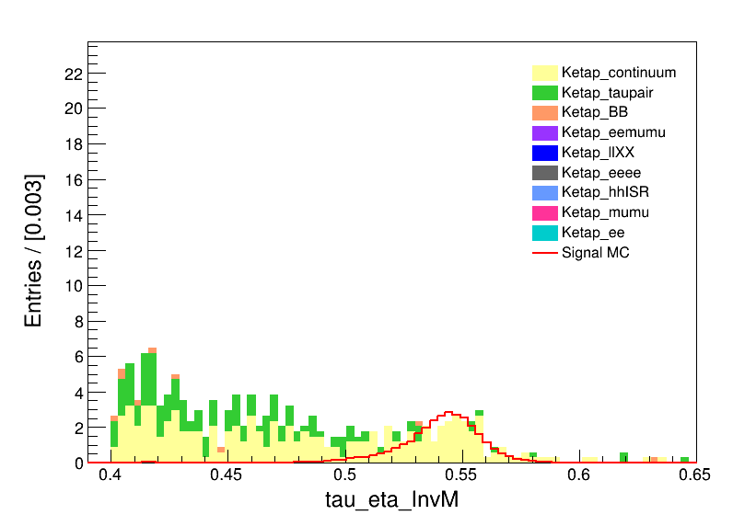
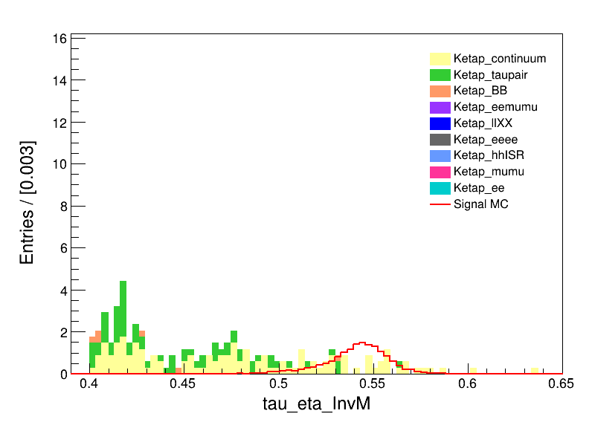
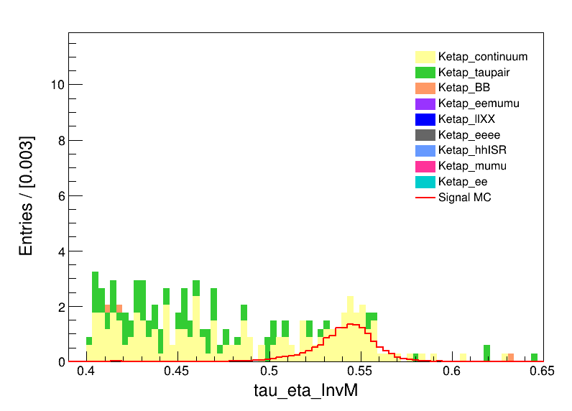
Some distributions
both
e
mu
both
e
mu

Slide 6
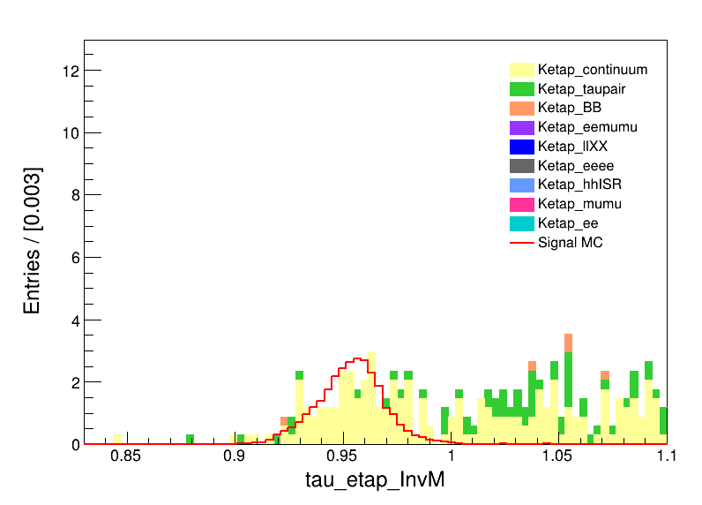
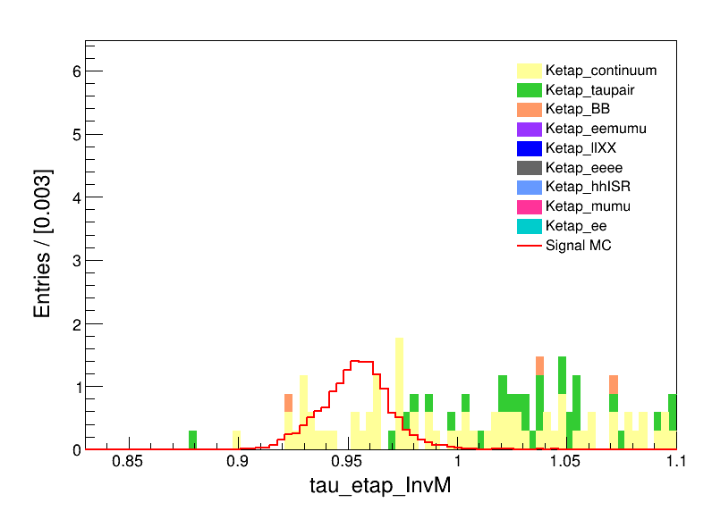
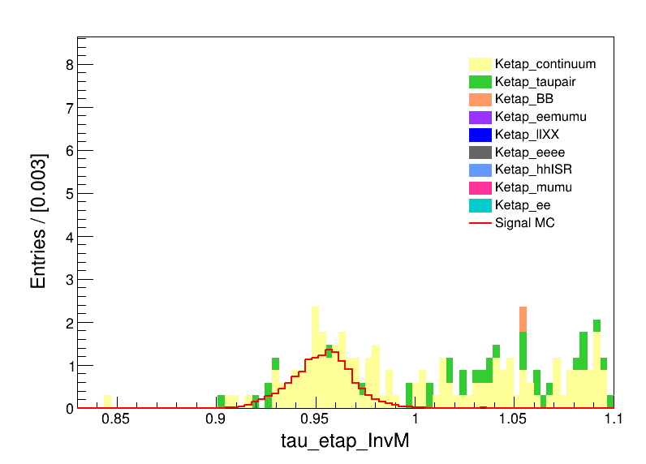
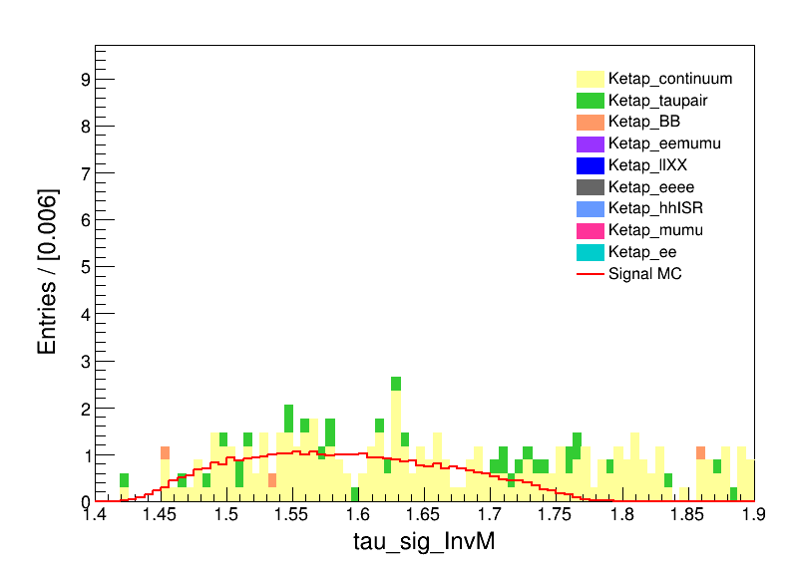
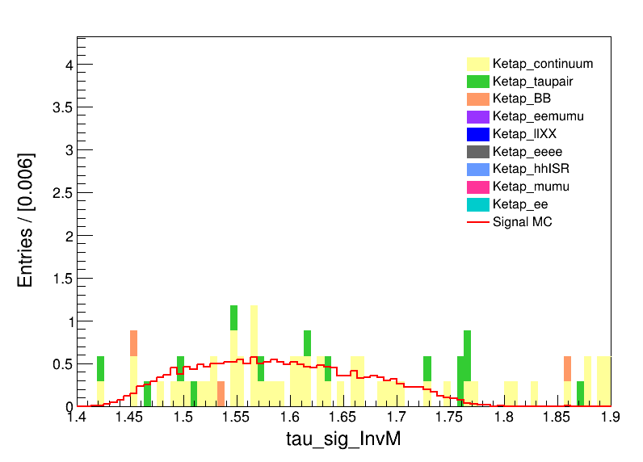
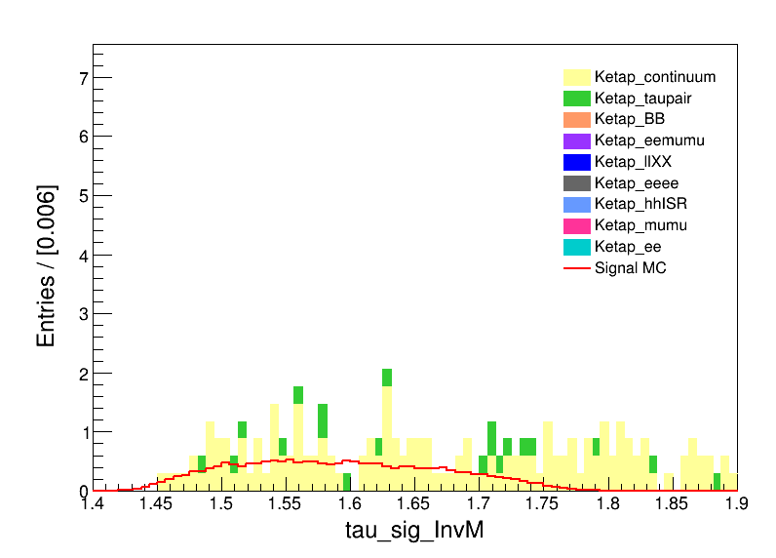
Some distributions
both
e
mu
both
e
mu

Slide 7
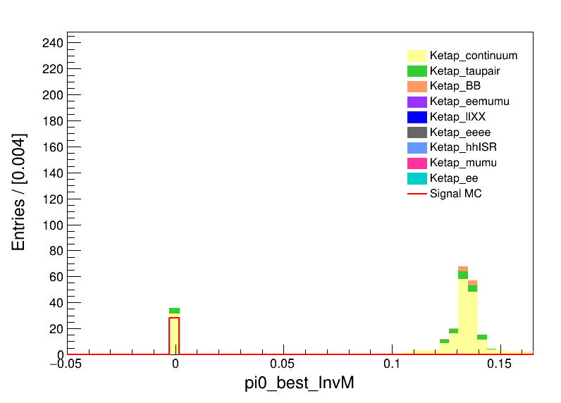
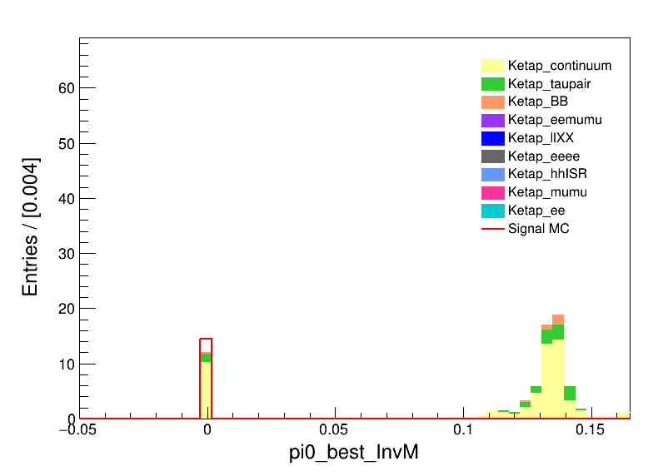

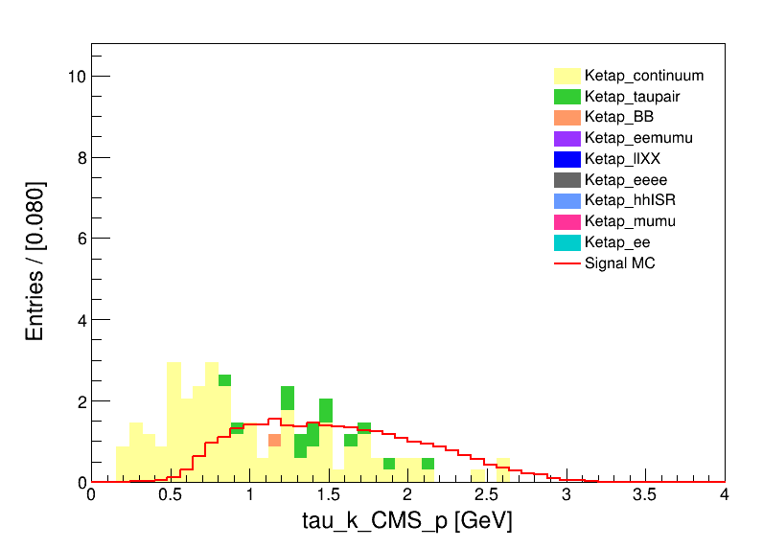
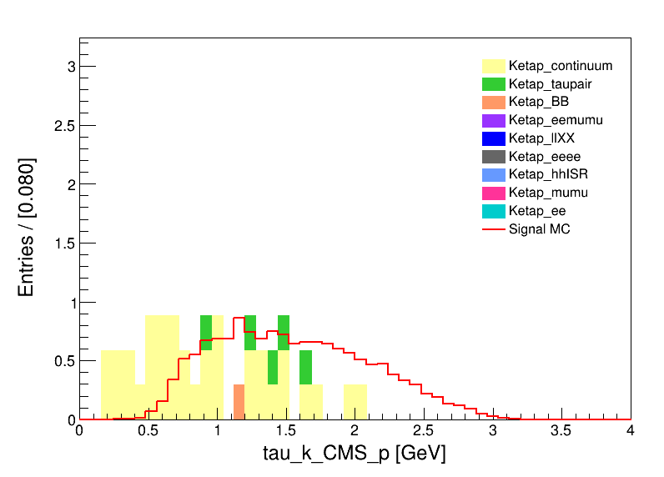
Some distributions
both
e
mu
both
e
mu

Slide 8
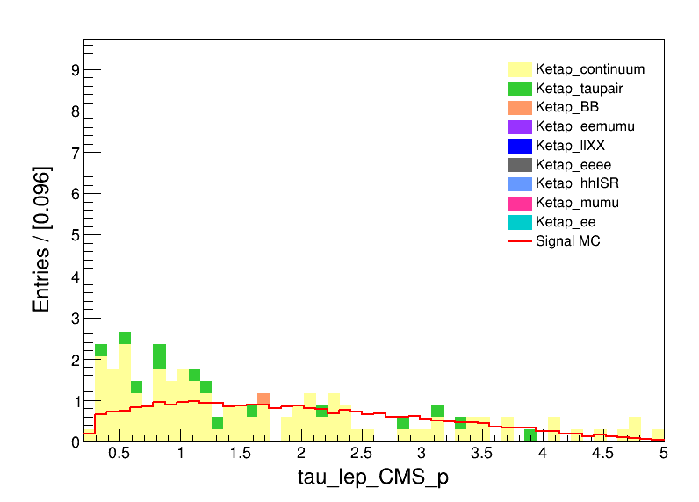
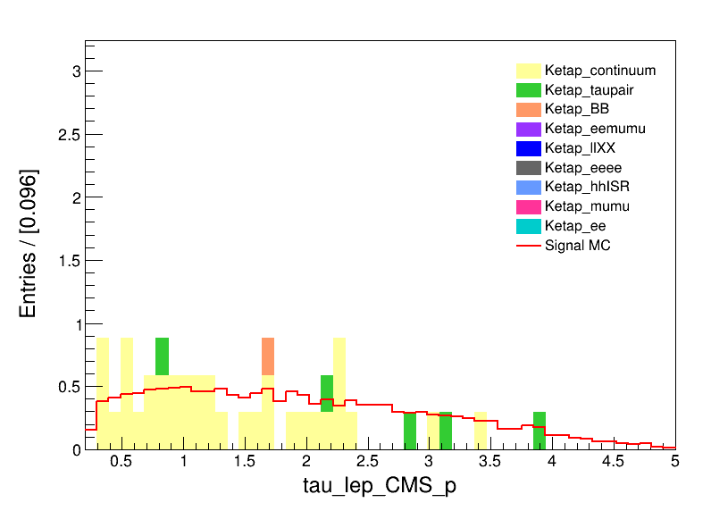
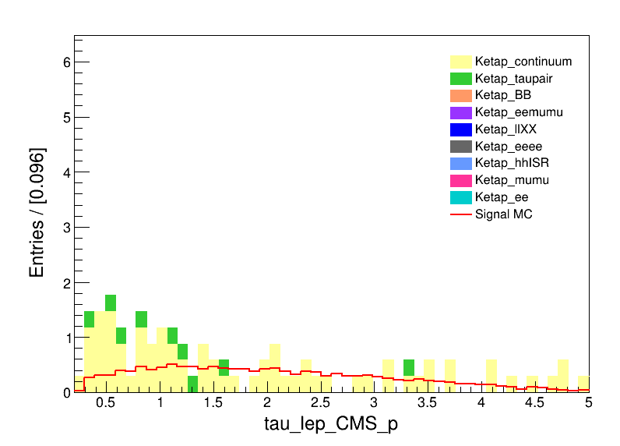
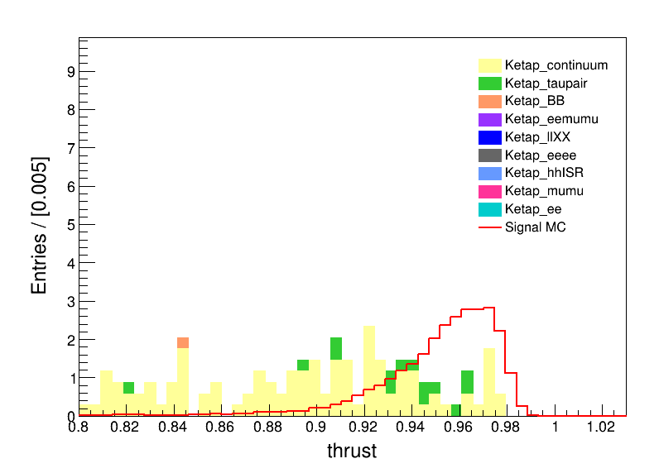
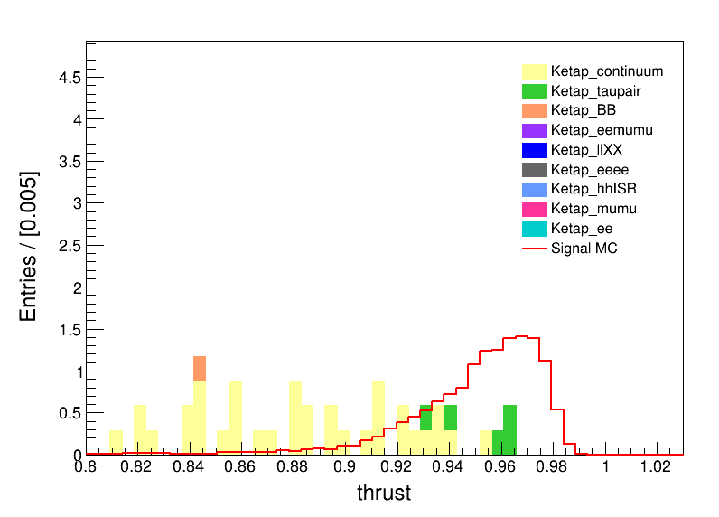
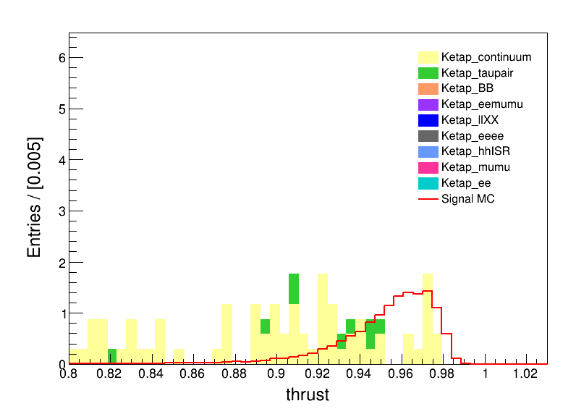
Some distributions
both
e
mu
both
e
mu

Slide 9
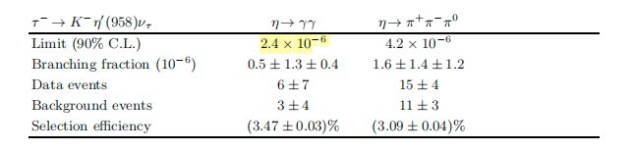
Barbar’s Result

Slide 10
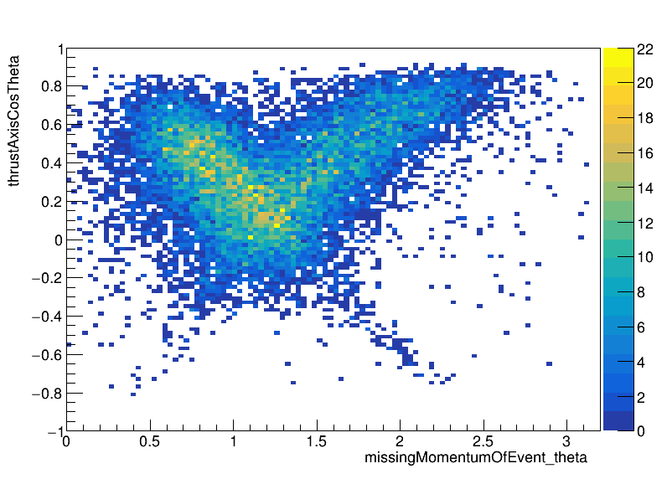
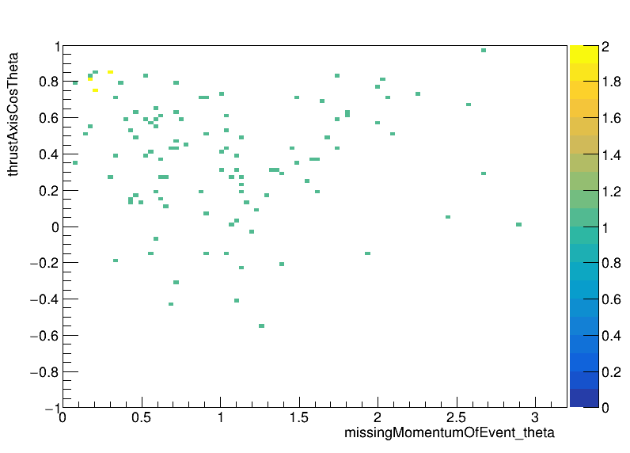

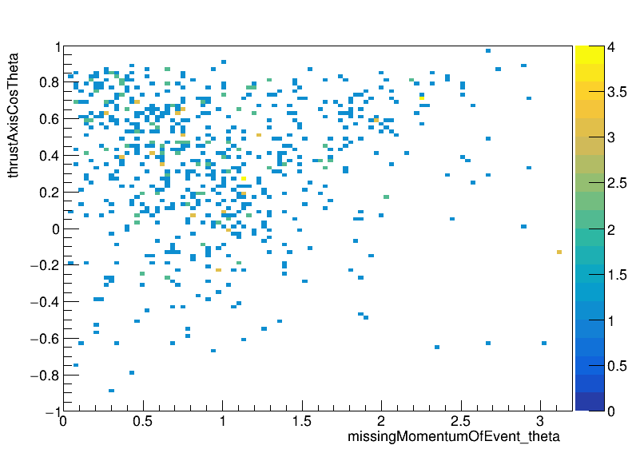
Mian Background-continuum
missingMomentumOfEvent_theta V.S. thrustAxisCosTheta
With extra-pi0 veto
Without extra-pi0 veto

Slide 11
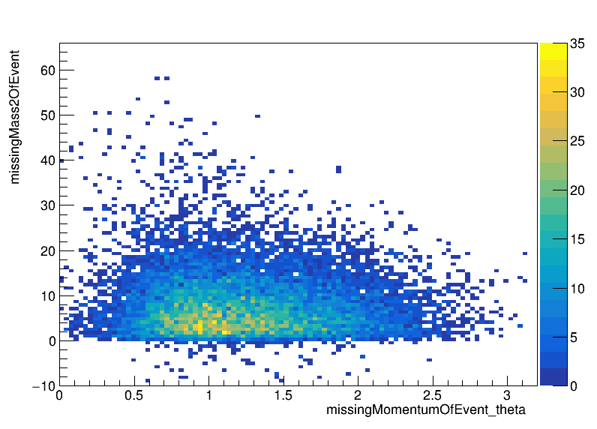
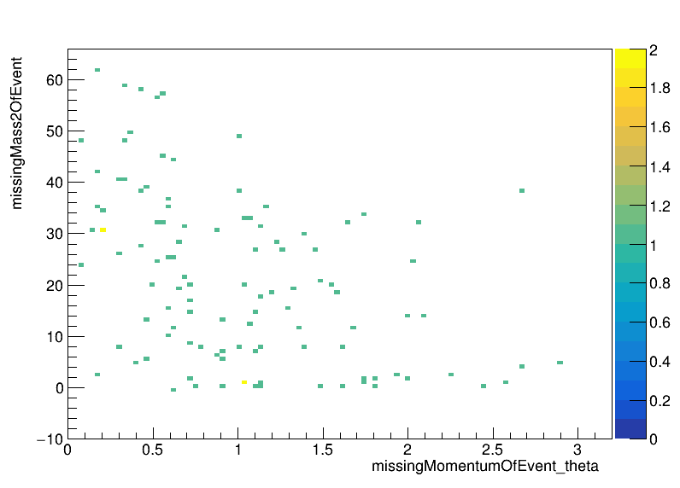
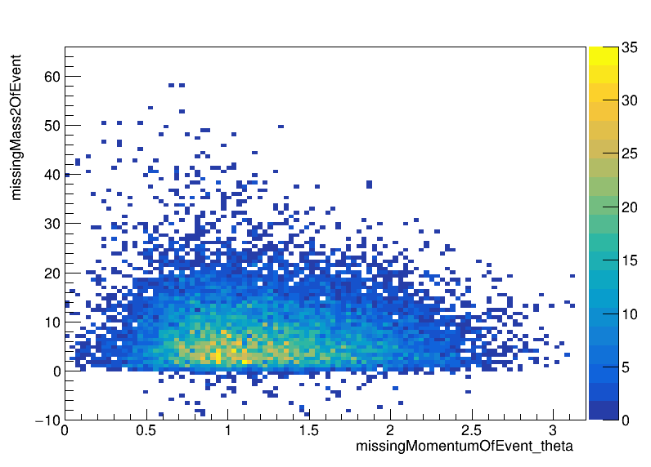
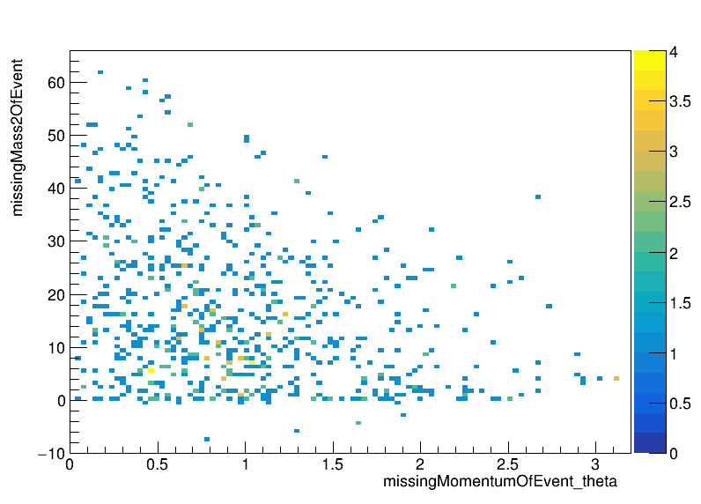
Mian Background-continuum
missingMomentumOfEvent_theta V.S. missingMass2OfEvent
With extra-pi0 veto
Without extra-pi0 veto

Slide 12
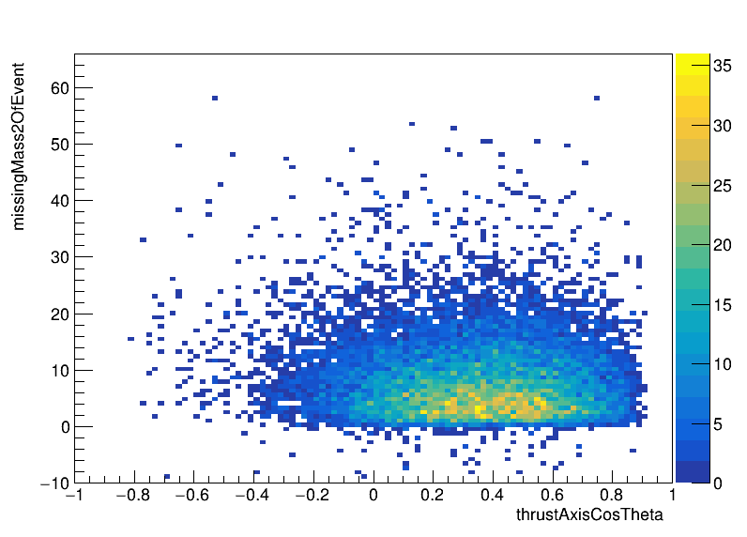
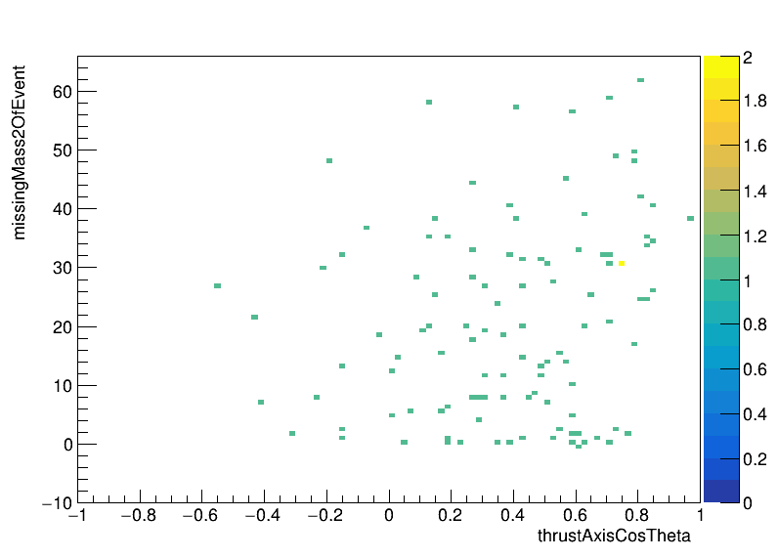

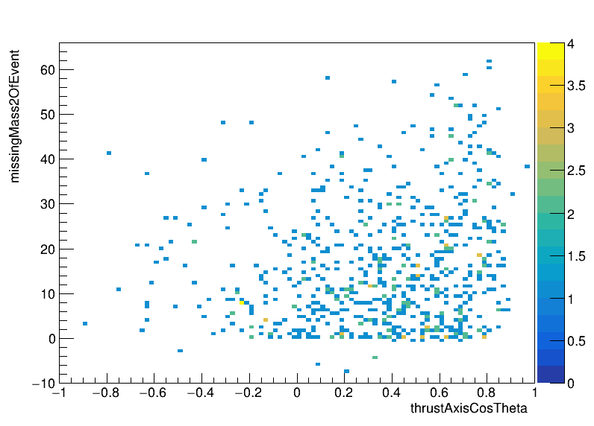
Mian Background-continuum
thrustAxisCosTheta V.S. missingMass2OfEvent
With extra-pi0 veto
Without extra-pi0 veto

Slide 13
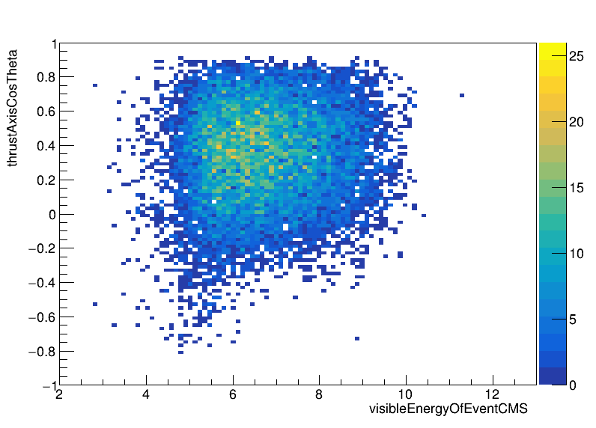
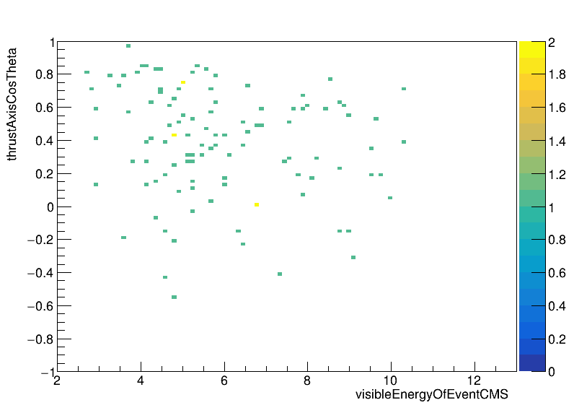

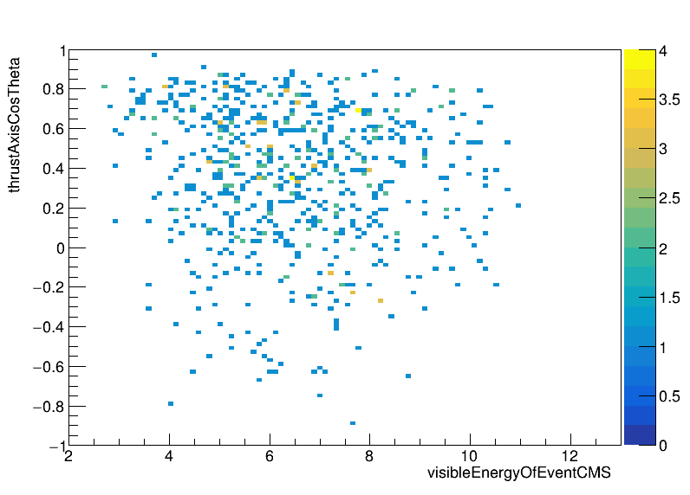
Mian Background-continuum
visibleEnergyOfEventCMS V.S. thrustAxisCosTheta
With extra-pi0 veto
Without extra-pi0 veto

Slide 14
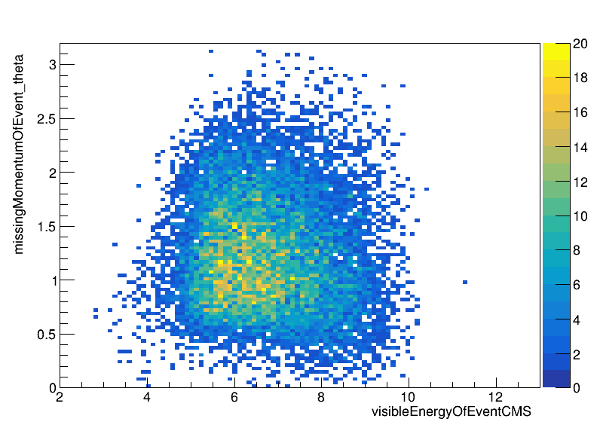
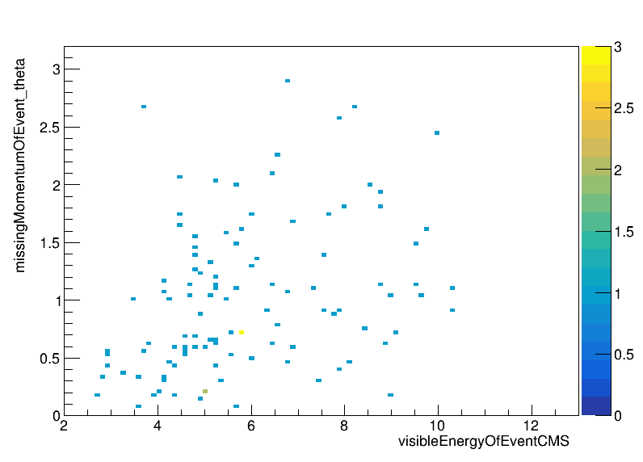
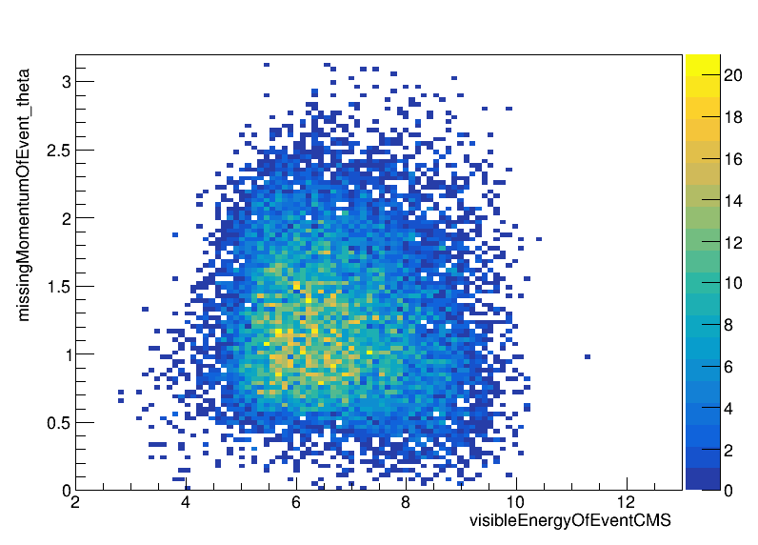
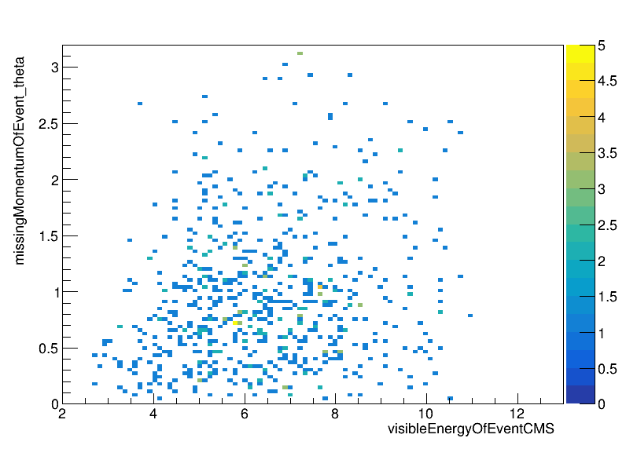
Mian Background-continuum
visibleEnergyOfEventCMS V.S missingMomentumOfEvent_theta
With extra-pi0 veto
Without extra-pi0 veto

Slide 15
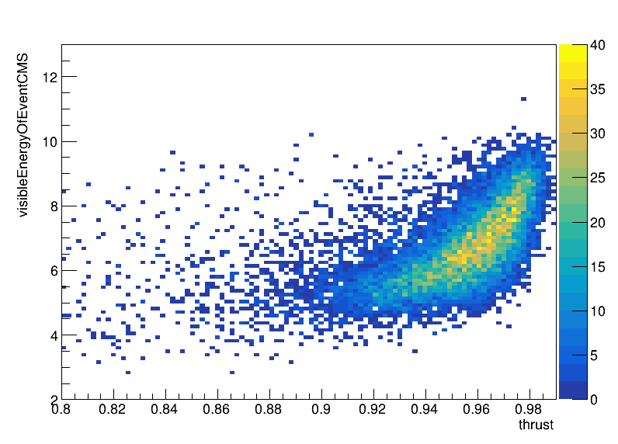



Mian Background-continuum
Thrust V.S. visibleEnergyOfEventCMS
With extra-pi0 veto
Without extra-pi0 veto

Slide 16




Mian Background-continuum
Thrust V.S. missingMomentumOfEvent_theta
With extra-pi0 veto
Without extra-pi0 veto

Slide 17




Mian Background-continuum
Thrust V.S. tau_sig_KSFWVariableshso24
With extra-pi0 veto
Without extra-pi0 veto

