Slide 1
2025.12.05 group meeting
陈伟文

Slide 2
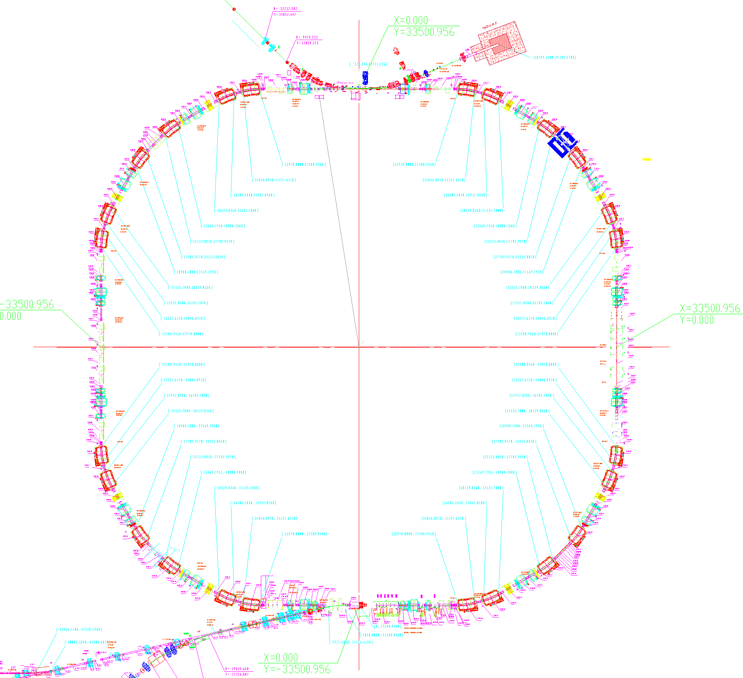
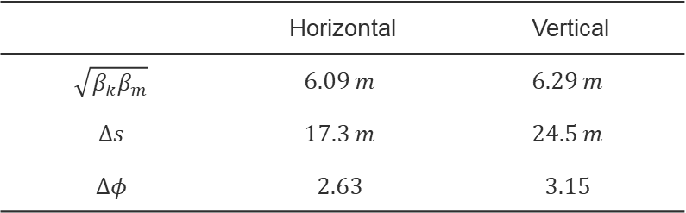
Feedback placement location
The horizontal kicker and tune BPM cable is connected to Zone R2
The Vertical kicker and R4RFBPM cable is connected to Zone R4
Libra-BPM
(R4RFBPM)
Power amplifier
Vertical kicker
?
BPM
 | Horizontal | Vertical
$$\sqrt{β_{k}β_{m}}$$ | $$6.09 m$$ | $$6.29 m$$
$$Δs$$ | $$17.3 m$$ | $$24.5 m$$
$$Δφ$$ | $$2.63$$ | $$3.15$$
Horizontal Tune BPM
Horizontal kicker

Slide 3
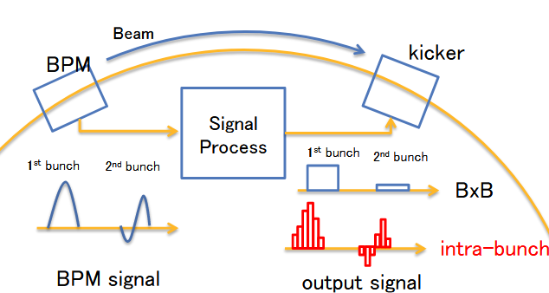
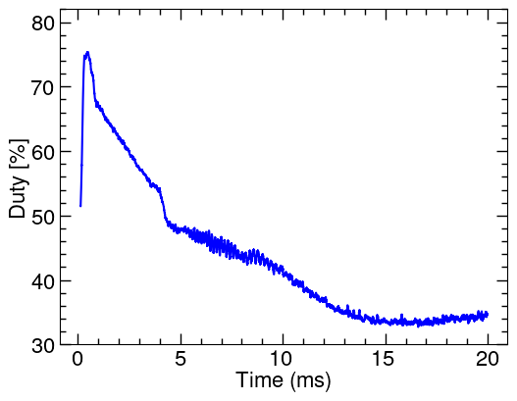
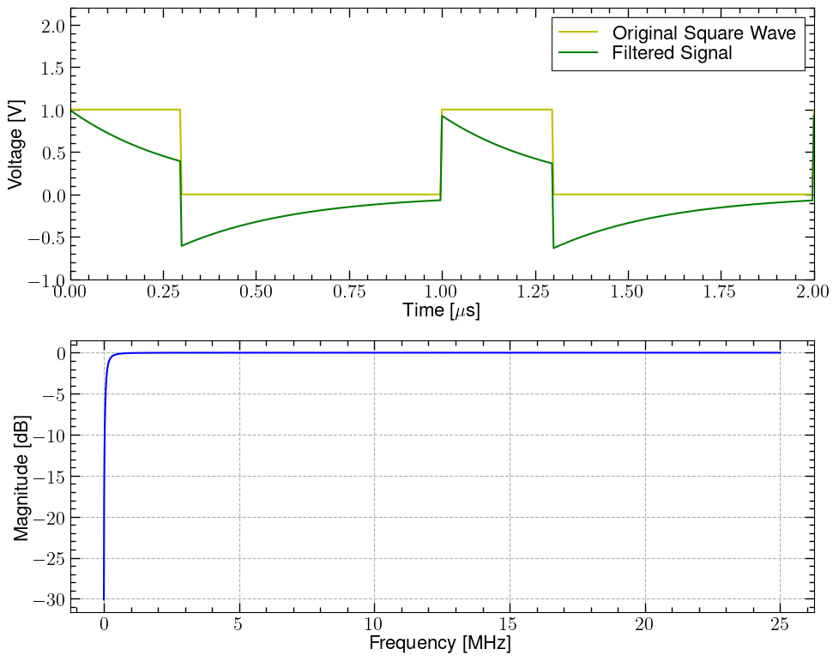
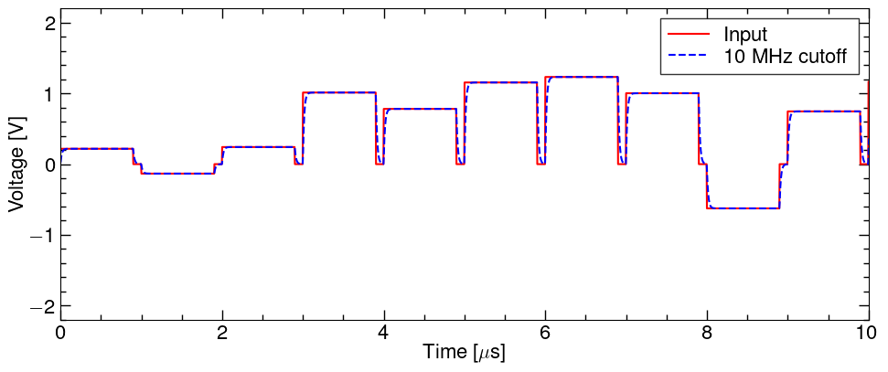
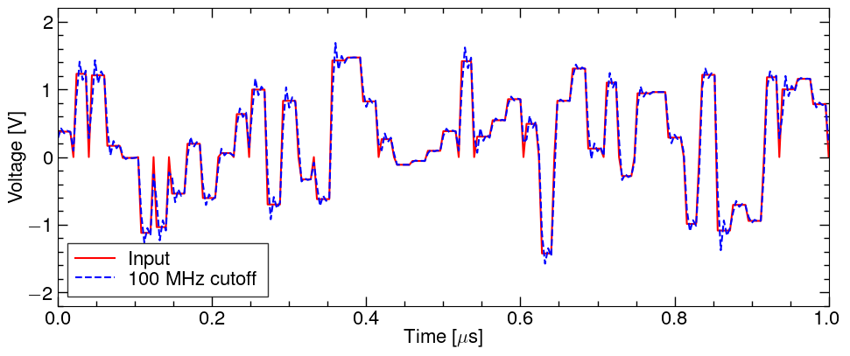
Power amplifier
Output waveform requirements
Feedback applied to the Kicker needs to be constant over the length of the bunch
Corresponding to amplifier needs
The limitation of the amplifier's low-frequency bandwidth -> output square wave signal will be drop
Considering that the output droop is less than 10%, the lower limit of the amplifier bandwidth requirement is 10 kHz (Simulation is needed to further quantify the impact)
The upper limit of the bandwidth -> rising and falling edge response of the output waveform
J-PARC MR feedback
Low frequency cut-off
High frequency cut-off
Duty =90%
BxB
Intra-bunch
[2] accelconf.web.cern.ch/HB2014/talks/tho3ab01_talk

Slide 4
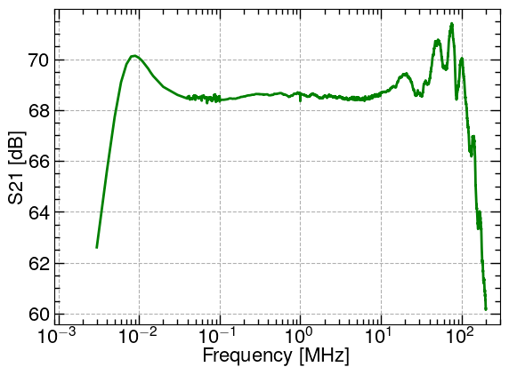
Power amplifier test
Power amplifier test
Bandwidth 5 kHz-148 MHz
Power amplifier
Attenuator
（DTS2000 40 dB）
input
ENA
output

Slide 5
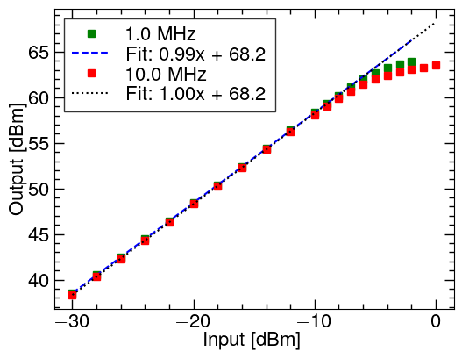
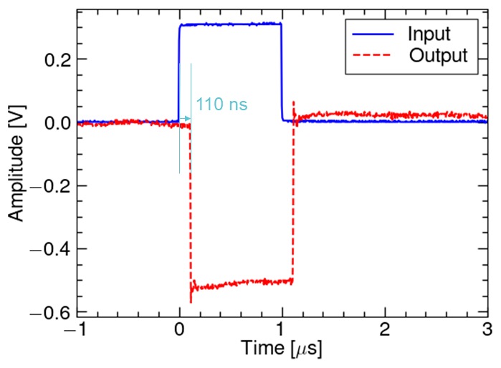
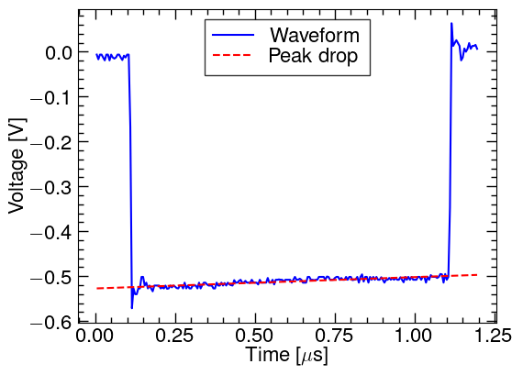
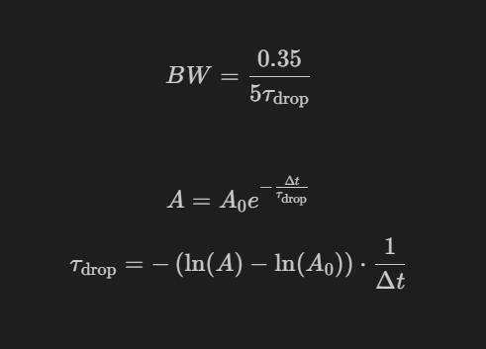
Power amplifier test
Power amplifier test
Source
(AFG 31000)
input
Power amplifier
Attenuator
（DTS2000 40 dB）
output
Oscilloscope
(DSOX3034T)
The output power of P-1 dB = 63 dB = 2000 W and a maximum output power of 2300 W
Output inversion, delay 110 ns, 1 us top drop <7%(corresponding to actual bandwidth ≈3 kHz)
Power and Linearity
single pulse response
Lower bandwidth ≈ 3.14 kHz

Slide 6
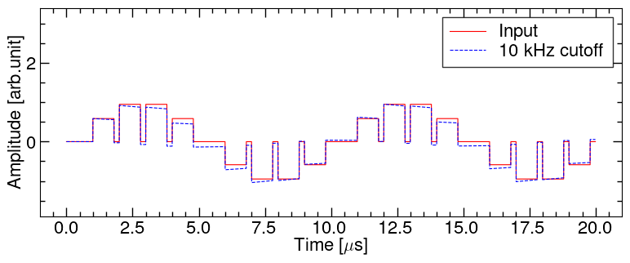
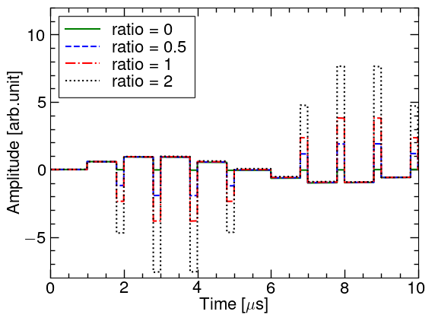
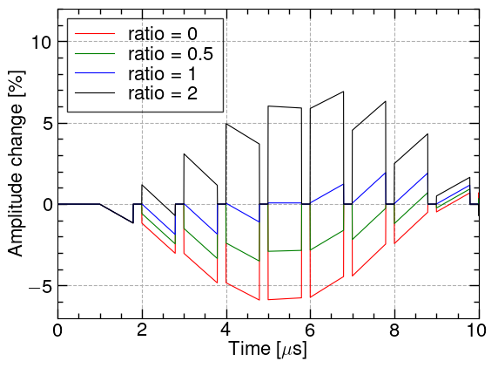
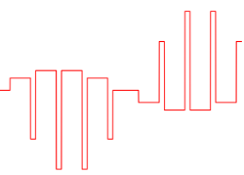
Simulated feedback output
There will be a low-frequency baseline drift superimposed on the subsequent pulses when continuous unipolar pulses generate a DC component
We can decrease the DC component by applying a contrast pulse in feedback off in one bucket without beam
Ratio = a/b
a
b

Slide 7
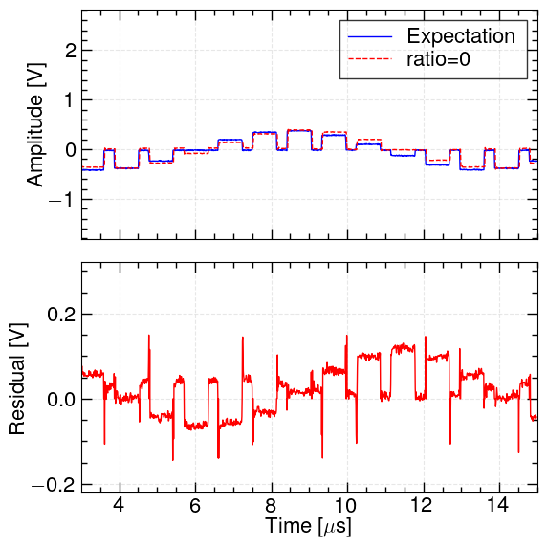
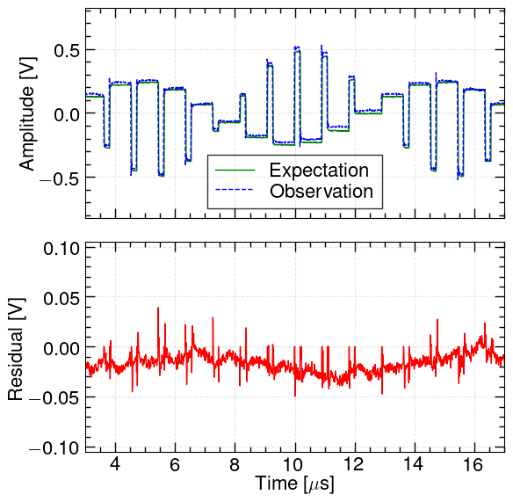
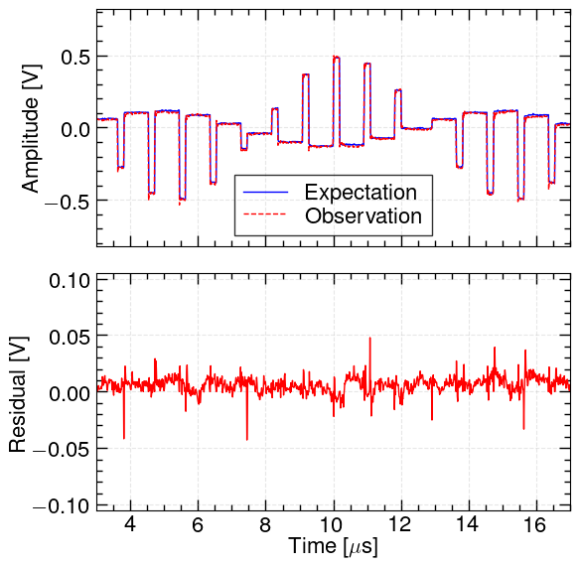
Feedback output test
Feedback simulated output generated by AFG31000 was input to power amplifier
The ratio = 1 mean that DC component ≈ 0
ratio = 0
ratio = 0.5
ratio = 1

Slide 8
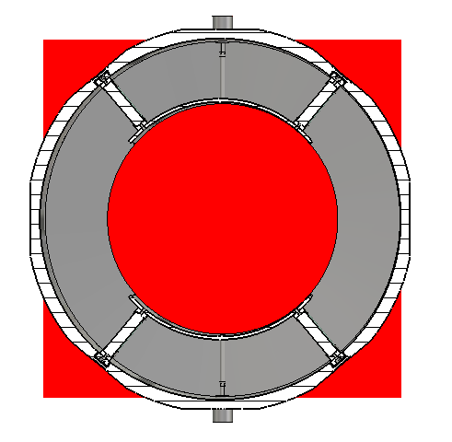
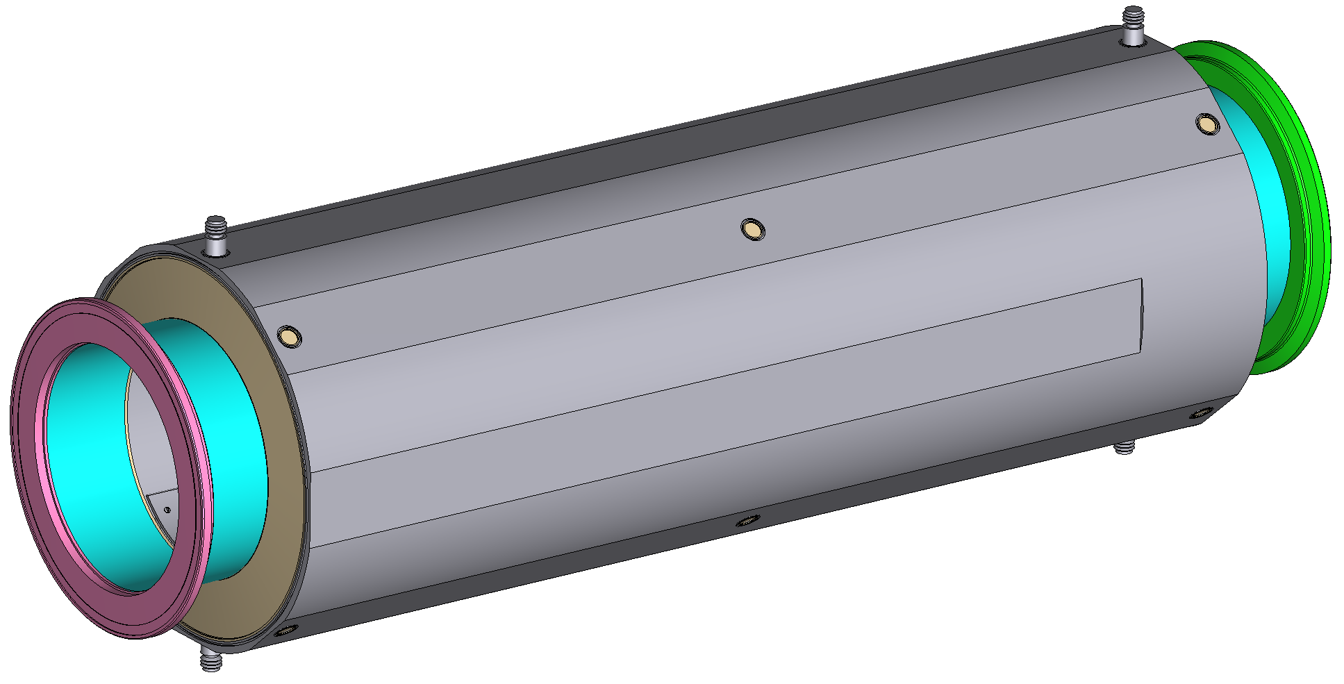
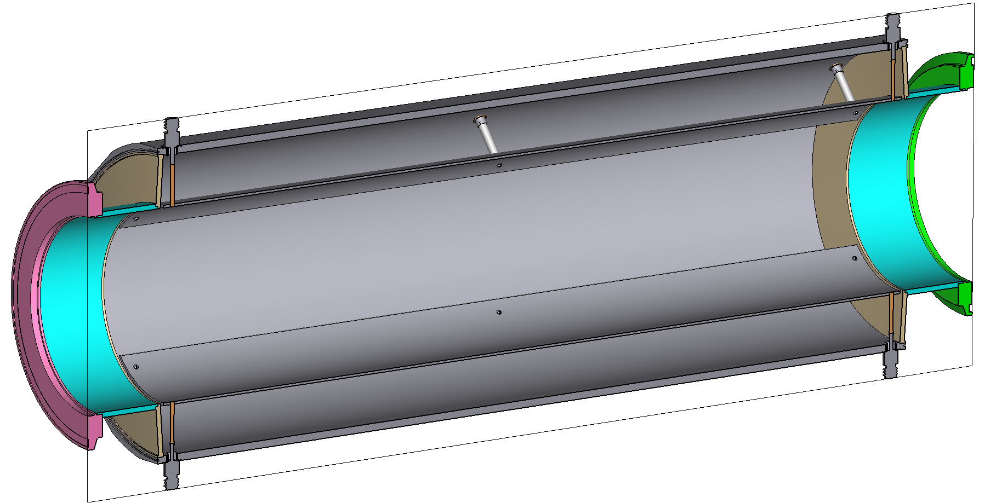
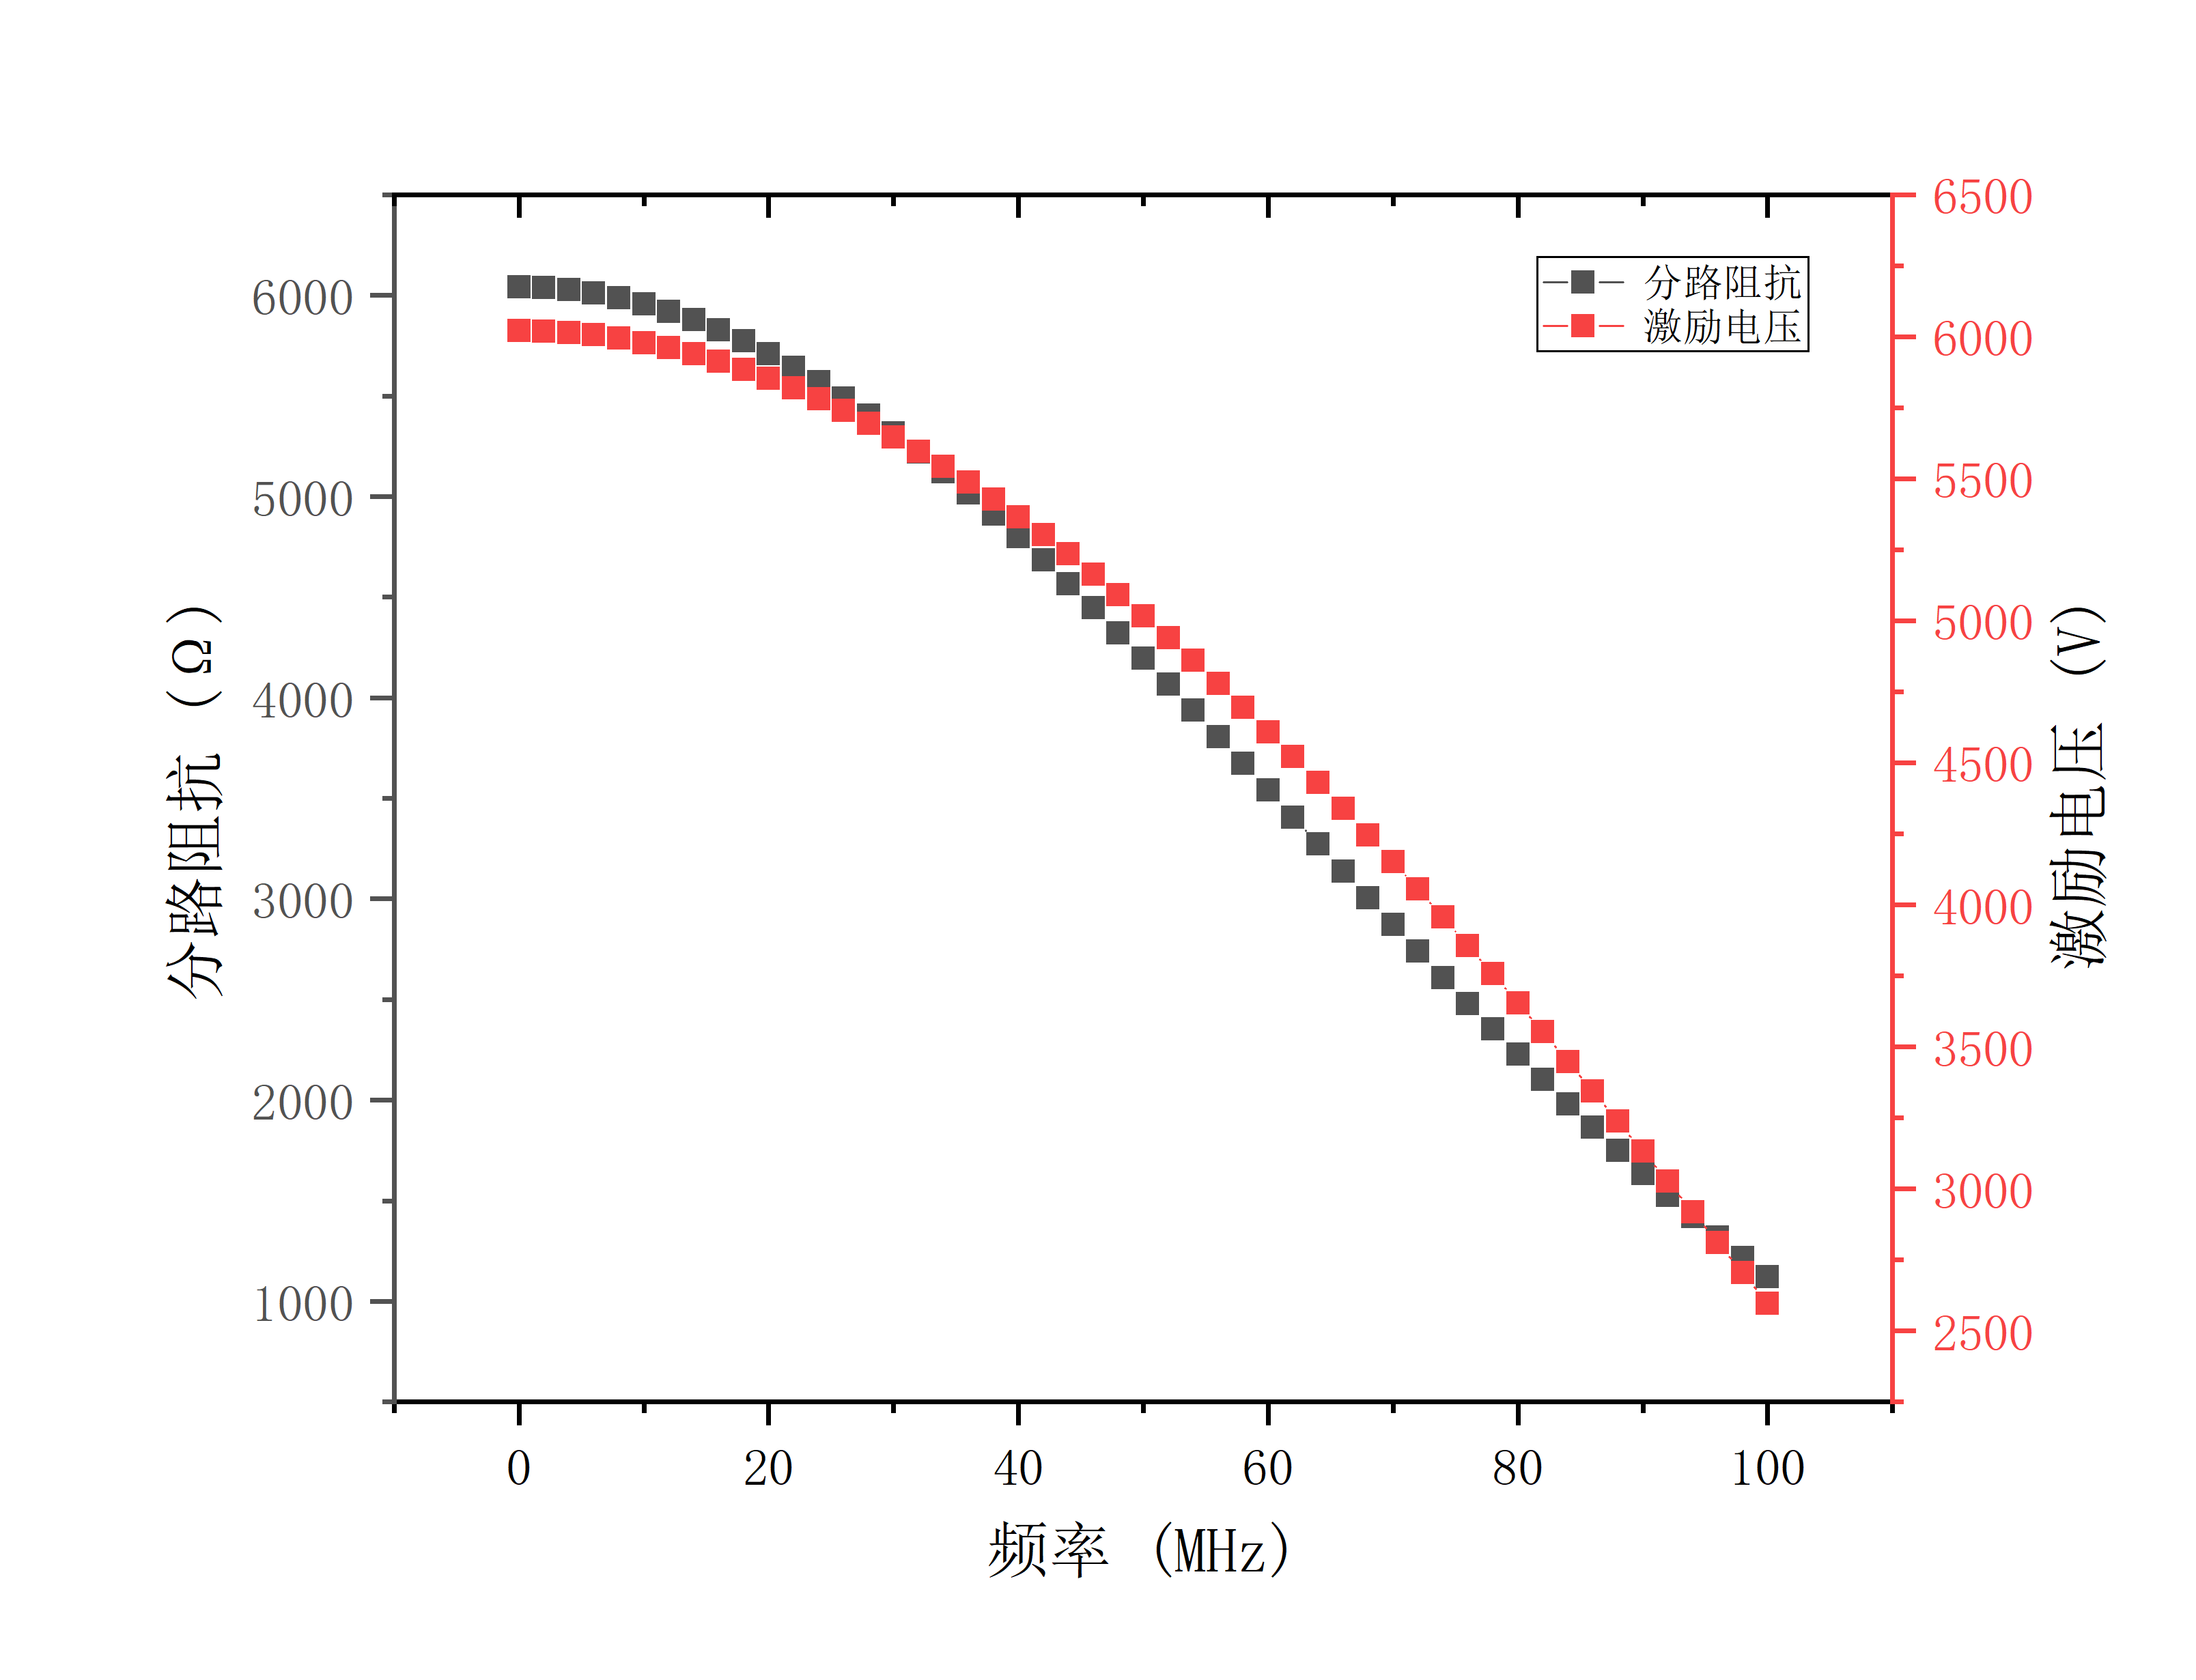
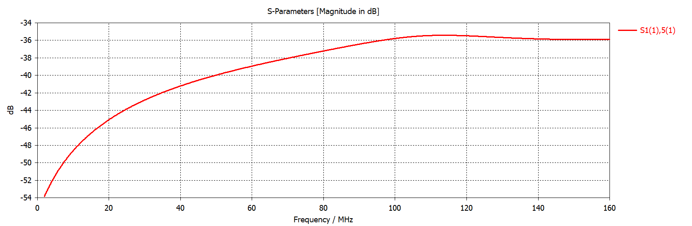
Kicker
Stripline kicker
220 mm
Voltage
Shunt impendence
Frequency

Slide 9
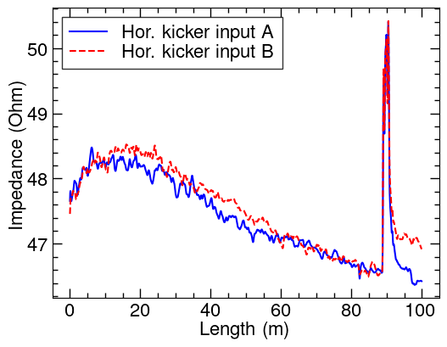
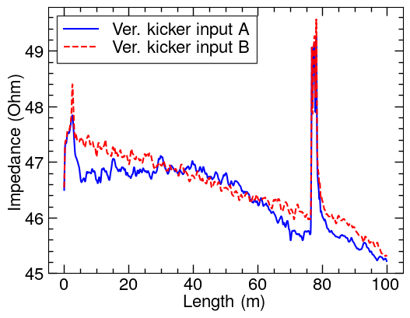
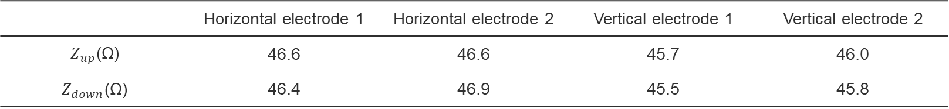
Kicker
Kicker cable TDR
Delay about 444.5 ns(Hor.)，382.5 ns(Ver.)
Characteristic impedance
R2 -> Hor. kicker
R4 -> Ver. kicker
88.9 m
76.5 m
 | Horizontal electrode 1 | Horizontal electrode 2 | Vertical electrode 1 | Vertical electrode 2
$Z_{up}$(Ω) | 46.6 | 46.6 | 45.7 | 46.0
$Z_{down}$(Ω) | 46.4 | 46.9 | 45.5 | 45.8

Slide 10
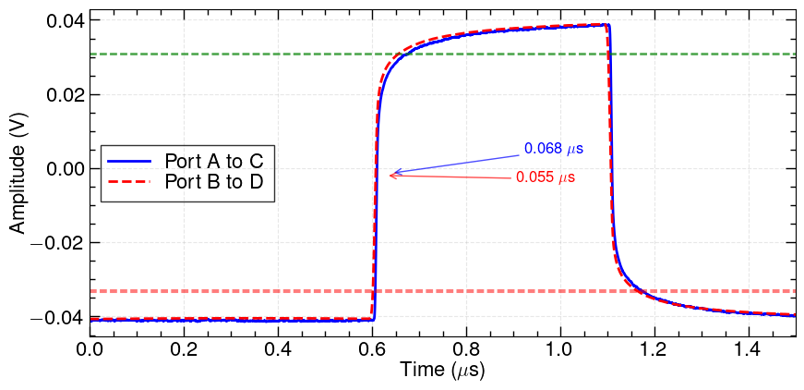
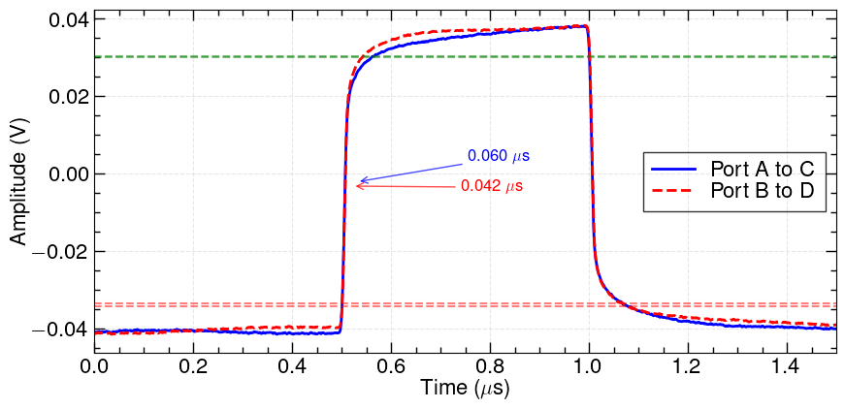
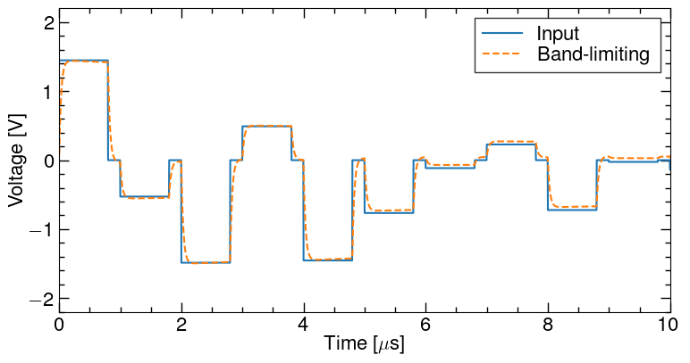
Kicker time response
Single square wave input test
Horizontal Kicker bandwidth < 5.15 MHz, vertical kicker bandwidth < 5.83 MHz
Hor.
Ver.
Simulation of 1 μs, 90% duty cycle module square wave time response
Frequency range limited to 4 kHz – 5 MHz
No obvious issues for bunch-by-bunch feedback

Slide 11
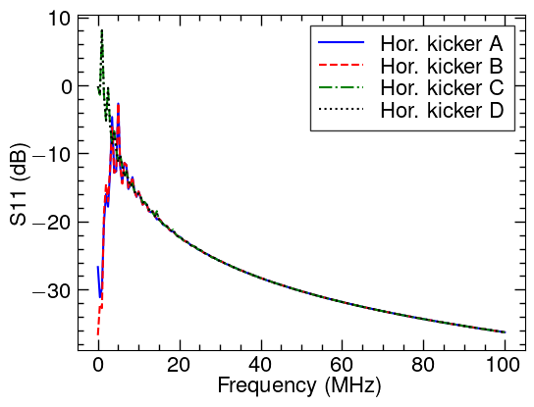
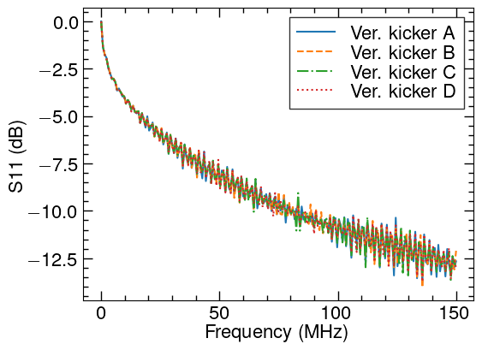
Kicker port test
Kicker S11
Seem no good.

Slide 12
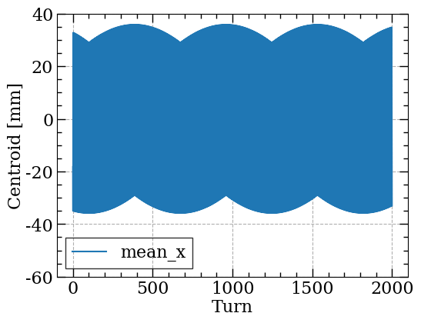
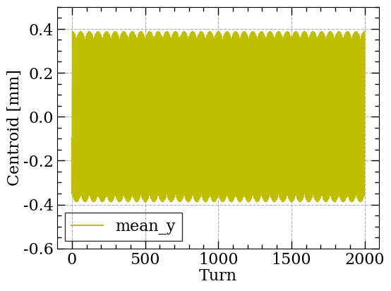
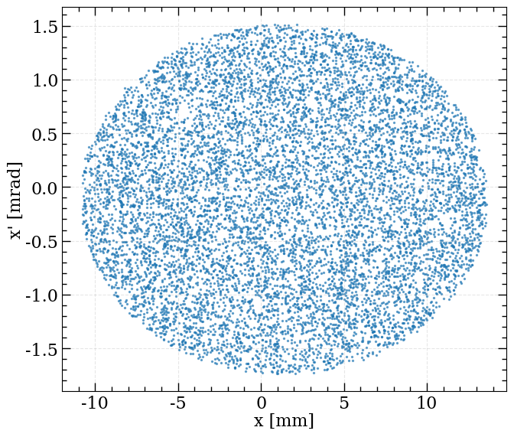
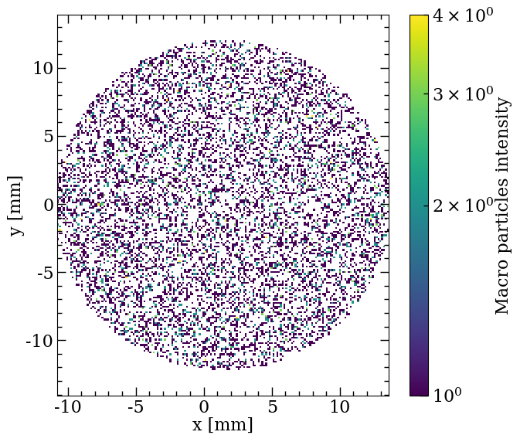
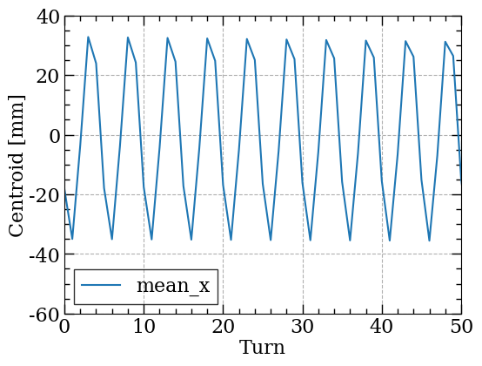
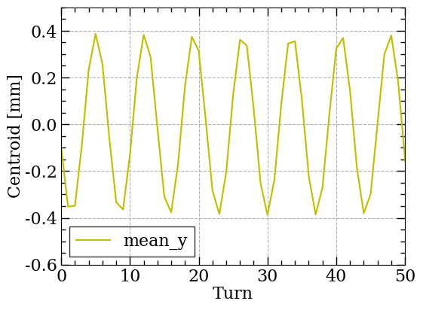
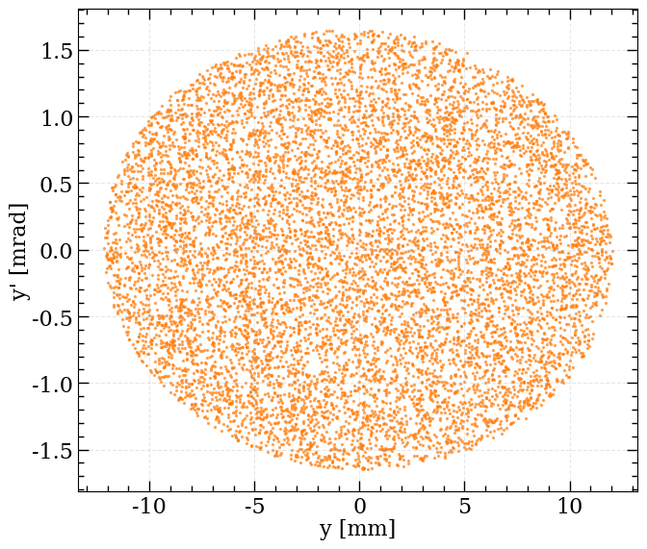
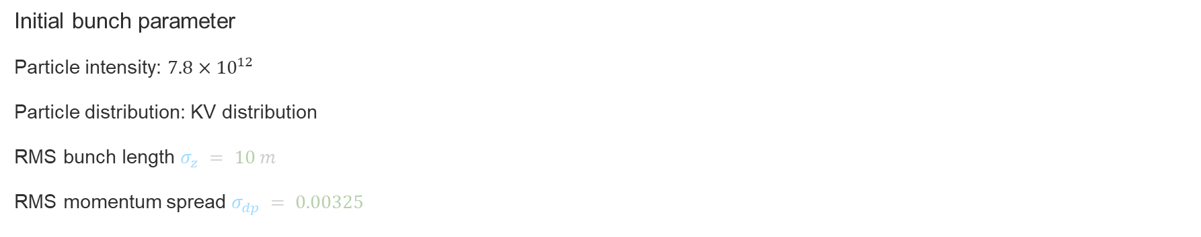
Beam instability generate
M_BtoK =
[[-1.12446315e+00, 4.35257954e+00, -4.64024432e-24, 1.10417008e-23, 0.00000000e+00, 0.00000000e+00, 0.00000000e+00],
[-1.66915475e-01, -2.43215735e-01, -9.65655416e-25, -1.06680597e-24, 0.00000000e+00, 0.00000000e+00, 0.00000000e+00],
[ 0.00000000e+00, 0.00000000e+00, -7.66843433e-01, 3.89955830e+00, 0.00000000e+00, 0.00000000e+00, 0.00000000e+00],
[ 0.00000000e+00, 0.00000000e+00, -1.78175096e-01, -3.97989749e-01, 0.00000000e+00, 0.00000000e+00, 0.00000000e+00],
[ 0.00000000e+00, 0.00000000e+00, -2.01150785e-23, 1.22458415e-23, 1.00000000e+00, 8.30464432e+01, 7.70548583e-15],
[ 0.00000000e+00, 0.00000000e+00, -9.64876874e-34, -4.50128356e-33, -5.98502761e-21, 9.99999835e-01, 2.04788238e-16]]
M_KtoB =
[[-7.51147889e-01, 2.93674690e+00, -2.89970864e-23, 3.25704876e-23, 0.00000000e+00, 0.00000000e+00, 0.00000000e+00],
[-1.05658648e-02, -1.28998543e+00, 1.80541107e-24, -3.32138783e-23, 0.00000000e+00, 0.00000000e+00, 0.00000000e+00],
[ 0.00000000e+00, 0.00000000e+00, -1.08435573e+00, 3.34106103e-01, 0.00000000e+00, 0.00000000e+00, 0.00000000e+00],
[ 0.00000000e+00, 0.00000000e+00, 3.27397833e-02, -9.32294062e-01, 0.00000000e+00, 0.00000000e+00, 0.00000000e+00],
[-4.41097632e-02, -4.49815175e+00, -2.74344292e-23, -8.17048356e-23, 9.99269350e-01, 1.10691441e+03, -9.39237536e-06],
[ 0.00000000e+00, 0.00000000e+00, 8.42882527e-30, -1.28715529e-28, -1.87469423e-06, 9.98652672e-01, -2.40988566e-08],
[ 0.00000000e+00, 0.00000000e+00, 0.00000000e+00, 0.00000000e+00, 0.00000000e+00, 0.00000000e+00, 1.00000000e+00]]
])
Initial bunch parameter
Particle intensity: $7.8×{10}^{12}$
Particle distribution: KV distribution
RMS bunch length $σ_{z} = 10 m$
RMS momentum spread $σ_{dp} = 0.00325$
Without wake fields

Slide 13
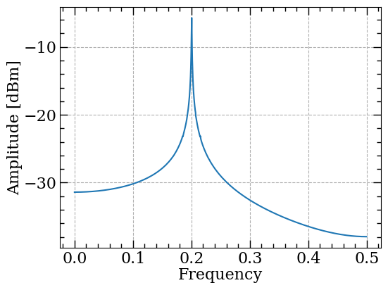
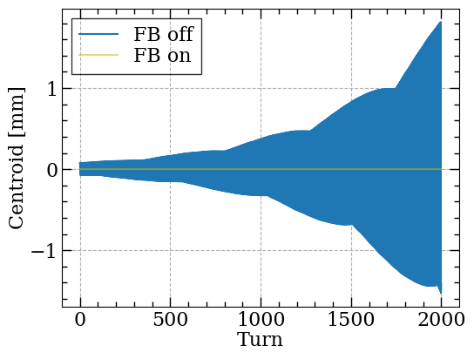
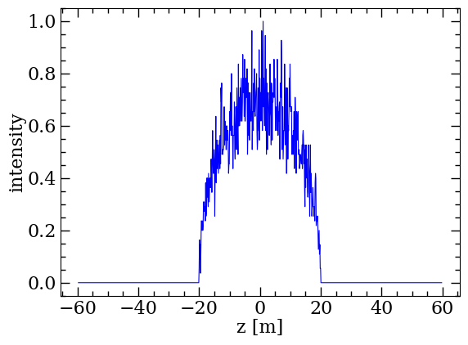

Beam instability tracking
Condition :
Without consider space charge
Without consider energy ramping by RF
Instability caused by wake field
No obvious other frequency
FB: Change the $xp$ with a fixed ratio correlated to $x$
No gauss

Slide 14
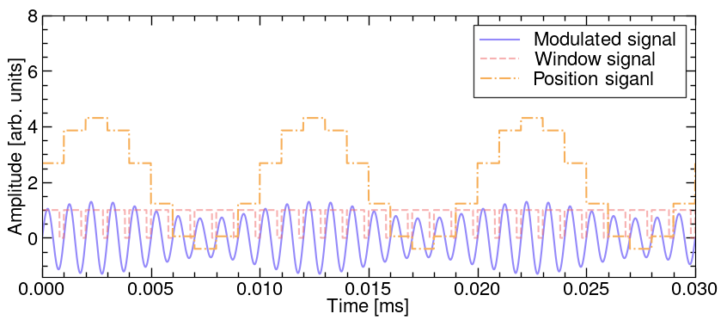
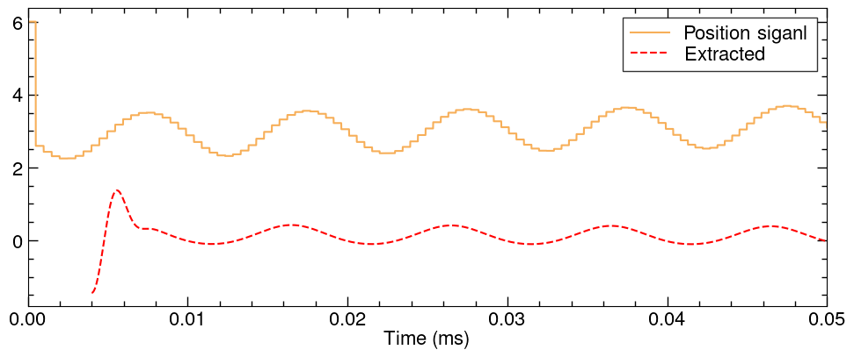
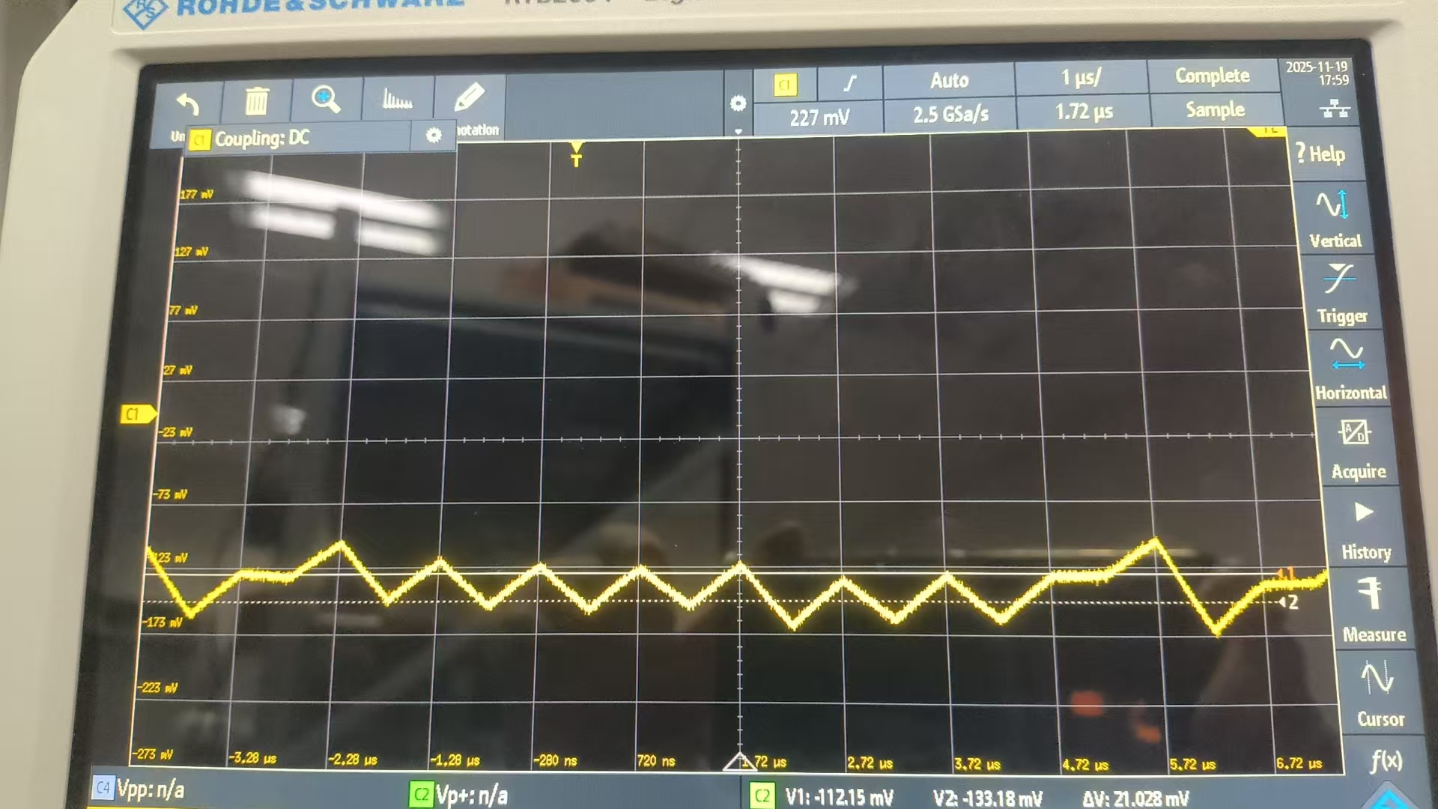
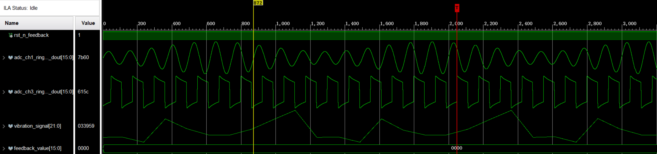
FPGA signal processing
Laboratory tests
Test protocol
Stage results
In electronics, the feedback signal can be generate, by have some problem in output from DAC
GUI
PCIE
RF signal generator
Modulated rf signal
(BPM signal)
MTCA4 electronics
RTM(SIS8900)
SIS8300KU
Ideal signal processing process
DAC output
示波器
Square wave signal
(RF window signal)
arbitrary signal generator
Pulse signal
(T0 signal)
The ideal is a sequence of square wave pulses with a duty cycle of 80%

Slide 15
Other and next plan
Feedback simulation
Add the BPM, electronic and kicker effect step by step
Finish the other power amplifier test
MTCA4 develops feedback electronic
Resolve PCIe connection issues
Implement PCIe transmission of control signals (based on existing API)
Debug DAC output to achieve normal feedback waveforms(before can also do the feedback in DC mode)

