Slide 1
Weekly Report
Minghao Li 2025.12.09

Slide 2
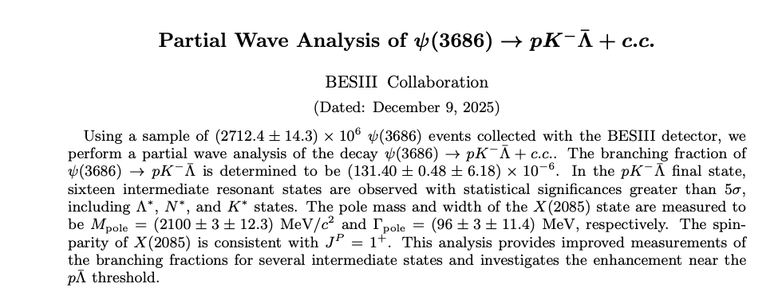


Weekly Report
Current working:
1. Complete the writing and revision of the first draft.
2. Regarding the 3.773 GeV data sample, run 0.5 times of the inclusive MC

