Slide 1





JAliEn
Java AliEn middleware
A. Grigoras, C. Grigoras, M. Pedreira
P Saiz, S. Schreiner
ACAT 2013

Slide 2
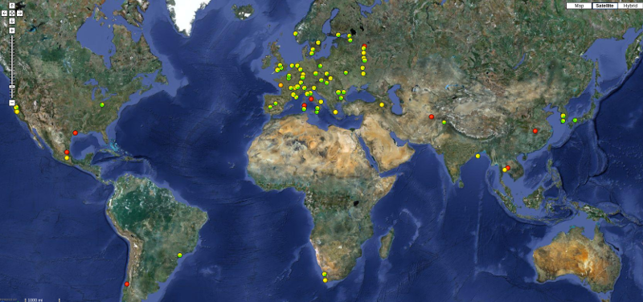
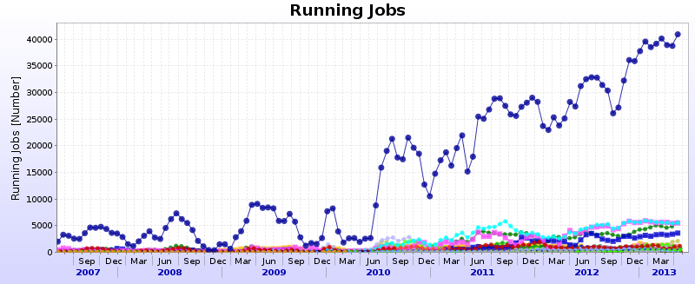
ALICE Grid Environment
100 sites
up to 60 000 concurrent jobs
>300 active users
14PB of data on tape
13PB on disk
+JAliEn

Slide 3
AliEn2 – Current status
TASKQUEUE
Site 1
All components to create a GRID
File Catalogue
  UNIX-like file system
  Mapping to physical files
  Metadata information
  SE discovery
Transfer Model
  With different plugins
TaskQueue
  Job Agent & pull model
  Automatic installation of software packages
  Simulation, reconstruction, analysis...
xrootd
CE
CREAMCE
Job
Optimizer
JA
MonALISA
Job
Manager
Site 2
Job
Job
Broker
Job
xrootd
Job
CE
File catalogue
CREAMCE
JA
MonALISA
LFN
GUID
Meta
data
Perl, C/C++, Bash scripting
~ 150 packages to maintain

Slide 4
Why JAliEn
ALICE uses MonALISA for monitoring
  Jobs, transfers, site services, central services, real-time and accounting data, network topology discovery, storage elements functional tests and many more
Based on the monitoring information a framework was developed to steer in an automatic way central productions, data registration and replication
Gradually this framework grew in a full implementation of the AliEn objects and interactions with the central databases
  File Catalogue: LFN, GUID, PFN, SE, booking table
  Job, JDL and TaskQueue interactions
  Users, quotas
    gLite packages for proxy­based authentication
    Support for signed JDLs by all parties involved
  Access envelope generation, storage management, transfer methods
    Parallel replica uploads and downloads for efficient end-user interaction with the federated SE space
  and the rest of supporting objects and methods in AliEn

Slide 5
Why JAliEn
Next step is to provide a full end-to-end Java implementation of AliEn
More efficient communication infrastructure
  Persistent, compressed, SSL channels
  Exchanging Java serialized objects
  Multi­layered channel multiplexing and object caching
  Logging and error propagation
No tokens for authentication, simply use the Grid certificate
Better real­time monitoring of all components
Platform­independent, easily maintainable code

Slide 6
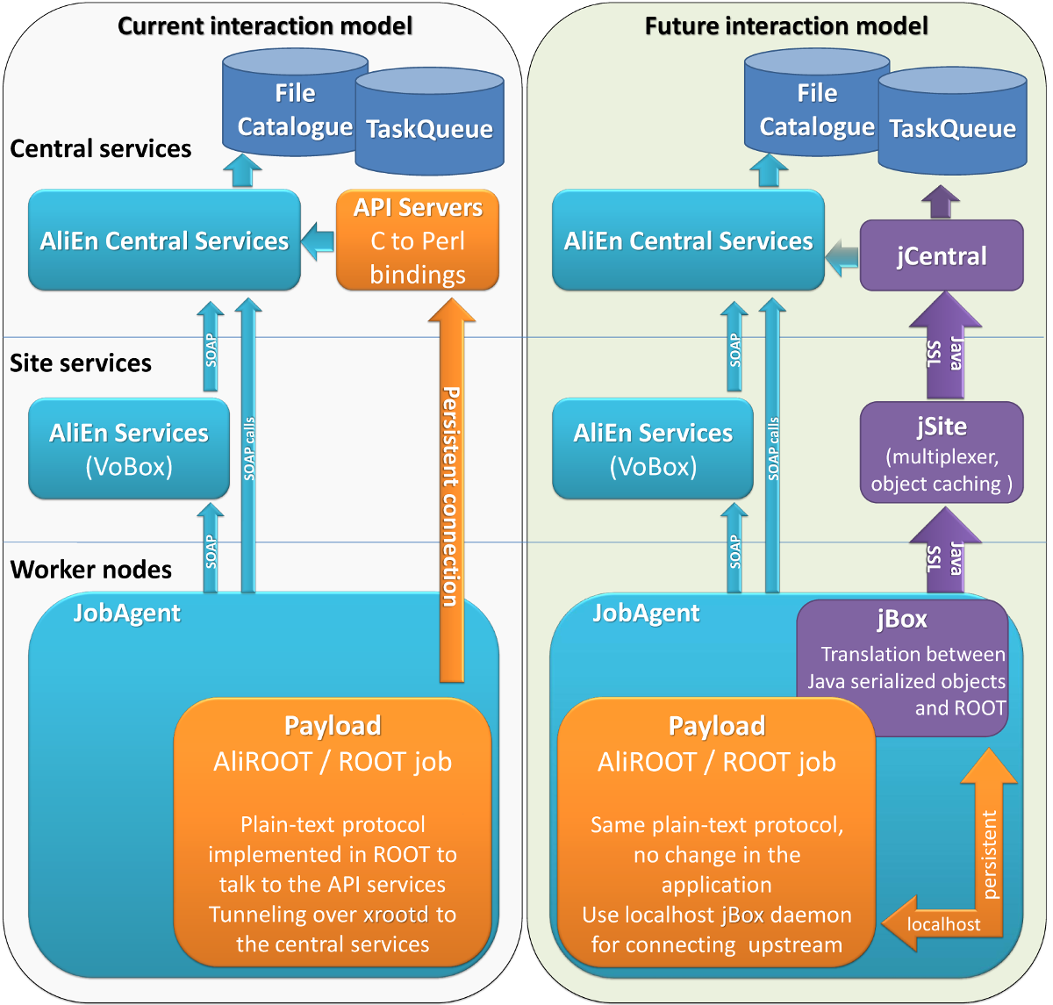
AliEn2 vs JAliEn

Slide 7
JCentral
Implement all AliEn objects in Java (LFN, PFN, GUID, Job, SE, access envelopes, users etc)
Direct connections to the DBs for all operations
  But for resubmit and kill for the moment
Delegates presentation to the end client
Implement the minimal set of commands as API calls via serializable objects
Encapsulating requester identity

Slide 8
JSite
Trusted entities that multiplex requests to the central services
Some of the objects are cacheable and can be quickly returned to the requester
  For example OCDB file locations …
Can be cascaded indefinitely in order to reduce the number of sockets per server to a reasonable number
  Or can be missing altogether, for small sites or opportunistic resources
Running as another AliEn service on the site VoBox

Slide 9
JBox
Authentication and authorization
  No more proxies for the users
Communication
  Listing, opening and writing files
  Submitting and accessing job information
Components
  Java daemon responsible for authentication/authorization and communication between user applications and central services
  ROOT implementation of TGrid functionality
  Java shell client – same aspect and functionality as previous client
    Commands implemented as classes using introspection

Slide 10
Current status
ALICE MonALISA uses it fully
  LPM and user job management
  Catalogue browser, file editing, quotas...
Storage cleanup, all scheduled file transfers
Communication channels working fine
Many end­user commands are implemented in Jbox
  cat, cp, mv, rm, rmdir, find, ls, cd, pwd, mkdir, guid2lfn, lfn2guid, ps, masterjob, packages, submit, kill, whereis, w, uptime, type, time, role, access, commit

Slide 11

Conclusions
JAliEn is the next version of AliEn Grid middleware
The transition will be done step by step until all services are replaced by JAliEn services

