Slide 1
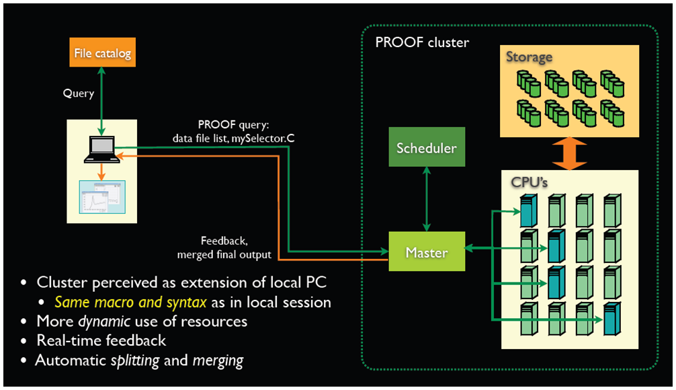
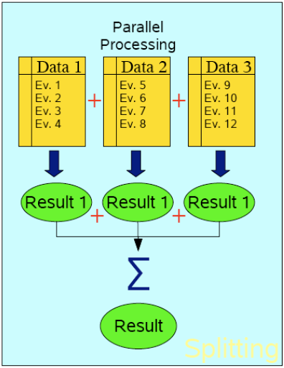
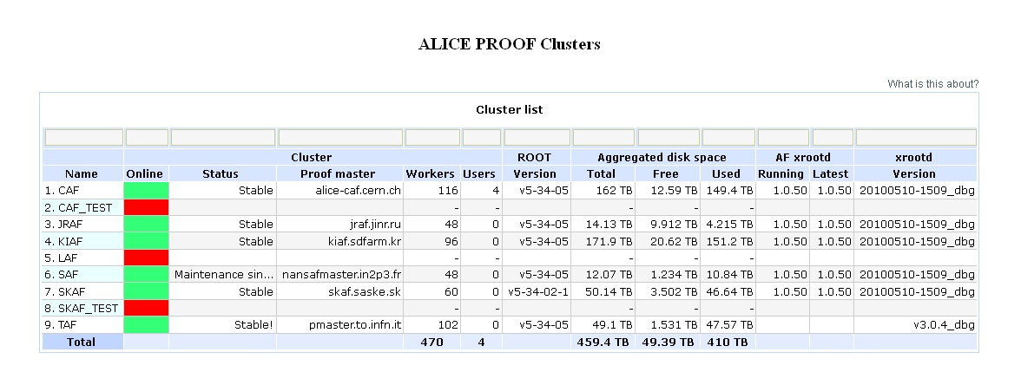
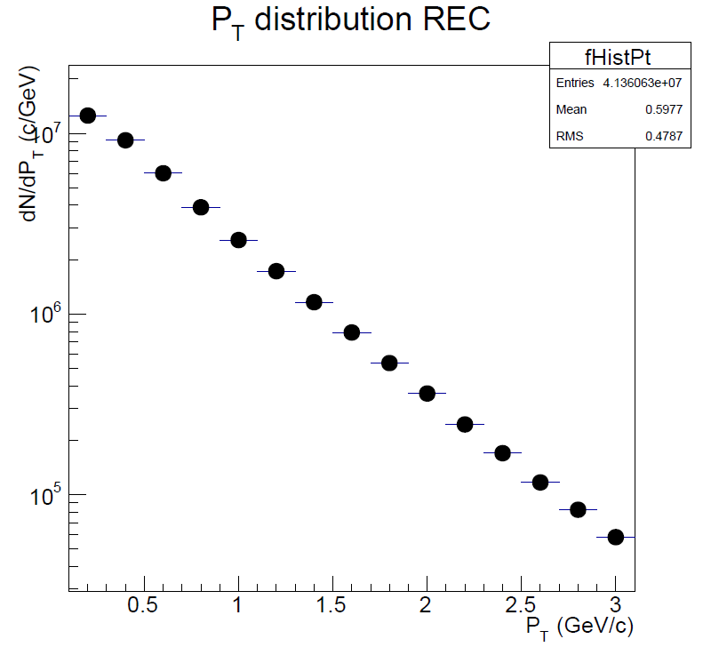
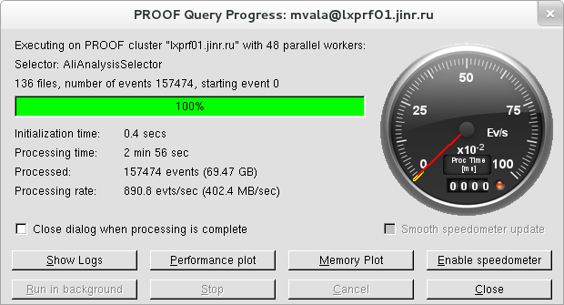
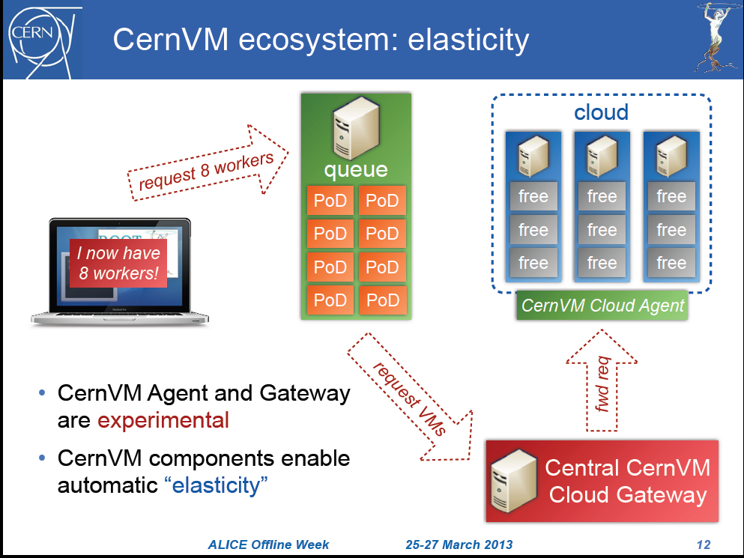
15th International Workshop of advanced computing and analysis technique in physics
Experience of PROOF cluster Installation and operation
at Joint Institute for NuclearResearch for ALICE data analysis
G. Shabratova, R. Semenov, G.Stiforov, M. Vala, L. Valova
( Joint Institute for Nuclear Research, Dubna, Russia)
PROOF stands for Parallel ROOt Facility
It allows parallel processing of large amount of data. The output results can be directly visualized (e.g. the output histogram can be drawn at the end of the proof session).
PROOF is NOT a batch system.
The data which you process with PROOF can reside on your computer, PROOF cluster disks or grid.
The usage of PROOF is transparent: you should not rewrite your code you are running locally on your computer
No special installation of PROOF software is necessary to execute your code: PROOF is included in ROOT distribution.
What is PROOF?
JRAF – PROOF cluster at JINR (Joint Institute for Nuclea Research
PROOF Cluster consists from 8cores PC like master with RAM = 32 Gb and 4 PCs of 48 cores summary for slaves. Disk space for data is equal 14.13TB.
Problems at installation and test of PROOF cluster. Found solutions
Problems | Solution
PROOF session crashed at SLC version higher 5.5 | back migration PC to version 5.5 of SLC
kPROOF_FATAL error at ROOT v5-34-02 , crash TStatus::Add(char const*) | bag has been fixed in VO_ALICE@ROOT::v5-34-02-1
*Break *: segmentation violation during close of PROOF session | orrected in VO_ALICE@ROOT::v5-34-05
Staged data problem due to alien token init fault - usage of obsolete alien server name | correction of alien server name to modern one at master and slave nodes.
Wrong JRAF disk capacity info at ALICE Mona Lisa page (only 7.049 TB instead of 14 .13TB). | change parameter of AAF_AFDSMGR_MAX_TRANSFERS from 10 to 40 in afdsmgrd config
PROOF session at JRAF
[gshabrat@alicepc19 aaf-tutorial-task]$ root.exe
*******************************************
* *
* W E L C O M E to R O O T *
* *
* Version 5.34/02 21 September 2012 *
* *
* You are welcome to visit our Web site *
* http://root.cern.ch *
* *
*******************************************
ROOT 5.34/02 (tags/v5-34-02@46115, Oct 29 2012, 11:30:06 on linuxx8664gcc)
CINT/ROOT C/C++ Interpreter version 5.18.00, July 2, 2010
Type ? for help. Commands must be C++ statements.
Enclose multiple statements between { }.
root [0] TProof::Open("jraf.jinr.ru");
Starting master: opening connection ...
Starting master: OK
Opening connections to workers: OK (48 workers)
Setting up worker servers: OK (48 workers)
PROOF set to parallel mode (48 workers)
root [1] gProof->ShowDataSets()
Dataset repository: /pool/PROOF-AAF/proof//dataset
Dataset URI | # Files | Default tree | # Events | Disk | Staged
/default/gshabrat/LHC11h_2_000170267_AllAODs| 161 | /aodTree | 1.575e+05| 66 GB | 84 %
/default/gshabrat/LHC11h_2_000170268_AllAODs| 2399 | /aodTree | 2.432e+06| 2 TB | 97 %
root [2] x runJRAF.C("jraf.jinr.ru","/default/gshabrat/LHC11h_2_000170268_AllAODs",kFALSE,"VO_ALICE@AliRoot::v5-04-22-AN",10000,0)
07:50:44 13603 Wrk-0.39 | Info in <TXProofServ::HandleCache>: loading macro AliAnalysisTaskCustom.cxx+g ...
07:50:44 5069 Wrk-0.44 | Info in <TXProofServ::HandleCache>: loading macro AliAnalysisTaskCustom.cxx+g ...
===== RUNNING PROOF ANALYSIS CAF test train ON DATASET /default/gshabrat/LHC11h_2_000170268_AllAODs
Looking up for exact location of files: OK (2341 files)
Validating files: OK (2341 files)
+++
+++ About 2.42 % of the requested files (58 out of 2399) are missing or unusable; details in the 'MissingFiles' list
+++
Mst-0: Number of mergers set dynamically to 7 (for 48 workers)
worker 0.34 on host lxprf04.jinr.ru will be merger for 6 additional workers
worker 0.35 on host lxprf05.jinr.ru will be merger for 6 additional workers
worker 0.15 on host lxprf05.jinr.ru will be merger for 6 additional workers
worker 0.7 on host lxprf05.jinr.ru will be merger for 5 additional workers
worker 0.44 on host lxprf02.jinr.ru will be merger for 6 additional workers
worker 0.17 on host lxprf03.jinr.ru will be merger for 6 additional workers
worker 0.5 on host lxprf03.jinr.ru will be merger for 6 additional workers
Mst-0: merging output objects ... done
Mst-0: grand total: sent 12 objects, size: 40686 bytes
Future development and application of PROOF technology

