Slide 1
Role of Multivariate Analysis Methods in LHC Physics
Pushpa Bhat
Fermilab
May 18, 2013
ACAT 2013, Beijing, China

Slide 2
Outline
The LHC, CMS, ATLAS
Multivariate Analysis Methods
Discovery of the Higgs Boson
Other Analyses
Summary

Slide 3
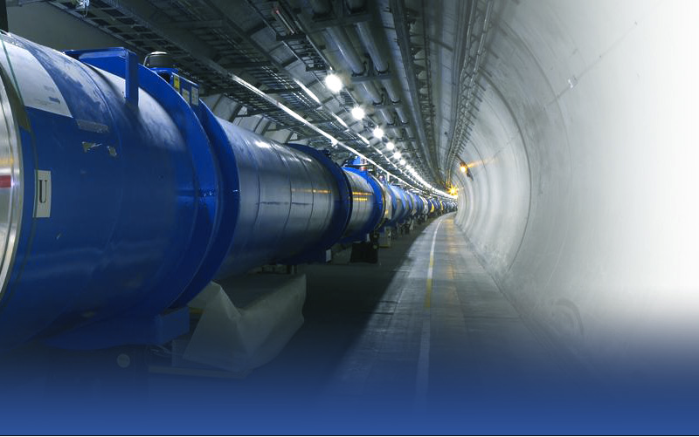
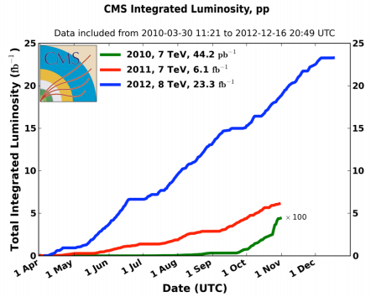
The Large Hadron Collider
A scientific & technological marvel!
Spectacular
performance!
Peak instantaneous luminosity
7.7 x 10³³ cm⁻² s⁻¹

Slide 4
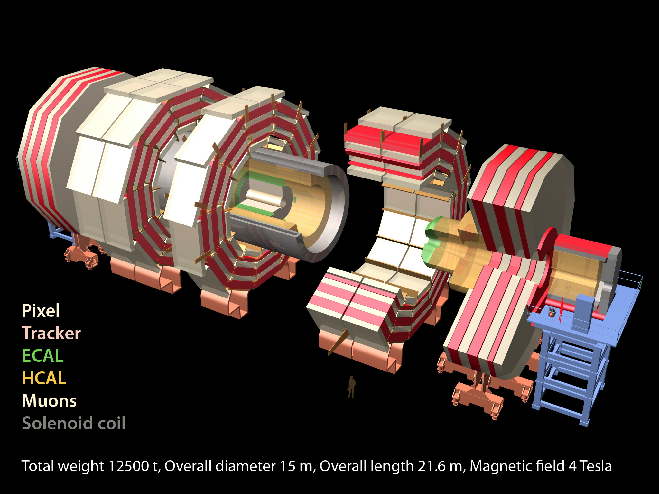
CMS
Total weight 14000 t
Overall diameter 15 m
Overall length 28.7 m
High Resolution
ECAL
76k scintillating
PbWO₄ crystals
MUON ENDCAPS
HCAL
Scintillator/brass
Interleaved ~7k ch
473 Cathode Strip Chambers (CSC)
432 Resistive Plate Chambers (RPC)
3.8T Solenoid
IRON YOKE
Preshower
Si Strips ~16 m²
~137k ch
YE1-3
YBO
Foward Cal
Steel + quartz Fibers ²~k ch
YB1-2
All Silicon
Pixels & Tracker
Pixels (100x150 μm²)
~ 1 m² ~66M ch
Si Strips (80-180 μm)
~200 m² ~9.6M ch
MUON BARREL
250 Drift Tubes (DT) and
480 Resistive Plate Chambers (RPC)
Notes:
Multi-purpose

Slide 5
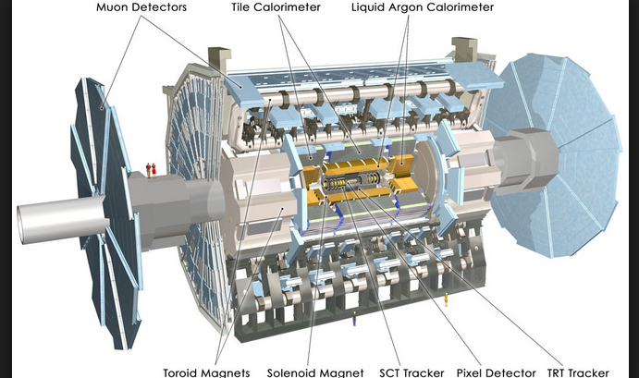
The ATLAS Detector

Slide 6
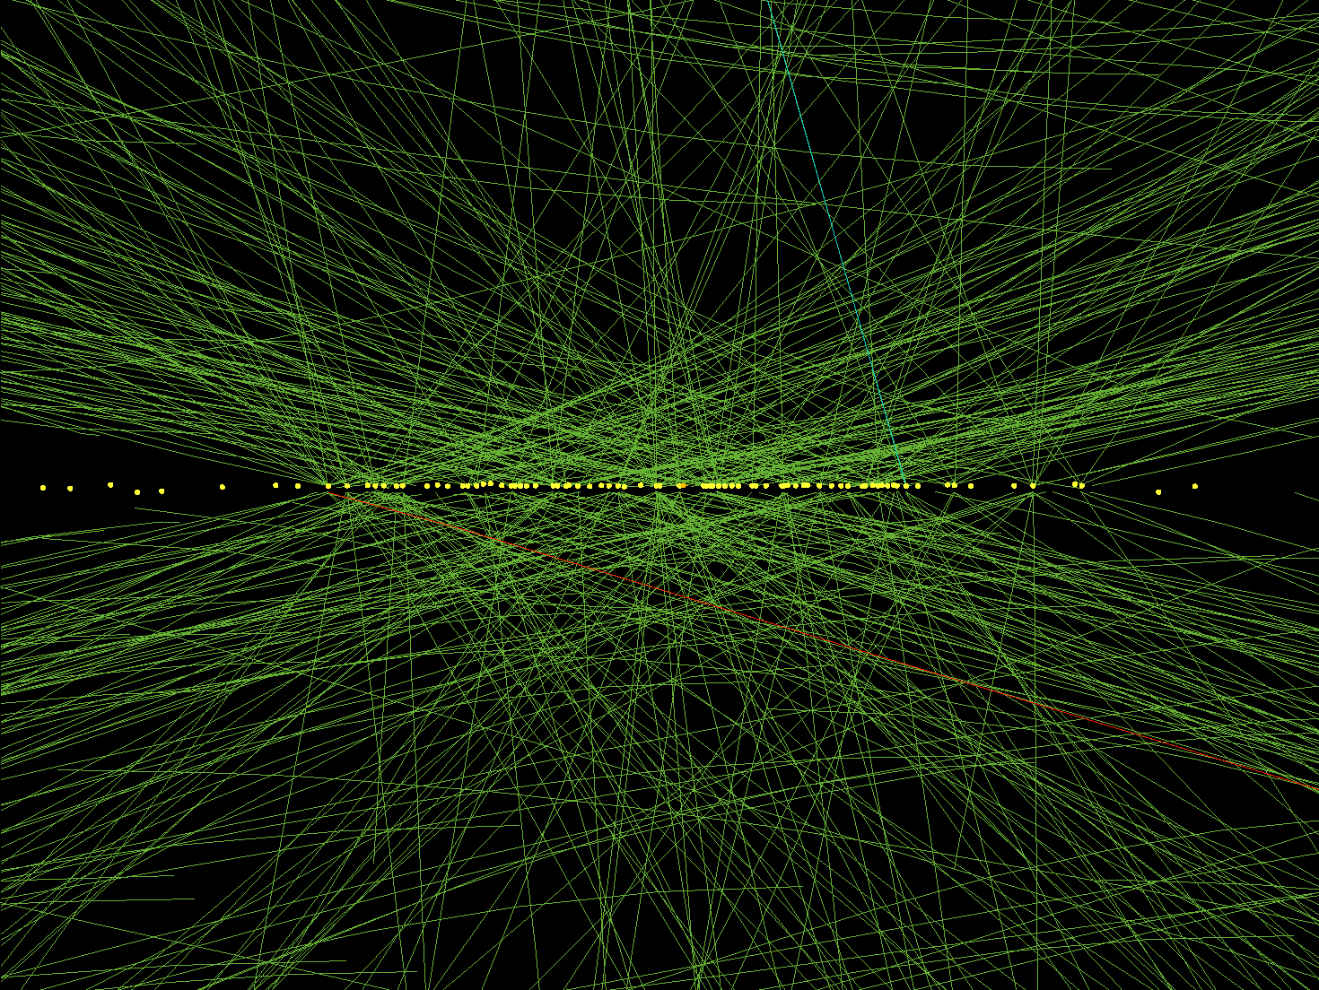
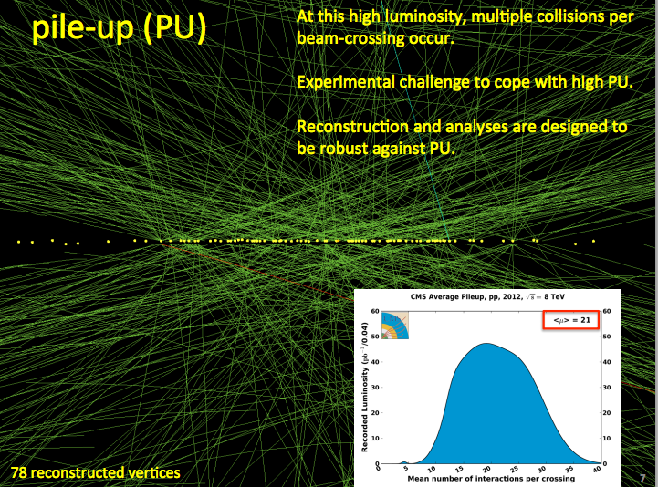
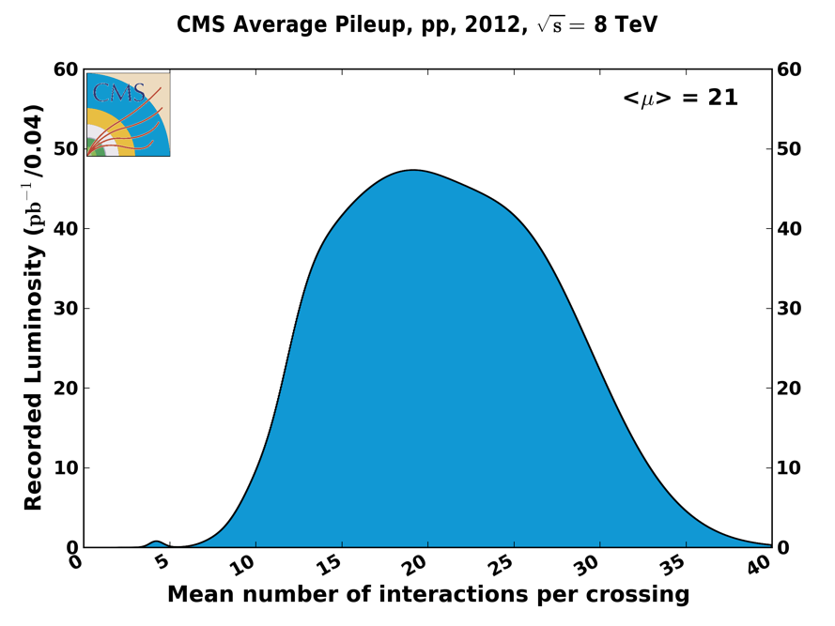
Pile-Up (PU)
At high luminosity, there are multiple interactions per beam-crossing.
Experiments need to cope with high PU.
Reconstruction and analyses need to cope with PU.
78 reconstructed vertices

Slide 7
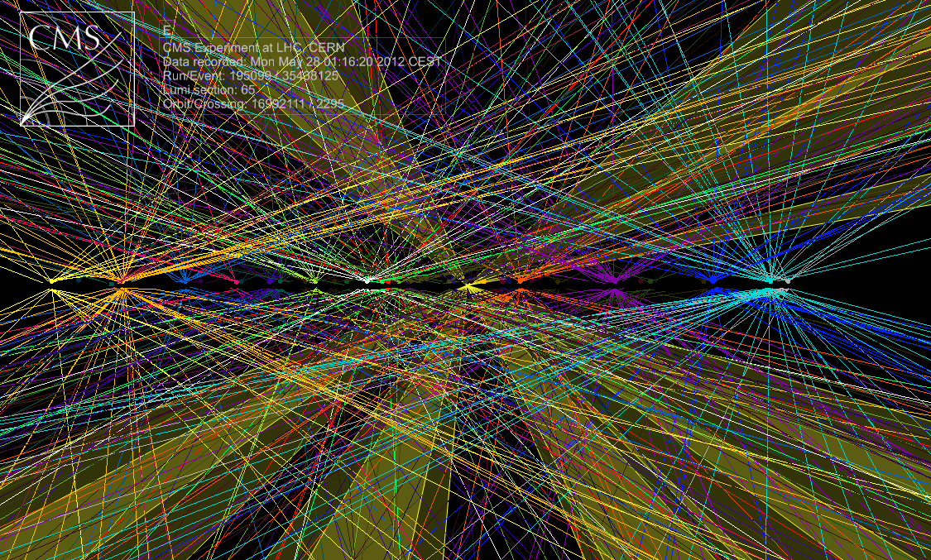
The so-called Pile-up!
Many interactions per crossing
A huge Challenge for reconstruction, object ID and measurements
Raw ΣE_{T}~2 TeV
14 jets with E_{T}>40
Estimated PU~50

Slide 8
Multivariate Methods:
Why and Where?
Why: To extract best possible physics!
  to meet the challenges of finding extremely small signals and making very precise measurements
    Maximize sensitivity to searches of new particles & processes
    Extract signals, known and new, with high efficiency
    Improve precision of measurements
Where: Almost everywhere since HEP events are multivariate
  Event selection, particle ID, signal/background discrimination, function fitting (jet energy corrections, tag rates), parameter estimation, data exploration

Slide 9
Broad Categories of
Analysis Tasks
Classification
  Object ID with high efficiency and low fake rates
    Identification of electrons, photons, taus, b-quark jets, ..
  signal/background discrimination
Parameter Estimation
  Measurement of quantities; observables ⬅➔ parameters
Function fitting
  Energy correction functions, tag-rate functions, …
Mathematically, all of these are Functional Approximation problems.

Slide 10
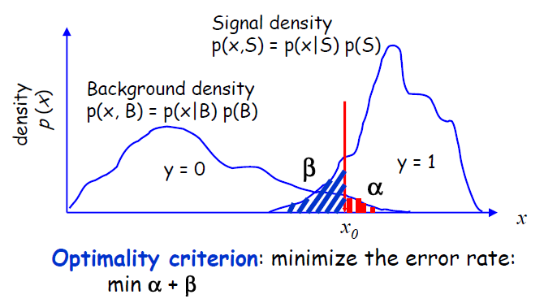
Optimizing Cuts
x_{cut} is the “cut” or
the “decision boundary”
x > x_{cut} => S, else B
Two types of misclassification errors
Type I error: False Positive
(False discovery)
Background hypothesis rejected when it is true
Type II error: False Negative
(Missed discovery)
Background hypothesis not rejected even when false
x_{cut}
“Excessive credulity”
Tests not specific enough
← Minimize the total misclassification error
“Excessive skepticism”
Significance level
1-β: Power

Slide 11
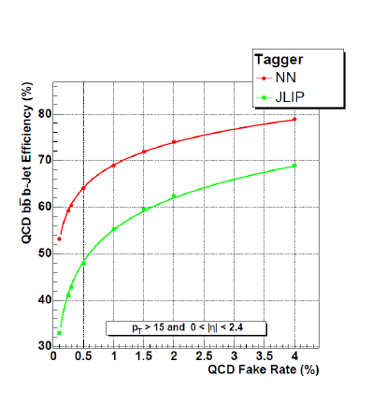
Optimizing Cuts
ε_{s}
Operating point
ε_{B}
x_{cut}
Or for fixed α maximize power
ε_{s} = 1- β; ε_{B} = α
Or for fixed α maximize power
ε_{s} = 1- β; ε_{B} = α

Slide 12
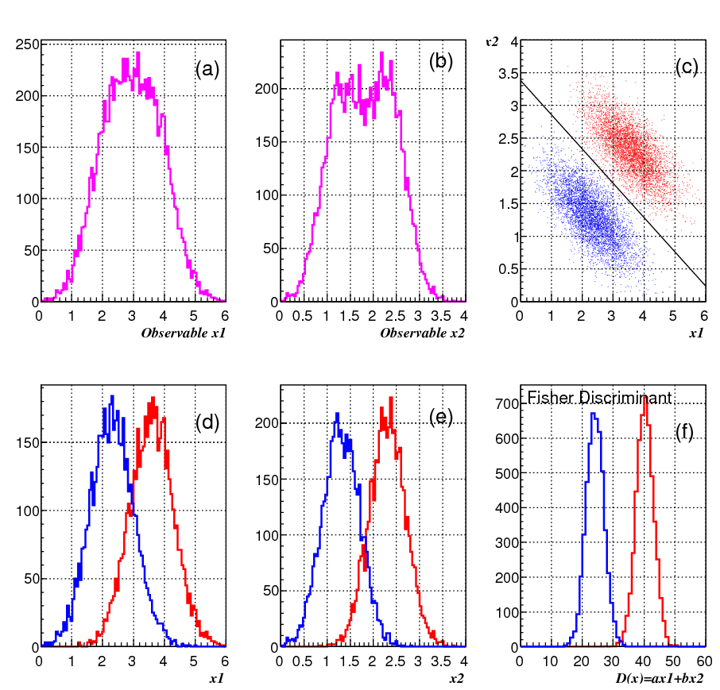
Stepping onto Flatland
More dimensions
can help!
But, you will have no idea if you are
confined to lower dimensions.
No independent cuts on the two variables
can completely separate the two classes as a correlated cut can
One-dimensional distributions
are marginalized distributions
of multivariate density
f(x1)=∫g(x1,x2,x3, .. )dx2dx3…

Slide 13
Leaping into Extra Dimensions
Our data are generally characterized by multiple objects and variables (>>2!) that are generally correlated.
  Four-vectors, energy in calorimeter cells, derived kinematic quantities,….
Each event (or object) represents a point in a multidimensional variable space called “Feature Space”
We want to map this multidimensional feature space onto a lower dimensional space of responses or answers!
Classification ➔ Is this signal or background
➔ Is this a quark jet or a gluon jet, etc.
Parameter Estimation ➔ Measure the value, say, Higgs mass!

Slide 14
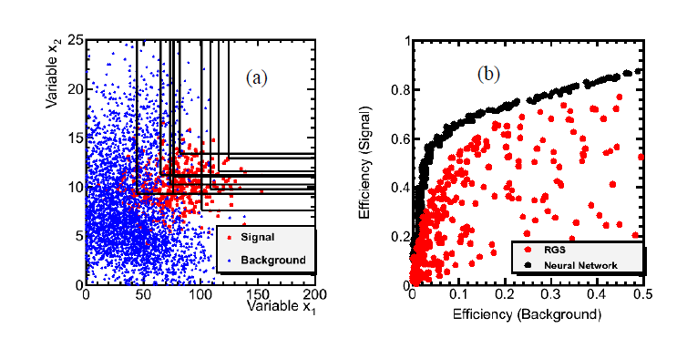
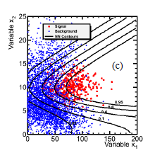
Multivariate Analysis Methods
It is necessary to be efficient at every stage of the analysis, in order to meet the challenge of extracting small signal from huge backgrounds.
Multivariate analysis (MVA) methods can help in identifying objects, correcting energies and in event classification of physics processes, with significant overall gains.
A simple illustration of MVA
PB, Annu. Rev. Nucl. Part. Sci. 2011, 61:281-309.
MVA
Simple
cuts
Simple
cuts

Slide 15
Multivariate Methods & Tools
A list of popular methods
  Random Grid Search
  Linear Discriminants
  Quadratic Discriminants
  Support Vector Machines
  Naïve Bayes (Likelihood Discriminant)
  Kernel Density Estimation
  Neural Networks
  Bayesian Neural Networks
  Decision Trees
  Random Forests
  Genetic Algorithms
Tools
  Jetnet
  MLPFit
  SNNS (Stuttgart NN Simulator)
  TMVA
  Stat Pattern Recognition
  FBM (Radford Neal – Flexible Bayesian Modeling)
  NeuroBayes
  NeuroEvolution
  Matrix Element (homegrown)

Slide 16
Which Method is best?
The “no free lunch” theorem tells you that there is no one method that is superior to all others for all problems.
However, in general, one can expect Bayesian neural networks (BNN), Boosted decision trees (BDT) and random forests (RF) and (matrix element method) to provide excellent performance over a wide range of problems.
BDT is popular because of robustness, noise resistance and psychological comfort!
Matrix Element method because of theoretical-motivation

Slide 17
MVA Applications in LHC Physics
Used extensively at CMS, especially in Higgs searches and studies
  Object ID → e/γ, τ, b-tagging
  Energy corrections, and errors
  Vertex assignment
  Event classification
  Higgs, top, ..
ATLAS uses MVA more sparingly, but that might change
  τ ID, b-tagging
  Single top, Higgs, ..

Slide 18
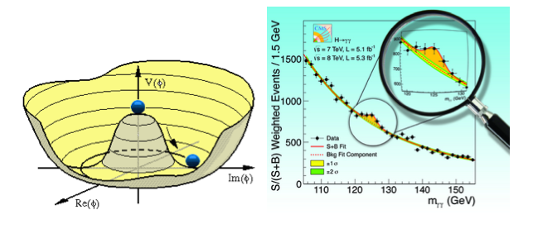
Higgs Physics
I will show mostly July 2012 observation results
and then some latest updates

Slide 19
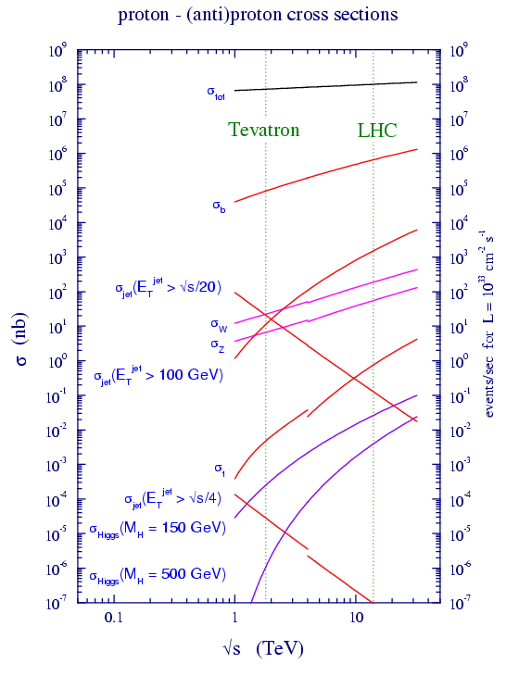
Physics Processes: Rates
Production relative to σ_{tot}:
    bb at 10⁻³,
    W→ℓν at 10⁻⁶ and
    Higgs (m=110 GeV) at ~10⁻¹¹
  32 MHz beam crossing, only about 300 Hz tape writing: 1/10⁵
  fast and sophisticated selection process essential: trigger
Trigger
  Basic triggers: use electron, muon, jet and energy or missing energy signatures

Slide 20
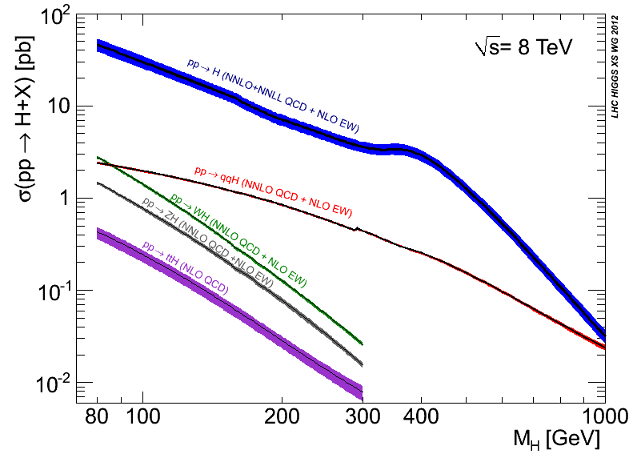
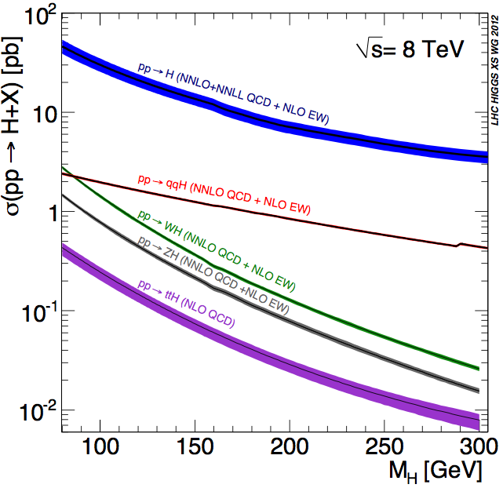
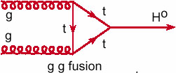
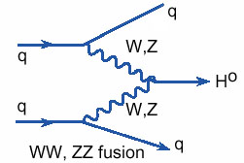
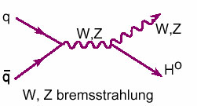
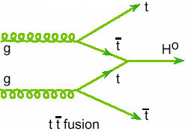
Higgs Boson production
√s=8 TeV: 25-30% higher σ than √s=7 TeV at low m_{H}
All production modes to be exploited
  gg VBF VH ttH: if H exists, we want to study them
  Latter 3 have smaller cross sections but better S/B in many cases

Slide 21
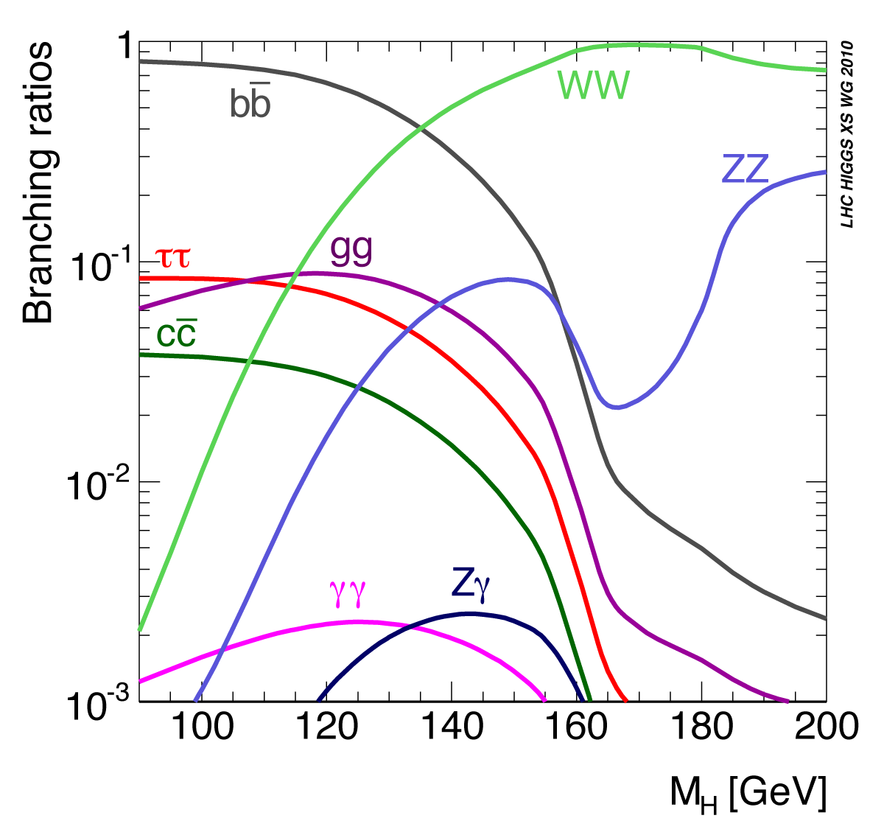
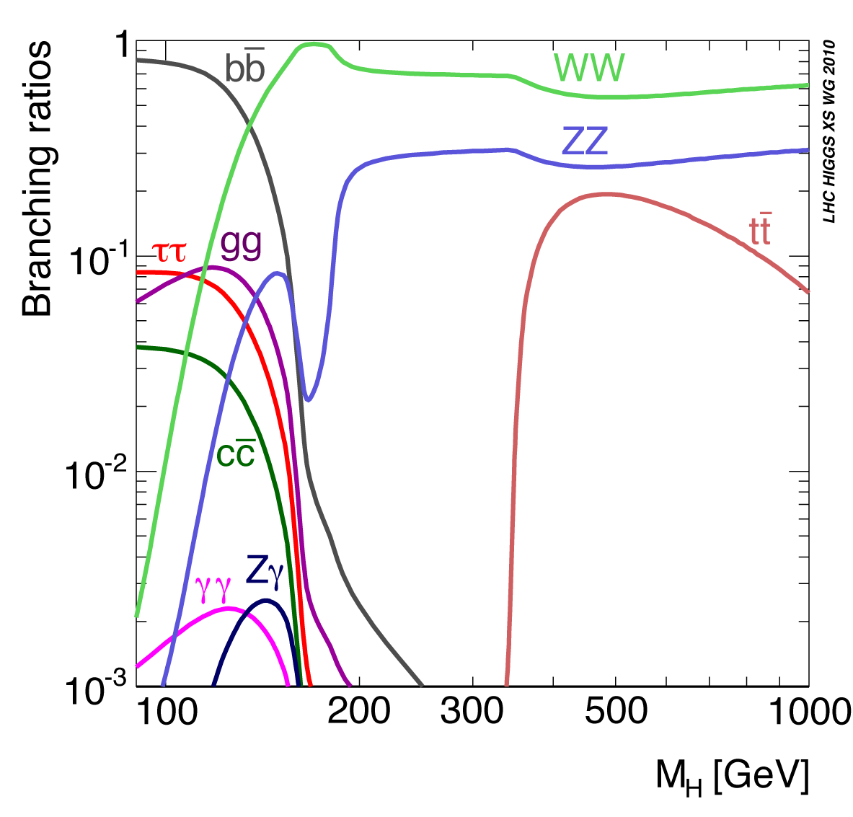
Higgs Boson decays
Decay modes exploit:
High mass: WW, ZZ ; Low mass: bb, ττ, WW, ZZ, γγ
High (mass) resolution Channels: H→γγ and H→ZZ→4l
Today, mostly concentrate on high sensitivity channels

Slide 22
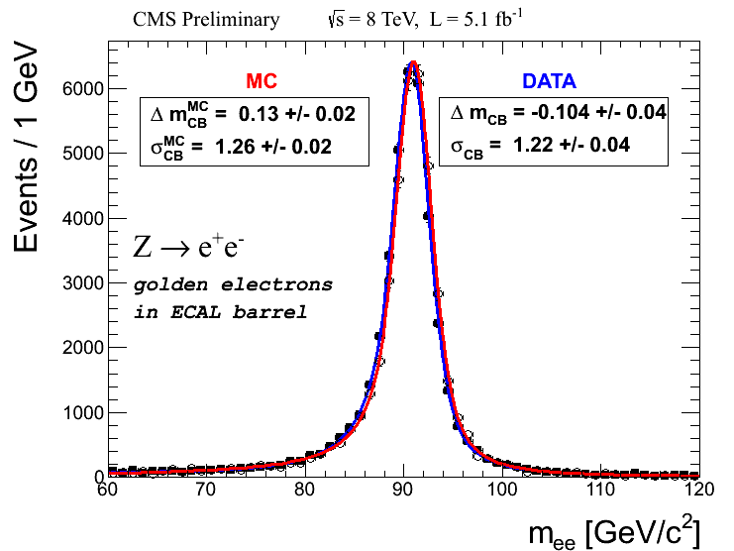
Electron/Photon reconstruction
Cluster reconstruction in ECAL
  Common for both electrons and photons. Designed to collect bremsstrahlung and conversions in extended phi region
Dedicated track reconstruction for electrons
Multivariate e identification in 2012
  Multivariate training against background in data
  ECAL, tracker, ECAL-tracker-HCAL matching,impact parameter
  30% efficiency improvement in H→ZZ→4e wrt cut based ID
Electrons
ECAL Barrel (EB)
Energy scale and resolution
  Extensive control with Z and
  J/ψ➔ee for both electrons and photons

Slide 23

H ➔γγ
candidate

Slide 24
H → γγ Overview
MVA methods used extensively
  Photon ID, energy correction and event classification
    Fit mass distribution in 4 event classes based on a diphoton MVA output + 2 di-jet categories
  Improvement in expected limit ~15% over cut-based analysis
Two alternate analyses for cross-checks.
  Cut-based photon ID and event classification
    Fit data mass distribution in 2 rapidity x 2 shower shape =4 categories with different Signal over Background (S/B) + 2 di-jet categories
  Alternative background model extraction:
    Fit output of a 2nd MVA combining diphoton MVA and m_{γγ} using data in mass sidebands to construct the background model

Slide 25
Photon Energy
Clusters of calibrated energies in ECAL + Pre-shower energy, if available. Corrected for loss in crystal transparency due to radiation damage.
Multivariate BDT regression to correct for losses in shower containment and upstream conversions
  Input Variables:
    global (η,ϕ) of the ECAL supercluster
    shower shape variables (energy deposition patterns)
    energy-weighted η-width and ϕ-width of the supercluster
    ratio of hadronic to electromagnetic energy.
  A second BDT trained to provide an event-by-event estimate of the energy uncertainty
    Uses the same variables
    Target to learn is the absolute deviation of correction predicted by BDT1 and true correction at the generator level

Slide 26
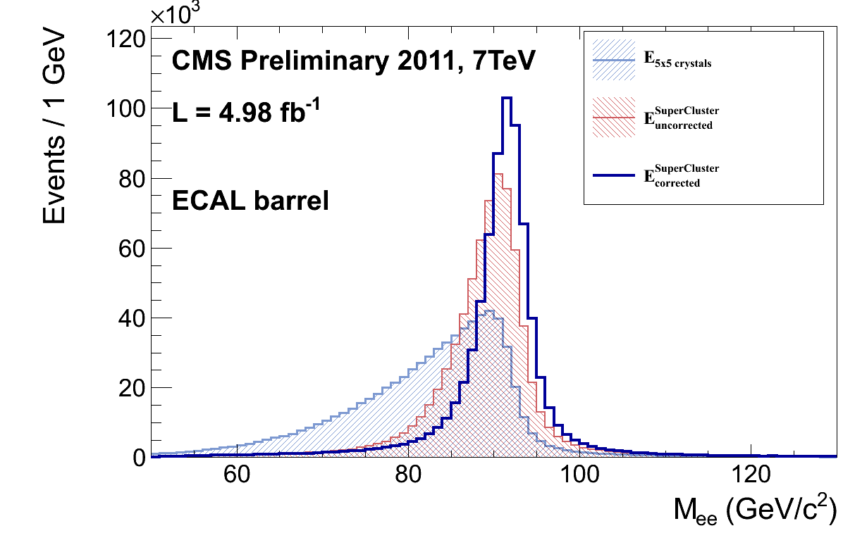
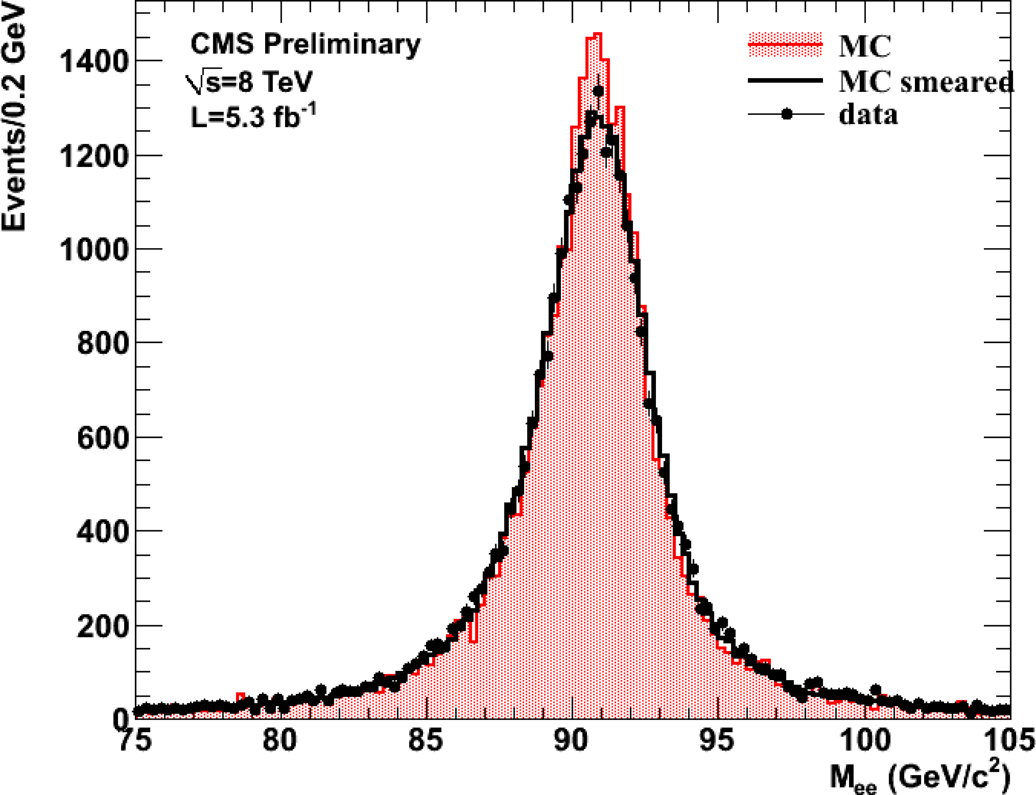
Photon Energy Scale and Resolution
ECAL clustered energies corrected using a MC trained multivariate regression
  Improves resolution and restores flat response of energy scale versus pileup
      Inputs: Raw cluster energies and positions, lateral and longitudinal shower shape variables, local shower positions w.r.t. crystal geometry, pileup estimators
Regression also used to provide a per photon energy resolution estimate
To measure the Energy Scale and resolution: use Z→e⁺e⁻
E_{5x5}
E_{SC}
E_{SC corr}
Both EB |η|<1
highR9
Effect of the regression on the
Z->ee peak
Notes:
RH plot shows that we get the smearing correct
LH plot shows the improvement coming from the regression

Slide 27
Photon ID/selection
MVA based photon ID discriminates photons from fakes:
  Inputs: isolation, shower shape variables, per event energy density, pseudorapidity
Vertex identification with a BDT
  Input variables: Σp_{t}², Σp_{t} projected onto the γγ transverse direction, p_{t} asymmetry and conversions
Correct vertex finding probability also estimated using a BDT
Photon pre-selection:
  E_{Tγ1}/m_{γγ}>3, E_{Tγ2}/m_{γγ}>4
  Photon Id a bit tighter than trigger selection and MC EM enrichment filters
    Efficiency measured using tag and probe with Z→ee
  Electron veto: Efficiency measured using tag and probe with Z→μμγ

Slide 28
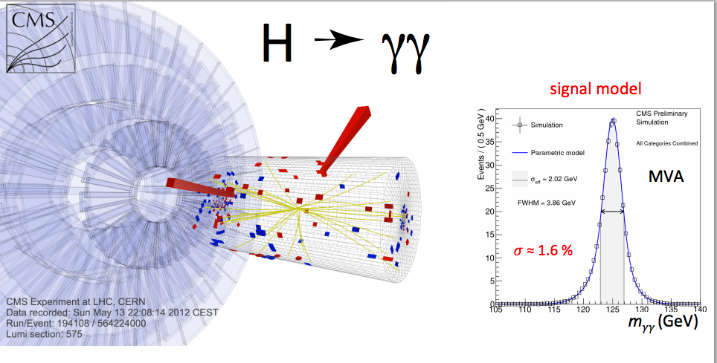

Slide 29
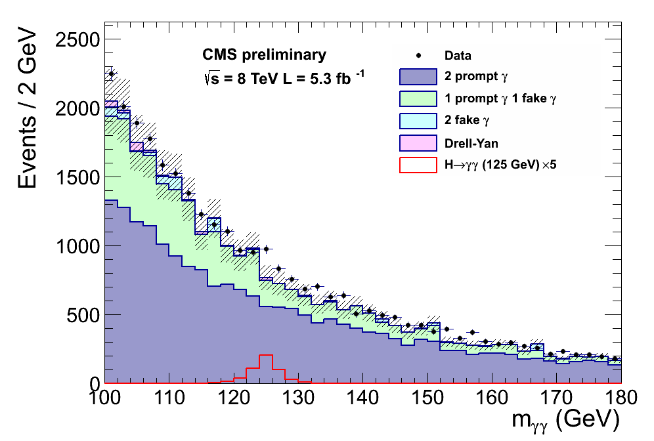
The di-photon Invariant Mass Spectrum
Blind analysis in 2012
Background MC only used for analysis optimization
Z→ee also to measure photon efficiencies and resolution with data
Backgrounds:
  prompt di-photons
  photon+jet(fake)
  Jet-jet (two fakes)

Slide 30
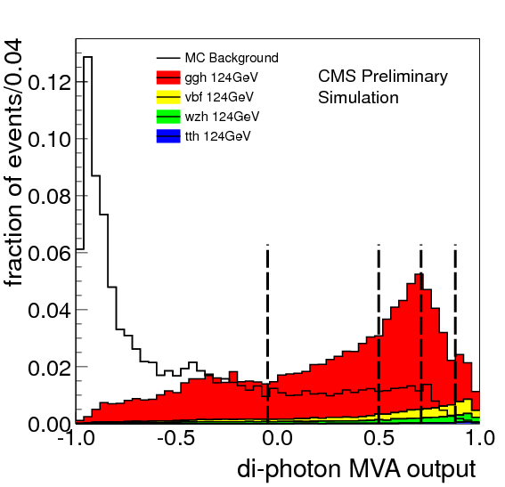
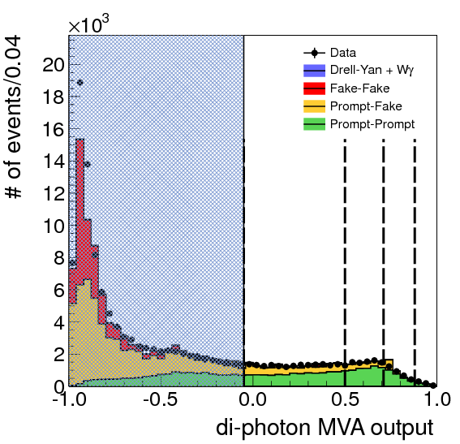

Diphoton MVA
Diphoton MVA trained on signal and background MC with input variables largely independent of m_{γγ}
  Kinematics: p_{T} and η of each photon, and cosΔφ between the 2 photons
  Photon ID MVA output for each photon
  per-event mass resolution and vertex probability
Encode all relevant information on signal vs background discrimination (aside from m_{γγ} itself) into a single di-photon MVA output to first order independent of m_{γγ}
Cat 3
Cat 2
Cat 0
Cat 3
Cat 2
Cat 0
Cat 1
Cat 1
Notes:
The larger amount of data at low bdt output indicates that there are more fakes in data but they do not affect the analysis.

Slide 31
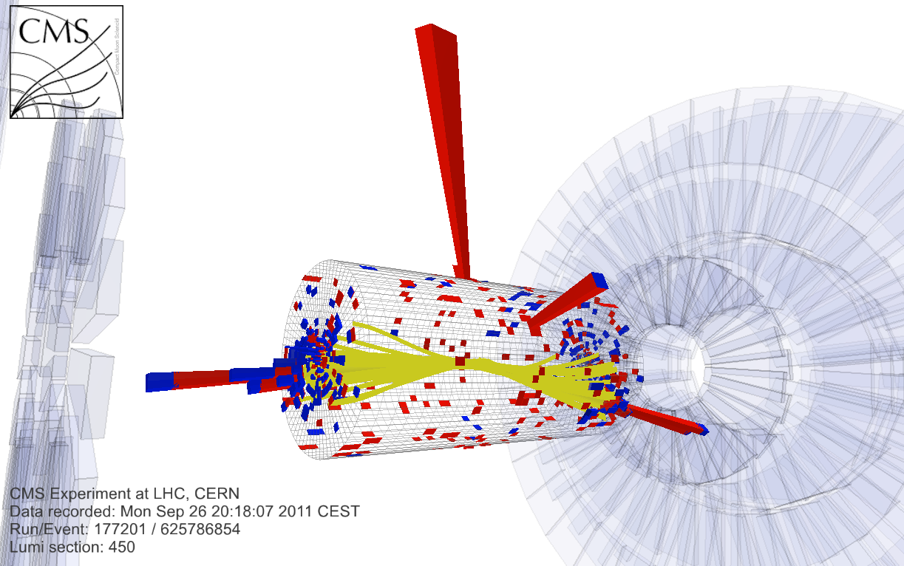
Di-jet Tagging
Exclusive selection of di-photon events with VBF-like topology:
  Two high pT jets with large pseudo-rapidity difference and invariant mass
High S/B
~80%-pure VBF events for large di-jet invariant masses
Di-jet event with:
diphoton mass 121.9 GeV
dijet mass 1460 GeV
jet p_{T}: 288.8 and 189.1 GeV
jet η: -2.022 and 1.860
Notes:
Here are the numbers confirmed by Paolo for glu-glu contamination in the 2 di-jet categories of 2012 and for the one dijet category of 2011:
For 2011, the dijet category had a 30% contamination from gly-glu. For 2012, the glu-glu contamination in the high mjj category is 20%. So in both years, the most sensitive dijet category is dominated by VBF.

Slide 32
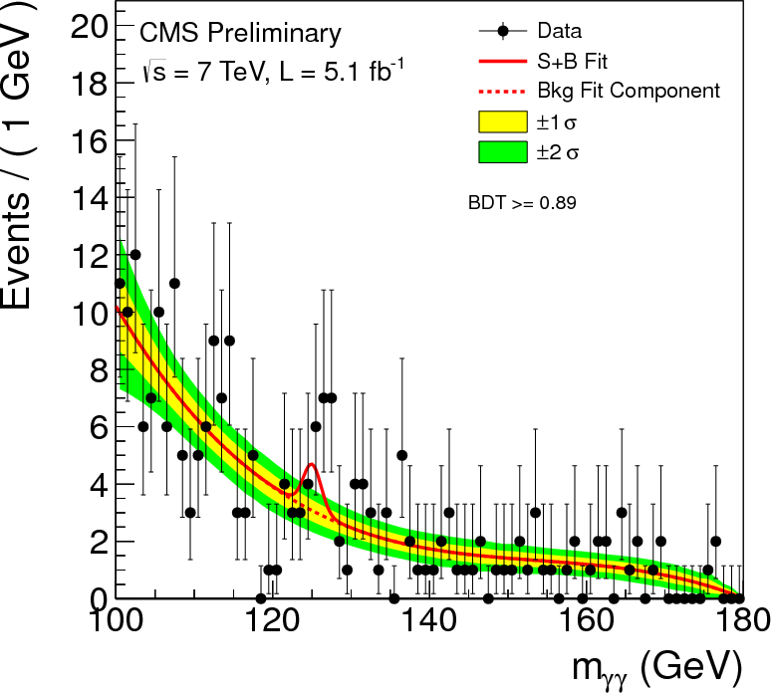
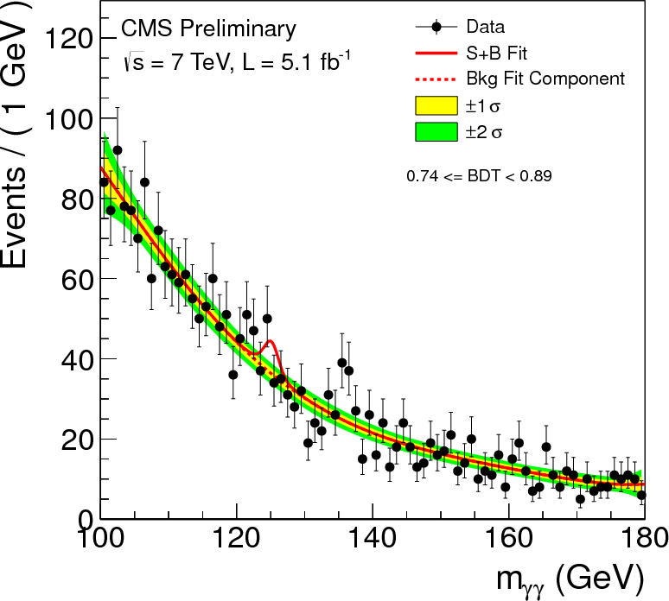
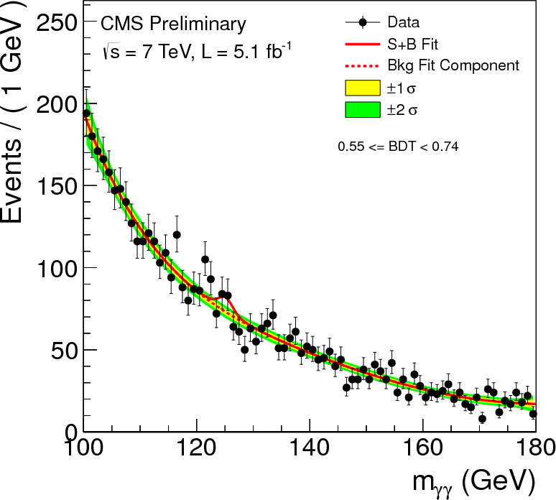
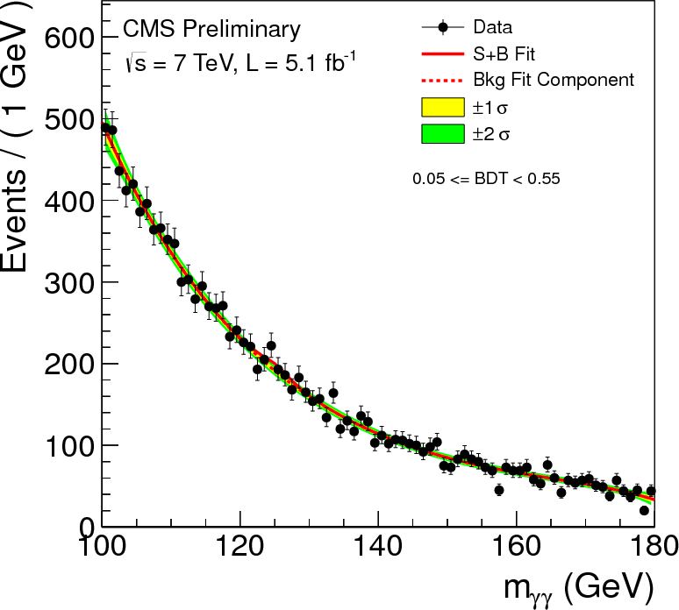
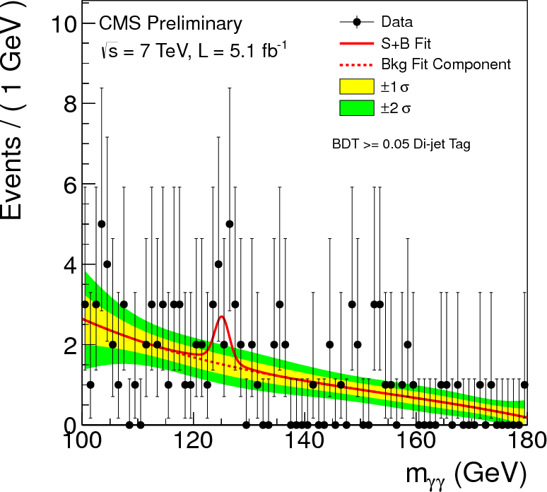
7 TeV Mass Distribution in Categories
Untagged 0
Untagged 1
Untagged 2
Background model is entirely from data.
Fit to mass distribution in each category with polynomial functions (3rd to 5th degree)
Untagged 3
Dijet tag
32

Slide 33
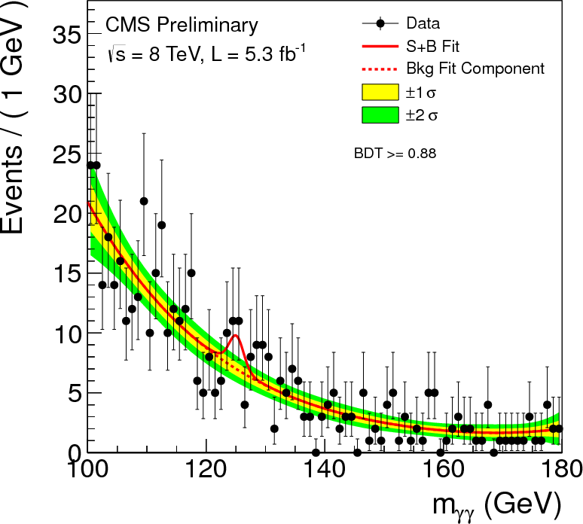
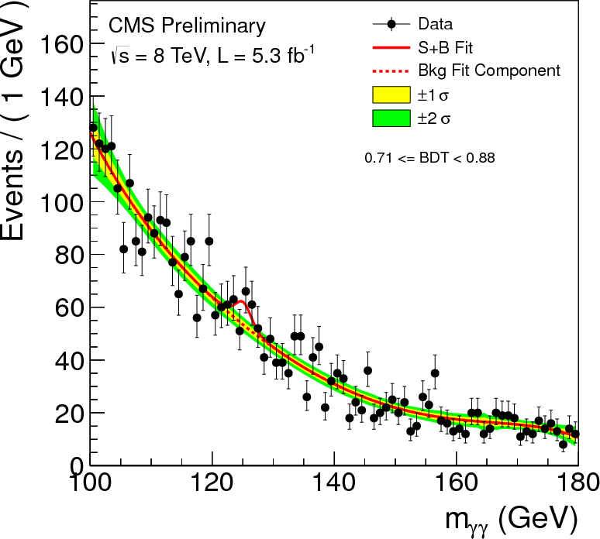
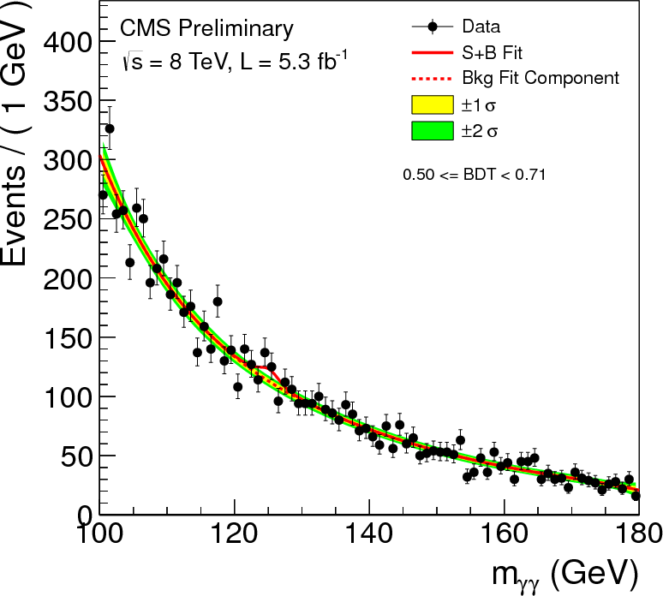
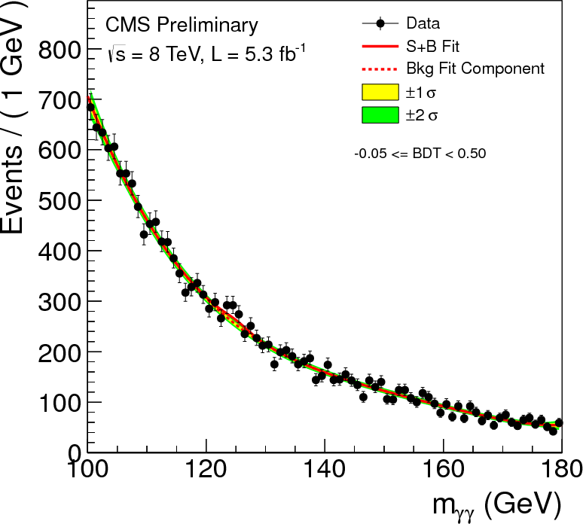
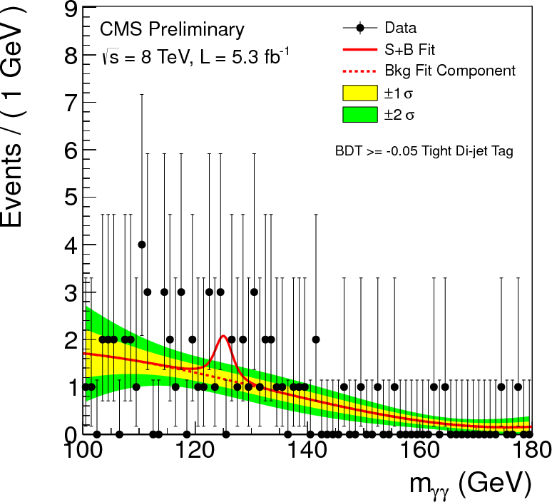
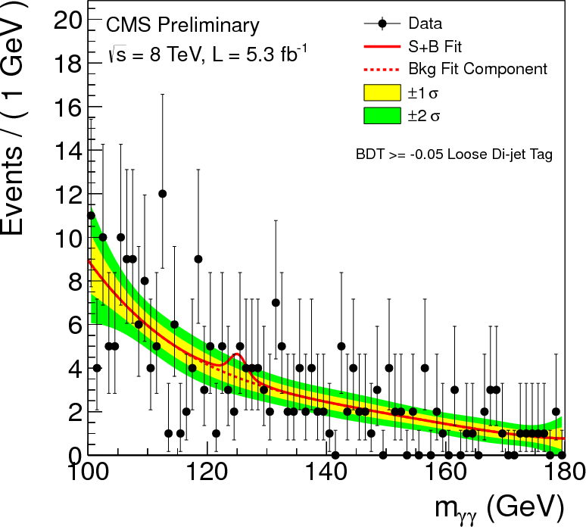
8 TeV Mass Distribution in Categories
Untagged 0
Untagged 1
Untagged 2
Untagged 3
Dijet tight
Dijet loose
33

Slide 34
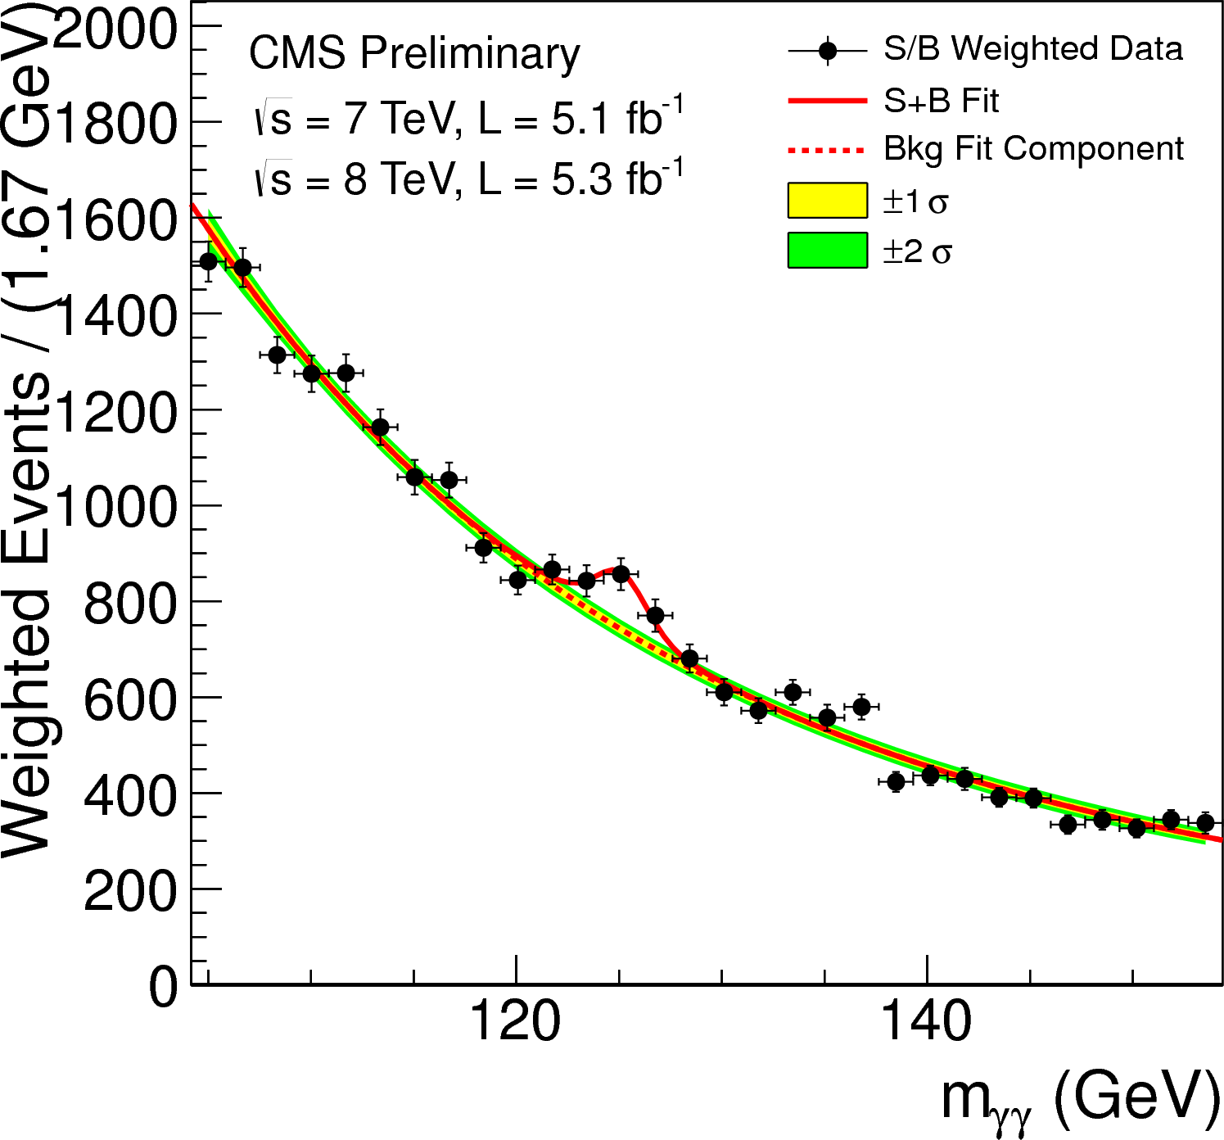
S/B Weighted Mass Distribution
Sum of mass distributions for each event class, weighted by S/B
  B is integral of background model over a constant signal fraction interval
July 2012
Notes:
The weighting of events is similar to what is used in the final significance extraction

Slide 35
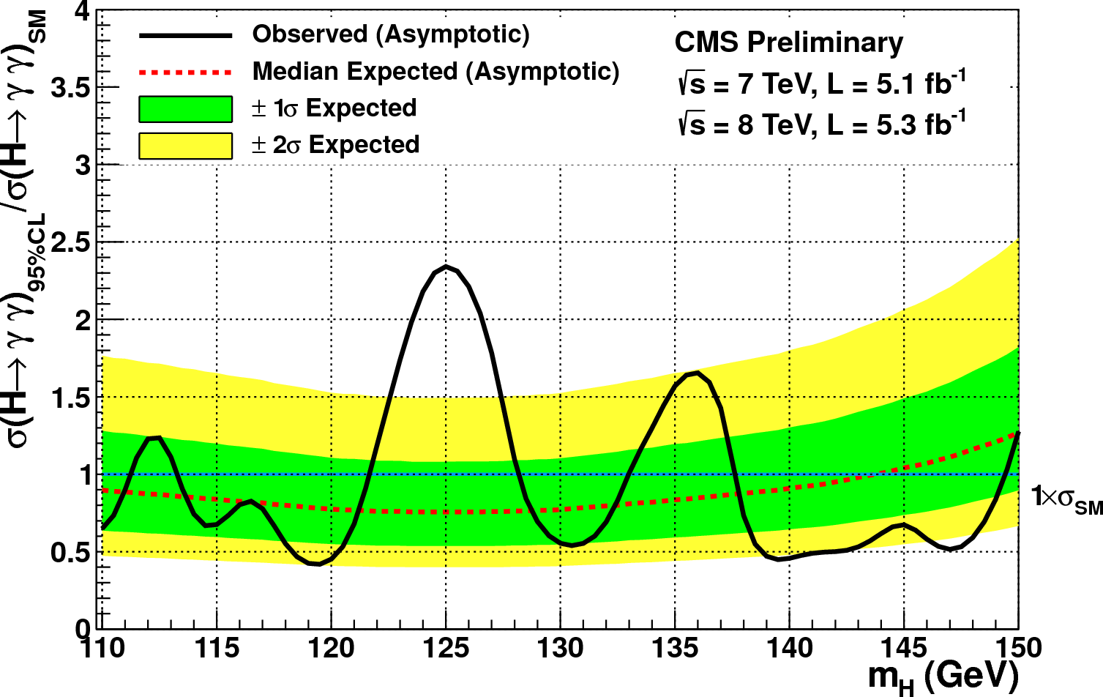
95% CL Exclusion for SM Higgs
July 2012
results
Expected 95% CL exclusion 0.76 times SM at 125 GeV
Large range with expected exclusion below σ_{SM}
Observe largest excess of events at 125 GeV
35

Slide 36
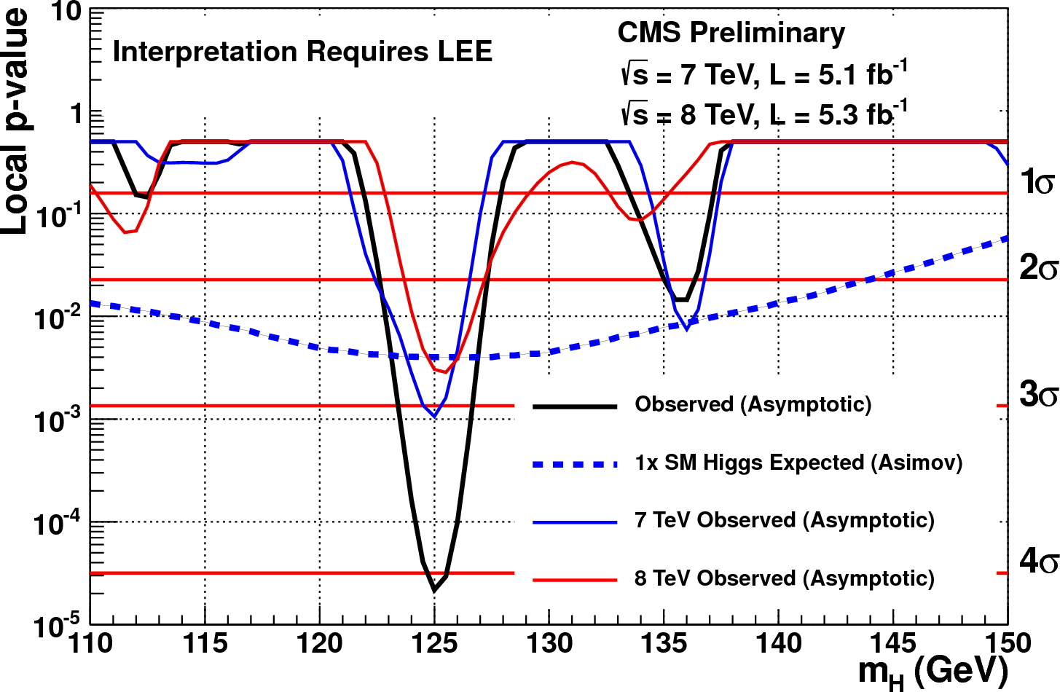
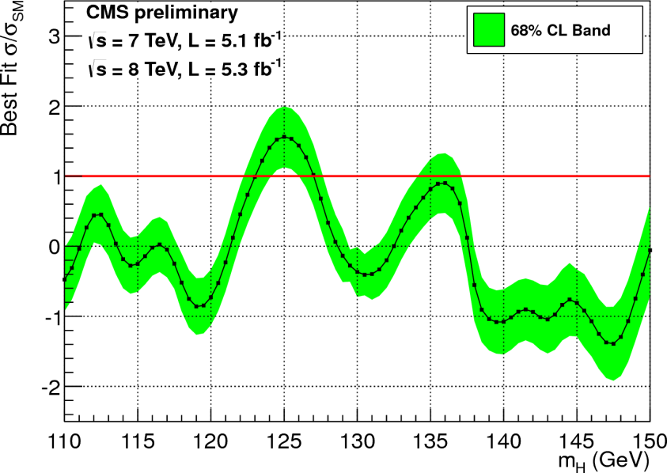
P-Values and signal strength
July 2012 results
Combined best fit signal strength
σ/σ_{SM} = 1.56±0.43 consistent with SM.
Minimum local p-value at 125 GeV with a local significance of 4.1 σ
Similar excess in 2011 and 2012
Independent cross check analyses give similar results
Global significance in the full search range (110-150 GeV) 3.2 σ
36

Slide 37
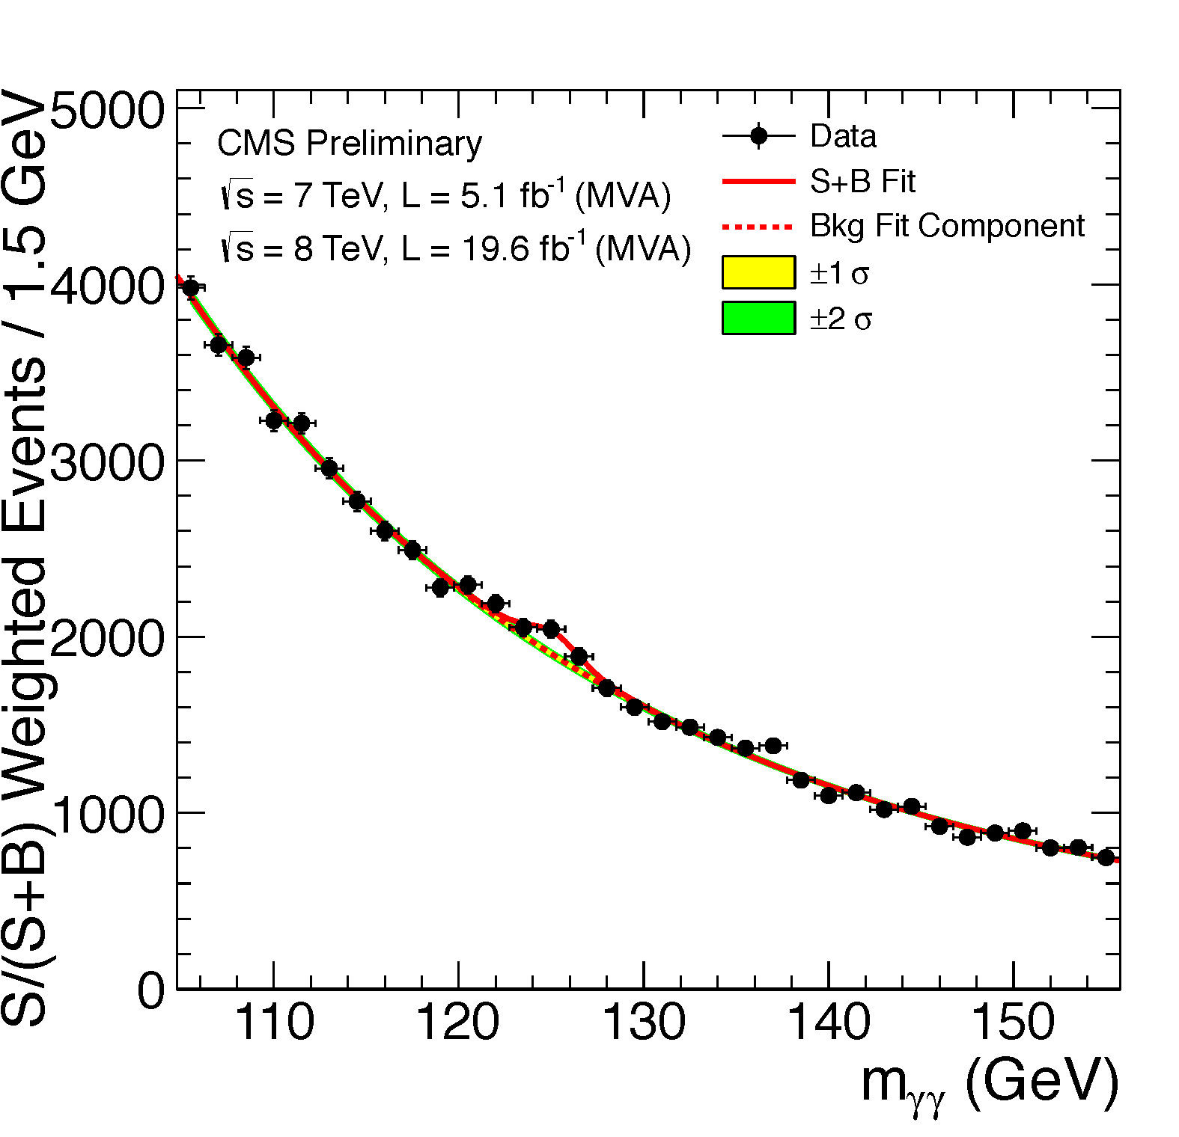
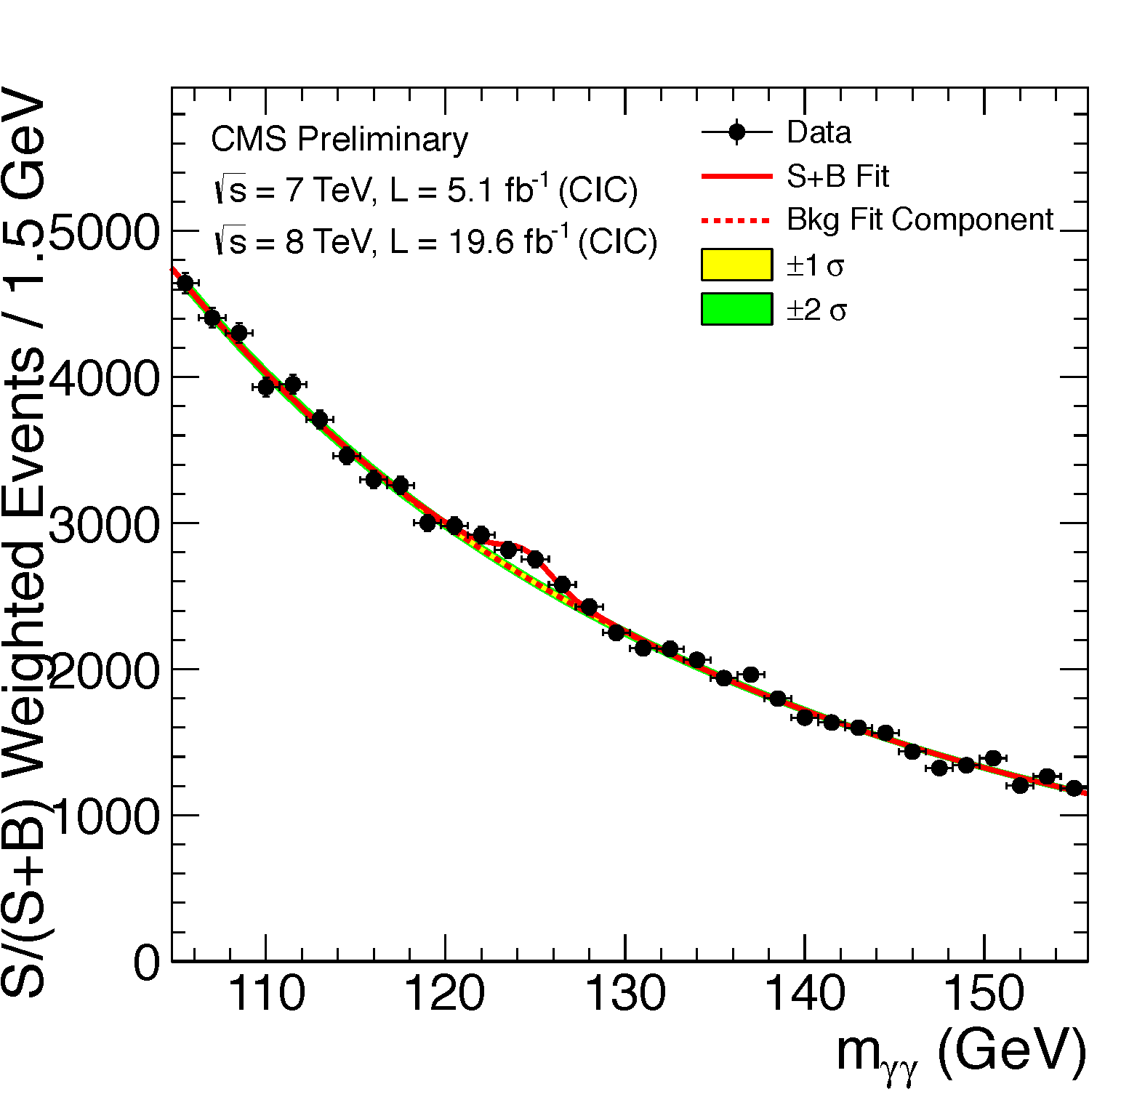
Latest Update
LHCP May 2013
MVA analysis
Cut-based analysis
m_{H} = 125.4 ± 0.5 (stat.) ± 0.6 (sys.) GeV

Slide 38
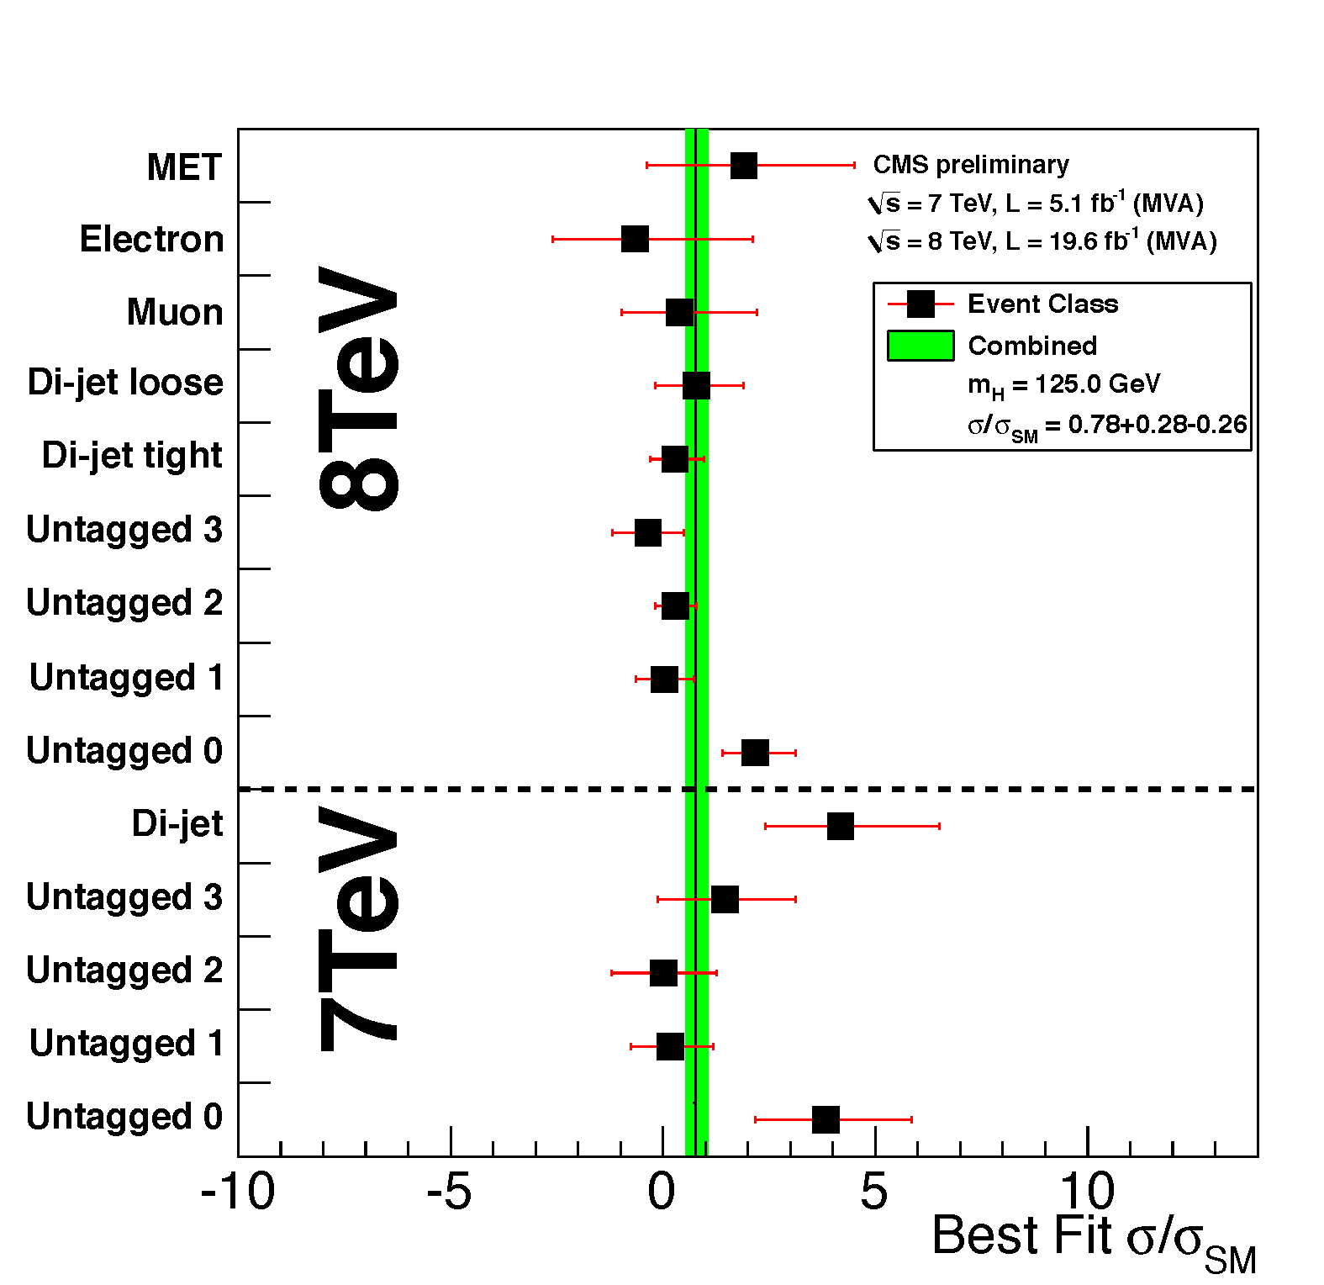
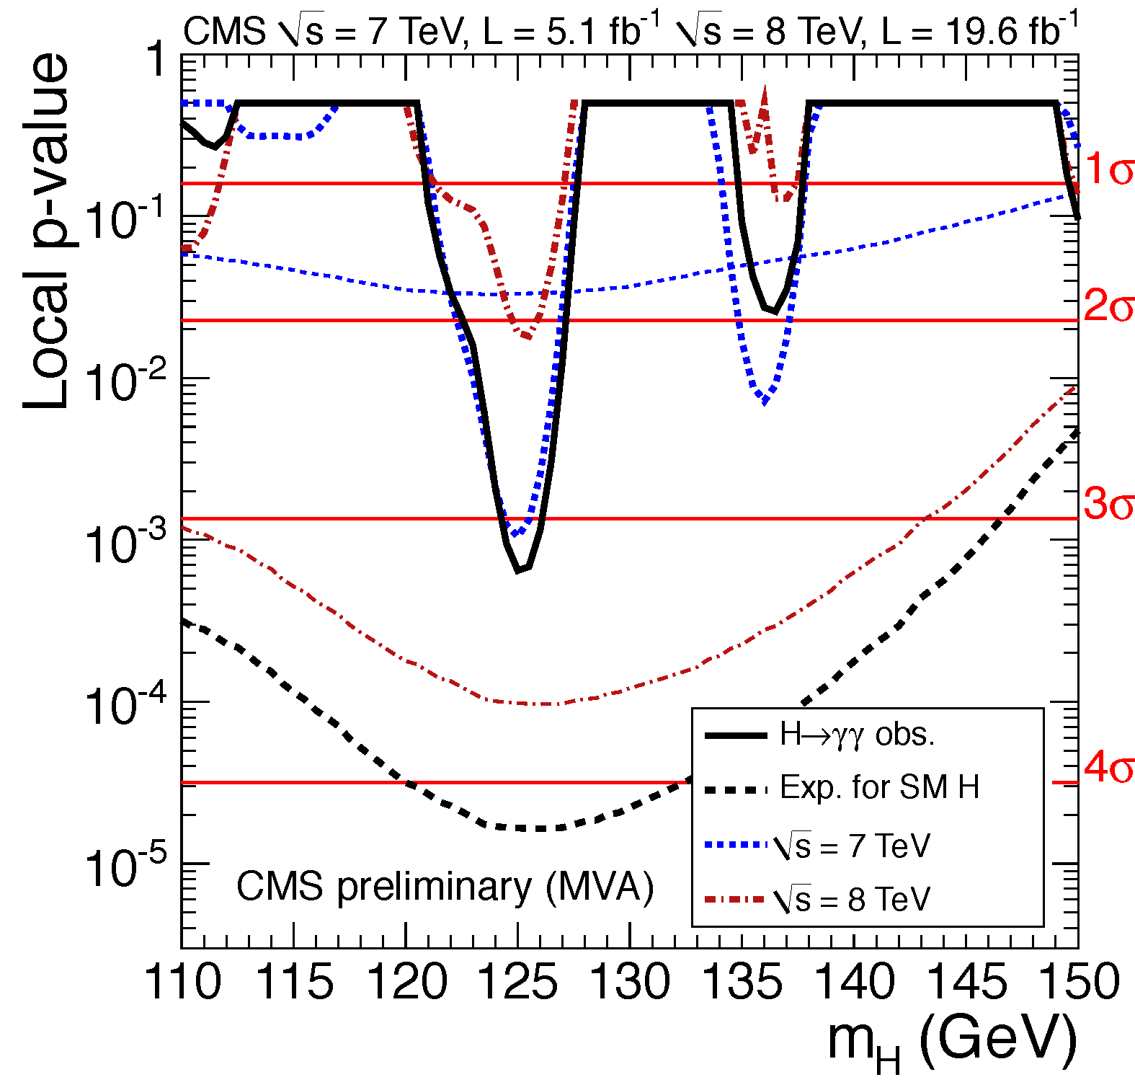
Latest Update
Ratio of the production cross section times the relevant branching fractions over the SM expectation: 𝜎/𝜎_{SM} = 0.78 ± 0.27 (m_{H} = 125 GeV)
Significances (𝜎) for m_{H} = 125 GeV:
  MVA: observed 3.2, expected 4.2
  Cut-based: observed 3.9, expected 3.5
MVA analysis

Slide 39
H ➔ZZ*→4l

Slide 40

H →ZZ^{(*)} →4l (l = e,μ): the golden channel
Clean signature: narrow peak, low background
Background: ZZ⁽*⁾; Z+jets, ttbar, WZ
One of the best performing channels in the whole mass range …
… but requires the highest possible efficiencies (lepton Reco/ID/Isolation) and classification
➔ Use MVA wherever possible
.

Slide 41

2012 analysis + improvements
Blinding policy: analysis optimized blindly for 2012,
applied to 2011 reoptimization
Do NOT look at 110 < m4l <140 GeV, and m4l > 300 GeV
Main changes:
        New lepton ID (MVA + PFlow)
        New lepton PFlow isolation
        Final State Radiation (FSR) recovery
2D analysis: m4l + Kinematic Discriminant
>20% improvement @ mH = 126 GeV
wrt 2011 analysis
Expected exclusion range
121–540 GeV
.

Slide 42
Background models
Irreducible background ZZ → 4l
  Estimated using simulation
  Phenomenological shape models
  Corrected for data/simulation scale
  Reducible backgrounds estimated from data
  Extrapolation from control samples enriched with misidentified leptons
  Total uncertainty ~50%
qq → ZZ → 4l
gg → ZZ → 4l
  Validation in data
4l
4l
  wrong flavors
  & charges
control sample
42
Notes:
REDUCIBLE Backgrounds ( Z->ll + leptons from b-decays or from mis-identification of light jets)
-Two complementary methods
based on the fake rate technique
-Fake rate is measured in relevant control regions
such as : Z + exactly 1 lepton + MET<25 GeV
(MET cut is used to reject WZ)
-Fake rate is applied in control regions such
as Z + 2 SS leptons
Validation on data of the methods are performed using the Wrong Flavour and Charge “signal” regions to estimate
the expected Z+X bkg events with the fake rate technique and compare with the MC expectation

Slide 43





MELA
PRD81,075022(2010)
http://arXiv.org/abs/arXiv:1001.5300
Matrix Element Likelihood Analysis:
uses kinematic inputs for
signal to background discrimination
{m₁,m₂,θ₁,θ₂,θ*,Φ,Φ₁}
SM H(125 GeV)
qqZZ

Slide 44



MELA
2D analysis using {m_{4l},MELA}
MELA offers powerful discrimination of background
CMS simulation
Higgs, 126 GeV
signal
background
technique applicable for signal hypothesis testing

Slide 45

μ⁺(Z₁) p_{T} : 43 GeV
e⁻(Z₂) p_{T} : 10 GeV
8 TeV DATA
4-lepton Mass : 126.9 GeV
μ⁻(Z₁) p_{T} : 24 GeV
e⁺(Z₂) p_{T} : 21 GeV
45

Slide 46

γ(Z₁) E_{T} : 8 GeV
μ⁻(Z₁) p_{T} : 28 GeV
7 TeV DATA
4μ+γ Mass : 126.1 GeV
μ⁺(Z₂) p_{T} : 6 GeV
μ⁻(Z₂) p_{T} : 14 GeV
μ⁺(Z₁) p_{T} : 67 GeV

Slide 47



Results: m(4l) spectrum
July 2012 results
2011+2012
Yields for m(4l)=110..160 GeV
164 events expected in [100, 800 GeV]
172 events observed in [100, 800 GeV]
Event-by-event errors
47
Notes:
-Z -> 4 l is a standard candle that shows good agreement
and high performance in reconstructing 4 lepton candidates
-Maybe one can stress that the Z peak represents a
cross check on how well we trust what we see in 125
GeV(ATLAS doesnt have it)

Slide 48



Results: MELA 2D plots
Data w.r.t Background expectation
Data w.r.t 126 GeV signal expectation
Cluster of events
around 125 GeV
48

Slide 49

Limits and p-values
July 2012
Expected exclusion at 95% CL :
121-550 GeV
Observed exclusion at 95% CL :
131-162 GeV and 172-530 GeV
Expected significance at 125.5 GeV :
3.8 σ
Observed significance at 125.5 GeV:
3.2 σ

Slide 50

Characterization of excess
July 2012
high sensitivity, high mass resolution channels: γγ+4l
  γγ: 4.1 σ excess
  4 leptons: 3.2 σ excess
  near the same mass 125 GeV
comb. significance: 5.0 σ
expected significance
for SM Higgs: 4.7 σ
50

Slide 51




H→ZZ→4l Update
LHCP May 2013
Z ➝ 4ℓ
mass of the candidates
X ➝ ZZ ➝ 4ℓ
Four-lepton reconstructed mass for the sum of the 4e, 4μ, and 2e2μ channels.
Mass resolution measured from data. ZZ background well under control.

Slide 52




The Z masses
LHCP May 2013
Distributions for events with m_{4ℓ} > 100 GeV
Events in the m_{4ℓ} range [121.5-130.5] GeV

Slide 53



Kinematic Discriminant
K_{D} = P_{S} / ( P_{S} + P_{B} )
where P_{S,B} = f (m₁, m₂, 𝜃₁, 𝜃₂, 𝛷₁, 𝜃*, 𝛷*|m_{4ℓ})
calculated from production and decay kinematics in the Z’s and H rest frames.
background expectation
m_{H} = 126 GeV signal

Slide 54


H→ ZZ → 4l
LHCP May 2013

Slide 55

Significance of the Excess
LHCP May 2013
3D fit to m_{4ℓ}, K_{D} and (for jet categories) p_{T}(4ℓ)/m_{4ℓ} or linear discriminant (VBF).
Significance (𝜎) for m_{H} = 125.8 GeV: observed 6.7, expected 7.2
𝜎/𝜎_{SM} = 0.91
+ 0.30
– 0.24
5𝜎
m_{H} = 125.8 ± 0.5 (stat.) ± 0.2 (sys.) GeV
7𝜎

Slide 56

Mass Measurement
LHCP May 2013

Slide 57

Higgs Results: ATLAS
L. Kashif
for ATLAS
LHCP, May 2013

Slide 58
ATLAS Physics with MVA

Slide 59
Applications in ATLAS
b-tagging using NN
τ ID
  Discriminate against fake τ’s originating from jets
  Use calorimeter info
  ID efficiency ~ 50%
  Jet mis_ID probability < 1%
Also in J^{P} hypothesis testing for Higgs in H→ZZ→4l and H→WW
Single top:
  t-channel single top: cross section measurement
  Wt production: First Evidence
B_{S} → ^{μ+μ-}

Slide 60

Top Physics: Single Top
Cross section measurements probe Standard Model predictions
Direct constraint on CKM matrix element |Vtb|
Charge asymmetry sensitive to proton PDF (u, d)
Search for new physics

Slide 61






ATLAS: Single Top
t-channel production
One high p_{T} lepton, 2 or 3 jets
b-tagged central jet, E_{t}^{miss}> 25 GeV
NN-based discriminant using NeuroBayes
  12 kinematic variables
  m(lνb): most powerful
NeuroBayes: Bayesian regularization
training to damp statistical fluctuations
In the training sample
ATLAS-CONF-2012-132

Slide 62



Single top: Wt production
Jan Stillings for
ATLAS, LHCP 2013

Slide 63
Single top: Wt production

Slide 64
Summary and Conclusions
MVA methods used gainfully at the LHC to extract significant physics results in many areas
  Higgs boson observation being the best example
MVA used in all aspects of the analyses from object ID to final results
BDT more popular than NN
Sophisticated use such as calculating errors
Some concerns:
    Generally too many variables used
    Multivariate modeling not always validated satisfactorily
We don’t need to make the case for use of MVA methods anymore, but rather for use with diligence and proper validation, as with any powerful tool!

Slide 65
Public Results
https://twiki.cern.ch/twiki/bin/view/CMSPublic/PhysicsResults
https://twiki.cern.ch/twiki/bin/view/AtlasPublic/

Slide 66
Back-up

Slide 67

CMS Design Specifications
|η|<2.5 : Tracker
|η|<4.9 : EM Calorimeter
|η|<4.9 : Had Calorimeter
|η|<2.6 : Muon spectrometer
(1TeV muons)

Slide 68
Standard Model Physics

Slide 69


The γγ Vertex Choice
Mass reconstruction
  Depends on the correct position of the primary vertex
Interaction vertex is identified using tracks from recoiling jets and underlying event plus conversions
  correct in ~83% of cases for pileup in 2011 sample.
  correct in ~80% of cases for pileup in 2012 sample.
Vertex identification with a BDT
  Input variables: Σp_{t}², Σp_{t} projected onto the γγ transverse direction, p_{t} asymmetry and conversions
Correct vertex finding probability also estimated using a BDT
Data-MC efficiency for Z->μμ
After removing the μ tracks
Efficiency to identify correct vertex

Slide 70

Final State Radiation recovery
Expected Performance for M_{H}=126 GeV
  6% of events affected
  Average purity of 80%
  2% added in analysis
Applied on each Z for photons near the leptons
μ,e
μ,e
γ
ΔR(l, γ)_{min}<0.5
Particle Flow ID
E_{T}> 2 GeV
|η|<2.4
Isolation
Z
Associates photon with Z if:
  M(ll+γ)< 100 GeV
  |M(ll+γ)-Μ_{Z}|<|M(ll)-M_{Z}|
Removes associated photons from lepton isolation calculation
70
Notes:
-FSR recovery affects 6% of the events
-80% of those events correspond to real FSR photons
-20% of those events are fakes
-The purity of 80% is enough as it can be seen from the shape
of the recovered plot. The upper tail is small and the peak
is symmetric which implies that the impurity does not affect
performance
-Maybe it can be stated in later slides that two of the events
in the interesting region have identified FSR

Slide 71



H ➛ ZZ ➛ 4ℓ
signal model
𝜎 ≈ 1.6 %
m_{4e} (GeV)
Four high-p_{T} isolated leptons from the primary vertex.
Narrow 4-lepton mass distribution, keep resolution and
momentum scale under control.
Clean 4e, 4𝜇 and 2e2𝜇 events, but low branching ratio.
Important to keep efficiency as high as possible.
Two jet categories: untagged (0/1) and dijet tagged (≥ 2).
𝜎 ≈ 1 %
m_{4𝜇} (GeV)

