Slide 1
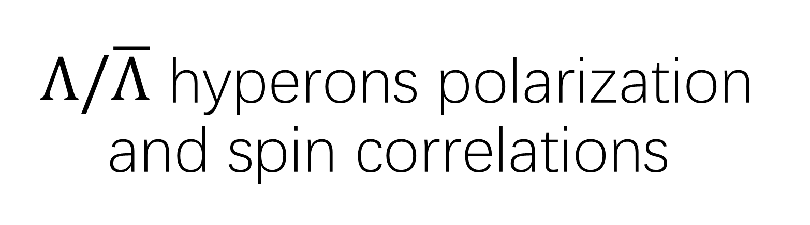
$Λ/\overline{Λ}$ hyperons polarization and spin correlations
Global quark spin correlations in relativistic heavy ion collisions, Ji-peng Lv, Xin-Nian Wang
Measurement of Bell-type inequalities and quantum entanglement from-hyperon spin correlations at high energy colliders, Wenjie Gong, Raju Venugopalan
Probing QCD Confinement with Spin Entanglement, The STAR Collaboration

Slide 2
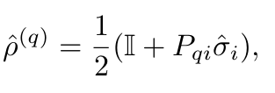
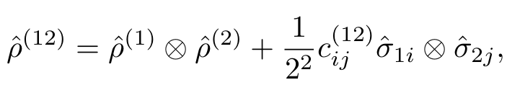


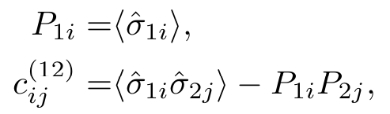
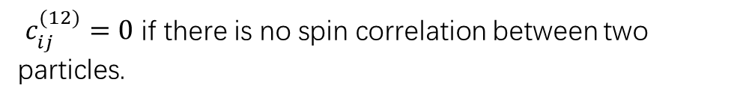
Global quark spin correlations in relativistic heavy ion collisions, Ji-peng Lv, Xin-Nian Wang
Spin 1/2 particle’s spin density matrix:
For two spin 1/2 particles system, the spin density matrix
$c_{ij}^{(12)}=0$ if there is no spin correlation between two particles.

Slide 3
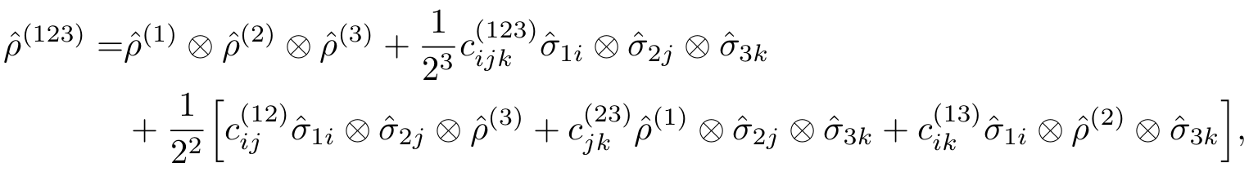
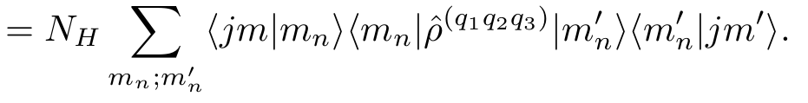

Global quark spin correlations in relativistic heavy ion collisions, Ji-peng Lv, Xin-Nian Wang
In the same way, we expand the spin density matrix for a system of three particles as
The matrix element of spin density matrix for the hyperon is
By inserting the first equation into last equation, we get element of spin density matrix and

Slide 4
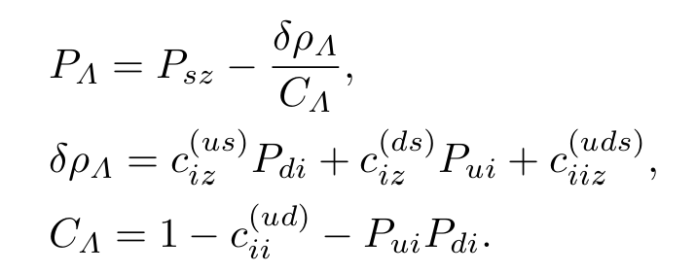
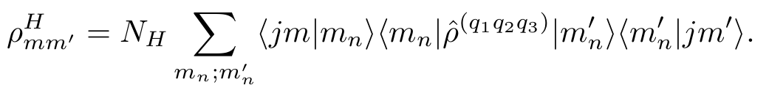
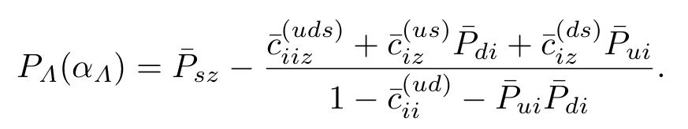
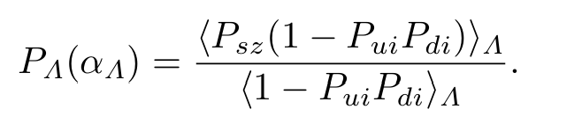




Global quark spin correlations in relativistic heavy ion collisions, Ji-peng Lv, Xin-Nian Wang
Hyperon polarization for Λ
with only spin degrees of freedom:
$$⟹$$
When quark spin correlations are zero, $P_{Λz}=P_{sz}$
Hyperon polarization for Λ
with other degrees of freedom $(α_{Λ})$:
$$⟹$$
If all quark spin correlations are

Slide 5
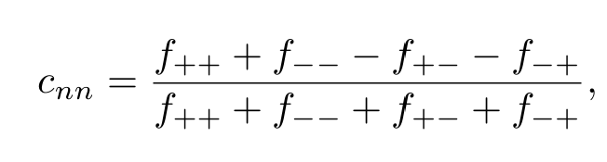

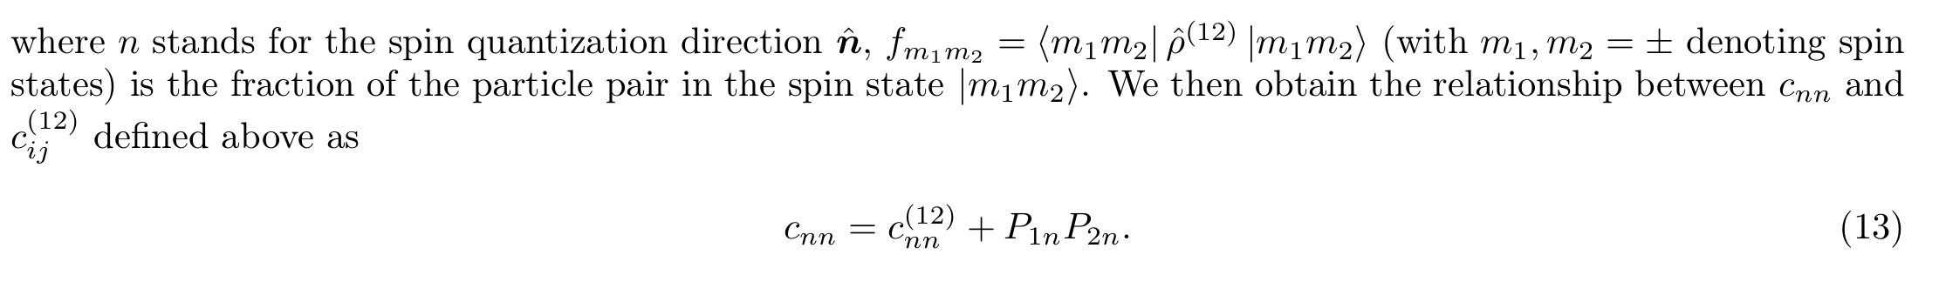

Global quark spin correlations in relativistic heavy ion collisions, Ji-peng Lv, Xin-Nian Wang
An observable:
$$=$$

Slide 6
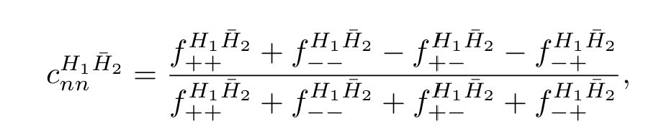
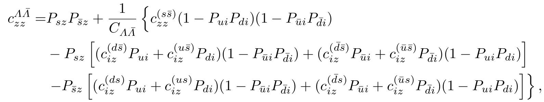
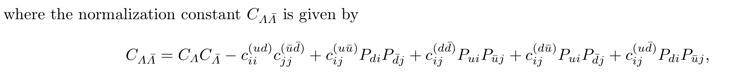
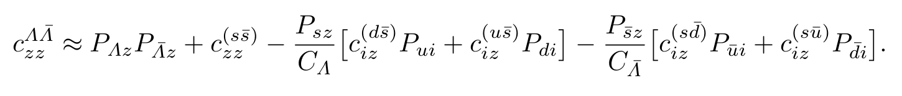
Global quark spin correlations in relativistic heavy ion collisions, Ji-peng Lv, Xin-Nian Wang
As for two spin-1/2 hyperons with only spin degrees of freedom,
two hyperons system is the six quarks system
and only consider two-particle spin correlations, we obtain

Slide 7
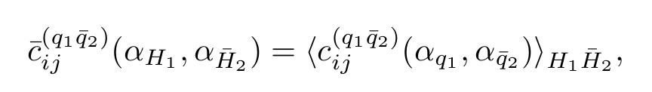
Global quark spin correlations in relativistic heavy ion collisions, Ji-peng Lv, Xin-Nian Wang
With other degrees of freedom,

Slide 8
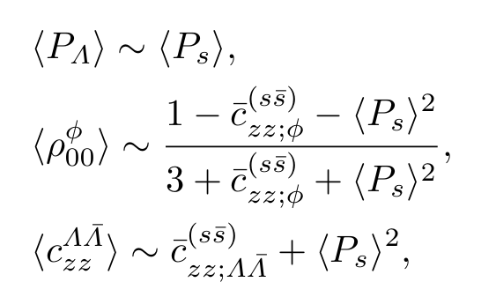
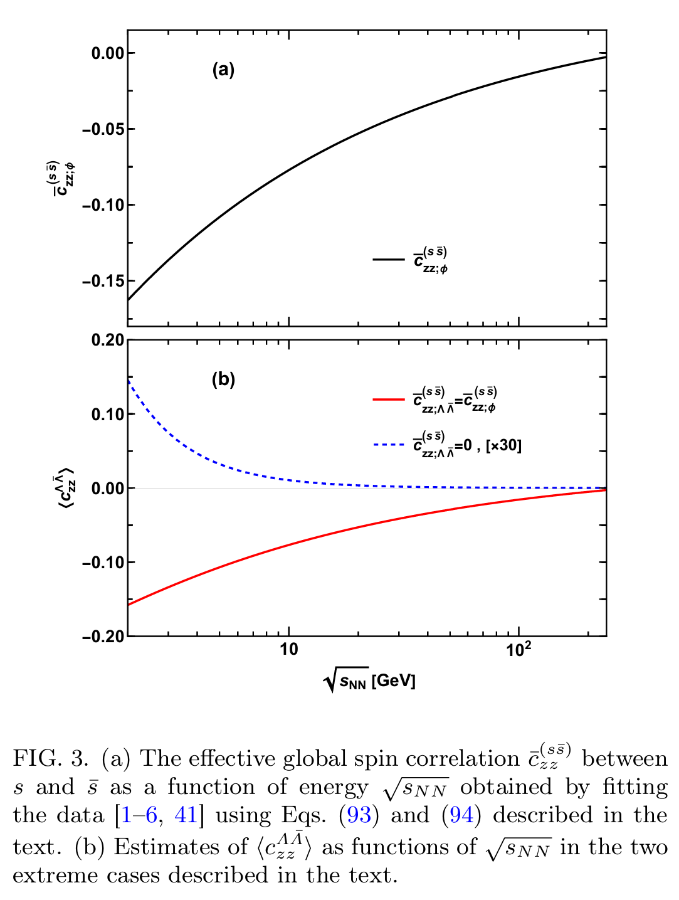
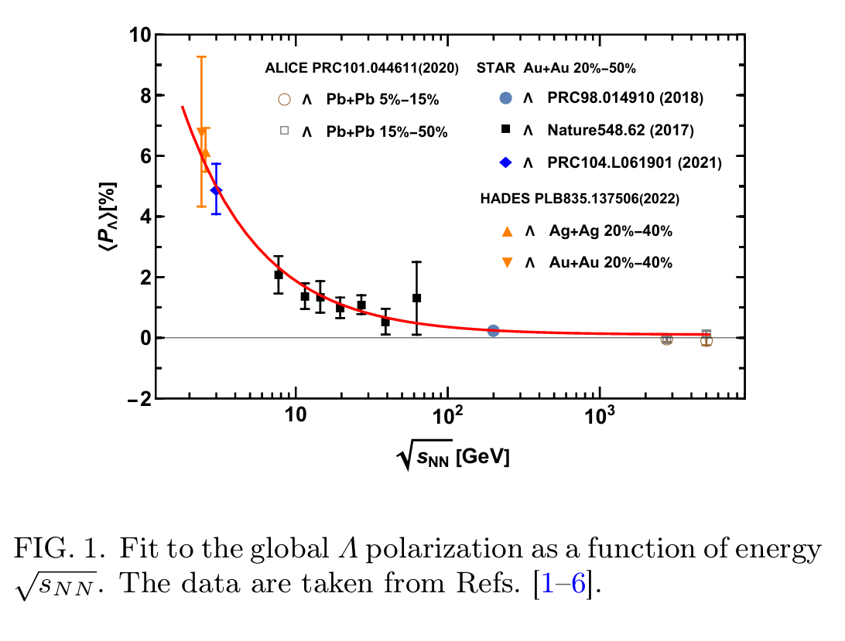
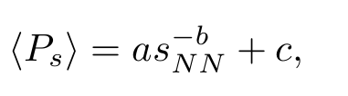
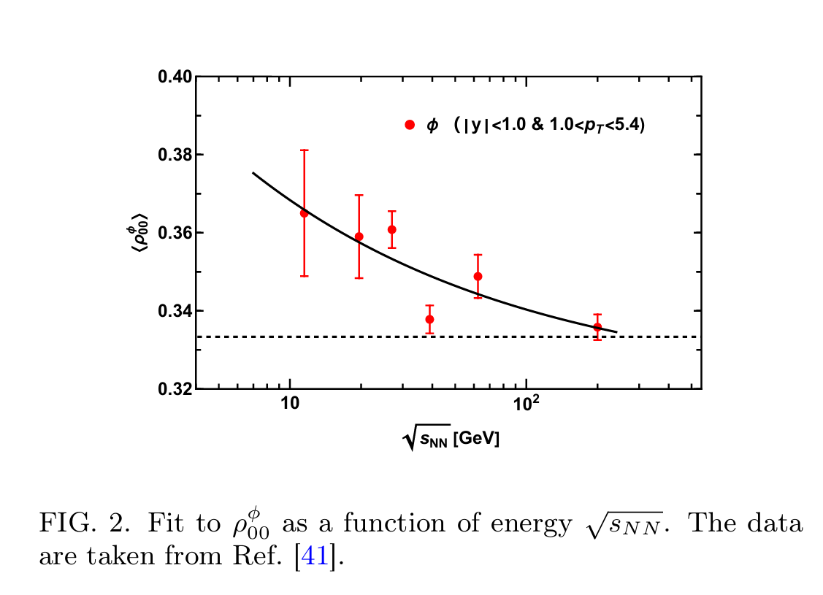
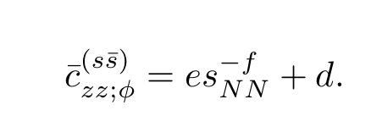
Global quark spin correlations in relativistic heavy ion collisions, Ji-peng Lv, Xin-Nian Wang
NUMERICAL ESTIMATES
taking the following forms as functions of collision energy,

Slide 9
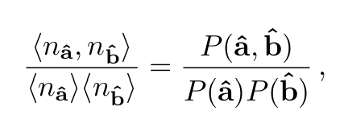
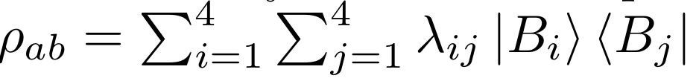
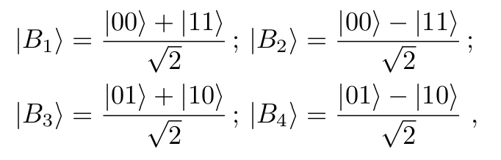
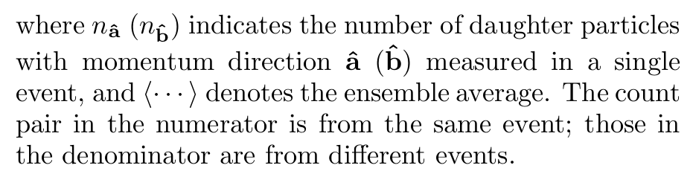
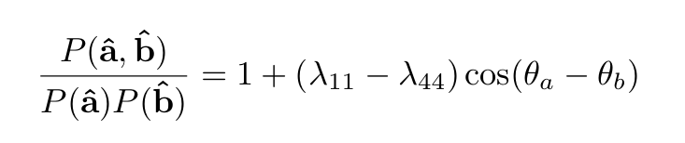
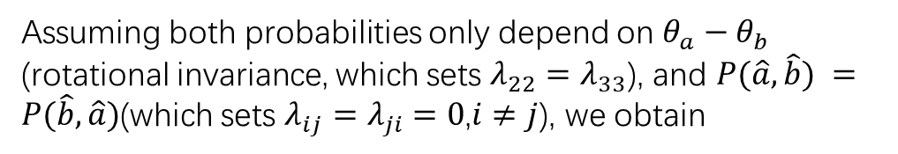
Measurement of Bell-type inequalities and quantum entanglement from-hyperon spin correlations at high energy colliders, Wenjie Gong, Raju Venugopalan, 2107.13007v3
two-particle correlation function is defined as,
The spin state of the two spin 1/2 hyperons in Bell basis,
Assuming both probabilities only depend on $θ_{a}−θ_{b}$ (rotational invariance, which sets $λ_{22}=λ_{33}$), and $P(\hat{a},\hat{b}) =P(\hat{b},\hat{a})$(which sets $λ_{ij}=λ_{ji}=0$,$i≠j$), we obtain

Slide 10
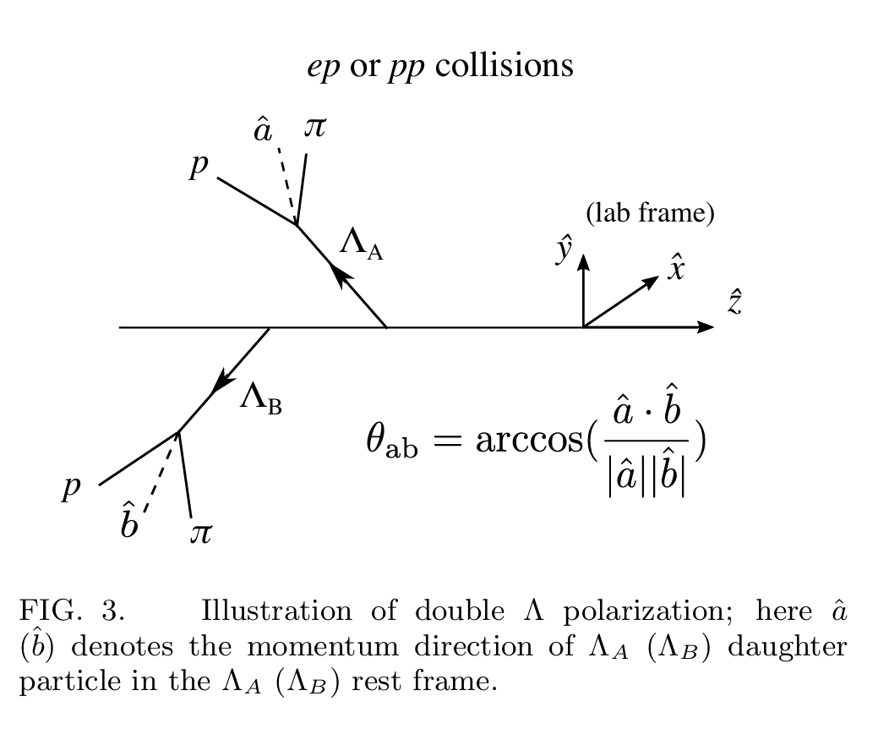



Measurement of Bell-type inequalities and quantum entanglement from-hyperon spin correlations at high energy colliders, Wenjie Gong, Raju Venugopalan, 2107.13007v3
The possibility of a pair of $Λ$
$P_{Λ,Λ}$is the spin correlations
where n is a free parameter that can be determined by the measurement and is expected to be less than unity due to a convolution between the intrinsic CHSH cosine modulation and the decay kinematics.
In experimental definition, $P_{Λ,Λ}≡\left\langle cos⁡(θ_{ab})\right\rangle =\left\langle \frac{\hat{a}⋅\hat{b}}{\left|\hat{a}\right||\hat{b}|}\right\rangle$

Slide 11
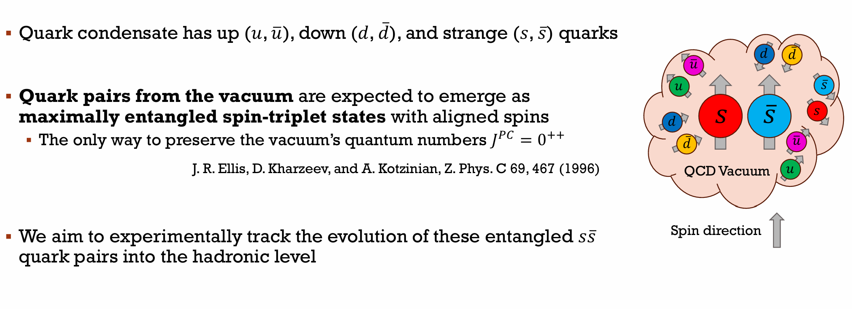
Probing QCD Confinement with Spin Entanglement, The STAR Collaboration, 2506.05499v1

Slide 12
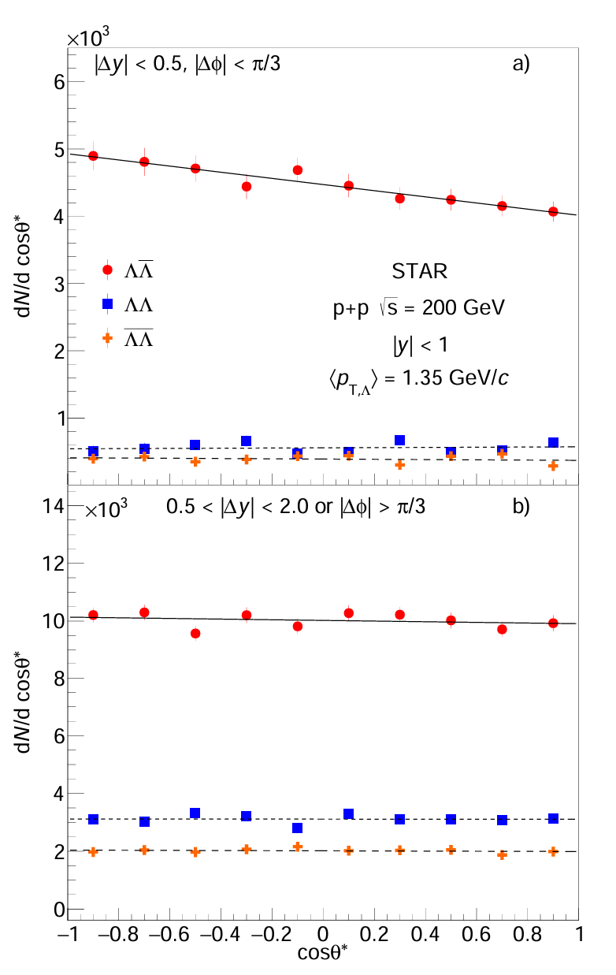
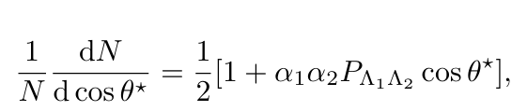




Probing QCD Confinement with Spin Entanglement, The STAR Collaboration, 2506.05499v1
In p+p collisions at 200GeV,
The distribution of the angle $θ^{∗}$is
Where $θ^{∗}=arccos ⁡(\frac{\hat{a}⋅\hat{b}}{\left|\hat{a}\right||\hat{b}|})$, $\hat{a},\hat{b}$ is proton1 and proton2’s moment in the respective $Λ_{1}$, $Λ_{2}$ rest frame.

Slide 13
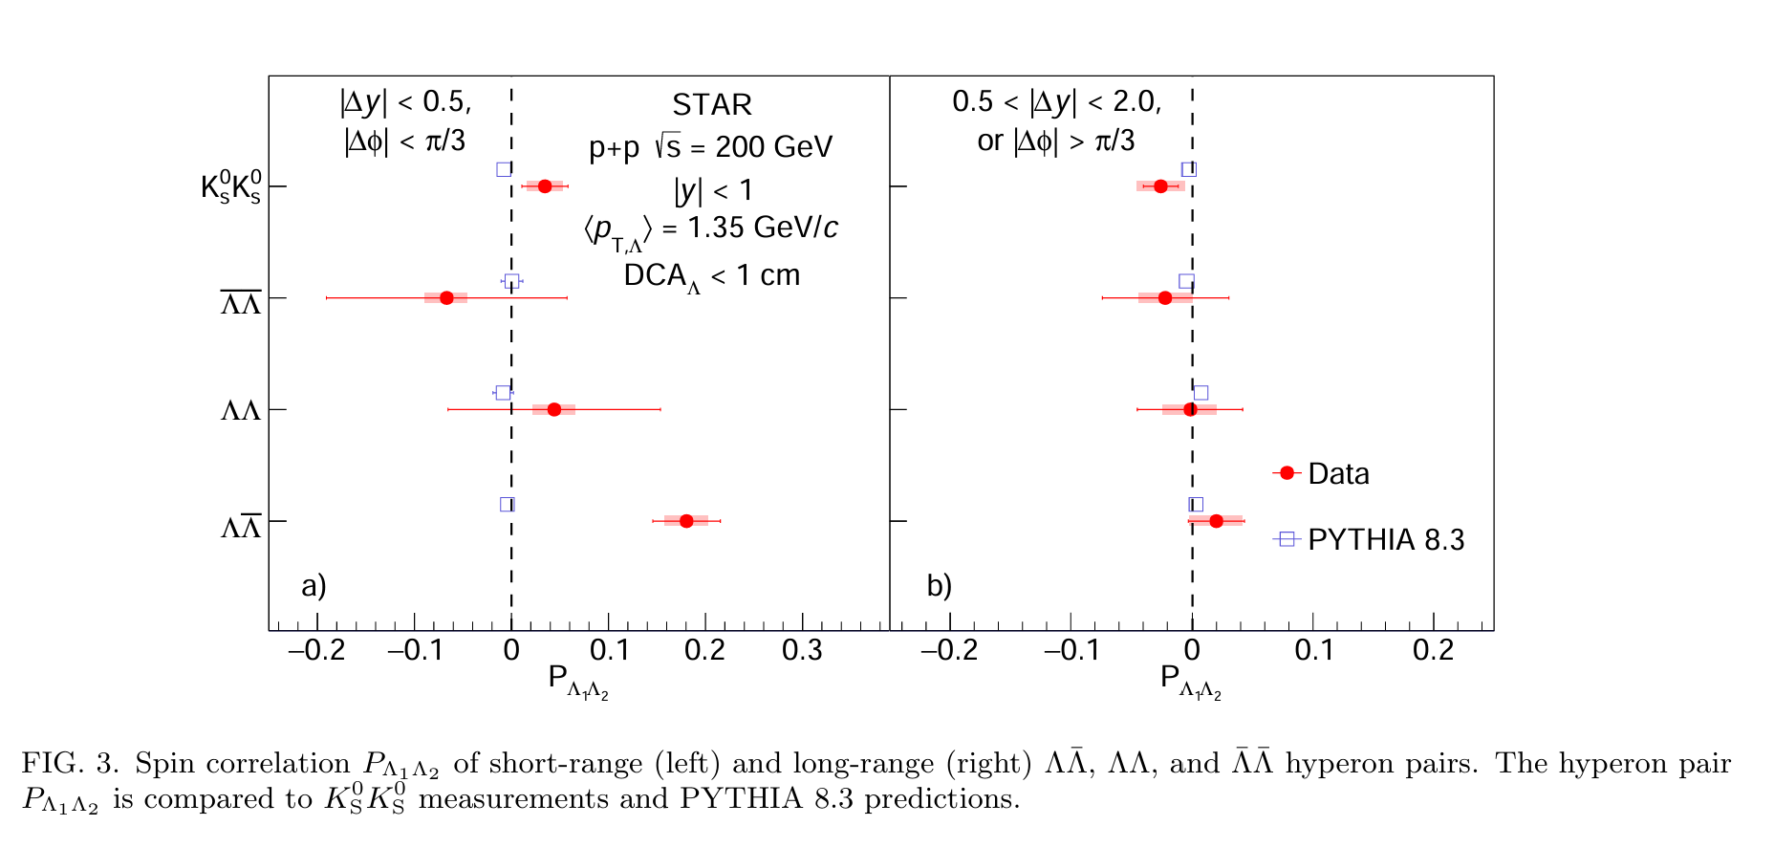
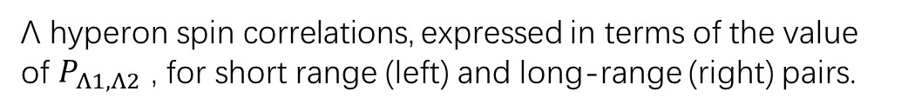

Probing QCD Confinement with Spin Entanglement, The STAR Collaboration, 2506.05499v1
Λ hyperon spin correlations, expressed in terms of the value of $P_{Λ1,Λ2}$ , for short range (left) and long-range (right) pairs.
short range: similar moment angles of two $Λ$
Long range: different moment angles of two $Λ$

Slide 14
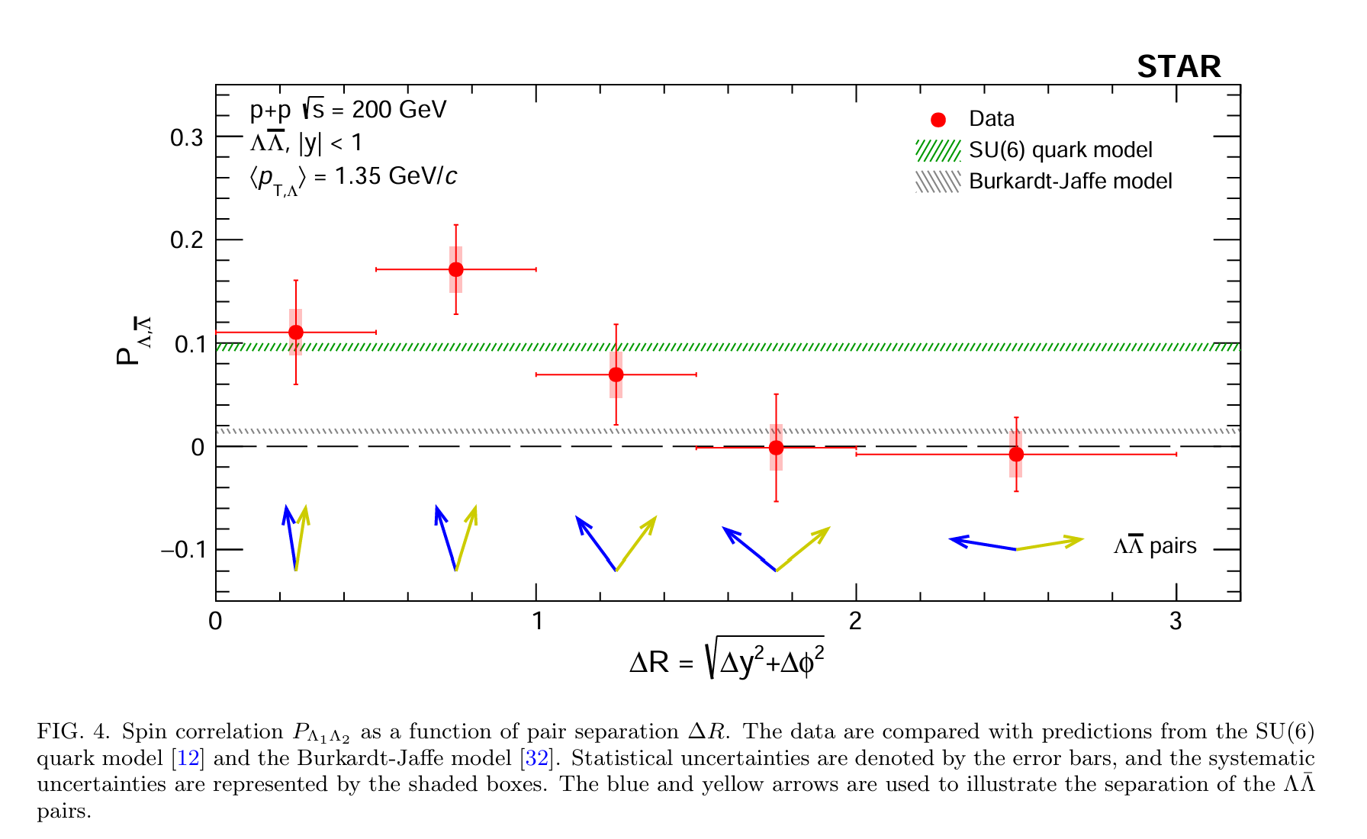
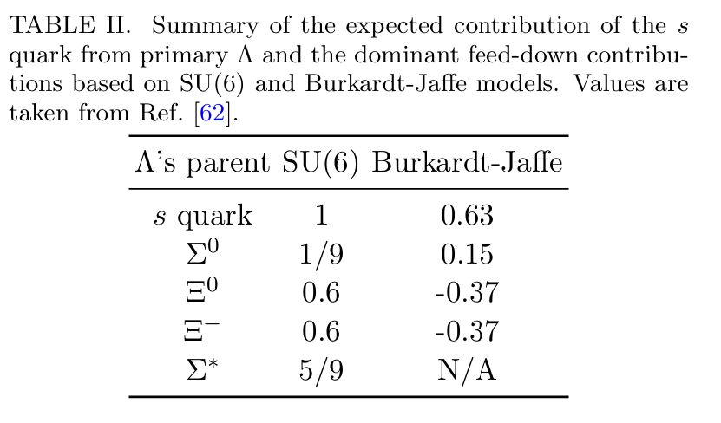
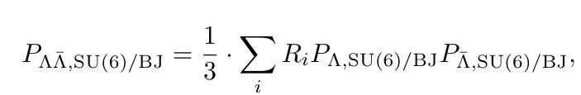
Probing QCD Confinement with Spin Entanglement, The STAR Collaboration, 2506.05499v1
where Ri are the relative feed-down contributions of the Λ¯ Λ pairs
Spin correlation vanishes when the hyperon pairs are widely separated in angle, consistent with the decoherence of the quantum system.

Slide 15
Appendix: hyperons polarization in p+p and e+e collision

Slide 16
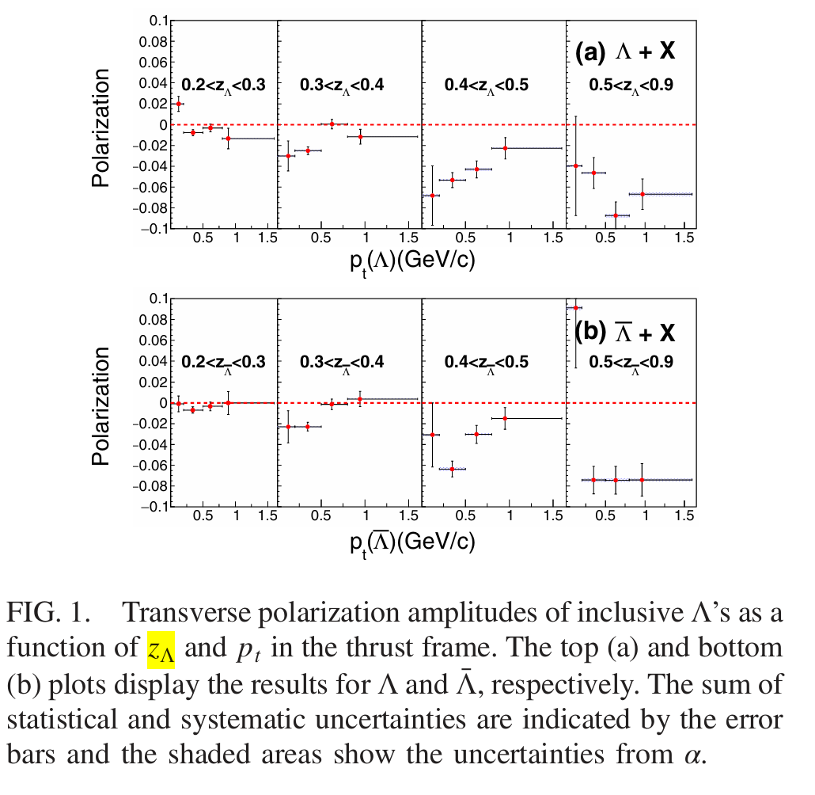
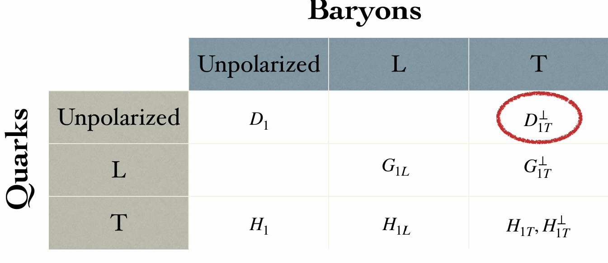
Measurement of transverse polarization of Λ( Λ) within jet in 𝑝𝑝 collisions at 200 and 510 GeV, Taoya Gao(高涛亚),SDU,QPT2025
Polarizing Fragmentation Function (PFF) ✓
Describing fragmentation of unpolarized quarks into polarized hadrons
More theory details are in QPT2025 talk:
Spin Polarization as a Novel Probe of Jet Quenching, Shu-yi Wei
Spin_polarization
Belle Collaboration,PhysRevLett.122.042001

Slide 17
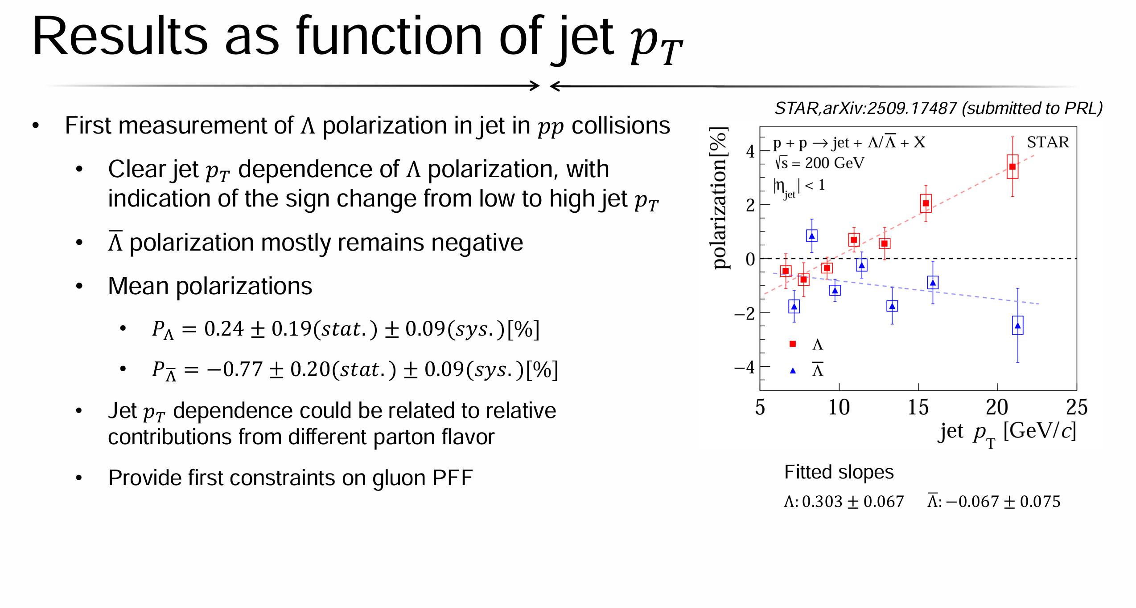
Measurement of transverse polarization of Λ( Λ) within jet in 𝑝𝑝 collisions at 200 and 510 GeV, Taoya Gao(高涛亚),SDU,QPT2025

Slide 18
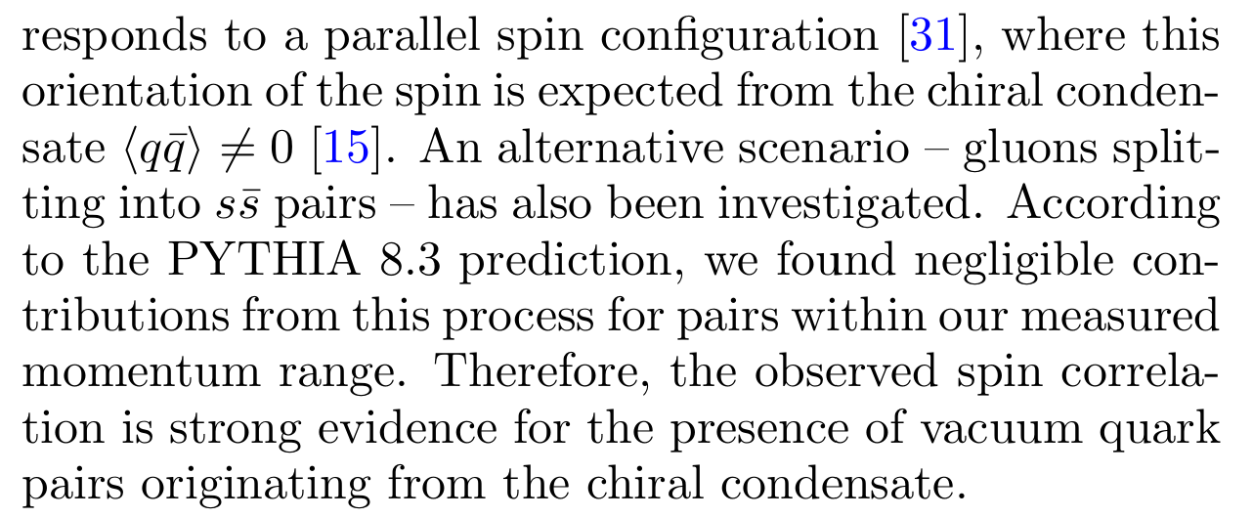
Probing QCD Confinement with Spin Entanglement, The STAR Collaboration, 2506.05499v1

Slide 19
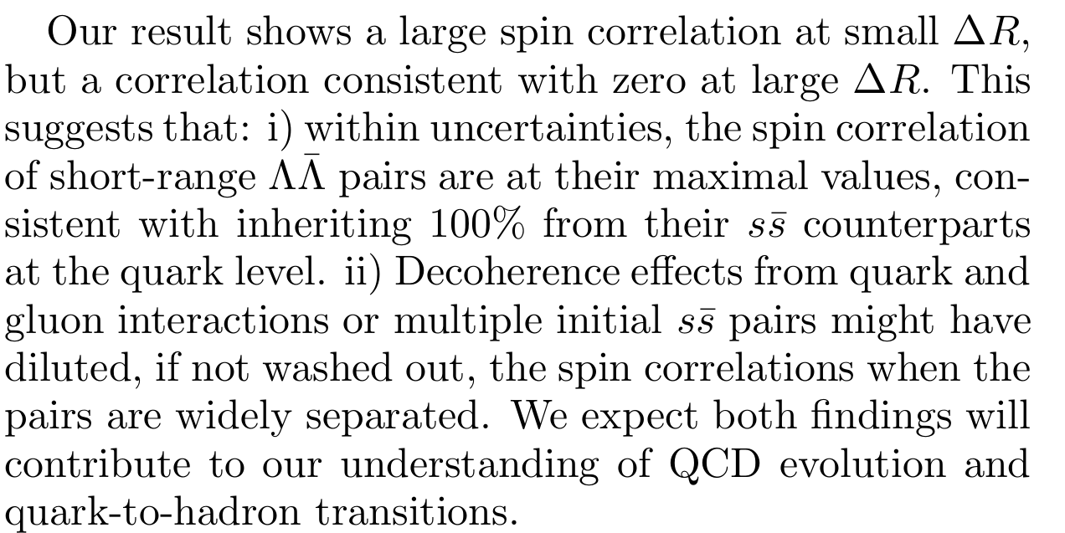
Probing QCD Confinement with Spin Entanglement, The STAR Collaboration, 2506.05499v1

Slide 20
