Slide 1
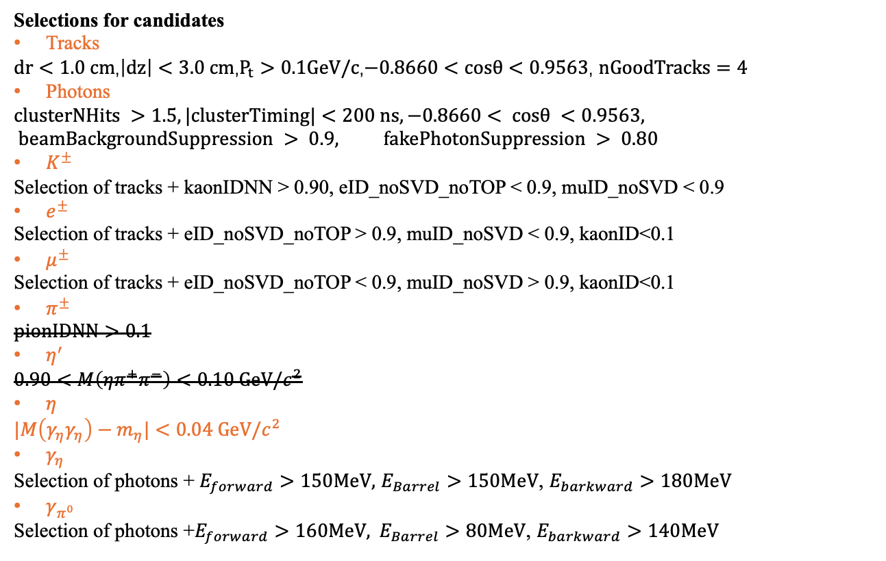
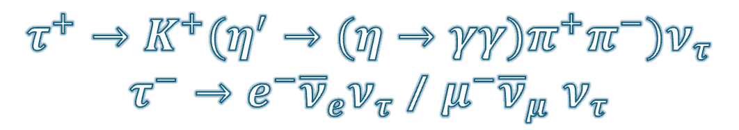
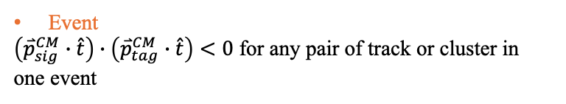
$$τ^{+}→K^{+}(η^{′}→(η→γγ)π^{+}π^{−})ν_{τ}$$
$τ^{−}→e^{−}{\overline{ν}}_{e}ν_{τ}$ / $μ^{−}{\overline{ν}}_{μ}$ $ν_{τ}$
Selections for candidates
Tracks
$dr<1.0 cm$,$\left|dz\right|<3.0 cm$,$P_{t}>0.1GeV/c$,$−0.8660<cosθ<0.9563$, $nGoodTracks=4$
Photons
$$clusterNHits >1.5, |clusterTiming|<200 ns, −0.8660< cosθ <0.9563, beamBackgroundSuppression > 0.9, fakePhotonSuppression > 0.80$$
$K^{±}$
Selection of tracks + kaonIDNN > 0.90, eID_noSVD_noTOP < 0.9, muID_noSVD < 0.9
$e^{±}$
Selection of tracks + eID_noSVD_noTOP > 0.9, muID_noSVD < 0.9, kaonID<0.1
$μ^{±}$
Selection of tracks + eID_noSVD_noTOP < 0.9, muID_noSVD > 0.9, kaonID<0.1
$π^{±}$
$$pionIDNN>0.1$$
$η^{′}$
$$0.90<M\left(ηπ^{+}π^{−}\right)<0.10 GeV/c^{2}$$
$η$
$$|M\left(γ_{η}γ_{η}\right)−m_{η}|<0.04 GeV/c^{2}$$
$γ_{η}$
Selection of photons + $E_{forward}>150MeV,$ $E_{Barrel}>150MeV$, $E_{barkward}>180MeV$
$γ_{π^{0}}$
Selection $\text{of} \text{photons}\text{ +}E_{forward}>160MeV, E_{Barrel}>80MeV\text{,} E_{barkward}>140MeV$
Event
$\left({\overset{⃑}{p}}_{sig}^{CM}∙\hat{t}\right)∙\left({\overset{⃑}{p}}_{tag}^{CM}∙\hat{t}\right)<0$ for any pair of track or cluster in one event

Slide 2

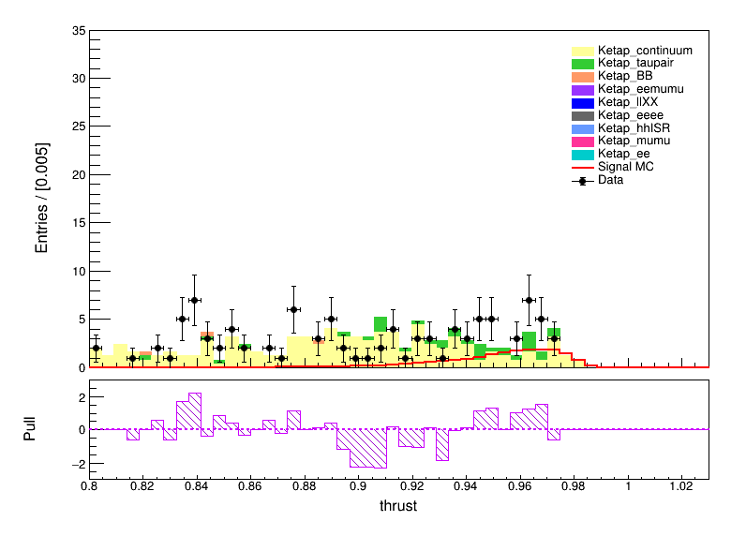
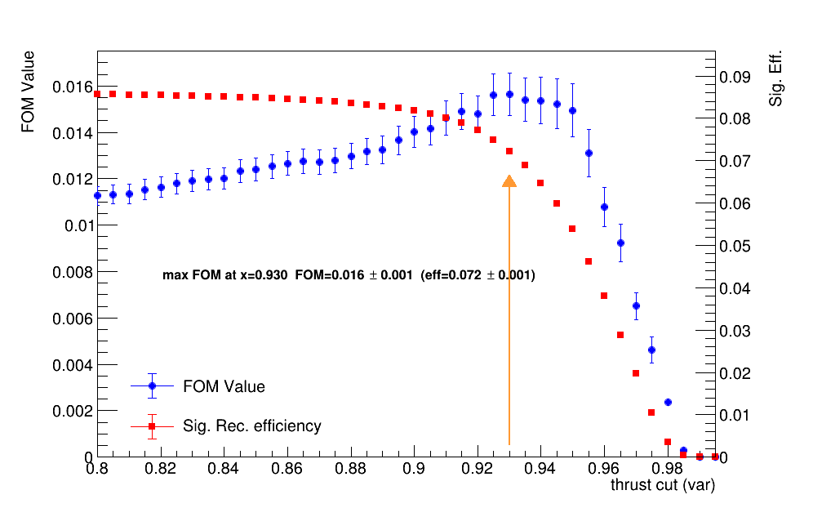

Comparison our selections with previous BARBAR’s
From previous BarBar’s paper:
FOM=0.0113 +/- 0.0004
eff=0.0848 +/- 0.0007
FOM=0.016 +/- 0.001
eff=0.072 +/- 0.001
$$⟹$$

Slide 3
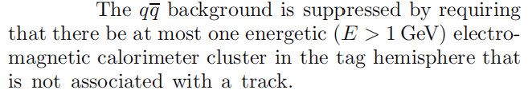
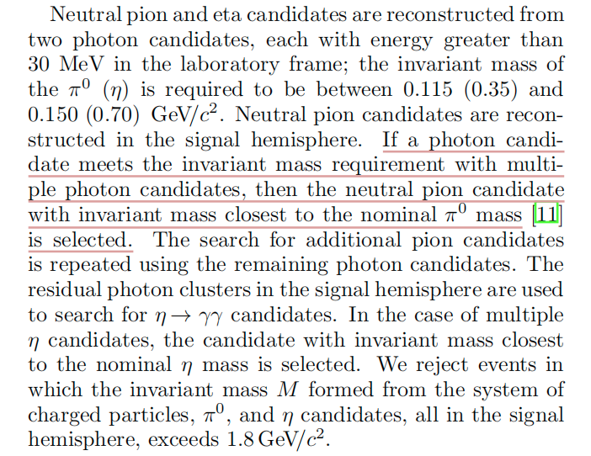
Comparison our selections with previous BARBAR’s

Slide 4
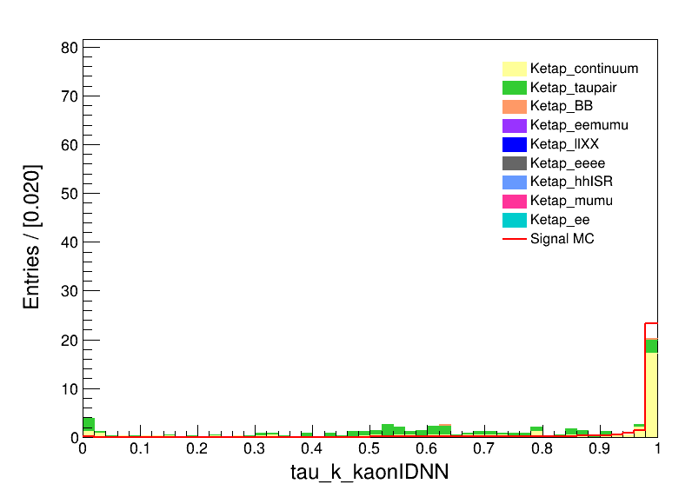
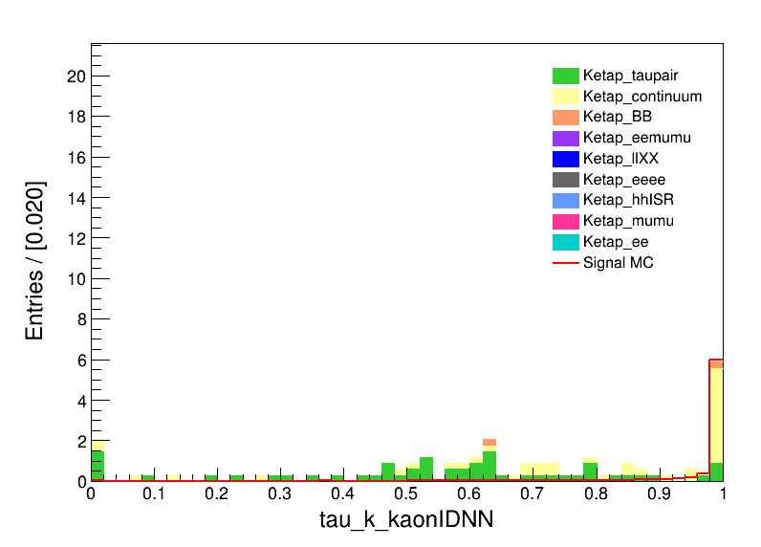

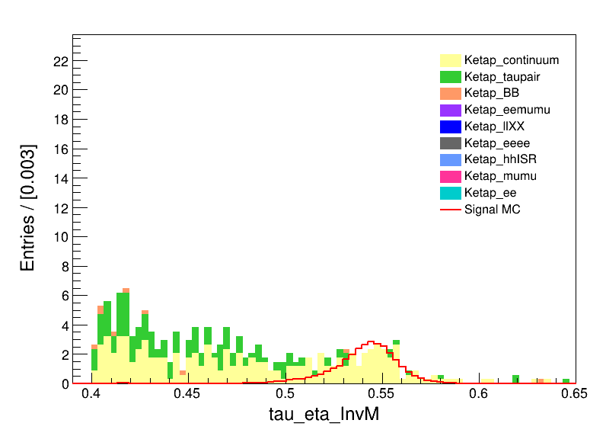
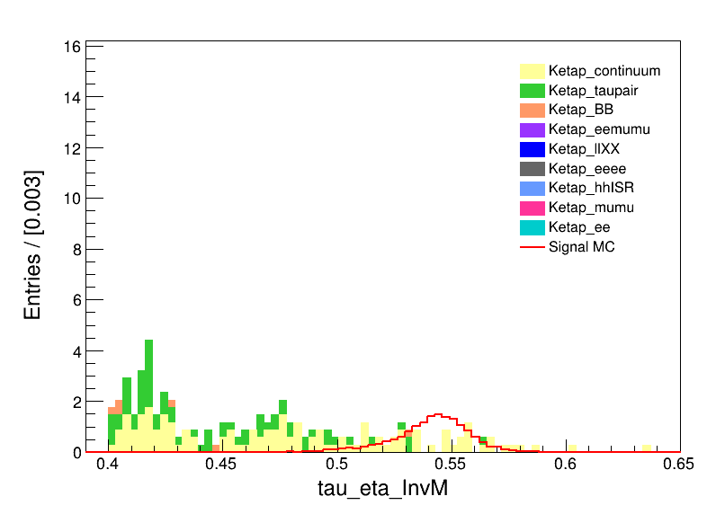
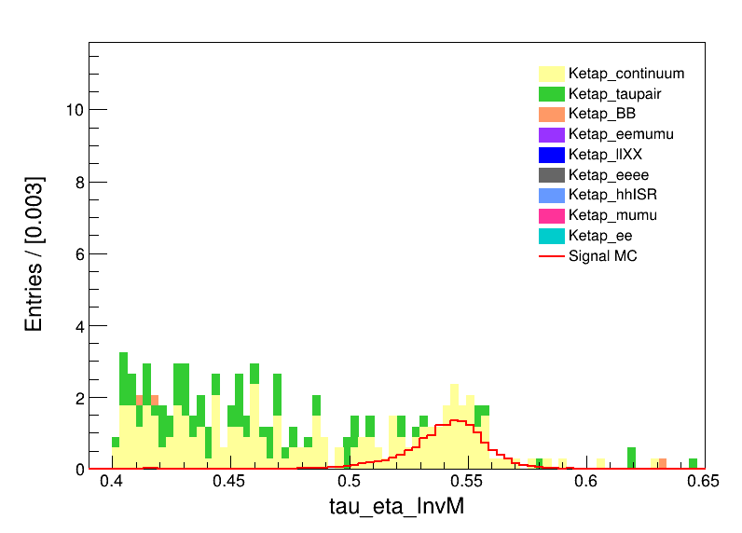
Some distributions
both
e
mu
both
e
mu

Slide 5
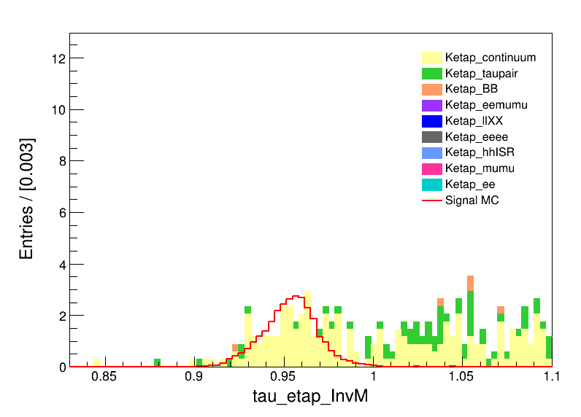
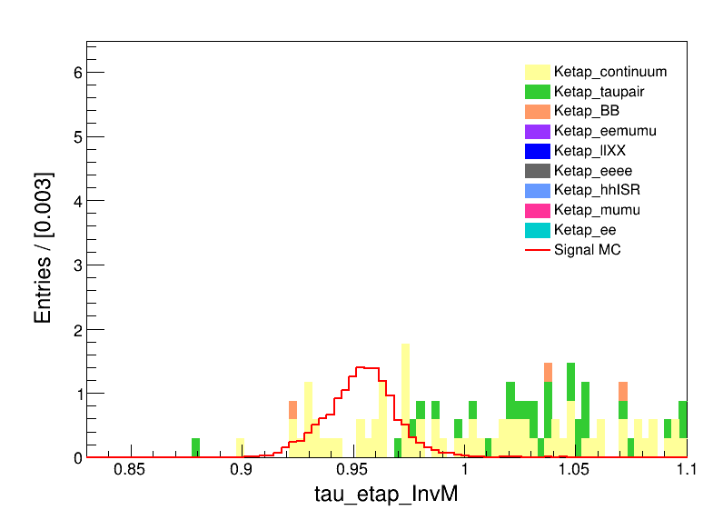
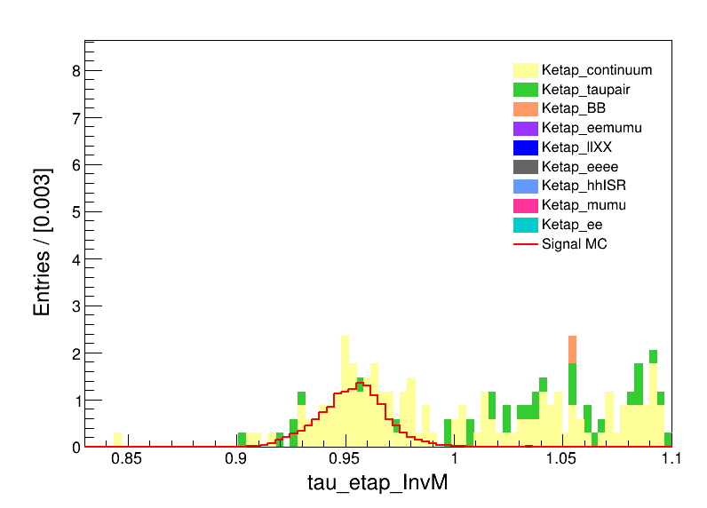
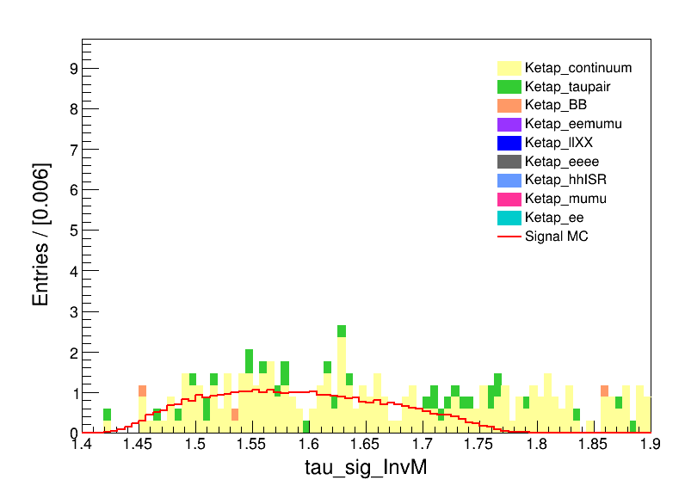
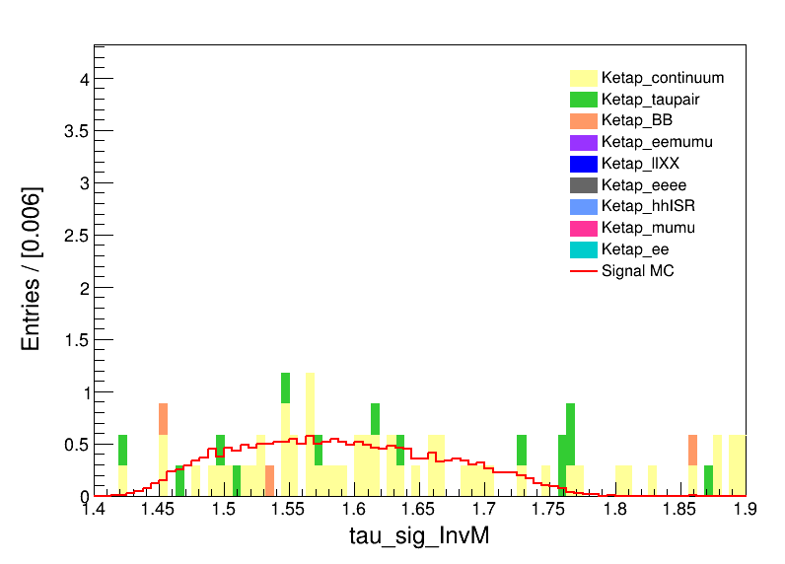
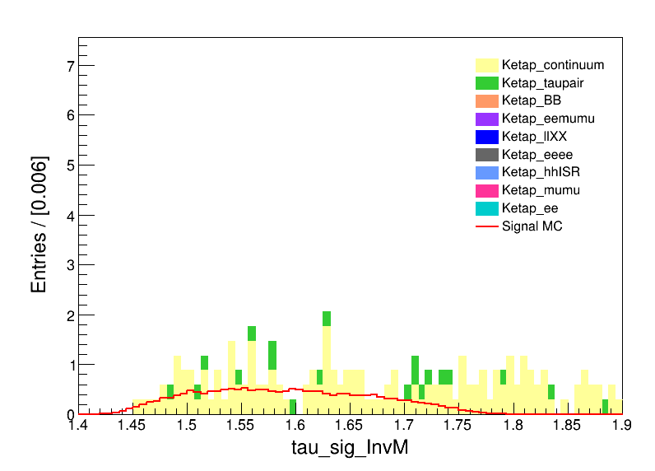
Some distributions
both
e
mu
both
e
mu

Slide 6
1202优化所用的条件，根据上限拟合预估
FBDT优化所用的条件，根据上限拟合预估
加上trust所用的条件，根据上限拟合预估

Slide 7
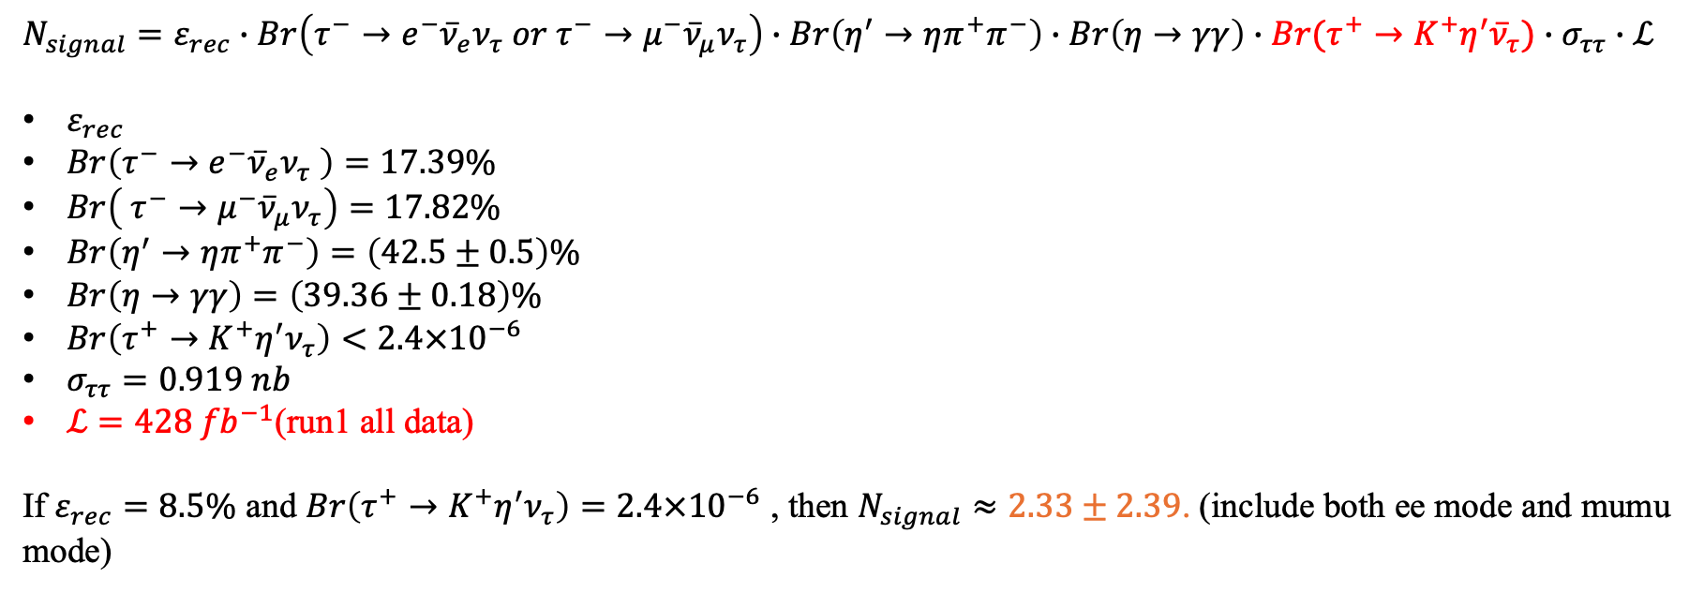
Evaluation of signal yield
$$N_{signal}=ε_{rec}∙Br\left(τ^{−}→e^{−}{\overline{ν}}_{e}ν_{τ} or τ^{−}→μ^{−}{\overline{ν}}_{μ}ν_{τ}\right)∙Br\left(η^{′}→ηπ^{+}π^{−}\right)∙Br\left(η→γγ\right)∙Br(τ^{+}→K^{+}η^{′}{\overline{ν}}_{τ})∙σ_{ττ}∙ℒ$$
$ε_{rec}$
$Br\left(τ^{−}→e^{−}{\overline{ν}}_{e}ν_{τ} \right)=17.39\%$
$Br\left( τ^{−}→μ^{−}{\overline{ν}}_{μ}ν_{τ}\right)=17.82\%$
$Br\left(η^{′}→ηπ^{+}π^{−}\right)=\left(42.5±0.5\right)\%$
$Br\left(η→γγ\right)=\left(39.36±0.18\right)\%$
$Br\left(τ^{+}→K^{+}η^{′}ν_{τ}\right)<2.4×{10}^{−6}$
$σ_{ττ}=0.919 nb$
$ℒ=428 {fb}^{−1}$(run1 all data)
If $ε_{rec}=8.5\%$ and $Br\left(τ^{+}→K^{+}η^{′}ν_{τ}\right)=2.4×{10}^{−6}$ , then $N_{signal}≈2.33±2.39$. (include both ee mode and mumu mode)
$FOM=\frac{ε_{sig}}{\frac{3}{2}+\sqrt{N_{exp}}}$, $FOM=0.0113±0.0004$, $ε_{sig}=0.0848±0.0007⟹N_{exp}=36.05±3.28$

Slide 8
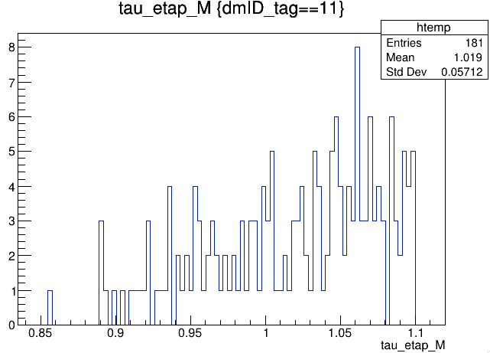
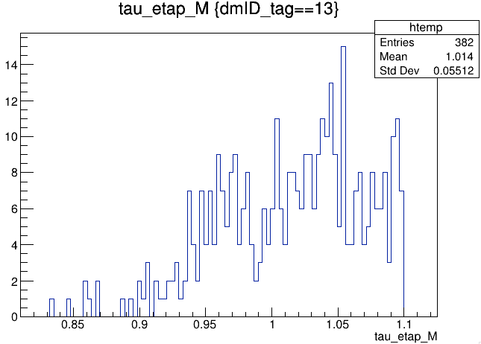
BB entries= 88 scale= 0.2937 scaled_count= 26
eemumu entries= 0 scale= 1.1749 scaled_count= 0
llXX entries= 1 scale= 0.2937 scaled_count= 0
continuum entries= 1916 scale= 0.2937 scaled_count= 563
eeee entries= 0 scale= 1.1749 scaled_count= 0
hhISR entries= 0 scale= 1.1749 scaled_count= 0
mumu entries= 0 scale= 0.2937 scaled_count= 0
ee entries= 0 scale=11.7489 scaled_count= 0
taupair entries= 262 scale= 0.2937 scaled_count= 77
e mode
mu mode
Main bkg:
Continuum background

Slide 9
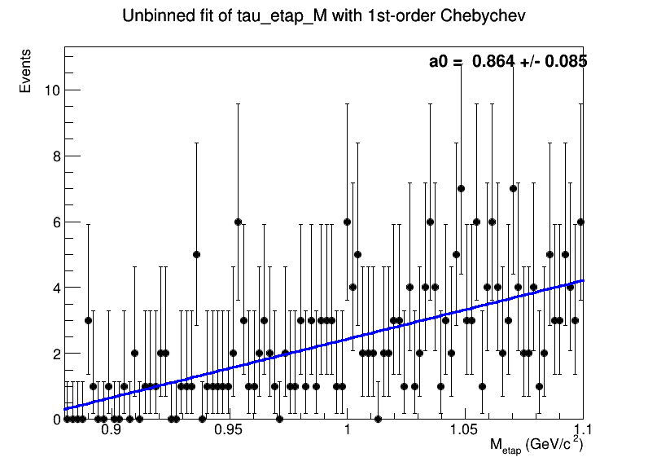
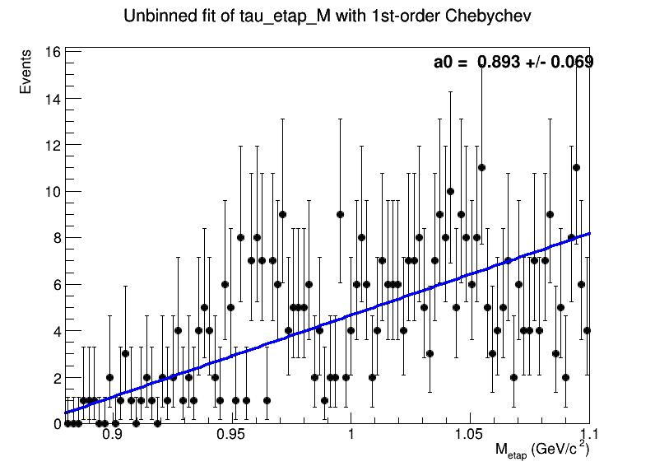
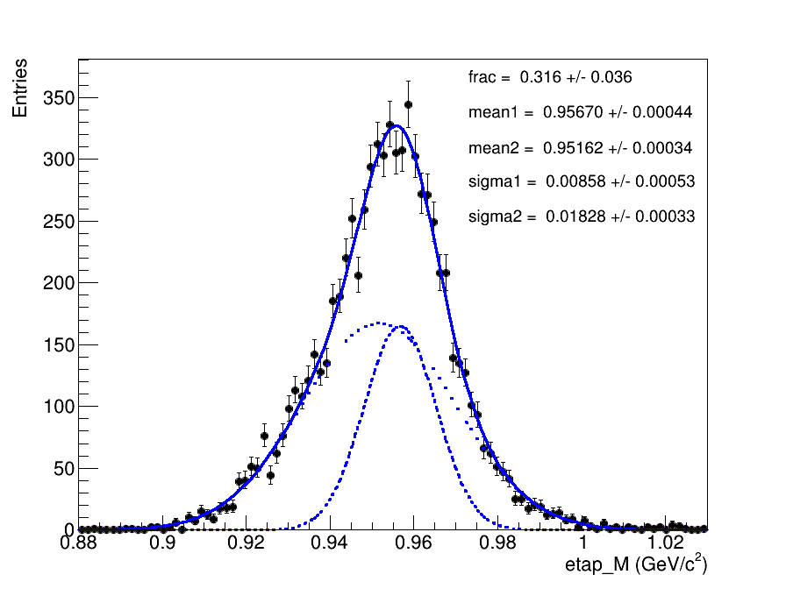
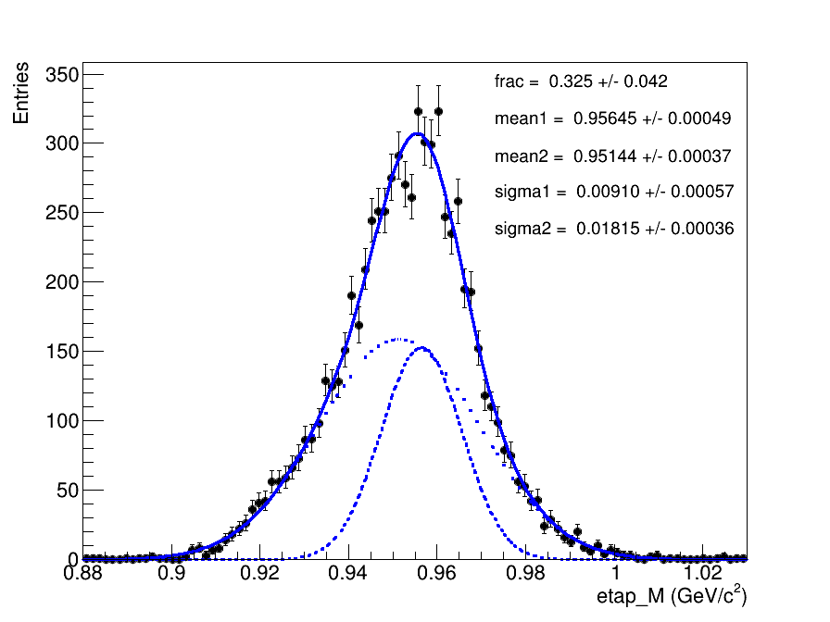
e mode
mu mode
Fit to total bkg.
e mode
mu mode
Fit to signal

Slide 10
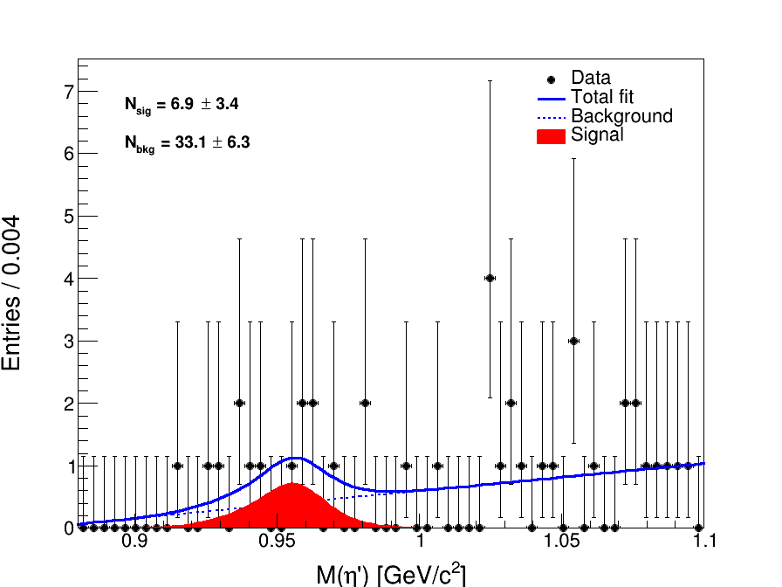
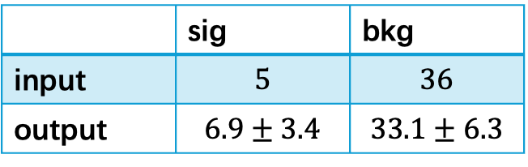
Fit to both e/mu mode:
FCN=-174.151
FCN=-171.866
 | sig | bkg
input | $$5$$ | $$36$$
output | $$6.9±3.4$$ | $$33.1±6.3$$
significance= 2.13776 * sigma

Slide 11
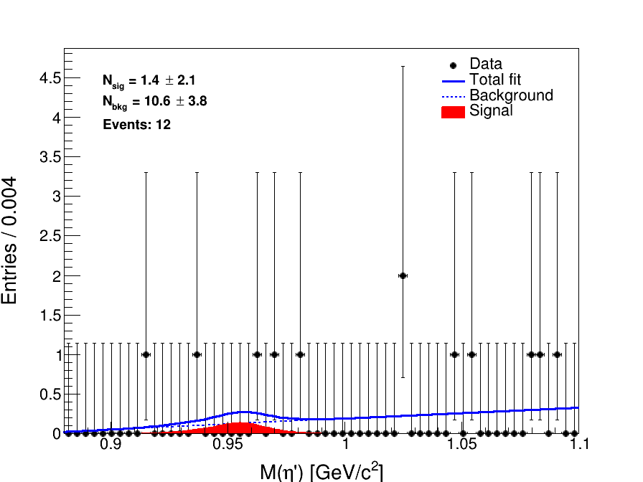

Fit to only e mode:
FCN=-37.3228
FCN=-37.0955
 | sig | bkg
input | $$2$$ | $$10$$
output | $$1.4±2.1$$ | $$10.6±3.8$$
significance= 0.67424 * sigma

Slide 12

Evaluation of signal yield
$$N_{signal}=ε_{rec}∙Br\left(τ^{−}→e^{−}{\overline{ν}}_{e}ν_{τ} or τ^{−}→μ^{−}{\overline{ν}}_{μ}ν_{τ}\right)∙Br\left(η^{′}→ηπ^{+}π^{−}\right)∙Br\left(η→γγ\right)∙Br(τ^{+}→K^{+}η^{′}{\overline{ν}}_{τ})∙σ_{ττ}∙ℒ$$
$ε_{rec}$
$Br\left(τ^{−}→e^{−}{\overline{ν}}_{e}ν_{τ} \right)=17.39\%$
$Br\left( τ^{−}→μ^{−}{\overline{ν}}_{μ}ν_{τ}\right)=17.82\%$
$Br\left(η^{′}→ηπ^{+}π^{−}\right)=\left(42.5±0.5\right)\%$
$Br\left(η→γγ\right)=\left(39.36±0.18\right)\%$
$Br\left(τ^{+}→K^{+}η^{′}ν_{τ}\right)<2.4×{10}^{−6}$
$σ_{ττ}=0.919 nb$
$ℒ=428 {fb}^{−1}$(run1 all data)
If $ε_{rec}=7.2\%$ and $Br\left(τ^{+}→K^{+}η^{′}ν_{τ}\right)=2.4×{10}^{−6}$ , then $N_{signal}≈1.98+2.03$. (include both ee mode and mumu mode)
$FOM=\frac{ε_{sig}}{\frac{3}{2}+\sqrt{N_{exp}}}$, $FOM=0.016±0.001$, $ε_{sig}=0.072±0.001⟹N_{exp}=9.0±1.8$

Slide 13
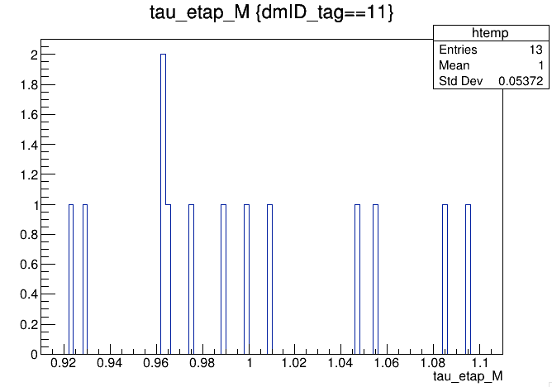
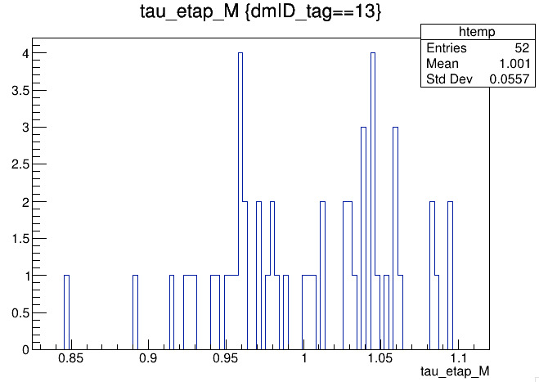
BB entries= 1 scaled= 0.294 prob=0.0025
eemumu entries= 0 scaled= 0.000 prob=0.0000
llXX entries= 0 scaled= 0.000 prob=0.0000
continuum entries= 220 scaled= 64.614 prob=0.5514
eeee entries= 0 scaled= 0.000 prob=0.0000
hhISR entries= 0 scaled= 0.000 prob=0.0000
mumu entries= 0 scaled= 0.000 prob=0.0000
ee entries= 0 scaled= 0.000 prob=0.0000
taupair entries= 178 scaled= 52.279 prob=0.4461
e mode
mu mode
Main bkg:
Continuum background

Slide 14
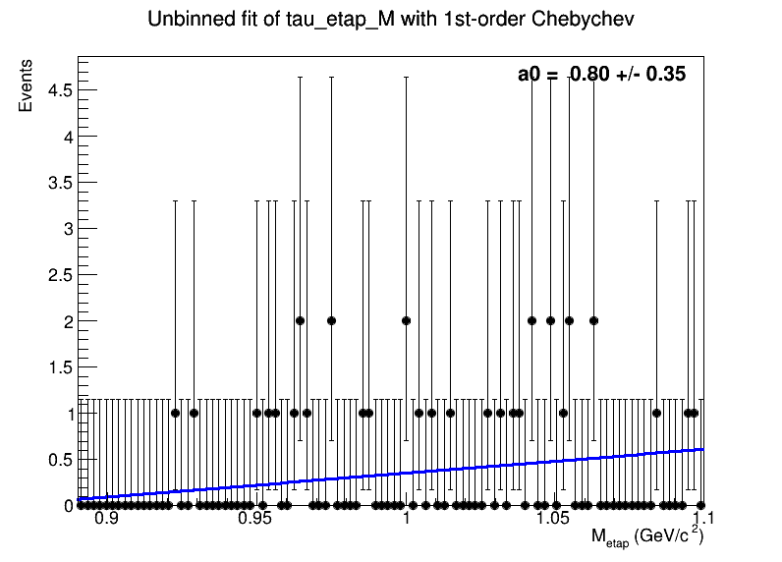
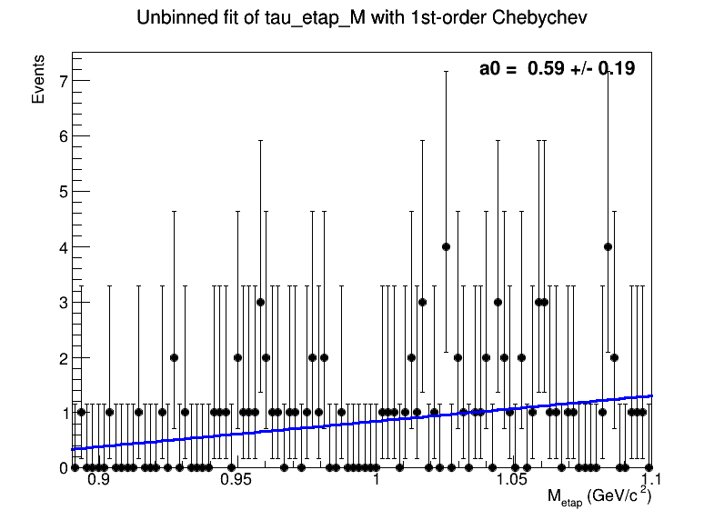
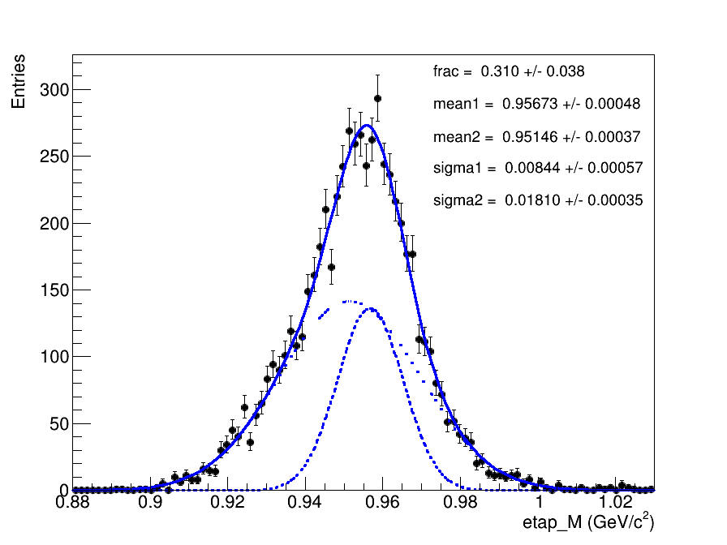
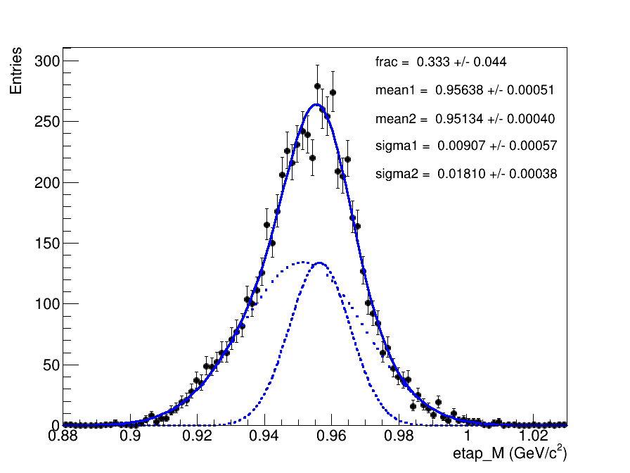
e mode
mu mode
Fit to total bkg.
e mode
mu mode
Fit to signal

Slide 15
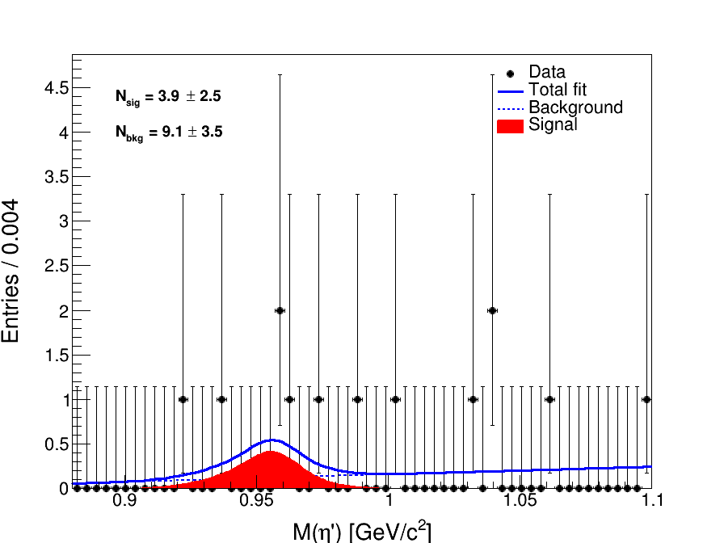
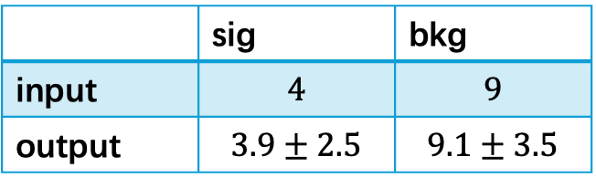
Fit to both e/mu mode:
FCN=-41.8916
FCN=-39.6903
 | sig | bkg
input | $$4$$ | $$9$$
output | $$3.9±2.5$$ | $$9.1±3.5$$
significance= 2.09824 * sigma

Slide 16
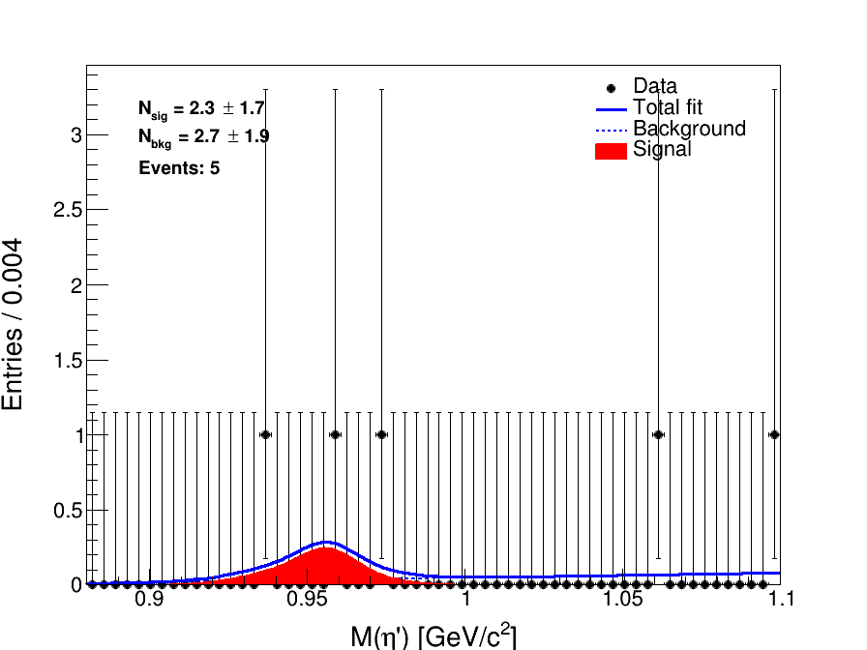
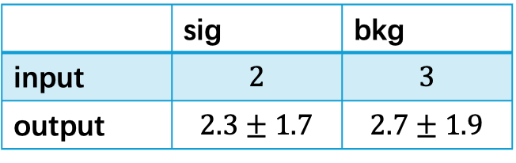
Fit to only e mode:
FCN=-12.2727
FCN=-10.7231
 | sig | bkg
input | $$2$$ | $$3$$
output | $$2.3±1.7$$ | $$2.7±1.9$$
significance= 1.76045 * sigma

Slide 17
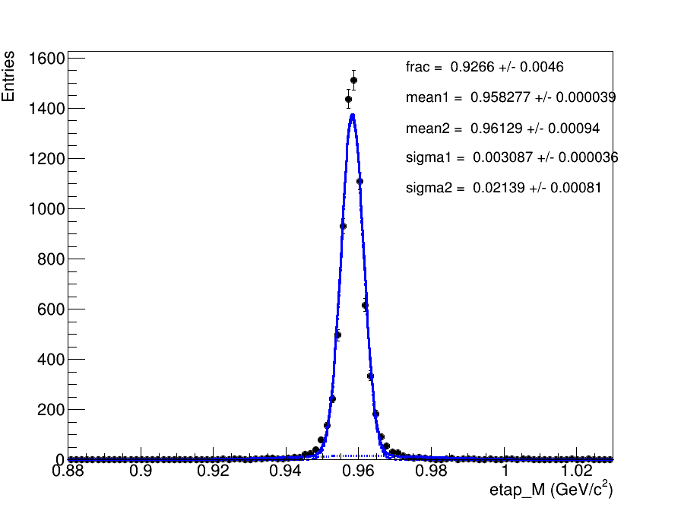
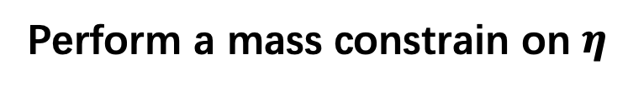
Perform a mass constrain on $η$

Slide 18
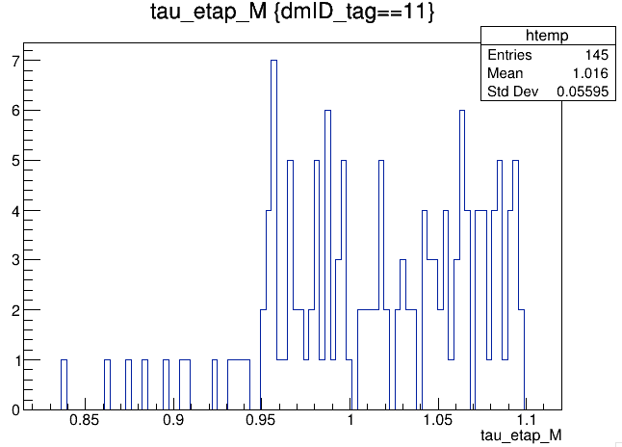
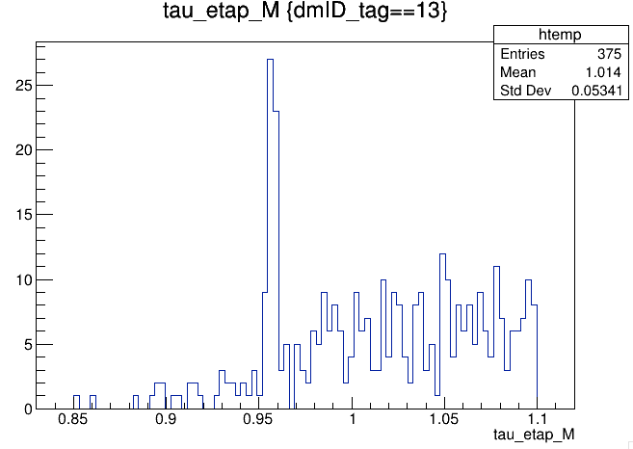
BB entries= 94 scaled= 27.608 prob=0.044277
eemumu entries= 0 scaled= 0.000 prob=0.000000
llXX entries= 1 scaled= 0.294 prob=0.000471
continuum entries= 1770 scaled= 519.849 prob=0.833726
eeee entries= 0 scaled= 0.000 prob=0.000000
hhISR entries= 0 scaled= 0.000 prob=0.000000
mumu entries= 0 scaled= 0.000 prob=0.000000
ee entries= 0 scaled= 0.000 prob=0.000000
taupair entries= 258 scaled= 75.775 prob=0.121526
Main bkg:
Continuum background
e mode
mu mode

