Slide 1

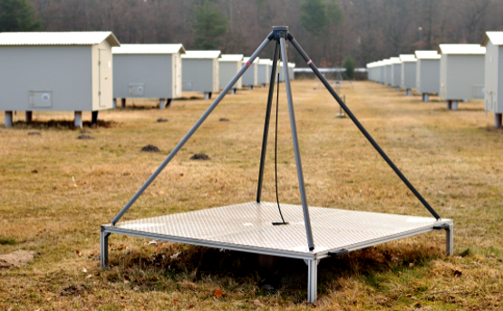
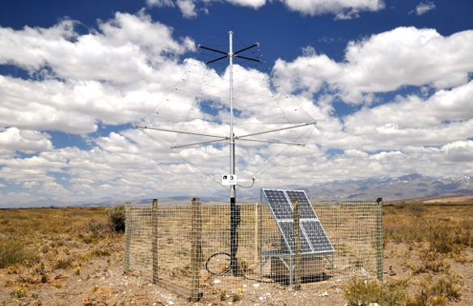
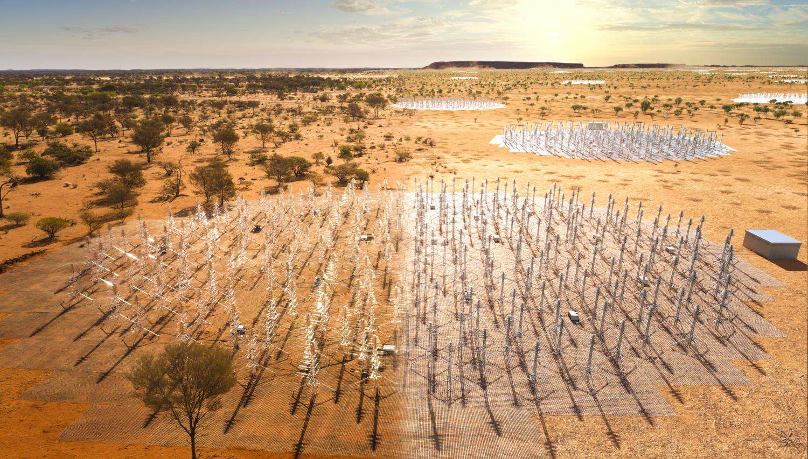
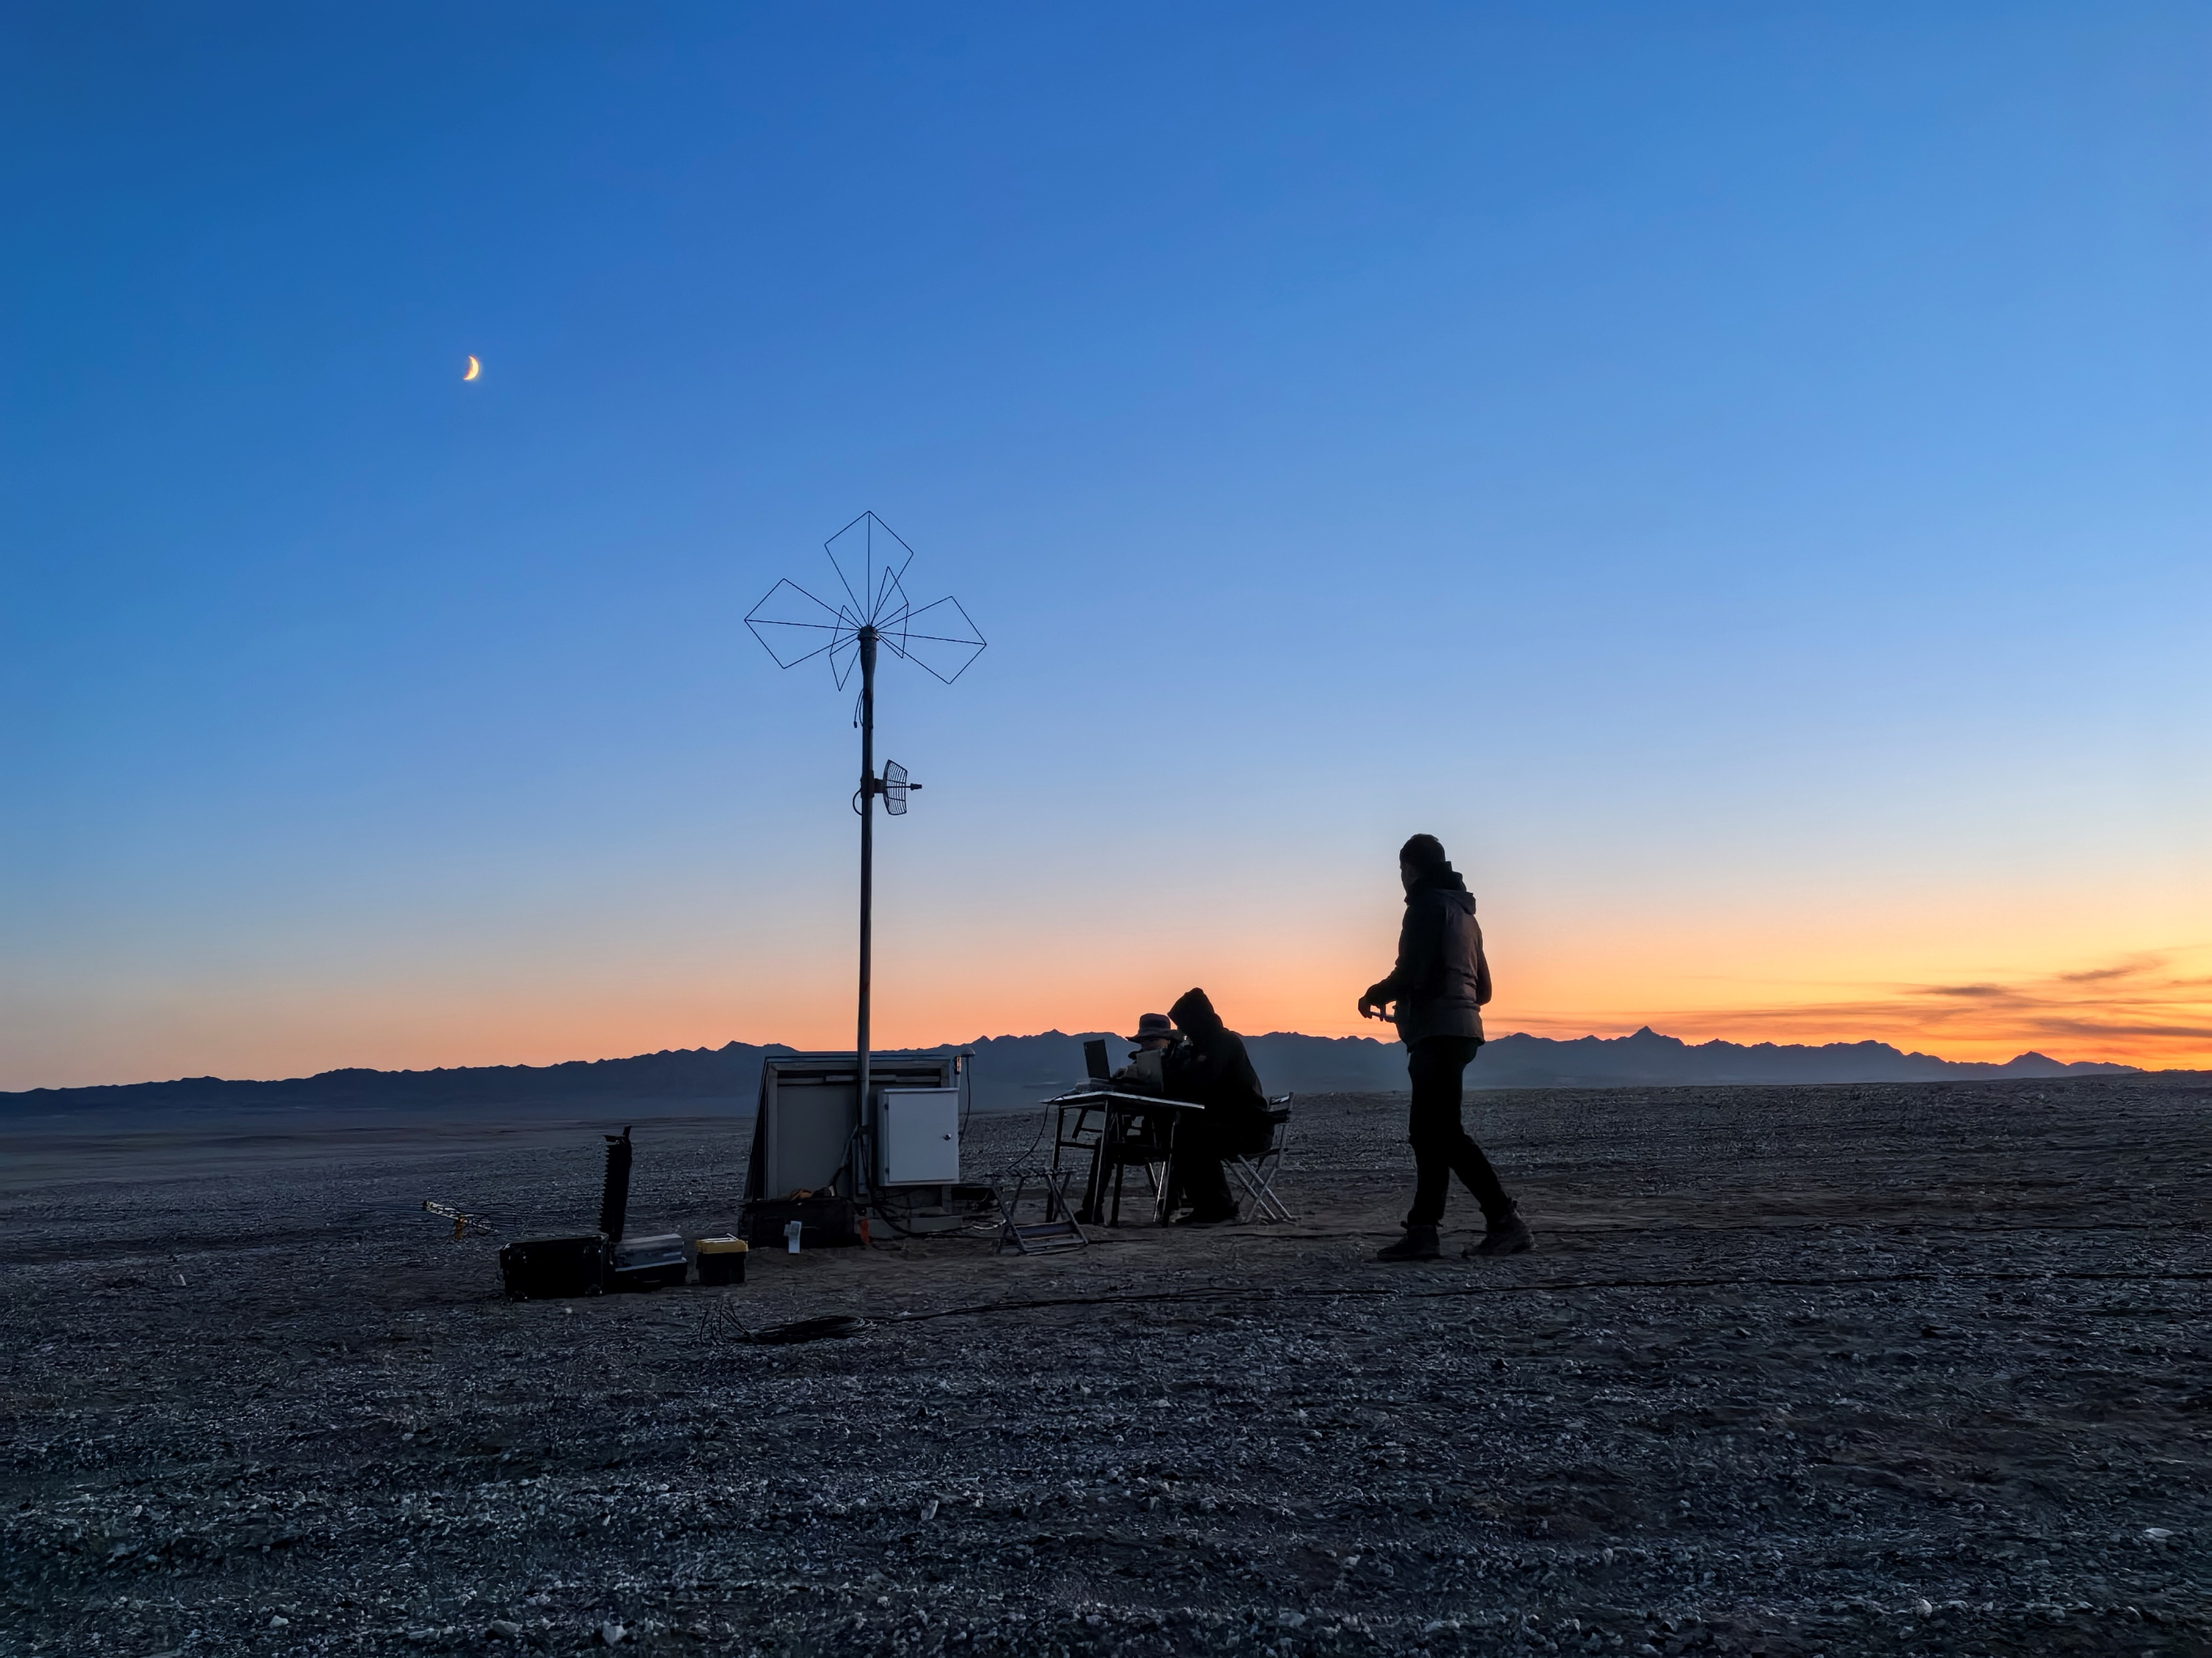
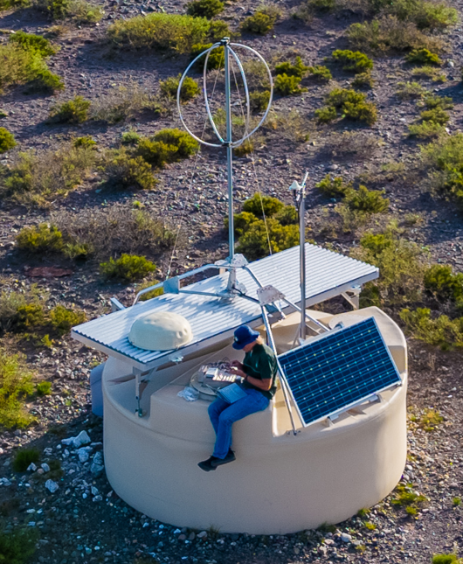
超高能宇宙粒子的射电探测
张毅
中国科学院紫金山天文台
第二届非加速器实验粒子探测和电子学技术研讨会 山东高等技术研究院 2026-3-28

Slide 2
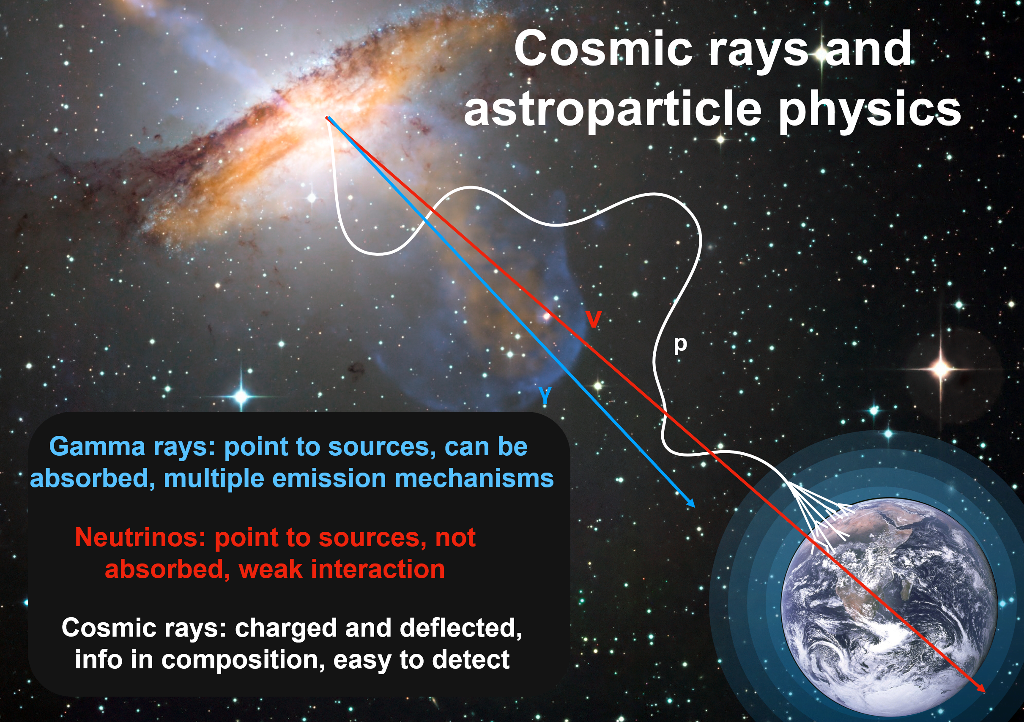
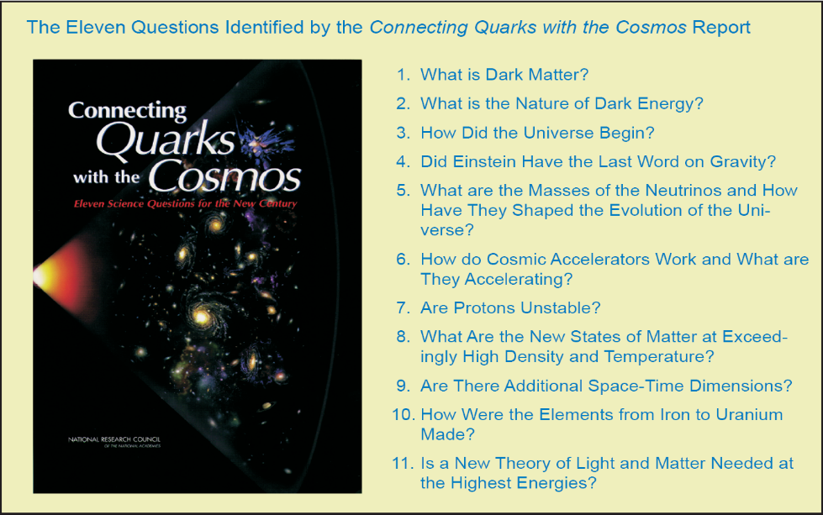
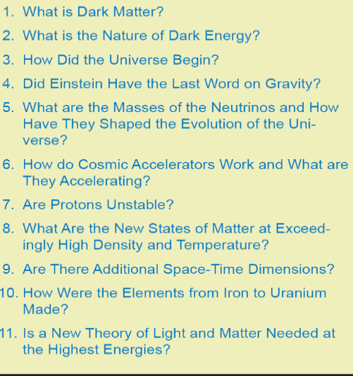
宇宙粒子探测面向的科学问题
21世纪宇宙物理学11个重大前沿问题
宇宙加速器的原理
最高能量物理规律检验

Slide 3
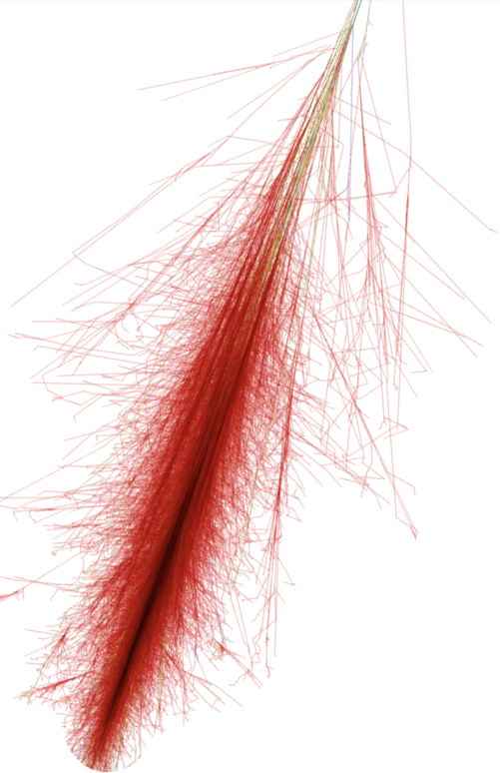
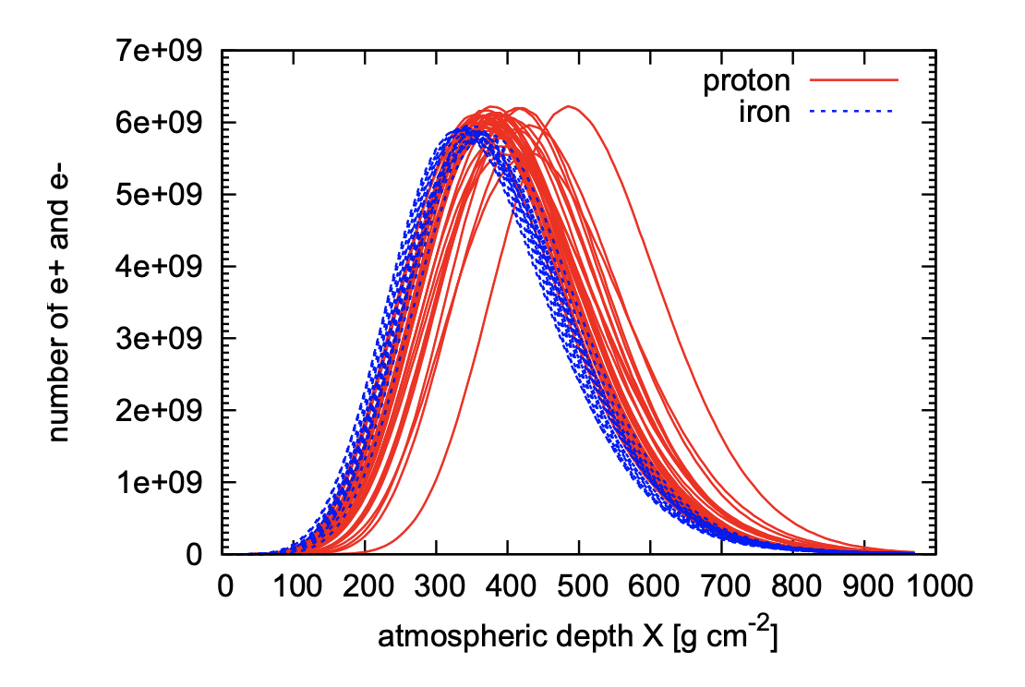
Extensive Air Showers
“Shower maximum”
Xmax
Proton
Iron
Cascade of secondary particles, reaching billions of particles at maximum
Simulated with Monte Carlo codes such as CORSIKA or Aires
Signal/particle arrival times: arrival direction
Total energy deposit in the atmosphere: primary particle energy
Depth of shower maximum, fluctuations: primary particle mass

Slide 4
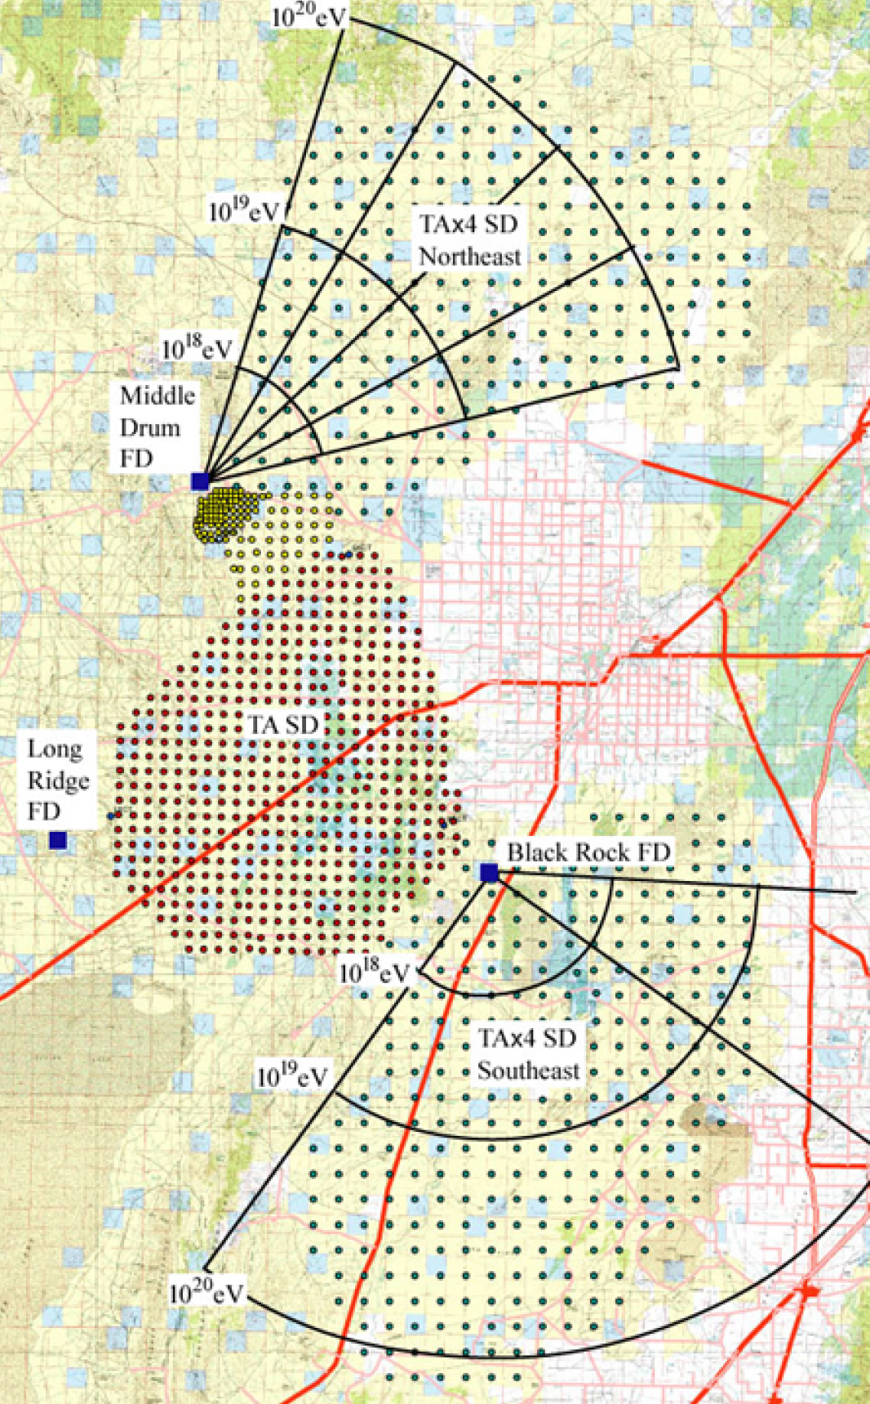
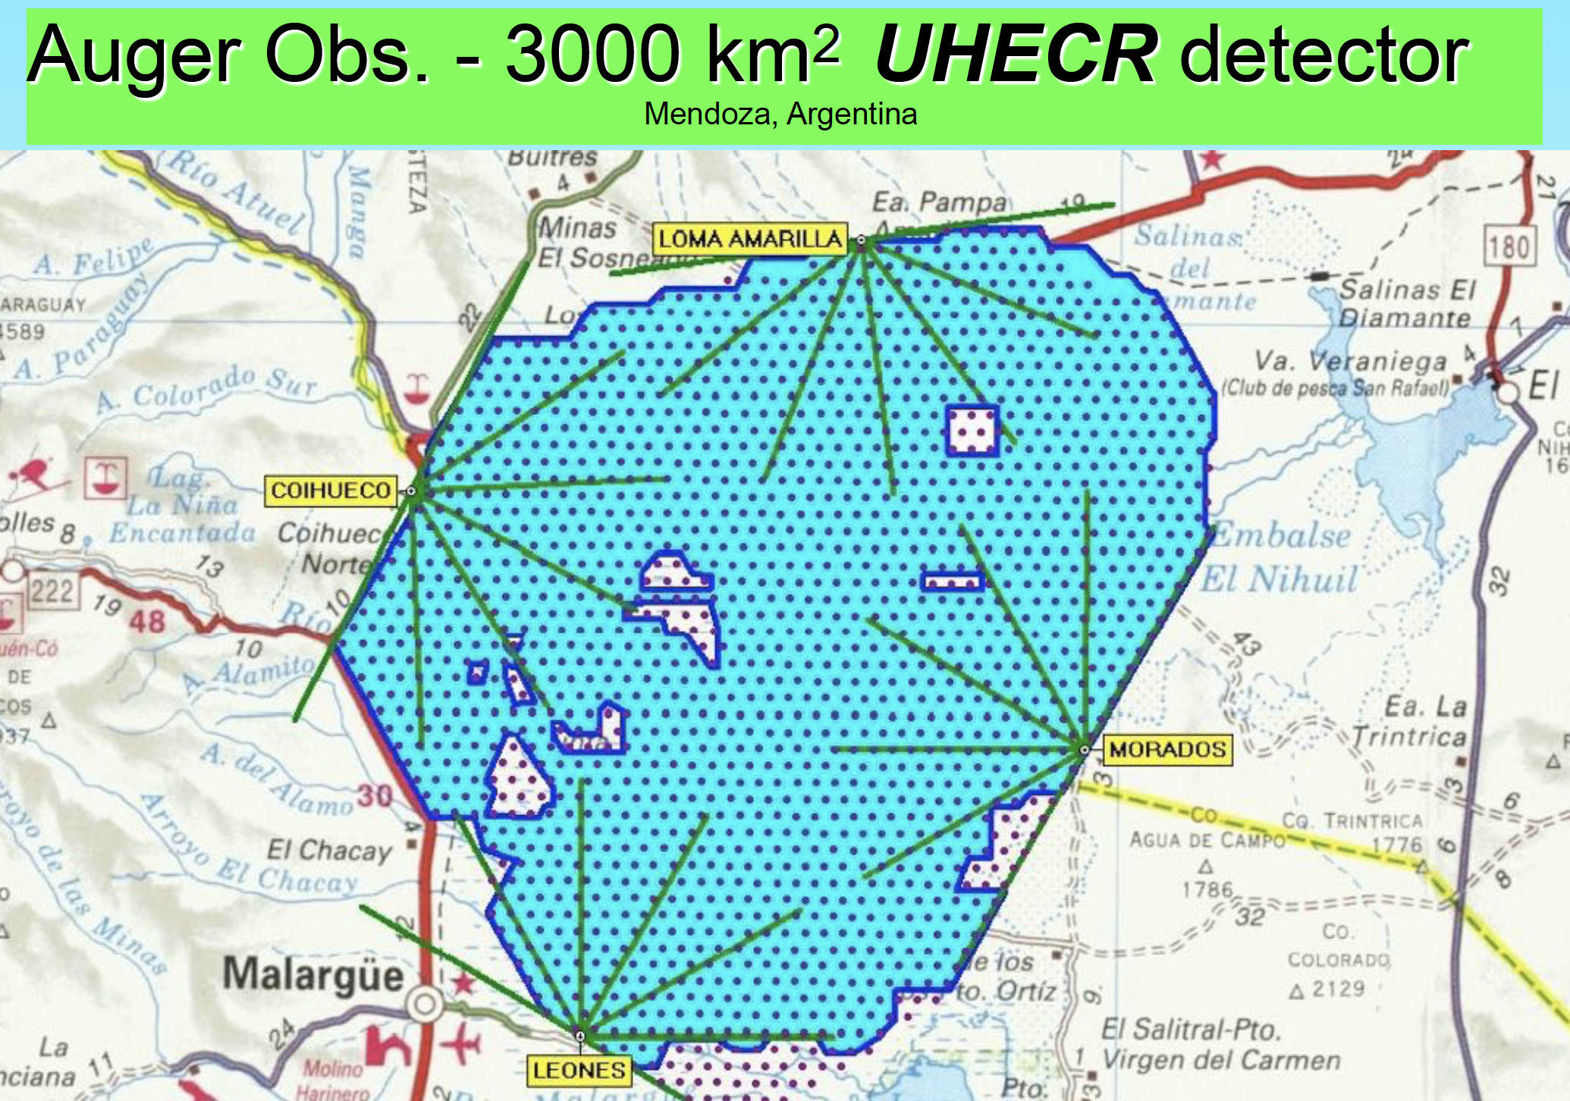
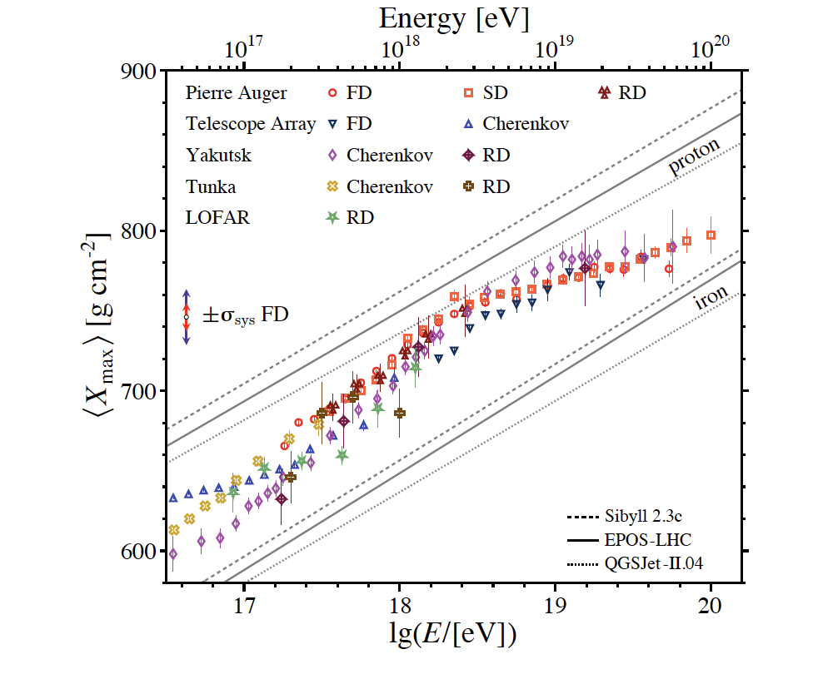
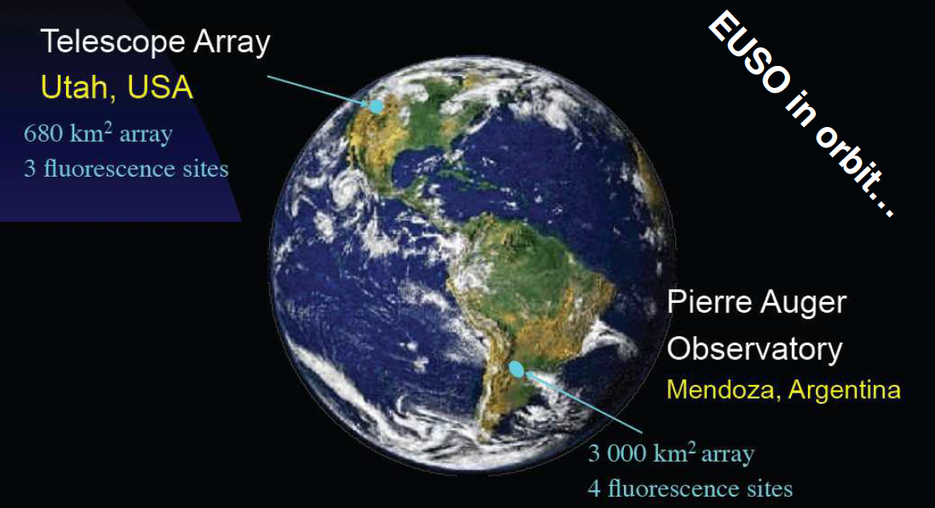

Current Knowledge on UHECRs
Auger and TA Experiments
Spectra
TA $700{km}^{2}$
Confirming ankle and cutoff features at ~ 5 EeV and 50 EeV
A new instep feature 13EeV
TAX4
Small statistics and composition discriminator being the main limiting factors
SNOWMASS review 2022, arXiv:2205.05845

Slide 5
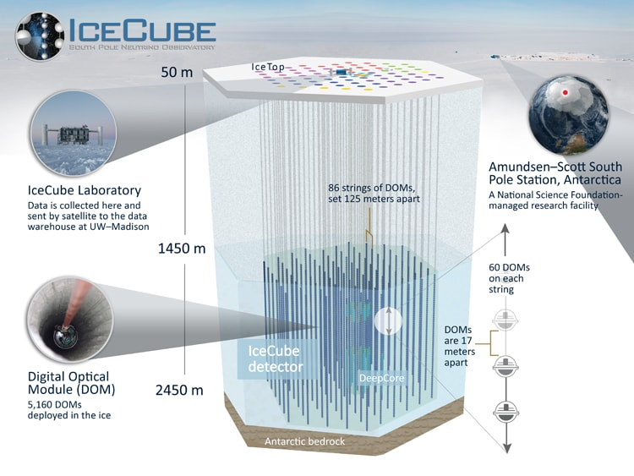
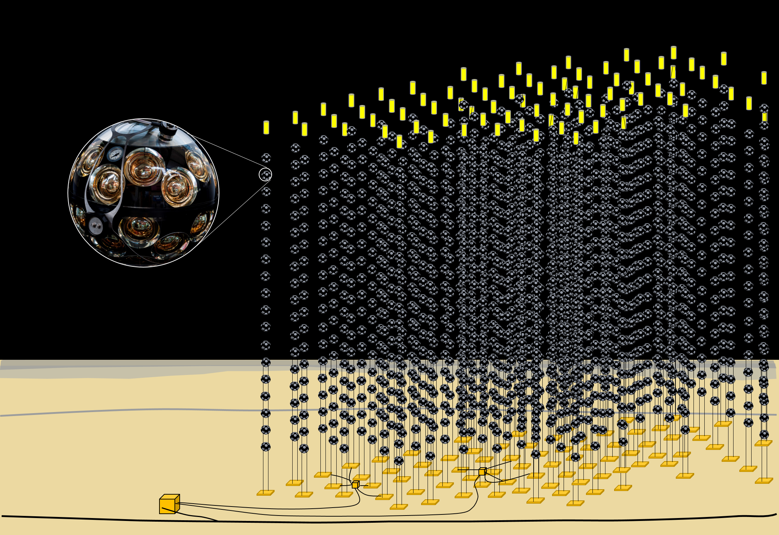
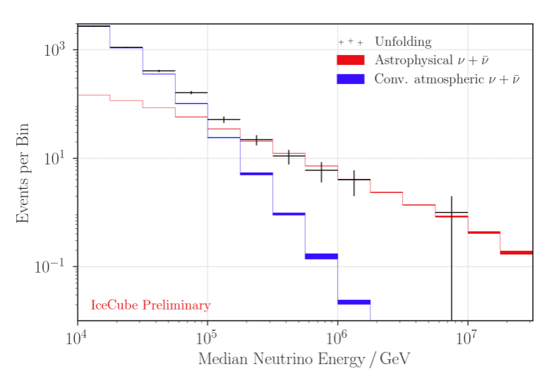
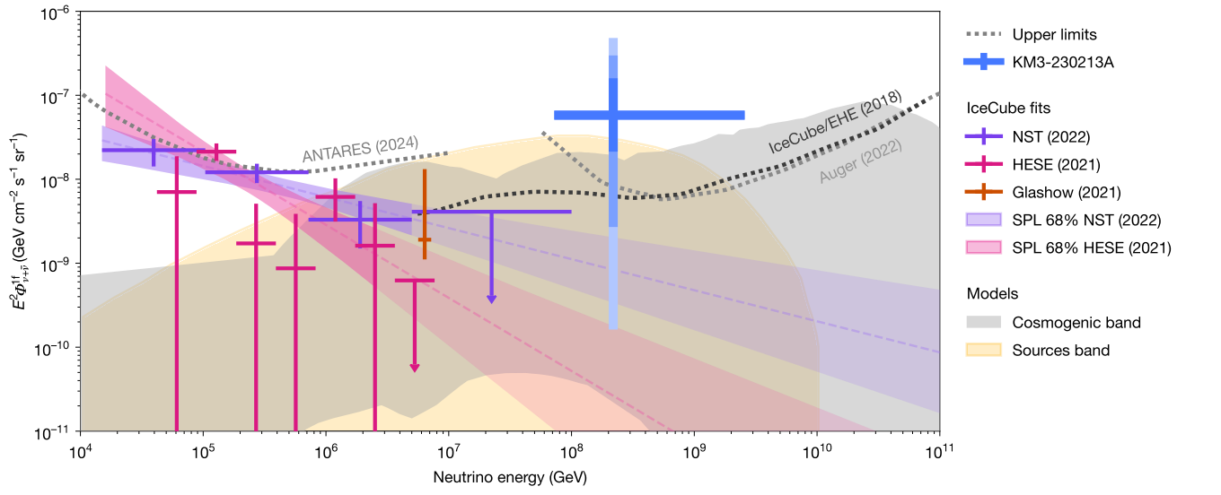
Astrophysical neutrinos
KM3NeT
Astrophysical neutrino
atmospheric neutrino background
Aiello,.et al Nature 638, 376–382 (2025)

Slide 6
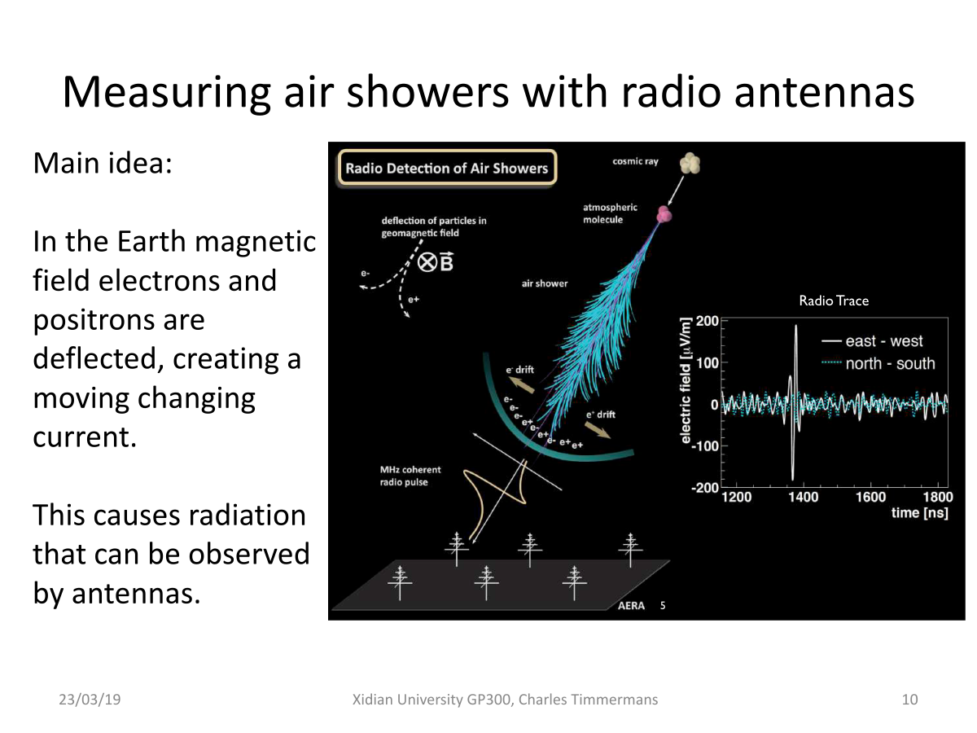
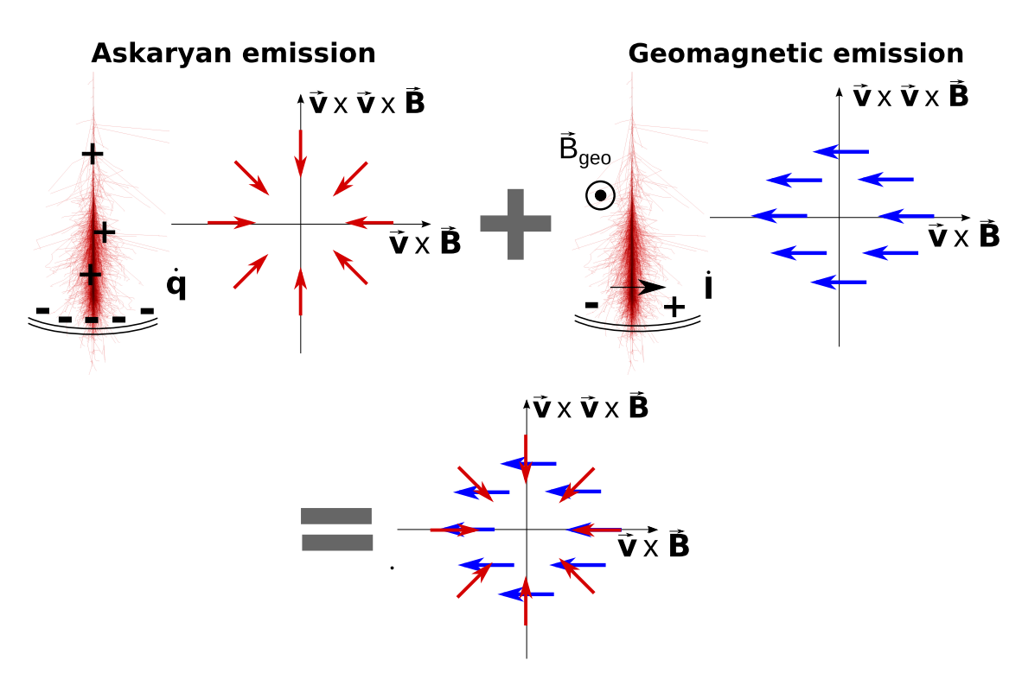
Radio signals from an air shower

Slide 7
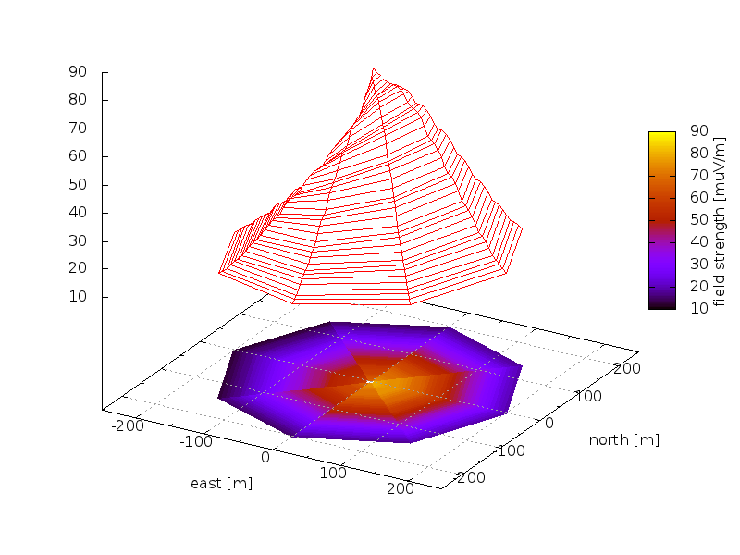

Complexity of radio LDF（横向分布）
Vertical iron shower at LOPES frequencies simulated with CoREAS

Slide 8
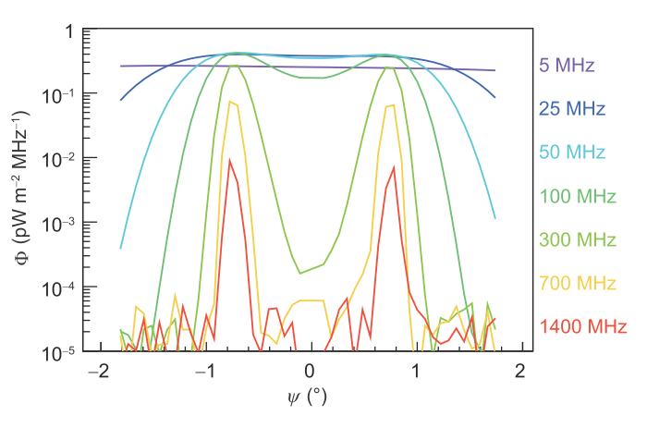
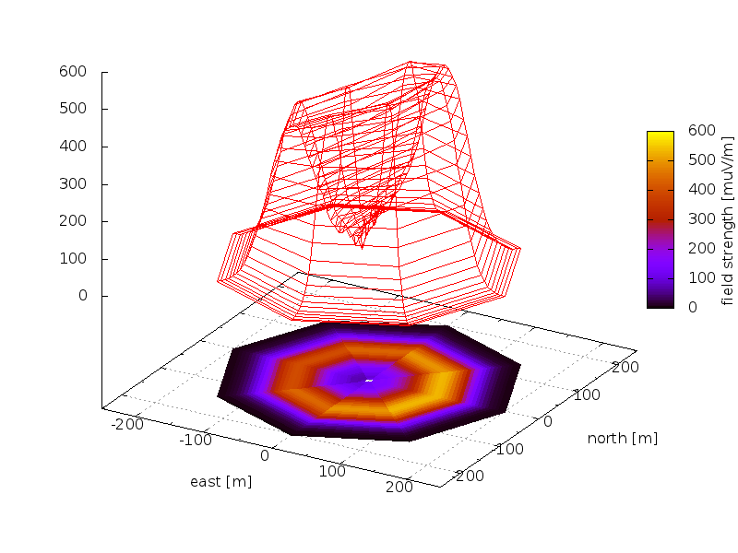
Characteristics of Radio signals 1
类切伦科夫环

Slide 9
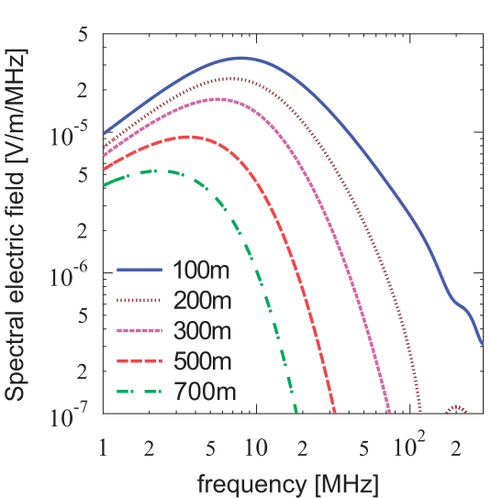
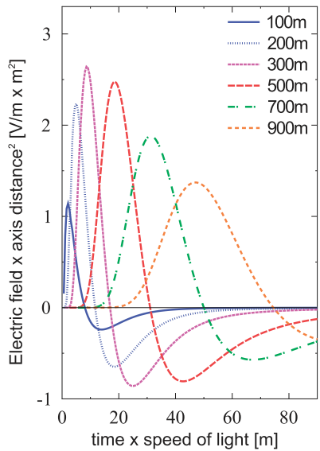
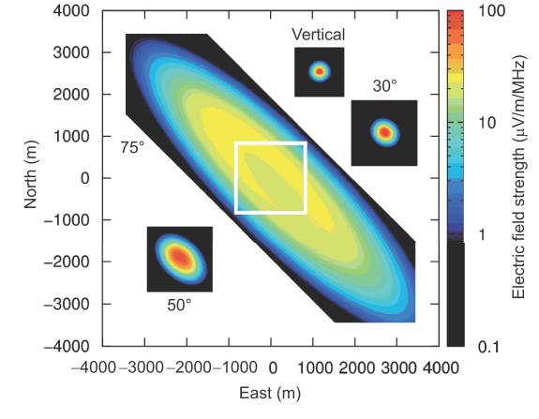
Characteristics of Radio signals 2
Nano seconds Pulse
~ µV/m electric field @ 1017eV
50MHz –200MHz

Slide 10
“Radiation energy” as energy estimator
energy resolution ~17%
of 10¹⁸ eV, only 10⁷ eV go into radio signals
radiation energy gives a calorimetric measurement of the energy in the electromagnetic cascade
比现有技术更好的能量分辨
Piere Auger Coll., Phys Rev. Lett. (2016), arXiv:1605.02564.

Slide 11
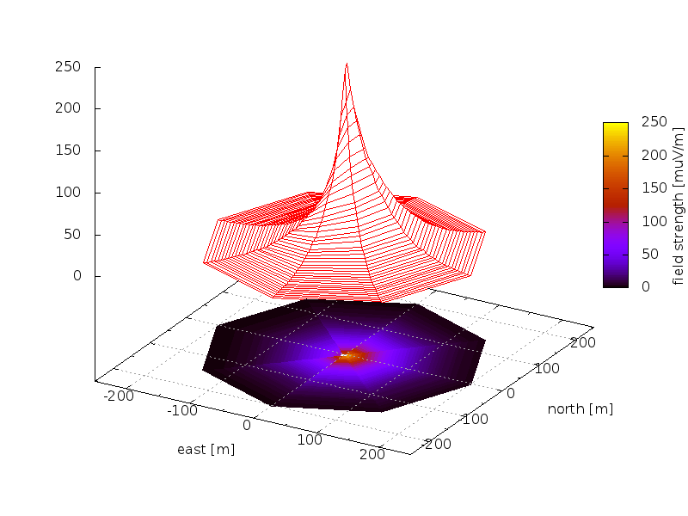
Lateral distribution as probe for composition
Relativistic forward beaming of emission: geometrical distance from source to observer influences emission pattern
Vertical proton shower simulated with CoREAS
Vertical iron shower simulated with CoREAS

Slide 12
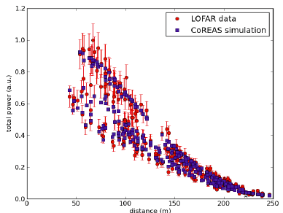
Fit of LOFAR particle and radio data
Data fit to CoREAS simulations gives Xmax to ~17 g/cm²
S. Buitink et al., Phys. Rev. D 90 (2014) 082003, S. Buitink et al. Nature 435 (2016) 70

Slide 13
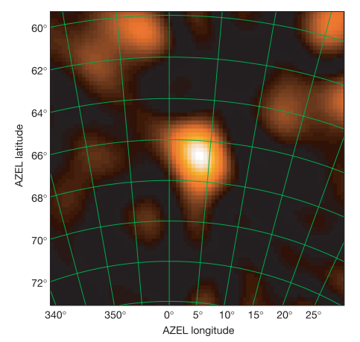
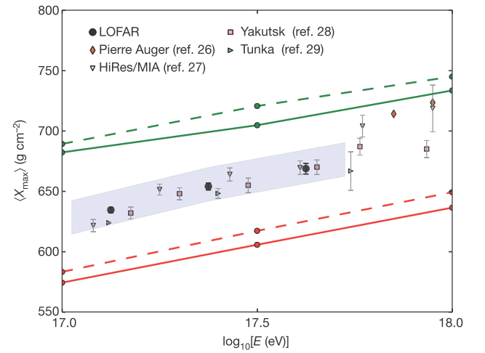
Milestones observation
LOFAR 2016, Nature 531, 70-73
Measure Xmax with high precision, 16g/cm²
LOPES 2005, Nature 435, pp. 313-316
Image of an air shower using Radio signals

Slide 14
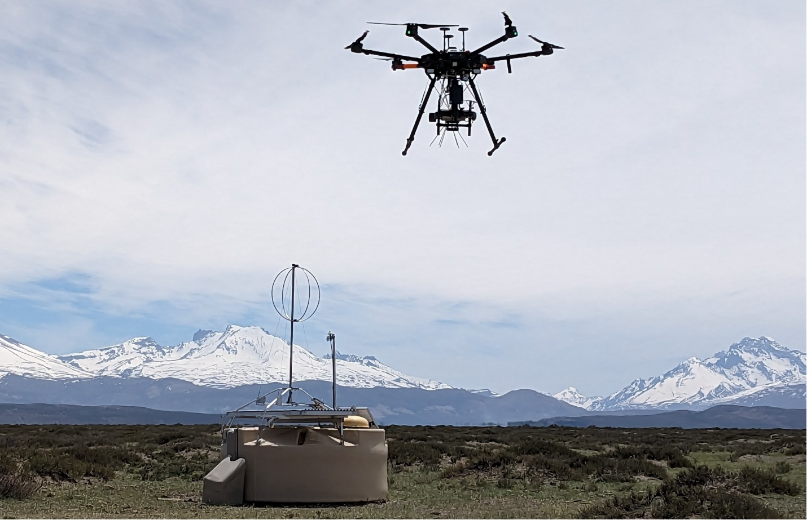
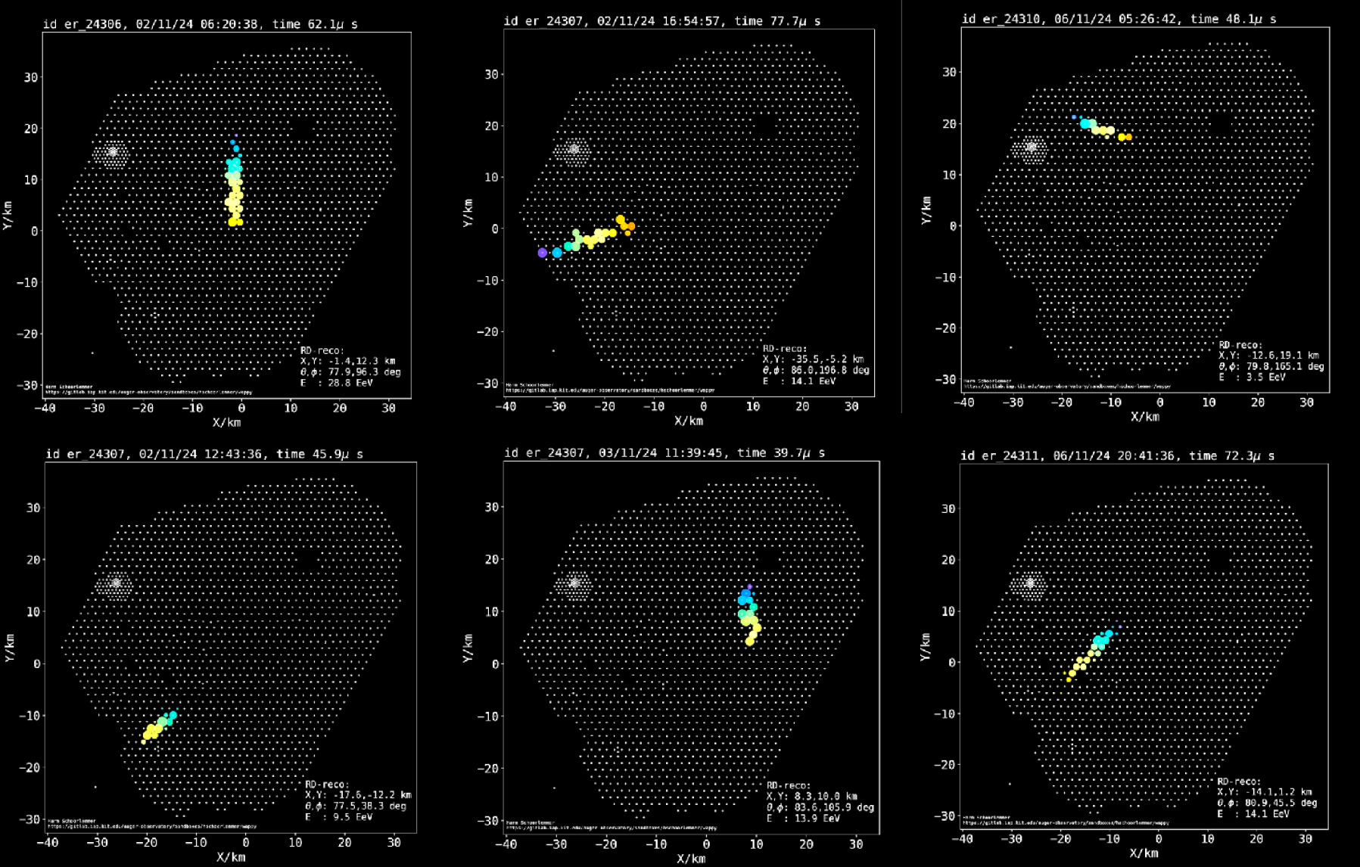
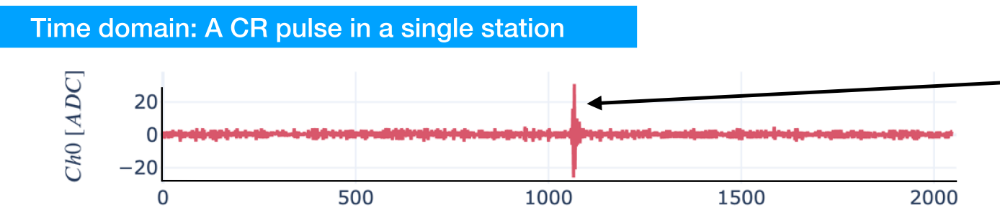
Pierre Auger Radio Detectors (3000 km²)
Radio signals of typical ~10¹⁹ eV air showers
Calibration measurement with a reference radio source mounted on a drone.
All ~1660 antennas deployed
改进CR测量的能量分辨，成分鉴别。

Slide 15
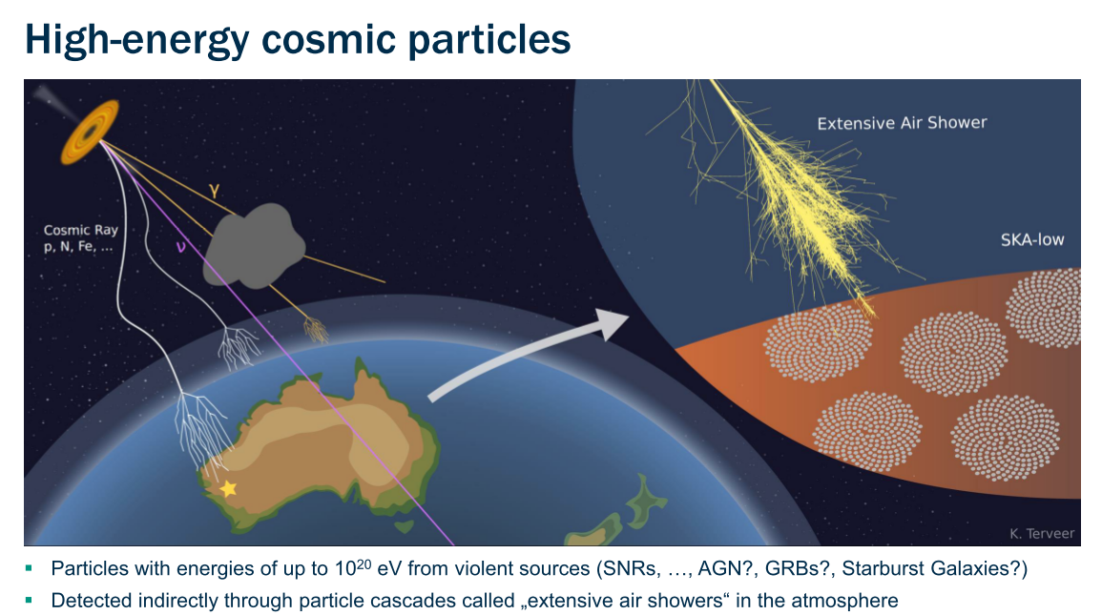
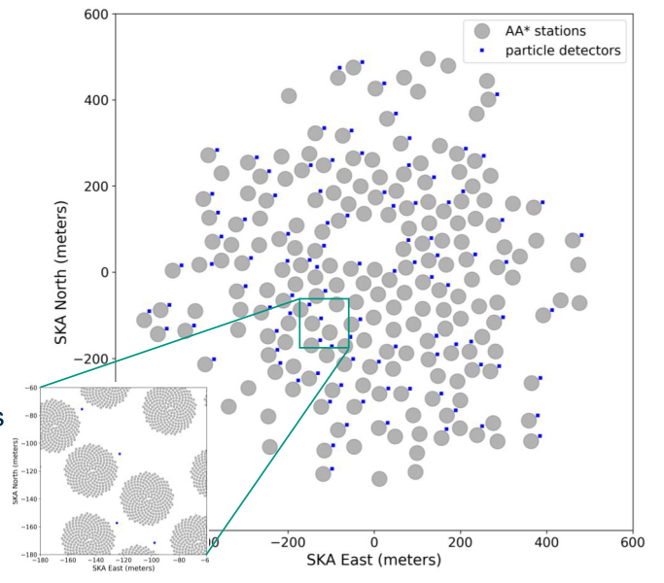
High energy particle detection by SKA
粒子探测器触发
利用密集天线阵列测量大气簇射前锋面精细结构。

Slide 16
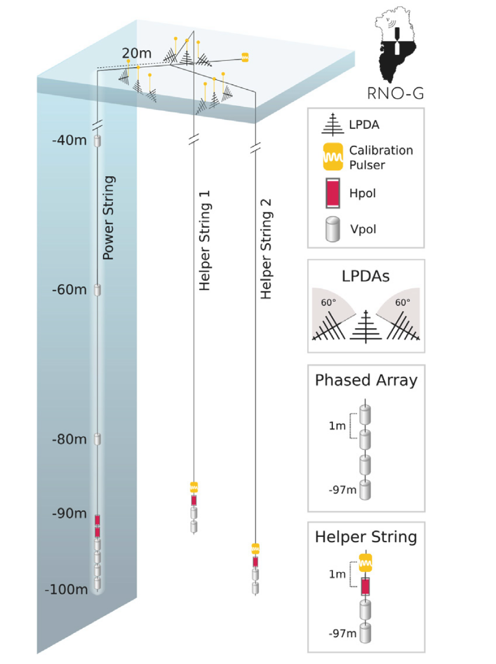
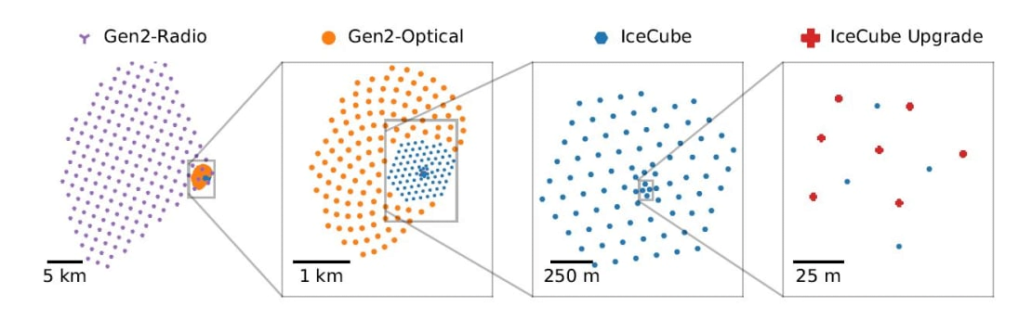
Radio Neutrino Observatory with ICE
ICEcube-Gen2 Radio Array 500km²
改进icecube更高能段的中微子灵敏度
格陵兰岛 RNO-G

Slide 17
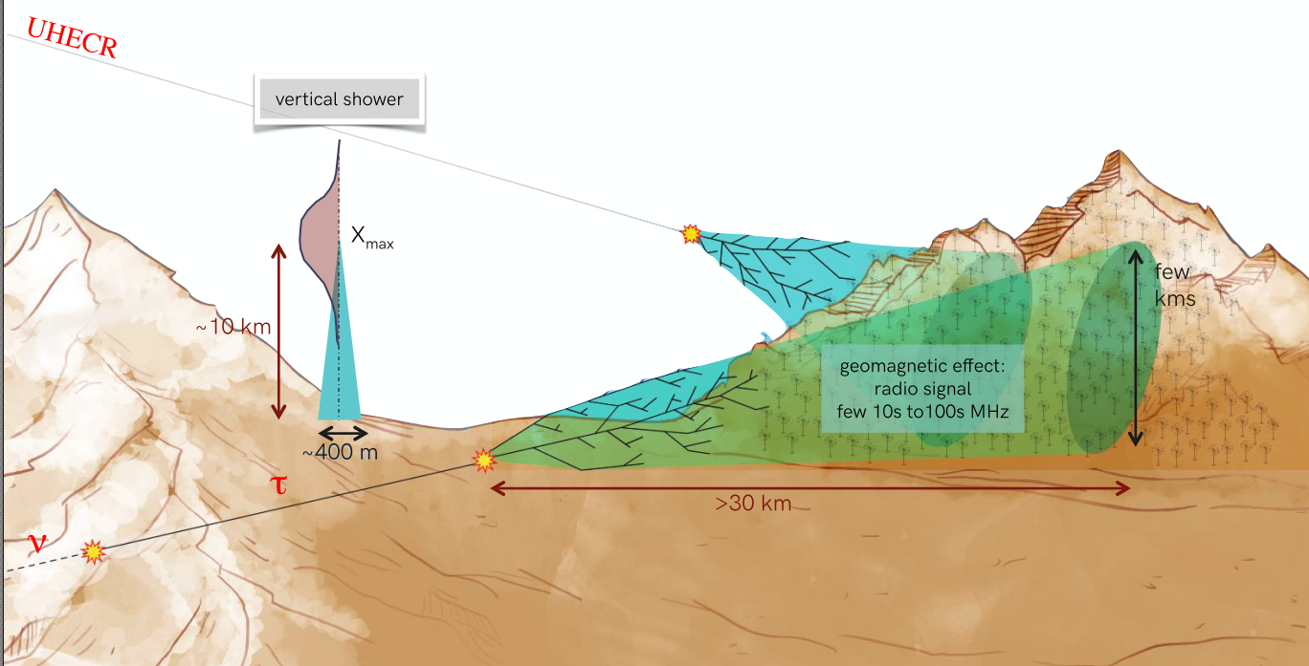
GRAND Concept
200k radio antennas array over several sub-arrays at favorable sites worldwide
Investigate the origin of UHE CRs and Tau neutrinos.
CRs hit the atmosphere Vτ interact with mountains->τ decay
Air showers ( radio emission due to
Geomagnetic filed)
Radio emission: ▪ undergoes little attenuation in the atmosphere; ▪ Can be detected far from the shower.
Advantages of Radio antennas: scalable, cheap, robust, ideal for giant arrays

Slide 18
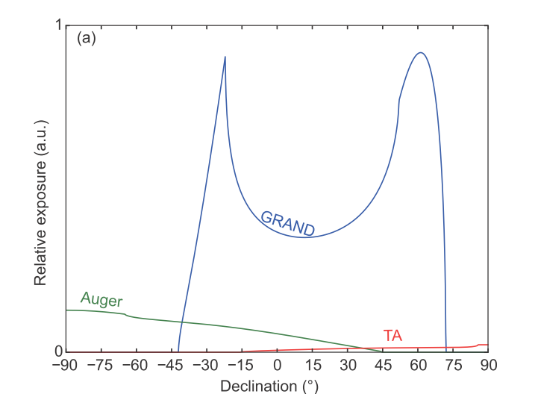
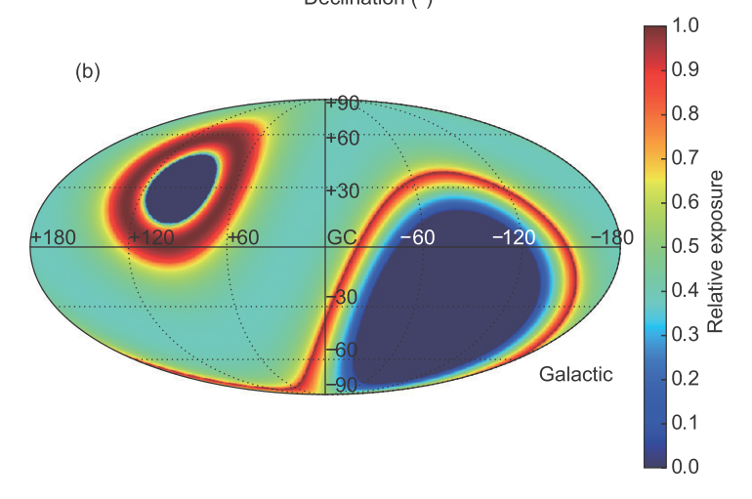
Expected performances for UHE Cosmic Rays
65◦ ≤ θz ≤ 85◦ for UHE CRs
One year, 6400 events above 10 ^{10 . 5} GeV Vs the combined ∼ 750
collected events of Auger and TA to date.

Slide 19
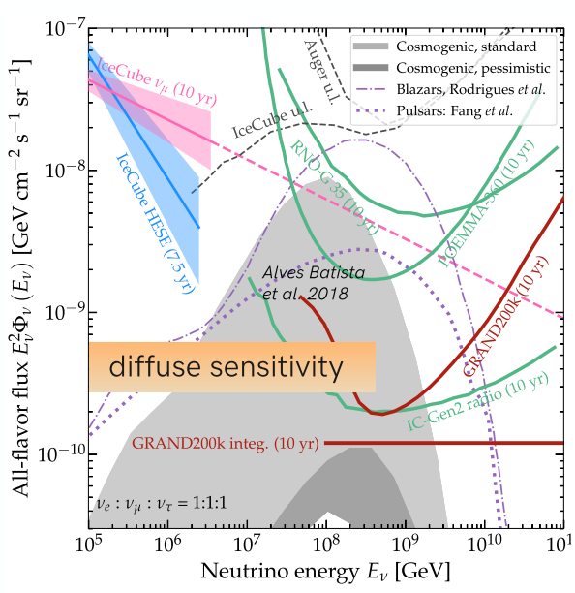
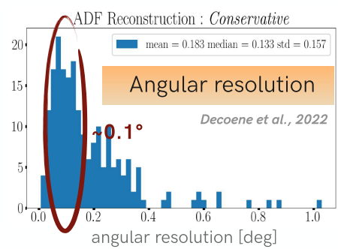
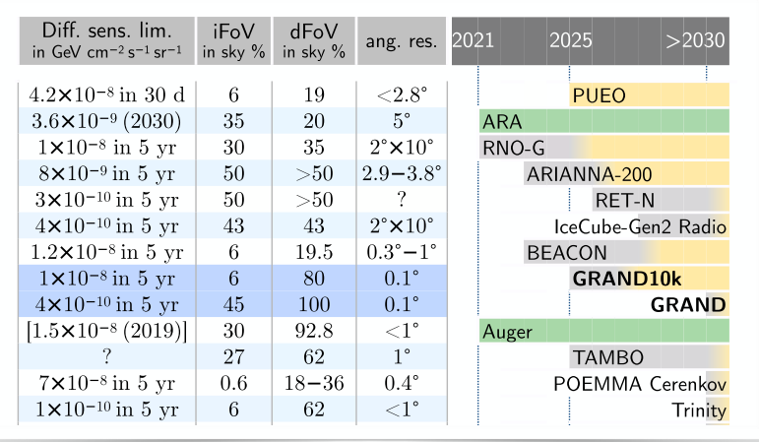
Expected performances for Neutrinos
GRAND could potentially detect a large number of cosmogenic neutrinos. The event rate in the 10⁸ -10¹¹ GeV energy range is about 1-18 events per year for the standard model.
Grand will potentially observe the UHE neutrino sources at 5 σ in 3 years.

Slide 20
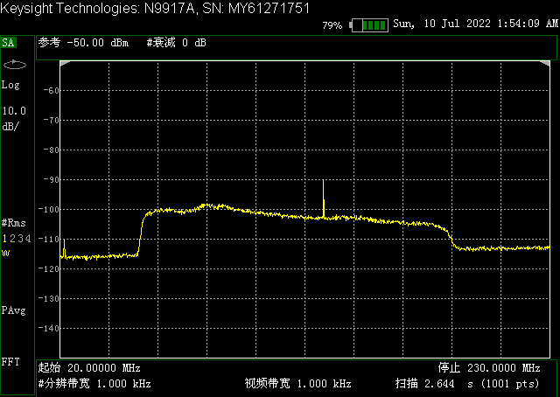
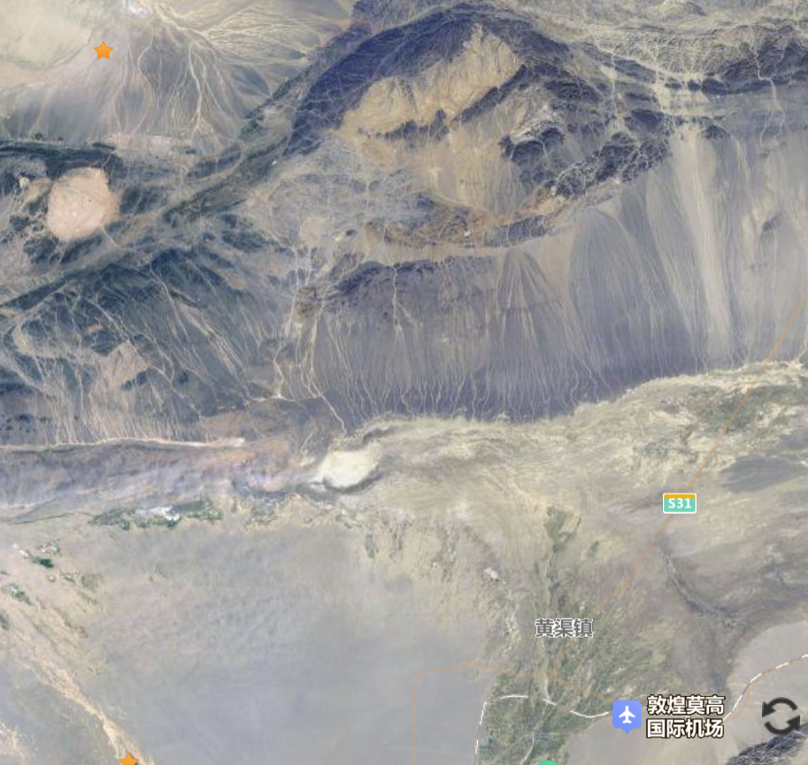
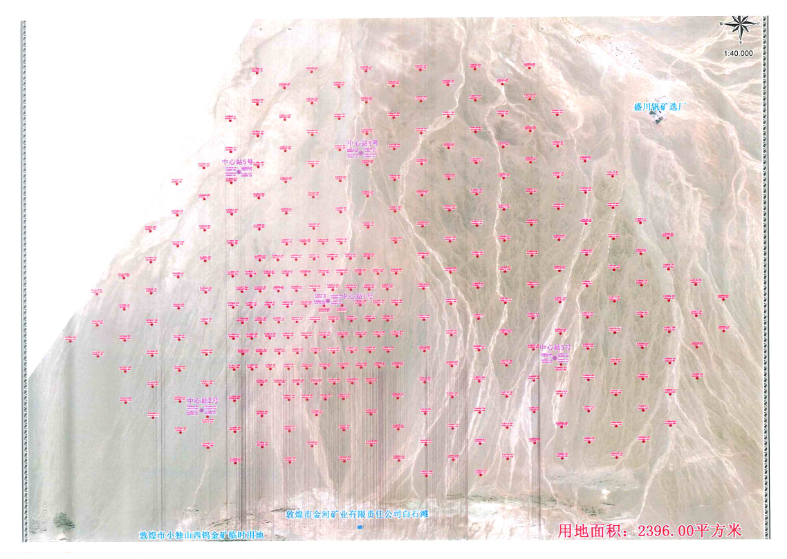
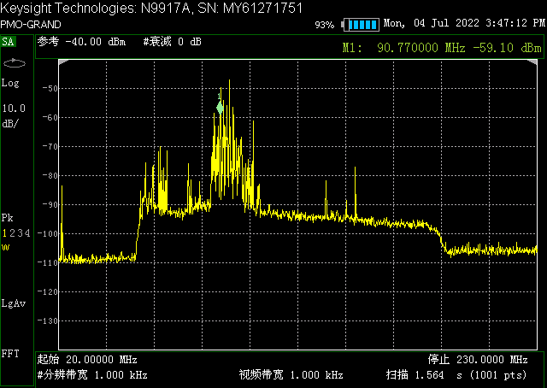
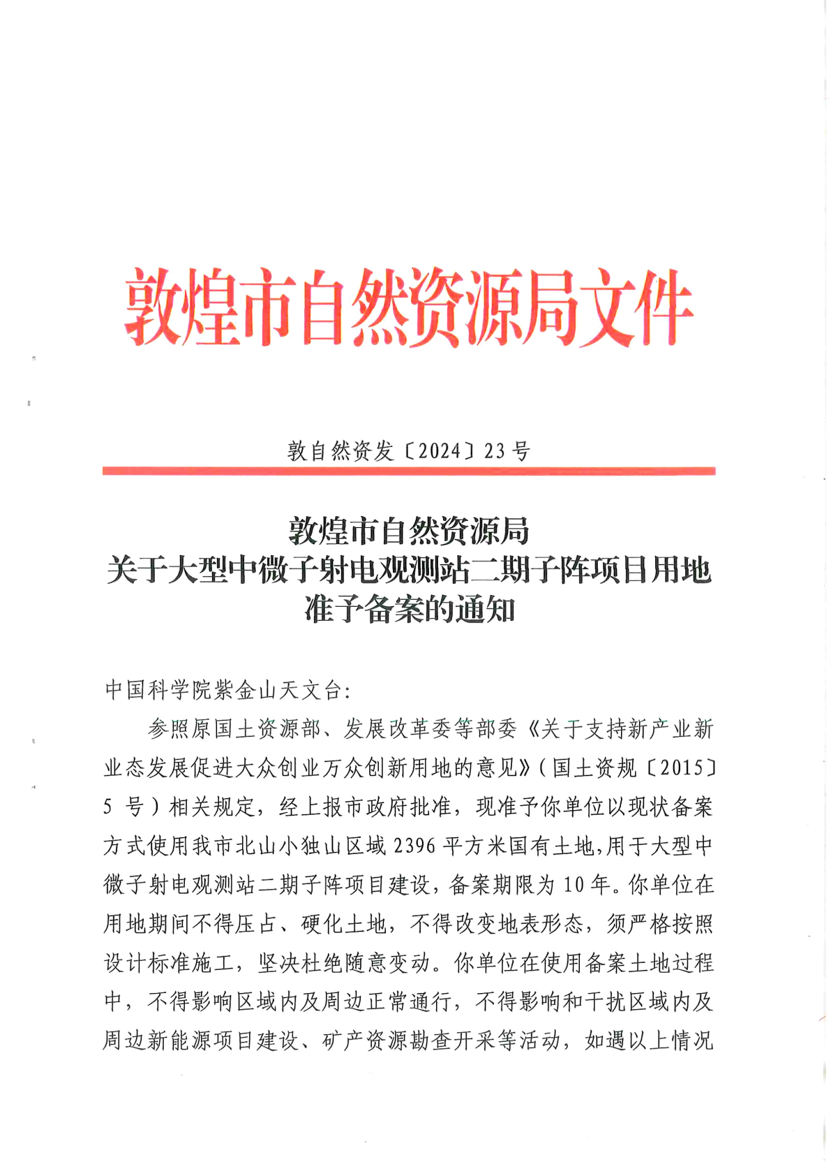
GrandProto300
Xiao Dushan
North Mountain
选定站点
~120km, ~ 3hours
其他候选点
DunHuang
锁定无线电宁静的优越站址;
获授约200平方公里范围内300个单元的点位用地许可。

Slide 21
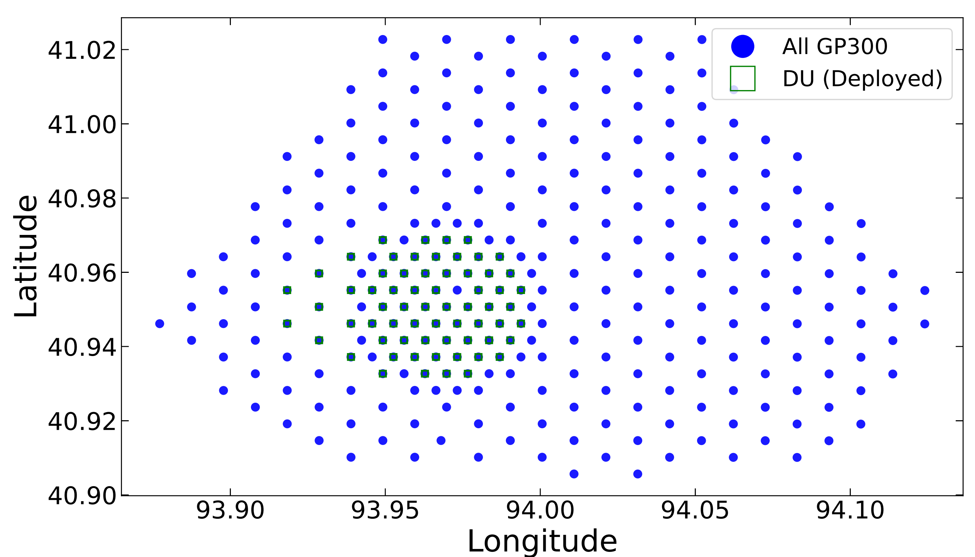
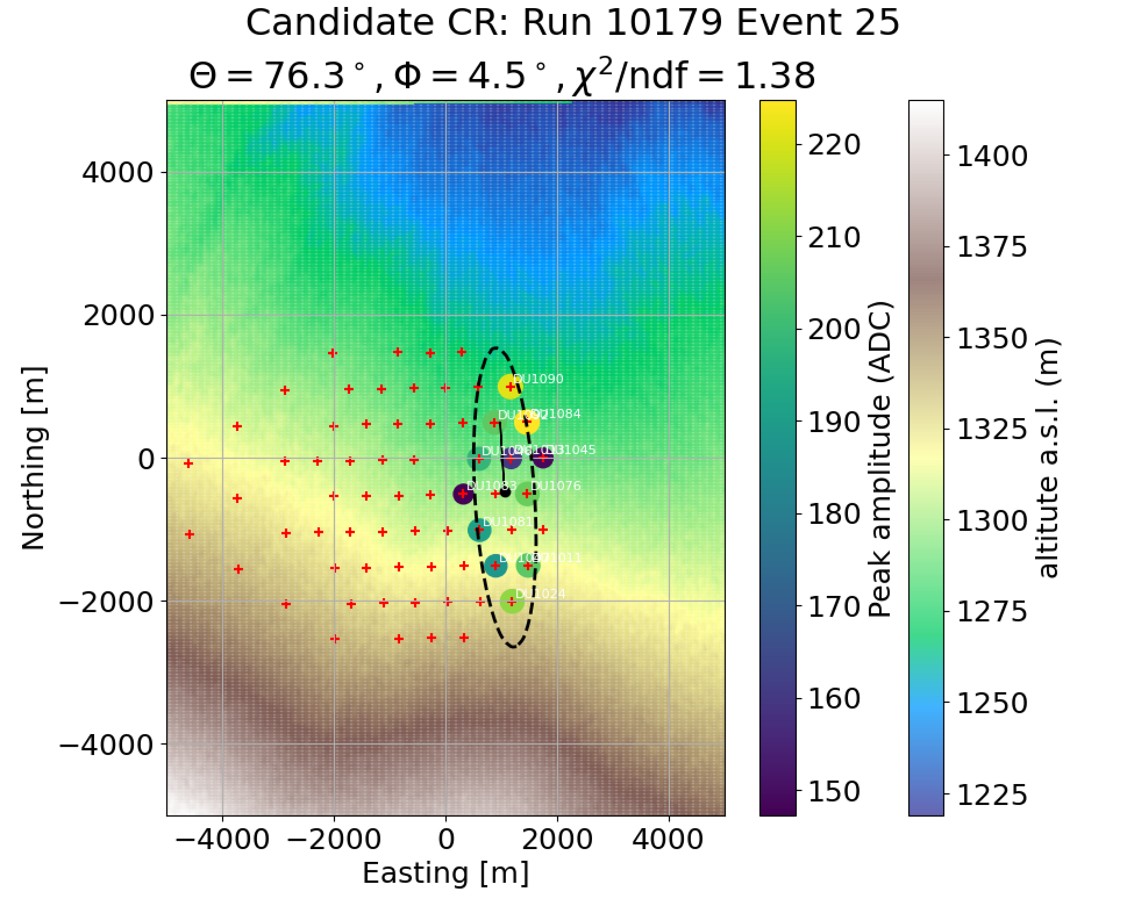



GrandProto300
候选事例的横向分布与预期
中心站
天线单元

Slide 22
Summary
The origin of the highest-energy cosmic rays remains an open question, in which multi-messenger astrophysics plays a key role.
Over the past two decades, radio detection of cosmic-ray air showers has evolved from pioneering prototypes into a precision measurement technique.
The field is now undergoing a revival, offering significant advantages over traditional particle detectors—such as all-weather operation, high energy resolution, and strong particle identification capabilities.
The physics underlying radio emission from air showers is well understood. Furthermore, neutrino detection via extensive air showers represents a highly promising direction. This is exemplified by projects like GRAND, which aims to instrument an area of up to 200,000 km². Prototype deployments in China are already making substantial progress.

Slide 23



预期曝光
样机阵列的预期有效曝光

Slide 24







站点
North Mountain
Xiao Dushan
Lech Piotrowski,Pengfei Zhang, Frédéric Magnard, Olivier Martineau, Yi Zhang,
Pengxiong Ma, Shen Wang, Xing Xu, Bohao Duan,Yu tang
~120km, ~ 3hours
DunHuang

Slide 25

测得的银河射电本底
预期银河射电本底

