Slide 1
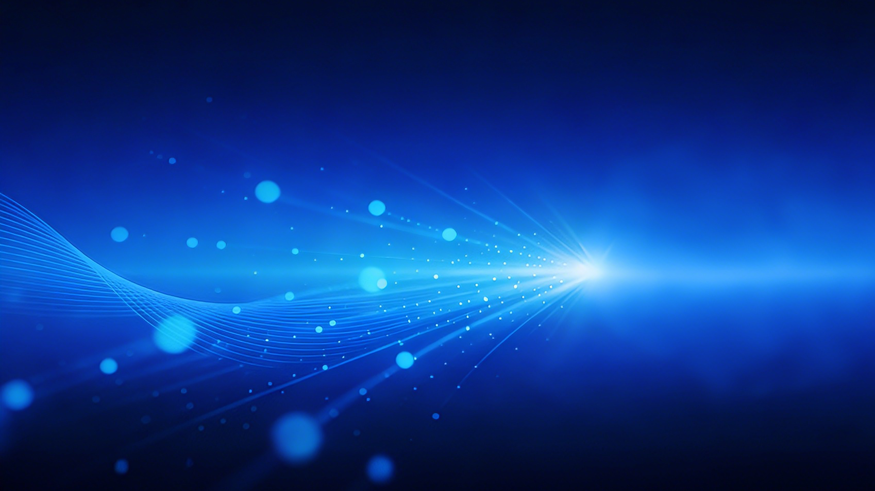
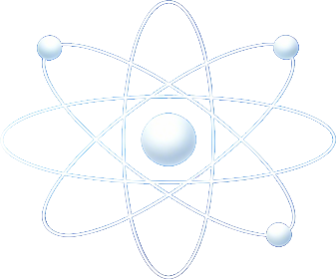






Direct observation of the Migdal effect induced by neutron bombardment
米格达尔(Migdal)效应的直接观测
Nature 649, 580 (2026)
刘 倩
MigdAl pRocess Validation by nEutruaL scattering (中性散射中的Migdal过程验证)
中国科学院大学
（代表 MARVEL 合作组团队）

Slide 2
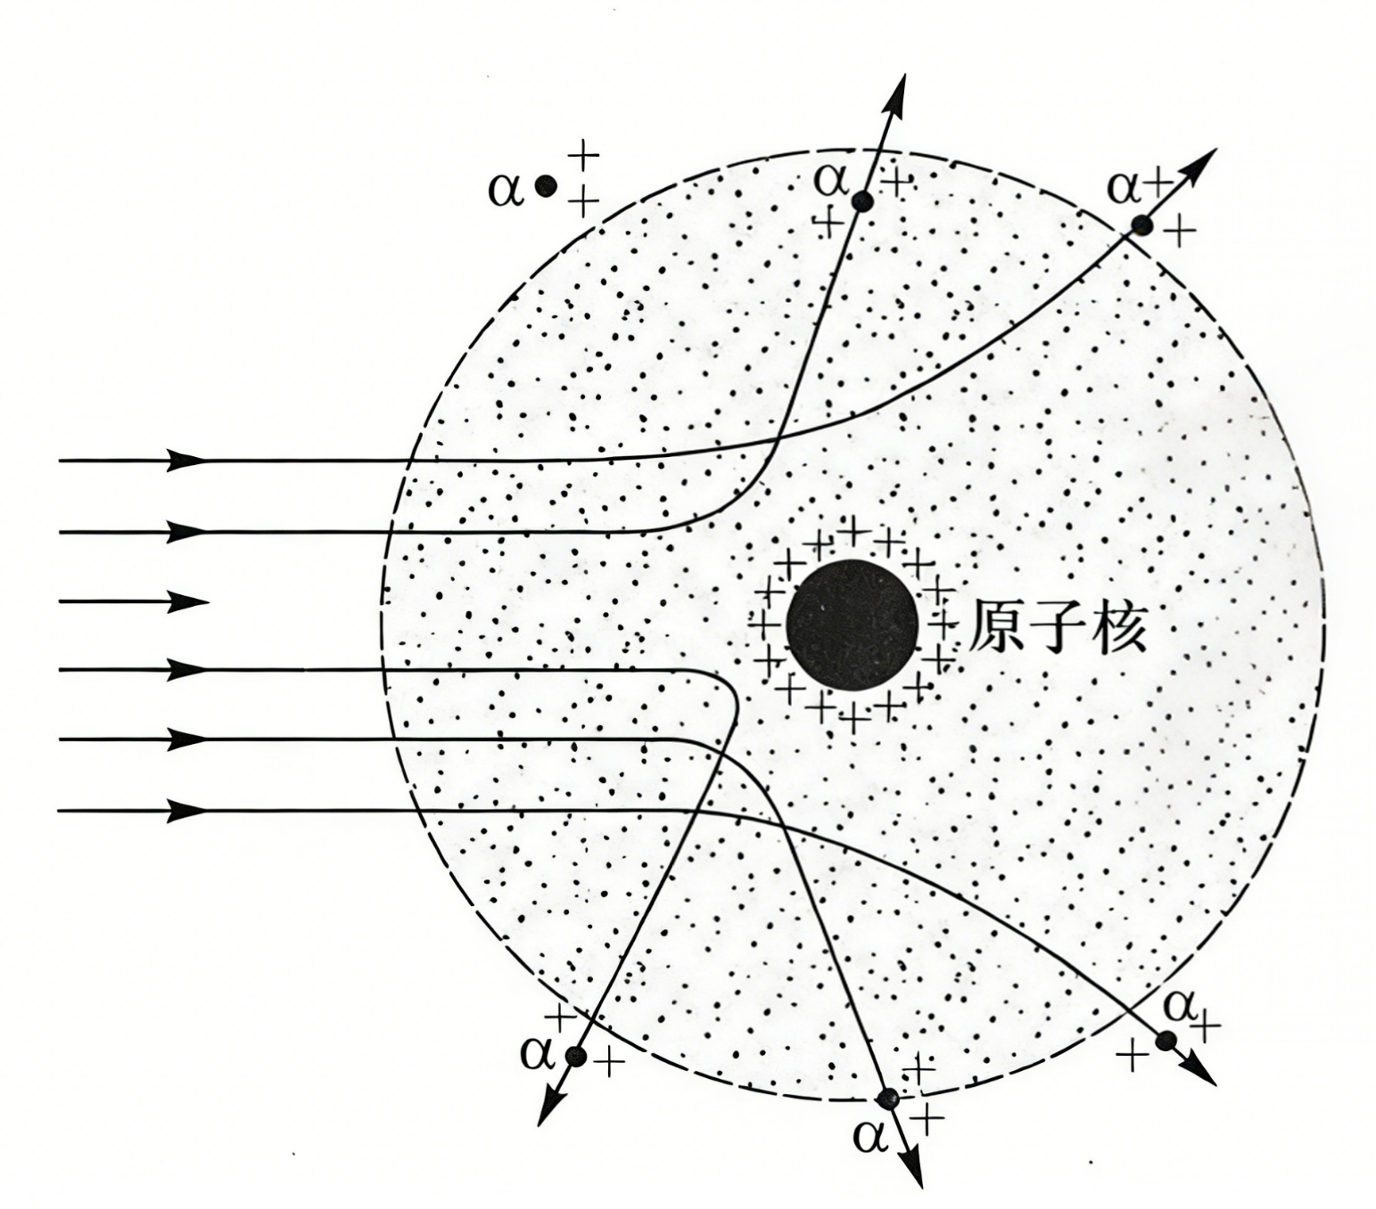

从卢瑟福散射实验说起
Au
He
He

Slide 3
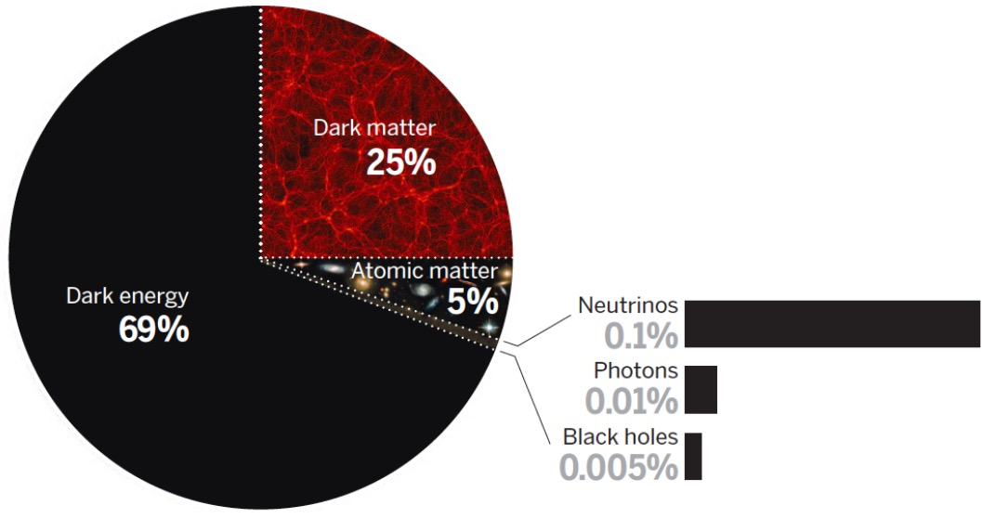
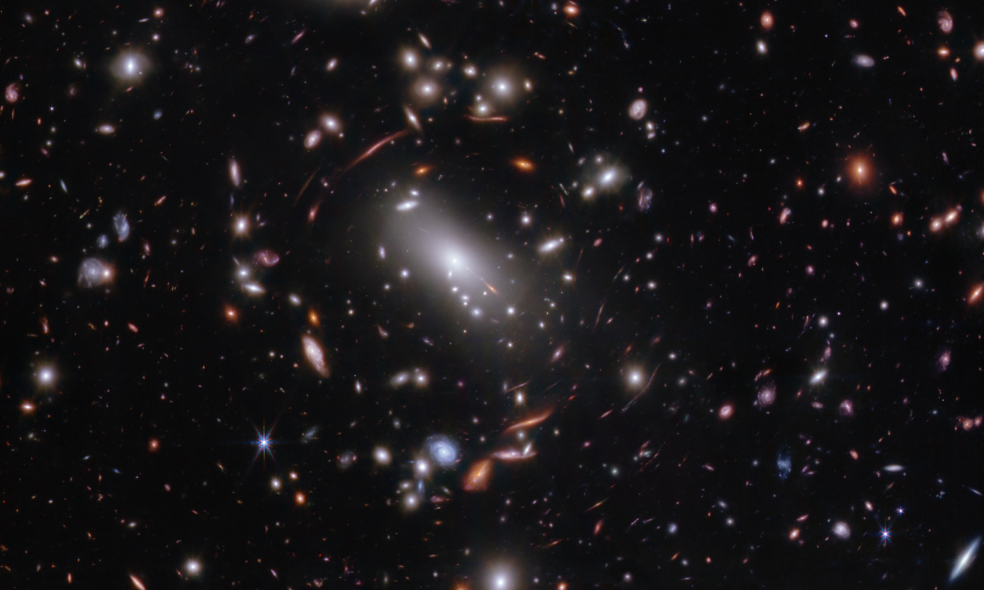
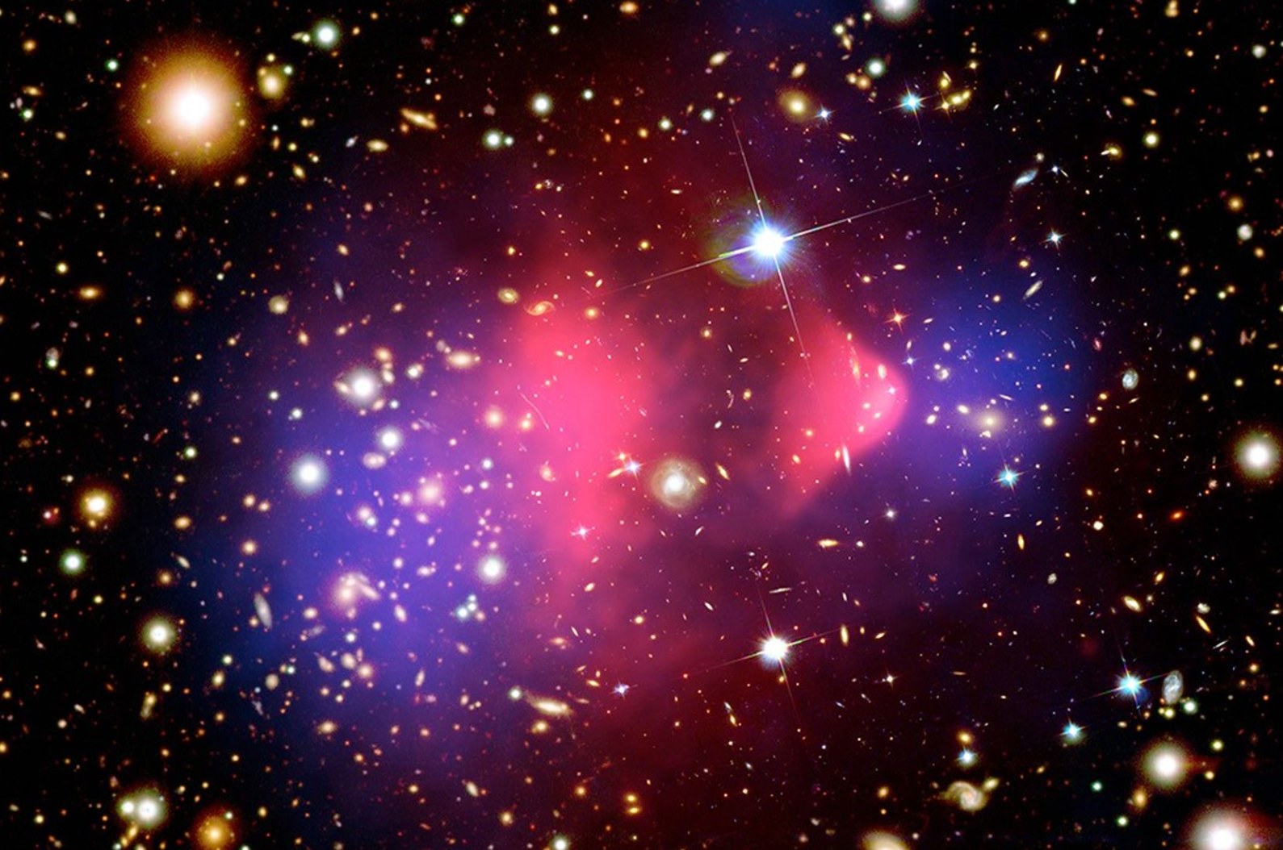
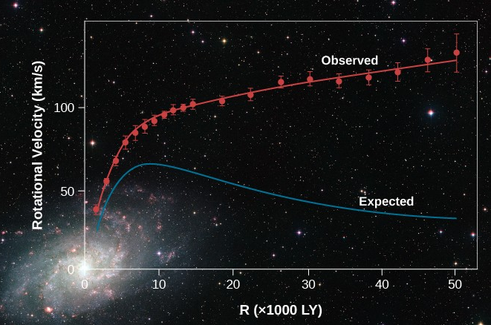
Dark matter
Dark matter makes up most of the mass in galaxies and galaxy clusters.
Current evidence comes solely from gravitational interaction.
Gravitational Lens
Galaxy mergers
Galactic rotation curve

Slide 4
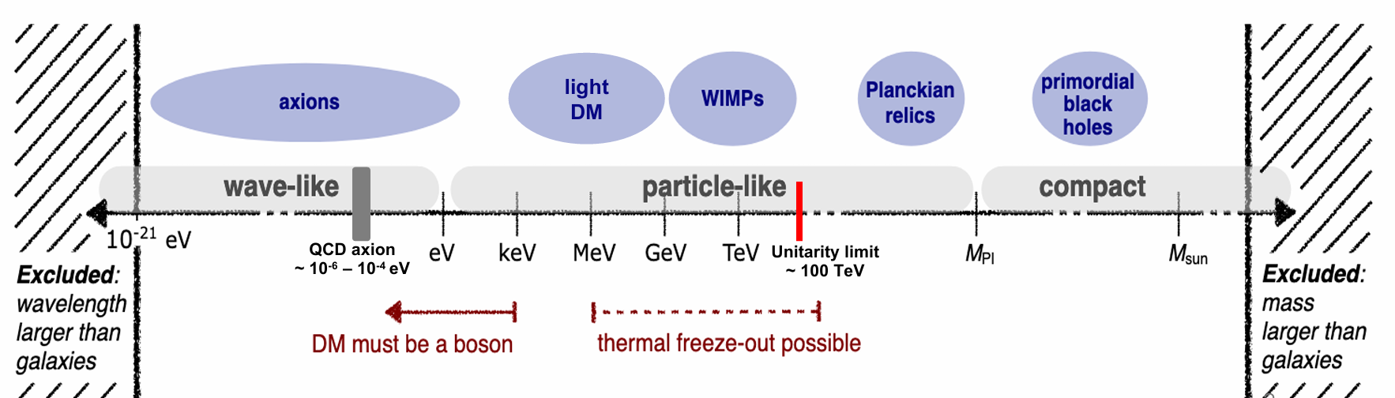
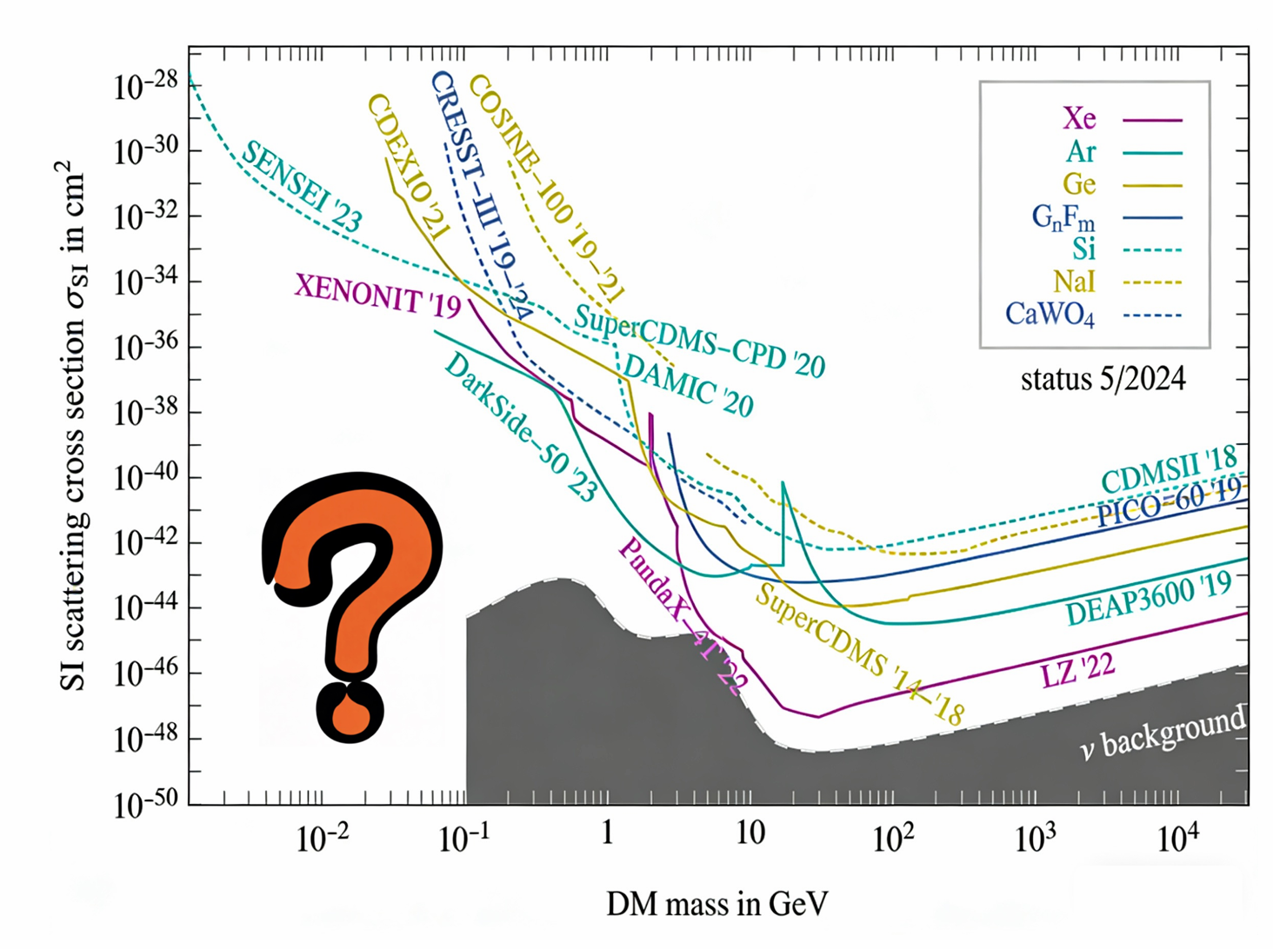

WIMP

Slide 5
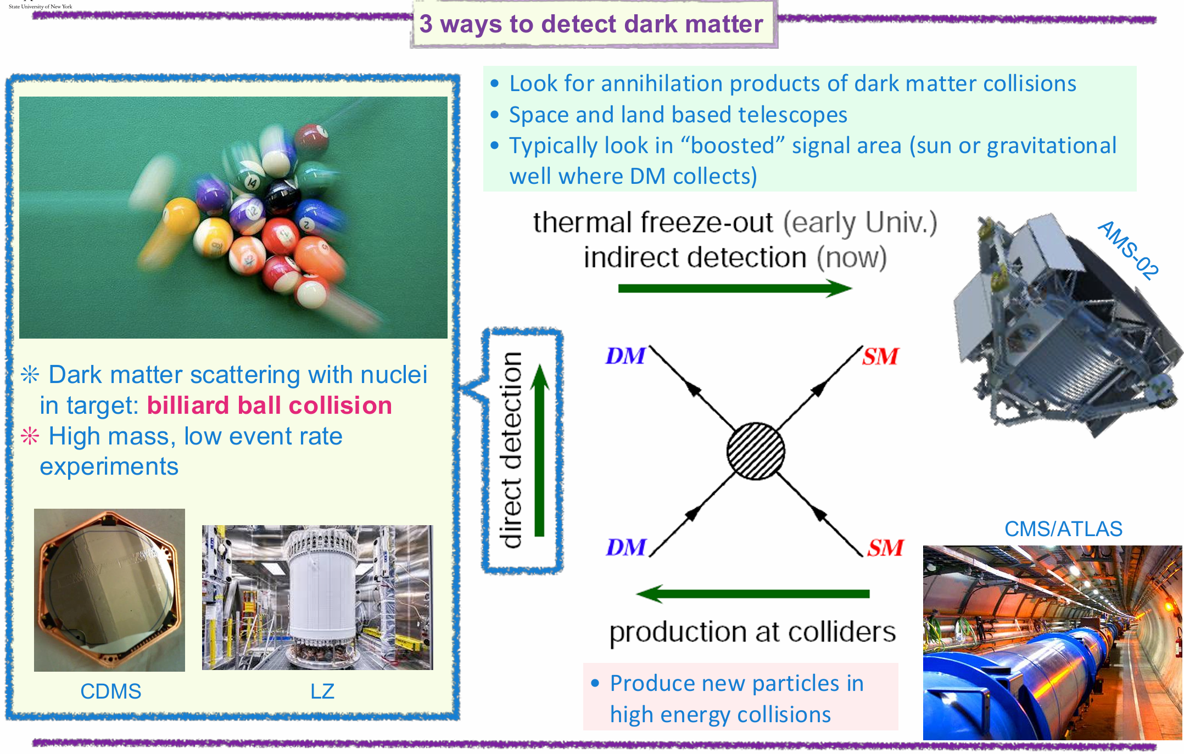
Dark matter experiments
WIMP dark matter searches, PIC-2025

Slide 6
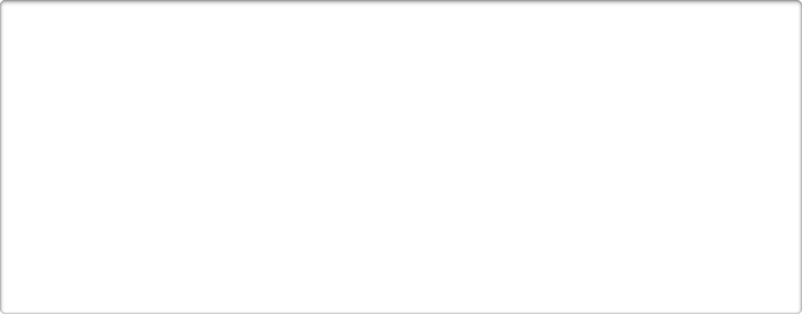
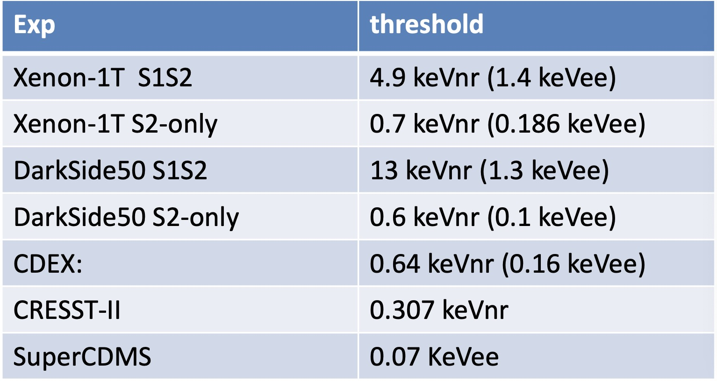
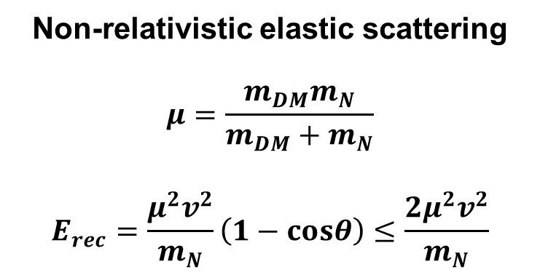


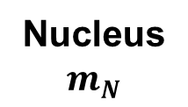
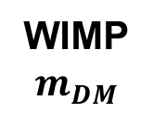
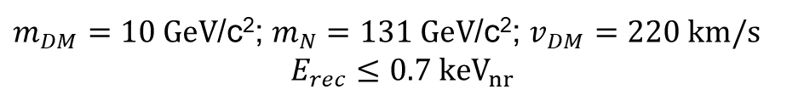
DM-nucleus elastic scattering
Non-relativistic elastic scattering
$$μ=\frac{m_{DM}m_{N}}{m_{DM}+m_{N}}$$
$$E_{rec}=\frac{μ^{2}v^{2}}{m_{N}}\left(1−cosθ\right)≤\frac{2μ^{2}v^{2}}{m_{N}}$$
$$E_{rec}$$
$$θ$$
$m_{DM}=10 GeV$/c²; $m_{N}=131 GeV$/c²; $v_{DM}=220 km/s$
$$E_{rec}≤0.7 {keV}_{nr}$$
WIMP
$$m_{DM}$$
Nucleus
$$m_{N}$$

Slide 7
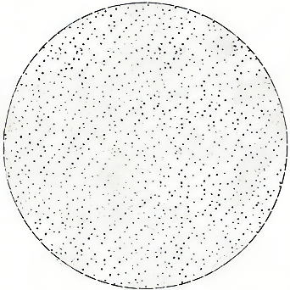
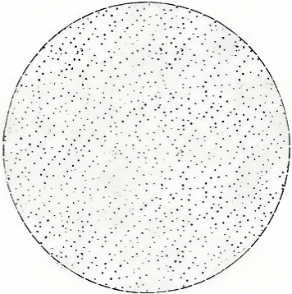
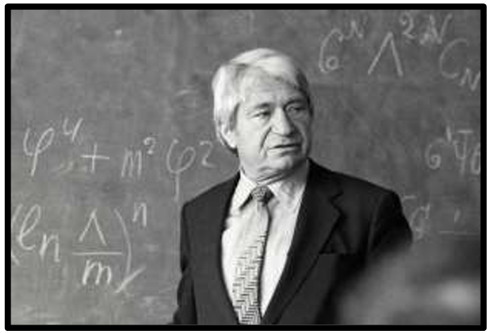
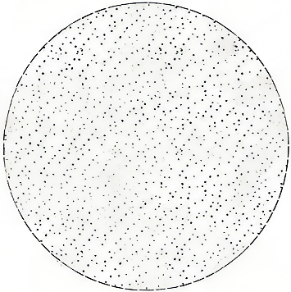
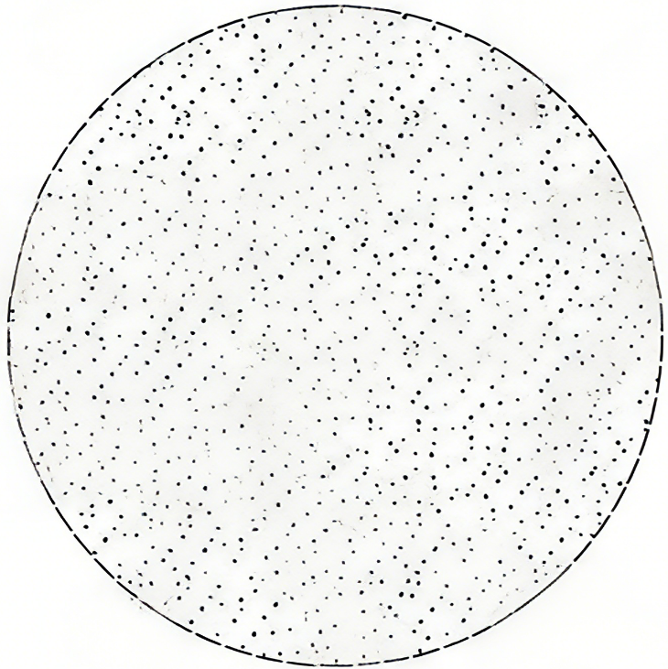
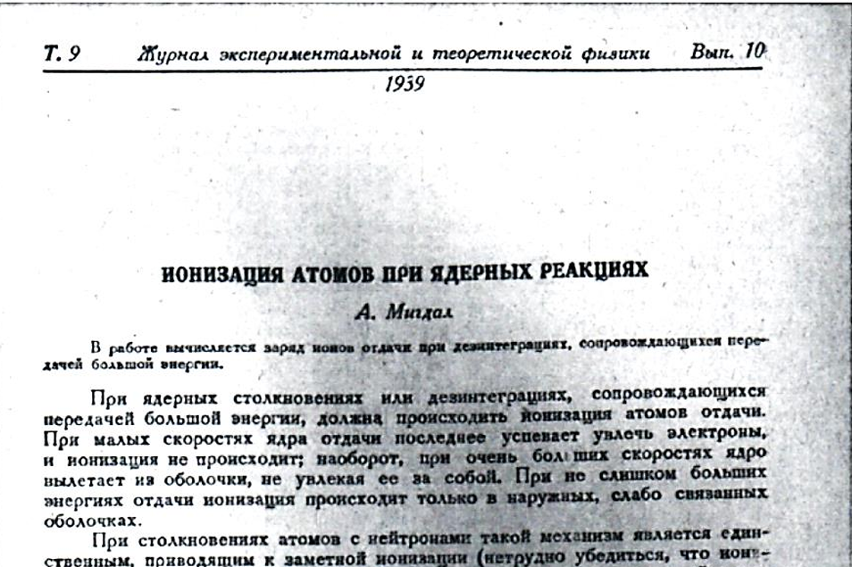





Migdal效应
$$v_{N}≫αc$$
$$v_{N}≪αc$$
$$E_{e}$$
1939年由前苏联科学家Migdal预言
$$v_{N}\sim αc$$
$$E_{N}$$
如何让核产生位移？

Slide 8
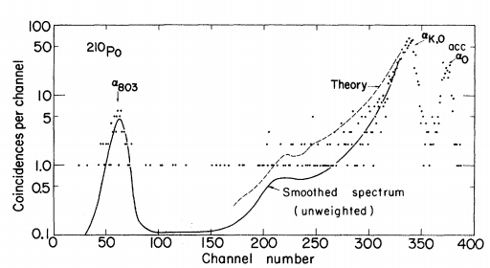
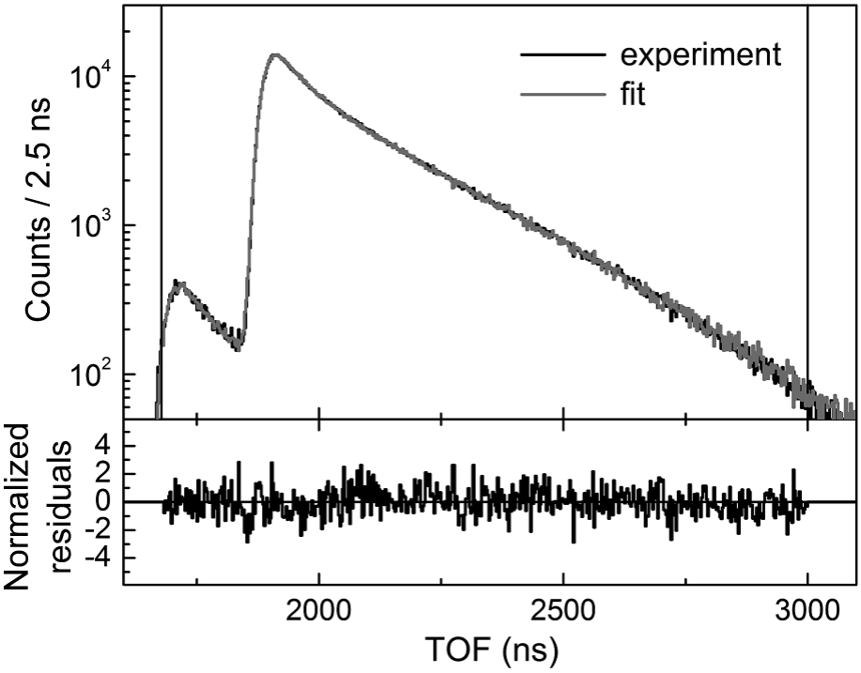
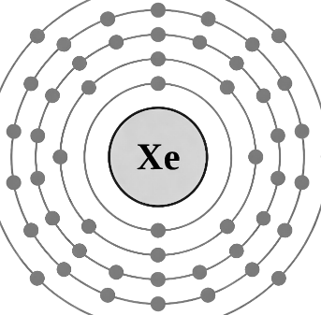




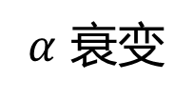




Migdal效应的间接探测证据
$α$ 衰变
PhysRevC.11.1740（1975）
$β$ 衰变
J. Phys. A: Math. Theor. 55 (2022)
PhysRevLett.108.243201（2012）
K shake off
$$210Po→4He+206Pb^{2−}$$
$$6He^{+}→6Li^{2+} or 6Li^{3+}$$
$$ν$$
$$α$$
$α$电离铅核的k层电子导致能量降低
$$e$$
$β$衰变中2价锂离子的核外电子产生3价锂离子
Pb
Li
测量的是核子信息

Slide 9
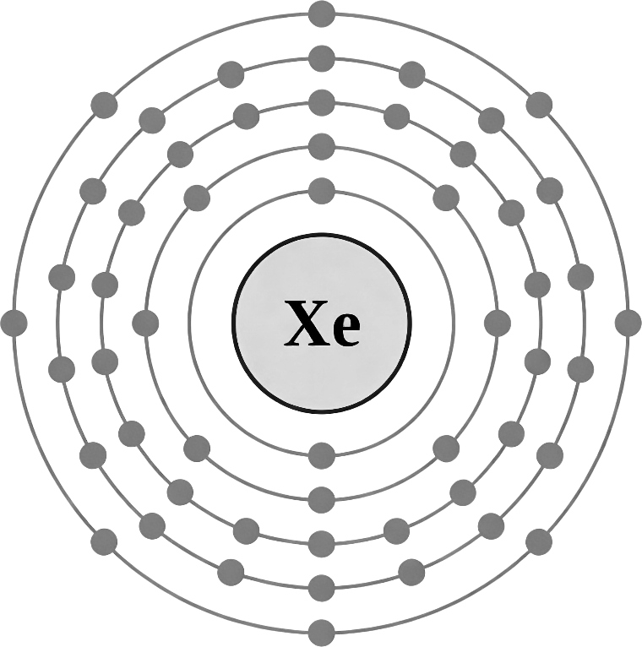
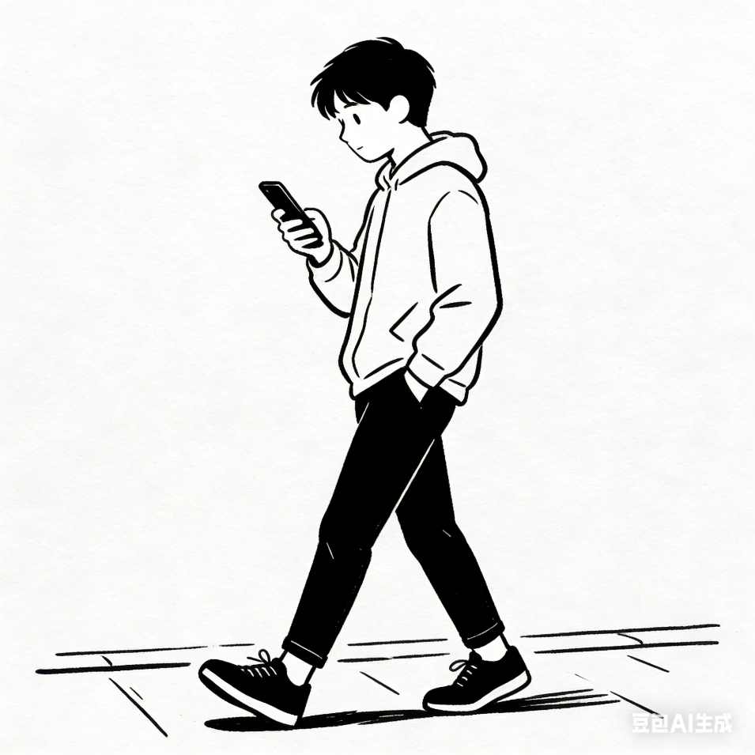
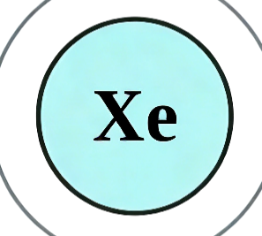



中性粒子碰撞中的Migdal效应
$$E_{e}$$
$$n/ν/χ$$
至今已有80余年，仍未有直接观测的证据

Slide 10
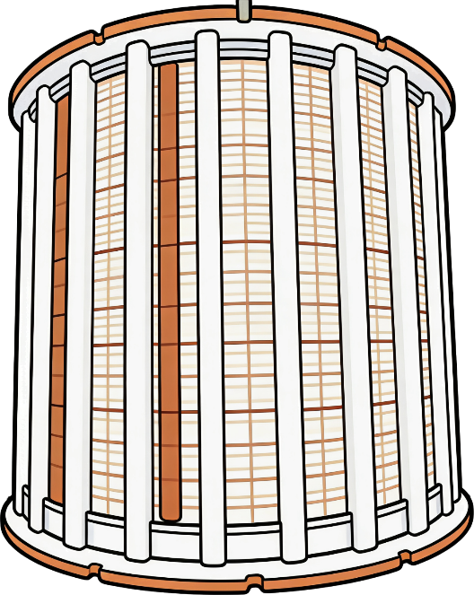
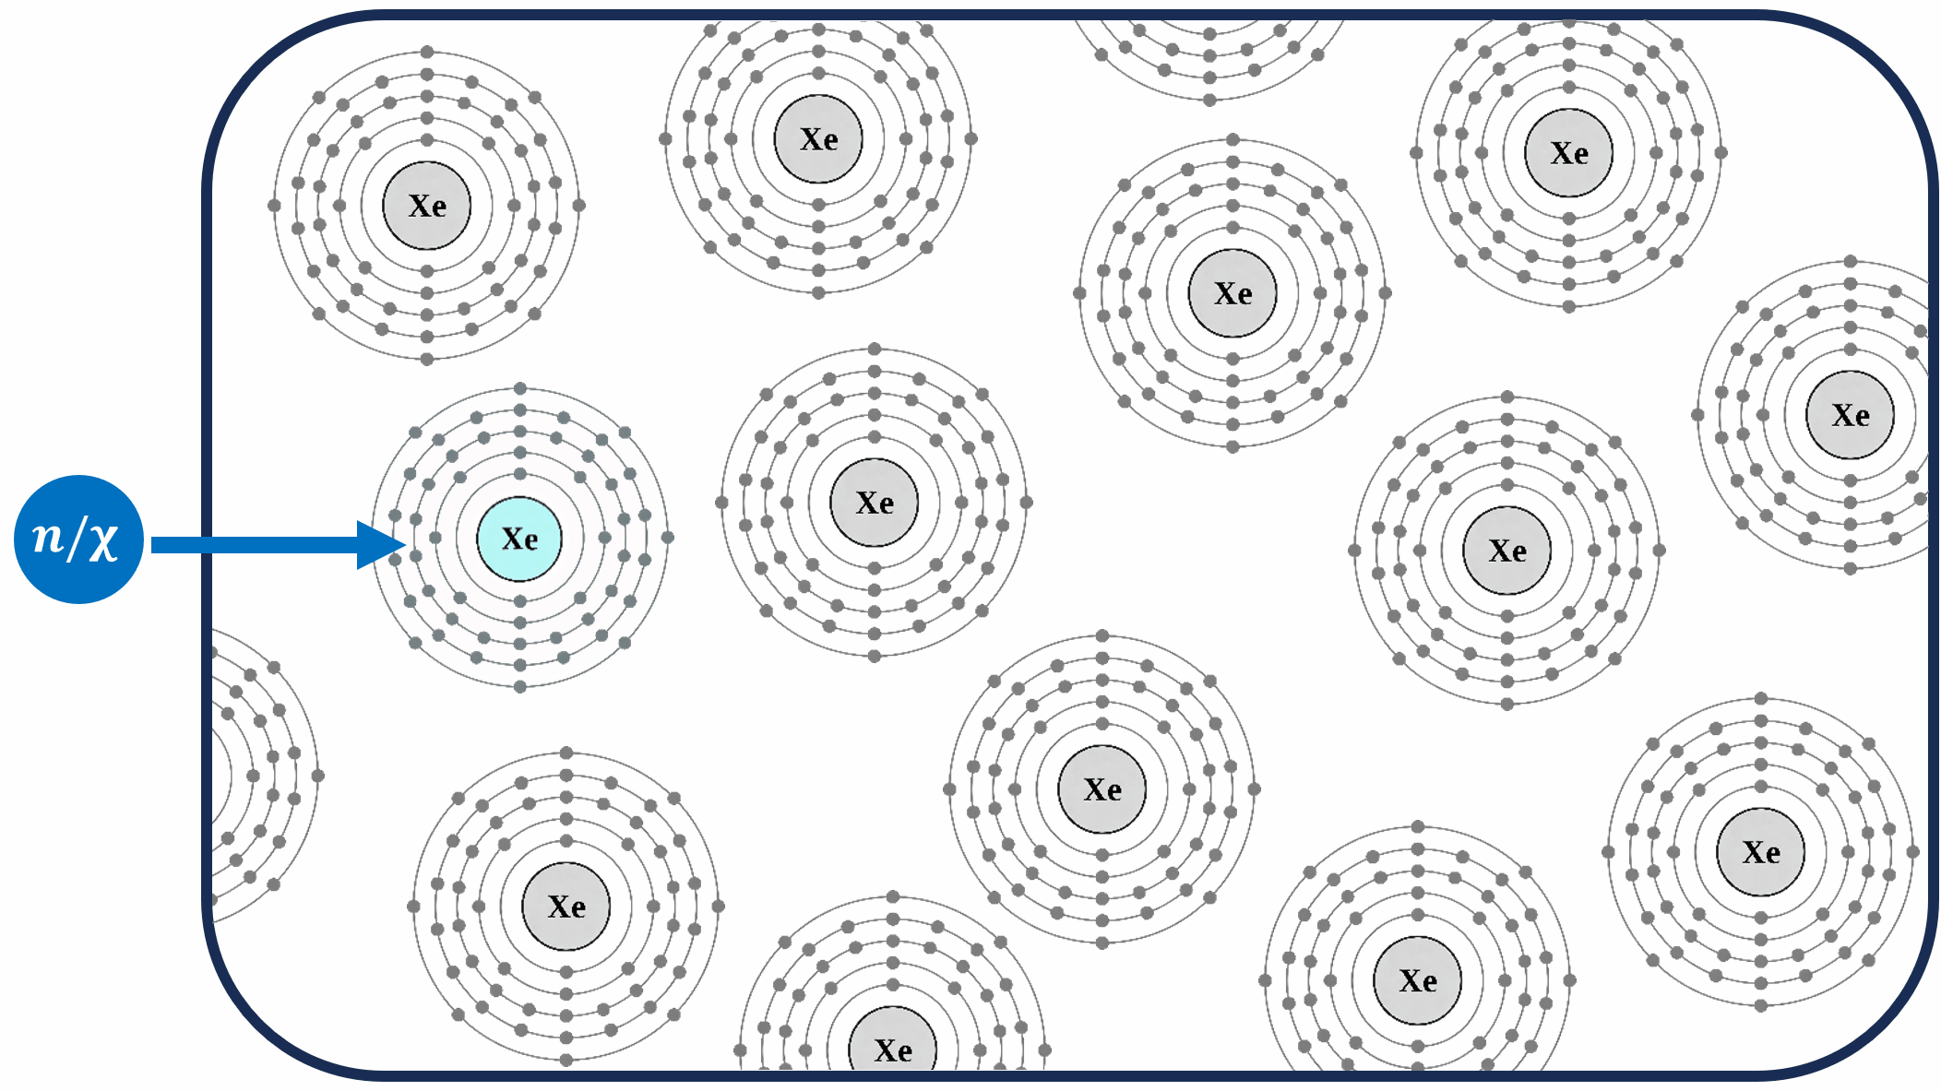
直接探测暗物质实验

Slide 11
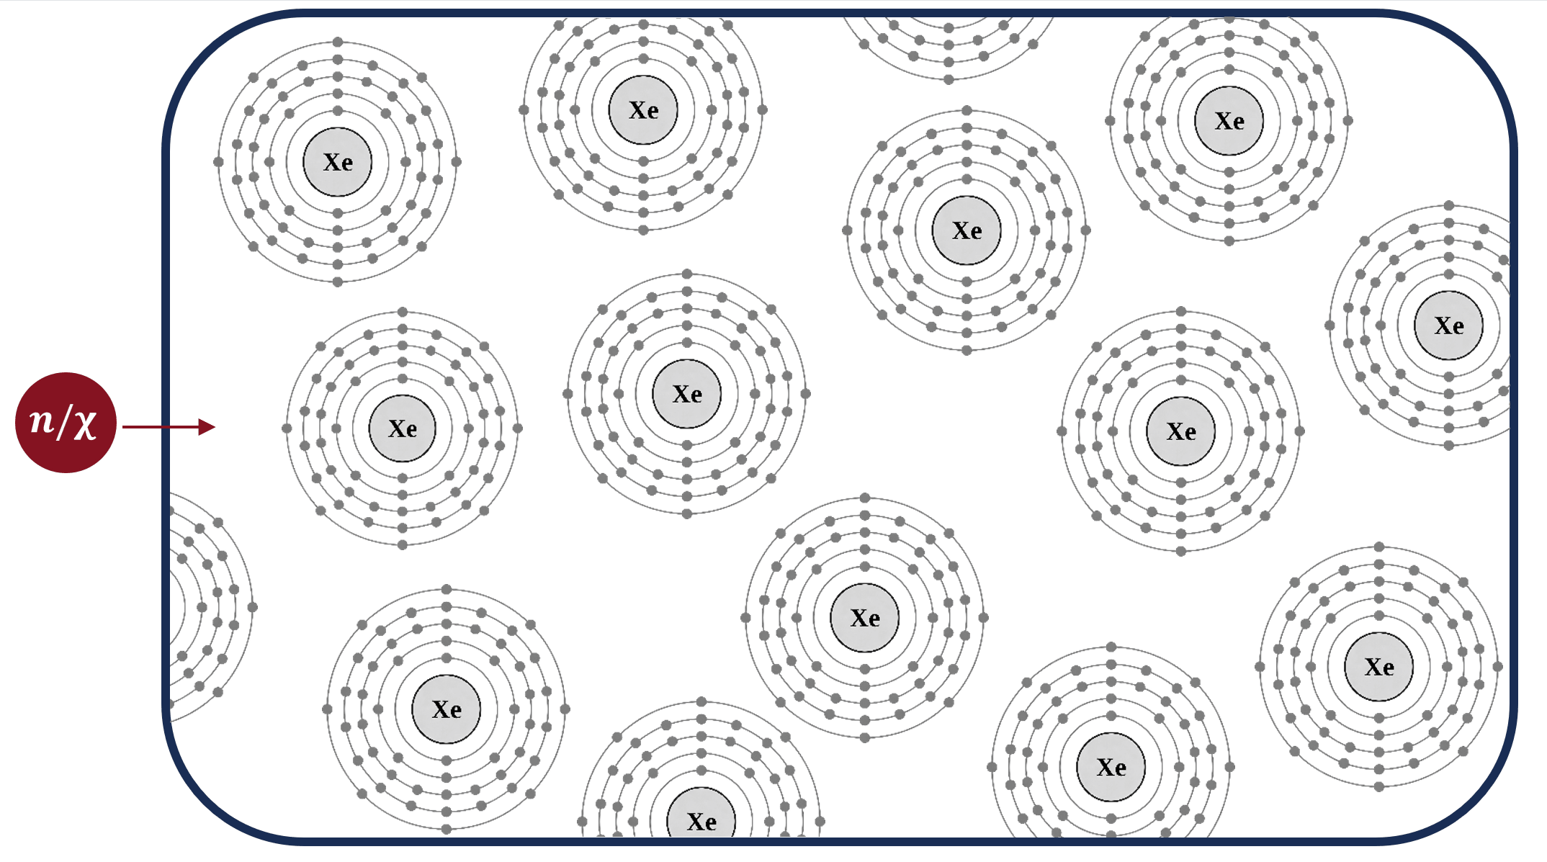
直接探测暗物质实验

Slide 12
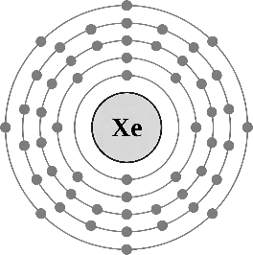
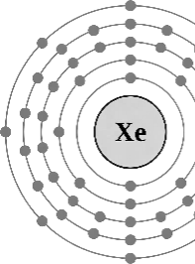
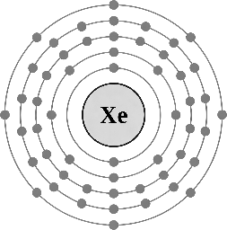
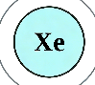
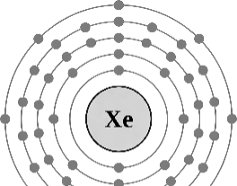



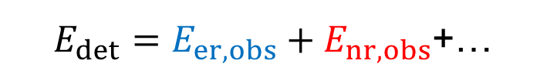
利用Migdal效应直接探测暗物质实验
$$E_{er,obs }=E_{er}−E_{bind}$$
$$n/χ$$
$$E_{nr,obs }=E_{nr}⋅ε_{QF}$$
$E_{det}=E_{er,obs}+E_{nr,obs}$+…
在低动量转移情况下仍然提供可探测信号！

Slide 13
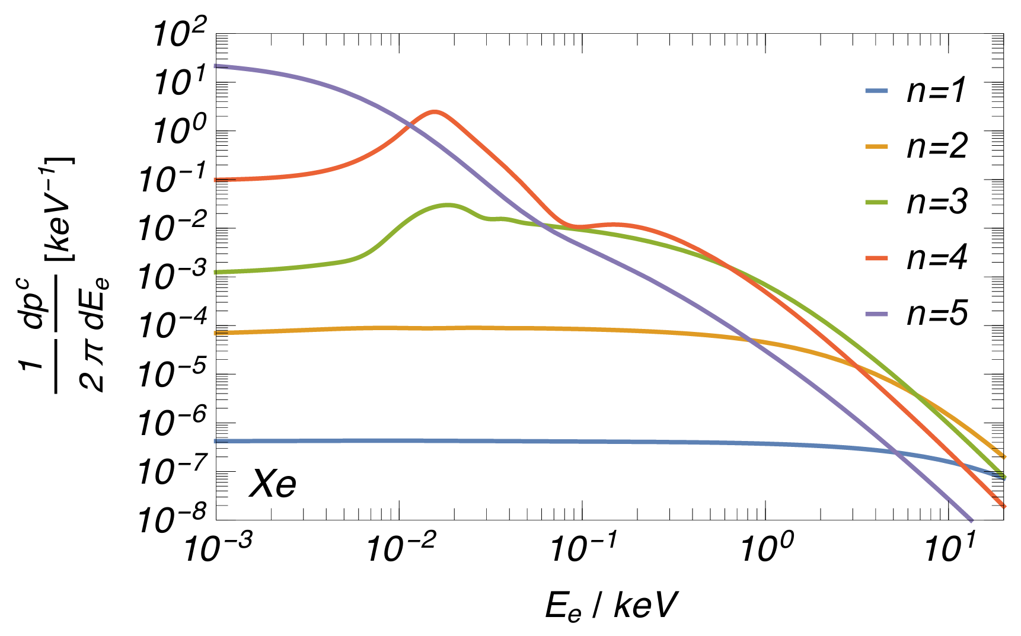
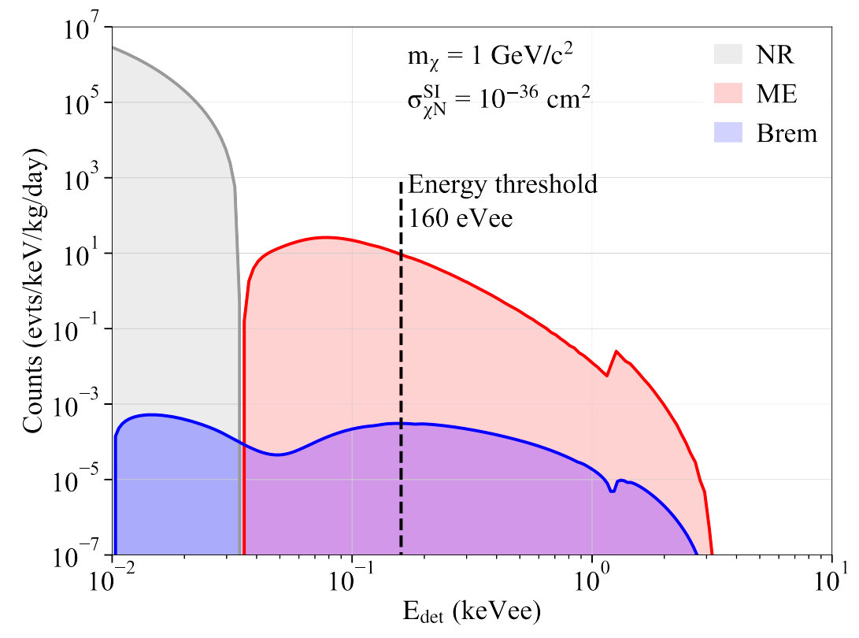
Migdal效应的特点
M. Ibe, JHEP03(2018)194
CDEX
不同轨道均可能产生Migdal电子
Migdal电子沉积能量大于核反冲能量

Slide 14
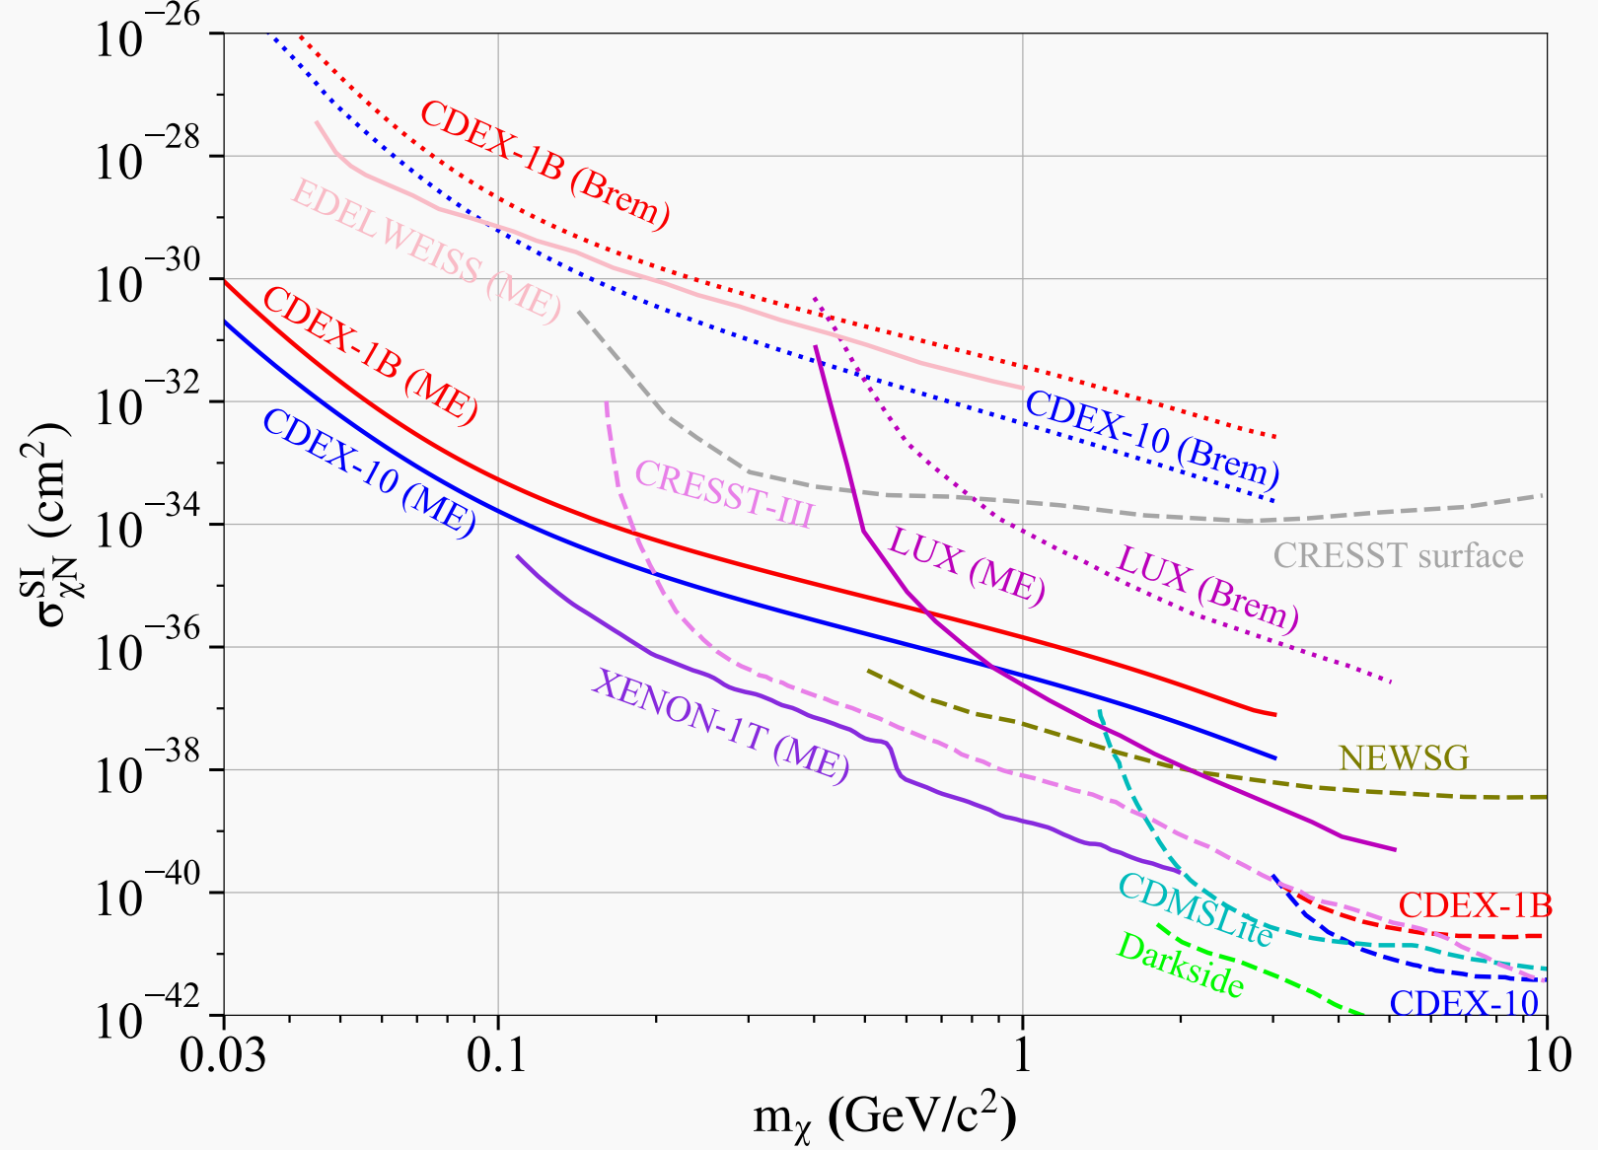
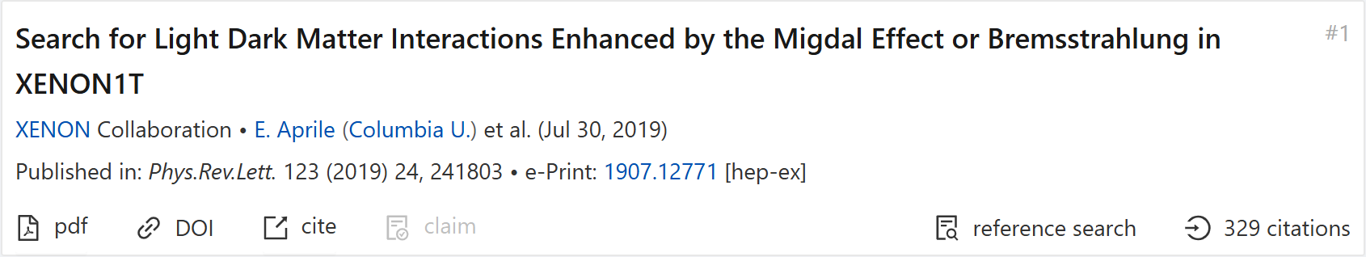
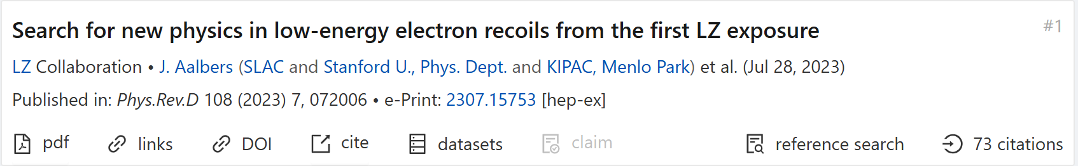
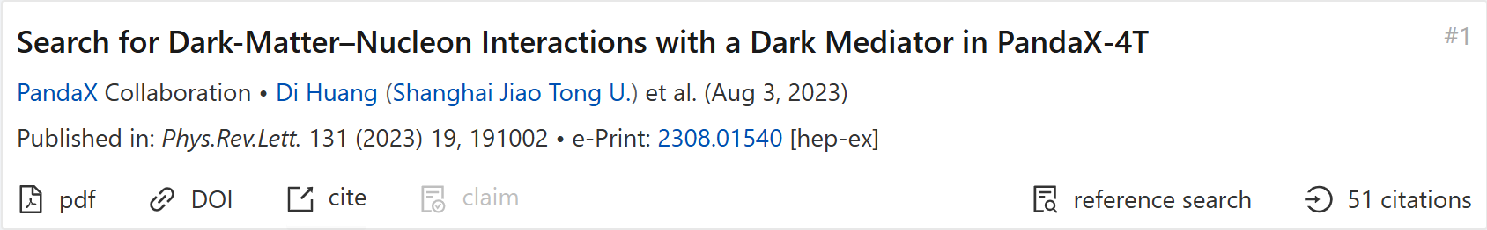
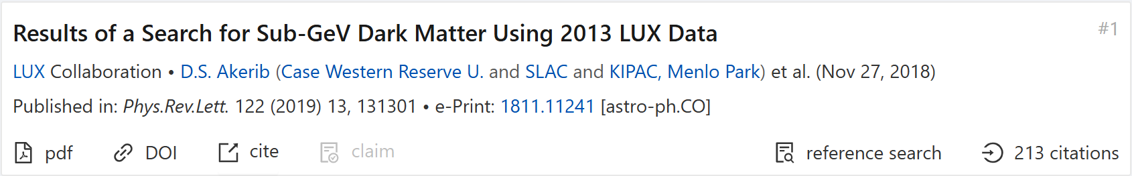
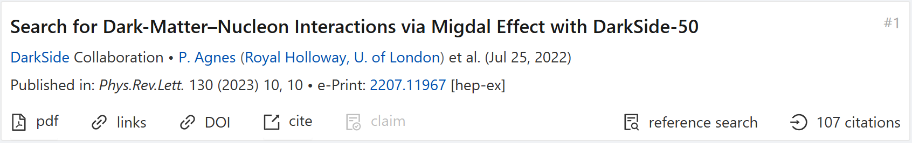
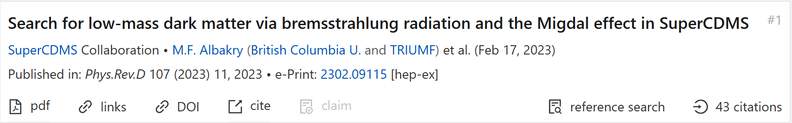
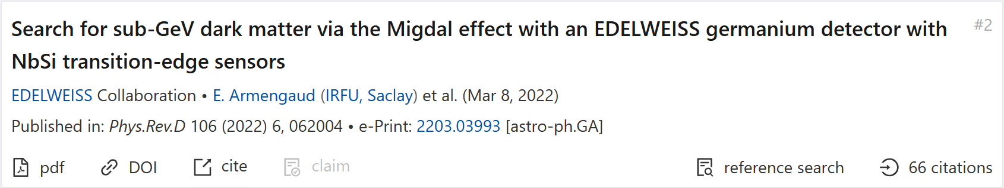
轻质量暗物质区间的探测限—由Migdal效应主导
Migdal （ME）
Bremsstrahlung (Brem)
Nuclear recoil
Z.Liu, [Phd thesis], 2022
各大暗物质实验：XENON/LZ/PandaX/CDEX/DarkSide50/SuperCDMS/EDELWEISS/LUX…

Slide 15
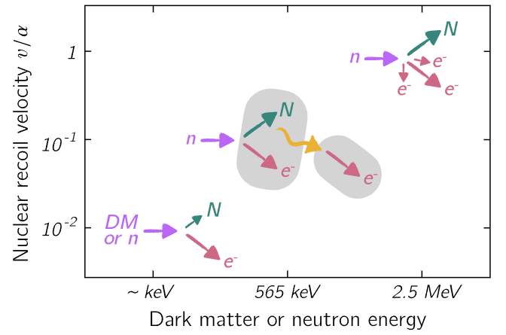
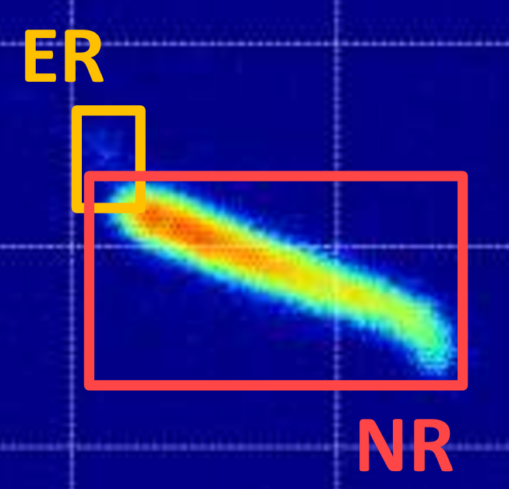






国际上中性粒子Migdal效应实验
Phys. Rev. D,107, 035032
Nr/Er的径迹成像
Phys. Rev. D, 109(5), L051101（2024）
测量沉积能量
测量cluster距离

Slide 16



Migdal事例的特征
A
电子径迹
布拉格峰
共顶点
核子径迹
B
？

Slide 17

Migdal事例的特征
电子径迹
布拉格峰
B
共顶点
核子径迹

Slide 18

对探测器的要求
核心挑战:
  信号：有效信号事例率极低
  本底：本底种类繁杂，且实验中存在大量伴生光子本底。
探测器性能要求:
  能量分辨好：电子径迹~keV，核子径迹~百keV，要求大动态范围
  空间分辨高：电子径迹仅数百微米
  有时间分辨能力：通过时间关联筛选信号，压低本底
解决方案:
  主动屏蔽：设计屏蔽体压低本底
  多维度：测量中子/光子能谱、开发蒙卡模拟、事例挑选、径迹重建、顶点重建等算法
模拟结果
e⁻
N⁺

Slide 19









MARVEL 实验装置示意
GMCP
DD neutron source
Migdal topology
Topmetal-II
GMCP
Topmetal-II
ER
NR

Slide 20





核心器件：GMCP
微结构气体探测器：GEM/THGEM、MicroMegas…
真空器件MCP并不能直接在气体下使用！
电荷累积在GEM孔内导致增益下降！
设计新工艺，在孔内制作阻性材料，释放电荷
真空器件微通道板（MCP）
运用于气体探测器（GMCP）

Slide 21







核心器件：像素芯片Topmetal
 | Topmetal-II⁻ | Topmetal-M1/M2 | Topmetal-L
Chip Size /mm² | 6 × 6 | 18 × 23 | 17 × 24
Pixel Array | 72 × 72 | 400 × 512 | 356 × 512
Pixel Size /um² | 83 × 83 | 45 × 45 | 45 × 45
ENC | ~ 13.4e- | ~ 15.4e- | ~ 20.0e-
Power Consumption | ~ 1W @3.3V | ~ 4.3W @3.3V | ~ 0.8W @3.3V
Clock | 40MHz | 5MHz | 20MHz
Frame Rate | 2.5ms | 2.4ms | 0.37ms @Sentinel Readout
Readout Mode | Rolling Shutter | Rolling Shutter | Rolling Shutter /Sentinel Readout
Readout Channel | 1 | 16 | 1
Topmetal-Ⅱ

Slide 22











Detector performance
Energy resolution
Dynamic range
Vertex resolution
Time resolution
Good linear energy response
20%-30% energy resolution(FWHM)
Energy resolution follows the relationship ~ $1/{\sqrt{E}}$
Stable gain under different count rates(no pile up)
Good linearity in charge response
~200 $μ$m vertex resolution
@ 6.4 keV
~262 $μs$ time resolution

Slide 23




Scintillator ①
D-D source monitoring
Scintillator ②
n/gamma spectrum meas.
D-D neutron source
shielding
Migdal detector
Scintillator ③
Working gas:
0.8 atm @ ~300 K
40% Helium + Dimethyl ether (DME,C₂H₆O)
D-D source monitoring

Slide 24



中子/光子能谱测量
Neutron energy spectrum
Gamma energy spectrum
0.5 MeV: e+/e- annihilation
0.8 MeV: ⁵⁶Fe
1.4 MeV: ⁴⁰K
2.2 MeV: H in polyethylene
采用液闪探测器进行中子/光子能谱测量
开发波形分析算法进行中子/光子鉴别
根据模拟及标定数据得到液闪探测器的响应矩阵；开发反卷积算法得到中子/光子能谱
Notes:
环境光子流强：139.99 cts/s/cm²

Slide 25




Neutron Flux & Detector performance monitor
neutron flux monitored by the two LS.
Gain monitored with an ⁵⁵Fe.
T & P are monitored.

Slide 26

































电子径迹与反冲核径迹
data
data

Slide 27






软件模拟框架
模拟探测器响应
提供MC模拟的truth信息
探测器的数字化模拟
模拟电子在探测器中的漂移、倍增及收集过程
模拟电子学对信号的采集及处理过程，并保存为与实验数据完全相同的格式输出

Slide 28




实验与模拟的一致性检验
6.4 keV photo-electron
²⁴¹Am alpha source

Slide 29



事例挑选
Data
YOLO*¹
preselection
NR
reconstruction
ER
reconstruction
Vertex cut
Labeling
Dataset |  | Train | Valid
Exp | ⁵⁵Fe | 3000 | 1493
 | D-D | 2994 | 1354
Sim | ER | 1200 | 301
 | NR | 1200 | 301
Total |  | 8394 | 3449
Training
*1 https://github.com/ultralytics/ultralytics

Slide 30




事例重建
Data
YOLO*¹
preselection
NR
reconstruction
ER
reconstruction
Vertex cut
1. Search for the NR vertex through recursive iteration:
2. Fit the NR(direction, diffusion σ) and subtract it from the image.
3. Search for the electron vertex using adaptive cutting algorithm(Nucl. Sci. Tech.doi:10.1007/s41365-021-00903-0).
4. Determine whether the electron vertex is adjacent to the nucleon vertex.

Slide 31


Migdal 事例

Slide 32

更多的Migdal事例！

Slide 33








全部通过YOLO识别！

Slide 34

电子与核子径迹
$$5 keV_{ee}<Ee<10 keV_{ee}, E_{nr}>35keV_{ee}$$
data
data
Migdal事例中的电子与⁵⁵Fe源的光电子样本区间一致；核反冲径迹与中子数据中核反冲控制样本一致！

Slide 35
本底估计
Background Component | Description | Expectation value (5 - 10 keV) | Method
Recoil induced δ ray | δ electron near NR track origin | 0.035±0.023(stat.)±0.0068(sys.) | Data driven
Particle Induced X-ray Emission
X-ray emission | Photoelectron near NR track origin | 0
Auger electrons | Auger electron near NR track origin | 0
Bremsstrahlung processes
Quasi-Free Electron (QFEB) | Photoelectron near NR track origin | ≈ 0
Secondary Electron (SEB) | Photoelectron near NR track origin | ≈ 0
Atomic (AB) | Photoelectron near NR track origin | ≈ 0
Nuclear (NB) | Photoelectron near NR track origin | ≈ 0
Random track coincidences | Photo-/Compton electron near NR track | 0.180±0.022(stat.)±0.042(sys.) | Data driven
Muon induced δ ray | δ electron near NR track origin | 0.013 | MC+Data
Gas radioactivity
Trace contaminants | Electron from decay near NR track origin | 0.001±0.00087(sys.) | Data driven
Neutron activation | Electron from decay near NR track origin | ≈ 0
Secondary nuclear recoil fork | NR track fork near track origin | ≈ 0
Total background |  | 0.229±0.032(stat.)±0.043(sys.)

Slide 36



1. Delta电子本底
H
N
e⁻
e⁻
n
No δ above 5 keV were found.
Estimate by extrapolating from the exponential fit
Only H has the δ electron > 5 keV.
Consider the selection efficiency for δ-electrons.
Finally get: 0.035±0.023(stat.)

Slide 37

2. 偶然符合本底
Method 1: 液闪测得的 n/γ 能谱代入GEANT4模拟
n
N
e⁻
N
e⁻
N
N*
n
n
n
e⁻
 | NR | Compton e⁻ | photonEle
I | 1 | $$4.32×{10}^{−5}$$ | $$1.06×{10}^{−5}$$
II | 1 | $$6.06×{10}^{−6}$$ | ~$3.63×{10}^{−8}$
III | 1 | $$3.11×{10}^{−6}$$ | $$7.15×{10}^{−7}$$
Gamma spectrum
Neutron spectrum
三种贡献之和为: 0.16±0.01(stat.)

Slide 38

2. 偶然符合本底
Method 2: 数据驱动的方法
  选取实验数据中的核径迹控制样本与光电子径迹在同一帧上的事例.
  考虑偶然符合在统一顶点的几率,得到最终本底结果为： 0.180±0.022(stat.)±0.042(sys.)
Method 1
keV
方法一与方法二的结果在统计误差范围内一致。

Slide 39




显著度
Background:0.229±0.032(stat.)±0.043(sys.)
定义概率密度函数
$$f\left(x,y | μ,b\right)={\frac{{\left(μ+b\right)}^{x}}{x!}e}^{−\left(μ+b\right)}⋅\frac{1}{\sqrt{2π}σ_{b}}\exp\left(−\frac{{\left(y−b\right)}^{2}}{2σ_{b}^{2}}\right)$$
构造最大似然函数
$$L\left(μ,b | x,y\right)=\prod_{i=1}^{n}{​f\left(x,y | μ,b\right)}$$
假设检验
  $H_{0}:μ=0$ versus $H_{a}:μ≠0$
在该本底水平下，观测到5.77个事例达到5σ

Slide 40





相对截面计算
Migdal过程截面与核反冲截面的比值:
参数:
上下限的计算方式:
最终结果:

Slide 41







总跃迁几率
$$\sum_{nl}{\frac{dp^{i}\left(nl→E_{e}\right)}{dE_{e}}}$$
初态为 $(n,l)$ 的电子跃迁到具有 $E_{e}$ 能量末态的几率.
$$H$$
$$He$$
$$C$$
$$O$$
每种元素的跃迁几率
总跃迁几率
41

Slide 42





总结
六家单位均为 BESIII 合作组成员单位。
中国科学院大学、广西大学、华中师范大学、兰州大学的相关核心教师，均具备 BESIII 等对撞机实验的科研工作经验。
项目组参与培养的马瑞廷、景新媚、黄文谦等多位学生，亦依托 BESIII 等对撞机实验完成学业与科研训练。
向 BESIII 实验组致以诚挚感谢！
谢 谢！

Slide 43
Backup

Slide 44


Cross section
He
Xe
Nr [MeV]
Nr [MeV]
Er [keV]
Er [keV]

Slide 45



Migdal Effect
arXiv:1711.09906v2
$$E_{nr,max}≤\frac{2μ^{2}v_{DM}^{2}}{m_{N}}$$
$$E_{er,max}≤\frac{1}{2}μv_{DM}^{2}$$
$m_{N}=131 GeV$/c²; $v_{DM}=220 km/s$
The electronic energy is much easier to detect than the nuclear recoil energy, especially in light DM region.
Nr + QF》补充quenching factor的内容

Slide 46






DM-nucleus elastic scattering
Non-relativistic elastic scattering
$$μ=\frac{m_{DM}m_{N}}{m_{DM}+m_{N}}$$
$$E_{rec}=\frac{μ^{2}v_{DM}^{2}}{m_{N}}\left(1−cosθ\right)≤\frac{2μ^{2}v_{DM}^{2}}{m_{N}}$$
$$E_{rec}$$
$$θ$$
$$v$$
$m_{DM}=10 GeV$/c²; $m_{N}=131 GeV$/c²; $v_{DM}=220 km/s$
$$E_{rec}≤0.7 {keV}_{nr}$$
WIMP
$$m_{DM}$$
Nucleus
$$m_{N}$$

Slide 47






Migdal Effect
$$E_{e}$$
e
First predicted by Migdal in 1939-1940
$$n/χ$$
Nucleus
$p_{i}$_{Initial momentum in the CMF}
$p_{f}$_{final momentum in the CMF}
$$\frac{{\left|p_{f}\right|}^{2}}{2μ}=\frac{{\left|p_{i}\right|}^{2}}{2μ}−E_{e}>0$$
$$E_{e,max}=\frac{1}{2}μv_{DM}^{2}$$

Slide 48

Simulation
The cross sections for nuclear interaction and electromagnetic interaction are from Geant4
The theoretical Migdal cross sections for Ar/C/F/Ge/He/Kr/Ne/Si/Xe nuclei are available.

Slide 49



Energy distribution of recoil nuclei
Recoil kinetic energy distribution
dE/dX distribution
The recoil energy range of different nucleons is mainly in the interval of hundreds of keV to MeV.
Different nucleons exhibit differences in their distribution peak positions, and the total contribution curve shows a good fit with the experimental data.

Slide 50


Adaptive cutting algorithm
Determine the economic center of gravity and its trajectory based on ignition point and energy deposition.
Calculate the sign of, $M_{d}$, $M_{d}=\sum_{point}{\left(d^{3}×q\right)}$, determine the head and tail(Bragg peak) of the trajectory
Slide a perpendicular line along the center of gravity, compute the second-order moment M₂ to measure trajectory curvature, and truncate at the point of maximum M₂ change for a straightened path.
Recalculate the center of gravity and its line for the truncated trajectory to identify the photoelectric interaction point and emission direction.
Incident direction

Slide 51



Bremsstrahlung processes
Process name | Energy Region | Mechanism
Quasi-Free Electron Bremsstrahlung, QFEB | Low | The electrons are scattered in the Coulomb field of the recoiling ion.
Secondary Electron Bremsstrahlung, SEB | Intermediate | The excited electrons interact with other atoms.
Atomic Bremsstrahlung, AB | Higher | The electrons are excited to highly bound states or the continuum and then return to their initial state.
Nuclear Bremsstrahlung, NB | Highest | The Coulomb scattering between the recoiling ion and the target atoms.
ratio of brem photons(E>5keV) and NR
Numb of photoelectron from simulation
Bremsstrahlung background is negligible.

Slide 52
Muon induced δ ray
Adopt Local Cosmic Muon Flux Measurement Results
  The local cosmic muon flux measurement(Liu,G.,et al, 2024) in Lanzhou is used for estimation.
Set Nuclear Recoil Rate Benchmark and Calculate δ-ray Ratio
  Set the nuclear recoil rate of the D-D neutron source as 1.4 event per second, and in the 5-10 keV energy range, considering the detector's energy resolution, calculate the ratio of δ-ray production to nuclear recoil as 1.85×10⁻⁵.
Considering random track coincidence
Include detector’s muon exclusion efficiency
Normalize to the number of experimental data points and determine that δ-rays contribute 0.013 events.

Slide 53


Trace contaminants
The working natural abundance:
  ³H:(6.38±6.38)×10⁻⁸ Bq
  ¹⁴C:(4.58 ± 4.58)×10⁻⁵ Bq
β decay between 5-10 keV:
  ³H:(2.29±2.29)×10⁻⁸ /s
  ¹⁴C:(2.59±2.59)×10⁻⁶ /s
β decay between 5-10 keV contributed by the ²²²Rn decay chain:
  (7.25 ± 0.94) × 10⁻⁷ /s
Combined with the natural abundance values of the working gas:
  (3.34 ± 2.71) × 10⁻⁶ /s
GEANT4 simulation of trace radioactivity generating 5-10 keV pseudo-Migdal events yields a selection efficiency of 11.4%
The final expectation for the background contribution from trace radioactivity is: 0.001 ± 0.001.
The detector's alpha decay count rate
The decay chain of ²²²Rn
Assuming:
  All alpha rays are attributed to the decay chain of ²²²Rn.
  The secondary nuclides with a half-life of less than 1 year have completely decayed.
  Decay process ultimately ceases at ²¹⁰Pb.

Slide 54



Electron momentum transfer models
a. The approximate treatment of the Original Migdal’s method
Nuclear rest frame, the electronic cloud state:
$$\left|Φ_{ec}^{′}\right\rangle =e^{−im_{e}∑_{i} v⋅{\overset{ˆ}{x}}_{i}}\left|Φ_{ec}\right\rangle$$
Nucleus recoil
Separate treatment of final-state ionization& nuclear recoil
Obscure energy-momentum & probability conservation
Ionization probability :
$$𝒫={\left|\left\langle Φ_{ec}^{∗}∣Φ_{ec}^{′}\right\rangle \right|}^{2}$$
(Ibe,IBS,2017)
Ionized eigenstate
b. From Nuclear Recoil to Atomic Recoil (Ibe, 2023)
$$iT_{FI}≃F_{A}\left(q_{A}^{2}\right)ℳ\left(q_{A}^{2}\right)×Z_{FI}\left(q_{e}\right)×i{(2π)}^{4}i\left(p_{F}−p_{I}\right)$$
Electron cloud transition
Nuclear scattering
Atom scattering coherently
Manifested conservation relation
Notes:
这一页简单介绍电子动量/能量转移的物理模型。

Slide 55



Ionization probability
Under Dirac-Hartree-Fock approximation:
$$Z_{FI}\left(q_{e}\right) \sim \underset{σ∈S_{N_{e}}}{\sum{ }} sgn\left(σ\right)\overset{N_{e}}{\underset{i=1}{\prod{ }}} \overset{4}{\underset{α_{i}=1}{\sum{ }}} \int{d^{3}}x_{i}φ_{o_{σ\left(i\right)}^{F}}^{α_{i}∗}\left(x_{i}\right)e^{−iq_{e}⋅x_{i}}φ_{o_{i}^{I}}^{α_{i}}\left(x_{i}\right)$$
Orthogonality:
$$\overset{4}{\underset{α=1}{\sum{ }}} \int{d^{3}}xφ_{o}(x{\left.)\right.}^{α∗}φ_{o^{′}}^{α}\left(x\right)=\left\{\begin{aligned}&δ_{nn^{′}}δ_{κκ^{′}}δ_{mm^{′}} && (bounded) \\ &\left(2π\right)δ\left(E−E^{′}\right)δ_{κκ^{′}}δ_{mm^{′}} && (unbounded) \end{aligned}\right.$$
Differential ionization probability
$$\frac{d}{dE_{e}}p_{q_{e}}^{i}\left(nl→E_{e}\right)=\frac{ω_{n,l}}{ω_{max}}\underset{spins}{\sum{ }} \left|−iq_{e}⋅\left\langle E_{e}κ^{′}m^{′}\right|x\right|nκm\left. \right\rangle | ^{2}$$
Notes:
这一页主要简单介绍何计算电子跃迁概率。在DHF近似中(用平均场代替电子与电子间的相互作用)，多电子原子状态被近似为一个Slater行列式,这里的Φ满足所有的量子数正交关系。

Slide 56



Migdal cross section
Under the soft limit, the neutron migdal effect scattering cross section can be factorized into two parts:
$$\frac{dσ_{Migdal}}{dE_{r}dE_{e}}=\sum_{i}{\left[\frac{dσ_{s}^{i}}{dE_{r}}⋅\sum_{nl}{\frac{dp^{i}\left(nl→E_{e}\right)}{dE_{e}}}\right]}$$
Migdal transition probability
neutron-nucleus cross-sections
mainly elastic scattering @ 2.5MeV
Sum up for each atom
Single atom approximation for $E_{n}$
The experiment detects the ratio of the Migdal cross-section to the neutron scattering cross-section.
$$\frac{dp_{Migdal}}{dE_{r}dE_{e}}=\frac{1}{σ_{tot}}\sum_{i}{\left[\frac{dσ_{elastic}^{i}}{dE_{r}}⋅\sum_{nl}{\frac{dp^{i}\left(nl→E_{e}\right)}{dE_{e}}}\right]}$$
Total cross section for n scattering

