Slide 1
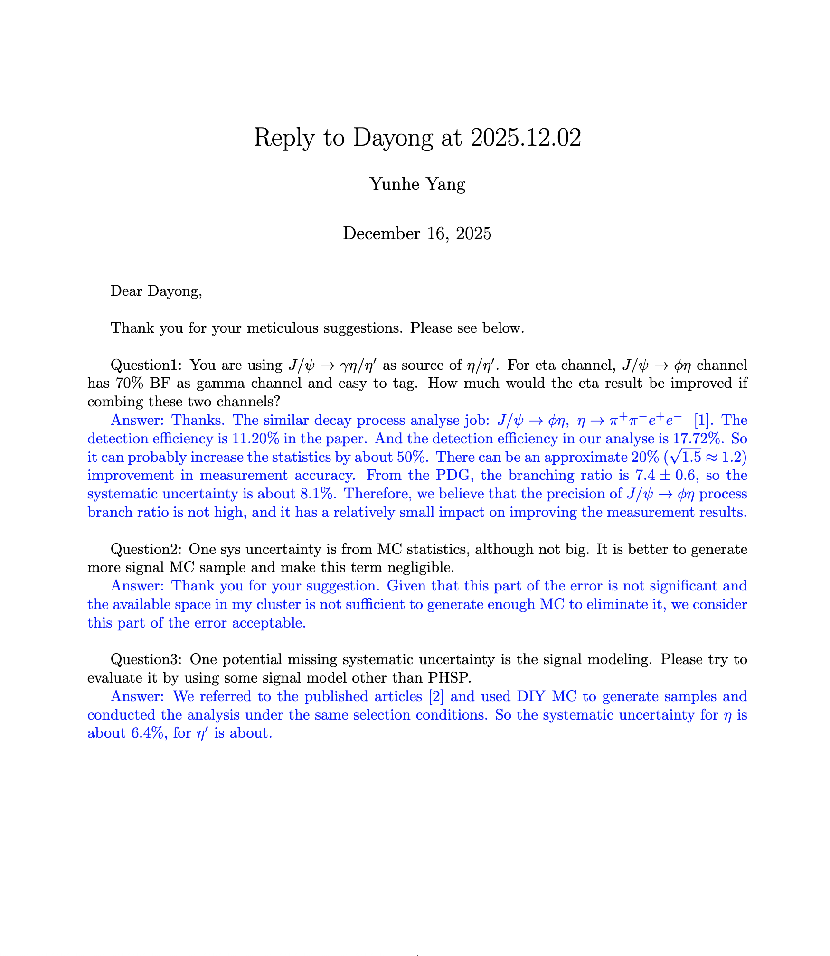
CLFV
Finish Prof. Wang Dayong’s question.
Next week：
  Reply on hpyernews

Slide 2
CPV
Professor Wang has not finished checking our memo, so we still need to wait a few days.

