Slide 1
The Step to Detect Cherenkov
Step 1: the Cherenkov light must reach the Anode
this step transform the light signal into the electronic signal
Note : The material of Anode should be considered.
Step 2:the electron will cross the region of MCP
this step will lead the number of electron prosper.
Step 3:Readout of signal by Topmetal
The Topmetal is one readout chip or silicon pixel chip.

Slide 2
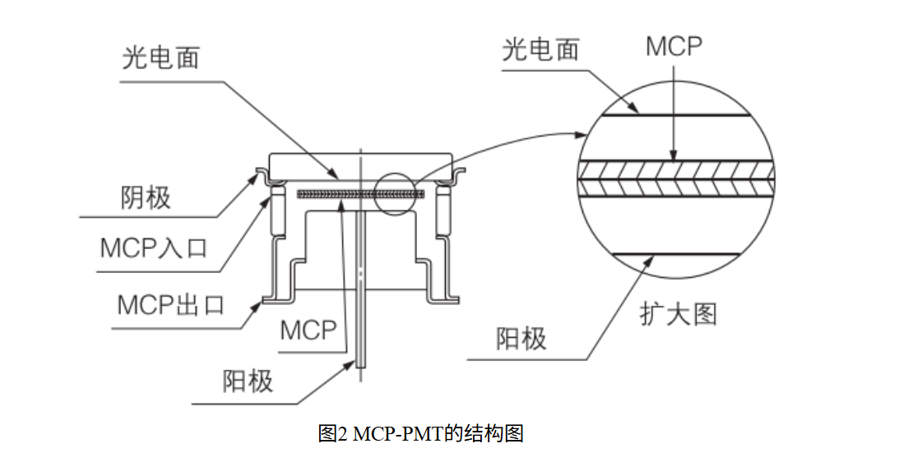

Slide 3
