Slide 1
Weekly Report
Minghao Li 2025.12.16

Slide 2


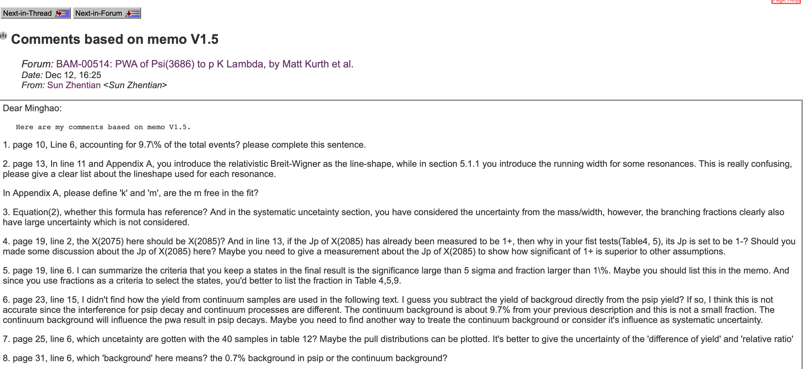
Weekly Report
Current working:
1. Regarding the 3.773 GeV data sample, run 0.5 times of the inclusive MC.
2. Preparing Prof. Sun's question and updated the memo.

