Slide 1
Producing and detecting long-lived particles at different experiments
at the LHC
Huaqiao Zhang(IHEP)
19 Apr. 2026
JHEP 02 （2022） 069
对撞机上新物理寻找 @ 南京大学苏州校区

Slide 2
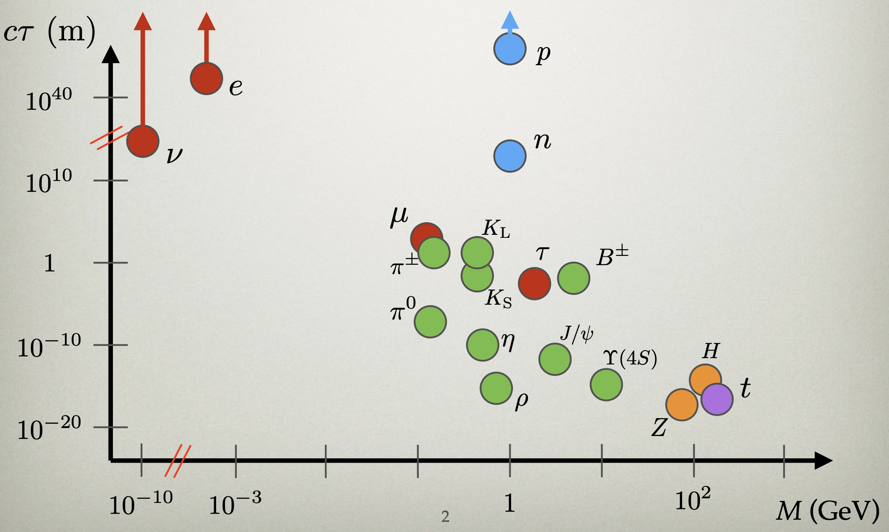
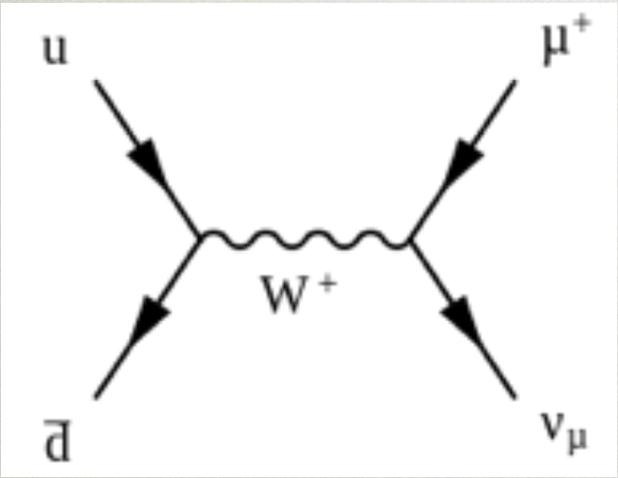
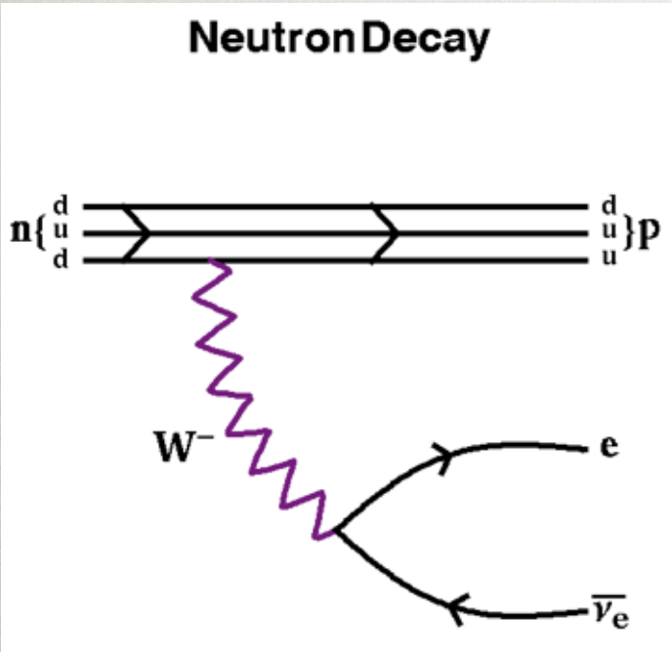
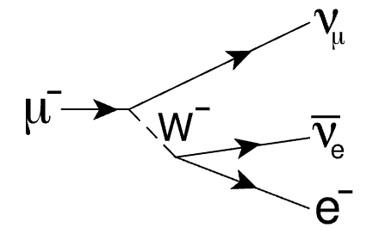
Searching for long-lived particles (1)
Long-lived particles generically exist in SM
And many extensions of SM
  SUSY, Hidden vector…
Discovery of BSM LLP indicate new hierarchies or old hierarchies in new places
Mass degeneration

Slide 3
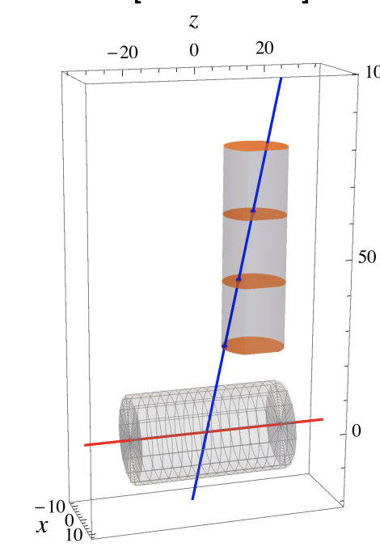
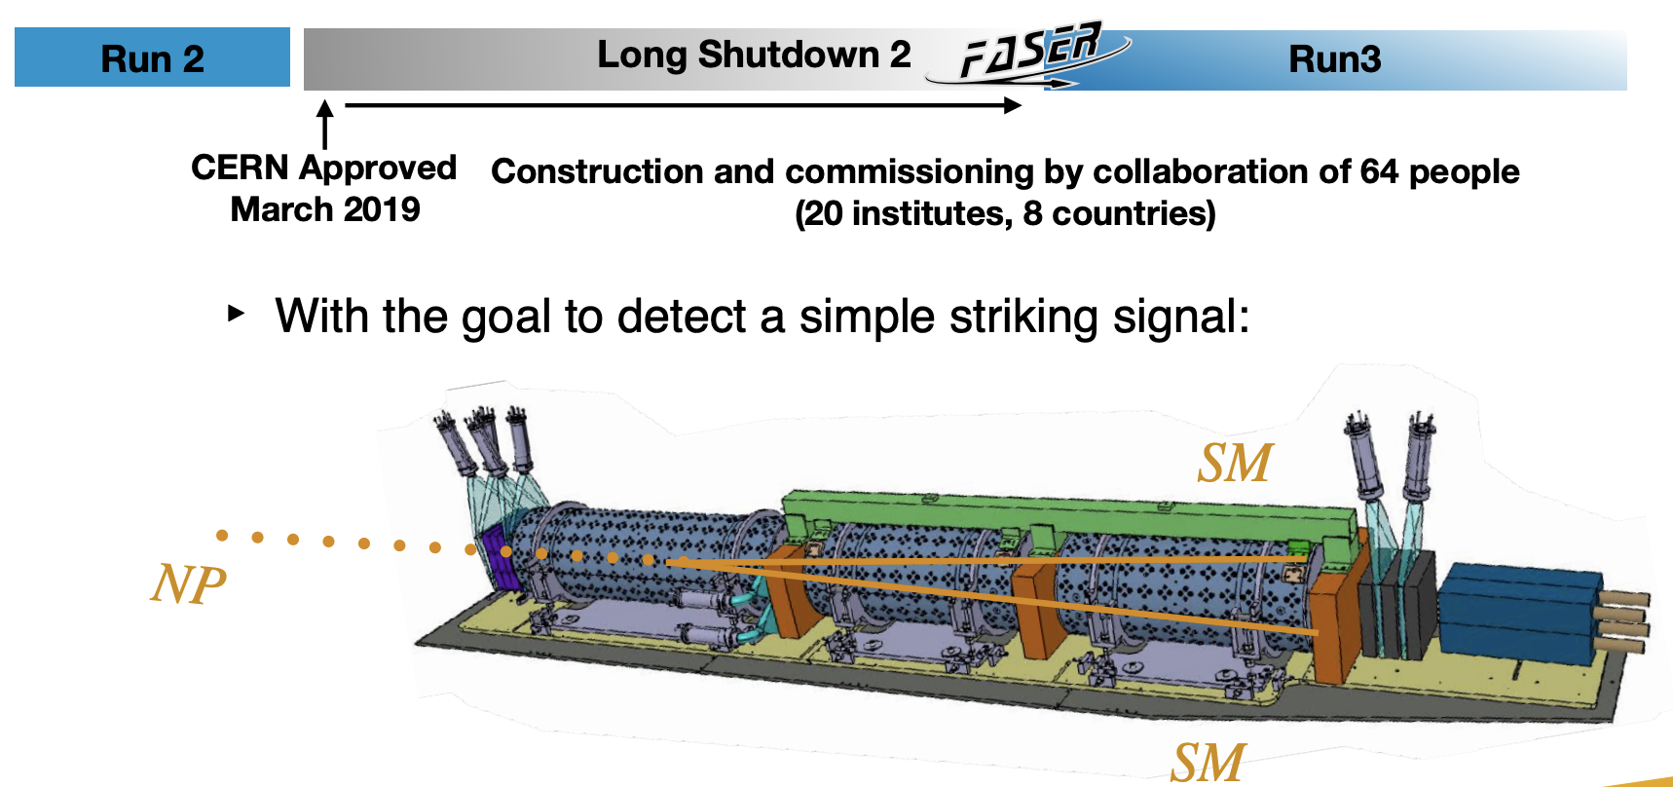
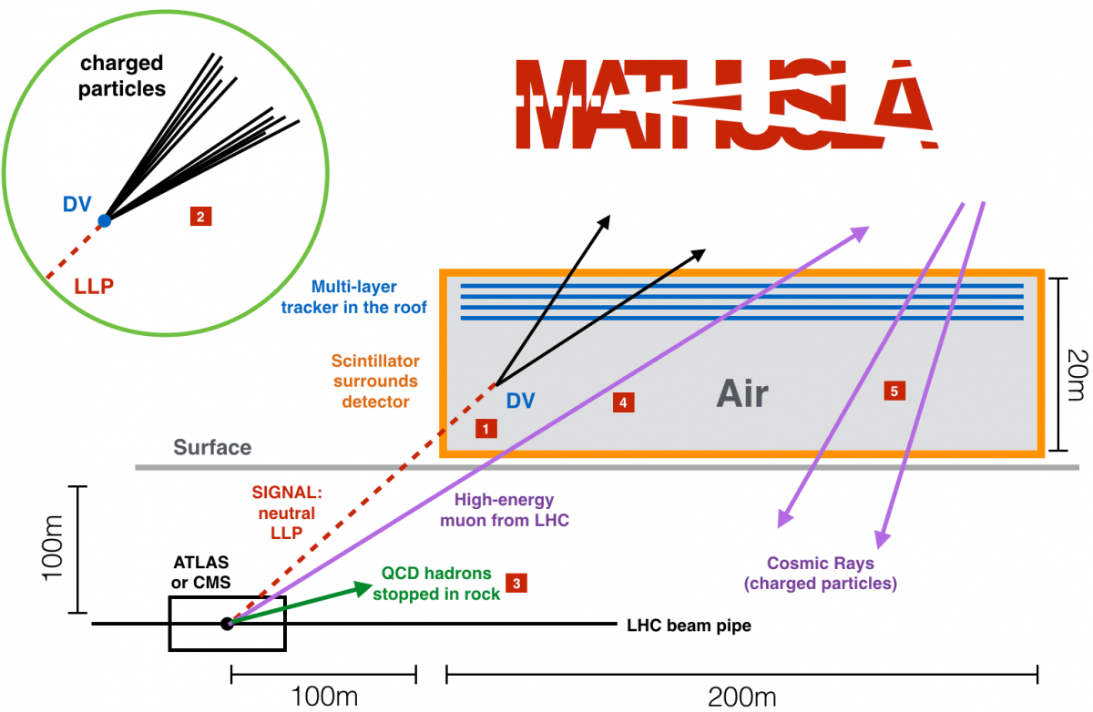
Searching for long-lived particles (2)
Search strategies roughly fall into two categories:
  New search/trigger strategies:
LHCb with VELO/RICH, timing trigger
Forward Spectrometer, CMS High Granularity Calorimeter
  Adding new modules:
FASER, MATHUSELA, CODEX-b, ANUBIS,
MoEDAL with MAPP/MALL/SHiP…
Phys. Lett. B 767 (2017) 29
ANUBIS
1909.13022
FASER

Slide 4
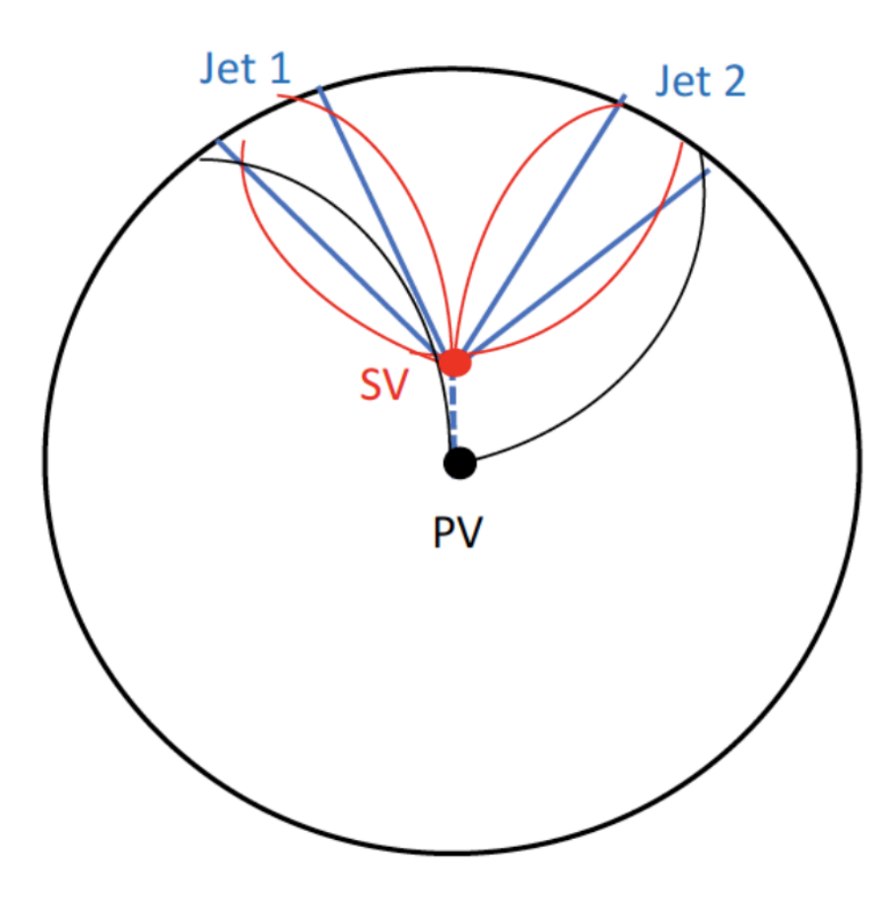
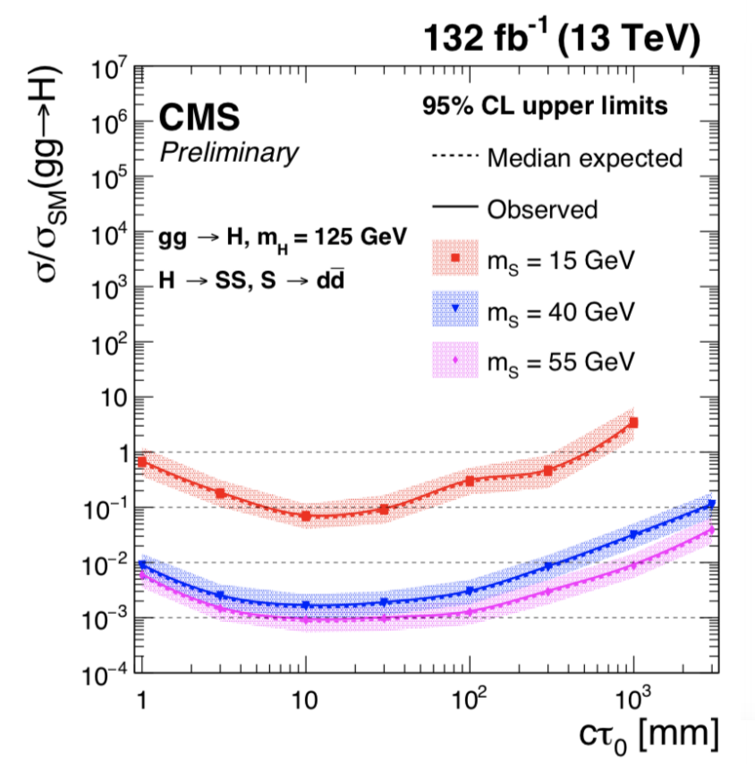
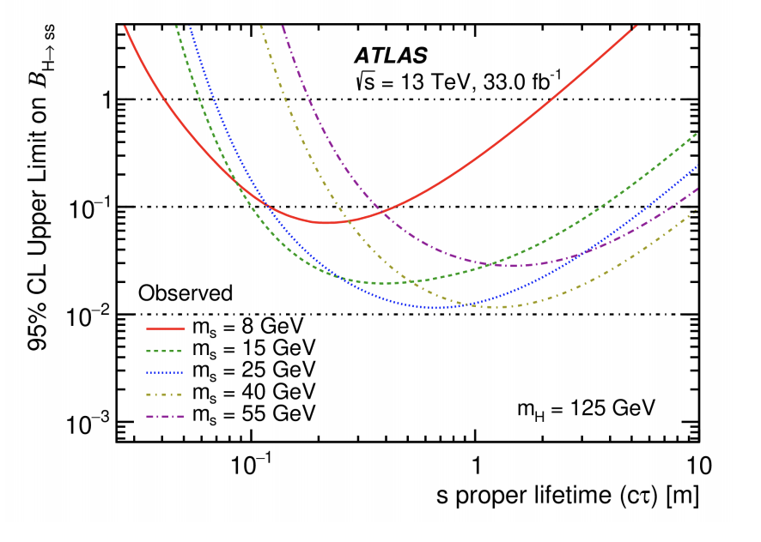
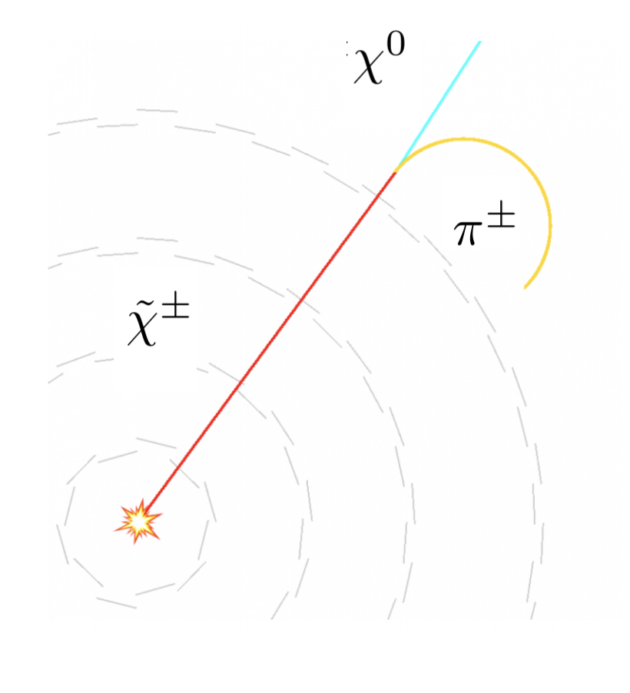
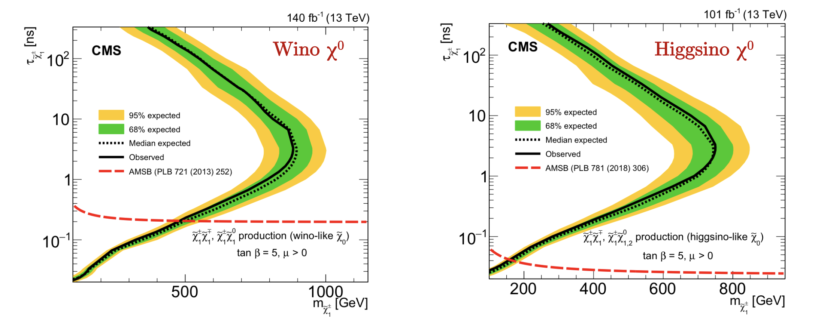
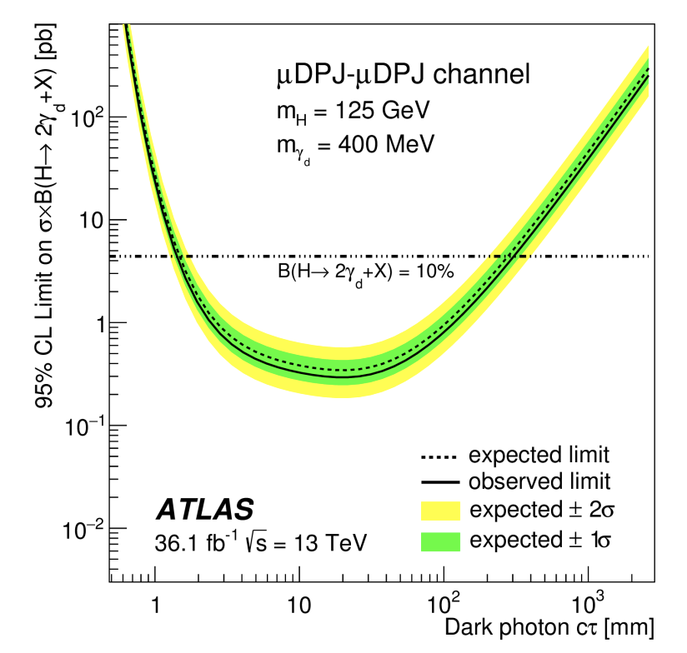
LLP at ATLAS/CMS
CMS/ATLAS
CMS-PAS-EXO-19-021
PRD 101(2020) 052013
CMS
1909.01246
2004.05153

Slide 5
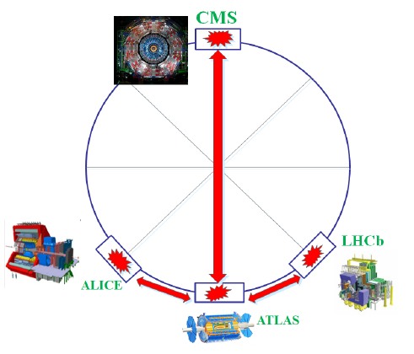
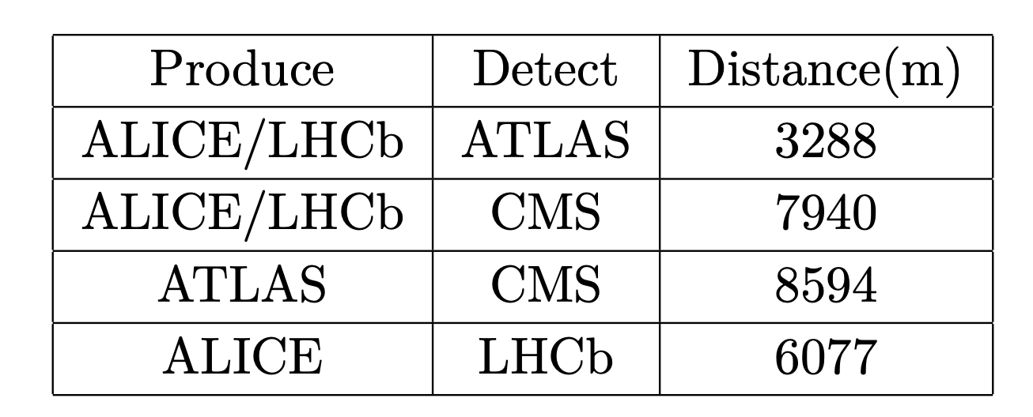
General picture of our idea
Rather than building new modules, one may use existing facilities as far detectors.
Very good muon system, including magnet field for precision momentum measurement
But small acceptance

Slide 6
Muon Channel
Muon chamber is usually the largest component in a detector
with much less busy environment.
trigger strategy at CMS and ATLAS:
  CMS Barrel Muon Track Finder (L1 tracking algorithm) for
  HL-LHC based on Kalman Filter algorithm.
  ATLAS Pointing angle based L1 trigger
ATLAS: diameter 25m; length 44 m
CMS: diameter 15m; length 28.7 m
LHCb: diameter 4.5m; length 4 m
ALICE: no muon chamber
largest
should only be treated
as a production site

Slide 7
The ideal combination
LHCb/ALICE for production, ATLAS for detection.
• Short distance
CMS is less attractive.
• Forward direction
• Large Muon chamber
• Luminosities: LHCb/ALICE is ~10 times lower than that of ATLAS.
Competing factors for the choice of production vs detection.
Combining LHCb and ALICE, we have 600 fb^-1 total luminosity.

Slide 8
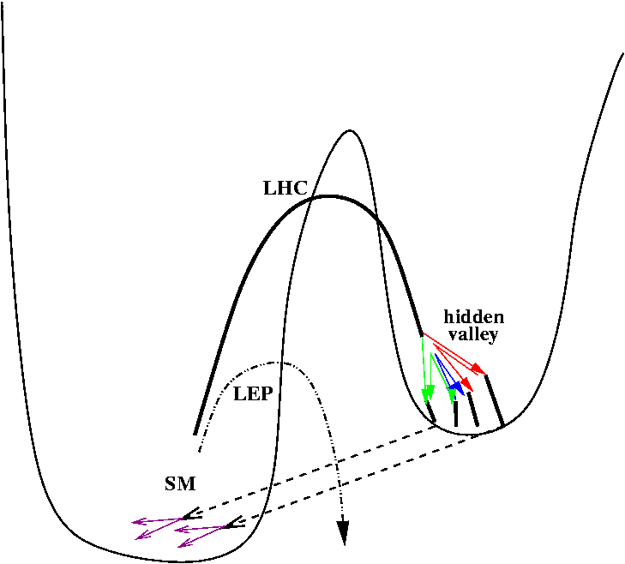
Model: Non-Abelian Dark Sector
Dark Sector remains largely unknown.
  Non-abelian choice on Dark Sector remains to be further studies!
  Generically classified as Hidden Valley models.
A Conceptual Diagram
Energy
Inaccessibility

Slide 9
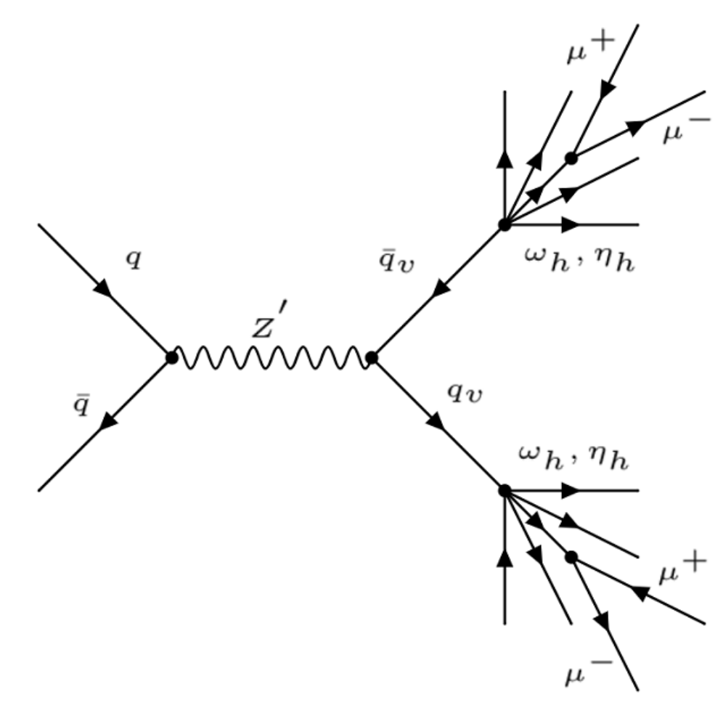
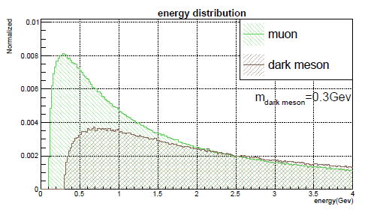
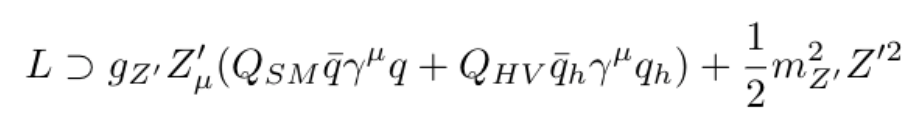

Non-Abelian Dark Sector
Z’ mass: 200 GeV
HV meson: 0.3 GeV
< N >: 40
Showering and hadronization in the hidden sector
distribute energy to many soft HV mesons.
Not easy to trigger in a conventional LHC search.

Slide 10
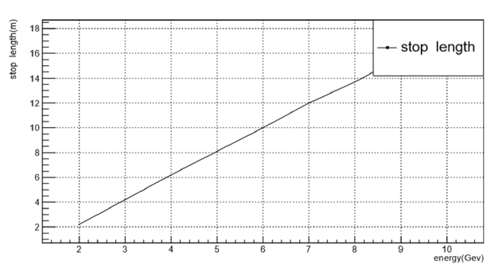
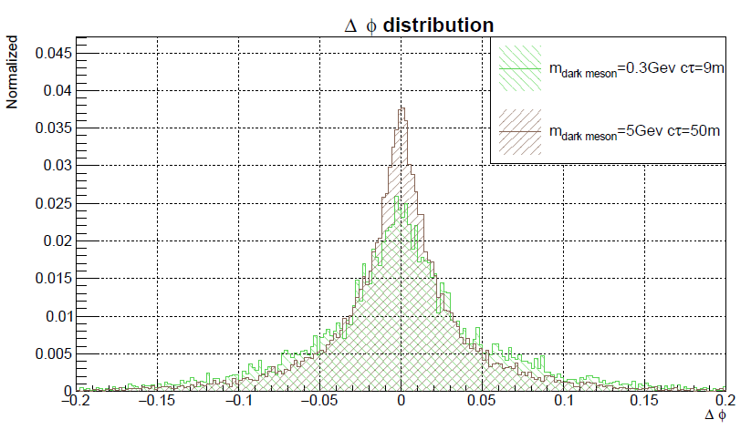
Muon Channel
Focus on muon channel
  result scales linearly with muon decay BR.
• Muon can travel for a long distance in earth.
• Its direction is barely changed during its propagation.

Slide 11
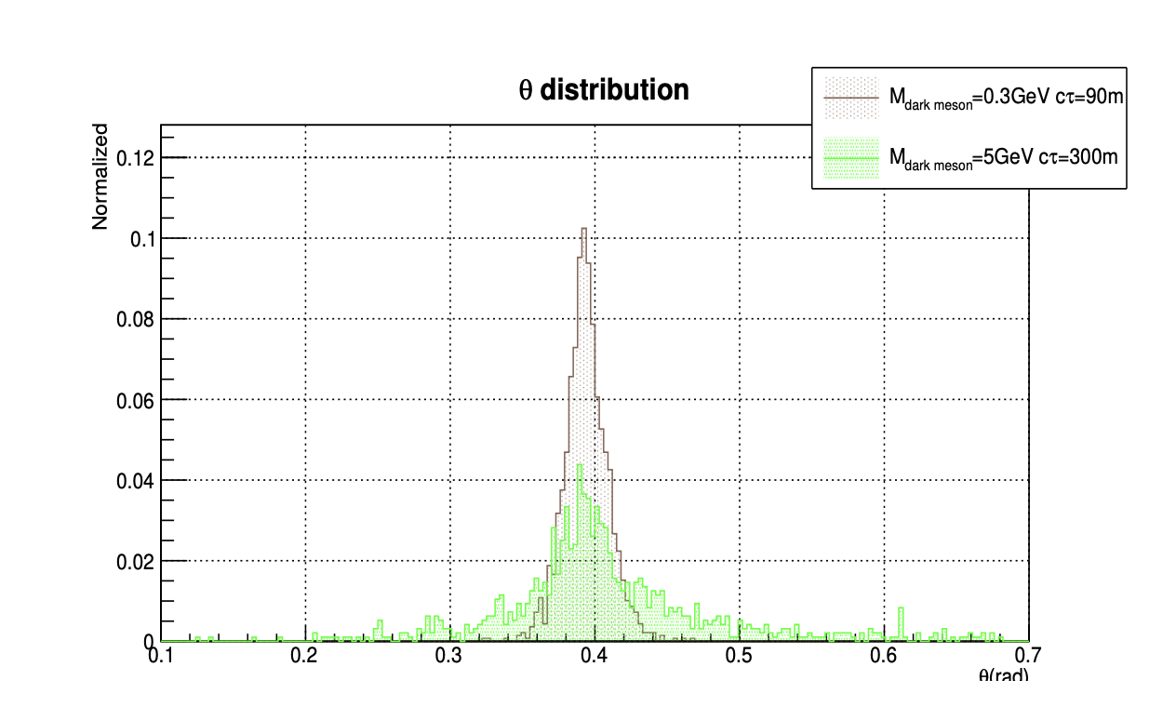
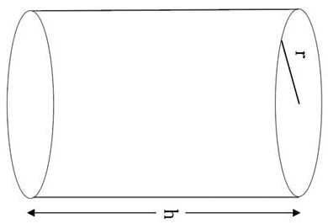
Signal characterization
Muons from LLP decays have a preferred incidence angle.
Large impact parameter: O(10) m
Timing sequence is reversed(out-in) to ATLAS collisions.
Impact point
good directional information pointing back to IP

Slide 12
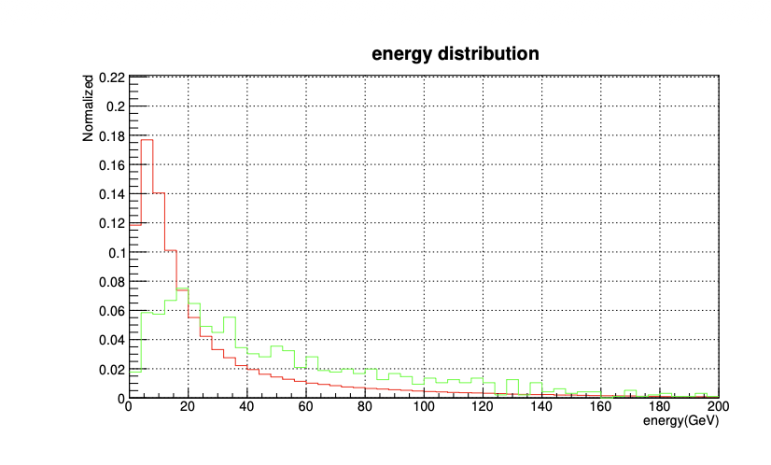
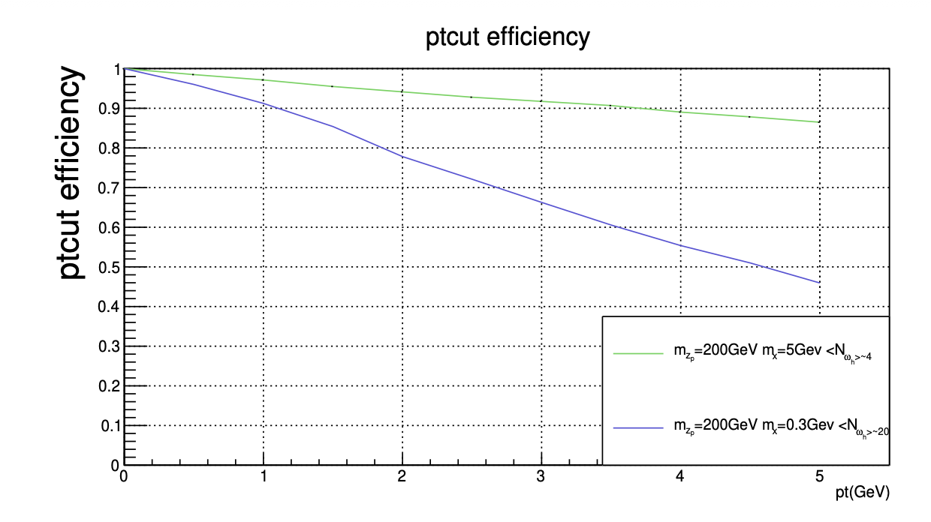
Singal characterization
s
Muon fly toward the far detector
Muon entered the far detector

Slide 13
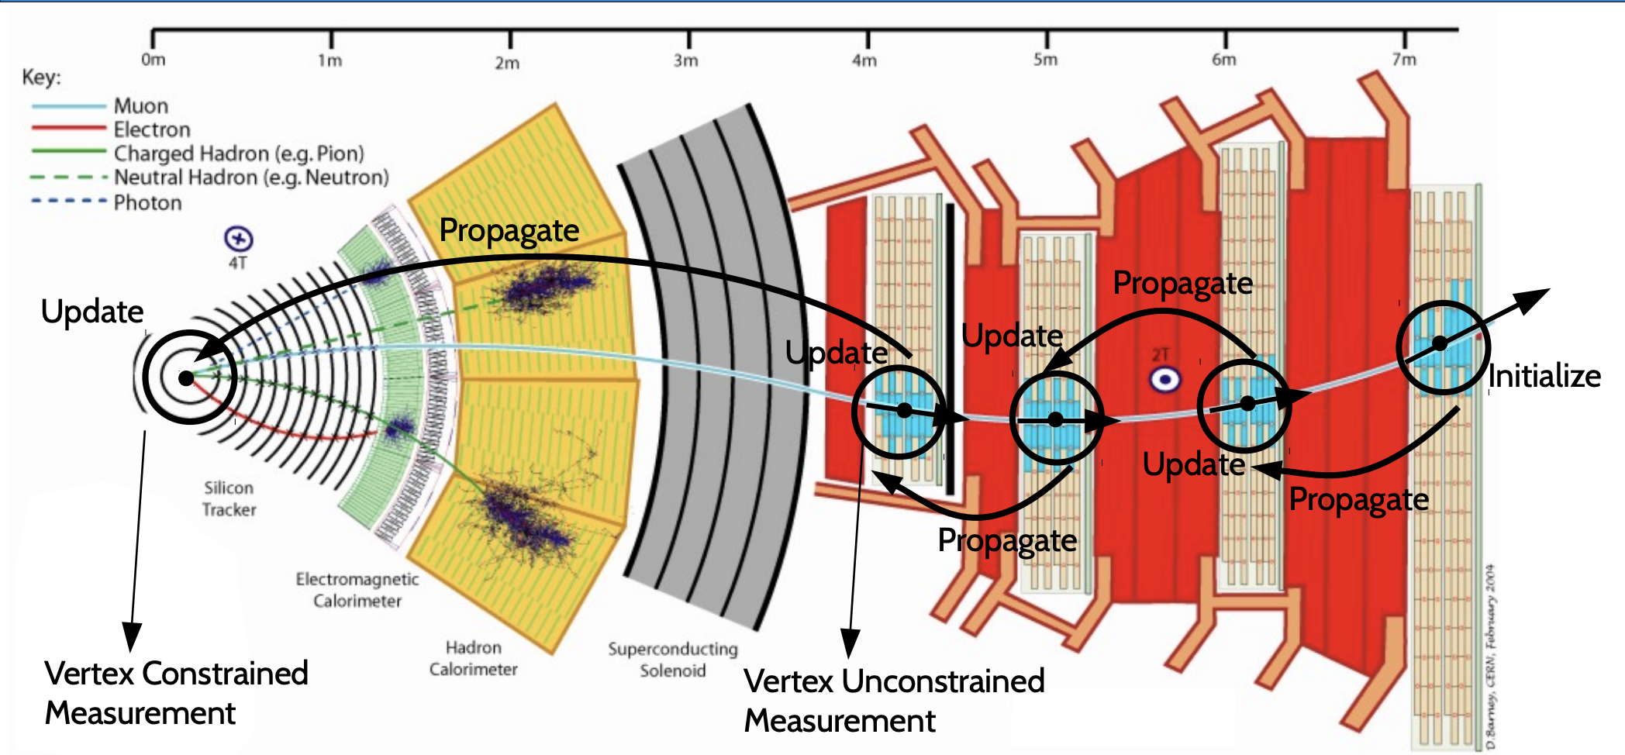
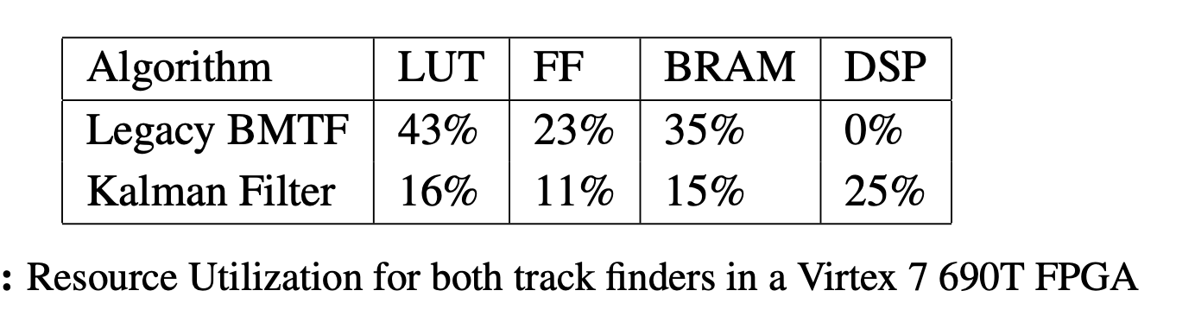
Trigger @ L1 for CMS: back tracking

Slide 14
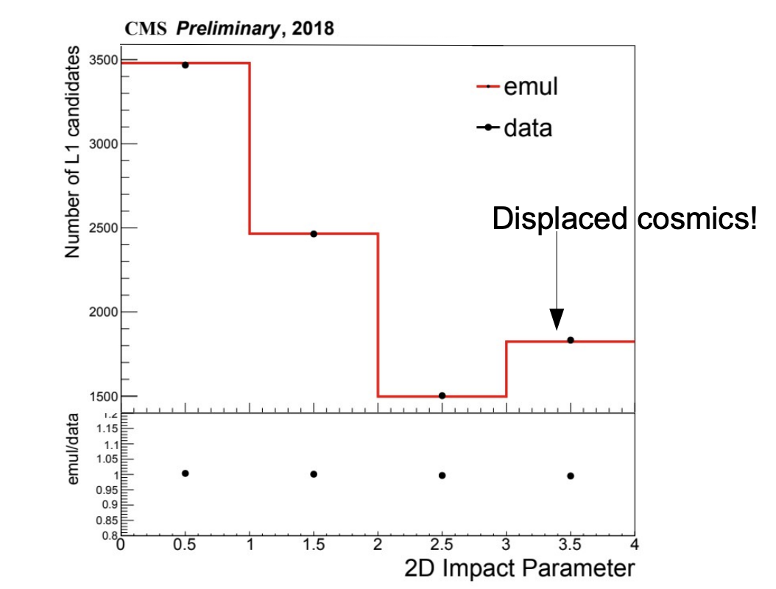
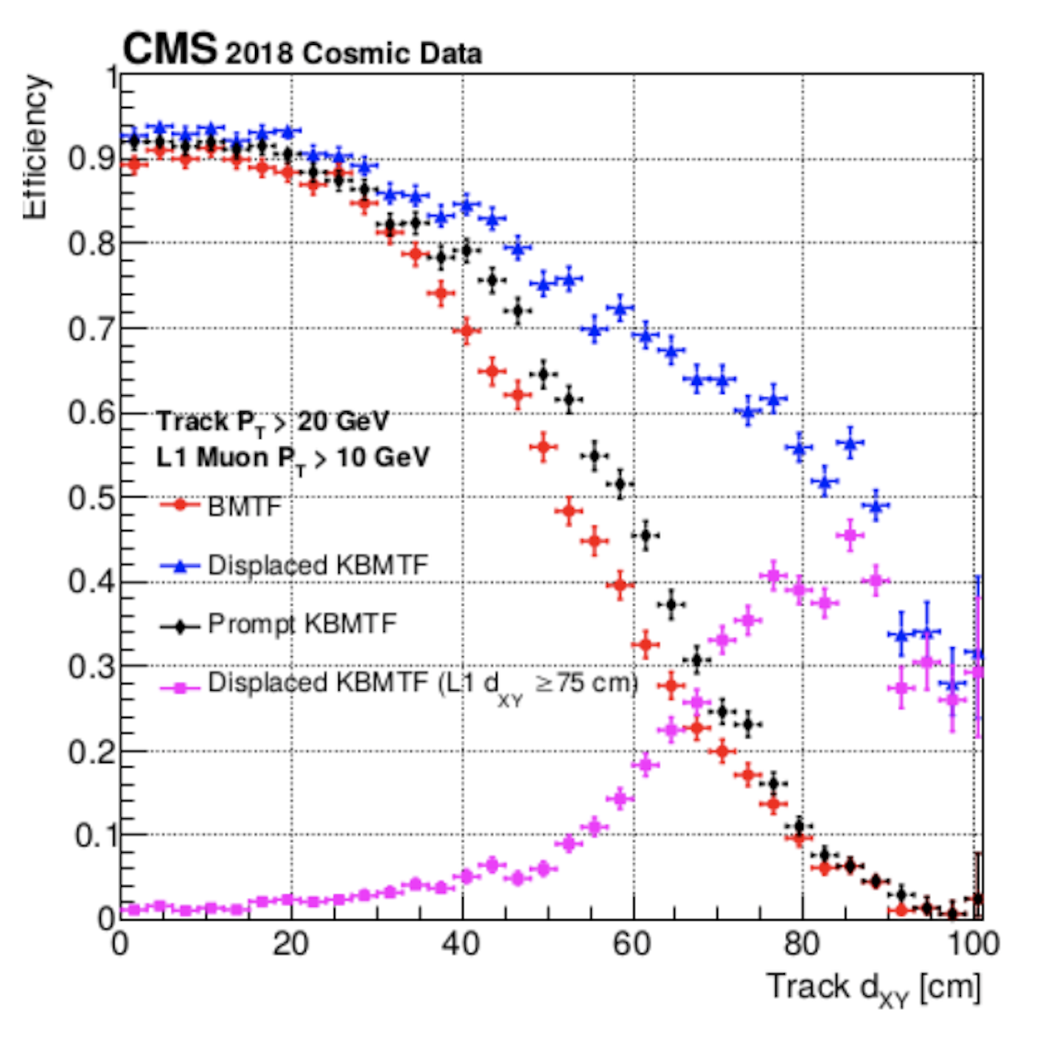
Event Trigger
https://indico.fnal.gov/event/18738/contributions/48810/attachments/30466/37474/KalmanFilter_RTS.pdf
Track from outside to inside use Kalman-Filter @ L1 for HL-LHC
Deployed in L1 FPGA, mainly use the DSP(25%)
Algorithm has been deployed for Run III
More details: PoS TWEPP2018(2019) 139.
  https://olympias.lib.uoi.gr/jspui/bitstream/123456789/29923/1/%CE%94.%CE%94.%20MALLIOS%20STAVROS%202019.pdf
  Page 120-121
Caveats: The LLP signal is not synchronized with LHC clock
  Need carefully define the “event” after triggering

Slide 15
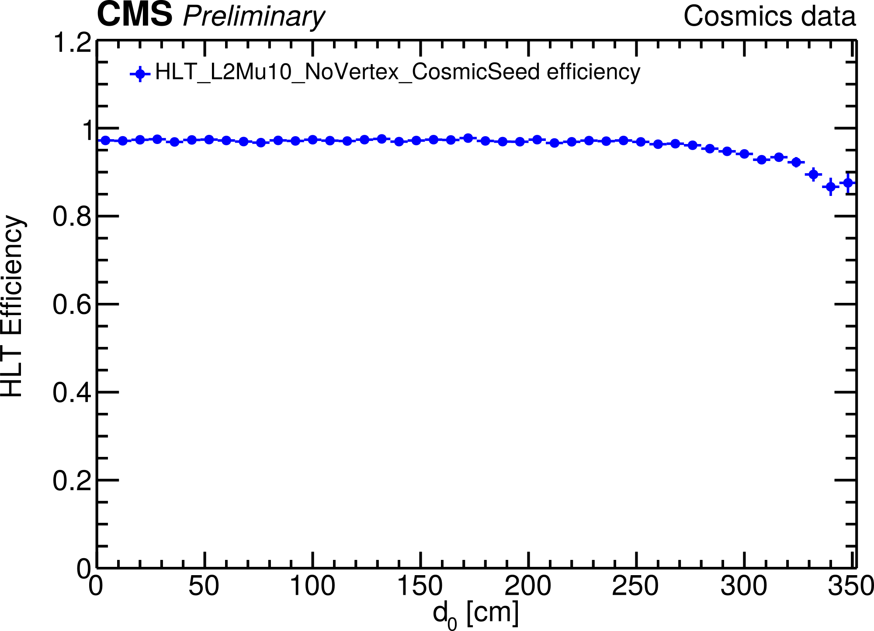
HLT effiency
After “event” triggered and proper defined
CMS DP-2019/028
http://cds.cern.ch/record/2690807
Figure: HLT_L2Mu10_NoVertex_CosmicSeed reconstruction efficiency for offline displaced standalone (dSA) muons measured in Cosmics data as a function of the transverse impact parameter d₀. Efficiencies are computed w.r.t. events with lower-leg offline dSA muons with p_{T} > 25 GeV selected with a SingleMuOpen L1 trigger. For all results, |𝜂| < 1.2 is applied.

Slide 16
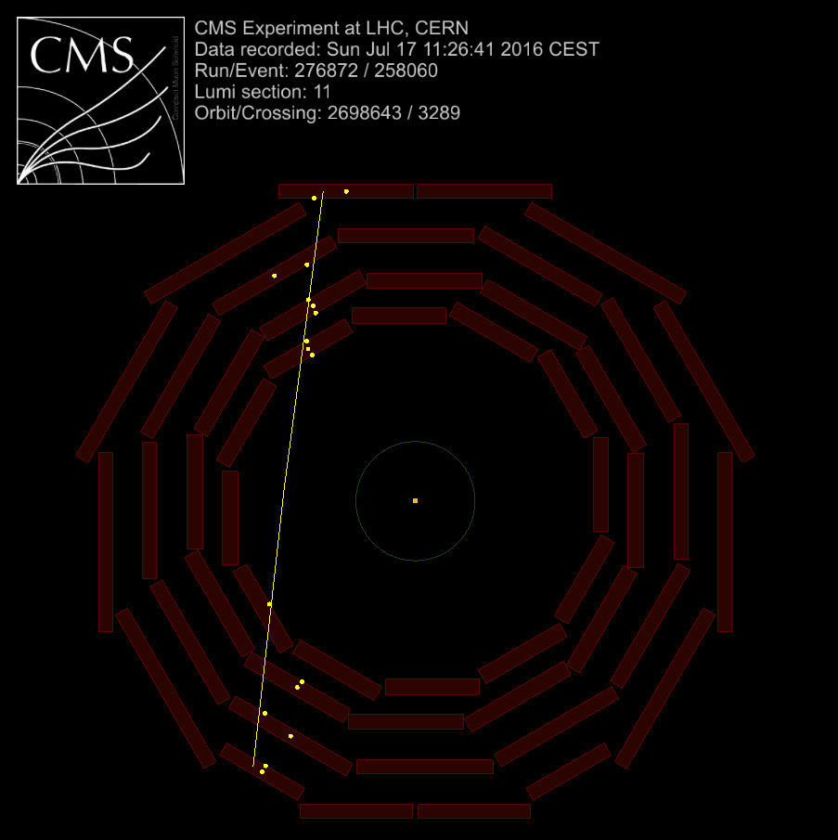
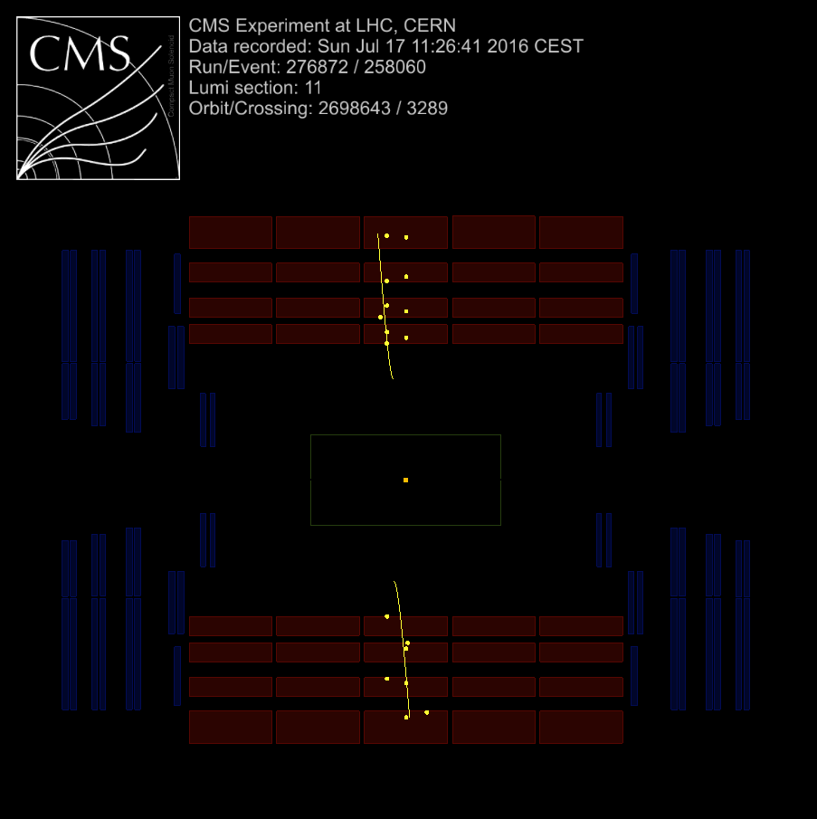
Event display of signal like cosmics
Validate L1 Trigger efficiency
𝜚-𝜙 plane
𝜚-z plane

Slide 17
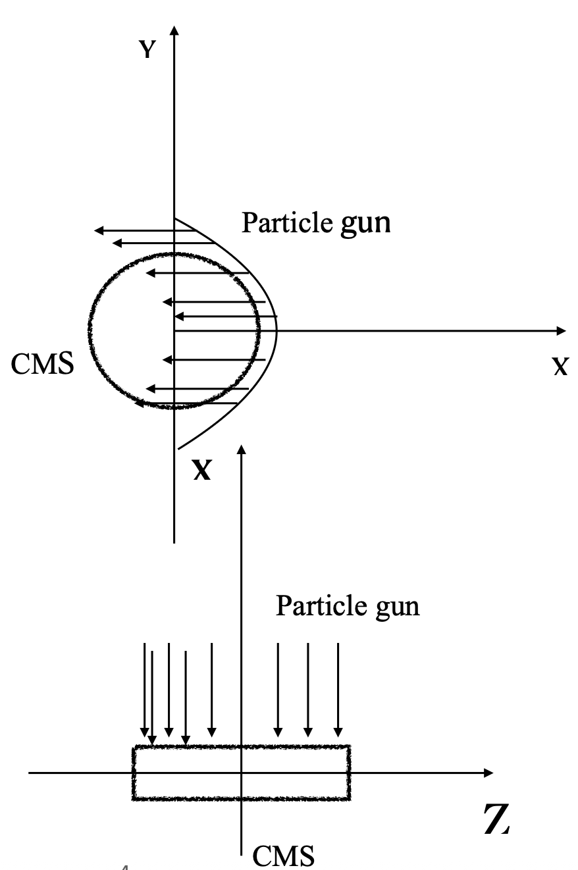
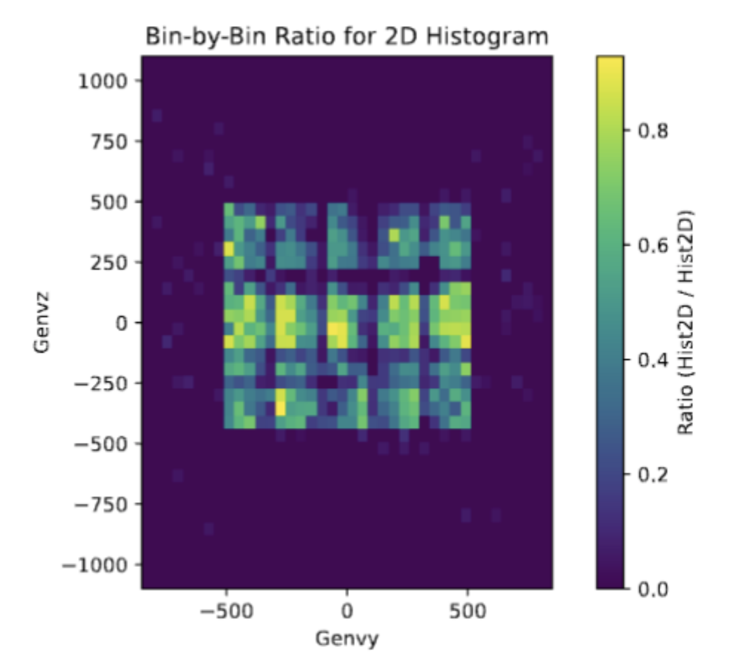
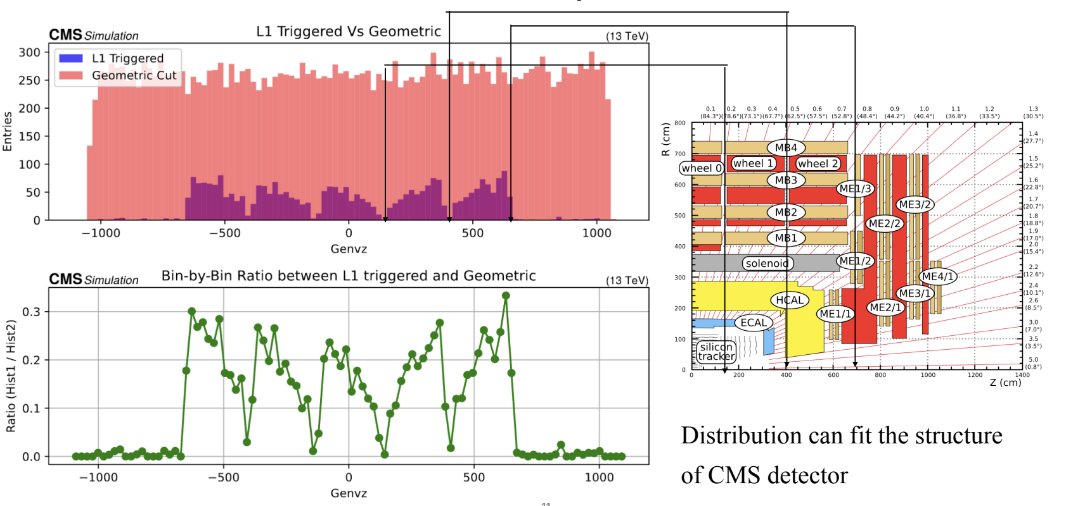
L1 Trigger efficiency at CMS
Simulation with CMS detector L1 trigger @ Run 3 (CMSSW)
Close to 100% eff. at Center region
0 efficiency for IP >3.5 m
0 efficiency at endcap
Not yet turn on for HLT stream

Slide 18
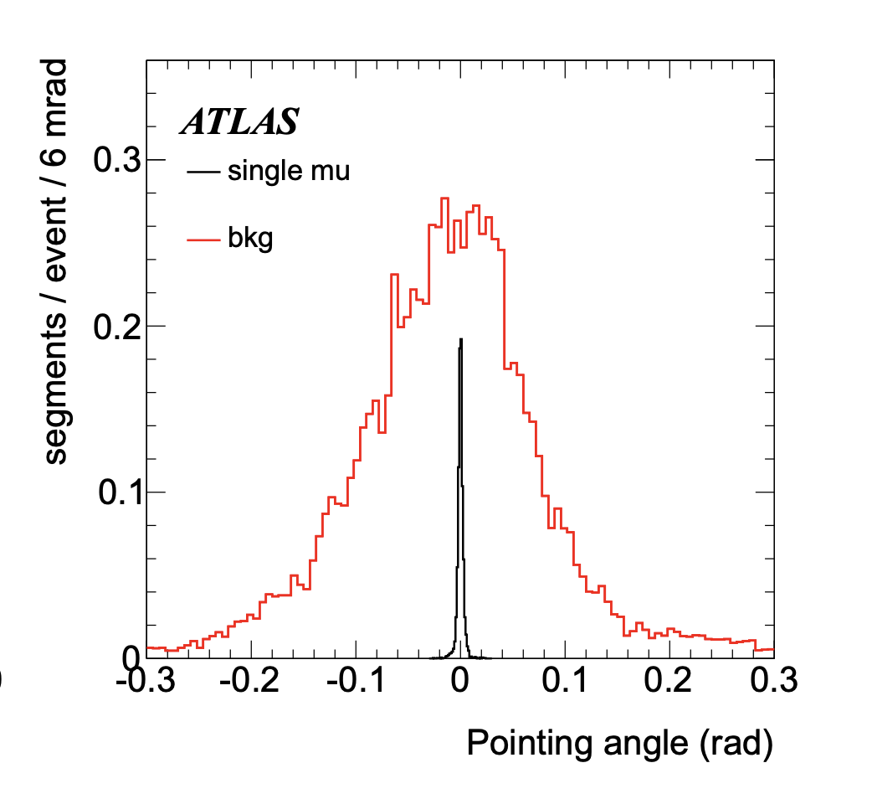
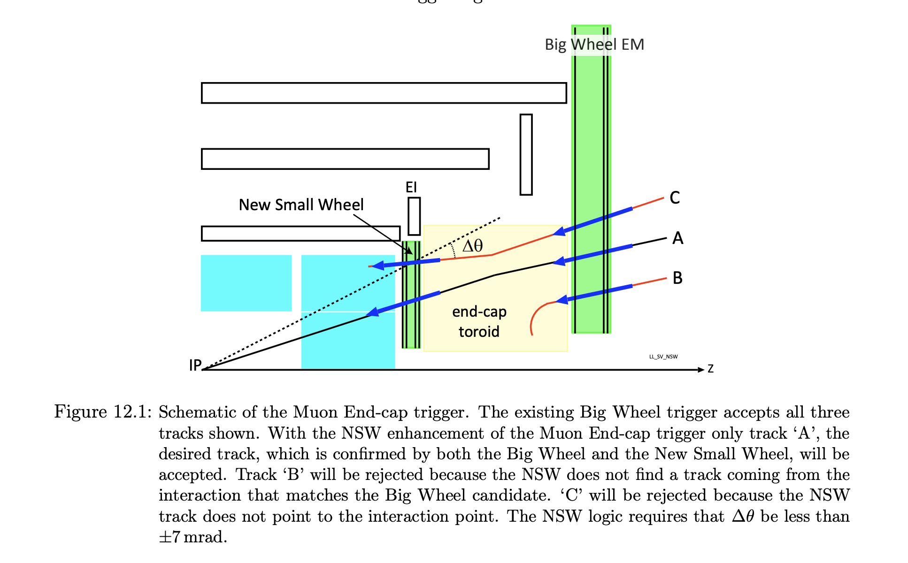
L1 Trigger @ ATLAS
Modification of L1 trigger algorithm
2 pointing angle:
one w.r.t. ATLAS IP, reverse cut
one w.r.t. LHCb/ALICE/CMS

Slide 19
Possible backgrounds
Cosmics removed by horizontal direction (~36km rocks)
Background from production site shielded by >3km rocks
Background from enviroment radioactive reomved by
  Pt>1GeV in detection detector(ATLAS)
Background from ATLAS are removed by:
  Pointing back to production site (LHCb/ALICE)
    Other horizontal direction servered as background control region
  Large Impact parameter
  Out-in track (Inverse timing) coincide with in-out track
Zero background is a reasonable expectation

Slide 20
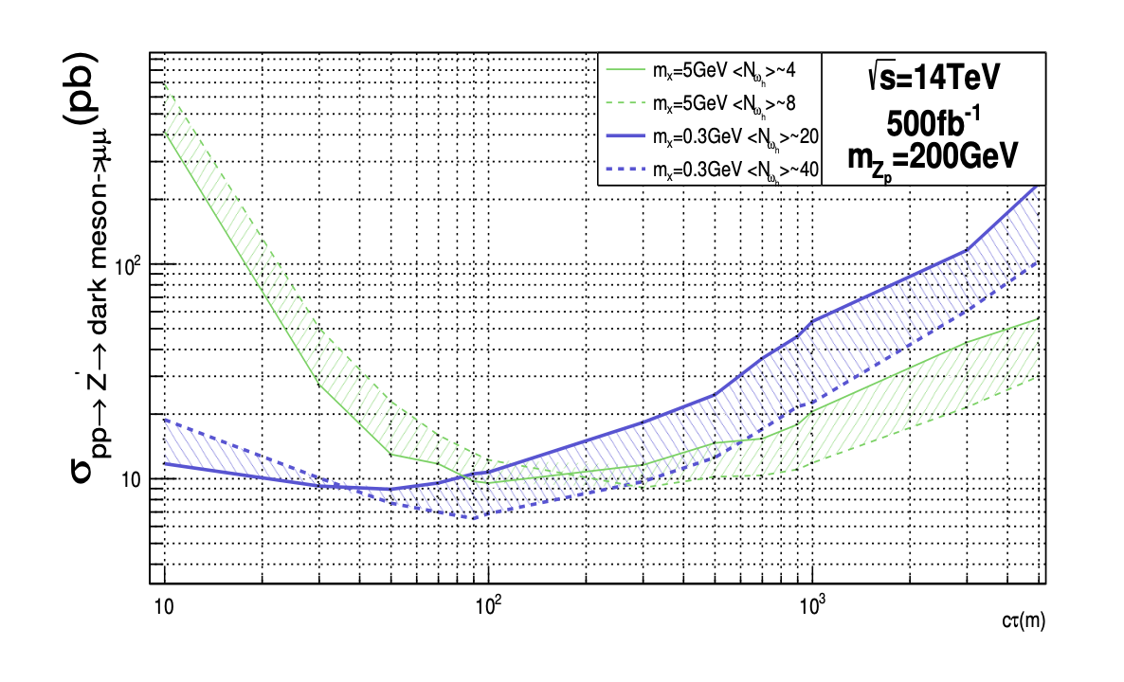
Expected sensitivity
Sensitivity of assume observe 3.1 events for different senarios
  LLP and dark shower simulated using pythia
  Muons passing through rock simulated using MUSIC (full simulation)
  Any track hit detection muon detector with Pt>1GeV count (100% eff.)
  Zero background during whole HL-LHC
  ALICE-ATLAS and LHCb-ATLAS configuration combined
Best sensitivity:
500fb @ c𝛕~100m

Slide 21
Summary
Producing and detecting long-lived particles at different experiments at the LHC
  Can carve into interesting unexplored parameter space.
  Cost-effective: only update firmware/software
    Could start even from Run III
    Extra luminosity for ATLAS
  Sensitivity comparable to other LLP searches like arXiv:1708.05389
    Could serve as an independent cross check.
  Similar strategy could be used in searches like up-going-muon(DM)

